Slide 1

Project Status and Prospects of Super Tau-Charm Facility
Jingyu Tang, USTC
On behalf of the STCF team
INFN-LNF, Rome, April 14, 2026
Notes:
报告时间：25+5

Slide 2
Topics
General introduction to STCF
Physics goals
Accelerator design and R&D efforts
Detector design and R&D efforts
Project status and planning
Summary

Slide 3
General Introduction to STCF

Slide 4
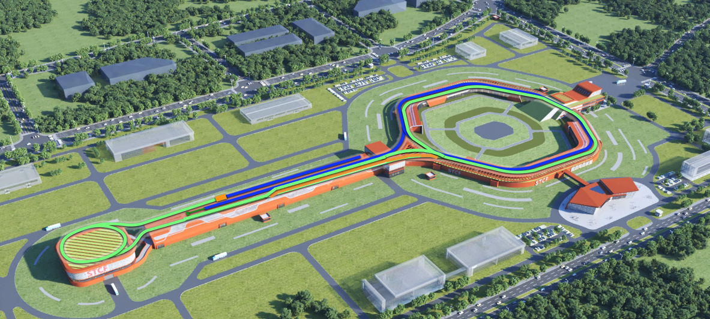
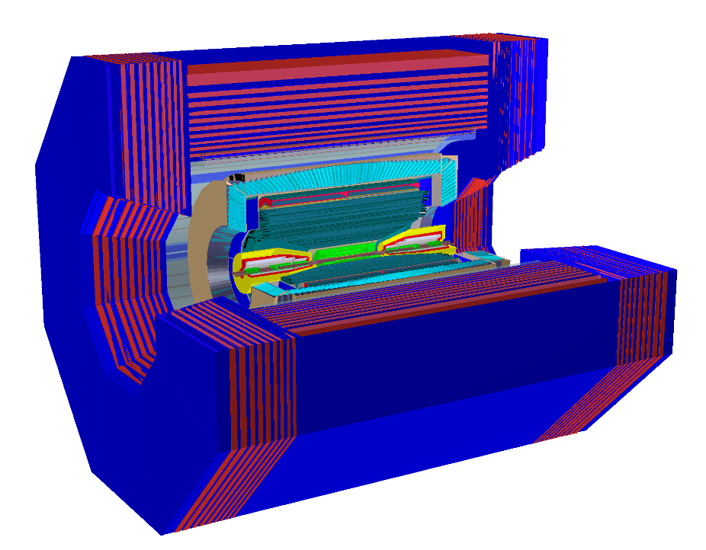
Super Tau-Charm Facility
A factory producing massive tau lepton and hadrons, to unravel the mystery of how quarks form matter and the symmetries of fundamental interactions
Detector
Collider Rings
825 m
Multi-Linac
Total 550 m
Positron Damping Ring 150 m
Center-of-Mass energy : 2-7 GeV
Peak Luminosity: > 0.5×10³⁵ cm⁻² s⁻¹ @ 4GeV
Potential to increase lumi. & polarized beam

Slide 5
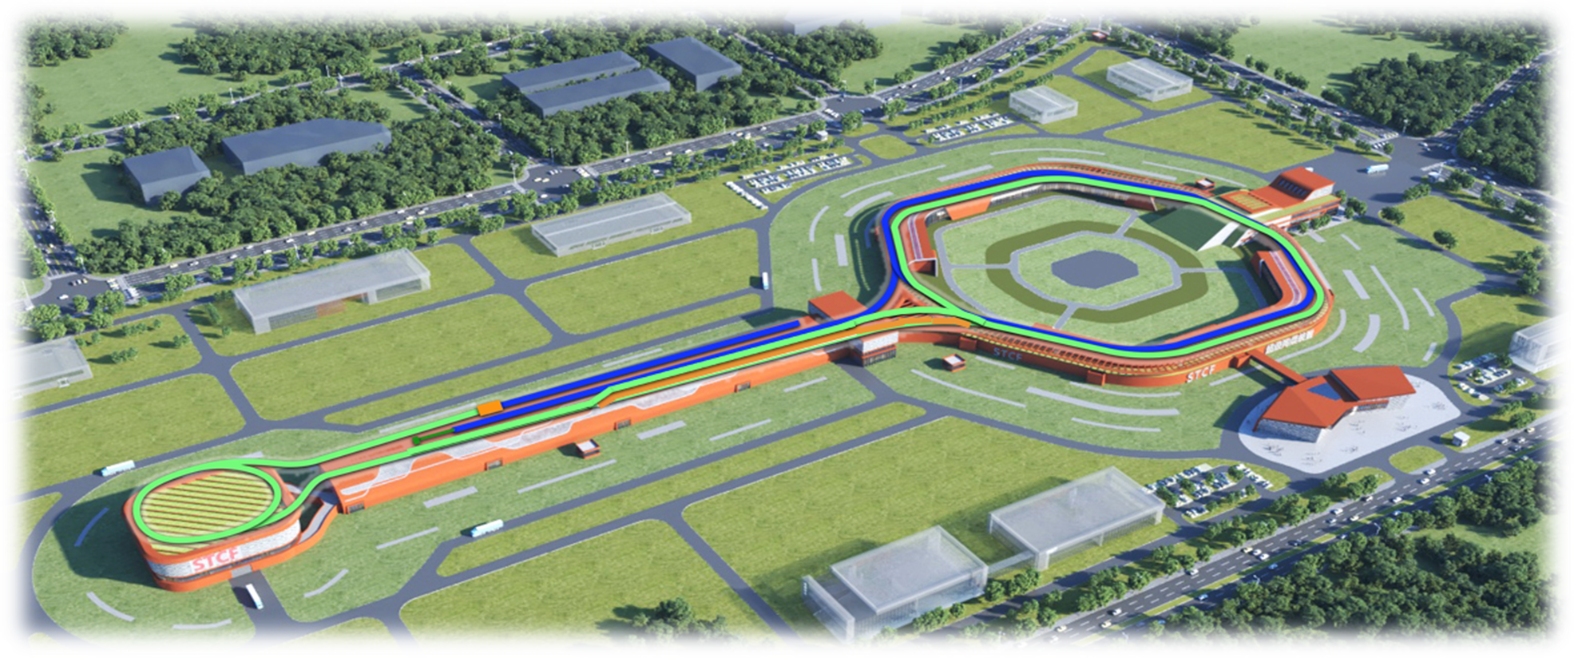
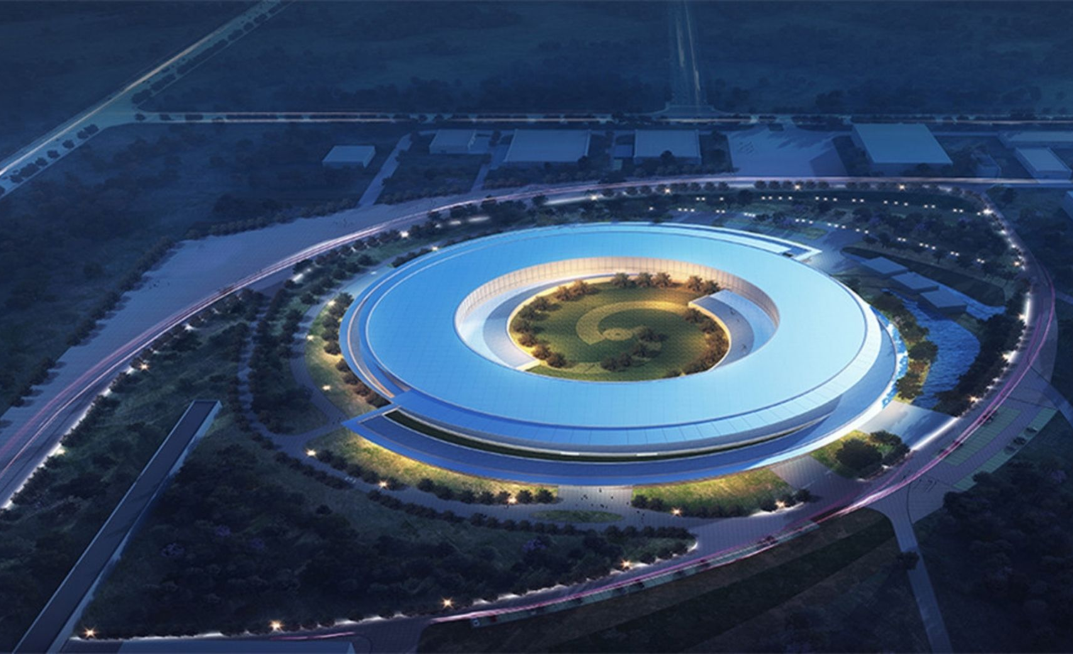
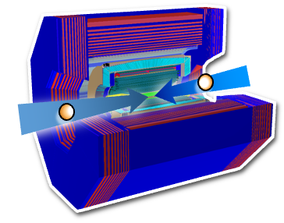


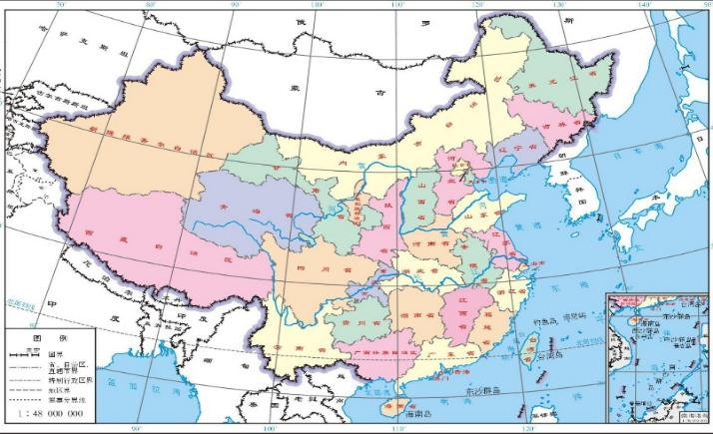
Site: Hefei, Anhui Province
Hefei Comprehensive National Science Center
"Future Big Science City", Hefei, Anhui Province
Super Tau-Charm Facility (STCF)
Hefei Advanced Light Facility (HALF) - under construction
Funded R&D : 364 Million CNY by Anhui Province
Construction budget : ~5 Billion CNY

Slide 6
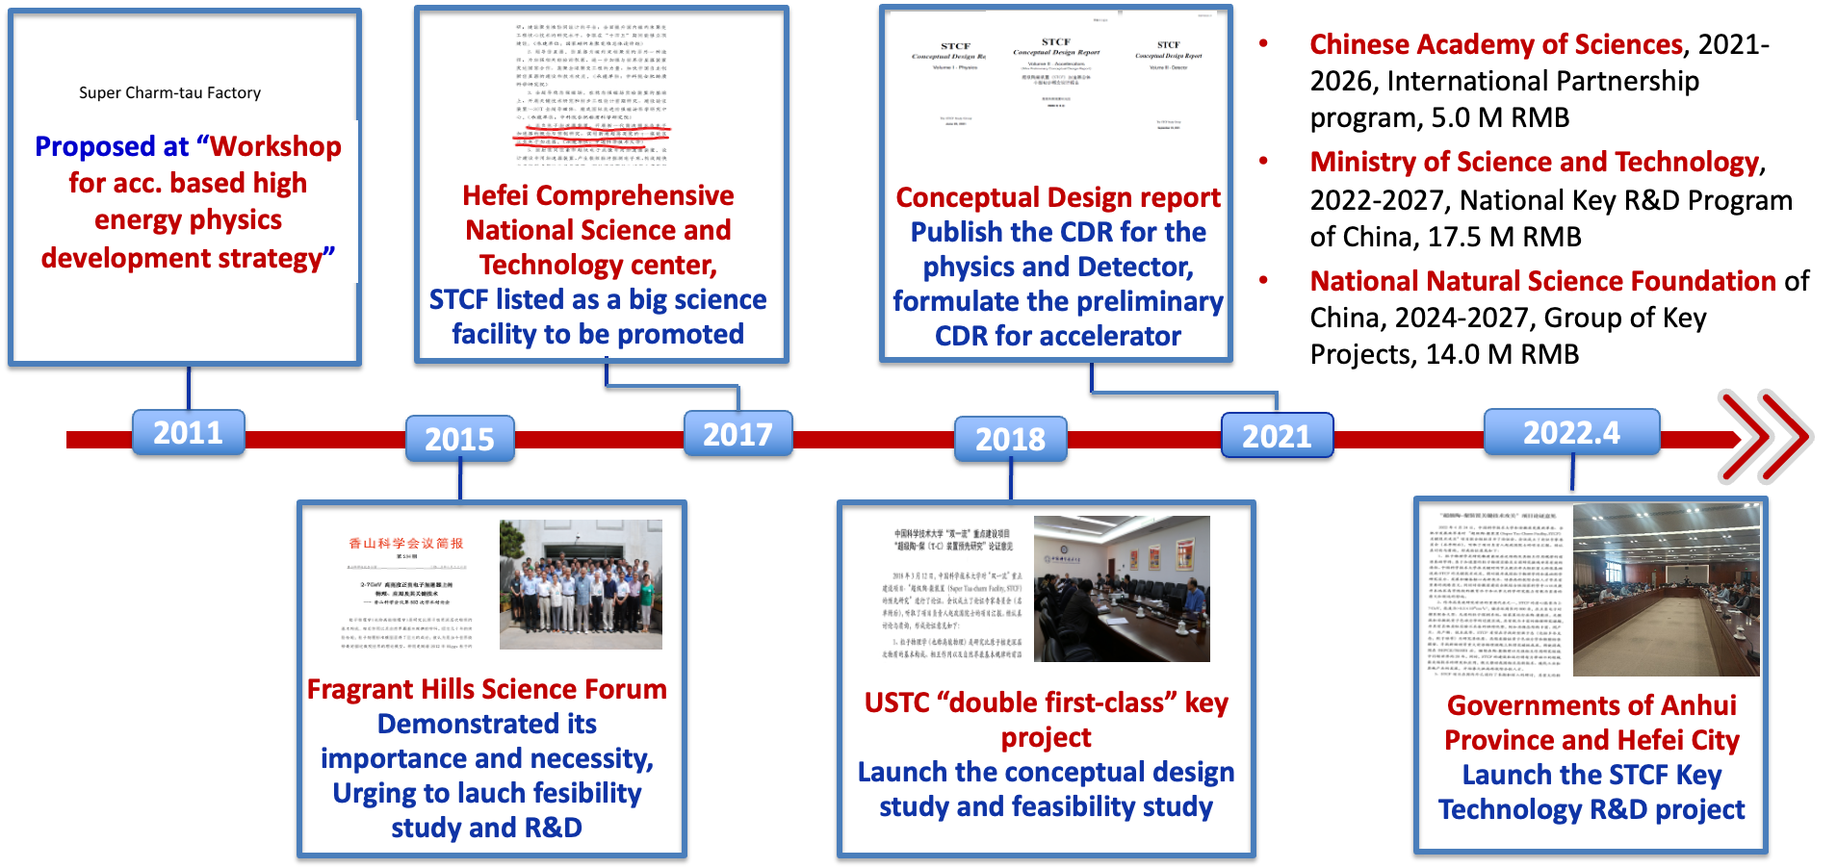
Project Promotion
China has a long-established base in tau-charm physics with BEPC (1990~)
STCF was conceived to take the relay for another 30 years

Slide 7
Physics goals

Slide 8
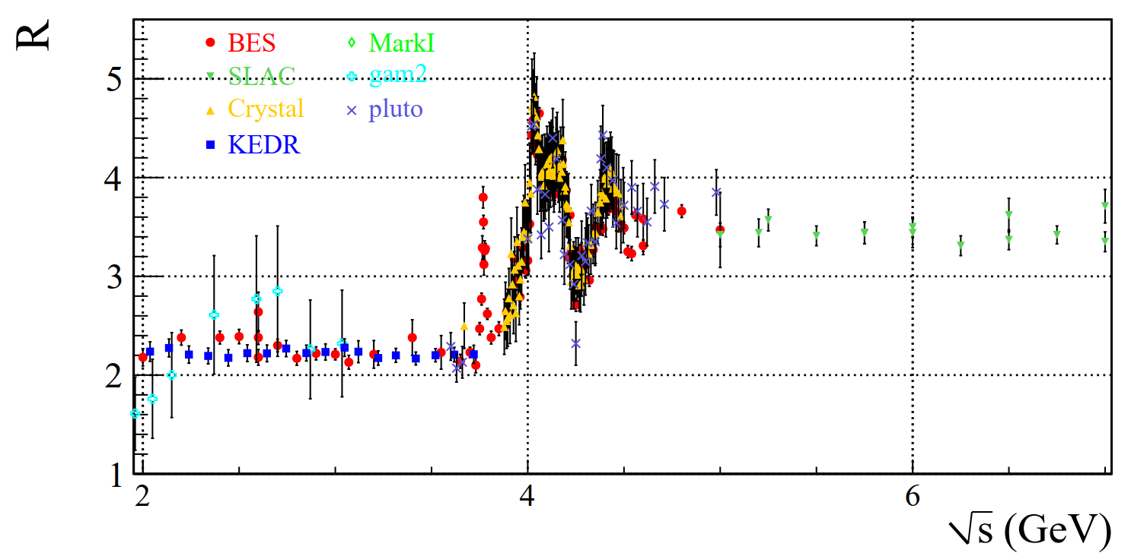

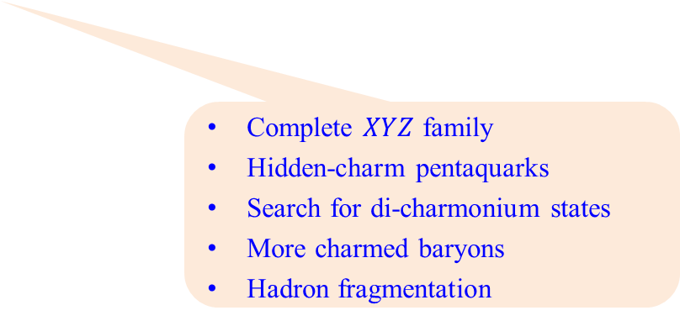
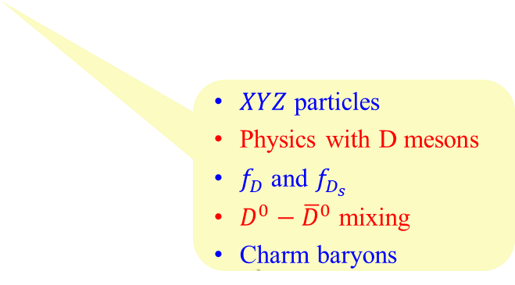
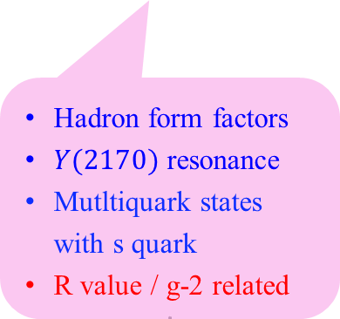
Physics at the Tau-Charm Energy Region
Unique Features τ-c facilities:
Transition region between perturbative and non-perturbative QCD
Threshold effects and quantum correlation of pair production of hadrons and τ leptons
Rich resonance structures, large production X-sec for charmonium(-like) states and exotics
Opportunities in 5~7 GeV
Hadron form factors
$Y(2170)$ resonance
Mutltiquark states with s quark
R value / g-2 related
Light hadron spectroscopy
Gluonic and exotic states
Processes of LFV and CPV
Rare and forbidden decays
Physics with τ lepton
$XYZ$particles
Physics with D mesons
$f_{D}$ and $f_{D_{s}}$
$D^{0}−{\overline{D}}^{0}$ mixing
Charm baryons
Complete $XYZ$ family
Hidden-charm pentaquarks
Search for di-charmonium states
More charmed baryons
Hadron fragmentation

Slide 9
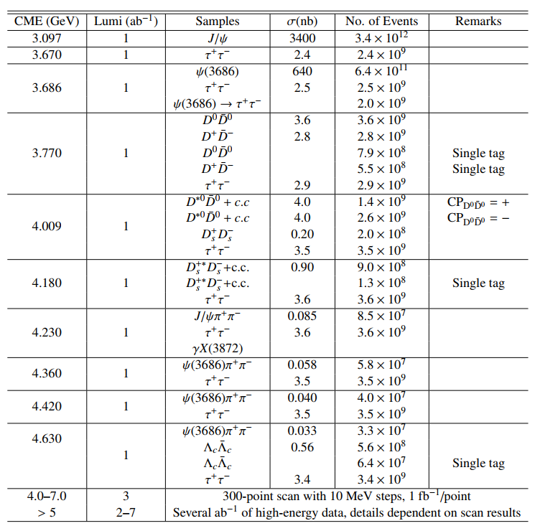
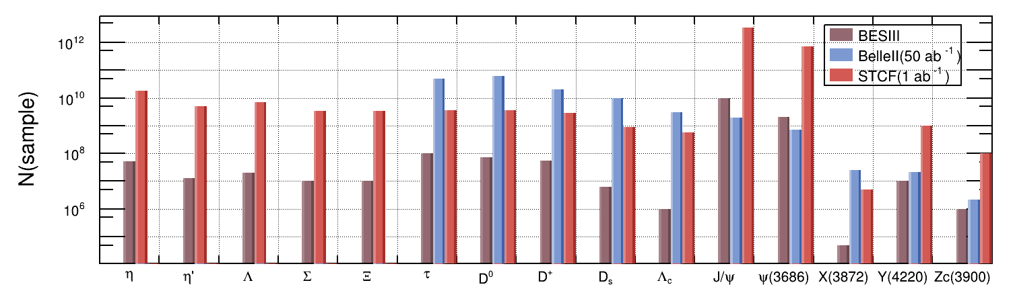
Unique Data Samples
Not only a τ-charm factory, but also a factory for XYZ, hyperons and light hadrons
BESIII 1 year
STCF: 1 year (1 ab⁻¹)
BelleII: 50 ab⁻¹
Light Hadrons
Charmed Hadrons
XYZ
10 years data taken proposal
τ-leptons
Notes:
STCF: 1 ab-1, one year
BelleII: 50 ab-1 ~10 years
世界独特的超大数据样本 + 高分辨 + 低本底 ➜ 高精度测量 ➜ 重大发现

Slide 10
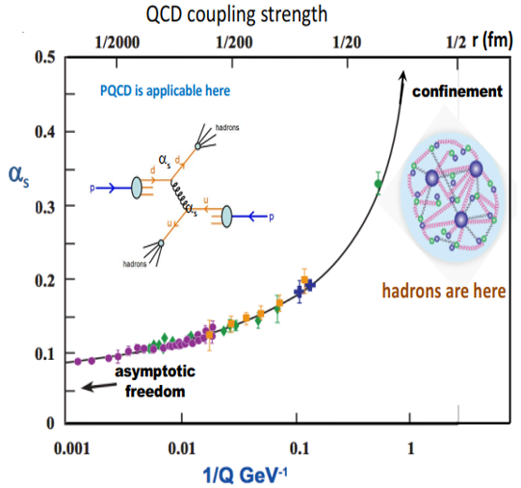
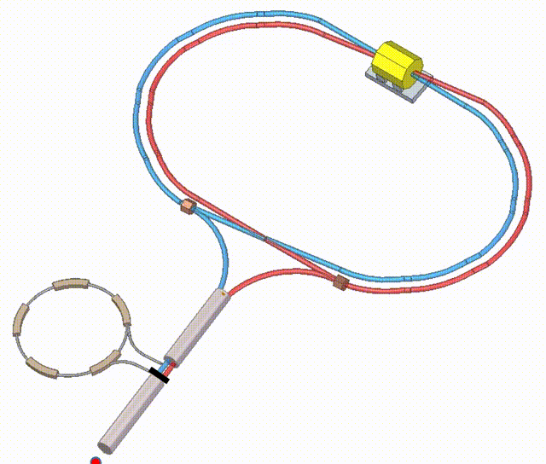
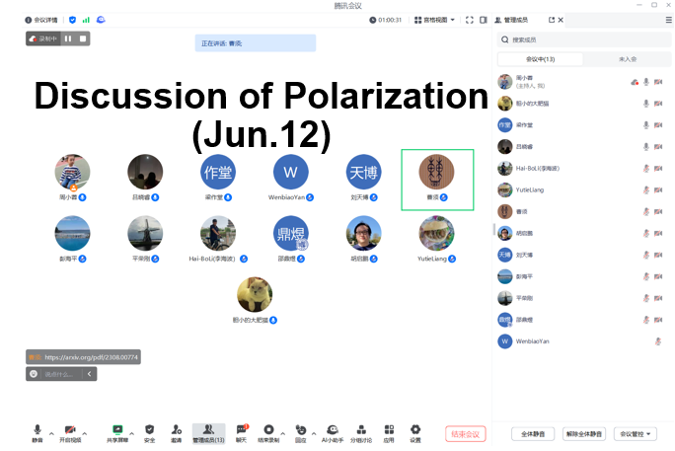
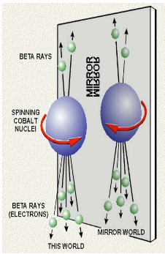
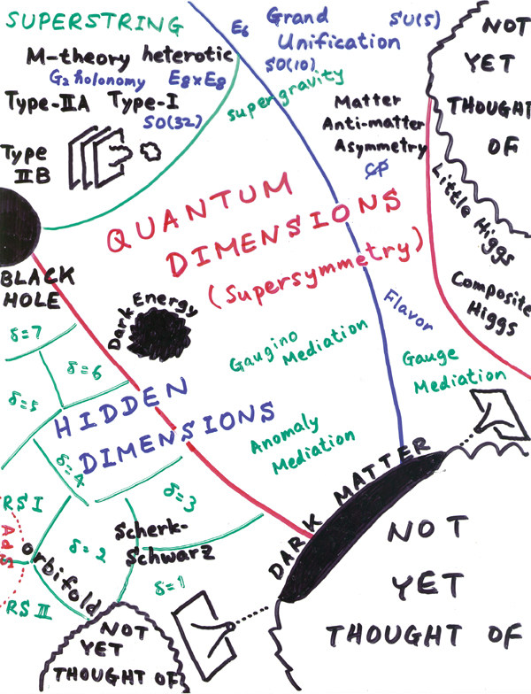
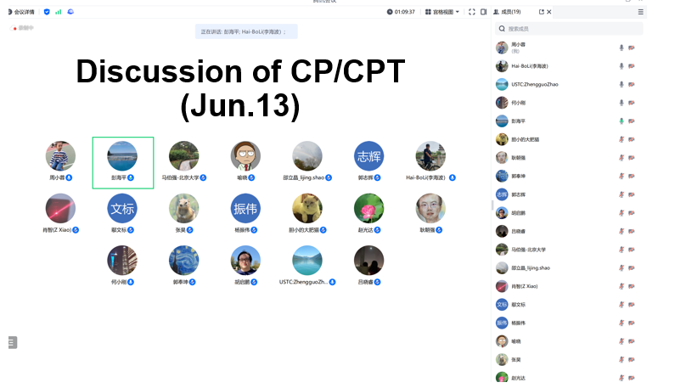
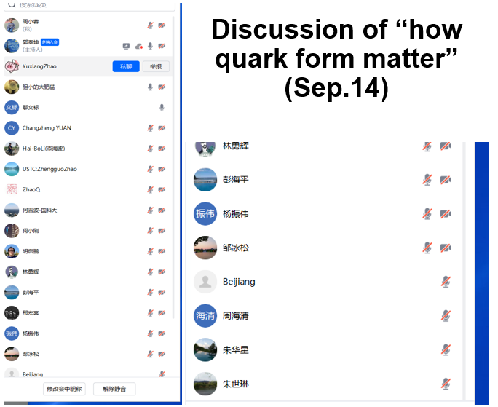
Transition region between perturbative and non-perturbative QCD
Broad physics are anticipated, several mini-workshops were organized to refine the core scientific goals
Key question 1:
What is the nature of color confinement?
STCF
Unprecedented large data samples and high-precision measurements
Key question 2:
New CPV source beyond SM?
Key question 3:
Any new physics? If so, where?

Slide 11

Flagship Measurements at STCF
STCF aims to reveal the mystery of how quarks form matter and the symmetry of fundamental interactions
Scientific question: how quarks form matter
  Hadron generation: fragmentation and energy correlator
  Exotic hadronic states and more
Scientific question: symmetry of fundamental interactions
  CP violation in the hyperon decay

Slide 12
Accelerator Design and R&D Efforts

Slide 13
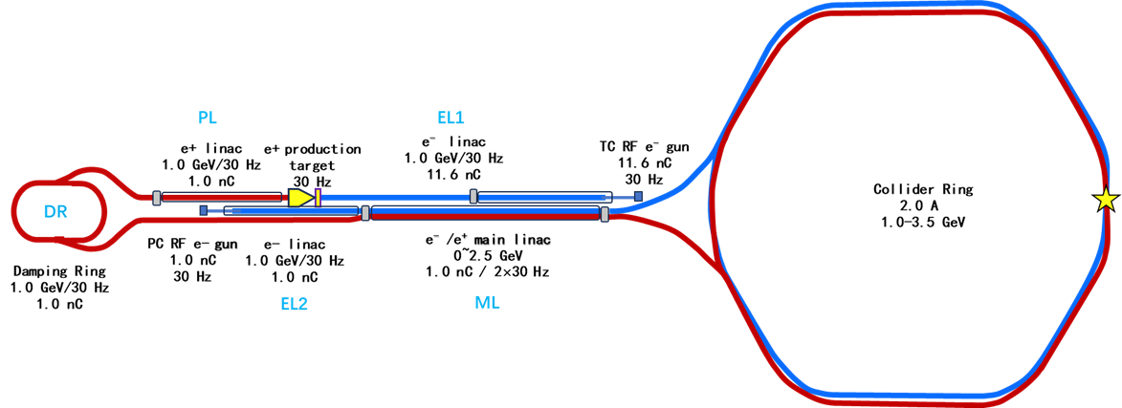
STCF Accelerator Design Goals
Core design goals:
  CoM energy: 2-7 GeV
  Luminosity: >5×10³⁴ cm⁻²s⁻¹ @4GeV
  Upgrading potential: polarized beam, higher luminosity
Accelerator structure:
  Double-ring collider:
  low emittance, high current, large Piwinski angle (crab-waist)
  Injector: full-energy linacs, e+ damping ring, beam transport lines

Slide 14
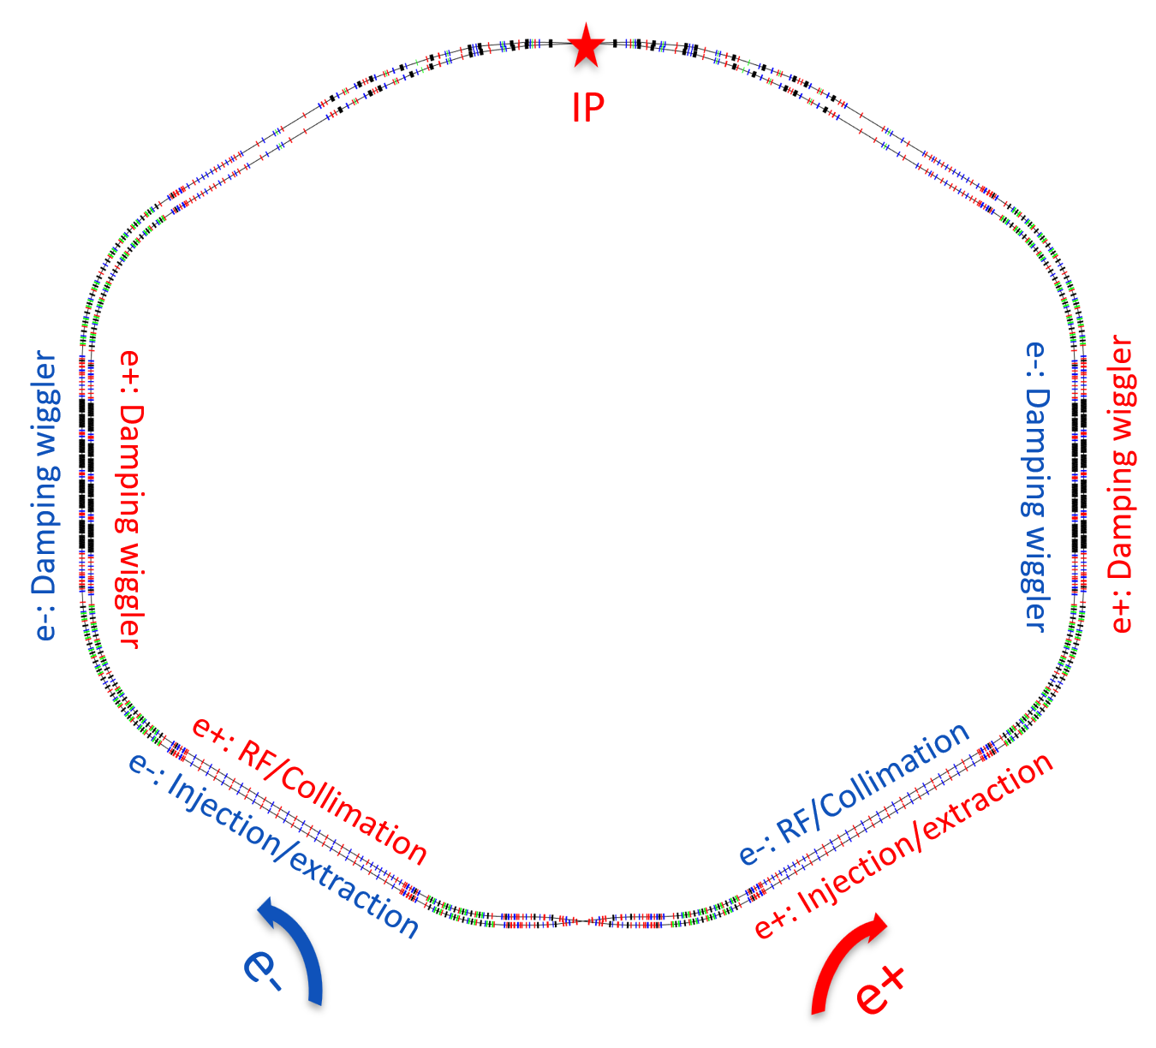
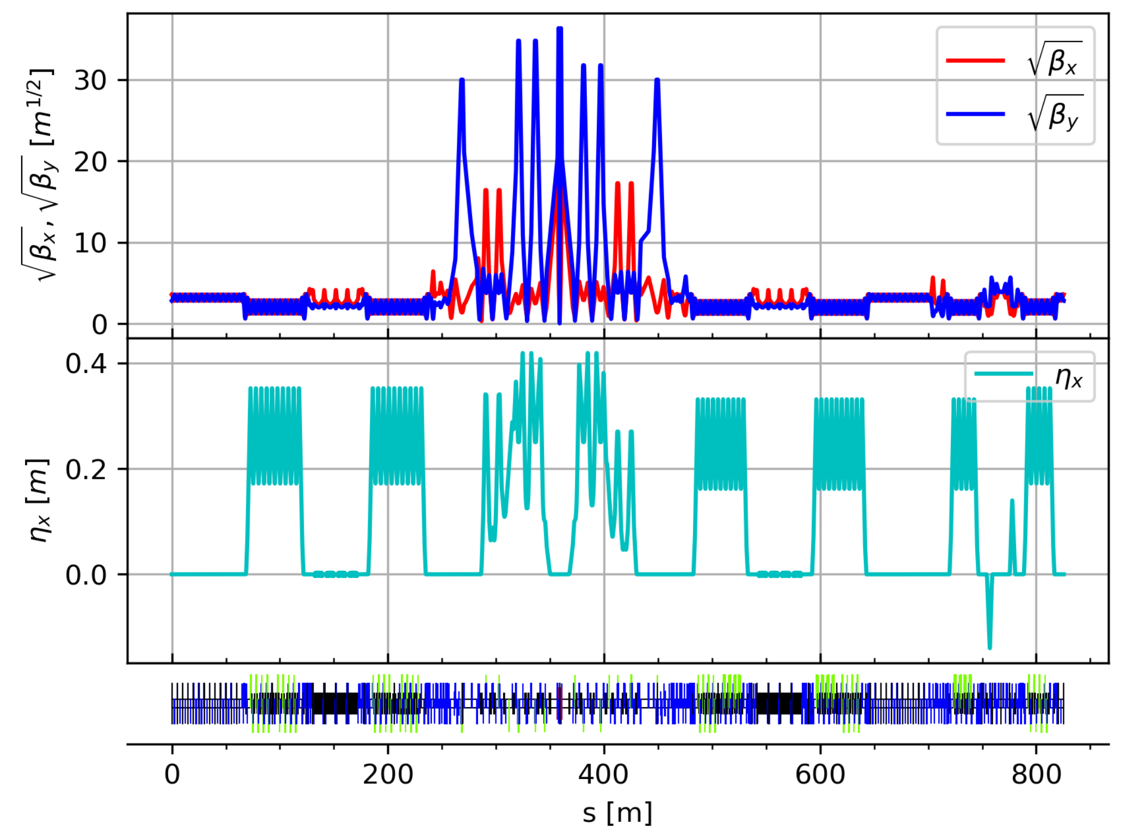
Collider Rings
Layout and lattice
  Based on the two-fold lattice scheme
  Key physics issues: Dynamic Aperture/Local Momentum Aperture, Touschek lifetime
  Adjustability (emittance/energy spread) to wide energy range (1.0-3.5 GeV)
  Straight sections for different functions (injection/extraction, damping wigglers, collimation, RF stations, beam crossing, tune matching, etc.)
  Present version: Lattice Ver. 5.0

Slide 15
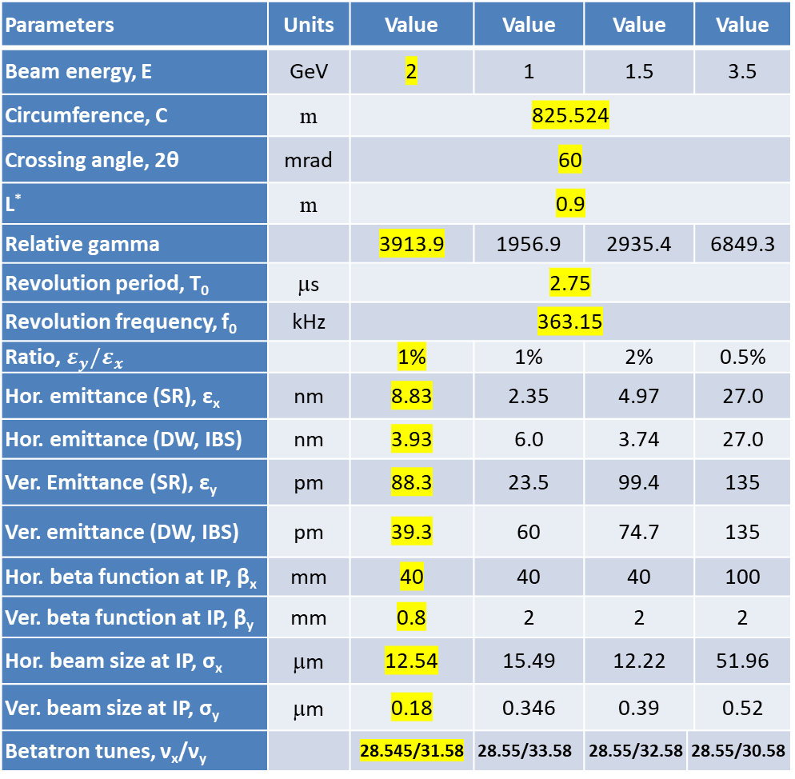
Main Parameters of the Collider Rings (Ver. 5.0)
Parameters | Units | Value | Value | Value |  | Value
Beam energy, E | GeV | 2 | 1 | 1.5 |  | 3.5
Circumference, C | m | 825.524
Crossing angle, 2θ | mrad | 60
L* | m | 0.9
Relative gamma |  | 3913.9 | 1956.9 | 2935.4 |  | 6849.3
Revolution period, T₀ | μs | 2.75
Revolution frequency, f₀ | kHz | 363.15
Ratio, $ε_{y}/ε_{x}$ |  | 1% | 1% | 2% |  | 0.5%
Hor. emittance (SR), ε_{x} | nm | 8.83 | 2.35 | 4.97 |  | 27.0
Hor. emittance (DW, IBS) | nm | 3.93 | 6.0 | 3.74 |  | 27.0
Ver. Emittance (SR), ε_{y} | pm | 88.3 | 23.5 | 99.4 |  | 135
Ver. emittance (DW, IBS) | pm | 39.3 | 60 | 74.7 |  | 135
Hor. beta function at IP, β_{x} | mm | 40 | 40 | 40 |  | 100
Ver. beta function at IP, β_{y} | mm | 0.8 | 2 | 2 |  | 2
Hor. beam size at IP, σ_{x} | μm | 12.54 | 15.49 | 12.22 |  | 51.96
Ver. beam size at IP, σ_{y} | μm | 0.18 | 0.346 | 0.39 |  | 0.52
Betatron tunes, ν_{x}/ν_{y} |  | 28.545/31.58 | 28.55/33.58 | 28.55/32.58 | 28.55/30.58
Parameters | Units | Value | Value | Value | Value
Mom. compaction factor, α_{p} | 10⁻⁴ | 14.07 | 13.36 | 13.9 | 14.3
Energy spread (DW, IBS), σ_{e} | 10⁻⁴ | 8.12 | 7.16 | 7.52 | 10.02
Beam current, I | A | 2 | 0.8 | 1.5 | 2
Bunch filling ratio |  | 48%
Bunch spacing, τ_{b} | ns | 4.0
Single-bunch charge | nC | 8.34 | 3.34 | 6.25 | 8.34
SR power per beam (Total) | MW | 1.25 | 0.1 | 0.47 | 2.99
Trans. damping time, τ_{x}, τ_{y} | ms | 18 | 44 | 27 | 13
RF frequency, f_{RF} | MHz | 499.7
RF voltage, V_{RF} | MV | 2.5 | 0.75 | 1.5 | 6
Bunch length (0.1Ω, IBS), | mm | 9.0 | 9.9 | 9.4 | 8.9
Piwinski angle, Ф_{piw} | rad | 21.53 | 19.09 | 23.12 | 5.12
Ver. beam-beam parameter |  | 0.1 | 0.093 | 0.109 | 0.049
Touschek lifetime (Elegant) | s | 364 | 267 | 371 | 10972
Luminosity, L | cm⁻²s⁻¹ | 1.0E+35 | 8.0E+33 | 2.6E+34 | 3.3E+34

Slide 16
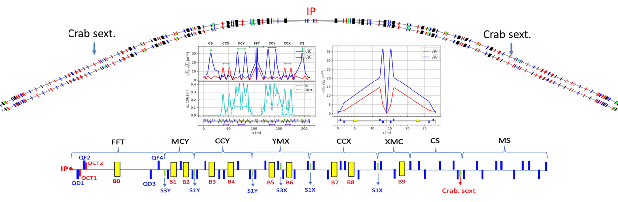
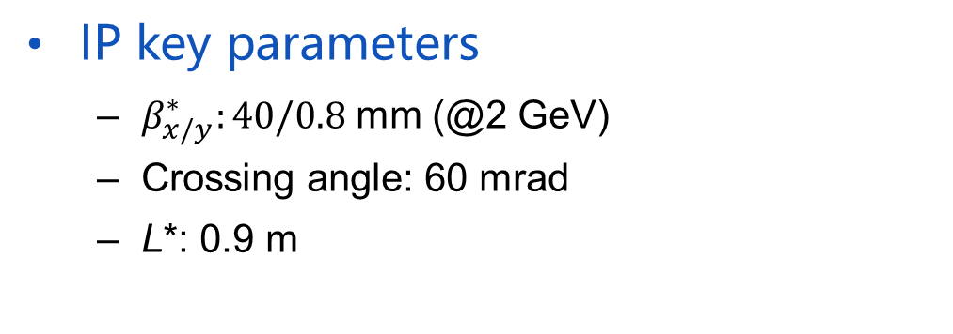
Collider Ring Physics Design (1)
IR design:
  ~200 m in length, 60° in bending
  Modular lattice design
  FFT: final focus telescope
  CCY/CCX: local chromaticity correction Y/X
  MCY/YMX/XMC： local matchings
  CS: crab sextupoles
  MS: matching section
IP key parameters
  $β_{x/y}^{∗}:40/0.8$ mm (@2 GeV)
  Crossing angle: 60 mrad
  L*: 0.9 m

Slide 17
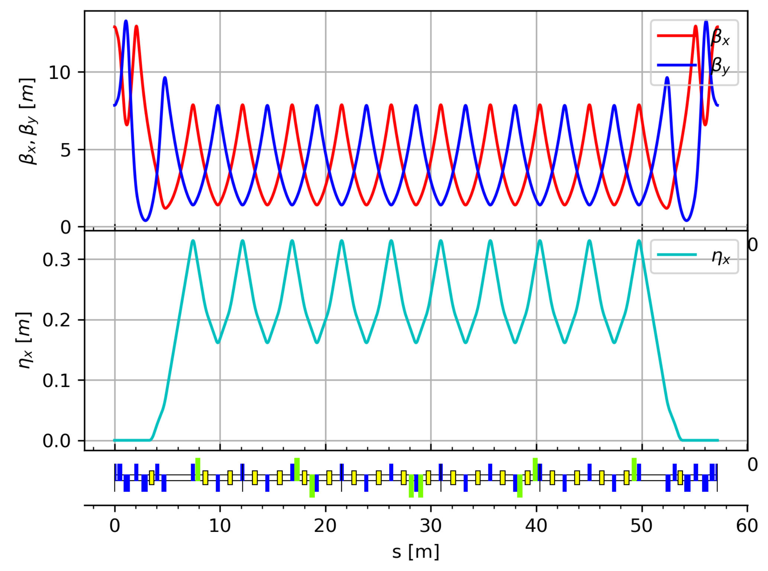
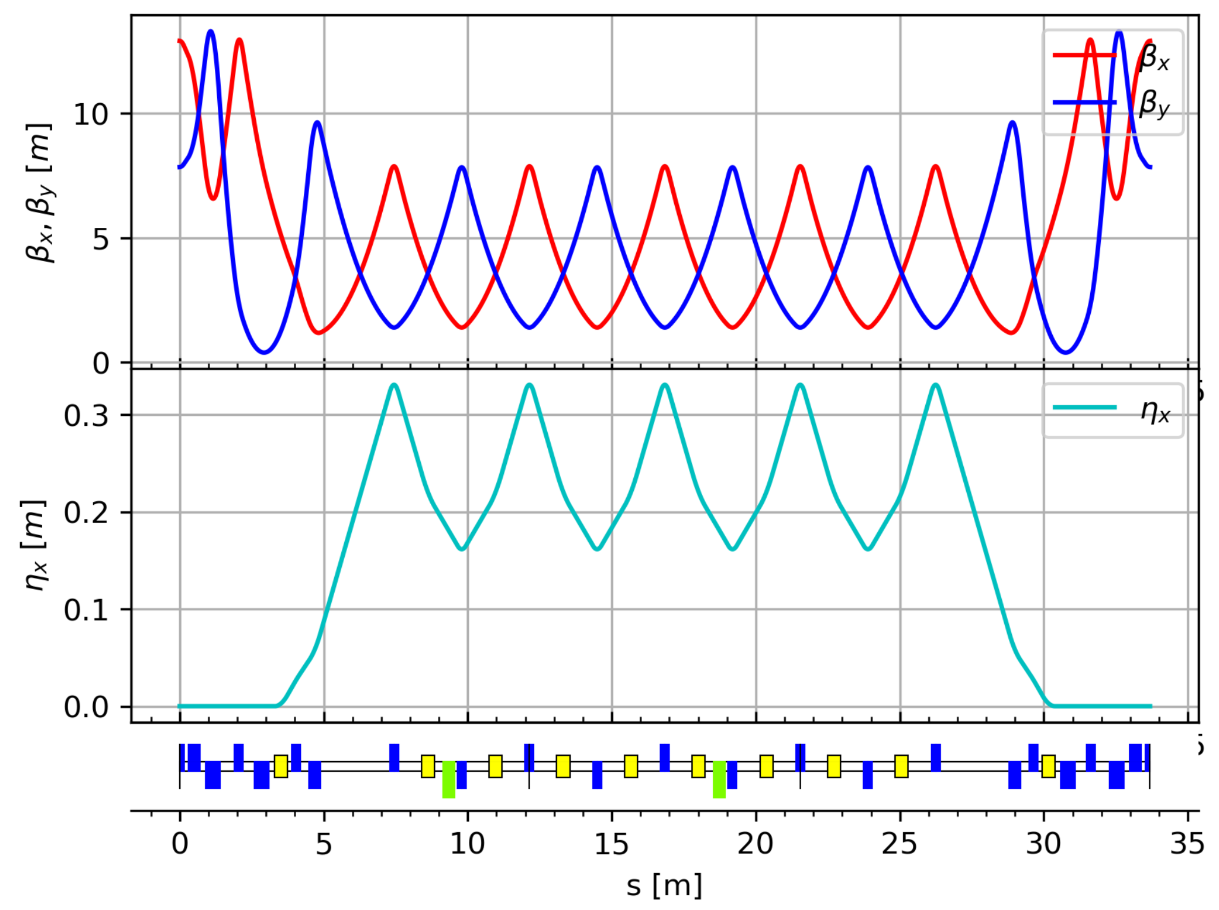
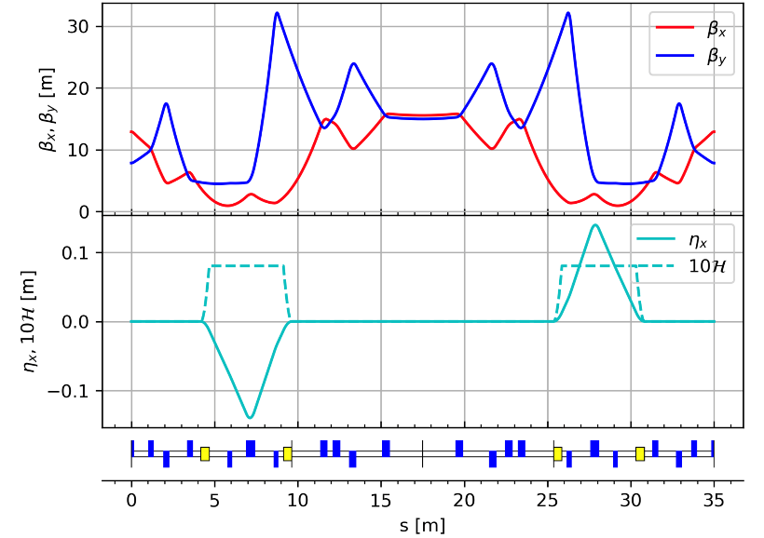
Collider Ring Physics Design (2)
Arc design:
  Four 60° arcs (~57.2 m) and two 30° arcs (33.7 m); another 60° is with IR.
  -I transfer between paired sextupoles
Crossing region
  Length: ~35 m
  Separation between rings: 2.0 m
Straight sections
  Default with FODO cells, functional ones with special designs (e.g. DW with triplets)
60-deg arc lattice
30-deg arc lattice
Crossing region lattice

Slide 18
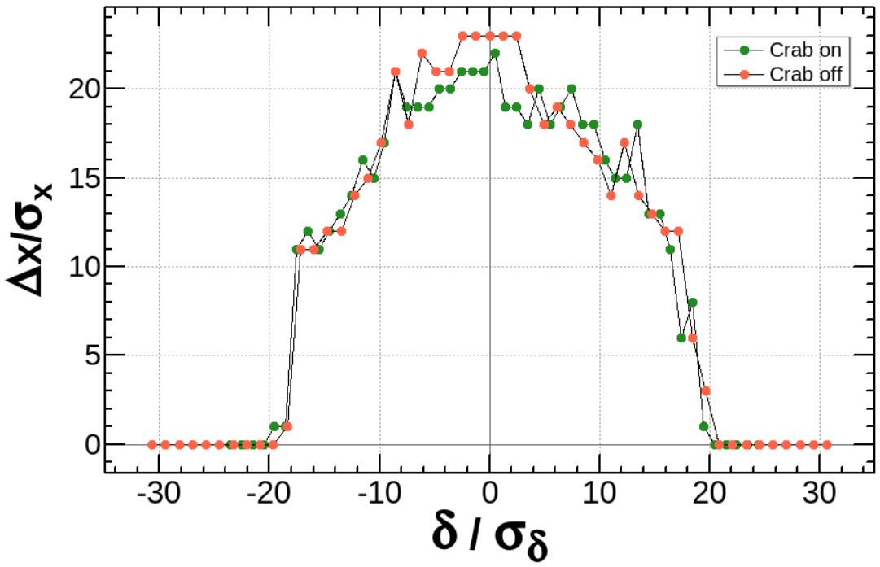
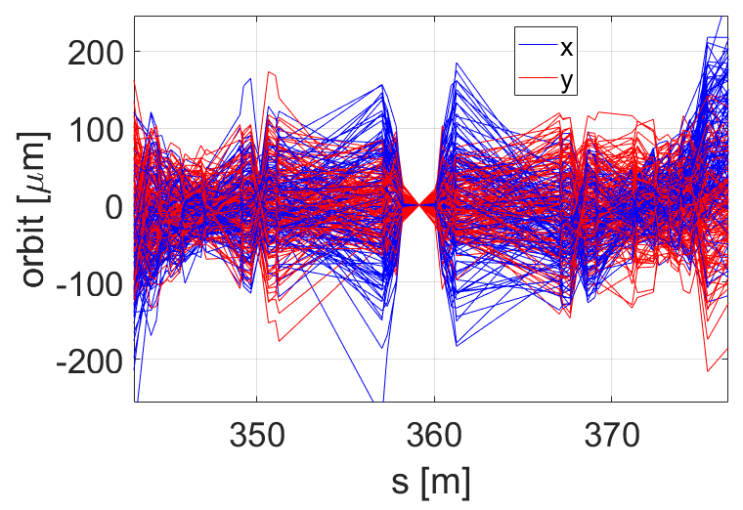
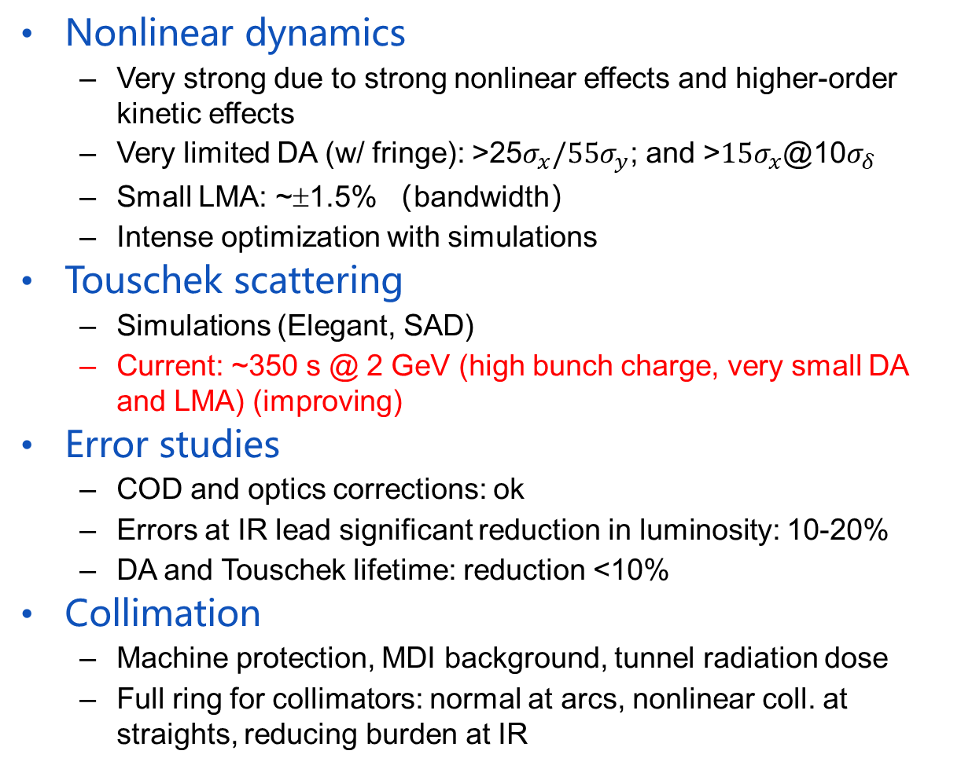
Collider Ring Physics Design (3)
Nonlinear dynamics
  Very strong due to strong nonlinear effects and higher-order kinetic effects
  Very limited DA (w/ fringe): >25$σ_{x}/55σ_{y}$; and >${15σ}_{x}$@10$σ_{δ}$
  Small LMA: ~±1.5% （bandwidth）
  Intense optimization with simulations
Touschek scattering
  Simulations (Elegant, SAD)
  Current: ~350 s @ 2 GeV (high bunch charge, very small DA and LMA) (improving)
Error studies
  COD and optics corrections: ok
  Errors at IR lead significant reduction in luminosity: 10-20%
  DA and Touschek lifetime: reduction <10%
Collimation
  Machine protection, MDI background, tunnel radiation dose
  Full ring for collimators: normal at arcs, nonlinear coll. at straights, reducing burden at IR
LMA
With BPM
Errors

Slide 19
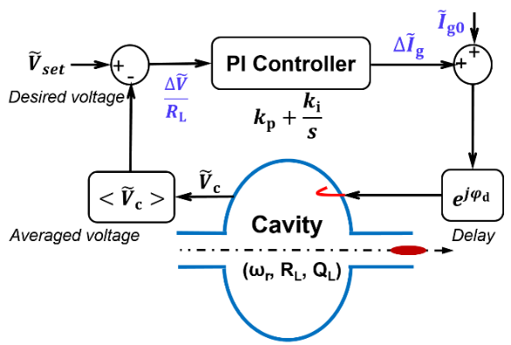
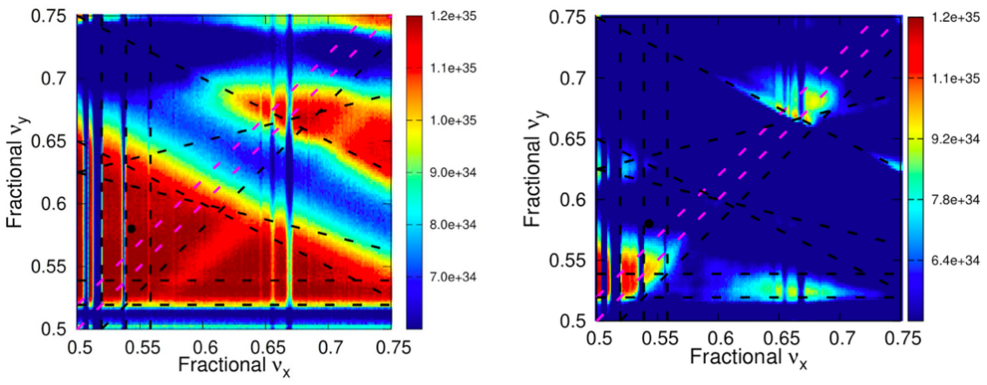
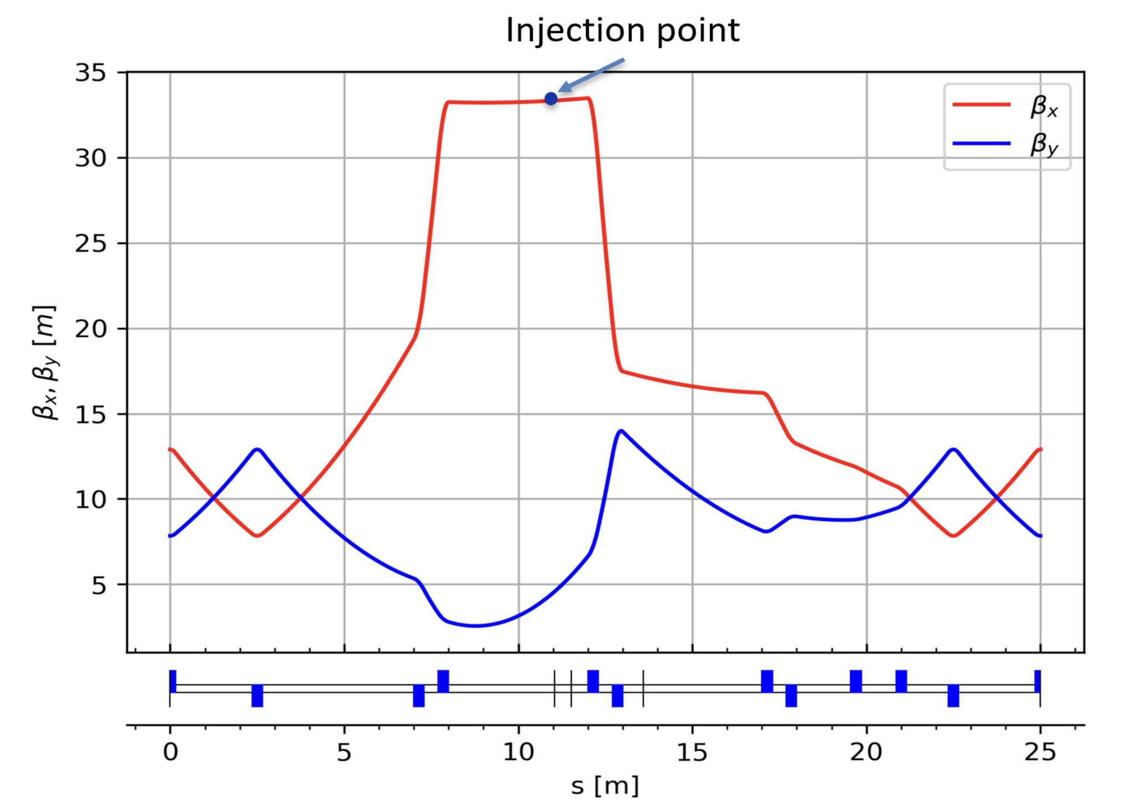
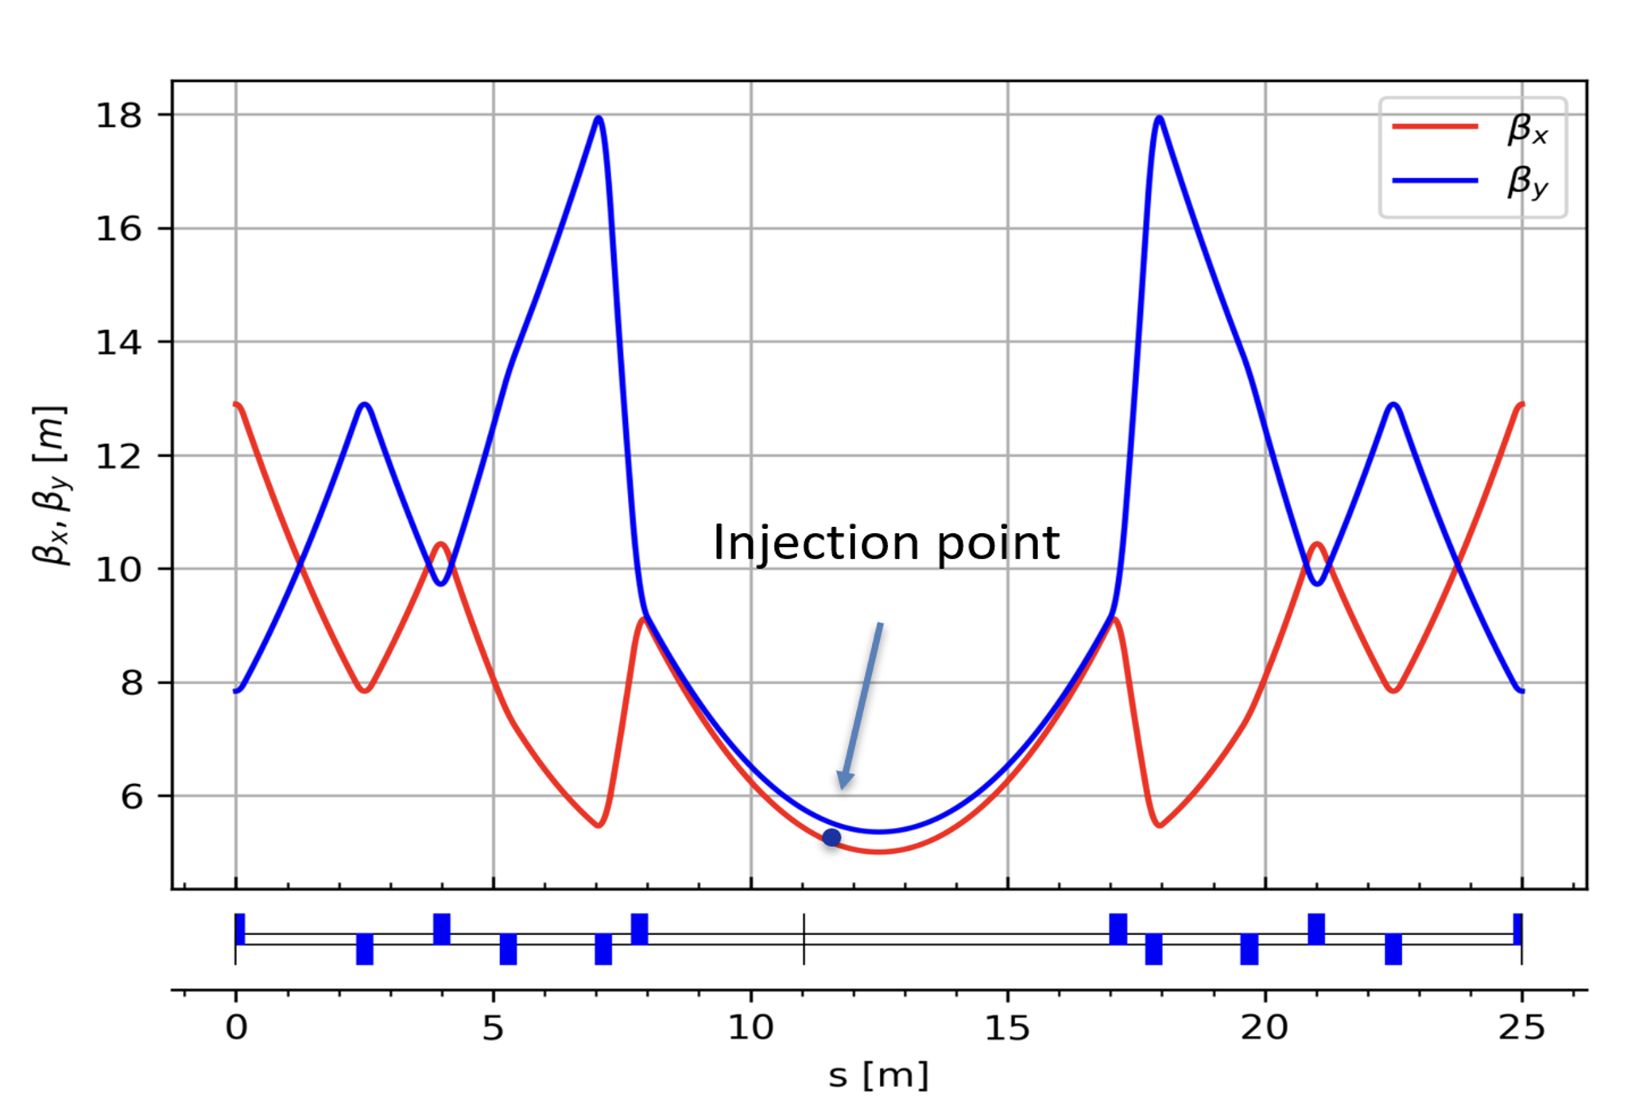
Collider Ring Physics Design (4)
Collective effects, instabilities and longitudinal dynamics
  IBS effects: emittance growth, bunch lengthening
  Impedance control, collective instabilities (feedbacks)
  Requirements to the RF system: HOM-damped TM020 cavities
Beam-beam effects
  Strong concern on X/Z instability
  Simulations (BBWS, BBSS, IBB, Xsuite)
  Tune scans: (0.543, 0.580) for now
Injection and extraction
  Off-axis injection (nominal) and swap-out injection (reserved)
  Dumping extraction (for machine protection, extracting all bunches in one turn) and reserved for swapped bunches
Damping wigglers
  DWs for adjusting damping time, energy spread, emittance
  Influence on focusing, DA and RF frequency

Slide 20
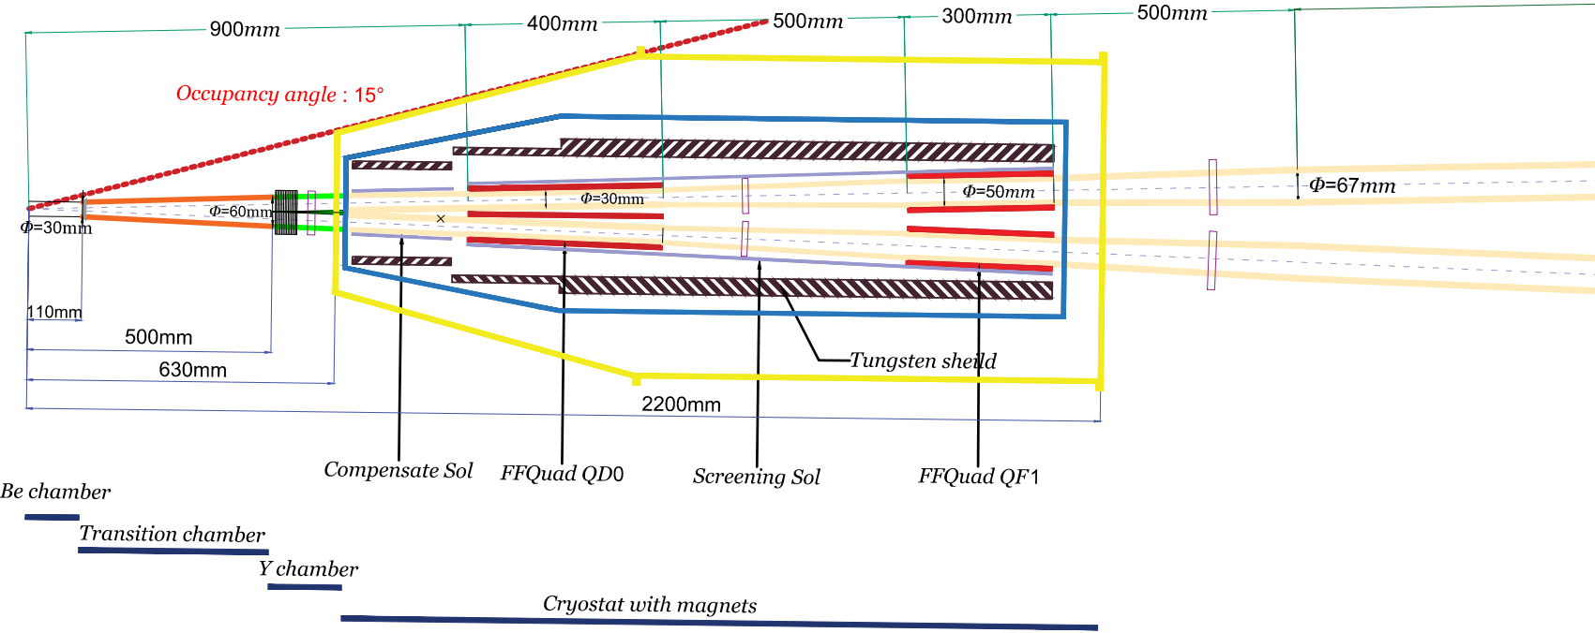
Collider Ring Physics Design (5)
MDI studies at large
  Joint study group (Accelerator: physics, IR magnet, vacuum, diagnostics, mechanics, alignment; Detector: background sim., inner detectors, luminosity monitor)
  Layout, interfaces and dimensions
  Regular meetings (every two or three months)
Background issues
  Studying beam loss mechanisms and reducing total beam losses (Touschek, beam-gas scattering, injection)
  Effective collimation (controlling most losses outside IR)
  Joint simulations (accelerator and detector) on the background

Slide 21
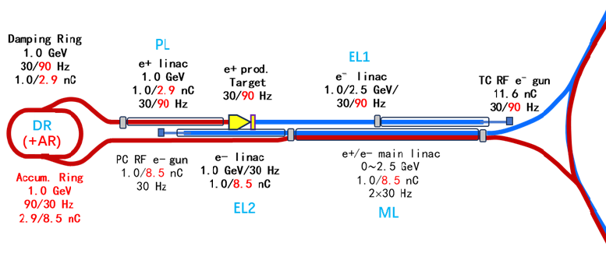
Injector Scheme
A compatible injector scheme for both the off-axis and swap-out injections in the collider rings, with off-axis injection first.
Off-axis (baseline scheme):
  Injection: 1.0 nC e+/e- with 30 Hz each
  e+ beam: 1.0GeV/11.6nC/30Hz e- linac, 1 GeV damping ring, 30 Hz
Swap-out (for future):
  Injection: 8.5 nC e+/e- also with 30 Hz each
  e+ beam: 2.5GeV/11.6nC/90Hz e- linac, 1 GeV DR+AR, ext. 30 Hz

Slide 22
Main Parameters of the Injector
Parameters | Value |  | Unit
Collider ring injection scheme | Off-axis | Swap-out
E-gun type | Photo/Therm. | Therm./Therm.
E-gun charge | 1.0/11.6 | 8.5/11.6 | nC
Injection e⁻ bunch charge | 1.0 | 8.5 | nC
Injection e⁺ bunch charge | 1.0 | 8.5 | nC
Injection energy | 1.0-3.5 | 1.0-3.5 | GeV
Optimal energy | 2.0 | 2.0 | GeV
MW frequency | 2998.2 | 2998.2 | MHz
Injection emittance (X/Y, Geo, rms) | ≤6 | ≤30 | nm-rad
Injection energy spread (rms) | ≤0.1 | ≤0.5 | %
Injection frequency e-/e+ | 30/30 | 30/30 | Hz
e- linac energy for direct injection (EL2) | 1.0 | 1.0 | GeV
e- linac energy for e+ production (EL1) | 1.0 | 2.5 | GeV
e+ linac energy (PS) | 1.0 | 1.0 | GeV
Main linac booster energy for e-/e+ (ML) | 0-2.5 | 0-2.5 | GeV
e+ DR/AR bunch numbers | 6 | 12
e+ DR/AR RF frequency | 499.7 | 499.7 | MHz
e+ DR/AR injection charge | 1.0 | 2.9 | nC
e+ DR/AR injection frequency | 30 | 90 | Hz
e+ DR/AR injection emittance (X/Y) (rms) | ≤1400 | ≤1400 | nm-rad
e+ DR/AR extraction emittance (X/Y) (rms) | ≤11/0.12 | ≤30/10 | nm-rad

Slide 23
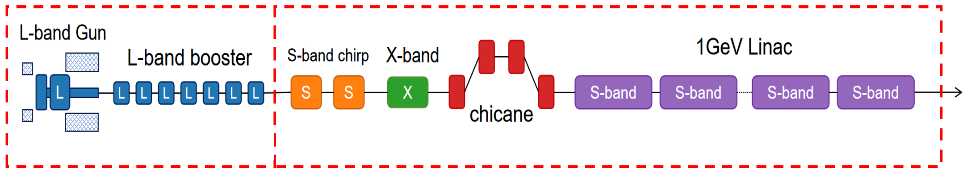
Injector Physics Design (1)
e- linac design
  With L-band photocathode gun: good emittance and momentum spread for direct injection (1.0 nC for off-axis,
  8.5 nC for swap-out)
  With thermionic gun (11.6 nC) for e+ production (off-axis): modest beam quality (90 Hz for swap-out)
Main linac (e-/e+) design
  Almost the same for off-axis and swap-out injections, only bunch charge different
  Energy boost: 0-2.5 GeV, 30 Hz + 30 Hz
Positron production and capture
  Tungsten target, AMD (pulsed peak field: 6.5 T)
  Relatively mature technique with off-axis injection
  Technically challenging with swap-out injection: high heat deposition, movable target design needed

Slide 24
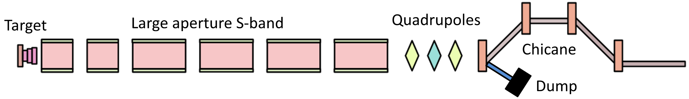
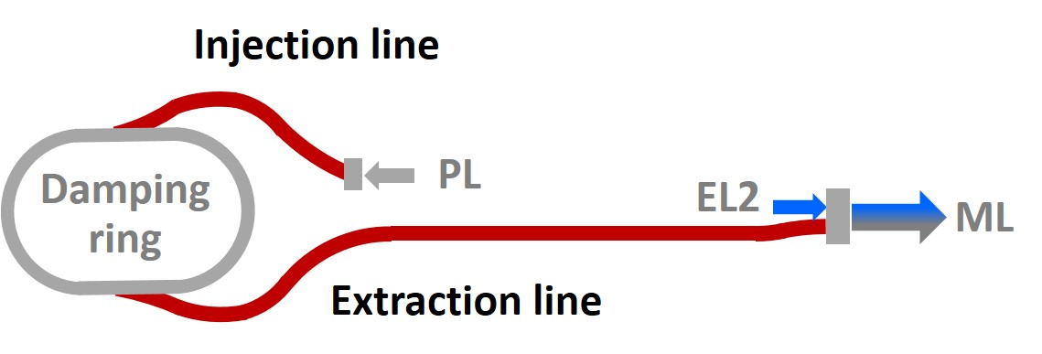
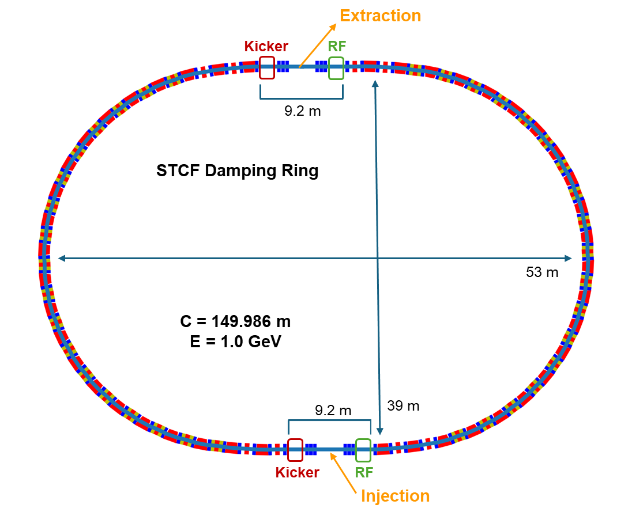
Injector Physics Design (2)
e+ linac
  Large aperture acceleration structure:
  capture
Damping ring / accumulator ring
  DR: several examples exist, 1 GeV, 150 m, 6 bunches circulating
  AR: some challenges, multiple off-axis injections, 12 bunches circulating; much larger horizontal acceptance
Beam transport lines
  DR injection line: reducing momentum spread
  DR extraction line: reducing bunch length
  Injection lines to the collider rings: controlling emittance growth, prolonging bunches, 60° horizontal bending

Slide 25
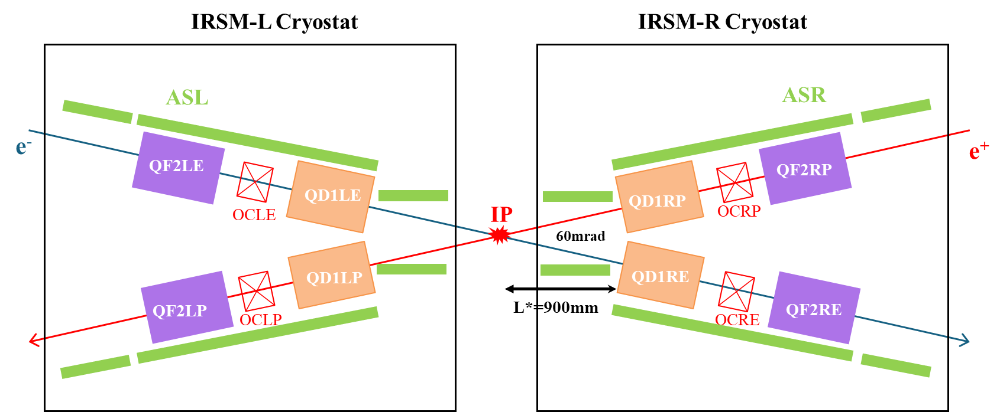
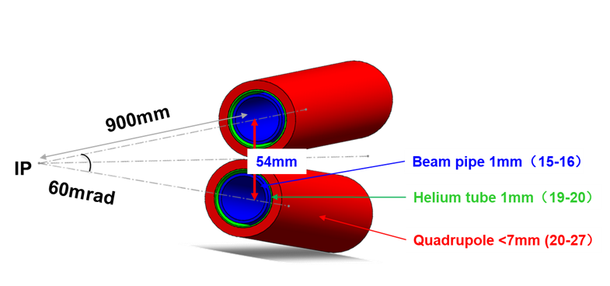
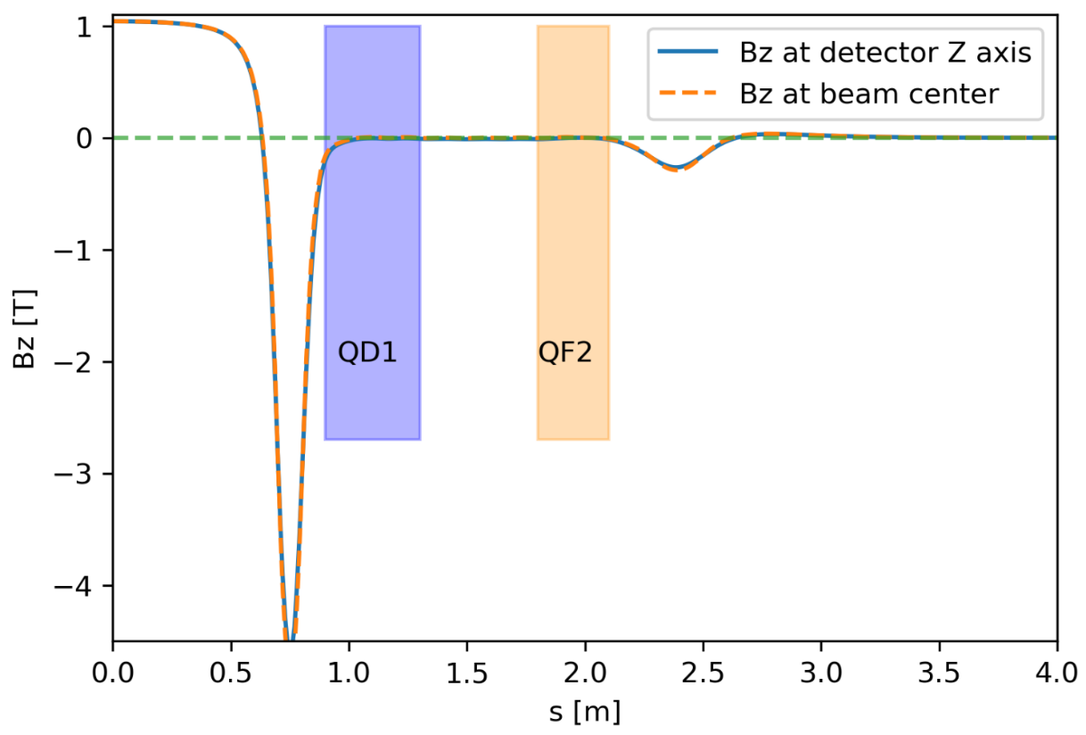
IR Superconducting Magnets (1)
IR SC quadrupole magnets:
  Based on the CCT technology
  CDR design and prototype design completed
  TDR design evolving along with the physics design
Other IR SC magnets
  Solenoids: screening and compensating the magnetic field from the detector solenoid
  Field cancellation within the two quads (QD1/QF2)
  Field compensation at the IP and at the far ends
  Correction coils/magnets (24 coils each side)

Slide 26
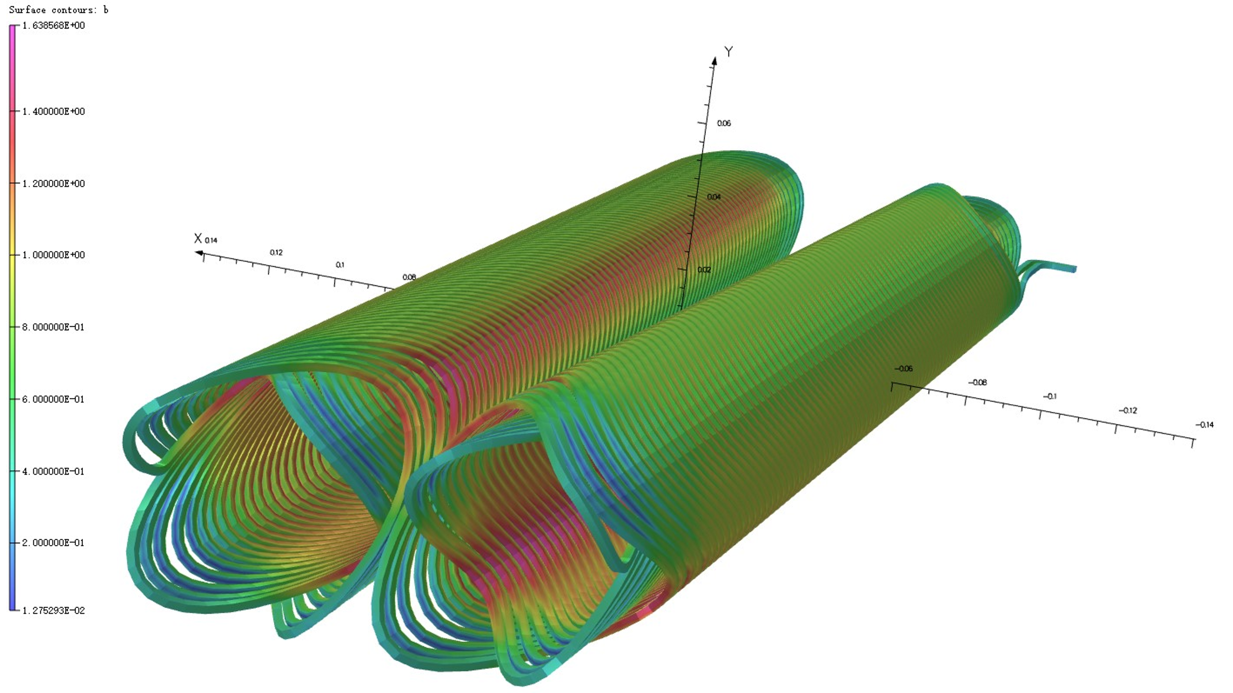
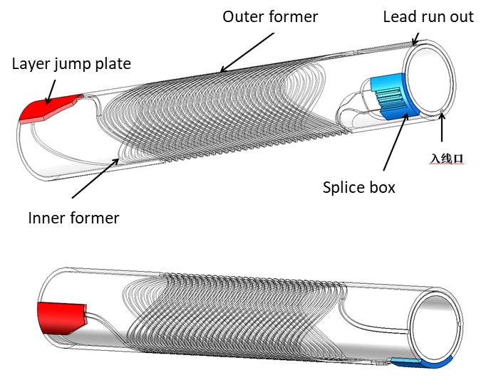
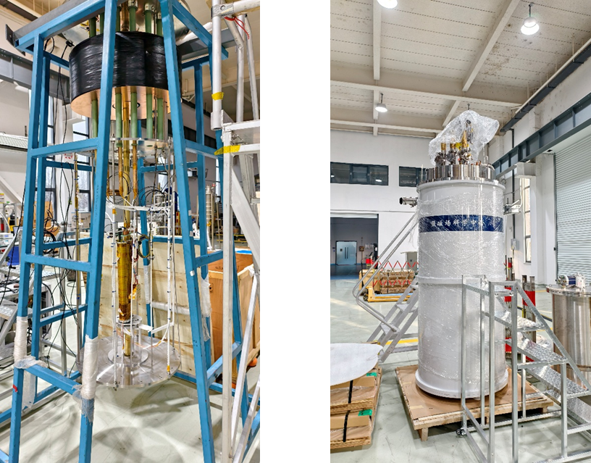
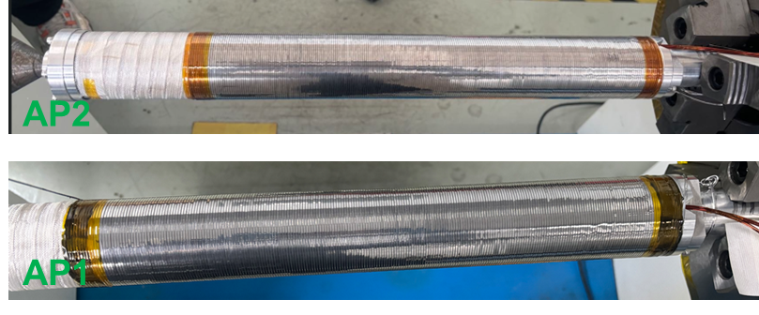
IR Superconducting Magnets (2)
R&D and prototyping
  Focus on the QD1 (most challenging);
  Electromagnetic field optimization: very good, meeting the design goals
  Studying the fabrication techniques
  Prototype fabrication completed, first test showing good performance (design current/field)
  Next test: field distributions
  QD1 prototype and magnet test/measurement

Slide 27
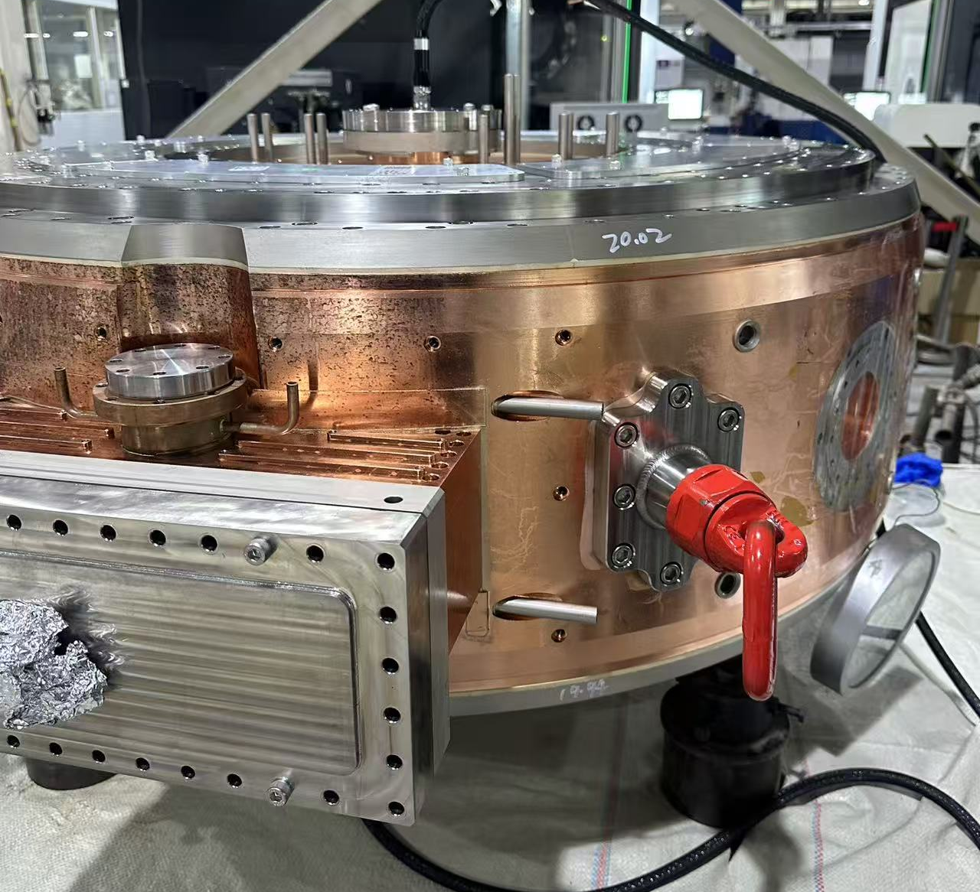




Ring RF system
Concerning two collider rings and DR
  CRs: Challenging due to very high RF power (>300 kW), deep HOM damping, and low R/Q
  DR: same RF frequency but relaxed requirements
  Room-temperature TM020-mode RF cavity was chosen
R&D and prototyping
  Prototype fabrication almost completed
  Performance test will be soon, using HALF RF
  power source and test platform
RF parameters
Working mode | TM020
Frequency [MHz] | 499.7
R/Q [Ω] | 95
Unloaded quality factor | ~60000
$${E_{p}}/{E_{acc}}$$ | 2.48
${B_{p}}/{E_{acc}}$ [mA/V] | 2.88
Schematic
HOM damper
Input coupler ceramic win.
Cavity in fabrication

Slide 28


Vacuum System
TDR under way
  CR vacuum very challenging, mature technology for the others
Vacuum requirements for the collider rings
  Very high SR load: up to 17 kW/m (beam current: 2 A; beam energy: 3.5 GeV)
  Very low pressure (dynamic): <5×10⁻⁸ Pa at arcs and straights; ~1×10⁻⁷ Pa at IR
  IR vacuum: very complicated structure (MDI)
  Low impedance
R&D efforts
  Prototype for a standard arc cell vacuum being started

Slide 29



RT magnets, Damping Wigglers, and Power Supplies
RT magnets and power supplies
  Conventional design for collider rings, linacs, transport lines
  Permanent magnets considered for Damping Ring dipoles
Damping wigglers
  RT electromagnetic wigglers adopted for baseline design
  SC wigglers under study
  Hybrid structure (with permanent magnet blocks) with special configuration found much helpful (increasing field from 1.6 T to 1.9 T @40mm, flatter field)
  Prototyping of the hybrid DW under way

Slide 30




Beam Instrumentation
TDR under way
  CR precise bunch meas.: bunch-by-bunch 3D meas., trans. position res. <5 μm, long. phase res.<0.2 ps
  CR B-by-B fast feedback: coupled bunch inst. (<0.4 ms)
  IP: orbit feedback
  Injector: bunch length and charge meas.
  Iterations between physics design and BI group are held regularly
R&D efforts in progress, to be tested in light sources and e+/e- beam test platform
  Bunch 3D meas.: probe, signal treat, electronics, S/N, integration
  B-by-B fast feedback: raising bandwidth, avoiding interference to single bunch
  Injector bunch length and charge meas.: cavity-based
  Prototypes: beam tests in different machines (SSRF, HLS, DLS)
without
with
Bunch by bunch profile monitor light path diagram
Offline test for cavity-based meas.

Slide 31




Injection and Extraction System
Technical design iteration with physics design
  Off-axis injection (CR/AR): conventional bump kickers, nonlinear kickers
  Swap-out injection: Ultrafast kickers (stripline type, <6 ns bottom)
  Extraction: swap-out bunch by bunch, MPS extracting all bunches
  Eddy current septum
  Anti-septum
R&D efforts
  Both nonlinear kicker and ultrafast kicker prototypes
  Ultrafast kicker test: <1 ns risetime
Nonlinear kicker
Ultrafast kicker
Eddy current septum

Slide 32



MDI and Mechanics
High attention on the MDI area
  Intense discussions among different groups
  IP central beam tube: design optimization, prototyping to start
  MDI mechanical model prototype: in fabrication
Technical design on the collimators are on iteration with physics design
IP central beam chamber
RVC (Remote Vacuum Contact)

Slide 33




Linac Microwave and Power Source
Linac acceleration structures for e-/e+ beams
  Standard: 40 MW klystron driving two 3-m acceleration tubes, with SLED: ~27 MV/m
  A few large-aperture tubes for e+ beam capture and early acceleration: ~20 MV/m
  50 Hz repetition rate 2998-MHz klystron is available in China, but 90 Hz needs more development
Cannon (left) and KMF418B (China, right)
Schematic and structure design

Slide 34




Positron Source
Positron source design
  Mature technique for off-axis injection scheme: heat load, 5.6 J/g
  Technically challenging for swap-out injection scheme: heat load 31.8 J/g; wobbling target design adopted.
  Prototype of the conventional design for the test beam platform under way
 | Parameter | Design
 |  | Off-axis | Swap-out
1 | e+ beam for DR/AR | 1 GeV/1.0 nC/30 Hz | 1 GeV/2.5 nC/90 Hz
2 | e- beam on target | 1.0 GeV/11.6 nC/30 Hz | 2.5GeV/11.6nC/90Hz
3 | Beam power | 348 W | 2443 W
4 | Peak power dep. | 5.6 J/g | 32.2 J/g
5 | AMD | 0.5-5 T | 0.5-5 T
6 | e-/e+ conv. Rate | 9.1 % | 25 %
7 | Solenoid field | 0.5 T | 0.5 T
8 | Accel. tube diam. | 30 mm | 30 mm
Coil1
Coil2
With wobbling target, temperature below 400°C
Conventional design

Slide 35

e-/e+ Beam Test Platform
Test platform to support several injector R&Ds
  Photocathode e-gun; High-power solid-state modulator; Positron target; Adiabatic matching device (AMD); Large-aperture S-band accel. tube; Beam diagnostics
Design scheme
  100-MeV e- linac + Positron target and AMD +100-MeV e+ linac
Elements fabrication: due 2026.5
Installation and test: 2026.05-09
HALF test hall

Slide 36
Other Technical Systems
Alignment
  Special attention to the IR (very challenging), the others similar to light sources
Electron sources
  Thermionic e- gun: 10-12 nC technical available
  L-band photocathode e- gun: ~1 nC for off-axis injection (mature), 8.5 nC for e- beam swap-out injection (needing further development)
Control system
  No technical challenges, just following the light sources
Radiation and safety
  Beam loss rate hundreds times higher than light sources, but shielding and safety design method the same
  Need more collimators and local shielding

Slide 37
Detector design and R&D efforts

Slide 38


STCF Detector Design
Inner Tracker (4 layers)
  MPGD: cylindrical uRGroove, σ_{x} ~100 μm
  Silicon: low-mass MAPS, <0.3%X₀/layer
Main Drift Chamber (σ_{p}/p~0.5% @ 1GeV)
  Small cells with helium-based gas, σ_{x} <130 μm
PID System (π/K ~4σ @ 2GeV, <0.3X₀)
  Barrel: DIRC-like TOF - BTOF (σ_{t}~30 ps)
  Endcap: RICH (<4mrad), ASHIPH, DTOF
EMC
  pCsI + APD + waveform readout: (σ_{E}/E~2.5%, σ_{x}~5 mm @ 1GeV & ~1 MHz/crystal )
Solenoid ：1 T
Muon Detector (eff. >95%, mis-rate <3.3% @1GeV)
  inner 5 layers : glass RPC，> 300 Hz/cm²
  outer 10 layers : scintillator strip + SiPM, ~ 2.4 m
Main Performance requirements
Tracking: eff>90%@0.1GeV, σ_{p}/p~0.5%@1GeV
Energy meas. : 25MeV-3.5GeV
σ_{E}/E ~ 2.5% @ 1 GeV
Hadron ID: π/K ~4σ @ 2 GeV, ~3σ @ 3 GeV
Muon ID： eff. >95%, mis-rate <3.3% @1 GeV

Slide 39









ITK : μRGroove and CMOS MAPS
Proposed and developed a novel single-stage MPGD, micro-resistive Groove detector (μRGroove) with larger signals and easier production compared to μRWELL. Developed a low-mass cylindrical μRGroove prototype: material budget ~ 0.23%X0/layer, the best in cylindrical MPGDs.
Ultra-low mass electrode
C-uRGroove Protytpe
Beam test @ CERN SPS
σ_{x} < 130μm in 1T
Cylindrical μRGroove
Targeting a low-power MAPS with moderate position resolution and both timing and charge measurement capabilities. Exploring strip-like MAPS designs and a super-pixel design
180nm
Chips received,
testing underway
90nm
Chips received,
to be tested
130nm
Chips received, testing underway
180nm
Supporting quadruple-well with possibility of
N-blanket implant and N-gap. Chips received, testing underway
N-blanket implant
N-gap

Slide 40







MAPS Testing
Characterized the prototype MAPS chips for threshold, noise, charge collection efficiency and capacitance with laser and radioactive sources.
Performed a beam test at CERN PS for detection efficiency, fake hit rate, position resolution, time resolution.

Slide 41






Main Drift Chamber
Endplate structure optimized to simplify the assembly process. Intensive R&D effort on feedthrough for super-small cells (~5 mm). A full-length super-small cell drift chamber prototype has been constructed.
Waveform digitizing electronics is developed to allow online waveform discriminating algorithms that run on PFGA to identify overlapping signal pulses

Slide 42








BTOF/DTOF Detectors
A DTOF prototype was built and tested with particle beams at CERN PS to demonstrate the PID capability of the DTOF detector
π/K separation >4σ @ 2GeV/c
A full-length BTOF prototype has been built and tested with particle beams at CERN PS. Data analysis is underway.

Slide 43










RICH Detector
Cosmic-ray test of a 32×32 cm² RICH prototype with both THGEM+MM and DMM
main issue: low photoelectron yield ~2pe/track.
$σ$=9.4 mrad
QE of photo cathode needs to be improved !
DMM gain 1.2$×{10}^{5}$
THGEM MM gain 0$.95×{10}^{5}$
Purifying C₆F₁₄ with good transmittance achieved

Slide 44




Electro-Magnetic Calorimeter : EMC
A crystal calorimeter using pCsI ( short decay time of 30ns ) to tackle the high background rate (~1 MHz/crystal ): crystal unit 5×5×28(15X₀) cm³ ; 4 APD(1×1cm²) to enhance light yield, ~8900 crystals in total.
Developed and implemented a dead-time free pileup correction algorithm involving waveform fitting based on pipelined optimal filtering.
Developed a fully-readout ECAL prototype with 5×5 pCsI crystals. Carried out two beam tests of the prototype at CERN PS: σ_{E}/E~2.1%, σ_{x}~5.5mm, σ_{t}~280ps @1GeV
Light yield : 50 p.e./MeV → 300 p.e./MeV
pCsI sprayed with WLS

Slide 45











Muon Detector
Scintillator strip + WLS + SiPM
  Design and fabrication of the scintillator unit ：reflector, fiber groove, optical coupling, surface processing.
  Fabricated 2.4 long scintillator units (efficiency>95%) and a 50×50 cm² scintillator strip array
Glass RPC
  Developed glass RPC fabrication techniques and built a 40×40 cm² glass prototype.
  Focusing on low-resistivity glass RPC for high count rate capabilities. Built some small prototypes.

Slide 46








Readout Electronics
Ongoing effort on development of readout ASICs and readout systems for all sub-detectors. Prototype ASIC chips and readout systems have been developed and tested (with detectors). Some ASIC designs have undergone three iterations and are maturing.

Slide 47




Trigger, DAQ, Clock, Data Transmission
Clock jitter ~ 5ps, physics event rate ~400 kHz @Jpsi，data rate ~30 GB/s
Design and development of architectures, algorithms, firmware, software, hardware components, ASICs, prototype systems

Slide 48








Combined Beam Tests
Two test beam campaigns for combined systems (ITK, RICH, DTOF, EMC, Clock, Trigger, DAQ)
CERN PS T9 beam line (Aug. 2025 & Oct. 2025 )
DTOF: σ_{t}~25 ps
EMC: σ_{E}/E ~2.1%
EMC Prototype
DTOF Prototype

Slide 49
Project status and planning

Slide 50
Project Schedule
14th five-years plan
15th five-years plan
 | 2018 | 2019 | 2020 | 2021 | 2022 | 2023 | 2024 | 2025 | 2026 | 2027 | 2028 | 2029 | 2030 | 2031 | 2032 | 2033-2043
Conceptual design and CDR
Key Technology R&D and TDR |  |  |  |  |  |  |  | ⭐️
Construction
Operation
Submit project proposal to central government:
Science, budget, feasibility and contribution to society
14th five-years plan : CDR/TDR and Key technology R&D, 364 M CNY
15th five-years plan : Construction 5 years, ~5 B CNY
Operating for 10-15 years; upgrading; operating again for ~10 years

Slide 51

Team & Collaboration
25 universities/Institutes:
170 faculties and 140 graduate students
Ongoing efforts to strengthen collaboration with BINP, KEK, INFN-LNF, DRD and others, especially on accelerator development

Slide 52
Project Proposal to the Government
Submit project proposal to the central government (National Development and Reform Commission, NDRC) for construction in the 15th Five-Year Plan (2026-2030)
  Several rounds of selection (done, waiting for final decision)
  National competition from all fields
  Lasting about one year from the first half 2025 (first two rounds within CAS)
If approved
  Feasibility study phase will come very soon
  Then the engineering design before the construction start
  Ideal construction plan: 2028-2034 (the 4G light source HALF to complete in 2028)
  Construction budget: ~5.0 billion RMB

Slide 53

Reports Writing
Detector and Physics CDR published in 2021 (2024)
Accelerator CDR completed in 2025
  In both Chinese and English editions, Spring 2025
  Internal review (Jan. 2025) and international review (June 2025)
  Published in NST [Nucl. Sci. Tech. 36, 242 (2025)], with 460 authors from around the world
STCF project proposal
  Only in Chinese edition (several versions)
  Submitted to the CAS and the central government
STCF TDR scheduled late 2026
  Chinese edition before October 2026
  English edition by end 2026

Slide 54
More key technology R&D on the accelerator
New R&D efforts
  Two items identified for R&D or prototyping (soon to start):
  Prototype for one standard vacuum cell of the collider ring arcs
  IP chamber prototype
  In late 2026, will identify more items (or the following-up of the current ones) for R&D

Slide 55






IAC meetings
International Advisory Committee
主席 | Guy Wilkinson | U. of Oxford | 英国
副主席 | Frank Zimmermann | CERN | 瑞士
成员 | Marica Biagini | INFN Frascati-National Lab. | 意大利
 | Ikaros Bigi | U. of Notre Dame | 美国
 | Alexander Bondar | BINP | 俄罗斯
 | Tom Browder | U. of Hawaii | 美国
 | 赵光达 | Perking U. | 中国
 | 高原宁 | Perking U. | 中国
 | Wolfgang Gradl | JGUM | 德国
 | David Hitlin | CIT | 美国
 | Tord Johansson | Uppsala U. | 瑞典
 | Marek Karliner | Tel Aviv U. | 以色列
 | Eugeny Levichev | BINP | 俄罗斯
 | 马余刚 | Fudan U. | 中国
 | Mikihiko Nakao | KEK | 日本
 | Stephen Olsen | Chung Ang U. | 韩国
 | Alexey Petrov | South Carolina U. | 美国
 | Antonio Pich | Valencia U. IFIC | 西班牙
 | Makoto Tobiyama | KEK | 日本
 | 赵红卫 | IMP, CAS | 中国
 | 赵振堂 | SARI, CAS | 中国
 | 邹冰松 | Tsinghua U. | 中国
2024 Jan. 1st IAC meeting
STCF will be a unique facility with a broad and impressive physics reach. It will allow for results of world-leading precision in many important topics, and has significant discovery potential. It will ideally complement the other facilities that are currently operational or are foreseen for the 2030s and 2040s, and will be of great interest to the international particle physics community……...
The IAC is pleased to note the substantial progress made in physics, detector and accelerator studies …………..
The IAC continues to endorse the very high scientific merit of the project. It congratulates the STCF team on the excellent progress made over the past year. Although substantial challenges remain to be overcome, the IAC considers that STCF will be able to achieve its design goals within the timescale specified,…...
2024 Oct. 2nd IAC meeting
2025. May 3rd IAC meeting
Great helps and encouragements!

Slide 56
Near-term Planning
Support the project application for construction in the 15th Five-Year Plan (2026-2030)
  Under course, national level selection
TDR work
  Until end 2026
  Review in the first half 2027
Strengthen the team and collaboration
  Continuously strengthen the accelerator team by recruiting new staff and inviting more domestic collaborators
  Enhance international collaborations, in particular, BINP, KEK and INFN-LNF

Slide 57
Summary
STCF design and R&D undergone great progresses, many thanks to all the team members and collaborators
Both Detector and Accelerator CDRs completed and reviewed
TDR under way, to be completed by end 2026
Current key technology R&D and prototyping are in schedule, and more items being started
Support the project proposal application for construction in 15th Five-Year Plan
Much welcome international collaboration!
Thanks for your attention!

