Slide 1






Darkside Masterclass
Instruction – Excel Part B
Istituto Istruzione Superiore Luigi Einaudi, Siracusa, 27 Marzo 2026

Slide 2
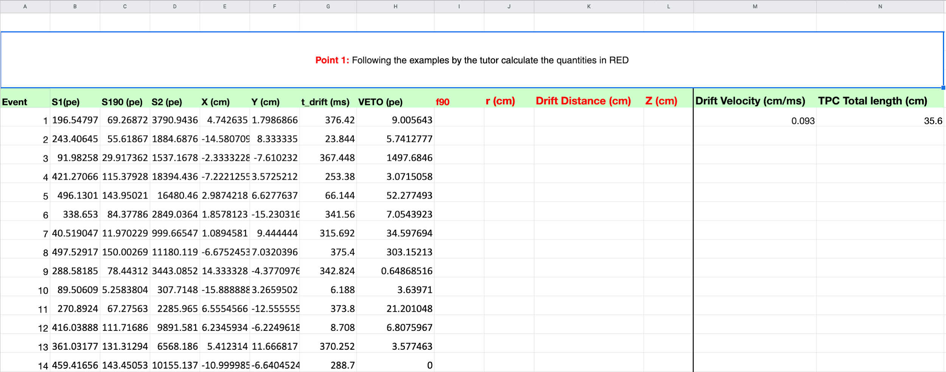
Purpose
This document shows how to proceed to analyze the data collected by the DarkSide50 (DS50) experiment using Google Sheet (or Excel)
Using a set of DS50 data
Final goal: learn how to select possible Dark Matter candidates

Slide 3
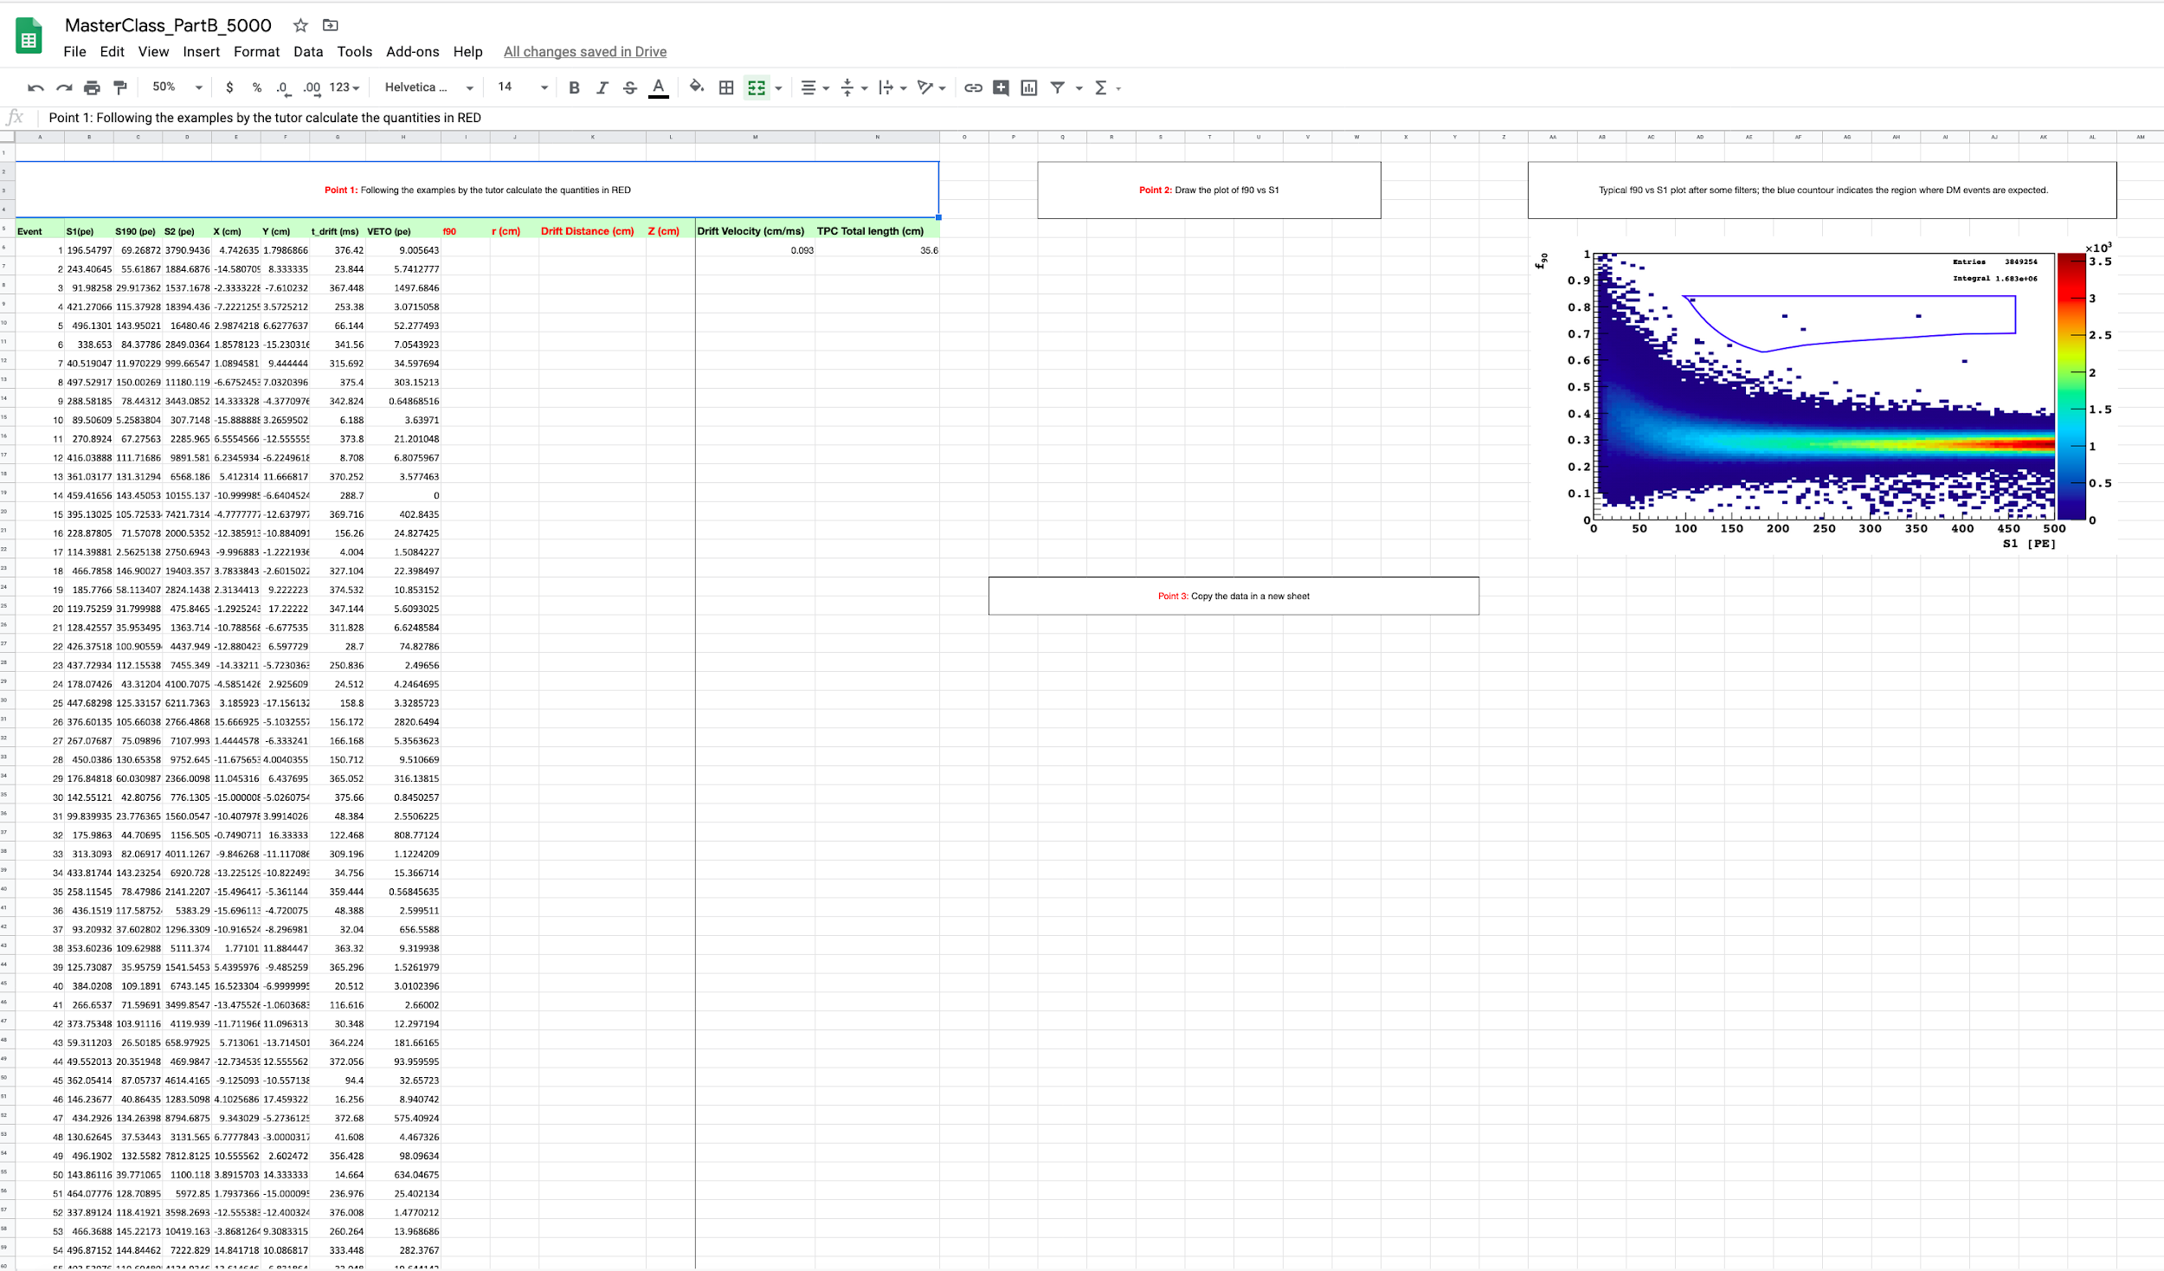
Global View

Slide 4
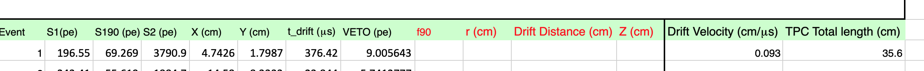
Excel View
PART 1:
Calculate the quantities in RED
f90=S190/S1
r(cm)
Drift Distance (cm)
Z (cm)

Slide 5
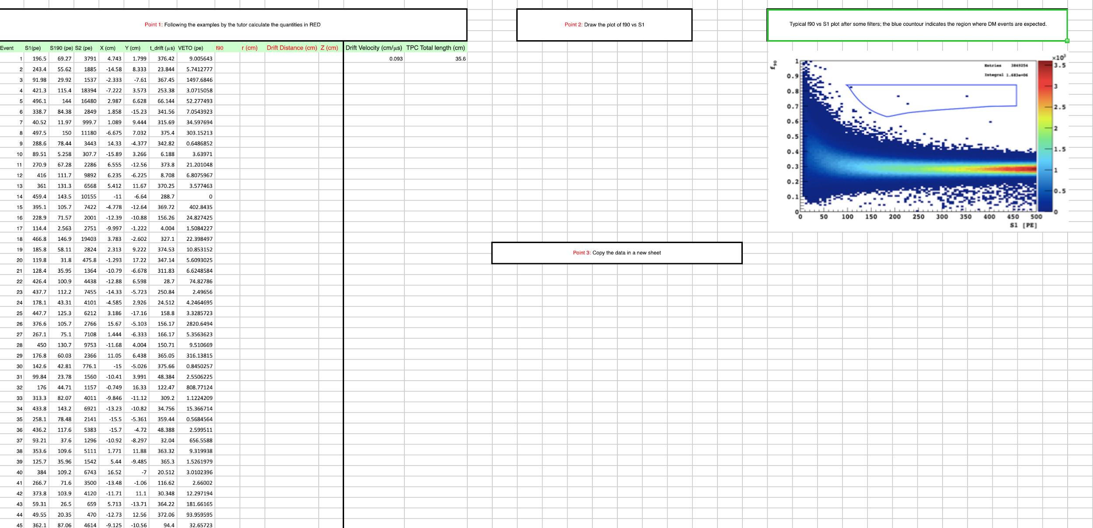
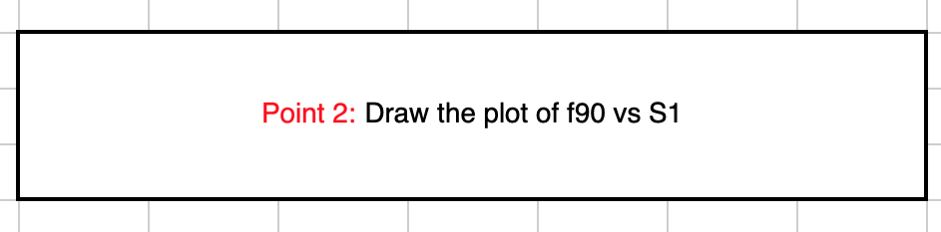
Excel View
PART 2:
Draw the plot f90 vs S1 and compare with the one shown

Slide 6
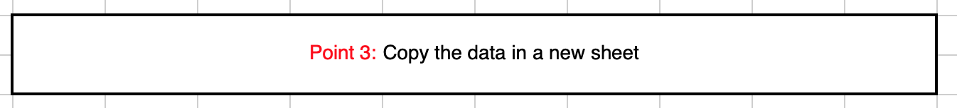
Excel View
PART 3:
Copy the data in a new sheet: duplicate the datasheet that will be used to apply filters to select possible Dark Matter candidates

Slide 7
PART 1
You will start with the following data:
The number (ID) of the event
The total amount of primary scintillation light S1 (in pe)
The amount of S1 (in pe) collected in the first 90 ns of the signal
The total amount of secondary scintillation light S2 (in pe)
x position of the particle in the TPC in centimetre (cm)
y position of the particle in the TPC in cm
Time between S1 and S2 in microsecond (μs=10⁻⁶ s)
Signal collected from the VETO system
Plus 2 constants
Velocity of an electron in LiquidAr in cm/μs
Total length of the TPC in cm

Slide 8
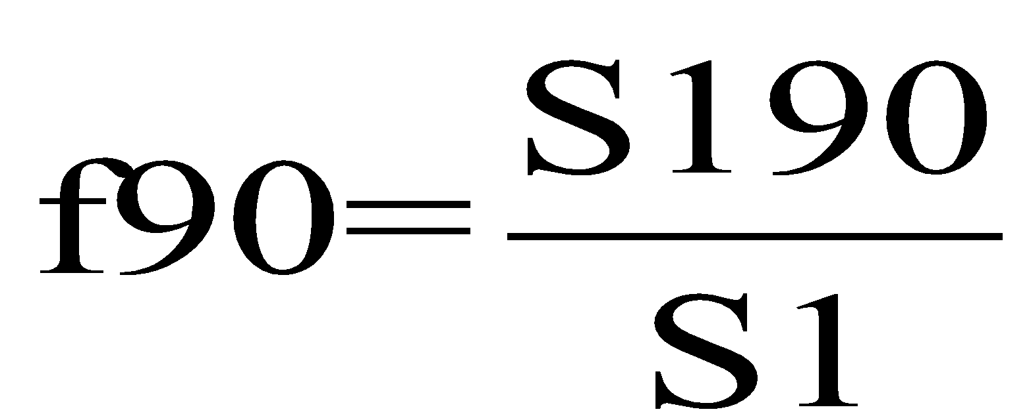
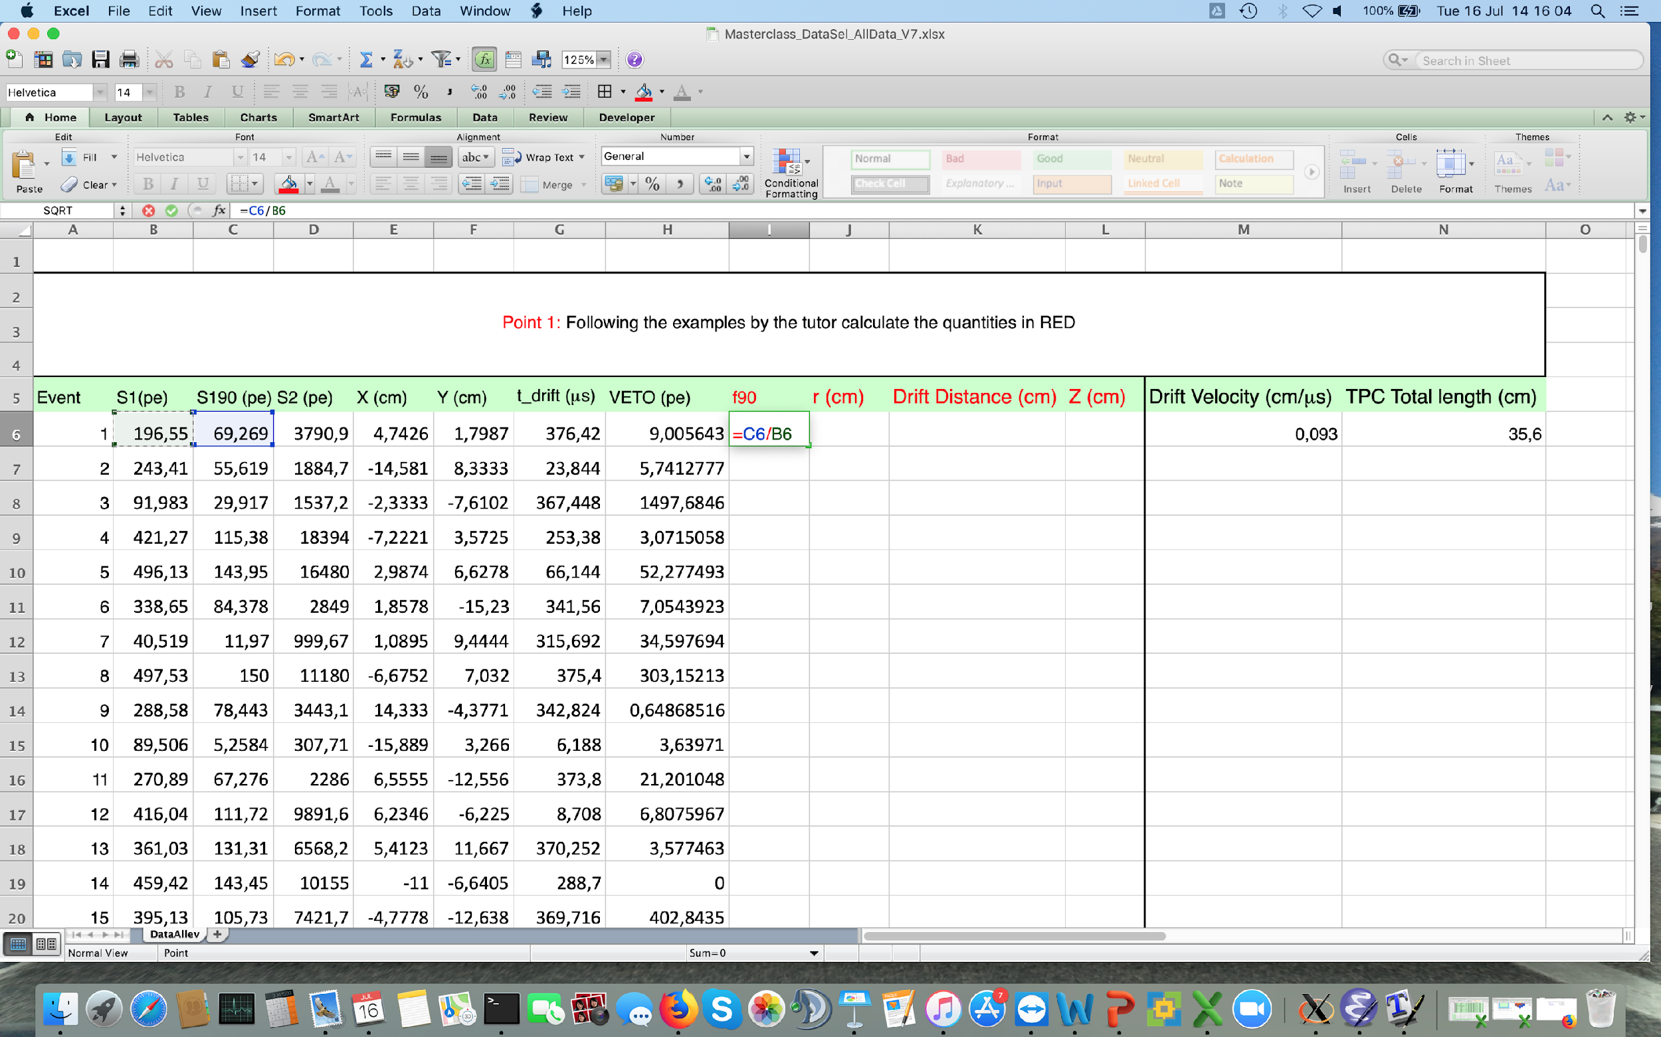
PART 1
f90 is defined as
Excel allows us to write the formulas in a easy way:
-click on the cell you want to insert the formula (cell I6 in the picture below);
-write =C6/B6 and press ENTER.
Now we need to repeat the calculation for all the events

Slide 9
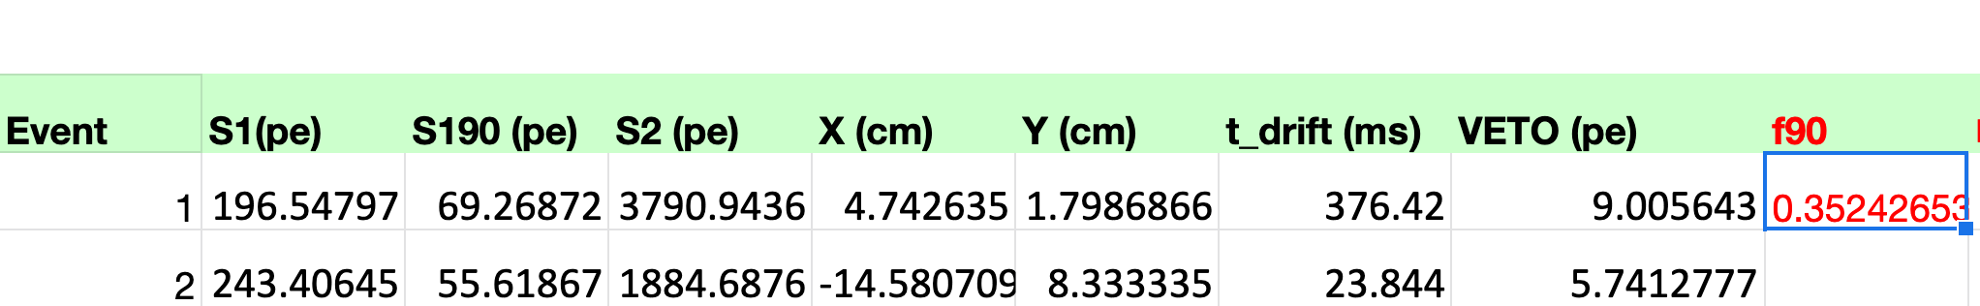
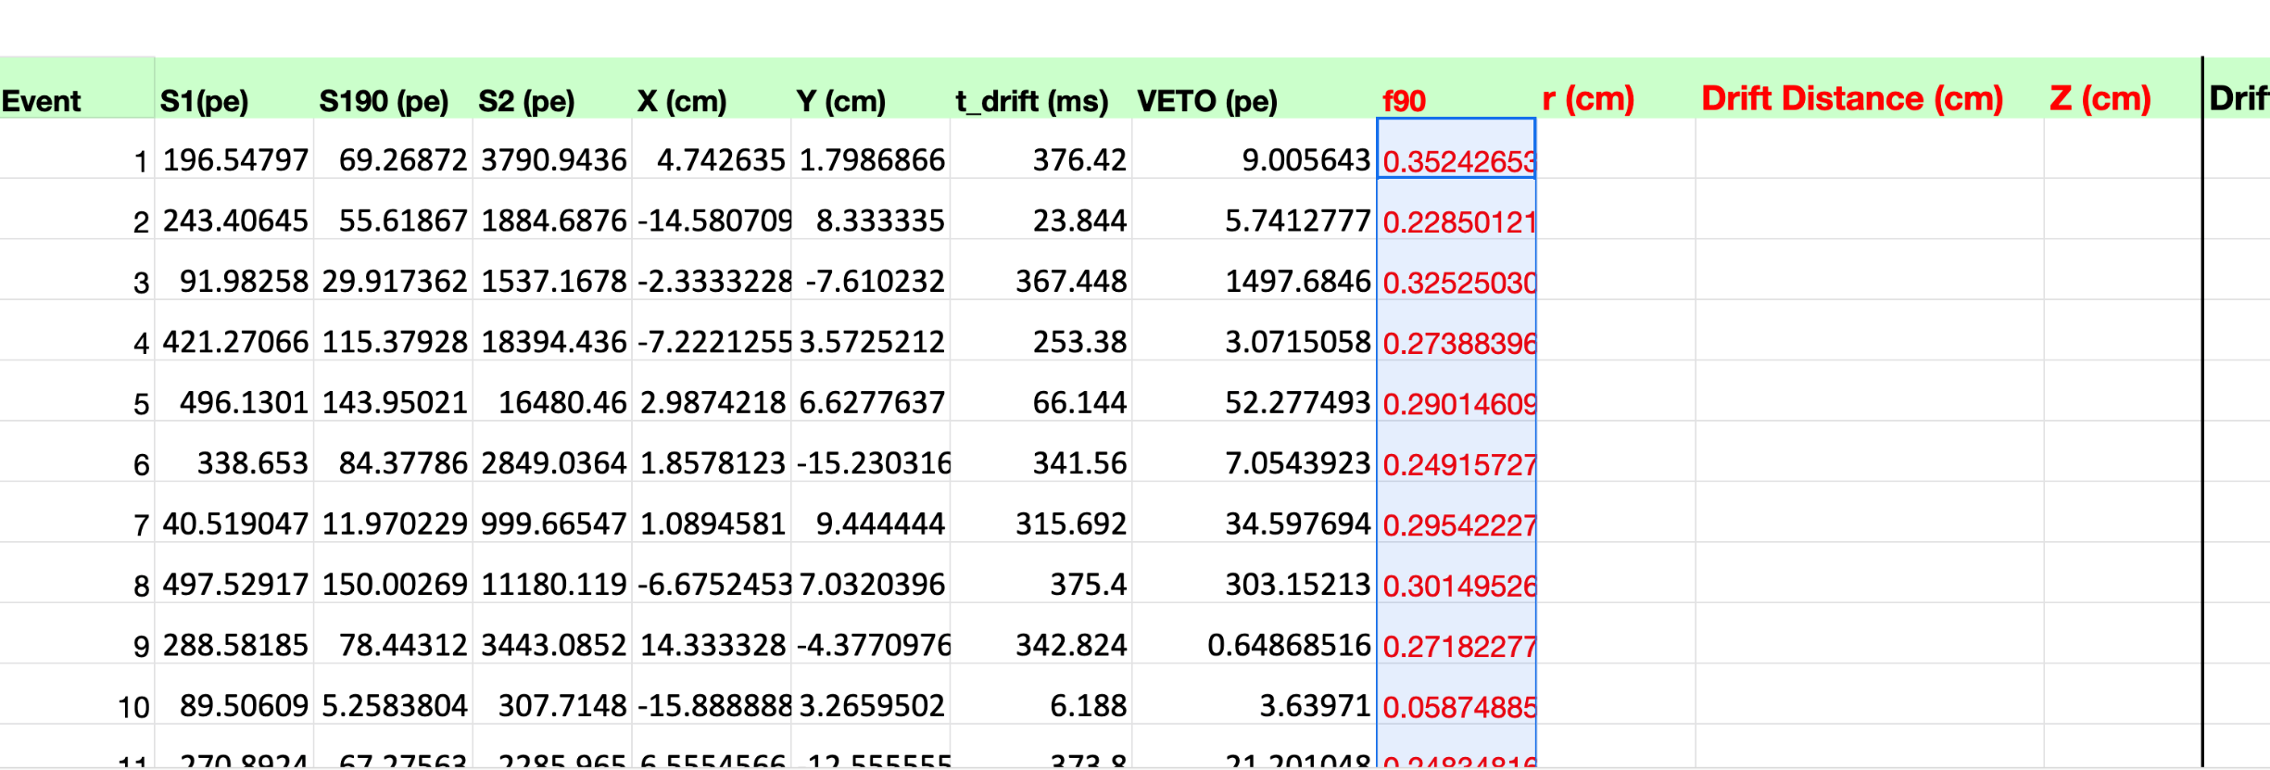
PART 1
EXCEL TIP
Repeat the calculation for all the events….
Method 1
Using the mouse you can selected the cell where you performed the calculation and pointing at the right lower corner of the cell a black (or blu) cross will show up.
Click the cross and drag down.

Slide 10
PART 1
EXCEL TIP
Repeat the calculation for all the events….
Method 2
Using the mouse you can selected the cell where you performed the calculation and pointing at the right lower corner of the cell a black (or blu) cross will show up.
Double click on the black cross

Slide 11
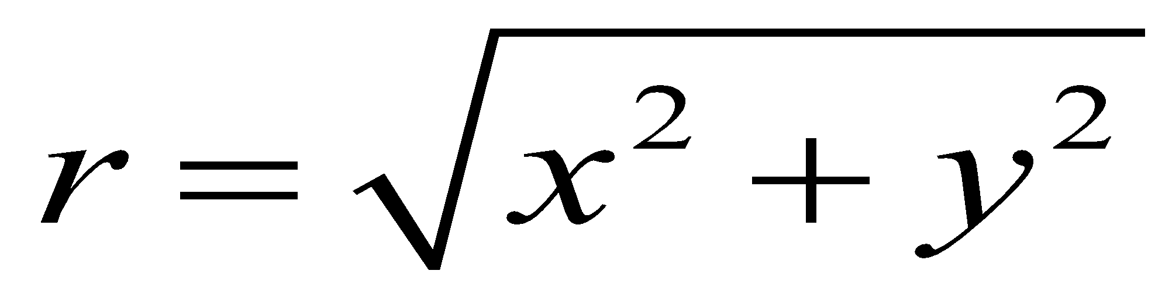
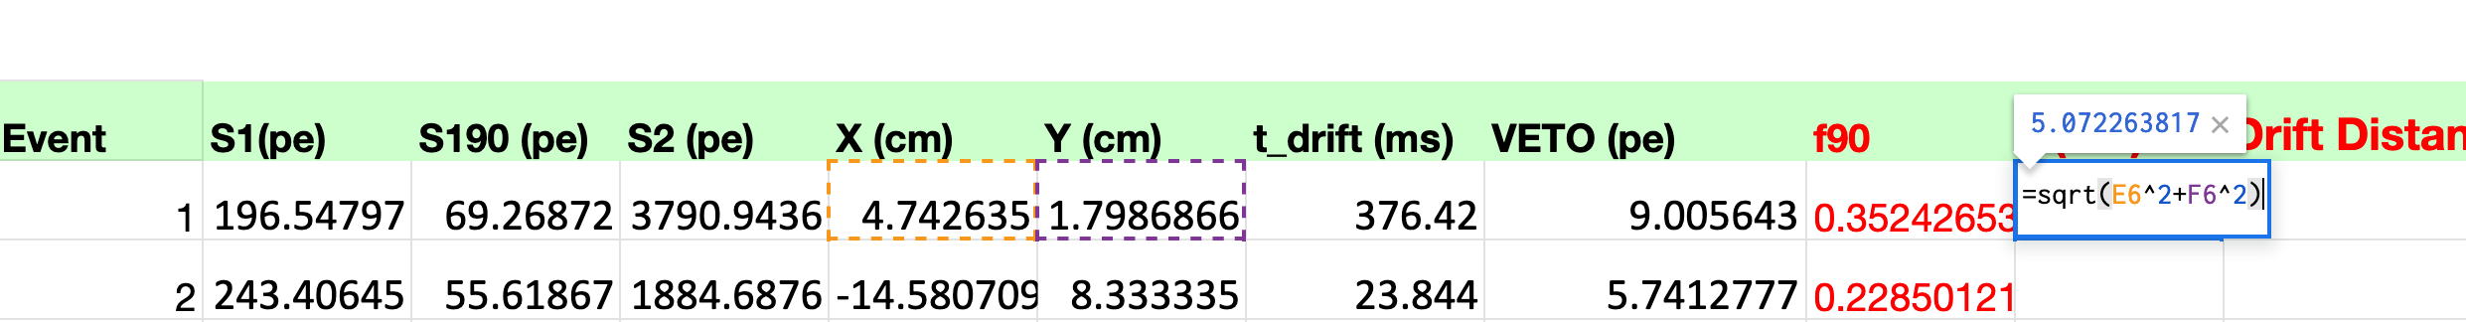
PART 1
To calculate the radius (r), which means the distance from the center in x and y of the TPC, you simply use the Pythagorean theorem:
Which, translate in excel is =SQRT(E6^2+F6^2)
Again press Enter and Excel will calculate the formula and double clicking on the black cross we can repeat the operation for all the cells.

Slide 12
PART 1
Drift Distance (cm): this quantity is the distance travelled by electrons from the interaction point till the top of the TPC. Knowing the value of the drift velocity, it is obtained as
Drift Distance=t_drift*Drift velocity
Which, translate in excel is =G6*$M$6
We use $M$6 because the value of the Drift Velocity remain constant for all the events.
Again press Enter and Excel will calculate the formula and double clicking on the black cross we can repeat the operation for all the cells.

Slide 13
PART 1
Z (cm): since we calculated the drift distance now we simply want to have the Z coordinate of the event. The Z coordinate is measured from the bottom of the TPC so it is obtained from the total length of the TPC (35.6 cm) as
Z= 35.6-Drift Distance
Again we need to notice that 35.6 is constant and so in Google sheet (or Excel) we need to write:
=$N$6-K6
Again press Enter and Excel will calculate the formula and double clicking on the black cross we can repeat the operation for all the cells.

Slide 14
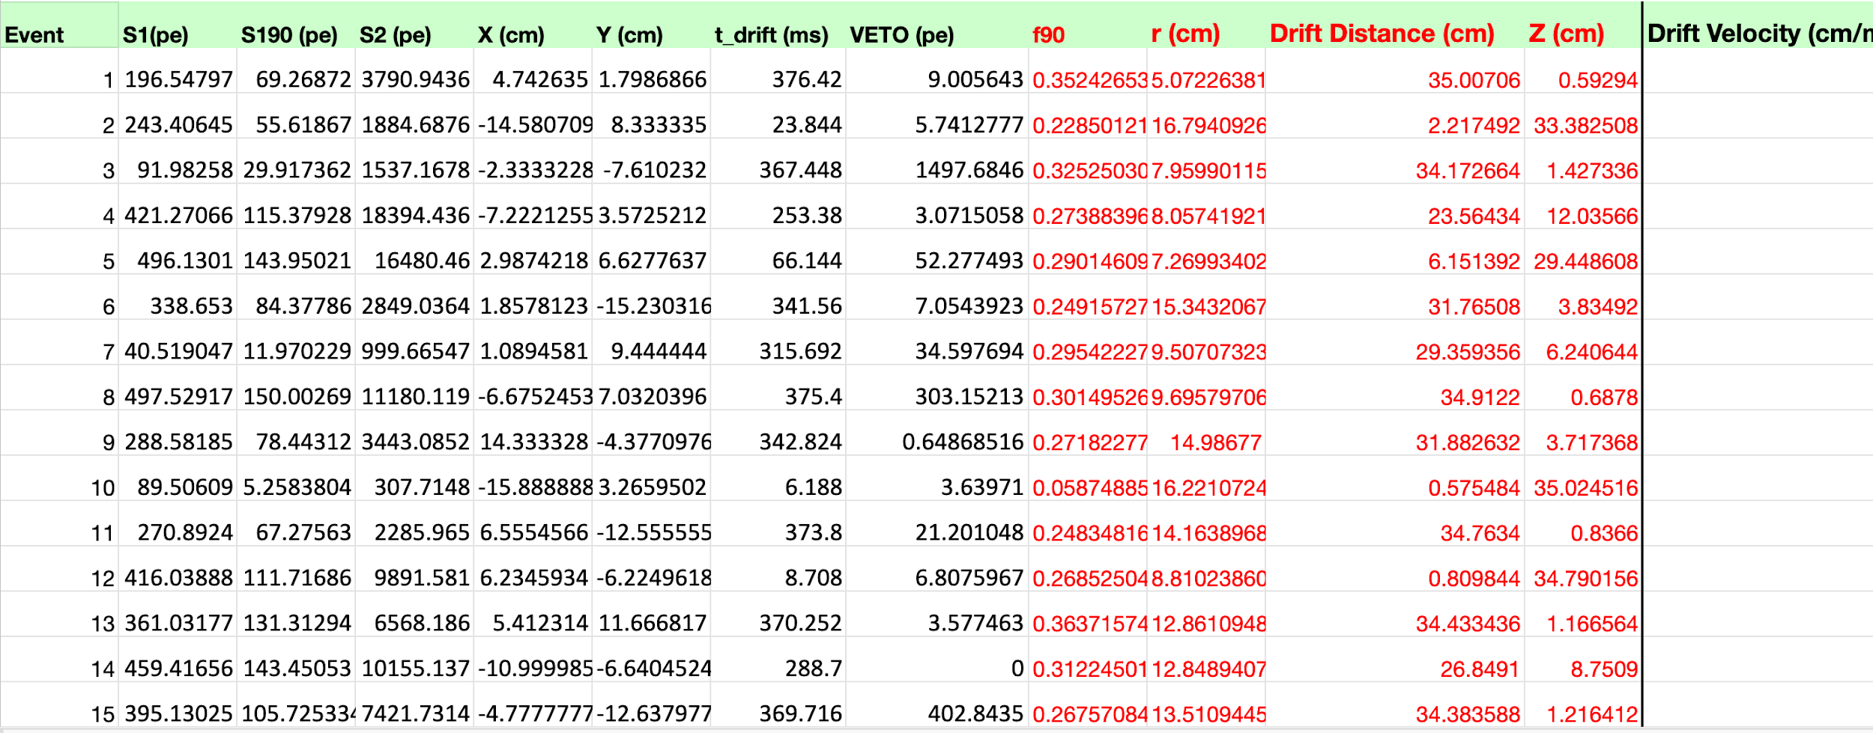
PART 1
COMPLETED

Slide 15
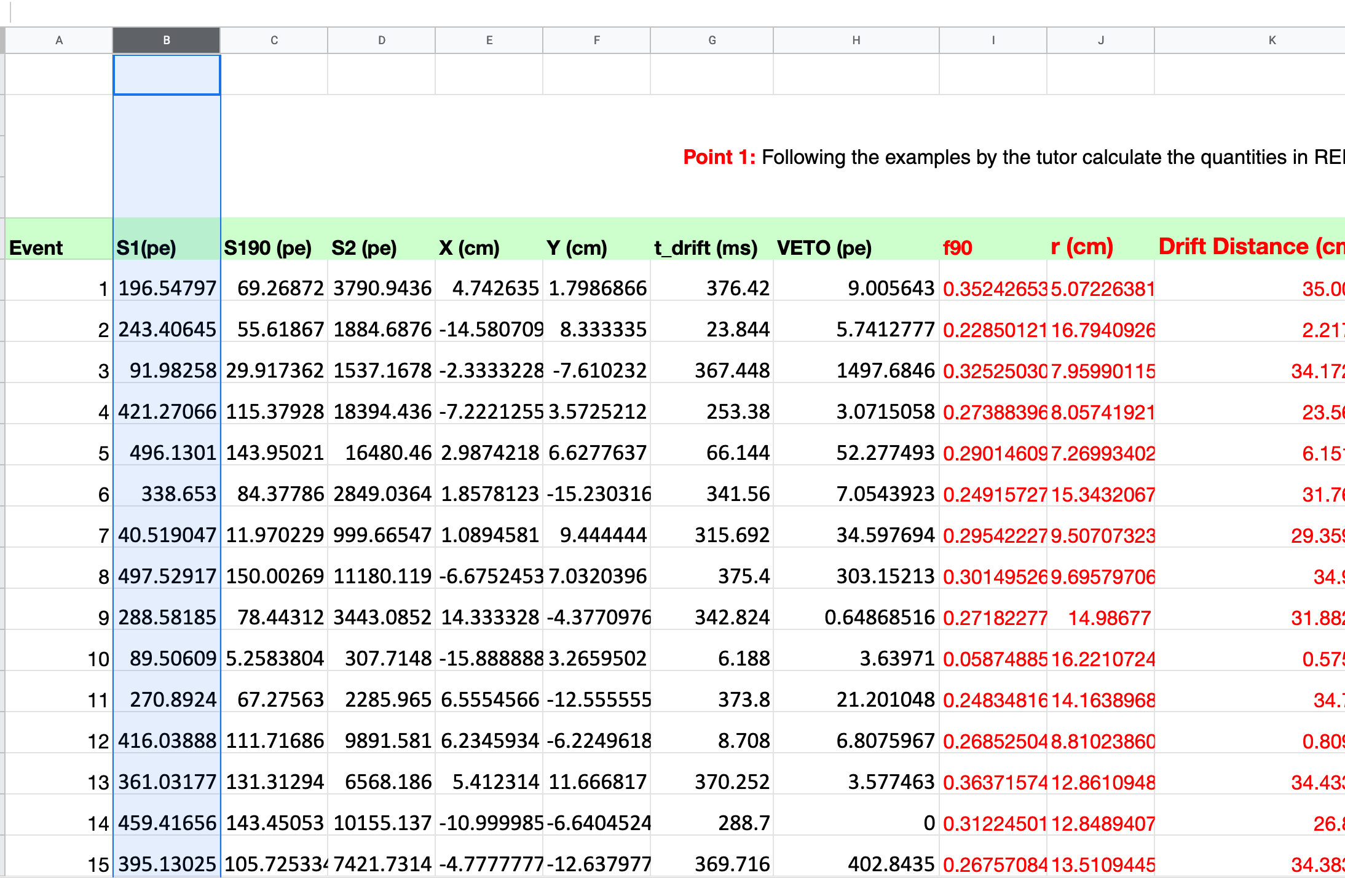
PART 2
Draw the plot of f90 vs S1. An easy tools to create plots. We will use the “Scatter Plot” that draws a variable versus another one. In our case we will have S1 on the x axis of our plot and f90 on the y axis.
First of all we select the x values that means all the values of column B. Click on the “B” column.
It we be highlighted

Slide 16
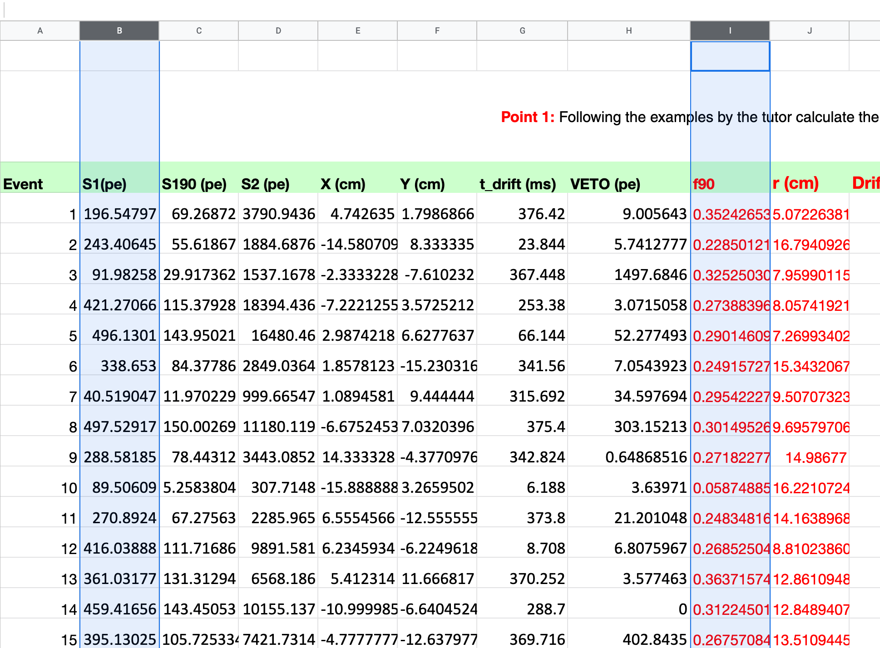
PART 2
Now keeping the Ctrl key (Command on MaC) pressed we select the y values by selecting the “I” column

Slide 17
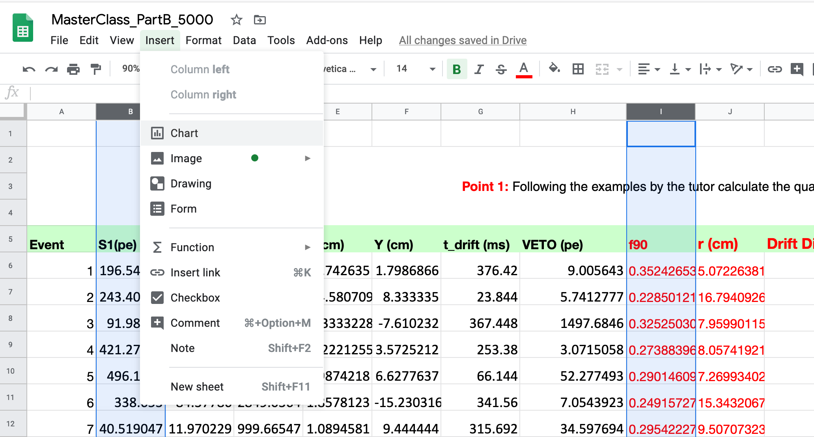

PART 2
We are ready to create the plot; go to the insert tab and look for chart and click on it
Press it and Excel will show you the Charts tab.

Slide 18
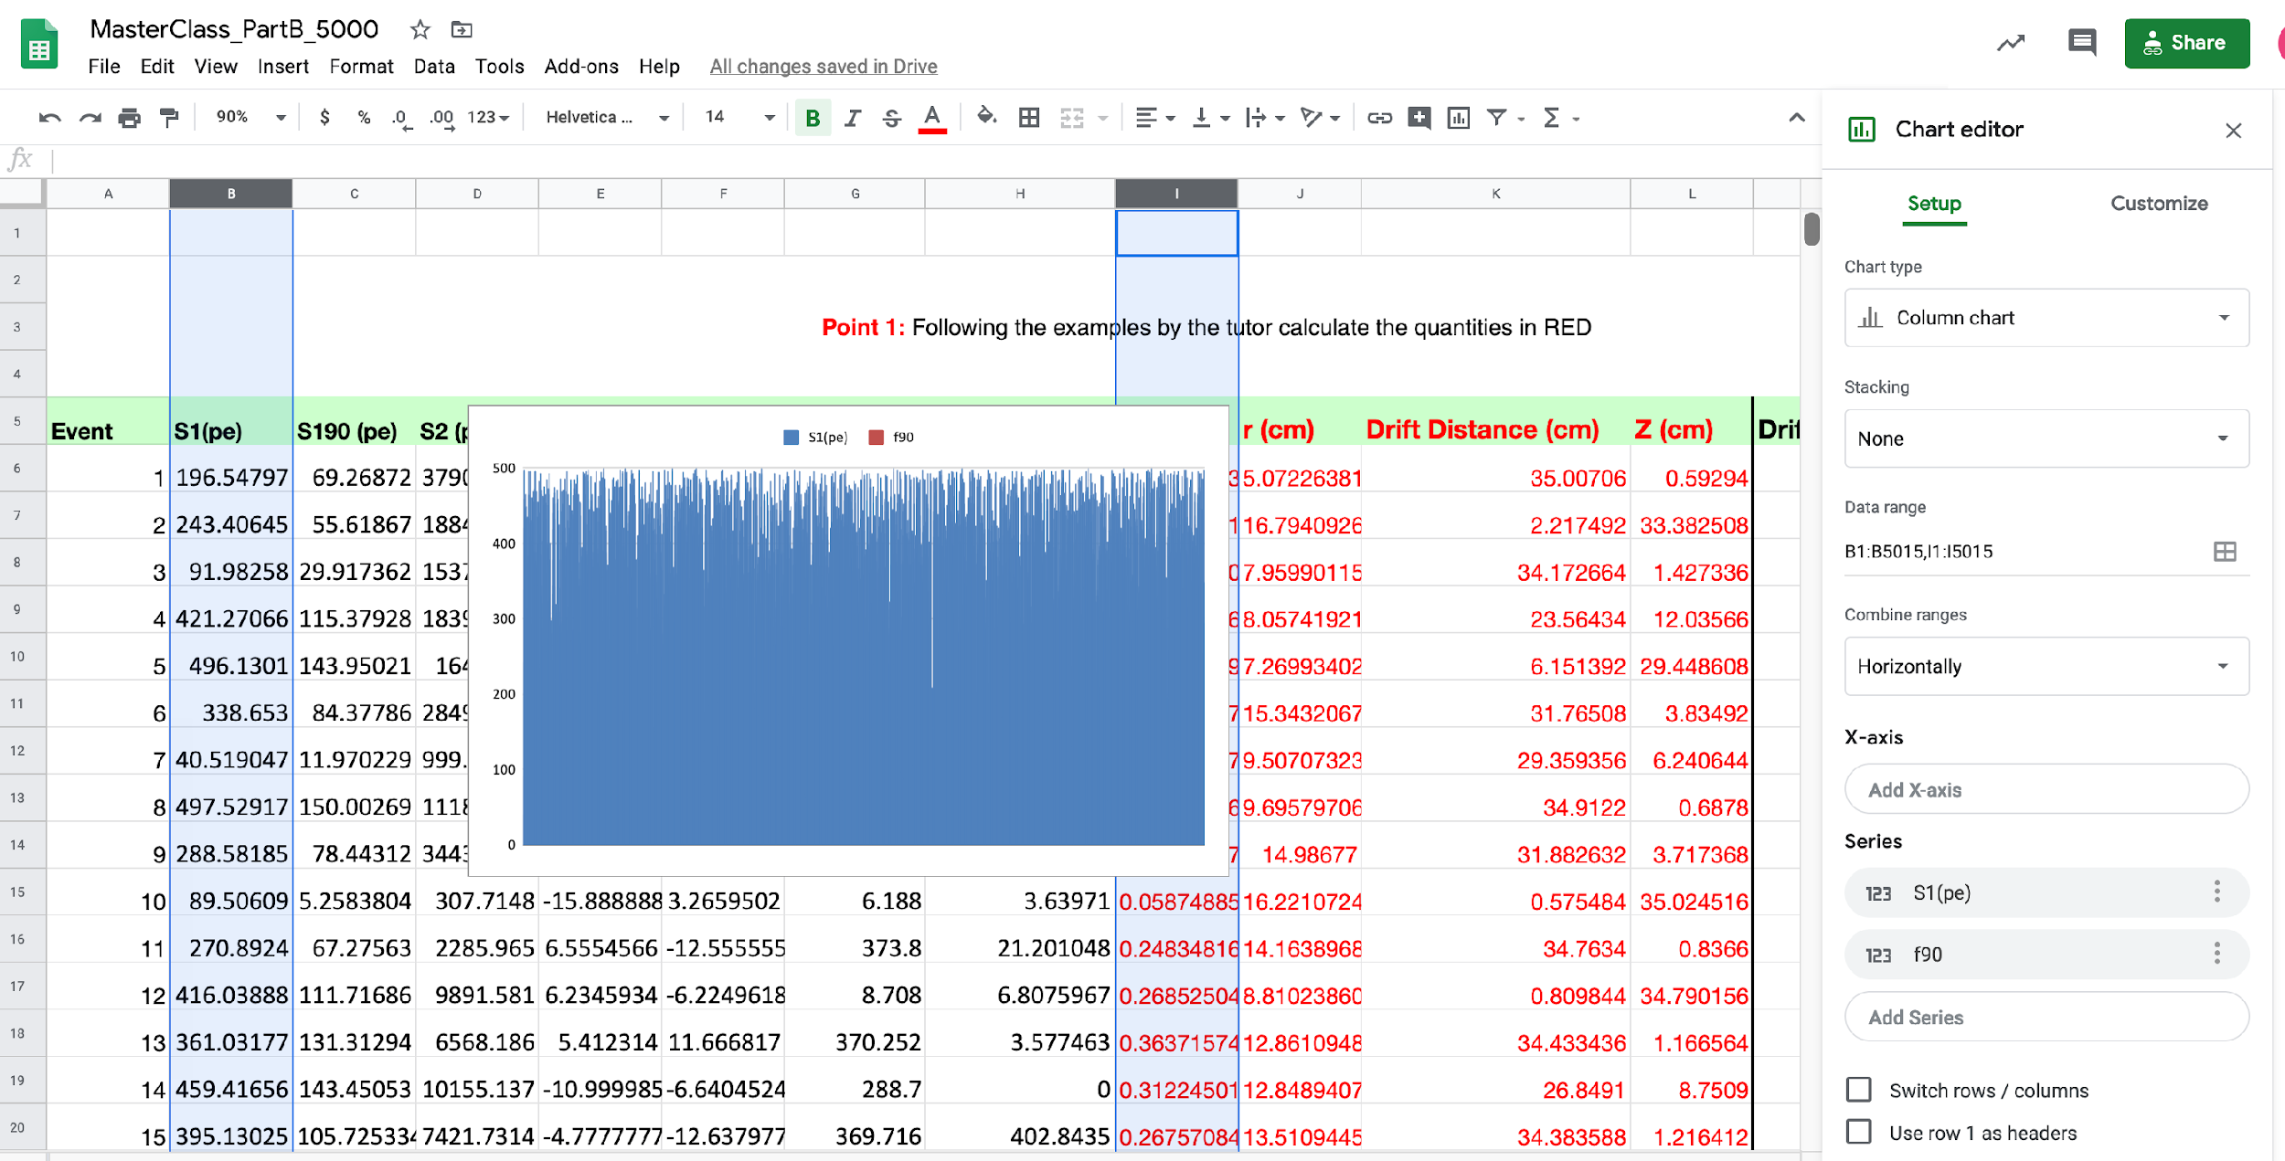
PART 2
This is the result; but this is not the scatter plot. By default in this way Google sheet (Excel) use a column chart. We can fix this using the right panel of the chart.

Slide 19
PART 2
Click on the tab menu;

Slide 20
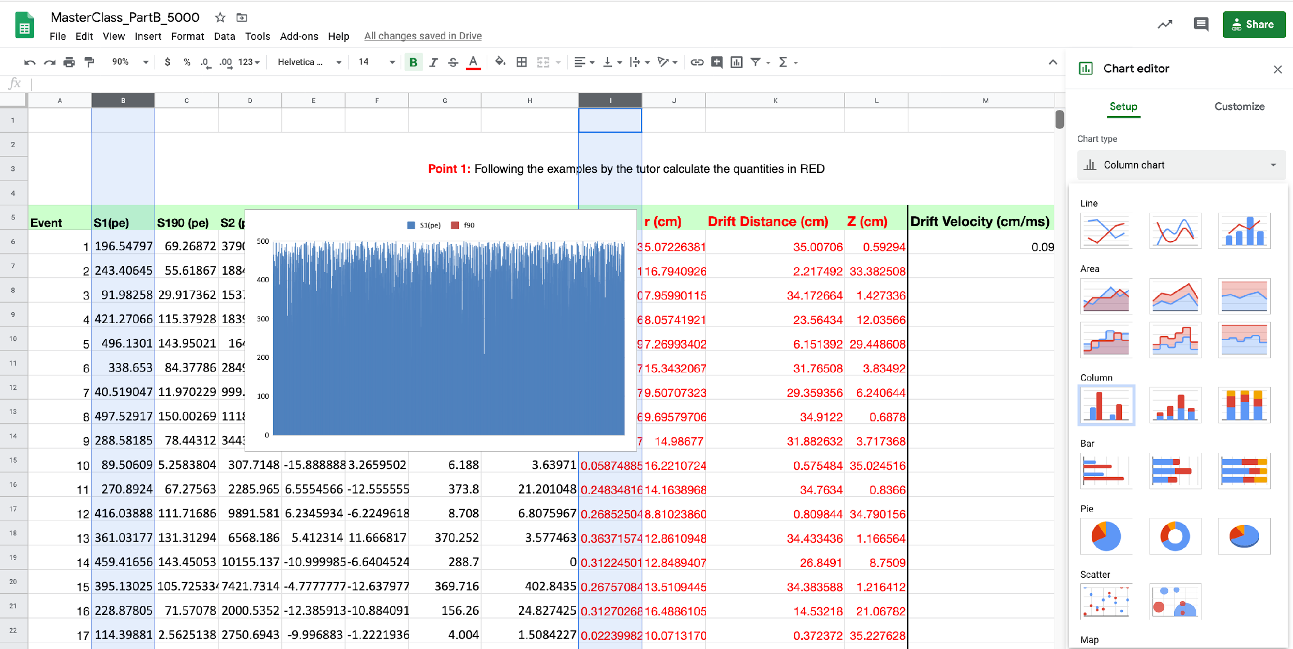
PART 2
Another menu will show up. Click on scatter plot.

Slide 21
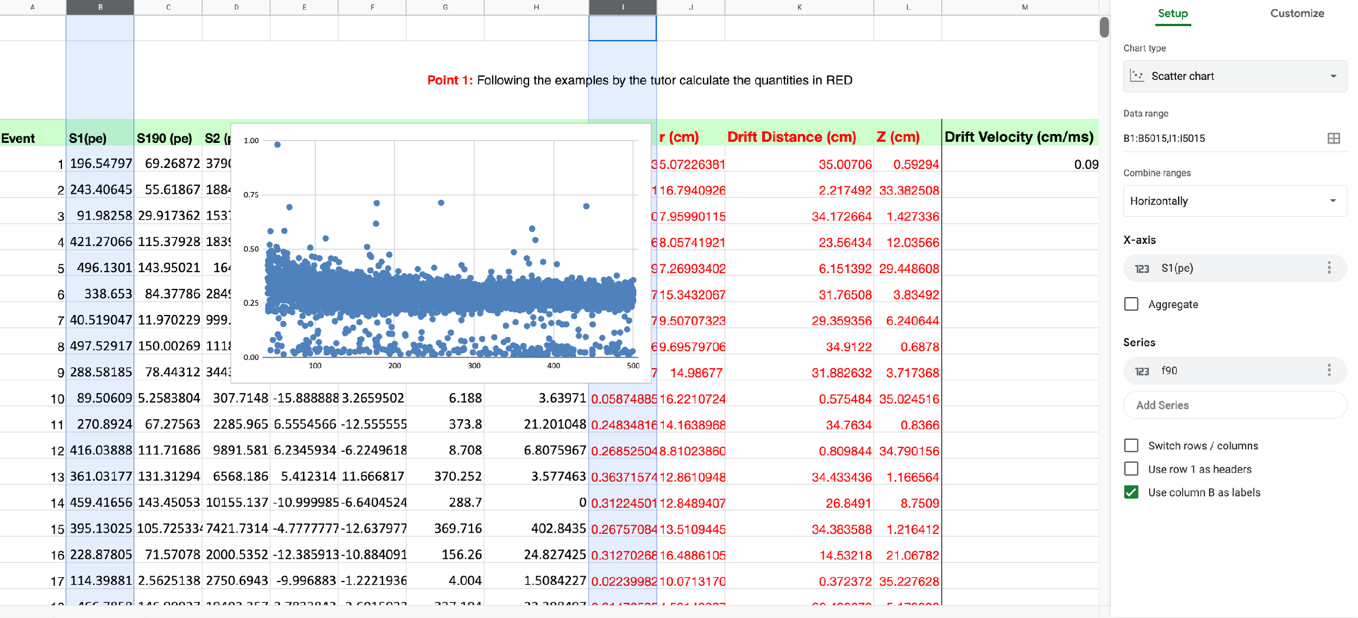
PART 2
And now we get the correct plot.

Slide 22
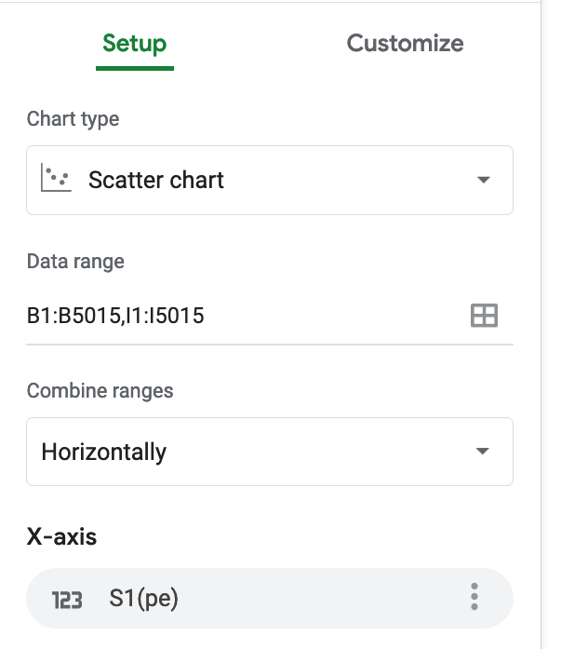
PART 2
Now just fix some details.
Just replace B1 with B6 and I1 with I6

Slide 23
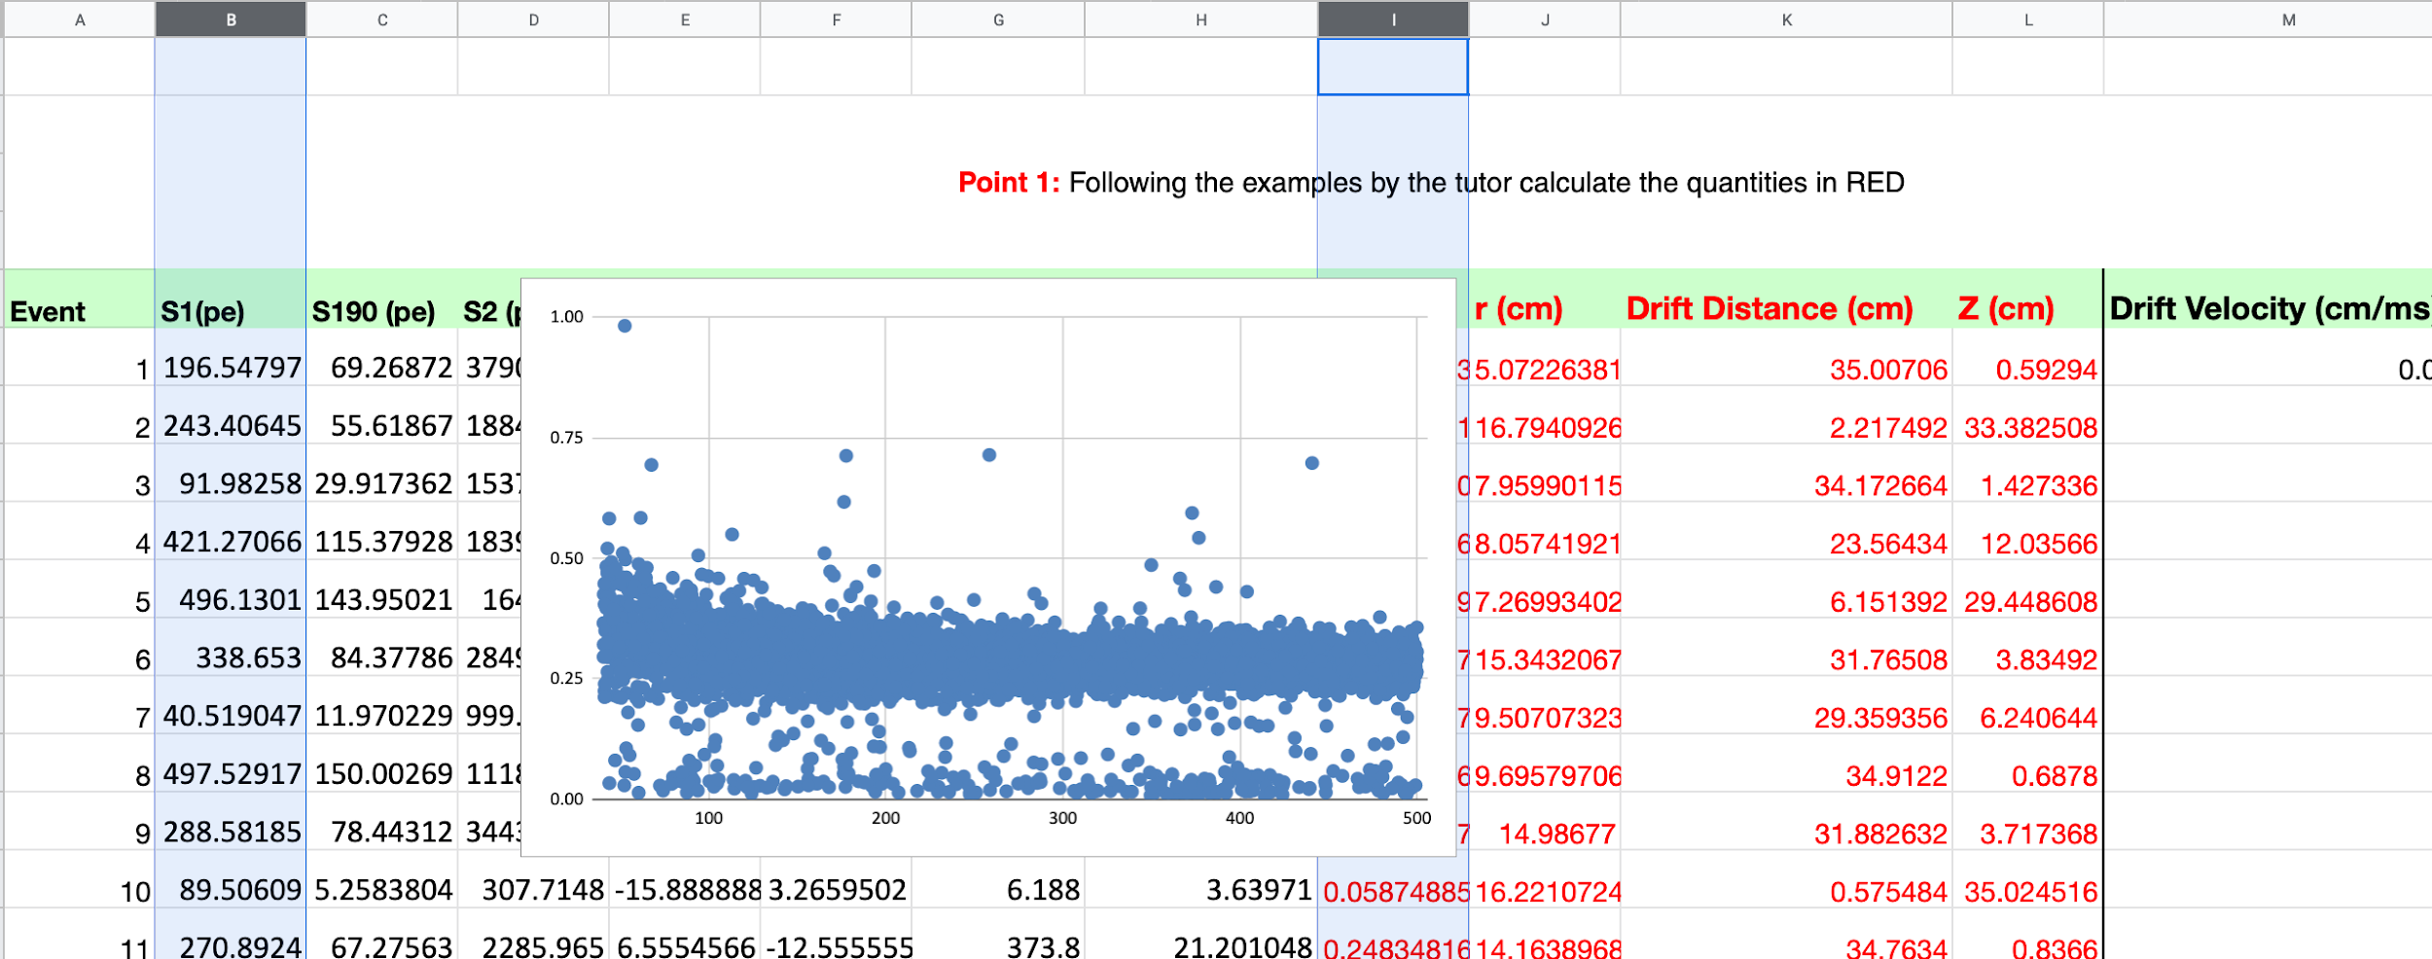
PART 2
Now just select the chart with the mouse and bring it in the correct place of the sheet.

Slide 24
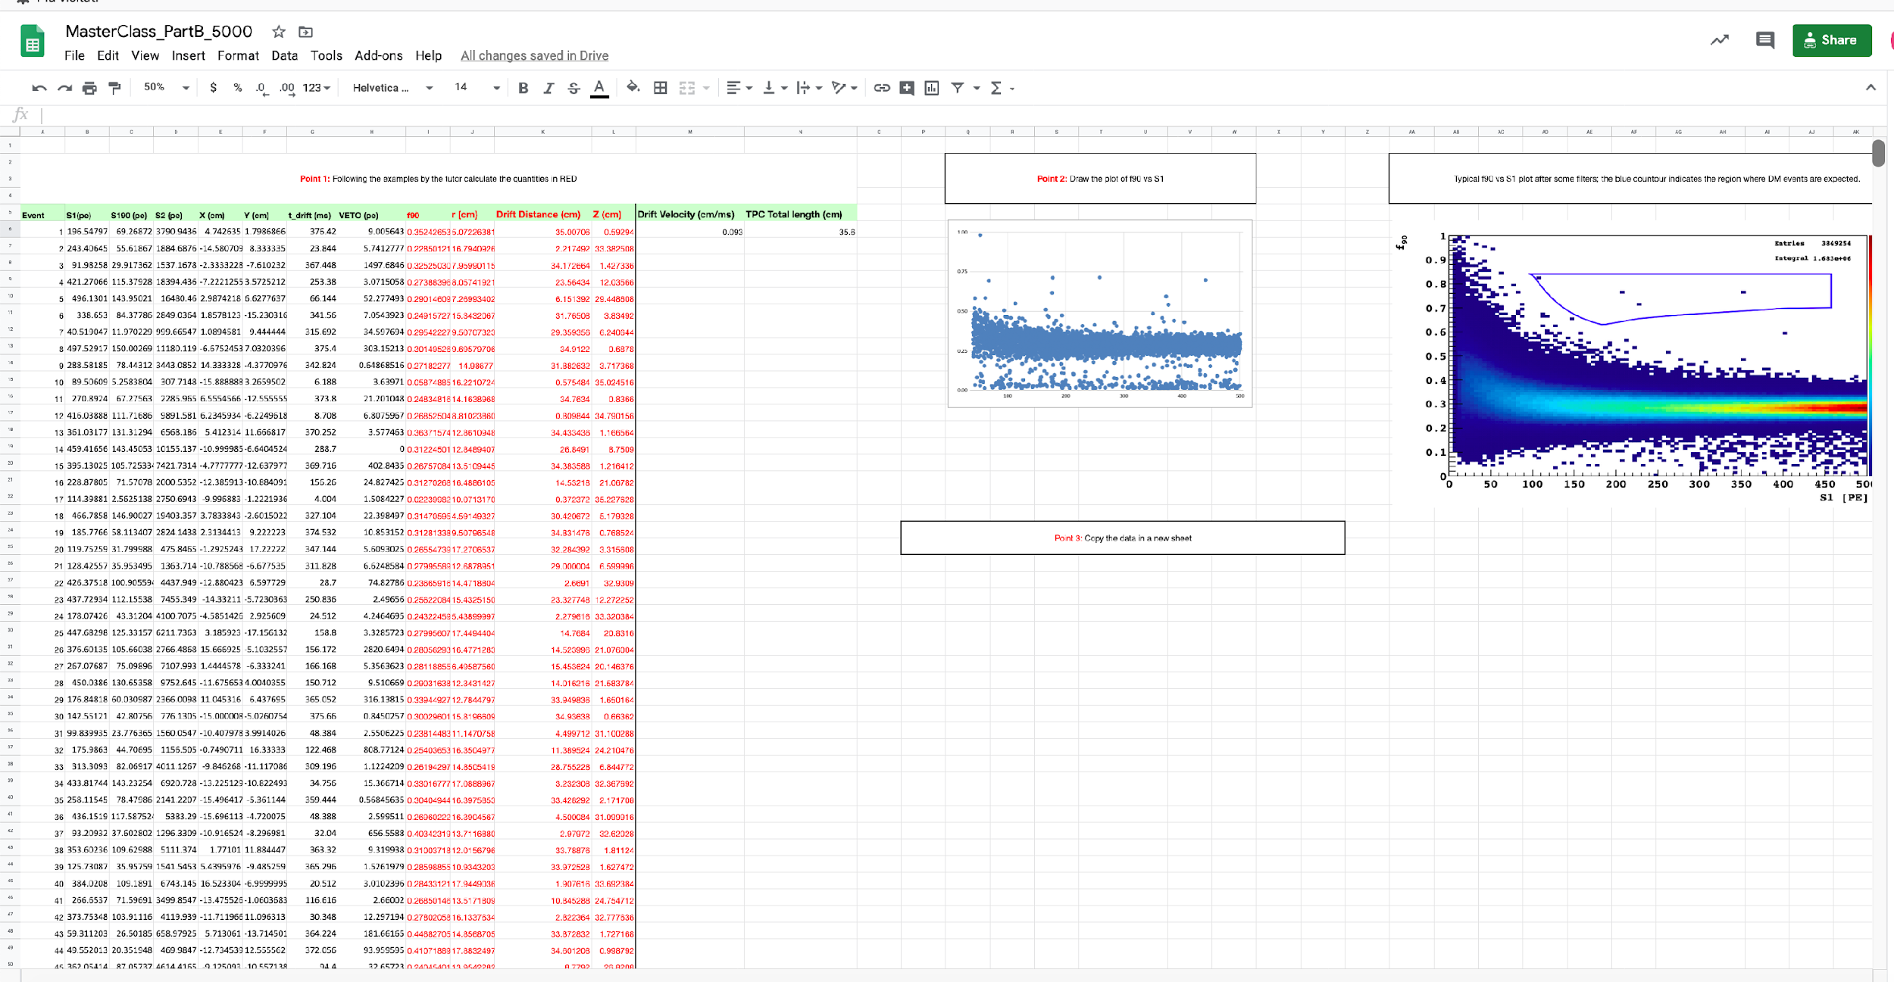
PART 2

Slide 25
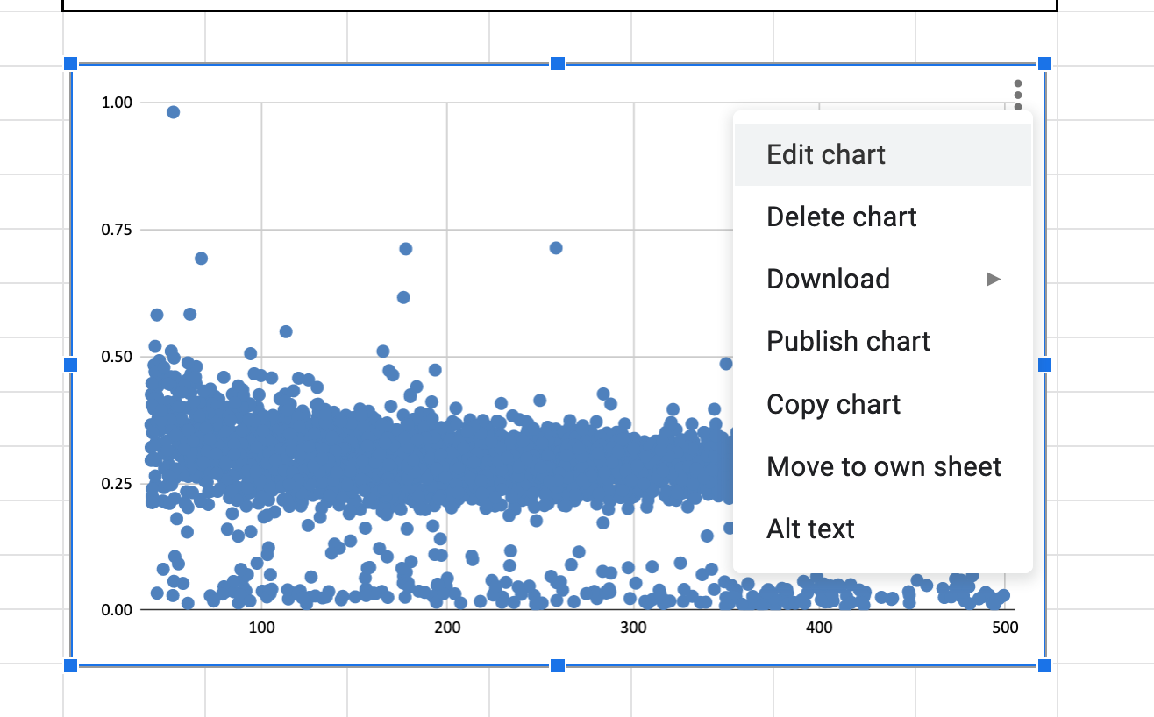
PART 2
If you select the chart with the mouse you can then open a menu and if you go to edit you can customize the chart (i.e. select marker type, marker color, and many ither options).
Anyway…

Slide 26
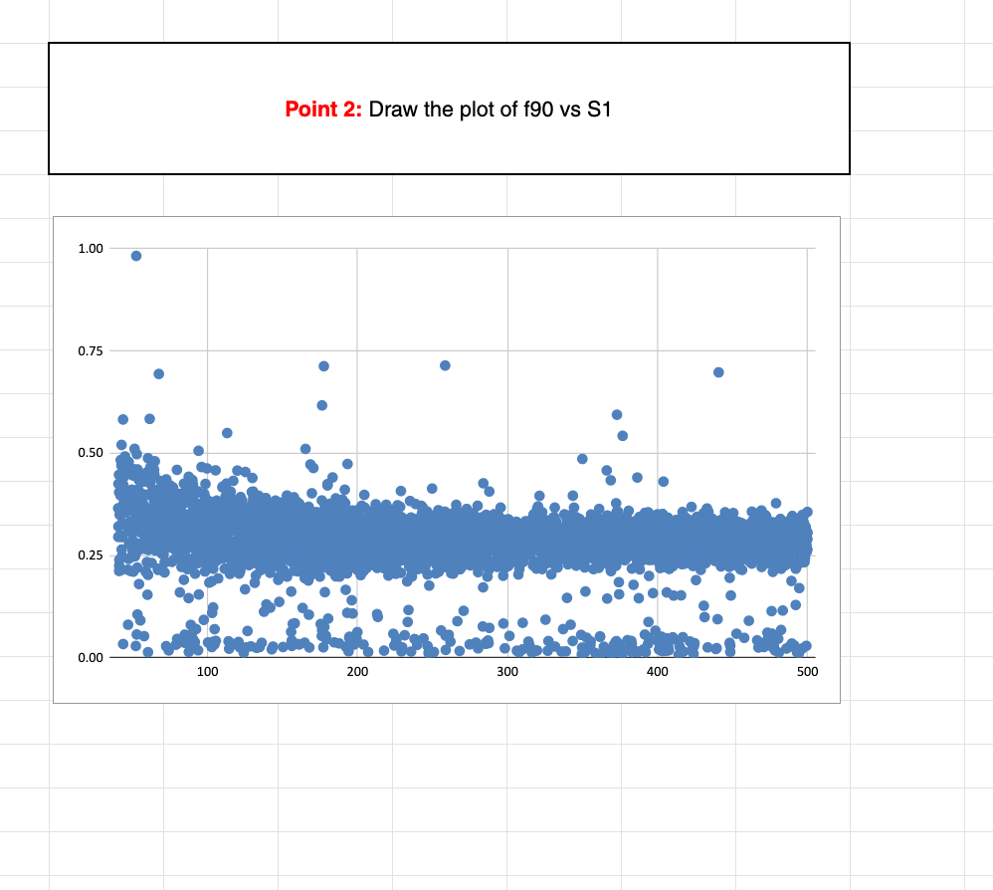
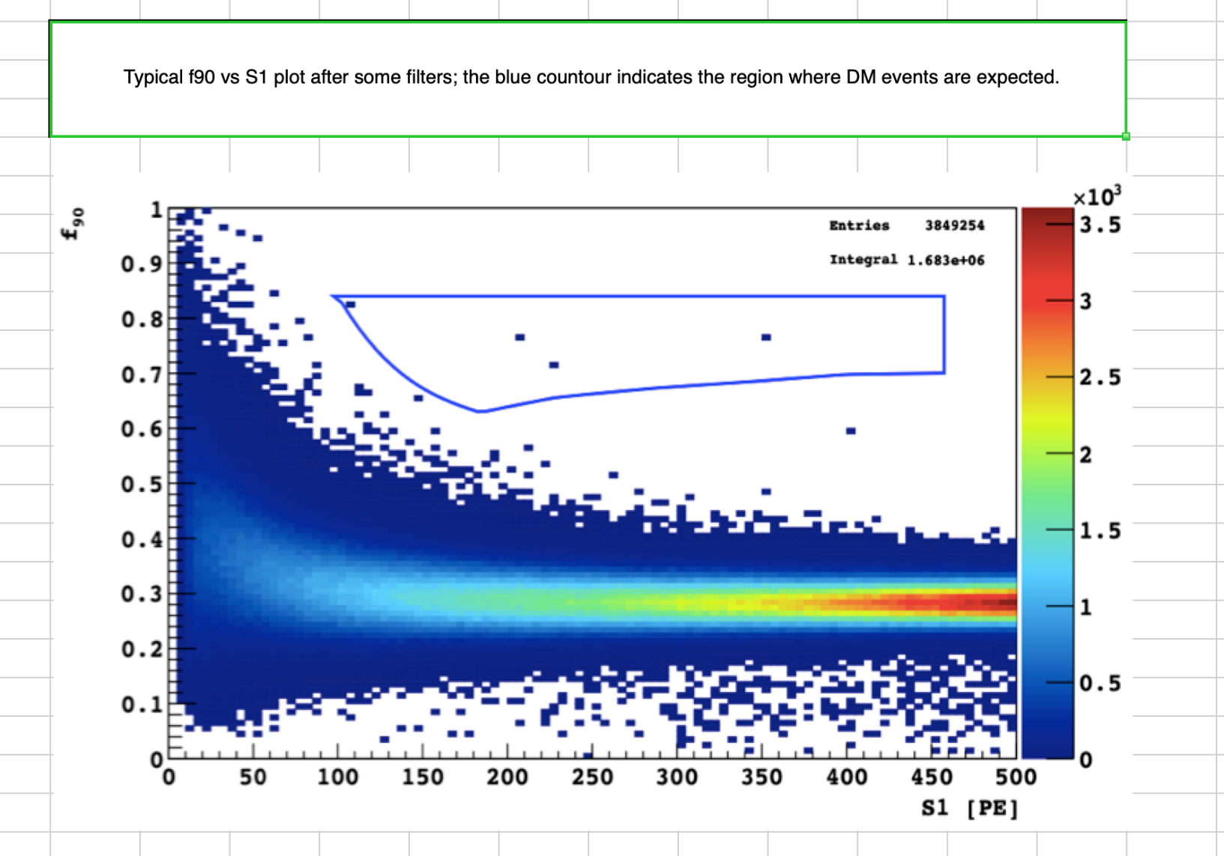
PART 2
Start comparing your plot with the one reported in the excel file
COMPLETED

Slide 27
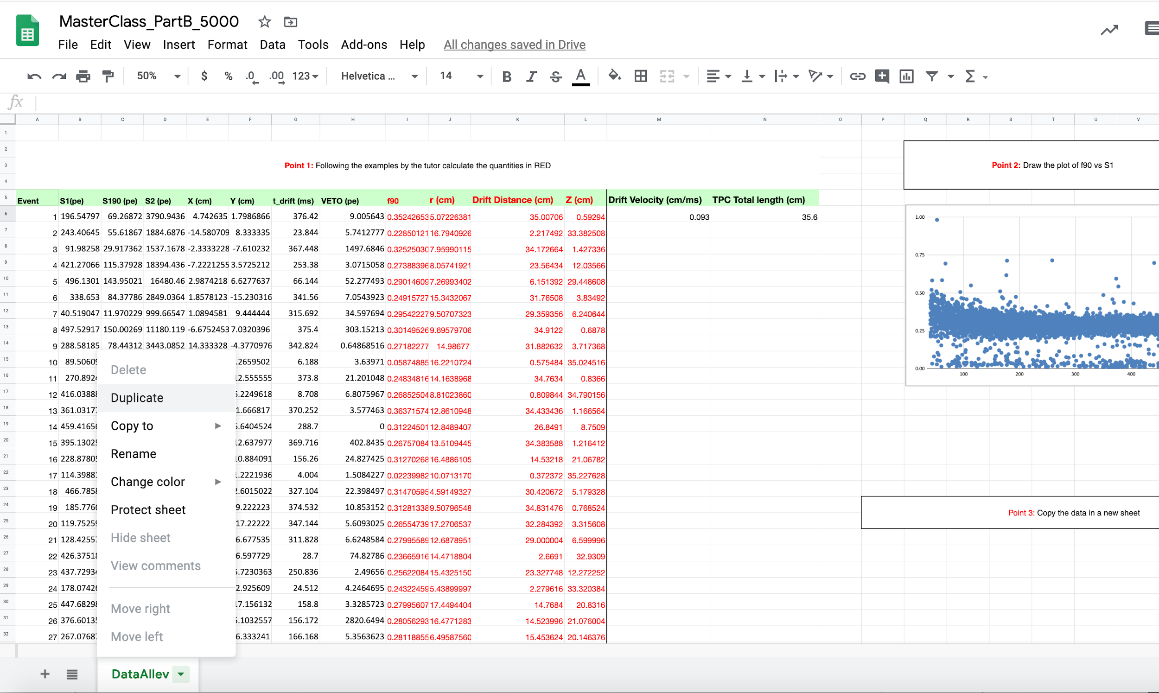
PART 3
We make a copy of this Excel sheet
2
1

Slide 28
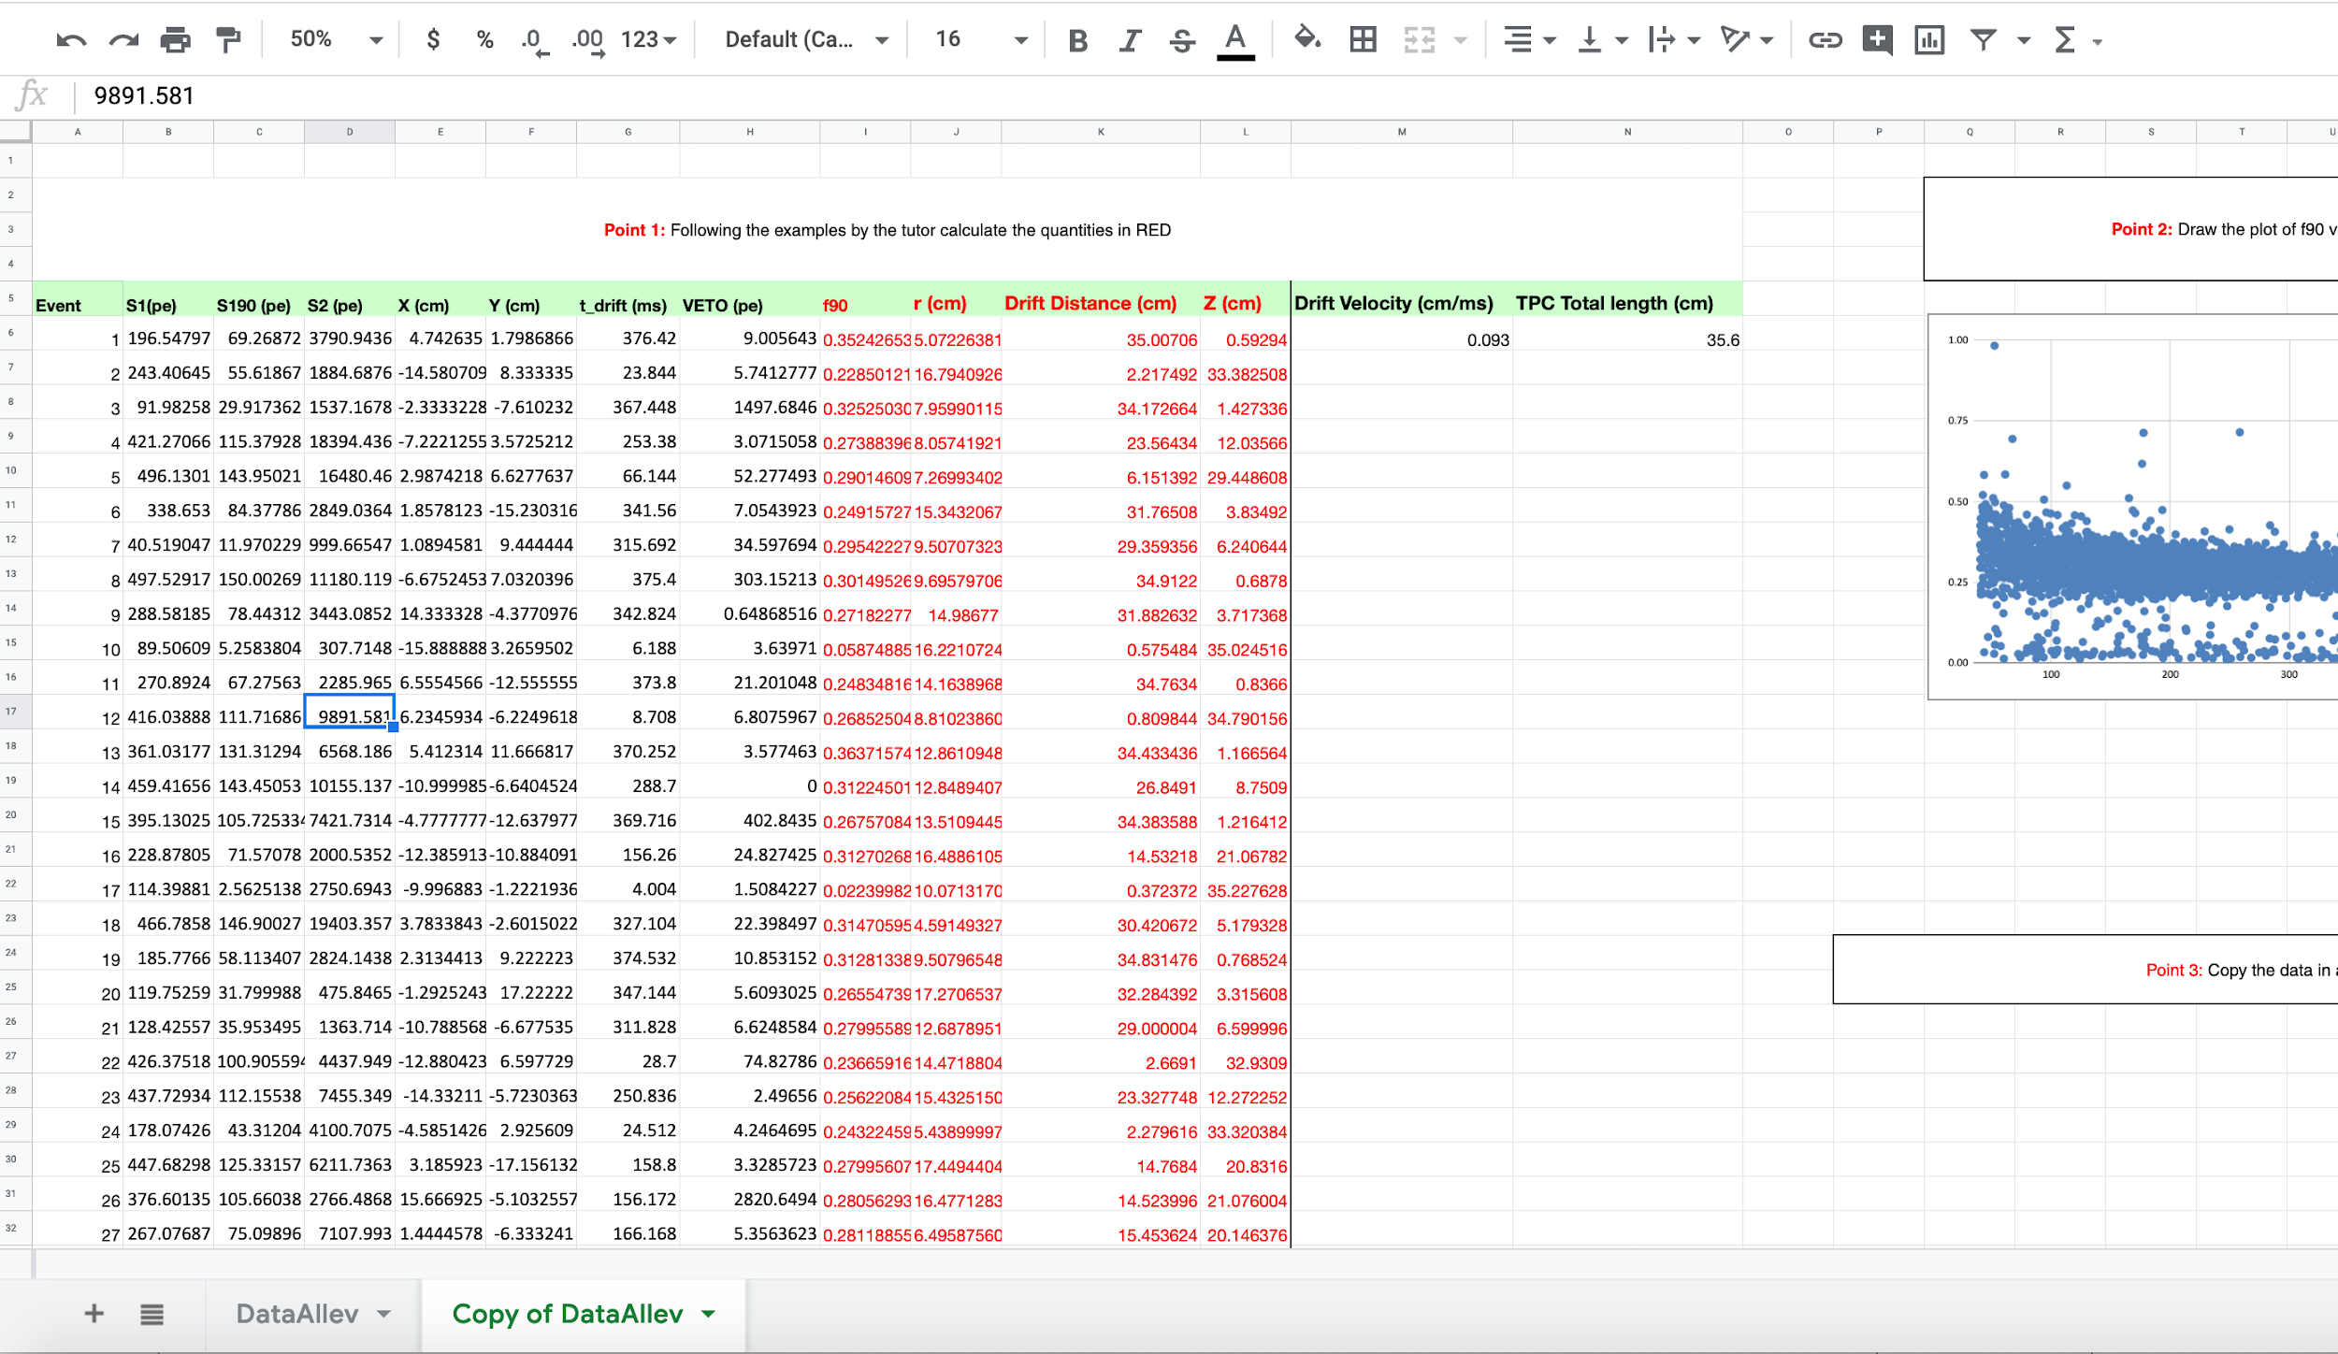
PART 3
Check the create a copy box and press ok

Slide 29
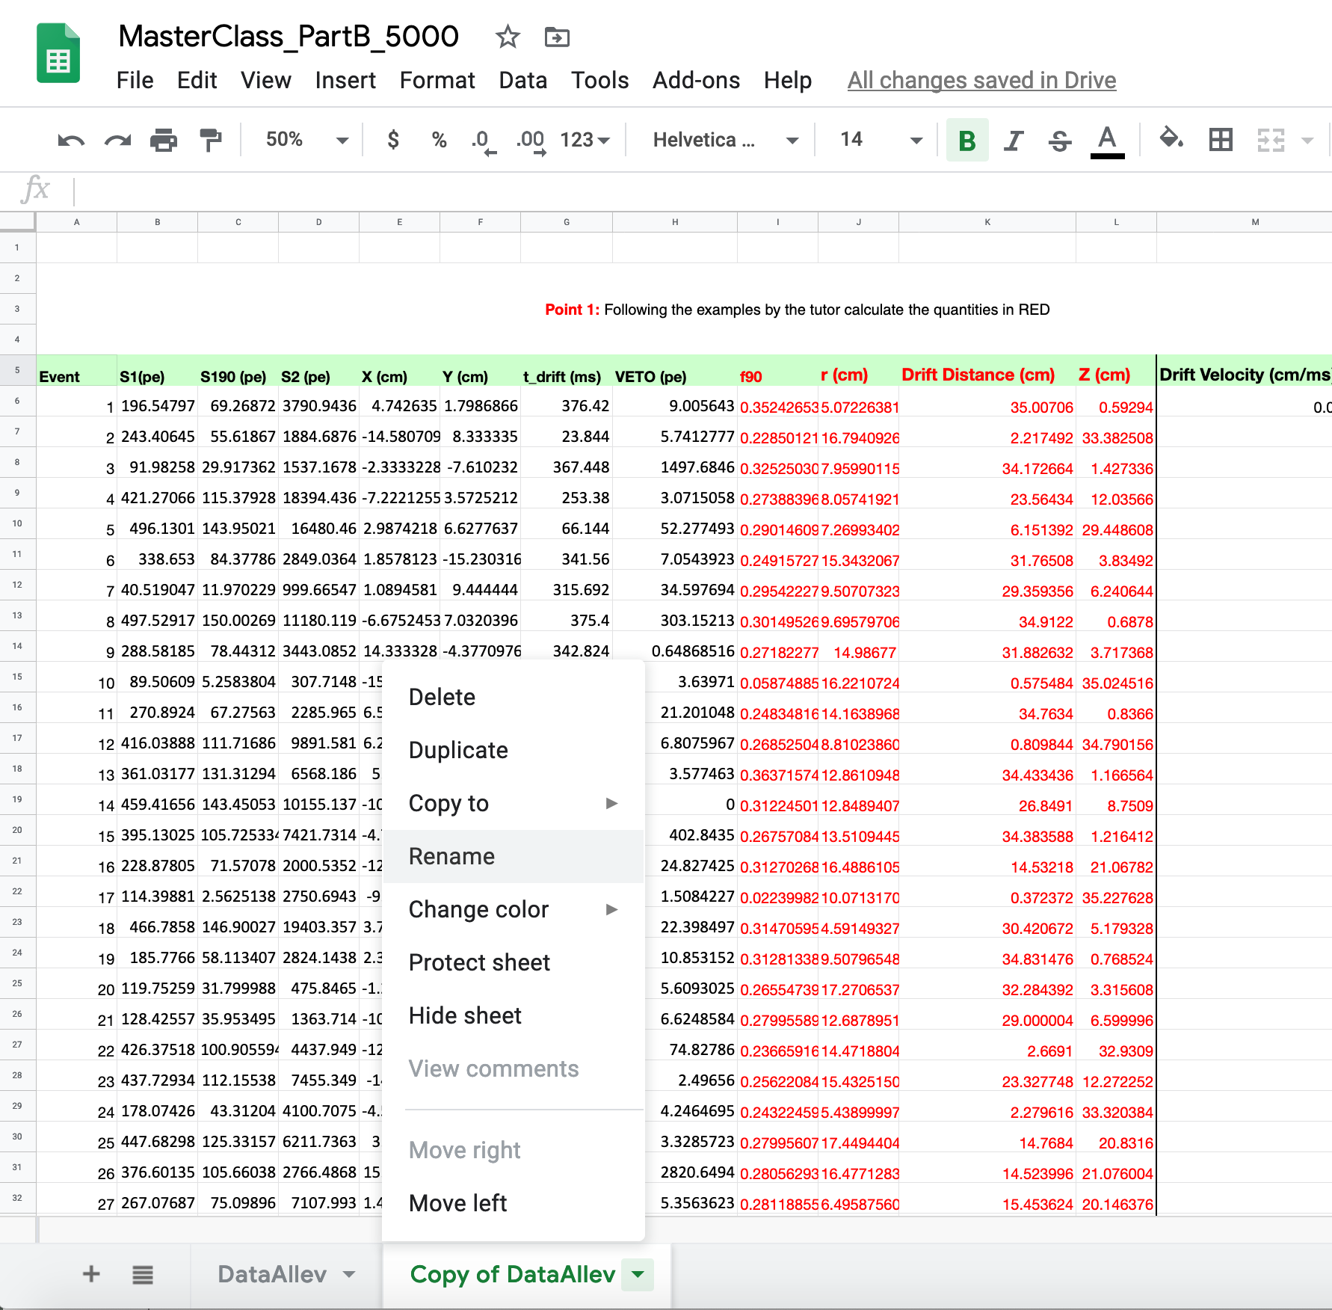
PART 3
Rename the new sheet
2
1

Slide 30
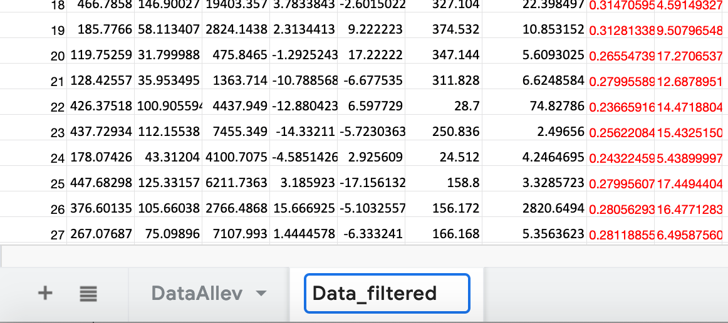
PART 3
COMPLETED
Rename the second one (Data_filtered)
We will use this replica of the data to apply filters, i.e. selection criteria on the events which should help in searching Dark Matter Candidates.

Slide 31
PART 4
Apply filters to the data and look for Dark Matter candidates

Slide 32
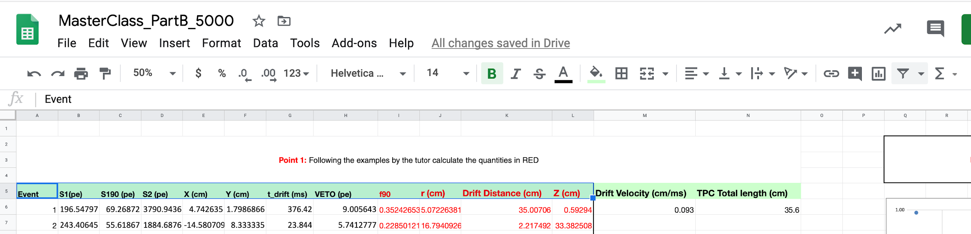
PART 4
We will see how to apply a filter to the data using Google sheet.
First of all select the cell from “Event” to “Z (cm)”.
Then press the filter button

Slide 33
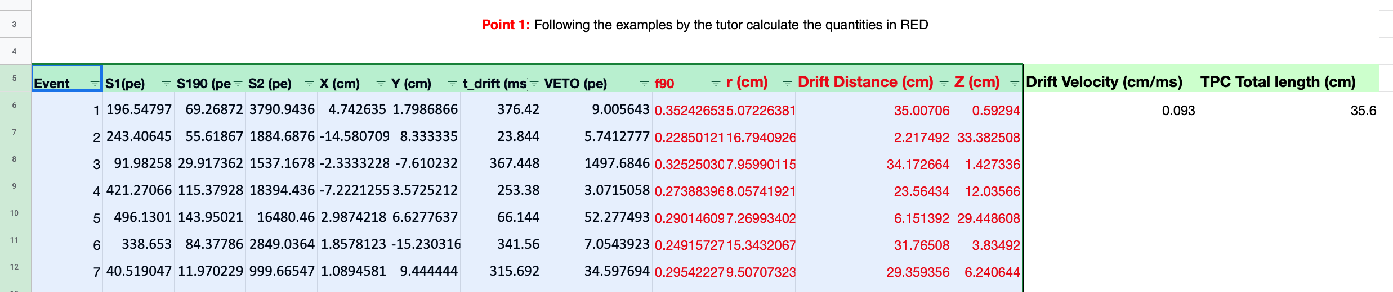
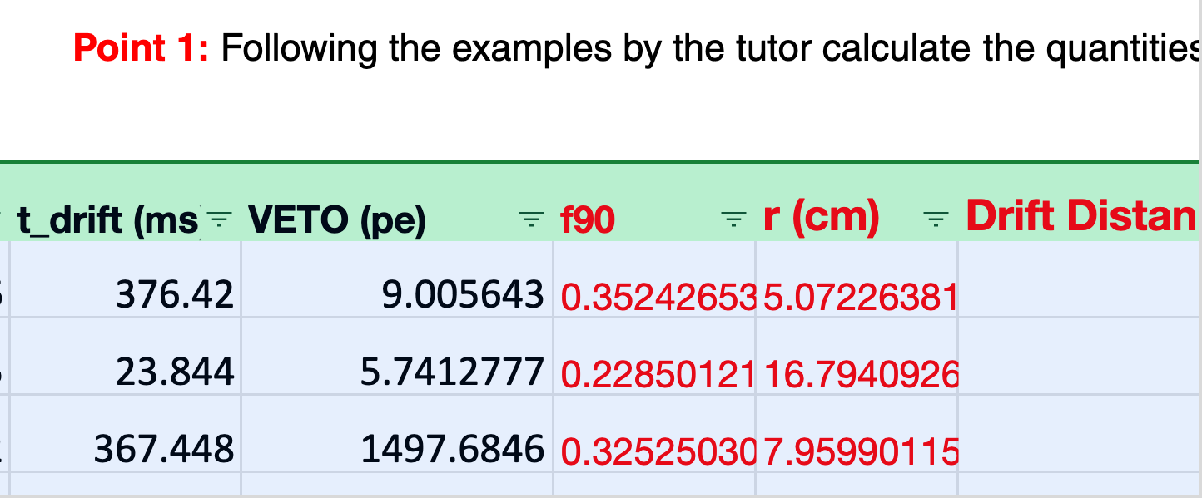
PART 4
The sheet will appear like this:
Zooming on each element you see that there is a symbol.
Let’s try to apply a filter on r. For example we want to select events that have r<15

Slide 34
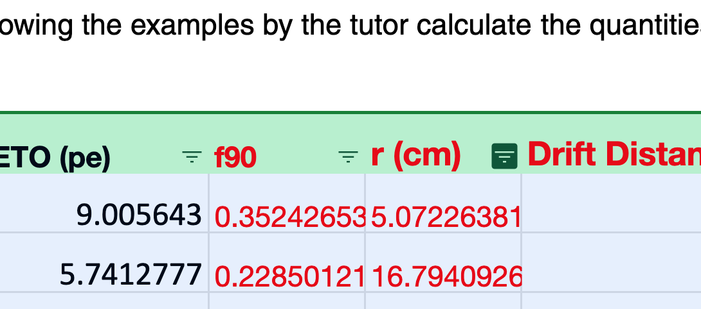
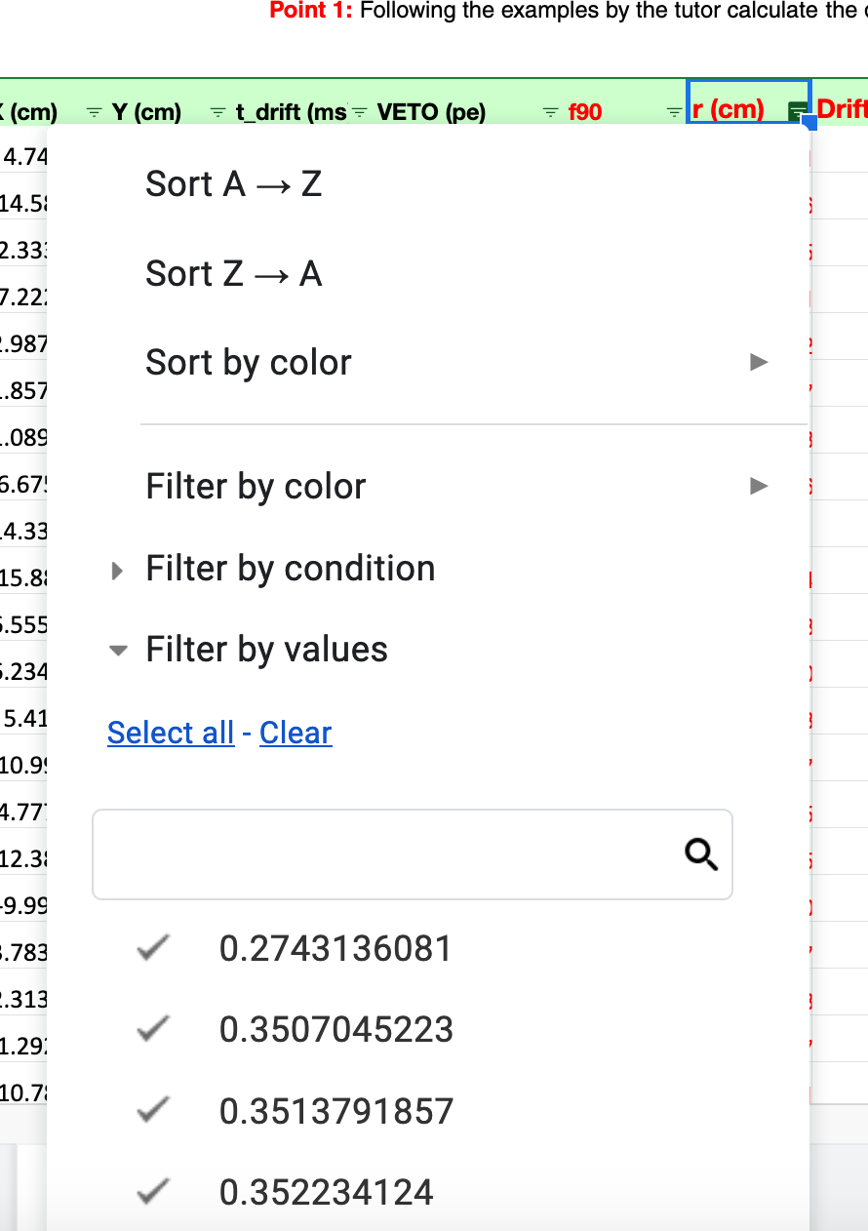

PART 4
Click on the filter symbol in the “r (cm)” column.
1

Slide 35
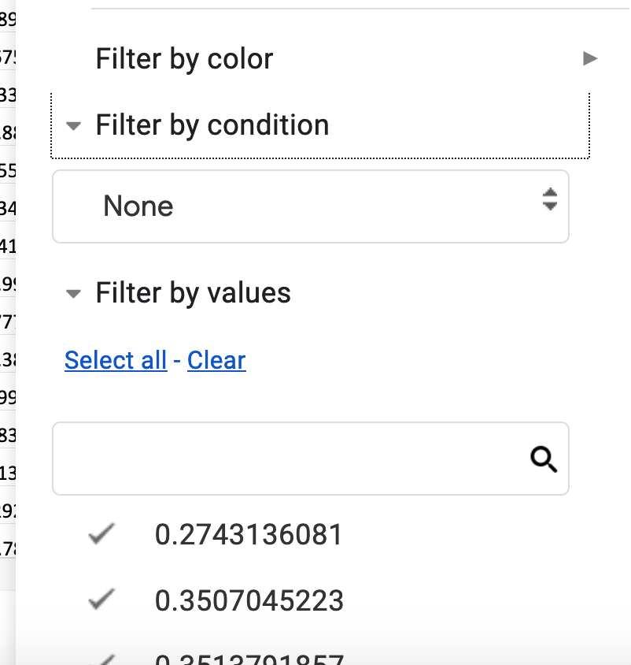
PART 4
Then press Filter by condition
2
Another menu will appear

Slide 36
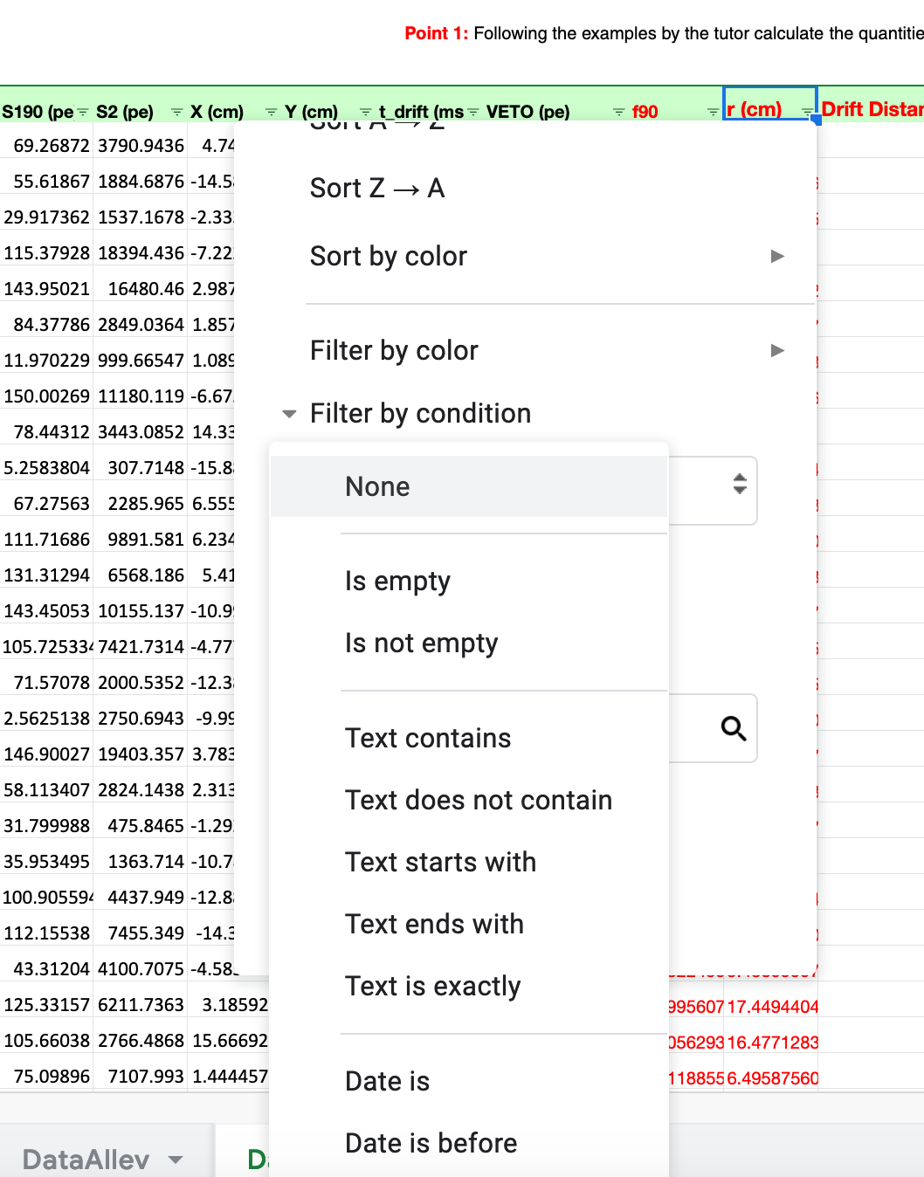
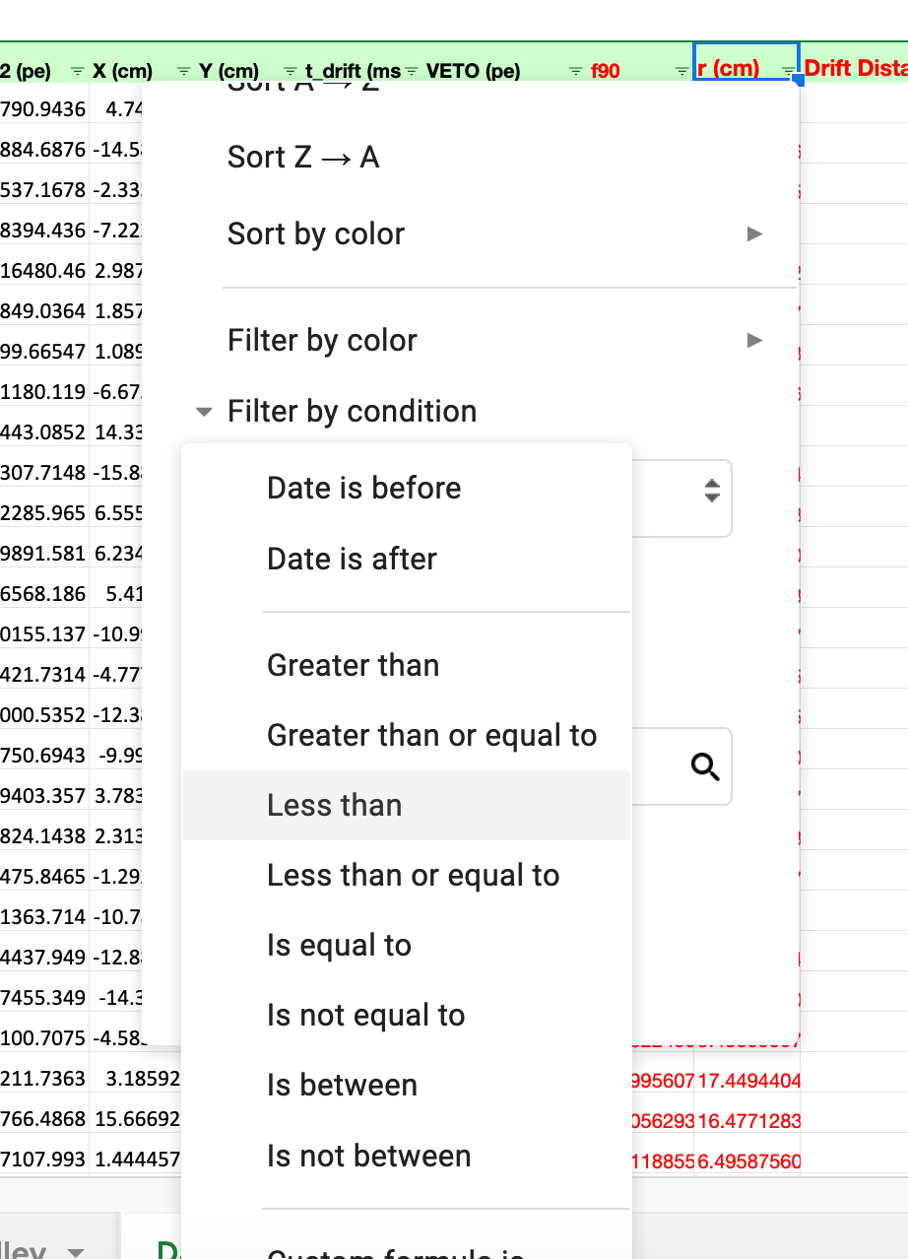
PART 4
Now scroll down this menu and search th e condition you want to apply, i. e. “Less than” and click.
3

Slide 37
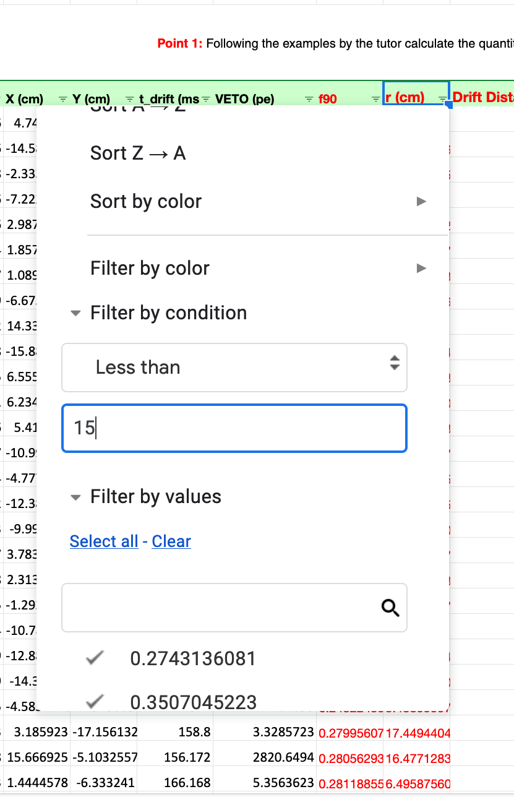
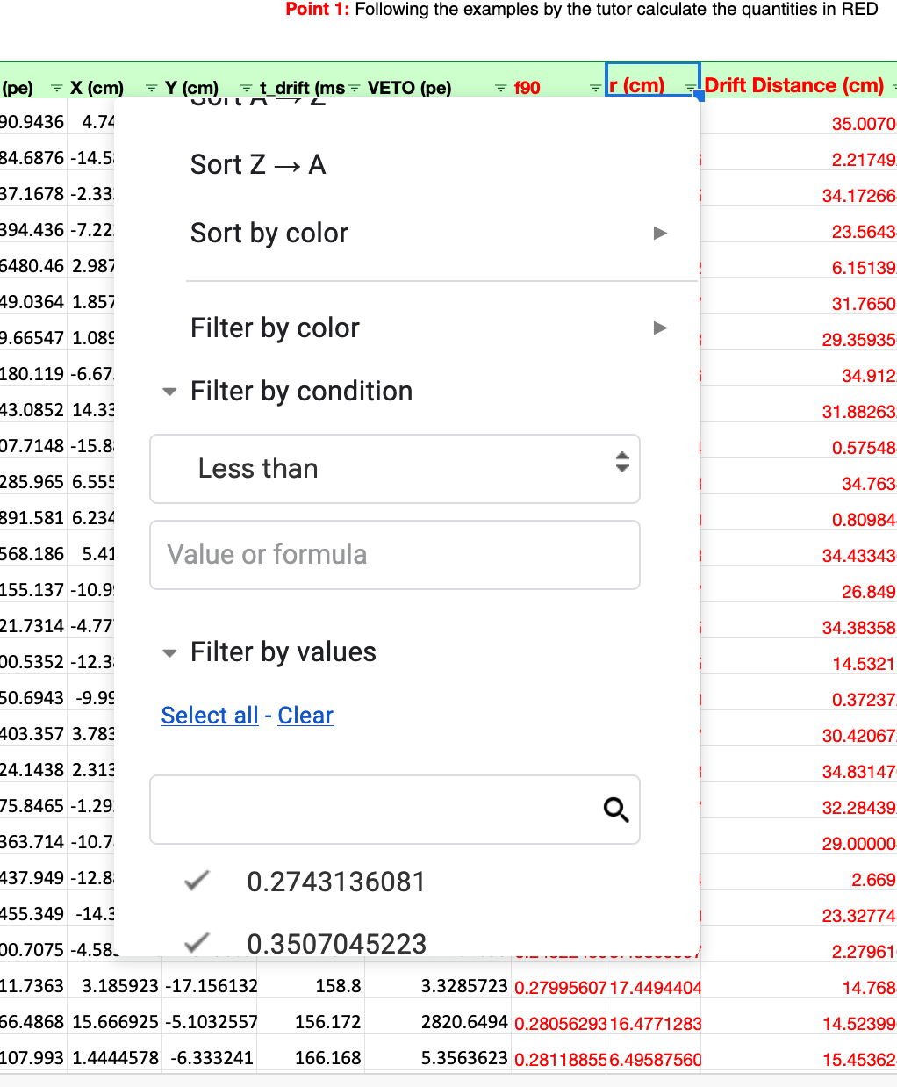
PART 4
Another box will appear.
Inside it you can put the value you want; we want r to be less than 15.
3

Slide 38
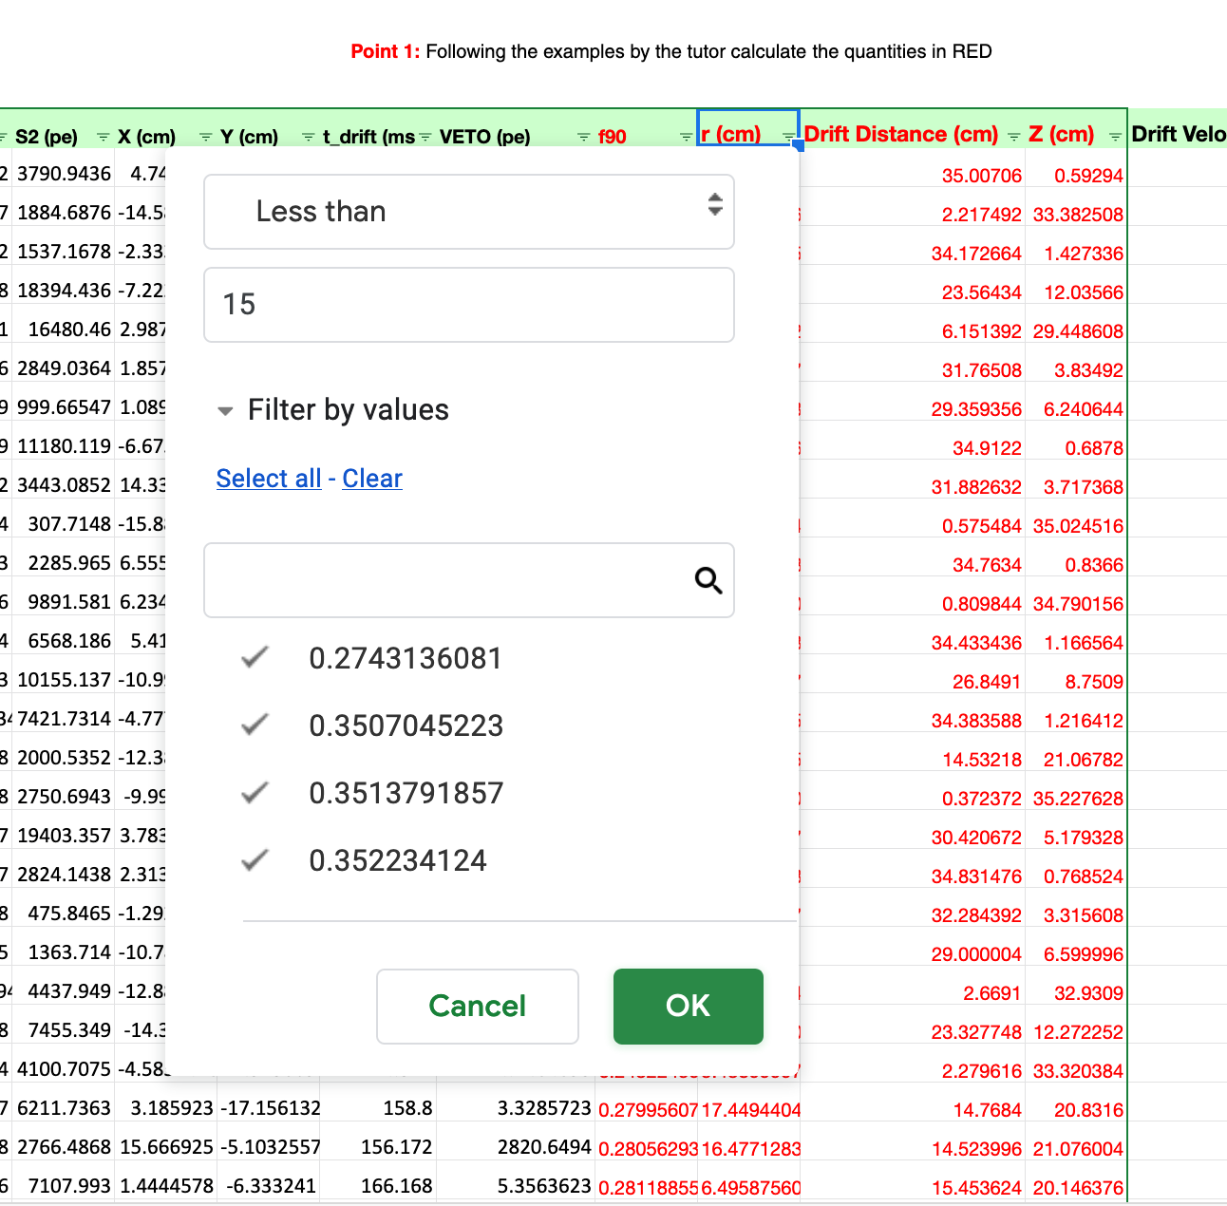
PART 4
Now Press “OK” in the filter menu and automatically the filter will be applied.

Slide 39
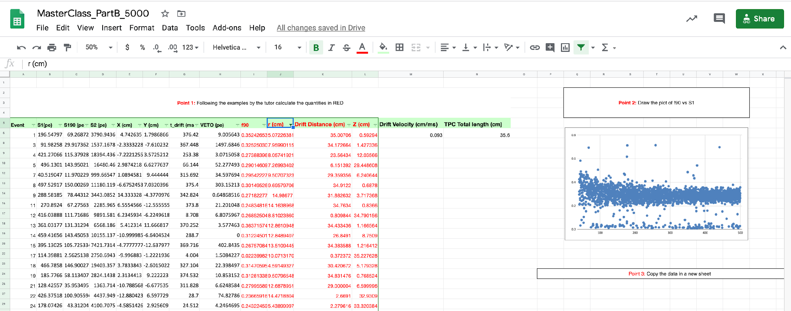
PART 4
The filter is applied?

Slide 40
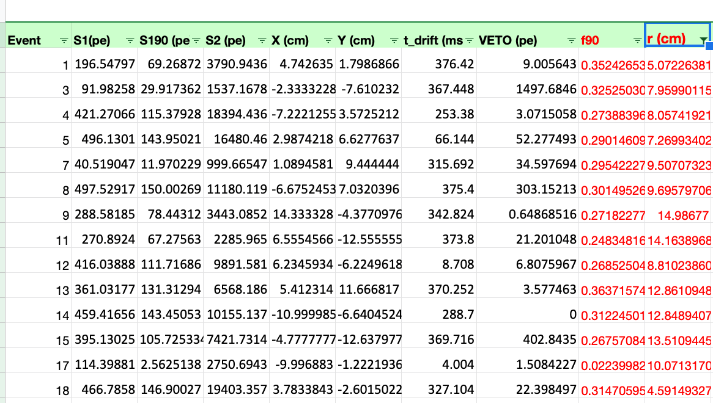
PART 4
Yes!

Slide 41
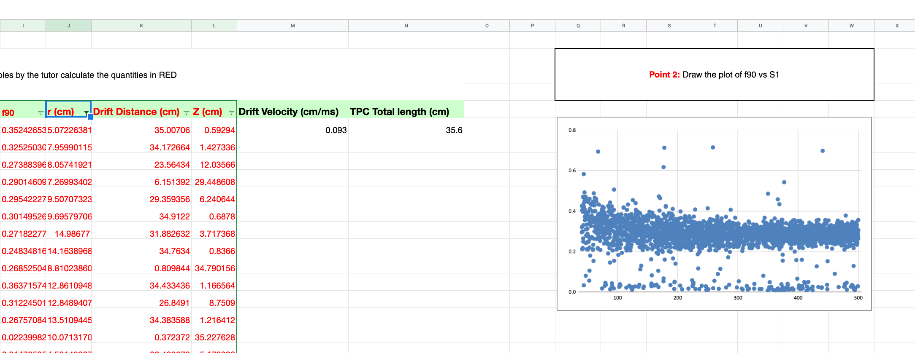
PART 4
COMPLETED
Note: the plot is automatically updated and only the events with r<15 are drawn!

Slide 42
PART 5
Apply all the filters needed to search for Dark Matter Candidates just adding them to the relevant variables.
In the following table the filters that have to be applied to search for Dark Matter candidates.
Filter | Description
r < 15 cm | Select events in the fiducial volume
4.352 cm< Z < 31.88 cm | Select events in the fiducial volume
VETO signal < 6 pe | Negligible signal in the VETO system
f90 > 0.65 | Rejects electron background
and

Slide 43
Good luck!

