Slide 1





Welcome to the
DarkSide
Masterclass
Part Two
F.Carnesecchi, F.Coccetti, D.De Gruttola, M.Garbini, D.Hatzifotiadou, R.Nania, C.Pellegrino
University and INFN of Bologna
University and INFN of Salerno
Museo Storico della Fisica e Centro Studi e Ricerche Enrico Fermi Roma
presented by Luciano Pandola
Istituto Istruzione Superiore Luigi Einaudi, Siracusa, March 27th, 2026

Slide 2
How can we detect WIMPs ?
Notes:
Connection to lesson one: due to the properties described before: is it an easy task?

Slide 3
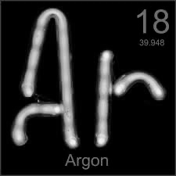
The DarkSide experiment solution:
a direct detection
WIMP-nucleus elastic collisions revealed by a Liquid (radiopure) Argon detector capable of unambiguously identifying a small number of nuclear recoils
Liquid Argon used as:
Target: to interact with WIMP
Detector: in a double phase state (liquid +gas) to measure the WIMP energy and position
Notes:
One possible solution: direclty detect DM interaction using proper elements
direclty detect DM -> look for collisions of WIMPS with “preferred” nuclei
Use Argon
And how you can use it
Details later on

Slide 4
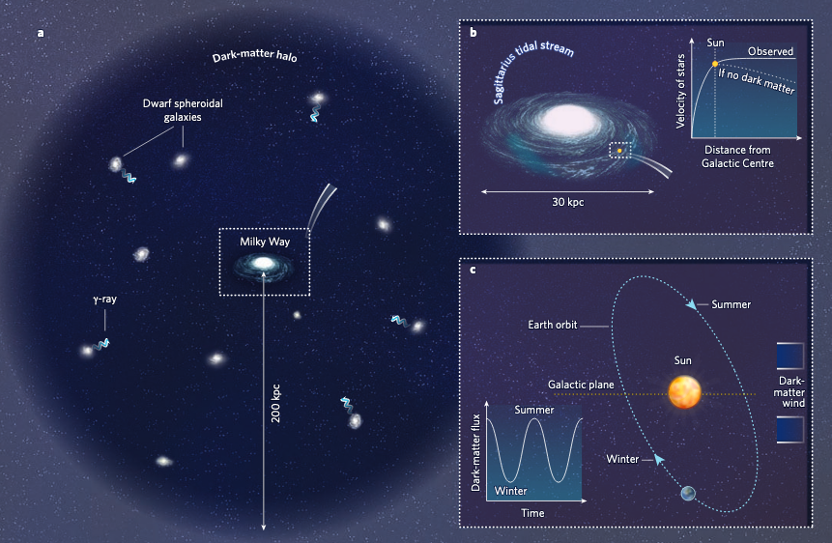
WIMP galactic wind
Notes:
Our galaxy is surrounded by a DM halo; so we can be hit by DM particle.
Some numbers:
WIMP velocity ~ 300 km/s, WIMP density 0.3 GeV/cm³ (1/3 of proton per cubic centimeter estimated in our galaxy).
Depending on the mass but we can estimate that 10 million WIMP pass through you hand every second but…it interacts less than once per year in a kg of detector…
Quickly comment on the possibility to observe a difference in the number of collisions depending on the season…that means our direction of motion around the Sun. This is an expected feature of the Number of DM interactions

Slide 5

Notes:
Working principle of a double phase Ar Time Projection Chamber
Spend time to explain it!

Slide 6

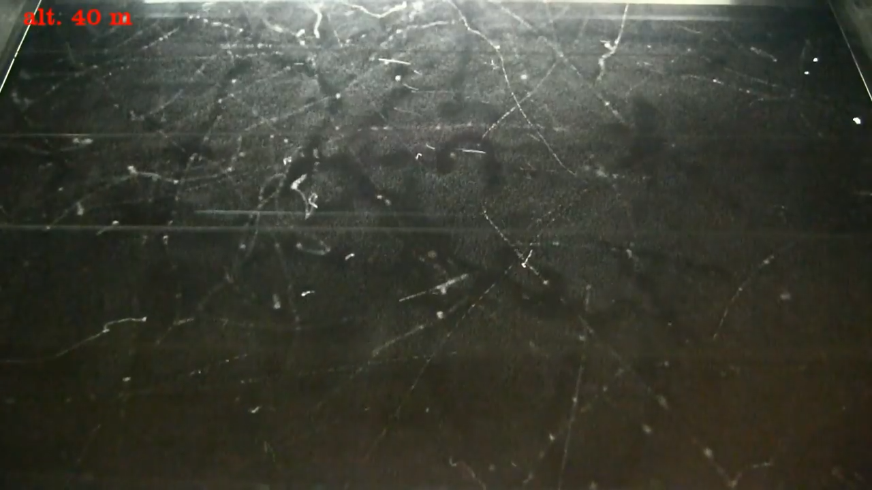
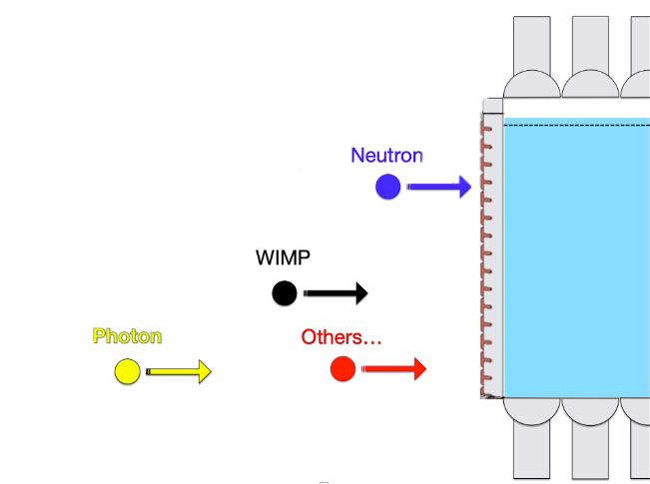
Detecting dark matter is very challenging mainly due to background particles.
WIMP
Notes:
Let the students think about signals that can mimic DM interaction or make it impossible to see them…
We need to find solution to make our detector free of “background” i.e. “no events but DM“
Maybe a good example are cosmic rays, as the video shows.
Together with the reduction of the background let the studend understand the importance of identify WIMP interactions over a residual backgrrund.

Slide 7
How can we reduce the background?
And how to identify a WIMP?

Slide 8
Going underground
All the materials are as radiopure as possible
Gran Sasso Laboratory
1400 m of rock
Notes:
External background-> bring the detector deep underground
Internal background -> do not use “dirty” materials

Slide 9
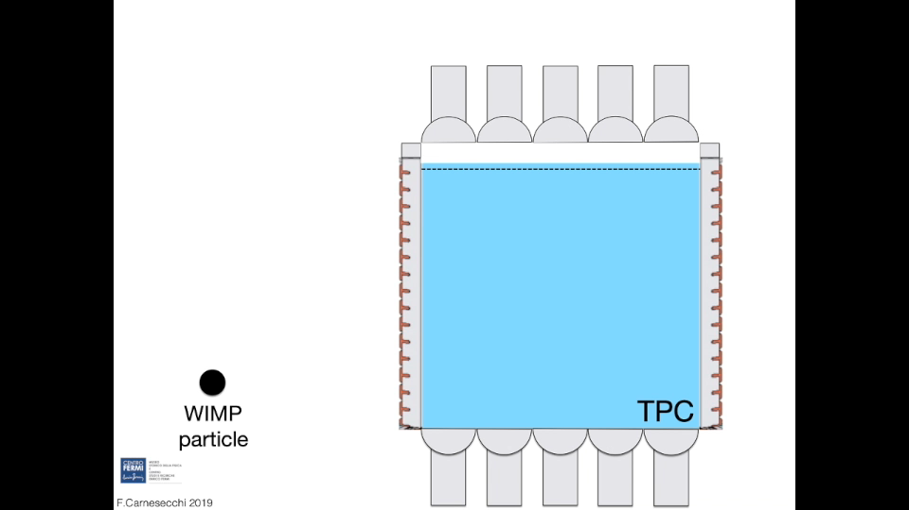
Notes:
How to distinguish WIMP from no-WIMP using VETO

Slide 10
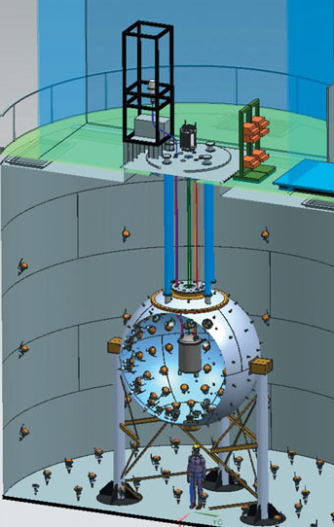
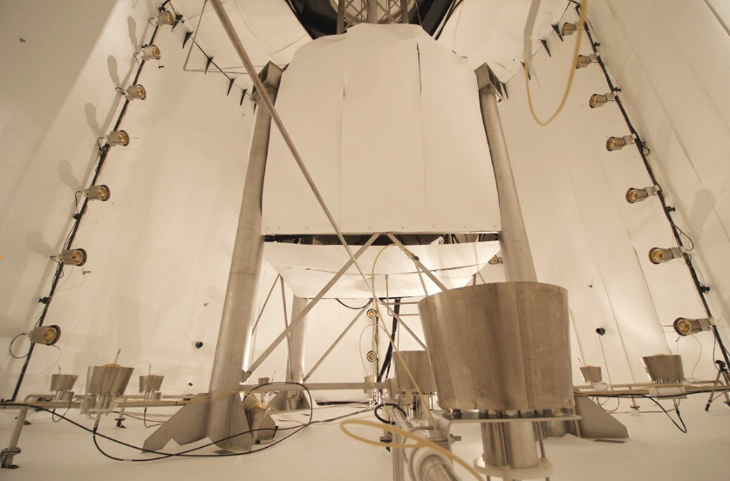
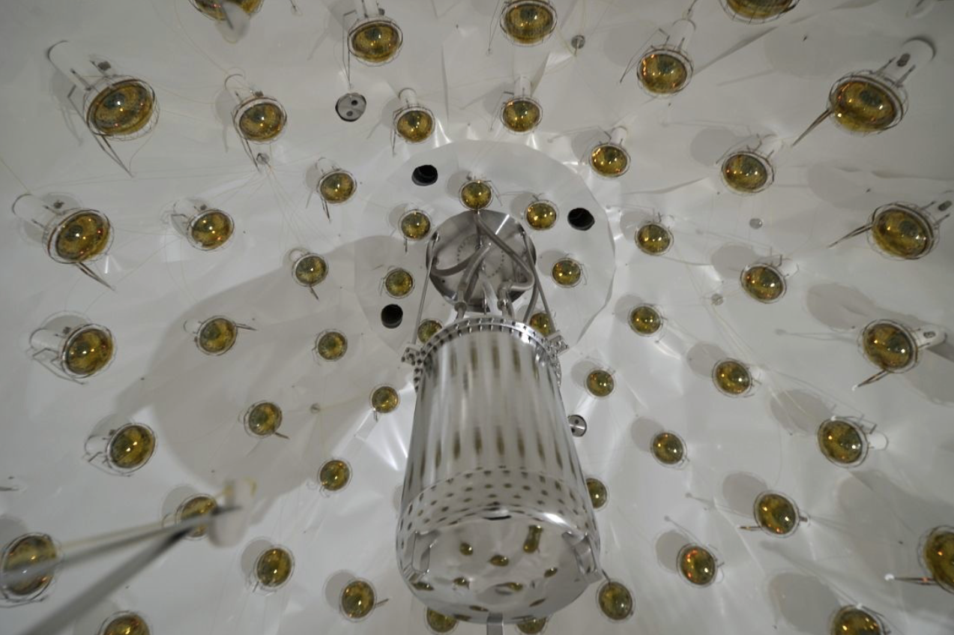
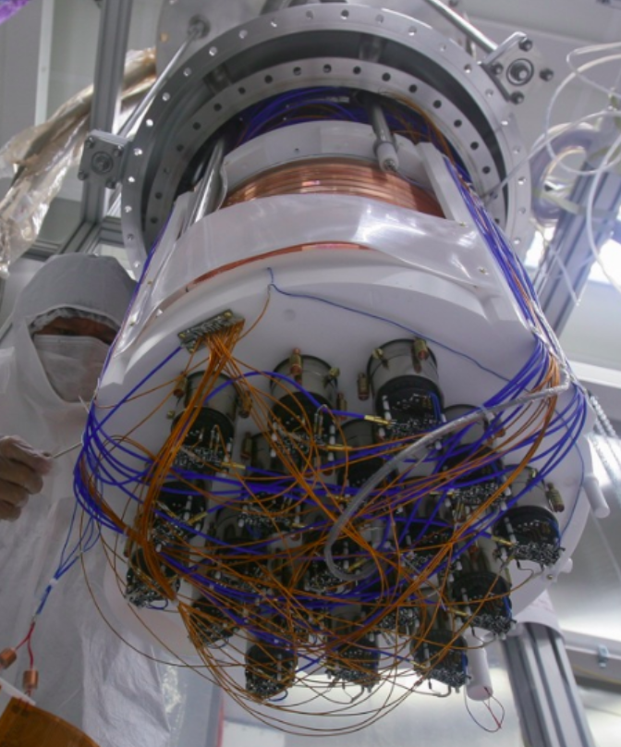
Cosmic-ray veto:
1 kton ultra pure Water Cherenkov
Neutron veto:
30 ton Borated Liquid Scintillator
Dark Matter Detector:
TPC 50 kg Liquid Argon from underground source depleted in ³⁹Ar
Notes:
Using the pictures, describe the DarkSide-50 experiment and VETO Systems (N.B. in the analisys the student will use as a cut just a generic cut called VETO).

Slide 11
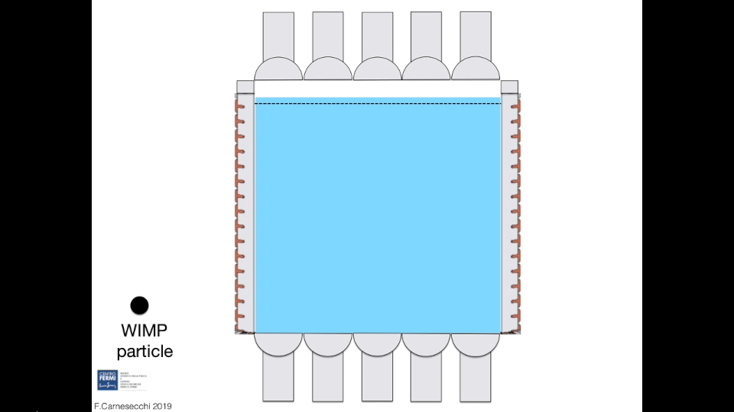
Notes:
Background coming from the detector materials -> cure it using position cut

Slide 12
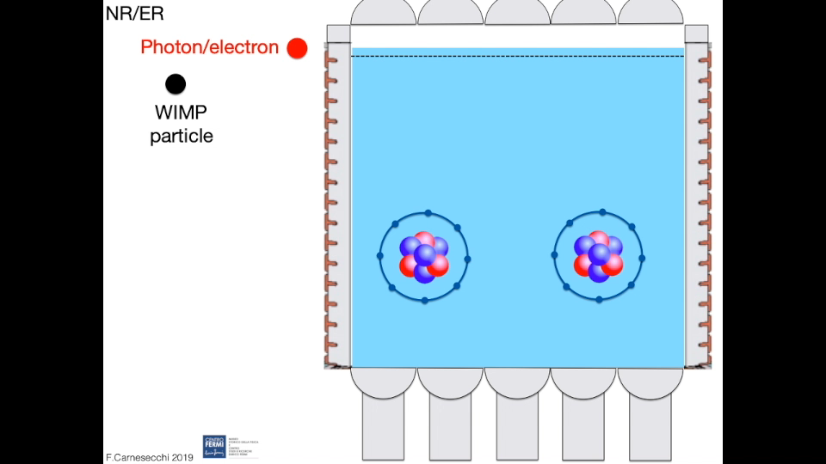
Notes:
Use the properties of S1 in Argon.
In case of WIMP (nuclear recoli interaction) the S1 arrives at once.
In case of Electron recoil the S1 is distributed in time

Slide 13
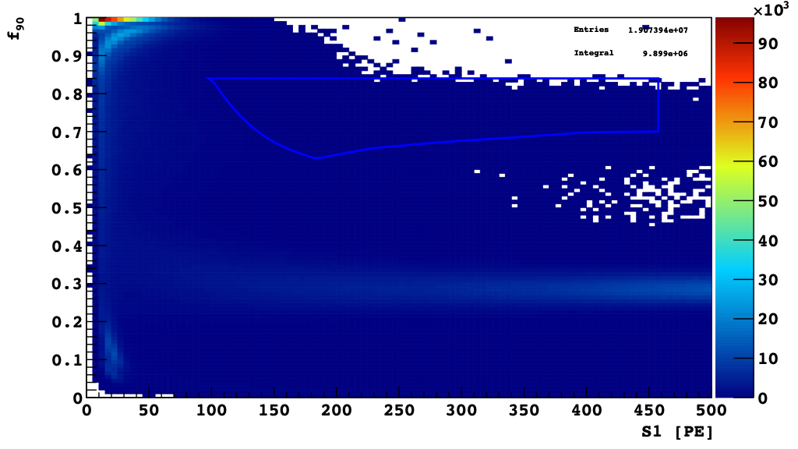
Before data cuts
WIMP region
f₉₀ = fraction of S1 light detected in the first 90 ns of a signal
= prompt light
Notes:
So we can try to use the f90 variable which is defined as…

Slide 14
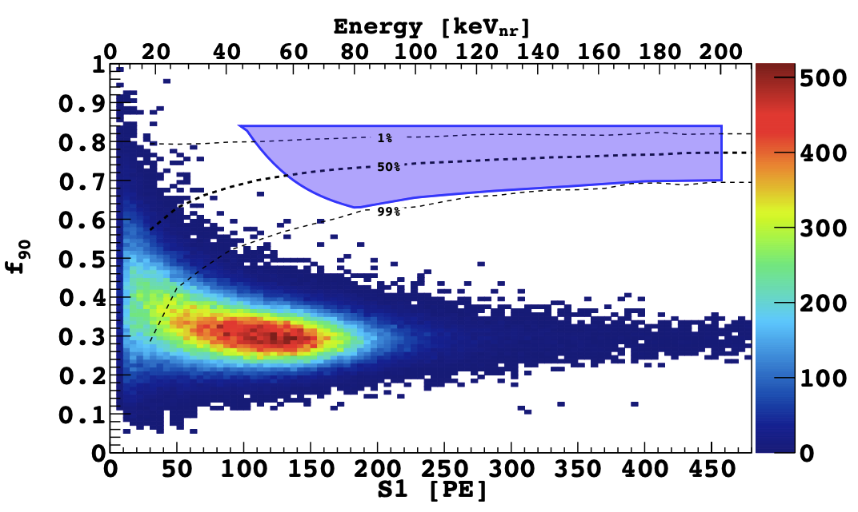
and after cuts
WIMP region
Notes:
And we can get this result
No DM candidate

Slide 15
Backup

Slide 16
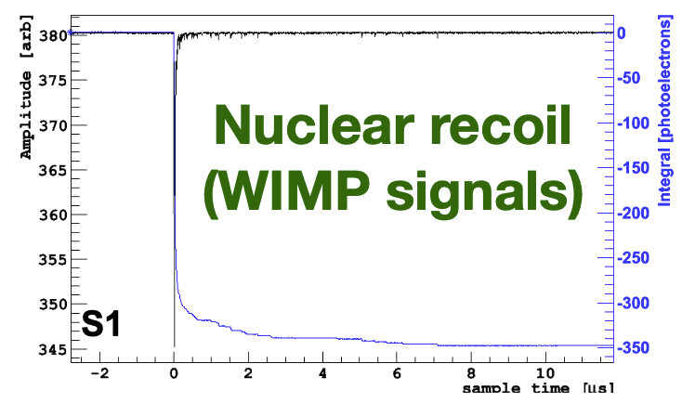
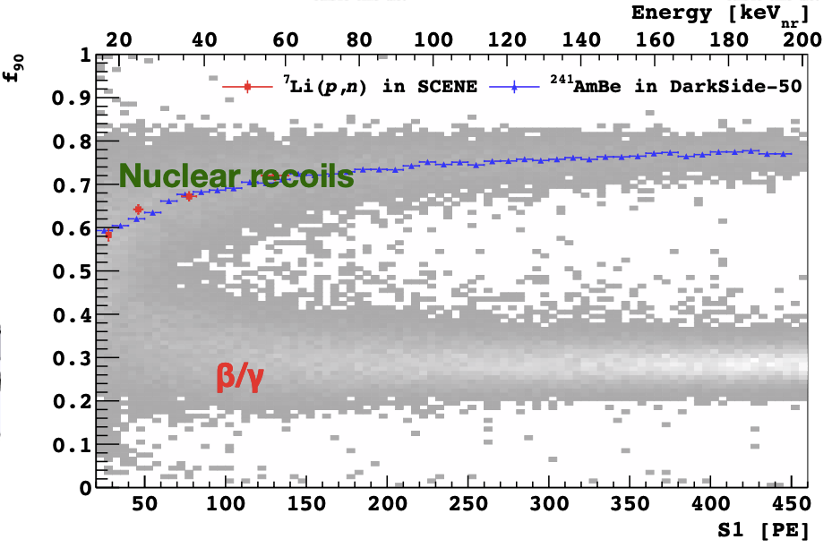
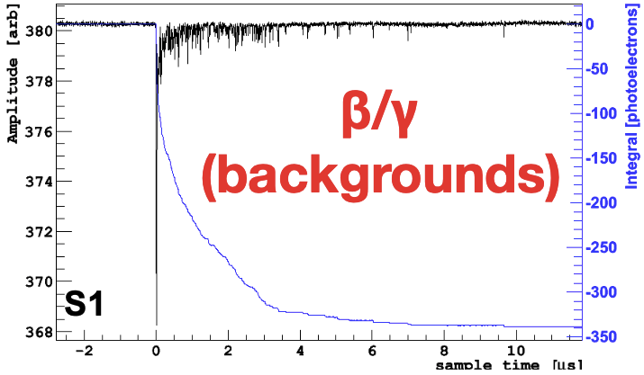
NR/ER, PSD on S1
Nuclear recoil: f₉₀~ 0.7
Electron recoil: f₉₀~ 0.3
Electron recoil

Slide 17
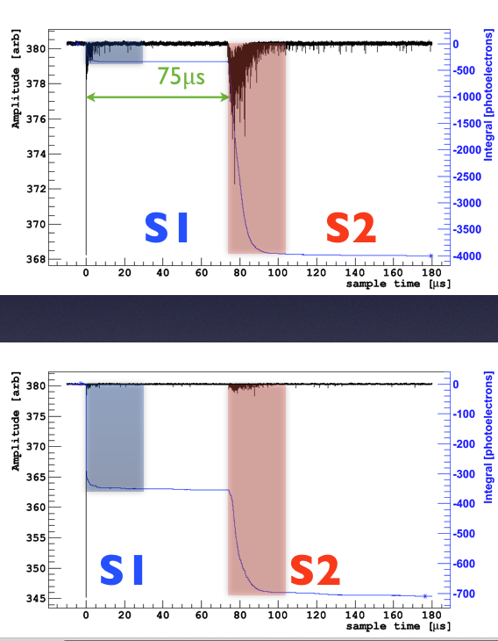
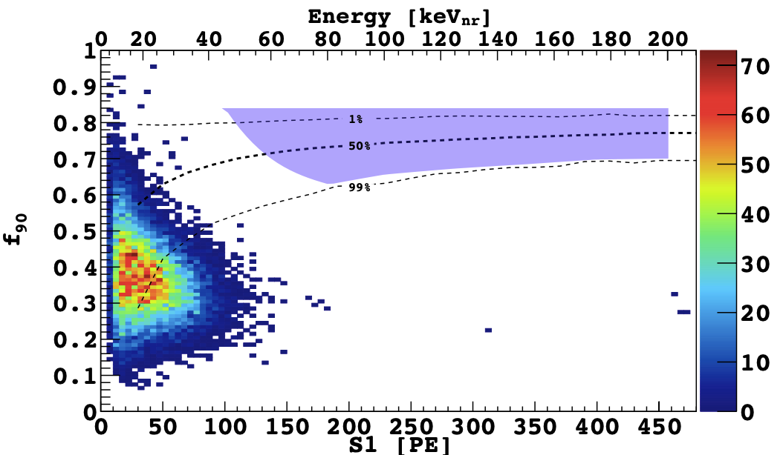
Nuclear Recoil
S2/S1
S2/S1 (NR) << S2/S1 (ER)
S2/S1 + tightened radial cuts
WIMP region
Electron Recoil

Slide 18
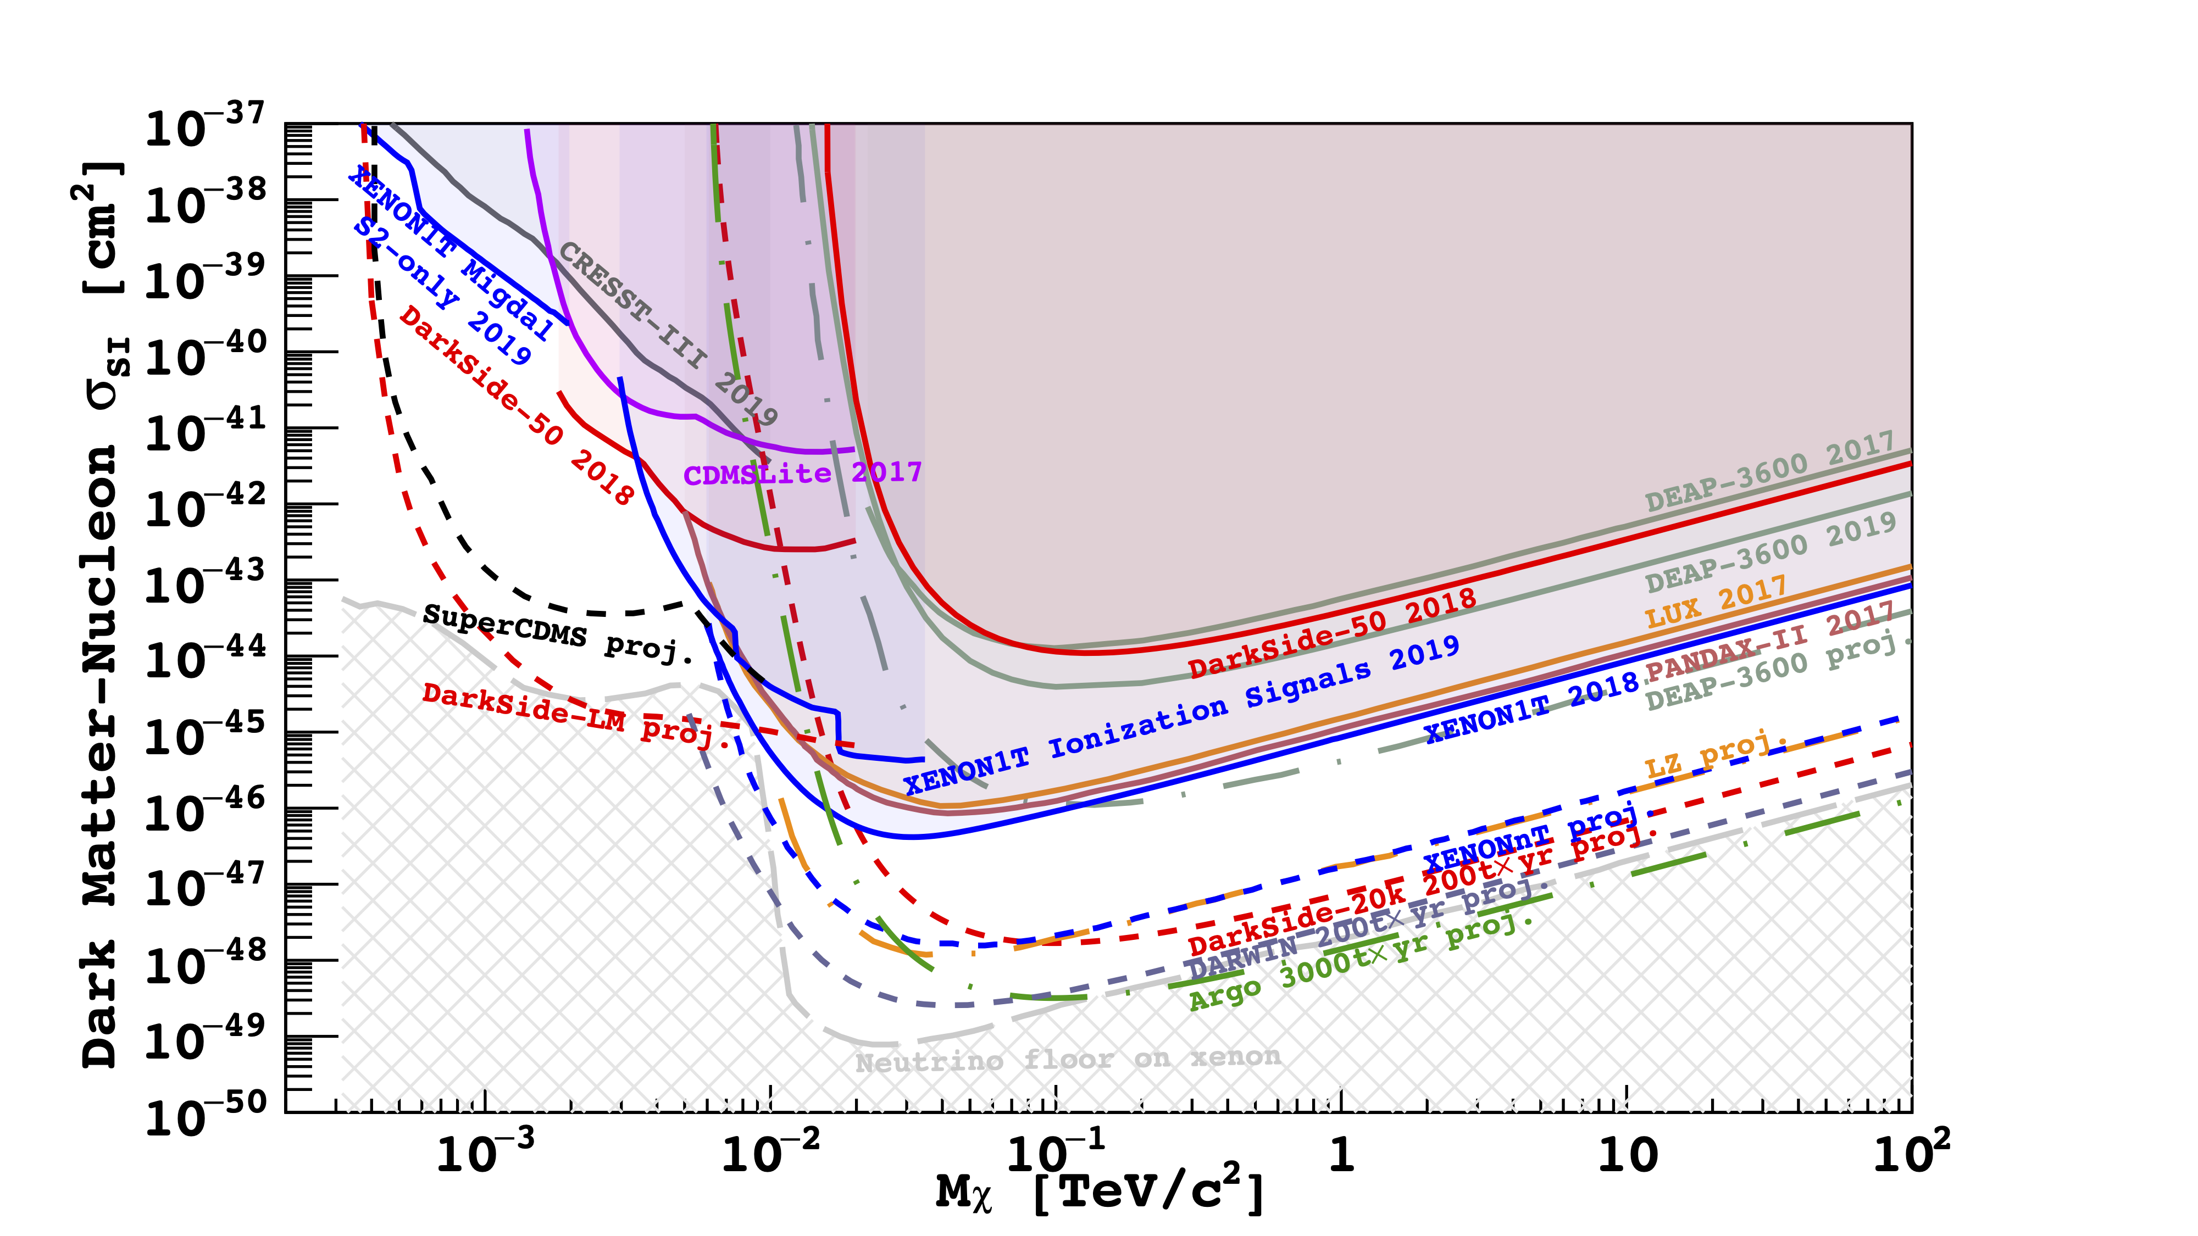
Exclusion Plot

