Slide 1
Evolution of Centralized Tier-1 HPC system
Giorgio Bolzon
Mirko Cestari
Debora Testi
Roma, 9 April 2026
GARR

Slide 2

Innovation: cloud integrated with HPC Systems
HPC
Cloud
Cloud and HPC are both central to support complex workflows
Cineca is bringing ADAcloud experience onto new large Cloud Systems
5–7 years of cloud usage experience are a good benchmark for analyzing trends in cloud adoption and its integration with traditional HPC systems
Storage multiprot.
Inference infrastructure
vLLM+VM+Proxy
partitions+ QoS+Service account+API
Slurm+proxy
workflow for sensitive data processing at scale
VM+ S3
service users+slurm partitions+QoS+ssh conf
Processing of data hosted on user premises
VM+S3
service users+slurm partitions+QoS+ssh conf
Notes:
Galileo100: sistema di supercalcolo «Tier-1»
564 nodi di calcolo
>20 PB storage
2 PFlops = 2 x 10¹⁵ Flops = 2 milioni di miliardi di operazioni in virgola mobile al secondo
(iPhone 14 Pro: 2 TFlops, PS4: 1.8 TFlops)

Slide 3
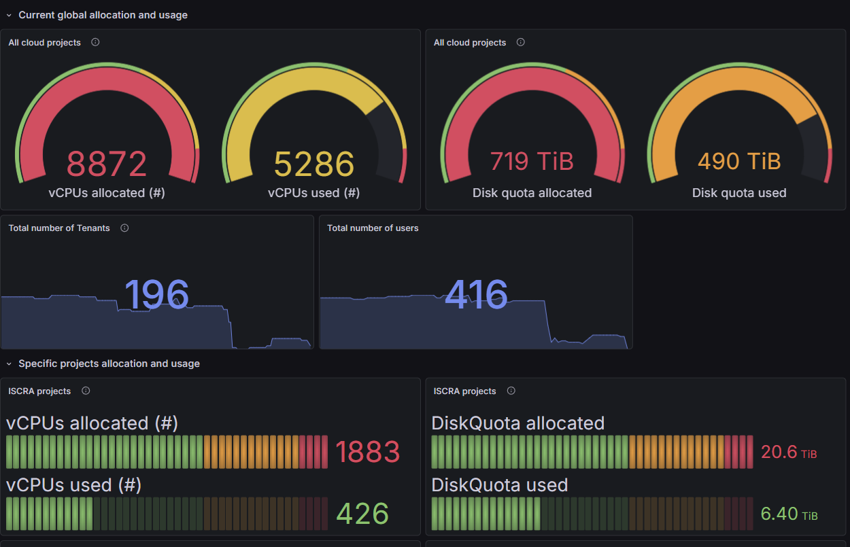
Sustainability
Cloud is central to flagship Euopean RI initiatives: AI factory, Gigafactory, and flagship European projects (DestinE, VHT, EBRAINS, …)
With TeRABIT we have raised the interest and need for large cloud infrastructure coupled with HPC (and eventually QM systems)
We were ahead of time and hope results will speak for themselves in order to make a compelling case
Cloud performance obsolescense is less pronounced than HPC, but the action in 6-7 years needs to be sustained
Notes:
Galileo100: sistema di supercalcolo «Tier-1»
564 nodi di calcolo
>20 PB storage
2 PFlops = 2 x 10¹⁵ Flops = 2 milioni di miliardi di operazioni in virgola mobile al secondo
(iPhone 14 Pro: 2 TFlops, PS4: 1.8 TFlops)

Slide 4
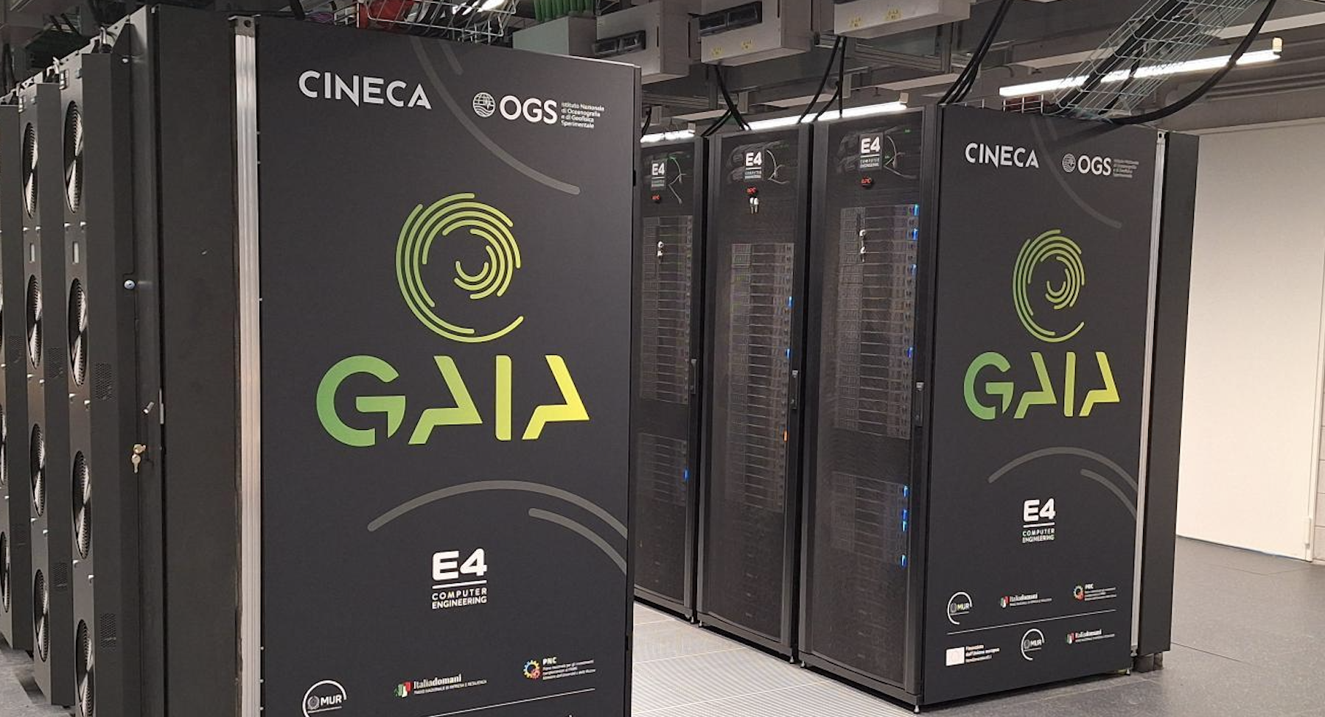
Added value in OGS perspective
Opportunities | GAIA intregrated in TeRABIT opens to OGS the possibility to become data distributor
HW solutions | No more problems of long term storages
Collaborative platform | Integration between researchers and SME (CREST)
Game changer | Evolution in researcher skills, we will replace powerful workstation on OGS offices (used as servers) with VMs. There is a layer of researchers that does not need whole HPC, which is naturally cloud-oriented.
Notes:
Galileo100: sistema di supercalcolo «Tier-1»
564 nodi di calcolo
>20 PB storage
2 PFlops = 2 x 10¹⁵ Flops = 2 milioni di miliardi di operazioni in virgola mobile al secondo
(iPhone 14 Pro: 2 TFlops, PS4: 1.8 TFlops)

Slide 5
Thank you
gbolzon@ogs.it, m.cestari@cineca.it
d.testi@cineca.it

