Slide 1
TeRABIT WP3 Centralized Tier-1 HPC system
Giorgio Bolzon
Mirko Cestari
Debora Testi
Roma, 9 April 2026
GARR

Slide 2

Brief history
Phase | Sudden shift | ex-post evaluation
User survey
 | The new system will not replace g100 HPC system, but it will work alongside g100; it will be only Cloud and Storage oriented, dedicated to HTC. | Ok
Tender technical specifications
Call for tender
Award of the contract, E4, 420 CPU Nodes / 280 required
Begin of installation at Casalecchio
 | October 2024, flood in Bologna; choosing Tecnopolo as new site | Ok
Delivery and installation at Tecnopolo, I03.2.3 BIM 11
 | Additional procurement with 650 KEur HR funds, increase GPU L40S and H100 NVL | Ok
 | Rear doors and re-delivery because of a fault in 456 transceivers | Due
Notes:
Galileo100: sistema di supercalcolo «Tier-1»
564 nodi di calcolo
>20 PB storage
2 PFlops = 2 x 10¹⁵ Flops = 2 milioni di miliardi di operazioni in virgola mobile al secondo
(iPhone 14 Pro: 2 TFlops, PS4: 1.8 TFlops)

Slide 3
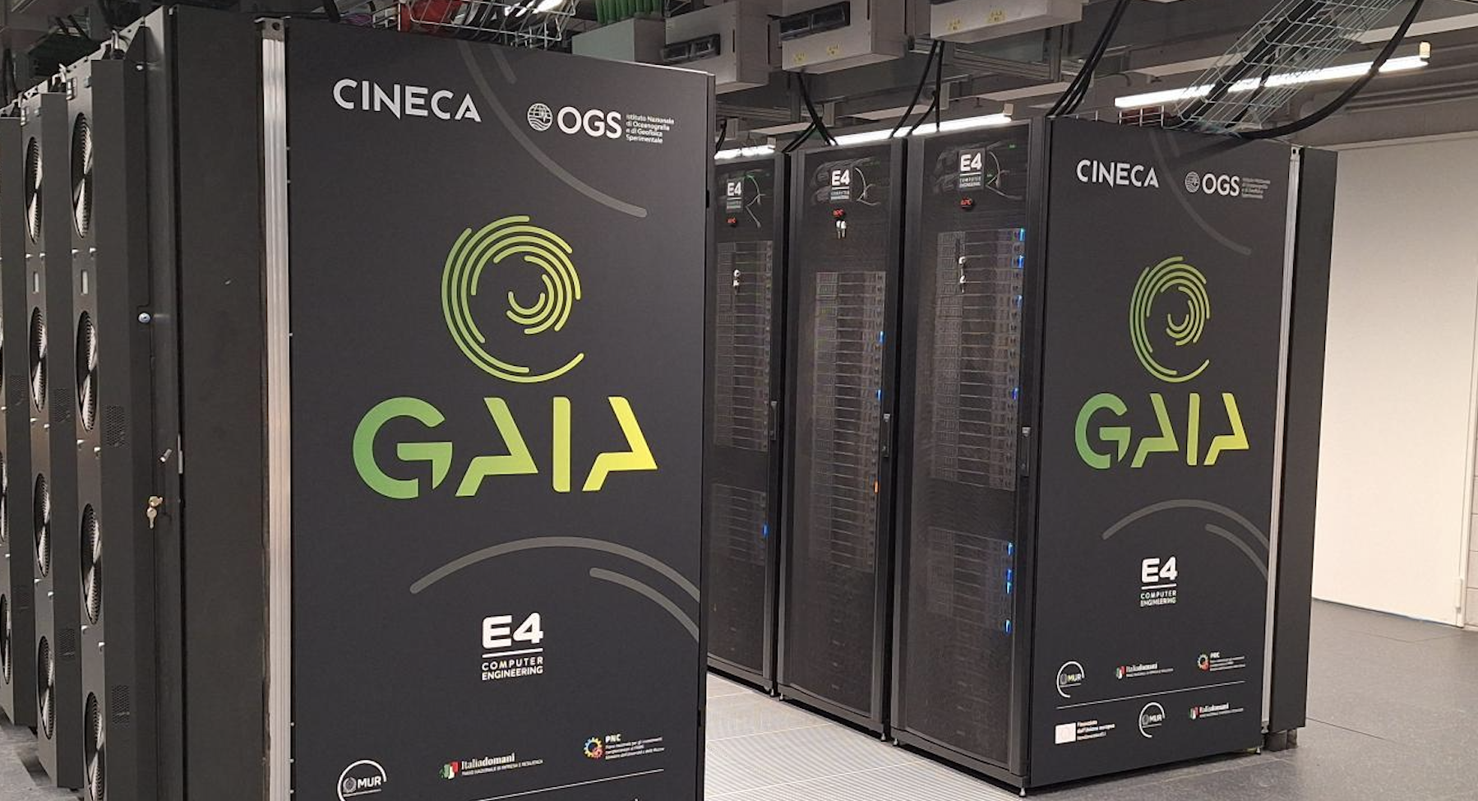
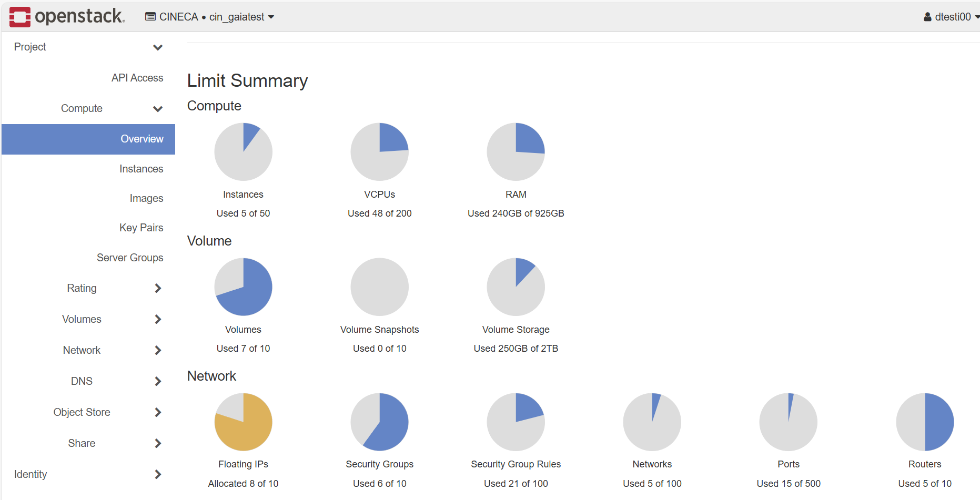
Breaking news
KPI IO3.2.5 BIM 12
30 Mar 2026, GAIA has been opened to Cineca staff in pre-production
Opening in production for users: Tue 28 Apr 2026 !
Notes:
Galileo100: sistema di supercalcolo «Tier-1»
564 nodi di calcolo
>20 PB storage
2 PFlops = 2 x 10¹⁵ Flops = 2 milioni di miliardi di operazioni in virgola mobile al secondo
(iPhone 14 Pro: 2 TFlops, PS4: 1.8 TFlops)

Slide 4
Thank you
gbolzon@ogs.it, mcestari@cineca.it, d.testi@cineca.it

