Slide 1
The EuPRAXIA@SPARC_LAB project
F. Villa, INFN-LNF
on behalf of the EuPRAXIA@SPARC_LAB collaboration

Slide 2
Layout
Introduction
EuPRAXIA@SPARC_LAB
FEL beamlines

Slide 3
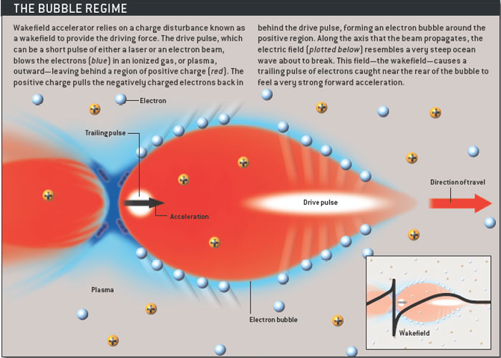
Plasma acceleration
Laser Wakefield Accelerator (LWFA):
Drive beam = laser beam
Plasma WakeField Accelerator (PWFA):
Drive beam = high energy electron or proton beam
Plasma acc: typical >1 GeV/m
RF structures: typical 20-60 MeV/m
Courtesy Sci. Am.

Slide 4
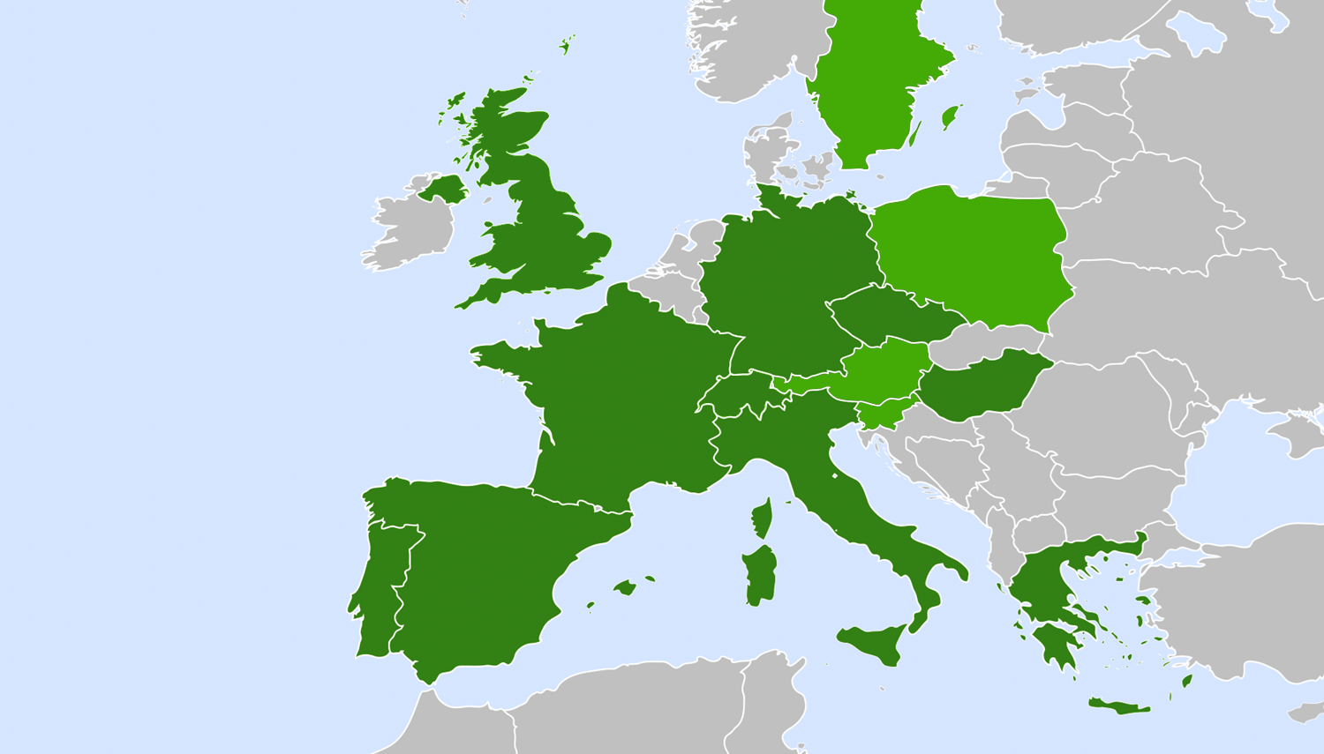


EuPRAXIA: Distributed Research Infrastructure
Beam-driven plasma user facility EuPRAXIA Headquarter
Laser-driven plasma user facility: ELI beamlines
National node
Laser-driven 5 GeV e⁻ R&D (EPAC, UK)
Laser-plasma acc. & high rep. rate R&D (D)
Laser-driven site (ELI-Beamlines, CZ)
National nodes perform technical developments, prototyping and component construction.
Beam diag. (CH)
User Data Center (H)
Laser-plasma acc. R&D (F)
Beam-driven site (INFN-LNF, IT) EuPRAXIA Headquarter
Laser R&D (IT)
Laser R&D (E)
Theory & simulations (P)
Beamline applications (GR)
Horizon Europe

Slide 5
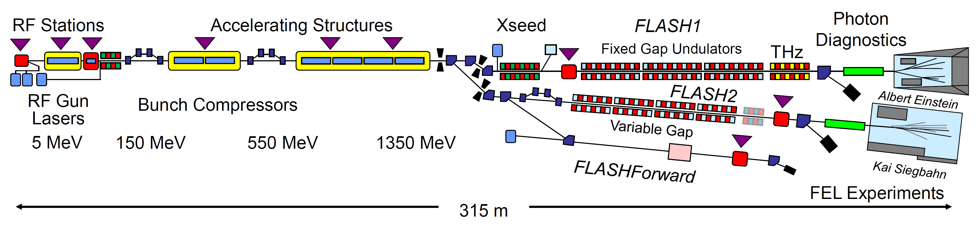
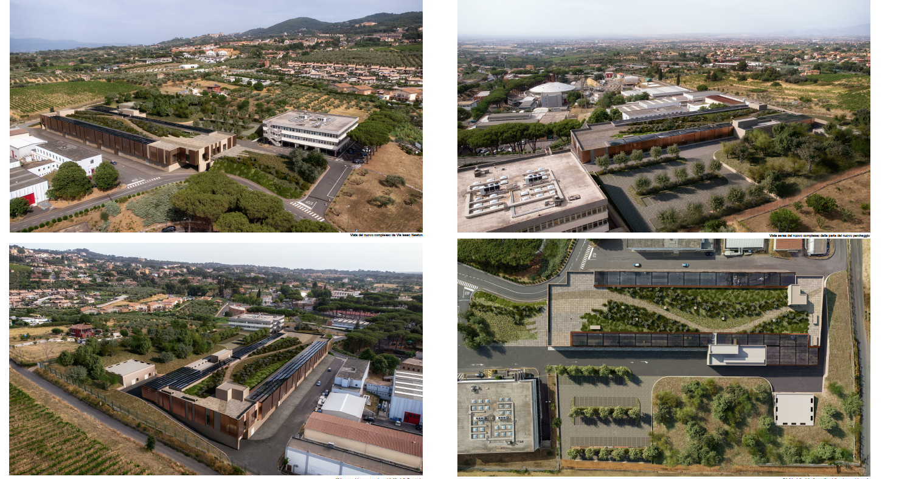
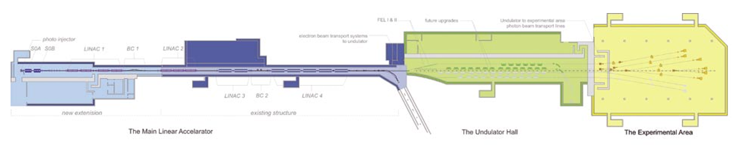
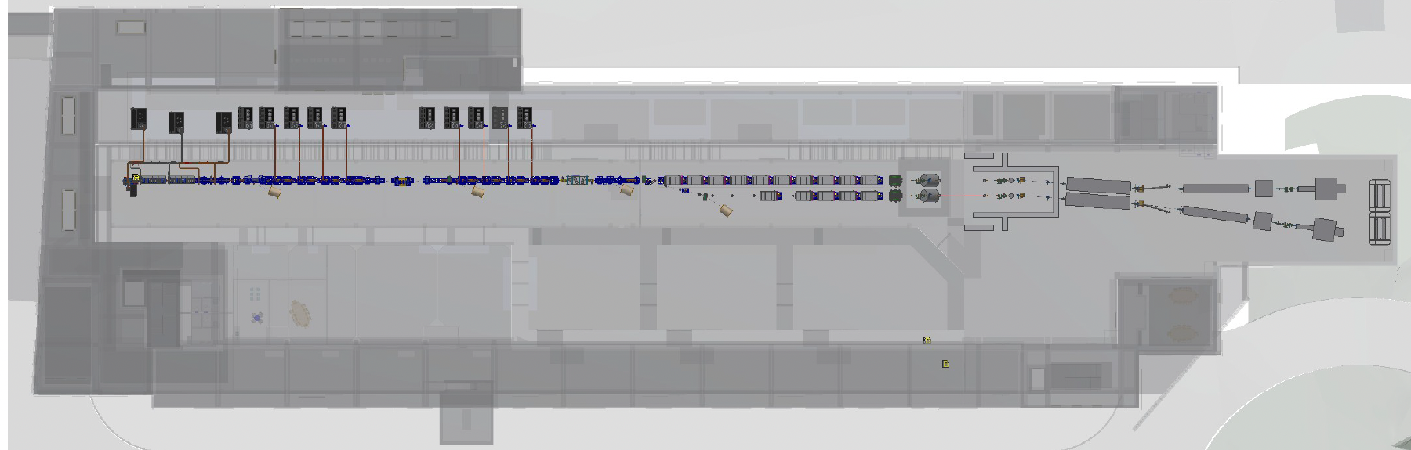
EuPRAXIA@SPARC_LAB
1.7 GeV
365 m
Technical rooms
159 m
Klystron & power supplies hall
Preparations labs
45 m
Accelerator hall
Undulator hall
1 (=>2+) GeV
Experimental hall
Lasers clean rooms
Laser and particle user rooms

Slide 6

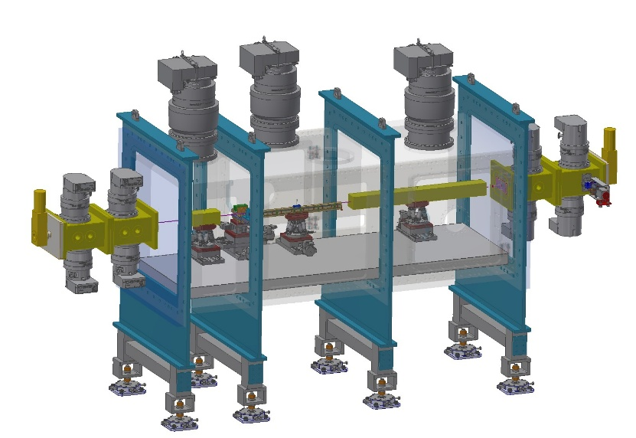
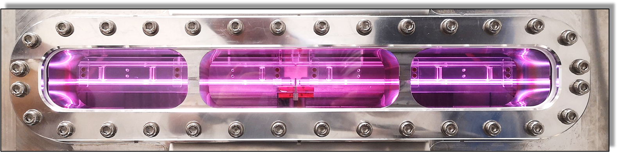
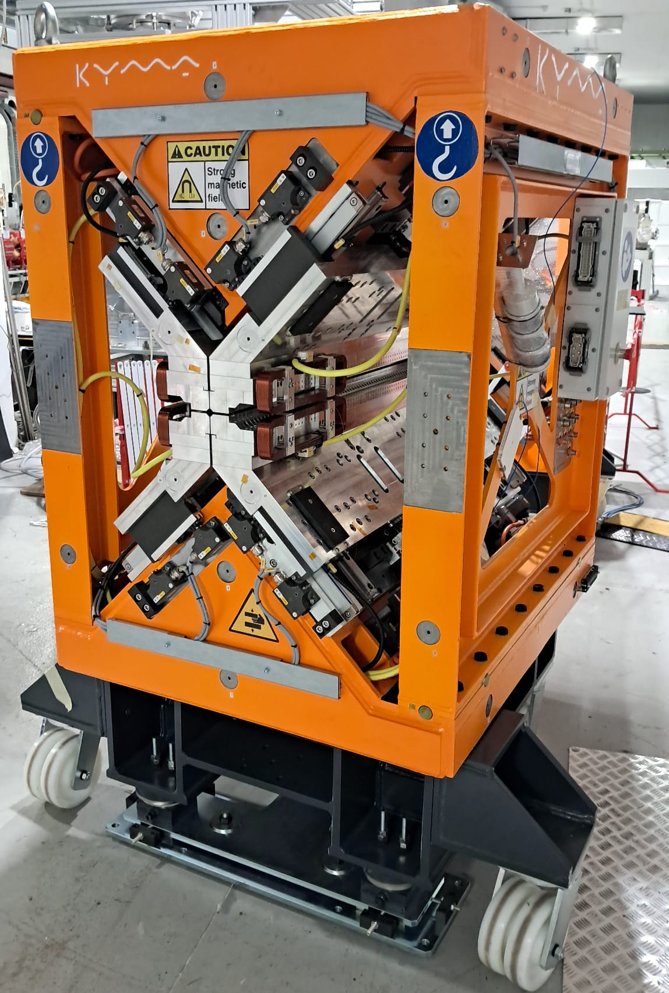
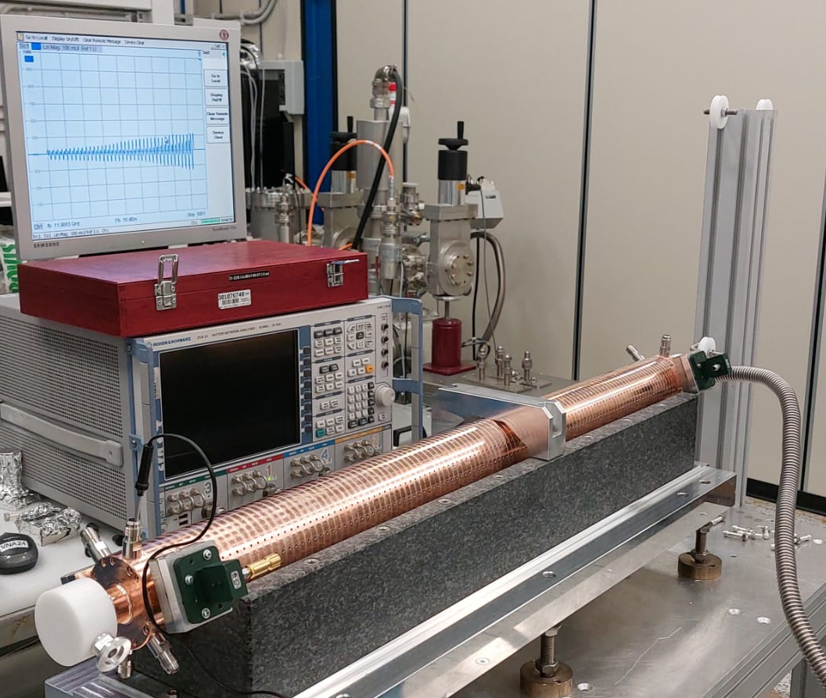
EuPRAXIA@SPARC_LAB
Plasma capillary: 0.6 m
54 m
AQUA Beamline
ARIA Beamline
28.5 m
Photon beamlines
Plasma chamber: 3.5 m
9 m
33.5 m
Undulators
Plasma module
17.5 m
X-band Linac
S-band Injector

Slide 7
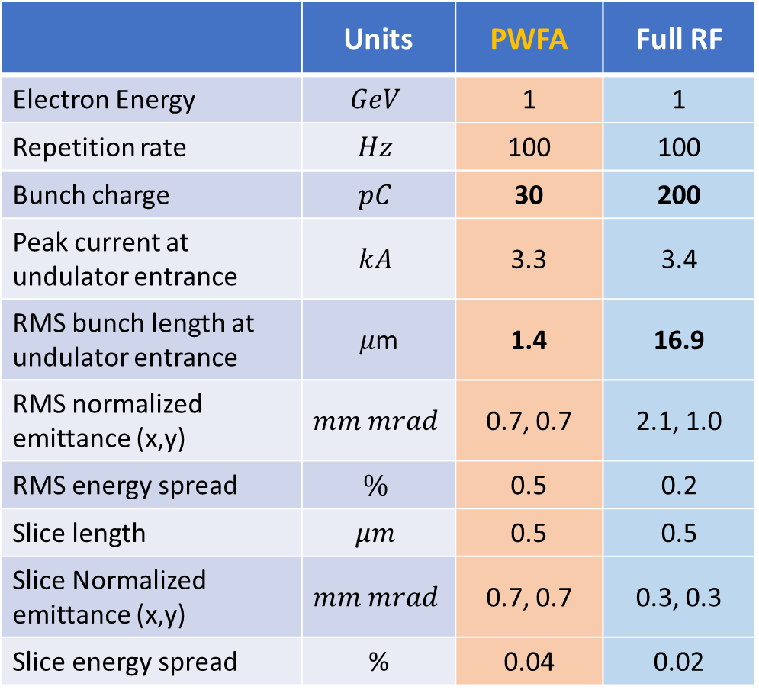
Expected electron parameters at 1 GeV
 | Units | PWFA | Full RF
Electron Energy | $$GeV$$ | 1 | 1
Repetition rate | $$Hz$$ | 100 | 100
Bunch charge | $$pC$$ | 30 | 200
Peak current at undulator entrance | $$kA$$ | 3.3 | 3.4
RMS bunch length at undulator entrance | 𝜇m | 1.4 | 16.9
RMS normalized emittance (x,y) | $$mm mrad$$ | 0.7, 0.7 | 2.1, 1.0
RMS energy spread | $$\%$$ | 0.5 | 0.2
Slice length | $$μm$$ | 0.5 | 0.5
Slice Normalized emittance (x,y) | $$mm mrad$$ | 0.7, 0.7 | 0.3, 0.3
Slice energy spread | % | 0.04 | 0.02
Two different configurations:
$∼$500 MeV beam from the X-band linac + 60 cm capillary PWFA acceleration
Final energy up to 1.25 GeV to reach harder FEL photons
Smaller accelerated charge
Shorter pulses
Final energy greatly upgradable in future with similar building occupancy ($∼m$)
$∼$1 GeV beam from the X-band linac alone (with additional RF power)
Larger charge per bunch
Longer pulses
At the upper limit of RF technology (not easily upgradable without extending the occupancy)
S2E simulations

Slide 8
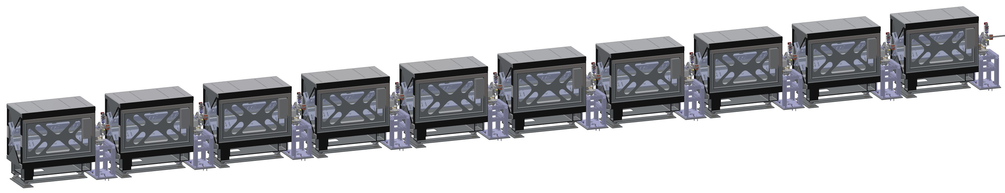
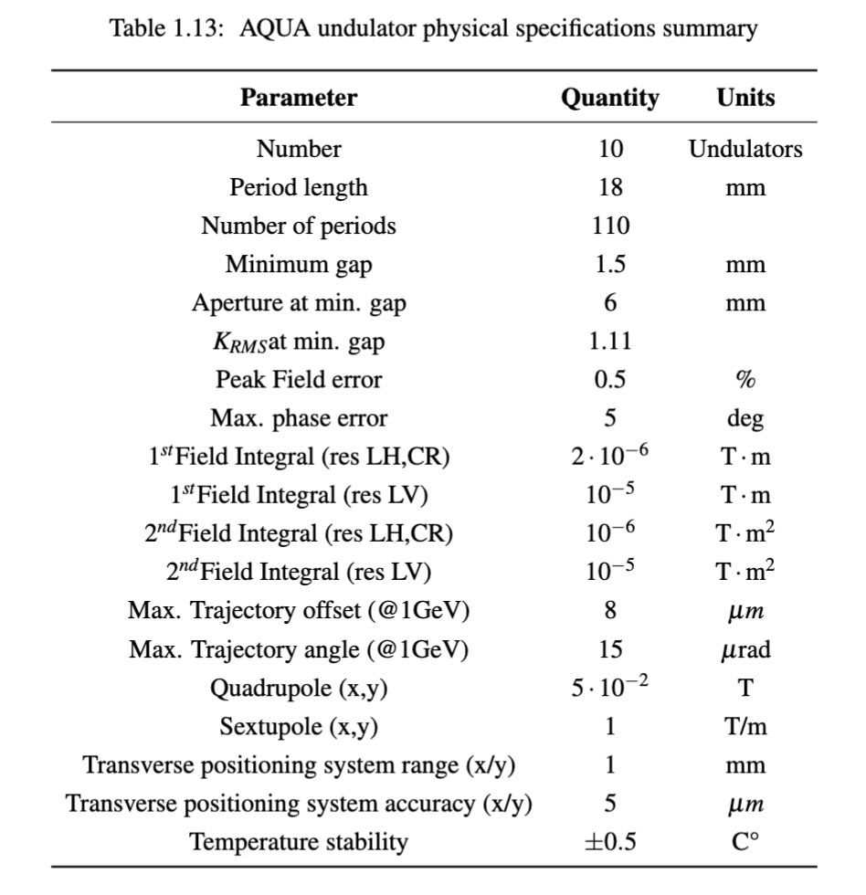
AQUA beamline: Undulators
10 Apple X undulators for SASE FEL in the water window with variable polarization
 | Units | PWFA | Full RF
𝜌 (3D) | $$×{10}^{−3}$$ | 0.77 | 1.49
Saturation length | $$m$$ | 20.5 | 20.0
Radiation wavelength | $$nm$$ | 4.0 | 4.0
Photon Pulse Energy | $$μJ$$ | 16 | 156
Photon per pulse | $$×{10}^{11}$$ | 3.2 | 31.3
Photon Bandwidth | $$\%$$ | 0.4 | 0.5
Photon pulse length (rms) | fs | 1.0 | 14.1

Slide 9
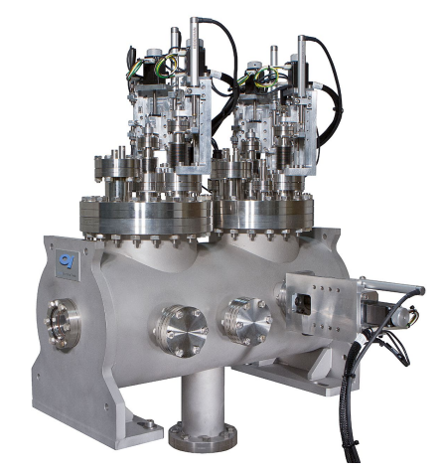
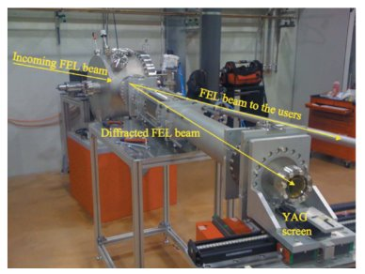
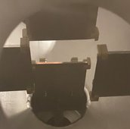
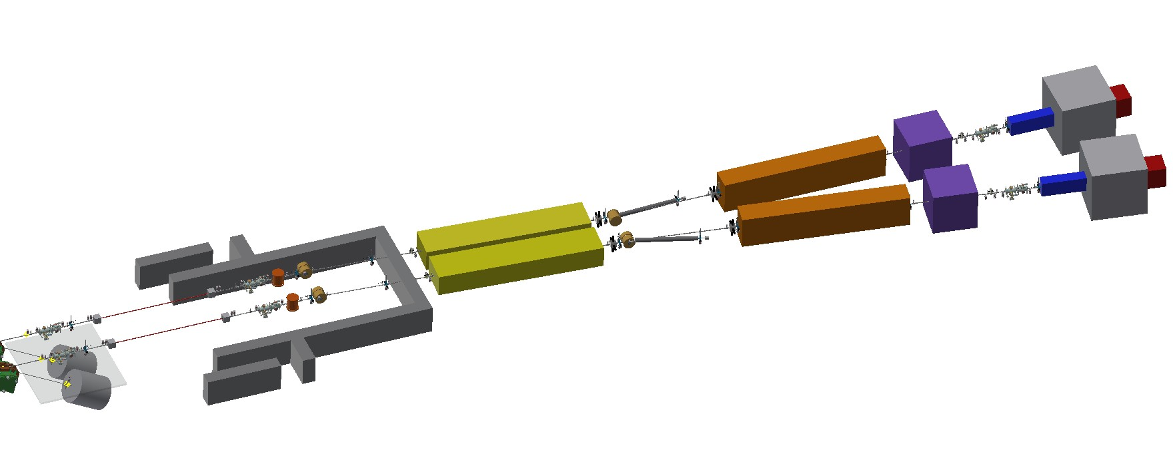
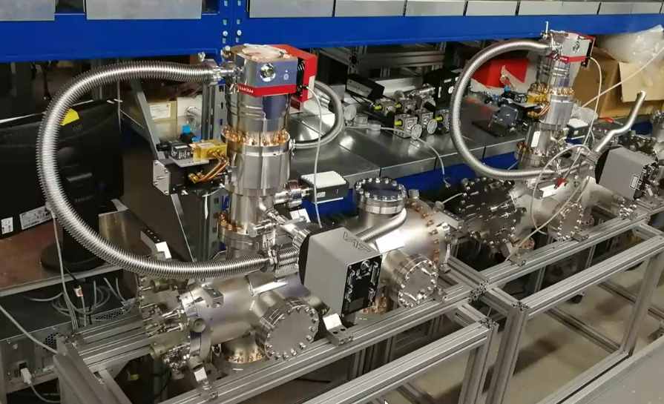

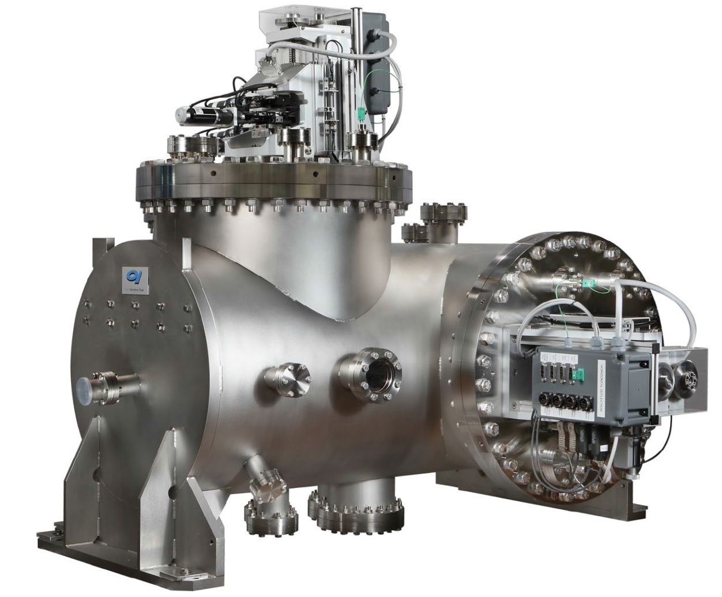
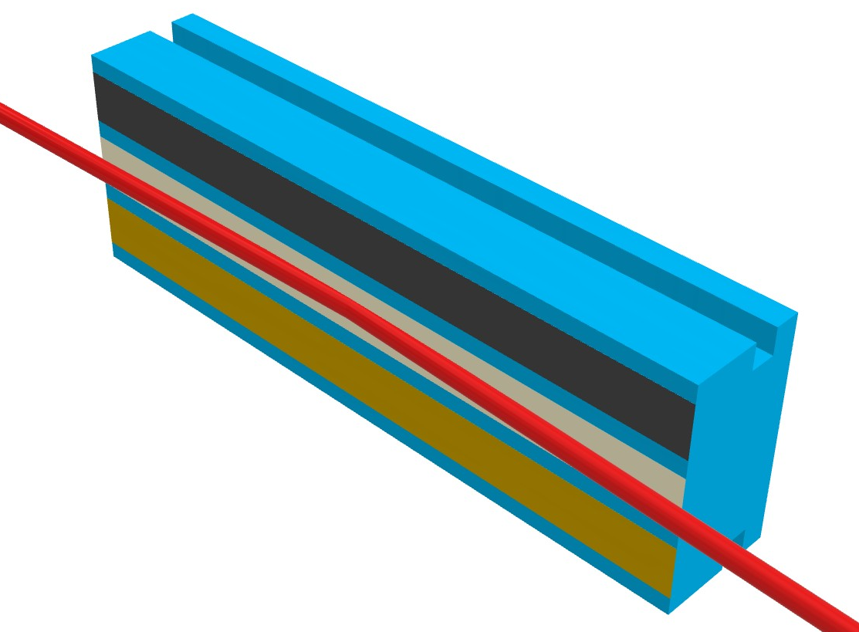
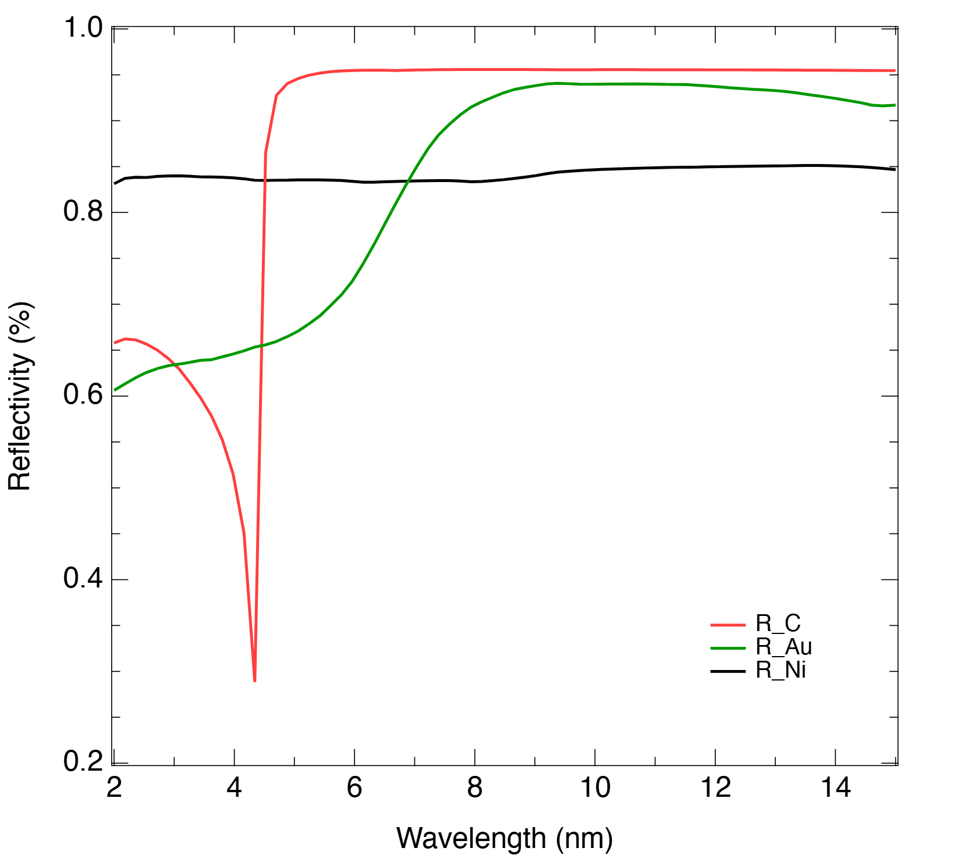
AQUA Beamline: Photon Beamline
Exp. Chamber area
K-B mirrors
Filters
GDM
Spectrometer
BPM
BPM
GDM
Aperture
Filters
Mirror
Split & delay line area
GDM
Monochromator area
Gas absorber
Radial ion. chamber area

Slide 10
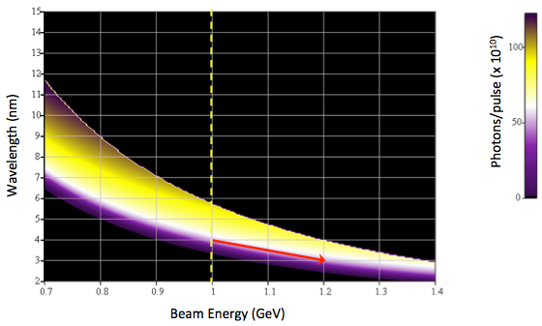
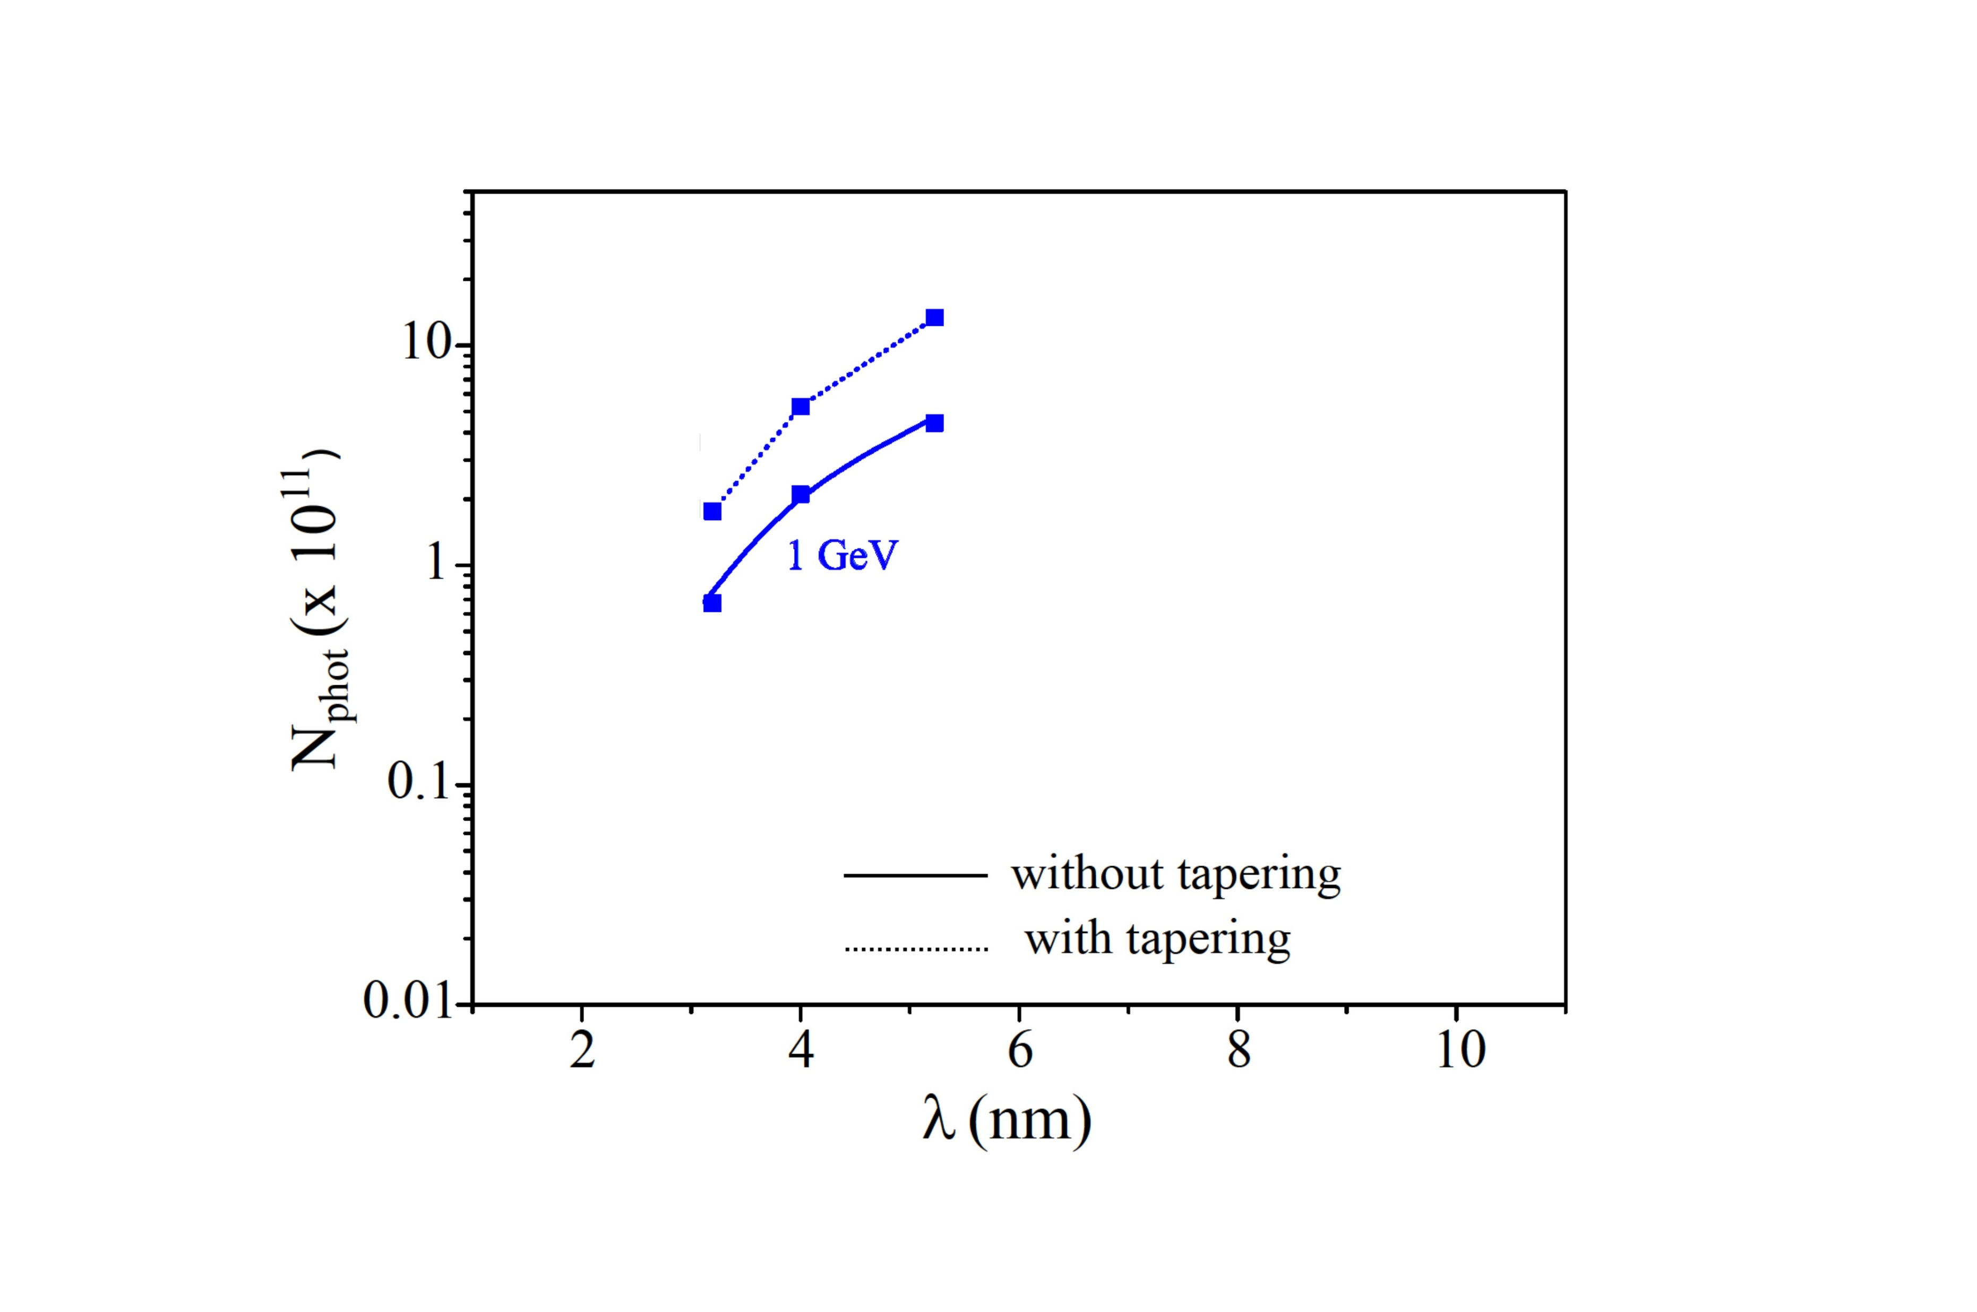
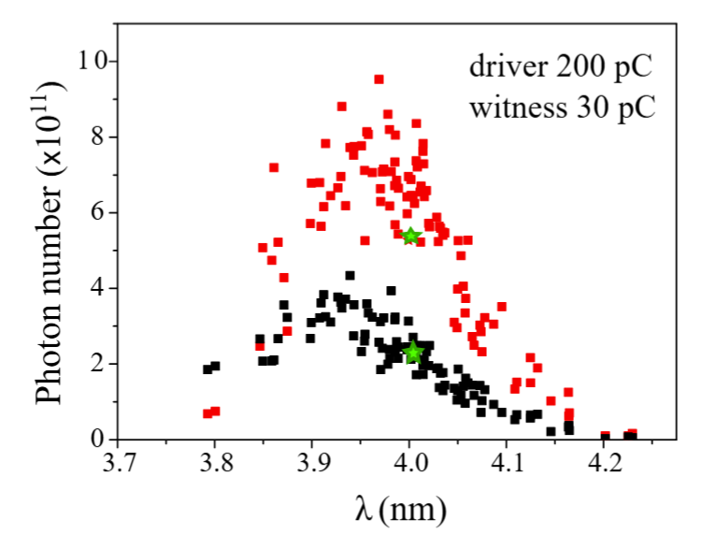
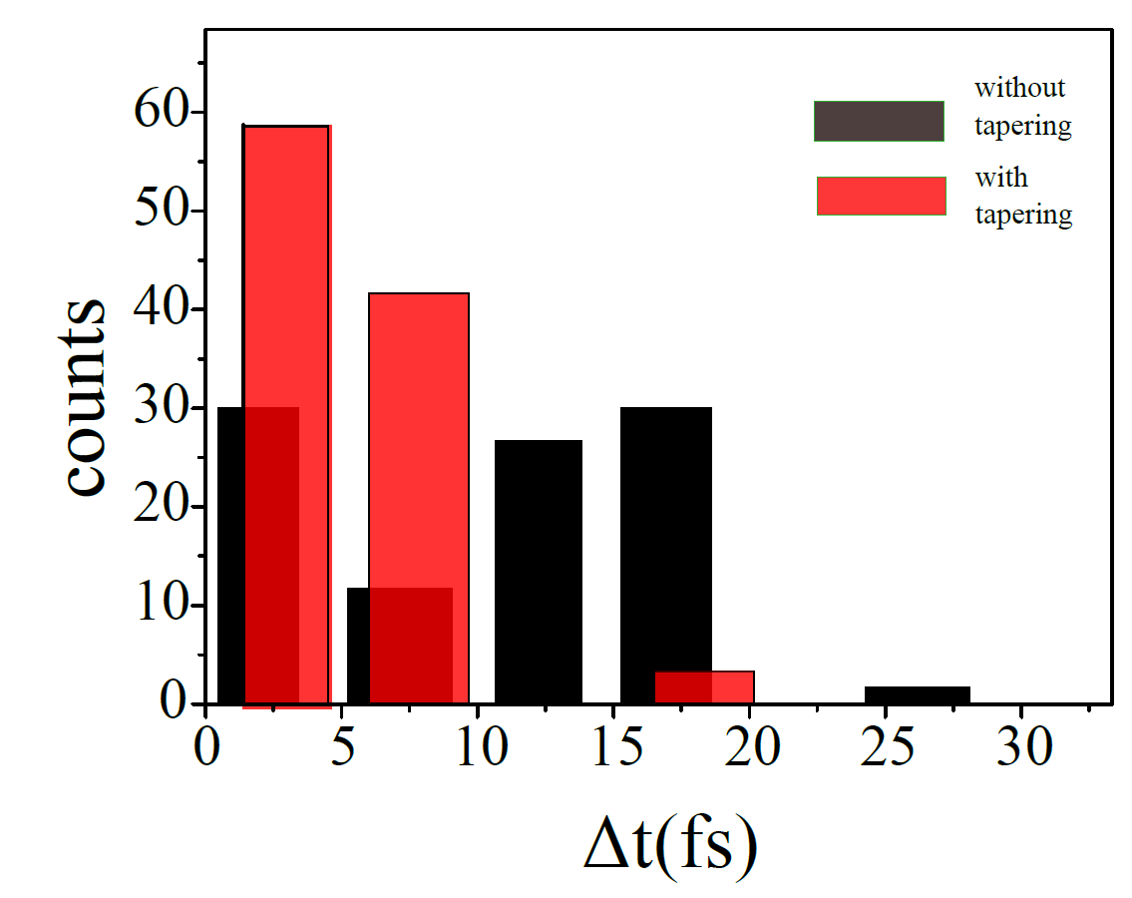
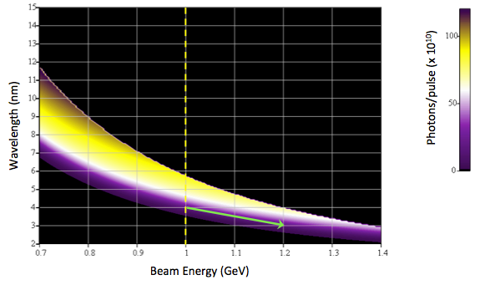
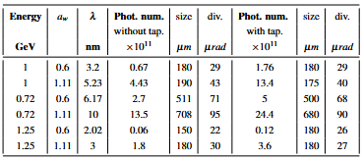
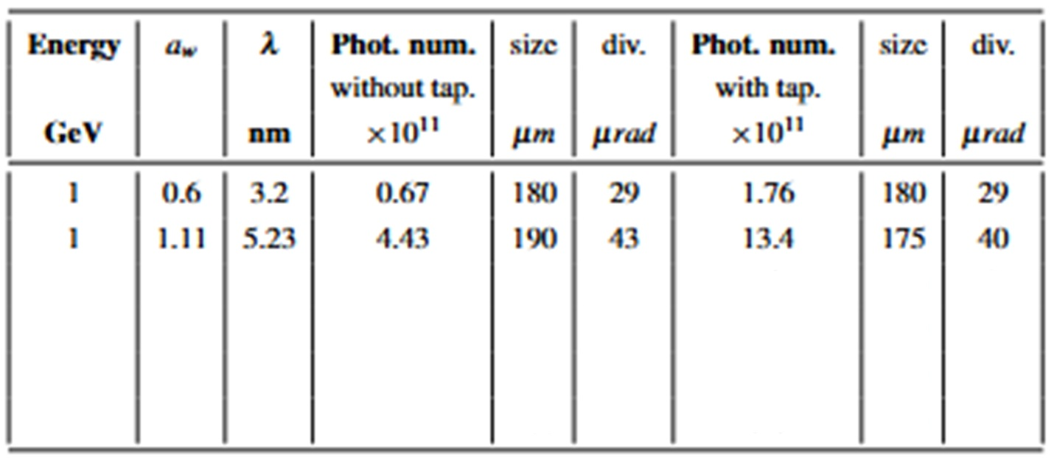
AQUA beamline: Wavelength tuning
Scale equations
Full start to end simulations (PWFA, linear polarization)
AQUA PWFA
circular
e- extrapolated parameters + Genesis simulations
AQUA PWFA
linear

Slide 11

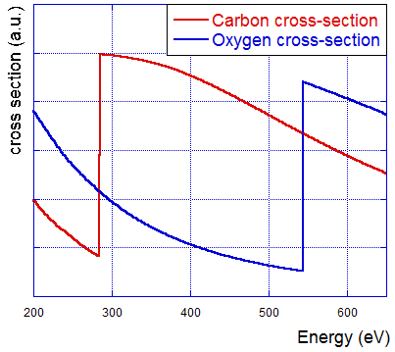
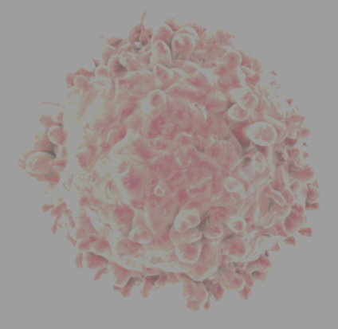
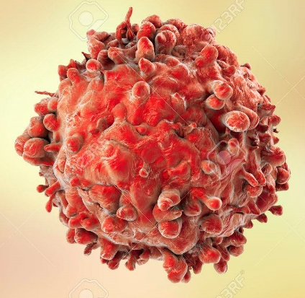
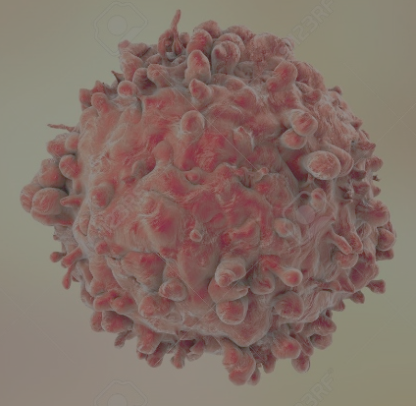
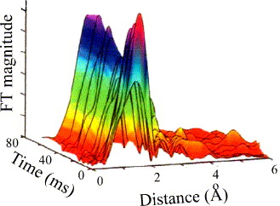
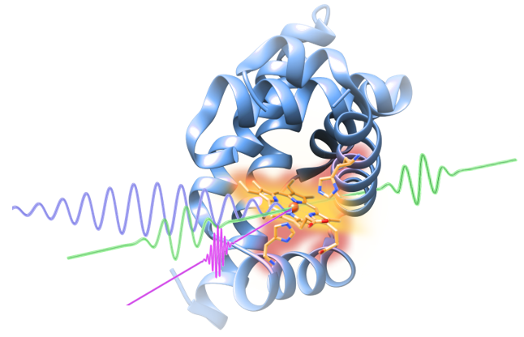
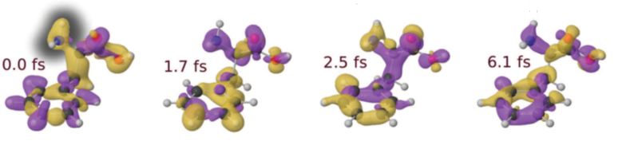
AQUA beamline: Scientific case
Experimental techniques and typology of samples
(Large) Viruses
Organelles
Bacteria/Cells
Organic molecules
Metals
Semiconductors
Superconductors
Magnetic materials
Coherent Diffraction Imaging
X-ray Spectroscopy
Raman Spectroscopy
Photo-Fragmentation of molecules
4 nm
3 nm 2 nm

Slide 12
FEL Photon Beamline
e- dumps
GMD
GMD
M
Spectr.
Sh
YAG
Gas att
BDA
YAG
YAG
Monochr.
time
GMD
diag
FW
BPM
YAG
Spectr.
BPM
YAG
S&DL
YAG
FW
Sh
YAG
KB
GMD
Sh
YAG
BDA
foc
YAG
Gas att
GMD
time
Monochr.
FW
YAG
Spectr.
BPM
YAG
S&DL
YAG
FW
Sh
GMD
YAG
KB
ARIA (150 – 50 nm, 8 – 25 eV)
Undulators’ end
Mainly due to longer wavelengths, respect to AQUA:
Larger grazing angle
Large divergence (recollimation needed)
Polarization (s/p) dependency of the reflectivity
Other aspects are very similar, thus also the equipment will be the same/similar

Slide 13
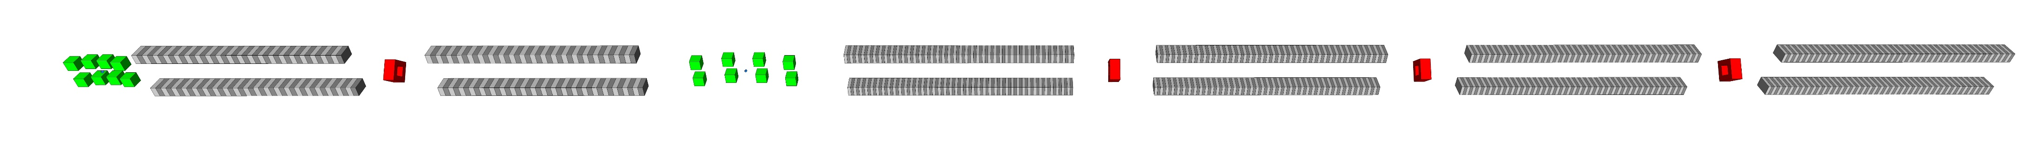
ARIA FEL Scheme: HGHG seeding
Dispersion
chicane
Modulator (λw=10cm)
Radiator (λw=5.5cm)
2 m
80 cm
2 m
2.2 m
1 T/m quad
4-dipole chicane
30 cm drifts,
10 cm 0.2-0.3 T dipoles
2 T/m quads
Laser seed:
λ₀=500 nm
λ₀=500 nm modulation
λ_{n}=50-160 nm via harmonic amplification (n=3-11)
Converts electron energy modulation to spatial bunching in harmonics Remove λ₀ radiation

Slide 14
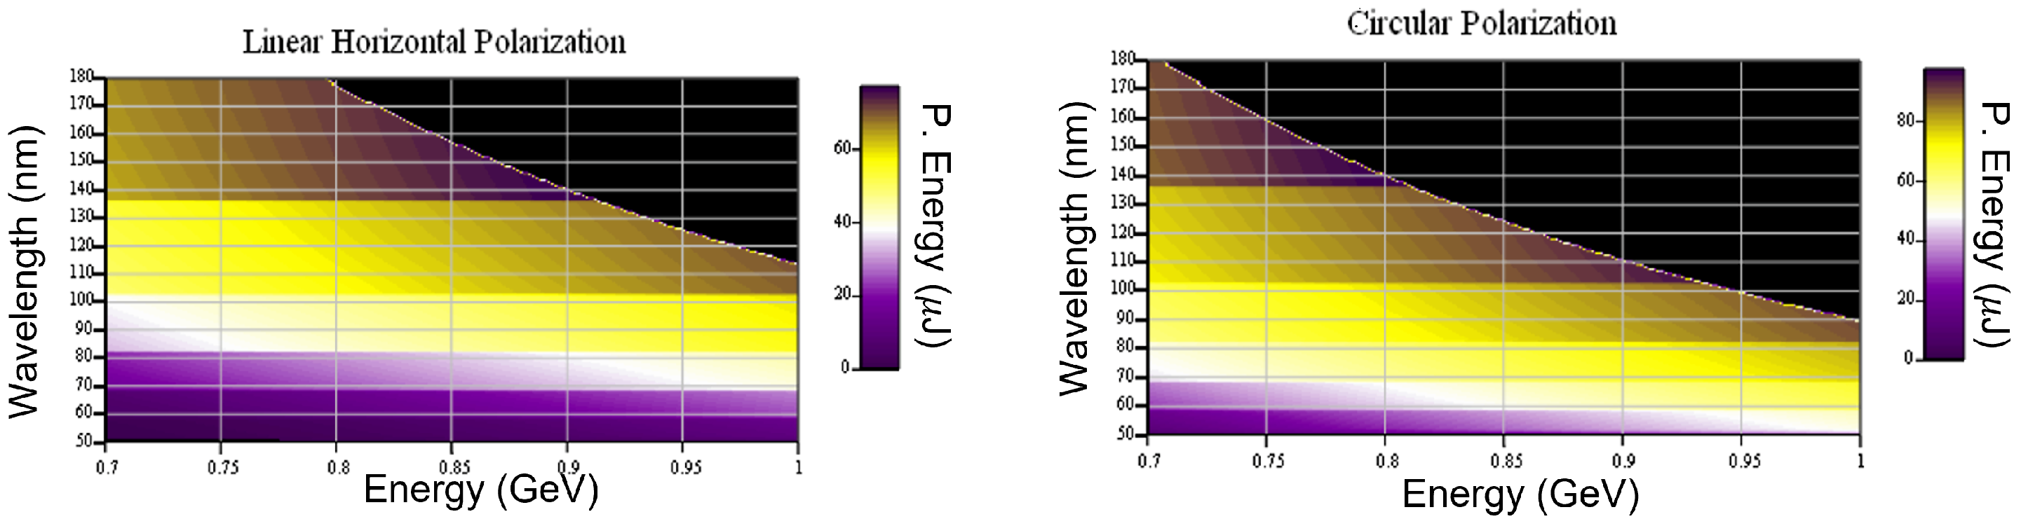
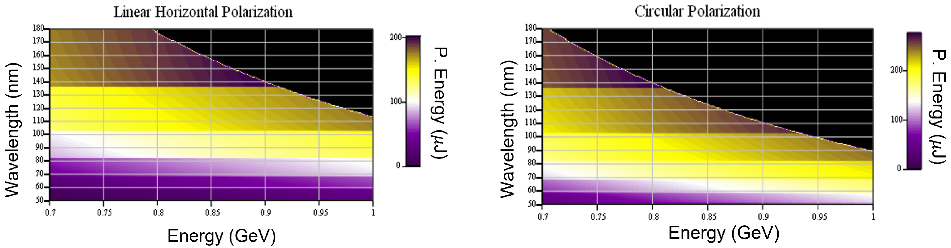
ARIA Beamline
Sim (same e- as AQUA)
Scale eq. (short bunch)
HN | 3 | 3 * | 4 | 4 * | 5 | 5 * | 7 | 9
λ (nm) | 153 | 153 | 115 | 115 | 92 | 92 | 65 | 51
Seed E (μJ) | 1.2 | 2.8 | 8 | 5.6 | 8 | 8 | 30 | 30
Photon E (μJ) | 22 | 13 | 27 | 9.5 | 24.7 | 9 | 9 | 5
FWHM Δt (fs) | 25 | 16 | 23 | 15 | 20 | 15 | 18 | 18
Ph/shot (10^13) | 1.35 | 1.02 | 1.78 | 0.73 | 1.13 | 0.55 | 0.39 | 0.08
BW (%) | 0.85 | 0.95 | 0.71 | 0.7 | 0.63 | 0.67 | 0.43 | 0.4
Pulse size (mm) | 1.2 | 1.15 | 1.11 | 1.2 | 1.17 | 1.08 | 1.07 | 0.8
Pulse div. (mrad) | 0.68 | 0.62 | 0.48 | 0.45 | 0.38 | 0.34 | 0.27 | 0.2
Scale eq. (long bunch)
Condens. Matter 2022, 7(1),11; https://doi.org/10.3390/condmat7010011
Simulations with real case parameter are ongoing

Slide 15
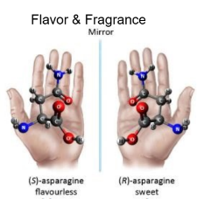
ARIA Beamline: Scientific case
Defining experimental techniques and typology of samples (and applications)
Gas phase & Atmosphere
(Earth & Planets)
Aerosols
(Pollution, nanoparticles)
Molecules & gases
(spectroscopies, time-of-flight)
Proteins
(spectroscopies)
Surfaces
(ablation & deposition)
Photoemission
Spectroscopy
Photoelectron Circular Dichroism
Raman spectroscopy
Photo-fragmentation of molecules
Time of Flight Spectroscopy

Slide 16
Timeline
Design
Tender preparation
ARIA Beamline
Tender
Procurement
Test & validation

Slide 17
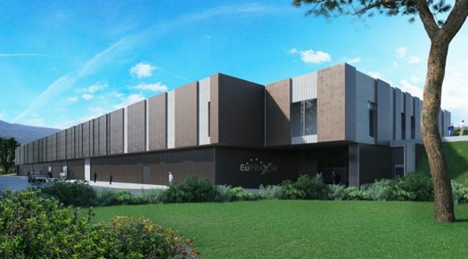
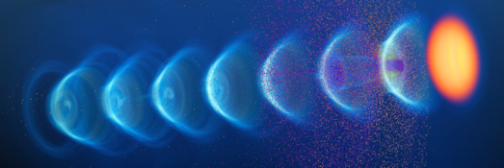
Conclusions & Acknowledgements
Plasma accelerators have advanced considerably in beam quality, achieving FEL lasing.
EuPRAXIA is a design and an ESFRI project for a distributed European Research Infrastructure, building two plasma-driven FELs in Europe.
EuPRAXIA@SPARC_LAB is mainly funded by INFN, building tender is ongoing and expected to delivery in 2029, and first FEL light is expected in 2031. In parallel, Regione Lazio is co-funding one beamline (with 10M€) that has to be accounted by end 2028.
EuPRAXIA@SPARC_LAB TDR (AQUA beamline only) is available at https://www.openaccessrepository.it/doi/10.15161/oar.it/aye3c-2cx65
Greatly appreciate slides from and discussions with THE ENTIRE EuPRAXIA@SPARC_LAB TEAM

Slide 18
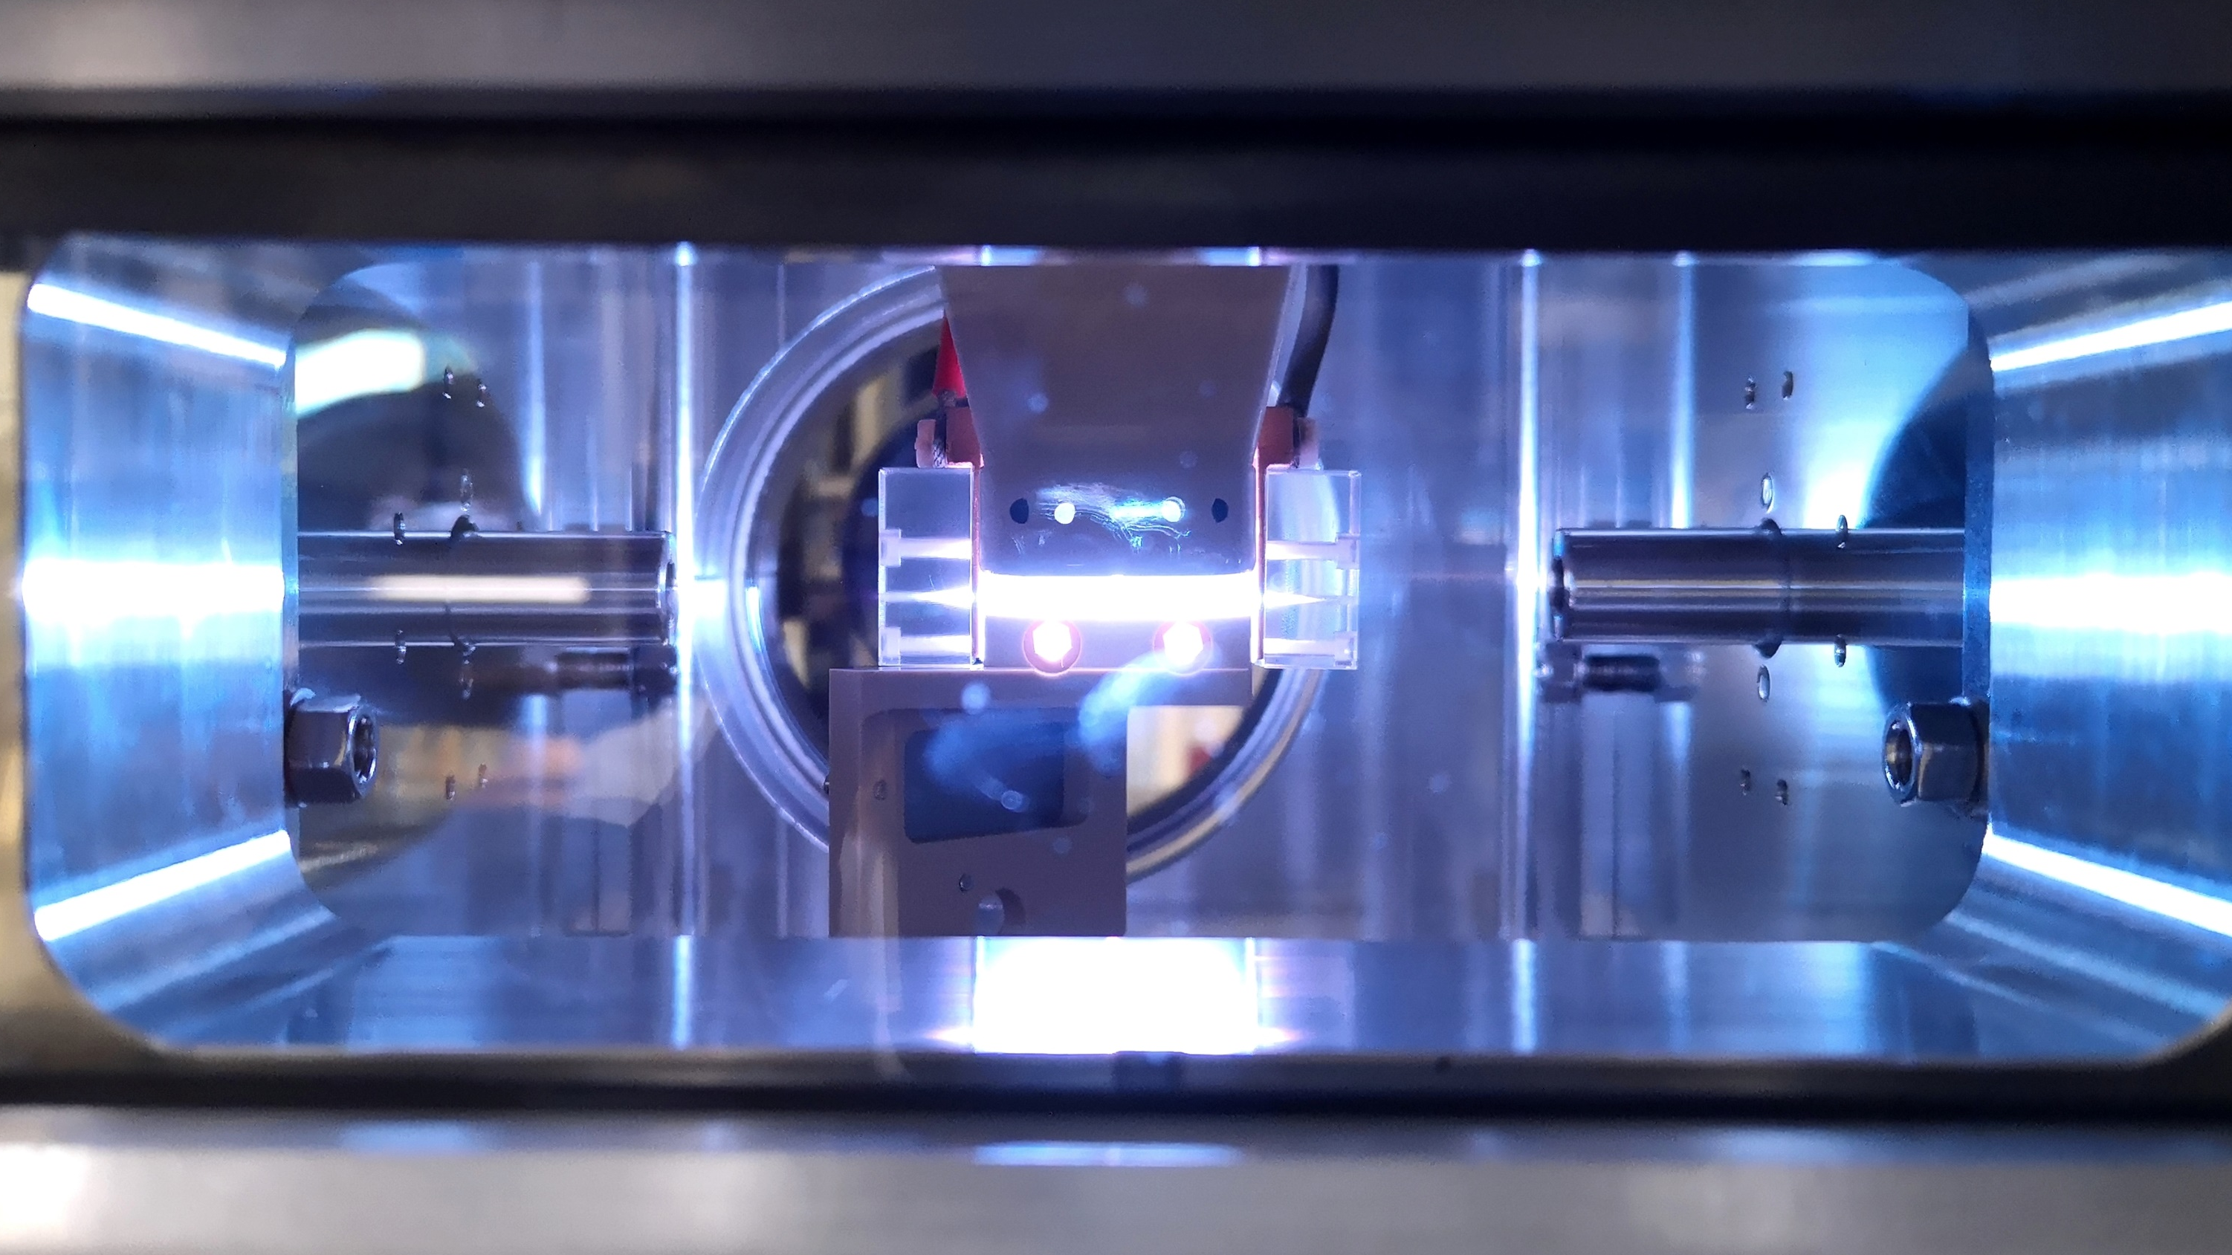
Thanks for your attention

