Slide 1
Noise simulations for Layer0-3 strip front-end
M. Manghisoni ^{a,c}, L. Ratti ^{b,c}
ª Università degli Studi di Bergamo
^{b} Università degli Studi di Pavia
^{c} INFN Pavia
SuperB FE chip phone meeting, 18/05/2012

Slide 2
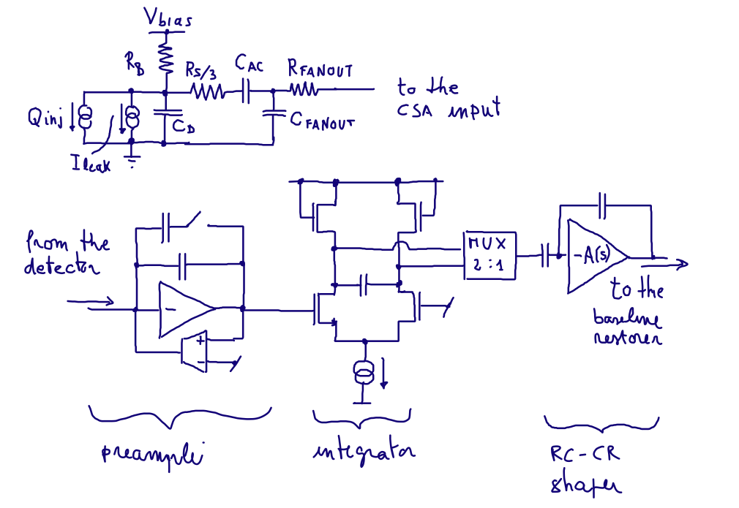
Fast front-end block diagram
Detector, bias network, readout channel
Peaking time: 25 ns t 200 ns with 25 ns step
Design of the last stages (baseline restorer, comparator) in progress

Slide 3
Summary
From page 4 to page 17: after 7.5 years of operation (only the effect on detector leakage current is considered)
From page 18 to page 31: safety factor 5 is included (equivalent to 37.5 years of operation)
8 different peaking times considered for all the layers in all the configurations (pairing, ganging) proposed by Luciano Bosisio
Data for the Layer0 not available yet (pages 4 and 18 still empty)

Slide 4
Phi-side Layer 0
 | ENC [e rms]
tp [ns] | CSA | Rf | Rs | Rb | Ileak | TOT
25
50
75
100
125
150
175
200
Without safety factor

Slide 5
Phi-side Layer 1
 | ENC [e rms]
tp [ns] | CSA | Rf | Rs | Rb | Ileak | TOT
25 | 1112 | 336 | 438 | 51 | 217 | 1262
50 | 873 | 256 | 334 | 70 | 299 | 1017
75 | 770 | 217 | 282 | 86 | 365 | 927
100 | 709 | 192 | 250 | 99 | 421 | 889
125 | 672 | 175 | 229 | 111 | 469 | 876
150 | 647 | 163 | 212 | 121 | 514 | 877
175 | 625 | 151 | 196 | 130 | 550 | 878
200 | 613 | 144 | 188 | 138 | 586 | 891
Without safety factor

Slide 6
Phi-side Layer 2
 | ENC [e rms]
tp [ns] | CSA | Rf | Rs | Rb | Ileak | TOT
25 | 1167 | 278 | 481 | 51 | 192 | 1308
50 | 918 | 212 | 367 | 70 | 265 | 1048
75 | 807 | 179 | 311 | 86 | 323 | 945
100 | 742 | 159 | 276 | 99 | 373 | 895
125 | 702 | 145 | 251 | 111 | 416 | 874
150 | 675 | 134 | 233 | 121 | 455 | 866
175 | 650 | 125 | 217 | 130 | 487 | 860
200 | 638 | 119 | 207 | 138 | 519 | 868
Without safety factor

Slide 7
Phi-side Layer 3
 | ENC [e rms]
tp [ns] | CSA | Rf | Rs | Rb | Ileak | TOT
25 | 1407 | 377 | 657 | 51 | 231 | 1615
50 | 1109 | 289 | 504 | 71 | 318 | 1294
75 | 975 | 245 | 428 | 86 | 385 | 1163
100 | 885 | 217 | 378 | 99 | 445 | 1087
125 | 831 | 198 | 346 | 111 | 495 | 1053
150 | 797 | 184 | 321 | 121 | 543 | 1041
175 | 772 | 173 | 302 | 130 | 586 | 1038
200 | 749 | 163 | 285 | 139 | 622 | 1037
Without safety factor

Slide 8
Z-side Layer 1 (ganging only)
 | ENC [e rms]
tp [ns] | CSA | Rf | Rs | Rb | Ileak | TOT
25 | 1197 | 558 | 231 | 72 | 259 | 1368
50 | 946 | 429 | 177 | 100 | 359 | 1118
75 | 829 | 362 | 150 | 122 | 437 | 1023
100 | 760 | 320 | 132 | 140 | 502 | 986
125 | 717 | 292 | 121 | 156 | 560 | 977
150 | 689 | 271 | 112 | 171 | 612 | 983
175 | 669 | 255 | 105 | 184 | 660 | 997
200 | 647 | 241 | 100 | 196 | 702 | 1009
Without safety factor

Slide 9
Z-side Layer 2 (ganging only)
 | ENC [e rms]
tp [ns] | CSA | Rf | Rs | Rb | Ileak | TOT
25 | 1262 | 606 | 288 | 50 | 221 | 1448
50 | 998 | 467 | 222 | 70 | 306 | 1167
75 | 876 | 395 | 188 | 86 | 372 | 1052
100 | 816 | 356 | 169 | 100 | 437 | 1011
125 | 760 | 320 | 152 | 111 | 480 | 973
150 | 726 | 296 | 141 | 120 | 522 | 960
175 | 703 | 278 | 132 | 130 | 563 | 961
200 | 685 | 263 | 125 | 138 | 599 | 966
Without safety factor

Slide 10
Z-side Layer 3 (ganging only)
 | ENC [e rms]
tp [ns] | CSA | Rf | Rs | Rb | Ileak | TOT
25 | 1532 | 874 | 571 | 51 | 207 | 1867
50 | 1219 | 681 | 446 | 70 | 285 | 1495
75 | 1073 | 582 | 381 | 86 | 348 | 1328
100 | 982 | 518 | 339 | 99 | 400 | 1233
125 | 923 | 474 | 310 | 111 | 447 | 1177
150 | 880 | 440 | 288 | 121 | 488 | 1142
175 | 850 | 414 | 271 | 130 | 527 | 1124
200 | 824 | 391 | 256 | 138 | 559 | 1109
Without safety factor

Slide 11
Z-side Layer 1x1 (pairing only)
 | ENC [e rms]
tp [ns] | CSA | Rf | Rs | Rb | Ileak | TOT
25 | 1004 | 405 | 99 | 51 | 184 | 1104
50 | 789 | 306 | 75 | 71 | 254 | 890
75 | 696 | 258 | 63 | 86 | 310 | 812
100 | 643 | 228 | 56 | 99 | 357 | 779
125 | 606 | 207 | 50 | 110 | 396 | 763
150 | 589 | 191 | 47 | 119 | 430 | 765
175 | 571 | 180 | 44 | 129 | 464 | 770
200 | 574 | 174 | 42 | 141 | 505 | 798
Without safety factor

Slide 12
Z-side Layer 1x2 (pairing only)
 | ENC [e rms]
tp [ns] | CSA | Rf | Rs | Rb | Ileak | TOT
25 | 911 | 247 | 99 | 72 | 260 | 987
50 | 717 | 186 | 74 | 100 | 359 | 833
75 | 634 | 157 | 63 | 122 | 437 | 798
100 | 588 | 138 | 55 | 140 | 503 | 801
125 | 561 | 126 | 50 | 156 | 561 | 820
150 | 544 | 117 | 46 | 171 | 612 | 846
175 | 533 | 110 | 44 | 184 | 660 | 877
200 | 526 | 104 | 41 | 196 | 702 | 906
Without safety factor

Slide 13
Z-side Layer 2x1 (pairing only)
 | ENC [e rms]
tp [ns] | CSA | Rf | Rs | Rb | Ileak | TOT
25 | 1038 | 431 | 123 | 36 | 157 | 1142
50 | 815 | 326 | 93 | 49 | 217 | 910
75 | 719 | 276 | 79 | 61 | 265 | 820
100 | 662 | 244 | 70 | 70 | 304 | 774
125 | 626 | 221 | 63 | 78 | 339 | 753
150 | 606 | 206 | 59 | 85 | 371 | 747
175 | 589 | 193 | 55 | 92 | 399 | 745
200 | 589 | 186 | 53 | 99 | 432 | 762
Without safety factor

Slide 14
Z-side Layer 2x2 (pairing only)
 | ENC [e rms]
tp [ns] | CSA | Rf | Rs | Rb | Ileak | TOT
25 | 956 | 274 | 124 | 51 | 222 | 1028
50 | 749 | 206 | 93 | 70 | 306 | 844
75 | 663 | 174 | 78 | 86 | 374 | 790
100 | 612 | 153 | 69 | 99 | 429 | 773
125 | 582 | 139 | 63 | 110 | 478 | 776
150 | 564 | 130 | 58 | 121 | 524 | 792
175 | 551 | 121 | 55 | 130 | 563 | 810
200 | 553 | 117 | 53 | 141 | 609 | 844
Without safety factor

Slide 15
Z-side Layer 3x1 (pairing only)
 | ENC [e rms]
tp [ns] | CSA | Rf | Rs | Rb | Ileak | TOT
25 | 1215 | 611 | 234 | 36 | 147 | 1389
50 | 954 | 466 | 178 | 50 | 202 | 1096
75 | 836 | 393 | 151 | 61 | 246 | 970
100 | 768 | 350 | 134 | 70 | 283 | 904
125 | 725 | 319 | 122 | 78 | 316 | 866
150 | 694 | 295 | 113 | 85 | 344 | 841
175 | 674 | 278 | 106 | 92 | 371 | 831
200 | 658 | 262 | 100 | 98 | 395 | 823
Without safety factor

Slide 16
Z-side Layer 3x2 (pairing only)
 | ENC [e rms]
tp [ns] | CSA | Rf | Rs | Rb | Ileak | TOT
25 | 1113 | 392 | 227 | 51 | 206 | 1221
50 | 877 | 298 | 172 | 70 | 285 | 987
75 | 772 | 252 | 146 | 86 | 348 | 900
100 | 710 | 223 | 129 | 99 | 400 | 861
125 | 671 | 203 | 118 | 110 | 446 | 847
150 | 646 | 188 | 109 | 121 | 488 | 847
175 | 627 | 176 | 102 | 130 | 524 | 852
200 | 608 | 167 | 97 | 138 | 567 | 865
Without safety factor

Slide 17
Z-side Layer 3x3 (pairing only)
 | ENC [e rms]
tp [ns] | CSA | Rf | Rs | Rb | Ileak | TOT
25 | 1136 | 334 | 231 | 62 | 253 | 1235
50 | 891 | 253 | 175 | 86 | 349 | 1009
75 | 782 | 223 | 148 | 105 | 426 | 936
100 | 720 | 190 | 131 | 120 | 490 | 909
125 | 681 | 173 | 119 | 135 | 547 | 908
150 | 654 | 160 | 110 | 147 | 597 | 920
175 | 635 | 150 | 103 | 158 | 642 | 935
200 | 623 | 142 | 98 | 169 | 685 | 957
Without safety factor

Slide 18
Phi-side Layer 0
 | ENC [e rms]
tp [ns] | CSA | Rf | Rs | Rb | Ileak | TOT
25
50
75
100
125
150
175
200
With safety factor = 5

Slide 19
Phi-side Layer 1
 | ENC [e rms]
tp [ns] | CSA | Rf | Rs | Rb | Ileak | TOT
25 | 1112 | 336 | 438 | 51 | 485 | 1334
50 | 873 | 256 | 334 | 70 | 668 | 1180
75 | 770 | 217 | 282 | 86 | 816 | 1180
100 | 709 | 192 | 250 | 99 | 941 | 1224
125 | 672 | 175 | 229 | 111 | 1048 | 1283
150 | 647 | 163 | 212 | 121 | 1149 | 1352
175 | 625 | 151 | 196 | 130 | 1229 | 1407
200 | 613 | 144 | 188 | 138 | 1311 | 1473
With safety factor = 5

Slide 20
Phi-side Layer 2
 | ENC [e rms]
tp [ns] | CSA | Rf | Rs | Rb | Ileak | TOT
25 | 1167 | 278 | 481 | 51 | 430 | 1363
50 | 918 | 212 | 367 | 70 | 593 | 1175
75 | 807 | 179 | 311 | 86 | 723 | 1145
100 | 742 | 159 | 276 | 99 | 834 | 1165
125 | 702 | 145 | 251 | 111 | 931 | 1207
150 | 675 | 134 | 233 | 121 | 1018 | 1257
175 | 650 | 125 | 217 | 130 | 1089 | 1299
200 | 638 | 119 | 207 | 138 | 1162 | 1354
With safety factor = 5

Slide 21
Phi-side Layer 3
 | ENC [e rms]
tp [ns] | CSA | Rf | Rs | Rb | Ileak | TOT
25 | 1407 | 377 | 657 | 51 | 517 | 1680
50 | 1109 | 289 | 504 | 71 | 712 | 1443
75 | 975 | 245 | 428 | 86 | 863 | 1395
100 | 885 | 217 | 378 | 99 | 995 | 1405
125 | 831 | 198 | 346 | 111 | 1108 | 1446
150 | 797 | 184 | 321 | 121 | 1215 | 1505
175 | 772 | 173 | 302 | 130 | 1311 | 1566
200 | 749 | 163 | 285 | 139 | 1392 | 1621
With safety factor = 5

Slide 22
Z-side Layer 1 (ganging only)
 | ENC [e rms]
tp [ns] | CSA | Rf | Rs | Rb | Ileak | TOT
25 | 1197 | 558 | 231 | 72 | 580 | 1463
50 | 946 | 429 | 177 | 100 | 804 | 1329
75 | 829 | 362 | 150 | 122 | 977 | 1346
100 | 760 | 320 | 132 | 140 | 1124 | 1408
125 | 717 | 292 | 121 | 156 | 1254 | 1487
150 | 689 | 271 | 112 | 171 | 1370 | 1571
175 | 669 | 255 | 105 | 184 | 1476 | 1655
200 | 647 | 241 | 100 | 196 | 1571 | 1730
With safety factor = 5

Slide 23
Z-side Layer 2 (ganging only)
 | ENC [e rms]
tp [ns] | CSA | Rf | Rs | Rb | Ileak | TOT
25 | 1262 | 606 | 288 | 50 | 494 | 1514
50 | 998 | 467 | 222 | 70 | 685 | 1318
75 | 876 | 395 | 188 | 86 | 833 | 1289
100 | 816 | 356 | 169 | 100 | 977 | 1337
125 | 760 | 320 | 152 | 111 | 1073 | 1367
150 | 726 | 296 | 141 | 120 | 1168 | 1419
175 | 703 | 278 | 132 | 130 | 1259 | 1481
200 | 685 | 263 | 125 | 138 | 1339 | 1539
With safety factor = 5

Slide 24
Z-side Layer 3 (ganging only)
 | ENC [e rms]
tp [ns] | CSA | Rf | Rs | Rb | Ileak | TOT
25 | 1532 | 874 | 571 | 51 | 463 | 1912
50 | 1219 | 681 | 446 | 70 | 638 | 1600
75 | 1073 | 582 | 381 | 86 | 778 | 1499
100 | 982 | 518 | 339 | 99 | 896 | 1470
125 | 923 | 474 | 310 | 111 | 1000 | 1478
150 | 880 | 440 | 288 | 121 | 1092 | 1503
175 | 850 | 414 | 271 | 130 | 1178 | 1541
200 | 824 | 391 | 256 | 138 | 1251 | 1575
With safety factor = 5

Slide 25
Z-side Layer 1x1 (pairing only)
 | ENC [e rms]
tp [ns] | CSA | Rf | Rs | Rb | Ileak | TOT
25 | 1004 | 405 | 99 | 51 | 413 | 1164
50 | 789 | 306 | 75 | 71 | 569 | 1025
75 | 696 | 258 | 63 | 86 | 694 | 1022
100 | 643 | 228 | 56 | 99 | 800 | 1058
125 | 606 | 207 | 50 | 110 | 885 | 1099
150 | 589 | 191 | 47 | 119 | 961 | 1151
175 | 571 | 180 | 44 | 129 | 1039 | 1207
200 | 574 | 174 | 42 | 141 | 1131 | 1289
With safety factor = 5

Slide 26
Z-side Layer 1x2 (pairing only)
 | ENC [e rms]
tp [ns] | CSA | Rf | Rs | Rb | Ileak | TOT
25 | 911 | 247 | 99 | 72 | 582 | 1116
50 | 717 | 186 | 74 | 100 | 803 | 1100
75 | 634 | 157 | 63 | 122 | 978 | 1184
100 | 588 | 138 | 55 | 140 | 1125 | 1287
125 | 561 | 126 | 50 | 156 | 1254 | 1390
150 | 544 | 117 | 46 | 171 | 1369 | 1489
175 | 533 | 110 | 44 | 184 | 1477 | 1585
200 | 526 | 104 | 41 | 196 | 1570 | 1671
With safety factor = 5

Slide 27
Z-side Layer 2x1 (pairing only)
 | ENC [e rms]
tp [ns] | CSA | Rf | Rs | Rb | Ileak | TOT
25 | 1038 | 431 | 123 | 36 | 352 | 1185
50 | 814 | 326 | 93 | 49 | 485 | 1008
75 | 719 | 276 | 79 | 61 | 593 | 977
100 | 662 | 244 | 70 | 70 | 680 | 985
125 | 626 | 221 | 63 | 78 | 758 | 1013
150 | 606 | 206 | 59 | 85 | 830 | 1054
175 | 589 | 193 | 55 | 92 | 892 | 1092
200 | 589 | 186 | 53 | 99 | 966 | 1152
With safety factor = 5

Slide 28
Z-side Layer 2x2 (pairing only)
 | ENC [e rms]
tp [ns] | CSA | Rf | Rs | Rb | Ileak | TOT
25 | 956 | 274 | 124 | 51 | 498 | 1120
50 | 749 | 206 | 93 | 70 | 685 | 1043
75 | 663 | 174 | 78 | 86 | 836 | 1088
100 | 612 | 153 | 69 | 99 | 960 | 1156
125 | 582 | 139 | 63 | 110 | 1069 | 1232
150 | 564 | 130 | 58 | 121 | 1172 | 1314
175 | 551 | 121 | 55 | 130 | 1259 | 1387
200 | 553 | 117 | 53 | 141 | 1362 | 1482
With safety factor = 5

Slide 29
Z-side Layer 3x1 (pairing only)
 | ENC [e rms]
tp [ns] | CSA | Rf | Rs | Rb | Ileak | TOT
25 | 1215 | 611 | 234 | 36 | 329 | 1420
50 | 954 | 466 | 178 | 50 | 452 | 1169
75 | 836 | 393 | 151 | 61 | 550 | 1087
100 | 768 | 350 | 134 | 70 | 634 | 1067
125 | 725 | 319 | 122 | 78 | 708 | 1073
150 | 694 | 295 | 113 | 85 | 771 | 1088
175 | 674 | 278 | 106 | 92 | 831 | 1115
200 | 658 | 262 | 100 | 98 | 884 | 1142
With safety factor = 5

Slide 30
Z-side Layer 3x2 (pairing only)
 | ENC [e rms]
tp [ns] | CSA | Rf | Rs | Rb | Ileak | TOT
25 | 1113 | 392 | 227 | 51 | 462 | 1289
50 | 877 | 298 | 172 | 70 | 637 | 1140
75 | 772 | 252 | 146 | 86 | 779 | 1138
100 | 710 | 223 | 129 | 99 | 895 | 1176
125 | 671 | 203 | 118 | 110 | 998 | 1231
150 | 646 | 188 | 109 | 121 | 1091 | 1292
175 | 627 | 176 | 102 | 130 | 1172 | 1352
200 | 608 | 167 | 97 | 138 | 1269 | 1427
With safety factor = 5

Slide 31
Z-side Layer 3x3 (pairing only)
 | ENC [e rms]
tp [ns] | CSA | Rf | Rs | Rb | Ileak | TOT
25 | 1136 | 334 | 231 | 62 | 567 | 1335
50 | 891 | 253 | 175 | 86 | 780 | 1227
75 | 782 | 223 | 148 | 105 | 954 | 1267
100 | 720 | 190 | 131 | 120 | 1096 | 1337
125 | 681 | 173 | 119 | 135 | 1223 | 1422
150 | 654 | 160 | 110 | 147 | 1336 | 1508
175 | 635 | 150 | 103 | 158 | 1436 | 1589
200 | 623 | 142 | 98 | 169 | 1532 | 1672
With safety factor = 5

