Slide 1
SuperB Nagios Monitoring
Alessandro Paolini
INFN-CNAF

Slide 2
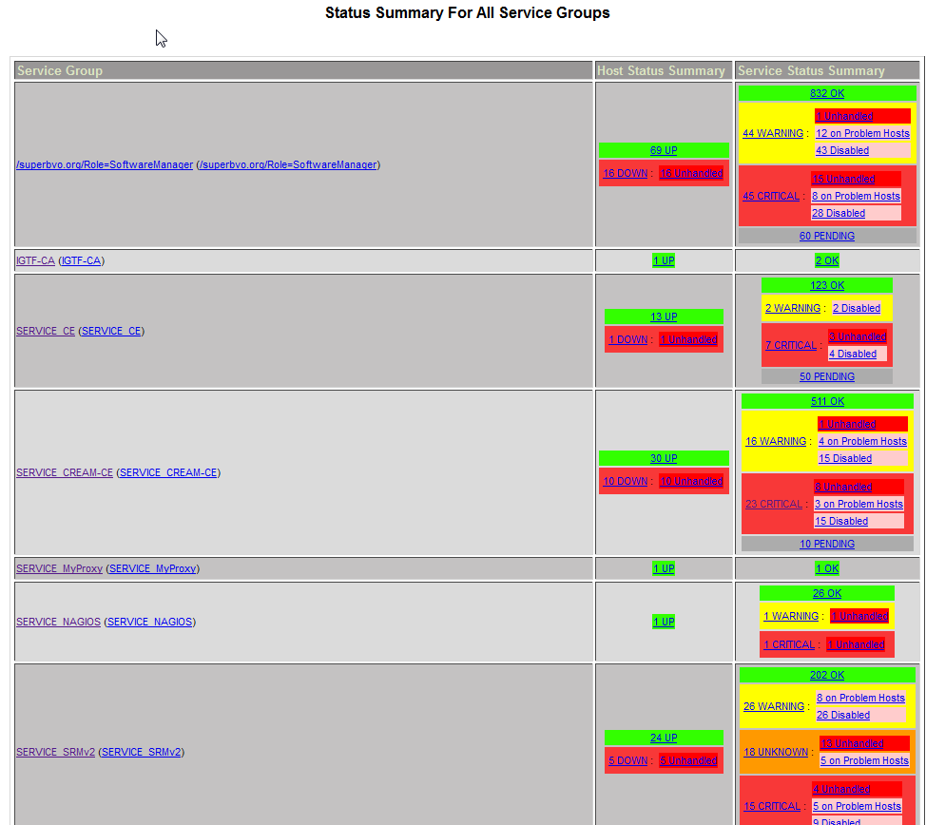
Monitoring
Sites status is monitored with NAGIOS:
https://sb-serv01.cr.cnaf.infn.it/nagios/
Checks performed on lcg-CE, CREAM-CE and SRM
tool provided by EGI project

Slide 3
Monitoring
The SuperB nagios server is hosted by INFN-T1 in the Italian NGI (NGI_IT) and the monitored sites are the ones included in this xml feed file:
http://bbr-serv09.cr.cnaf.infn.it:8080/nagiosvo/superb-sites-for-nagios.xml
The EGI Standard checks are executed:
Job submission (direct to CREAM and through WMS), replicas test from WNs to SRM and directly on SRM
It will be added specific superbvo.org checks
What is monitored is the service, not the host
each check is perfomed using GRID stuff

Slide 4
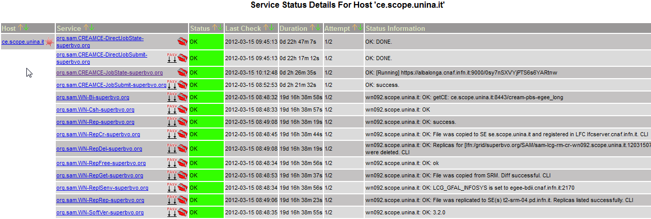
Monitoring
CREAM direct job submission
WMS job submission
Replicas test from WN
SRM direct checks

Slide 5
Monitoring
The sites status is stored in an external DB
Every time a service status changes, a nagios plugin updates this DB
The information present in this DB are used by SuperB Framework to prevent the production job submission to problematic sites
Wiki: http://mailman.fe.infn.it/superbwiki/index.php/Distributed_Computing/VO_nagios_monitoring

Slide 6
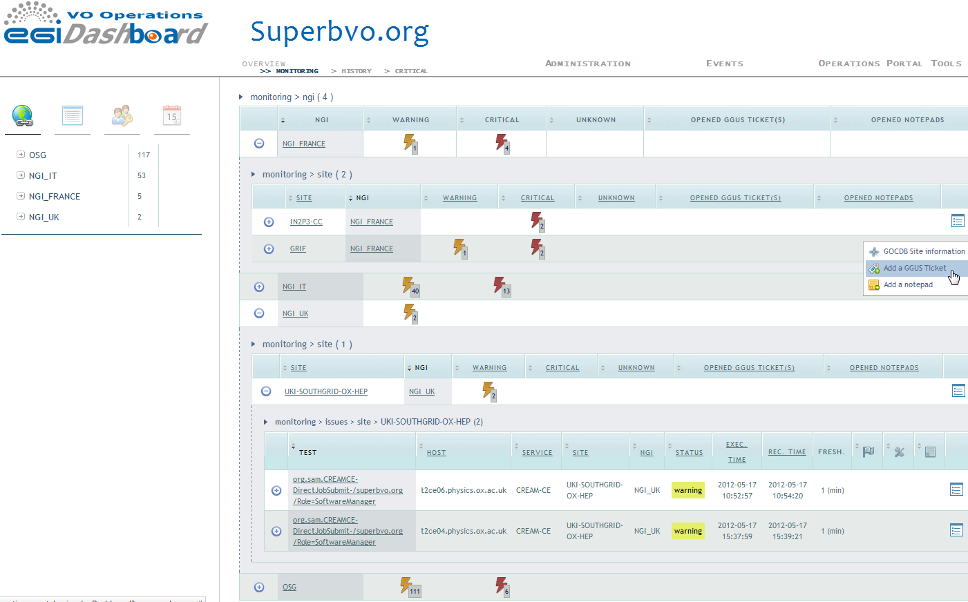
VO Dashboard

Slide 7
VO Dashboard
Tool provided by Operations Portal Team
https://operations-portal.egi.eu/voDashboard?vo=superbvo.org
Access only for registered people (several roles available)
It receive notifications by nagios
It is displayed alarms related to failing checks for the monitored sites
Sites are grouped by NGI
Opening GGUS tickets for not working sites and problems follow-up

