Slide 1

44th LNF Scientific Committee Meeting
June 4th, 2012
Mission of SPARC_LAB is primarily to integrate and harmonize all the existing activities at the test-facility, coordinate commissioning, operation and upgrade of the experiments, stimulate research and development and submissions of proposals for experiments to be performed at the SPARC_LAB test-facility.
Enrica Chiadroni
on behalf of the SPARC_LAB collaboration

Slide 2
Outline
INTRODUCTION
  The SPARC_LAB Facility: FLAME laser and SPARC injector
    Layout
    Goals and achievements
    Activities
INSTALLATION STATUS
  THz beamlines (TERASPARC)
  Interaction chamber (EXIN and THOMSON)
  Electro Optical Sampling and Cavity BPM (COMB)
STATUS OF THE EXPERIMENTS
  FEL studies
  THz source characterization
  Advanced beam dynamics experiments
  Laser-based condensation experiment
ONGOING ACTIVITIES
  ELI – NP Proposal
  Electron beam energy upgrade
  Electron and photons synchronization upgrade
  Short period undulator experiments
44th LNF SC Meeting, June 4th, 2012

Slide 3
introduction
44th LNF SC Meeting, June 4th, 2012

Slide 4
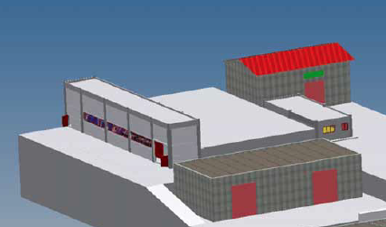





The SPARC_LAB Facility
SPARC_LAB is a facility based on the unique combination of high brightness electron beams, from the SPARC photo-injector, with high intensity ultra-short laser pulses, from FLAME. It will allow the investigation of all the different configurations of plasma acceleration and the development of a wide spectrum inter-disciplinary leading-edge research activity with advanced radiation sources, e.g. x-ray and THz radiation.
FLAME
Klystrons
Control
Room
SPARC Bunker
Experimental Hall
(Next future ??)
44th LNF SC Meeting, June 4th, 2012

Slide 5
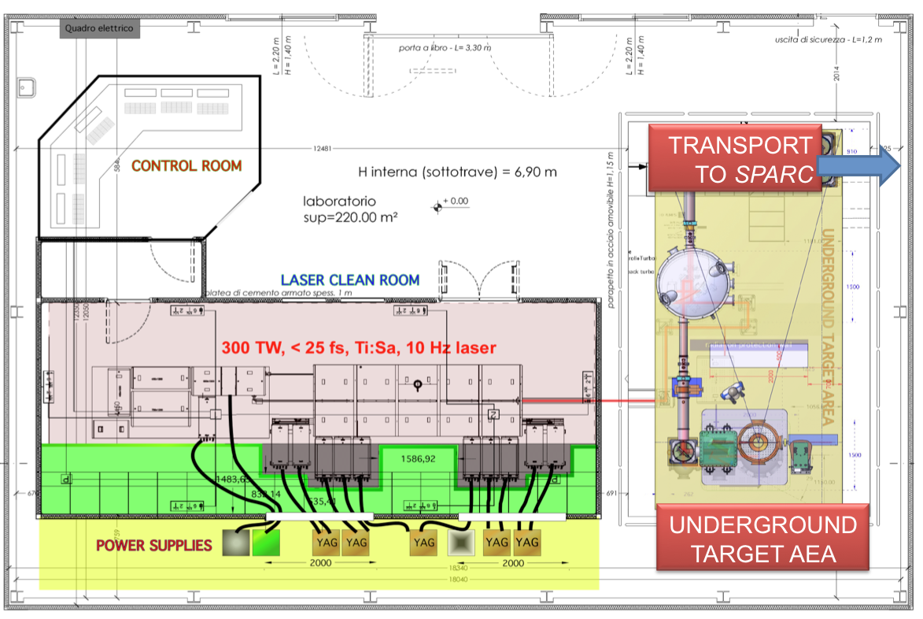
FLAME: a 300 TW Ti:Sa Laser
44th LNF SC Meeting, June 4th, 2012

Slide 6
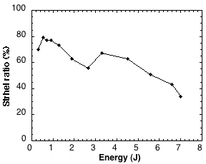
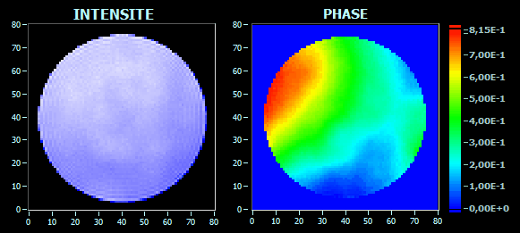
Status and Achievements
Among the different uses of FLAME, the scientific program includes self-injection and external injection experiments and the realization of an X-ray source based on the Thomson backscattering.
A careful characterization of FLAME performances was carried out during the commissioning, with particular attention to the transverse beam quality.
The phase front pattern remains very stable from shot to shot at a given pulse energy
➔ Phase front correction with adaptive optics will allow to achieve a high quality focal spot (by the end of 2012)
44th LNF SC Meeting, June 4th, 2012

Slide 7
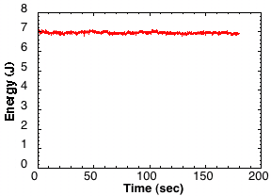
FLAME Performances (to date)
Energy stability plot at 7J output over 180 sec.
Energy before compression @ 7.3 J
Vacuum compressor transmission > 70%
Pulse duration down to 23 fs
ASE Contrast ratio: better than 2x10⁹
Pre-Pulse Contrast better than 10⁸
RMS Pulse Stability @ 0.8%
Pointing Stability (incl. Path) < 2μrad
Phase front correction needed – adaptive optics
Full power vacuum compression to be performed
44th LNF SC Meeting, June 4th, 2012

Slide 8
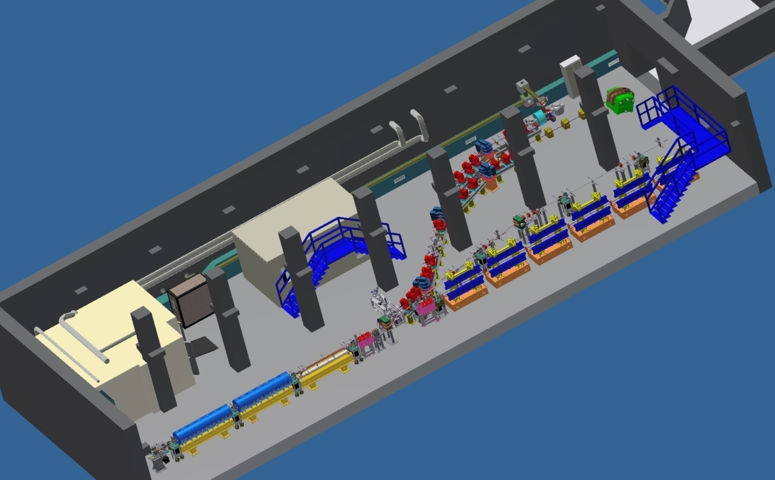
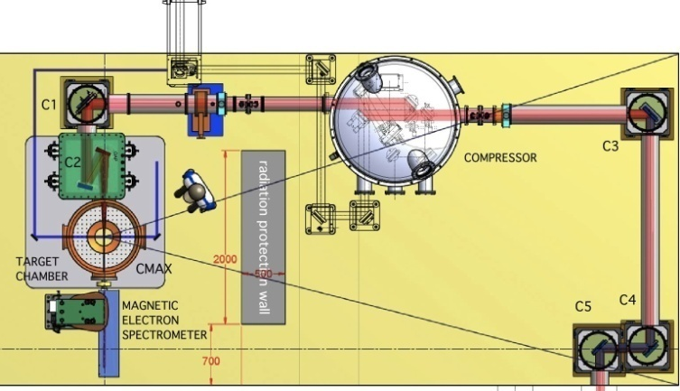
Highlight:
Laser assisted condensation experiment in the cloud chamber: Phase 1
M. Petrarca, S. Henin, P. Joly, J. Kasparian and Prof J-P Wolf, GAP University of Geneva
G. Gatti, M. Anania, M. Ferrario, A. Ghigo, LNF-INFN
A. Vogel, K. Weber, FH Dusseldorf
S. Henin et al., Field measurements suggest the mechanism of laser-assisted water condensation
Nature Comm. DOI: 10.1038/ncomms1462 (2011)
44th LNF SC Meeting, June 4th, 2012

Slide 9
Highlight:
Laser assisted condensation experiment in the cloud chamber: Phase 1
Laser based condensation process at high energy but low power (2.5J, 0.5TW) has been investigated. The preliminary data show more than a linear scaling of particles generation with laser power that could lead to macroscopic effects in real atmosphere. Complementary measurements are required.
The experimental area is very favorable: laser and bunker atmosphere are stable and allows to collect about 4points/hour at required relative humidity and temperature setting (85% Relative Humidity and 10°C) of the cloud chamber.
Beam profile in air
0.5TW, t=4ps FWHM
Strong filament
Weak filament
44th LNF SC Meeting, June 4th, 2012

Slide 10
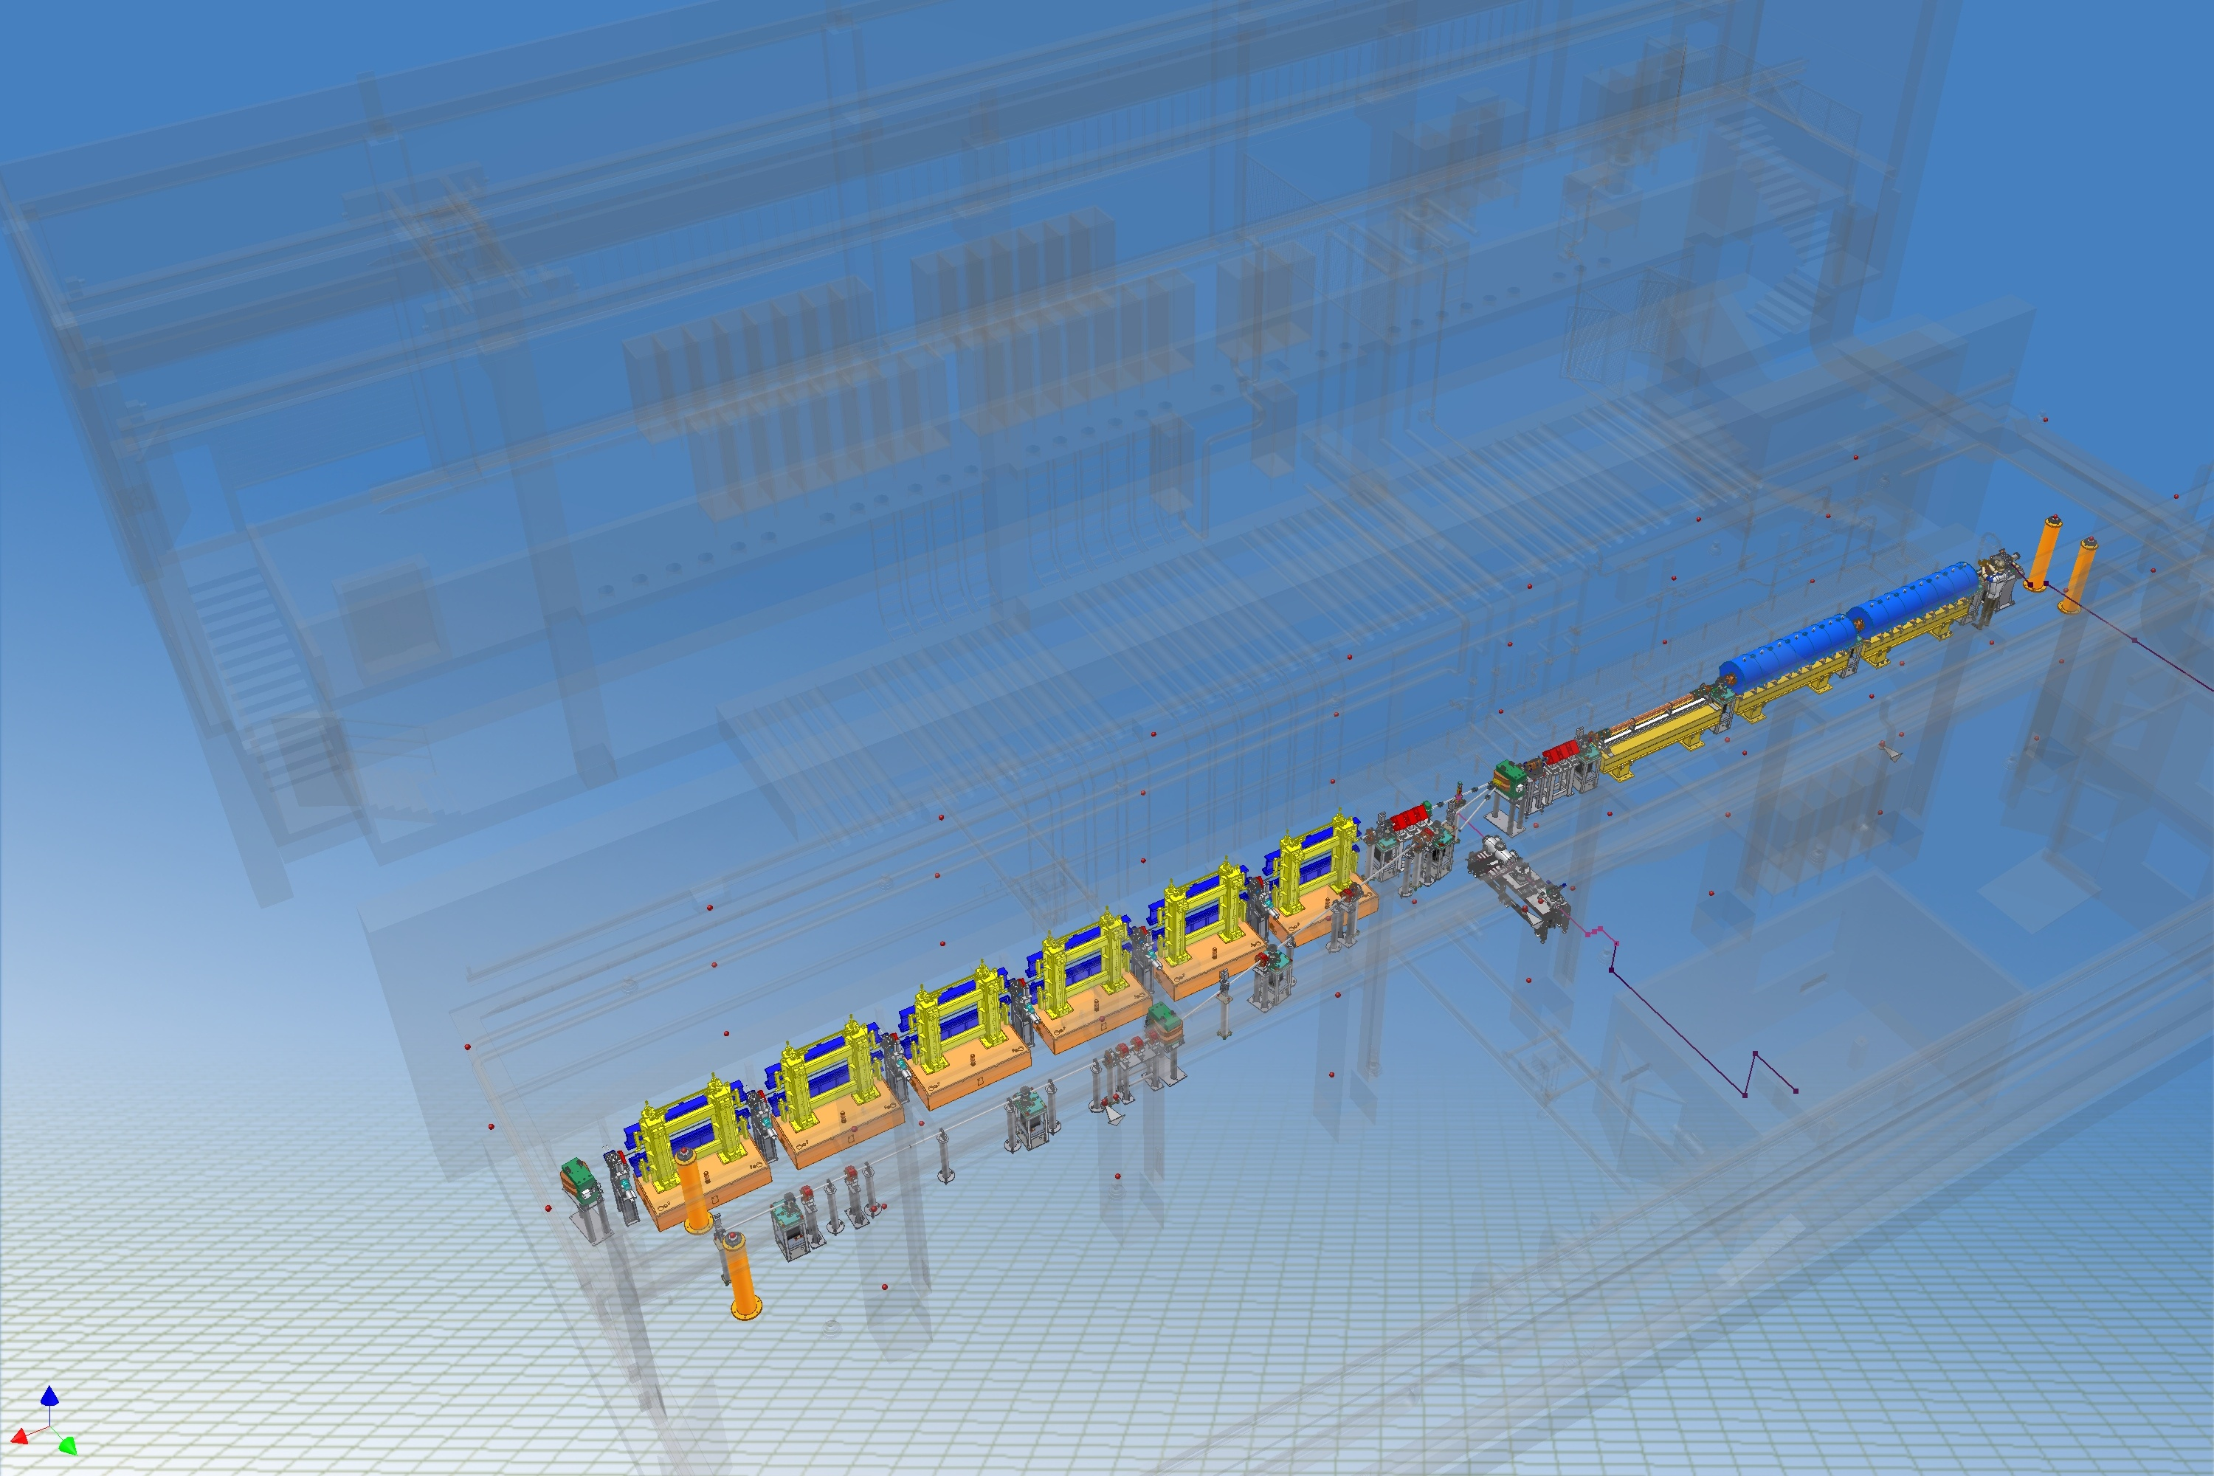



SPARC Photoinjector
170 MeV S-band linac
Velocity Bunching
Diagnostic and Matching
12 m
S-band Gun
Long Solenoids
44th LNF SC Meeting, June 4th, 2012

Slide 11
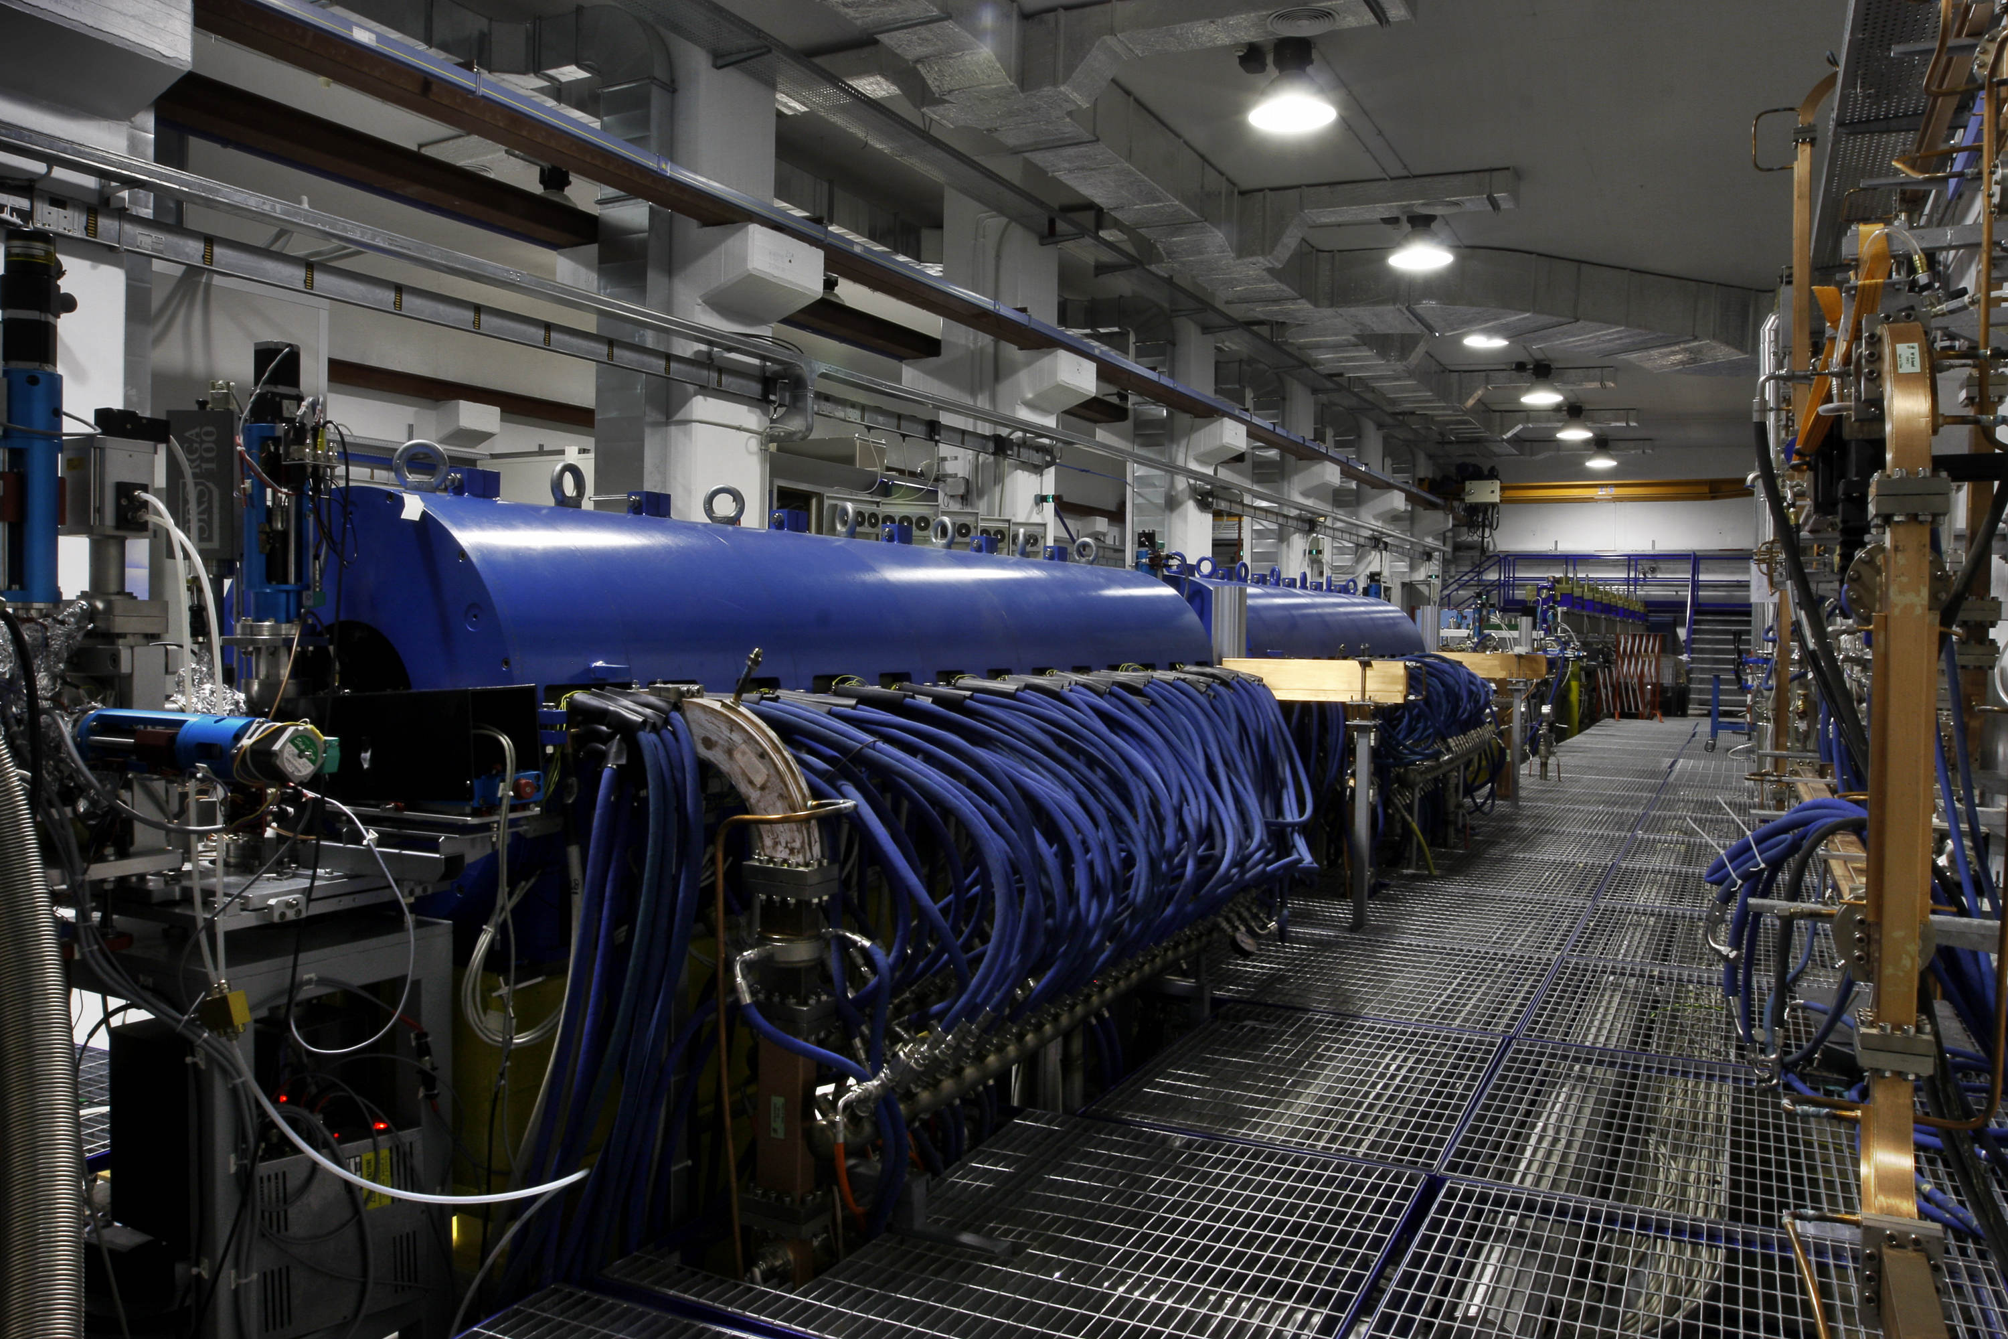
SPARC Photoinjector
C_Band driver
THz Radiation
Velocity Bunching
LWFA_ext
THz Radiation
LASER COMB
PWFA
DWFA
FEL
Thomson
FEL Single Spike
44th LNF SC Meeting, June 4th, 2012

Slide 12
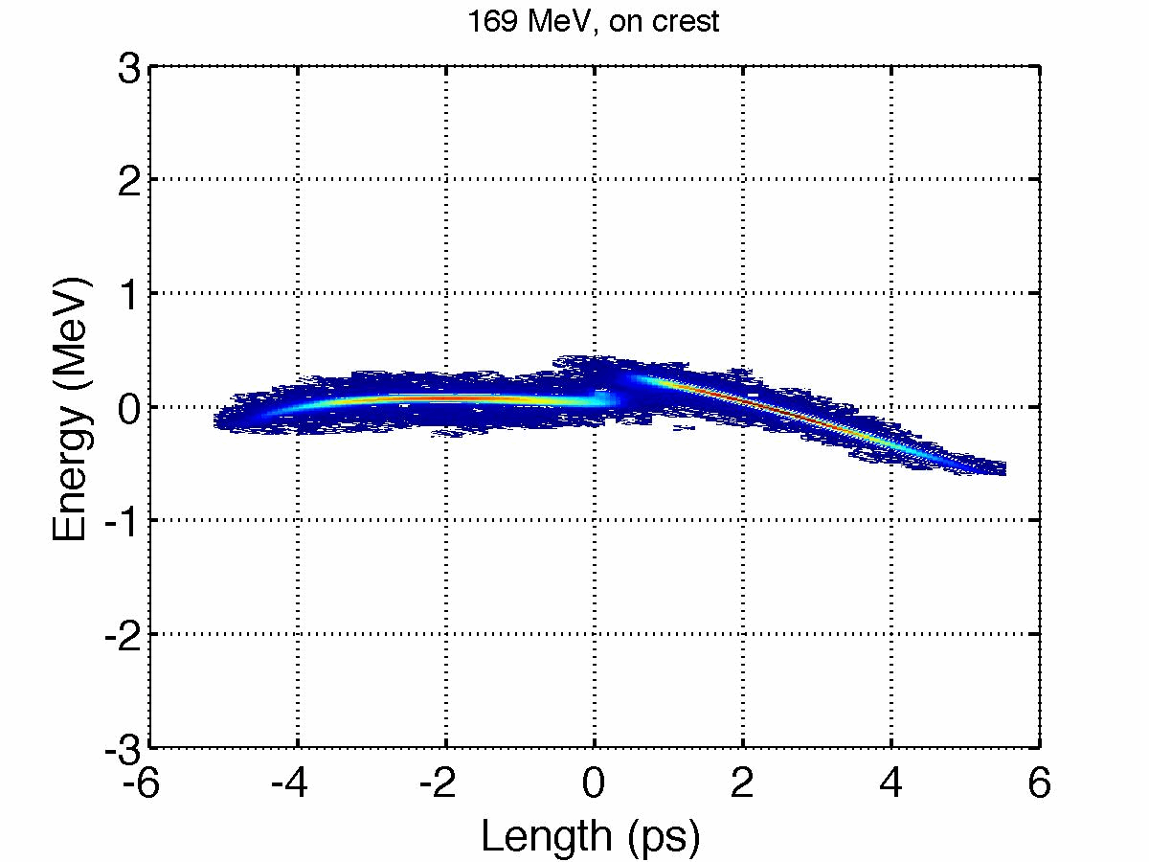
Status and Achievements:
2-Bunches Comb Beam
Measurements with 200pC, 300pC, 400pC bunch train.
Gun energy 5.6MeV
Charge 150pC/150pC
Energy 169-109 MeV
Energy Spread <0.7%
Bunch length on crest
2.505 (0.010) ps
Min. bunch length
244 (11) fs
Gun ext. phase
35 deg
44th LNF SC Meeting, June 4th, 2012

Slide 13
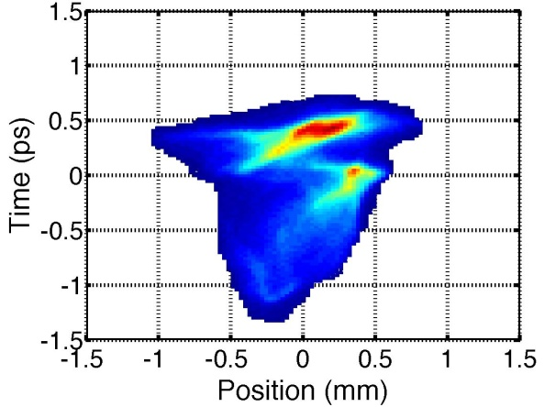

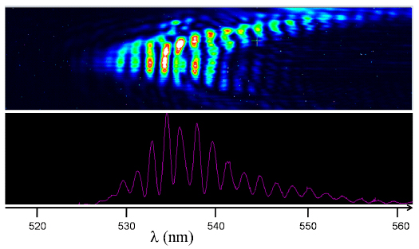
Status and Achievements:
FEL Light from a 2-Bunches Comb Beam
Charge 90pC/90pC
Bunch Separation (from RFD)
0.8091 (0.053)ps
0.62 (0.16)ps
44th LNF SC Meeting, June 4th, 2012

Slide 14
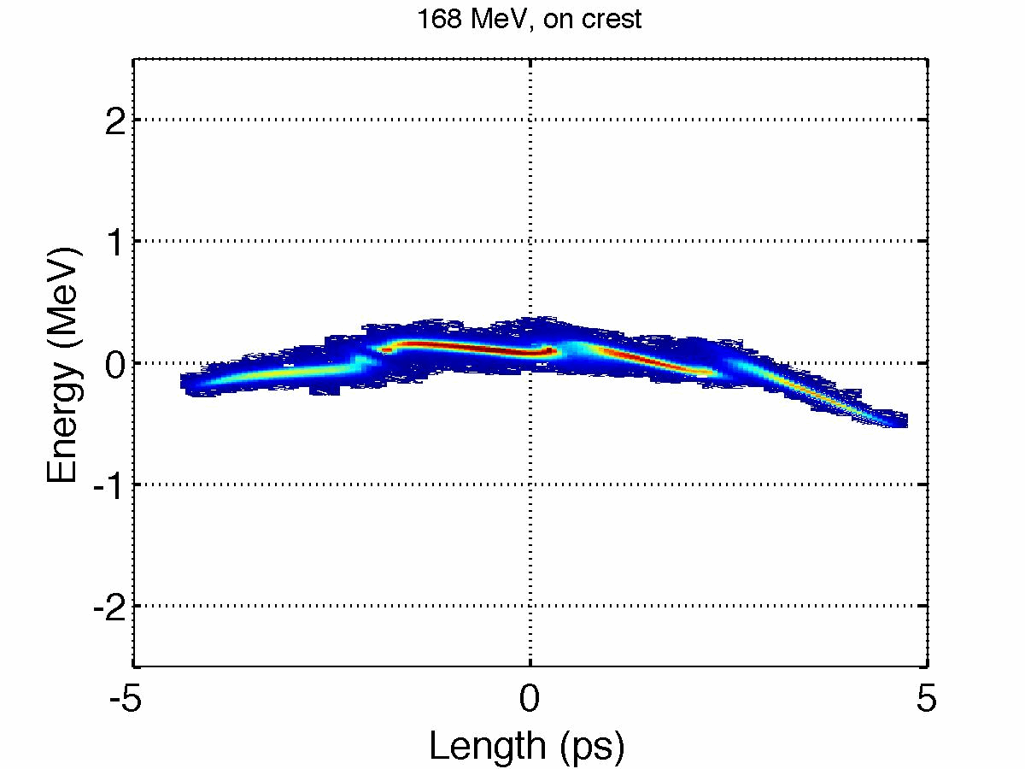
Status and Achievements:
4-Bunches Comb Beam
Measurements with 200pC
Gun energy 5.7MeV
Charge
40pC/80pC/50pC/30pC
Energy 168-109 MeV
Energy Spread <0.8%
Bunch length on crest
2126.3 (8.7) fs
Min. bunch length
168.2 (8.7) fs
Gun ext. phase
35 deg
44th LNF SC Meeting, June 4th, 2012

Slide 15
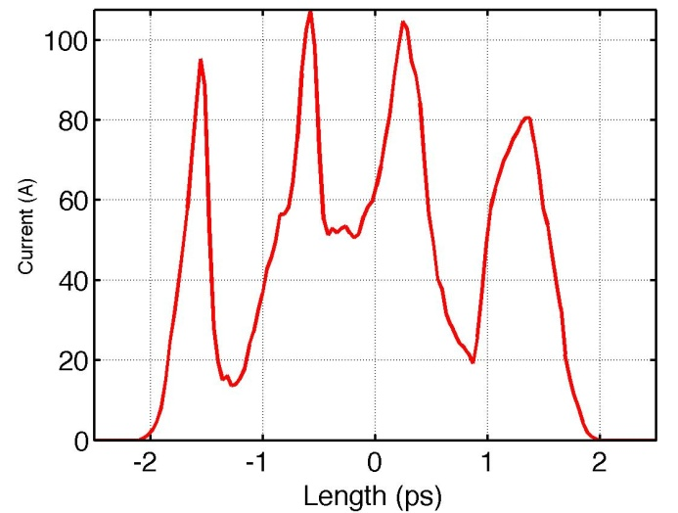
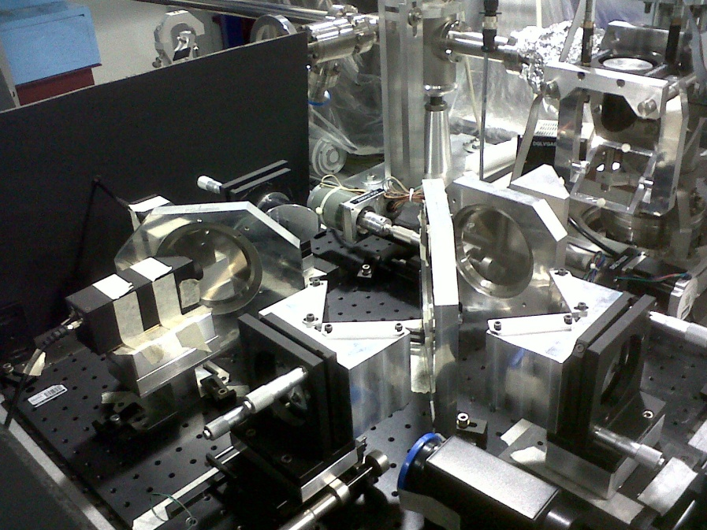
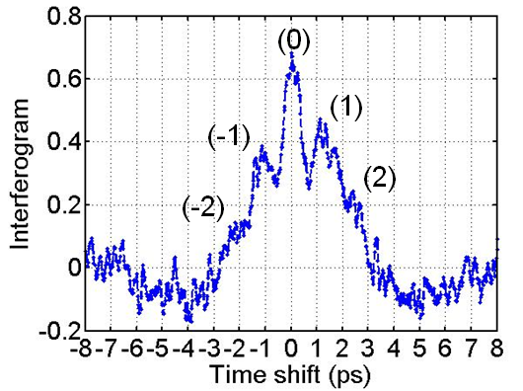
Status and Achievements:
Narrow band THz radiation
The source is Coherent Transition Radiation (CTR) from an aluminum-coated silicon screen.
Martin-Pupplet
Interferometer
E. Chiadroni et al.,
J.Phys.Conf.Ser. 359, 012018 (2012).
E. Chiadroni et al.,
J.Phys.Conf.Ser. 357, 012034 (2012).
44th LNF SC Meeting, June 4th, 2012

Slide 16
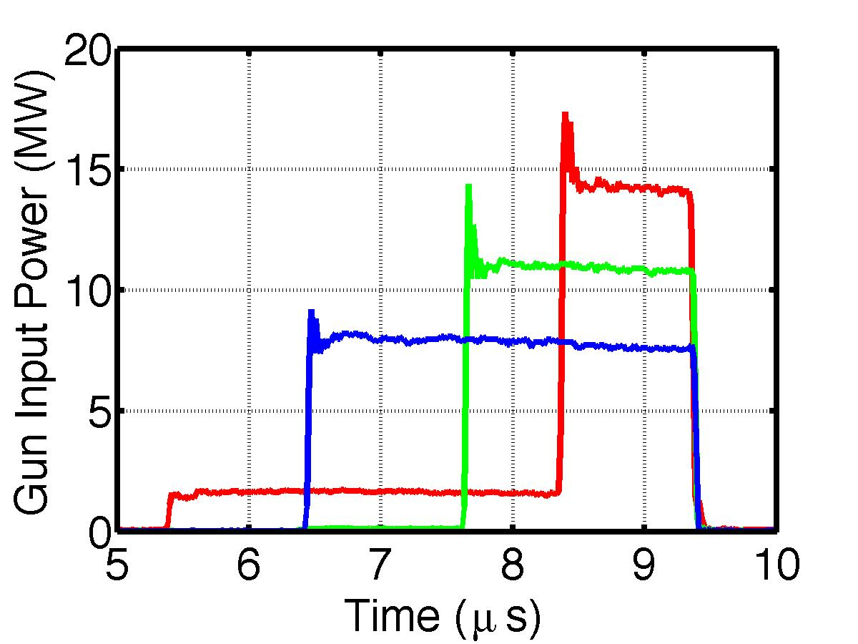
Performance Improvements
Beam energy at the gun exit
14 MW - 130 MV/m – 6.2 MeV
11 MW - 115 MV/m – 5.1 MeV
M. Bellaveglia, D. Alesini, M. Ferrario, A. Gallo, SPARC-RF-12/001, July 07, 2011.
7.5 MW - 95 MV/m – 4.4 MeV
3 μs
1 μs
1.7 μs
    Peak brightness improved of a factor 2.6.
Machine stability
3 μs
    Locking the RF synchronization to the laser master clock, we achieved a machine jitter stability < 150fs_{RMS}
44th LNF SC Meeting, June 4th, 2012

Slide 17
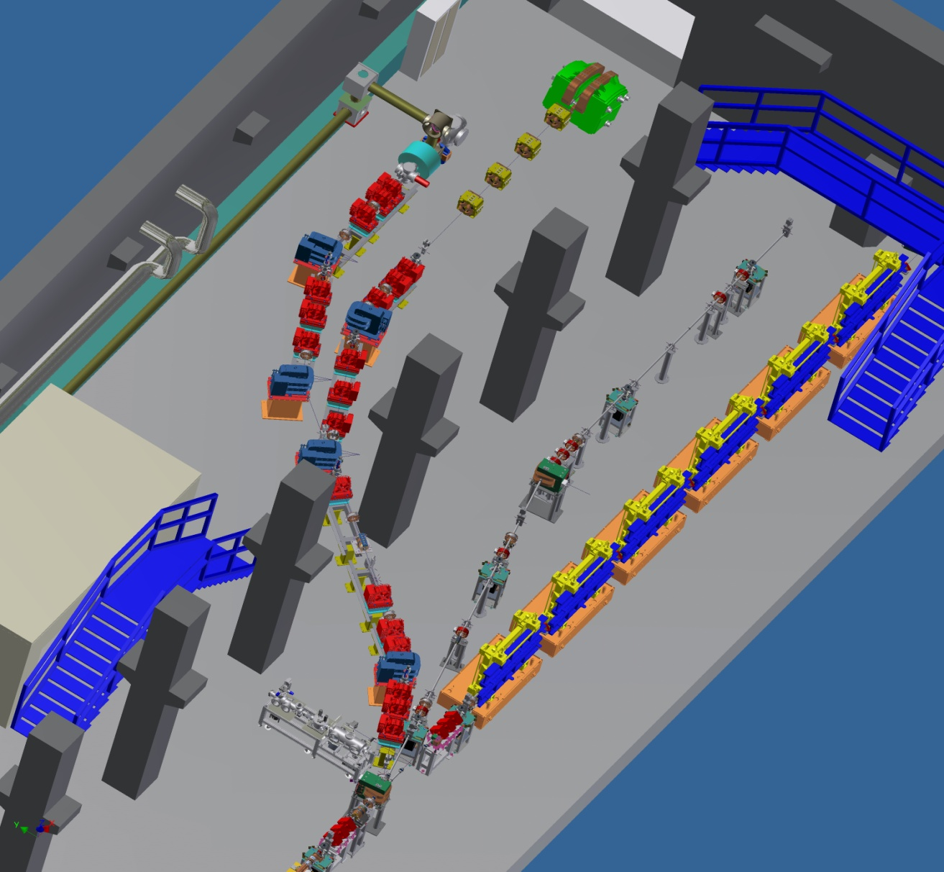

The SPARC_LAB Layout
Interaction chamber
Plasma capillary
laser input line
300 TW, < 25 fs
Ti:Sa laser
Test bench beamline
for THz, EOS, advanced BPMs
Thomson scattering
beamline
Undulator beamline
Plasma Acceleration
beamline
THz beamline
44th LNF SC Meeting, June 4th, 2012

Slide 18
The SPARC_LAB Activities
High gradient acceleration (COMB, EXIN, SITE)
FEL physics and applications (SPARC, SASE, SEEDING, HHG, COMB)
Advanced radiation sources and applications (THOMSON, BEATS2,
TERASPARC, γ-RESIST, ELI_NP)
Advanced beam physics and accelerator technology (SPARC, COMB, ELI_NP)
Fundamental physics (γ-RESIST)
Positron source (POSSO)
Laser/Plasma physics (γ-RESIST, THOMSON)
Promote Spin-off of previous activities (SPARC, ELI_NP)
Laser/Plasma based ion sources (LILIA)
44th LNF SC Meeting, June 4th, 2012

Slide 19
Installation status
44th LNF SC Meeting, June 4th, 2012

Slide 20
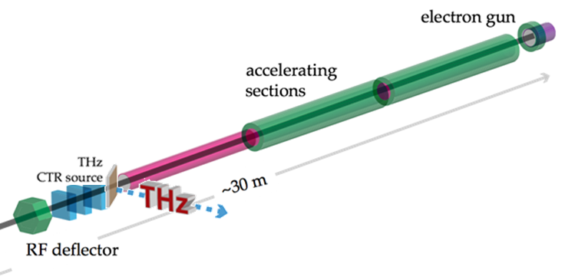
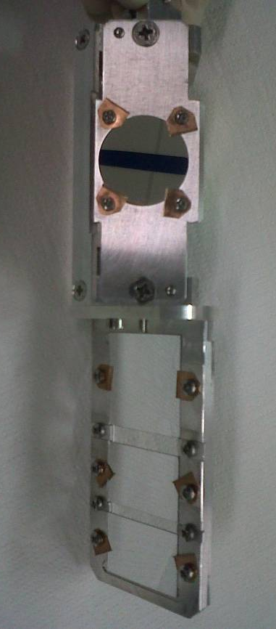
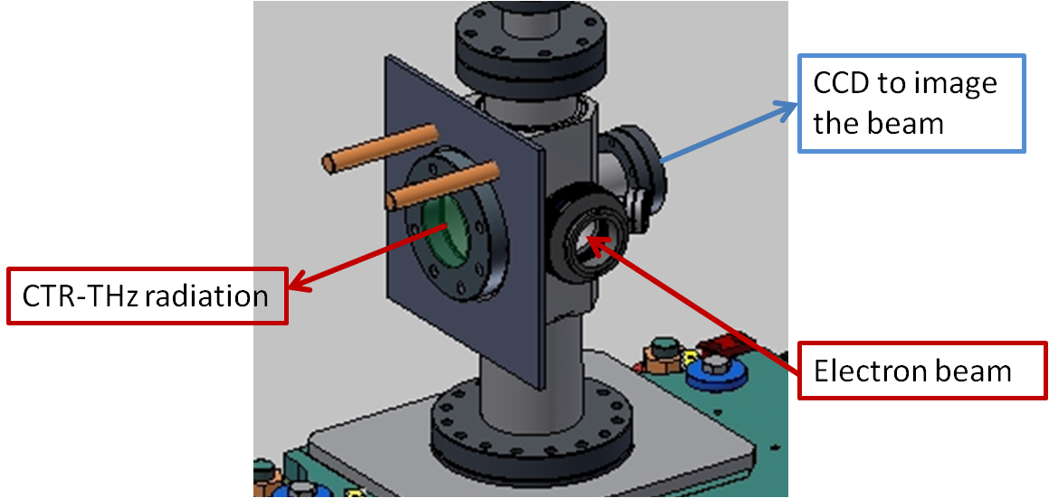
The New THz Beamline
The sources are Coherent Transition Radiation (CTR) from an aluminum-coated silicon screen and Coherent Diffraction Radiation (CDR) from
a rectangular slit.
Targets holder
YAG:Ce screen
Si-Al screen (CTR)
New vacuum chamber
5 mm slit (CDR)
3 mm slit (CDR)
44th LNF SC Meeting, June 4th, 2012

Slide 21
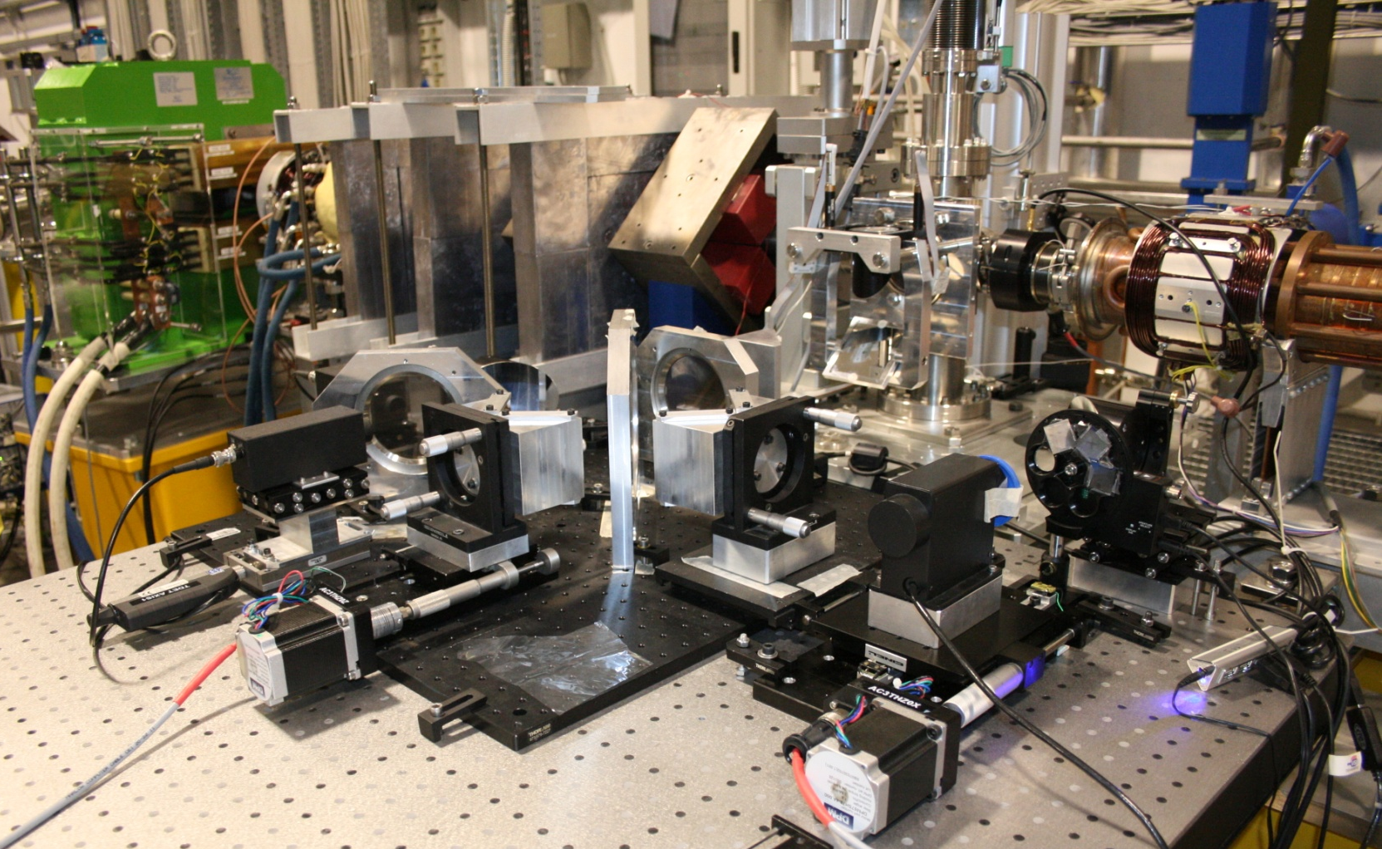
The New THz Beamline
ELECTRON BEAM
44th LNF SC Meeting, June 4th, 2012

Slide 22
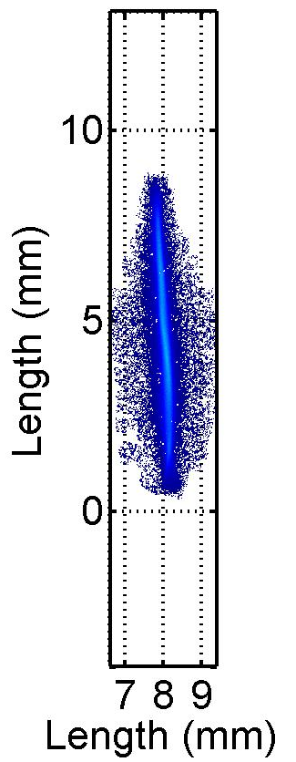
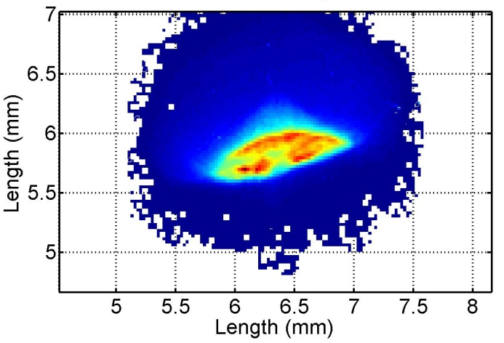
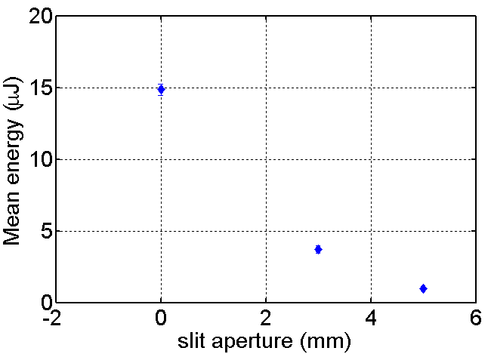
Highlights
Broad Band THz Radiation
(150 GHz – 5 THz) with sub-ps high-brightness electron bunches
Velocity Bunching
0.876 ps/mm
σ_{t} = 160 fs
Time
Golay cell detector
1.389 ps/mm
σ_{t} = 2.586 ps
CTR
CDR
Charge: 300 pC
Beam energy: 140 MeV
CDR
44th LNF SC Meeting, June 4th, 2012

Slide 23

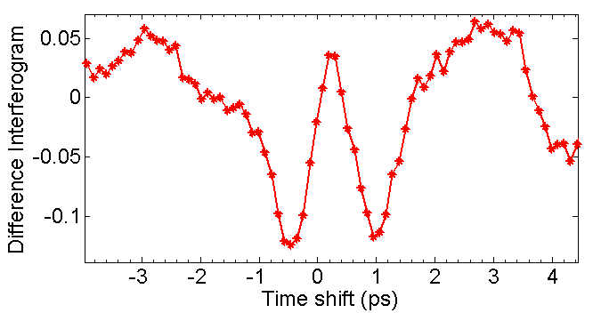
Martin-Puplett Interferometer
ANALYZING
GRID
ELECTRONS
PYRO-DETECTORS
POLARIZING
GRID
BEAM
SPLITTER
ROOF MIRRORS
CTR
44th LNF SC Meeting, June 4th, 2012

Slide 24
The Thomson Source
The Thomson back-scattering (TS) X-ray source is foreseen to work in three different operating modes
  the high-flux-moderate-monochromaticity mode (HFM2), suitable for medical imaging,
  the moderate-flux-monochromatic mode(MFM), suitable to improve the detection/dose performance
  the short-and monochromatic mode (SM) useful for pump-and-probe experiments e.g. in physical-chemistry when tens of femtosecond long monochromatic pulses are needed
Laser parameters
Wavelength | 800 nm
Compressed pulse energy | 5 J
Pulse duration/bandwidth | 3-12 (80) ps/nm
Rep. Rate | 10 Hz
Beam quality M2 | <1.5
Energy stability | 10%
Pointing stability | < 2 μm
Synchronization with SPARC photoinjector clock | < 1 ps
Electron beam parameters
Bunch charge | 0.2 – 1 nC
Energy | 28 – 150 MeV
Pulse Length | 15 – 20 ps
Rep. Rate | 10 Hz
ε_{nx,y} | 1 – 5 mm mrad
Energy spread | 0.1 – 0.2%
Spot size at IP | < 5 – 20 μm
44th LNF SC Meeting, June 4th, 2012

Slide 25
SL_THOMSON:
Procurement Status
Quadrupoles and Dipoles delivery: completed and installed
  Magnetic axes alignment: on going
Steering Magnets delivery: completed and installed
Quadrupole Power Supplies delivered
Vacuum chambers for mirrors (photon beamlines): delivered
Beam Current Monitors : delivered
Cables delivery: completed
Interaction Vacuum Chamber delivery and installation: by the end of July 2012
Sigmaphi Solenoid magnet delivery: September 2012
Sigmaphi Dumping dipole delivery : end of 2012
  Alternative solution = old bypass dipole located downstream the mirror chamber
  Two ways vacuum chamber delivery: Mid of May 2012
  Well off realization
  Beam Position Monitors (stripline) delivery: Mid of May 2012
  BPM electronics delivery (4) : order emitted first week of February 2012
44th LNF SC Meeting, June 4th, 2012

Slide 26
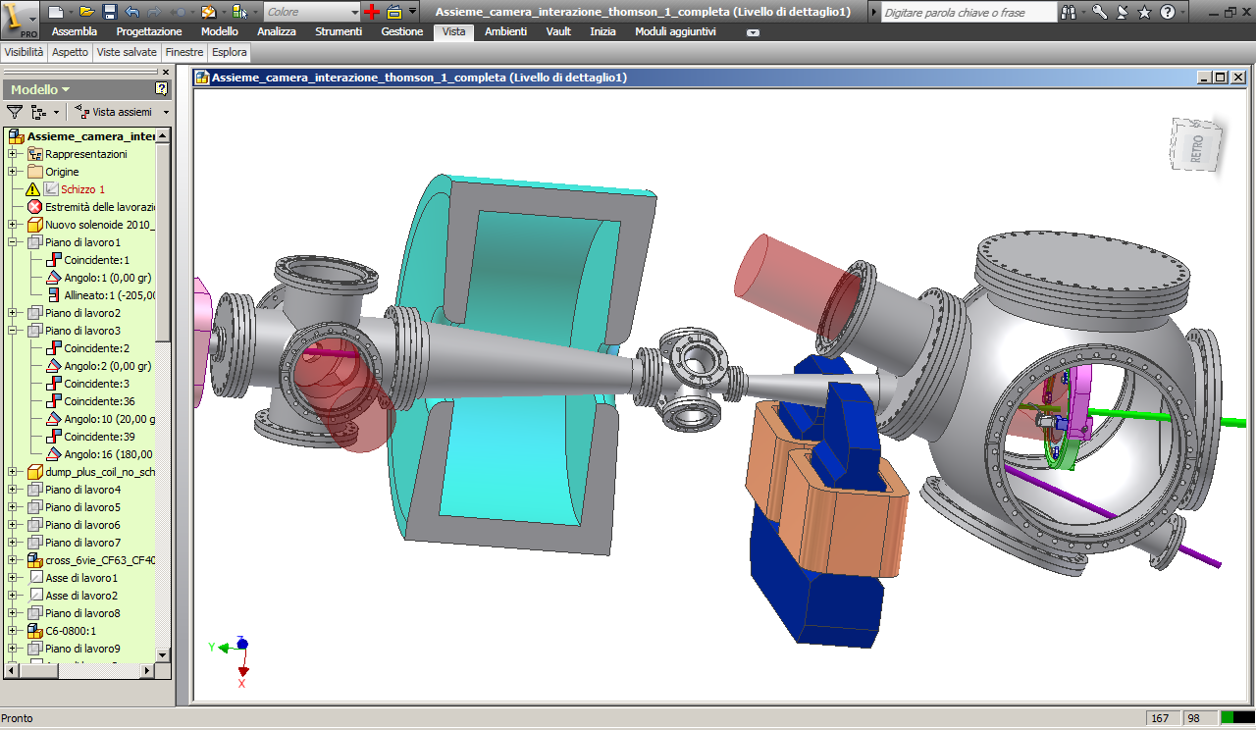
Thomson Interaction region
(20-550 keV)
e⁻ and laser beam diagnostic:
double flag w attuator
Interaction chamber
Laser beam
X-rays beam
(hν)_{X}=4 (hν)_{laser} ( T/ 0.511)²
Bent e- beam
laser: pulse 6 ps, 5 J
e⁻ bunch: 1 nC , l: 2 mm (rms)
X ray pulse: 10 ps, 10⁹ fotoni per interactionj
α emission: 12 mrad
(hν)_{laser} = 1.2 eV
T = 30.28 MeV
44th LNF SC Meeting, June 4th, 2012

Slide 27
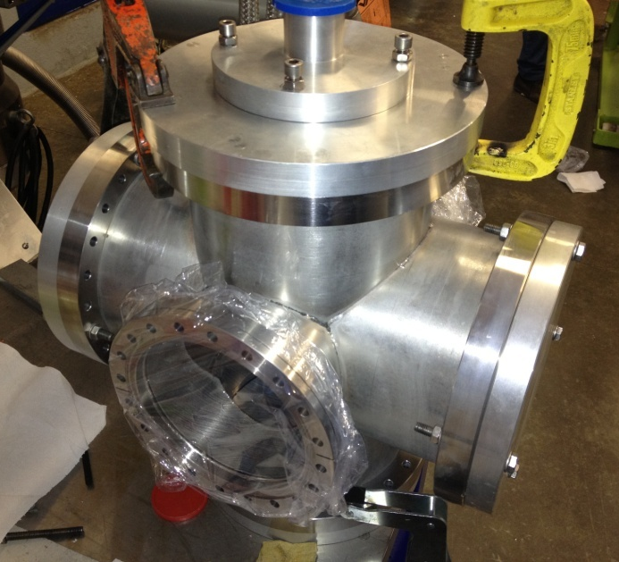
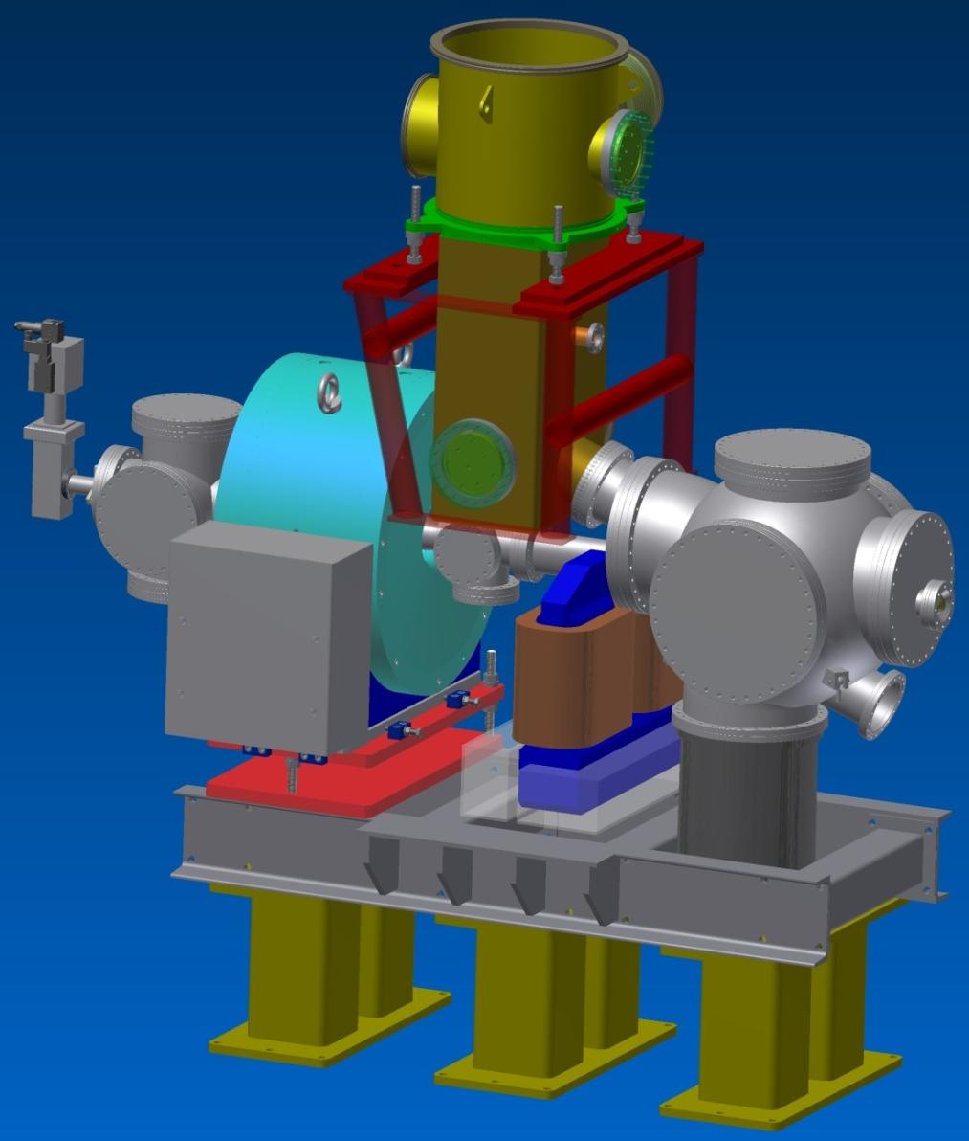
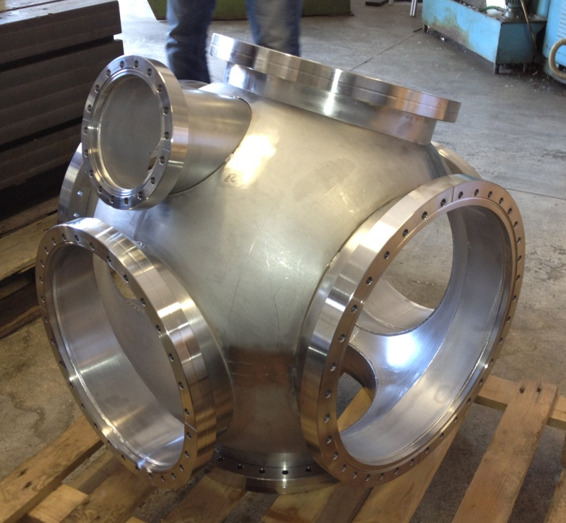
Thomson Interaction Chamber
The installation is foreseen to be completed by July 2012
The commissioning is foreseen for September 2012
Courtesy of A. Zolla
44th LNF SC Meeting, June 4th, 2012

Slide 28
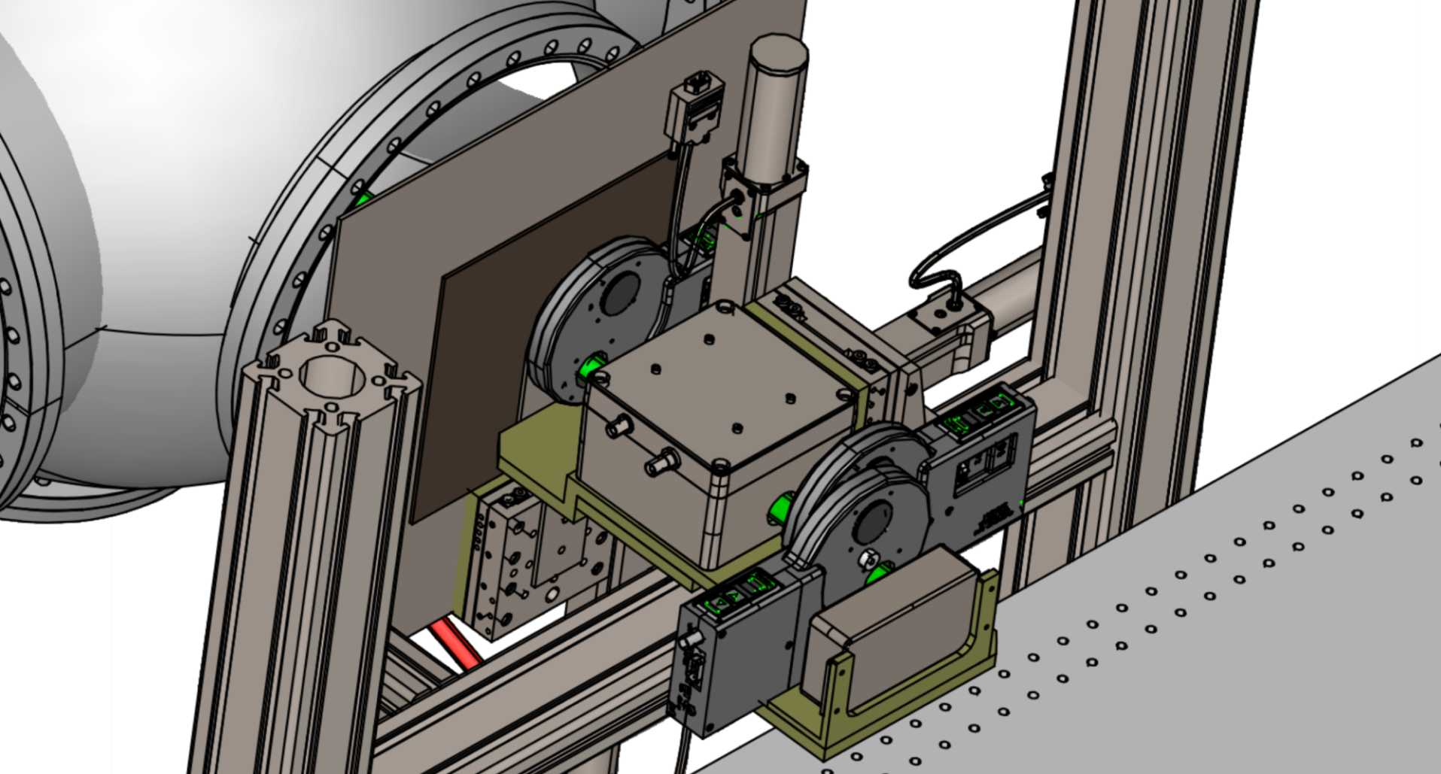
BEATS2 Experiment
I year: Experimental verification of possible applications to breast diagnostic of the X Thomson beam produced at SPARC_LAB.
II year: Monochromatic absorption radiography experiments with human tissue equivalent samples and dosimetry at 20 keV.
monitor
chamber
X-ray characterization system
collimators and
filter holdes
pin diode detector
44th LNF SC Meeting, June 4th, 2012

Slide 29
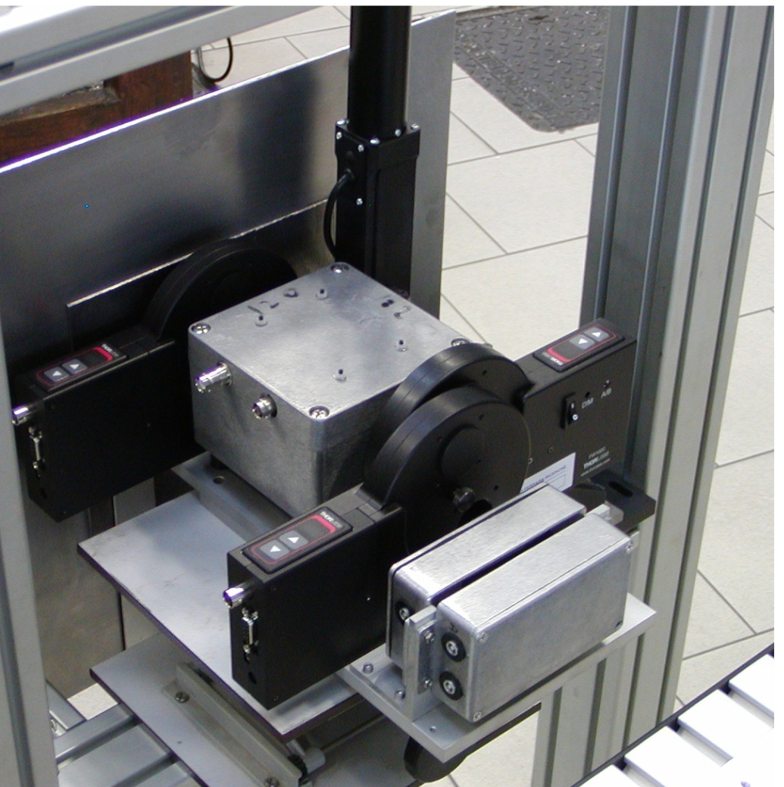
BEATS2 Experiment
I year: Experimental verification of possible applications to breast diagnostic of the X Thomson beam produced at SPARC_LAB.
II year: Monochromatic absorption radiography experiments with human tissue equivalent samples and dosimetry at 20 keV.
monitor
chamber
collimators and
filter holdes
pin diode detector
44th LNF SC Meeting, June 4th, 2012

Slide 30
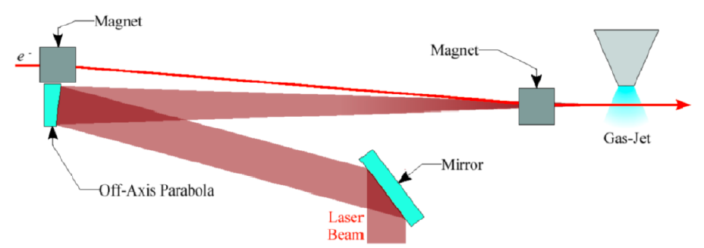
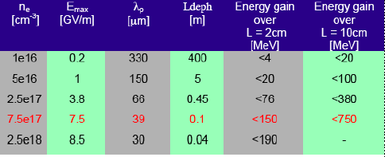
Plasma Acceleration Beamline: EXternal INjection
Gas capillary
Complete Simulations for injection and acceleration in capillary (SEP. 2012)
Start Acquisition Procedure for magnets of diagnostic transport line (OCT. 2012)
Complete Design of Interaction Chamber (DEC. 2012)
44th LNF SC Meeting, June 4th, 2012

Slide 31
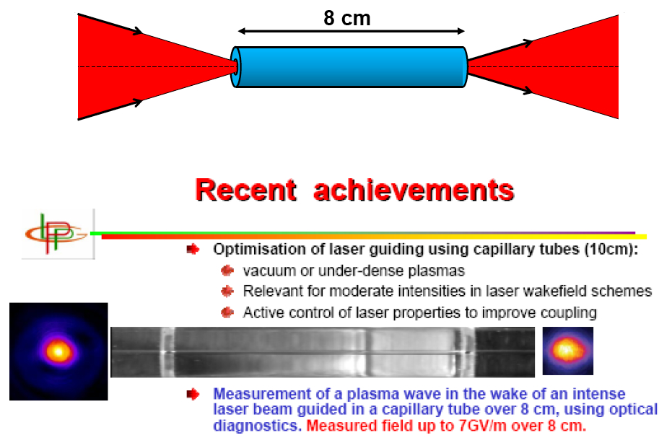
Plasma Acceleration Beamline: EXternal INjection
Hollow Dielectric Waveguide Capillaries, with LPGP Orsay, B. Cros et al.
44th LNF SC Meeting, June 4th, 2012

Slide 32
Plasma Acceleration Beamline: COMB
Resonant plasma Oscillations by Multiple electron Bunches
Weak blowout regime with resonant amplification of plasma wave by a train of high brightness electron bunches produced by Laser Comb technique ➔ 5 GV/m with a train of 3 bunches, 100 pC/bunch, 50 μm long, 20 μm spot size, in a plasma of density 10²² e⁻/m³ at λ_{p}=300 μm ?
Ramped bunch train configuration to enhance transformer ratio?
High quality bunch preservation during acceleration and transport?
Strong blowout regime with pC/fs bunches ➔ TV/m regime ?
44th LNF SC Meeting, June 4th, 2012

Slide 33
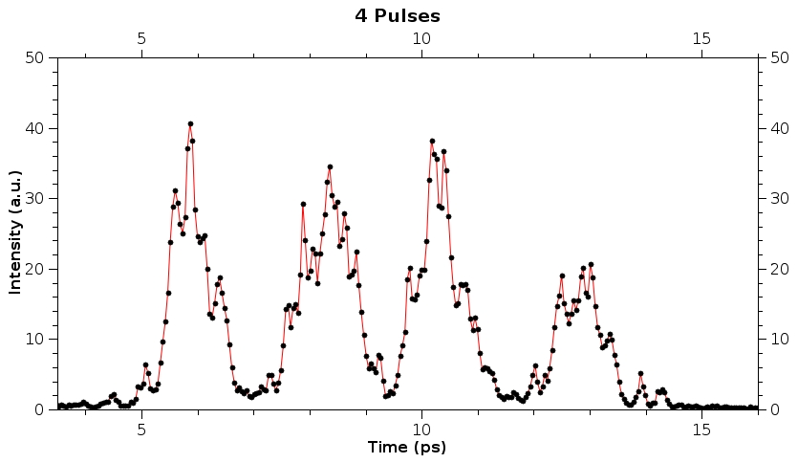

Plasma Acceleration Beamline: COMB
Measured Longitudinal Phase Space
Measured Longitudinal Laser Profile
4-pulses-time-structure
4-levels-energy-spectrum
longitudinal phase space
time
vertical dim
time
horizontal dim
energy
energy
44th LNF SC Meeting, June 4th, 2012

Slide 34
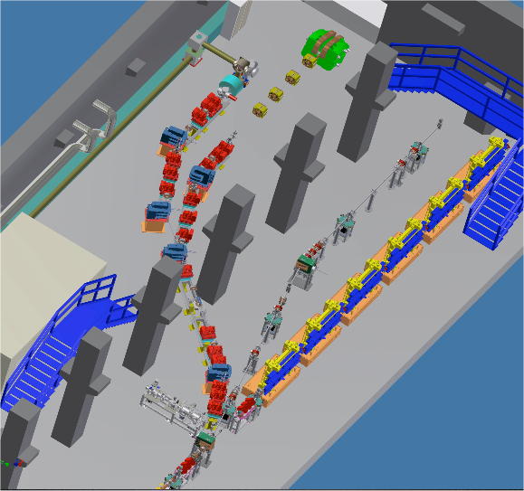
Plasma Acceleration Beamline: COMB
EOS and
cavity BPM
Advantages
Single-shot and non-intercepting longitudinal diagnostic tool
Resolution down to 100 fs
It can be used as Bunch Arrival Time Monitor
Disadvantages
Small signals
Complex system layout
High cost
44th LNF SC Meeting, June 4th, 2012

Slide 35
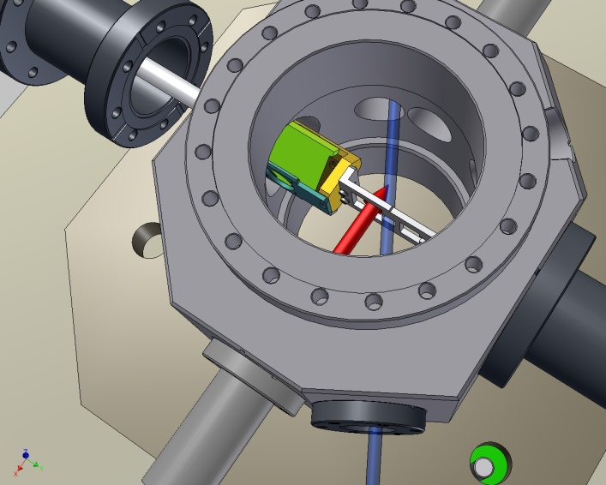
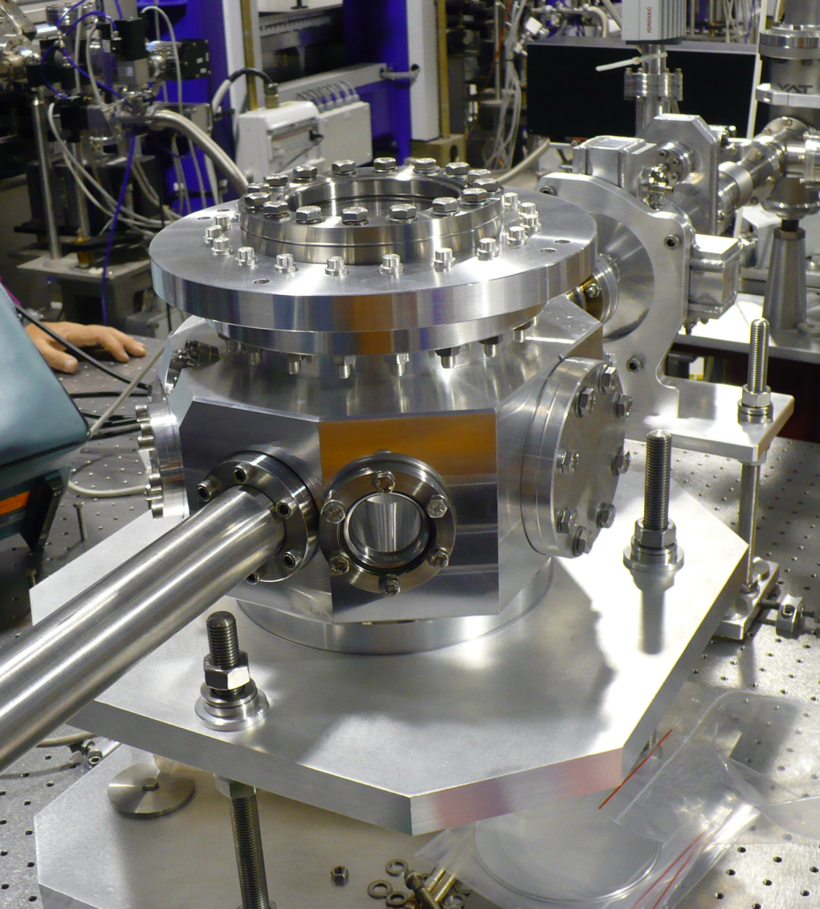
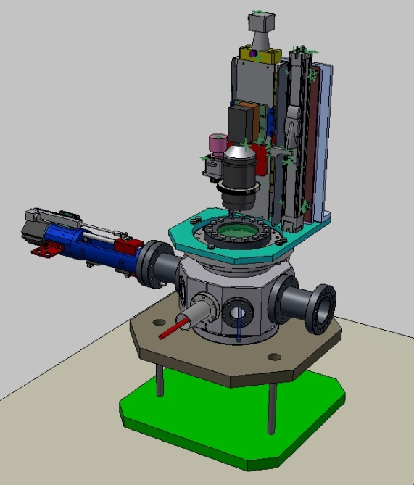
Plasma Acceleration Beamline: EOS chamber setup @ SPARC
Laser transfer line layout (from SPARC photocatode to the EOS chamber) ready by July ➔ Completed and working apparatus by the end of 2012
44th LNF SC Meeting, June 4th, 2012

Slide 36
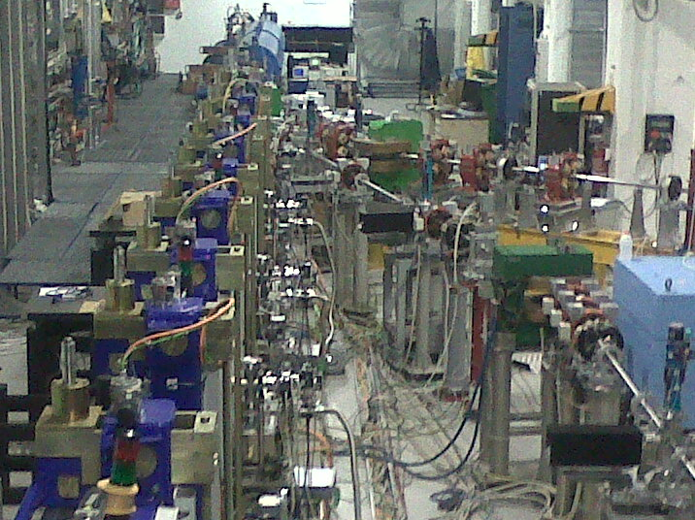
Present SPARC_LAB Layout
44th LNF SC Meeting, June 4th, 2012

Slide 37
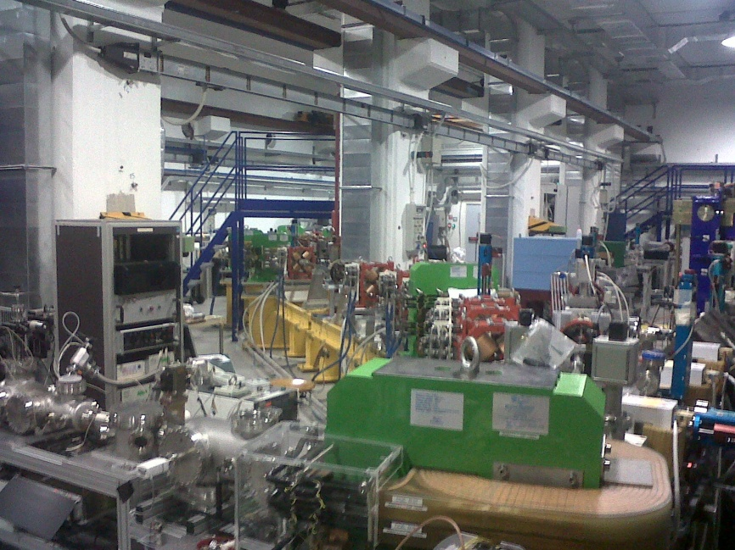
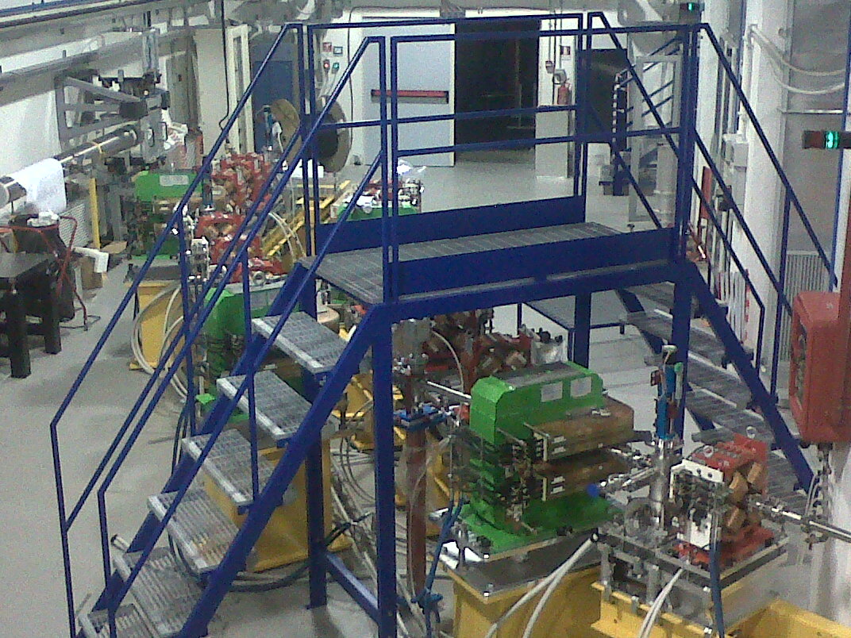
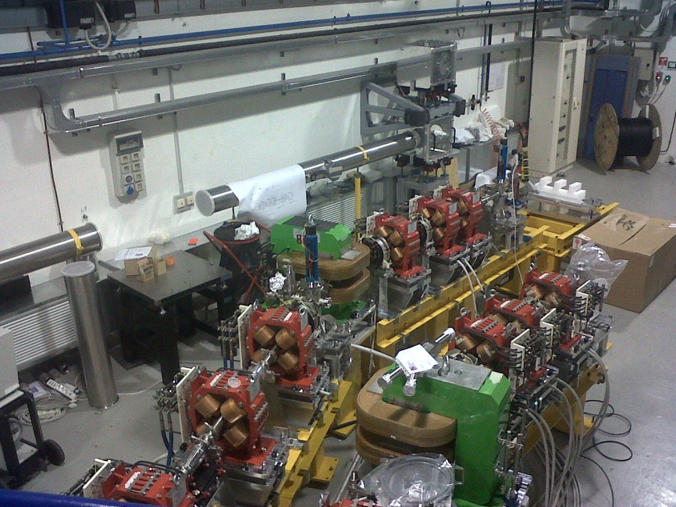
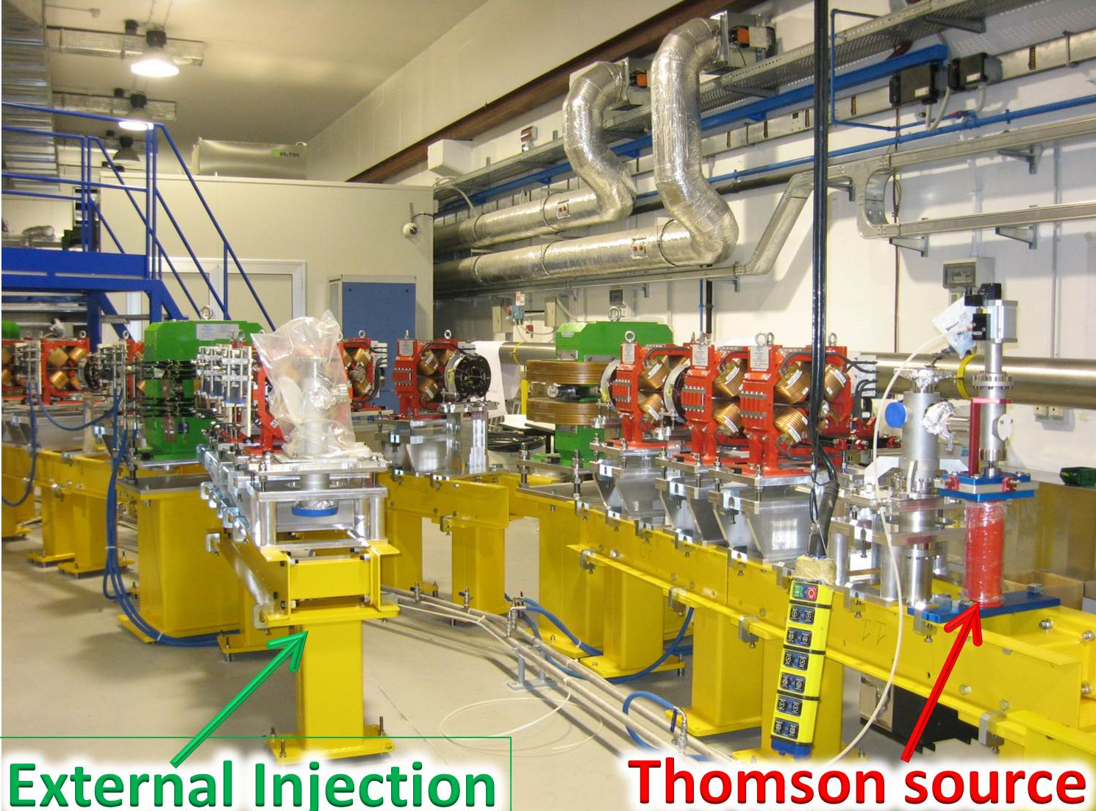
Present SPARC_LAB Layout
44th LNF SC Meeting, June 4th, 2012

Slide 38
Status of the experiments
44th LNF SC Meeting, June 4th, 2012

Slide 39
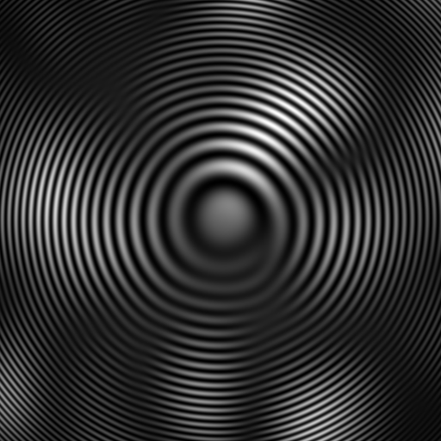

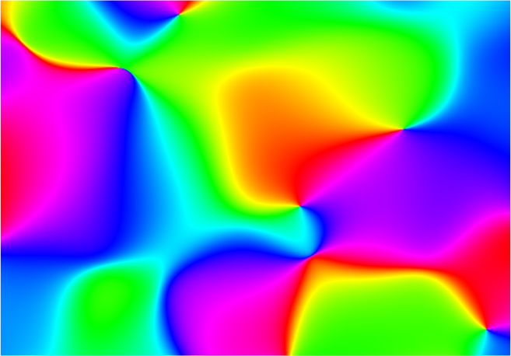
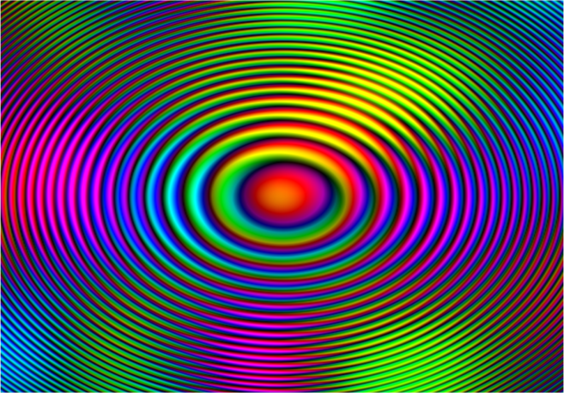

FEL Studies:
Coherence Measurement at SPARC
In-Line Holography
Q
Simulated Time-Averaged Distribution
P
P₀
Resulting Intensity
Complex Coherence Factor
Visibility:
Resulting Intensity
k_{s}
θ
q
Courtesy of M. Alaimo (Univ. of Milano)
k₀
44th LNF SC Meeting, June 4th, 2012

Slide 40
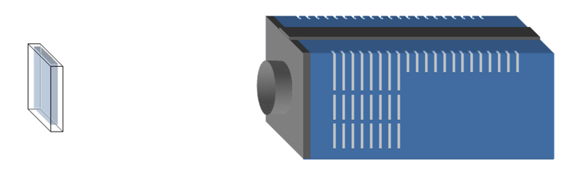
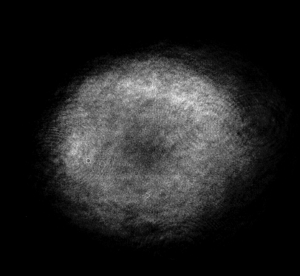

FEL Studies:
Coherence Measurement at SPARC
Mirror
Measure of the corresponding Fourier component in the Power Spectrum of a Near Field Speckle system produced by small particles
13 cm
Undulator
Sample:
Colloidal particles in water suspension
Polystyrene (n=1,59)
d= 2,1μm
SASE regime: λ=400nm
Camera:
1600x1200
dpx = 7,4 μm
14bit
heterodyne speckles
Coherence measurement:
heterodyne speckle approach
k
θ
q
Courtesy of M. Alaimo (Univ. of Milano)
44th LNF SC Meeting, June 4th, 2012

Slide 41
Ongoing activities
44th LNF SC Meeting, June 4th, 2012

Slide 42

Laser to RF phase lock upgrade
Phase noise spectrum of the reference RF (blue) and laser (red) oscillator
A new PLL has been designed and tested with very good results
The two oscillators have a spectrum very similar in the low frequency
offset region (the most
important to keep the
laser phase noise low)
The relative jitter has
to be measured but is
estimated to be
below 30fs
44th LNF SC Meeting, June 4th, 2012

Slide 43


SPARC-FLAME Synchronization
FLAME AREA
  Next future solution
  Electrical reference:
  Coaxial cable distribution
  Easiest and quickest
  Low cost
  Possible temperature stabilized cable bundle
  <100fs_{RMS} laser-to-RF synchronization
  Requires PC Synchrolock upgrade
  Present phase detection resolution ≈40fs
FLAME oscillator
In 2856MHz
Out 79.33MHz
RF reference
2856MHz
PC laser
Oscillator
79.33MHz
SPARC HALL
RF reference
2856MHz
44th LNF SC Meeting, June 4th, 2012

Slide 44
Enhanced Synchronization
FLAME AREA
End of 2012 solution
Optical reference:
  Fiber laser OMO
  Major system modification needed
  Higher cost
  Fiber stabilized links to distribute the signal
  Possible optical mixing for laser clients
  <<50fs_{RMS} laser-to-RF synchronization
FLAME laser
oscillator
PC laser
oscillator
SPARC HALL
OMO
fiber laser
oscillator
RF
synthesizer
44th LNF SC Meeting, June 4th, 2012

Slide 45

SPARC Energy Upgrade
2 x 1.4 m C-band to be installed
1 S-band
to be removed
100÷120 MeV
44th LNF SC Meeting, June 4th, 2012

Slide 46


POWER TEST at KEK
High power RF test of a C-band cavity prototype has been carried out at KEK, where a 50 MW, 5712 MHz power station was available.
The power test has been very successful.
A 50 cm long prototype was power tested up to 100 MW peak with a gradient of ≈ 50 MV/m.
C-band prototype
44th LNF SC Meeting, June 4th, 2012

Slide 47


C-Band Structure:
Present Status
Low power test of the actual accelerating cavity.
Designed at LNF and manufactured by local firms (COMEB).
Final brazing:
LNF + TSC (local company)
50 MW C-band power station
under test at LNF
May 29, 2012
May 15, 2012
44th LNF SC Meeting, June 4th, 2012

Slide 48


1.4 m C-Band Structure
Installation: end 2012
System commissioning: early 2013
Expected energy upgrade up to 240 MeV
44th LNF SC Meeting, June 4th, 2012

Slide 49


Machine Layout
44th LNF SC Meeting, June 4th, 2012

Slide 50


γ-source parameters
e-beam parameters
44th LNF SC Meeting, June 4th, 2012

Slide 51



Short Period Undulator
ENERGY Upgrade to 245 MeV
  Mitigate energy spread induced by compression with «velocity bunching»:
    Three stage superradiant cascade
    Harmonic cascade
DELTA like undulator (end of 2012)
  λu = 14.0mm, gap g = 5mm, Br = 1.22T.
Alternative seed sources
  Kagome fibers (N. Joly, MP - M.E. Couprie Soleil)
HHG seeding (5° .. Up to 9°)
  Studying extension to even harmonics (G. Lambert LOA)
44th LNF SC Meeting, June 4th, 2012

Slide 52



Short Period Undulator:
Three stages cascade – seed at 266nm – final λ = 66nm
Electron beam parameters
Beam energy | 200 MeV
Current | 150 A
ε_{n} | 1.5 mm mrad
Energy spread | 4 x 10⁻⁴
Less than 20 fs pulse length (fwhm) up to 1 uJ @ 66nm
Seed
λ=266nm
λ=133nm
λ=66nm
44th LNF SC Meeting, June 4th, 2012

Slide 53
Conclusions
SPARC_LAB is becoming a test bench for advanced high brightness beam applications (e.g. novel FEL schemes, coherent THz generation, x-ray radiation, PWFA and LWFA)
Mission of SPARC_LAB is primarily to integrate and harmonize all the existing activities at the test-facility, coordinate commissioning, operation and upgrade of the experiments, stimulate research and development and submissions of proposals for experiments to be performed at the SPARC_LAB test-facility.
Therefore a very tight schedule is foreseen to accomplish the whole bunch of activities, i.e.
  Injector optimization to test the final performances of SPARC
  FEL experiments with novel schemes
  COMB for THz, FEL experiments and Resonant-PWFA tests
  Commissioning of THOMSON beams (30 MeV and 350 pC)
  THz pump-probe experiment
  First THOMSON electron-photon collisions
44th LNF SC Meeting, June 4th, 2012

Slide 54
THANK YOU FOR YOUR ATTENTION
44th LNF SC Meeting, June 4th, 2012

Slide 55

G-RESIST: γ-Ray Emitter from Self‐Injected (Staged) Thomson Scattering
G-RESIST aims at using laser-plasma acceleration with self-injection to:
a) Control Injection and staging for multi-GeV electron acceleration;
b) Demonstrate generation of tunable gamma-ray source for nuclear resonance fluorescence (NRF) in the 100keV-1MeV using Thomson scattering;
c) Explore conditions for experimental confirmation of Landau-Lifshitz equation in radiation-friction dominated regime.
The experiment is based upon a counter-propagating laser pulse configuration obtained by splitting the main FLAME laser pulse into two pulses focused using two off-axis parabolic mirrors.
One of the pulses will be used to
generate high energy electron bunches.
The other pulse is focused
at 180° with respect to the first one and
is used to collide with the electron
bunches to generate gamma-radiation.
A third pulse (the Auxiliary "probe"
FLAME laser pulse) is used to control
the electron injection process.
44th LNF SC Meeting, June 4th, 2012

Slide 56


LILIA:
Laser Induced Light Ions Acceleration
LILIA is finalized to study, design and verify a scheme which foreseen the production, the characterization and the transport of a proton beam toward a stage of post acceleration (high frequency compact linacs).
5-30 MeV
10¹⁰-10¹² protons/shot.
44th LNF SC Meeting, June 4th, 2012

Slide 57
POSSO:
POSitron SOurce
The optimized combination of the conventional methods for positron sources with channeling becomes more and more promising for getting high brilliant positron beams for the future e-/e+ colliders.
Within the proposing project we are going:
- to perform preliminary studies on channeling and channeling radiation physics by means of the SPARC facility (for instance, THz area), finalizing in creation of the group/knowledge/experience necessary for detailed research in the future;
- to prepare a technical design for a positron source based on channeling radiation to be applied at SuperB Frascati;
- to perform detailed theoretical analysis of relativistic electrons channeling in various crystals taking into account all the processes of coherent and incoherent scattering (dechanneling/rechanneling processes based on the solution of kinetic equations);
- to study electron channeling at SPARC energies as a powerful x ray source;
- to analyze the feasibility of crystal channeling technique for testing of the features of basic physics (atomic clock, beams diffusion, etc.)
44th LNF SC Meeting, June 4th, 2012

Slide 58




Status and Achievements
200 pC
300 pC
400 pC
On crest
Compression
Max
Compression
Over
Compression
Four-pulses beam
Single pulse
44th LNF SC Meeting, June 4th, 2012

Slide 59


Three stages cascade – seed at 266nm – final λ=66nm
100p
50p

Slide 60

Pulse/spectrum at the end of the three stages
1° stage
2° stage
3° stage
Less than 20 fs pulse length (fwhm)
Up to 1 uJ @ 66nm

Slide 61
Interaction Chamber for EXT-INJ and COMB
must contain:
OAP with 75 cm focal length (8 mm hole diam)
Adiabatic Focusing element (permanent quadrupole or laser focus inside capillary): a common solution to COMB
< 20 cm Capillary supported by Exapod

Slide 62

Plasma Acceleration Beamline: COMB
1.2 ps
Electron bunch (COMB)
  4-pulses with 200 pC (total)
  Energy: 120 MeV
  Length 250 fs (FWHM); distance: 1.2 ps
  Distance from observation point: 2.0 mm
Laser pulse (from photocatode laser)
  Wavelength: 800nm (Ti:Sa)
  Duration (rms): 100 fs
  Energy pulse: 1 μJ
  Crystal incidence angle: 30° (high induced birefringence and low reflection losses)
  Laser diameter must be related to bunch length → 5 mm to scan pulses of Δt=10 ps
250 fs (FWHM)
44th LNF SC Meeting, June 4th, 2012

Slide 63

Plasma Acceleration Beamline: COMB
ZnTe, 500μm
1.28 ps
1.27 ps
1.27 ps
240 fs
240 fs
245 fs
290 fs
Laser transfer line layout (from SPARC photocatode to the EOS chamber) ready by July ➔ Completed and working apparatus before the end of 2012
44th LNF SC Meeting, June 4th, 2012

Slide 64


FEL Studies: Time-domain measurements of near single-spike radiation
Electron beam and undulator parameters
44th LNF SC Meeting, June 4th, 2012
Notes:
The first time-domain measurements of near single-spike radiation
produced from a single pass SASE FEL amplifier operating
under the e-beam energy chirp and undulator tapering
conditions discussed above, by utilizing a relatively
new transient-grating (TG) FROG diagnostic. We compare
these results with fully three-dimensional time dependent
numerical simulations obtained from the code
GENESIS[13]

Slide 65


FEL Studies: Time-domain measurements of near single-spike radiation
44th LNF SC Meeting, June 4th, 2012
Notes:
the first
time-domain measurements of near single-spike radiation
produced from a single pass SASE FEL amplifier operating
under the e-beam energy chirp and undulator tapering
conditions discussed above, by utilizing a relatively
new transient-grating (TG) FROG diagnostic. We compare
these results with fully three-dimensional time dependent
numerical simulations obtained from the code
GENESIS[13]

Slide 66


FEL Studies:
Coherence Measurement at SPARC
SASE regime: λ=400nm
Beam +
weak scattered field
Background subtraction
Heterodyne speckles
6 mm
Fourier analysis
Coherence length:
FWHM = 4 mm
Data + TF
CCF (a.u)
Gaussian fit
Courtesy of M. Alaimo (Univ. of Milano)
44th LNF SC Meeting, June 4th, 2012
R (mm)
Notes:
The Spatial Coherence ultimately is the ability of radiation of Writing Interference Fringes. Let’s see how we can measure it.
Here we have a double slit experiment, in which light is selected by two Pinholes and is let interfere on a screen at a certain distance.
The Degree of Mutual Coherence of the Fields at the points P0 and P1 can be measured by measuring the Fringe Visibility [defined as the Dark-Light difference divided by the average intensity]. A more sophisticated object can be used, that is the Complex Coherence Factor, defined as [the normalized Two Point Field Correlatior]. In fact these two object are strictly related since It is possible to show that Visibility is proportional to the modulus of complex coherence factor, and, since we have a convolutionm for the FT properties V can be related to the squared Power Spectrum,too. This means that information about Visibility is contained in the Power Spectrum.
Varying Pinhole separation one would observe Fringes with different Period and Visibility. So, ideally, we could measure the coherence by spanning all the possibile distances. However, the same information about visibility can be obtained by Measuring the corresponding Fourier Component in the Power Spectrum of a Near Field Speckle System produced by small Particles.
[1’45’’-2’] Lunga

Slide 67

Comb Beam Manipulation
C. Ronsivalle, TSTEP simulations.
44th LNF SC Meeting, June 4th, 2012

