Slide 1

Quantal Rotation and pn interaction:
Lifetime measurements in the N=Z=31 ⁶²Ga
F. F. Zeng
Legnaro National Laborotary, INFN, Padova, Italy

Slide 2

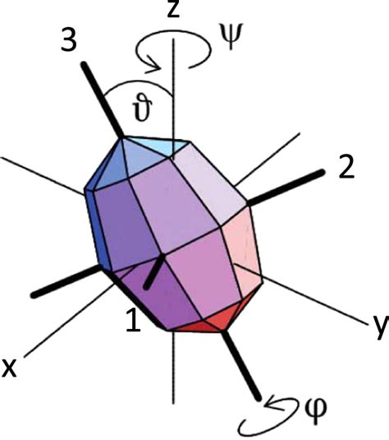
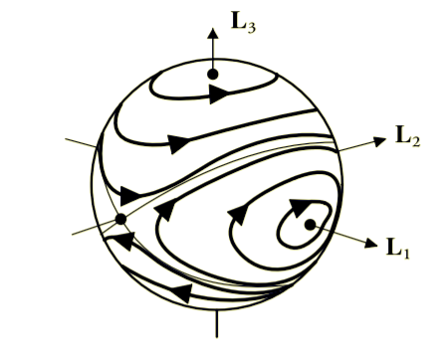

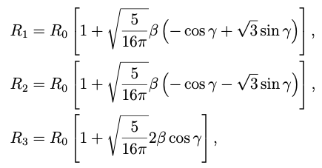






Rotation of a Triaxial System: the Dzhanibekov effect
Quantal
Classical
Euler equations of motion
For a torque-free system L is
a constant of motion
and the total rotational kinetic energy
Is also a constant of motion
Variational Principles in Classical Mechanics
D. Cline LibreTexts
the equation of an ellipsoid

Slide 3
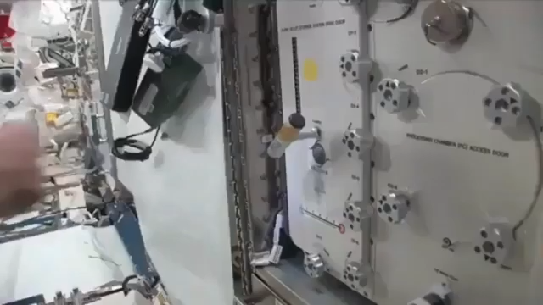
The DZHANIBEKOF Effect (1985 Salyut 7)
Notes:
Screwing a dice Dzanibekov noticed the following behavior (the video is from the NASA). The dice was rotating around the intermediate axis and the rotation was unstable. The effect was considered to be new, and the new effect was then called Dzanibekov effect, from the astronaut that had found it and very well dibated in the web

Slide 4
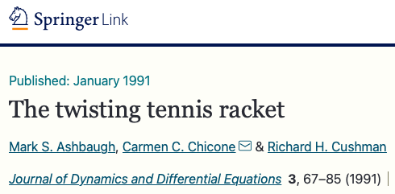
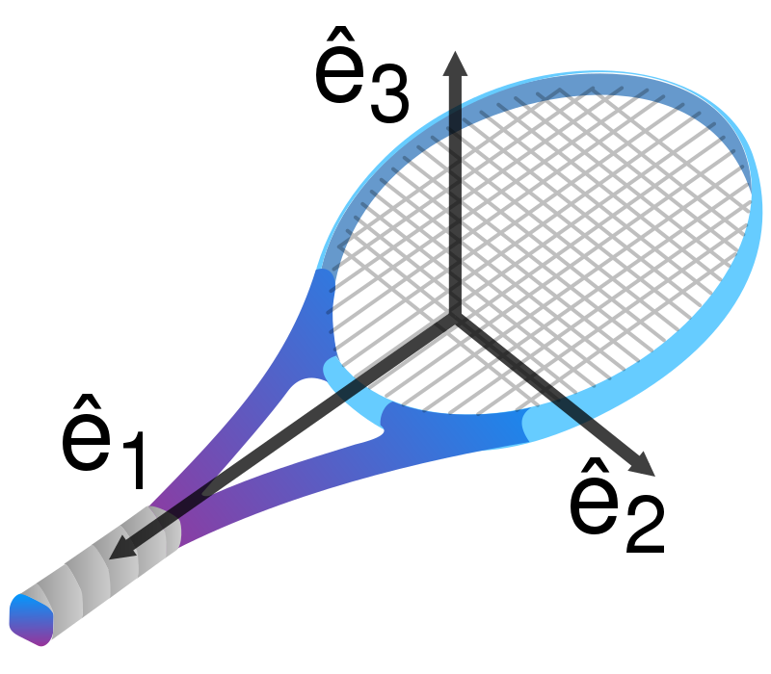
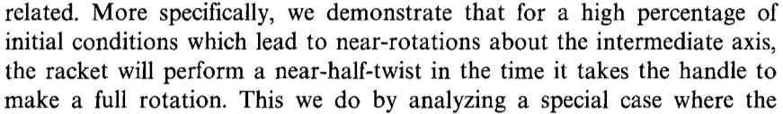
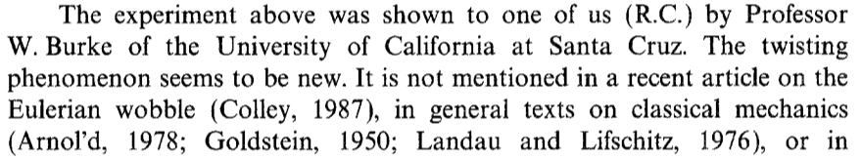
Rotation of a triaxial system
Notes:
It even brought to a publication in 1991 in a matematical journal, where it is written that the effect seems to be new since it is not reported in the main books on the rotation of solid bodies.

Slide 5
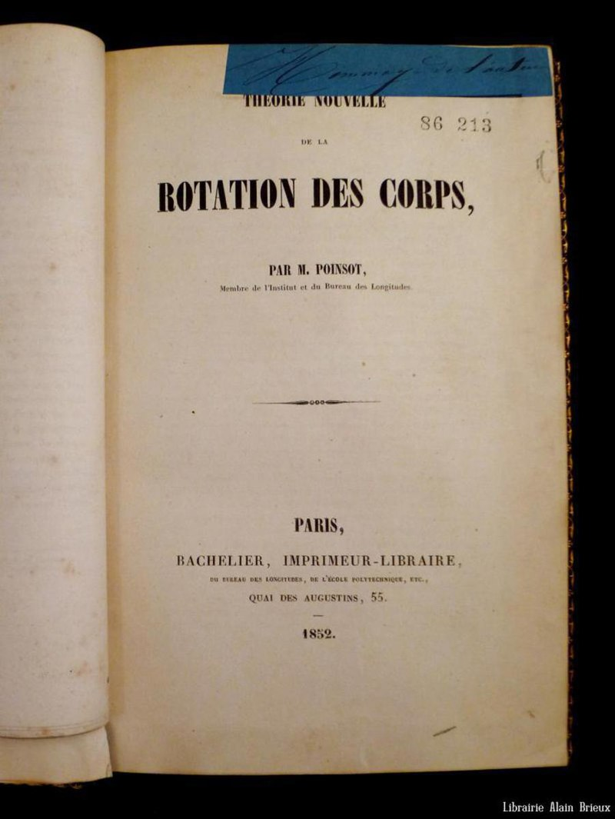
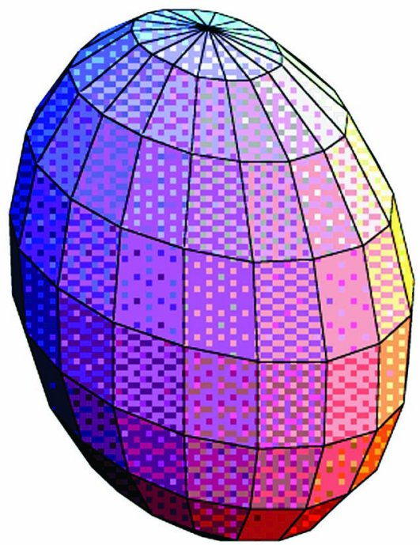
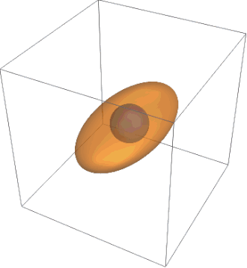
Luis Poinsot: Rotation of a triaxial system(1802)
Notes:
But this was not true, as we well know from nuclear physics, this rotational behavior was studied in 1802 and published by luis Poinsot, whose name you can find on the first floar of the Eiffel Tor within the 70 scientists that have contributed to the success of France
Poisot even invented the rapresentation of the rotation of a body due to the intercetp between the ellissoid and the shere which represent the conservation of angular momentum and energy (he conied the word Polhode for the trajectory of the Pole of the rotating body).

Slide 6



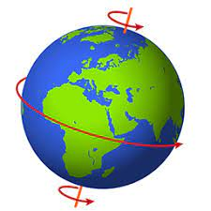

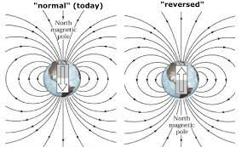
R₀ (polar)=6357 km
Notes:
Interestingly since the earth is known to be triaxial, even if with small asymmetry, somebody also suggested that the new Dzanibekov effect could have been the reason for the inversion of the magnetic poles, a quite frightening perspective.

Slide 7
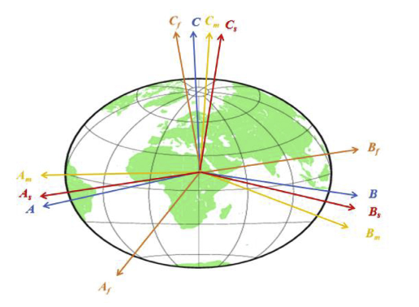
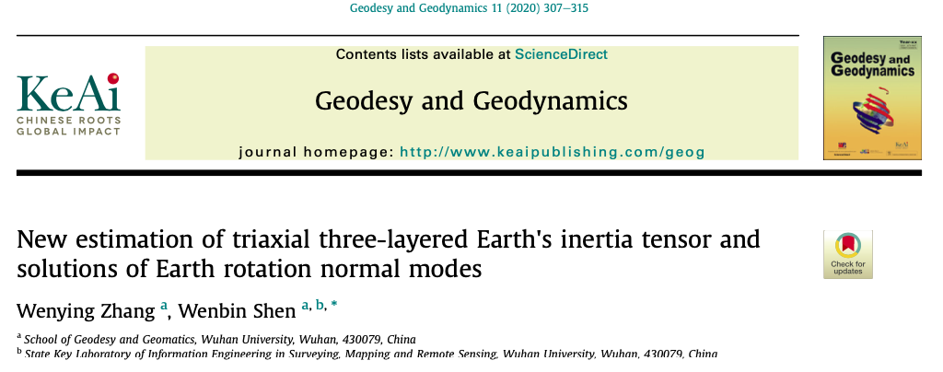
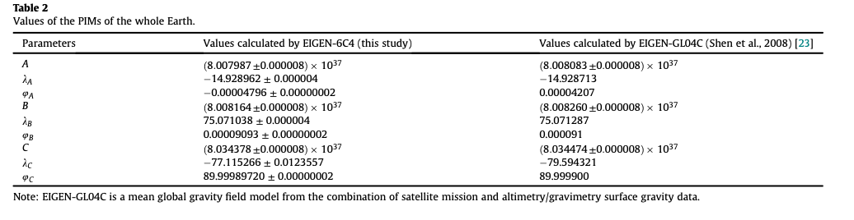
R₀ (polar)=6357 km
Notes:
Let me conclude with a conforting consideration
Recently the moment of inertia of the earth have been measured with great precisions. Thsi can be done trough the sitellite drift or through gravitational measurements
As you can see they are different, therefore the earth is triaxial, but we are rotating around the C axis (the shortest), the one with the largets moment of inertia.
Therefore the earth will not flip. And this is quite common for the rotation of a fluid system. Once one introduces a disiipative element in the hamiltonian whicever is the Original axis of rotation the sytem choose the one of minimum energy, which is the shortest.

Slide 8
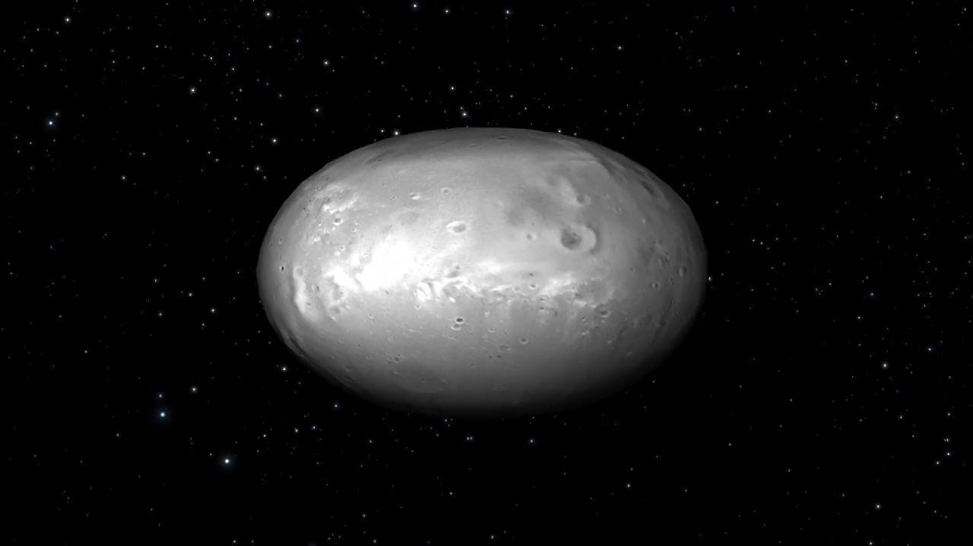
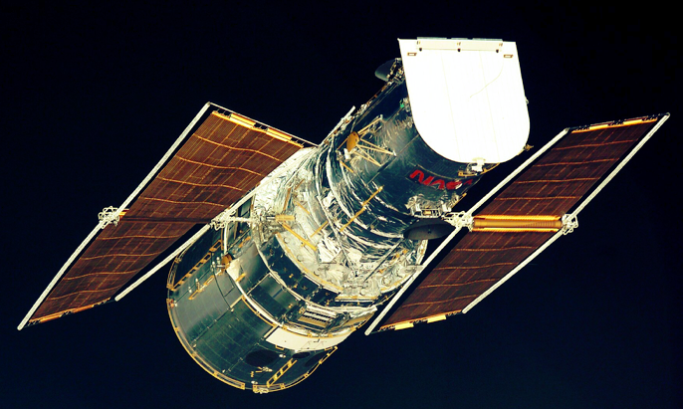
Nix, satellite of Pluto, diameter (long axis) 49.8 km. Discovered with Pluto's outermost moon Hydra 15/4/2005 Hubble Telescope

Slide 9
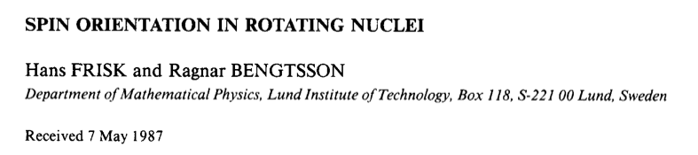
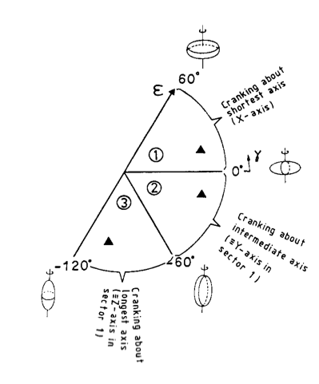
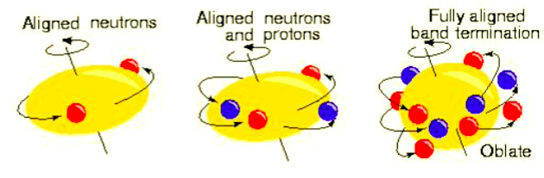
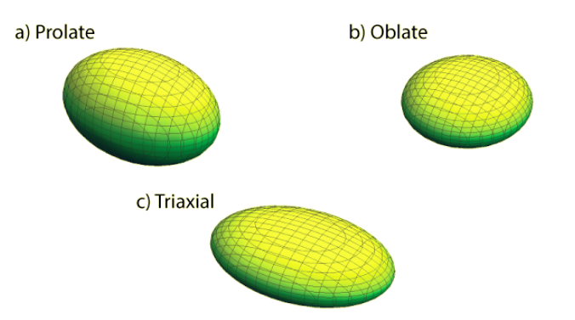
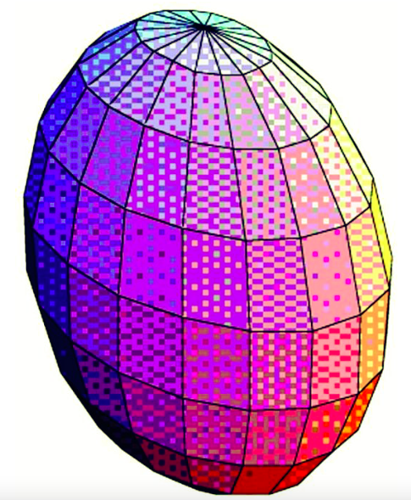

Rotation of a triaxial system
Quantal
If the ratio of the three moments of inertia of the core is similar to the ones for irrotational flow, then J2 is largest for γ = 30º and it is favorable to built up the core angular momentum along the 2-axis
Notes:
The case of a rotating triaxial systems has been first investigated by Frisk and Bengtsson for the axial rotation, the one I am referring now, and later by Frauendorf for non axial rotation. As shown in the Beta-Gamma plane triaxial nuclei are expected to rotate around the intermediate axis as lowest excitation. The requirements of quantal rotation and irrotational flow make J2 the axis with the largest moment of inertia.

Slide 10
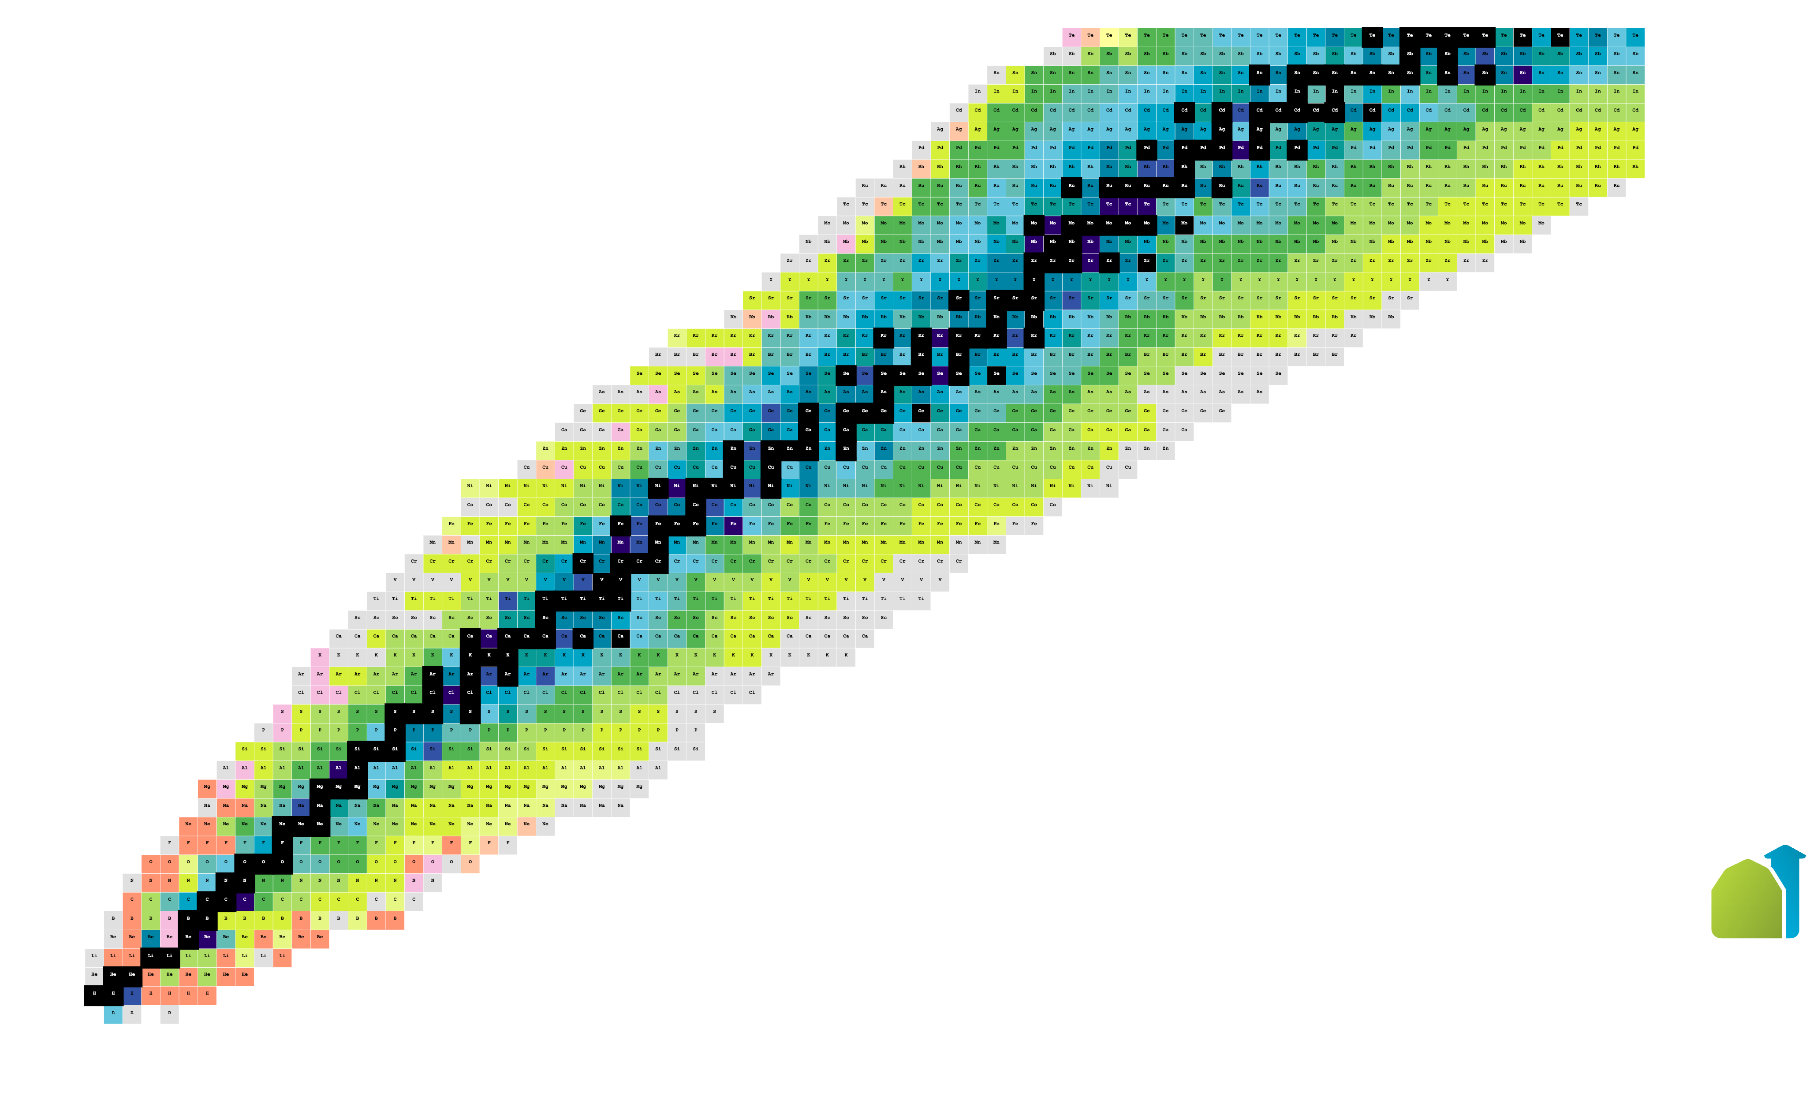
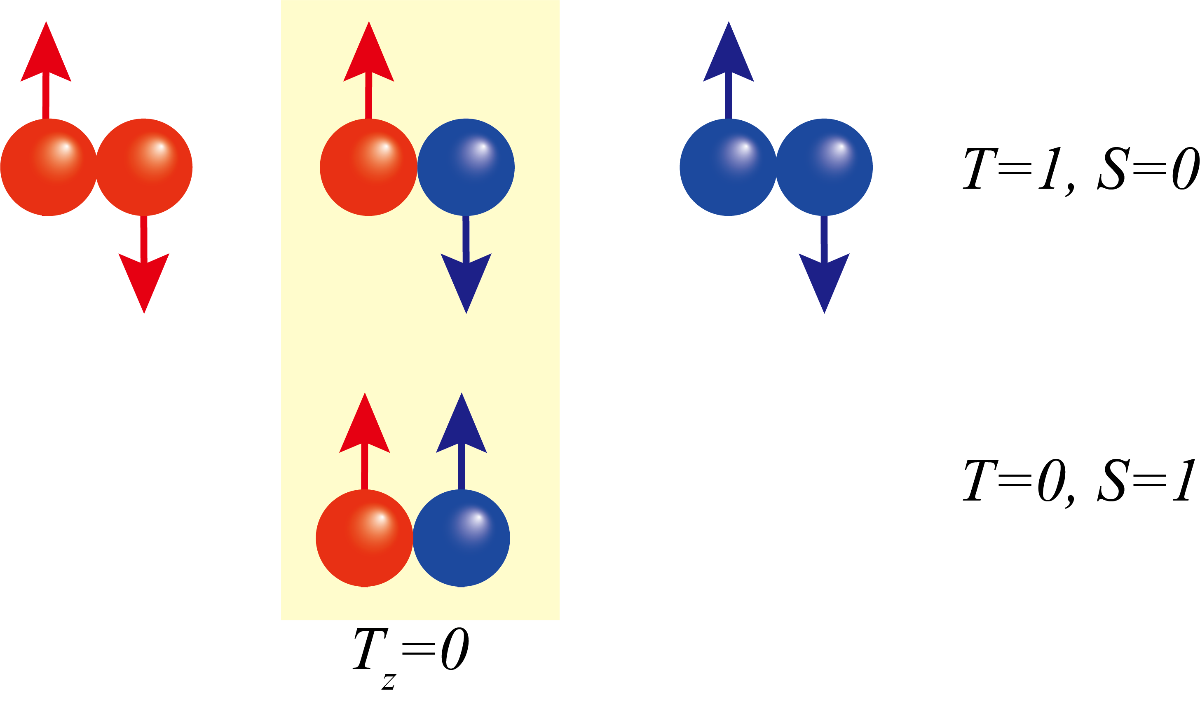
Z
N=Z
J^{𝜋}=0⁺
J^{𝜋}=1⁺
N
Notes:
Why N=Z nuclei? Because the np interaction is strong because of the overlap of the wave function. Which allows the nn pp, np in the same nuclei and pn can couple to the fully alignment pair. Particularly interesting is the impact of an aligned pn pair on the quantal rotation of a triaxial system.

Slide 11
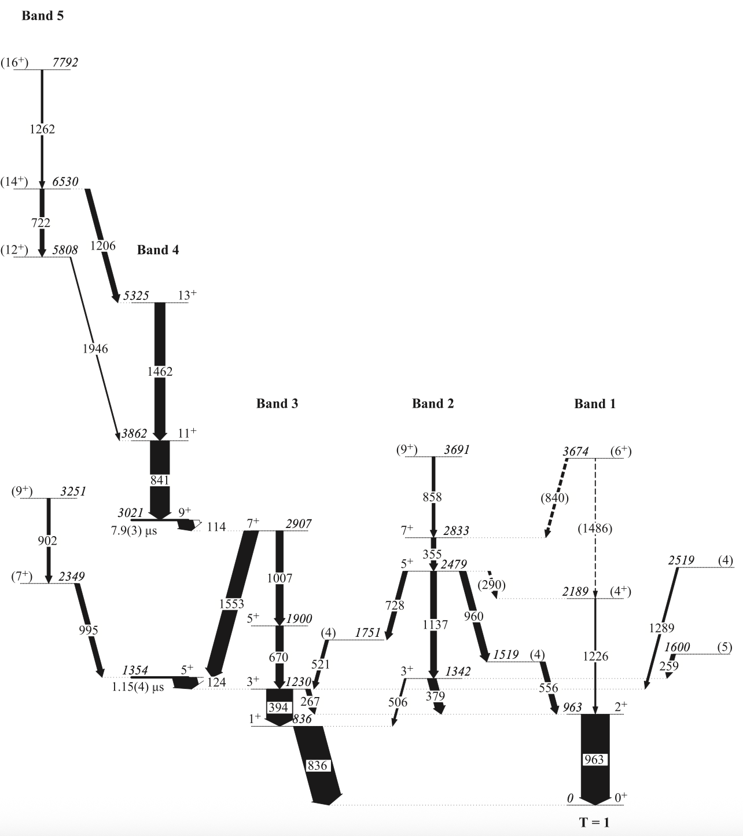
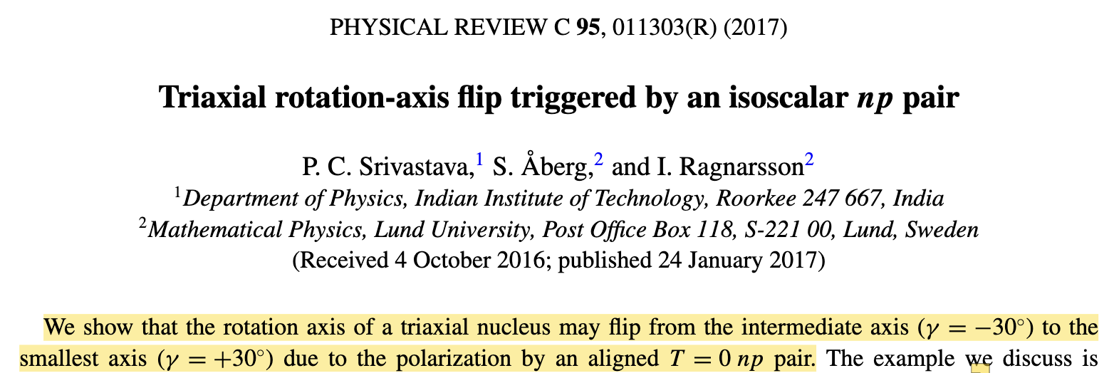
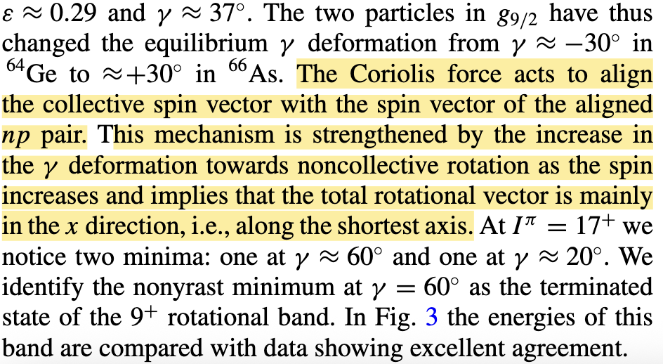
g_{9/2}(pn)⊗GSD
GSD
Notes:
As is predict in the paper, pn paire will result in the flip of the rotational axis.

Slide 12
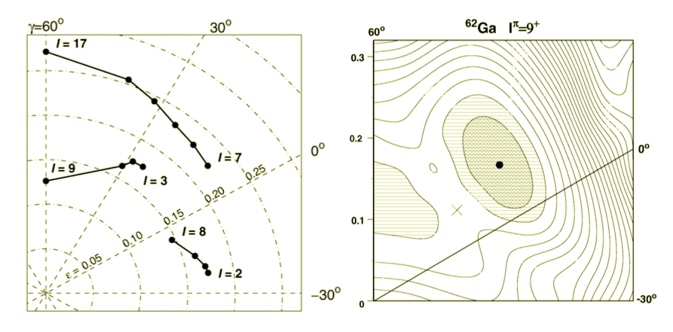
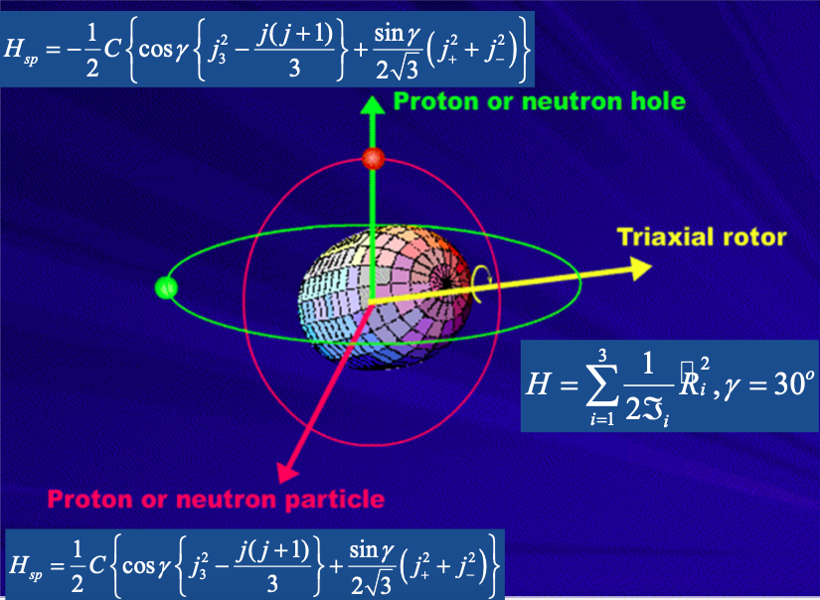

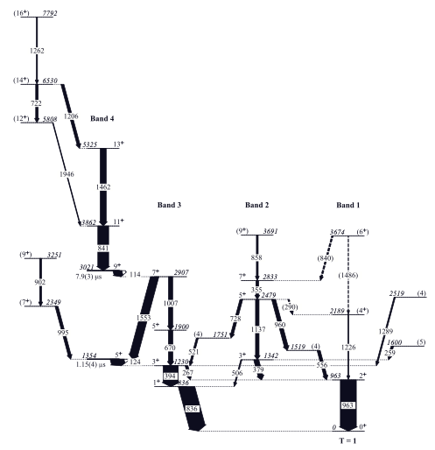
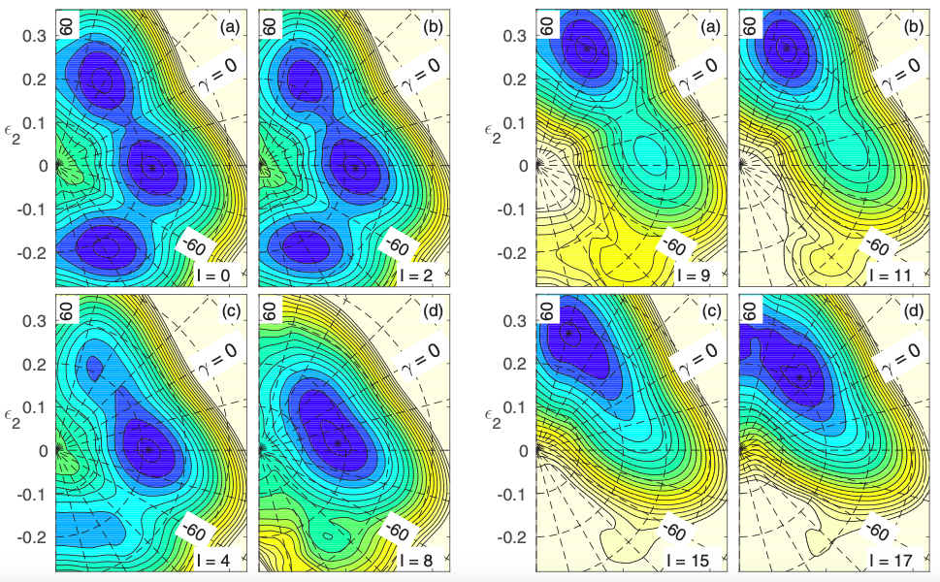

Quantal: Triaxial rotation-axis flip triggered by a pn pair
⁶⁶As
Prolate
Triaxial
Fingerprint of Triaxiality

Slide 13
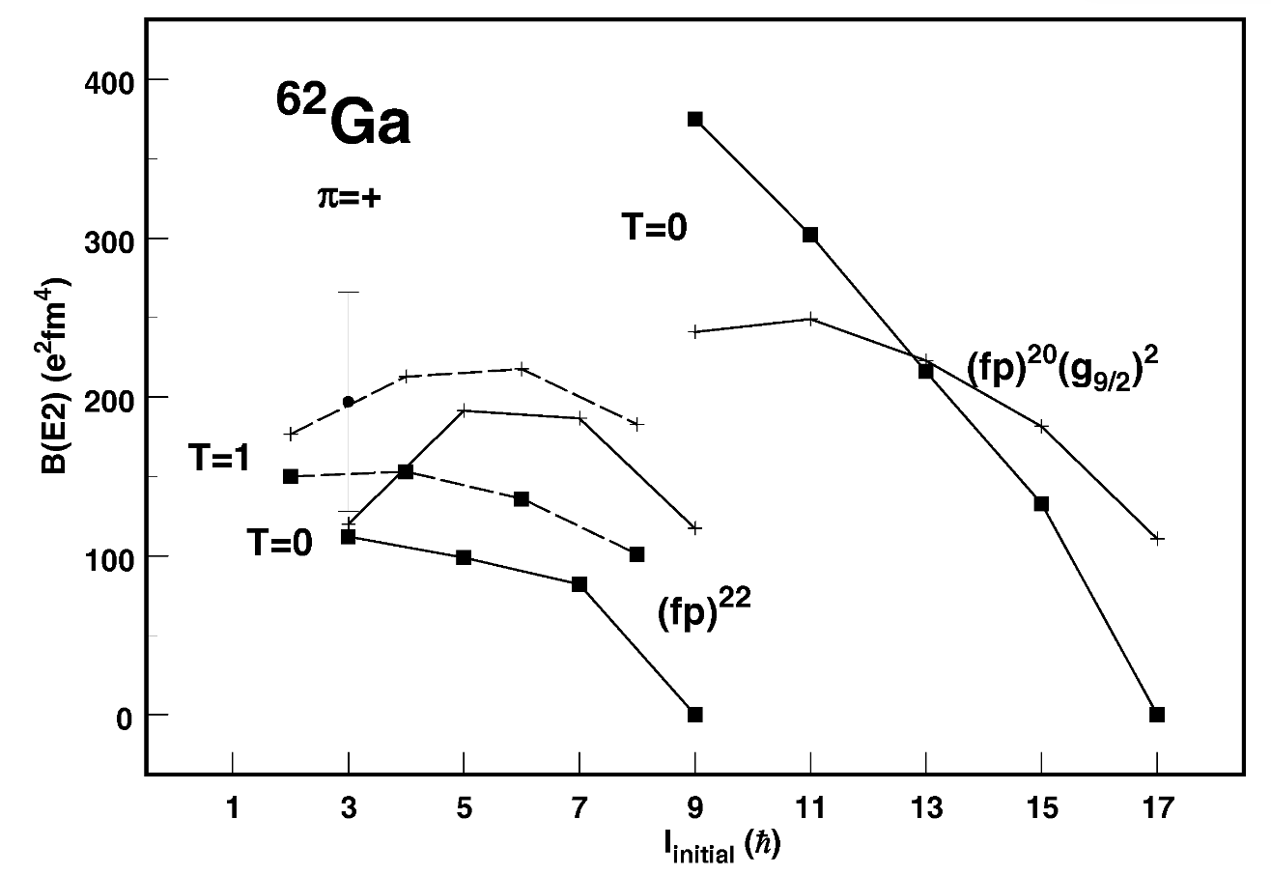
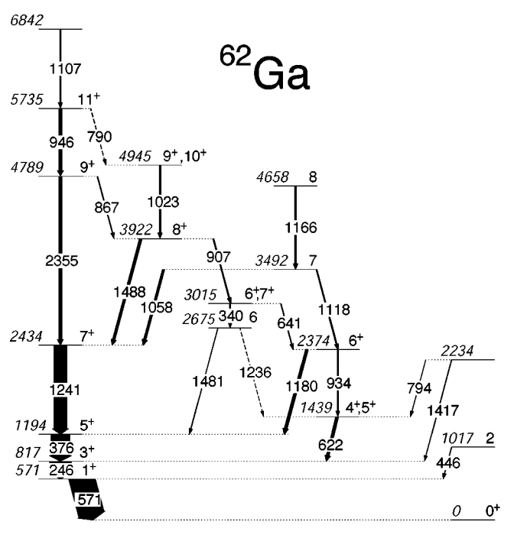
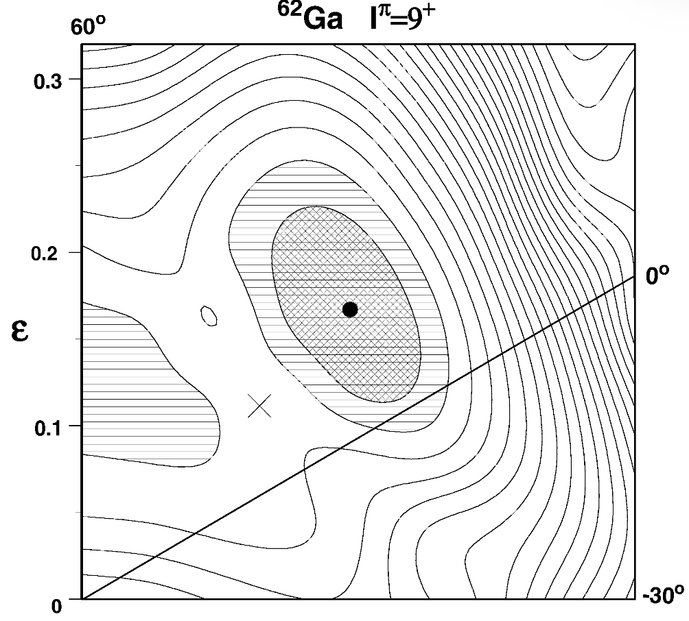
Candidate of Axis flip ⁶²Ga
PRC C 69, 034309 (2004)
NPA 683 (2001) 207–226
Notes:
The N=Z= 31 nucleus 62Ga is, in such a contest, of special interest. Its ground state is suggested to be triaxial in several calculations [1,2] as well as
from data [3]. Theory predicts γ instability in the ground state and triaxiality in the low lying excited states, i.e., quadrupole deformation β2=0.22 and γ=-270 [2]. Since, for an N=Z nucleus protons and neutrons occupy identical orbitals, one expects strong proton-neutron interactions.
Favorable configurations are observed built from maximal aligned isoscalar-coupled np nucleon pairs in high-j shells, a building block with a large spin vector that can flip the rotation axis of a triaxial rotor.

Slide 14
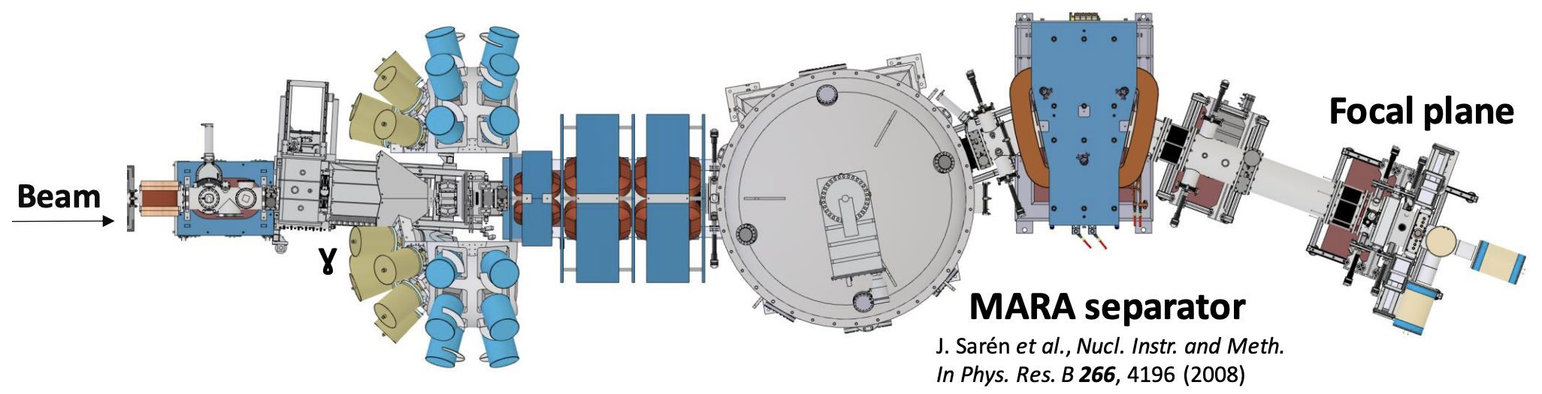
Experiment at JYU
Target: ^{nat}Mg 0.52 mg/cm²
Beam: ⁴⁰Ca (6⁺) @ 111 MeV
Beam intensity: ~1 pnA
Degrader: ⁹³Nb 1.33 mg/cm²
Detector Setup: Jurogam3+JYTube+Plunger+MARA+DSSD+Tuike
Beam time: ~10 days
Notes:
Magnesium Mg
Nb Niobium

Slide 15
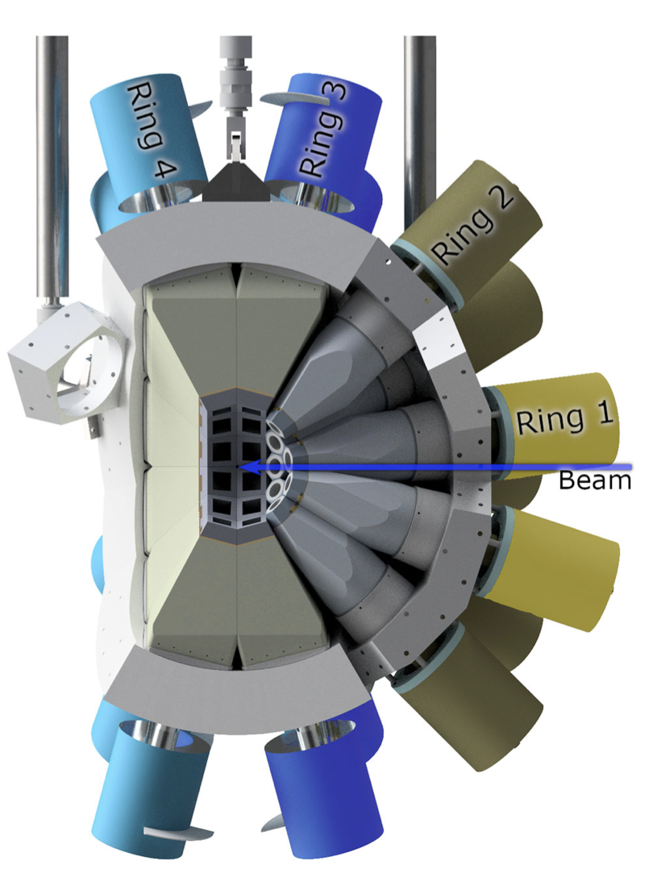
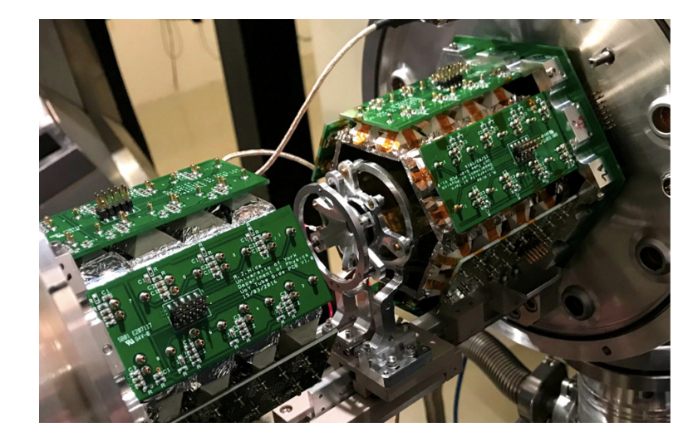
Target area detectors
JYTube + Plunger + JUROGAM 3
NIMB 541 (2023) 33–36
Eur. Phys. J. A (2020) 56:149

Slide 16
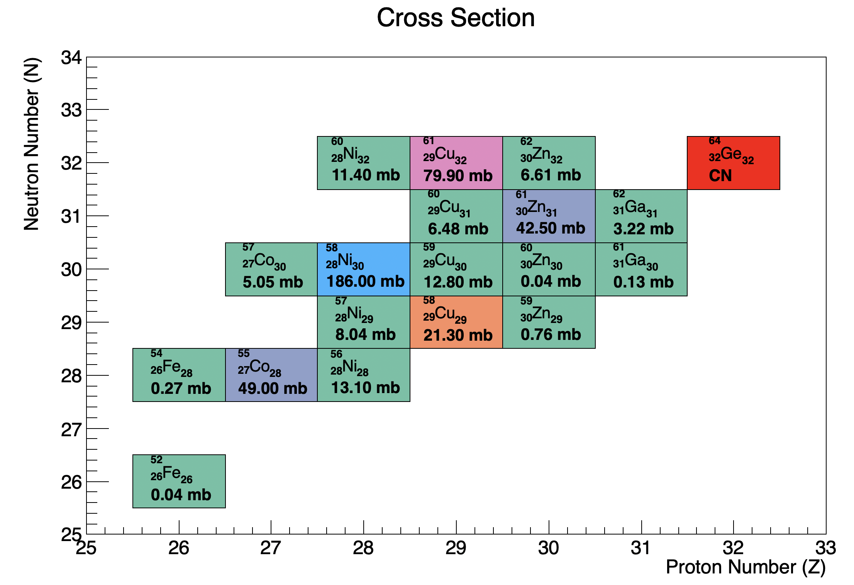
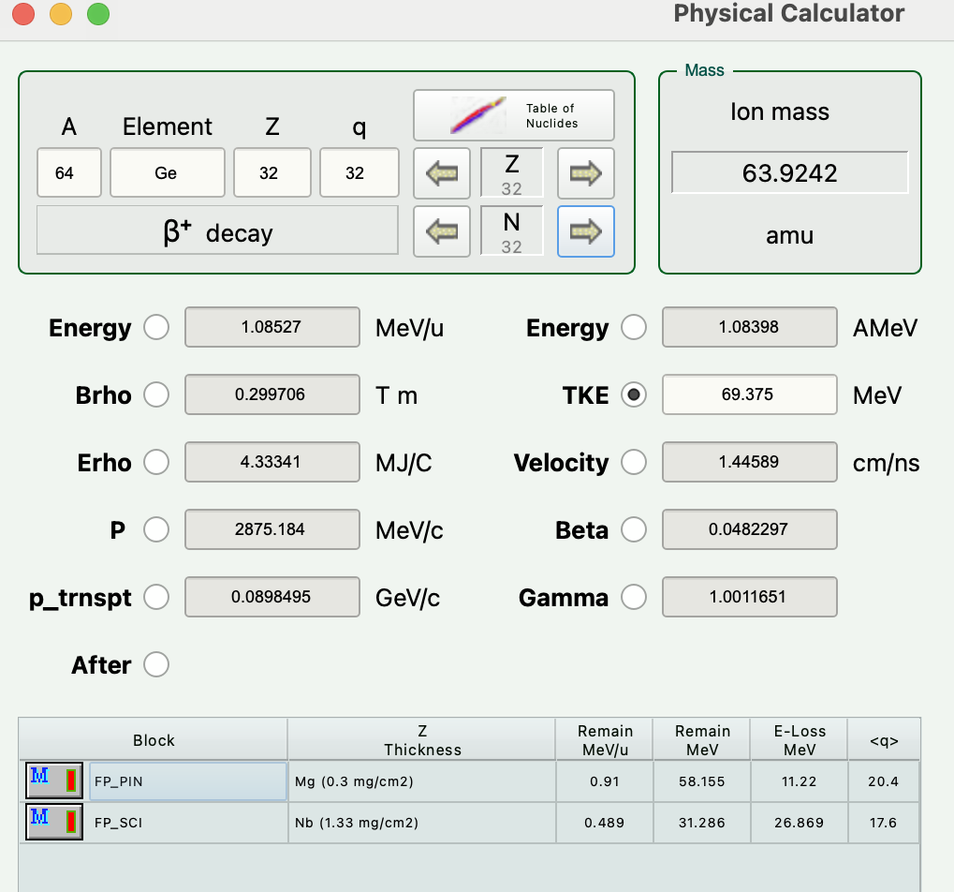
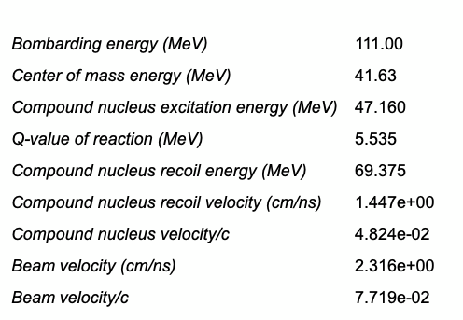

After degrader, $β_{CN}=0.0324$

Slide 17
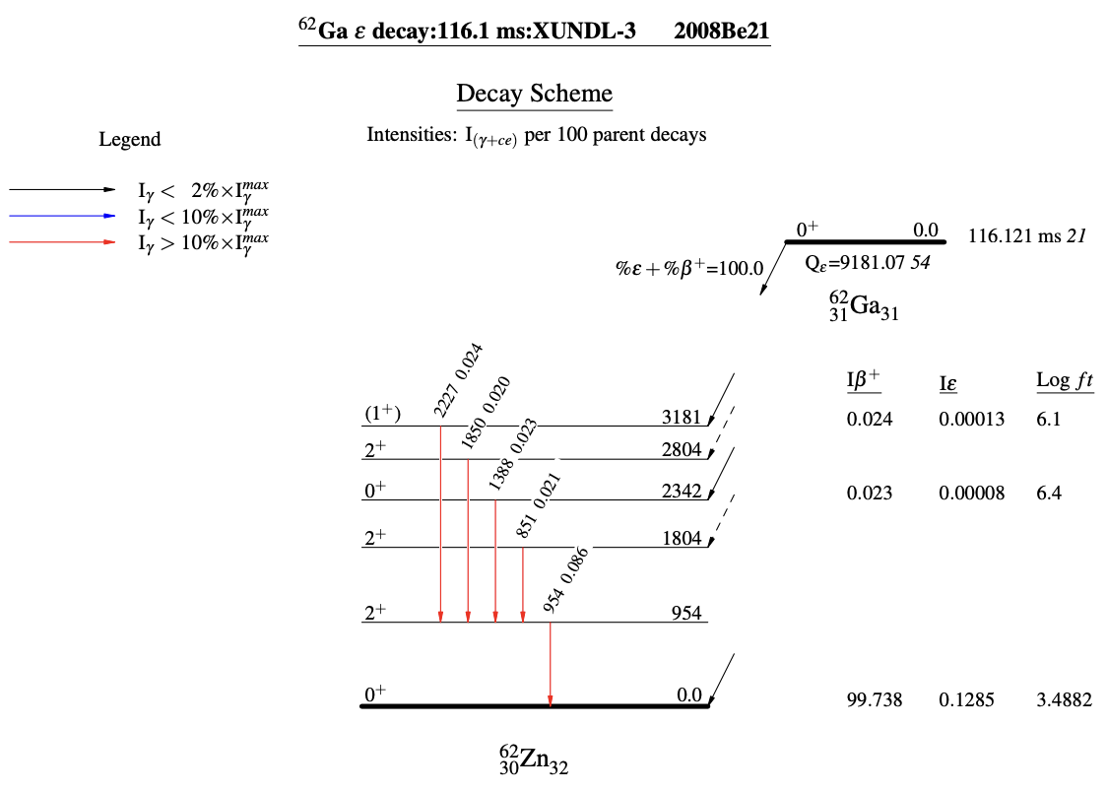
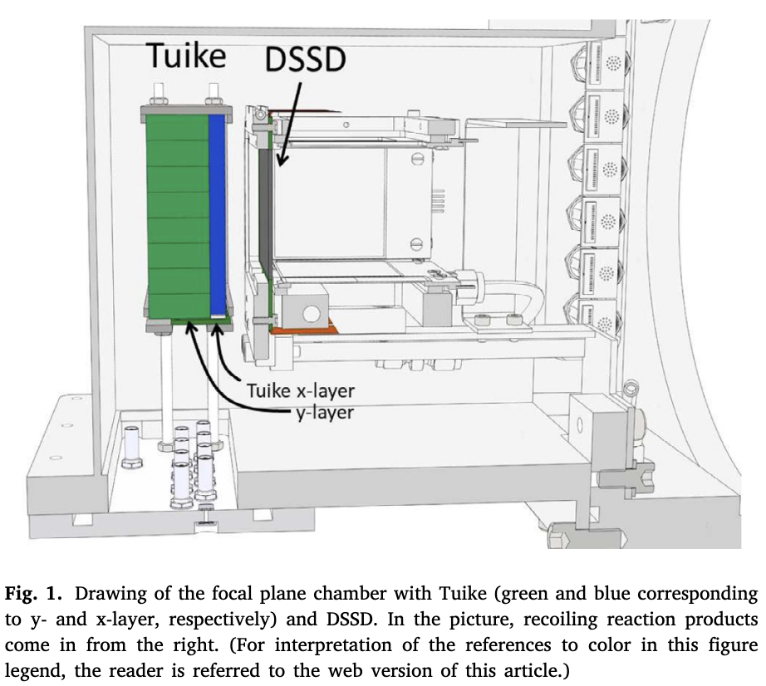
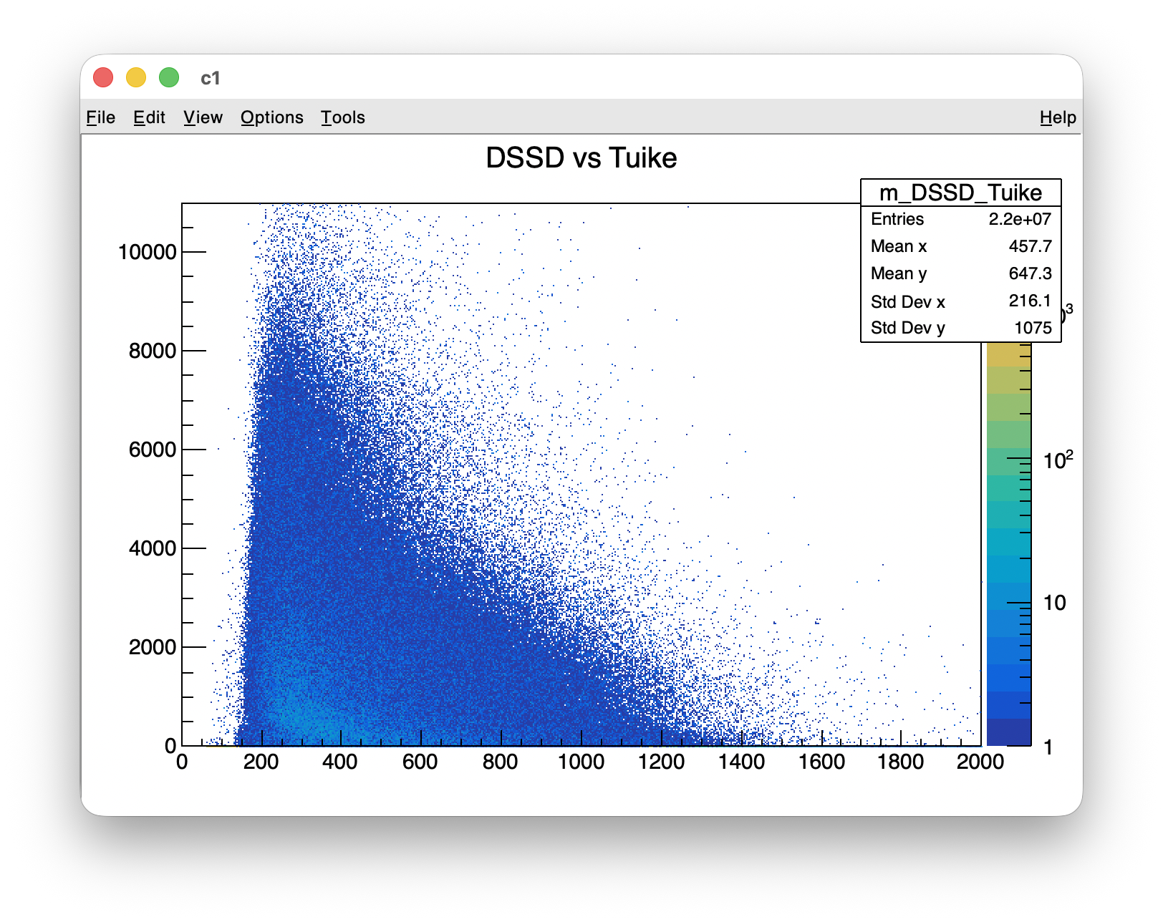
Recoil Beta Tagging
NIMA 1027 (2022) 166253
NIMA 565 (2) (2006) 630–636

Slide 18
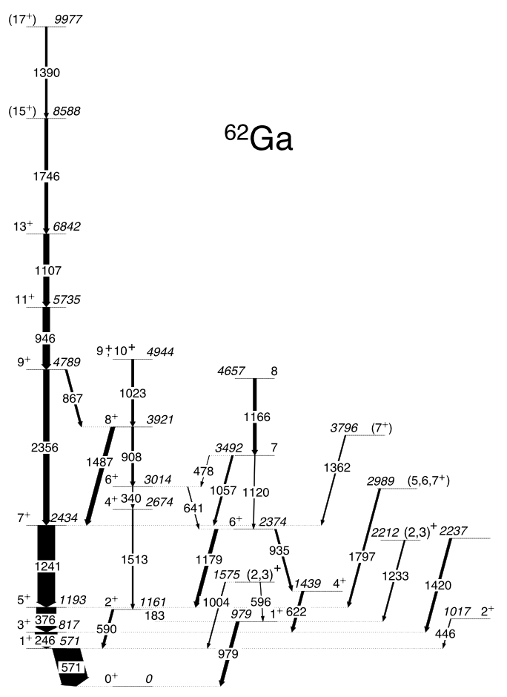
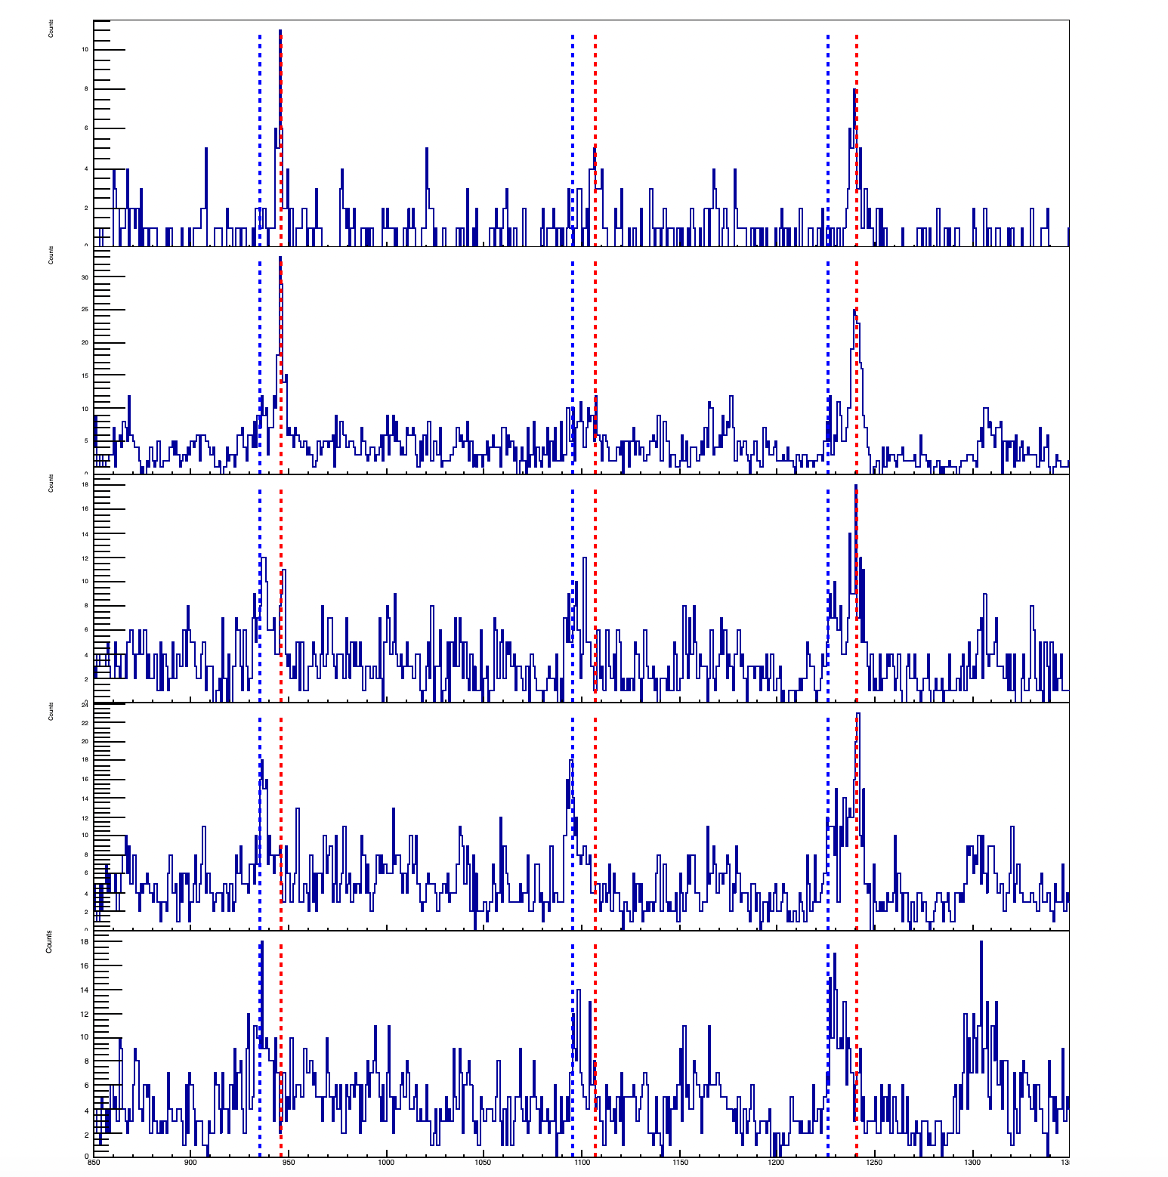
946keV 11⁺->9⁺
1241keV 7⁺->5⁺
1107keV 13⁺->11⁺
15um
25um
50um
70um
120um

Slide 19
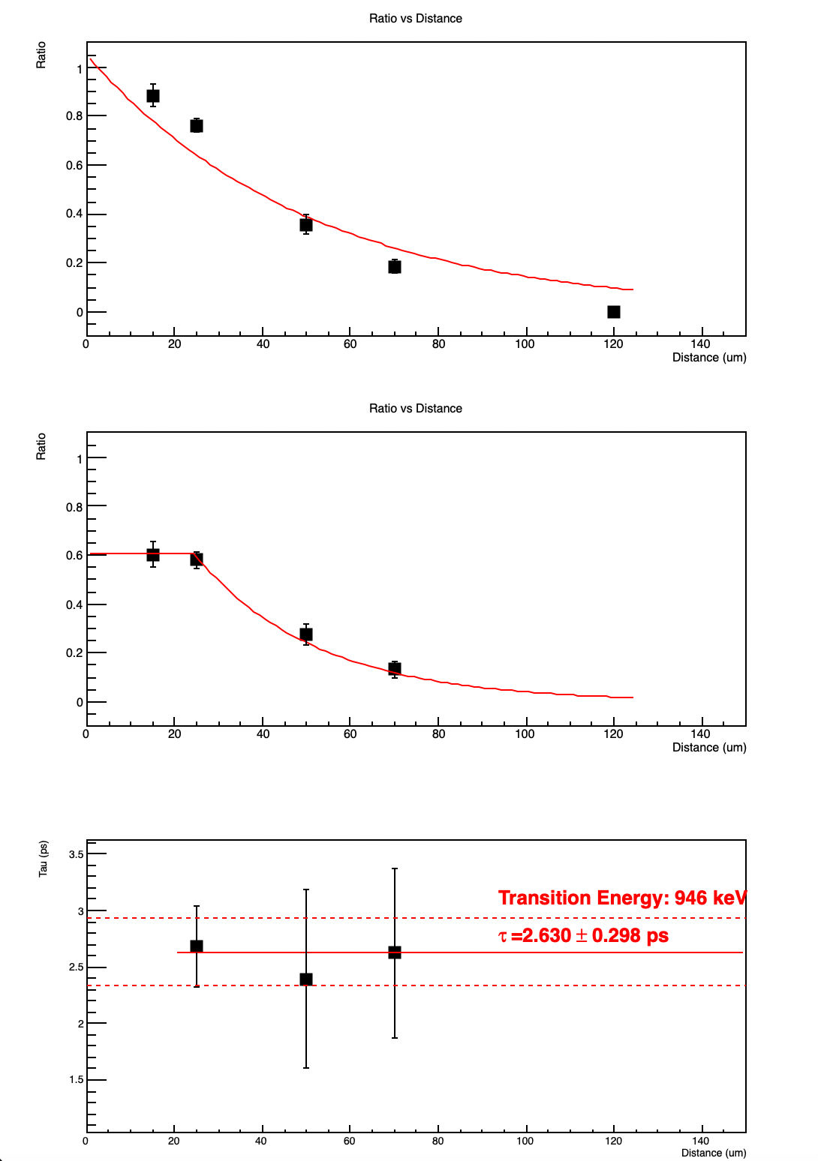
3.27 ps
2.63 ps
4.8 ps

Slide 20
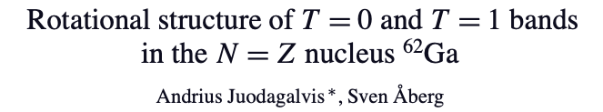
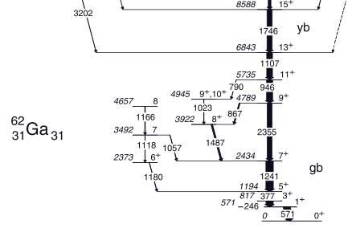
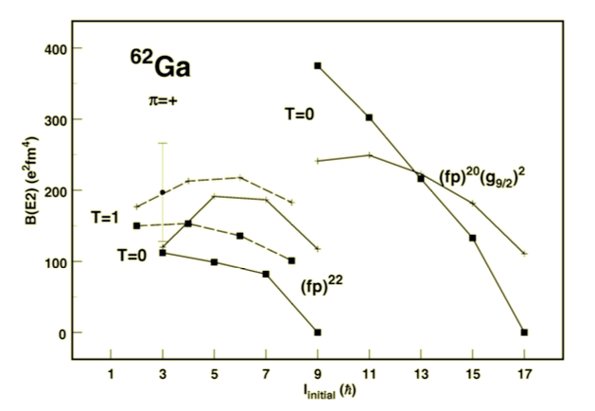

Rotation around the shortest axis
3.27 ps
2.63 ps
4.8 ps
τ⁻¹ ~ B(E2: J_{i} →J_{f}) = 1/(2J_{i} +1)‹ψ_{f} ||E2|| ψ_{i}›²
Rotation around the intermediate axis

Slide 21
Summary
We have measured the lifetime of the isoscalar band built on 9⁺ by Plunger device.
There are still a lot of work to do for the data analysis to optimize these results.
Theoretical calculation based on these results.
…….

Slide 22


Thanks !

