Slide 1
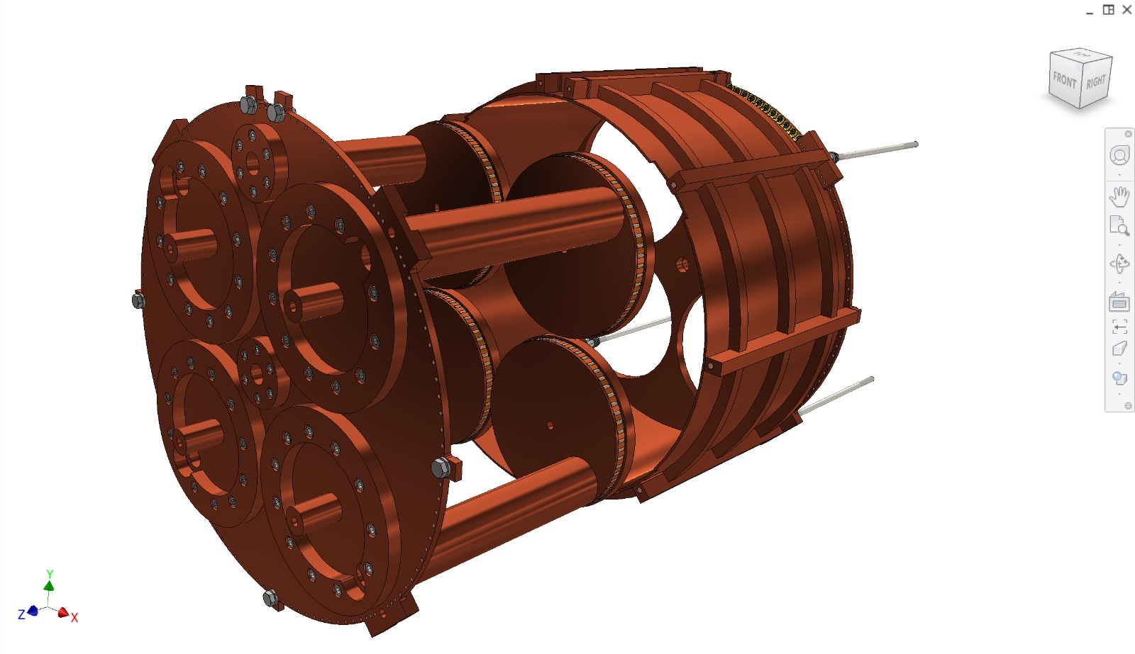
Surface roughness <=1 micron
Circumference=1105mm
d=352 mm
h=287,3 mm
Lateral wall: Foil 1200x300x2 mm³
Endcaps: plates thickness 10mm diameter 400 mm
Longherons: bars section 16x11.5 mm length 300mm
Tuners: tubes
d/h=1960/1600=1,225

Slide 2
We purchased:
two 10 mm thick plates, measuring 420 x 500 mm2
a 35 mm external diameter, 2.5 mm thick tube for the tuner bars, 5 m.
In the metal warehouse:
Two 2mm thick copper sheets (uncertified) are available: one intact, measuring 1000x2000 mm2, and one partially used, measuring 1000x1350 mm2.

Slide 3
