Slide 1
Calibration in an Experiment

Slide 2
Why Do We Need Calibration?
Calibration is meant to ensure that what we measure corresponds to the quantity that we want to measure:
Detectors are not perfect.
Each detector has intrinsic offsets.
Electronics introduce timing uncertainties.
Environmental conditions can affect the measurements.
Without calibration → biased physics results.

Slide 3
What is Calibration?
Calibration is the process of correcting systematic deviations in detector measurements.
True signal → Detector → Offset → Measured signal
Calibration → Corrected signal

Slide 4
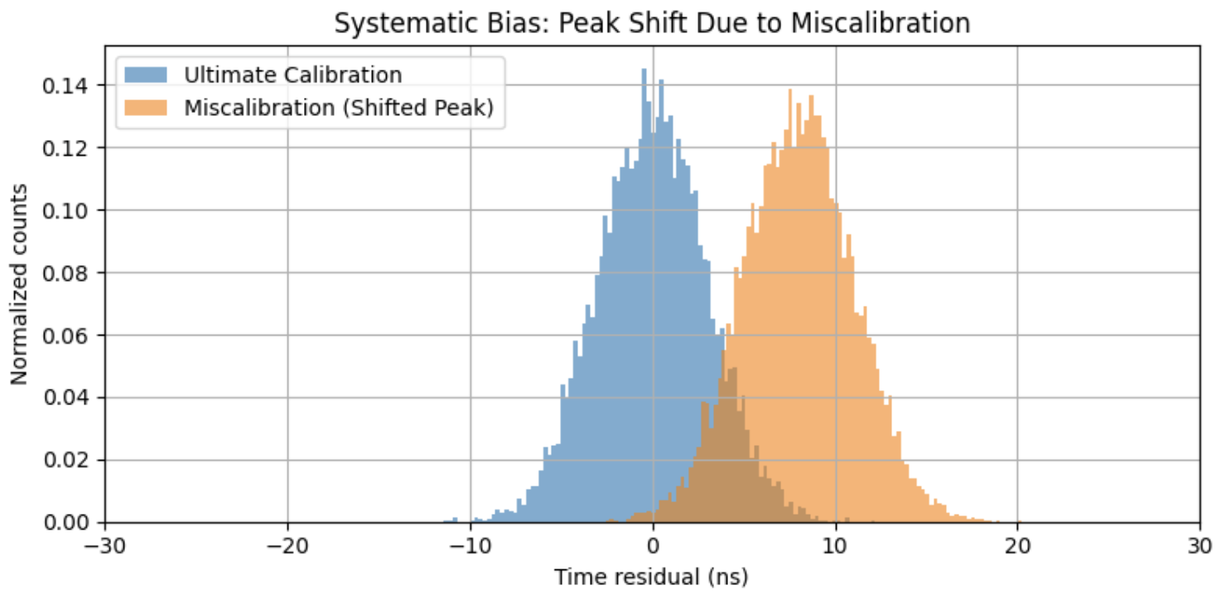
Miscalibration Effects
Miscalibration increases systematic uncertainty.
Time residual = the difference, for each PMT hit detected in a detection unit, between detection time and the estimated time (inferred from the reconstruction of a muon track based on the signals collected from the other detection units)

Slide 5
Example: Timing Offsets in Detection Units
Each Detection Unit (DU) may have a non-negligible time offset.
Even a few nanoseconds matter!
Timing affects:
Direction reconstruction
Event classification
Angular resolution
Small timing shifts can translate into large angular errors.

Slide 6
Our exercise
In this exercise, we reconstruct the direction of particles using timing.
If one detection unit is even slightly miscalibrated, the reconstruction algorithm may think the particle came from a slightly different direction.
You have a set of ten, miscalibrated detection units that you need to calibrate based on their time residual plots:
-> look at the plots using a null-calibration set + look at the corresponding sky map -> recursively apply a correction offset to each DU (in an attempt to place the peaks as close as to zero time residual), then look at the changes in the sky map -> set up the best calibration you can reach and finalize the analysis

