Slide 1
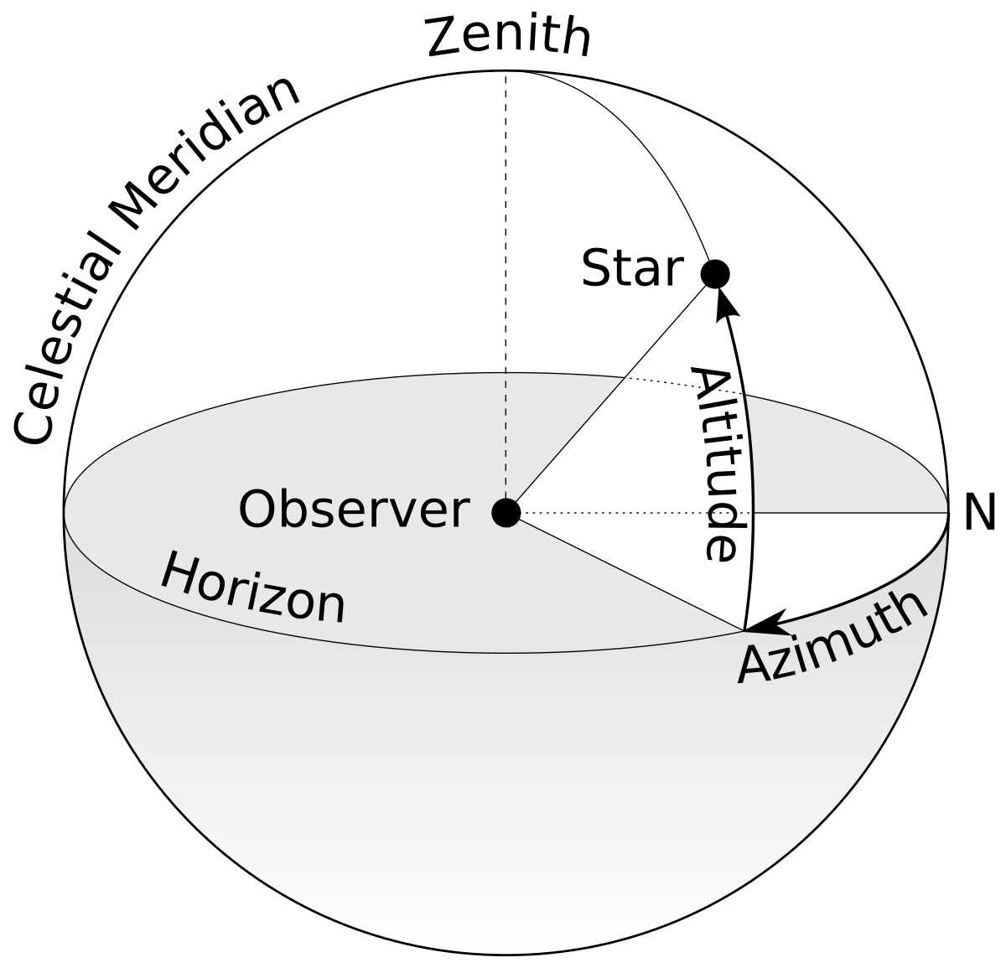
How we locate a point in the sky
The Observer and the Sky
Imagine the sky as a giant dome surrounding the observer.
The observer stands at the center.
The point straight above your head is the zenith.
In astronomy, the astronomical horizon is defined as the intersection between the celestial sphere and a plane perpendicular to the zenith axis of the observer.
  This is a geometrical reference plane used to define celestial coordinates.
  It does not coincide with the place where the sky appears to meet the Earth. That would only be true if the Earth were flat.
  The line where the sky seems to touch the ground is instead called the visual horizon, which depends on the observer’s position and on the curvature of the Earth.

Slide 2
How we locate a point in the sky
Altitude = “Sky Latitude”
Altitude tells us how high an object is in the sky.
It is measured upward from the horizon.
  0° → object is on the horizon
  90° → object is at the zenith (straight overhead)
Analogy:
Like latitude on Earth, which tells how far North or South a location is.

Slide 3
How we locate a point in the sky
Azimuth = “Sky Longitude”
Azimuth tells us which direction to look along the horizon.
It is measured around the horizon, starting from North.
  North = 0°
  East = 90°
  South = 180°
  West = 270°
Analogy:
Like longitude on Earth, which tells how far East or West a location is.

Slide 4
What we can try to measure with KM3NeT in a local coordinate sky map
Above the horizon (altitude > 0°):
  mainly the huge contribution of atmospheric muons (background)
  atmospheric and cosmic neutrinos are completely overwhelmed by muons
Slightly below the horizon (-10° < altitude < 0°)
  many poorly reconstructed downgoing muons that decrease more and more as we move to more negative altitude (background)
  atmospheric and cosmic neutrinos are still significantly overwhelmed by muons
Below the horizon (altitude < -10°)
  No atmospheric muons (muons cannot cross the Earth to reach the detector from below)
  some atmospheric neutrinos (background)
  a few cosmic neutrinos (signal!)

Slide 5
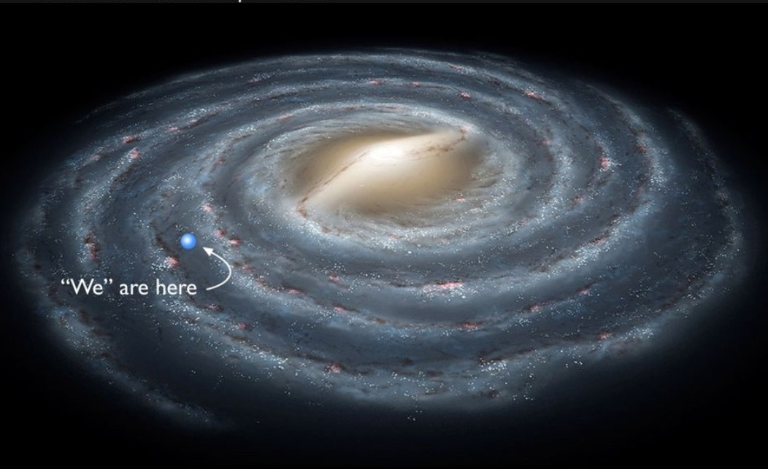
Galactic coordinates
The Milky Way is shaped like a flat disk (like a giant pancake).
We live inside this disk, not outside it.

Slide 6
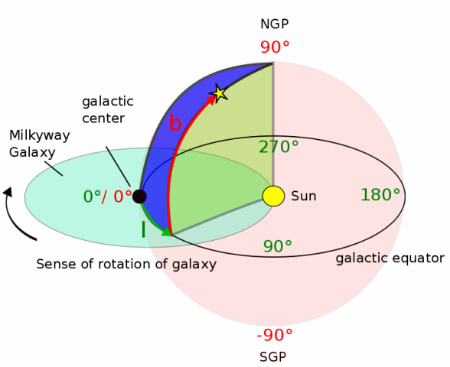
Galactic coordinates
The Sun is our reference point (yellow dot).
The galactic centre is the middle of the galaxy (black dot).
l = galactic longitude
b = galactic latitude

Slide 7
Galactic coordinates
Galactic Longitude (Gal Lon)
Galactic longitude tells us which direction we look within the galaxy.
It is measured around the galactic disk:
  0°→ toward the galactic center
  90°, 180°, 270° → other directions around the galaxy
Analogy:
Like longitude on Earth, measuring East–West position.
l = galactic longitude
b = galactic latitude

Slide 8
Galactic coordinates
Galactic Latitude (Gal Lat)
Galactic latitude tells us how far above or below the galactic disk an object is.
It is measured up or down from the galactic equator:
  0°→ inside the galactic disk
  +90° → North Galactic Pole (NGP)
  −90° → South Galactic Pole (SGP)
Analogy:
Like latitude on Earth, measuring North–South position.
l = galactic longitude
b = galactic latitude

Slide 9
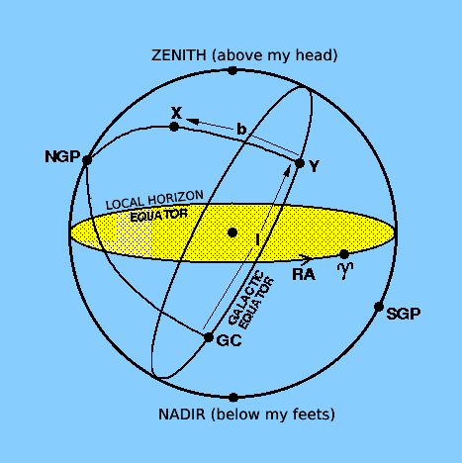
Local coordinates vs Galactic coordinates
The celestial sphere does not change!
All stars are projected onto the same celestial sphere
What changes is how we draw the reference plane on that sphere
The picture shows different planes crossing the same sphere

Slide 10
Local coordinates vs Galactic coordinates
A star stays in the same position in space
But its coordinates change because:
We rotate the reference plane (Earth rotates!)
Mathematically, this is like rotating the coordinate system, not moving the star

Slide 11
Local coordinates vs Galactic coordinates
Local Coordinates (Altitude & Azimuth)
Based on where you are standing on Earth
Dependant on:
  Your location
  The time of day
Great for:
  Pointing a telescope
  Saying “Look there, above the horizon!”
Problem:
  The same star has different coordinates for different observers
They answer the question:
  “Where is the object in my view right now?”
Galactic Coordinates (Galactic Lat/Lon)
Based on the structure of the Milky Way
Independent of:
  The observer
  The time
Ideal for:
  Making sky maps
  Sharing scientific data
Advantage:
  Everyone measures the same coordinates
They answer the question:
  “Where is the object in the universe?”

Slide 12
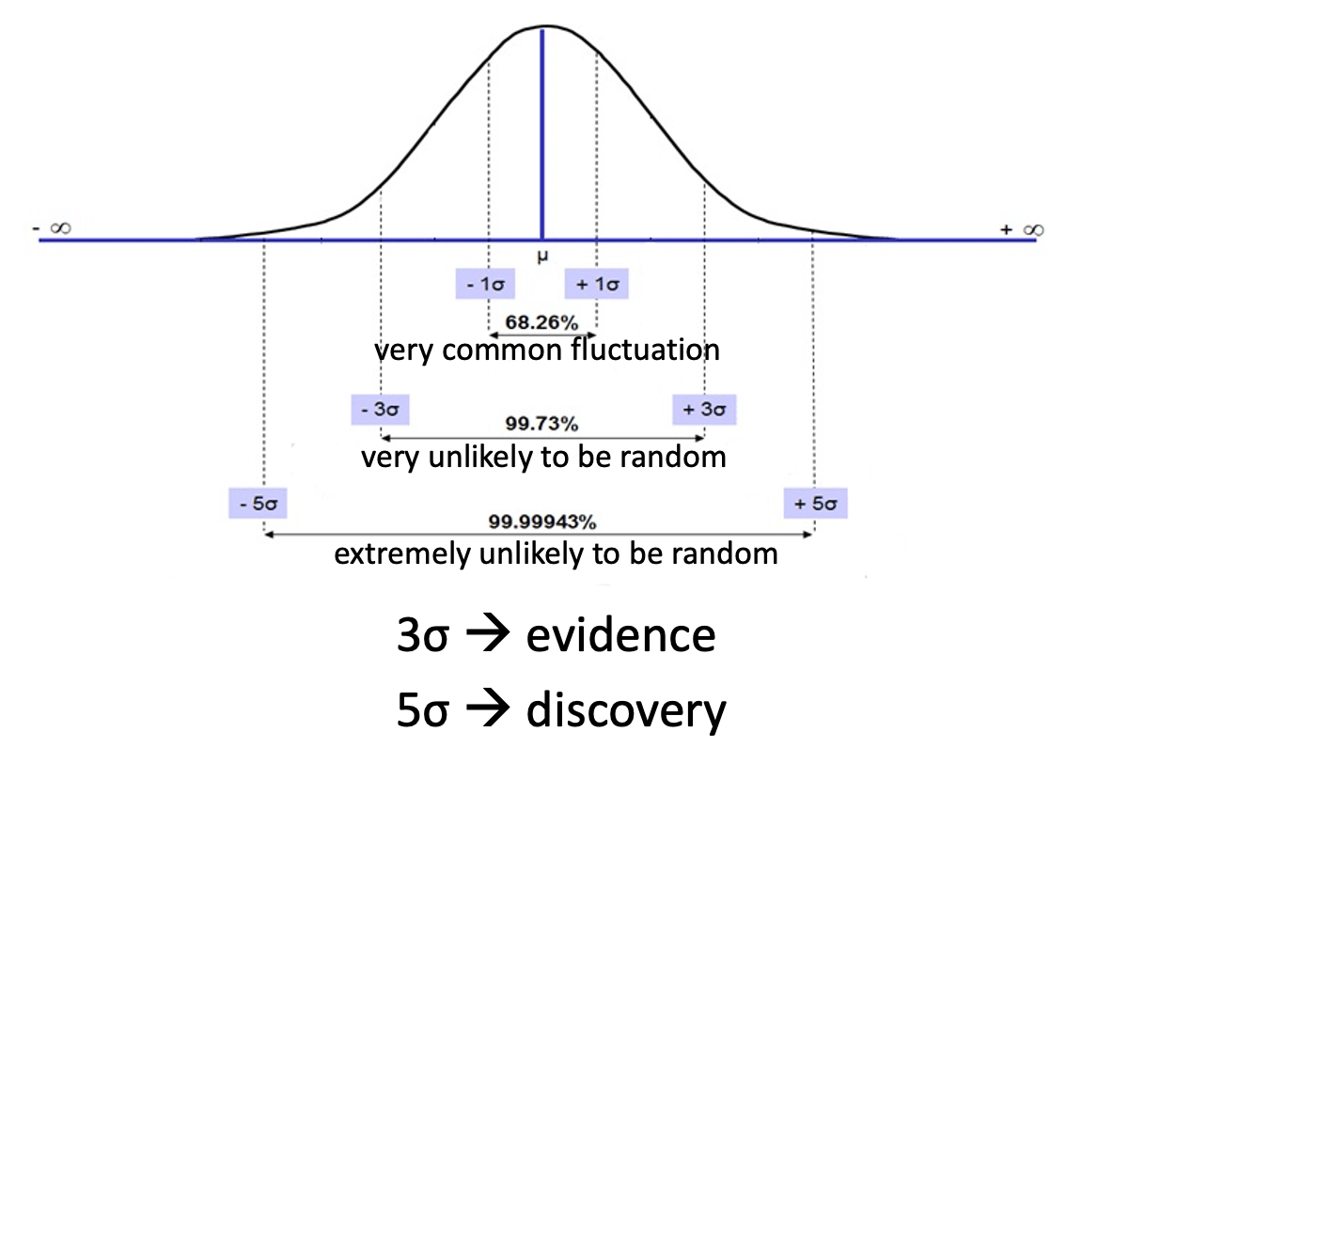
What is “statistical significance”?
When we measure something, the result is never exactly the same
Small differences come from:
  Random fluctuations
  Measurement errors
Statistics helps us decide:
  Is this result real, or just random chance?

Slide 13
Significance estimation with ON/OFF zones
Neutrino detectors see many events
Most of them are background (not from a source)
We need a way to tell if a source is really producing neutrinos
ON zone:
  a 0.3° circle around the astrophysical source
  If the source emits neutrinos, extra events should appear here
OFF zone:
  the rest of the sky outside the ON zone (at the same altitude)
  It is assumed to contain:
    Only background neutrinos
    No contribution from the source
It tells us how many background events we expect

Slide 14
Significance estimation with ON/OFF zones
Compare ON and OFF
  Count events in the ON zone
  Use the OFF zone to estimate the background
  Ask: “Are there more events in the ON zone than those expected by chance?”
Statistical significance
  If ON zone events ≈ expected background → no detection
  If ON zone events > background by 3σ → evidence of a signal
  If ON zone events > background by 5σ → discovery of a source

Slide 15
Significance estimation with likelihood
Why go beyond ON/OFF?
ON/OFF counts how many events we see
But it ignores where exactly the events are inside the region
Likelihood uses all the information we have
Signal hypothesis
  Cosmic neutrinos come from the source direction
  Signal centered on the source
  Signal width → KM3NeT angular resolution
  Events closer to the source are more likely signal
Background hypothesis
  Background events come from everywhere
  Their directions are uniformly spread
  Same probability everywhere in the region

Slide 16
Significance estimation with likelihood
For each detected event, we ask:
“Is this event more likely signal or background?”
We combine all events together
We estimate the amount of signal that best explains the data
We compute the significance of our observation

Slide 17
Analysis instructions
Open the analysis webpage link
Upload a calibration file
Click on ‘run analysis’
The plots will be shown in the browser
If you are not satisfied with the result (or the calibration plots), you can try to improve the calibration and repeat the analysis.

Slide 18
Candidate sources
In this exercise, we will investigate four sources belonging to two different categories:
Blazars
Blazars are extremely energetic galaxies with a supermassive black hole at their center.
The black hole launches powerful jets of particles moving close to the speed of light.
When one of these jets points toward Earth, we observe very strong radiation across many wavelengths (from radio waves to gamma rays).
They are among the brightest and most variable objects in the universe.
Pulsar Wind Nebulae (PWN)
A pulsar wind nebula forms around a pulsar, which is a rapidly spinning neutron star left after a supernova explosion
The pulsar emits a wind of very energetic particles.
These particles interact with the surrounding material and magnetic fields, creating a glowing nebula.
PWNe are important sources of high-energy radiation such as X-rays and gamma rays.

Slide 19
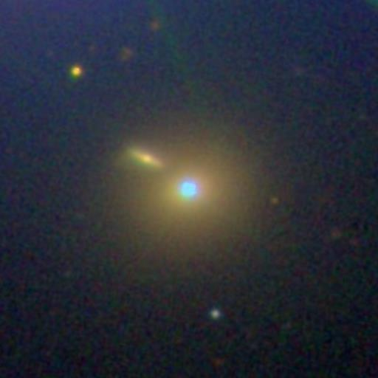
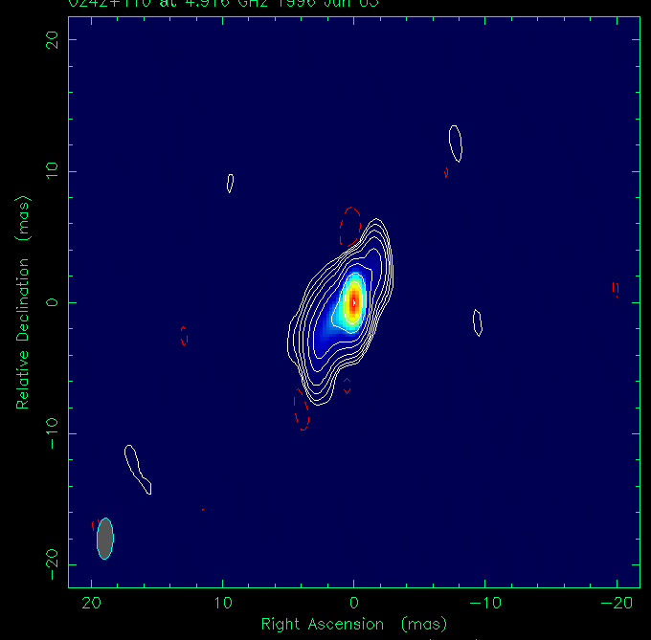
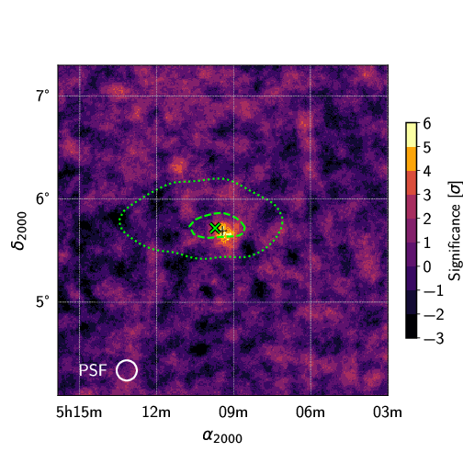
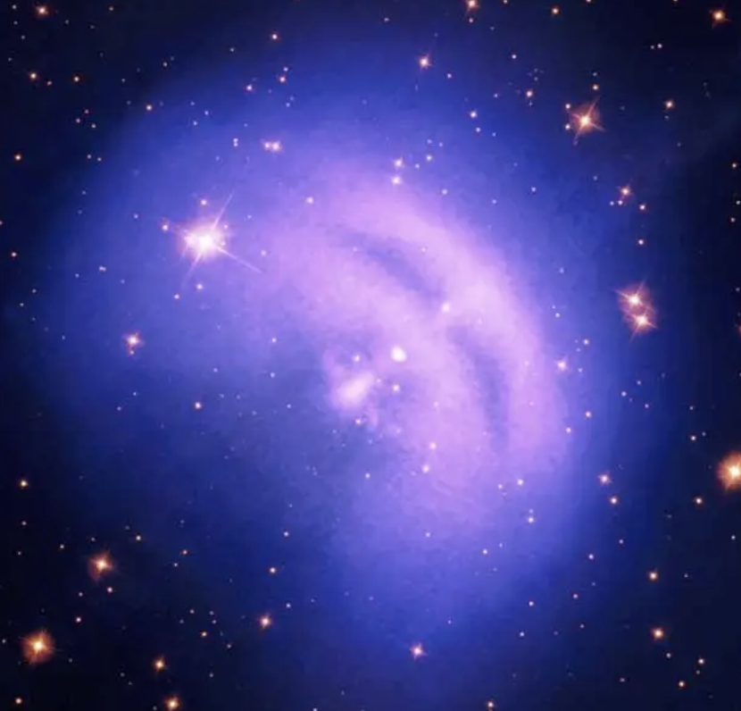
Candidate sources
A - Markarian 421
Blazar
B - PKS 0239+108
Blazar
C - Vela X
Pulsar wind nebula
D - TXS 0506+056
Blazar

Slide 20
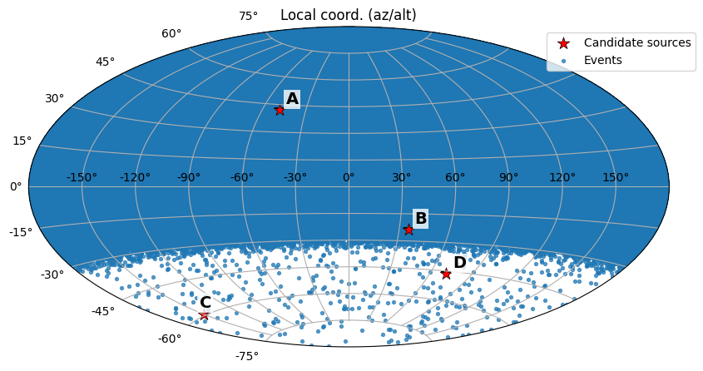
How to interpret the plots
above the detector
horizon of the detector
azimuth
below the detector
altitude

Slide 21
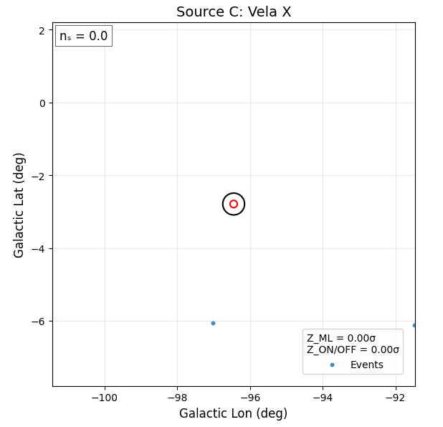
How to interpret the plots
Number of cosmic neutrinos (signal) that best explains the data
Red circle: 0.1° distance from the source
Black circle: 0.3° distance from the source
Significance computed with the likelihood method
Significance computed with the ON/OFF method
3σ → evidence
5σ → discovery!

