Slide 1

Introduction to event display

Slide 2
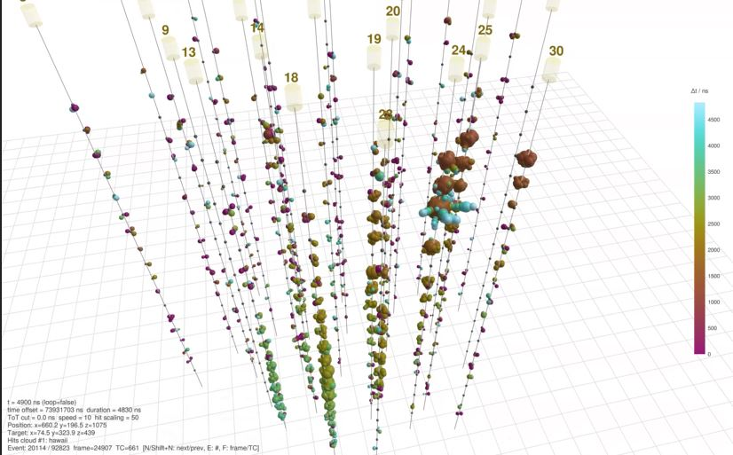
Why the event displays?
Event displays are a powerful means to guess the main features of the events
They are also useful tools to check the performance of the apparatus

Slide 3
What you will find for this exercise:
What you are requested to do:
10 event displays (movies)
10 sets of plots for the same events (but scrambled!)
Find the association between events 1, … 10 and plots A, … J
Detemine for each event the category that you consider more appropriate, choosing from:
Downwardgoing / horizontal / upwardgoing tracks
Cascades

Slide 4
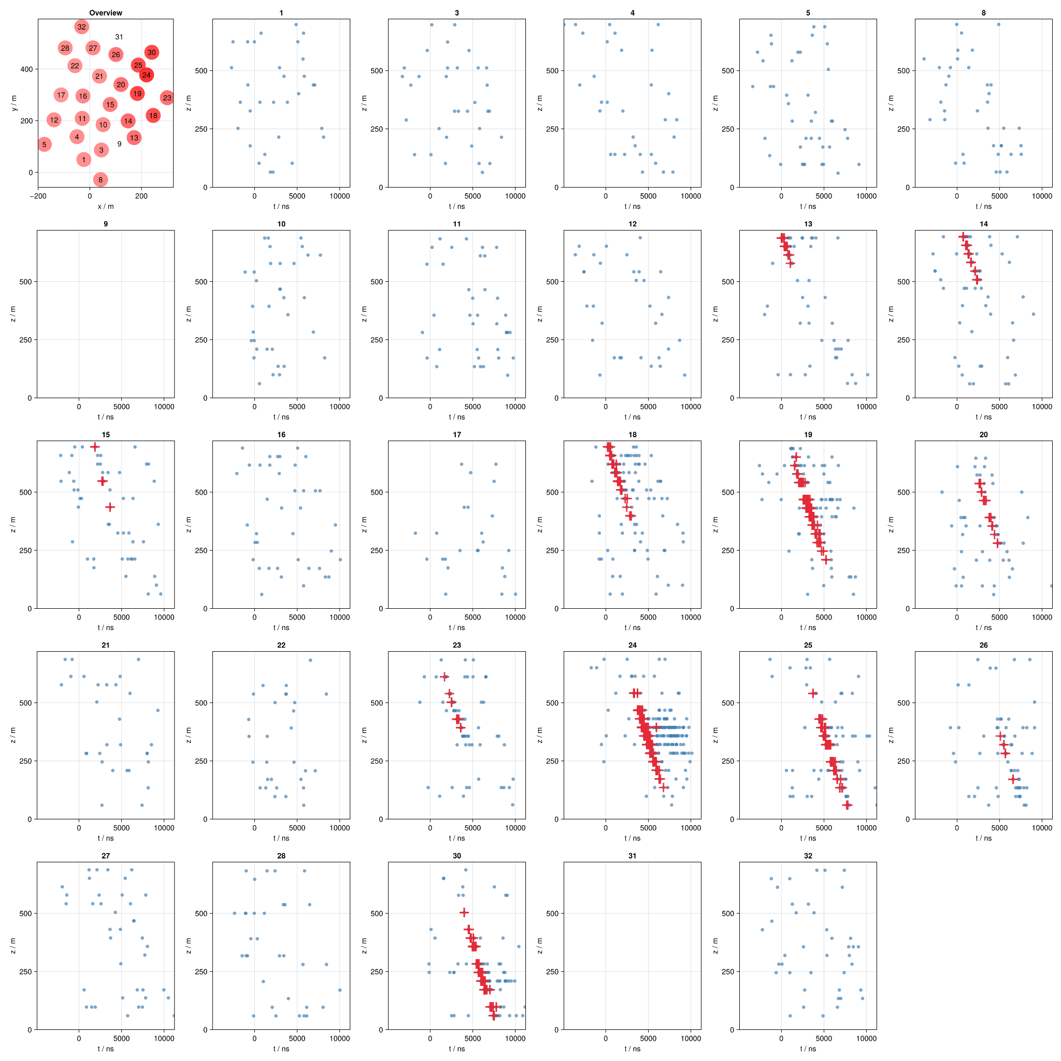
How to interpret the plots
Top left: layout of the apparatus, showing the positions of the detection units and the amount of signals they detected (increasing with increasing level of colour)
Rest of the page: one plot per detection unit, showing the vertical level and the time of detection of each signal
(Remark: red signals are those contributing to the event trigger, which occurs at t = 0)

Slide 5
How to interpret the movies
The colours indicate the detection time of the signals (with the count starting at the time of the trigger)
In the bottom left you find key information about the event (not really relevant for your exercise)

