Slide 1

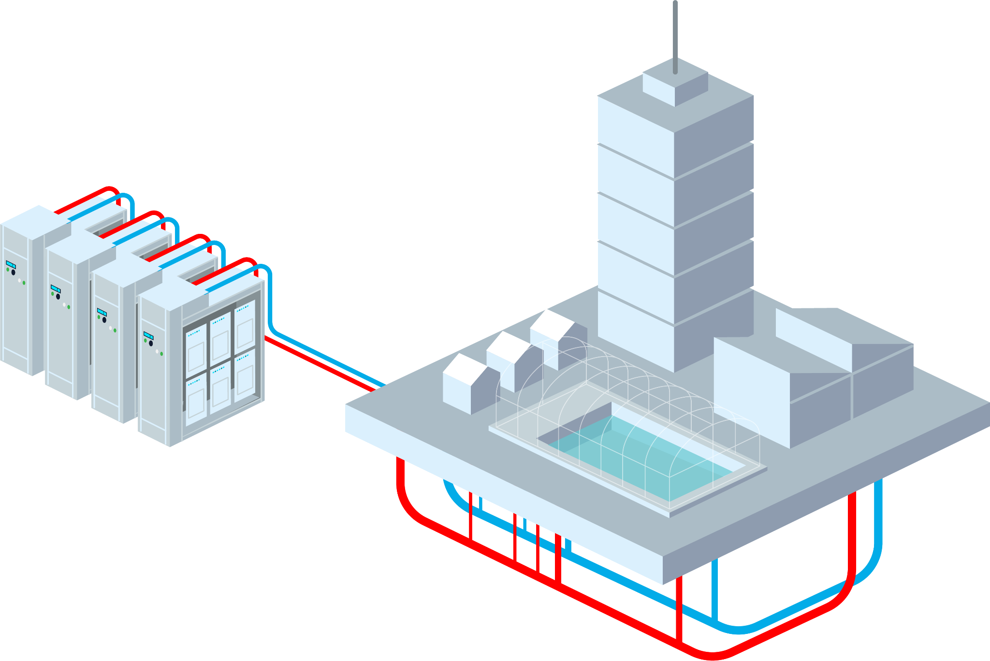
Waste Heat as a Resource:
Qarnot's Distributed Computing Model for Sustainable HPC
Speaker: Mario Pesce

Slide 2
Summary
Context
What is HPC?
The carbon footprint of digital technology
The Qarnot model
Technical Challenges
Heat-reusing system
Align the heat demand to the compute offer
Re-use the heat while keeping top-level performances
What comes next?

Slide 3
Context
HPC
High-Performance Computing: clusters of servers doing intensive computation — scientific simulation, AI training, rendering.
Whatever the workload, every Watt of electricity going in over comes back out as heat.

Slide 4
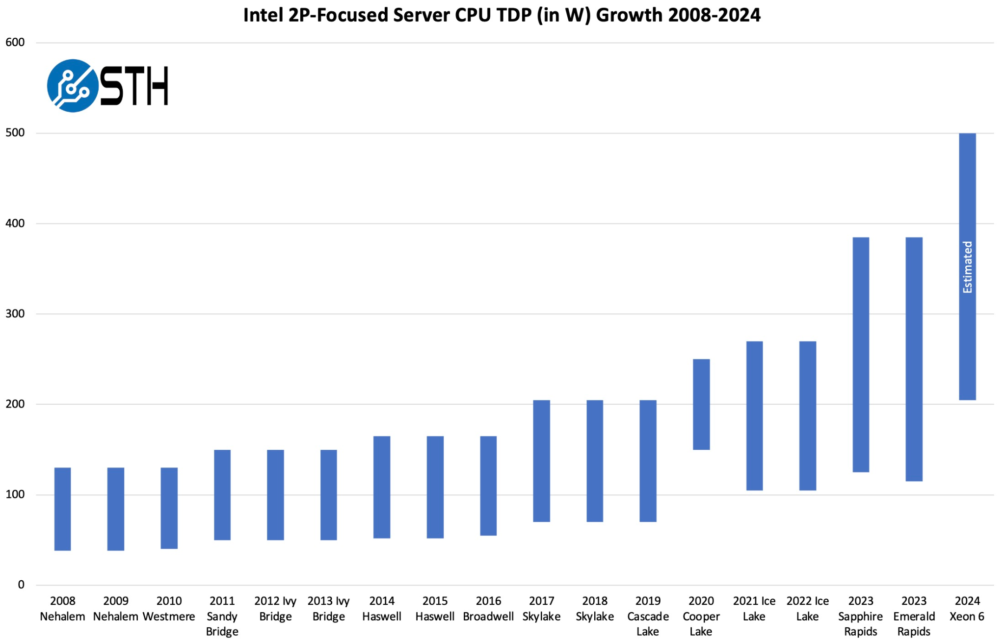
Chip level
Challenges: Increase in carbon footprint of the Compute sector - CPU level
Top-end CPU power need has roughly tripled over the last two chip generations — more heat concentrated in the same footprint, which is both a cooling issue and more energy available to recapture
Evolution of Intel high-end CPUs TDP (in W)
Notes:
TDP: thermal dissipation power. BIGGER CPUs →increasing power request for squared cm of cpu AND carbon footprint is increasing for CPU
Power Wall broke in 2023 because of liquid cooling performance boost. GPU TDP 2.6 kW (so 4x the highest on the graph)

Slide 5

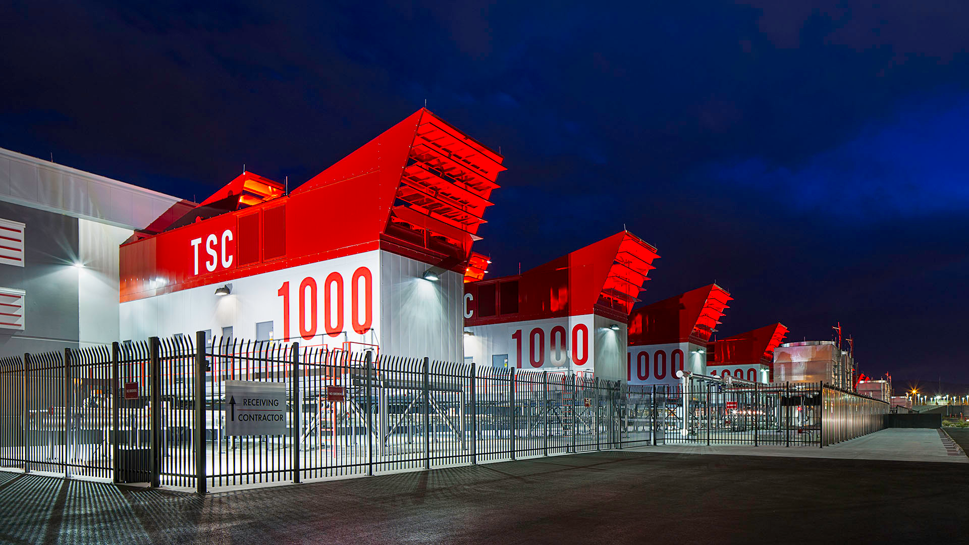
Data Center Level
Challenges: Increase in carbon footprint of the Compute sector - Data Center level
Switch DC in Nevada
650MW
Meta started building a 1GW DC and plans a 5GW DC
Notes:
we have a change of order of magnitude because we are not on CPU level → data center level increase in order of magnitude because of raise of AI

Slide 6
Context
EU Legislation
German Efficiency Act extract:
In addition, an energy reuse factor (ERF) has been imposed specifically on data centers: Data centers that start operations on or after July 1, 2026, must be constructed and operated to achieve an ERF of at least 10%; data centers that start operating on or after July 1, 2027, must achieve a projected ERF of 15%; and data centers that start operating after July 1, 2028, must achieve a projected ERF of 20%. The requirements are not to be achieved on an annual average basis until two years after the start of operations.
Carbon footprint always rising
Increase in energy demand with AI rise - Beyond carbon, the binding constraint is increasingly physical: finding megawatts of available grid connection for new compute capacity is getting harder in most of Europe
New laws (German Efficiency Act) to limit surge of carbon footprint DC:
15% reused waste heat for data centers starting operation from July 1, 2026
20% for those starting from July 1, 2028
Notes:
talk about the minimum requirements of heat reuse for data center ← 2026 german law

Slide 7
Summary
Context
What is HPC?
The carbon footprint of digital technology
The Qarnot model
Technical Challenges
Heat-reusing system
Align the heat demand to the compute offer
Re-use the heat while keeping top-level performances
What comes next?

Slide 8
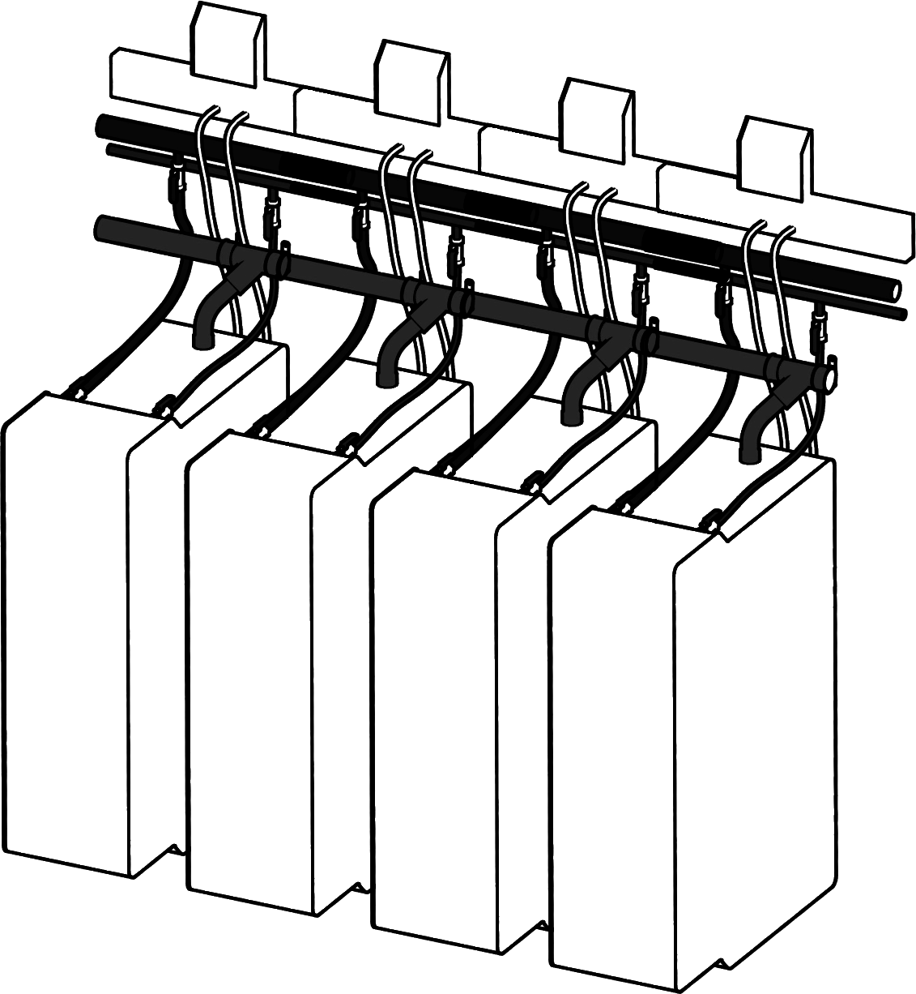
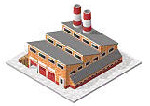

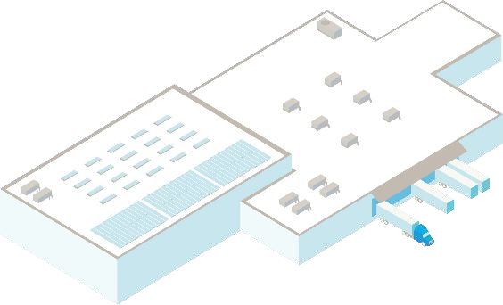
The Qarnot model: European HPC provider reusing IT waste heat| part of Scaleway, a European Cloud provider
We install our servers where the heat is needed
Q·ware
Notes:
"Instead of one large site, compute is split across many small sites — buildings, district heating substations — sized to the local heat demand. Q·ware, our scheduling middleware, treats every site as one logical HPC resource, so from the user's side it behaves like a single cluster."
Targets for site installation: Pools, factories with heat need, heat district networks, site with overall 100kW and up to 2MW with Scaleway

Slide 9


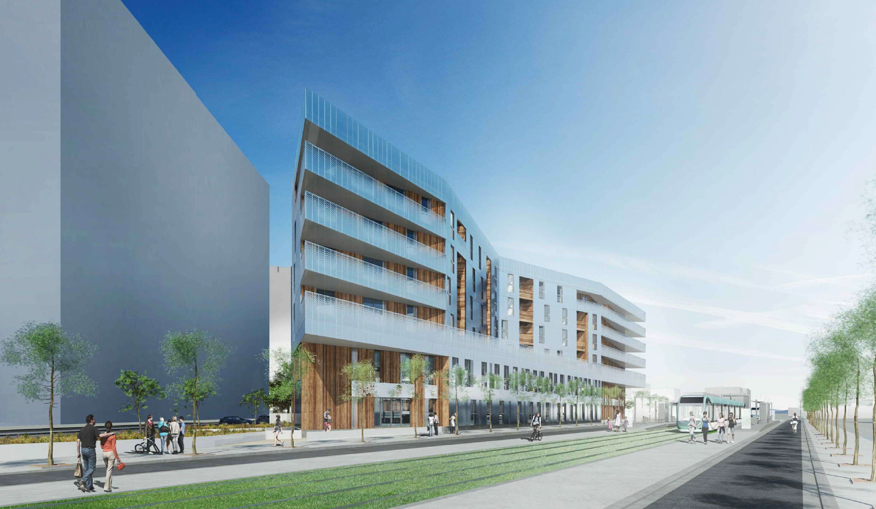




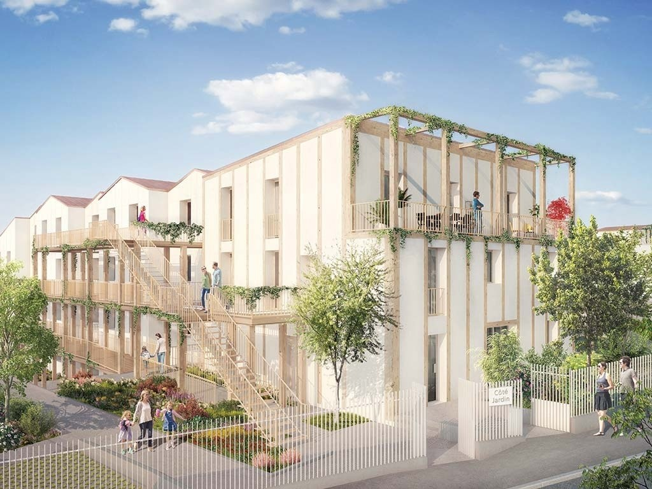


The Qarnot model
A two faces business model
Compute
Buildings
QB·X
Clients need free heat
Notes:
Heat is 10% of CA of overall compute

Slide 10
The Qarnot model
Impact of reusing IT waste heat
Scope
DC: 5MW
Heating system: 5MW
Duration: a year
French electricity carbon intensity factor
PUE/ERE meaning?
note proposition:
PUE measures how much extra energy the building uses on top of IT load — it says nothing about what happens to that energy once it becomes heat. ERE corrects for this by subtracting the heat that's actually recovered and reused
Scenario #1
Regular DC
PUE = 1,6
ERE = 1,6
Scenario #2
Reusing heat DC
PUE = 1,05
ERE = 0,10

Slide 11
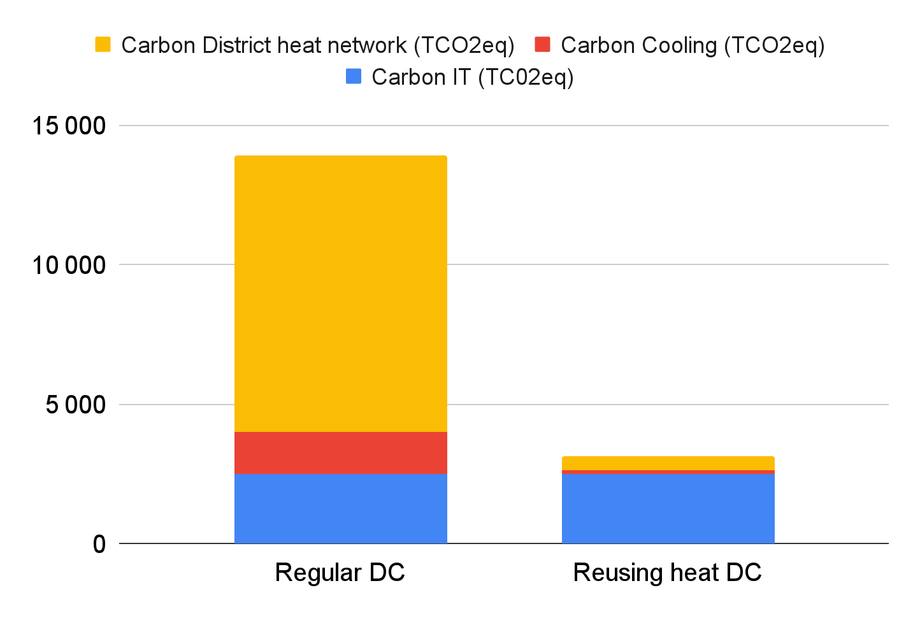
The Qarnot model
Impact of reusing IT waste heat - Data Center and Building not connected
Scope
DC: 5MW
Heating system: 5MW
Duration: a year
French electricity carbon intensity factor
cooling needed for data center and high electricity consumption → high CO2eq
Carbon footprint for each scenario (TCO2eq)
Notes:
PUE measures how much extra energy the building uses on top of IT load — it says nothing about what happens to that energy once it becomes heat. ERE corrects for this by subtracting the heat that's actually recovered and reused

Slide 12
The Qarnot model - 11k TCO2eq tons CO2eq avoided per year at 5MW scale
Impact of reusing IT waste heat - Data Center and Building connected
Scope
DC: 5MW
Heating system: 5MW
Duration: a year
French electricity carbon intensity factor
no cooling needed because we recycled heat from compute in the building
Carbon savings
Scenario #1
Regular DC
PUE = 1,6
ERE = 1,6
Scenario #2
Reusing heat DC
PUE = 1,05
ERE = 0,10
Carbon footprint for each scenario (TCO2eq)

Slide 13
Summary
Context
What is HPC?
The carbon footprint of digital technology
The Qarnot model
Technical Challenges
Heat-reusing system
Align the heat demand to the compute offer
Re-use the heat while keeping top-level performances
What comes next?

Slide 14
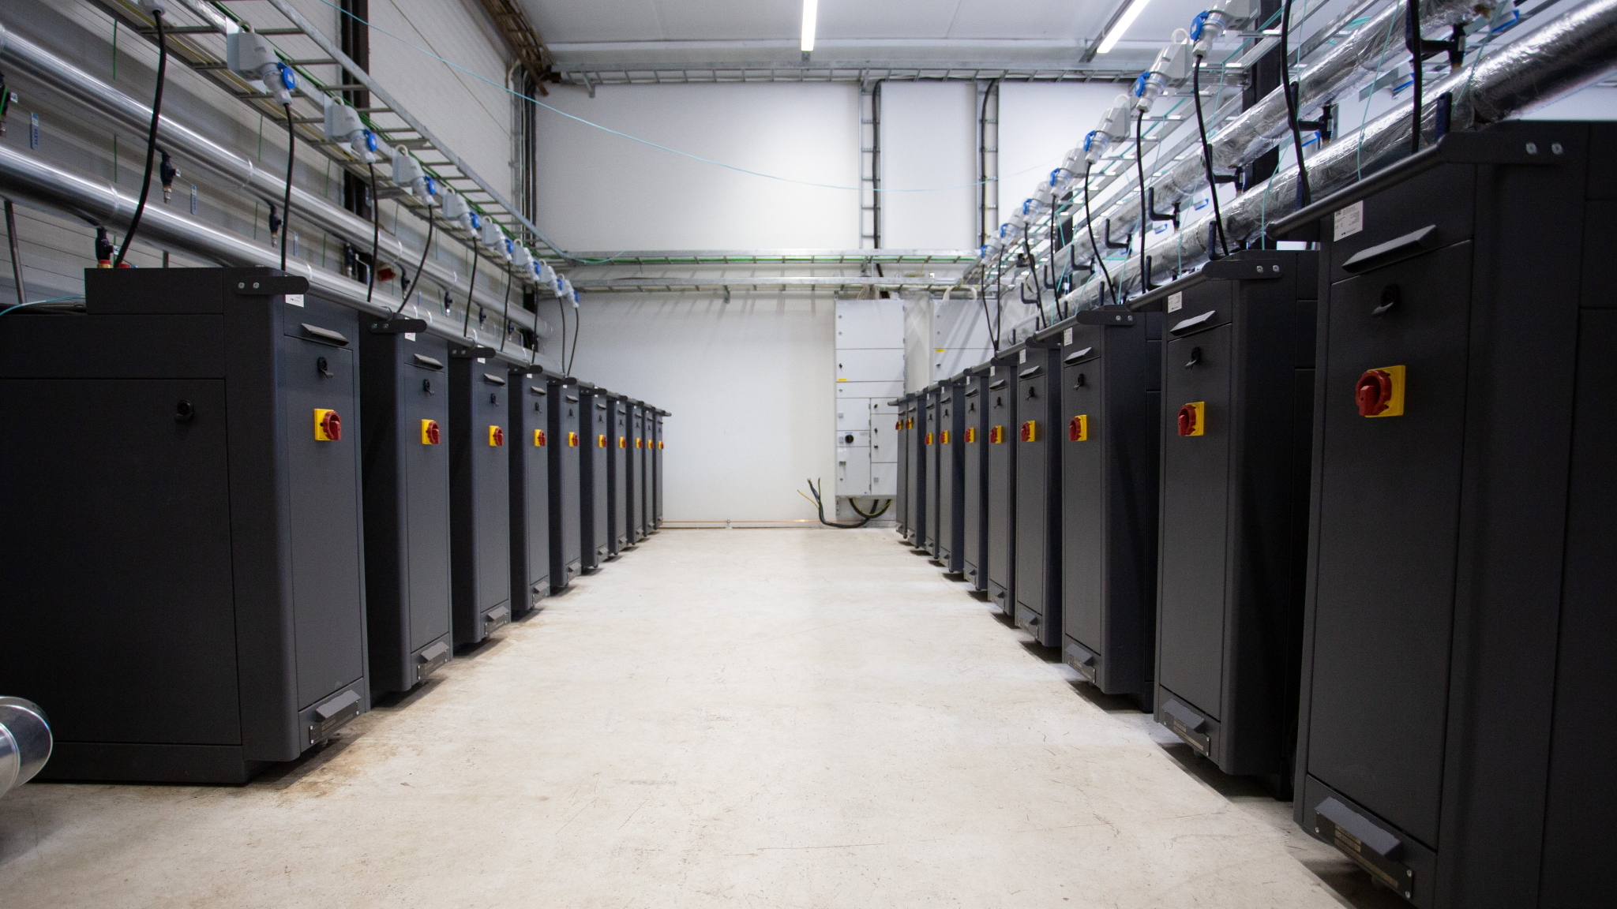
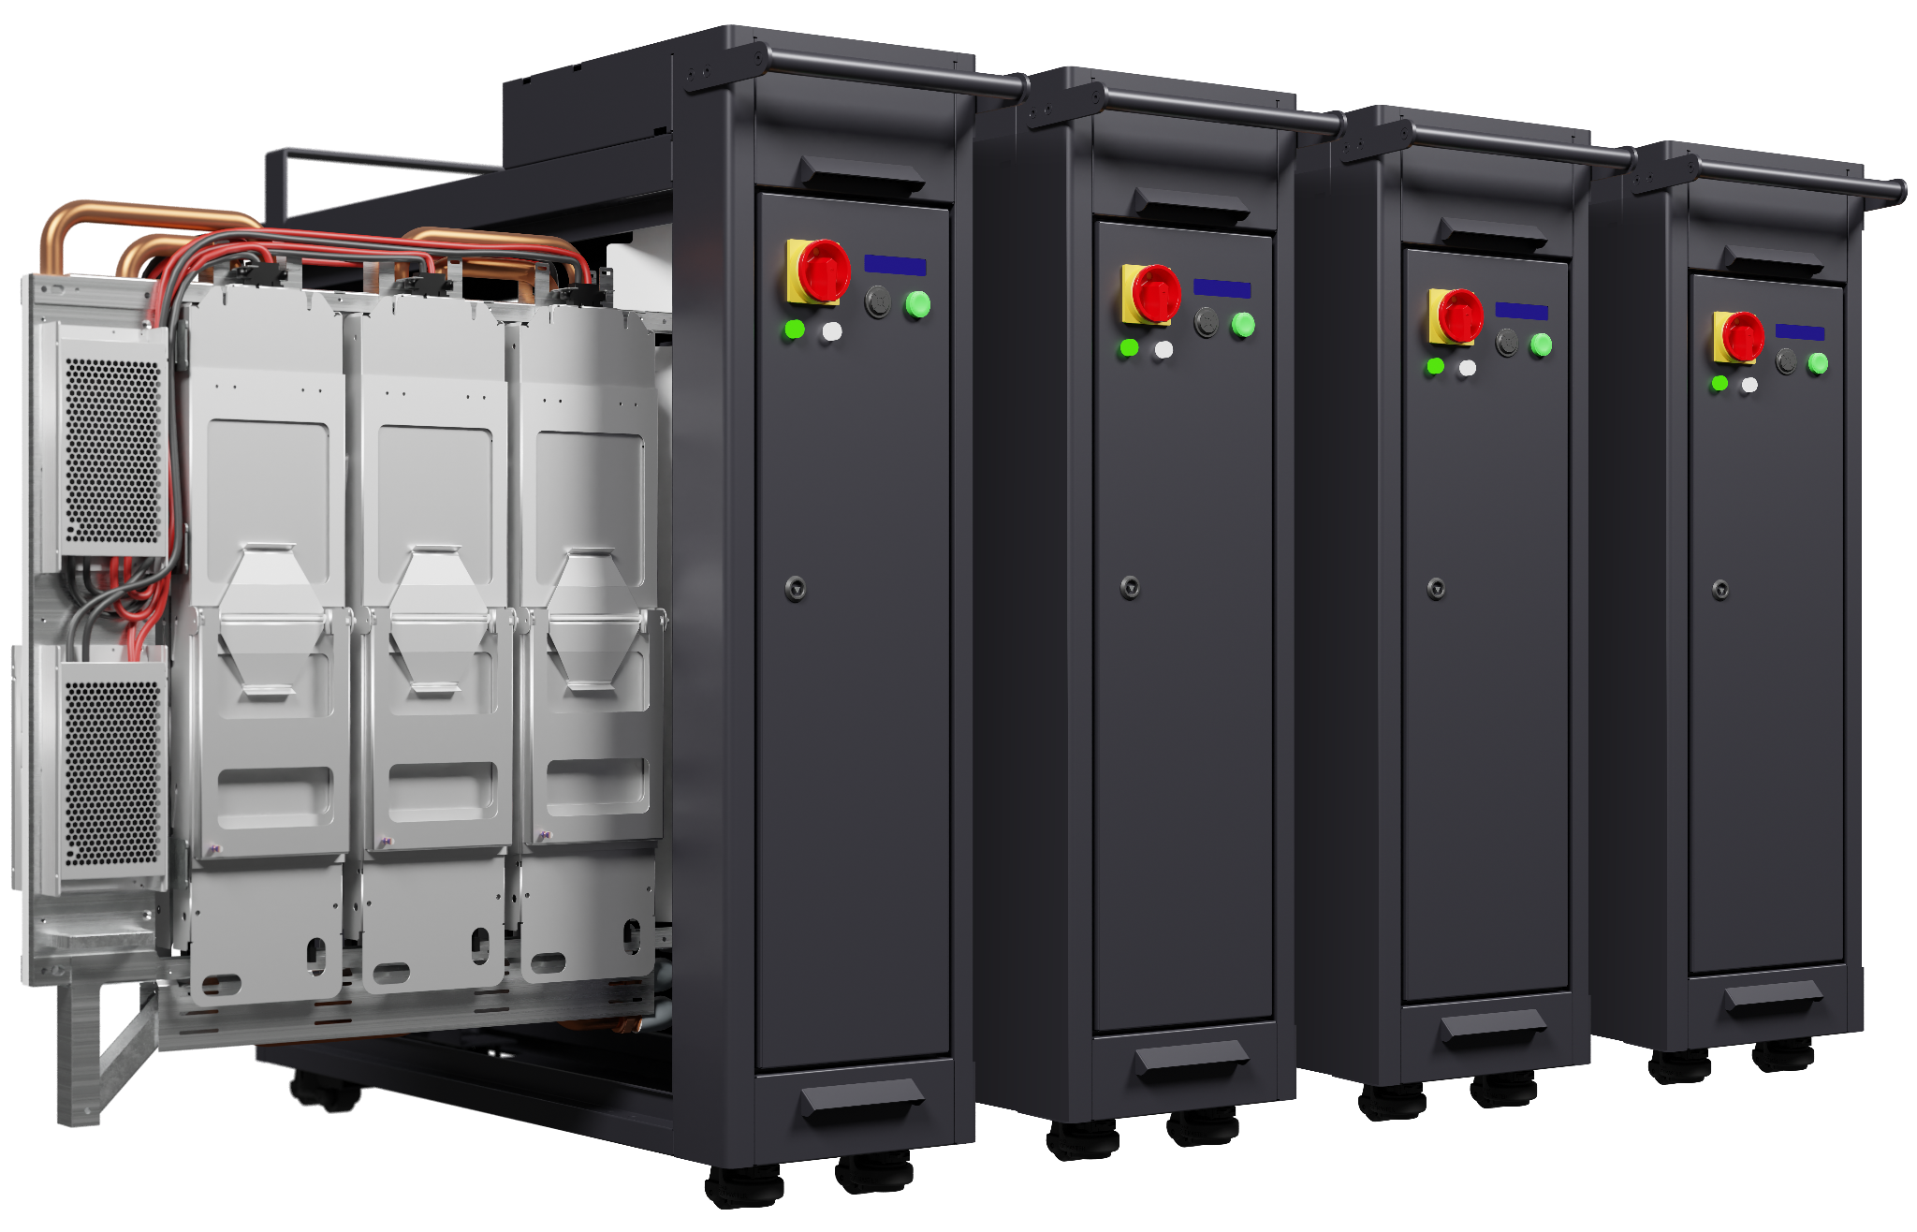
Technical Challenges
Heat Reuse System - A computing boiler
Notes:
Each unit is a sealed, liquid-cooled digital boiler — the same heat that would need active cooling in a conventional data center is instead captured and piped out as usable hot water. Example of pool installation every unit is a 8kW computing boiler, total is 100kW more or less to hetat up a pool

Slide 15
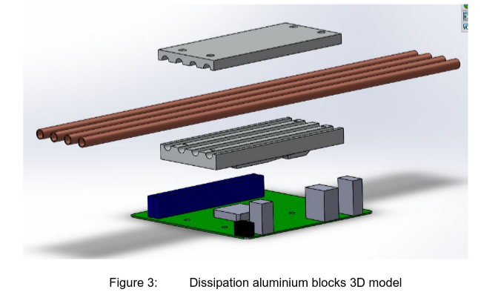
Technical Challenges
Heat Reuse Tech- A liquid cooled cold plate
Notes:
How the cold plate interfaces with the CPU/GPU and where the water goes next (heat exchanger → cold plate in alluinium that trap heat -> pipes in copper -> water pipe = building loop)

Slide 16
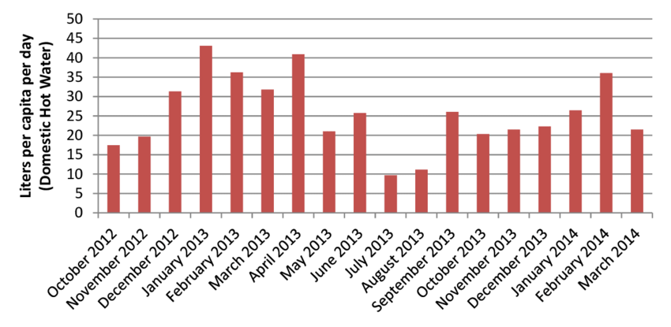
Technical Challenges
Heat Reuse System - “How do you do in the summer?”
Notes:
go to next slide to give explanation

Slide 17
Technical Challenges
Align heat demand and compute offer
what if heat demand > compute demand?
⇒ there is an additional gas boiler that takes up when more heat is needed
what if compute demand > heat demand?
⇒ donating spare compute to research when heat demand is low via the project folding@home
Notes:
servers need to run all the time, if they don’t we do folding@home a project where you connect your laptop unused for folding (HPC branch that studies protein interactions between them)

Slide 18
Technical Challenges
The temperature challenge
Heat customers want water at 60°C+ to be useful and for health reasons (for space heating, domestic hot water); but the hotter your outlet water, the harder it is on your IT hardware

Slide 19
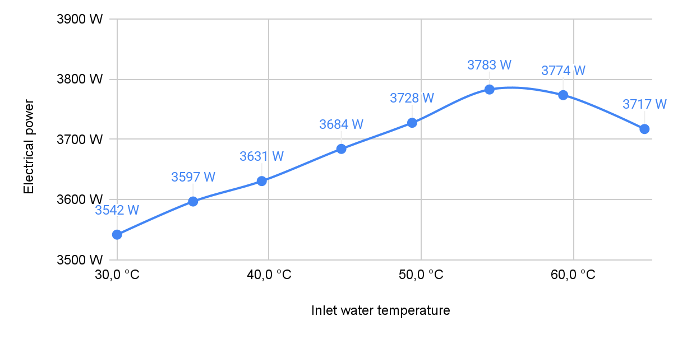
The Qarnot approach
The temperature challenge: impact of heat on power
Power vs inlet water temperature
Heat providers need high outlet water temperatures (60°C+) but high temperatures are challenging:
IT consumes more electricity with increasing temperature
Notes:
for Qarnot all power (almost) turns into heat so we don’t have waste and we don’t have this power issue

Slide 20
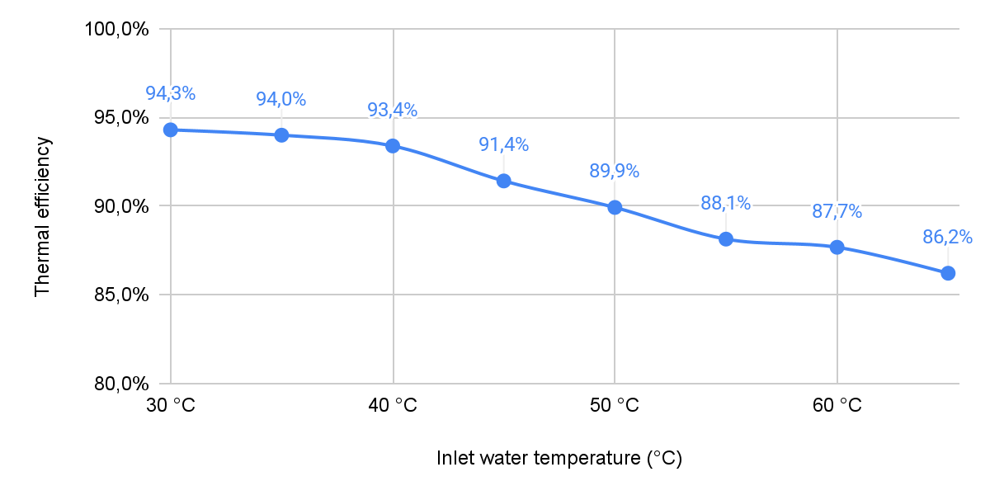
The Qarnot approach
The temperature challenge: impact of heat on thermal efficiency
Thermal efficiency vs inlet water temperature
Heat providers need high outlet water temperatures (60°C+) but high temperatures are challenging:
IT consumes more electricity with increasing temperature
thermal efficiency decreases with increasing temperature
Notes:
Test bench: on our boilers with a power meters in input and temperature sensor in every QB in use and water mass flow measured. heat % that we can actually recycle

Slide 21
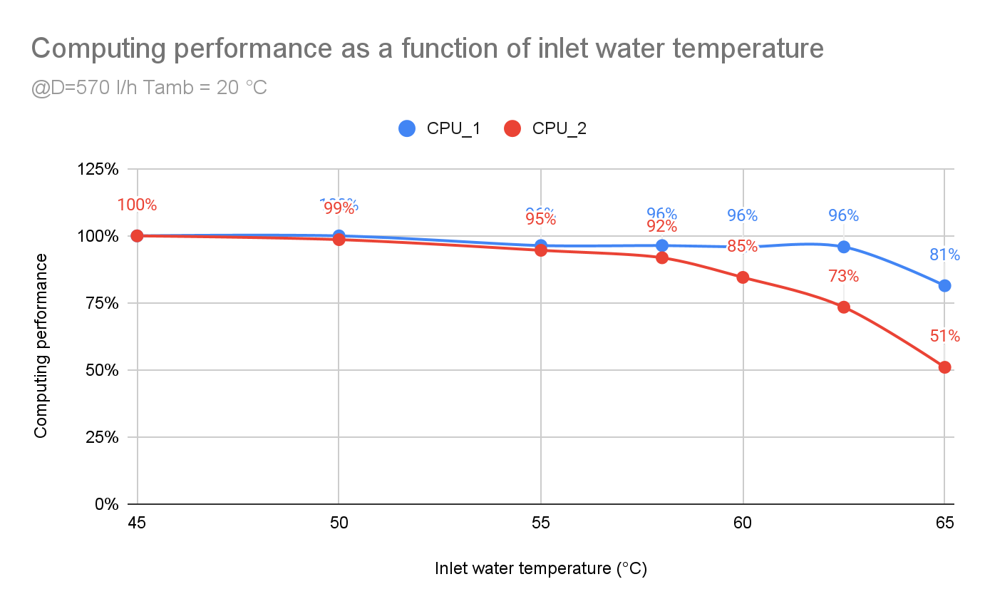
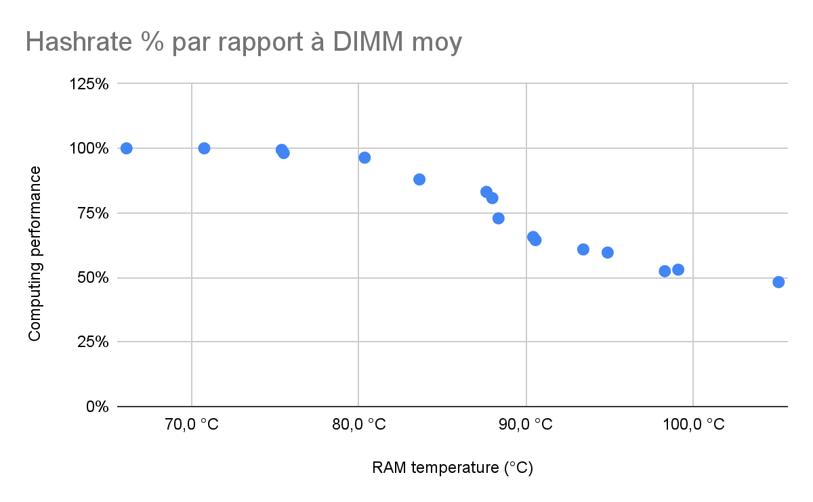
The Qarnot approach
The temperature challenge: impact of heat on computing performance
Computing performance vs inlet water temperature
Computing performance vs RAM temperature
Heat providers need high outlet water temperatures (60°C+) but high temperatures are challenging:
IT consumes more electricity with increasing temperature
thermal efficiency decreases with increasing temperature
computing performance decreases with increasing temperature
Notes:
evolution of compute performance wrt water temperature. our client want performace to run at nominal frequency of the CPU (at 95% normally). Here we see the 2 CPUs (xeon and epyc) and if we increase the T we plateau at 60 degC and then it drops because the heat is too high and the cpu auto regulated its frequency not to burn. we test all kind of cpus and we check the operating point of the server. Based on the site constraints, we put different kind of cpus dispensing of the requirements of water temperature output

Slide 22
Summary
Context
What is HPC?
The carbon footprint of digital technology
The Qarnot model
Technical Challenges
Heat-reusing system
Align the heat demand to the compute offer
Re-use the heat while keeping top-level performances
What comes next?

Slide 23






What is next for heat recovery?
New use case: cold
Heat district networks
Swimming pools
Greenhouses
Fish farms
Desalination
Cold production
Notes:
we run already the green circles, but as a new tech: adsorption chilling; use a heat source to produce cold, but required too high temperature. new materials can lower the entry temperature

Slide 24
What is next for heat recovery?
Experiments
Our goals
Evaluate how much 15°C cold we can produce with our system.
Check how it impacts our energy metrics.

Slide 25
What is next for heat recovery?
Experiments
Our goals
Evaluate how much 15°C cold we can produce with our system.
Check how it impacts our energy metrics.
Thermal efficiency: 76%
Cold production: 2,6kW for 100W of electricity
Notes:
where are these numbers from? how do you calculate COP (coeff of perf) useful cooling output/elec power input ? so these numbers are actually 2.6 kWh output per kWh input

Slide 26


Compute Better. Innovate Faster.
Thank you!

