Slide 1
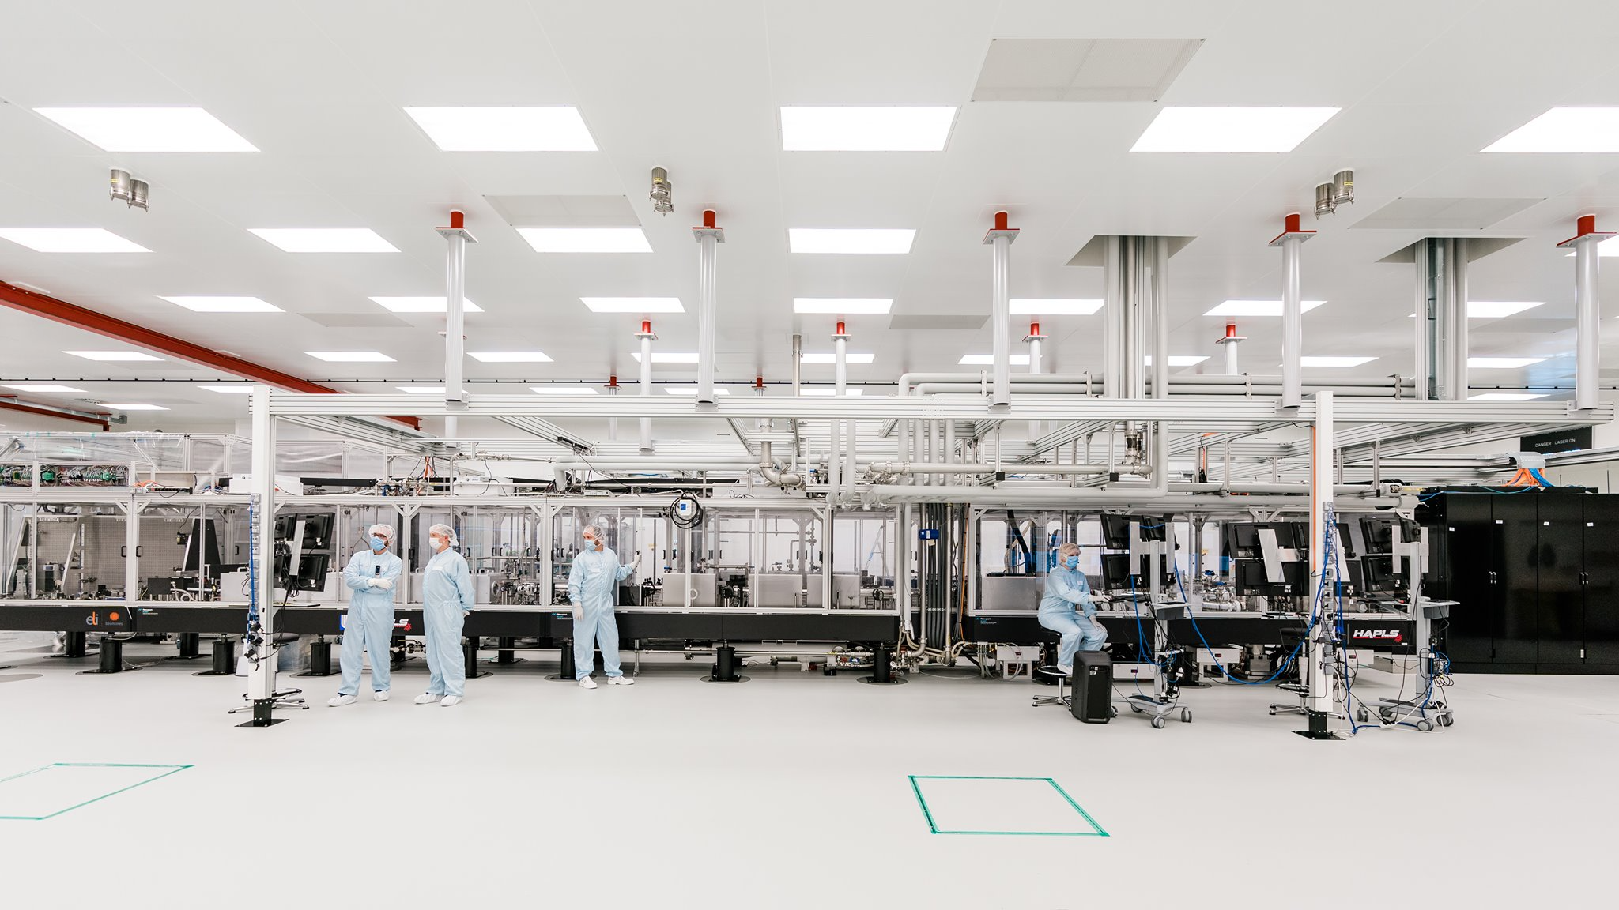


2 February 2026
EuPRAXIA@ELI
TDR TImeline
Extreme Light Infrastructure
IWG EuPRAXIA 2nd Meeitng
Roman Hvězda
Director of ELI Beamlines Facility
A European Research Infrastructure Consortium

Slide 2
TDR Timeline - Original
04/2025
TDR Kick-off & Working Group Formation
Initial coordination meeting at ELI Beamlines; responsibilities and structure agreed.
08/2025
12/2025
06/2026
4/2026
01/2027
Performance & Cost Validation Workshop
Cross-check of S2E simulations, cost model, and risk analysis with expert panels.
D16.2 Milestone – Interim Status Report
Delivery of official status update to EuPRAXIA PP with consolidated content.
Review 1.0 & Draft TDR
Review with collaboration partners; integration of diagnostics, beamlines, and safety.
Draft of Key Technical Sections
Initial chapters on Laser, LPA, Electron Beamline, and Undulator Line complete.
Definition of Technical Baselines
Core architecture, interface points, and parameter ranges frozen with WP leaders.
03/2027
Review 2.0 & Pre-Final TDR v0.9 – Internal Approval
Final draft completed for Phase 1, aligned with infrastructure planning.
09/2027
Final TDR v2.0 (Phase 1) + Advanced Draft (Phase 2)
Finalized submission of Phase 1 TDR; preview of advanced upgrades and options for Phase 2.

Slide 3
From Physics to TDR: LPA-Driven Roadmap
Physics & System Simulations
Core Architecture Definition
Laser
Laser-Plasma Accelerator (LPA)
Critical path
Photon BT & End Station 1&2 & Diagnostics. & Detectors
Electron BT & Undulators
Requirements (Parameter Ranges)
Requirements (Parameter Ranges)
Physics Feasibility & Scaling
Baseline Architecture
Building Adaptations
Preliminary Design (Assumption-Driven)
Laser–LPA Co-Design
Performance Verification (LPA Envelope)
Injection Scheme Selection
Decision Gate 1
Experimental Parameter Demo I (energy, charge, partial stability)
FEL-Relevant Beam Parameter Demo Decision Gate 2
LPA–FEL Compatibility Validation
LPA Prototype & Design Freeze
FEL-Grade LPA Qualification
Architecture Definition
Detailed Design
Subsystem Performance Qualification
Architecture
Design
Subsystem Performance Qualification
Functional Requirements & Interfaces
Architectural Design
Detailed Engineering Design
Construction & Commissioning
Interface & Boundary Conditions
Validated System Parameter Envelopes
Requirements & Performance Targets
*Final laser parameters frozen after LPA parameter closure.
*Designed to accommodate expected LPA beam parameter envelope.
Non-LPA subsystems progress in parallel within conservative parameter envelopes.
Q4-2025 | 2026 | 2027 | 2028

Slide 4
LPA Timeline
Physics feasibility & scaling
3–6 months
Scheme down-selection (DG1)
2–3 m
Experimental parameter demo
4–6 m
FEL-relevant parameter demo (DG2)
6–9 m
Integrated LPA–FEL validation
3–6 months
Prototype & qualification
3–6 months
DG – Decision Gate
16 months
36 months

Slide 5
Laser Timeline
Requirements & baseline architecture
0-6 months
Preliminary design (assumption-driven)
6-18 months
Co-design with LPA
12-24
Performance verification
After DG2
24 months

Slide 6
TDR Timeline
04/2025 — TDR Kick-off & Governance Setup
12/2025 — Technical Baseline Definition (Design Envelope Freeze)
03/2026 — First Technical Draft (Core Systems)
04/2026 — D16.2 Interim Status Report
10/2026 — Review 1.0 & Draft TDR v0.6
03/2027 — Performance, Cost & Risk Validation
10/2027–03/2028 — Review 2.0 & Pre-Final TDR v0.9
02/2028–12/2028 — Final TDR v1.0 (Phase 1) + Phase 2 Options
TDR process launched with working groups, roles, and coordination structure agreed.
Core architecture, interfaces, and system parameter envelopes defined and frozen.
Initial draft of laser, LPA, electron beam transport, and undulator systems completed.
Consolidated technical status and roadmap delivered to the EuPRAXIA PP.
First integrated review with partners and updated draft TDR produced.
System performance, cost model, and key risks validated with expert input.
Final internal review completed and pre-final TDR prepared for approval.
Final Phase 1 TDR submitted with advanced upgrade options outlined.
Implementation phase … in PARALLEL: LASER & Betatron & Positron

Slide 7
Back-up slides

Slide 8
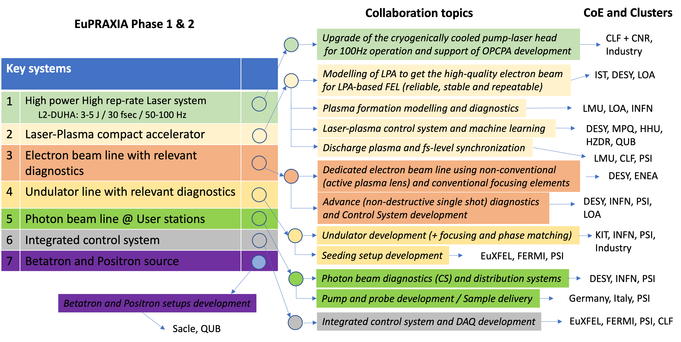
Support within EuPRAXIA partners
COLLABORATIVE APPROACH
Collaborative Funding Model
Combines in-kind contributions from partners with direct cash funding for integration and commissioning.
ELI Beamlines Coordination
Acts as the system integrator, ensuring delivery, integration, and full operation of key instruments and components.
Sustainable Framework
Leverages national and institutional commitments to maximize partner engagement and ownership.

Slide 9
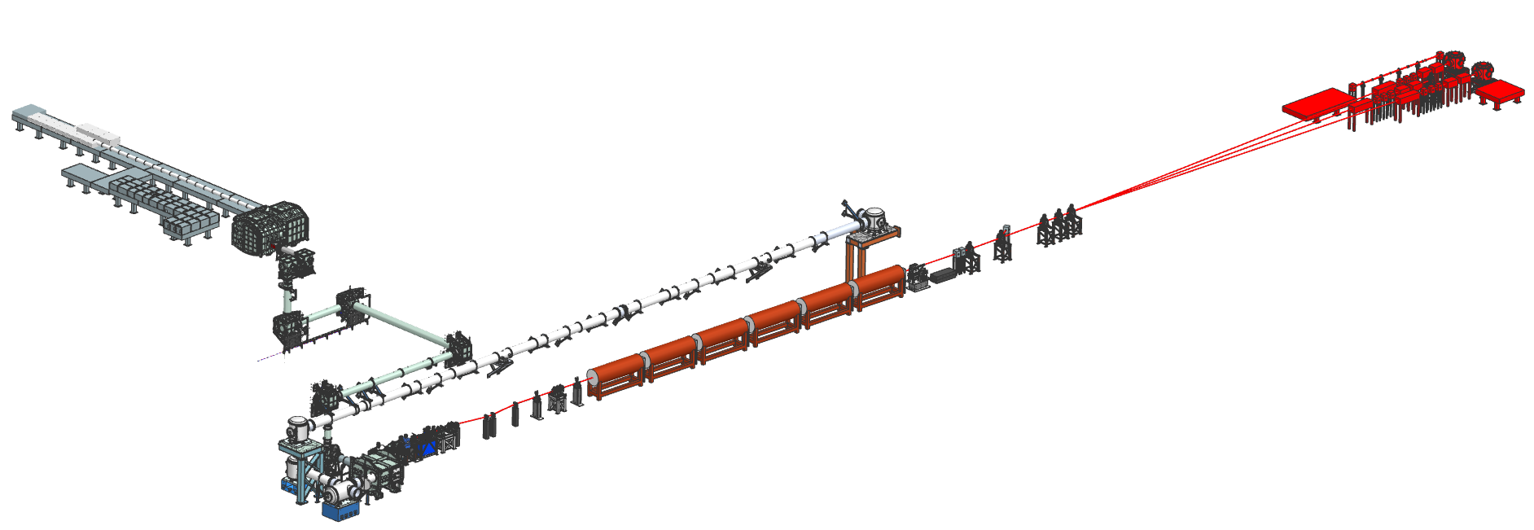
EuPRAXIA@ELI Beamlines: NN feedback
August-October 2025
NN | Laser @ BT | LPA | E-BT | Undulator | Photon BL | User stations
France | + | +++ | + | + | + | +
Italy | + | ++ | + | - | - | +
Germany | + | ++ | + | + | - | +
Portugal | + | ++ | - | - | - | +
UK | +++ | ++ | + | + | + | +
Switzerland | - | - | ++ | +++ | - | -
Spain | + | + | + | - | + | +
Pump-probe set-up
Pump-probe set-up
Next step (November-December 2025)
Contribution to LPA-based TDR
R&D&I Project plan for 2026-27
Framework for collaboration
Financial support (BOFS discussion)
User Stations
AMO vs CQM
User Stations
AMO vs CQM
L3 Beam Transport
L2 DUHA Laser
L3 Beam Transport
L2 DUHA Laser
L2 Beam Transport
L2 Beam Transport
Photon beamline
Photon beamline
Undulator line
Undulator line
Electron Beamline
Electron Beamline
LPA
LPA

Slide 10
TDR Structure & Collaboration Plan
TDR Section | Action required | WP EuPRAXIA PP / PACRI
Start to End Simulations | Lock a minimal set of Phase-1 operating points | WP8 (Vieira), IST, CNRS, CLF
Laser and Transport | Demonstration of parameters, timing, stability, synchronization | WP12 (Gizzi, Crump), THALES, CNR-INO, CLF
Laser-Plasma Accelerator | Test prototype, beam quality | WP10 (Cassou, Shalloo), HHU, LMU, DESY, SPARC-Lab, WP14 (Hidding, Karsch), Transformative Innovation Paths
Electron Beam Line | Optics design, validation | WP9 (Antipov), DANFYSIK, SIGMAPHI
Undulator Line | Short module prototype, field tuning | WP9 (Nguyen), KYMA, Euro-XFEL, PSI
Photon Beamlines & End-Stations |  | WP11 (Sarri, Chiadroni), PSI, Elettra/FERMI, Euro-XFEL
Diagnostics | Integration, testing | WP13 (Cianchi, Ischebeck), ESRF, Swiss-FEL
Controls & Alignment | CS, Data, Timinig system integration | ESRF, CERN, Euro-XFEL
Conventional Facilities, Safety, Costing | Utilities, shielding adaptation | Swiss-FEL, Euro-XFEL, ENEA, Infradev

Slide 11






EuPRAXIA lifecycle & governance
Governance Framework Transition for EuPRAXIA
Each phase so far governed by a dedicated collaboration agreement (project/fund-based, DESCA model)
The upcoming Implementation Phase (INFN & ELI ERIC) requires a common operational framework
LEGAL ENTITY ESTABLISHED
MoU
DESCA MODEL
DESCA MODEL
DESCA MODEL
AISBL(?) Governance
PREPARATORY PHASE
PRE IMPLEMENTATION PHASE
DESIGN PHASE
ESFRI MoU
2015 2016 2017 2018 2019 2020 2021 2022 2023
2024 2025 2026 2027 2028 2029 2030
2031 2032
2033
Bridging the Gap → New MoU
Scope: Implementation Sites + National Nodes + Project Clusters
Term: Open-ended, aligned with AISBL implementation
Advisory: STAB & BOFS (as in EuPRAXIA-PP/EIP) + TDR review committees
Observers: included
PROCUREMENT & INSTALLATION
OPERATION

