Slide 1



Recent Development on CMOS MAPS for the Silicon Vertex Tracker
Giuliana Rizzo
INFN and University, Pisa
on behalf of SVT-SuperB group
12th Pisa Meeting on Advanced Detectors
May 20-26, 2012 La Biodola, Isola d’Elba, Italy
Notes:
update

Slide 2
Outline
To be updated
The SuperB Project Status
The Silicon Vertex Tracker & Layer0
CMOS MAPS options for Layer0 upgrade
  DNW MAPS achieved performance
  3D MAPS with vertical integration
  2D MAPS with quadruple well process
Conclusions
Notes:
update

Slide 3
The SuperB Project
To be updated
The physics case for a high luminosity B Factory is clearly established.
  Flavour physics is rich, promises sensitivity to New Physics ... but large statistics (50-100 ab⁻¹) is needed
First generation of B-Factories (PEP-II and KEKB) exceeded their design goals (L ~1.2-1.7 x10³⁴ cm⁻² s⁻¹ , integrated 1.2 ab⁻¹) but an upgrade of ~2 orders of magnitude in L is needed to get 50ab⁻¹ .
Increasing Luminosity by brute-force (higher currents) is expensive and difficult
  wall plug power and detector background explosion
  effective limitation around 5x10³⁵ cm⁻² s⁻¹
The SuperB italian accelerator concept allows to reach L =10³⁶ cm⁻² s⁻¹ with moderate beam current (2A) using very small beam size (~1/100 of present B-Factories beams exploiting the ILC R&D on damping rings & final focus) with the help of the Crab Waist scheme at the IP to keep the beams small & stable after collision (verified with tests on Dafne)
This approach allows to (re-) use parts of existing detectors and machine components.
Notes:
update

Slide 4

The SuperB Process
To be updated
SuperB Conceptual Design Report published in 2007
All scientific reviews are positive. Presented to CERN Council and approved for preparatory phase.
Growing international interest and participation with formal international collaboration being formed. Project structure defined.
MOUs signed with France, Russia and SLAC and a letter of support from Canada.
Technical Design Report phase approved by INFN in 2009
R&D is proceeding on various items (eg. SVT Layer0)
Intermediate Progress Report published this summer
  http://arxiv.org/abs/1007.4241
SuperB inserted as first project in the National Research Plan by the Italian Research Ministry
NEXT STEPS
Government approval expected very soon
Technical Design Report: summer 2011
Operation by 2015.
Notes:
update

Slide 5
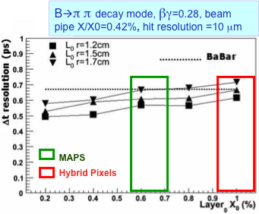
The SuperB Silicon Vertex Tracker
The SVT provides precise tracking and vertex reconstruction, crucial for time dependent measurements.
BaBar SVT
5 Layers of double-sided Si strip sensor
Low-mass design. (P_{t} < 2.7 GeV)
Stand-alone tracking for slow particles.
97% reconstruction efficiency
Resolution ~15μm at normal incidence
SuperB SVT based on
Babar SVT design for R>3cm. BUT:
1) reduced beam energy asymmetry
(7x4 GeV vs. 9x3.1 GeV) requires an
improved vertex resolution (~factor 2)
    Layer0 very close to IP (@1.5 cm)
    with low material budget (<1% X0)
    and fine granularity (50 μm pitch)
    Layer0 area 100 cm²
2) bkg levels depend steeply on radius
    Layer0 needs to be fast and rad hard
    hit rate 20 MHz/cm², TID 3 MRad/yr,
    eq. neutron fluence 7 x 10¹² n/cm²/yr
    x5 safety factor to be inlcuded!
Notes:
update

Slide 6
SuperB SVT Layer 0 technology options
To be updated
Striplets option: mature technology, not so robust
against background occupancy.
  Marginal with back. rate > 100 MHz/cm²
  Moderate R&D needed on FE chip module
  interconnection/mechanics
Hybrid Pixel option: viable, slightly marginal.
  Reduction of total material at 1%X₀ doable.
  Reduction of front-end pitch to 50x50 μm²
  → Produced and tested FE prototype chip with 50x50 μm² pitch & fast data push readout (already developed for DNW MAPS) - (4k pixels, ST 130 nm)
CMOS MAPS option: new & challenging technology.
  Sensor & readout in 50 μm thick chip!
  Extensive R&D (SLIM5-INFN Collaboration) on
    Deep N-well devices 50x50μm² with in-pixel sparsification.
    Fast readout architecture implemented
  CMOS MAPS (4k pixels) successfully tested with beams.
Thin pixels with Vertical Integration: reduction of material and improved performance.
  Two options are being pursued (VIPIX – INFN Collab.)
    DNW MAPS with 2 tiers
    Hybrid Pixel: FE chip with 2 tiers + high resistivity sensor
MAPS and 3D vertically integrated pixels are the two most advanced options considered for Layer0 upgrade:
Complexity
Wafer bonding & electrical interconn.
Digital tier
Analog tier
Sensor
Notes:
update

Slide 7
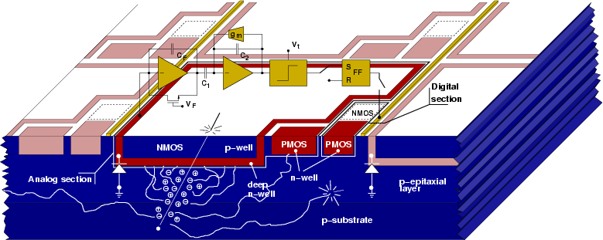
Deep Nwell (DNW) sensor concept
New approach in CMOS MAPS design compatible with data sparsification architecture to improve readout speed potential
SHAPER
PREAMPL
DISC
LATCH
Developed in a 130 nm CMOS
process, various different chips
successfully tested with
radioactive sources and beam
A classical optimum signal processing chain for capacitive detectors can be implemented at pixel level:
Charge-to-Voltage conversion done by the charge preamplifier
The collecting electrode (Deep N-Well) can be extended to obtain higher single pixel collected charge (the gain does NOT depend on the sensor capacitance), reducing charge loss due to competitive N-wells where PMOSFETs are located
Need to keep the fill factor (DNW/tot N-well ) as high as possible: ~ 90% in our design.
7

Slide 8
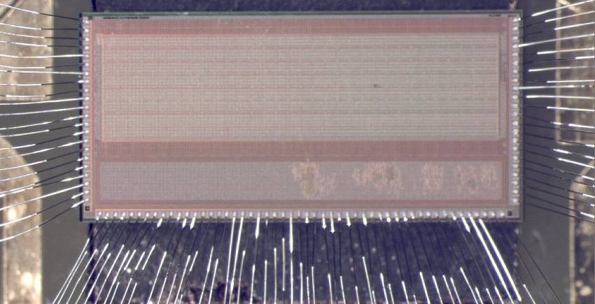
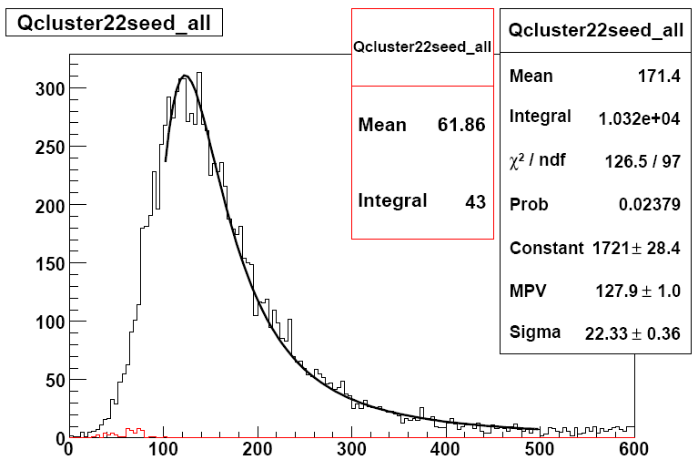
Latest 2D generation of DNW MAPS: APSEL4D
In the active sensor area we minimized:
  logical blocks with PMOS to reduce the area of competitive n-wells
  digital lines for point to point connections to allow scalability of the architecture with matrix dimensions
32x128 pix - 50 μm pitch
perif & spars logic
4K(32x128) 50x50 μm² matrix subdivided in MacroPixel (MP=4x4) with point to point connection to the periphery readout logic:
  Register hit MP & store timestamp
  Enable MP readout
  Receive, sparsify, format data to output bus
S/N ~ 20 with power consumption ~ 30 μW/ch
Signal for MIP (MPV) =980e-
⁹⁰Sr electrons
MP 4x4 pixels
Data lines in common
S/N=23
Landau
mV
2 MP private lines
Column enable lines in common
Data out bus
Noise events
Cluster signal (mV)
Periphery readout logic
Threshold dispersion = 60 e-
Gain = 860 mV/fC

Slide 9
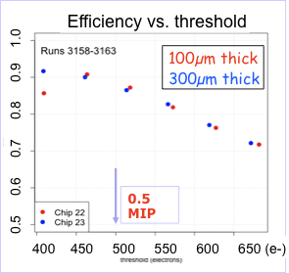
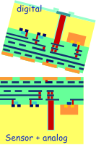
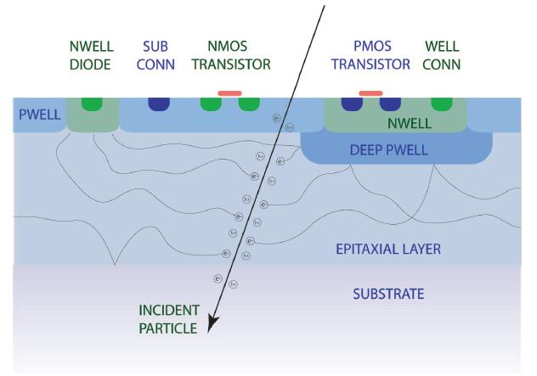
Evolution of DNW MAPS
To be updated
DNW MAPS efficiency 92%: competitive N-wells (PMOS) in pixel cell steal charge reducing the hit efficiency: fill factor (DNW/tot N-well) ~ 90 %
Charge collection efficiency main limitation of DNW MAPS for application in Layer0:
Area of competive Nwell increses with more complex in-pixel logic (fast readout needed)
Charge collection further reduced by radiation damage
Two approaches to improve MAPS performance
3D MAPS: (2 tiers for sensor&analog + digital)
  fill factor and efficiency can improves significantly.
2D MAPS with INMAPS 180 nm process
  4th well (deep Pwell), below competitive Nwells, used to avoid parassitic charge collection
  high-Ω epilayer also available for improved charge collection and radiation hardness!

Slide 10
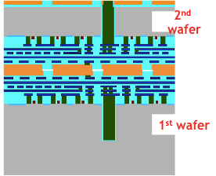
Evolving from 2D to 3D MAPS
2D CMOS technology
3D integration of 2 CMOS layers
The use of vertical integration (2 CMOS layers interconnected) can improve MAPS performance
  higher sensor efficiency (PMOS in competitive N-wells removed from the sensing layer)
  deep N-well area can be reduced (lower C_{D}→ better noise/power trade-off)
  more advanced readout architecture can be integrated on pixel
  an extra high res. substrate can be used as pixel sensor and connected
First APSEL-like DNW MAPS (2 tiers) realized within the 3DIC Consortium to explore the 130 nm Chartered/Tezzaron process.
Several problems with 3D interconnection (bad alignment …)
While still waiting for good 3D chips:
test of the sensor+analog layer confirmed the expected improvemente in collection efficiency
prepare new 3D run Tezzaron/GlobalFoundries technology (organized by CMP/MOSIS)
Chartered/Tezzaron technology
(Fermilab MPW run)
10

Slide 11
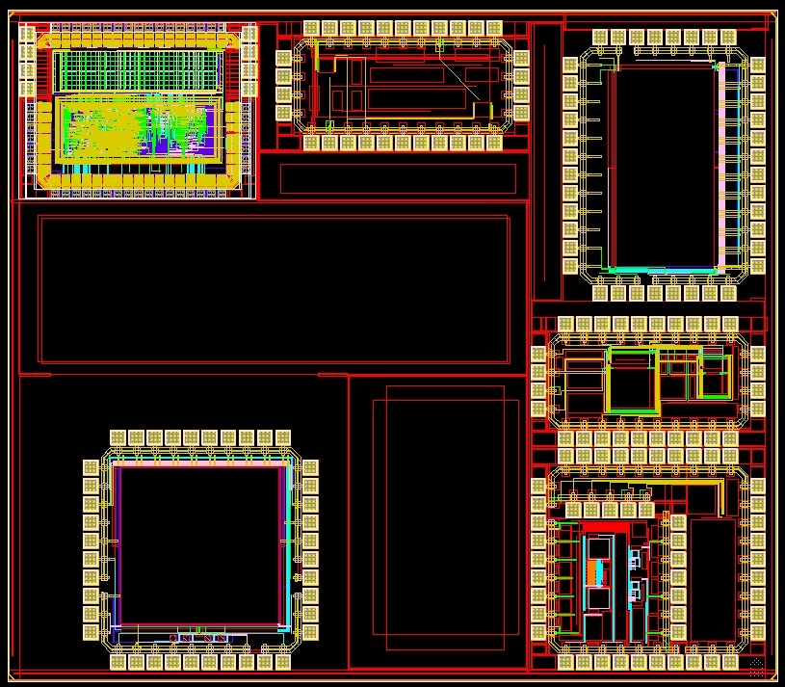
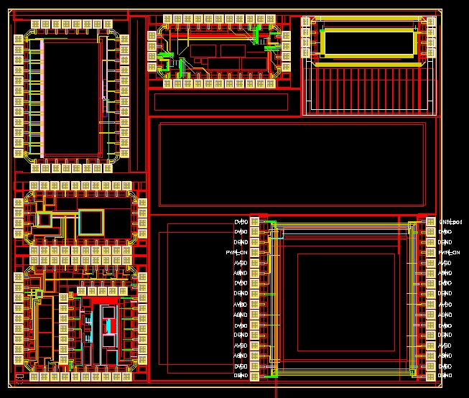
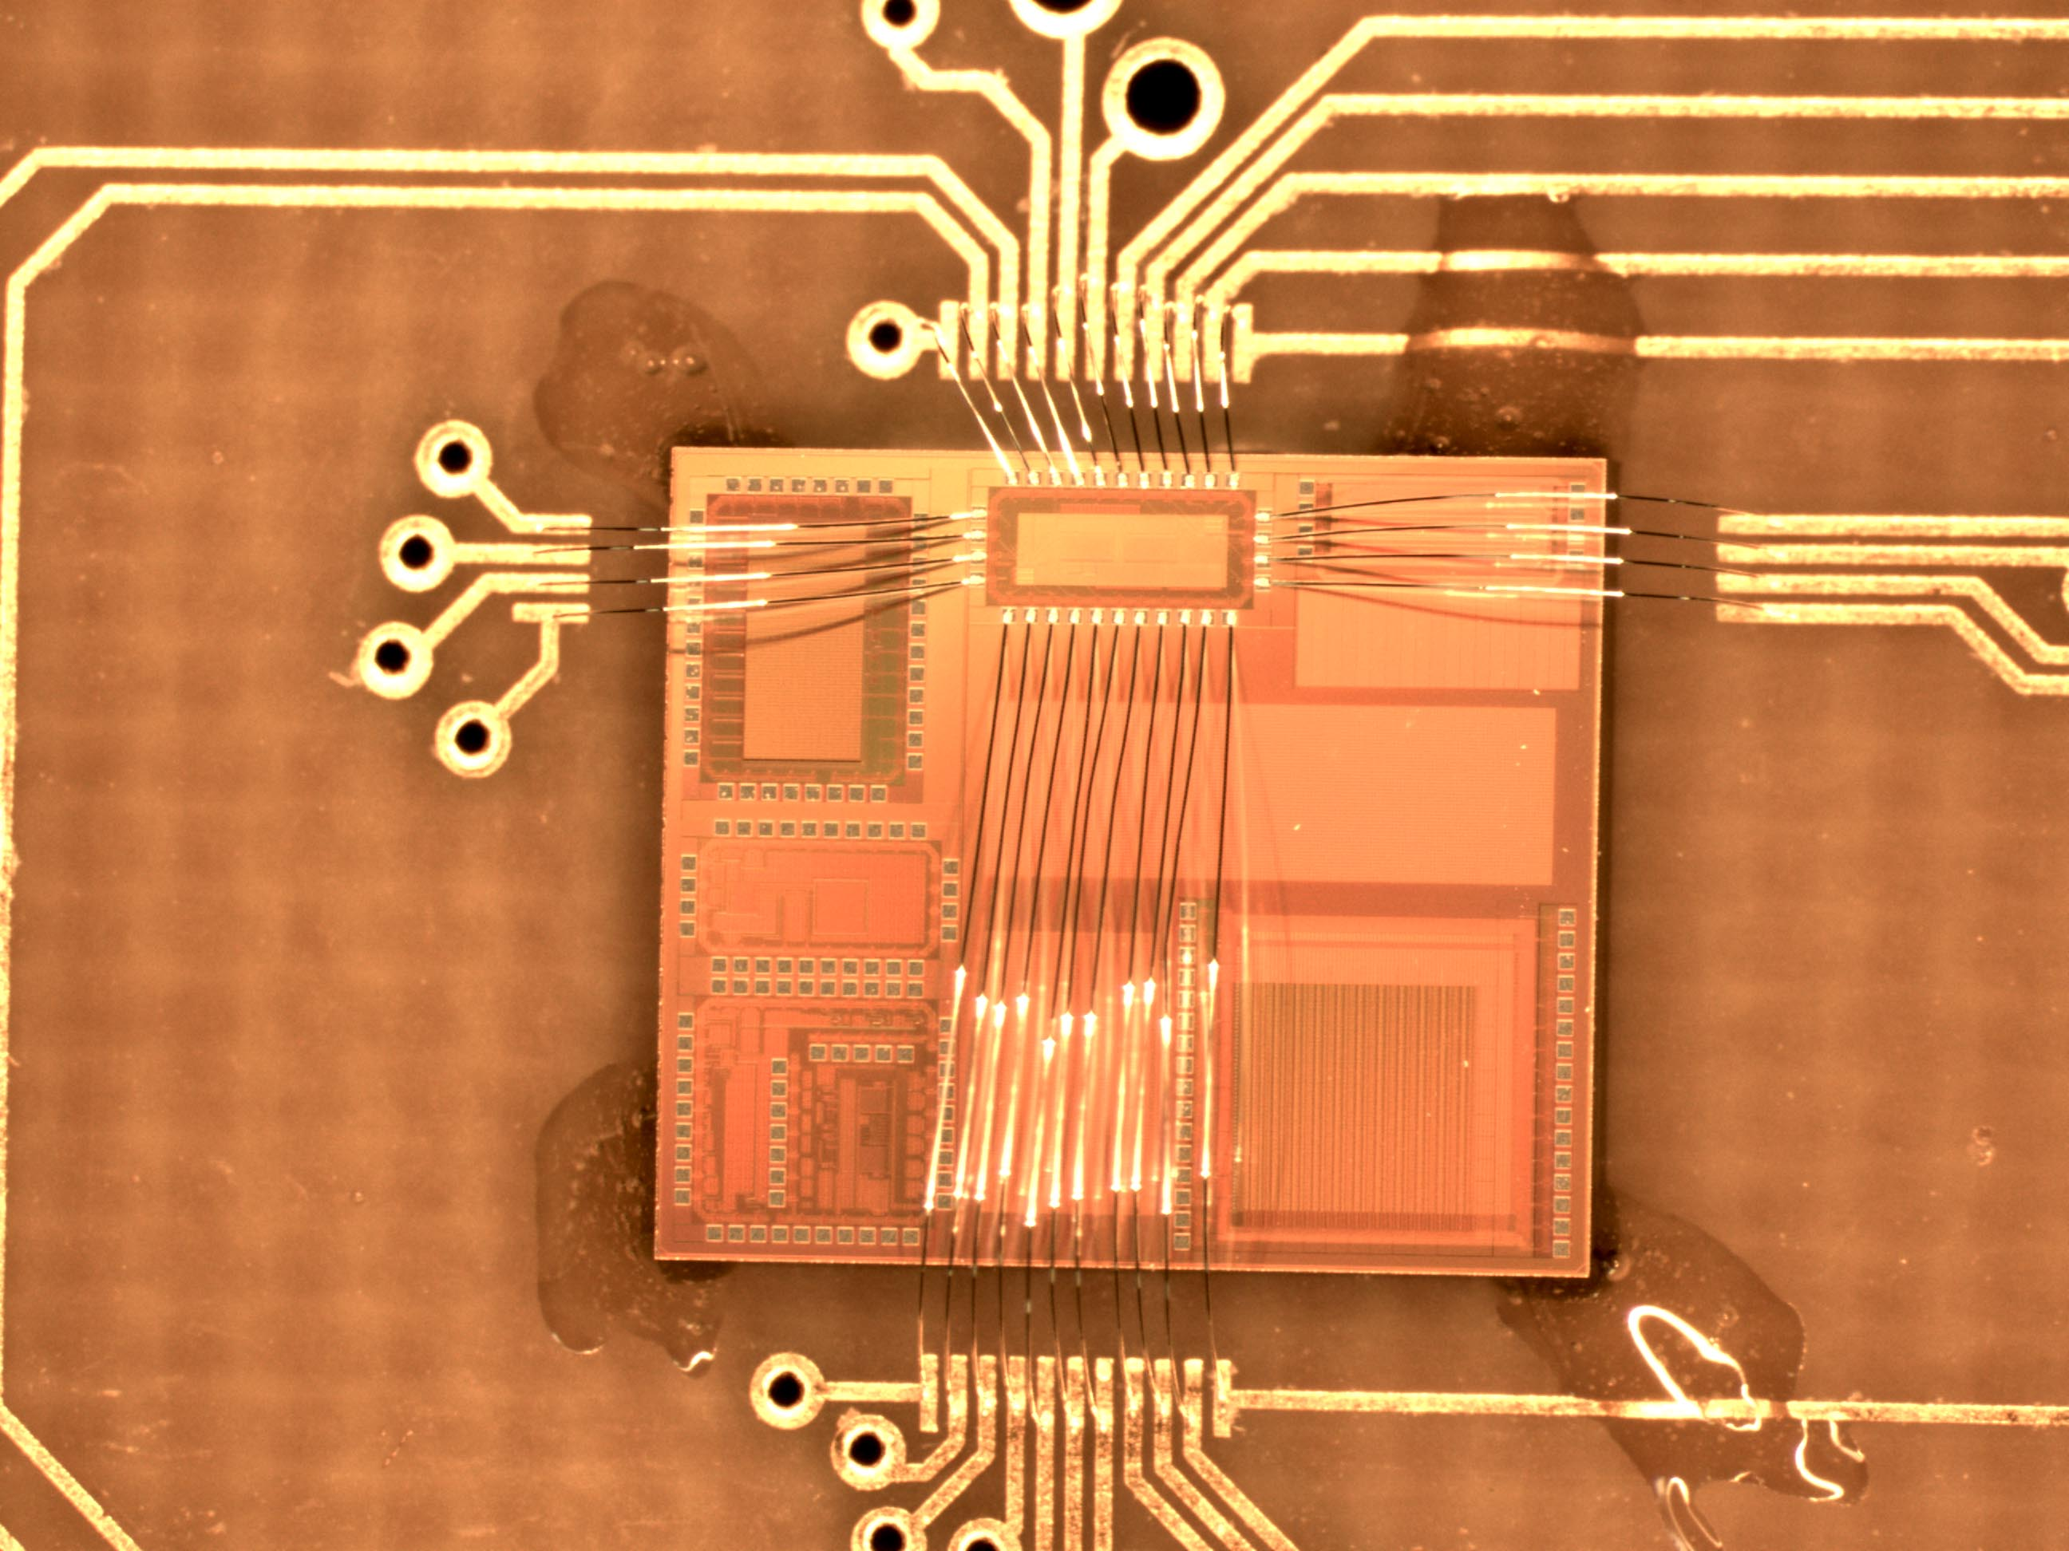
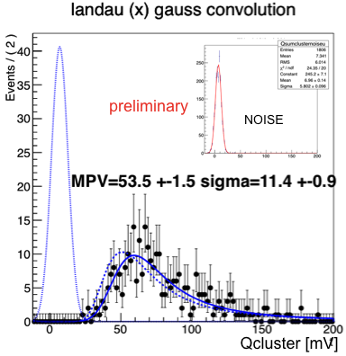
Tests of the layer with sensing electrode and analog front-end in first 3D APSEL chips
digital
Digital layer
Fe⁵⁵ γ (5.9 keV) – 3x3 matrix
Lab Tests
ENC = 45e-
Gain = 300 mV/fC
Sensor + analog
Sensor + analog
Beam test @ CERN
Efficiency vs thr. on pixel seed
Cluster signal-hits on track
Efficiency > 98% thanks to reduced PMOS N-wells in the pixel cell with 3D
Preliminary
7x σ_noise
Noise events==off time
S/N=23
MPV=1044 e-
Gain =320 mV/fC (Fe55)
Noise events==off time window (w.r.t. scintillator)
PH seed cut e-]

Slide 12
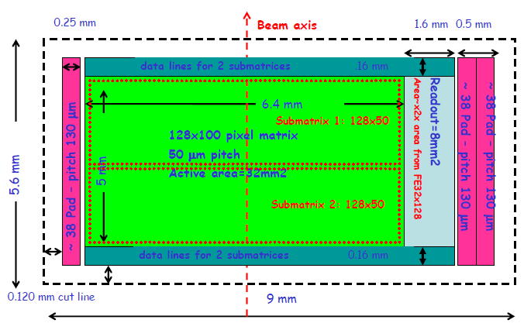
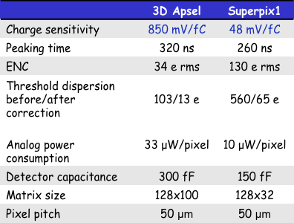
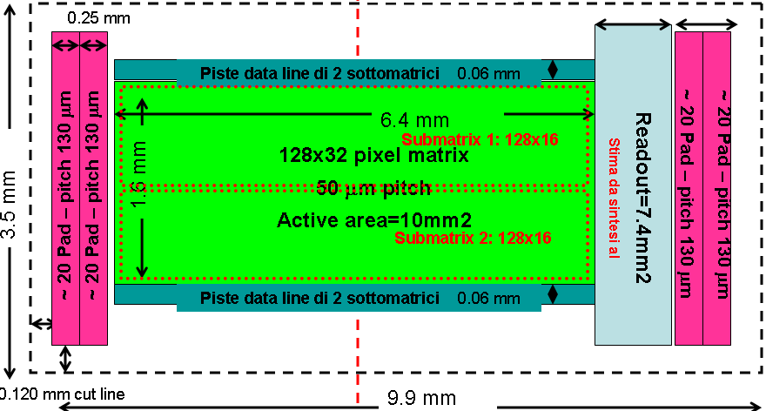
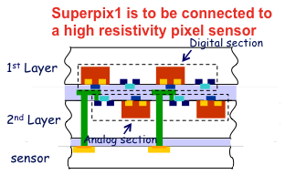
Design features for next 3D devices
3D Apsel
In the next 3D run (Tezzaron/GlobalFoundries) two pixel chips for SuperB Layer0 application:
  3D APSEL larger CMOS MAPS matrix (128x100)
  Superpix1 FE chip for hybrid det. (128x32)
Both chips share a new readout architecture flexible: : data push & triggered version)
Superpix1
3D Apsel
12

Slide 13

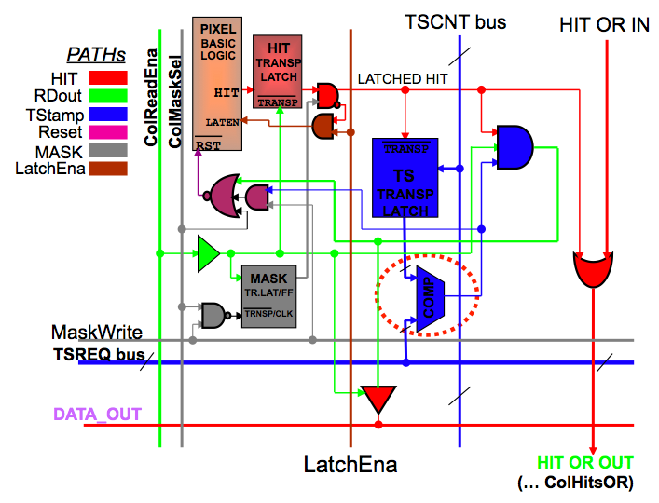

Readout architecture in the pixel cell: time-stamp latch and comparator for a time-ordered triggered readout
In-pixel logic for a time-ordered readout
Complex in-pixel logic can be implemented without reducing the pixel collection efficiency; readout can be data push or triggered (only selected time stamps are read out).
Timestamp (TS) is broadcast to pixels and each pixel latches the current TS when fires.
Matrix readout is TS ordered
A readout TS enters the pixel and an HIT-OR-OUT is generated for columns with hits associated to that TS
A column is read only if HIT-OR-OUT=1
DATA_OUT is generated for pixels in the active columns with hits associated to that TS.
13

Slide 14
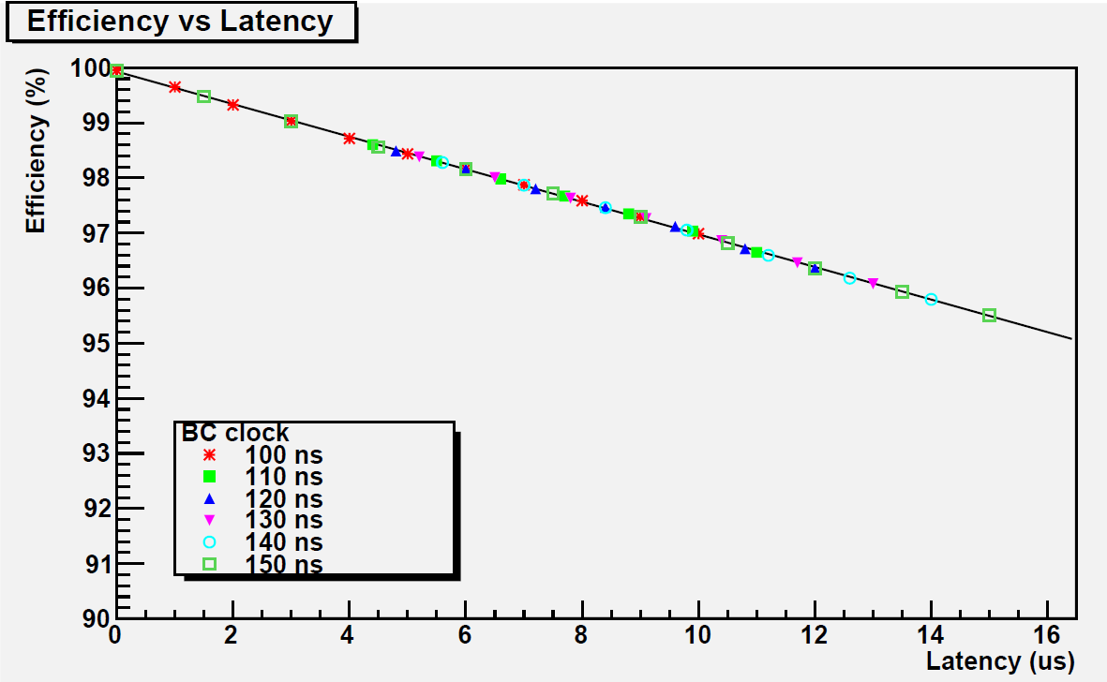
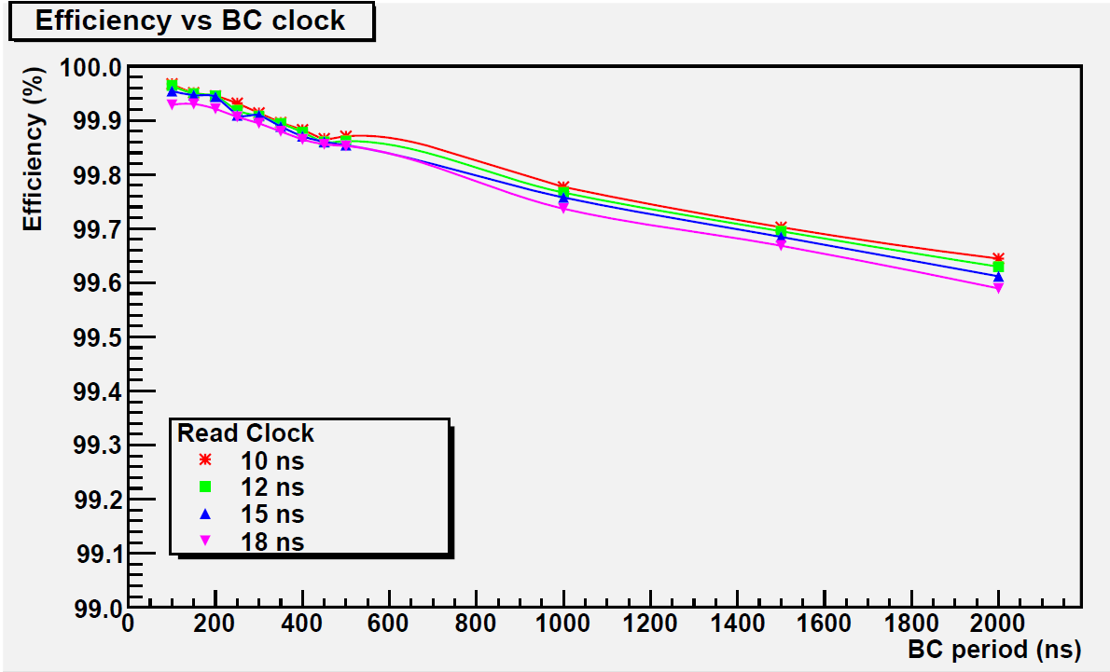
New Pixel Readout Architecture Features
Matrix
In-pixel Hit & Time Stamp Latch
TS request to the matrix
Pixel FastOR activates IF
latched TS == requested TS
Cascaded column FastORs
1 column sparsified in 1 clk cycle
(whatever the occupancy )
Only active-FastOR columns are enabled in sequence.
(i.e. 10 active column FastORs → 10 clk cycles readout)
Triggered and Data-Push mode.
Implemented in our last INMAPS submission & ready for next 3D submissions
1
2
3
1
Requesting TS: 1
2
0
3
1
0
1
3
0
2
3
0
Encoding & Dequeuing
System
Active Column
Simulations DO NOT take into account:
  Sensor Efficiency.
  Analog FE.
TRIGGERED MODE
Pixel latches as latency buffers
DATA PUSH MODE
98.2%
Expected working
condition
130 MHz hit rate.
192x256 matrix
50 MHz read clock
2.5 MHz trigger rate (stressed condition)
200k events per point
130 MHz hit rate.

Slide 15
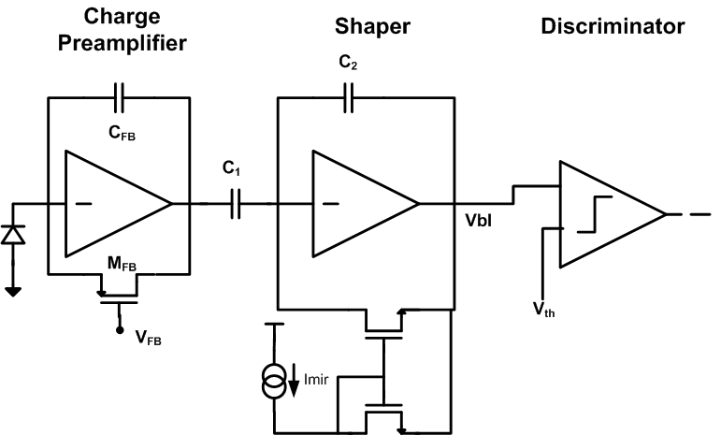
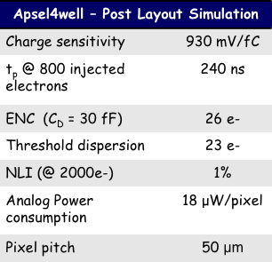
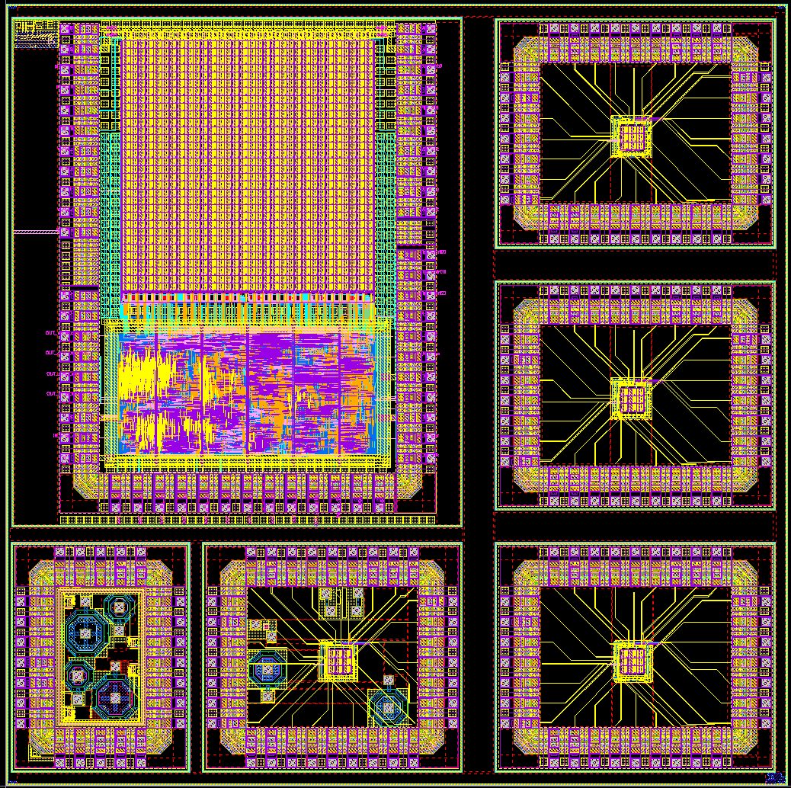
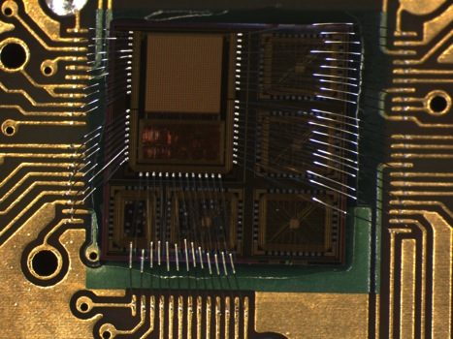
INMAPS developments for SuperB Layer0
Small N-well collecting diodes with small input capacitance and low power consumption.
The forth-well prevents charge stealing by the parasitic N-wells (→efficiency benefit).
Same analog and digital architecture as APSEL chips, to fit at best the high background rate of Layer0.
32x32 matrix with sparsified digital readout architecture
3x3 analog matrices with different diodes configurations
INMAPS Chip (5x5 mm²)
First chips under test now

Slide 16
INMAPS CELL
1.5 x 1.5 μm²
See S. Zucca’s poster for more details on analog design

Slide 17
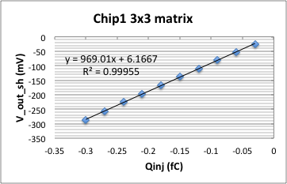
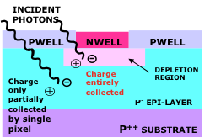
INMAPS RESULTS: 3x3 analog matrix
Preliminary
Noise and gain measured in 3x3 analog matrix in good agreement with PLS:
  ENC = 30 e- (~20% dispersion)
  Gain=920 mV/fC (~10% dispersion)
Response to radioactive source
⁵⁵Fe γ: 5.9keV foto peak hardly visible due to very small diode area.
  Charge totally collected for γ interaction in the depleted volume below the diode. Partial collection elsewhere. End point (5.9 keV + 3 σ noise) used for gain evaluation (agreement within 10% with Cinj)
⁹⁰Sr e- signal cluster: MPV ~ 300 e-, compatible with 5 um epi layer of first chips → chips with 12 um epi layer (standard & high resistivity) available in June.
⁹⁰Sr e- - Chip1
⁵⁵Fe γ – Chip1
5 μm epi layer
Pixel signal (mV)
Cluster signal (mV)

Slide 18
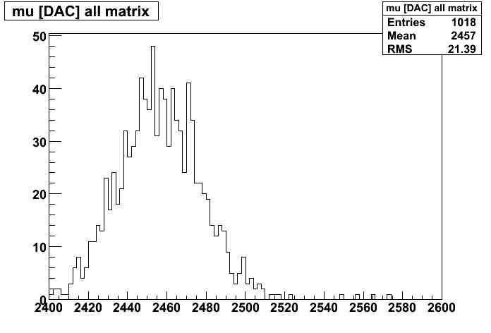
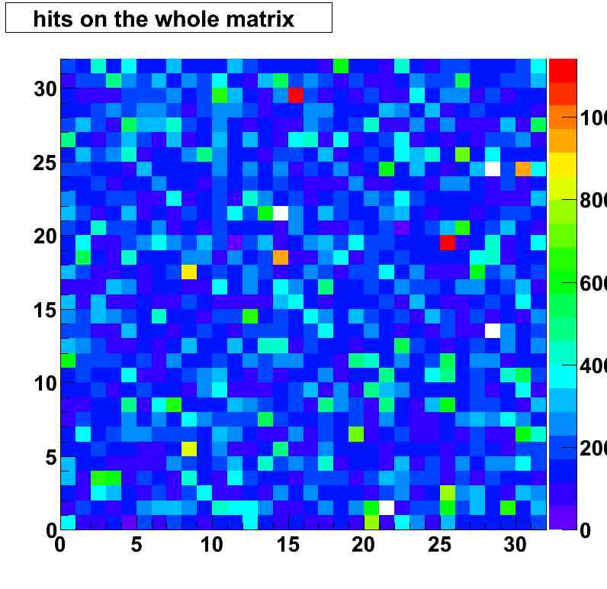
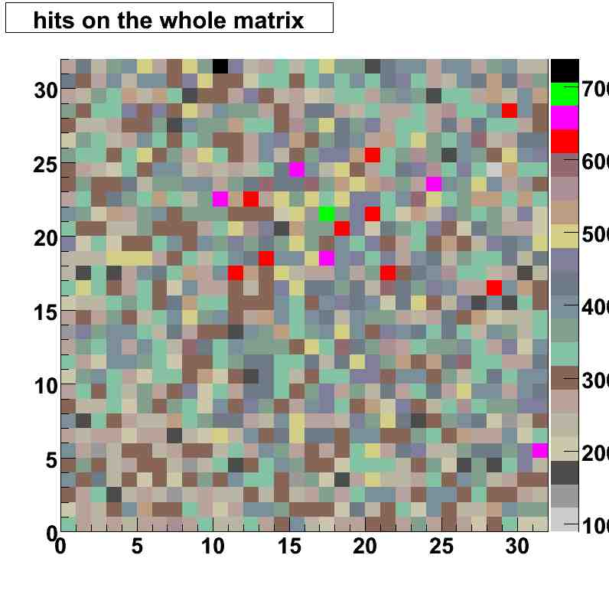
INMAPS 32x32 digital matrix (I)
Preliminary
Noise and gain measured in pixels with Cinj and analog output
  ENC = 30 e- gain=680 mV/fC
Maybe Insert plot with gain for 32x32 chip 2 V vs Q e- vrif_mir bassa
Threshold and noise dispersion inside matrix measured with noise scans (occupancy vs discriminator threshold)
Threshold dispersion = 7mV (~ 2 xσ_noise )
Noise (+gain) dispersion ~ 35-40%
Further tests to evaluate gain dispersion with Fe55 end point ongoing.
Baseline – Chip3
Few dead pixels: ~ 0.3% (on 3 chips 32x32)
Noise hits – Chip3
Sr90 hits – Chip1

Slide 19
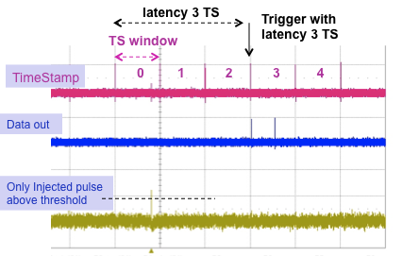
INMAPS 32x32 digital matrix (II)
Preliminary
Standard functionality of new readout architecture verified in the two operation modes available on chip: data push (all TS readout) and triggered (only selected TS readout).
Threshold scans similar in both operation modes.
+ data push
+ triggered
Triggered mode also verified with specific test retrieving data injected at selected TS.
Pulse injection @ TS = 0
→ high threshold
→ no noise hits above threshold
Trigger arrives @ TS =2 with trigger latency setting = 3 TS
→ triggered event TS = 0
Data out stream info:
  TS =0: 0 pixels in submatrix0
  TS =0: 1 fired pixel in submatrix1

Slide 20
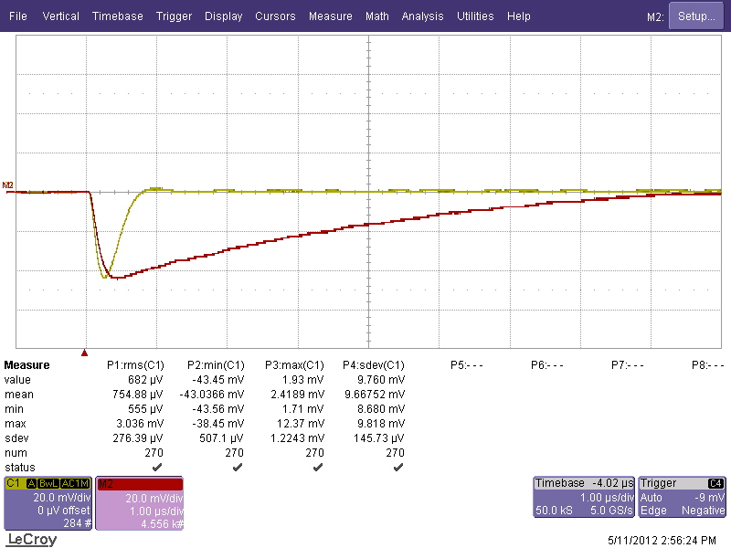
Investigating a discriminator problem
During initial tests: noise and injection scans look strange for small signal.
During investigation discovered that for small signal injected (and seen with the analog output) no hit registred by the discriminator
  → no change in the 50% turn on THR w.r.t. THR without injection
This problem was tracked with a “slow” turn on of the discriminator that prevent signals to be seen if the Time over Threshold (TOT) is too small.
Fix implemented: increase the discharge time of the analog signal to increase the TOT and allow the “slow” discriminator to fire
  Not optimal for fast operation!
Larger TOT for slow discharging signal
  Now investigating more carefully the design to understand the origin of the problem (reproduced in simulation with some corner process parameters) and implement a more robust design of the discriminator for next chips

Slide 21
Conclusions

Slide 22
backup

Slide 23
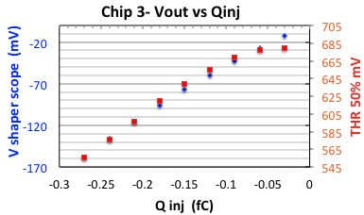
Investigating a discriminator problem (I)
Preliminary
During initial tests noise and injection scans (channel with Cinj available) looked strange for small signal.
Noise lower than the one measured with analog output and turn on curve very narrow and strongly asymmetric.
For small signal injected (and seen with the analog output) no hit registred by the discriminator → no change in the 50% turn on THR w.r.t. THR without injection
  Gain measured with the 50% turn point (THR 50% in red in the plot) vs. Q injected underestimated w.r.t to gain measured using the analog output (in blue).
Notes:
Decide which plot

Slide 24
Investigating a discriminator problem (II)
This problem was tracked with a “slow” turn on of the discriminator that prevent signals to be seen if the Time over Threshold (TOT) is too small.
Fix implemented: increase the discharge time of the analog signal to increase the TOT and allow the “slow” discriminator to fire
  Not optimal for fast operation!
Larger TOT for slow discharging signal
Injection scans now OK: gain measured with analog output and with 50% turn on THR agree!
  Show old vs new plot
For THR close to signal peak TOT is still too small for the slow discriminator to be seen (~1-2 mV overdrive from simple analytical calculation) → noise from threshold scan still underestimated by ~this amount. Need a proper simulation to quantify this effect.
  Now investigating more carefully the design to understand the origin of the problem (reproduced in simulation with some corner process parameters) and implement a more robust design of the discriminator for next chips

Slide 25
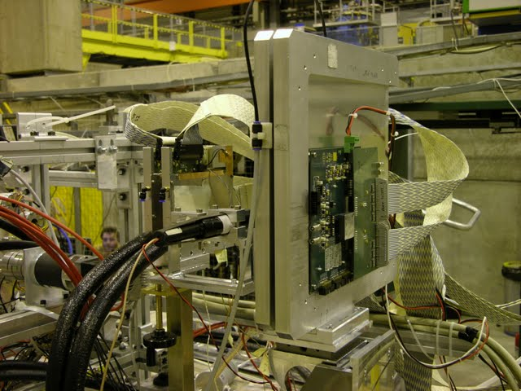
Tesbeam with irradiated MAPS - 2009
July 2009 CERN Testbeam
Results for MAPS (3x3 matrix) with analog output (pre/post irrad. 10 Mrad ⁶⁰Co γ )
Qcluster ~1040 e- for M1 (930 e- for M2)
S/N~15-20 depending on the electrode geometry
Efficiency~90% for both M1,2 in agreement with the measurements on digital MAPS
Modest reduction in collected charge and efficiency in chip irradiated up to 10 Mrad
  ENC increased by ~35%
apsel3T1
M1 - 3x3 cluster signal
120 Gev pions - after 10 Mrad
M1 - chip 8 not irradiated
M1 chip 24 @ 10 Mrad
Efficiency
THR < 4 σ Noise
S = 1003 e-
Thr. e-

Slide 26
Exploiting 3D integration: pixel pitch and sensor efficiency
Main design features and simulation results
A three-dimensional technology makes it possible to significantly reduce the area of charge stealing N-wells → significant improvement in charge collection efficiency expected
W/L=30/0.3
C_{D}=250 fF
~1 μs peaking time
Charge sensitivity: 750 mV/fC
Equivalent noise charge (ENC): 33 e rms
Threshold dispersion: 40 e rms
Collecting electrode
40 μm
Parasitic N-wells
Sensor area: 346μm²
NW-PMOS area: 22μm²
Fill Factor: 0.94 (0.87 in the “2D” version)
Notes:
ciao
saluti

Slide 27
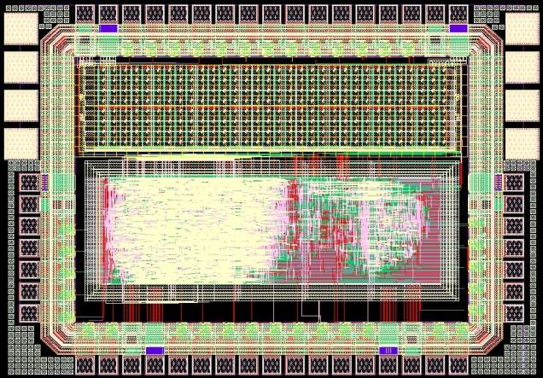
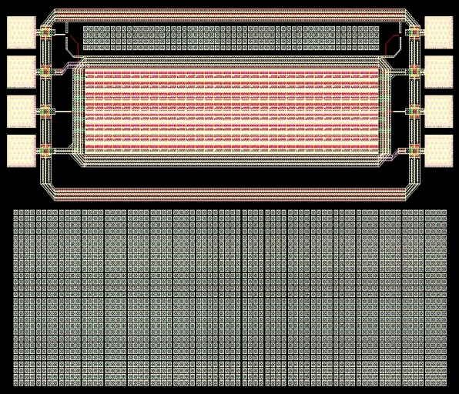
Readout electronics in a 40 x 40 μm² 3D MAPS pixel cell
Sensing diode and charge sensitive preamplifier
TIER 2
(TOP)
Pixel-level digital front end
discriminator
AVDD
AVDD
DVDD
Inter-tier bond pads
V_{fbk}
V_{t}
DGND
Digital readout electronics
C_{F}
AGND
Pixel-level sparsification logic
3D integration removes layout constraints and will allow for an improved readout architecture (no macropixel) in future chips
TIER 1
(BOTTOM)
from the discriminator
8x32 pixel matrix
N-well
Notes:
ciao
saluti
skip

