Slide 1
SuperB SVT Update on Strip Parameters and Layer 3 Readout Options
Irina Rashevskaya, Lorenzo Vitale, Livio Lanceri, Luciano Bosisio, Erik Vallazza
INFN-Trieste e Università di Trieste

Slide 2
Outline
Updated estimates of detector parameters (sensor + fanout)
Layers 1 to 5 (Layer 0 under way…)
z-side options included:
both pairing and ganging for Layers 1 to 3
ganging only for outer Layers (4 & 5)
Radiation fluences from Giuliana’s mail
Considerations about Lorentz angles
Layer 3 readout options:
p-type strips on Φ-side (100 µm readout pitch)
n-type strips on Φ-side (as in BaBar, but readout pitch 110 µm instead of 55 µm)

Slide 3
Strip Parameters for Layers 1 - 5 Φ-SIDE
OPTION A – LAYER 3 Φ-SIDE READ OUT BY SENSOR P-SIDE (at 100 µm pitch)
Series resistance of sensors estimated assuming 2.5 µm aluminum thickness.
Leakage currents estimated for 7.5 years of operation (1×10⁷ s/year)
Current damage factor α = 2.8×10⁻¹⁷ A/cm (accounts for annealing)
NO safety factor
Noise contributions from the sensor calculated assuming a simple CR-RC shaping (not CR-RC² as adopted for the preamplifier)
CAUTION: Noise contribution from the front-end electronics NOT included

Slide 4
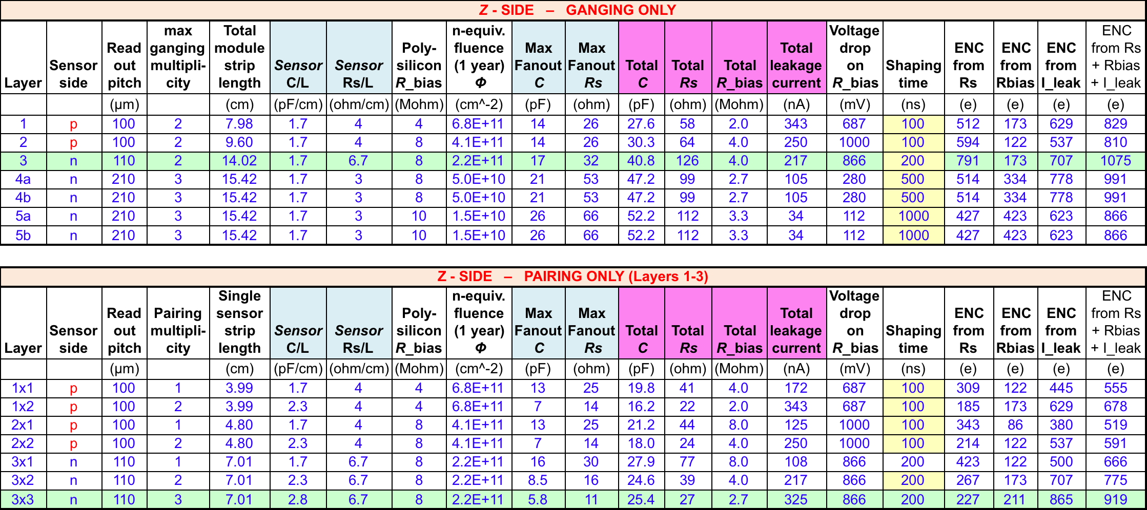
Strip Parameters for Layers 1 - 5 Z-SIDE
OPTION A – LAYER 3 Z-SIDE READ OUT BY SENSOR N-SIDE (at 110 µm pitch)
Leakage currents estimated for 7.5 years of operation (1×10⁷ s/year)
NO safety factor

Slide 5
Strip Parameters for Layers 1 - 5 Φ-SIDE
OPTION A – LAYER 3 Φ-SIDE READ OUT BY SENSOR P-SIDE (at 100 µm pitch)
Leakage currents estimated for 7.5 years of operation (1×10⁷ s/year)
5x safety factor
Noise contributions from the sensor calculated assuming a simple CR-RC shaping (not CR-RC² as adopted for the preamplifier)
CAUTION: Noise contribution from the front-end electronics NOT included

Slide 6
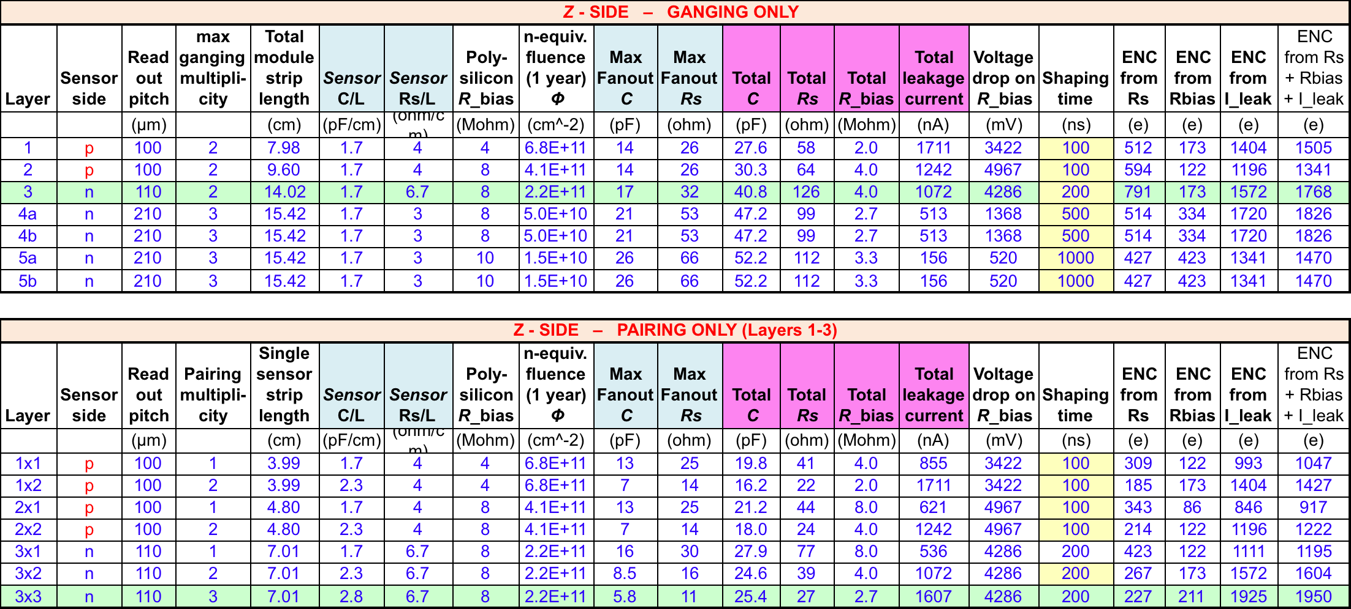
Strip Parameters for Layers 1 - 5 Z-SIDE
OPTION A – LAYER 3 Z-SIDE READ OUT BY SENSOR N-SIDE (at 110 µm pitch)
Leakage currents estimated for 7.5 years of operation (1×10⁷ s/year)
5x safety factor

Slide 7
COMMENTS ON S/N
On z-side, pairing gives better S/N than ganging (as expected).
The strip resistance brings an important contribution to noise. A metal thickness of 2.5 µm has been assumed. (Could be further increased? Waiting for feedback from suppliers.)
Polysilicon bias resistor values could be increased to ~20 MΩ, but this may require a larger dead area at the edges, and for the high leakage currents after irradiation the voltage drop is already a problem.
In evaluating the S/N ratio, we must keep in mind that there could be other possible noise contributions (the estimates have a tendency to underestimate the noise….) and that the collected charge is always less than the ‘standard’ 24 ke, due to angled tracks, low field regions (particularly at large pitch near the p-stops), charge collected by the p-stops, ballistic deficit at short shaping times...

Slide 8
Lorentz Angle
The B field along z will displace the carrier drift direction; the angle between the drift velocity and the electric field is given by tanθ = µ_{H}B, where the Hall mobility µ_{H} is ~ 4.5 times larger for electrons than for holes. For a 1.5 T magnetic field we get:
θ_{n} = 14 degrees for electrons
θ_{p} = 3.2 degrees for holes
The displacement will spread the collected charge in the r-Φ plane, perpendicular to the z axis. So the z readout will be unaffected (to first order) while the Φ clusters will be displaced and their width modified, depending on the track incidence angle. In order to minimize the effect, it would be desirable to read the rΦ coordinate with the hole-collecting p-type strips. This is our choice for Layers 4 and 5 and, in the present scheme, also for Layer 3.
However, Layers 1 and 2 will collect electrons, with a large Lorentz angle, and the inner layers (1 to 3) are arranged in a pinwheel geometry, with faces tilted by ~ ?? degrees. It is desirable to orient the faces so that the tilt angle will partially offset the Lorentz angle on Layers 1 and 2.
Then the tilt angle will add to the (smaller) Lorentz angle on Layer 3. We would reach a symmetric situation between Layers 1+2 and 3 for a tilt angle equal to (θ_{n} – θ_{p})/2 = 5.4 degrees.

Slide 9
Layer 3 Readout Options
The choice of shifting the Layer 3 Φ readout from n-side (as in BaBar, and in Layers 1,2) to p-side was driven by the need to reduce the large noise contribution from the metal strip resistance. Since we are now forced to increase the aluminum thickness by a factor of ~ 2.5 or more, the situation for Layer 3 could be reconsidered.
A first estimate of the noise contributions for Layer 3 in the two options, made with the ganging scheme on z-side and lower leakage currents, indicated a more symmetric situation with Φ readout on n-side. This would have been more favorable also in consideration of the Lorentz angle.
However, with high leakage currents and by adopting a pairing scheme on z-side things change, and the noise situation becomes more symmetrical with the Φ readout on p-side.
The final decision should also take into account the different performance requirements on the two sides.

Slide 10
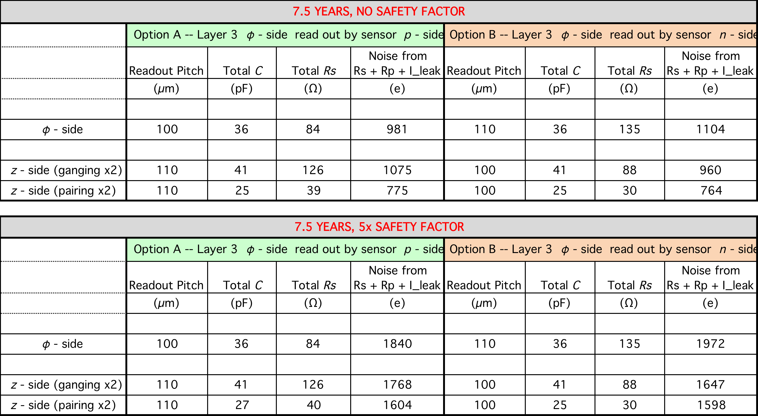
Comparison of Layer 3 Readout Options

