Slide 1
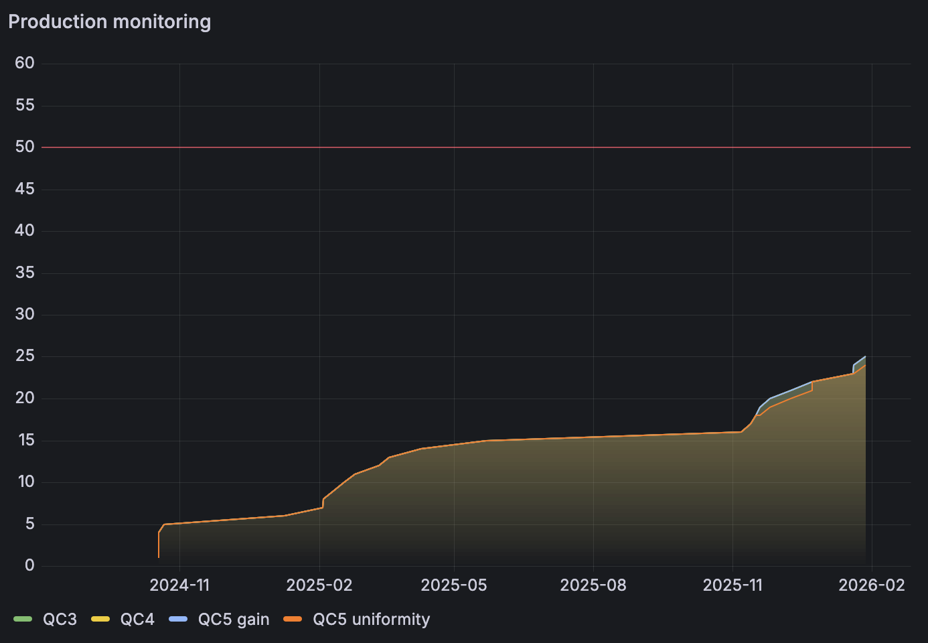
GEM ME0 production status
Bari producion site
25 modules assembled and tested up to QC5 in 2025
25/30 modules to be produced in 2026
reduced person power in Bari wrt last year
2025: 2-3 seniors; 2 postdocs; 3 PhDs
2026: 2-3 seniors; 2 postdocs; 0.5 PhD
plan to assemble and test one module per week starting from next week –> very tight schedule
box with the new kit shipped from CERN
CERN lab (contribution from Bari)
F. Nenna for ME0 stack validation undercosmics at 904 (simil-fellow)
L. Generoso for modules reparation and gain uniformity checks (~6 months)
M. Franco (?) → we need to discuss withTC
General schedule
ME0 module production up to end of 2026
ME0 Stack assembly and test up to March 2027
Prepare GE11 Refurbishment Fall 2026
Involve construction sites in GE11 in 2027
Finish GE11 Refurbishment by June 2028

