Slide 1


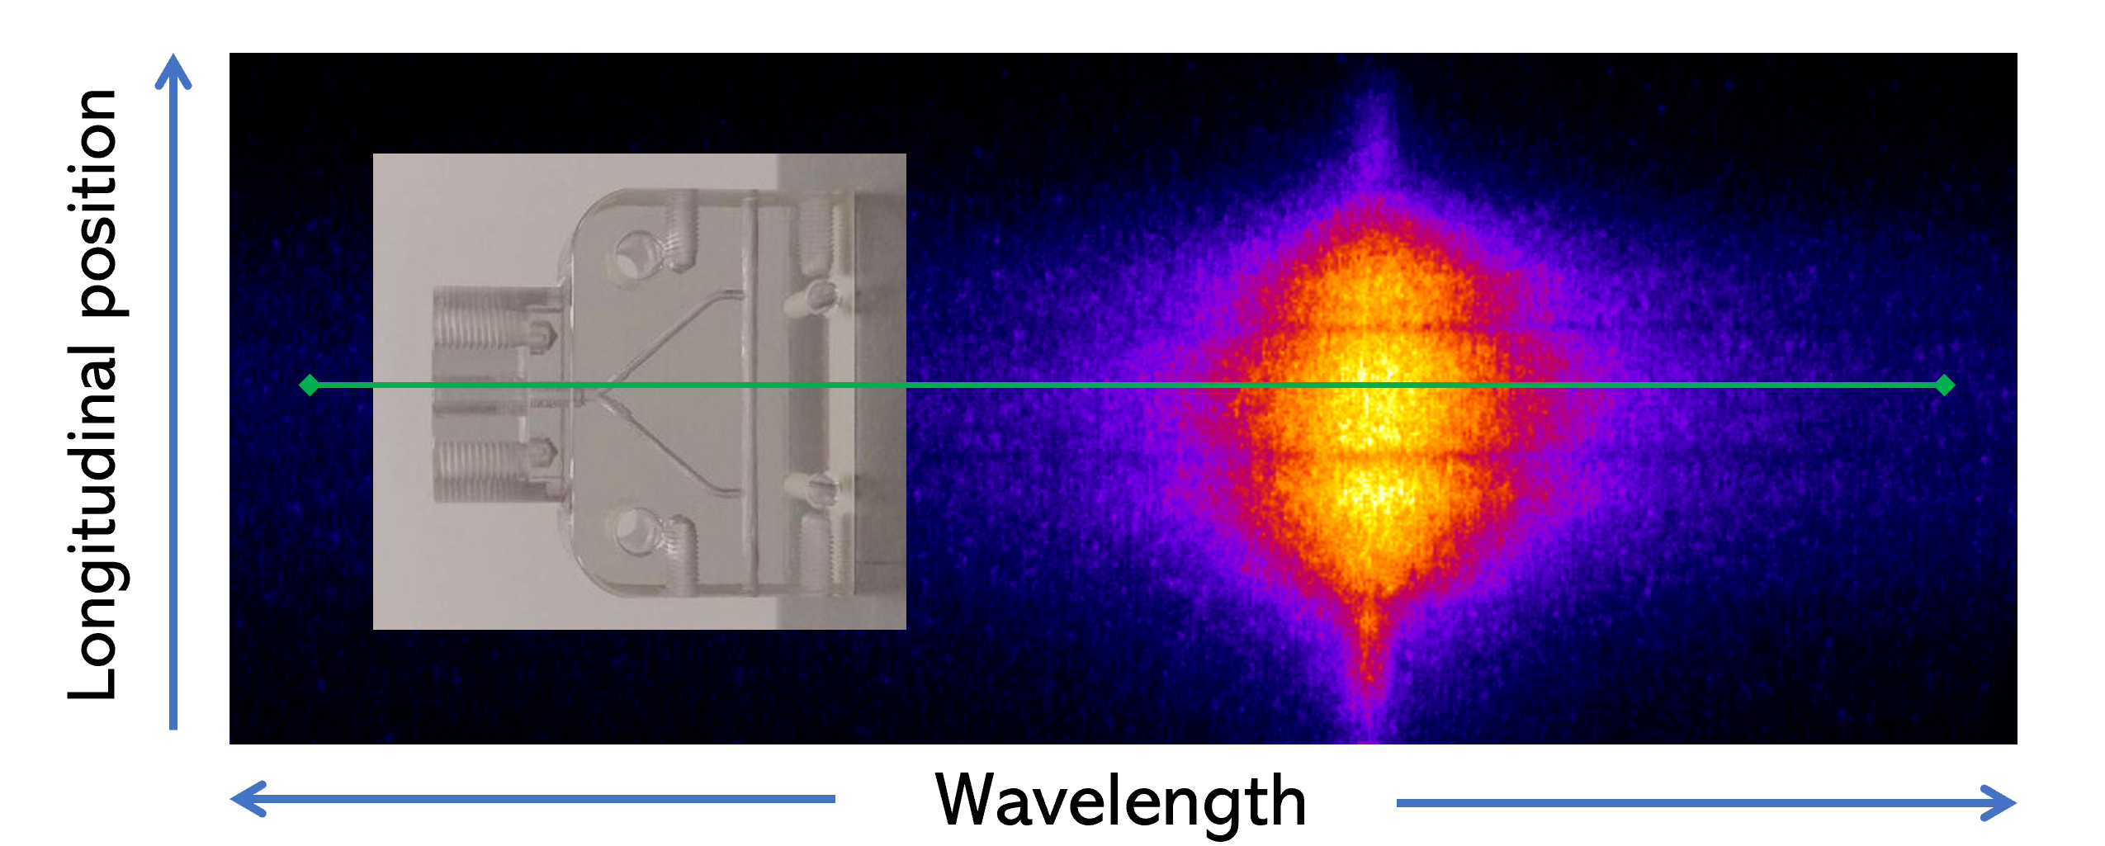
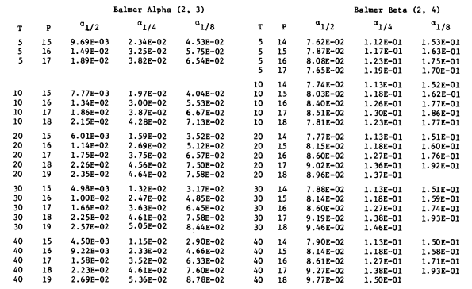
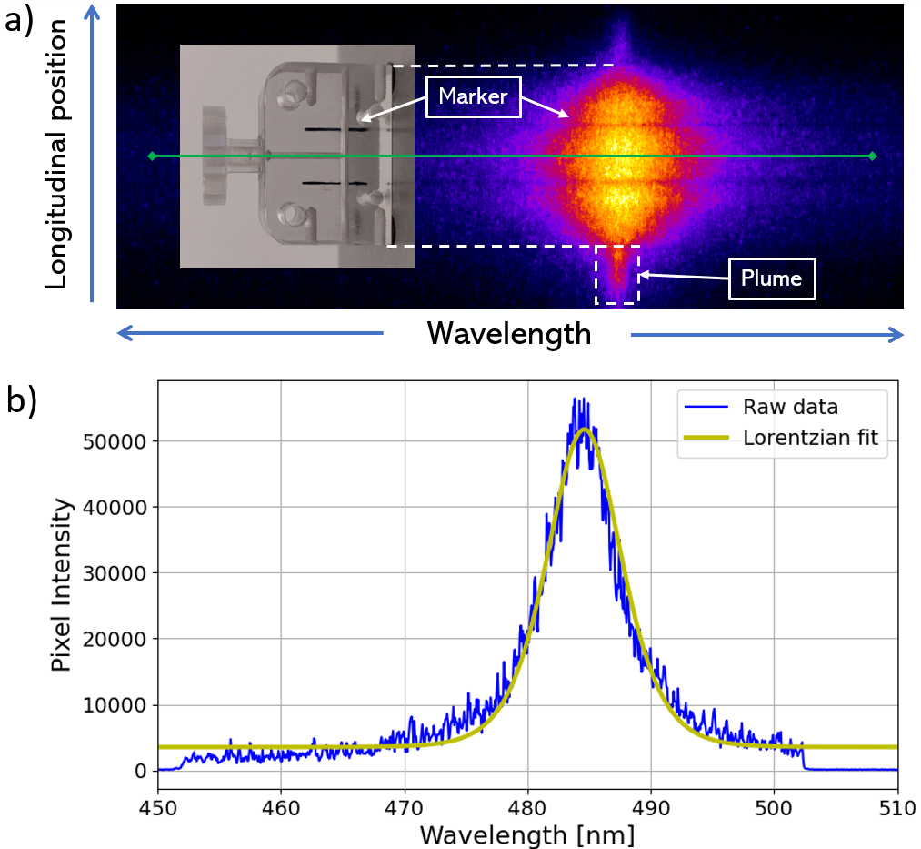
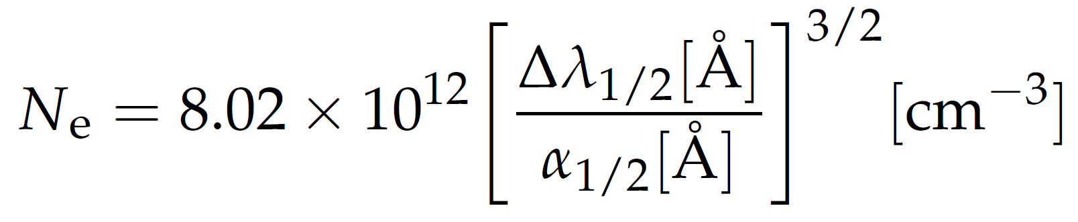
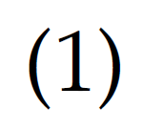
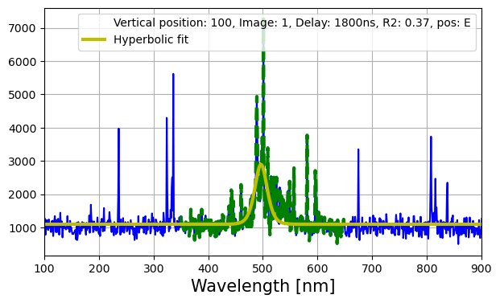
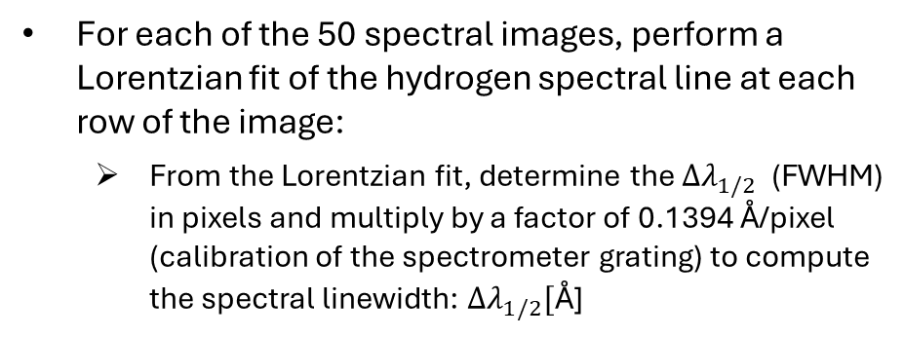
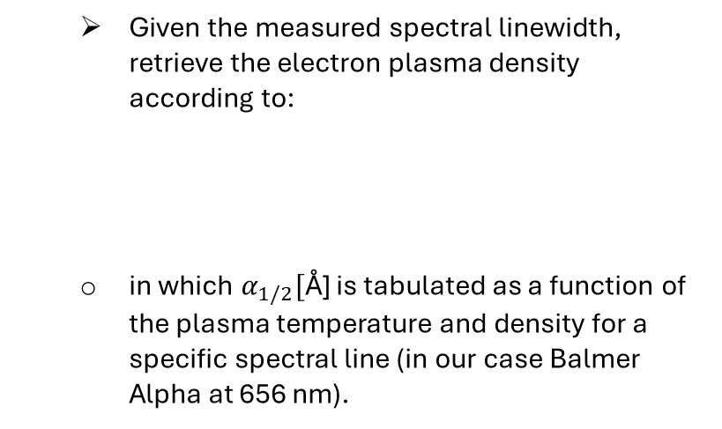

Spectroscopic analysis procedure
Import “.sif” files, each containing a stack of 50 spectral images for a given delay (use the sif_parser module for python)
For each of the 50 spectral images, perform a Lorentzian fit of the hydrogen spectral line at each row of the image:
From the Lorentzian fit, determine the ${∆λ}_{1/2}$ (FWHM) in pixels and multiply by a factor of 0.1394 Å/pixel (calibration of the spectrometer grating) to compute the spectral linewidth: ${∆λ}_{1/2}[\text{Å}\text{]}$
Given the measured spectral linewidth, retrieve the electron plasma density according to:
in which $α_{1/2}[\text{Å}\text{]}$ is tabulated as a function of the plasma temperature and density for a specific spectral line (in our case Balmer Alpha at 656 nm).
$${∆λ}_{1/2}$$
lucio.crincoli@lnf.infn.it

Slide 2
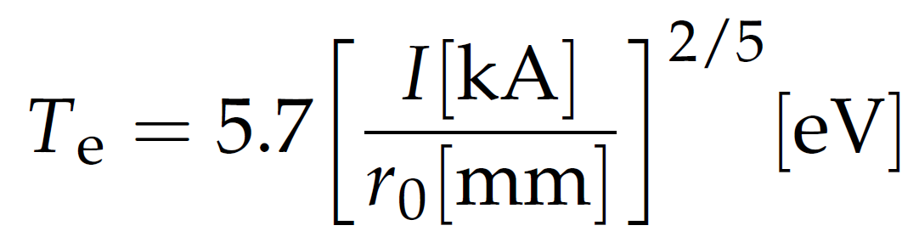
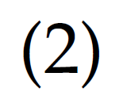
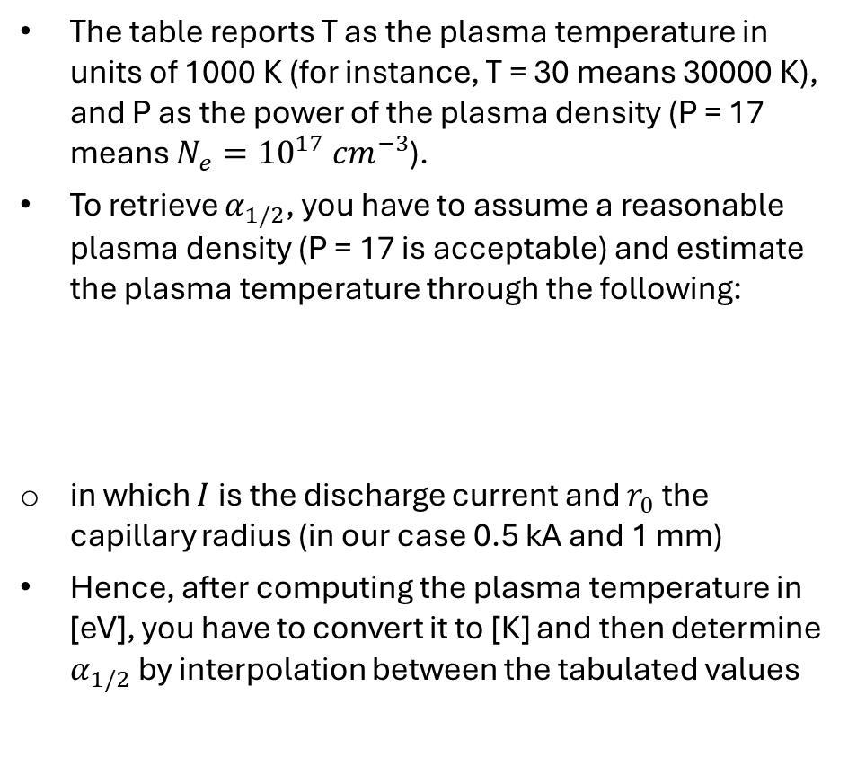
Spectroscopic analysis procedure
The table reports T as the plasma temperature in units of 1000 K (for instance, T = 30 means 30000 K), and P as the power of the plasma density (P = 17 means $N_{e}={10}^{17} {cm}^{−3}$).
To retrieve $α_{1/2}$, you have to assume a reasonable plasma density (P = 17 is acceptable) and estimate the plasma temperature through the following:
in which $I$ is the discharge current and $r_{0}$ the capillary radius (in our case 0.5 kA and 1 mm)
Hence, after computing the plasma temperature in [eV], you have to convert it to [K] and then determine $α_{1/2}$ by interpolation between the tabulated values
lucio.crincoli@lnf.infn.it

Slide 3
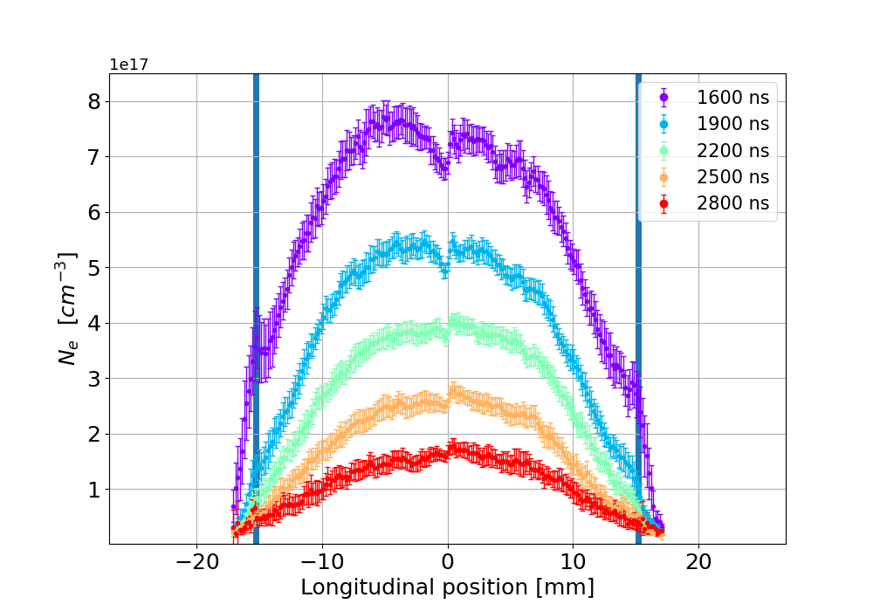
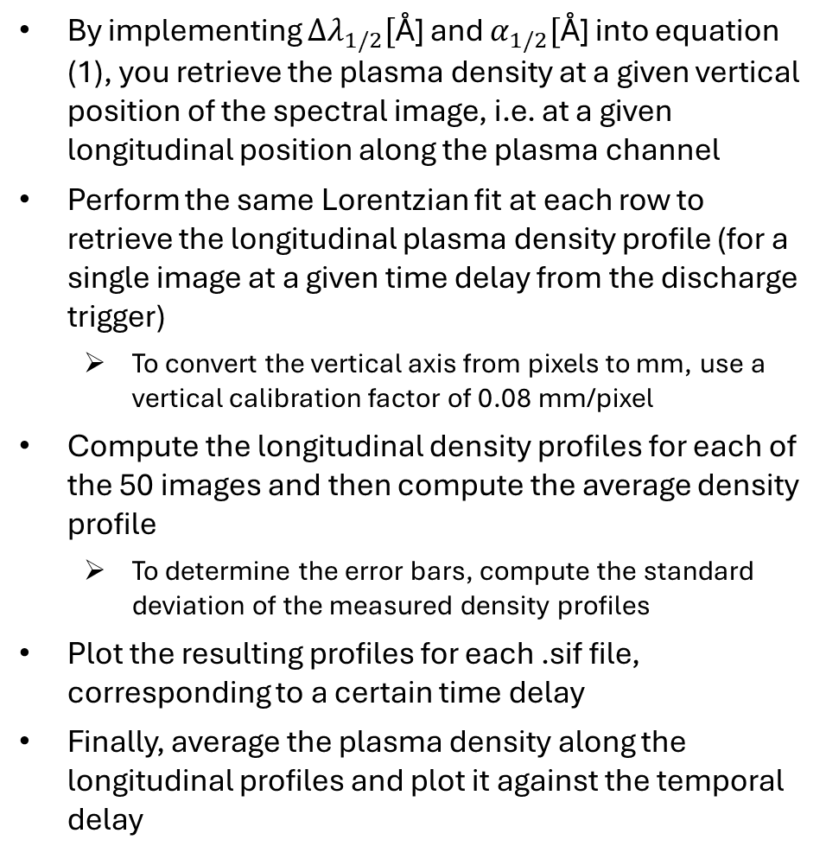
Spectroscopic analysis procedure
By implementing ${∆λ}_{1/2}[\text{Å}\text{]}$ and $α_{1/2}[\text{Å}\text{]}$ into equation (1), you retrieve the plasma density at a given vertical position of the spectral image, i.e. at a given longitudinal position along the plasma channel
Perform the same Lorentzian fit at each row to retrieve the longitudinal plasma density profile (for a single image at a given time delay from the discharge trigger)
To convert the vertical axis from pixels to mm, use a vertical calibration factor of 0.08 mm/pixel
Compute the longitudinal density profiles for each of the 50 images and then compute the average density profile
To determine the error bars, compute the standard deviation of the measured density profiles
Plot the resulting profiles for each .sif file, corresponding to a certain time delay
Finally, average the plasma density along the longitudinal profiles and plot it against the temporal delay
lucio.crincoli@lnf.infn.it

