Slide 1


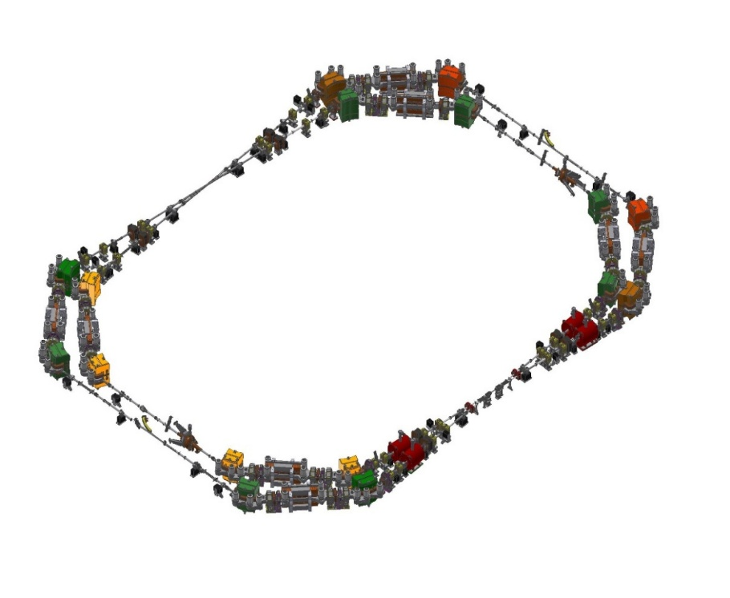
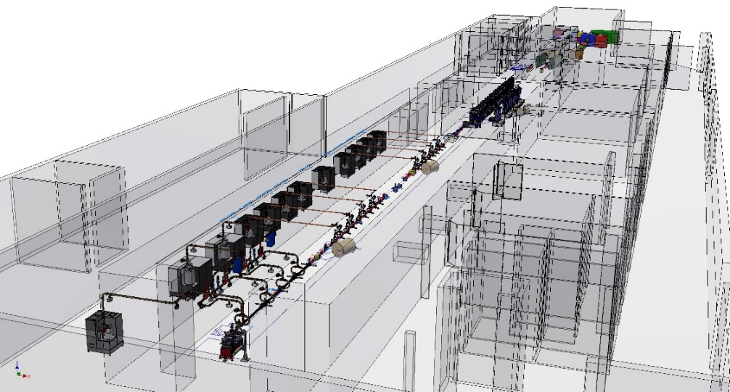
LABORATORIO ACCELERATORI
METROLOGY
ENRICO DI PASQUALE
FRASCATI 10/04/2026
MECHANICAL ENGINEERING SERVICE
The Mechanical Engineering Service (four mechanical engineers and eight technicians) provides support to the Accelerators Division for mechanical design with 3D CAD, FEM simulation, installation and alignment of accelerator elements, mechanical characterization of components and small workshop productions. The alignment laboratory has two laser trackers and two portable CMMs (scanharm), and the workshop is also equipped with a CNC milling machine, two lathes and other machinery for mechanical processing (band saw, vertical drill...). Our activity includes the detailed design of magnets, vacuum chambers and support structures, the management of the overall 3D layout of the experiments, the mechanical measurements, the installation of the component parts of the experiments. The Group often collaborates with other research institutions in Italy and abroad.

Slide 2
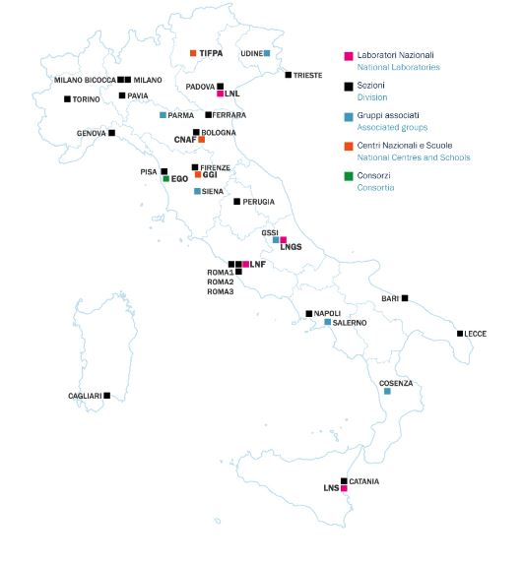
NATIONAL INSTITUTE OF NUCLEAR PHYSICS

Slide 3
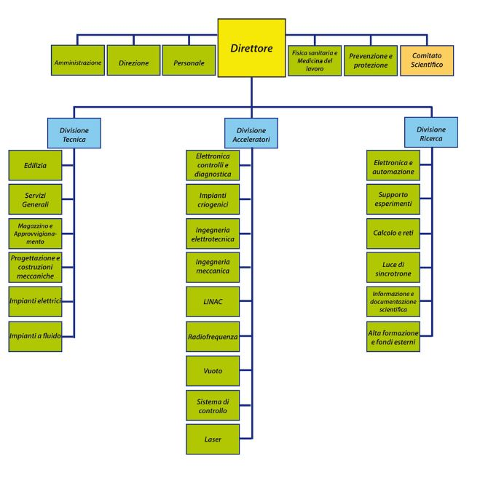
FRASCATI NATIONAL LABORATORIES

Slide 4
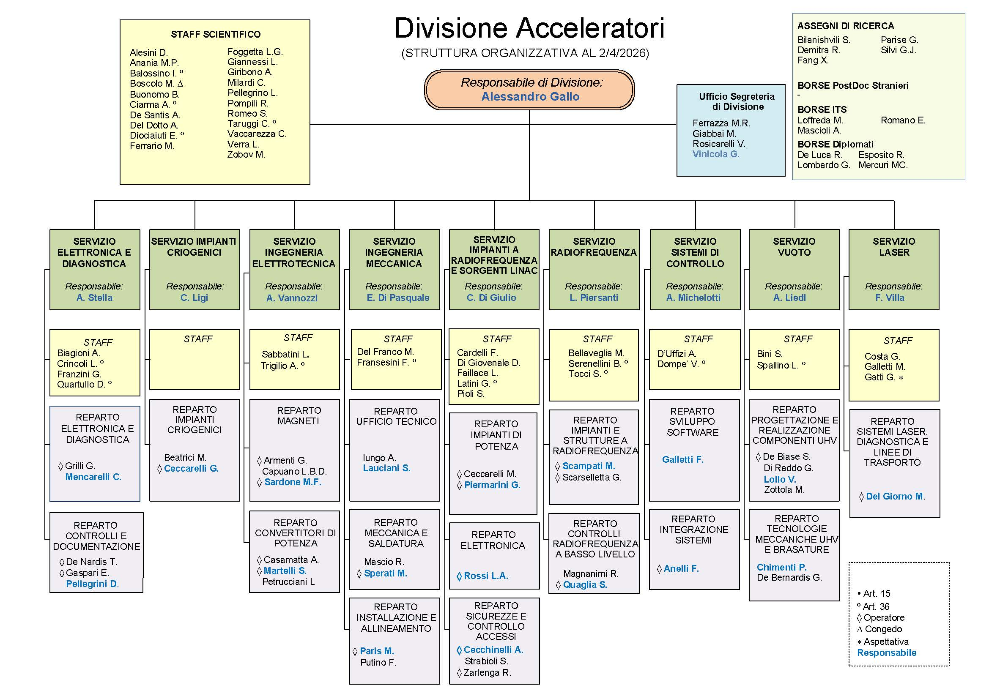
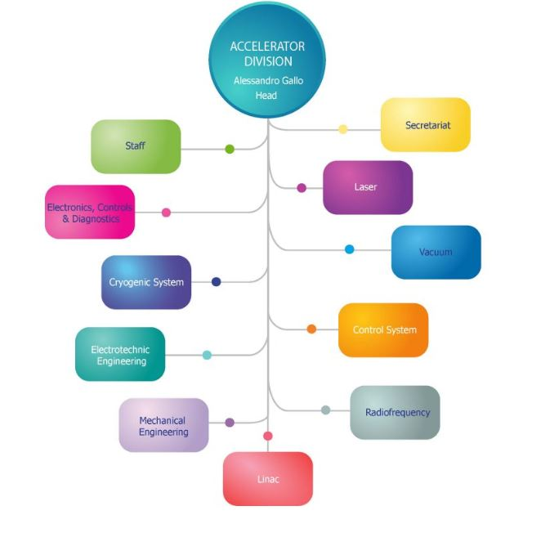
ACCELERATORS DIVISION
Comprende più di 100 persone tra ricercatori, tecnologi, tecnici e amministrativi dedicati alle operazioni e allo studio delle macchine acceleratrici e vari servizi di supporto interni.

Slide 5
ACCELERATORS AND FACILITIES
BEAM TEST FACILITY:
In the BTF (Beam Test Facility) laboratory, beams of particles of different nature arrive, directly derived from the electron beam of the DAΦNE Linac: electrons, positrons, photons and neutrons. The laboratory has the peculiarity of providing different types of beams: each of these has a variable number of constituent particles and energy, within the limits allowed by the properties of the primary beam of the Linac.
DAΦNE:
is the collider currently in operation in Frascati. The accelerator consists of 2 rings about 100 m long, in which high-intensity beams of electrons and positrons circulate and cross each other at two possible interaction points, one of which is currently used around which the detector of the KLOE-2 experiment is installed. The total energy of the beams in the reference frame of the center of mass is equal to 1.02 GeV, corresponding to the mass of the mesons Φ that are produced at the rate of 300 per second. The first particle beams circulated in DAΦNE in 1997.
DAΦNE LUCE:
"To make the invisible visible" It is the synchrotron light laboratory of the Frascati National Laboratories. Synchrotron light is the radiation emitted by accelerated charged particles – in the case of DAΦNE, electrons – traveling at relativistic speeds. The radiation produced has a high brightness and wavelengths that extend, continuously, from infrared to X-rays, which makes it an ideal probe for studying physical systems ranging in size from atomic to those of biological systems such as cells and tissues.
SPARC_LAB:
Sources for Plasma Accelerators and Radiation Compton with Laser And Beam is an LNF laboratory born from the merger of the previous SPARC and PLASMONX projects and is characterized by a high-brightness electron photoinjector, SPARC, and a high-power laser (hundreds of TW), FLAME.

Slide 6
EuPRAXIA:
The EuPRAXIA project aims to build an innovative electron accelerator using a laser and field acceleration of a plasma generated by an electron beam, leading to a significant reduction in size and possible cost reduction compared to current radiofrequency-based acceleration techniques.
EuAPS:
distributed user facility to make advanced radiation sources available to groups of users; these consist of a plasma-based betatron source to produce partially coherent soft X-rays.
LATINO:
It is an open research infrastructure that makes available to companies and the scientific community the advanced technologies and skills developed in the field of particle accelerators for research, medical and industrial applications. It is based on 4 distinct laboratories: Radio Frequency (high Power test stand in the X band and low power measurements up to 120GHz), Magnetic Measurements, Vacuum and heat treatments, Mechanical Integration (in collaboration with the ROME section). Project co-financed by the Lazio region (POR-FESR 2014-2020 KET – Advanced Manufacturing System)
SABINA:
Source of Advanced Beam Imaging for Novel Applications. Consolidation of the SPARC_LAB research facility, which includes the SPARC photoinjector and the FLAME power laser, with the aim of improving performance and increasing facility uptime.
Collaborations:
FCC
STAR
SSRIP
CLIC
LHC

Slide 7
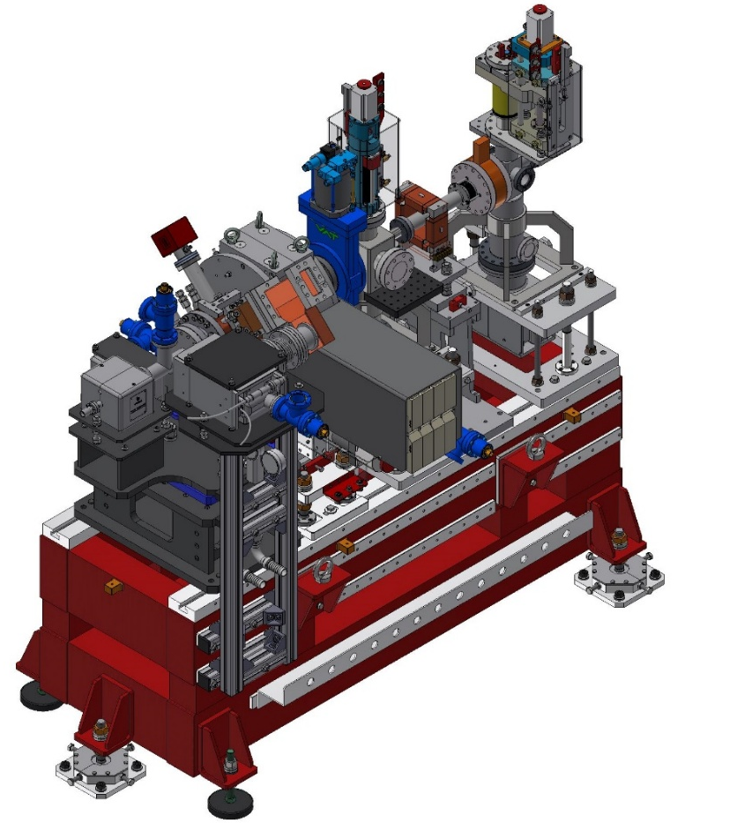

AUTODESK INVENTOR 2025
Three-dimensional prototyping software for mechanical design
MODULO GUN SPARC-EuPRAXIA
3D modeling allows you to drastically reduce the processing time of the order, this is because it allows you to build virtual models of objects or structures much faster than 2D, representing all their technical and physical characteristics. Through 3D modeling, designers and draftsmen are able to determine problems and non-conformities such as footprints, physical interferences or wrong component choices, in advance of 2D design.

Slide 8
Parametric modelingIt
is a particularly interesting way to structure and create virtual 3D models, as it allows you to chain a series of changes and automate processes every time you go to act on a certain parameter to make a change. A well-structured parametric definition (file) allows you to quickly and accurately make changes to the project or to study in a relatively simple way a series of possibilities or alternatives starting from assigned numerical (dimensional, quantitative, etc.) or formal assumptions.
Assembly Modeling
Learn how design components combine and work at the assembly level
Creating Drawings
Quickly create clear, precise, and detailed drawings for production
Collaborate with shared views
Collaborate on projects with key stakeholders from any device
Using non-native data
Directly open designs created by other CAD systems without any conversion
Interoperability BIM
Building Information Modeling (BIM) is the holistic process of creating and managing information related to a building. Based on an intelligent model and supported by a cloud platform, BIM integrates multidisciplinary structured data to create a digital representation of an asset throughout its lifecycle, from planning and design to construction and commissioning (VAULT).

Slide 9
Project configurations
Speed up the 3D modeling process by quickly creating new design configurations
Automatic chassis design
Quickly create and simulate 3D models of weld frame designs
Sheet metal
Design and prepare complex sheet metal products ready for production
Content Center
Choose standard components from a comprehensive customizable library

Slide 10
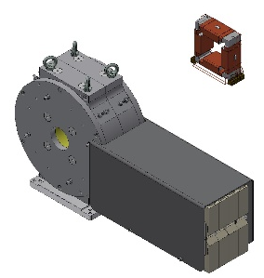

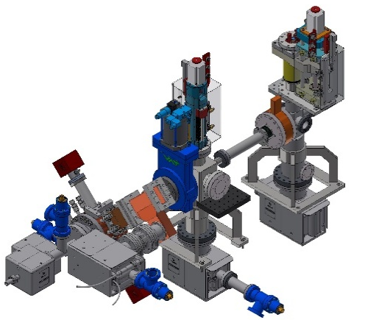
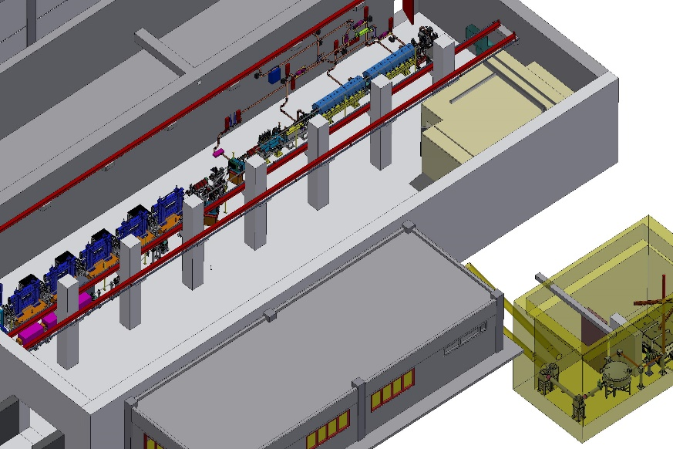
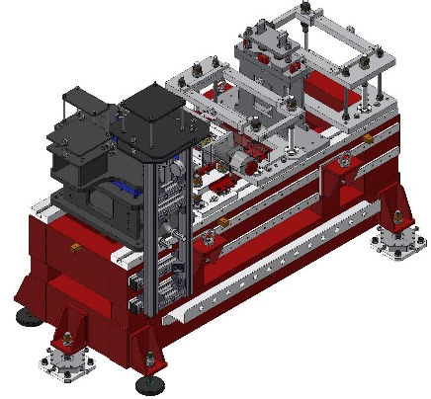
PHILOSOPHY OF MECHANICAL DESIGN OF PARTICLE ACCELERATORS
MAGNETI
VUOTO
SUPPORTI

Slide 11
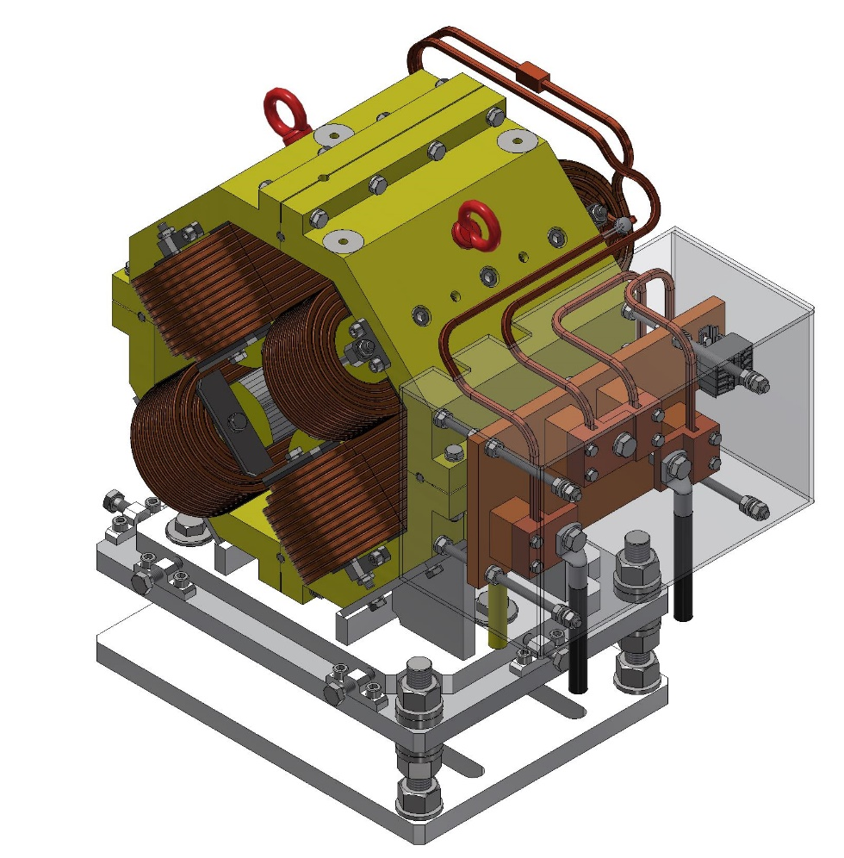
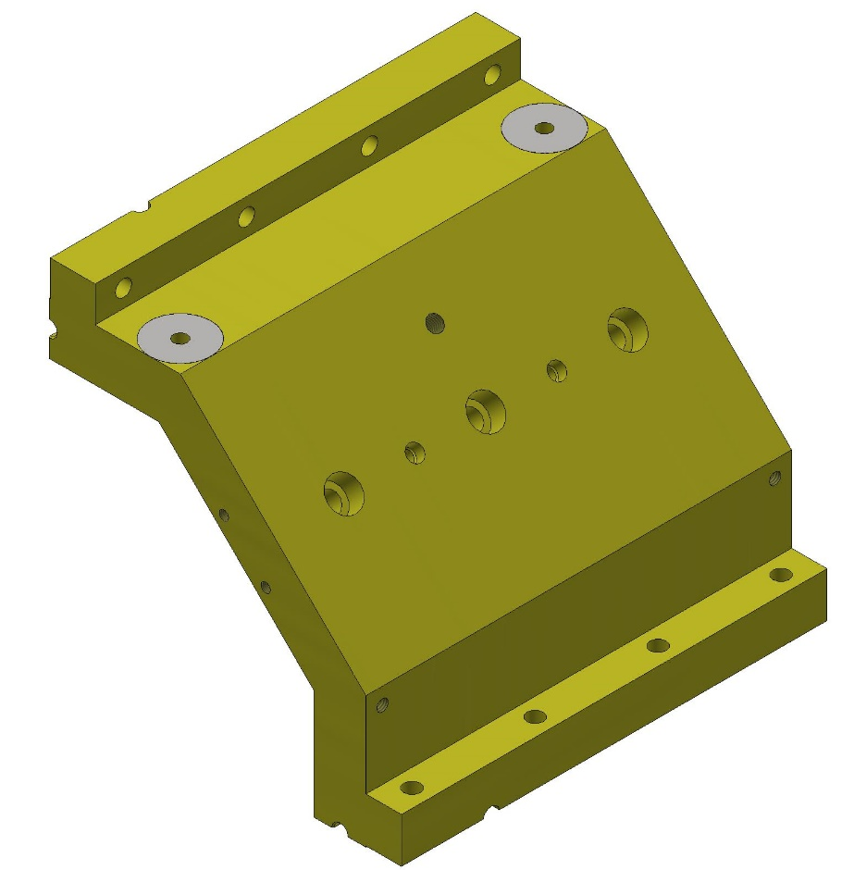
QUADRUPOLO BTF (ASSIEME)
1/4 GIOGO (PARTE)

Slide 12
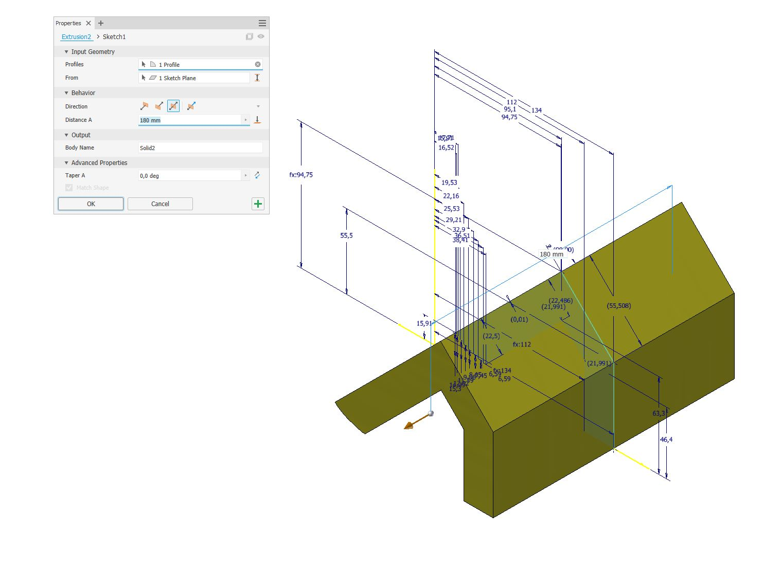
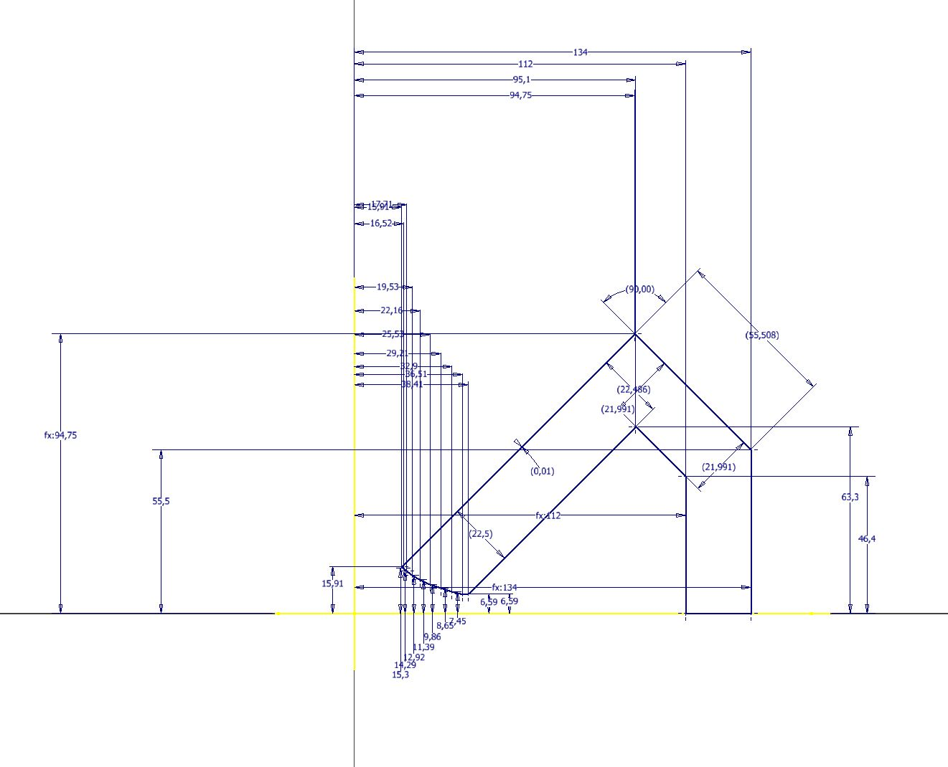
SKETCH 2D
ESTRUSIONE

Slide 13
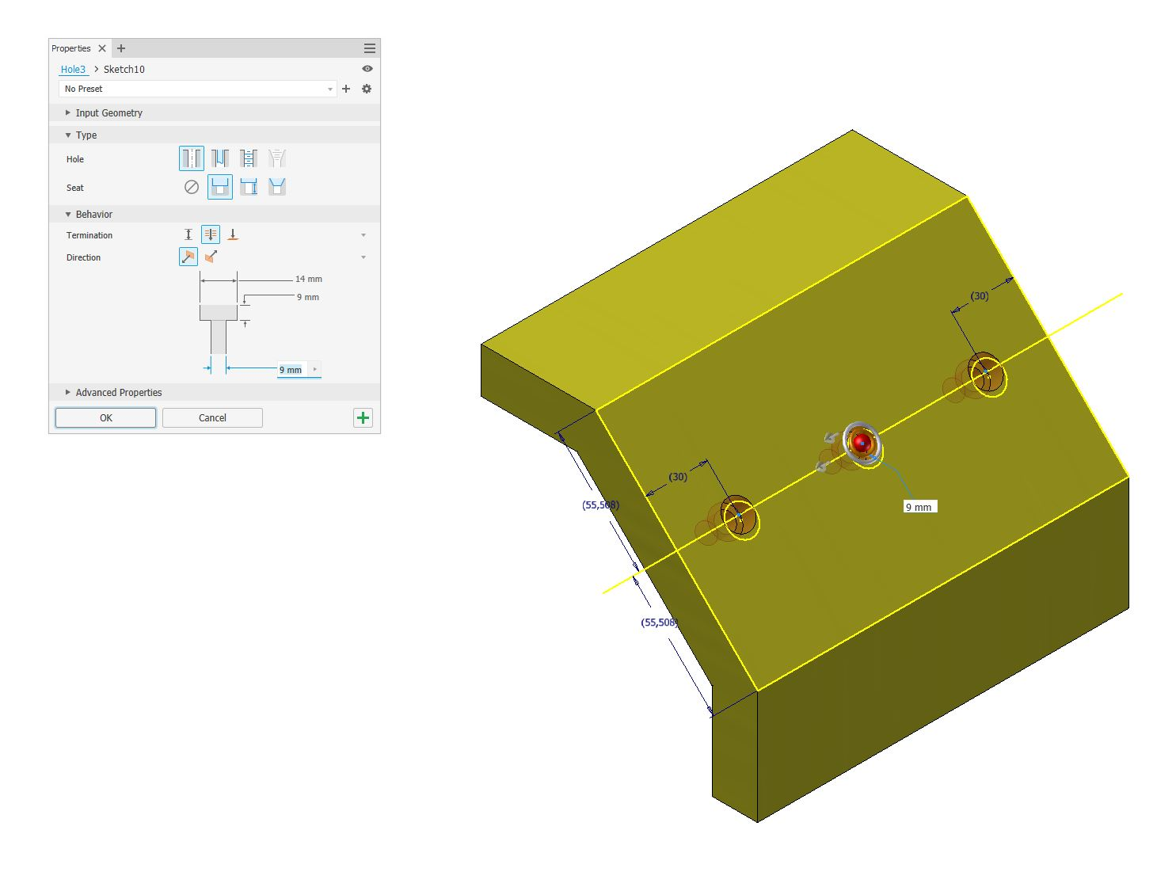
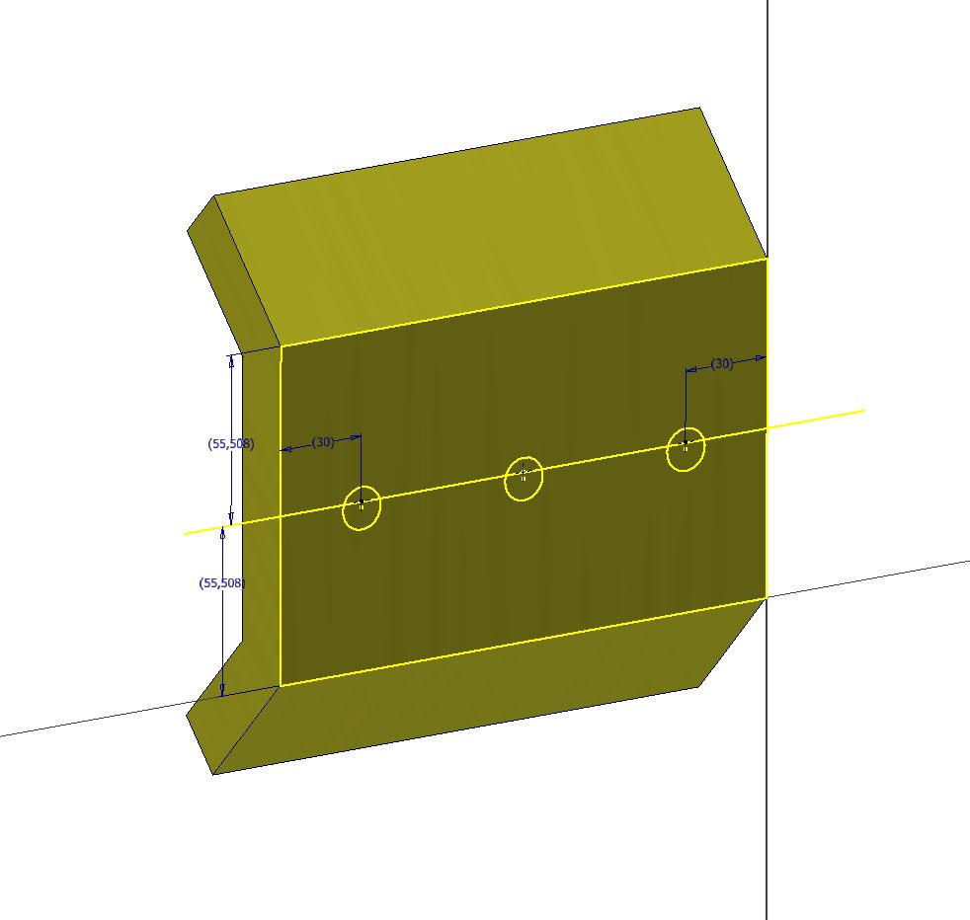
SKETCH 2D LAVORAZIONE
LAVORAZIONE FORO

Slide 14
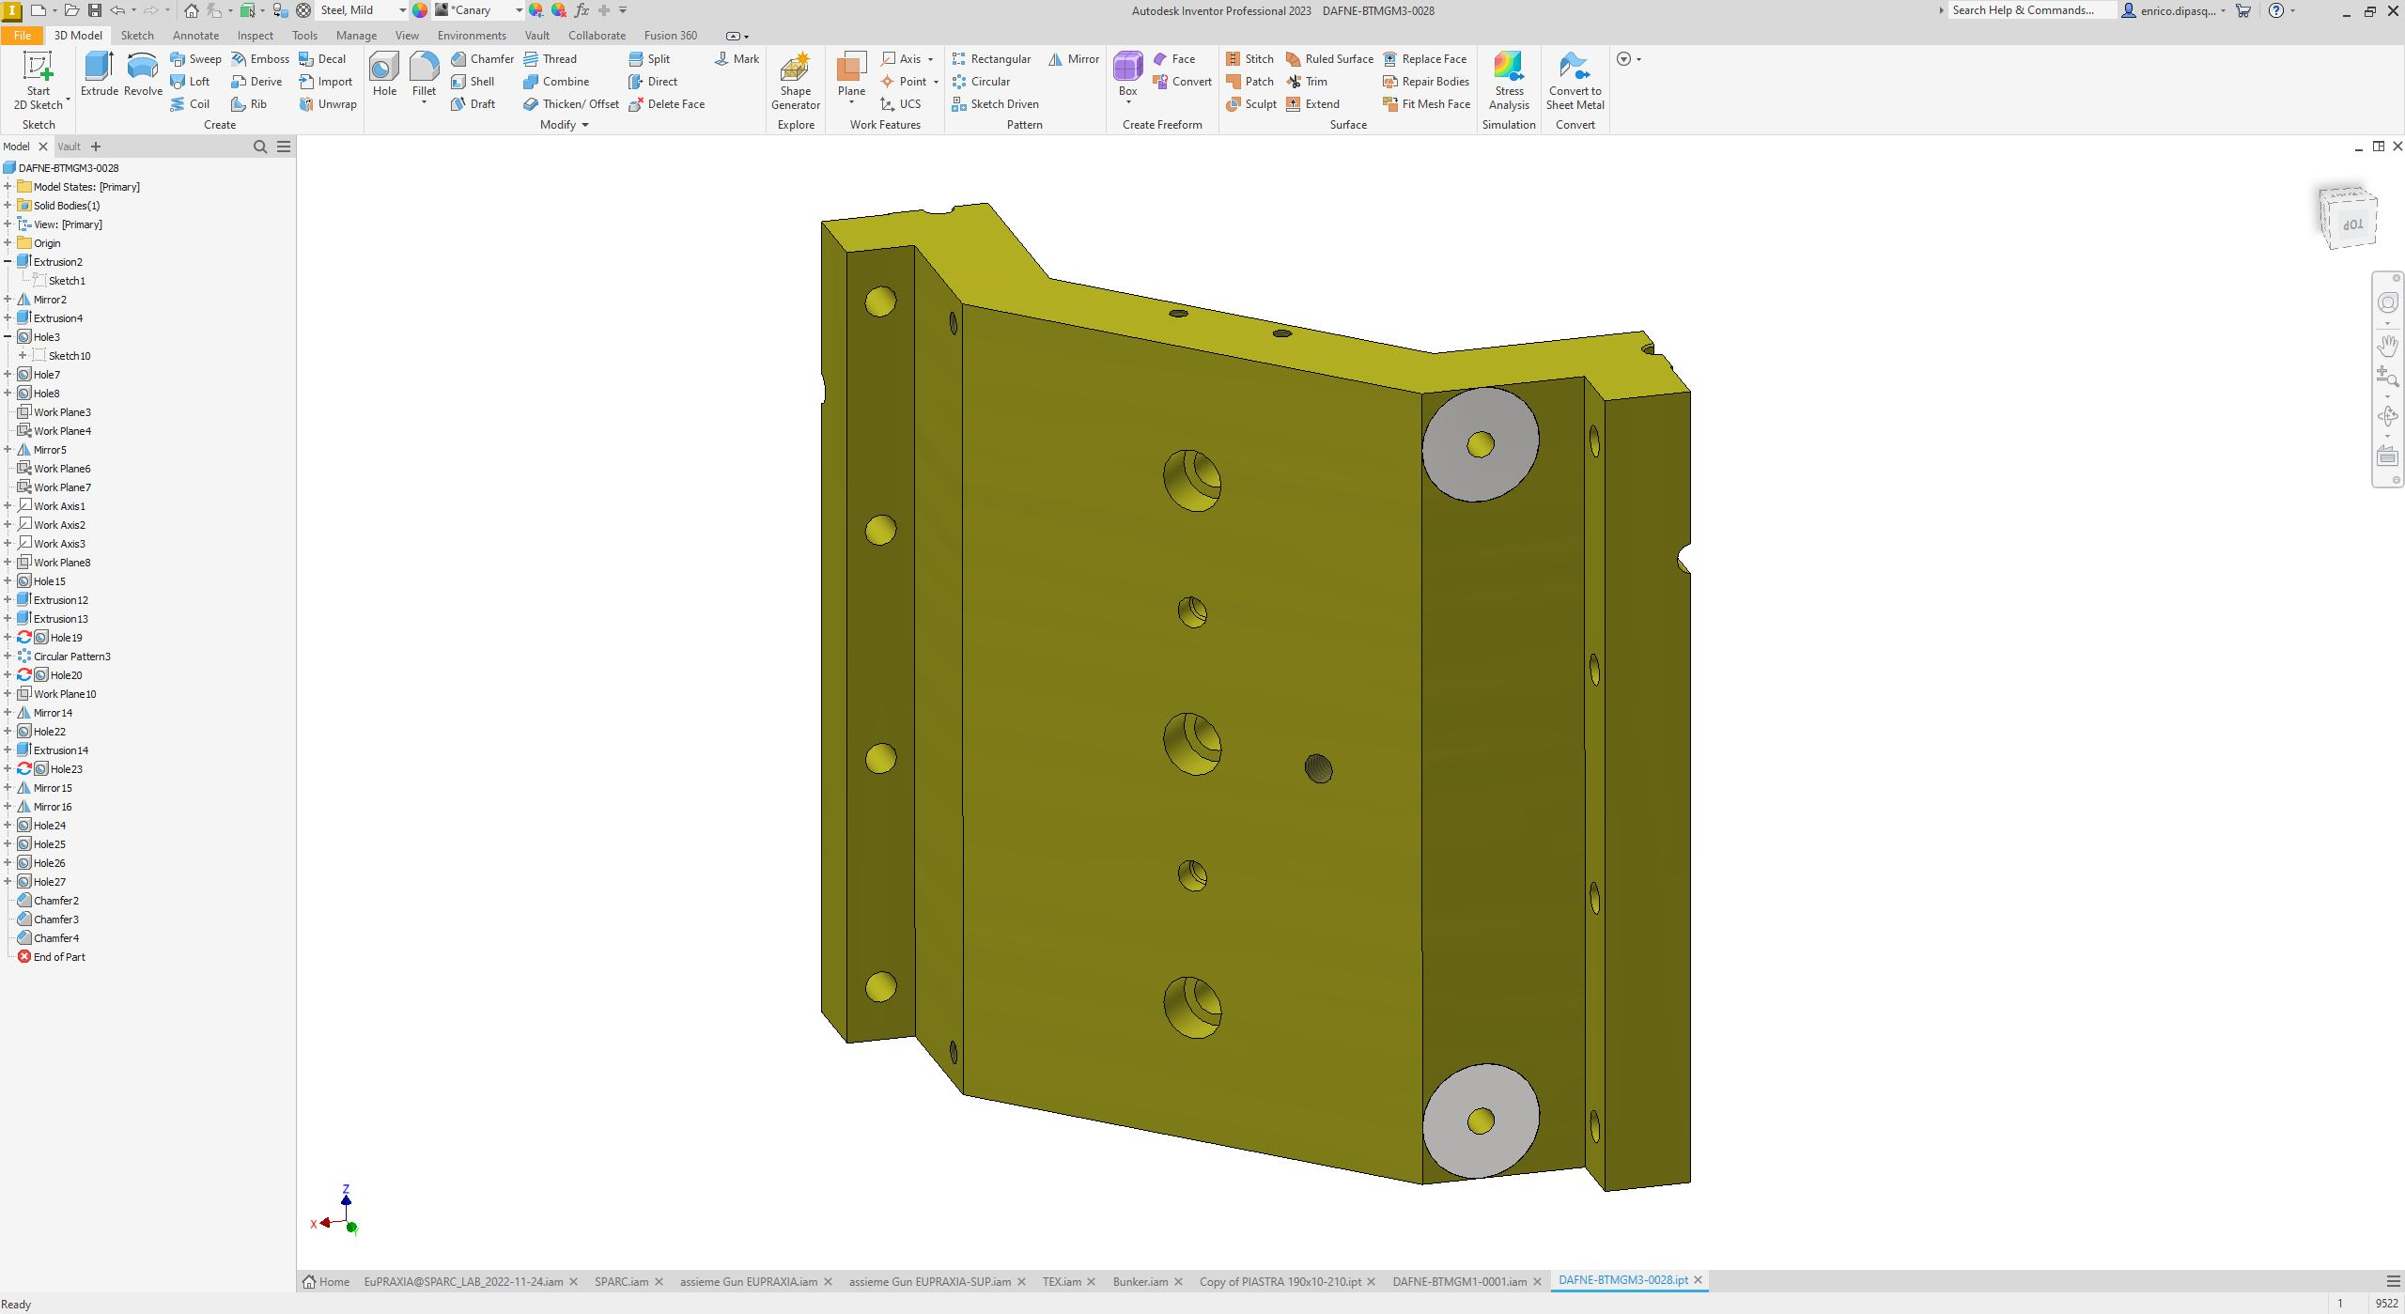

Slide 15
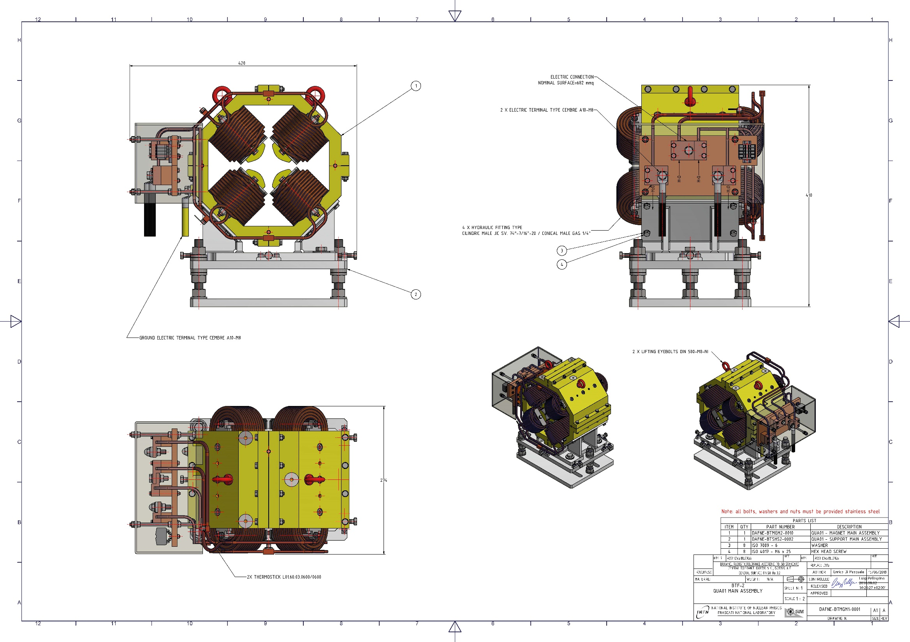

Slide 16
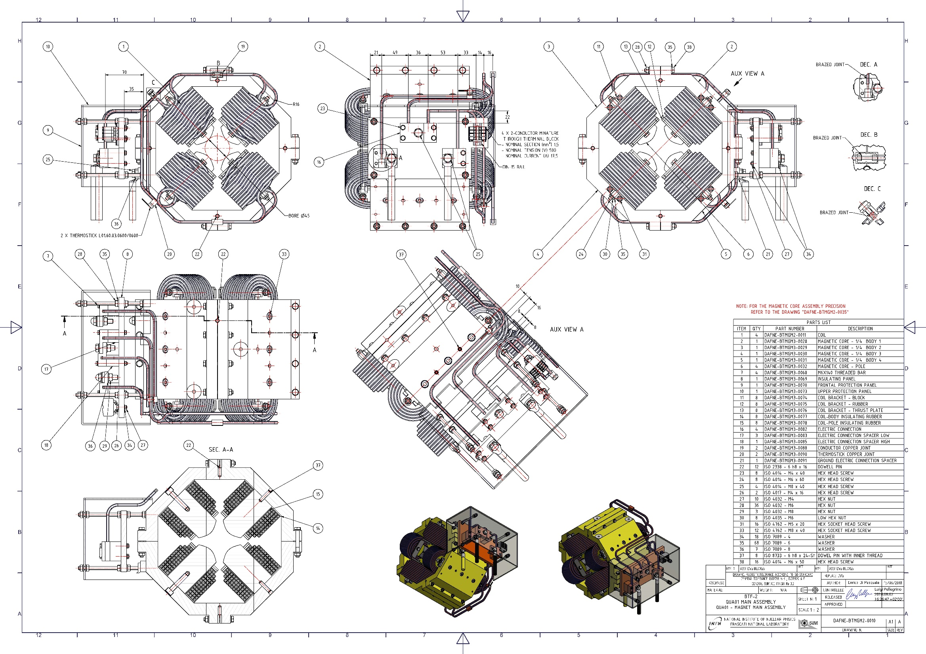

Slide 17
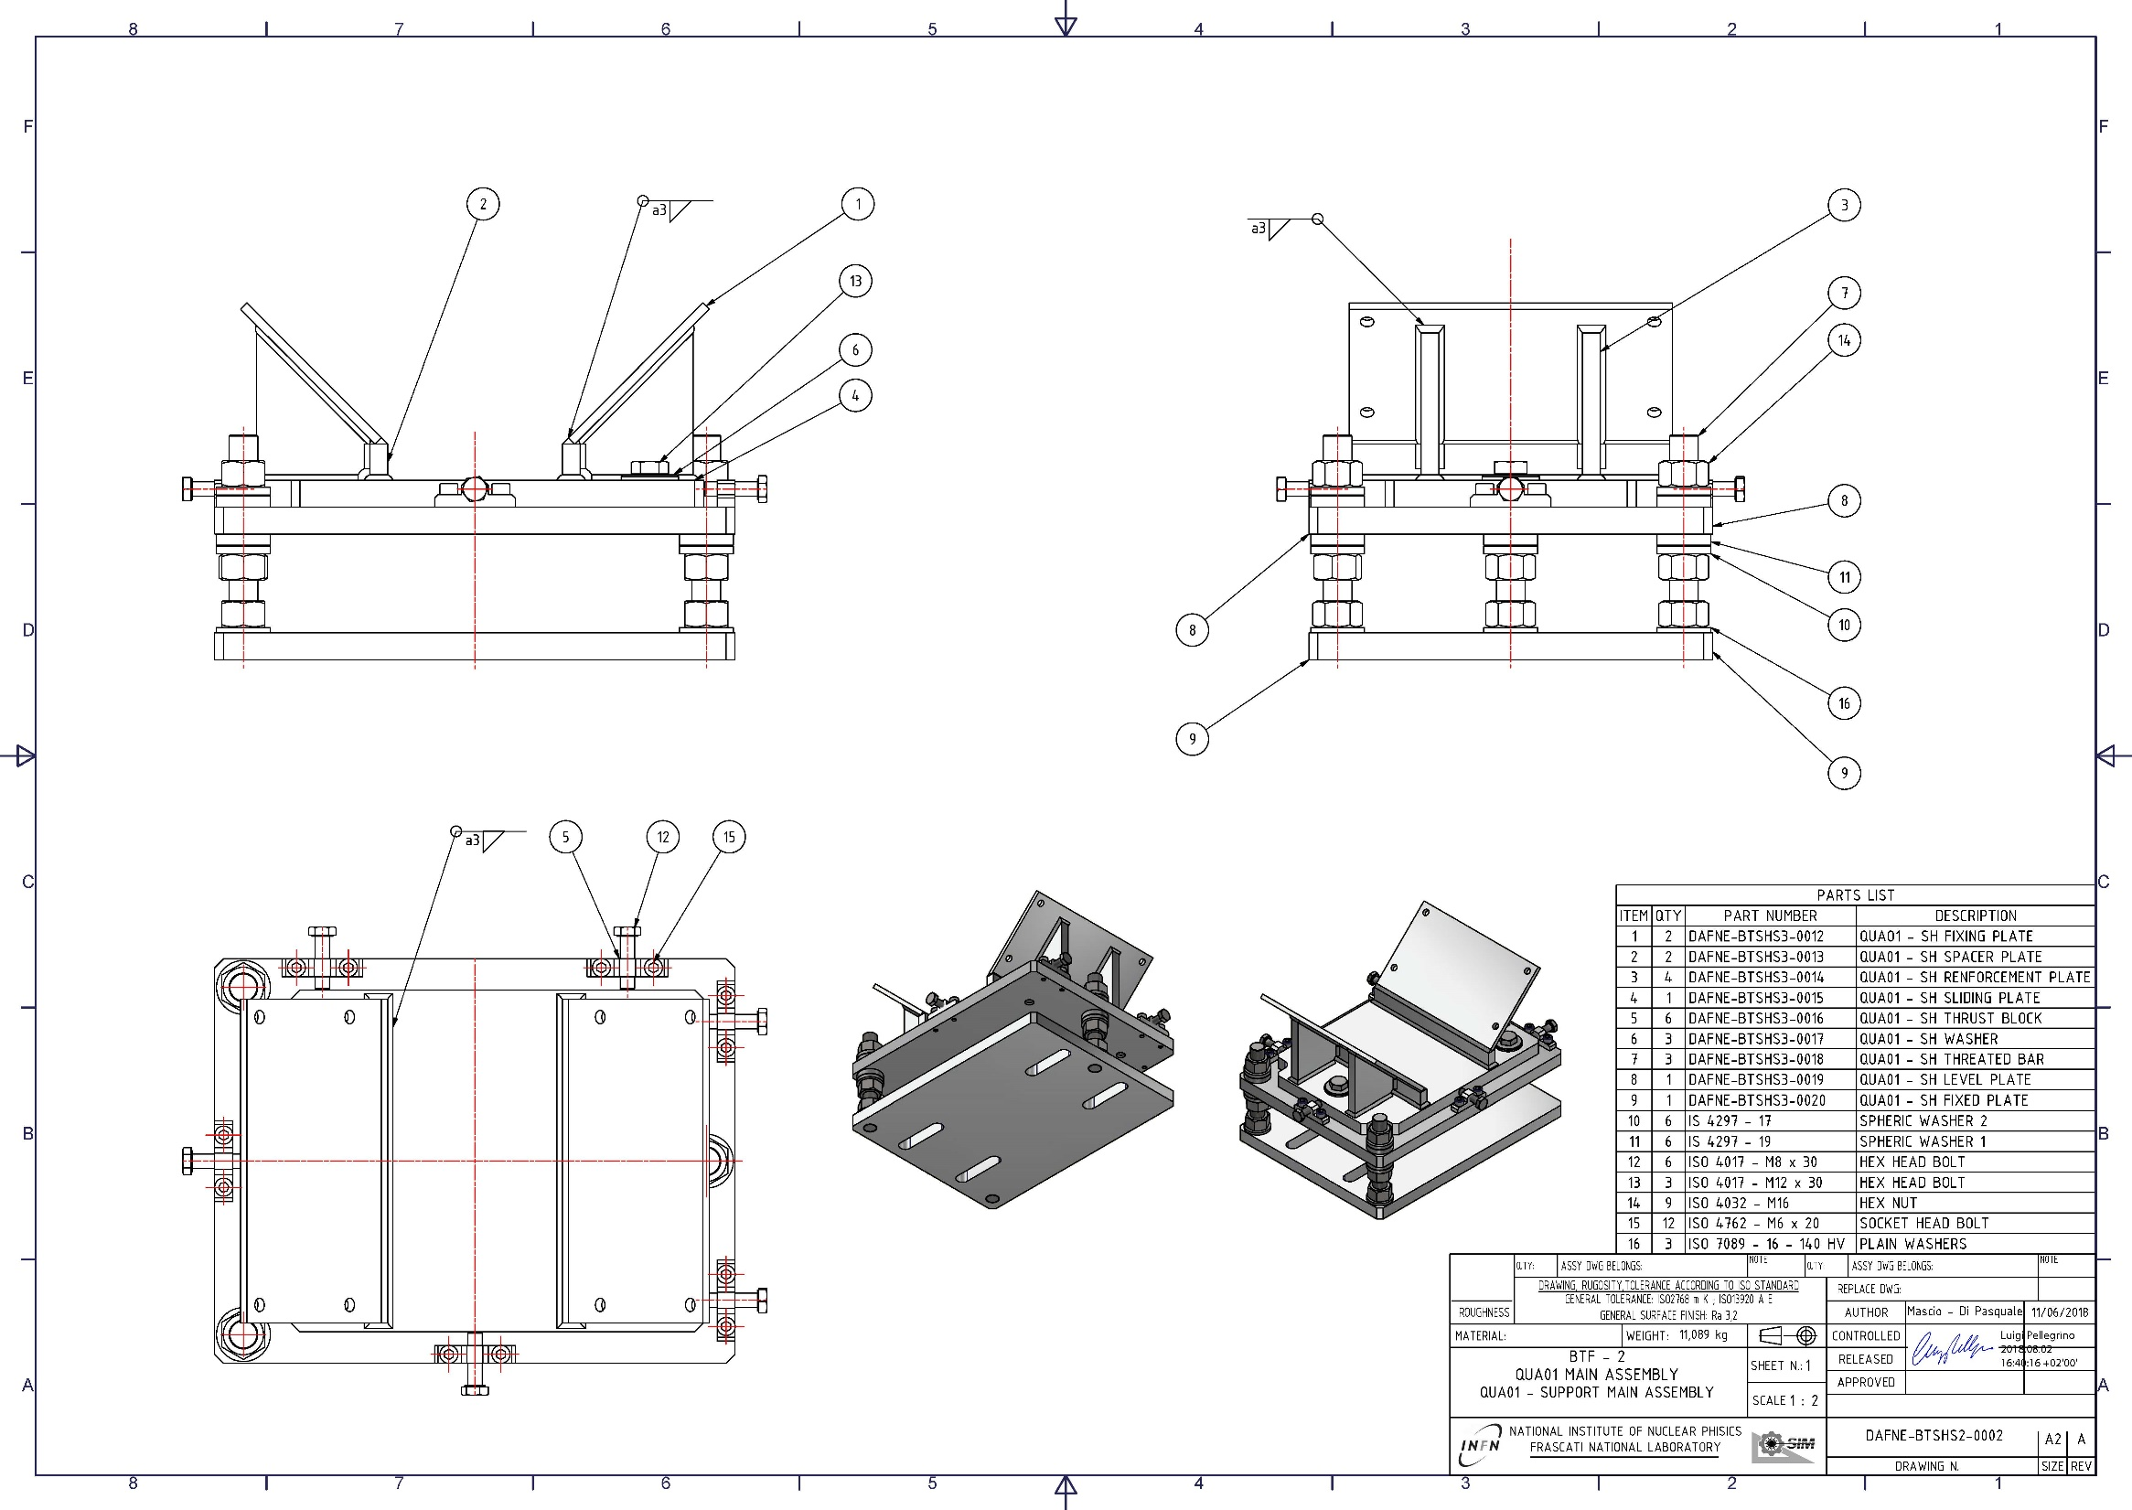

Slide 18
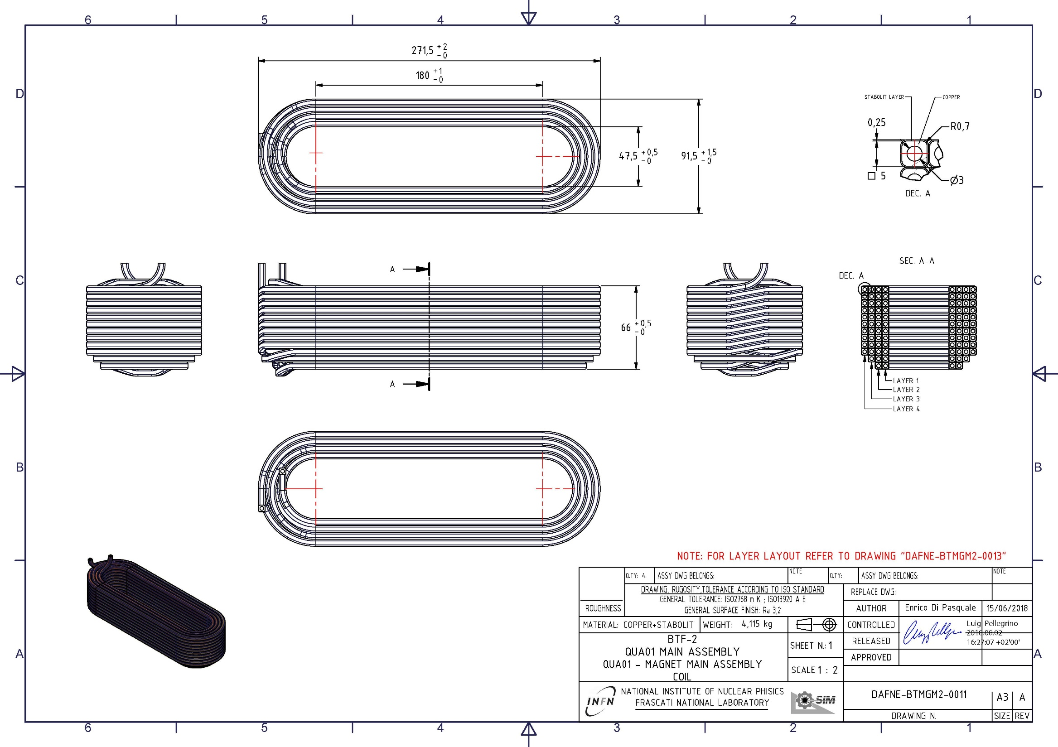

Slide 19
What is metrology
Metrology is the science that has as its object the study of the principles, methods and means necessary to carry out the measurement of physical quantities, which is essential to ensure the accuracy, repeatability and traceability of the results, making them globally comparable. It covers theoretical and experimental aspects, applying to all scientific and production fields, with three main areas: scientific, industrial and legal.
Scientific Metrology: it deals with the establishment, development and maintenance of the fundamental measurement standards and units of measurement (International System - SI).
Industrial Metrology: ensures the correct functioning of measuring instruments used in industry and quality control, often through accredited laboratories.
Legal Metrology: ensures the correctness of measurements in commercial transactions, health and environmental protection, protecting the consumer (e.g. periodic verification of scales and meters).
Key points:
Traceability: assicura che le misurazioni siano collegate a campioni nazionali o internazionali.
INRiM: the National Institute of Metrological Research is the main point of reference in Italy for scientific metrology.
Normative: Legal metrology makes use of periodic and first checks (legal stamps) to ensure the conformity of the instruments.
In summary, metrology ensures that measurements are reliable, crucial for safety, trade, and technological innovation.
It therefore deals only with physical quantities; so much so that, in order to have the right to be defined as such, the properties of an object or phenomenon they must be measurable, i.e. it must be possible to define units of measurement and methods of measurement.

Slide 20
What is a unit of measurement
To measure a physical quantity, it is compared with one of the same kind, that is, with a unit of measurement. Over the centuries, precise criteria have gradually been imposed for the adoption of units of measurement;
They are:
• simplicity
• availability • reproducibility • precision.
In ancient times, the first three criteria led to the use of anthropometric units, i.e. based on body size human; Currently, the technology makes it possible to meet even the highest precision requirements using natural measurements, i.e. based on quantities or phenomena existing in nature. Currently, the meter is defined as a function of the speed of light, thanks to the availability of very precise instruments.
What is a measure
By measurement of a physical quantity we mean the product of two factors, one of which is a quantity of the same kind, chosen as a unit of measurement, and the other is a pure number, which expresses how many times this unit is contained in the quantity to be measured.
How to measure it
Two methods can be used to obtain a measurement: • direct measurement;
• indirect measurement; A direct measurement occurs when the unit of measurement is directly compared with the quantity to be measured and the number of units contained in the measured quantity is established. For example, the height of a man, the heartbeat, the mass of a table can be measured directly. On the other hand, there is an indirect measurement, when other measurements performed directly are processed with products and/or mathematical ratios. For example, the speed of a car, the power of a light bulb or the distance between the Earth and the Moon are measured indirectly.

Slide 21
What is a system of units of measurement
A system of units of measurement is the set of a few fundamental units, of which an operational definition is given, and of all the others, called derived units, which can be obtained from the fundamentals through products and/or ratios. The system must be such as to guarantee independence between the fundamental units. A system is said: • absolute, if its units derive from natural phenomena not related to the place and time of measurement; • coherent, if the product and quotient of several fundamental units give a new derived unit with a numerical coefficient of 1; • rationalized, if it is obtained by eliminating the irrational number p from all formulas, except those relating to circles, spheres and cylinders. • decimal, if it has multiples and submultiples in base 10.
The current International System (IS) is characterized by being absolute, coherent, rationalized, and decimal.
The international system(si)
The International System of Units, whose abbreviation is SI, was adopted in 1960 and completed in 1983, and is based on seven fundamental quantities: the four of the previous MKSA System, or Giorgi System, namely the length, the mass, the time intervals, the intensity of electric current, to which the temperature has been added, the light intensity and the amount of substance. The SI System is a decimal system, therefore with multiples and submultiples in base 10.

Slide 22
Fundamental units of the system are
SIZE, UNIT AND SYMBOL DEFINITION
Length
Meter (m) Distance traveled in a vacuum by light in the time interval of 1/299 792 458 s. Time Frame second(s) Duration of 9 192 631 770 oscillations of the radiation emitted in the transition between the two hyperfine levels of the s t a t o foundation by the Cesium 133 atom. Mass kilogram (kg) Mass of the platinum-iridium prototype deposited in Sèvres. Temperature kelvin (K) Fraction 1/273.16 of the thermodynamic temperature of the triple point of water. Current intensity ampere (A) A constant electric current which, flowing in two straight, parallel, indefinitely long conductors with a negligible circular cross-section, placed at a distance of 1 m in a vacuum, determines a force of 2 . 10–7 N per meter of conductor. Light intensity Candle (CD) Light intensity, in a given direction, of a source emitting monochromatic radiation of frequency 540 . 1012 Hz and whose energy intensity in this direction is (1/683) W/sr. Quantity of matter Grinding Wheels (mol) Quantity of substance in a system containing as many elementary entities as there are atoms in 0.012 kg of carbon 12.

Slide 23
Measuring instruments
By means of measuring instruments we are able to express the value of quantities. These devices are characterized by some relevant metrological properties, such as: • the flow rate, i.e. the maximum value that the instrument can detect; • the resolution, i.e. the minimum measurement that can be detected by the instrument; • sensitivity, i.e. the ability to report small variations in the measurement; • precision, i.e. the deviation from a sample instrument.

Slide 24
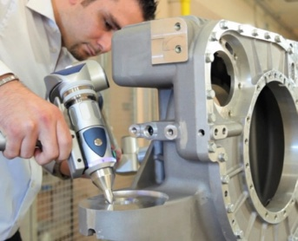
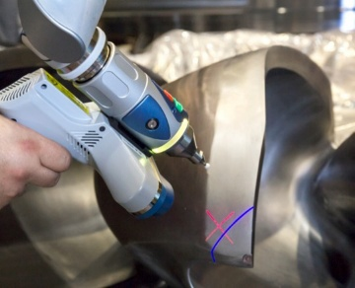
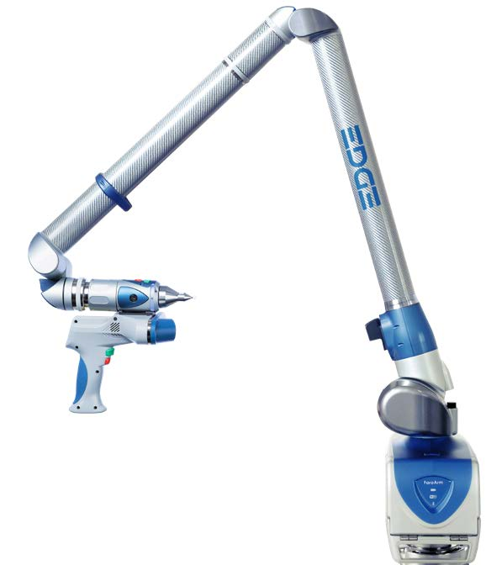
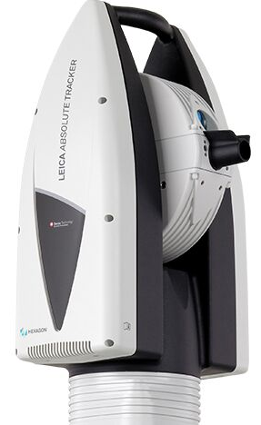
Mechanical Engineering Service Measuring Instruments
Measuring instruments: The metrology laboratory is equipped with a number of measuring instruments: 2 laser trackers, 2 portable CMMs (portable measuring arms) that can also be used for laser scanning (scanning arm - measurements and reverse engineering).
CAM2 ®
8-Axis Edge Arm e ScanArm
Leica Absolute Tracker AT960
The Leica Absolute Tracker integrates interferometer and absolute distance meter
in a single instrument for distance measurement and two very high precision angular
encoders that measure elevation angle and azimuth.
Tracking
Transversal tracking speed > 4 m/s
Radial tracking speed > 6 m/s
Acceleration > 2 g
360° horizontal measurement sectors
Vertical measurement sectors +/- 145°
Measuring volume 80 m.
Precision
Angular resolution 0.14 arcsec
Coordinated repeatability ± 7.5 µm + 3 µm/m
Accuracy relative to full range ± 15 µm + 6 m/m
Volume accuracy of 2.5 x 5 x 10 m ± 10 µm + 5 µm/m
Absolute Interferometer (AIFM)
Interferometer distance resolution 0.32 µm
Interferometer distance accuracy ± 0.5 µm/m
Dynamic locking precision ± 10 µm
Wavelength 633 nm / 795 nm (visible / IR)
Typical operating range of docking 1 – 80 m
Scan probe specifications
Accuracy: ±25 μm
Repeatability: 25 μm, 2σ
Stand Off: 115mm
Depth of field: 115mm
Effective scanning width: Minimum distance 80 mm
Maximum distance 150 mm
Points per line: 2,000 points/line
Minimum dot spacing: 40 μm
Scanning speed: 280 frames/second,280 fps x 2,000 dots/line
= 560,000 points/second

Slide 25
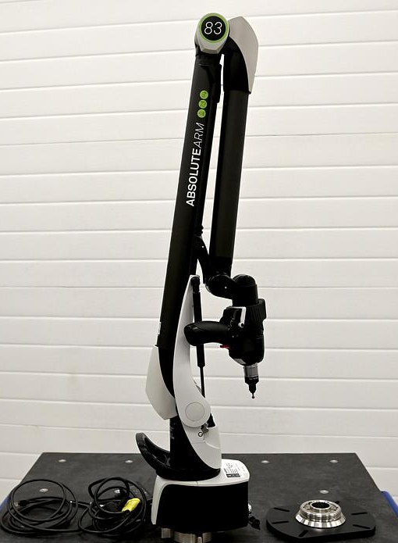
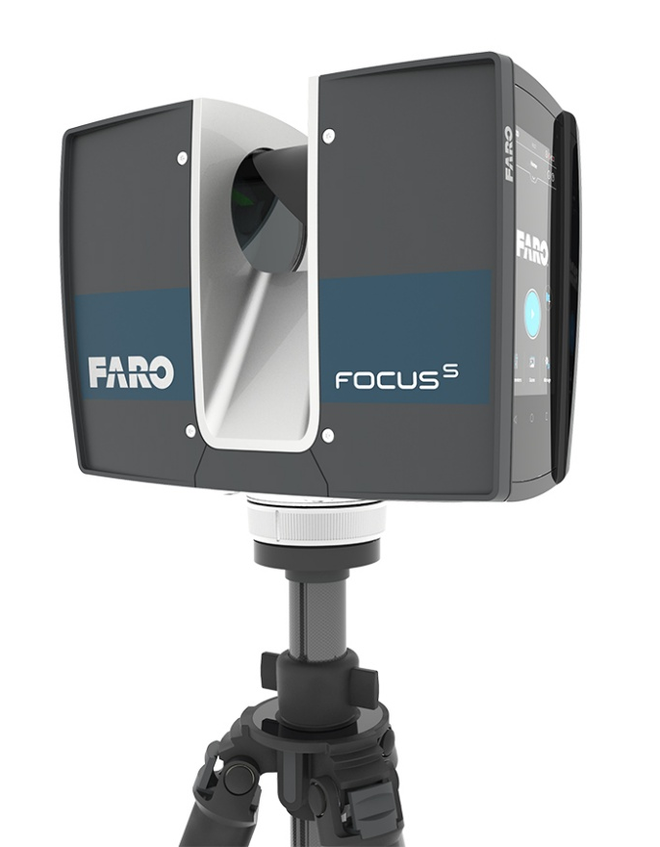
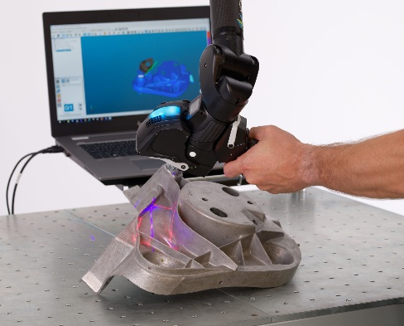
Hexagon Absolute Arm 83 Romer, 7 Axis
CAM2 Laser Scanner FOCUS
Romer 7-axis arm with RS6 laser head, blue light, 1,200,000 dots per second
Laser scanners for fast and precise indoor and outdoor 3D environmental measurements.

Slide 26
Allineamento di elementi di acceleratori di particelle
The performance of particle accelerators is highly dependent on the relative alignment between their components. The position and orientation of the magnetic centers that form the beam trajectory are kept within micrometric tolerances in a range of hundreds of meters of the length of the machines. The length of particle accelerators ranges from small machines to large national or international plants, with typical lengths ranging from hundreds of meters to a few kilometers. This relatively large volume, combined with the micrometric positioning tolerances, makes the alignment task a classic problem of large-scale dimensional metrology. The concept of alignment is based on networks of fixed reference points installed on the building structure (alignment network), to which Once all the components of the accelerator have been referred, a main reference system is built outside the machine. The main building blocks of particle accelerators are magnets, which are responsible for keeping the beams of charged particles along the the desired trajectory. Magnets are usually grouped into support structures, called girders. In turn, all magnets are mounted individually on their own alignment supports that allow them to be moved in space. Each magnet has a nominal mechanical center (the one from CAD) and a magnetic center, the result of the magnetic field produced by the magnet itself. It is identified with special measurement systems (Hall probe) with that operation, carried out in a magnetic measurement laboratory, which is called magnet characterization. In an ideal world, magnetic mechanical center coincide but it can be statistically stated that nominal mechanical center and magnetic center They always have different positions. The result is the knowledge of the deviation in the space between the mechanical and magnetic centers and the position of the latter with respect to the magnetic center the mechanical references of the magnet, necessary for its final alignment, with respect to the main reference system. Aligning a magnet in a particle accelerator means that the magnetic center on the beam path matches the required accuracy. Laser trackers are used to guide installation and measure the position of the elements, using the alignment network.

Slide 27
So far we have only talked about the alignment of magnets for obvious reasons of importance, in reality the elements that align in a magnet accelerator Particles are also of other types, such as vacuum elements and beam diagnostic elements. In alignment measurements, standard mean errors and standard deviations are normally used interchangeably, and the uncertainty of measurement is often overlooked. Although some solutions have been successfully deployed in several accelerators, there is no standard procedure for performing alignment. In addition, each alignment campaign uses different measurement tools to achieve the desired results, which makes the alignment process a complex measurement chain.
THANK YOU FOR YOUR ATTENTION

