Slide 1
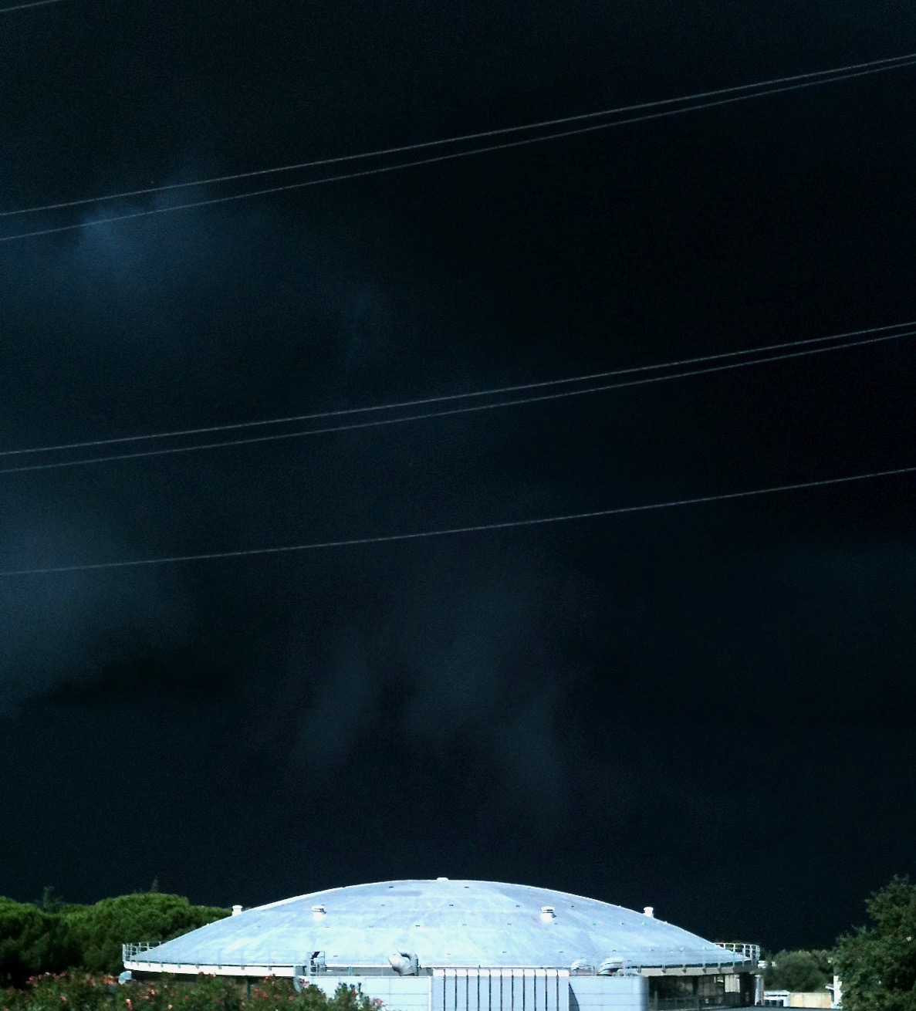
Control Systems
Andrea Michelotti
INFN-LNF • Accelerator Division

Slide 2


Slide 3
telemetria

Slide 4

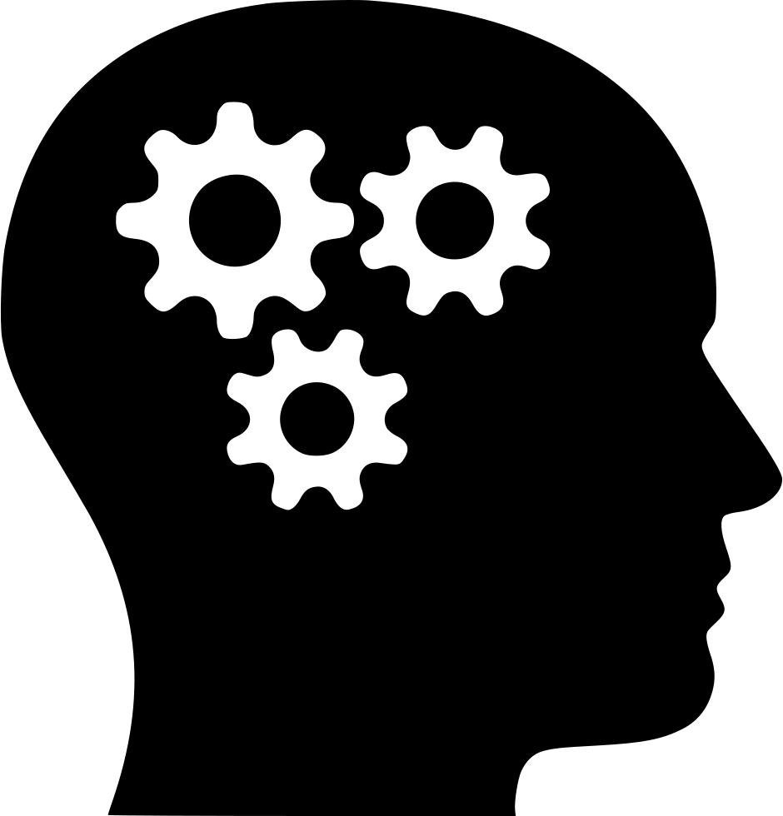

A Control System is a system that allows the output variables of a process to be varied (or kept constant) according to predetermined laws.
Open loop
Action is based on initial static information.
Closed loop
Action is based on dynamic information continuously read back from the controlled system.
Notes:
Leggi prestabilite > Open Loop, Closed Loop

Slide 5
Key elements of a Control System:
actuators
sensors
control algorithms

Slide 6
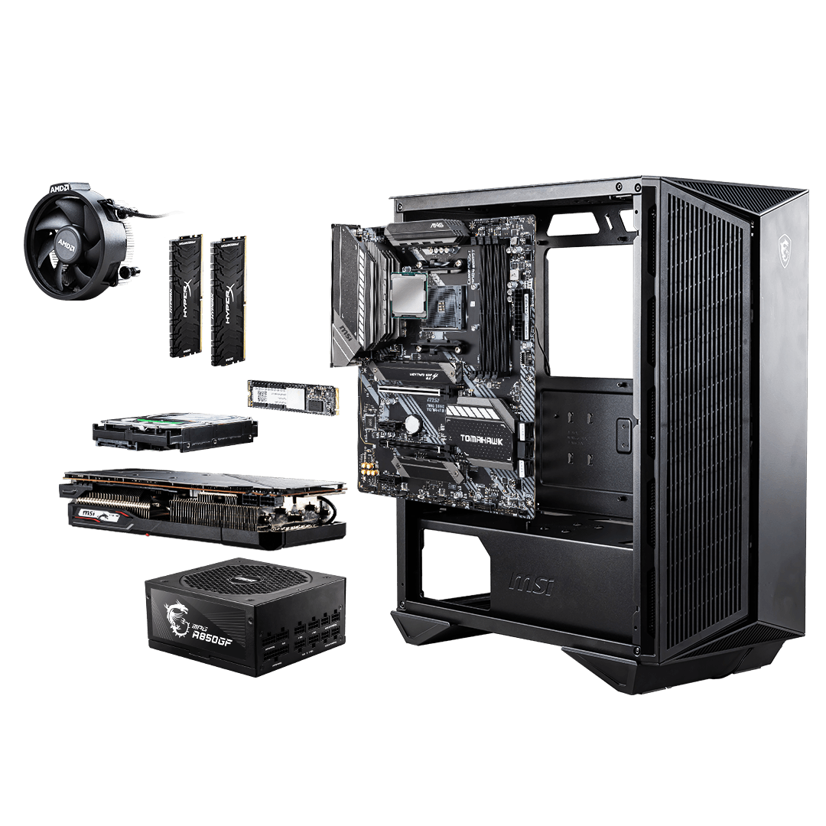
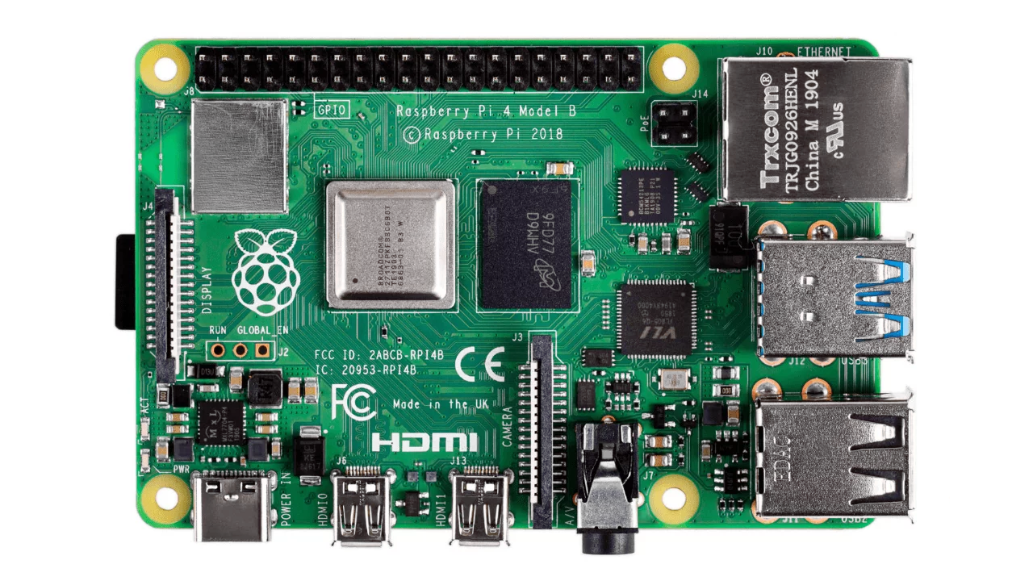
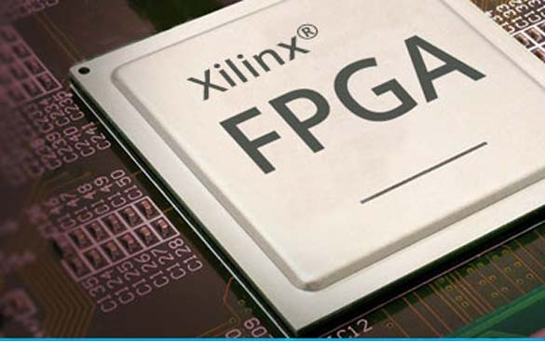
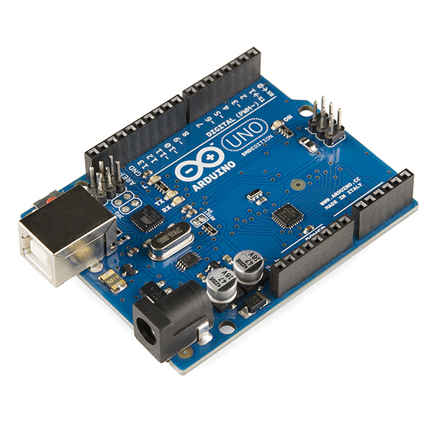
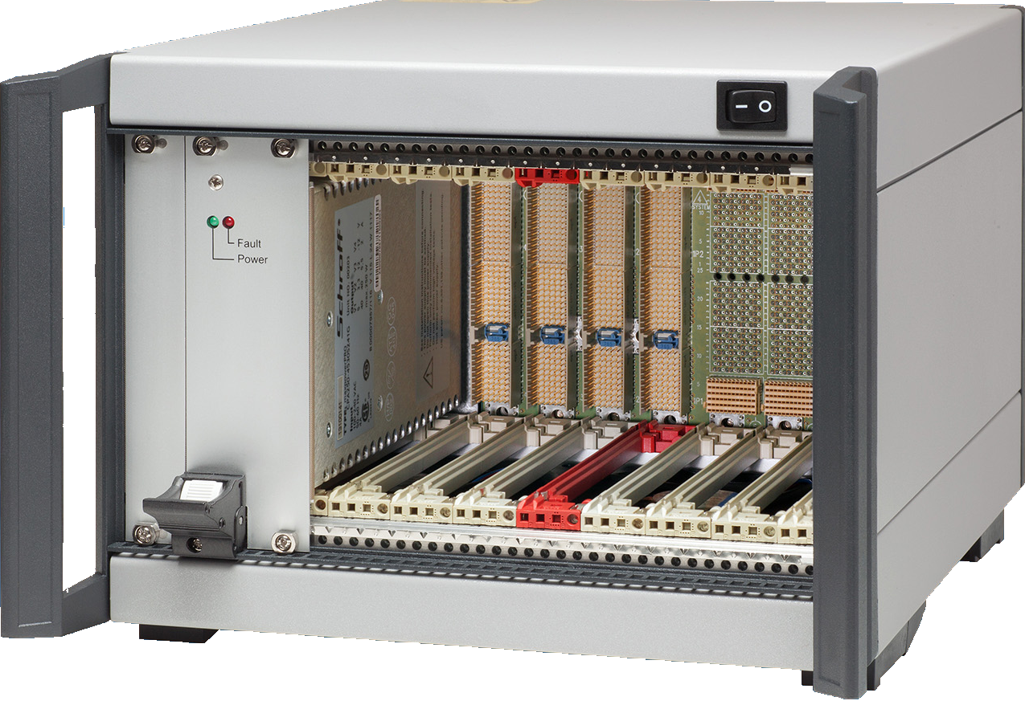
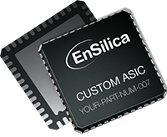
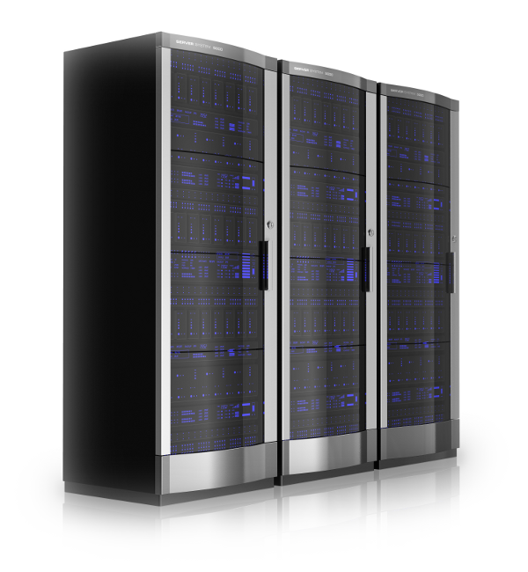
Controls adopting "CPUs"
Computers t ~ 1-10 ms
PC
SBC: Single Board Computer
Embedded processor
FPGA: Field Programmable Gate Array
t ~ ns
Virtual
Machines
uP: microprocessor
t ~ 1 ms
ASIC: Application-Specific Integrated Circuit

Slide 7
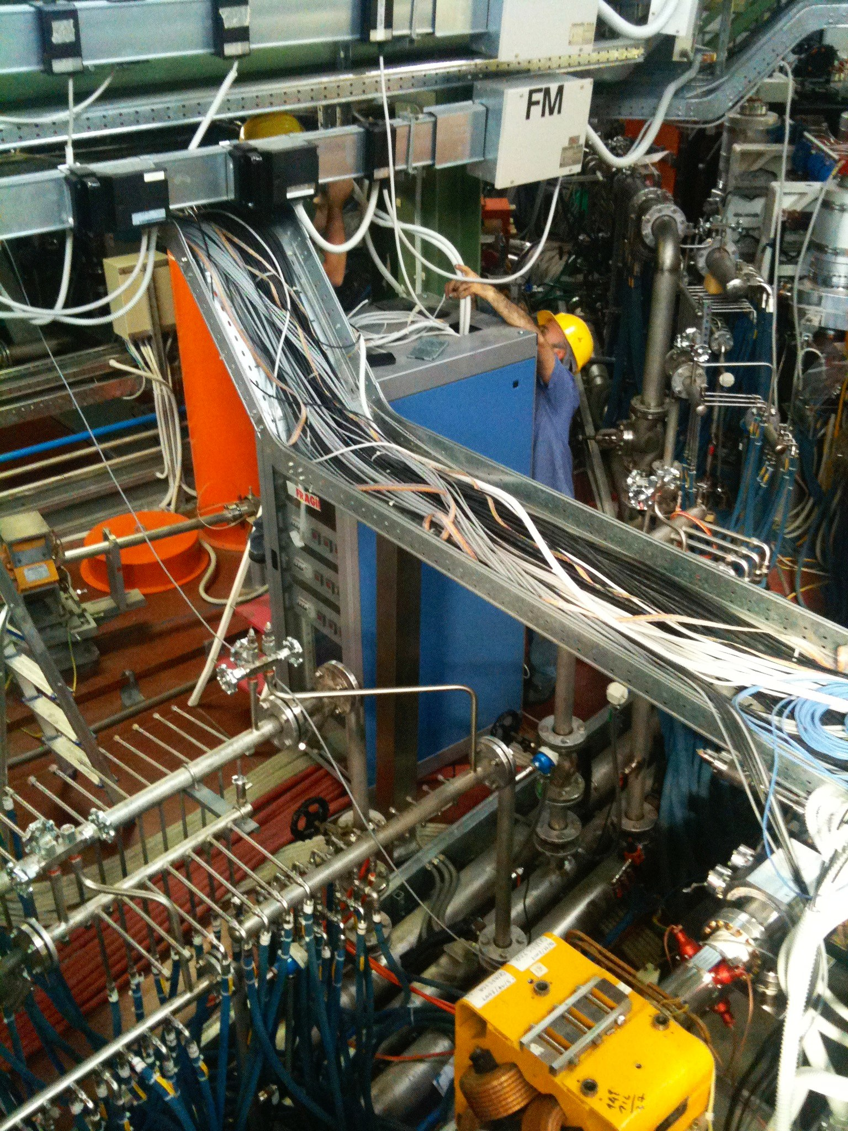
plant

Slide 8
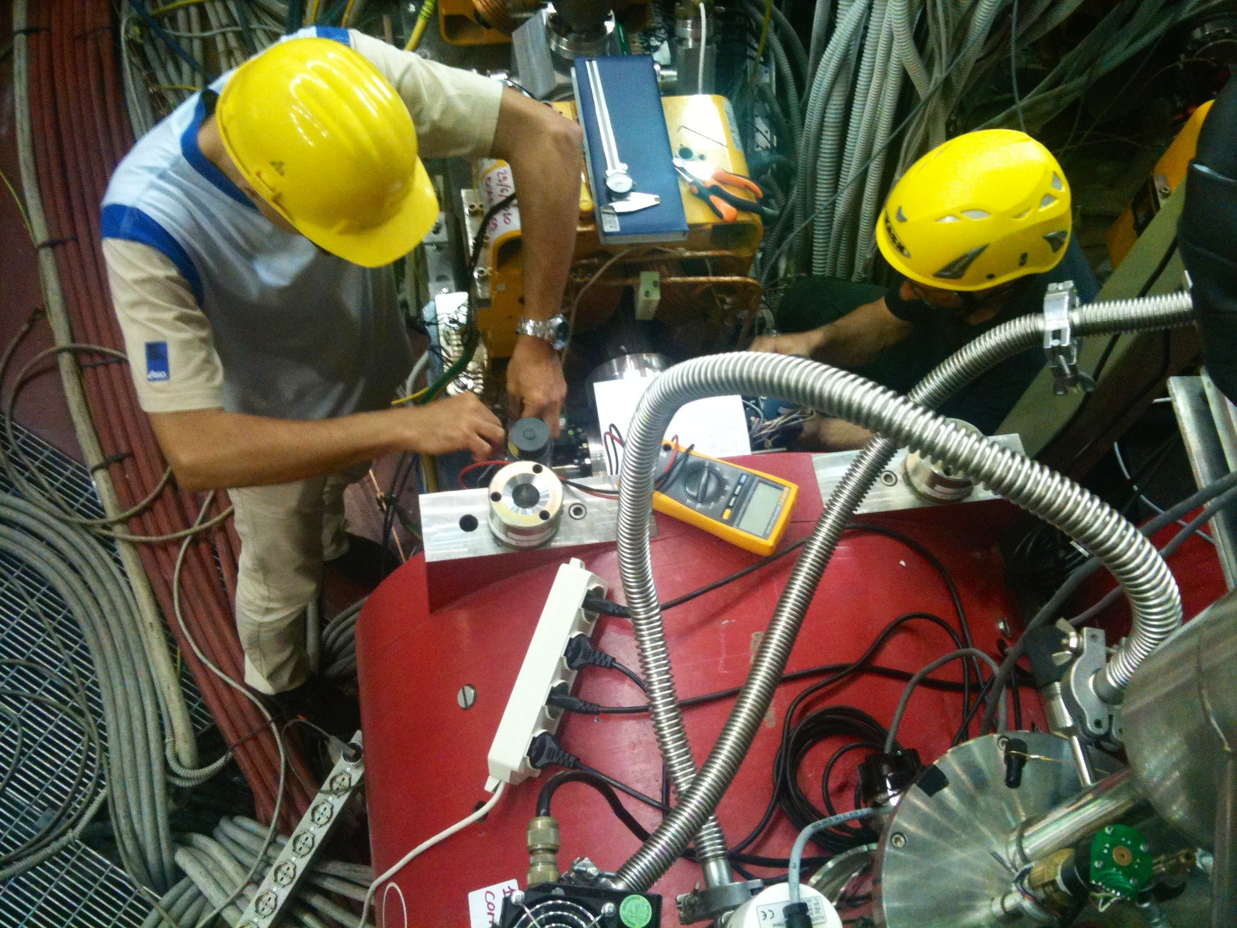
plant → sensors/actuators

Slide 9
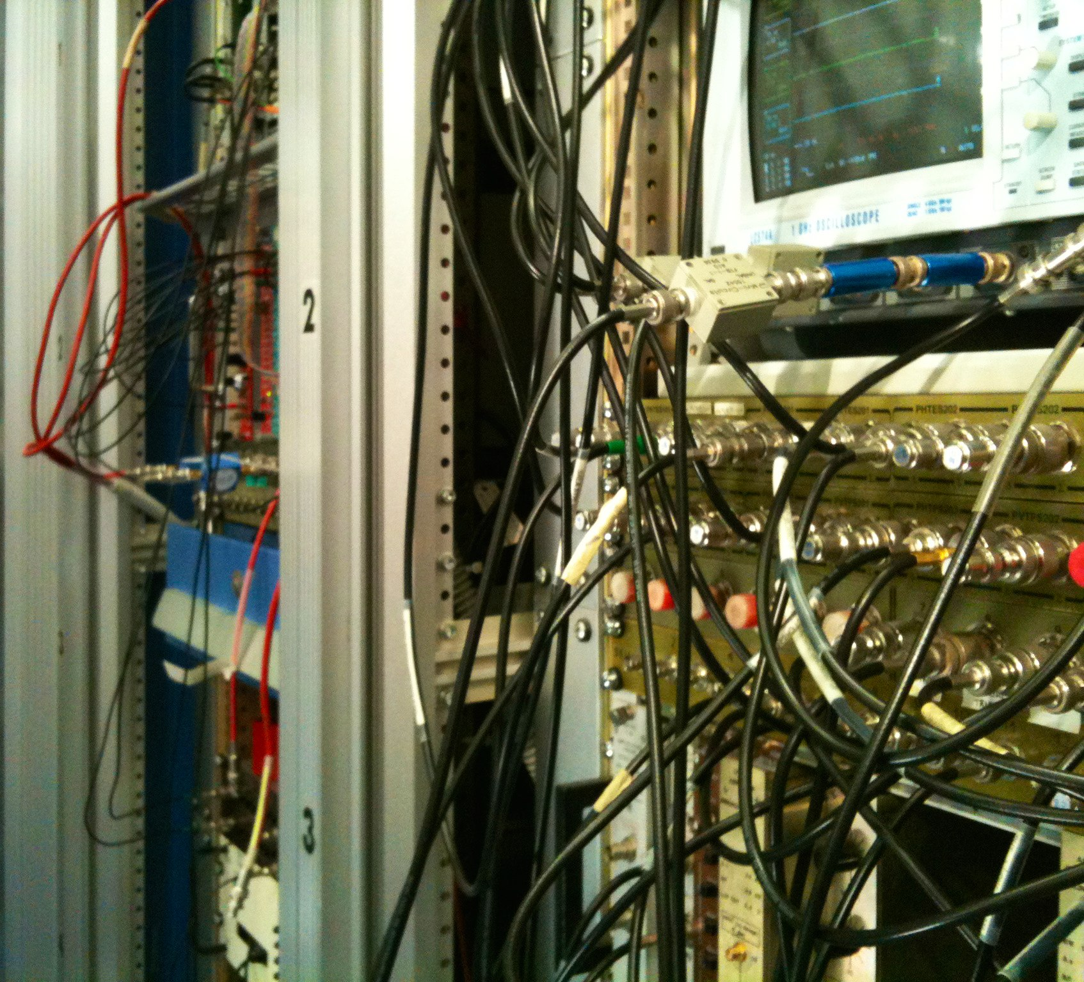
plant → sensors/actuators → front-end

Slide 10
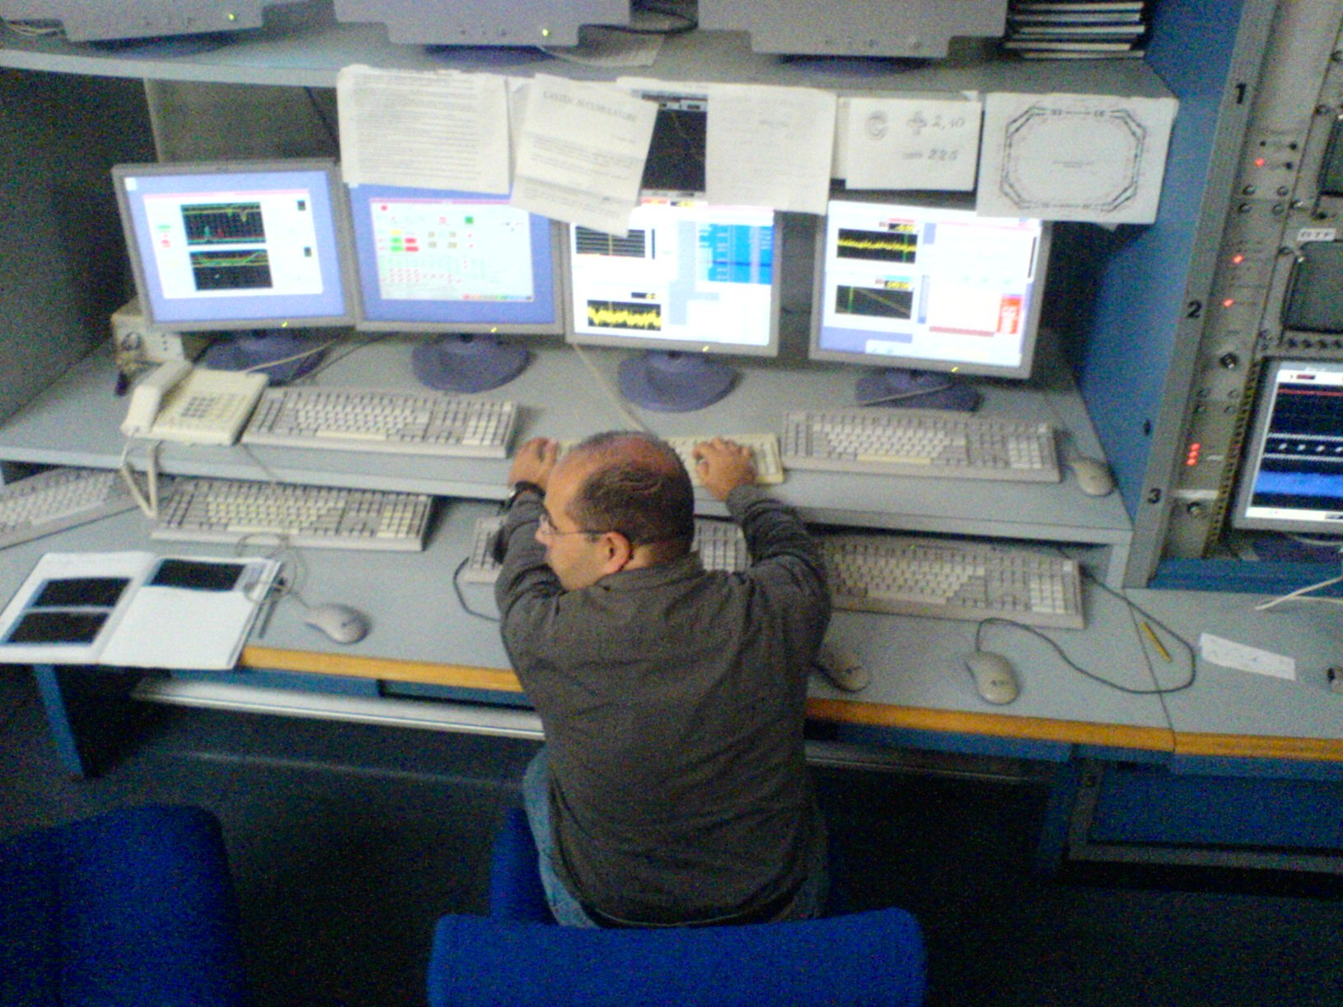
plant → sensors/actuators → front-end → control room

Slide 11
General characteristics
Open and interoperable with other systems (e.g., experiments, DAQ, machine protection, service plants);
User-friendly, with ergonomic interfaces, data import/export capabilities, and support for custom software integration;
Scalable to match the size of the plant and required performance;
Reliable, avoiding single points of failure and supporting redundancy;
Flexible and adaptable to evolving technologies.

Slide 12
Obsolescence of standards
popularity
time
The lesson is: a system has to be as independent as possible
from hardware standards and specific software products.

Slide 13
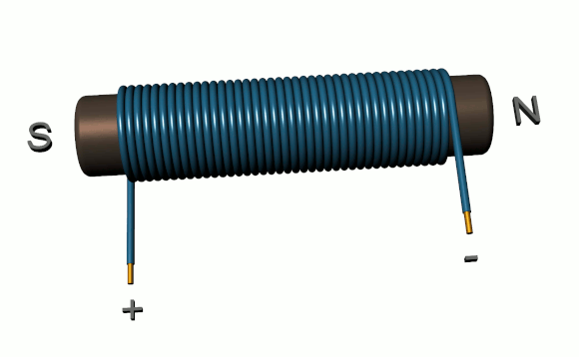
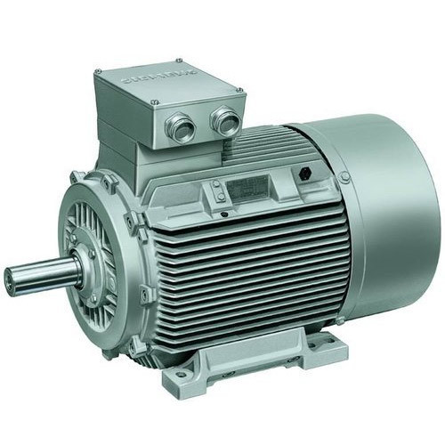

UI
UI
UI
UI
Control Room
Once upon a time
centralized
Central computer
Devices

Slide 14
UI
UI
UI
UI
Control Room
Live data request
Distributed CS
CP
CP
CP
Devices

Slide 15



UI
UI
UI
UI
Live data retention/streaming
CP
CP
CP

Slide 16
UI
UI
UI
UI
SEND COMMAND
CP
CP
CP

Slide 17
UI
UI
UI
UI
NETWORK
CP
CP
CP

Slide 18
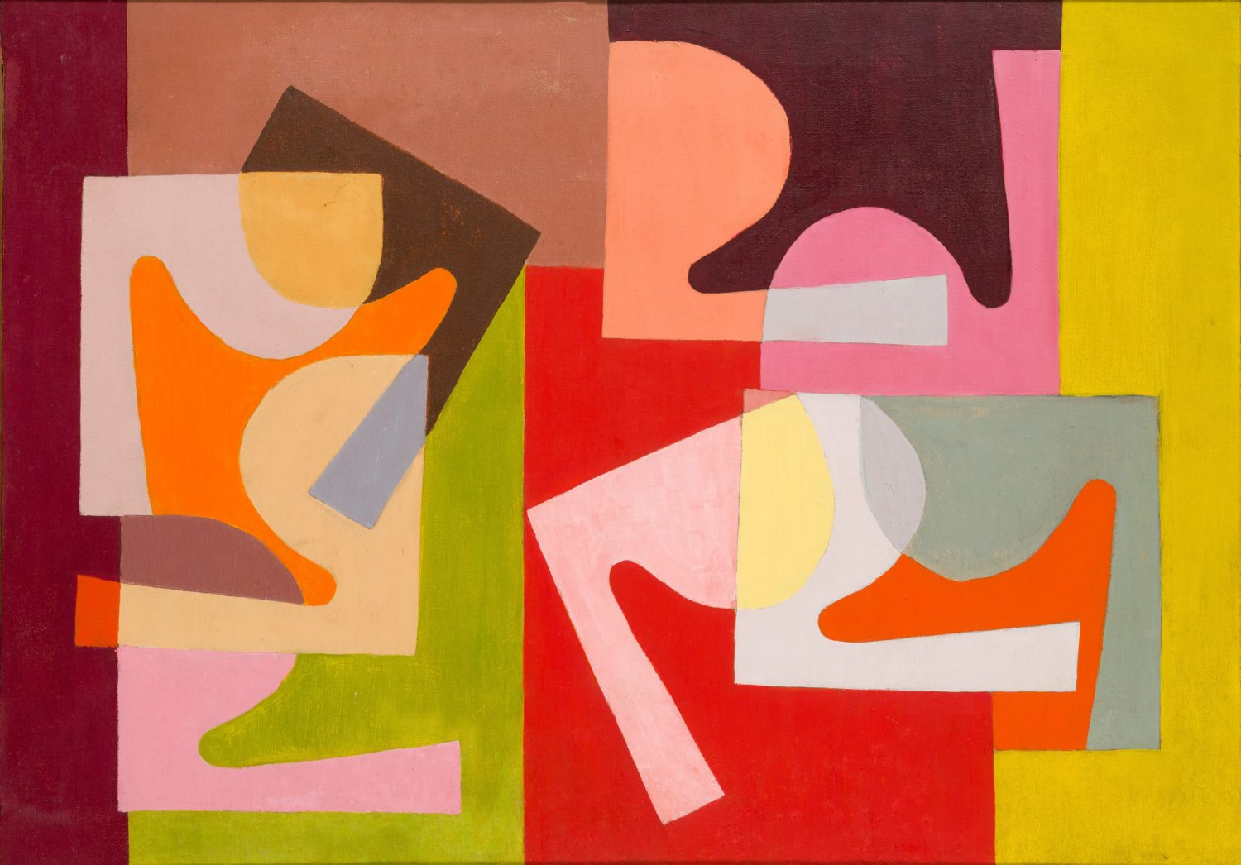
Abstraction
Saloua Raouda Choucair, Fractional Module

Slide 19
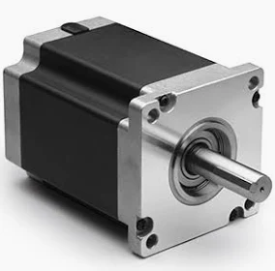
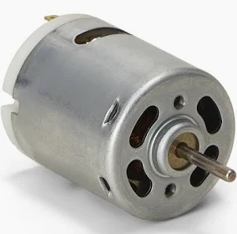
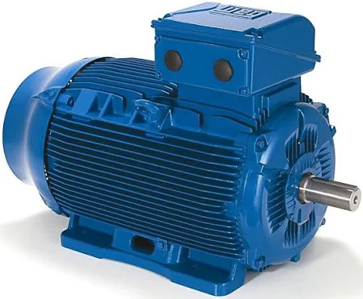
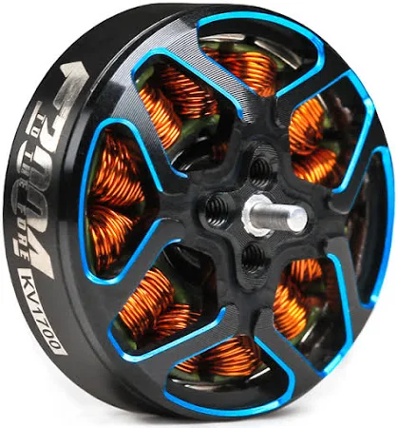
M
M
M
CP

Slide 20
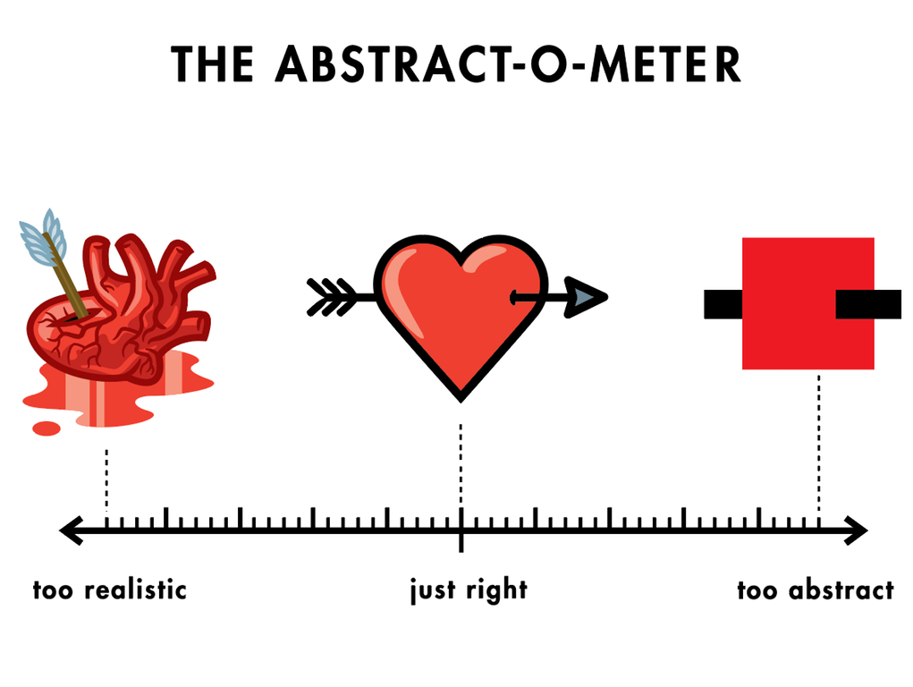

Slide 21
Features of a Control System
acquisition/actuation
communication
storage
presentation
analysis / correlation
historization

Slide 22
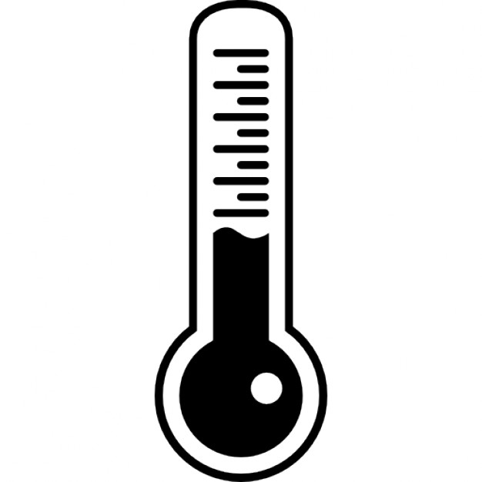

acquisition/actuation
communication
storage
presentation
analysis / correlation
historization
acquisition
`
`
voltage
`
ADC
Analog to Digital Converter
UI
`
`
0 1 1 1
CP
tempo
actuation
DAC
Digital to Analog Converter
CP
UI
current
0 1 1 1

Slide 23
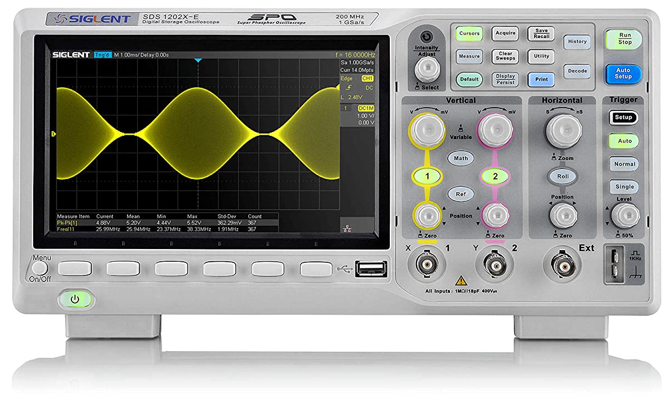
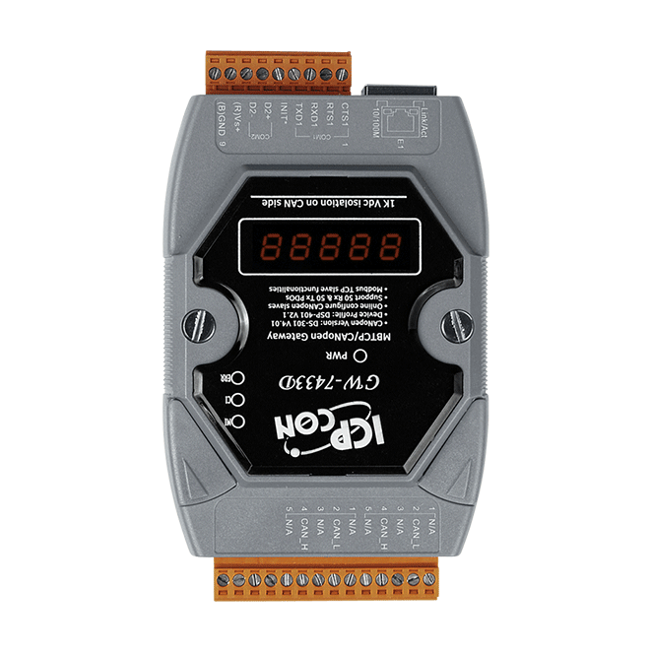
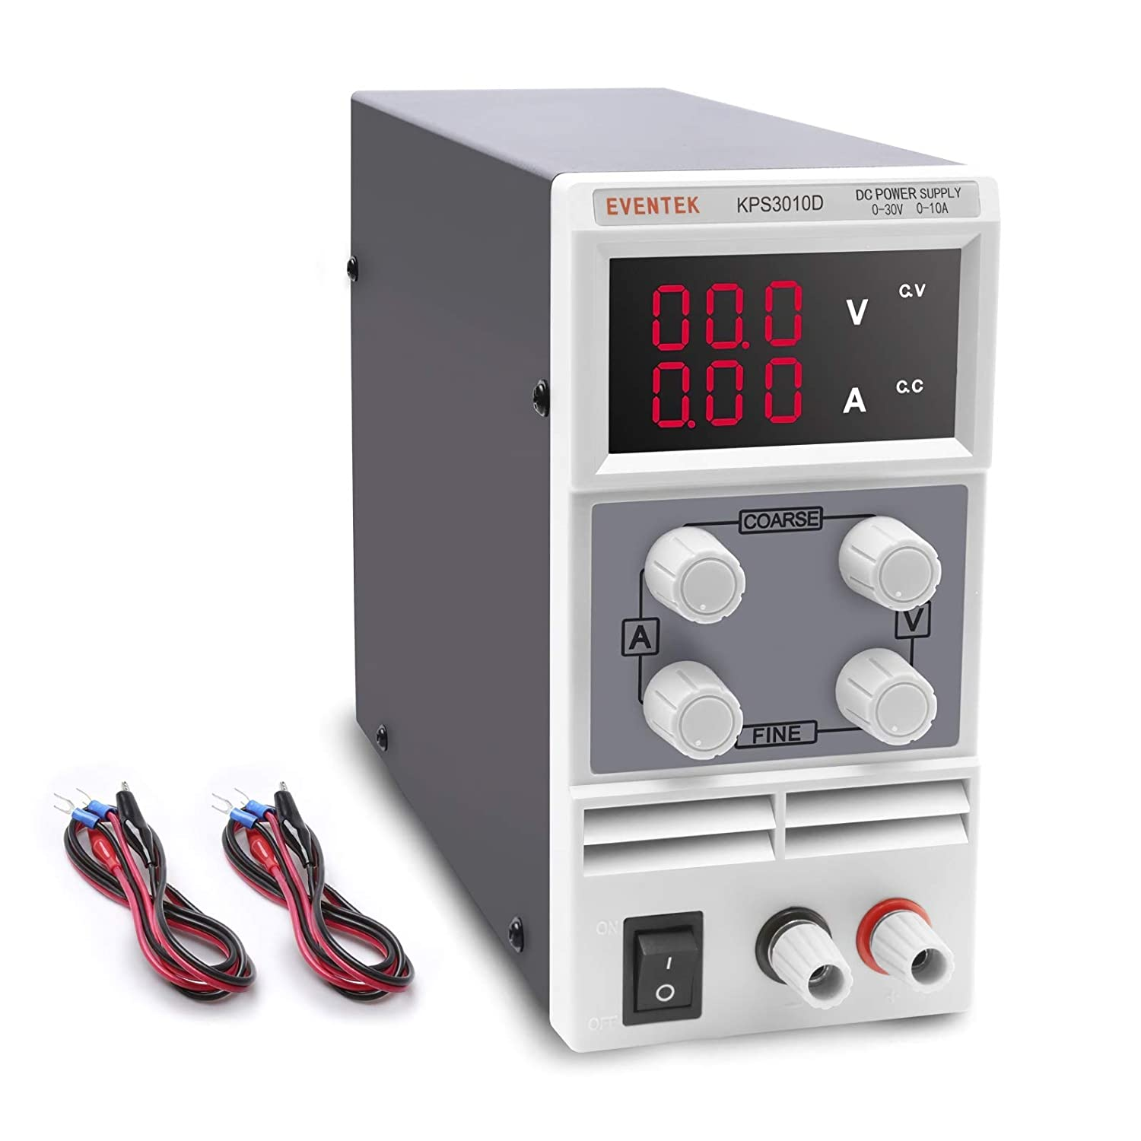
acquisition/actuation
communication
storage
presentation
analysis / correlation
historization
CP
CP
Bus di campo
USB
Serial lines
CAN bus
Profibus
GPIB
...
ADC/DAC
conversion
Embedded devices
CP
CP
Intelligent devices
Digital devices
Analog devices

Slide 24
acquisition/actuation
communication
storage
presentation
analysis / correlation
historization
CP
CP
NETWORK
Network
interface
ADC/DAC
conversion
Embedded devices
CP
CP
Intelligent devices
Digital devices
Analog devices

Slide 25



acquisition/actuation
communication
storage
presentation
analysis / correlation
historization
average size (@DAFNE)
~ 650 byte
{
float64 temperature_read;
char units;
boolean status;
....
}
{
float64 current_read;
float64 current_set;
char units;
boolean error;
....
}
{
float64 mag_field_read;
float64 mag_field_set;
int polarity;
....
}
{
int aperture;
int time;
int n_pixels_h;
int n_pixels_v;
boolean status;
....
}
CP
CP
CP
CP

Slide 26
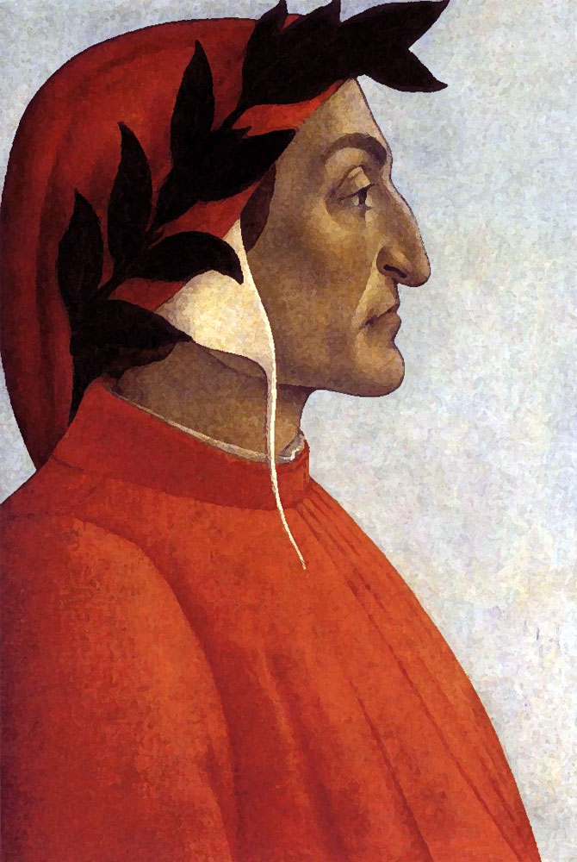
650 byte
Nel mezzo del cammin di nostra vita
mi ritrovai per una selva oscura,
ché la diritta via era smarrita.
Ahi quanto a dir qual era è cosa dura
esta selva selvaggia e aspra e forte
che nel pensier rinova la paura!
Tant’è amara che poco è più morte;
ma per trattar del ben ch’i’ vi trovai,
dirò de l’altre cose ch’i’ v’ho scorte.
Io non so ben ridir com’i’ v’intrai,
tant’era pien di sonno a quel punto
che la verace via abbandonai.
Ma poi ch’i’ fui al piè d’un colle giunto,
là dove terminava quella valle
che m’avea di paura il cor compunto
guardai in alto e vidi le sue spalle
vestite già de’ raggi del pianeta
che mena dritto altrui per ogne calle.
Dante Alighieri (1265–1321)
The Divin Comedy
~0.5 Mbyte
DAFNE ~1.4 Mbyte

Slide 27
Relational database ➝
{
float64 temperature_read;
char units;
boolean status;
....
}
{
float64 current_read;
float64 current_set;
char units;
boolean error;
....
}
{
float64 mag_field_read;
float64 mag_field_set;
int polarity;
....
}
{
int aperture;
int time;
int n_pixels_h;
int n_pixels_v;
boolean status;
....
}
CP
CP
CP
CP

Slide 28
Relational database ➝
{
float64 temperature_read;
char units;
boolean status;
....
}
{
float64 current_read;
float64 current_set;
char units;
boolean error;
....
}
{
float64 mag_field_read;
float64 mag_field_set;
int polarity;
....
}
{
int aperture;
int time;
int n_pixels_h;
int n_pixels_v;
boolean status;
....
}
CP
CP
CP
CP

Slide 29
Relational database ➝
{
float64 temperature_read;
char units;
boolean status;
....
}
{
float64 current_read;
float64 current_set;
char units;
boolean error;
....
}
{
float64 mag_field_read;
float64 mag_field_set;
float64 orientation;
int polarity;
....
}
{
float64 mag_field_read;
float64 mag_field_set;
int polarity;
....
}
{
int aperture;
int time;
int n_pixels_h;
int n_pixels_v;
boolean status;
....
}
CP
CP
CP
CP

Slide 30
Serialization: self-describing data vs formatted data
BEGIN OF DATA
here it is described a rhombus;
each side measures 100 mm;
the orientation of the diagonal is 0 deg;
blah blah...;
END OF DATA

Slide 31
Most popular self-describing data formats
<note>
<to>Andrew</to>
<from>Jane</from>
<heading>Reminder</heading>
<body>Don't forget me this weekend!</body>
</note>
XML
YAML
JSON
note:
to: Andrew
from: Jane
heading: Reminder
body: "Don't forget me this weekend!"
{
"note":{
"to":"Andrew",
"from":"Jane",
"heading":"Reminder",
"body":"Don't forget me this weekend!"
}
}

Slide 32
Non relational database
Key
Value
my_data
0x16\0x00\0x00\0x00\0x02hello\0x00\0x06\0x00\0x00\0x00world\0x00\0x00
my_other_data
.... another descriptive sequence .......
e.g. BSON serialization
\0x16\0x00\0x00\0x00 total document size
\0x02 0x02 = field data type is string
hello\0x00 field name
\0x06\0x00\0x00\0x00world\0x00 field value (size of value, value, terminator)
\0x00 type EOO ('end of object')

Slide 33
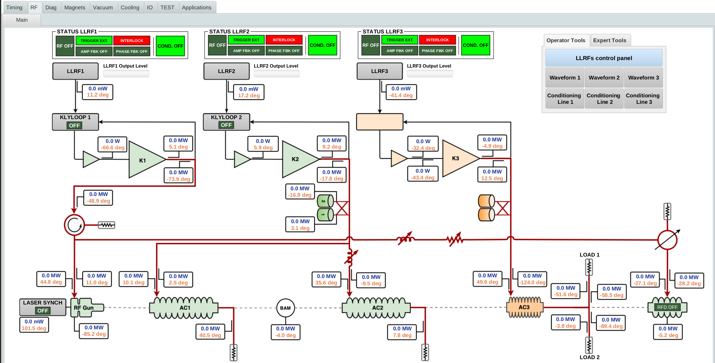
User Interface
acquisition/actuation
communication
storage
presentation
analysis / correlation
historization

Slide 34
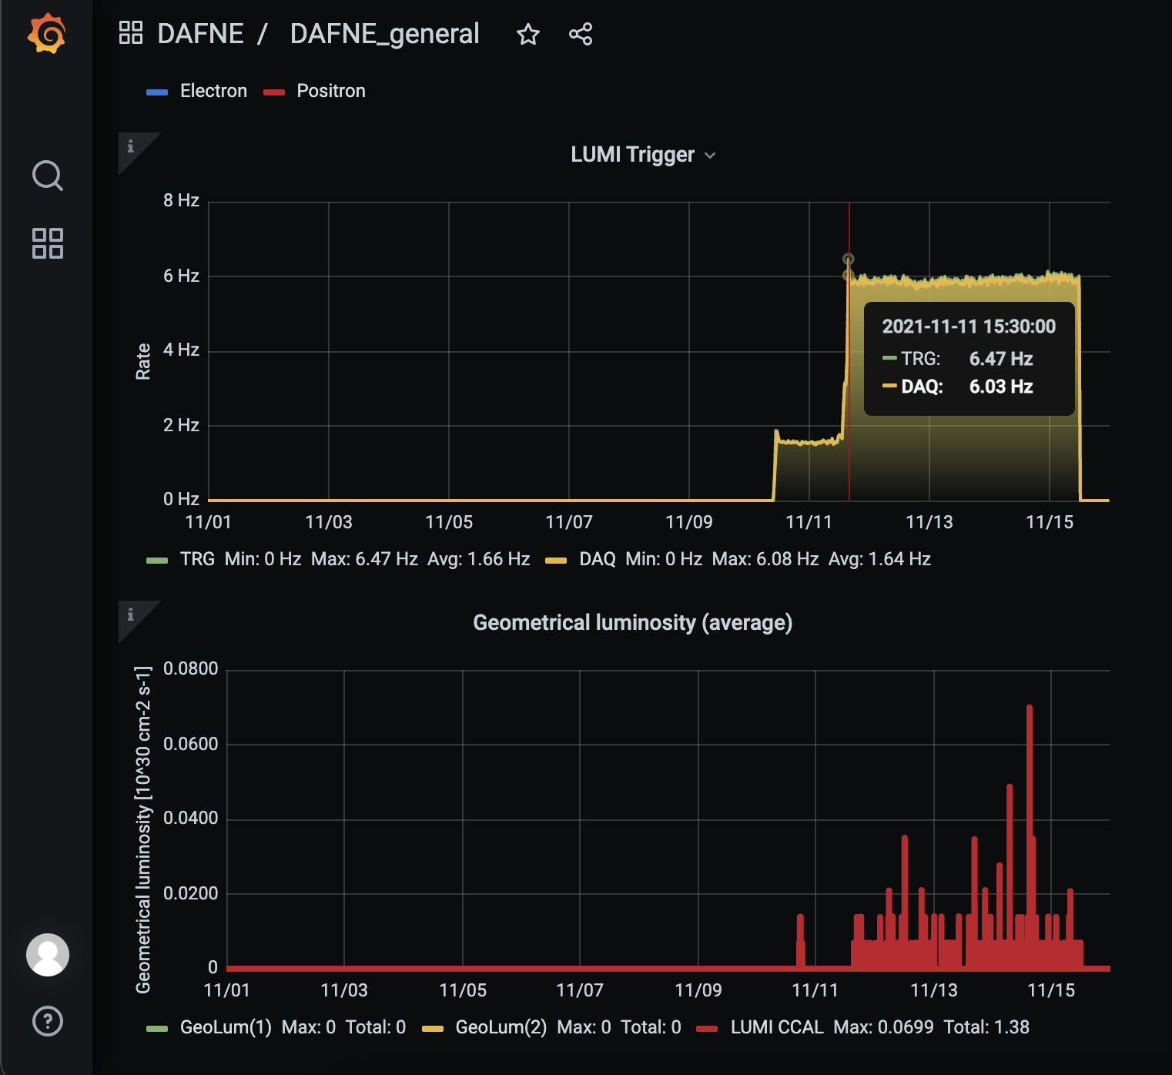
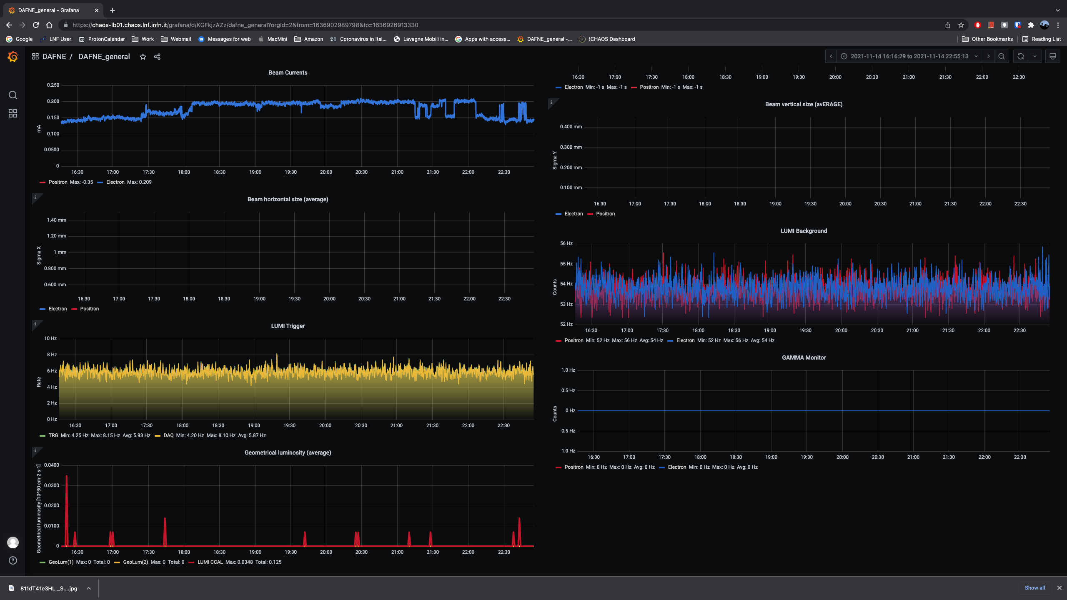
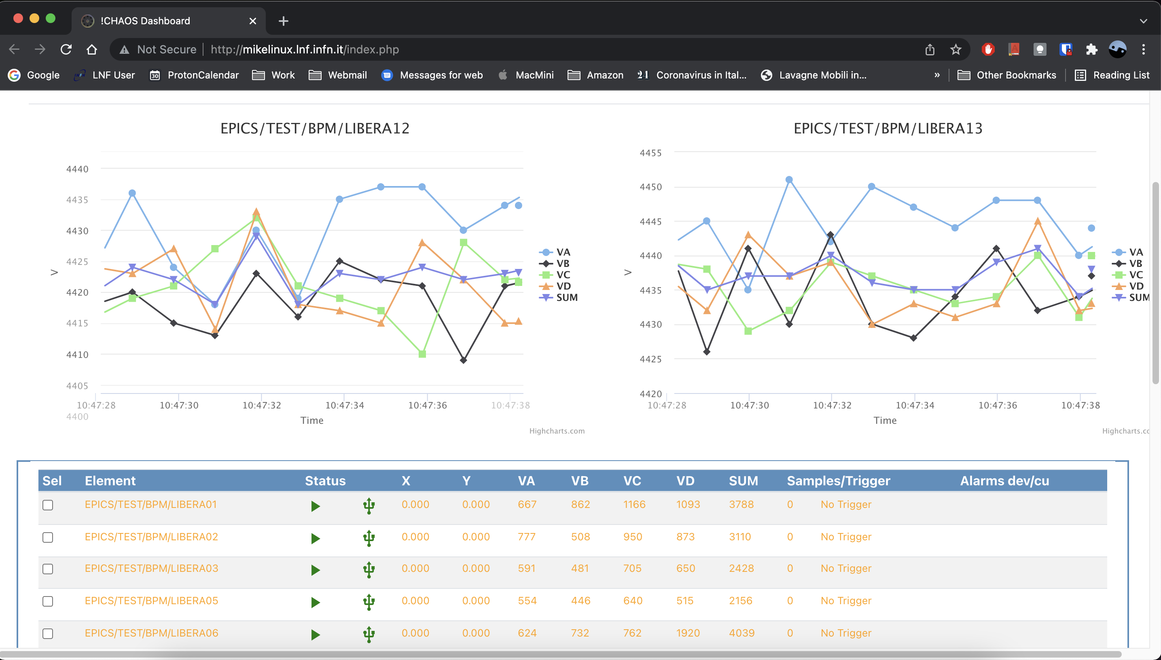
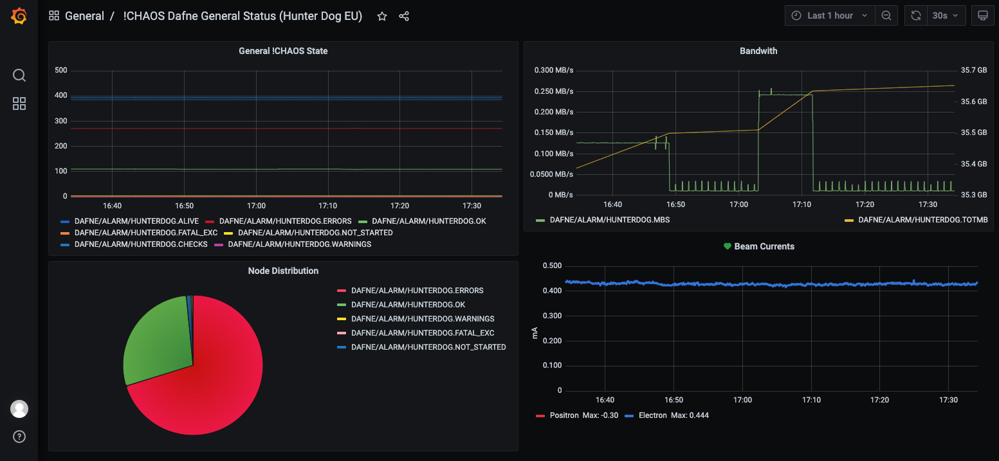
acquisition/actuation
communication
storage
presentation
analysis / correlation
historization
User Interface

Slide 35
acquisition/actuation
communication
storage
presentation
analysis / correlation
historization
Correlation and analysis processes
z = f(x, y, ...)
WRITE
READ
SEND COMMAND
READ
z
y
x
CP
CP
CP

Slide 36
acquisition / actuation
communication
storage
presentation
analysis / correlation
historization
z = f(x, y, ...)
CP
CP
CP
Long term
storage

Slide 37

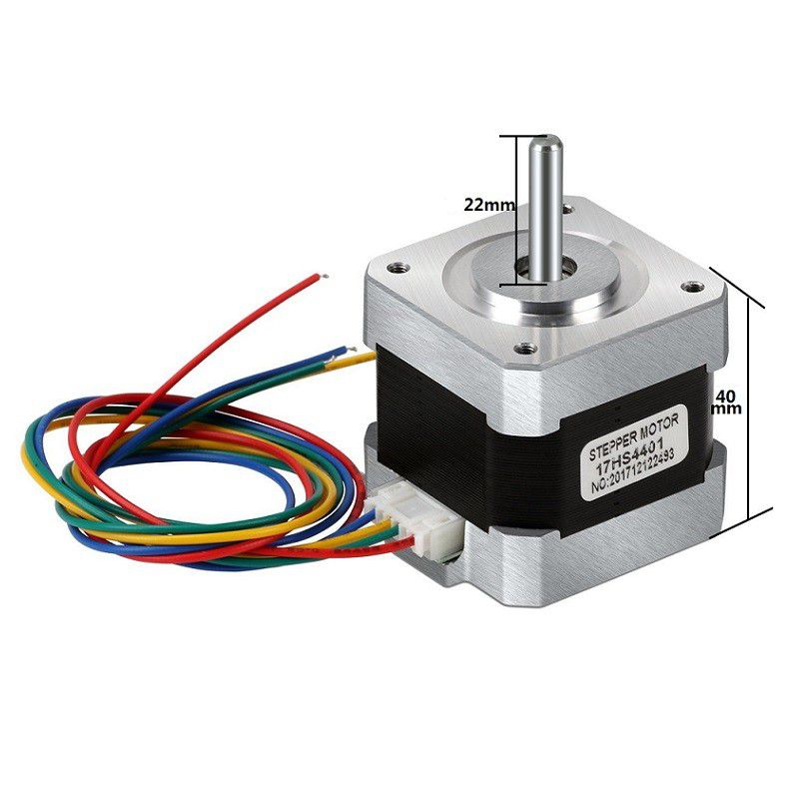
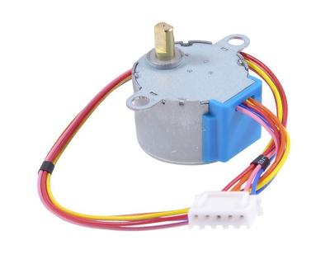
UI
Let’s review the full stack
Command
issuing
Live data fetching
Live data request
Data correlation
Live data retention
Data retrieval
Data logging
Command
reception
Live data injection
Live data return
Feedbacks,
data processing
CP
Command
execution
Monitoring
Class driver
Low level driver
Low level driver

Slide 38
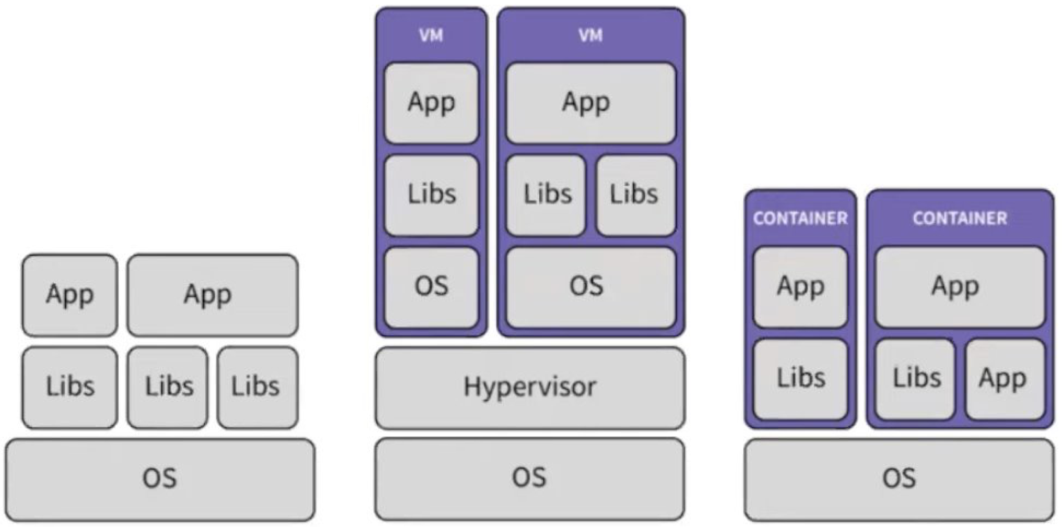
IT interesting topics
Big data
AI
Virtual machines, Containers/Dockers/Orchestrators (K8S)
Bare Metal Virtual Machines Containers
Courtesy of Giles Knap (Diamond)​

Slide 39
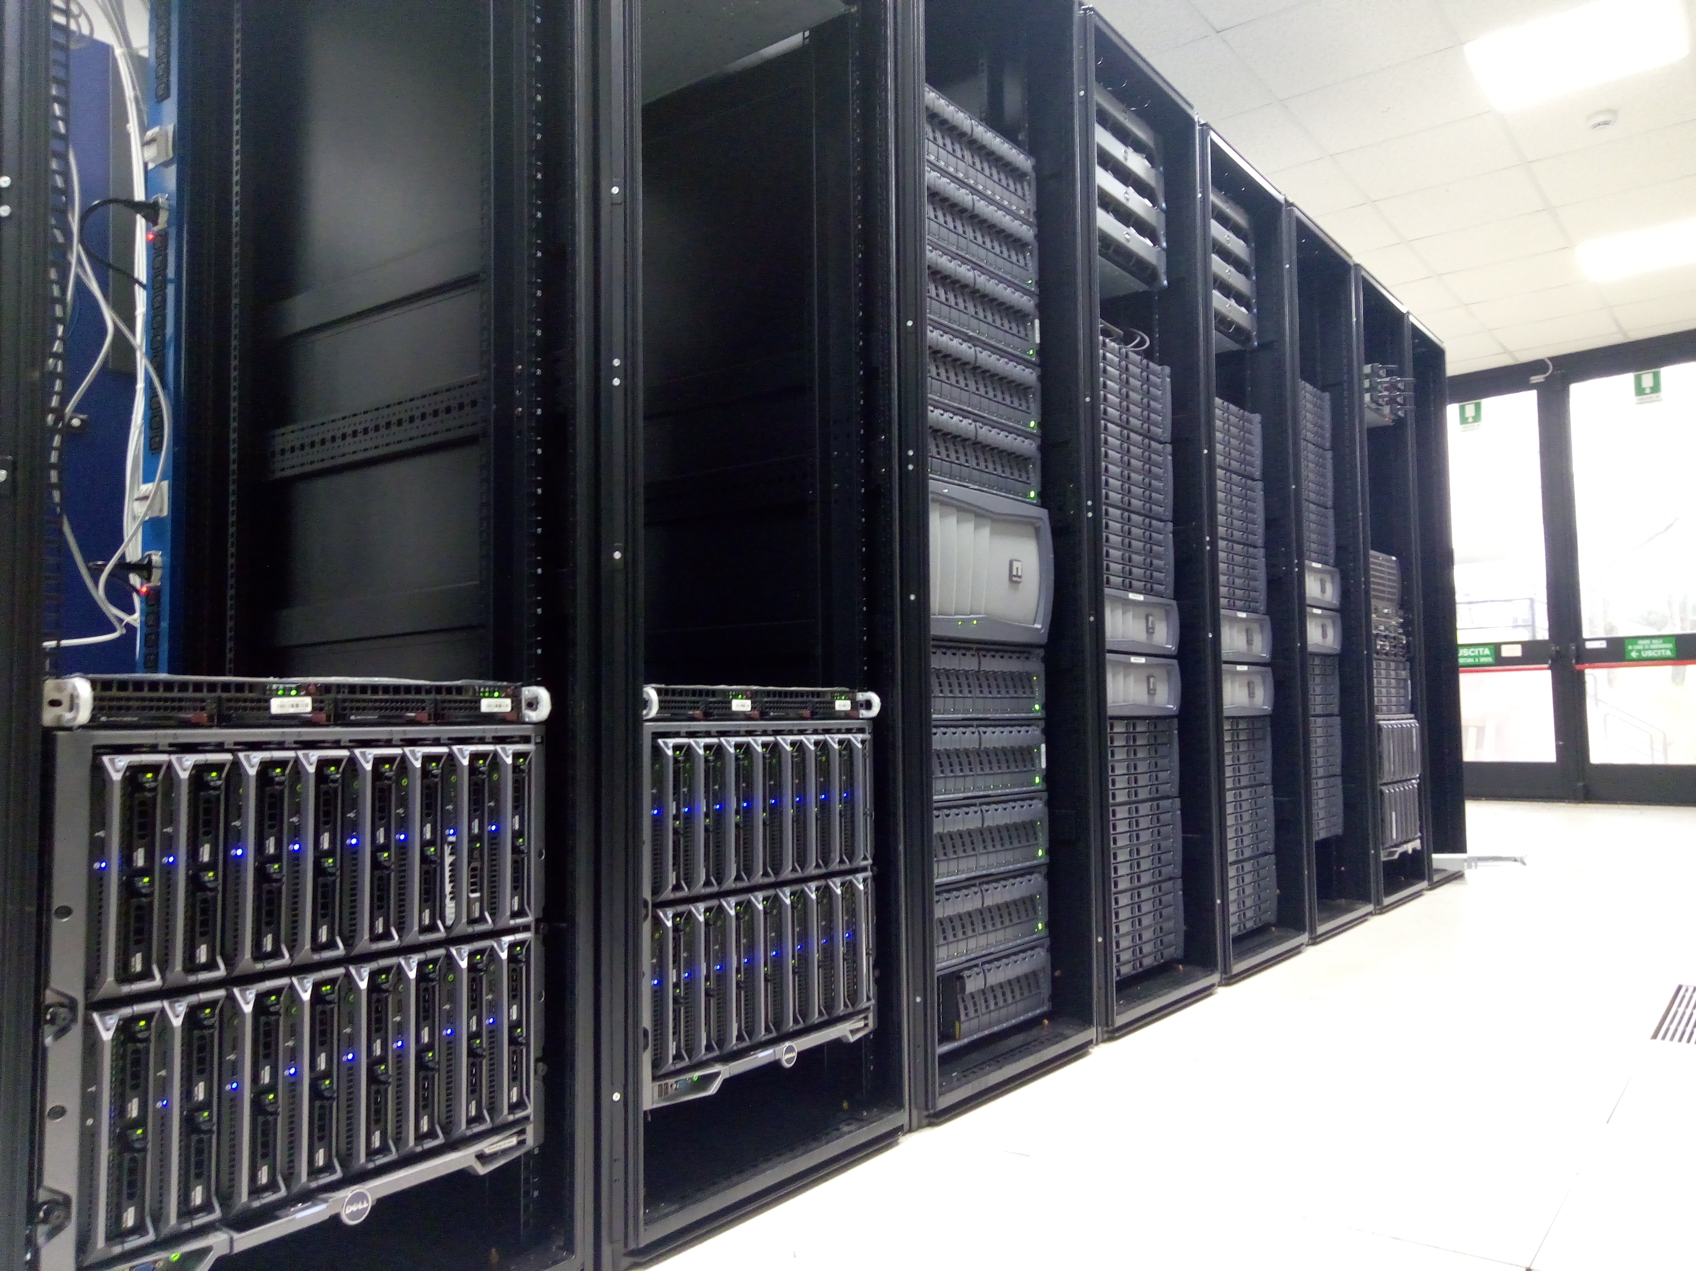
Infrastructure @LNF
PRODUCTION CLUSTER
SERVICE CLUSTER
STORAGE 1/2 PB
SERVICE CLUSTER
SPARES
DEVELOPMENT CLUSTER
PRE-PRODUCTION CLUSTER
376 cores
824 GB RAM
500 TB HD

Slide 40
$ practical experience

