Slide 1
EPICS Containerized Controls
A hands-on training for PhD students
INFN – April 2026

Slide 2
Agenda – 4 hours
PART 1
Theory – What is EPICS?
45 min
PART 2
Hands-on – Simulated beamline
45 min
☕ Break
15 min
PART 3
Python & p4p in Jupyter
45 min
PART 4
Build a Beam-Center application
45 min
PART 5
Run on the real hardware!
30 min

Slide 3
Part 1 – Theory
What is a Control System? What is EPICS? (≈ 45 min)

Slide 4
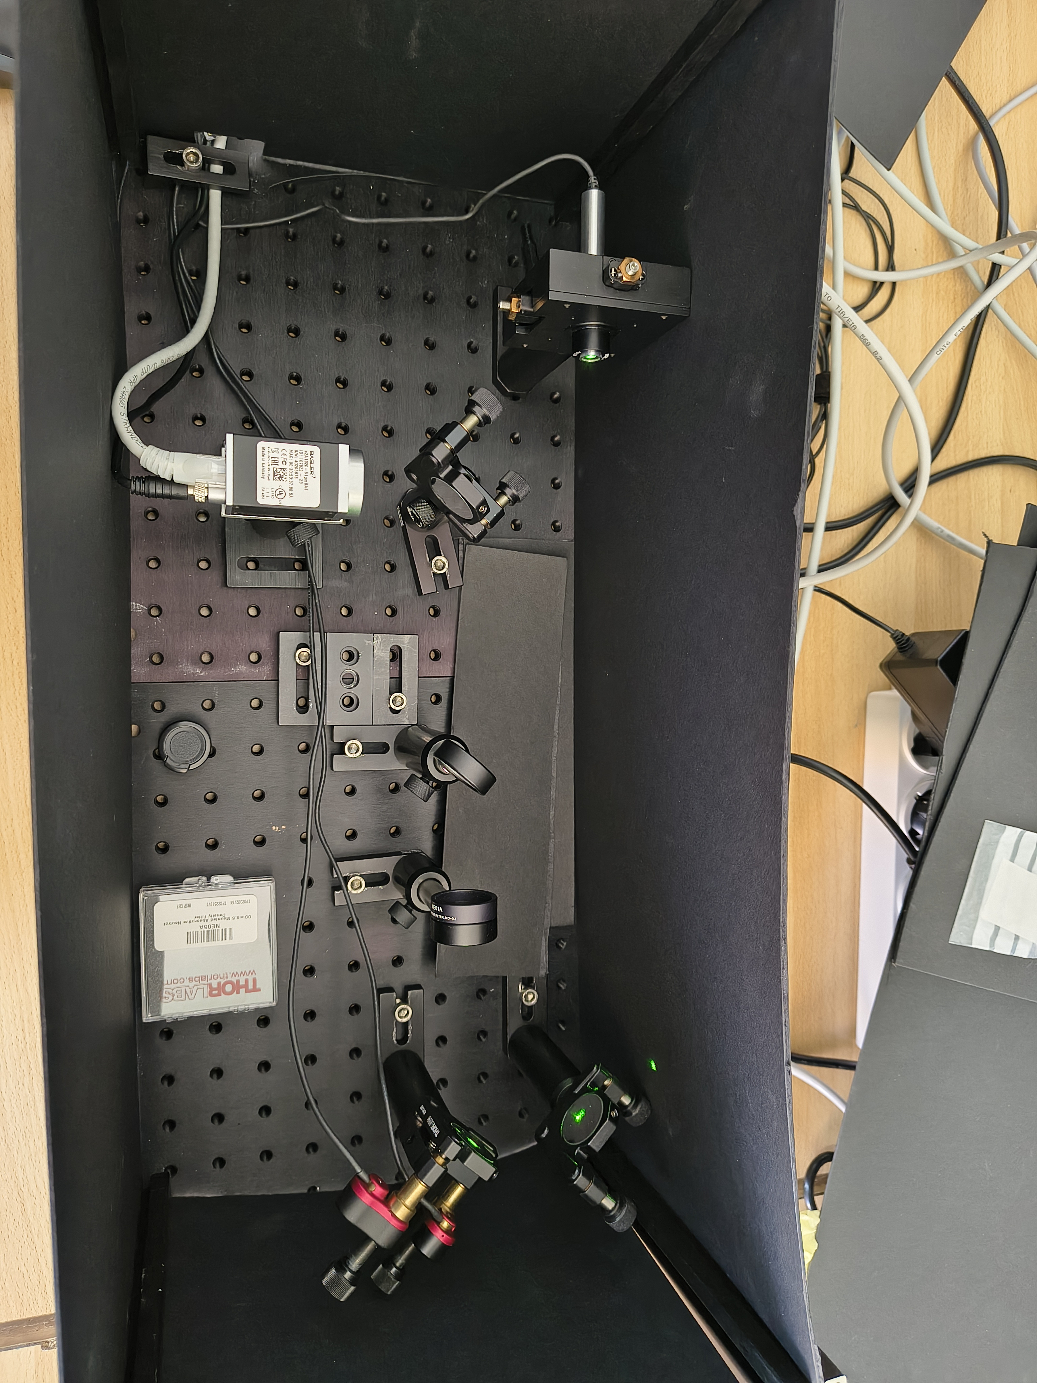
Setup
epik8s-training-lab/test-compose/

Slide 5
Setup
epik8s-training-lab/test-compose/

Slide 6
What is a Control System?
▸ Every accelerator / experiment needs to READ sensors and WRITE to actuators
▸ Temperature, vacuum, motor positions, camera images …
▸ A control system connects thousands of devices to operators and software
▸ Key requirements: real-time data, reliability, scalability
▸ We use EPICS – the de-facto standard in physics facilities worldwide

Slide 7
EPICS in 60 seconds
▸ EPICS = Experimental Physics and Industrial Control System
▸ Born at Los Alamos / Argonne in the 1990s – open source, community-driven
▸ Used at DLS, ESS, SLAC, DESY, INFN, … hundreds of facilities
▸ Core idea: everything is a Process Variable (PV)
▸ Network protocols: Channel Access (CA) and PV Access (PVA)

Slide 8
Process Variables (PVs)
▸ A PV is a named value on the network – like a URL for a sensor/actuator
▸ Examples:
‣ LAB:SIM:HMIR.VAL → horizontal mirror motor set-point
‣ LAB:SIM:HMIR.RBV → horizontal mirror readback position
‣ LAB:SIM:CAM01:image1:ArrayData → camera image array
▸ Any client on the network can read (caget) or write (caput) a PV
▸ PVs have types: float, int, string, enum, waveform (array) …
▸ PVs have metadata: alarm status, units, limits, timestamp

Slide 9
IOC – Input/Output Controller
▸ An IOC is the process that owns and serves PVs
▸ It runs the device driver + EPICS database records
▸ Example IOCs in our lab:
‣ motorsim → simulated motor IOC (2 axes: HMIR, VMIR)
‣ camerasim → simulated camera IOC (1900×1200 peaks image)
‣ simtwin → digital twin linking motors ↔ camera
▸ Multiple IOCs form a distributed control system
▸ Each IOC can run in a container (Docker / Kubernetes)

Slide 10
Phoebus – The Operator Interface
▸ Phoebus is a Java-based GUI for operating EPICS systems
▸ Built-in tools: PV probe, strip charts, alarm panels, OPI screens
▸ OPI screens (*.bob files) are custom control panels
▸ We pre-built screens for:
‣ Motor control panel – move, home, set limits
‣ Camera viewer – live image, overlays, statistics
‣ Launcher – one-click access to all screens
▸ You open Phoebus from the terminal: phoebus -settings settings.ini -resource Launcher.bob

Slide 11
Containerized EPICS – Why Docker?
▸ Traditional: compile & install IOCs on each machine → painful
▸ Docker: package IOC + runtime in an image, run anywhere
▸ Our toolchain:
‣ beamline.yaml → describes all IOCs, devices, services
‣ epik8s-compose → generates docker-compose.yaml
‣ docker compose up → starts the entire beamline in seconds
▸ Same images run locally (docker) or in production (Kubernetes)==> EPIK8s our creature *
▸ Reproducible, version-controlled, easy to share
* Michelotti, A.; Gargana, R.; Knap, G. EPIK8S: A Kubernetes-Based Framework for Scalable EPICS Control System Deployment in Accelerator Facilities. J. Instrum..

Slide 12
Key PV Names – Cheat Sheet
▸ Motors
▸ LAB:SIM:HMIR.VAL (set)
▸ LAB:SIM:HMIR.RBV (readback)
▸ LAB:SIM:HMIR.DMOV (done)
▸ LAB:SIM:VMIR.* (same)
▸
▸ Camera
▸ LAB:SIM:CAM01:Acquire
▸ LAB:SIM:CAM01:image1:ArrayData
▸ Statistics
▸ ...:Stats1:CentroidX_RBV
▸ ...:Stats1:CentroidY_RBV
▸ ...:Stats1:ComputeCentroid
▸
▸ Overlay 1
▸ ...:Overlay1:1:PositionX
▸ ...:Overlay1:1:SizeX
▸ ...:Overlay1:1:Use

Slide 13
Part 2 – Hands-on
Start the simulated beamline & explore with Phoebus (≈ 45 min)

Slide 14
Step 1 – Start the beamline
▸ Open a terminal and go to the training directory (https://github.com/infn-epics/epik8s-training-lab)
▸ Start all containers:
‣ cd test-compose
‣ docker compose up
▸ Wait for all services to be ready (~30 seconds)
▸ You should see log lines from camerasim, motorsim, simtwin, notebook …
▸ Leave this terminal running!

Slide 15
Step 2 – Launch Phoebus
▸ Open a NEW terminal:
‣ cd opi
‣ phoebus -settings settings.ini -resource Launcher.bob
▸ The Launcher screen opens – click on each panel to explore
▸ Try the Motor panel first ⟶

Slide 16
Exercise 2a – Move the motors
▸ Open the Motor panel from the Launcher
▸ Move HMIR (horizontal mirror) to position 5.0
▸ Move VMIR (vertical mirror) to position -3.0
▸ Observe: the RBV (readback) follows the setpoint
▸ Watch the camera image – the beam spot moves!
▸ Tip: the simtwin translates motor positions → peak position on camera

Slide 17
Exercise 2b – Explore the camera
▸ Open the Camera panel from the Launcher
▸ Enable acquisition: set Acquire = Start
▸ You should see a live image with a bright peak (the 'beam')
▸ Try the overlay mode: draw a rectangle on the image
▸ Click Apply – an overlay rectangle appears on the live image
▸ The overlay marks the 'target zone' for beam centering

Slide 18
Exercise 2c – PV Probe
▸ In Phoebus: menu → Applications → PV Probe (or Ctrl+P)
▸ Type a PV name: LAB:SIM:HMIR.RBV
▸ Observe the live value, timestamp, alarm status
▸ Try writing: LAB:SIM:HMIR.VAL → enter a new position
▸ Try other PVs:
‣ LAB:SIM:CAM01:Stats1:CentroidX_RBV
‣ LAB:SIM:CAM01:Acquire
▸ This is how EPICS clients communicate – by PV name

Slide 19
☕ Break
15 minutes – stretch, ask questions!

Slide 20
Part 3 – Python & p4p
Controlling EPICS from Jupyter notebooks (≈ 45 min)

Slide 21
Why Python for Controls?
▸ Physicists already know (some) Python – low barrier
▸ Rich ecosystem: NumPy, Matplotlib, SciPy, Bluesky …
▸ Two Python client libraries for EPICS:
‣ pyepics → Channel Access (classic)
‣ p4p → PV Access (modern, structured data, images)
▸ We'll use p4p – it supports both protocols and is the future
▸ All running inside Jupyter – included in our docker compose!

Slide 22
Step 3 – Open Jupyter
▸ Open your web browser and navigate to:
‣ http://localhost:8090
▸ No password required – we configured token-free access
▸ Create a new Python 3 notebook
▸ The notebook has p4p pre-installed (via beamline.yaml pip list)
▸ Your work is saved in the 'work' folder (persistent on host)

Slide 23
p4p basics – Access a PV
python
from p4p.client.thread import Context
# Create a PV Access context (connects to the EPICS network)
ctx = Context('pva')
ctx.put('LAB:SIM:CAM01:Stats1:ComputeCentroid',1)
# Read a motor position
pos = ctx.get('LAB:SIM:HMIR')
print(f"HMIR position: {pos}")
# Read camera centroid
cx = ctx.get('LAB:SIM:CAM01:Stats1:CentroidX_RBV')
cy = ctx.get('LAB:SIM:CAM01:Stats1:CentroidY_RBV')
print(f"Beam centroid: ({cx}, {cy})")

Slide 24
p4p basics – Write a PV
python
from p4p.client.thread import Context
import time
ctx = Context('pva')
# Move horizontal mirror to position 10.0
ctx.put('LAB:SIM:HMIR', 10.0)
print("Motor moving...")
# Wait and read back
time.sleep(2)
pos = ctx.get('LAB:SIM:HMIR')
print(f"HMIR arrived at: {pos}")

Slide 25
p4p basics – Monitor (live updates)
python
from p4p.client.thread import Context
import time
ctx = Context('pva')
def on_value_change(value):
print(f"HMIR moved to: {value}")
# Subscribe to live updates
sub = ctx.monitor('LAB:SIM:HMIR', on_value_change)
# Move the motor from Phoebus and watch the prints!
time.sleep(30)
sub.close()

Slide 26
Exercise 3a – Your first PV script
▸ In Jupyter, create a new notebook called 'epics_basics'
▸ Read both motor positions: LAB:SIM:HMIR and LAB:SIM:VMIR
▸ Read the camera centroid: Stats1:CentroidX_RBV, CentroidY_RBV
▸ Move HMIR to position 5.0 → wait 2s → read back
▸ Move VMIR to position -2.0 → wait 2s → read back
▸ Re-read the centroid – did it change?
▸ Tip: the simtwin maps motor → beam position with some geometry

Slide 27
Exercise 3b – Read the overlay target
python
from p4p.client.thread import Context
ctx = Context('pva')
CAM = 'LAB:SIM:CAM01'
# Read overlay 1 rectangle
ox = ctx.get(f'{CAM}:Overlay1:1:PositionX_RBV')
oy = ctx.get(f'{CAM}:Overlay1:1:PositionY_RBV')
sx = ctx.get(f'{CAM}:Overlay1:1:SizeX_RBV')
sy = ctx.get(f'{CAM}:Overlay1:1:SizeY_RBV')
# Compute overlay center
target_x = ox + sx / 2
target_y = oy + sy / 2
print(f"Target center: ({target_x}, {target_y})")
# Compute error
cx = ctx.get(f'{CAM}:Stats1:CentroidX_RBV')
cy = ctx.get(f'{CAM}:Stats1:CentroidY_RBV')
print(f"Beam centroid: ({cx}, {cy})")
print(f"Error: ({target_x - cx:.1f}, {target_y - cy:.1f}) pixels")

Slide 28
Part 4 – Build a Beam-Center App
Closed-loop: move motors to center the beam on overlay (≈ 45 min)

Slide 29
The Challenge
▸ Goal: automatically move HMIR and VMIR so that the beam centroid
lands exactly in the center of overlay rectangle 1
▸
▸ You need:
‣ Read the beam centroid (Stats1:CentroidX_RBV, CentroidY_RBV)
‣ Read the overlay center (Overlay1:1:Position + Size / 2)
‣ Compute the error in pixels
‣ Convert pixel error → motor correction (gain factor)
‣ Move motors, wait, repeat until error < tolerance
▸
▸ This is a proportional control loop!

Slide 30
Algorithm – Step by step
▸ 1. Enable centroid computation: Stats1:ComputeCentroid = 1
▸ 2. LOOP:
‣ a. Read beam centroid (cx, cy)
‣ b. Read overlay 1 center (tx, ty)
‣ c. error_x = tx – cx , error_y = ty – cy
‣ d. If |error_x| < tolerance AND |error_y| < tolerance → DONE!
‣ e. delta_motor_x = error_x × gain
‣ f. delta_motor_y = error_y × gain
‣ g. Move HMIR by delta_motor_x
‣ h. Move VMIR by delta_motor_y
‣ i. Wait for motors to finish, then go to step 2

Slide 31
What is 'gain'?
▸ Gain converts pixels → motor units
▸ If the beam moves 100 pixels when the motor moves 1 mm → gain ≈ 0.01
▸ Too large gain → overshooting, oscillation
▸ Too small gain → slow convergence, many iterations
▸ Start with gain = 0.01 and adjust!
▸
▸ Tolerance = how close is 'good enough' (e.g., 5 pixels)

Slide 32
Skeleton – beam_center notebook
python
from p4p.client.thread import Context
import time
ctx = Context('pva')
CAM = 'LAB:SIM:CAM01'
GAIN = 0.01 # pixels -> motor units
TOLERANCE = 5.0 # pixels
# Step 1: enable centroid calculation
ctx.put(f'{CAM}:Stats1:ComputeCentroid', 1)
for iteration in range(20): # max 20 iterations
# Step 2a: read beam centroid
cx = ctx.get(f'{CAM}:Stats1:CentroidX_RBV')
cy = ctx.get(f'{CAM}:Stats1:CentroidY_RBV')
# Step 2b: read overlay center (FILL THIS IN!)
# tx = ...
# ty = ...
# Step 2c-d: compute error and check convergence
# ...
# Step 2e-h: move motors
# ...
time.sleep(1) # wait before next iteration
Notes:
Let students fill in the blanks themselves first!

Slide 33
Solution – beam_center (1/2)
python
from p4p.client.thread import Context
import time
ctx = Context('pva')
CAM = 'LAB:SIM:CAM01'
MOTX = 'LAB:SIM:HMIR'
MOTY = 'LAB:SIM:VMIR'
GAIN = 0.01
TOLERANCE = 5.0
# Enable centroid
ctx.put(f'{CAM}:Stats1:ComputeCentroid', 1)
time.sleep(0.5)
for i in range(20):
# Read beam centroid
cx = ctx.get(f'{CAM}:Stats1:CentroidX_RBV')
cy = ctx.get(f'{CAM}:Stats1:CentroidY_RBV')
# Read overlay 1 center
ox = ctx.get(f'{CAM}:Overlay1:1:PositionX_RBV')
oy = ctx.get(f'{CAM}:Overlay1:1:PositionY_RBV')
sx = ctx.get(f'{CAM}:Overlay1:1:SizeX_RBV')
sy = ctx.get(f'{CAM}:Overlay1:1:SizeY_RBV')
tx, ty = ox + sx/2, oy + sy/2

Slide 34
Solution – beam_center (2/2)
python
# Compute error
ex, ey = tx - cx, ty - cy
print(f"[{i}] centroid=({cx:.0f},{cy:.0f}) "
f"target=({tx:.0f},{ty:.0f}) err=({ex:.1f},{ey:.1f})")
if abs(ex) < TOLERANCE and abs(ey) < TOLERANCE:
print(f"✅ Converged in {i+1} iterations!")
break
# Move motors
cur_x = ctx.get(f'{MOTX}')
cur_y = ctx.get(f'{MOTY}')
ctx.put(f'{MOTX}', cur_x + ex * GAIN)
ctx.put(f'{MOTY}', cur_y + ey * GAIN)
time.sleep(1.5) # wait for motors + new image
else:
print("⚠️ Did not converge in 20 iterations – try adjusting GAIN")

Slide 35
Exercise 4 – Try it yourself!
▸ 1. In Phoebus: set overlay 1 somewhere on the camera image
▸ 2. In Jupyter: create a 'beam_center' notebook
▸ 3. Implement the closed loop (use the skeleton or write your own)
▸ 4. Run it and watch the beam move in the camera panel!
▸
▸ Experiment:
‣ Change GAIN – what happens with 0.1? with 0.001?
‣ Change TOLERANCE – can you get to 1 pixel?
‣ Move the overlay to a different position and re-run
‣ Add a plot of error vs. iteration (matplotlib)

Slide 36
Bonus – Plot convergence
python
import matplotlib.pyplot as plt
# (after running the loop, collect errors in a list)
errors_x = [] # append ex each iteration
errors_y = [] # append ey each iteration
# ... run your loop, collecting errors ...
plt.figure(figsize=(8, 4))
plt.plot(errors_x, label='Error X (px)')
plt.plot(errors_y, label='Error Y (px)')
plt.axhline(y=0, color='gray', linestyle='--')
plt.axhline(y=TOLERANCE, color='red', linestyle=':', alpha=0.5)
plt.axhline(y=-TOLERANCE, color='red', linestyle=':', alpha=0.5)
plt.xlabel('Iteration')
plt.ylabel('Error (pixels)')
plt.title('Beam Center Convergence')
plt.legend()
plt.grid(True, alpha=0.3)
plt.show()

Slide 37
Part 5 – Real Hardware!
From simulation to reality (≈ 30 min)

Slide 38
Switching to Real Hardware
▸ The real setup: laser → motorized mirror → camera
▸ Same PV structure, different prefix:
‣ Simulated: LAB:SIM:HMIR / LAB:SIM:CAM01
‣ Real: LAB:REAL:HMIR / LAB:REAL:CAM01
▸
▸ In your notebook, change just TWO variables:
‣ CAM = 'LAB:REAL:CAM01'
‣ MOTX = 'LAB:REAL:HMIR'
‣ MOTY = 'LAB:REAL:VMIR'
▸
▸ Everything else stays the same – that's the power of EPICS!

Slide 39
Safety first! 🔒
▸ Real motors can damage equipment if driven too far!
▸ Before running your beam-center loop on real HW:
‣ Check motor limits in Phoebus (DHLM, DLLM)
‣ Start with very small GAIN (1)
‣ Use small max iterations (5) and check visually
‣ If the beam goes the WRONG way → your gain sign is wrong!
▸
▸ Always have someone watching the real setup while driving motors

Slide 40
Exercise 5 – Real beam centering
▸ 1. Open the real camera in Phoebus – you should see the laser spot
▸ 2. Place overlay 1 where you want the beam to go
▸ 3. In Jupyter, switch to real PV prefixes
▸ 4. Run the beam-center loop with GAIN=0.001, max 5 iterations
▸ 5. Observe: does the beam move toward the overlay?
▸ 6. Increase GAIN gradually until convergence is smooth
▸
▸ Congratulations – you've built a real feedback control system! 🎉

Slide 41
Wrap-up
What did we learn?

Slide 42
Summary
▸ ✓ EPICS: distributed control via Process Variables (PVs)
▸ ✓ IOCs serve PVs – each device has its own IOC
▸ ✓ Phoebus: GUI to monitor and control – OPI screens, PV Probe
▸ ✓ Docker: package IOCs in containers, deploy anywhere
▸ ✓ Python + p4p: read/write PVs from scripts & notebooks
▸ ✓ Feedback loops: read sensors → compute → drive actuators
▸ ✓ Same code works on simulation AND real hardware

Slide 43
Where to go from here
▸ EPICS documentation: https://docs.epics-controls.org
▸ Rich INFN-EPICS repository: https://github.com/infn-epics
▸ Our tools: epik8s-tools, epik8s-compose: pip install epik8s-tools
▸ Kubernetes (k8s): production deployment of EPICS containers
▸ Bluesky – scan framework for ‌data acquisition & experiment automation
▸ ophyd-hal – EPICS device abstraction layer for Bluesky
▸ Questions? Ask now or reach out later!

Slide 44
Thank you!
Now go center some beams! 🔬

