Slide 1
LAr Calorimeter Upgrades M. Citterio on behalf of INFN Milano
Physics Motivations
Upgrades for Phase 1
Demonstrator for Phase 0
Milano’s interests

Slide 2
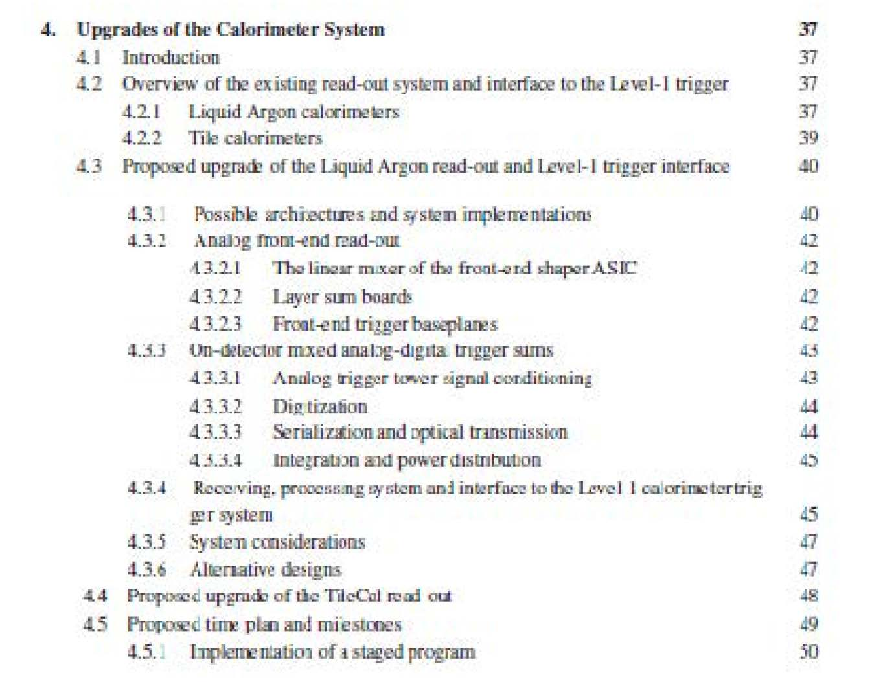
Physics Motivations
Main focus of ATLAS Phase-1 upgrade is “trigger enhancement”
Can the present trigger system cope with the foreseen luminosity increase?
Can ATLAS continues to use low-P_{T} lepton thresholds keeping physics acceptance high and trigger rates under control?
No. We would need to raise the thresholds
Do we need to keep low-P_{T} thresholds?
What are the physics motivations?

Slide 5
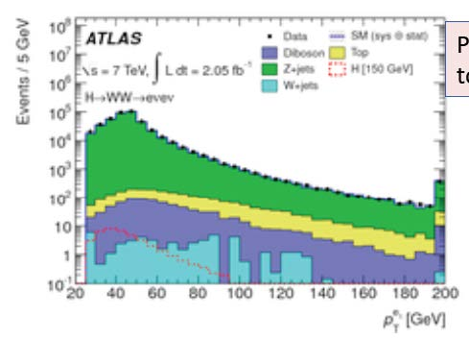
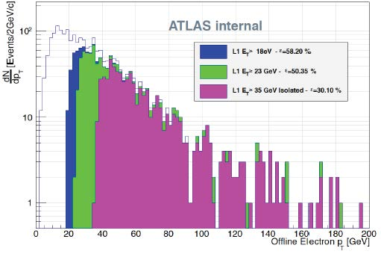

Slide 6
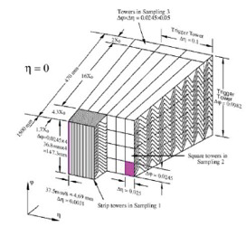
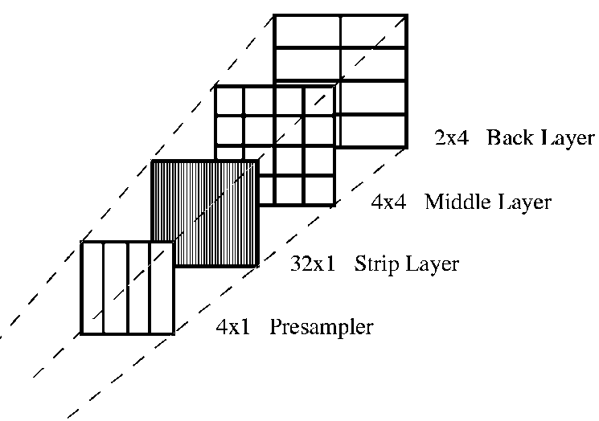
L1CALO trigger
The current Level 1 calorimeter trigger uses:
Transverse Energy thresholds based on ΔηxΔφ=0.1x 0.1 trigger towers
Lateral or Longitudinal isolation
No direction or sampling level information available.
The present granularity trigger readout DO NOT allow for computation of lateral and longitudinal shower shapes in each sampling of the calorimeter.
Is it possible to increase the granularity within the current FE electronics framework?

Slide 8
Tower formation and TBB
Schematic diagram showing the functions of the TBB. Inputs signals have different delay, peaking time and gain values. TBB compensates the signal before adding them
Top, 60 cells of one Barrel tower (distributed in 4 layers) are added to build a trigger tower.
Bottom, diagram of the Level-1 trigger chain, showing where these sums are implemented and the TBB

Slide 9
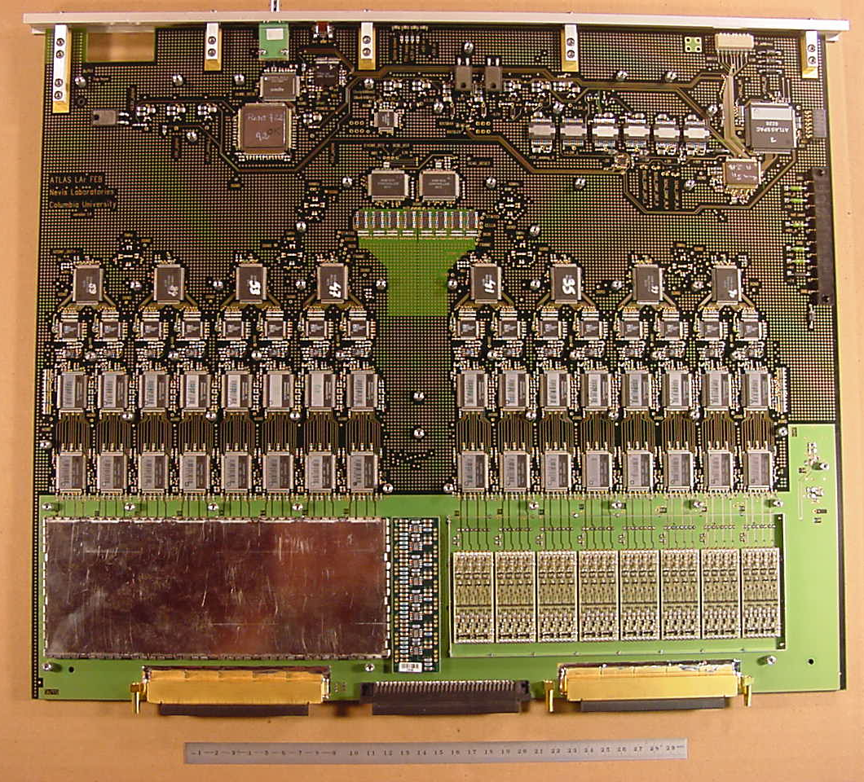
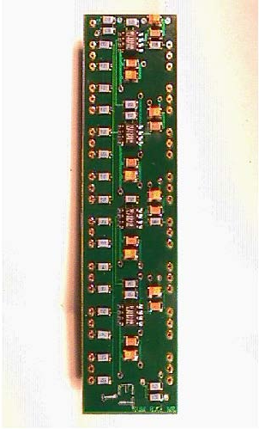
E.g. in the middle layer
In the FEB cells are summed to go from 16 read-out middle cells to 1 trigger tower.
Sums are performed in two stages:
Shaper ASIC: sums the output of 4 preamps with gain selectable (sum in φ). The last stage of the linear mixer is a CR-RC shaper.
Cannot be changed without a complete FEB redesign.
Layer sum boards (LSB), which are pluggable daughter cards, 2 on each FEB, to provide analog sum signals (in η) for first stage sums. Can be replaced.

Slide 15
Baseplane

Slide 16
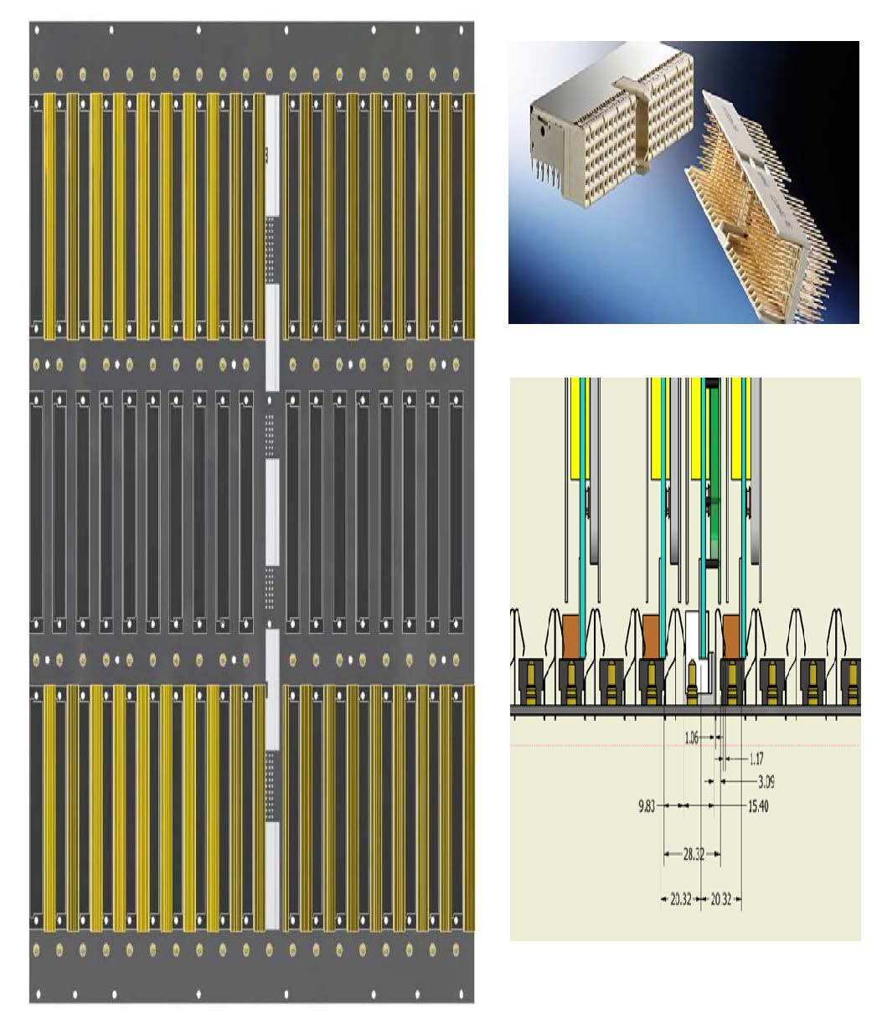
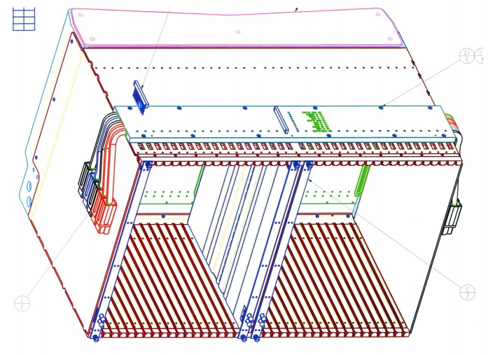
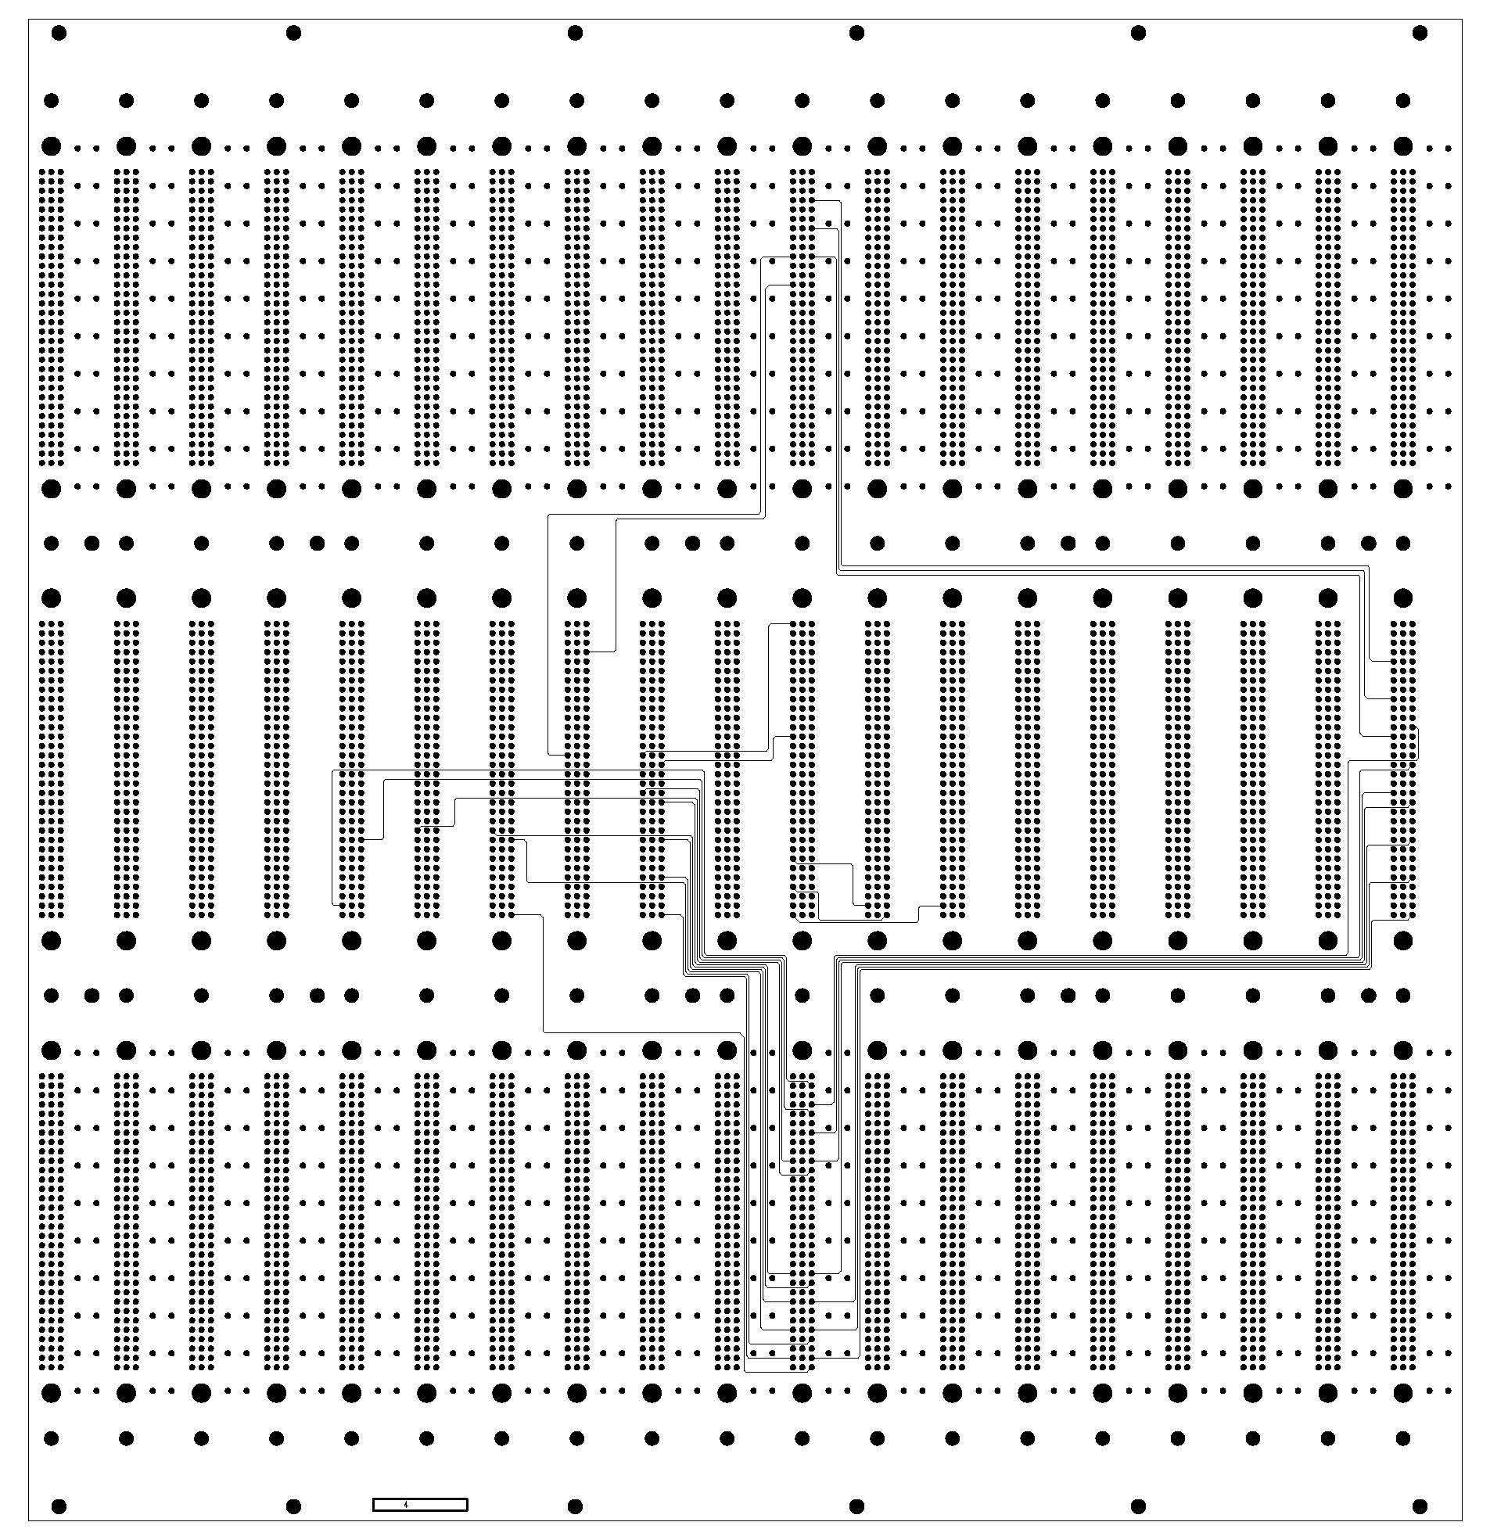
Baseplane redesign
Baseplanes must be re-designed to provide the new granularity to the Digital Tower Builder Board (DTBB).
For the EM barrel the DTBB will have 284 channels.
Space for the DTBBs exist in the crates … FEB position shifts implemented in the new baseplane layout
A “common” baseplane for all crates could be possible.
Signal integrity is a must in the baseplane, i.e. transport of low level analog signals.
New baseplane samples, together with new LSB, needed to demonstrate upgrade feasibility (Phase 0)

Slide 17
When and what in ATLAS ?
Phase-0: - LAr/L1CALO demonstrator (1-2 crates in EM Barrel
- Replacement of all Low Voltage Power Supplies
Phase-1: New LAr trigger
Phase-2: - New sLAr FE electronics
- sFCAL
- New HEC cold electronics

Slide 18
Milano interests/ possible contributions to the upgrade
Baseplanes: → redesign
→ ~ 1/3 of the production in Italy
[collaboration with US-BNL, JINR-Dubna, MPI-Munich, IN2P3-LAL Orsay]
Layer Summing Boards: → redesign
→ ~ 1/3 of the production in Italy
[collaboration with US-BNL, JINR-Dubna, MPI-Munich]
On-detector new DTBB: → participation to development and design
[collaboration with US-BNL, CEA-Saclay, IN2P3-LAL Orsay, JINR-Dubna]
→ power distribution on the DTBB, design and prototyping
(POL instead of LVDS, extension of the Gruppo V - APOLLO Project)
[collaboration with US-BNL]

Slide 19
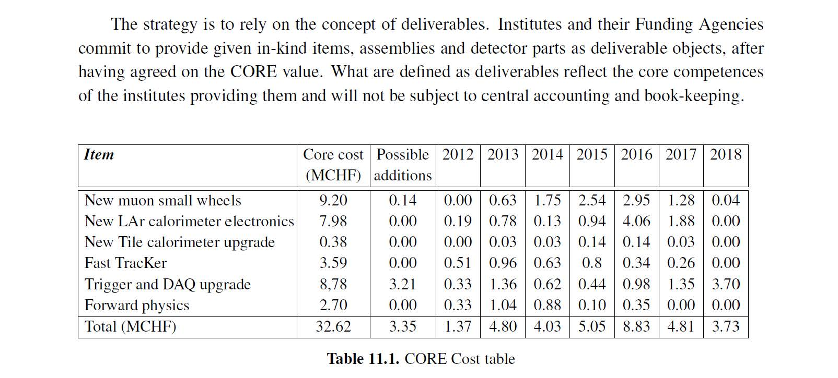
Cost Evaluation from LoI
Deliverables |  | CORE COST (MCHF) |  | 2013 | 2014 | 2015 | 2016 | 2017 | 2018
Baseplane |  |  | 1.076
 | Baseplane construction and assembly | 0.894 |  | 0.007 | 0.007 | 0.440 | 0.440 | 0.000 | 0.000
 | FEB connectors and shields | 0.182 |  | 0.000 | 0.000 | 0.091 | 0.091 | 0.000 | 0.000
Front-End Electronics |  |  | 0.743
 | LSB EM | 0.689 |  | 0.014 | 0.000 | 0.000 | 0.675 | 0.000 | 0.000
 | LSB FCAL | 0.020 |  | 0.000 | 0.000 | 0.000 | 0.020 | 0.000 | 0.000
 | HEC Preshapers | 0.034 |  | 0.000 | 0.000 | 0.000 | 0.034 | 0.000 | 0.000

Slide 20
Requests
To participate effectively to the demonstrator phase → ~ 15 Keuro
For Phase 1, we could participate to part of the production of Baseplane and LSB (one of both items) → < 600 Keuro

