Slide 1
IL progetto AFP
Schema di principio del rivelatore
Gli argomenti di Fisica
Il rivelatore
  La beam pipe
  Il sistema di tracking
  Il sistema di timing
Stato di approvazione
Organigramma
Scala temporale, costi, risorse umane
Argomenti ancora non coperti
Passi successivi per arrivare al TDR
L’interesse dei gruppi italiani (BO, GE, MI)
Conclusioni
Marco Bruschi
ATLAS ITALIA- Milano 17 Maggio 2012

Slide 2
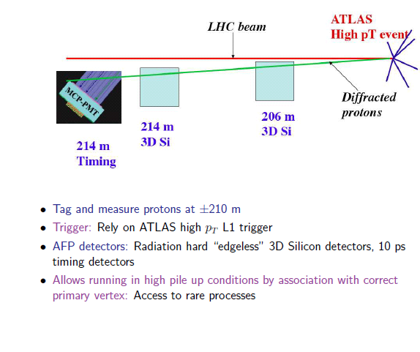
The AFP detector

Slide 3
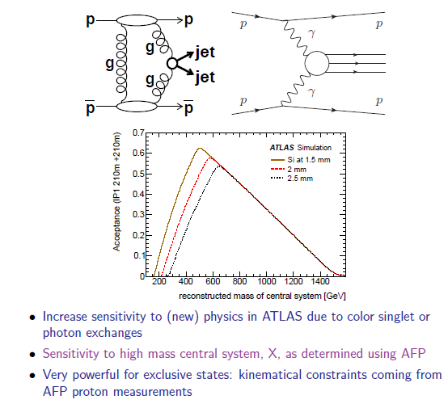
AFP Physics topics

Slide 4
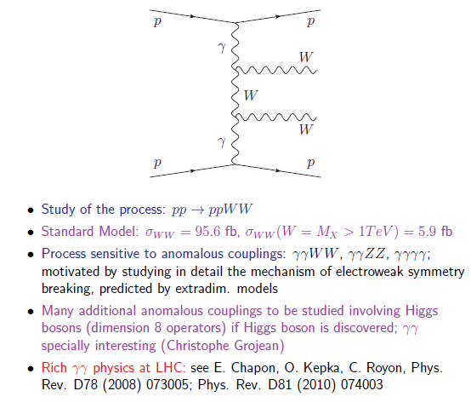
Search for γγWW quartic anomalous coupling

Slide 5
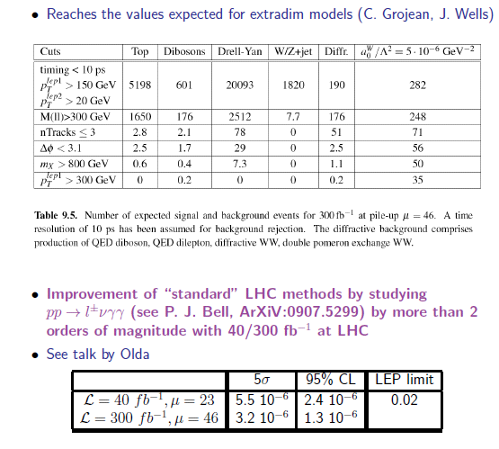
Results from full simulation

Slide 6
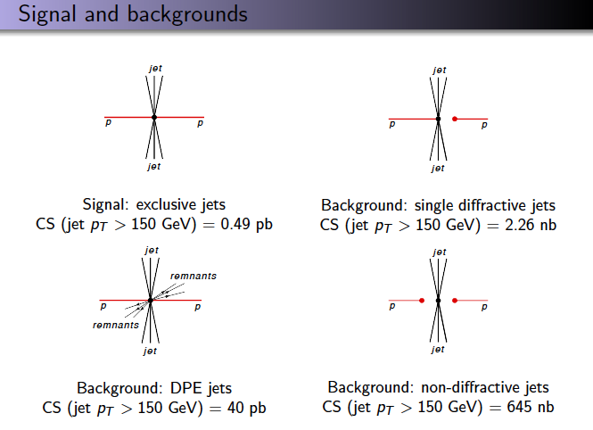
Exclusive Jet production

Slide 7
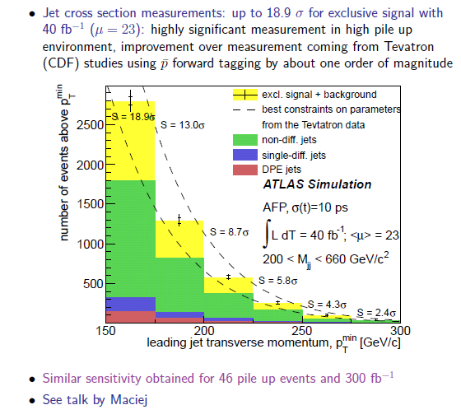
Exclusive jet production

Slide 8
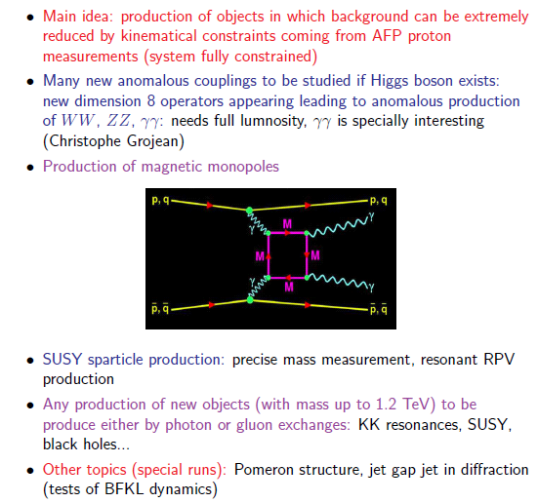
Additional topics at full lumi (to be studied)

Slide 9
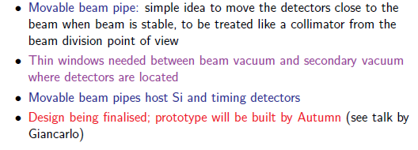
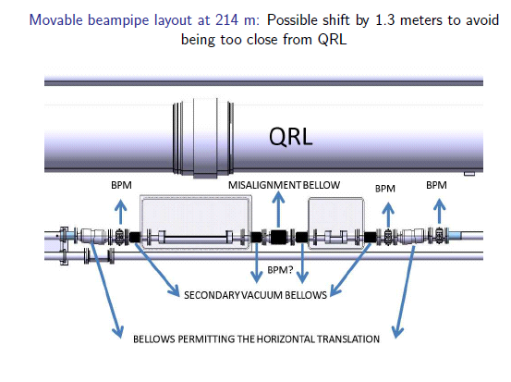
Movable beam pipe hosting the Si/timing detectors

Slide 10
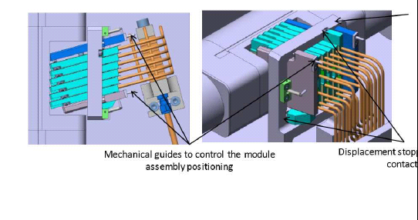
AFP tracking system
We need to measure the proton position with a precision of ~ 15 μm
Use 3D Si detectors developed for IBL: possibility to use one or more of the IBL group involved facilities (sensor production, assembly and testing).
Scribe-cleave method allowing significantly to reduce a dead zone, possibly to 100 μm (tested by Barcelona)
Phase I detectors: edgeless 3D in progress at SLAC
Mechanics: study in progress in Saclay including cooling, alignment studies, to be discussed with lab building prototype

Slide 11
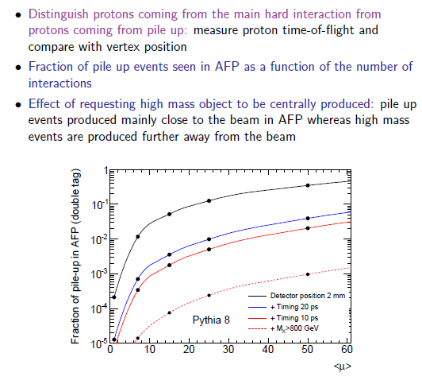
Why do we need timing detectors?

Slide 12
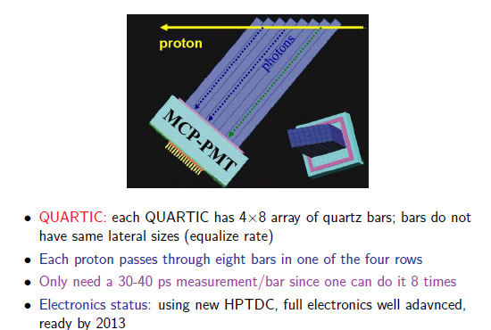
QUARTIC is the primary AFP timing detector

Slide 13
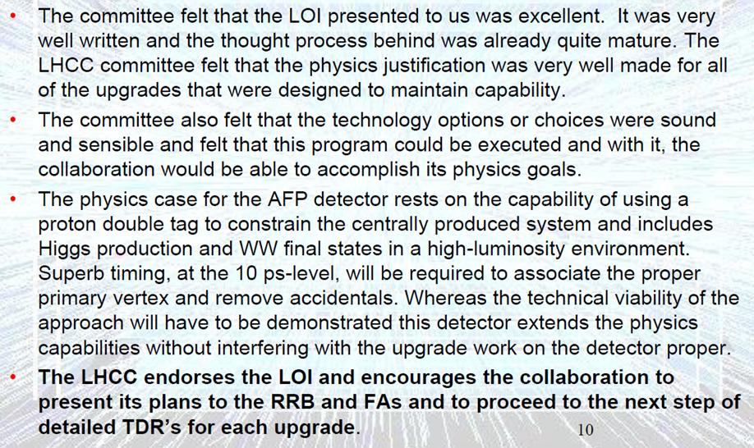
Status of the approval
AFP
  LOI phase I approved by the CB at the end of January
  LHCC referees needed some clarifications (on the role of ALFA and AFP in ATLAS and on the relevance of the physics case )
  Presentation by Christophe Royon at the LHCC open session to clarify the case. Added some other new ideas for possible measurements with AFP. Positive impact
  Final referee report was positive and the impact to RRB at the end of APRIL as well
  Time to organize about the next steps: Organigram, TDR, MOU

Slide 14
Current and new collaborators
Canada: Alberta
Czech Republic: Prague (Inst. Of Phys., Charles Uni., Technical Uni)
France: Saclay
Italy: Bologna Genova, Milano
Poland: Cracow (PAN, AGH)
Spain: Barcelona
Switzerland: CERN
UK: Glasgow, Manchester
USA: Stony Brook, Uni. Of Oklahoma, Texas Arlington, Oklahoma State Uni., New Mexico, SLAC
Interest from additional institutes: Toronto, Oslo, Lisbon, Uni. of Geneve

Slide 15
Forward Group: M. Bruschi (Bologna)
AFP Project : C. Royon (Saclay)
FDIB: H. Stenzel (Giessen)
AFP Technical Coordinator: D. Macina (CERN)
Interface with LHC: D. Macina (CERN)
Physics: A. Kupco (Prague) (C. Royon, Saclay)
Silicon: P. Sicho (Prague) (C. Da Via, Manchester)
Timing: A. Brandt (Texas) (M. Rijssenbeek,
Stony Brook)
Movable beam pipe: G. Spigo (CERN)
Detector :A Brandt (Texas)
Simulation: Y. Liu (Giessen)
QUARTIC: A. Brandt, J. Pinfold (Alberta)
Radiators: A. Brandt, J. Pinfold, H. Stenzel
Detector layout: A. Brandt, J. Pinfold
MCP-PMT A. Brandt
Electronics: M. Rijssenbeek (Stony Brook)
Amp+CFD: M. Rijssenbeek, J. Pinfold
ADC: M. Rijssenbeek
HPTDC: J. Pinfold
Sampling chip E. Delagnes, H. Grabas (Saclay)
Pulser S. Seidel (New Mexico)
Reference Clock A. Brandt, A.Davis (Texas)
Readout: J. Pinfold (Alberta)
Optomodules: S. Khanov (Oklahoma)
LCE: D. Tsybychev (Stony Brook)
ROD: NN
Mechanics: J. Pinfold
Interface with pocket Testing: A. Brandt
Testing: A. Brandt
Beam and laser tests: A. Brandt
Radiation tests: S. Seidel (New Mexico)
Slow Controls : NN
Trigger: NN (M. Rijssenbeek, Portugal?)
LV/HV : NN
Installation: NN
Physics topics: L. Schoeffel (Saclay) /
O. Kepka (Prague)
Detector design: A. Kupco (Prague)
Trigger: M. Tasevsky (Prague)
Simulation: L. Schoeffel (Saclay) /
T. Sykora (Prague)
Alignment and Calibration: P. Bussey (Glasgow)
Proton tracking: J. Chwastowski (Cracow)/
O. Kepka (Prague)
Reconstruction, integration: T. Sykora (Prague)
MC production: L. Schoeffel (Saclay)
Mechanics: N. Grouas (Saclay)/M. Cadabeschi (Alberta)
Cooling: V. Vacek (Prague)
Sensors and bump bonding: C.Padila (Barcelona) ,
O. Rohne (Oslo) , C. Gemme (Genova)
FEI4: P. Sicho (Prague)
Module assembly: C.Gemme (Genova)
Internal electrical services and Optobox: S.Welch
(Oklahoma), Su Dong (SLAC)
Optoboard: S. Smith (Ohio)
Voltage regulators: M. Citterio (Milano) / C. Meroni
(Milano)
DCS: P. Sicho (Prague)
ROD: A. Gabrielli (Bologna)
Optical links - BOC: J. Dopke (CERN)
External services: P. Sicho (Prague)
Installation in the tunnel and USA15: P.Sicho (Prague)
DAQ: P.Morettini (Genova)
System tests: Su Dong (SLAC) / P. Sicho (Prague)
Radiation tests: S. Seidel (New Mexico)
Testbeam: D.Caforio (Bologna), P. Grenier (SLAC)
Simulation: NN

Slide 16
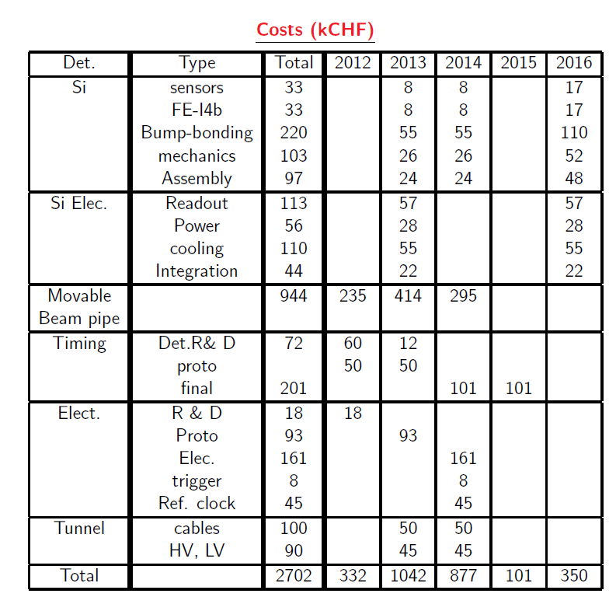
Difficulty in evaluating some costs: precise mechanics for Si, mechanics for timing, second version of timing detector

Slide 17
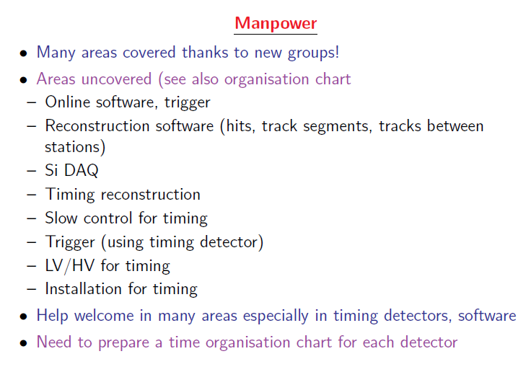
Help is also welcome in areas which are already partially covered (for instance sensors)

Slide 18

IMoUs with the role of each institute clearly defined by the end of this summer

Slide 19
Milano AFP interest
Power distribution: IBL PP2 crate “modified” to AFP needs (2 crates)
The AFP regulation stations (crates) can be very similar to the IBL crate
  In reality they are less “demanding”
  Backplane could be different and simpler, but at the moment no AFP specific design has been undertaken
The AFP crate and regulation boards will be produced accordingly to IBL services schedule
  The two schedules look compatible
The radiation environment in the LHC tunnel, where the crates will be installed should be better understood
Possible collaboration with:
  FBK (sensors)
  Genova (assembly&testing)
  Milano (bonding, Selex & DISCO,thinning&dicing)
Si detectors: 4 identical detectors with 6 planes each (24 SC IBL-like)

Slide 20
AFP Contribution on Modules
INFN (Genova – Milano - Trento) could contribute on AFP module development and production:
  Spin-off technology from IBL
What do we have in hands?
  IBL 3D sensors from FBK. Have no active edge, but demonstrated to go to 100µm thin edge with inside fence dicing(see next slide)
  Bump-bonding development with Selex – Thin modules 100÷150 µm successfully made with planar and 3D sensors and FE-I4A
  Flex design and module assembly – production of 50% of IBL
Developments
  Test tight dicing of FE-I4B and 3D sensors from FBK.
  We have easy access to IBL 3D sensors and FE-I4B wafers + bump-bonding and module assembly.
  Note: the 3D from the FBK are the best suitable today for thin edge. CNM would probably give higher leakage current if diced at same distance. Active edge need a new design for FE-I4 (bias tab on “interesting” edge) -> Money & Time!

Slide 21
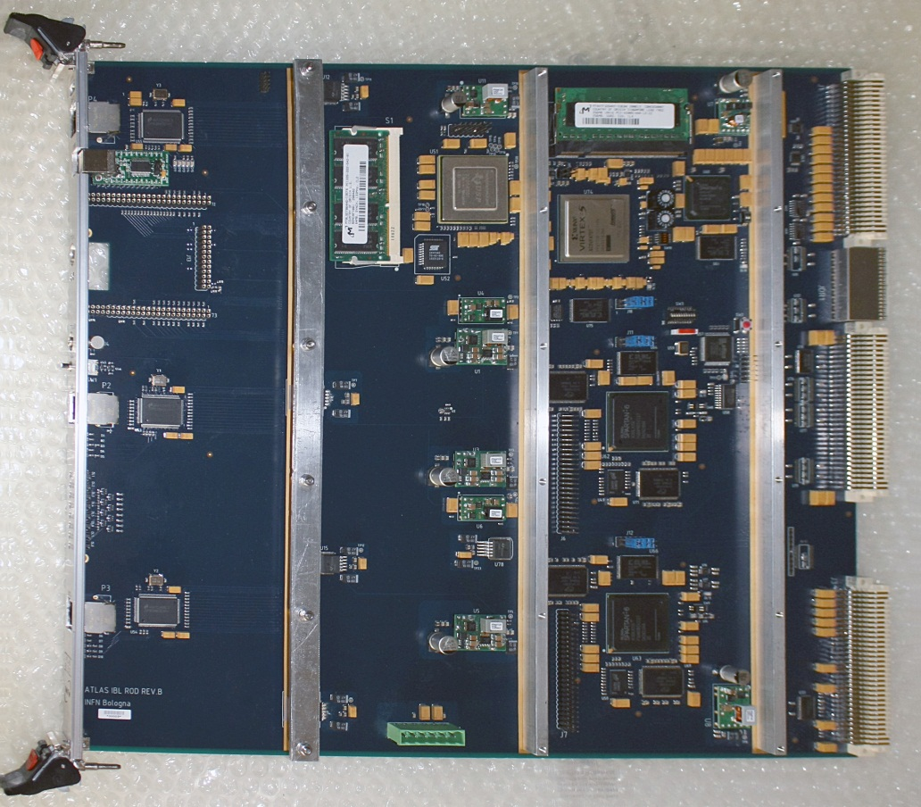
IBL ROD Bologna
Main Features
3 Gb/Ethernet buses
J1/J2/J3 + J0 VME connectors
1 USB port
1 JTAG port
1 TTCrq interface
2 Spartan6 + 2Gb DDR + 9 MB SSRAM
1 VIRTEX5 + PowerPC + 512 MB SDRAM + Flash
1 DSP @ 200 MHz + DDR
Performance
Interface with up to 32 FE-I4 chips
Interface with up to 4 Slinks via VME
VME ROD-BOC data @ 80 MHz
Calibration by off-board GPUs via Gb/Ethernet
Data Taking via VME @ 80 MHz
Production in Summer-Fall 2012: 14 boards plus spares
System Test (Detector-BOC-ROD-TDAQ) foreseen in Summer 2012 at CERN
Possible board upgrades to high-speed electrical bus (VXS, ATCA)

Slide 22
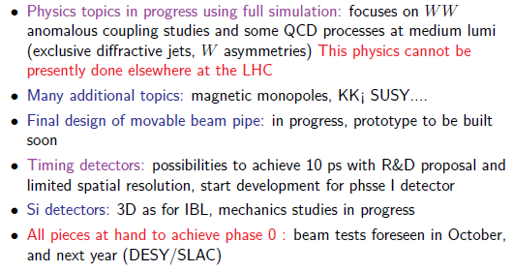
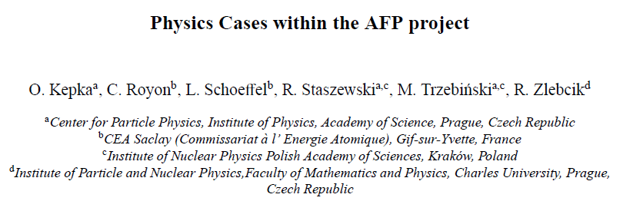
Conclusions
Next steps toward italian groups participation to be discussed
This physics cannot be presently done elsewhere at the LHC
ATLAS NOTE ALMOST READY →

Slide 23
Backup Slides

Slide 24
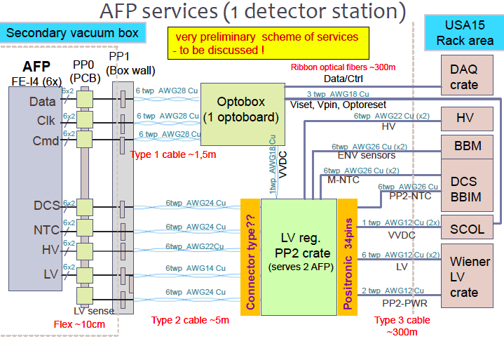

Slide 26
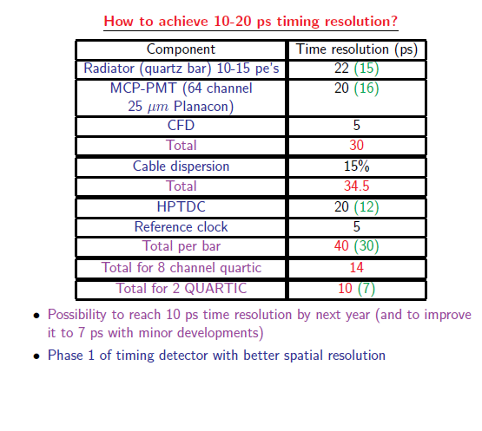

Slide 27
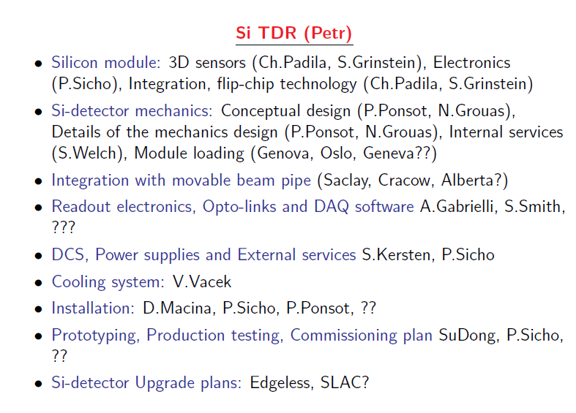

Slide 28
FE-I4A Dicing off top pads test
Test done with FE-I4A. Diced off top pad test (80 µm instead of 220µm).
Tested chip shows no damage
  FE-I4B need to be tested, but <100 µm should be feasible
Ref.: M. Garcia-Sciveres, P. Murray, G. Shaw LBNL Sept. 15, 2011

Slide 29
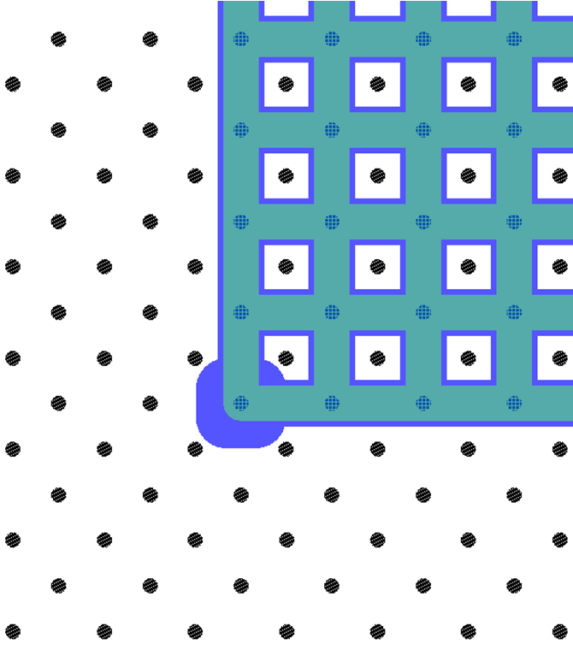
3D FBK Thin Edge
IBL FBK 3D are very suitable for thin(ner) edge. One row of ohmic holes is sufficient to “stop” the depletion region: ~100µm edge.
Ref.: G.-Giacomini et al., 6th Trento Workshop,
2-4 March 2011 (http://tredi.fbk.eu)
3th cut
5th cut
6th cut
40 μm
1st cut
p+ (ohmic)
columns
n+ (junction)
columns

