Slide 1
DPDF Mettings
Dec. 16th

Slide 2
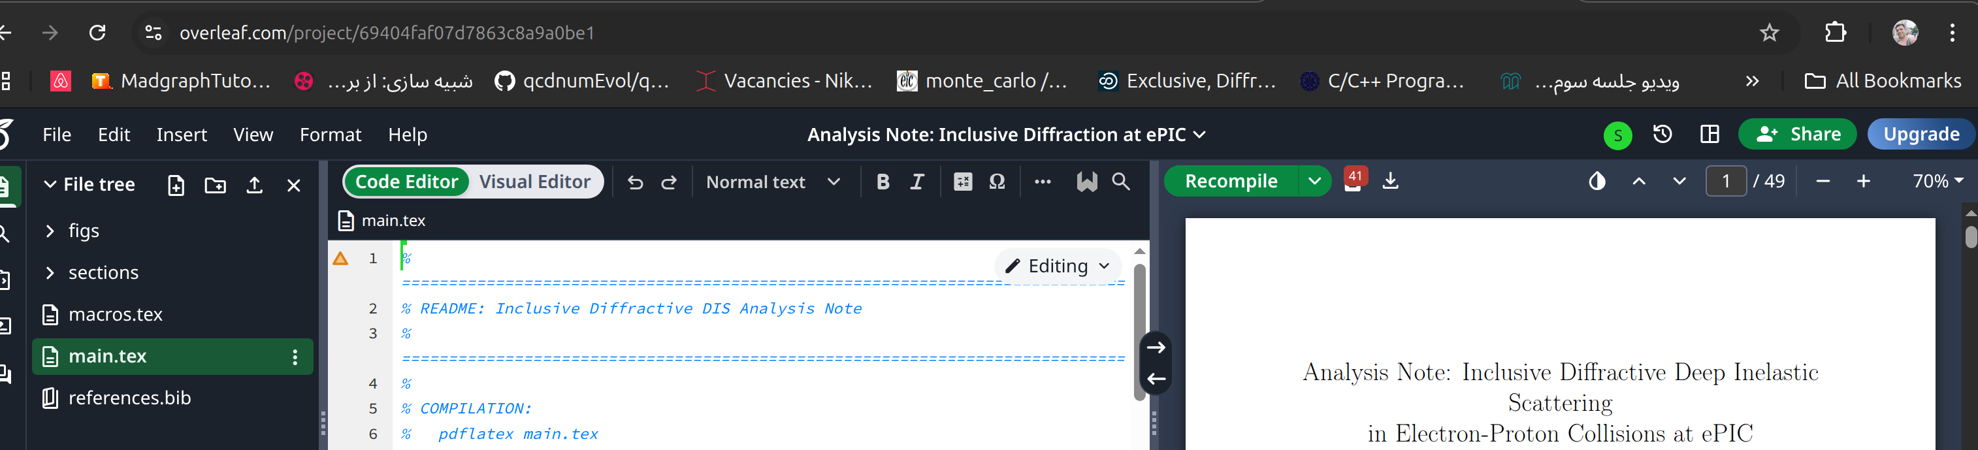
updates
The AN note is on Overleaf, added a few TODOs
still TODO on the draft: Adding figures, summarizing

Slide 3
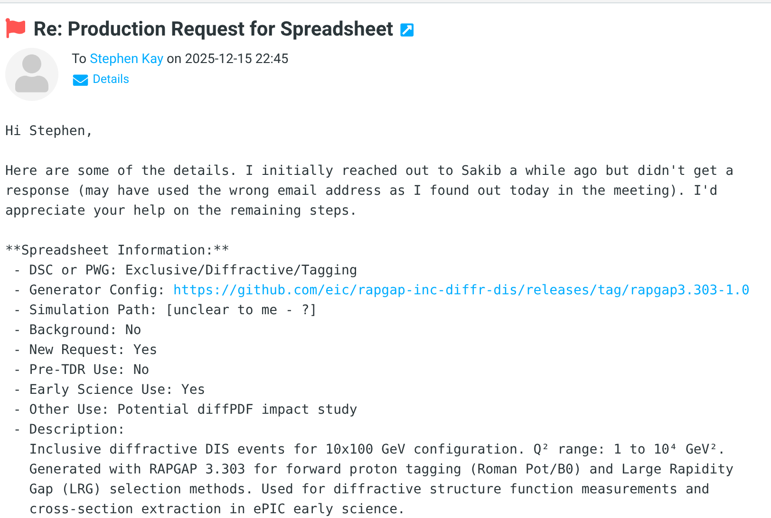
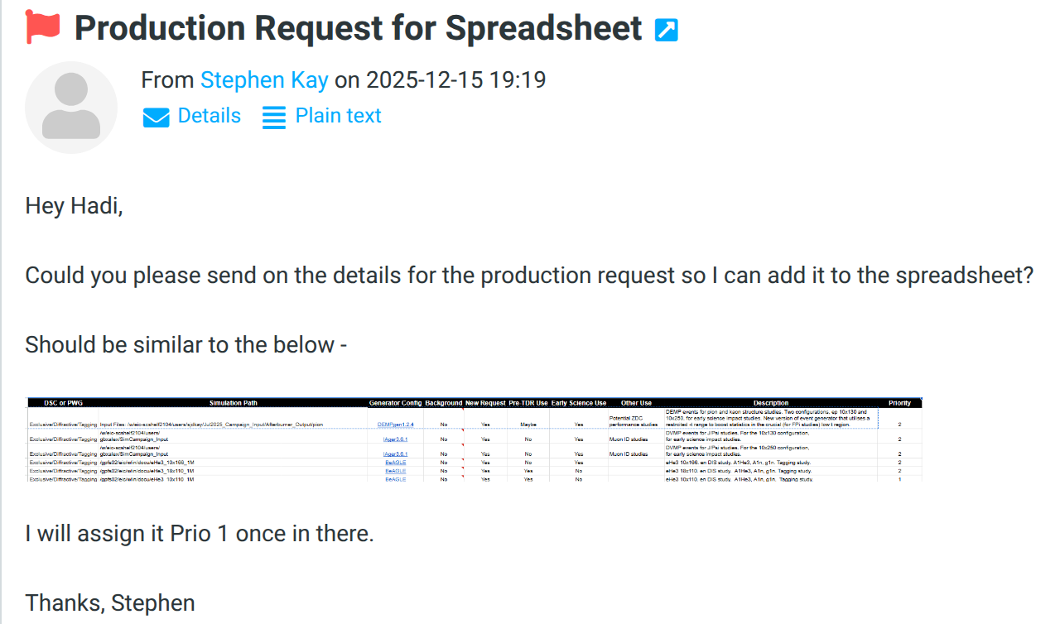
updates
Replied with the info I had , and asked for those I did not.

Slide 4
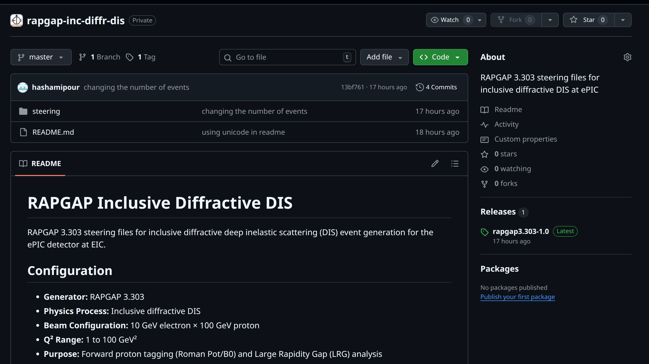
updates
Github repo for the steering file and logs version control
https://github.com/eic/rapgap-inc-diffr-dis
TODO: complete the readme with installation (?)
Got response from Sakib
Will talk to him tonight

Slide 5
Updates
On the categorizing the figures, there is a smidge done already, will prioritize this to get it done this week.
I'll update the github, just need to tidy up the code a bit. (https://github.com/hashamipour/eic_EarlyScience)

