Slide 1

IRIS Green Superconducting Line (GSL)
Stefano Maffezzoli Felis
Advisor: Dott. Marco Statera
Supervisor: Prof. Lucio Rossi
PhD Thesis Defense
14/01/2026

Slide 2
Outline
The IRIS Project
The Green Superconducting Line (GSL)
Physical Behaviour
Power Consumption and Use Cases
Conclusion

Slide 3
The IRIS Project

Slide 4
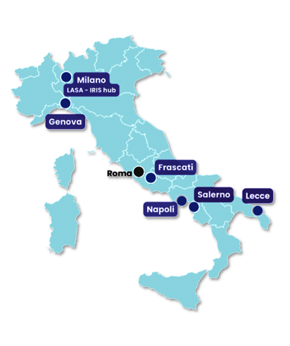
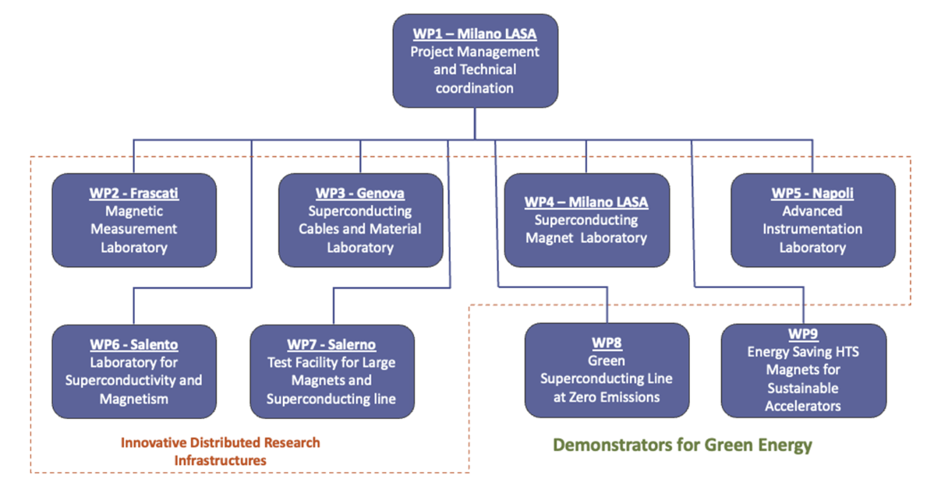
The IRIS Project
Innovative Research Infrastructure for applied Superconductivity
Goal
Establishing a national research network to advance applied superconductivity in Italy for next-generation particle accelerators and energy-saving 'green' power solutions.
Work-packages Structure
Involved Institutions
Milano LASA (INFN, University)
Genova (INFN, University, CNR-SPIN)
Frascati (INFN LNF)
Napoli (University, CNR-SPIN)
Lecce (Salento University)
Salerno (INFN, University, CNR-SPIN)

Slide 5
The Green Superconducting Line (GSL)

Slide 6
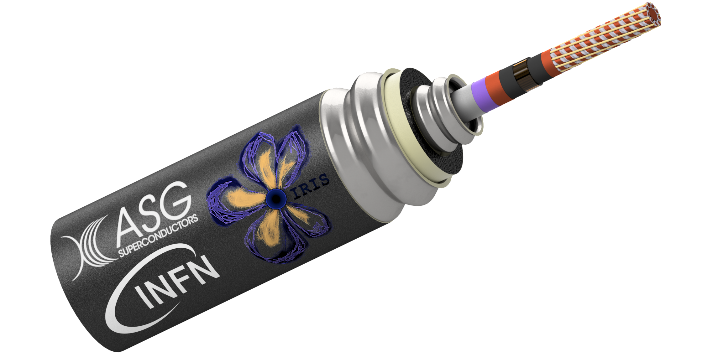
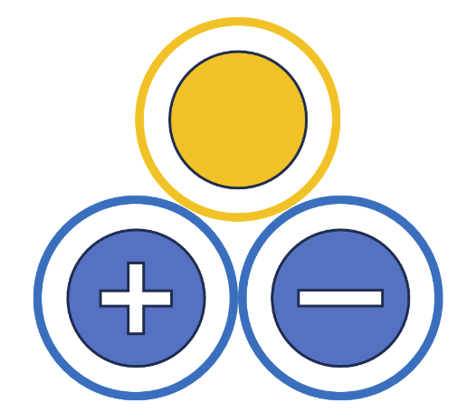
The Green Superconducting Line (GSL)
Line characteristics
Power transport | 1 GW
Voltage | 25 kV
Direct Current | 40 kA
Operating temperature | 20 K nominal (Min 18 K (inlet) Max 23 K (outlet))
Cooling | He gas
Line length | 130 m
Expected losses | <1.5 W/m at 20 K (single cryostat)
Bending radius | 2.2 m
Inner pressure | 10 bar
Superconductor | MgB₂
Redundancy | 2 active conductors
Single pole to be tested in Salerno IRIS test cable facility

Slide 7
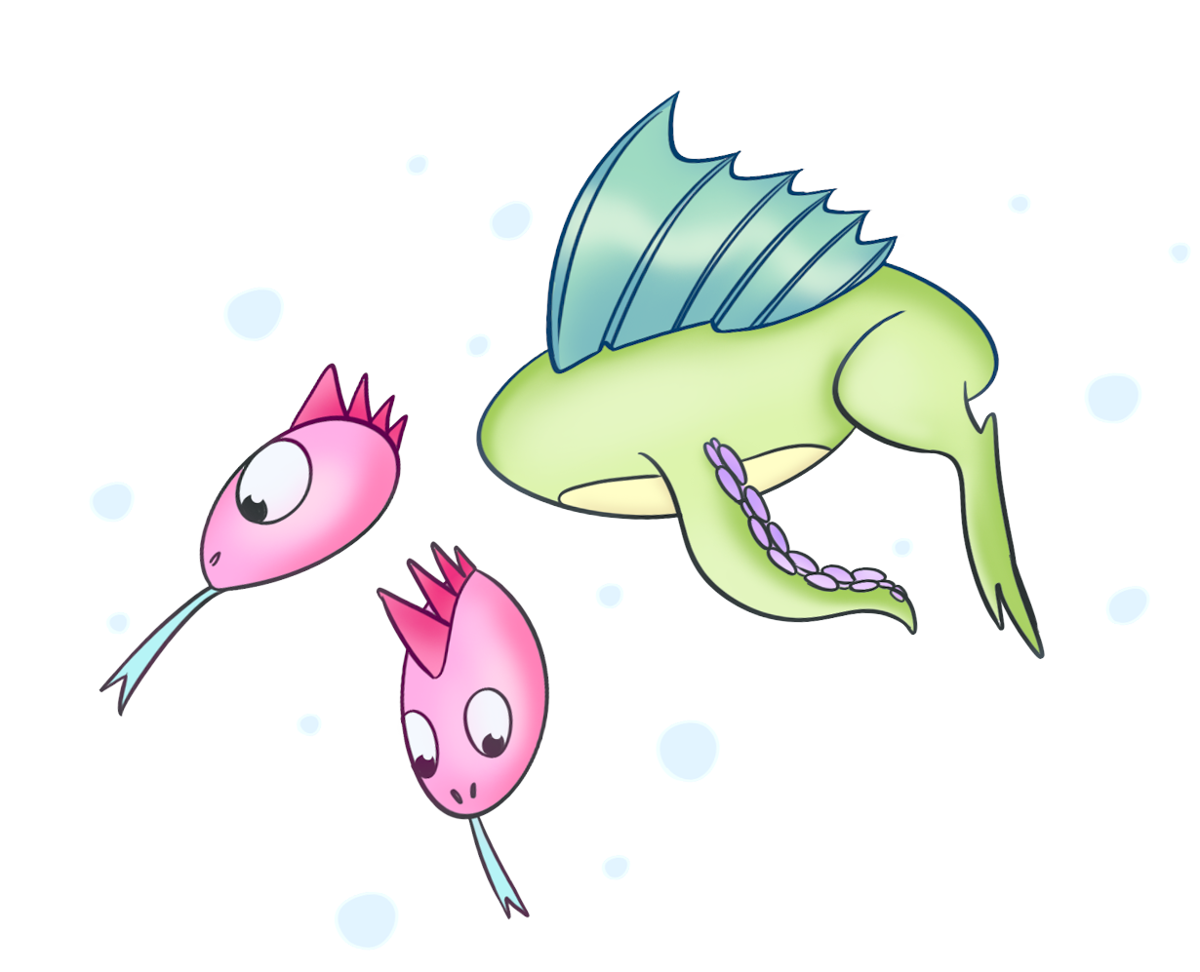
The Green Superconducting Line (GSL)
Why Magnesium Diboride (MgB₂)
Higher Operating Temperature: MgB₂ can operate around 20 K, which is significantly higher than low-temperature superconductors (LTS), meaning it doesn't require expensive liquid helium.
Hydrogen Compatibility: Its operating temperature is compatible with liquid hydrogen infrastructure, allowing a doble energy vector.
Cost-Effectiveness: Material costs for MgB₂ wire are lower than those for high-temperature superconducting (HTS) tapes.
Simplified Cable Assembly: The round-wire geometry simplifies the assembly of a multi-wire cable.
Commercial Availability: It is available in long, continuous lengths, which reduces or removes the need for resistive joints common in HTS-based systems, improving overall performance and reliability.
Italian Excellence: Europe — and Italy in particular — is the world leader in research and development of MgB₂.

Slide 8

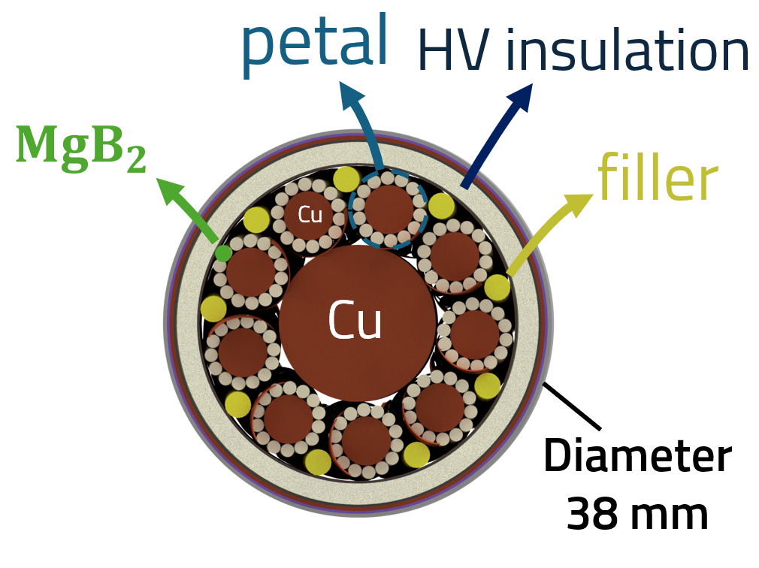
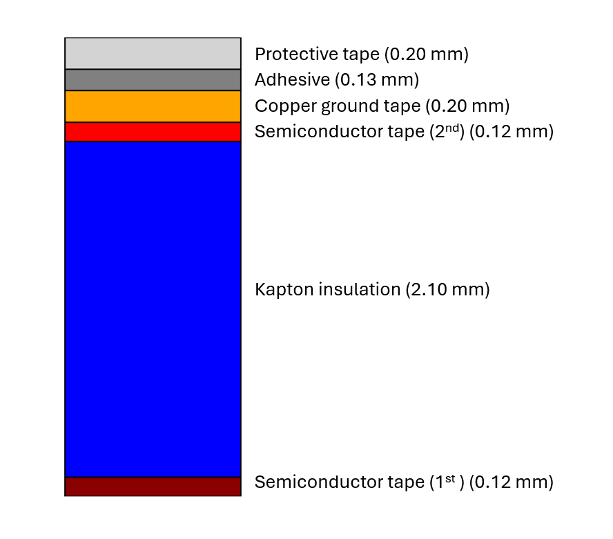

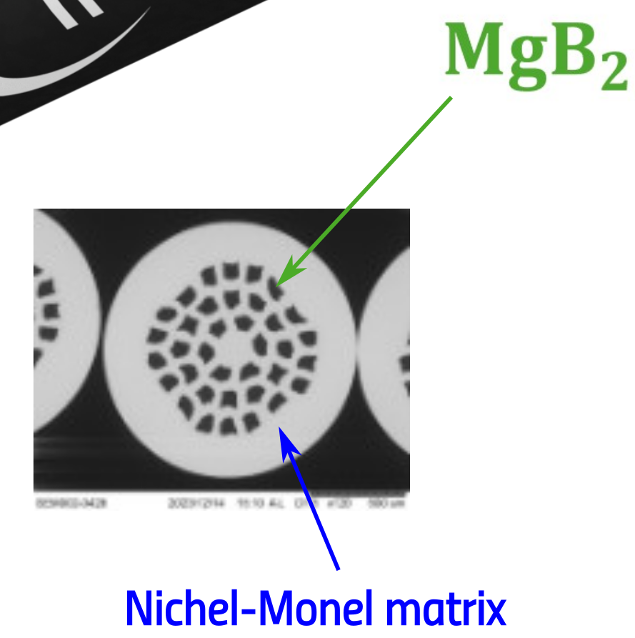
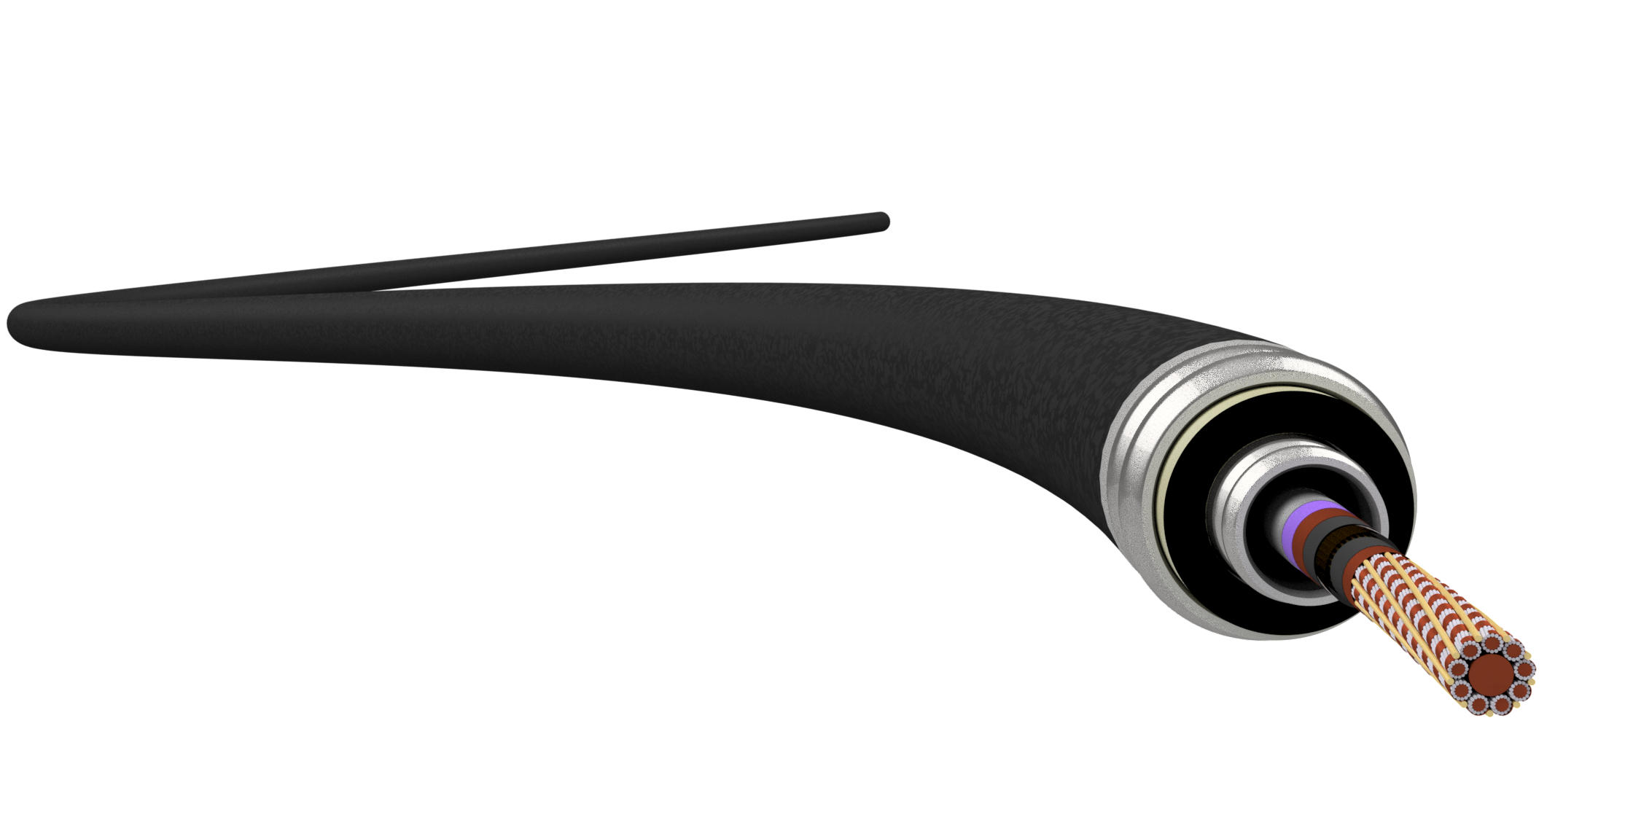
The Green Superconducting Line (GSL)
Diameter
93 μm
Polyimide insulation (2.10 mm)
Diameter
1.33 mm
Conductor Composition
9 petals
14 Superconducting Strands
36 MgB₂ Filaments
17.5% Filling Factor

Slide 9
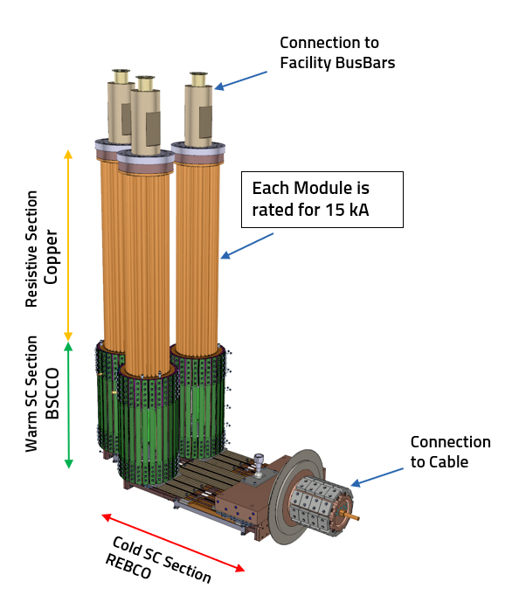
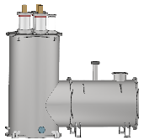
The Green Superconducting Line (GSL)
Current Leads

Slide 10
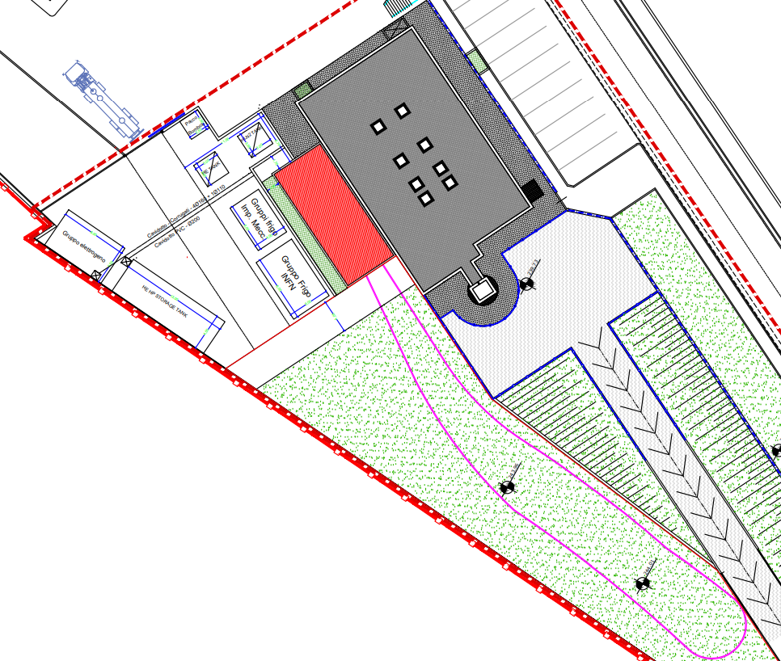
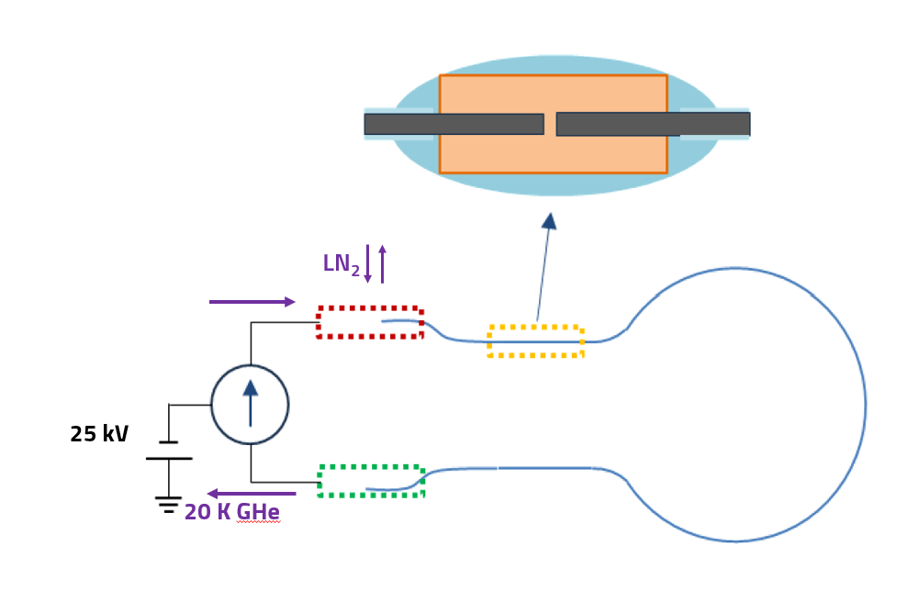

The Green Superconducting Line (GSL)
$$R=20 nΩ$$
In-line junction
IRIS test station in Salerno

Slide 11
Physical Behaviour

Slide 12
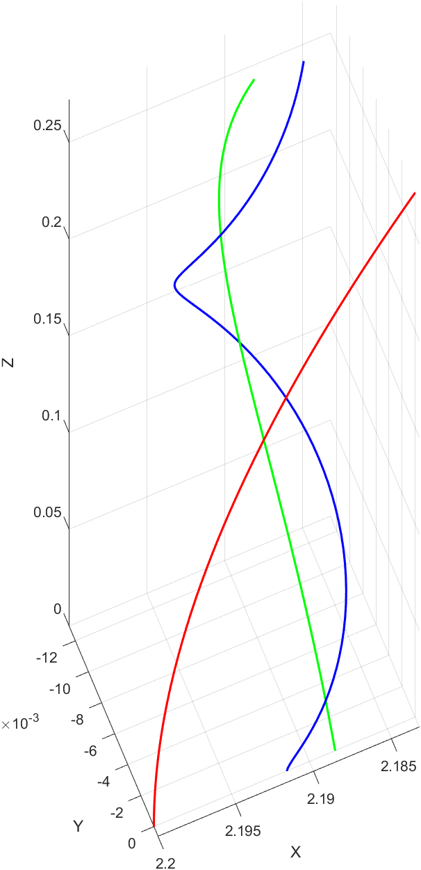
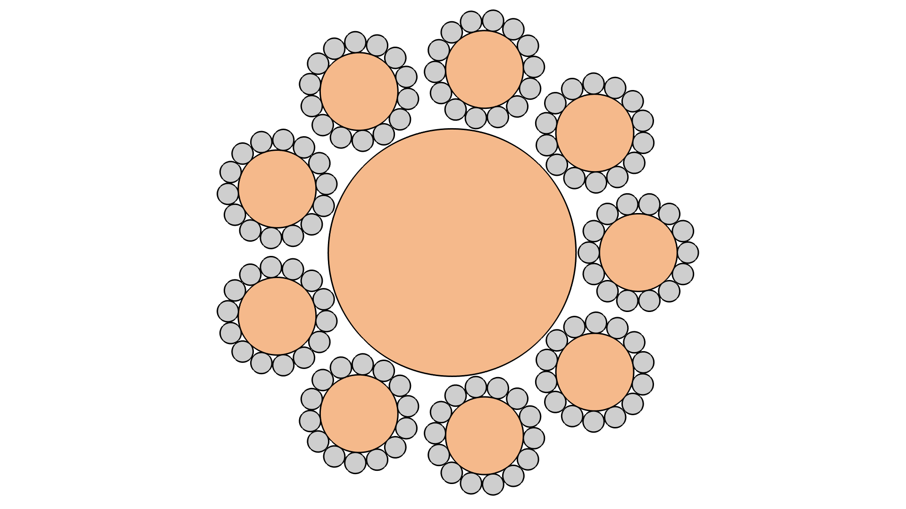
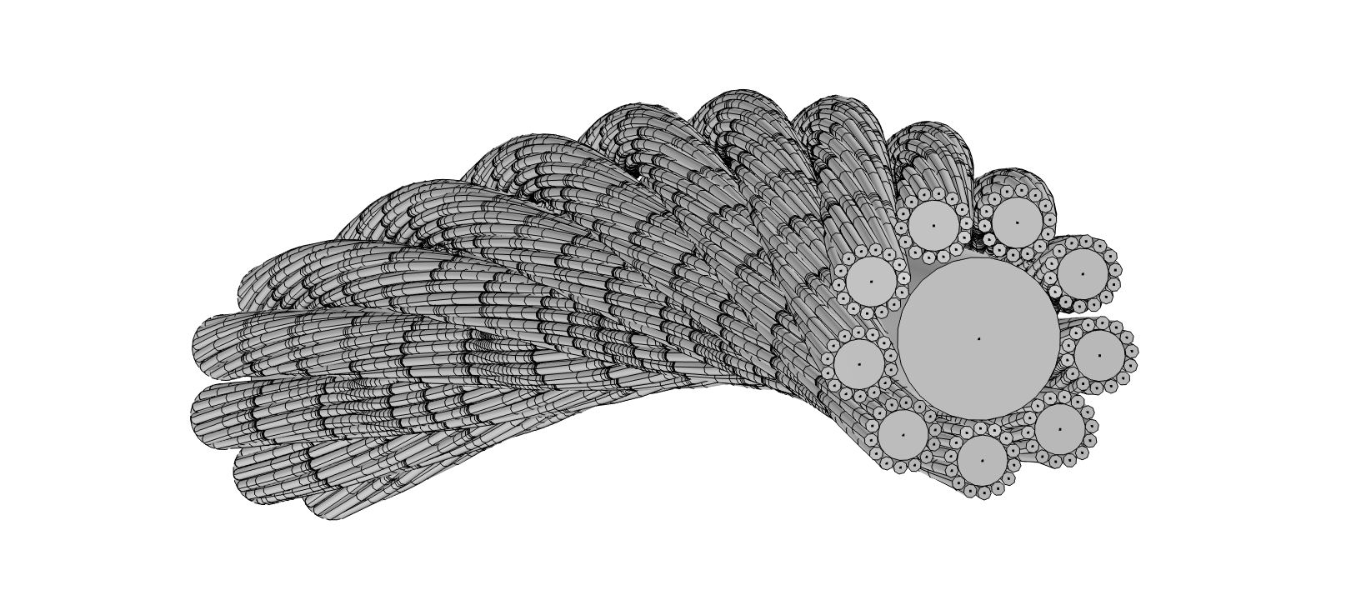
Geometry Construction
Mathematical definition of the helix traces
  Twist pitches
  Radii
  Length
Creation of the geometry following the traces
  Number of petals
  Number of strands

Slide 13
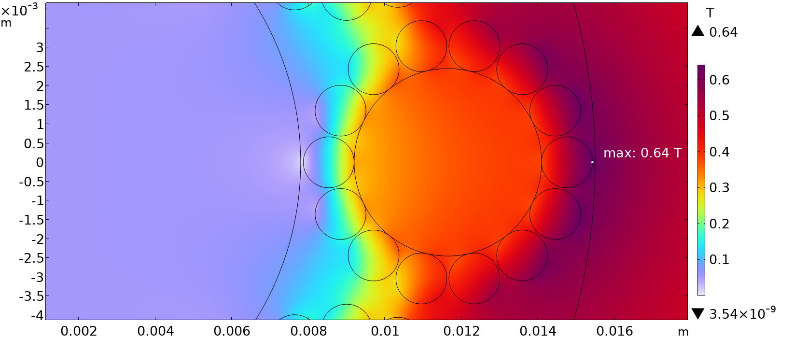
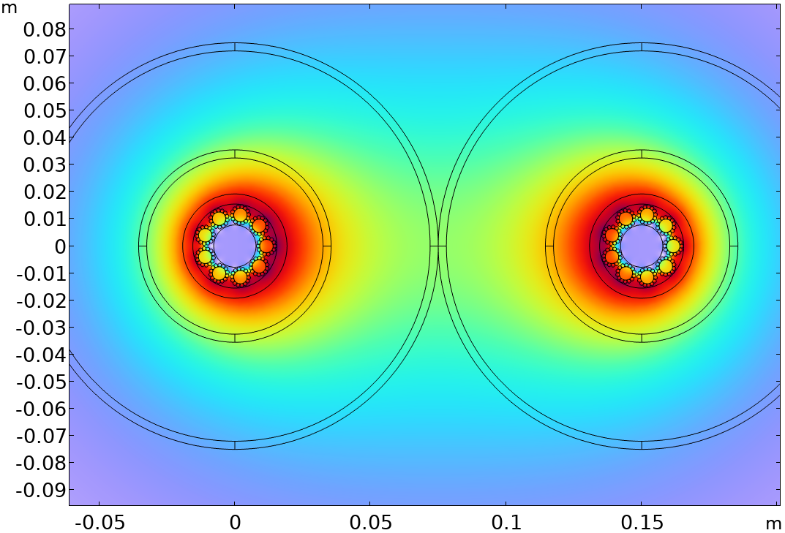
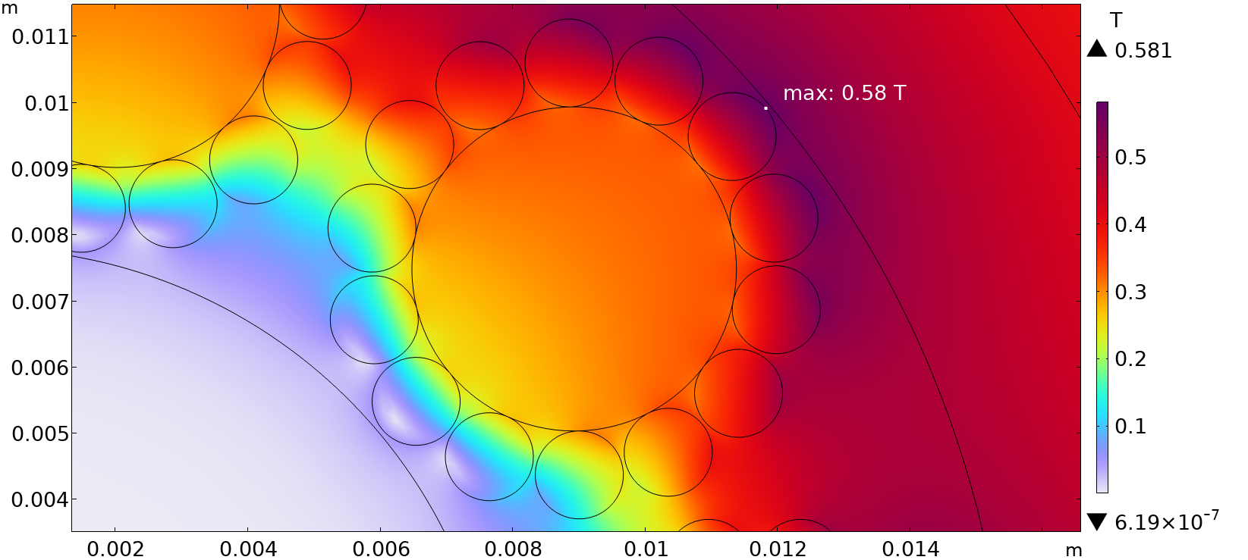
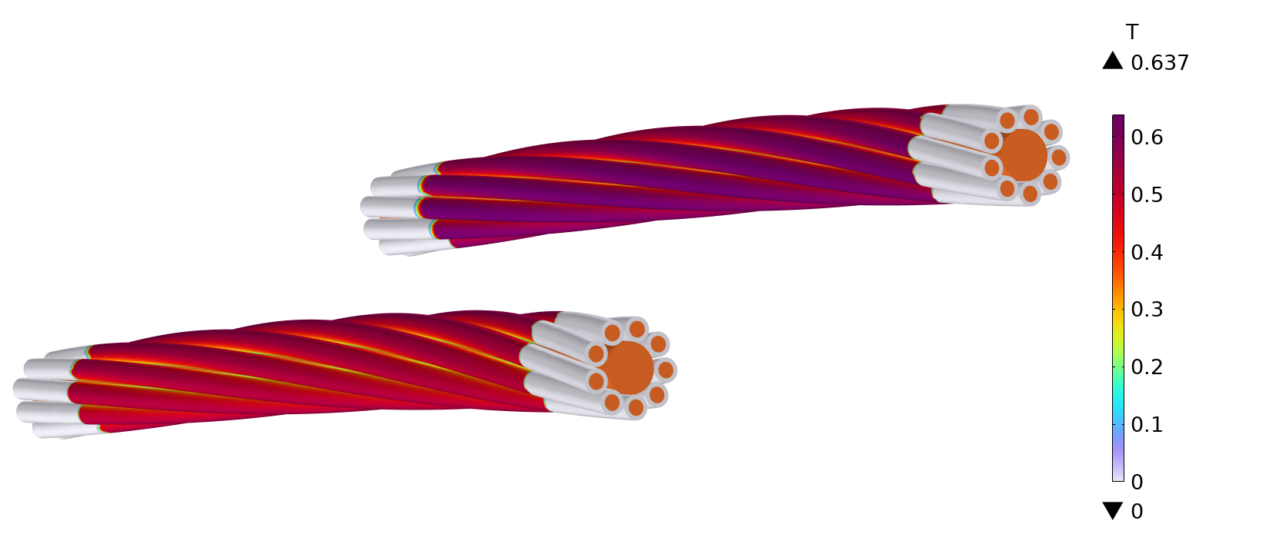
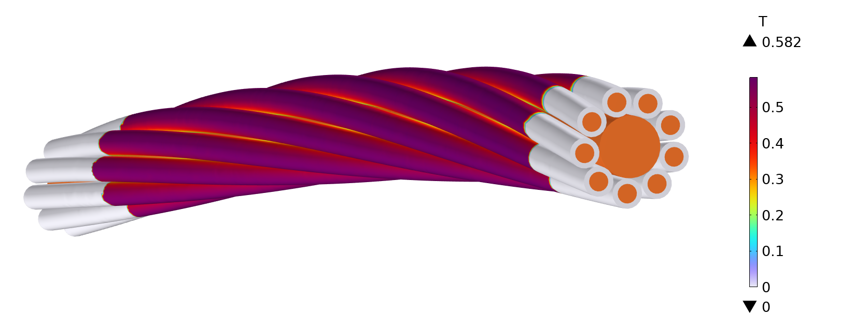
Physical Behaviour
Magnetic Analysis - 2D&3D
Double Cable
Single Cable
Configuration | Peak Magnetic Field
Single | 0.58 T
Double | 0.64 T

Slide 14
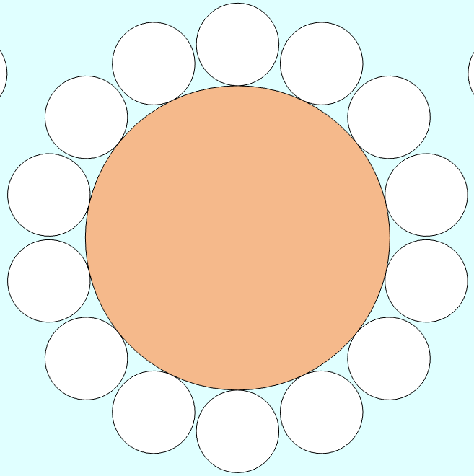
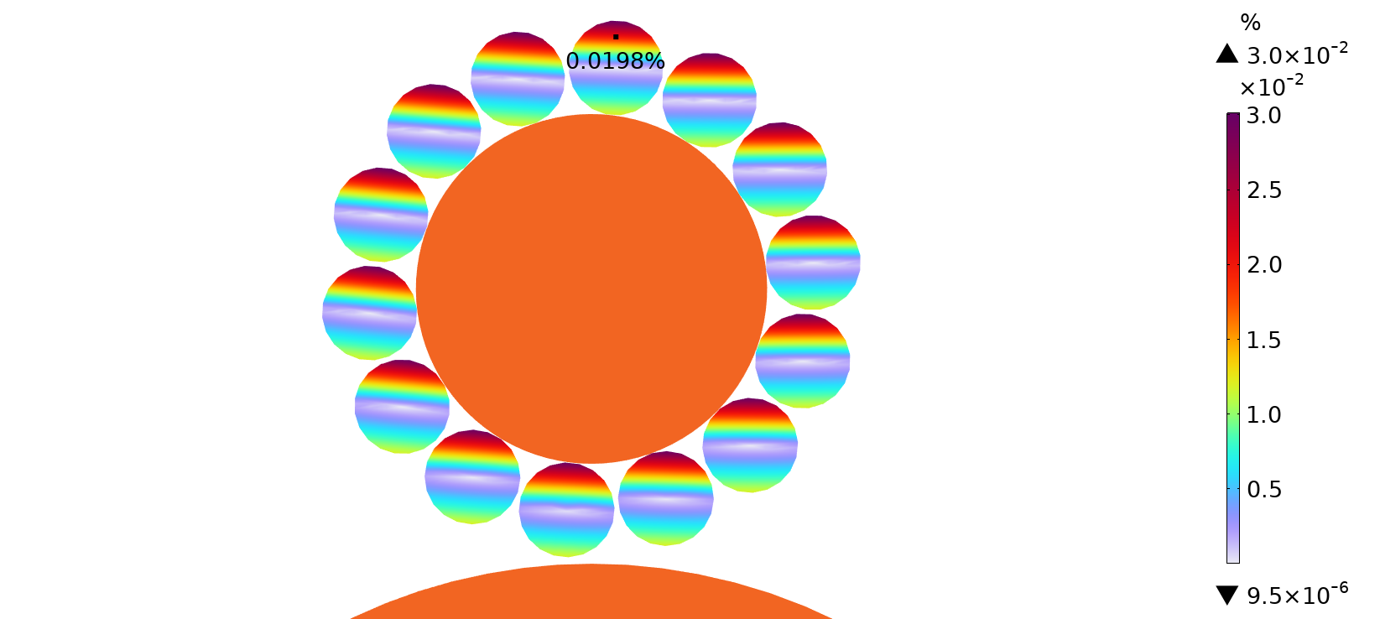
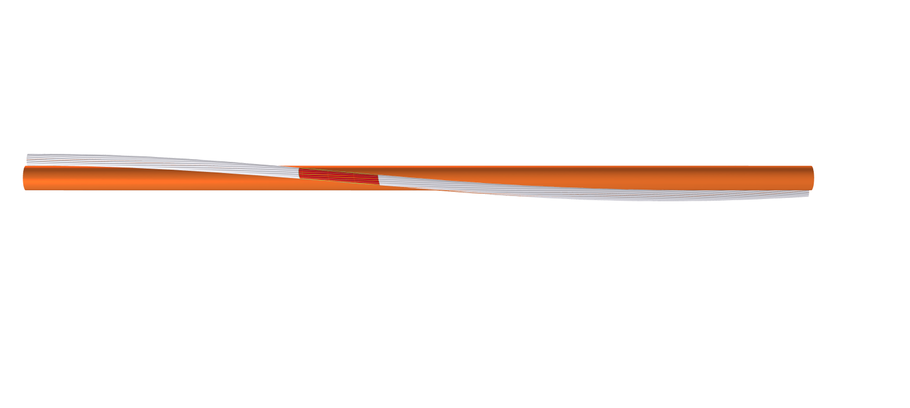

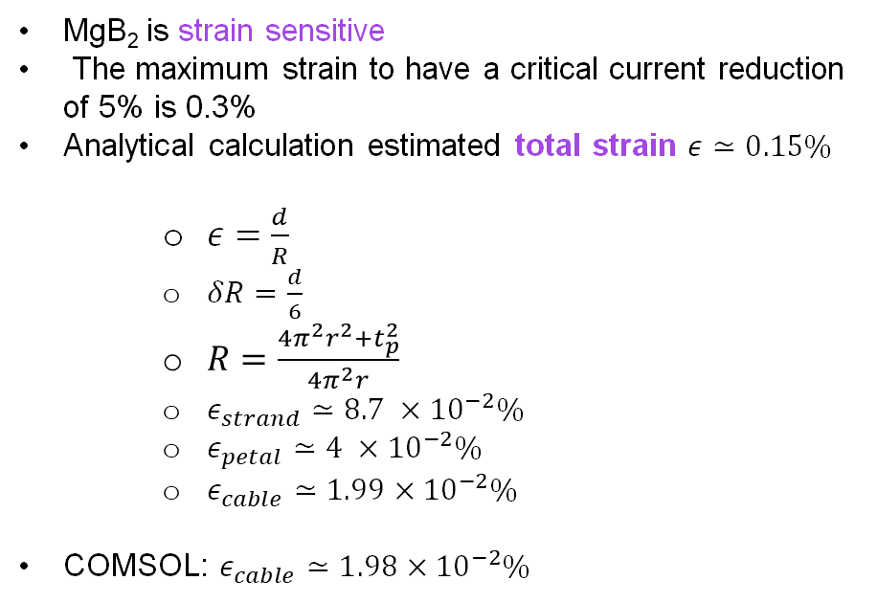
Physical Behaviour
Mechanical Analysis - Analytic
MgB₂ is strain sensitive
The maximum strain to have a critical current reduction of 5% is 0.3%
Analytical calculation estimated total strain $ε≃0.15\%$
    $ε=\frac{d}{R}$
    $δR=\frac{d}{6}$
    $R=\frac{4π^{2}r^{2}+t_{p}^{2}}{4π^{2}r}$
    $ε_{strand}≃8.7 ×{10}^{−2}\%$
    $ε_{petal}≃4 ×{10}^{−2}\%$
    $ε_{cable}≃1.99×{10}^{−2}\%$
COMSOL: $ε_{cable}≃1.98×{10}^{−2}\%$
$$δR$$
Neutral axis
r
d

Slide 15
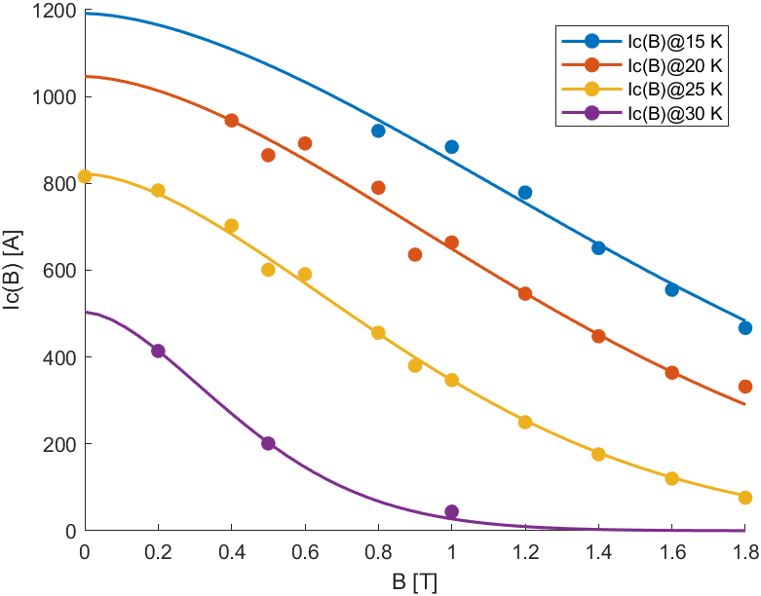
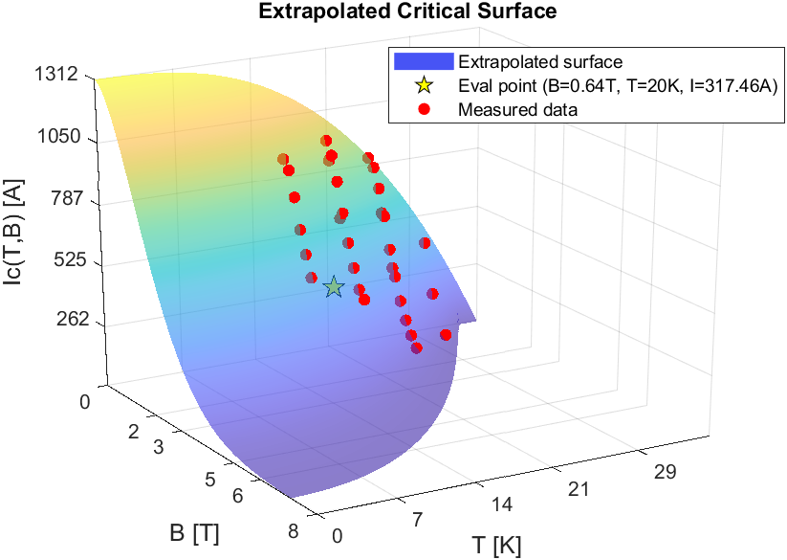
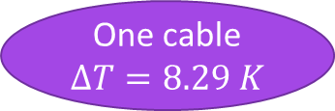
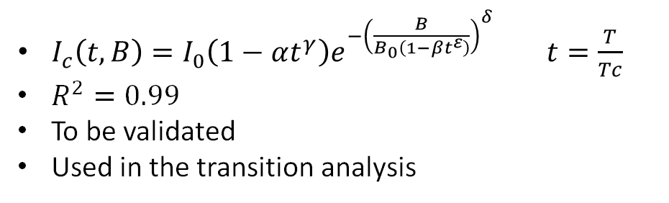
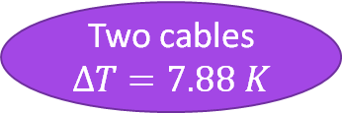
Physical Behaviour
Critical Current - Data Fit
$I_{c}\left(t,B\right)=I_{0}\left(1−αt^{γ}\right)e^{−{\left(\frac{B}{B_{0}\left(1−βt^{ε}\right)}\right)}^{δ}} t=\frac{T}{Tc}$
$R^{2}=0.99$
To be validated
Used in the transition analysis
One cable
$$∆T=8.29 K$$
Two cables
$$∆T=7.88 K$$

Slide 16
Physical Behaviour
Transition Analysis
The objectives are to determine the energy required to initiate the phase transition between superconducting and normal phase of the MgB₂ strands, to characterise the temperature rise and its propagation, and to identify the requirements for any necessary protection systems.
Protection in the context of the IRIS GSL is primarily an early-warning and reconfiguration mechanism. Detection must identify evolving critical states with sufficient margin and lead time to route the load to redundant conductors or spare infrastructure to maintain continuous operation.

Slide 17
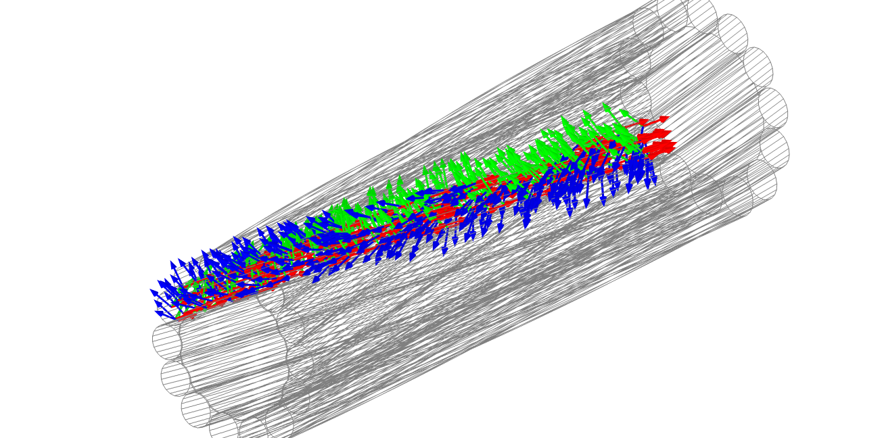
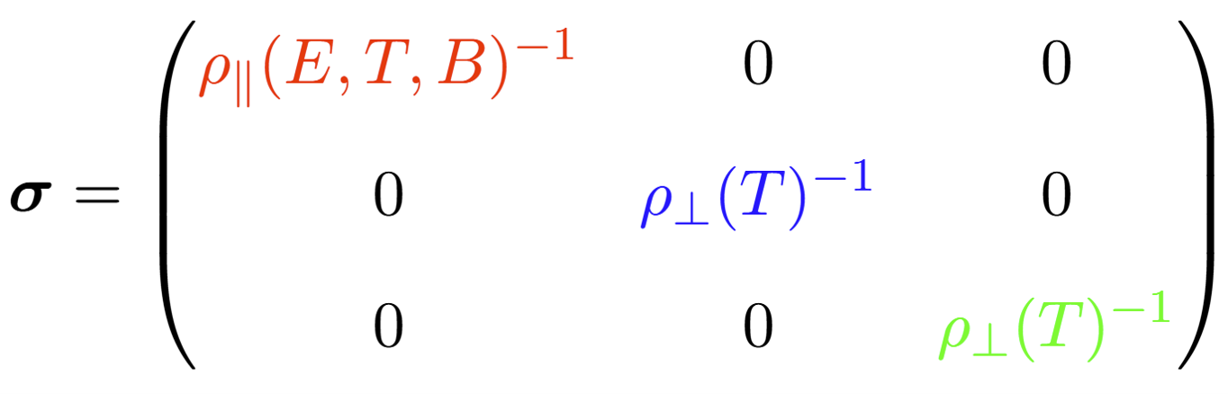
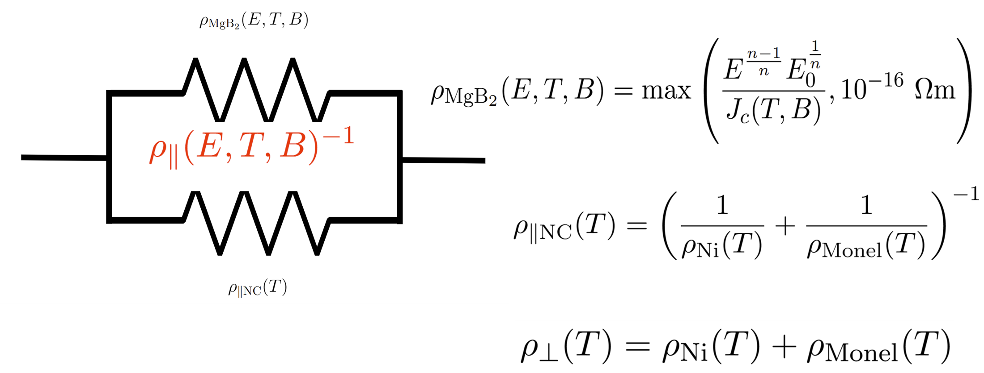
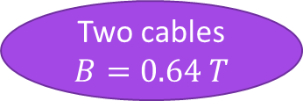
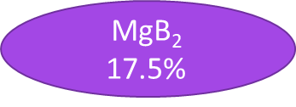
Physical Behaviour
Transition Analysis - Model
Homogenised strand
Conductivity of the Strands
MgB₂
Nickel
Monel
$$\text{MgB}\text{2}$$
17.5%
Two cables
$$B=0.64 T$$
NC Matrix
82.5%

Slide 18
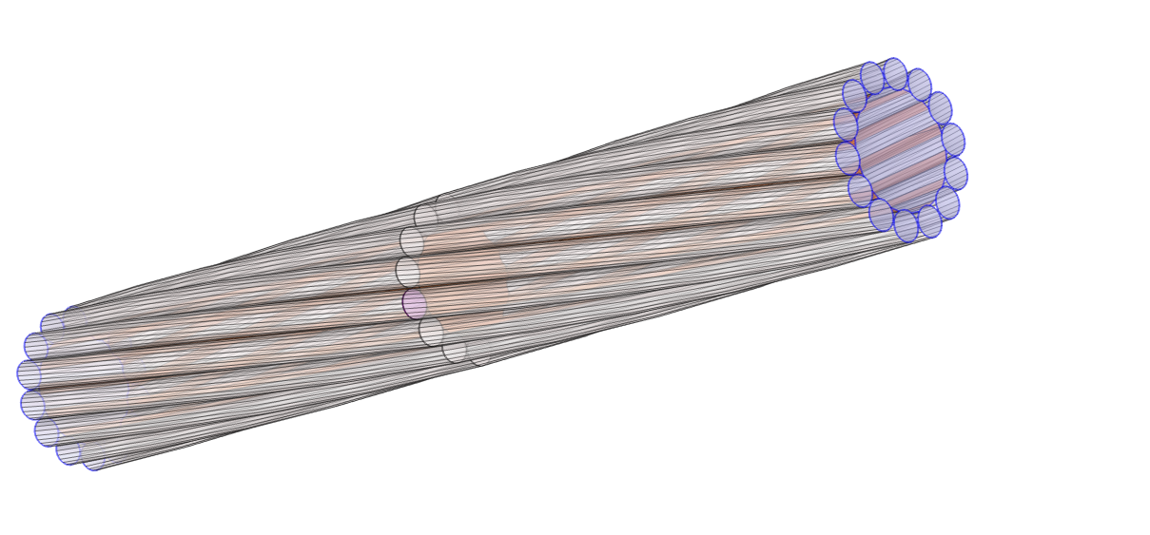
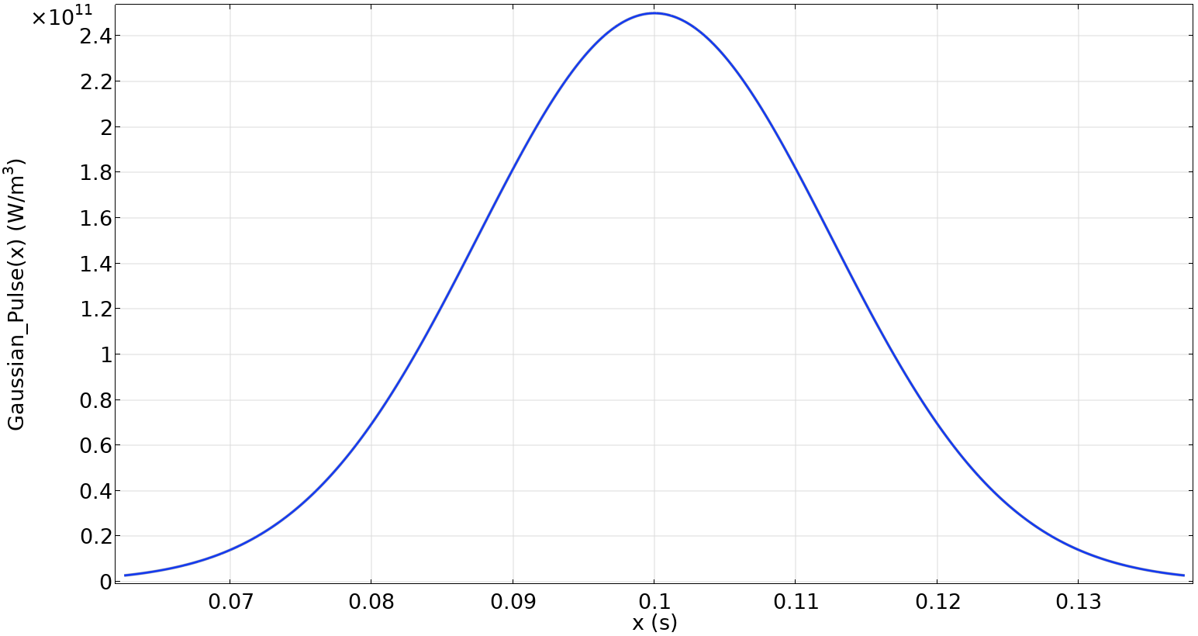



Physical Behaviour
Transition Analysis - Model
20 K
50 mm
Adiabatic cooling
hot-spot
$$I≈4.4×{10}^{3}A$$
$$V_{hs}≈7×{10}^{−2} mm^{3}$$
20 K
Q₀
$$2.5×{10}^{−2} s$$

Slide 19
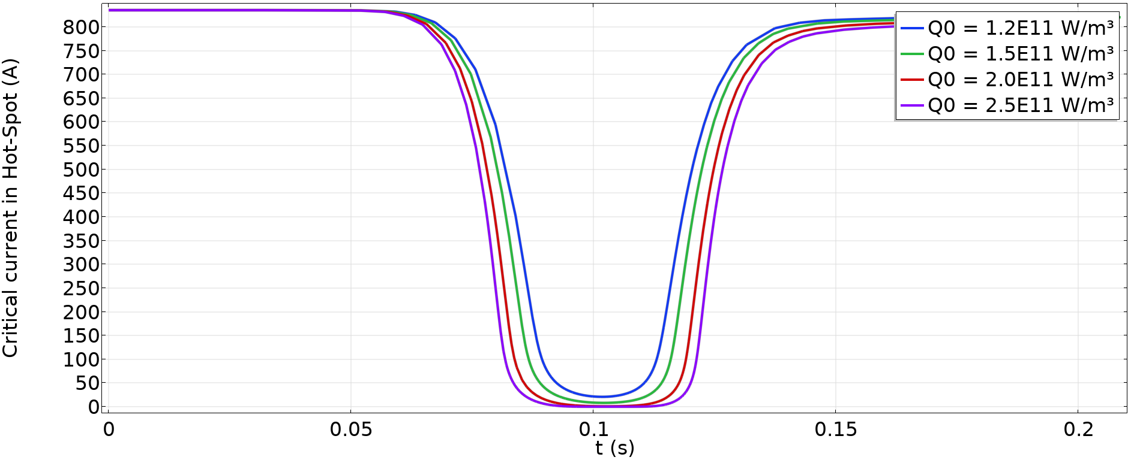

Physical Behaviour
Transition Analysis - Results
Parametric evaluation of Q₀
$$I_{c}=0$$

Slide 20
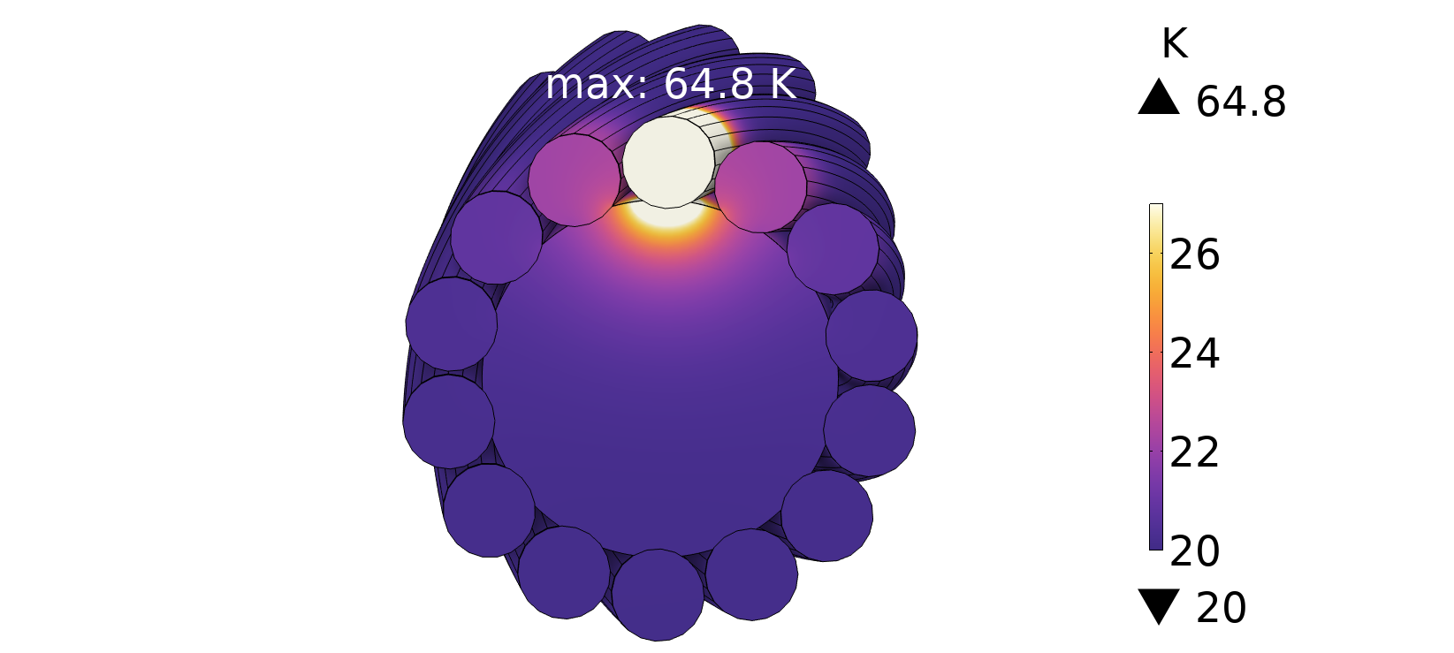
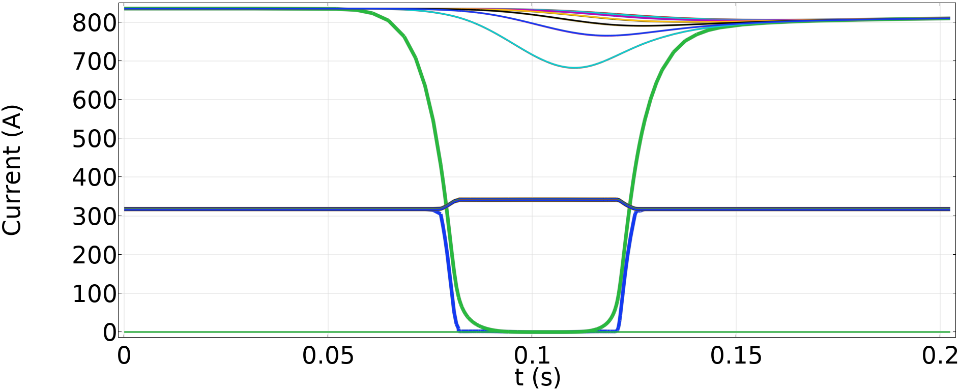
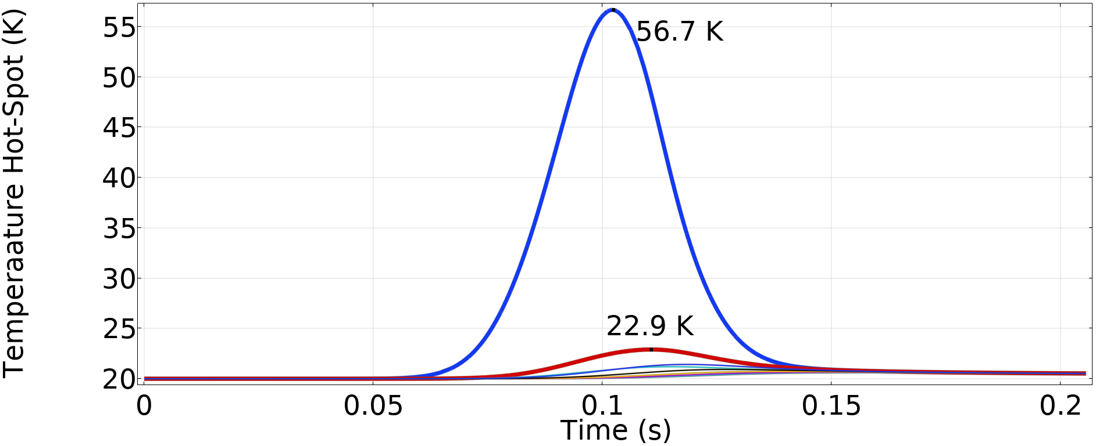




Physical Behaviour
Transition Analysis - Results
Critical Current
$$835 A$$
$$Q_{0}=2.5×{10}^{11} \frac{W}{m^{3}}$$
Hot-Spot
Transport Current
$$317.46 A$$
$$342 A$$
Temperature
Hot-Spot
The cable recover after the transition
No thermal runaway
Adjacent strands

Slide 21
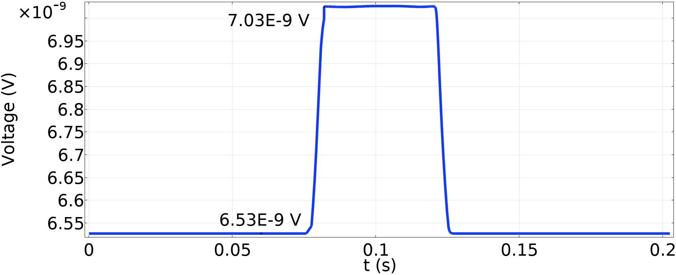

Physical Behaviour
Transition Analysis - Results
Voltage Variation
$$Q_{0}=2.5×{10}^{11} \frac{W}{m^{3}}$$
Voltage
Value too low for common voltage taps
Protection system should rely mainly on temperature sensors (i.e. fibreglass)
$$δV≈0.5 nV$$

Slide 22
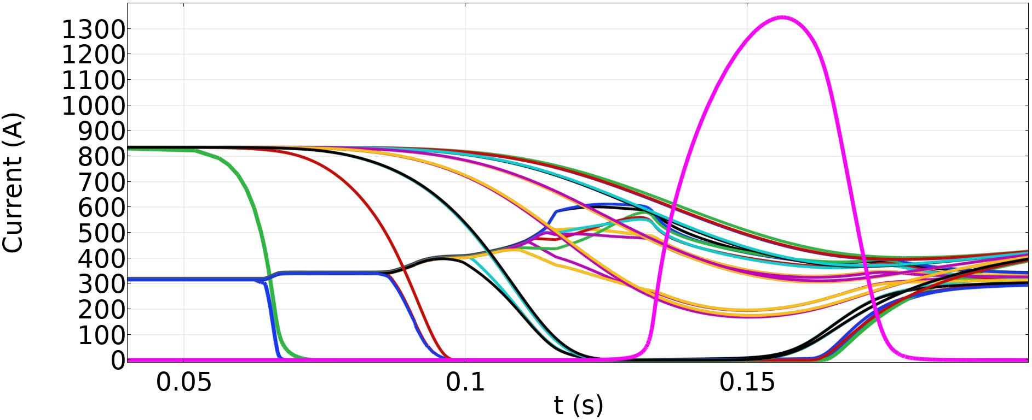
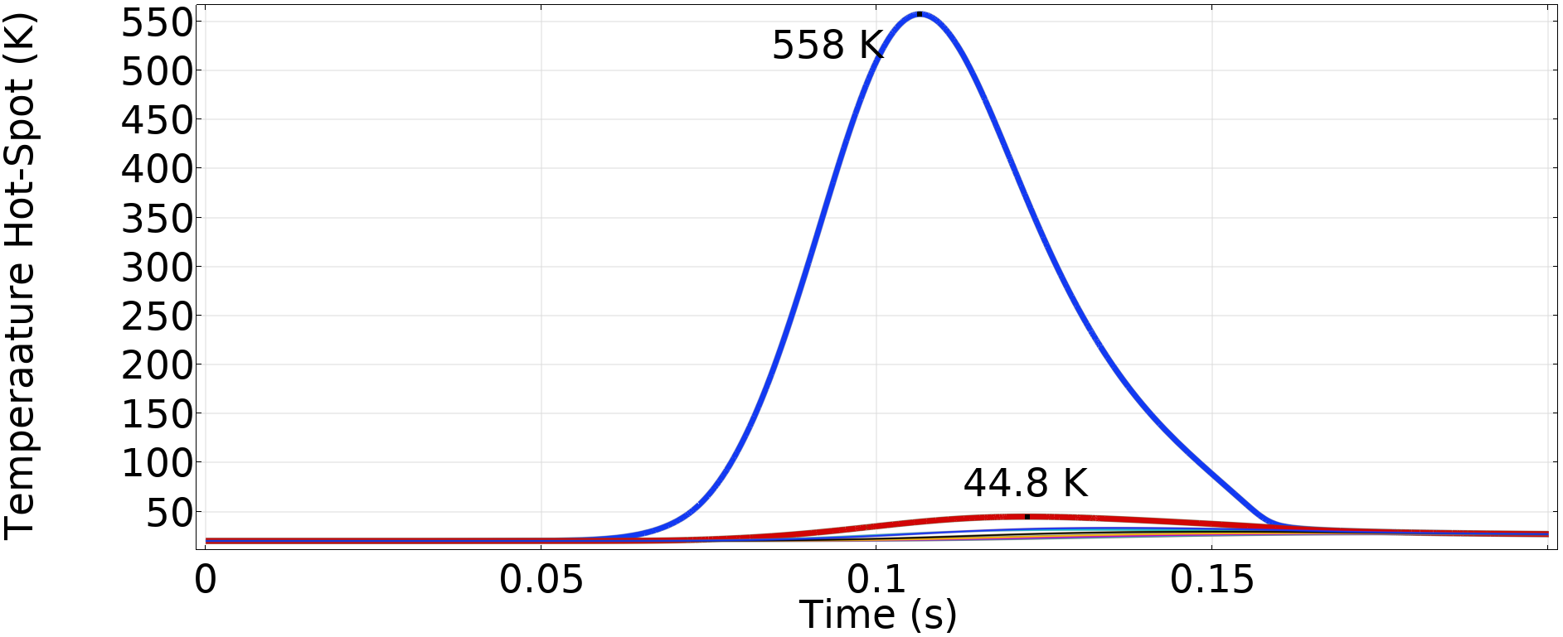
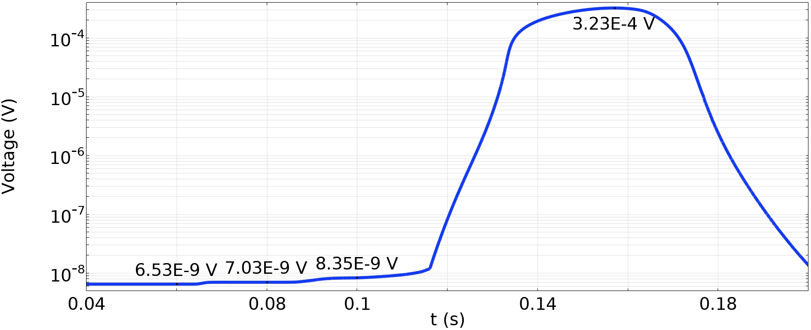

Physical Behaviour
Transition Analysis - Results
Current Variation
Copper Core
$$Q_{0}=3×{10}^{12} \frac{W}{m^{3}}$$
The cable recover after the transition
No thermal runaway
Temperature
Hot-Spot
Voltage Variation

Slide 23
Power Consumption and Use Cases

Slide 24
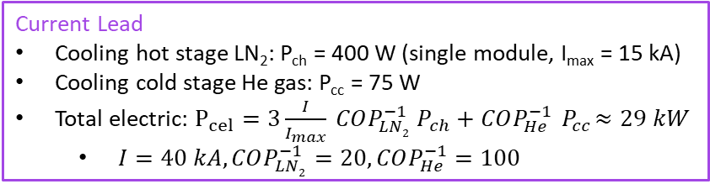
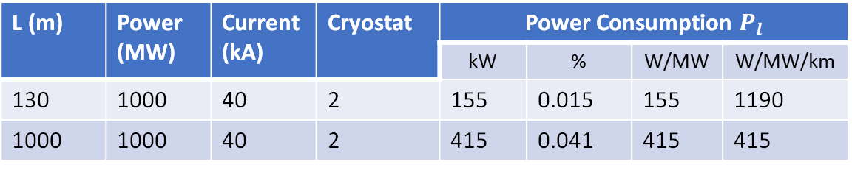

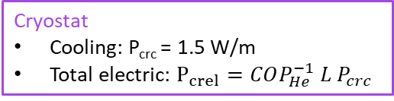
Power Consumption and Use Cases
GSL Electric Consumption
Current Lead
Cooling hot stage LN₂: P_{ch} = 400 W (single module, I_{max} = 15 kA)
Cooling cold stage He gas: P_{cc} = 75 W
Total electric: $P_{cel}=3\frac{I}{I_{max}} COP_{LN2}^{−1} P_{ch}+COP_{He}^{−1}{ P}_{cc}≈29 kW$
  $I=40 kA,COP_{LN2}^{−1}=20,COP_{He}^{−1}=100$
L
Line
$P_{l}=n_{cr} P_{crel}+n_{cl} P_{cel}$
L (m) | Power (MW) | Current (kA) | Cryostat | Power Consumption $P_{l}$
 |  |  |  | kW | % | W/MW | W/MW/km
130 | 1000 | 40 | 2 | 155 | 0.015 | 155 | 1190
1000 | 1000 | 40 | 2 | 415 | 0.041 | 415 | 415
Cryostat
Cooling: P_{crc} = 1.5 W/m
Total electric: $P_{crel}=COP_{He}^{−1} L P_{crc}$
For longer lines the power consumption due to the cryostat becomes the relevant component

Slide 25
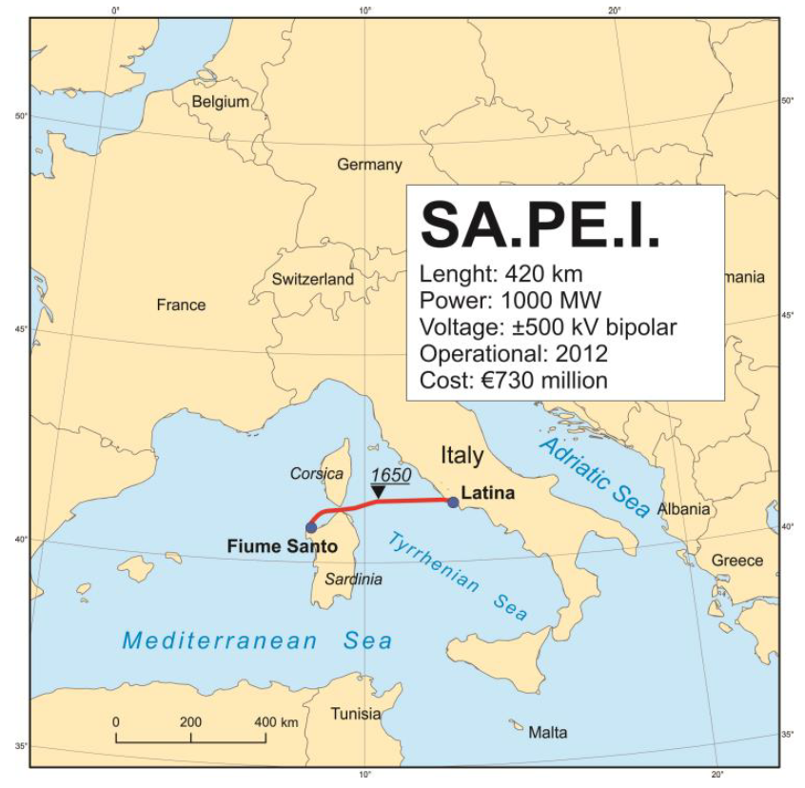

Power Consumption and Use Cases
HVDC Comparative Analysis
SuedLink
Length: 540 km
Power: 2000 MW
Voltage: ±525 kV
Case | Power (MW) | Voltage (kV) | Power Consumption
 |  |  | kW | % | W/MW
SA.PE.I. | 1000 | 1000 | 47.3 | 0.005 | 47.3
SuedLink | 2000 | 1050 | 51.8 | 0.002 | 25.9
GSL IRIS | 1000 | 25 | 415 | 0.04 | 415
GSL (1x0.5 W/m) | 1000 | 25 | 165 | 0.016 | 165
Can be lowered with a more efficient cryostat to obtain W/MW in the same range of the showed HVDC

Slide 26


Power Consumption and Use Cases
Modular Composition
Full configuration
L (m) | Power (MW) | Current (kA) | Cryostat | Power Consumption
 |  |  |  | kW | % | W/MW
1000 | 1000 | 40 | 2 | 415 | 0.041 | 415
1000 | 200 | 8 | 1 | 197 | 0.098 | 985
1000 | 2 | 0.08 | 1 | 180 | 9 | 90k
SURE
LNF Data Centre
$$200 MW$$
$$2 MW$$
Since the consumption depends on the cryostat losses, Higher Power means lower consumption
More suitable for high power application

Slide 27





Power Consumption and Use Cases
FCC Grid Connection Example
The cooling can be integrated in the existing cooling plants
Connection (2 petals, 25 kV, 0.5 W/m) | L (km) | Power (MW) | Cooling Systems (every 1.5 km) | Power Consumption
 |  |  |  | kW | % | W/MW
CORNIER–GENISSIAT – PH | 1.6 | 220 | 1 | 88 | 0.04 | 400
BOIS-TOLLOT–GENISSIAT – PL | 1.5 | 200 | 1 | 308 | 0.04 | 415
CORNIER – PD (redundancy) | 11 | 220 | 7 | 558 | 0.25 | 2540
CERN internal (i.e. magnets) | 30 | 200 | 20 | 1510 | 0.75 | 7540

Slide 28



Power Consumption and Use Cases
HVDC Comparative Analysis
HVDC: lower consumption
IRIS GSL:
  lower voltage (less complex and less vulnerable)
  higher power density (retrofit, urban areas, accelerator facilities and data centres)
Power Station (200 MW) (size estimation)
120 m
Conductor Coss-section Area
22 m
$$30 cm^{2}$$
8 m
$$12 cm^{2}$$
$$8.2 cm^{2}$$
60 m
50 m
50 m
SA.PE.I.
IRIS GSL
SuedLink
±525 kV
±12.5 kV

Slide 29

Power Consumption and Use Cases
Double Energy Vector

Slide 30
Conclusion

Slide 31
Conclusion
Pros
Robust to electrical failure. Potential failures are more likely to originate in the cooling system; such faults are typically slower and are consequently easier to detect and assess (fibreglass detection).
Capable of carrying much larger currents than conventional conductors (e.g. 40 kA vs. ∼ 1 kA). Useful to powering accelerator magnets and data centres.
Operates at substantially lower voltages (e.g. 25 kV vs. ∼ 1000 kV), reducing the size and complexity of voltage-conversion equipment.
Offers higher power density, requiring less land take (urban areas, accelerator and data centres) and can be installed within existing HVDC trenches to upgrade transmission capacity (retrofit) without major enlargement of civil works.
May serve a dual function if cooled with liquid hydrogen: electrical trans-mission combined with integrated energy storage and free cooling, enabling novel system architectures in an eventually hydrogen dominated society.
Cons
Because the losses depend primarily on the cryostat, the technology maybe uneconomical for medium–low transmitted powers.
For distances greater than 1.5 km, multiple cooling stations are required in the most favourable (best-case) scenario. An alternative is the use of higher-pressure cooling systems.
It is not always advantageous: in some cases, the electrical power required for refrigeration exceeds the Joule losses saved. However, this can be reduced with optimised—albeit typically more expensive—cooling plants.

Slide 32
Conclusion
The IRIS Green Superconducting Line can represent a valid alternative to conventional HVDC systems for specific applications. Its suitability depends on the overall system context: it is particularly advantageous where very high currents and powers are required, where cryogenic infrastructure is already available, or where spatial and civil-engineering constraints make compact, high-power links desirable. The analyses are conducted under conservative assumptions, with improving margins.

Slide 33


The End

Slide 34
Backup

Slide 35




Critical Current - Data interpolation
One cable
$$∆T=8.34 K$$
Two cables
$$∆T=8.03 K$$

Slide 36




Temperature Margines
Operative current for single strand
$$I_{s}=\frac{40 kA}{9∗14}≈317.46 A$$
$$ΔT_{0.58T}≈8.29 K$$
From FIT
$$ΔT_{0.71T}≈7.41 K$$

Slide 37


Slide 38



Cooling Systems

Slide 39





Cable Geometry Mathematical Model - CGMM
$\vec{c}\left(t\right)$ is an arc of circumference with length $L_{c}=0.5 m$ and curvature radius $R=2.2 m$, to simulate the minimum required bending of the cable, and $t∈\left[0,\frac{L}{R}\right]$
$\vec{h}(t)$is an helix looping around $\vec{c}\left(t\right)$, with radius given by the sum of the radius of the cable core plus the radius of the petal core plus the diameter of the strand
$\vec{h_{1}}(t)$is an helix looping around $\vec{h}\left(t\right)$, with radius given by the sum of the radius of the petal core plus the radius of the strand
the length $L_{c}$was chosen to have at least two complete loops of the strand around the petal core
$$\vec{c}(t)$$
$$\vec{h}(t)$$
$$\vec{h_{1}}(t)$$

Slide 40


Cable Geometry Mathematical Model - CGMM
Every petal has a phase $\frac{2πn}{N_{p}}$, where $N_{p}$ is the number of petals and $n∈[0,N_{p}−1]$
Every strand has a phase $\frac{2πn}{N_{s}}$, where $N_{s}$ is the number of strands and $n∈[0,N_{s}−1]$
This is a critical point when it comes to fully automating the model, because even though it's possible to parameterise the number of petals, I haven’t yet found a way to avoid doing all the sweeps manually

Slide 41


Cable Geometry Mathematical Model - CGMM
A twisted cable can be parametrised as a helix that goes around a core
The core itself can be described as a curve, e.g. a helix
The generic form of a helix around a curve $\vec{c}\left(t\right)$ is:
$$\vec{h}\left(t,θ\right)=\vec{c}\left(t\right)+A\cos\left(θ\right)\hat{n}\left(t\right)+A sin⁡(θ)\hat{b}(t)$$
Where:
$A$ is the radius of the helix
$\hat{n}\left(t\right)$ is the normal unit vector and $\vec{b}\left(t\right)$ is the binormal unit vector of $\vec{c}\left(t\right)$
$\hat{n}\left(t\right)$ and $\hat{b}\left(t\right)$ describe the plane orthogonal to $\vec{c}\left(t\right)$
Setting $θ=k t$ we have that $\vec{h}\left(t,θ\right)$ loops $k$-times around $\vec{c}\left(t\right)$

Slide 42


Cable Geometry Mathematical Model - CGMM
In cartesian coordinates useful for design in Comsol/Inventor
$$\vec{h}\left(t\right)=\left\{\begin{aligned}h_{x}\left(t\right)=c_{x}\left(t\right)+A\cos\left(kt\right)n_{x}\left(t\right)+A\sin\left(kt\right)b_{x}(t) \\ h_{y}\left(t\right)=c_{y}\left(t\right)+A\cos\left(kt\right)n_{y}\left(t\right)+A\sin\left(kt\right)b_{y}(t) \\ h_{z}\left(t\right)=c_{z}\left(t\right)+A\cos\left(kt\right)n_{z}\left(t\right)+A\sin\left(kt\right)b_{z}(t)\end{aligned}\right.$$
Iterating the process, one can write a helix that goes around $\vec{h}\left(t\right)$ as:
$$\vec{h_{1}}\left(t\right)=\vec{h}\left(t\right)+a\cos\left(k_{1}t\right)\hat{n_{h}}\left(t\right)+a sin⁡(k_{1}t)\hat{b_{h}}(t)$$
Where:
The subscript $h$ is referred to $\vec{h}\left(t\right)$
$k_{1}$ is the looping times around $\vec{h}\left(t\right)$ and A is the radius of ${\vec{h}}_{1}\left(t\right)$

Slide 43

Cable Geometry Mathematical Model - CGMM
$k$ and $k_{1}$ are the number of times that the respective helix loops around its core for one loop of the core itself, regardless of its length. To relate them to the twist pitches $tp$, they should be normalised with respect to the effective core length $L_{c}$.
In general, $tp=\frac{L_{c}}{n}$, where $n$ is the number of loops.
When the effective length of the core is different from the length of one loop $L_{l}$, one should use $k=\frac{n}{x_{L}}$, where $x_{L}=\frac{L_{c}}{L_{l}}$.
The length of the parametrised helix $\vec{h}(t)$is given by $L_{h}=\int_{0}^{T}{\left\|\vec{h′}(t)\right\|dt}$, with $T=2π$ for one loop, or any suitable value when considering not a loop.

