Slide 1


Saba Imtiaz
Saba.imtiaz@inaf.it
Astrophysics and Astronomy PHD –39th Cycle
PhD retreat at the INFN Laboratori Nazionali del Sud
16-19 February 2026

Slide 2


Slide 3
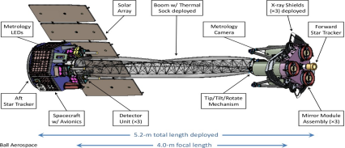
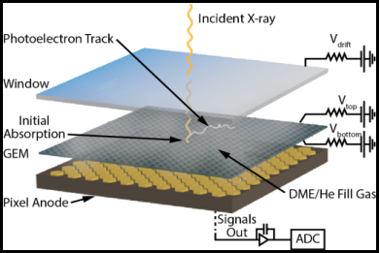
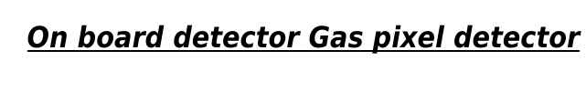
Introduction to IXPE
IXPE provides unique comprehension about polarized x rays emissions from many
Astrophysical sources such as galactic black holes binaries radio quiet and radio loud AGNS and neutron stars. Polarization maps in X rays of pulsar wind Nebulae and supernova remnants have been probed.
Figure A: Overview of space observatory:
Figure: A
Figure B
Figure B: Gas Pixel Detector

Slide 4
Limitations of Gas pixel Detector of IXPE
it has a relatively narrow energy band coupled with rapidly declining efficiency.
2. IXPE GPDs is the large dead time (1.1ms), which is incompatible with the brightest sources.
3. Due to the deposition of ions onto the dielectric of Gas Electron Multiplier (GEM) leads towards the decrease in the gas gain.
4. The ASIC of Gass pixel detector offers 2D photoelectron track.
5. Also its shows low energy resolution and less effective area.

Slide 5
GridPix Detector as an Advanced Alternative to IXPE GPD: Experimental Characterization and Validation with GEANT4 Simulations.

Slide 6
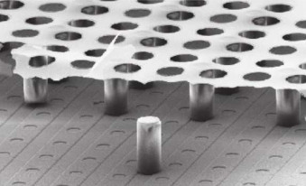
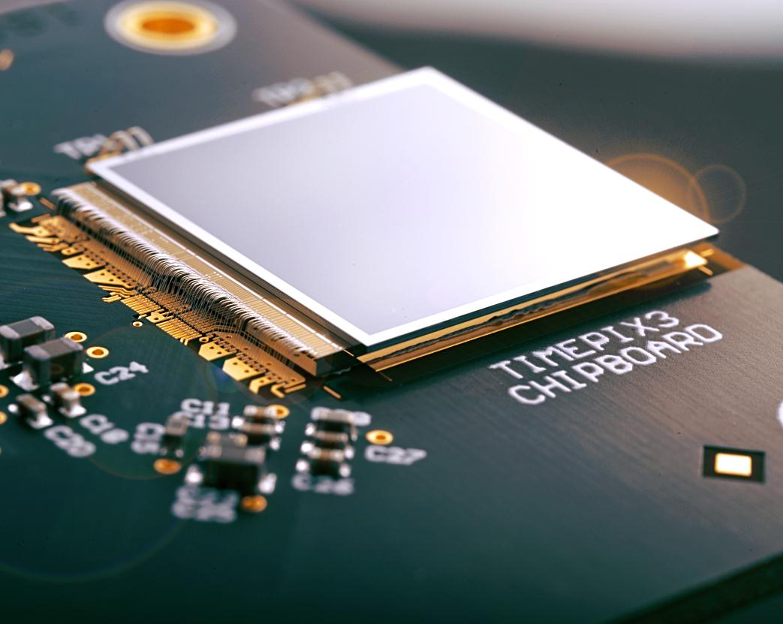
Gridpix Detector with Timepix3 ASIC:
X ray polarimetry is most powerful and exciting tool in astrophysics. To determine the polarization of x ray beam by tracking the photoelectrons is achieved with Gridpix detector.
Gridpix detector is combination of :
(I) highly granular Timepix3 ASIC
(II) InGrid (which holes are aligned with pixel of ASIC).
Production of micromegas Structure:

Slide 7
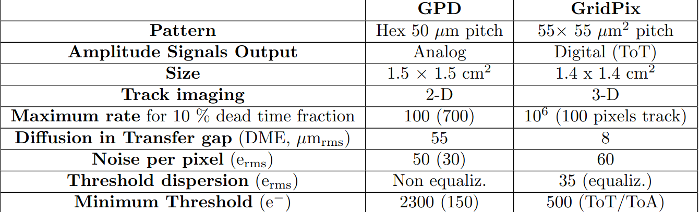
Why Gridpix?
Unlike Gass pixel detector in Imaging X ray Polarimetry Explorer(IXPE),
Gridpix detector provides :
Gridpix structure in principle prevents the buildup of charge
on the metallic mesh, offering a small diffusion with respect to GEM.
2. Timepix ASIC enables measurement
of TOA and TOT.
3. 3-D reconstruction of photoelectron
track.
4. its improves the sensitivity and leading to high modulation factor
Table of Comparison of Performances between IXPE/GPD and Gridpix with Timepix3
5. Also timepix3 has zero dead time.

Slide 8
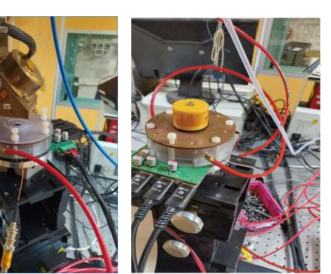
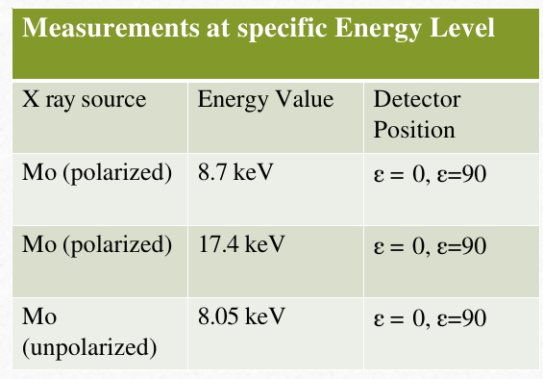
Energy Calibration and Performance Evaluation of the GridPix Detector Using X-ray Sources
A proto-type of the GridPix detectors was tested at the X-ray polarization calibration facility at IAPS using gas mixtures with Ar-DME(80%-20%) at various energy ranges.
Prototype of GridPix detector at the Calibration facility at IAPS. Polarized X-ray source (X- ray tube and crystal scatterer) can be seen on the top to measure the response to fully polarized X-rays.

Slide 9
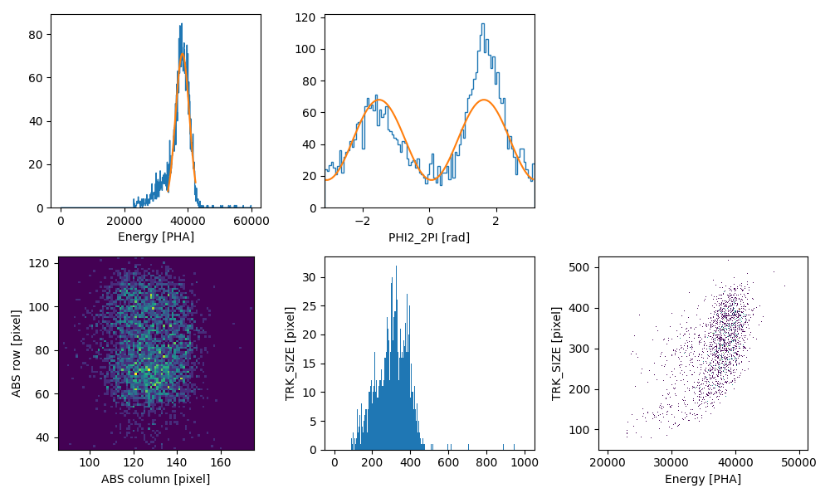
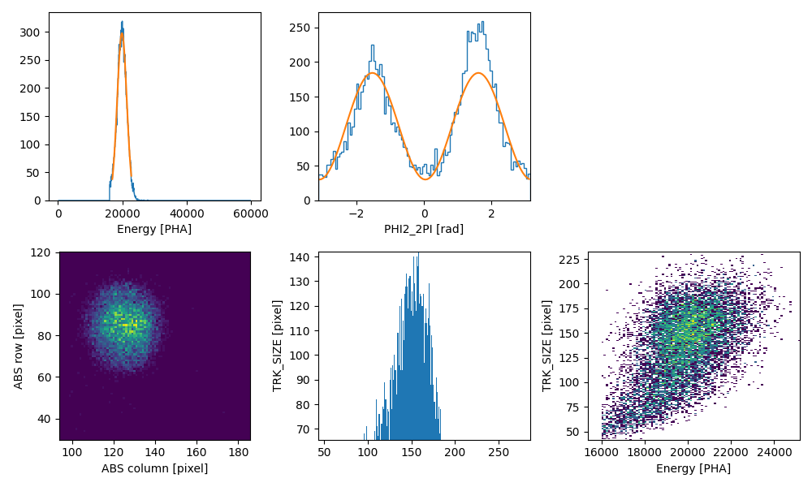
Analysis of Raw Experimental Data from the GridPix Detector
For 8.7 KeV
Top Left: Energy Spectrum
Top Right: Histogram of reconstructed photoelectron emission angles (PHI).
Bottom Left: 2D spatial distribution of X ray interaction points on the detector.
Bottom Center: Distribution of reconstructed photoelectrons track size.
Bottom Right: Relationship between track size and deposited energy.
For 17.4 KeV

Slide 10
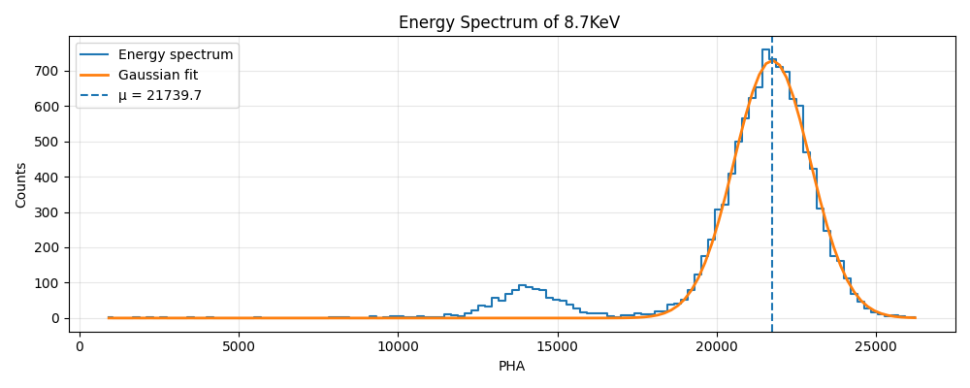
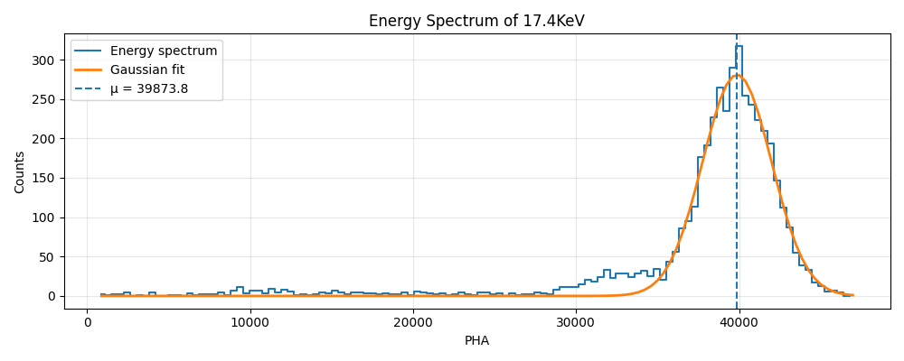
Analysis with GEANT4 Simulations:
Energy Spectrum of 8.7 keV and 17.4 KeV

Slide 11
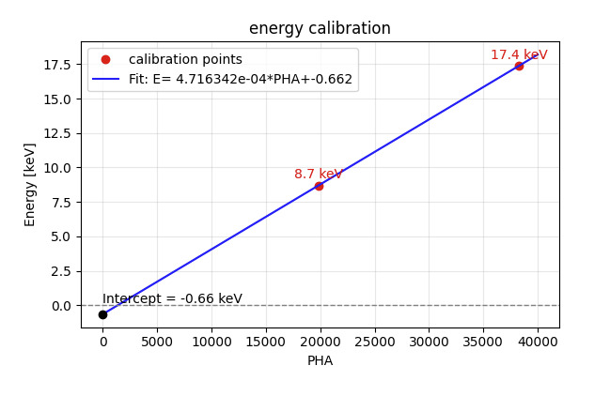
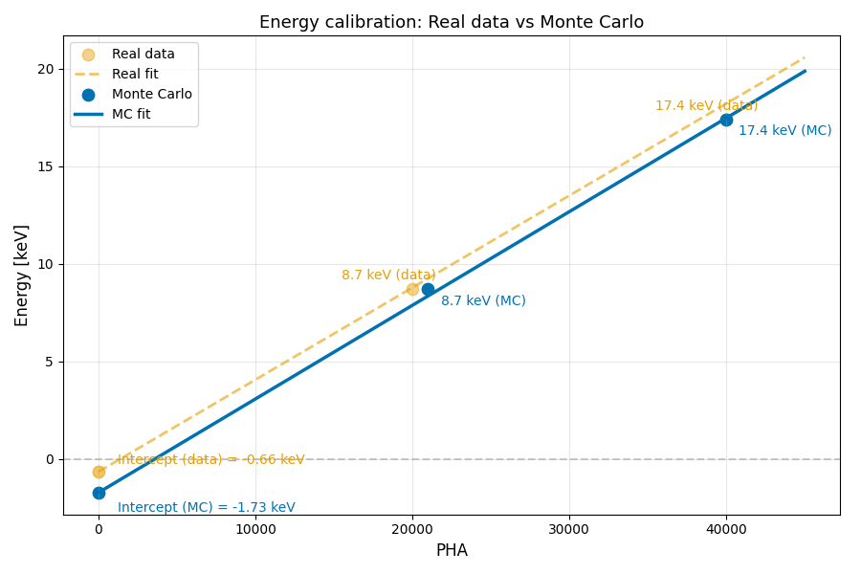
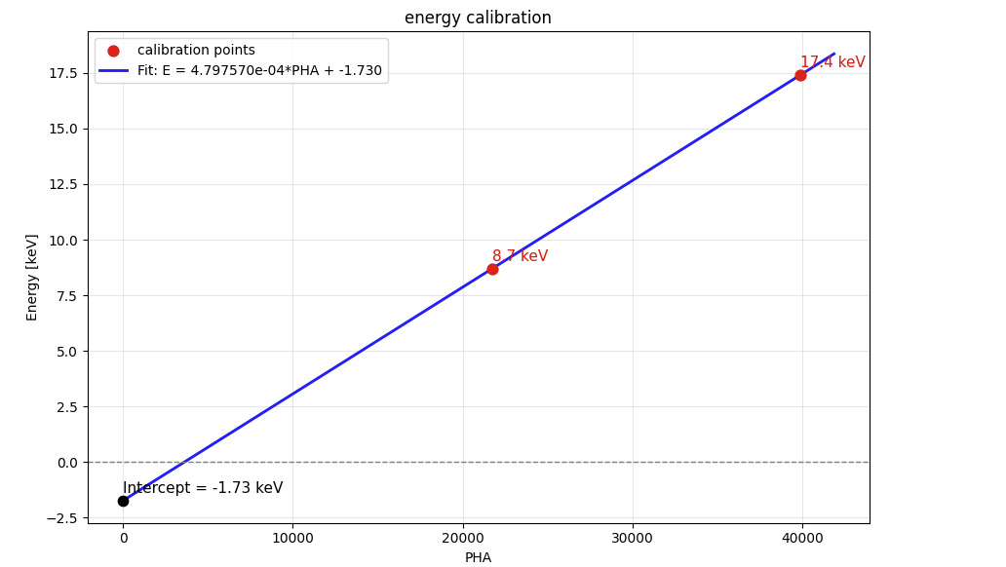
Energy Calibration and Validation Using Experimental Data and Monte Carlo
Real_Data
MC Simulations
Monte Carlo results closely match the experimental data, validating the detector model

Slide 12
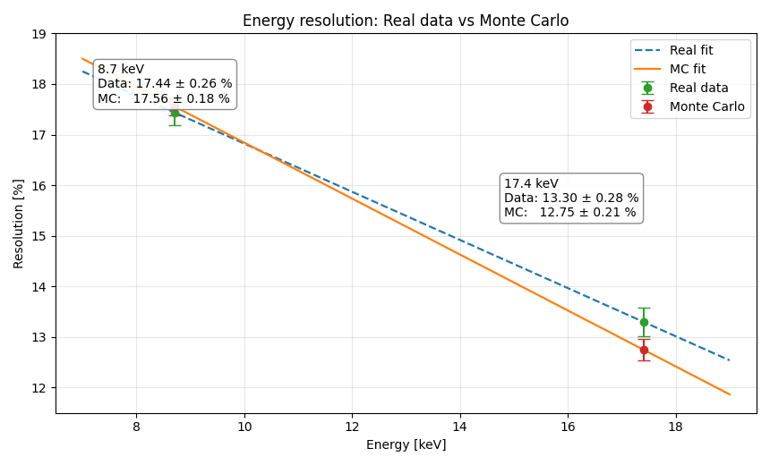
Energy Calibration and Validation Using Experimental Data and Monte Carlo

Slide 13
Conclusion:
GridPix with Timepix3 overcomes key limitations of IXPE GPD.
Experimental characterization confirms stable spectral and polarimetric performance.
Energy calibration demonstrates excellent linear response.
Strong agreement between Monte Carlo and experimental data validates the detector model.
GridPix is a promising candidate for future high-precision X-ray polarimetry.

