Slide 1
Università degli Studi di Padova
Computing curriculum
PHD PROJECT OVERVIEW
SPACE SITUATIONAL AWARENESS AND CHARACTERISATION OF RESIDENT SPACE OBJECTS USING OPTICAL TECHNIQUES
Submitted by
Miriana Lucchini

Slide 2

INTRODUCTION
The growing congestion of the orbital environment makes it necessary to develop advanced Space Situational Awareness tools capable not only of monitoring, but also of characterising and predicting the behaviour of space objects, integrating optical observations, physical models and artificial intelligence techniques.
01
PhD Project Overview

Slide 3

OBJECTIVES
Realistic simulations
Satellite orbit & attitude and optical response of different materials
Data comparison
Simulated vs real for model validation
AI algorithms
For reconstruction, classification and anomaly detection of resident space objects
Operational SSA
Real data integration and unified platform to support scientific and operational SSA
02
PhD Project Overview

Slide 4
METHODOLOGY OVERVIEW - 1
Dynamic Module
Radiometric Module
Synthetic Data Generation
Orbital propagation and attitude
Optical chain simulation, atmosphere, PSF, MTF, noise
Light curves, images, multi-object scenarios
03
PhD Project Overview

Slide 5
METHODOLOGY OVERVIEW - 2
AI algorithms
Validation with OGS
Integrated SSA Platform
Parameter reconstruction, classification, anomaly detection
Photometry, polarimetry
Scientific and operational support
04
PhD Project Overview

Slide 6
FIRST-YEAR ACTIVITIES
FROM SATELLITE OBSERVATION TO OPTICAL RESPONSE
Classification of known satellites observed by the team
Study of the platform’s main materials, orbit and attitude dynamics
Laboratory measurements on materials
Polarimetric response of typical satellite materials (solar cells, MLI, etc.) at different illumination and observation angles
Optical and polarimetric model of satellite
Derivation of an optical-polarimetric model of the satellite from laboratory measurements, used to simulate responses observable from the ground.
Comparison with real data
Analysis of optical and polarimetric observations: search for correlations between physical characteristics of the satellite peculiarities in the observed data
05
PhD Project Presentation

Slide 7

Incomplete and confidential data
Detailed information on satellites is not available in the literature or disclosed by manufacturers, making it difficult to correlate optical observations with actual characteristics.
Geometric variability
Relative position of the observer–satellite–Sun is constantly changing; lighting conditions are not repeatable between observations taken at different times, complicating data comparison.
Choice of spectral band
Different satellite surfaces respond differently; identifying the optimal band (blue, infrared, etc.) for reliable observations is complex.
CRITICALITIES
06
PhD Project Presentation

Slide 8

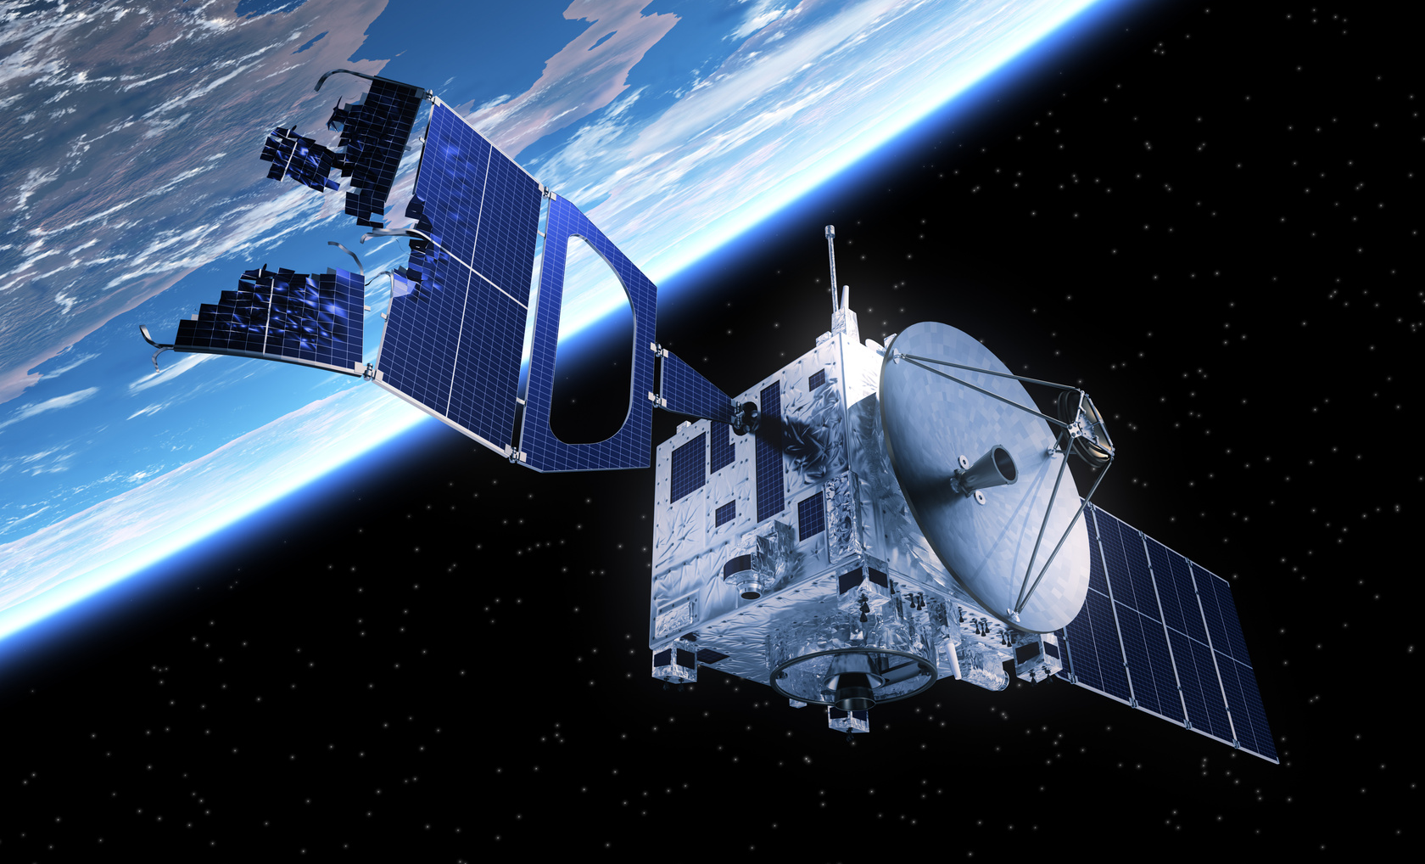
CONCLUSION
In summary, the work proposes an innovative approach to Space Situational Awareness that integrates optical observations, physical modelling and artificial intelligence to interpret and predict the behaviour of space objects in a more comprehensive and reliable manner.
07
PhD Project Presentation

Slide 9
Università degli Studi di Padova
Computing curriculum
THANK YOU

