Slide 1
ST + IT @ CNAO2025
Giacomo Traini, Giorgio Splendiani , Christian Fink, Riccardo Ridolfi,Marco Toppi, Giacomo Ubaldi, Eleuterio Spiriti

Slide 2
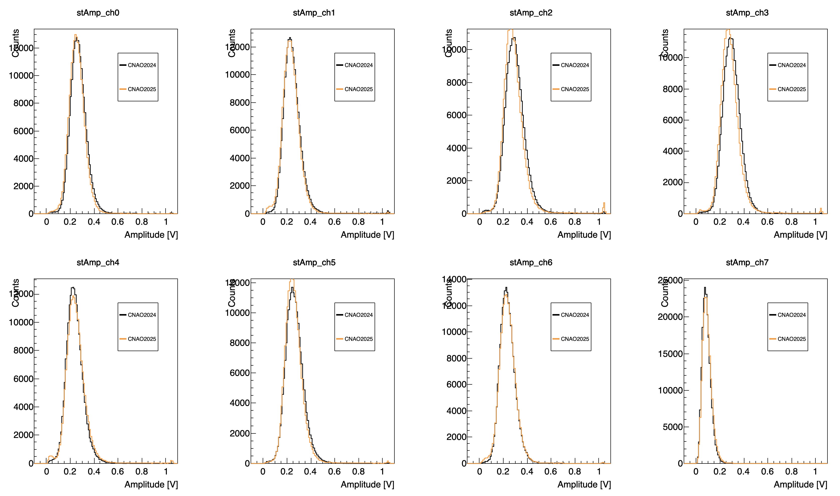
ST amplitude

Slide 3
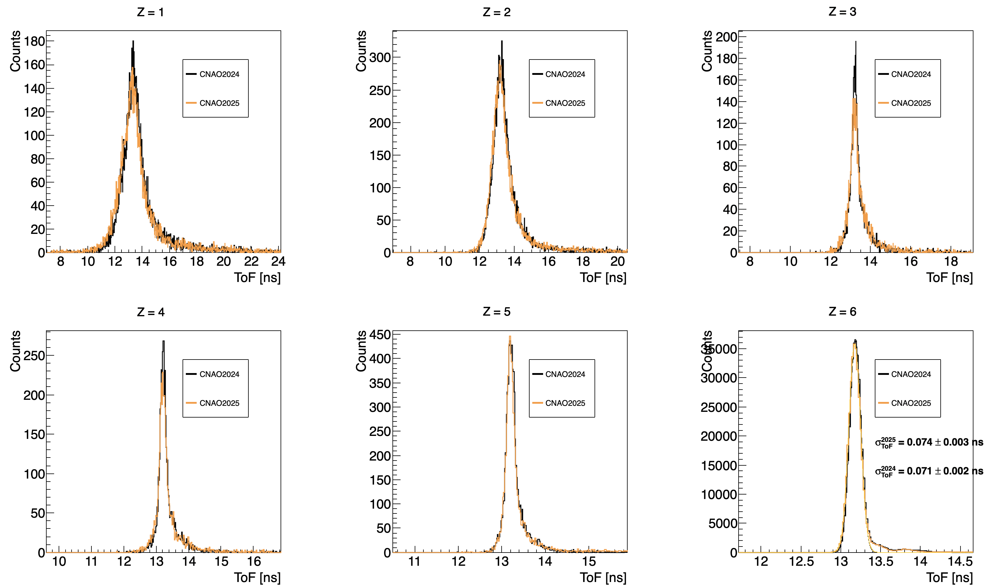
Time of flight resolution
Next future: check for possible noise to cancel with a FFT filter

Slide 4
IT setup summary
Unsuccessful replacement of datalink 111: sensors read-out from that board seems to be broken (to be fully investigated after the data taking @ LNF). The IT has been operated using 27/32 sensors.
The additional De10 board used to set the delay on the trigger line has some trouble in distributing the busy signal (wrong connection? firmware bug? ). The delay has been sent using a different system as done @ LNF
Thresholds: due to lack of time, to ensure a smooth data acquisition during the 1st night the IT has been precautionary operated @ 12σ. The 2nd night thresholds has been optimized with a noise scan
Delay
(NIM)
Trig delayed (NIM)
V1495
(VME)
DAQ
Trig(NIM)
busy
r_clk
clk
IT
Trig delayed (LVDS)

Slide 5
IT setup summary
p 200 MeV, thr=12σ, delay=360 μs
p 150 MeV, thr=12σ, delay=360 μs
p 70 MeV, thr=12σ, delay=360 μs
C 200 MeV/u, thr=12σ, delay=360 μs, no TGT, B on
C 200 MeV/u, thr=12σ, delay=360 μs, no TGT, B on
C 200 MeV/u, thr=12σ, delay=440 μs, no TGT, B on
C 200 MeV/u, thr=12σ, delay=440 μs, no TGT, B off
C 200 MeV/u, thr=12σ, delay=440 μs, TGT, B off
C 200 MeV/u, thr=custom, delay=440 μs, TGT, B off
C 400 MeV/u, thr=custom, delay=440 μs, TGT, B off
C 200 MeV/u, thr=custom, delay=440 μs, TGT, B on
Delay
(NIM)
Trig delayed (NIM)
V1495
(VME)
DAQ
Trig(NIM)
busy
r_clk
clk
IT
Trig delayed (LVDS)

Slide 6
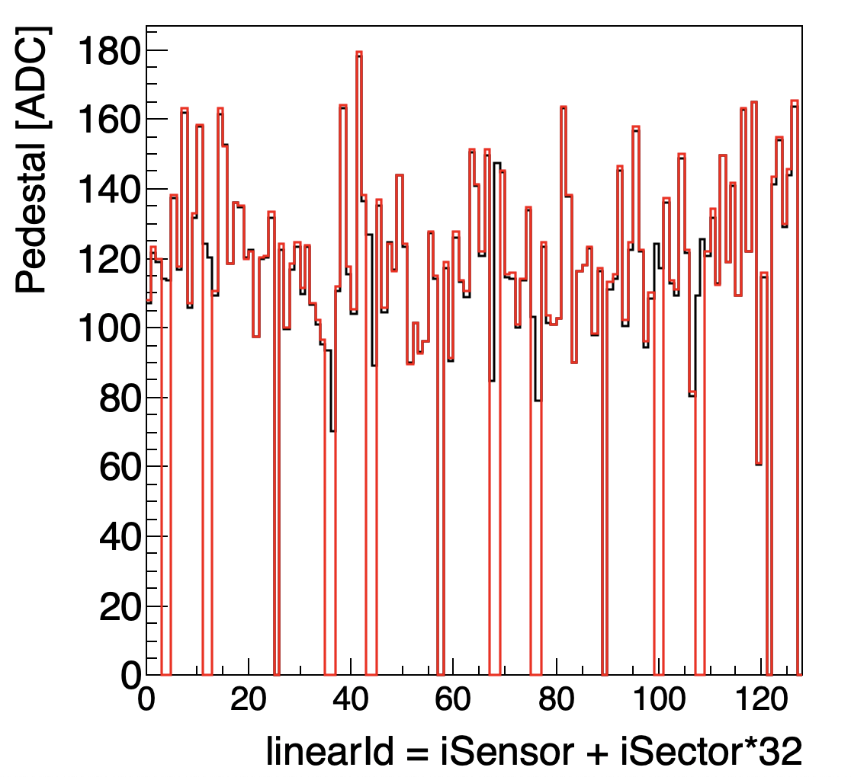
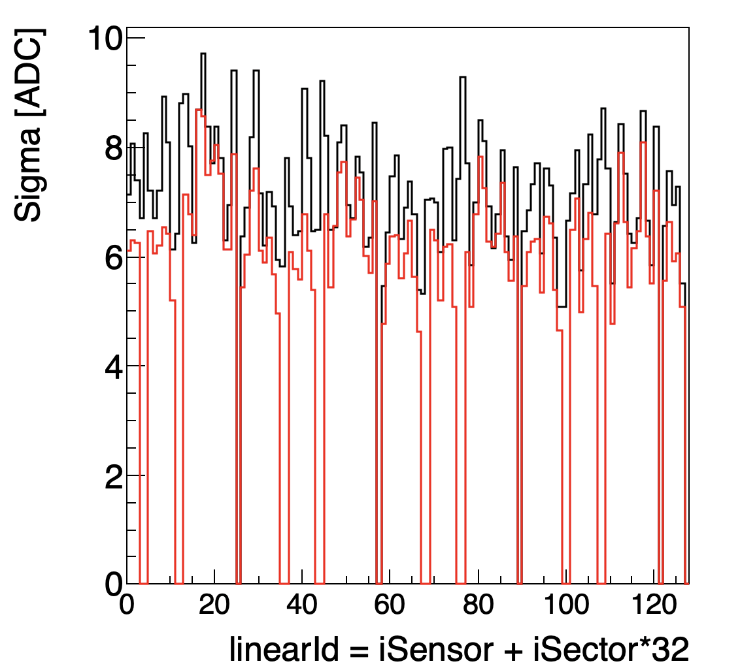
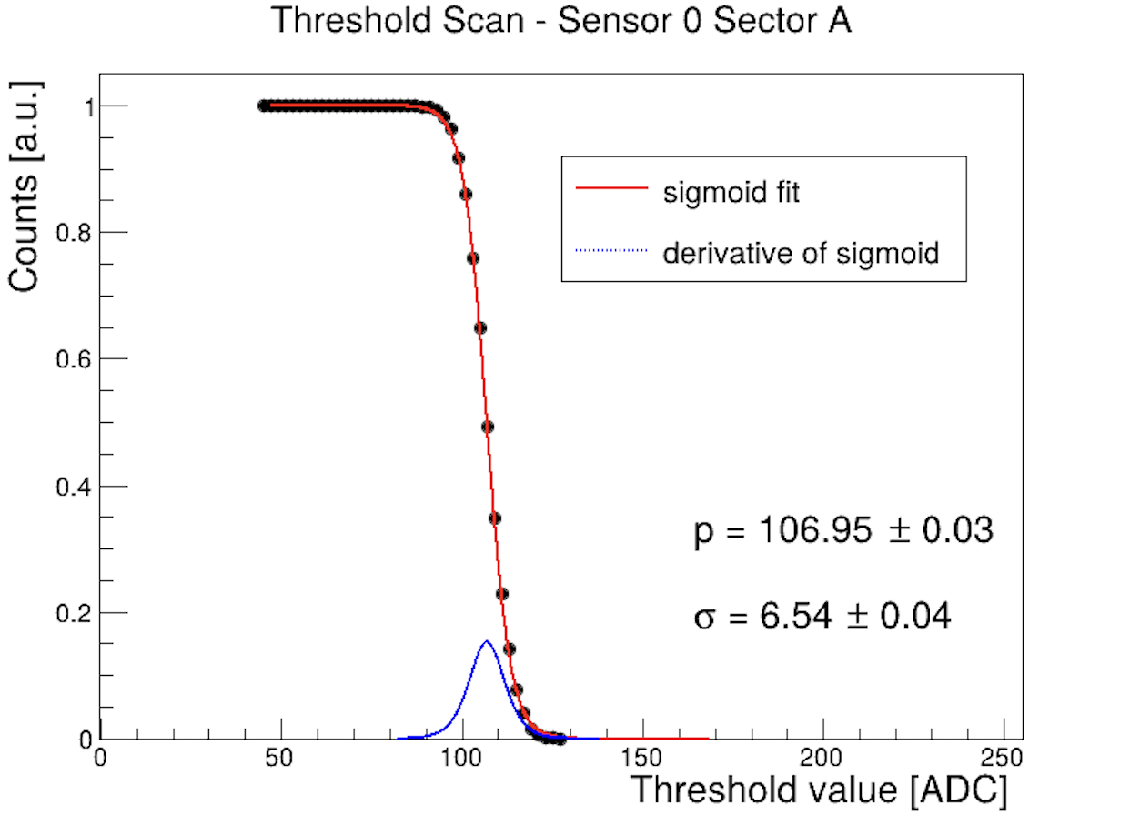
Noise and thresholds (I)
CNAO LNF
Automatic pedestal scan performed @ CNAO between th 1st and 2nd night.
No significant differences wrt LNF in the pedestal mean values, while a slightly smaller sigmas have been observed (different temperature?)
x 128

Slide 7
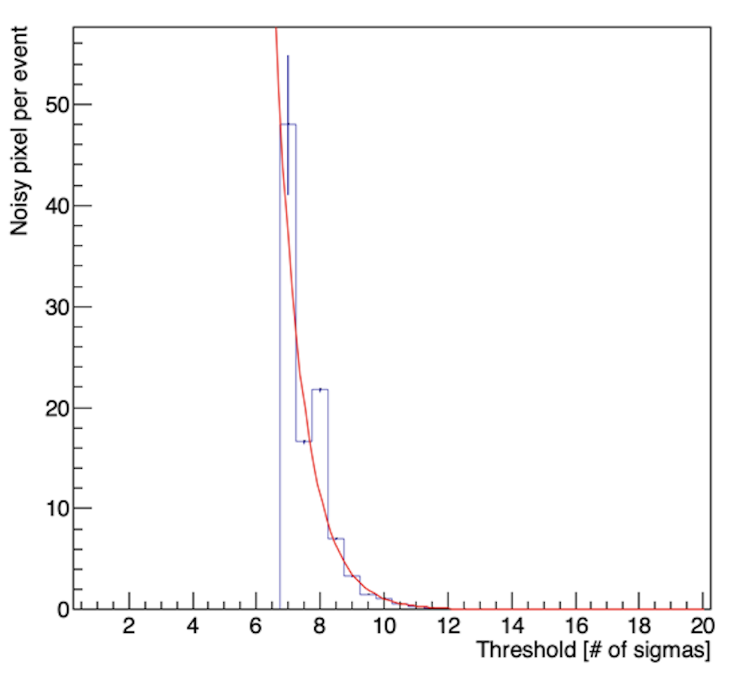
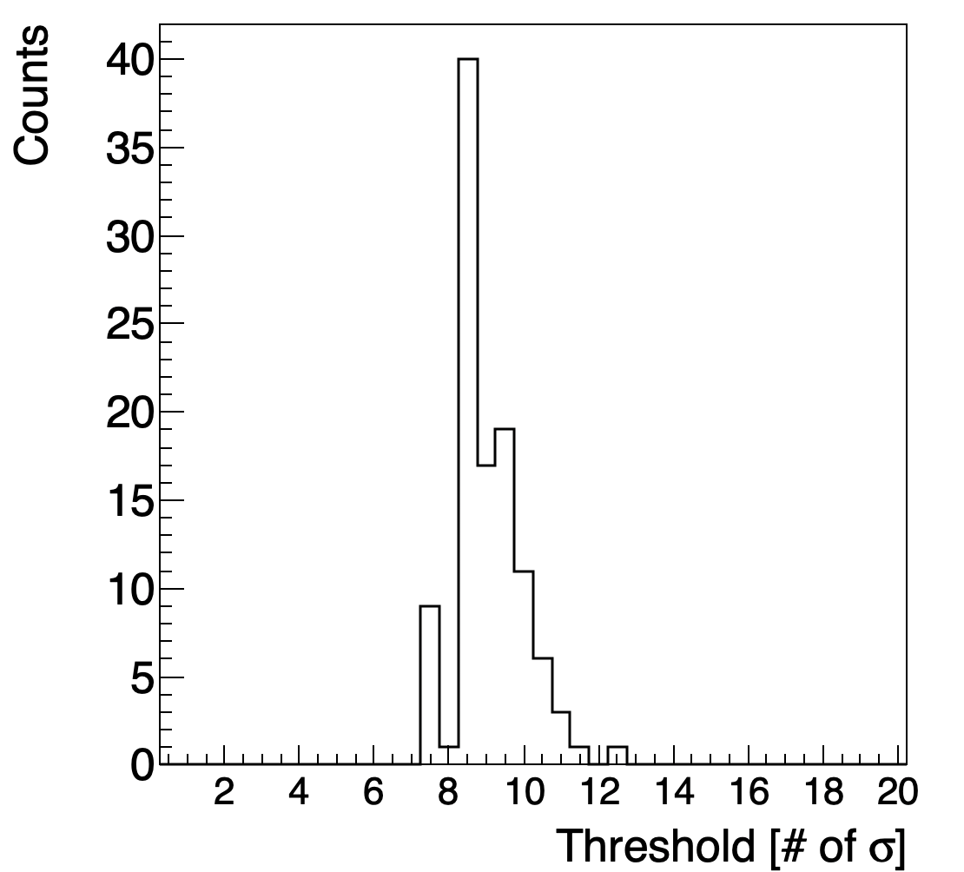
Noise and thresholds (II)
We performed a noise scan with random trigger, stdalone acquisition to set thresholds (2nd night)
We set 128 thresholds (32 sensors x 4 sectors) imposing a noise of 0.5 pixel/sector/event
Distribution of set thresholds @ CNAO
“custom thresholds”
x 128

Slide 8
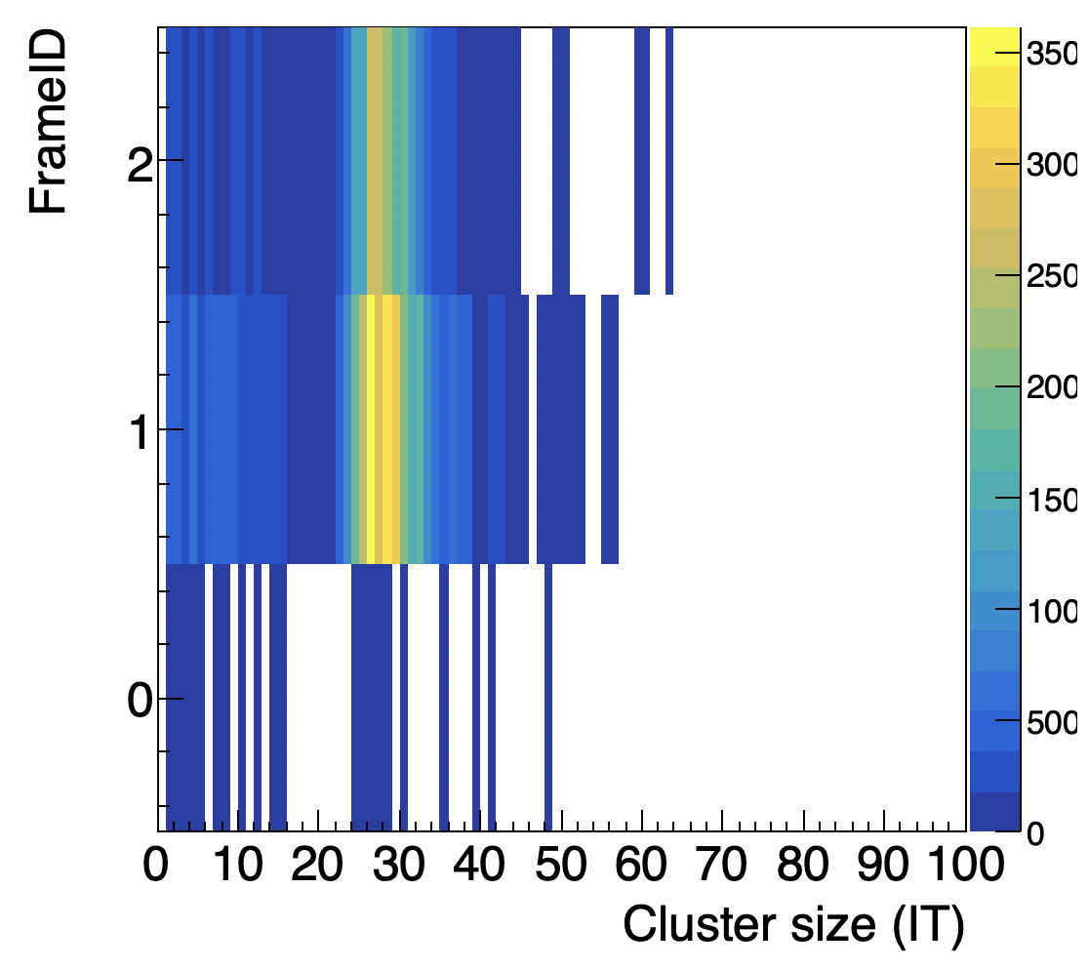
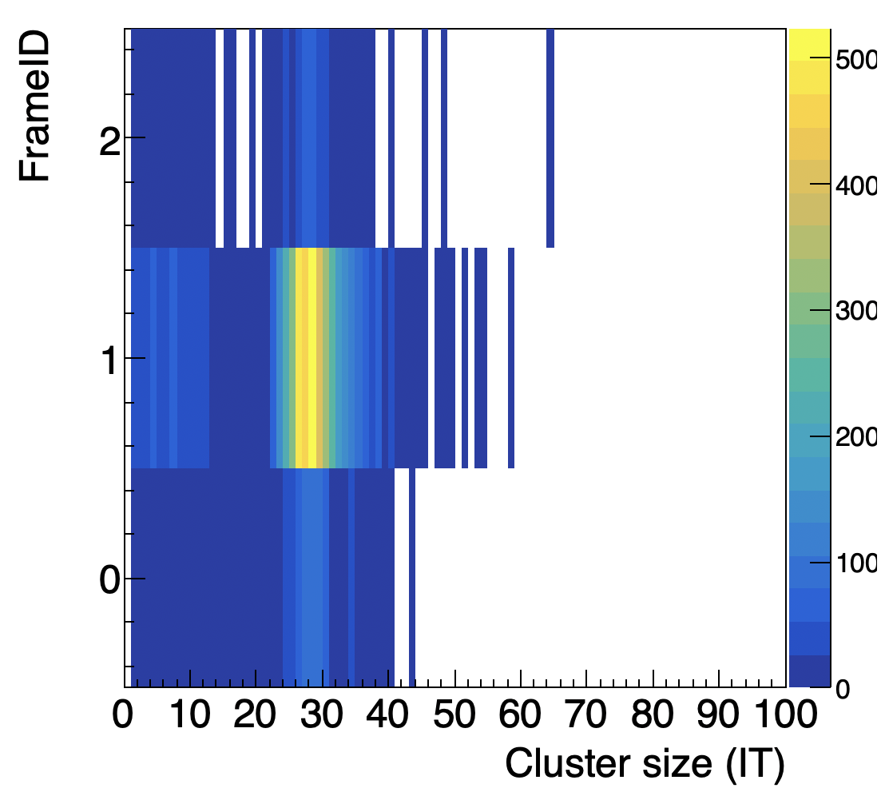
Delay effectiveness: IT frame distribution
run 8010, C @ 200MeV/u, B on, delay=360 μs
run 8016, C @ 200MeV/u, B on, delay=440 μs
Final choice

Slide 9
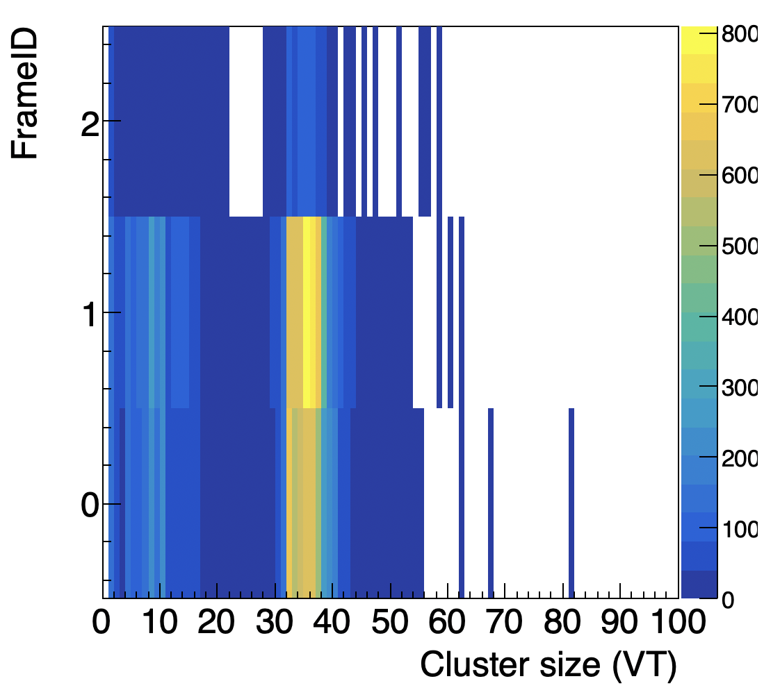
IT vs VT frame distribution
run 8016, C @ 200MeV/u, B on,
VT
run 8016, C @ 200MeV/u, B on, IT, delay=440 μs
Expected difference according to the measurement perfomed @ LNF, but still a not understood behaviour

Slide 10
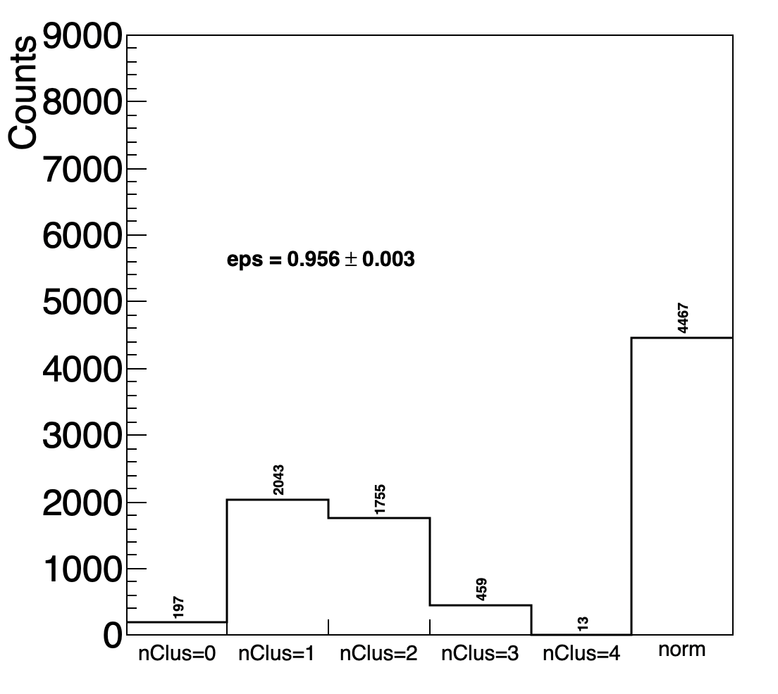
Delay effectiveness: efficiency on C ions
Run 8039, C200, TGT, B off
custom thresholds
IT
VT
preliminary
Selection: 1BMtrack, 1Trk in VT with BM match (norm)
We project the VT track on the IT and we search and count the clusters with dist<1mm
Due to inactive sensors?

Slide 11
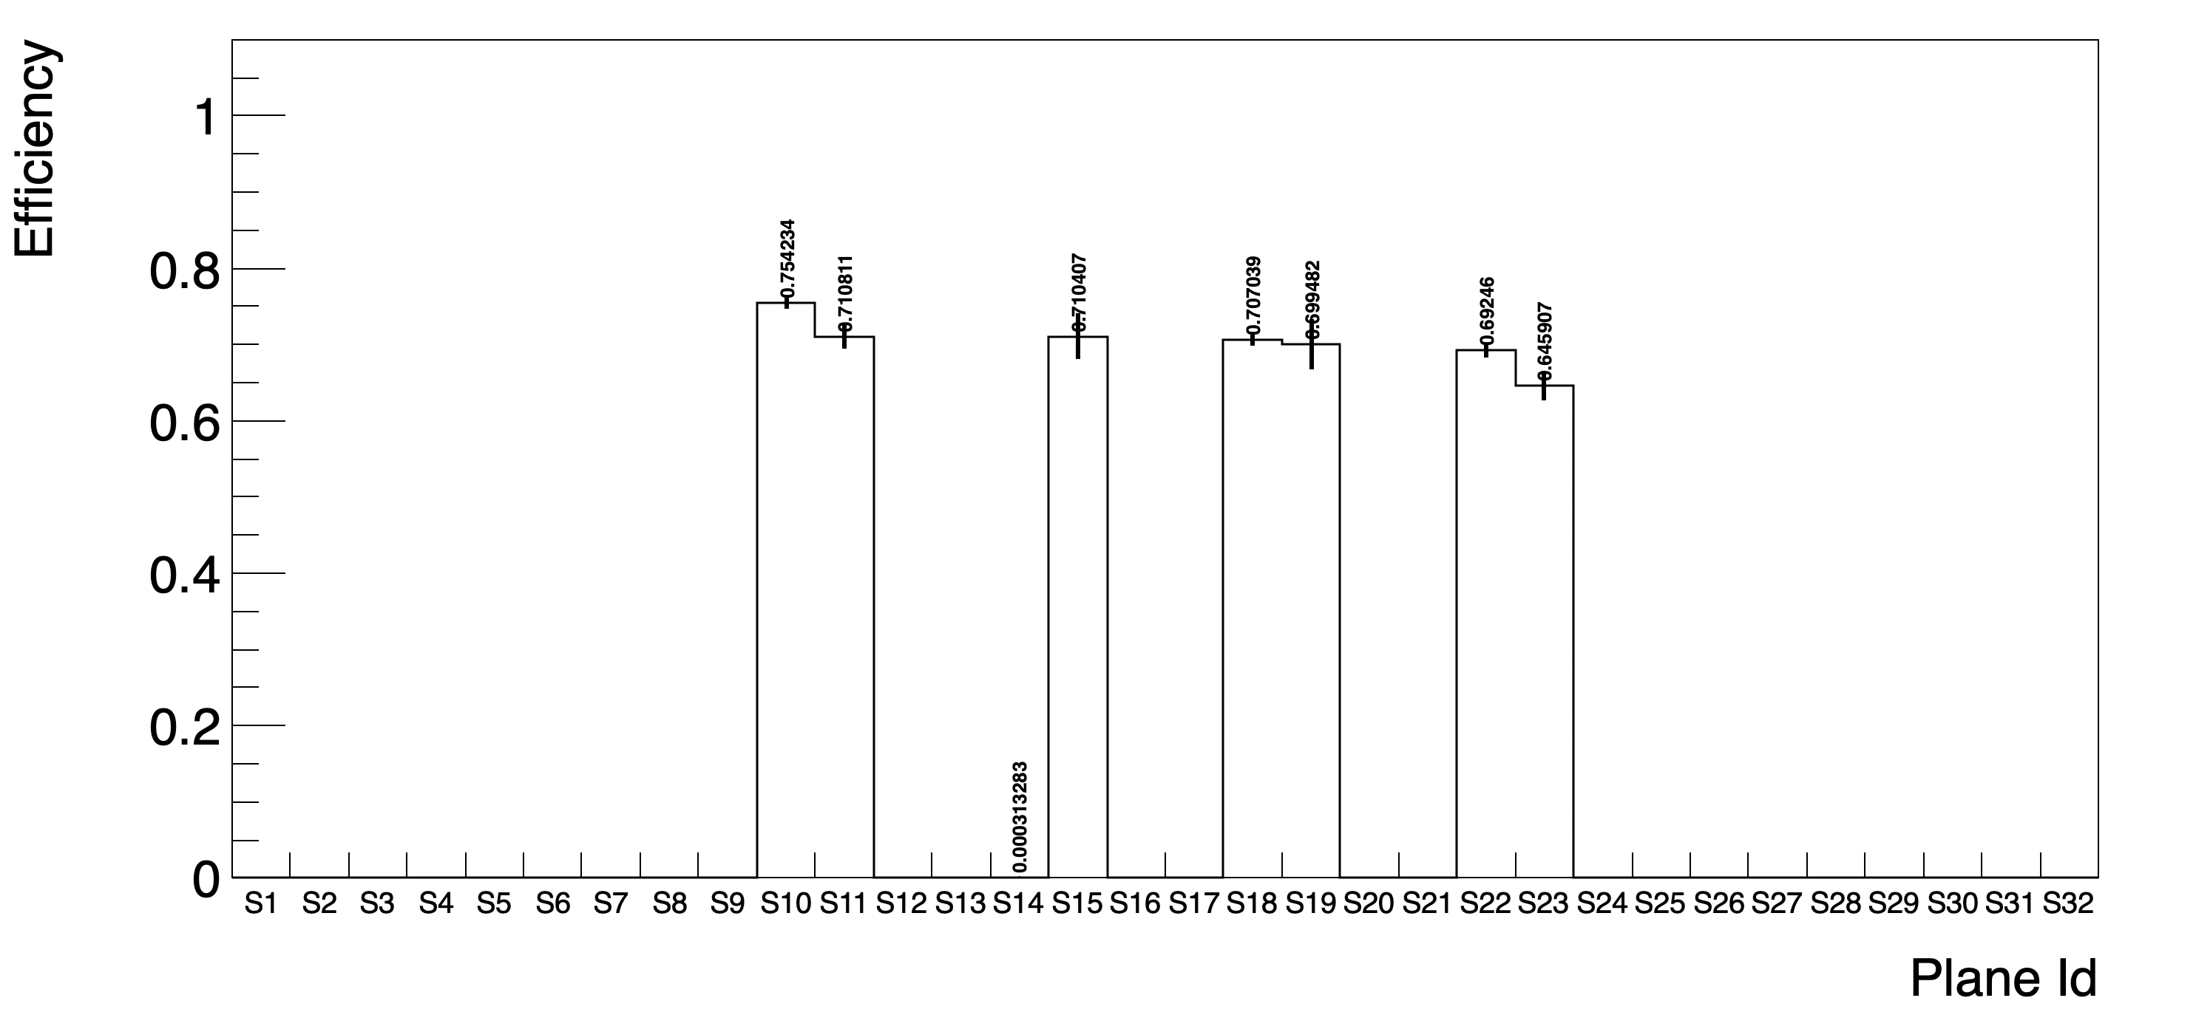
Single sensor efficiency
We suspect some small geometry issues (+ alignment accuracy)
The cluster may be in the adjacent sensor if the sensor assignment is wrong

Slide 12
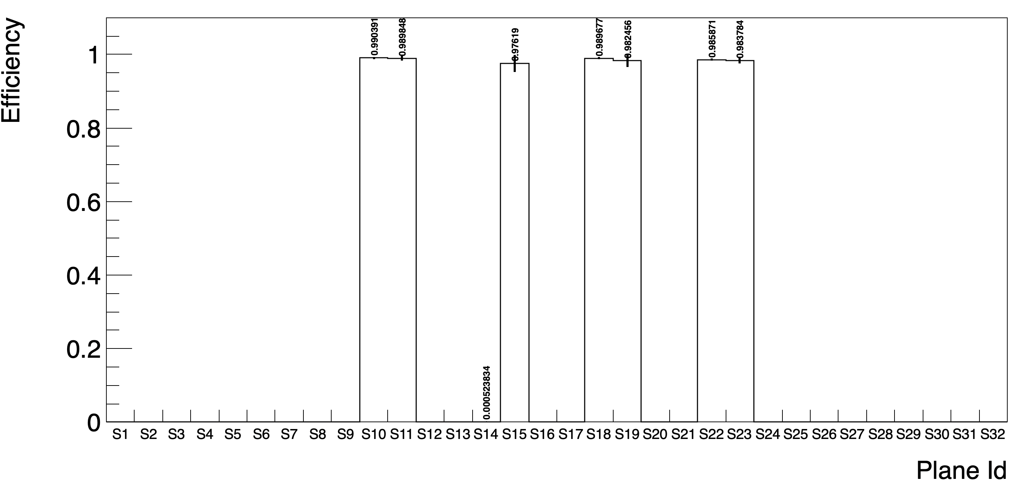
Single sensor efficiency
The cluster may be in the adjacent sensor if the sensor assignment is wrong
When we exclude the events where the track impinging the sensor boundaries thins are better

Slide 13

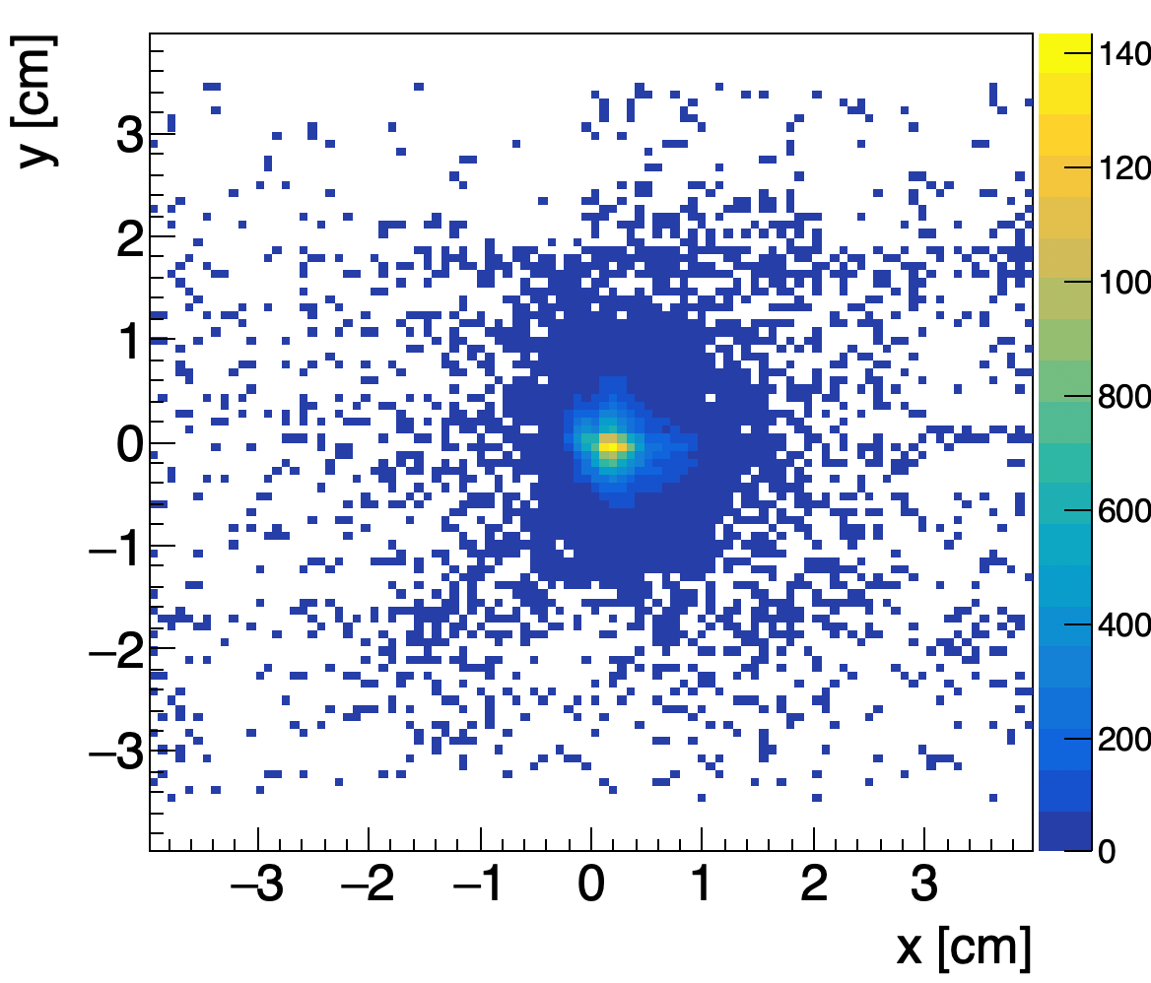
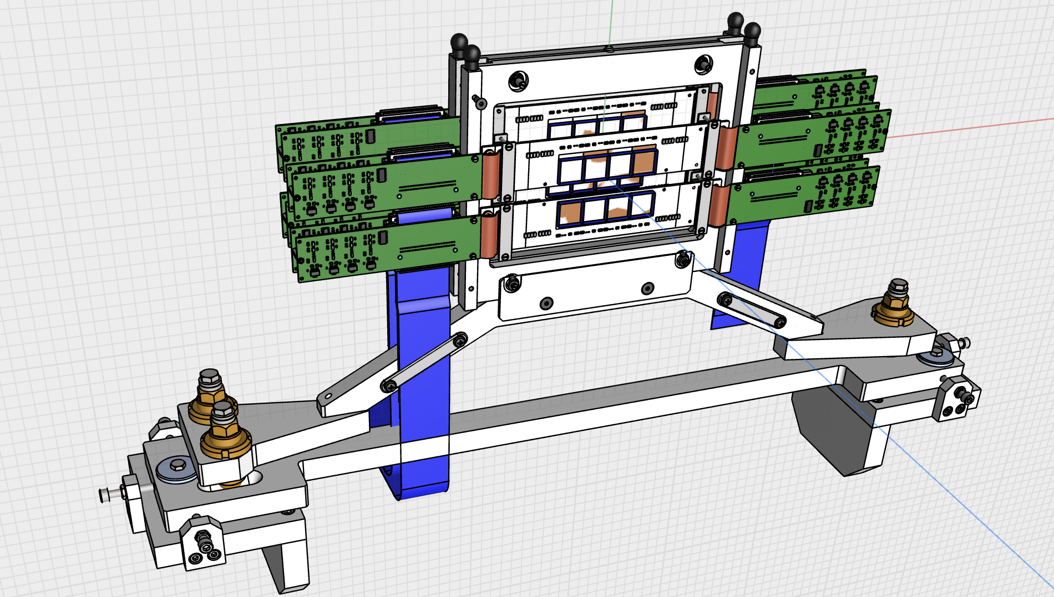
Beam map on IT
Run 8039, C200, TGT, B off
with the B field we move towards the missing sensor…
Keep in mind that sensors have different depths! In principle we should have at least one hit per particle…
broken sensors

Slide 14
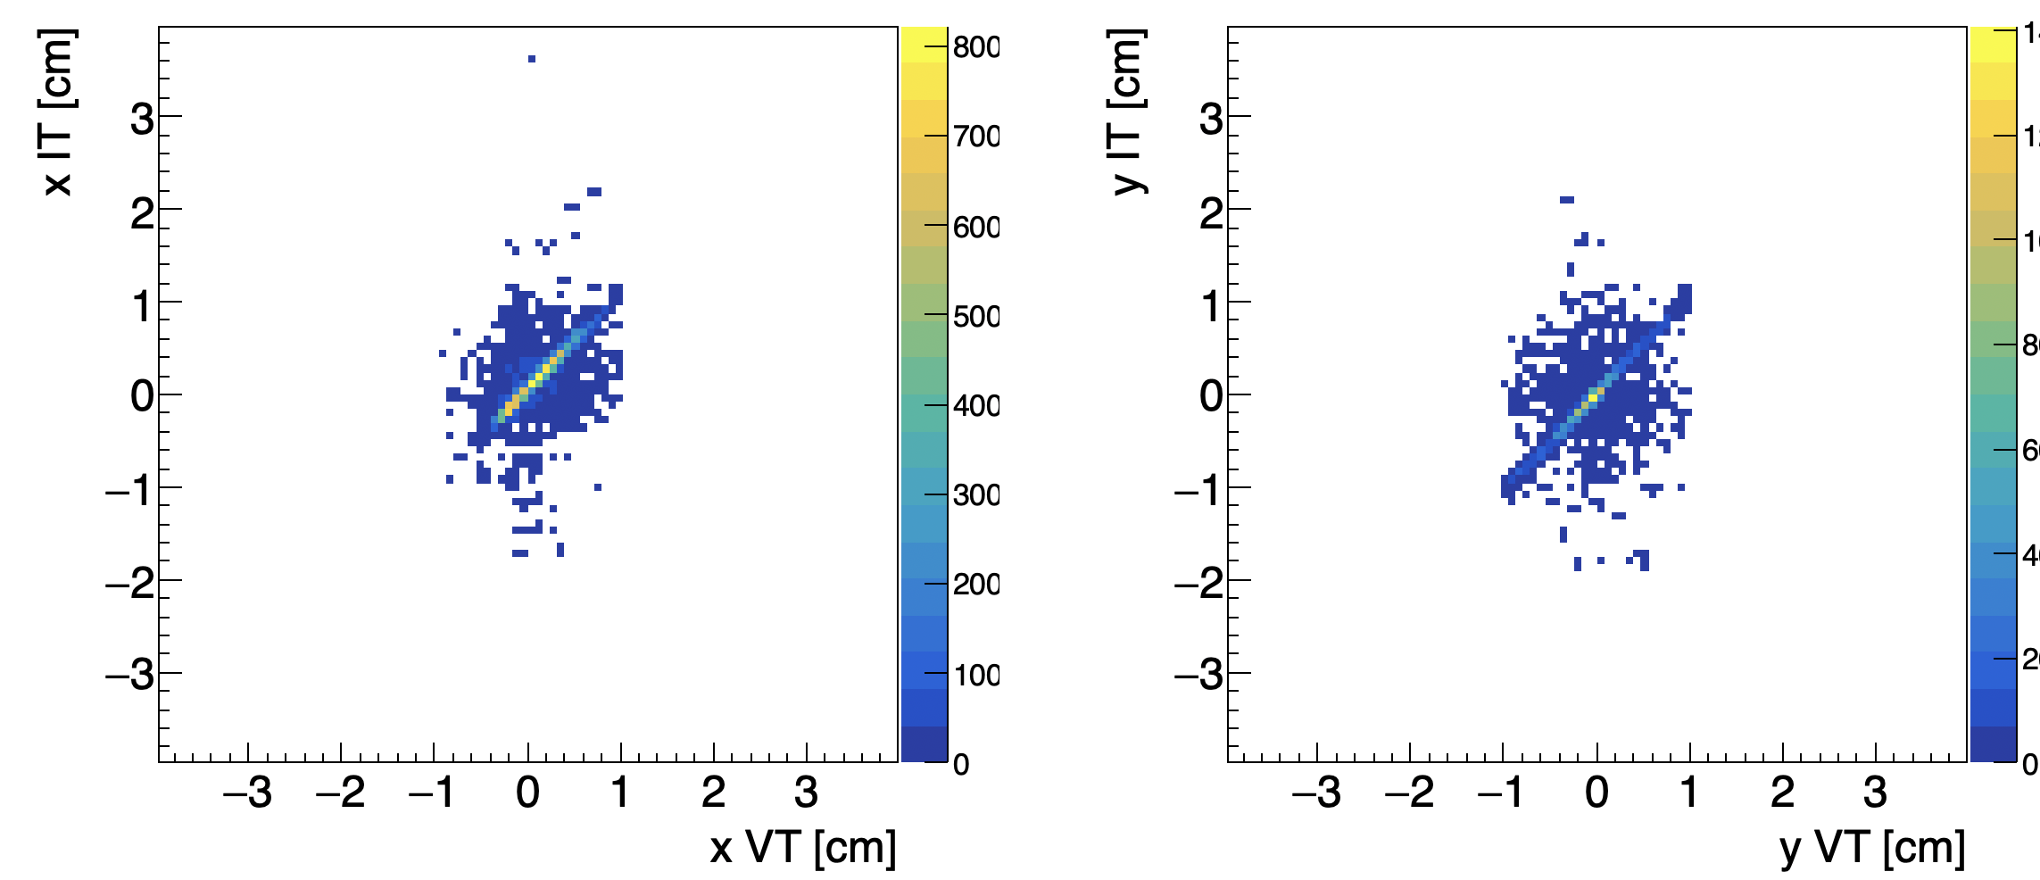
IT vs VT correlation
Run 8022, alignment run, C200, no TGT, B off
In x correlation seem worse than y…

Slide 15
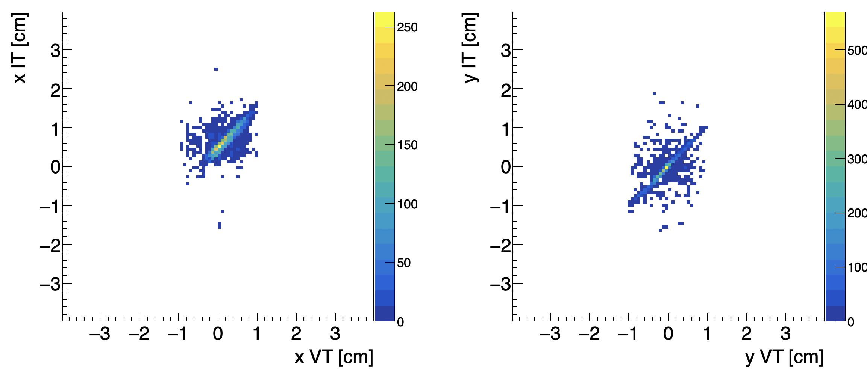
IT vs VT correlation
Run 8016, C200, no TGT, B on
Spread
Particles
deflection
… may be due to residual B? check in the MC

Slide 16
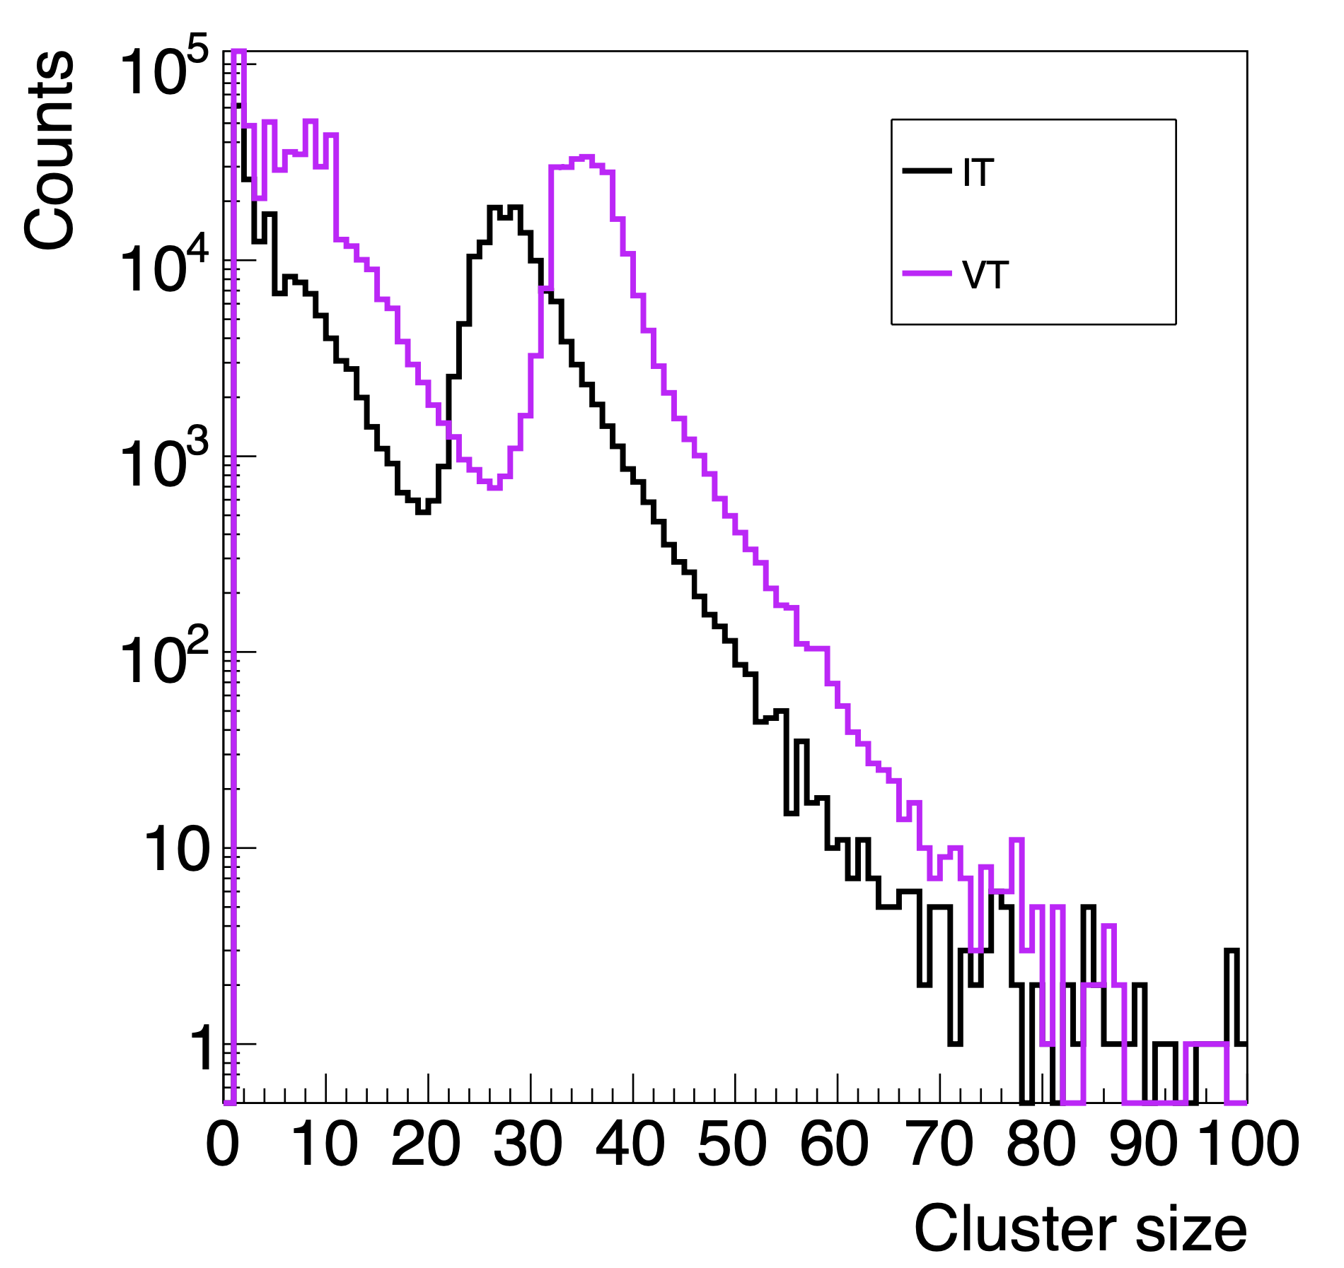
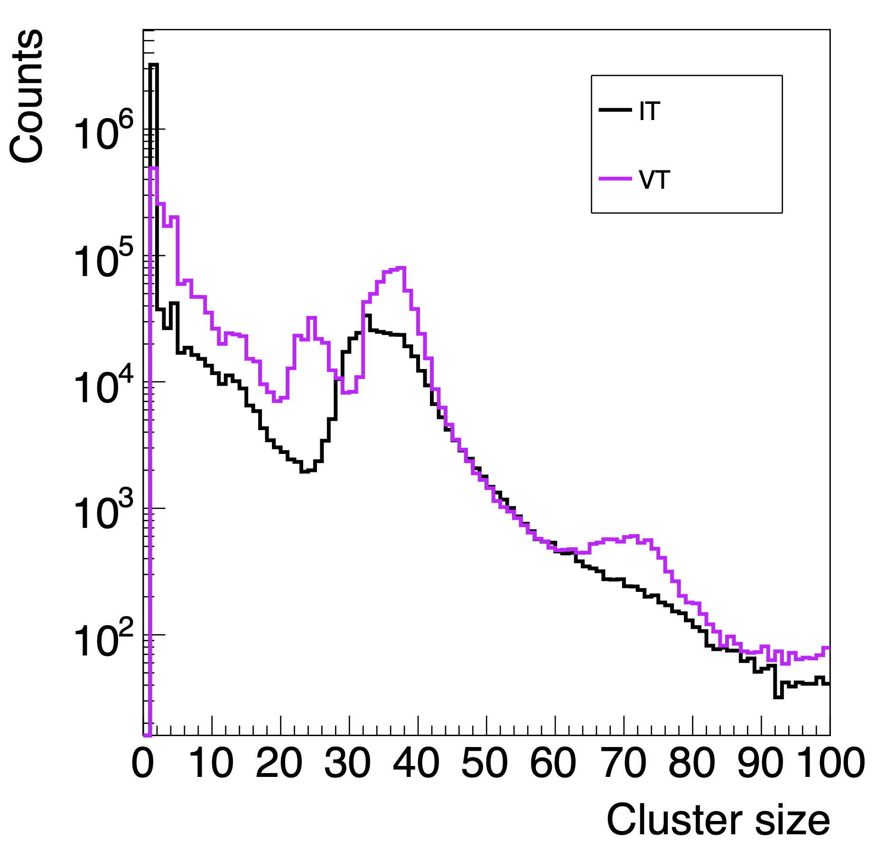
IT response
run 8016, C200, Thr = 12σ
run 8038, C200, Thr = custom

Slide 17
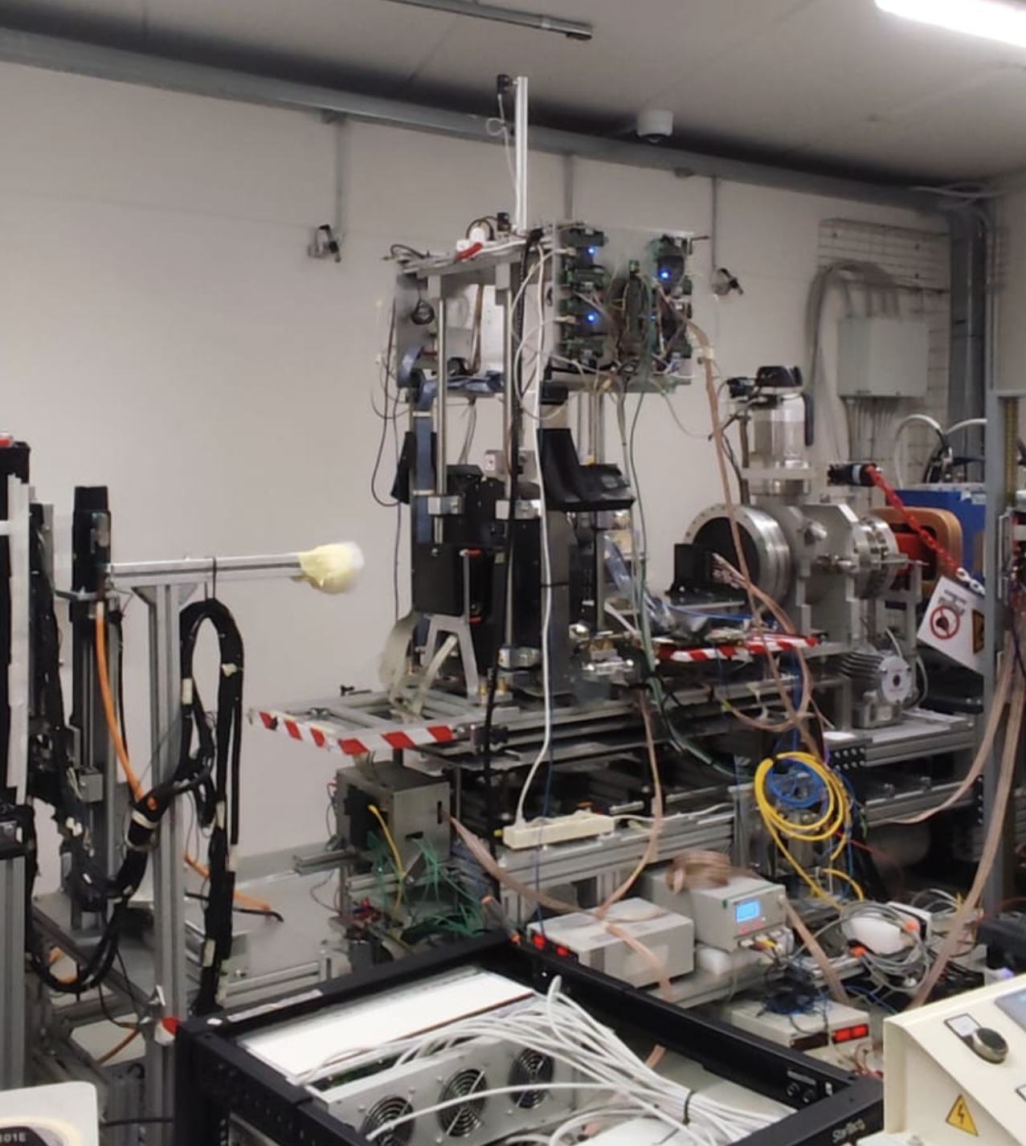
Conclusions
We do not know if, how (and when) the lost sensors could be recovered. Fortunately, the other sensors seems to perform as expected
Wrt the schedule agreed before the data-taking we did not perform the delay scan due to the De10 problem.
However, according to the shown results (even really preliminary), I would privilege a smooth data-acquisition to maximise data collection keeping the setup as it is, postponing all the studies after the data-taking (a test with electrons is scheduled @ BTF in Feb 2026)

Slide 18
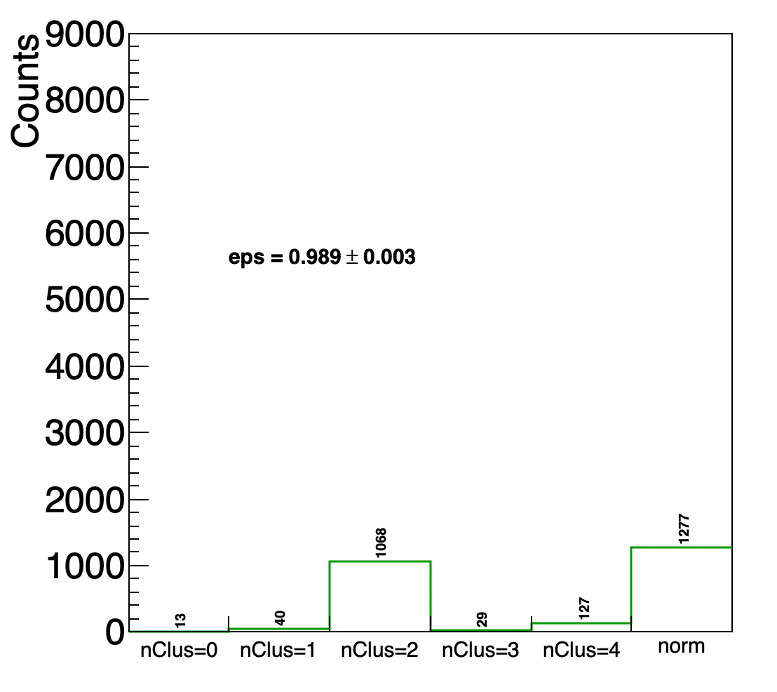
Delay effectiveness: efficiency on C ions
Run 8039, C200, TGT, B off
custom thresholds
IT
VT tracks not crossing sensor14
VT
preliminary
Selection: 1BMtrack, 1Trk in VT with BM match (norm)
We project the VT track on the IT and we search and count the clusters with dist<1mm

