Slide 1


Computing tools and infrastructures to address societal challenges Simulations, Digital Twins, Computational Neuroscience and Artificial Intelligence
Alessandra Retico
INFN - Pisa Division
INFN-IN2P3 workshop on "Nuclear for the benefit of society"

Slide 2

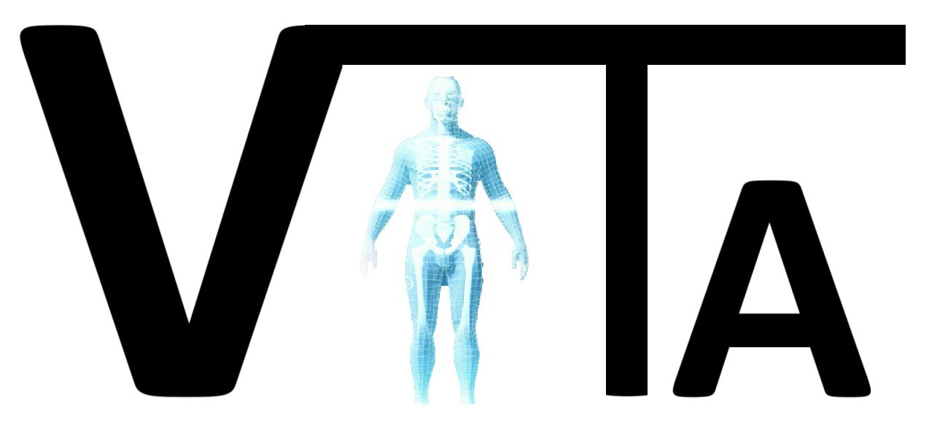












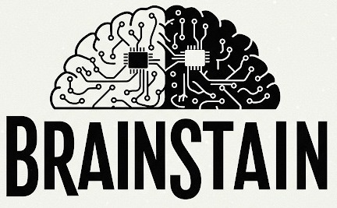

Overview
The development of Scientific Computing in INFN was driven by the needs of theoretical and experimental communities.
However, being at the forefront of computer science research seeded many projects which have a broader scope.
On-going research projects involve:
Modeling and simulations
Computing infrastructures for big data
Data analysis and Artificial Intelligence
Computational neuroscience

Slide 3

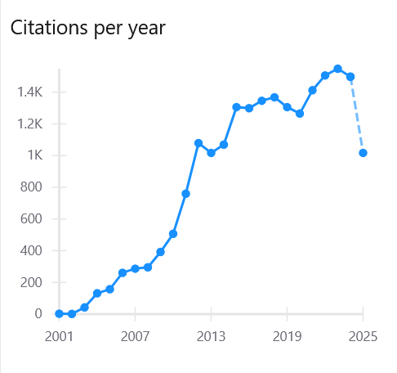
Simulation of radiation-matter interactions
Key ingredient for a large number of physics applications
Geant4 is successful general-purpose tool, open source
Toolkit to simulate interaction of radiation with matter
Developed by an international Collaboration, established in 1998
Regular releases (last version Geant4 11.4, Dec 5th, 2025)
INFN in the game since the very beginning (currently Geant4INFN group within INFN-CSN5)
EM physics, hadronic physics, examples
Highly transversal product, papers highly cited
S. Agostinelli et al., NIM A 506 (2003) 250 → 20.3k citations (2nd most-cited on ISPIRES)
More than 1300 citations/year
Growing interest also in the medical physics community
contact: pandola@lns.infn.it
http://geant4.org

Slide 4
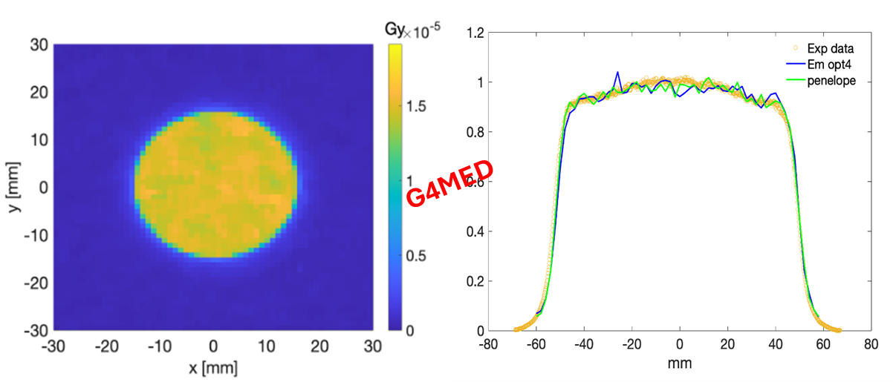
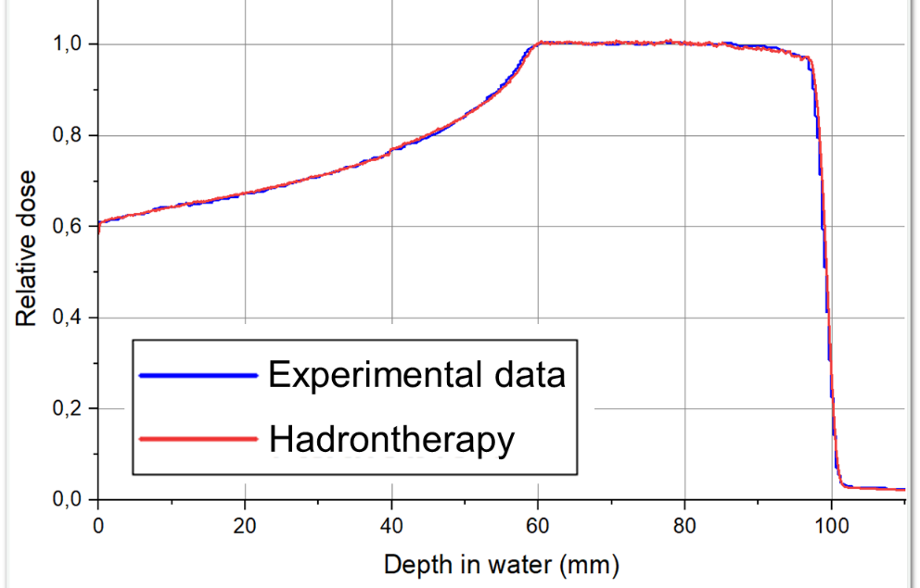
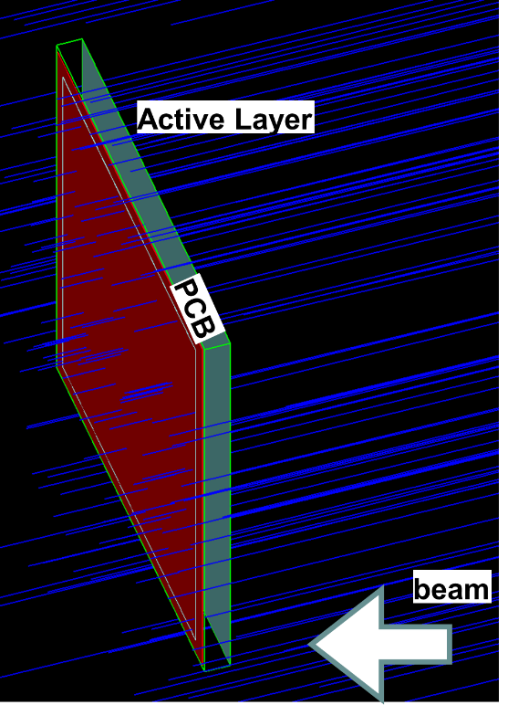
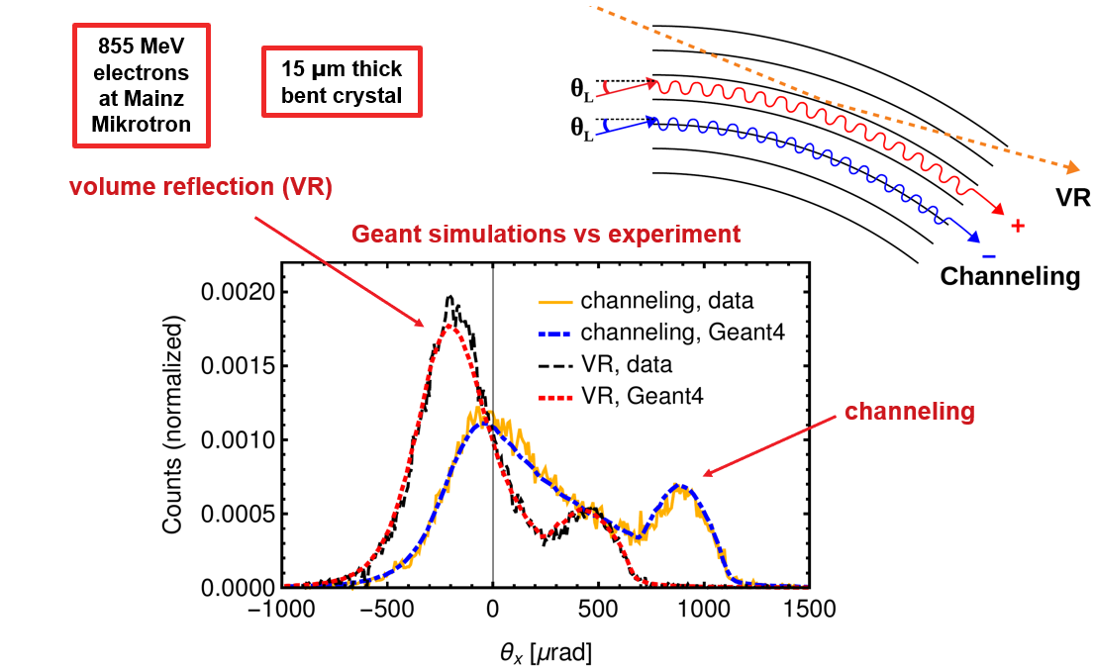

Geant4 @INFN
Very intense activity of the INFN groups in medical physics → development of advanced examples
Focusing on validation for medical physics
G4Med project to benchmark Geant4 for medical use cases
[Arce P, et al.. Med Phys. 2025;1-55.]
Current developments in radiobiology, FLASH and microdosimetry (TEPC, SiC)
P. Arce et al, Med. Phys. 48 (2021) 19
Kernel developments: modeling of EM interactions with crystalline materials
Channeling, beam deflection, etc.

Slide 5

The next challenge: Geant4-DNA
Modeling of biological damage → challenging
Need precise description at the molecular/DNA level (< µm scale)
Must give up the condensed history approach of general MCs
Physics to be described by detailed track-structure models to ~eV
Also chemical processes involved, following primary physical interaction
Much more CPU-intensive
Geant4-DNA project: extension of Geant4 for the simulation of interactions of radiation with biological systems at the cellular and DNA level
Initiated by ESA in 2001, highly inter-disciplinary
Developed and maintained by an international Collaboration within the Geant4 Collaboration
Leading role of CNRS/IN2P3
Geant4INFN group involved in Geant4-DNA (next slide)
Development of models
Validation with experimental data, benchmarking

Slide 6
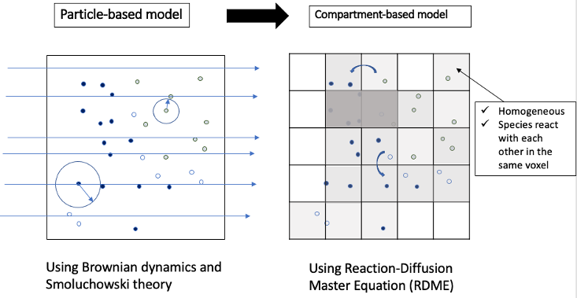
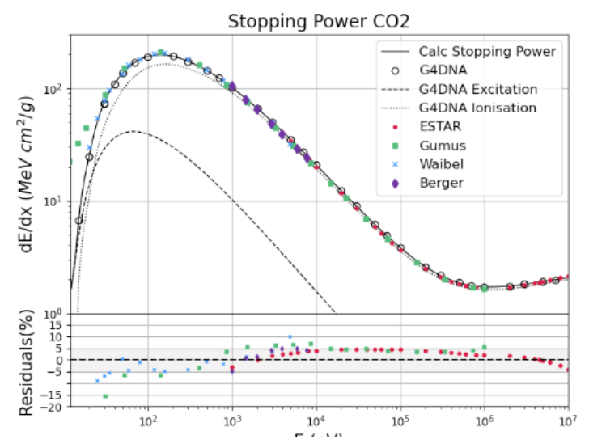
Geant4 DNA @ INFN
Development of models for the chemical stage
Production, diffusion and mutual interactions of radicals → DNA damage!
Extremely CPU intensive, if a step-by-step approach is employed
Faster alternative: mesoscopic model → density of different species evolution by compartment-based representation
Validation of simulated DNA damage for BNCT radiation mixed field (α, ⁷Li, protons, e-)
Development of physics models for atmospheric gases (N₂, O_{2,} CO₂)
Detailed models relevant for climatology
Full set of e- models available (10 eV – 10 MeV), e+ in progress
Benchmark range and dE/dx vs. NIST
F. Nicolanti, et al, Physica Medica 114 (2023) 102661
F. Nicolanti, et al, Physica Medica 128 (2024):104838
E (eV)

Slide 7
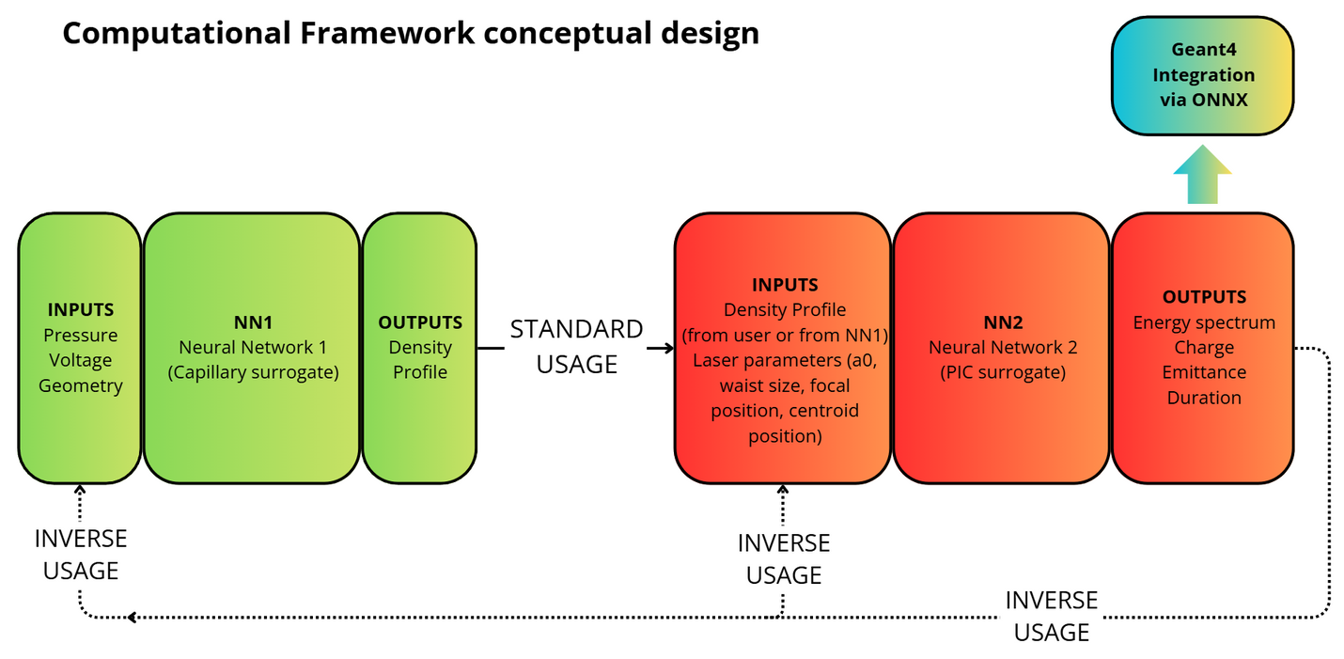
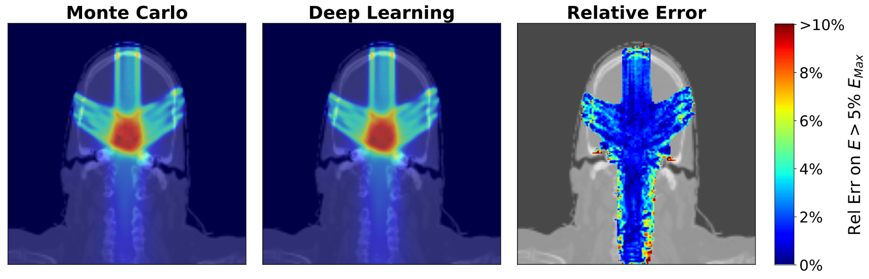
At the MC-AI border
Use AI algorithms to emulate the results of (very CPU-intensive) full MC simulations
The slow MC production is used only as training sample
Optimization of laser accelerated electron beams
Enables both forward prediction & inverse design
Optimization of RT treatment planning
Graph NN trained to reproduce MC dose profiles from pencil beams
Full TP produced in seconds
Validated on multiple benches, passing 3%/3mm 𝛾-index
A. Sciuto, et al, submitted to Plasma Phys. And Contr. Fusion
L. Arsini et al. Algorithms, 2023, 16(3), 143;
L. Arsini et al. Physica Medica, 136, 2025, 105012

Slide 8

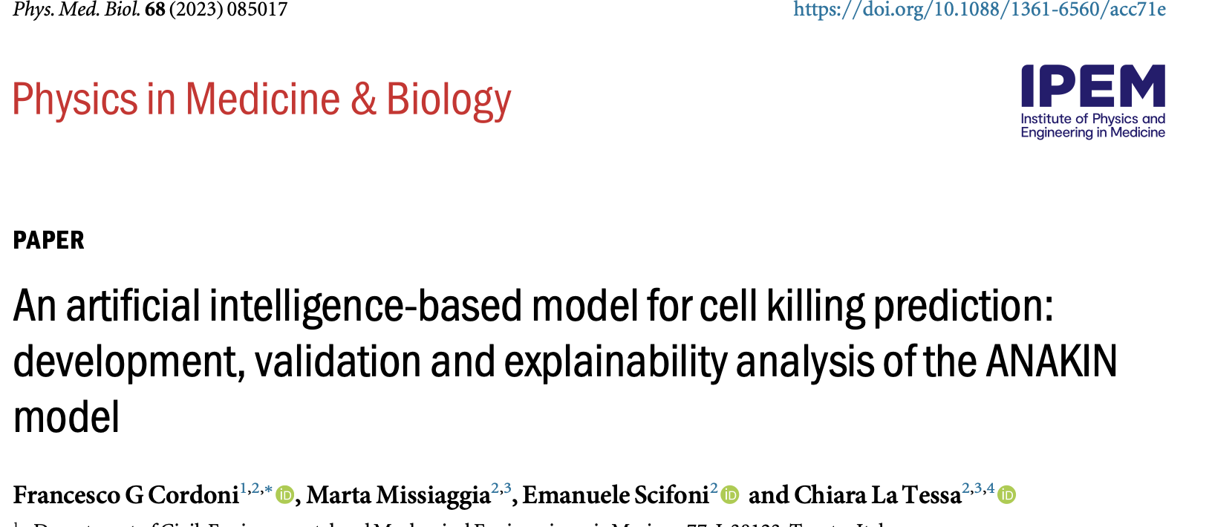
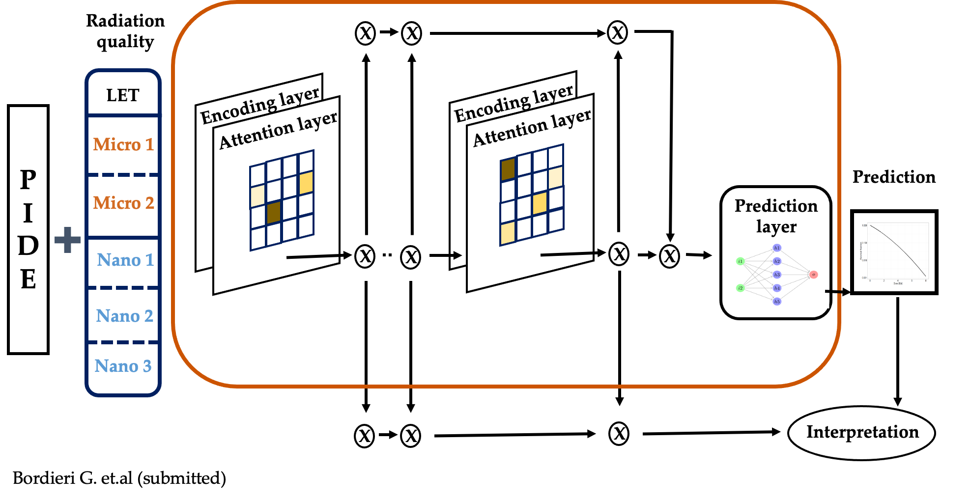
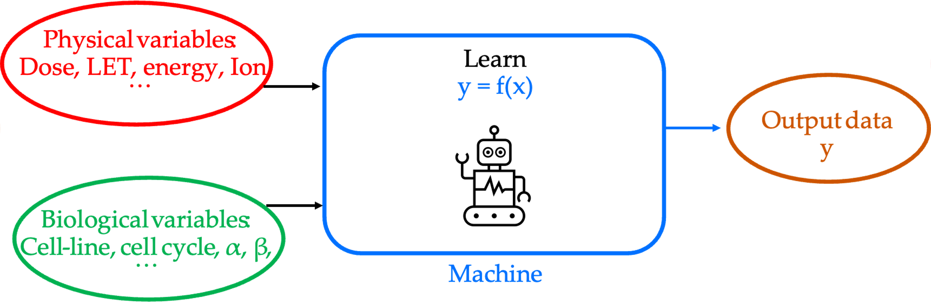
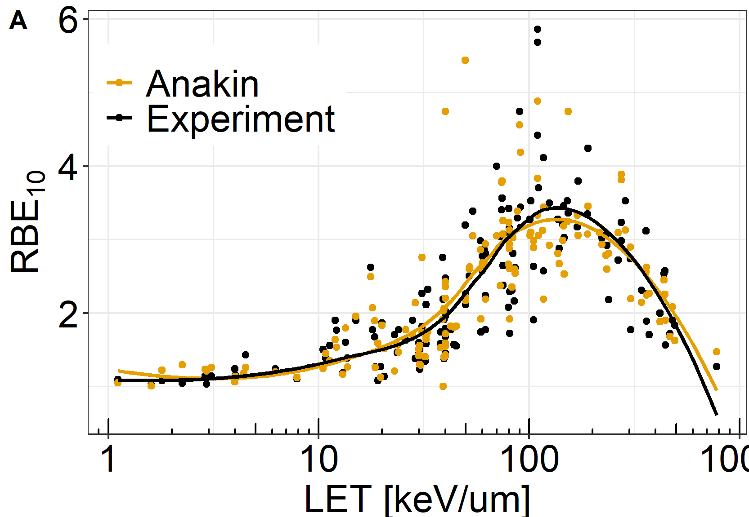
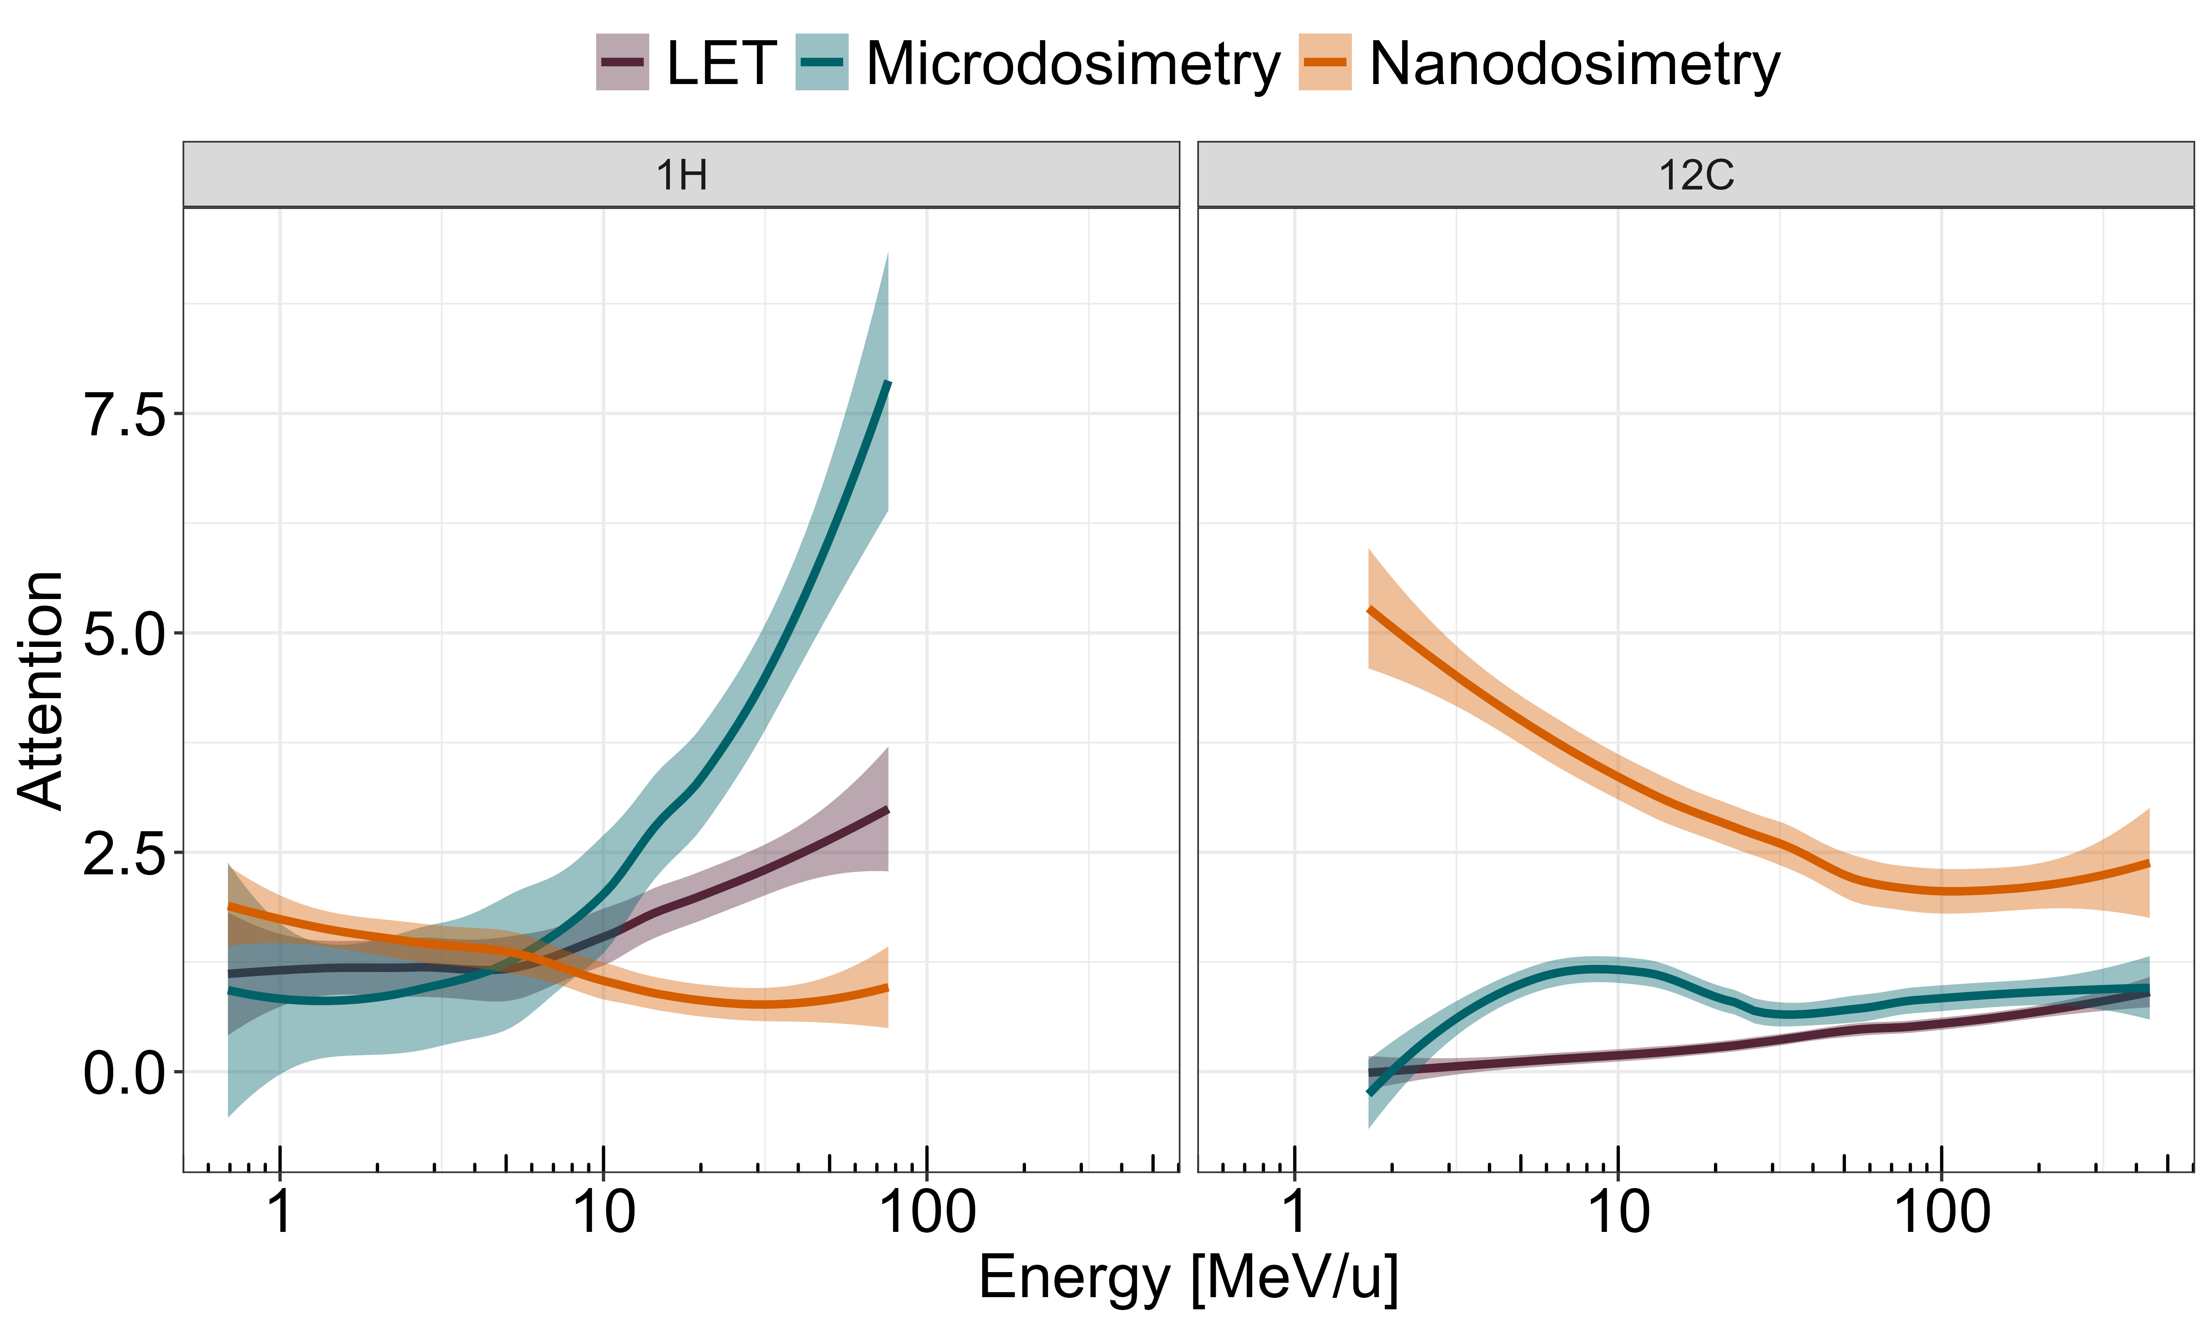
Combining AI with Hadron Therapy biophysical modeling
INFN-CSN5
﻿ANAKIN: an Artificial iNtelligence bAsed model for (radiation-induced) cell KIlliNg prediction
Cordoni et al. PMB 2023
ANAKIN model through interpretability features allows to retrieve information on the more relevant “radiation quality” metrics, i.e. LET, microdos and nanodos parameters and their combination to describe the observed biological response to particle beams
Contact: emanuele.scifoni@unitn.it

Slide 9
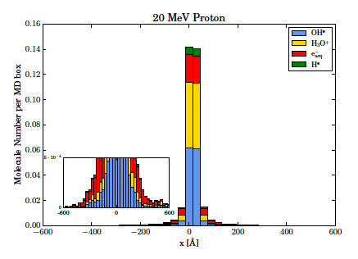
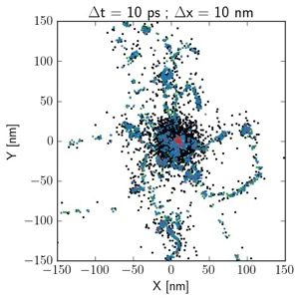
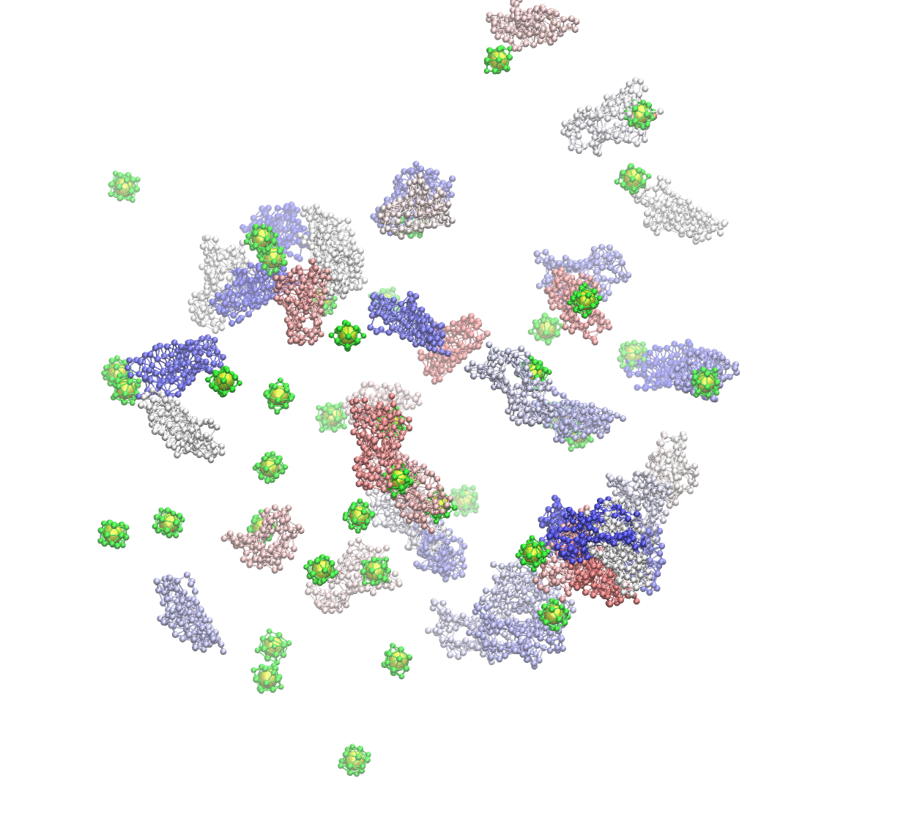

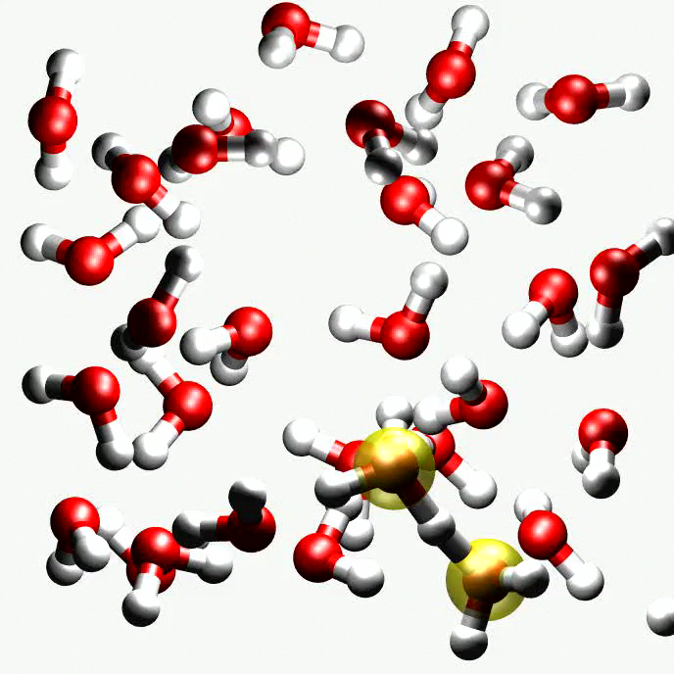


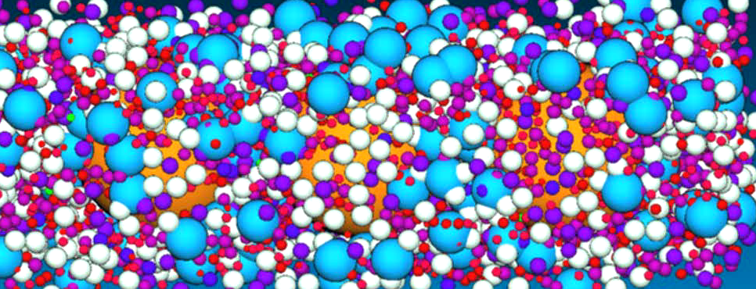
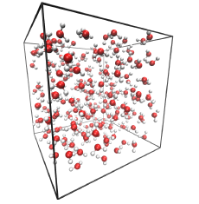


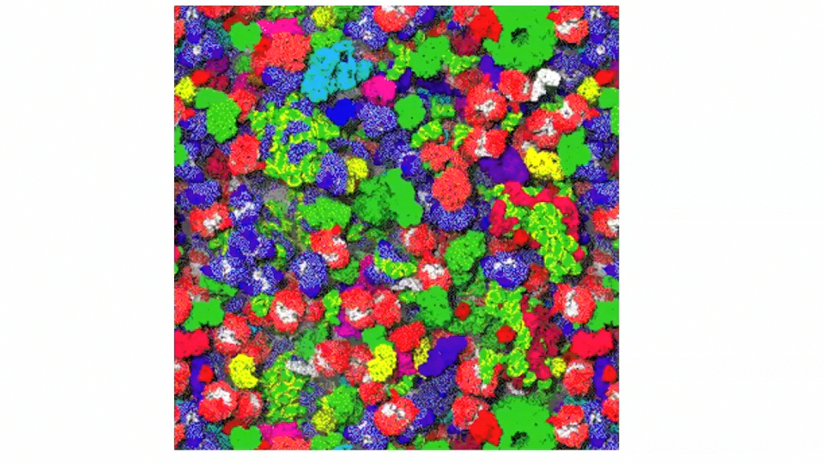






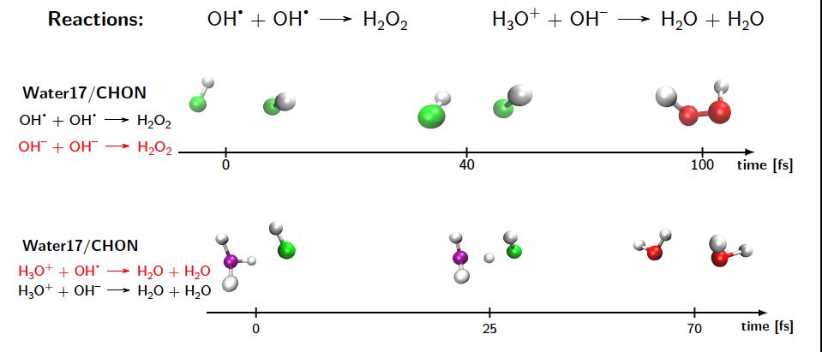
Multiscale Hadron Therapy biophysical modeling: Joining Molecular Dynamic to MC Track structure
INFN-CSN5
m
Tissue damage/repair
Tissue «continuum» models
mm
input-output exchange
params optimization
Homogeneous chemistry & biochemical stage
Coarse Grained models
Browniand dynamics
Intra-cell enzymatic processes/signaling
Biochemical Network models
Kinetic equations
μm
Physical stage
Monte Carlo
Pre-chemical and heterogeneous chemical stage
Atomistic Dynamics
MC & diffusion
Ab initio Molecular Dyn
Reactive force fields
input-output exchange
params optimization
Inter-calibration
→ Machine learning
nm
fs
ps
ns
μs
ms
sec
min
hours
Days/months
Using reactive force fields (REAXFF)
Understanding of the biological response observed, requires deep analysis of the full spatiotemporal cascade of events following the primary radiation events
L. Castelli, V. Tozzini & E. Scifoni in prep
Contact: emanuele.scifoni@unitn.it

Slide 10
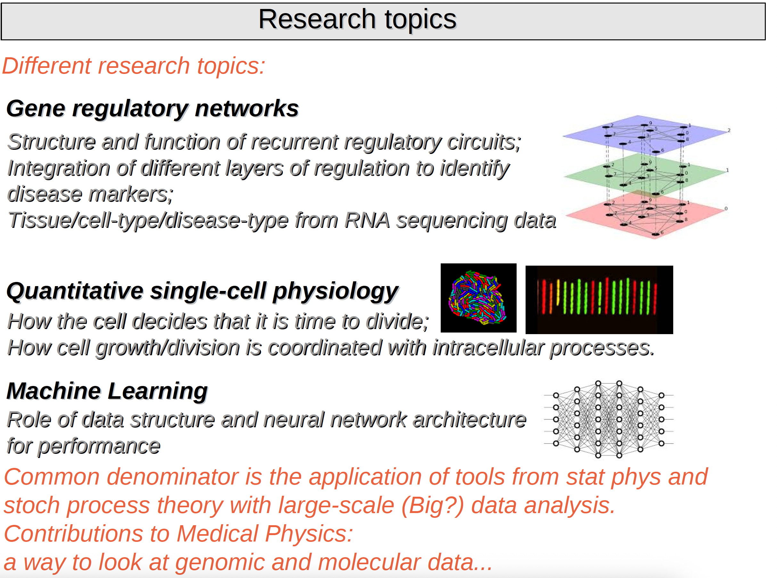
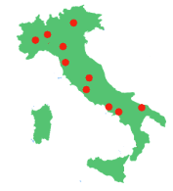
BIOPHYS: Biological Theoretical Physics
INFN-CSN4
BIOPHYS aims to model and discover emergent properties of biological systems, encompassing molecular factors, genomes, cells and organs, whose theoretical description is only possible at the system level, by using innovative methods and ideas coming from theoretical physics.
Torino group – Michele Caselle caselle@to.infn.it
BIOPHYS coordinator:
S. Stramaglia, INFN-Bari
sebastiano.stramaglia@uniba.it

Slide 11
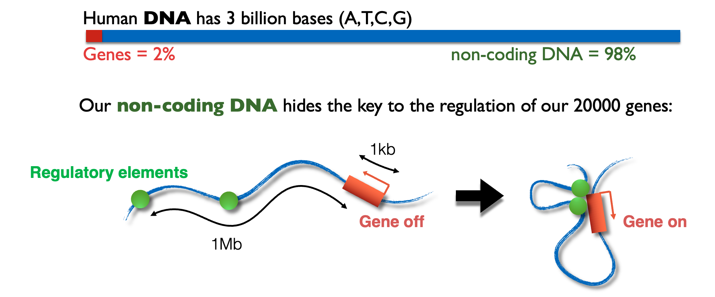
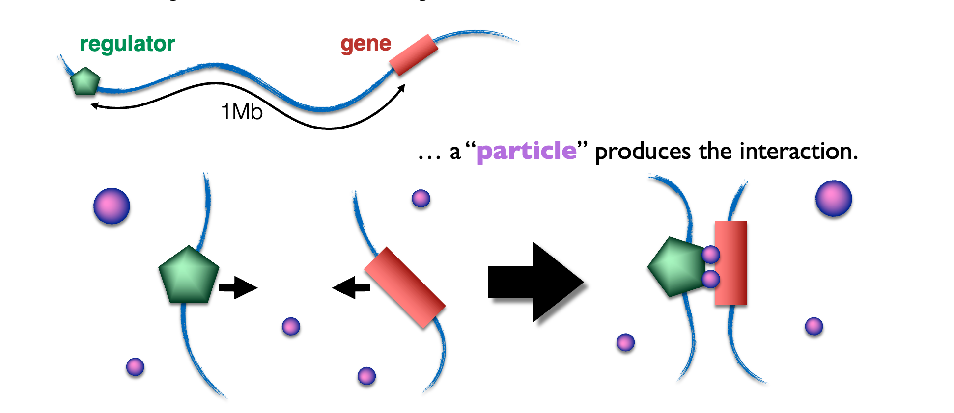
BIOPHYS: Biological Theoretical Physics
INFN-CSN4
Napoli group – mario.nicodemi@na.infn.it
Our genome has a complex 3D architecture in the cell nucleus
How can genes and their distal regulators find each other?
A polymer micro-phase separation was proposed as the underlying mechanisms, as later experimentally verified in health and disease
[Barbieri et al., Nature SMB 2017; Bianco et al. Nature Get. 2018; Kragesteen et al. Nature Get. 2018; Oudelaar et al. Nature Get. 2019; Conte et al. Nature Com. 2020 - http://dx.doi.org/10.1038/s41467-020-17141-4]
A new technology was developed to measure contacts genome-wide
[Beagrie et al., Nature 2017; Fiorillo et al. Nature Meth. 20222]

Slide 12



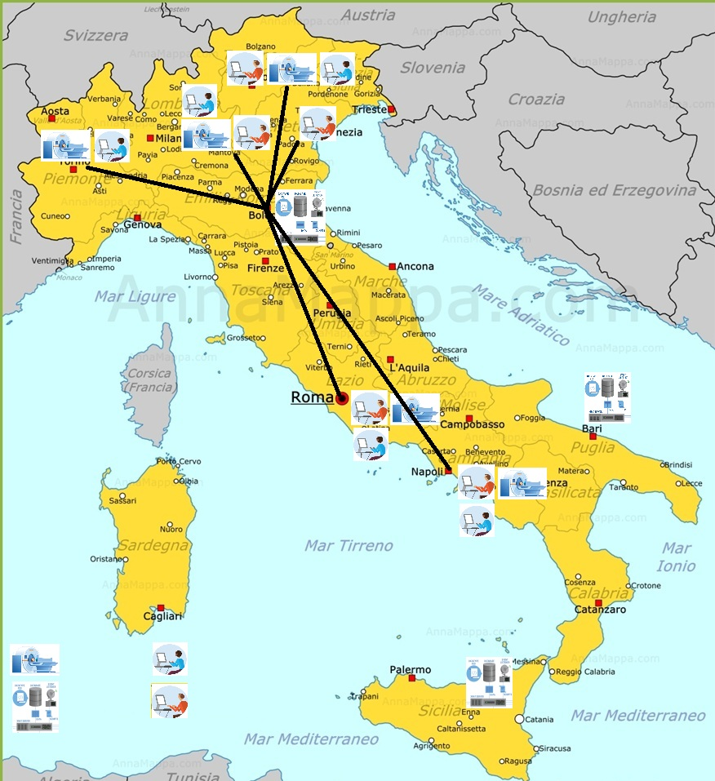
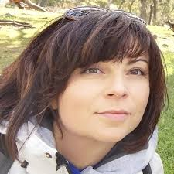
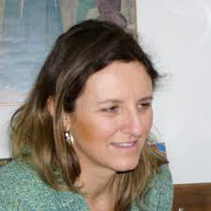
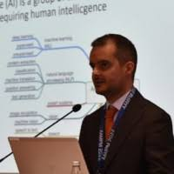
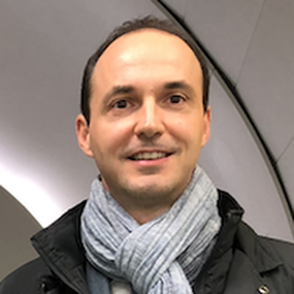
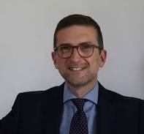
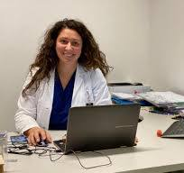
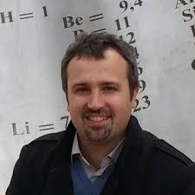
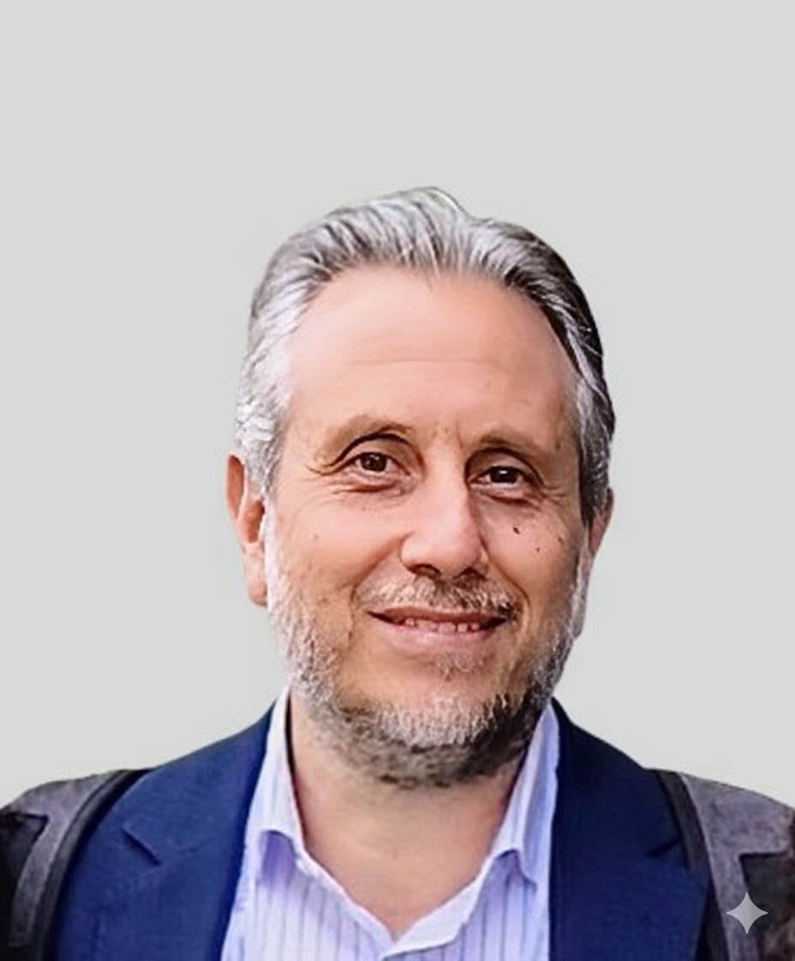
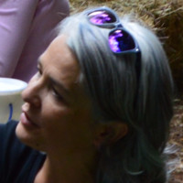
Virtual Imaging TriAls in Medicine (VITA)
12
INFN-CSN5
Barbara Martelli (CNAF)
First Technologists
INFN CNAF, Bologna
Virtual Imaging Trials (VITs) are simulations of medical imaging experiments that use computerized patients, scanner models, and image interpretation models.
VITs are a fast, cost-effective, and ethical alternative to traditional clinical trials.
Barbara Caccia
First Researcher
ISS, Rome
Main goal of VITA:
To create a National Center for VITs
Michele Avanzo
Medical Physics
Centro di Riferimento Oncologico Aviano, PN
The collaboration between INFN, the Italian Association of Medical Physicists (AIFM) and the Italian National Istitute of Health (ISS) will bring together computational resources, hardware and software tools to build an archive of real and generated data, accessible at the national level.
Angelo Schiavi
Associate Professor at
Università di Roma ‘Sapienza’
and INFN, Roma
Carlo Cavedon
AIFM Past President
Director of Medical Physics Unit at Verona University Hospital
Annalisa Trianni (TIFPA)
Director of Medical Physics Unit
at Azienda Provinciale Trento
Oscar Rampado
Medical Physics
AOU Città della Salute e della Scienza, Torino
Giovanni Mettivier
Medical Physics Research Laboratory,
Associate Professor at University of Napoli
‘Federico II’ and INFN, Napoli
Adriana Taddeucci (Firenze)
Medical Physics at Azienda Ospedaliero-Universitaria Careggi, Florence

Slide 13
Motivations
The use of Virtual Imaging Trials is attracting increasing interest internationally.
To enable the implementation of these modalities in the clinical setting:
strong and broad collaborations must be established at the national and international levels
a regulatory process for these activities is nedeed.
Main components of VITA:
Computing Infrastructure
INFN researchers and technologists will identify and implement the best solutions to create an IT infrastructure capable of providing shared storage for phantoms and software tools, available to the partners according to access policies agreed for these resources.
Virtual Patients
Library of phantoms modeling a wide range of anatomies, including pathological aspects in tissues and organs with known characteristics. Library of images generated ”on-demand" using AI (GAN).
Virtual Scanner
Optimization of two simulation platforms (one for breast CT and one for ocular brachytherapy), previously developed by the Naples unit and the ISS
Virtual Readers
In the clinic, medical images are interpreted by radiologists. The creation of a computational equivalent in the form of virtual readers (observer models, radiomics, and neural networks) is a very interesting and active area of ​​research.

Slide 14
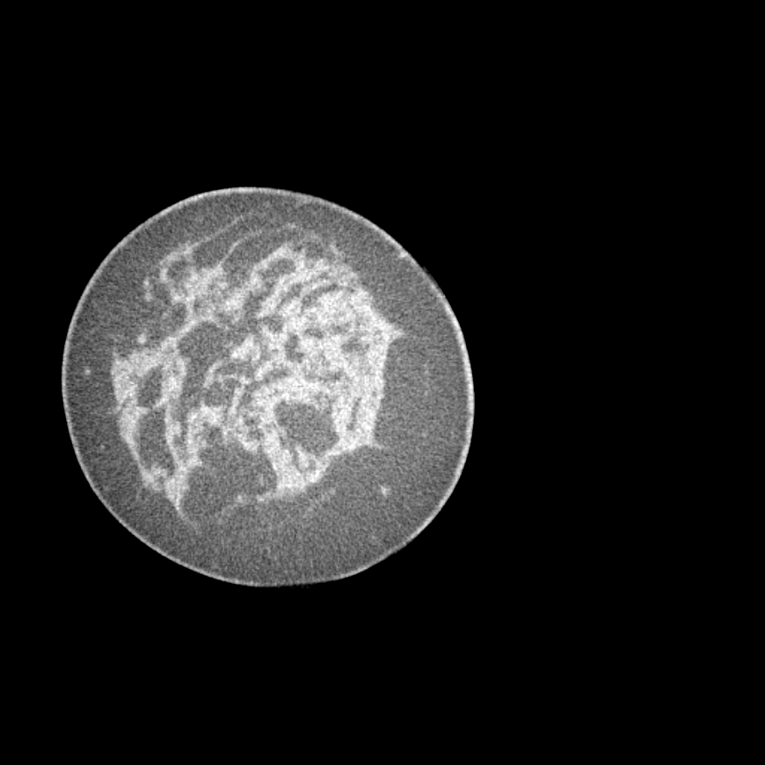
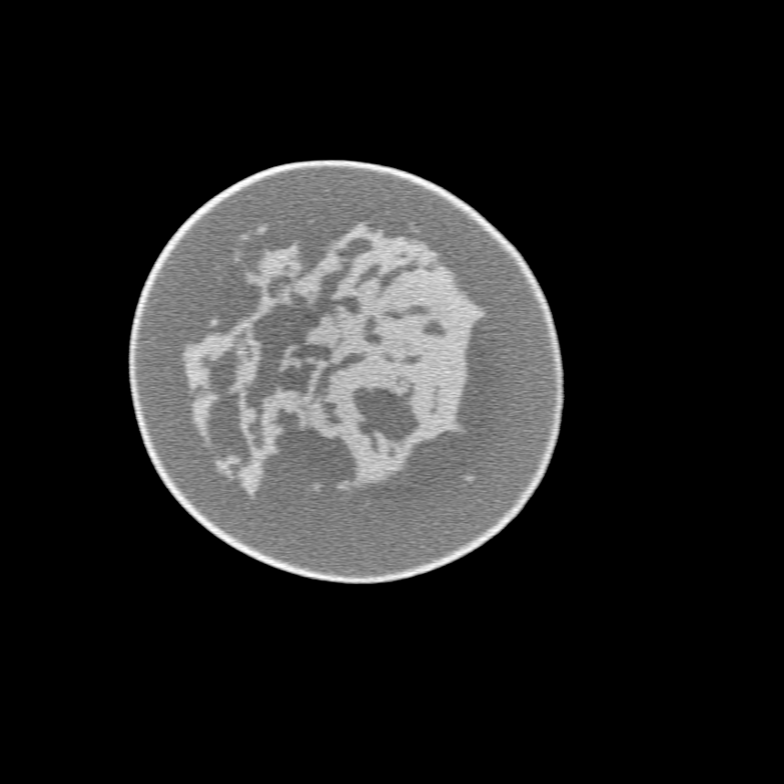
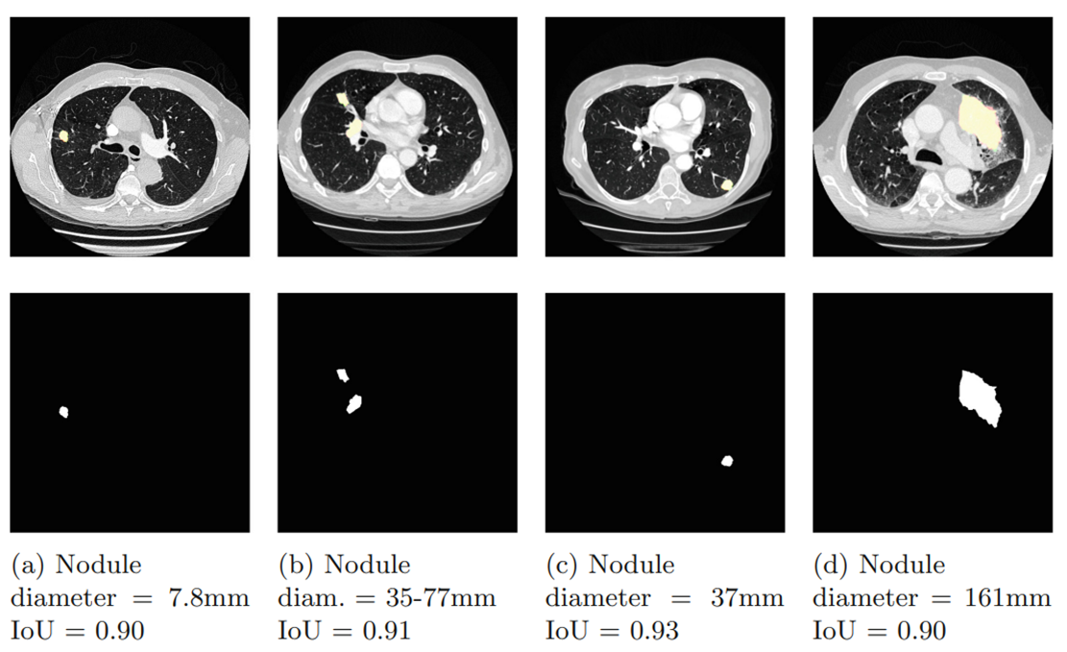
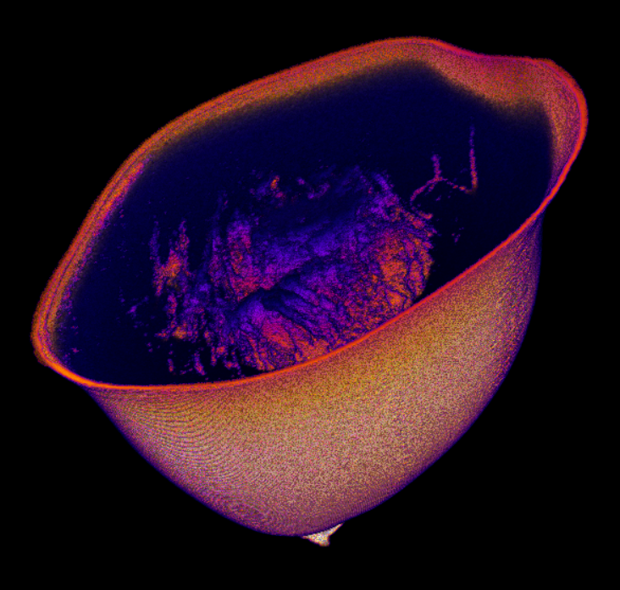
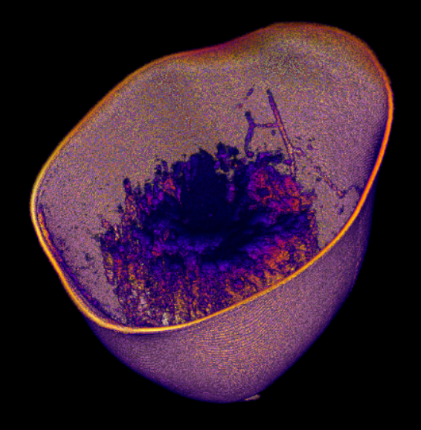
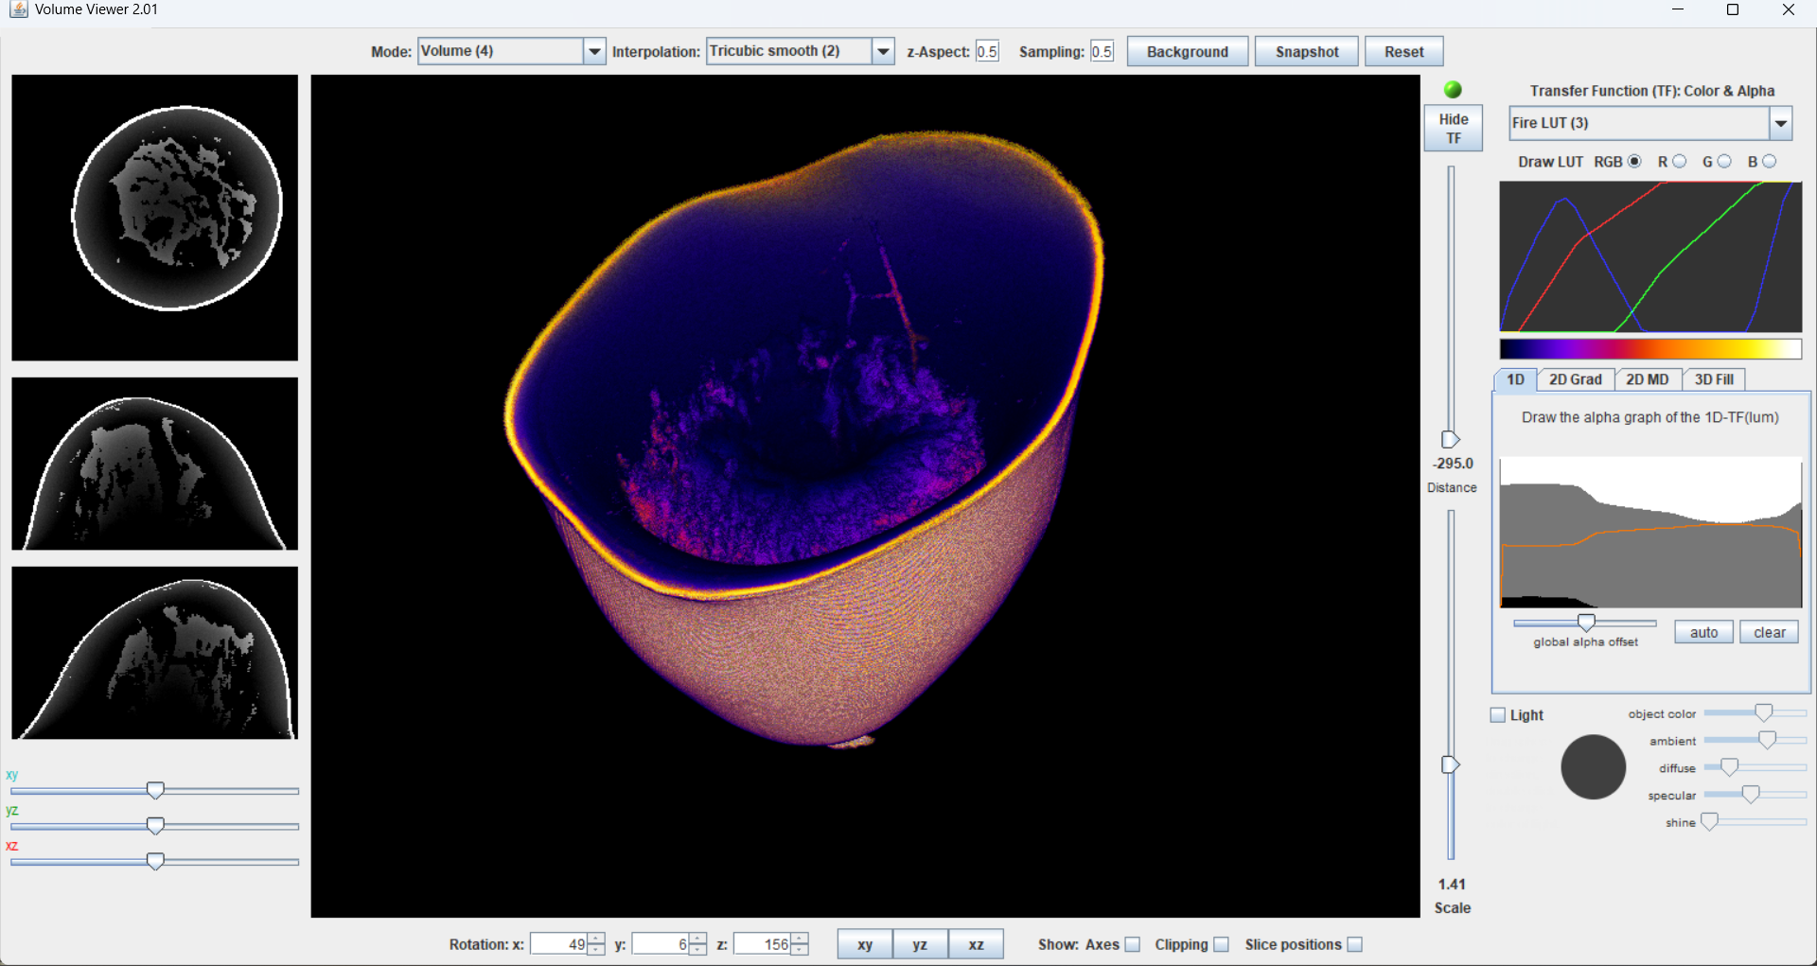
Highlights
Generation of realistic synthetic patients from real ones
The collection of imaging data and lesion masks of real patients from VITA clinical partners is in progress to build virtual patients/lesions.
The images of the UniToChest dataset (lung CT scans from 623 patients with lung nodule masks) will be adapted for virtual imaging trial studies
https://zenodo.org/records/5797912
Clinical Image Simulated Image
Comparison of 3D dose distributions for the same virtual patient obtained with the three different virtual CT scanners
Scanner 1 Scanner 2 Scanner 3

Slide 15
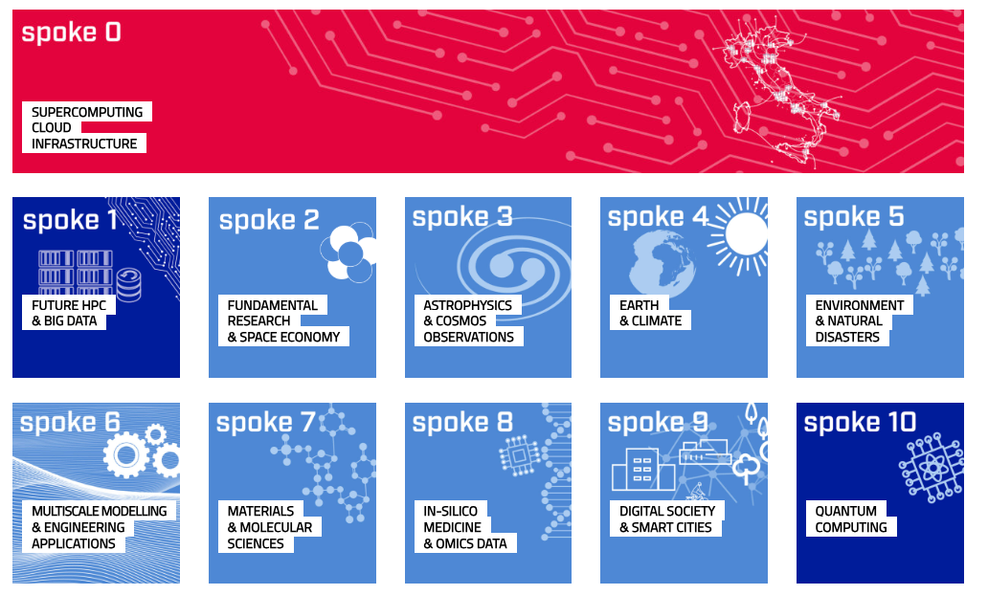
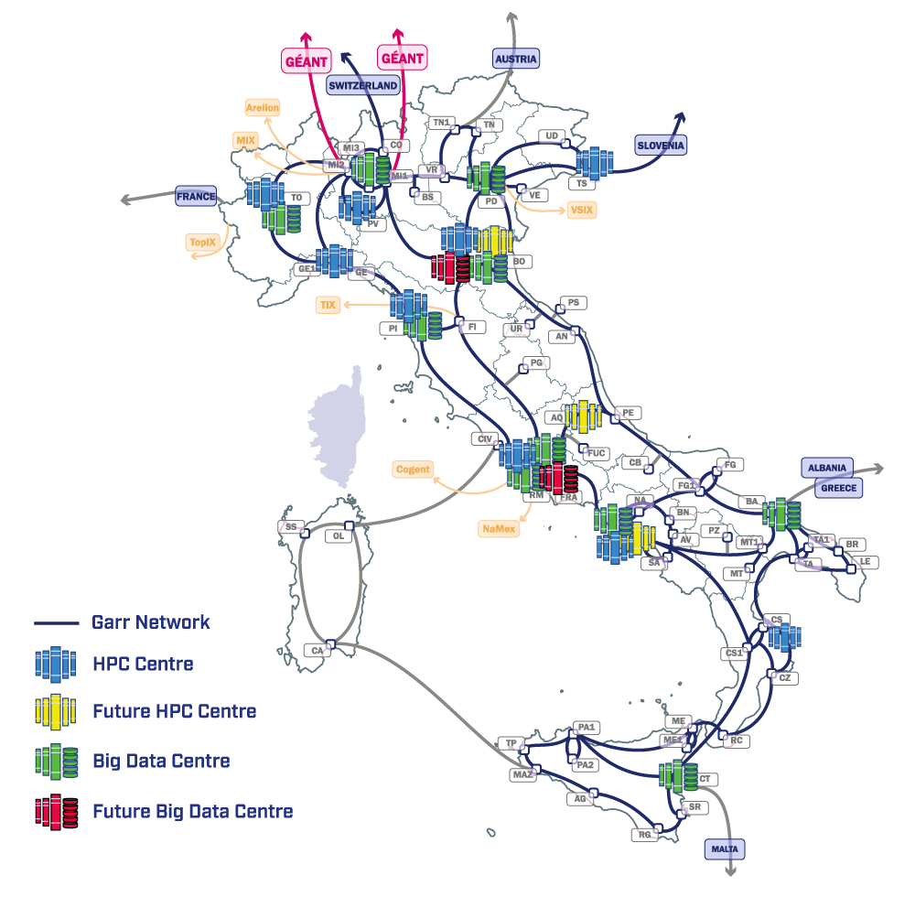


The PNRR ICSC National Center
The Italian Center for Supercomputing (ICSC) is a national research hub dedicated to advancing high-performance computing (HPC), big data analytics, and quantum computing
ICSC & INFN Resources:
Supercomputing resources (Leonardo and Galileo and HPC Bubbles: CPU and CPU+GPU)
Cloud resources (CINECA and INFN)
GRID/BATCH resources (INFN)
Storage (Disk and Tape, GRID and Cloud, POSIX and Object, accessible via multiple protocols)
FPGA resources via a collaboration with TeRABIT
EPIC Cloud (Enhanced PrIvacy and Compliance Cloud) resources (computing and storage)
SPOKE 0
federate and improve the CINECA and INFN computing resources
Strengthen the GARR IT network
IN-SILICO MEDICINE & OMICS DATA
The activity of this spoke is focused on medical research which relies on supercomputing to enable a precision medicine approach in Healthcare

Slide 16

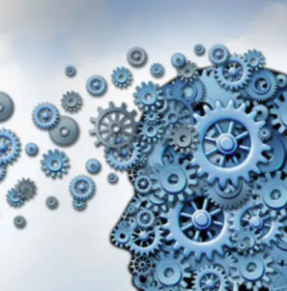

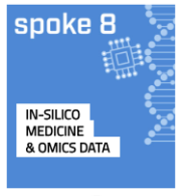
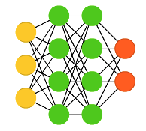
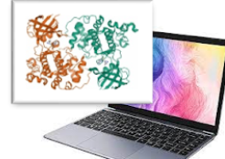
ICSC Spoke 8: In-Silico Medicine & Omics Data
WP1 Implementation of modelling & simulation platforms through HPC solvers (Francesco Pappalardo - UniCT)
In-Silico
Medicine
WP2 Digital Twins and In Silico Trials (Marco Viceconti - UniBO)
WP3 Integrated digital data flow between clinics and HPC centres and Easy-to-use GUI for HPC solvers (Barbara Martelli - INFN)
🧬
WP4 Genome bioinformatics pipelines for GPU-based HPC infrastructures (Chiara Romualdi - UniPD)
Omics Data
WP5 Development of clinical machine learning algorithms for EHRs and omics data (including radiomics) (Luigi Terracciano - Humanitas)
WP6 Drug-target studies and drug repurposing (Giorgio Colombo - CNR)
Notes:
EPIC Data Cloud is the cloud service developed and managed by CNAF to fulfill the requirements of projects and experiments dealing with clinical, biomedical and genomic data.

Slide 17











- Digital lifelong prevention
A national strategic initiative funded by the Ministry of University and Research (MUR) for the years 2022-2026 as part of the National Plan for Complementary Investments to the PNRR
A public-private partnership aimed at studying, coordinating and implementing innovative digital health solutions in Italy with a specific focus on primary, secondary and tertiary prevention: from mitigation of health risks to disease monitoring.​
https://www.fondazionedare.it/
Processing of sensitive data according to laws
Development of models with supercomputing resources
Risk predictors
Clinical translation
Quantification

Slide 18










Health Big Data is a multi-year funded project by the Italian Ministry of Health
Objective
To create an integrated and federated cloud platform to collect, share and analyse clinical and scientific data of patients from 51 Italian research Hospitals (IRCCS), and to provide advanced analytical resources for data analysis.
https://www.healthbigdata.it/
CBIM
HBD Data Cloud
Cloud ACC-INFN
The base for the national Molecular Tumor Board platform
51 IRCCS

Slide 19

INFN DataCloud and the adoption of Machine Learning
Courtesy of F. Lizzi and L. Anderlini
In early 2020, INFN introduced INFN Cloud as a private cloud provider federating sites in Bologna and Bari.
It complements the WLCG infrastructure with a focus on smaller experiments and individual researchers.
By 2023, DataCloud emerged as a flagship model for resource federation at national level within the NRPP.
DataCloud leverages composable, open-source, industrial-grade software, simplifying the management of heterogeneous hardware, as GPUs and specialized processors.
→ Immediate appeal for Machine Learning development!
Two specialized initiatives leveraging DataCloud:
2020 − 2023: ML_INFN, or the VM phase
2024 − 2026: AI_INFN, or the container phase
INFN-CSN5
The mandate of AI_INFN is to ease the adoption of Machine Learning techniques for INFN research.
And in particular:
Providing shared, low-bureaucracy access to GPU resources for interactive development;
Training (young) researchers with dedicated coding events (e.g. hackathons)
Building a network of experts on the adoption of machine learning for science
Exploring advanced hardware (e.g. FPGAs and Quantum systems) for ML tasks.

Slide 20





Offloading computing tasks to CINECA Leonardo and other HPC sites
Courtesy of F. Lizzi and L. Anderlini
The federated computing resources are significantly diverse (HTC, HPC, amd64, arm64, GPUs, FPGAs…)
Assigning tasks to the most suitable resources is key for a cost-effective, large-scale computation.
The AI_INFN Platform offloads tasks to 5 national sites via InterLink: a plugin-based Virtual Kubelet provider
The AI_INFN Platform on Kubernetes
Data reduction
or
Serialization
GPU-accelerated statistical data analysis
Interactive data analysis and visualization
Reporting/logging
results
D. Ciangottini, ICSC, CHEP 2024 L. Anderlini, ICSC, SIF 2024
Kubernetes-centric solution
Sites federated
✅ CINECA Leonardo
✅ ​TeRABIT HPC Bubble Padova
✅ CNAF Tier-1 − WLCG Site
✅ ReCaS Tier-2 − WLCG Site
HTC
HPC
Cloud

Slide 21




The AI_INFN Platform: a K8s cluster at the heart of developments
Courtesy of F. Lizzi and L. Anderlini
Monitoring
Highly-customizable platform based on JupyterHub, used to provide interactive development resources to INFN researchers.
Dedicated instances are deployed for the yearly hackathons.

Slide 22



Highlights
Healthcare applications: Development of AI-based system to predict of the Methylguanine-DNA methyltransferase (MGMT) Methylation Status from multiparametric brain MRI
UPENN-GBM dataset TCIA
https://wiki.cancerimagingarchive.net
Analysis of the multi-modal UPENN dataset:
brain-stem normalized images
5-fold cross-validation + test set
trained on a V100 GPU
binary cross-entropy + ADAM optimizer
Radiomic Features
T2 MRI
Brain Stem normalization
Enhancing Tumor
Random Forest
Multi-Layer Perceptrons
Model 1 - only radiomic
Model | Data | AUC
M1. RF, MLP | Radiomic features | Chance Level
M2. multi-input CNN | 3D FA and MD | 0.63 ± 0.09
M3. Multi-input CNN | 3D FA and MD+ Radiomic | Chance Level
Fractional Anisotropy
ResConv3D block
Concatenate
ResConv3D block
x5
MLP
Axial Diffusivity
ResConv3D block
Model 2 - only 3D images
For each subject: 11 MRI volumes + segmentations + clinical data are available
Model 3 - 3D DTI images + radiomic features
Lizzi, F., Saponaro, S., Giuliano, A., Talamonti, C., & Ubaldi, L. (2025). Radiomics and Deep Learning interplay for predicting MGMT Methylation in Glioblastoma: the Crucial Role of Segmentation Quality, Cancers, under review
INFN group in FAIR Spoke8: F Lizzi, F. Sensi, A. Chincarini and A. Retico

Slide 23













InTrEPID
In vivo 3D dosimetry in radiotherapy Treatments with EPID
MUR PRIN 2022
The complexity of the preparation and execution of Radiotherapy (RT) treatments has strongly increased in the last decades.
→ Reliable and fast Quality Assurance (QA) procedures are needed, also to comply to current regulations
The information encoded in EPID images acquired during the RT treatment, combined with the patient anatomy (CT), will be used by an AI algorithm to reconstruct the 3D dose map delivered to the patient
Coordinator: C. Talamonti, Univ. FI & Careggi Hospital
Sub-unit: M. Avanzo, IRCCS Centro
Riferimento Oncologico (CRO), Aviano (PN)
INFN Unit: A. Retico (Pisa)
A database of over 200 EPID measurements and corresponding PD simulations from the Monaco TPS was created, employing different phantoms and fields
The first phase of the project, focused on 2D data, was completed
A mean Gamma index of:
3%/3mm 94.5% ± 2.1%
5%/5mm 99.6% ± 0.3%
was obtained on an independent test set of 22 images
CIRS E2E torax. Multiplug Solid water
Training data for the 3D DL model was acquired. The design of the 3D model is in progress:
EPID image + 3D CT → 3D delivered dose map
INFN-CSN5. PI: A. Kraan

Slide 24





Pediatric Network for tele-monitoring and tele-rehabilitation of neurodevelopmental disorders and disabilities through the identification and analysis of digital biomarkers, identified through artificial intelligence
PI: IRCCS Stella Maris
4 INFN groups:
P. Oliva (project coordinator, Cagliari)
S. Tangaro, G. Donvito (Bari)
A. Galante (Lab. Naz. Gran Sasso)
A. Retico (Pisa)
Objectives:
to build a shared database of clinical data, functional scales, imaging and genomics for the main neurodevelopmental disorders and disabilities
to develop AI models to identify digital biomarkers for tele-monitoring and tele-rehabilitation in order to personalize therapies
platform for data management
ML analysis of temporal signals to monitor the human gait in disease conditions
[Tiddia G, Mainas F, Retico A, Oliva P. (2025). Applied Sciences (Switzerland), 15(14), 1–19. https://doi.org/10.3390/app15148078

Slide 25




PNRR ECS THE Tuscany Health Ecosystem INFN and Univ. of Pisa are involved in Spoke 1 - ADVANCED RADIOTHERAPIES AND DIAGNOSTICS IN ONCOLOGY coordinated by L. Gizzi (CNR, Pisa)
The CPFR (Centro Pisano Flash RadioTherapy), partnered
by INFN, performs in vitro and in vivo experiments to investigate basic mechanisms and parameter dependency of FLASH effect
Dosimeter for ultra-high dose-per-pulse and dose rates
(Di Martino et al, 2022 doi:10.1016/j.ejmp.2022.08.010)
INFN is contributing to the different experimental activities, and it is also developing a dedicated IT platform for data storage, sharing and AI-based data analysis. The IT platform is built on the XNAT technology (www.xnat.org)
XNAT
INFN group in THE: C Scapicchio, S Arezzini, T Boccali, M Celentano, A Formuso, A Kraan, S Lossano, E Mazzoni, A Moggi and A Retico
Notes:
dosimeter

Slide 26




CONNECTING DATA TO UNDERSTAND MECHANISMS: An IT Platform with Integrated Analysis for FLASH Effect Understanding
By properly organizing and connecting the data, the platform can facilitate multivariate analyses based on mathematical modeling and AI.
Explainable ML to uncover hidden links between experimental parameters and radiobiological outcomes
The platform links datasets across experimental domains: diverse raw data in heterogeneous formats generated from preclinical studies (beam and dosimetric parameters, biological parameters describing the irradiated sample, the experiment, and the endpoints, and simulation data).
Explainable AI
(feature importance, SHAP,…)
WHEN (for which irradiation parameters, type of tissue,…) does the effect happen?
INFN group in THE: C Scapicchio, S Arezzini, T Boccali, M Celentano, A Formuso, A Kraan, S Lossano, E Mazzoni, A Moggi and A Retico

Slide 27

Artificial Intelligence in Medicine: focus on Multi-Input Analysis (AIM_MIA)
INFN-CSN5
General goal: to take a step forward in the development and validation of AI-based tools for medical data analysis
Funded by INFN, CSN5: 2025-2027
Precision medicine promises improved health by accounting for individual variability in genes, environment, and lifestyle.
Big data collections and advanced analytics approaches (including AI) are needed to fully exploit the potential of the large amount of digital information available today for each patient.
Resp. Naz.: A. Retico
13 Research Units:
Bari (S. Tangaro) Bologna (D. Remondini) Cagliari (P. Oliva) Catania (M. Marrale) Ferrara (G. Di Domenico) Firenze (C. Talamonti) Genova (A. Chincarini) Lab. Naz. Sud (G. Russo)
Lecce (G. De Nunzio)
Milano (C. Lenardi)
Napoli (G. Mettivier)
Pavia (A. Lascialfari)
Pisa (M.E. Fantacci)
Objectives
Mining multi-modal information
Handling incomplete/missing/limited datasets
Development of a dedicated data and computing platform:
⇒ FAIR Guiding Principles:
Scientific data should be Findable, Accessible, Interoperable, and Reusable

Slide 28



Multiparametric Graph Neural Networks for studying human connectome: Autism Spectrum Disorder (ASD) case study
Graph Neural Networks (GNNs) are powerful tools for analyzing brain graphs.
Based on specific parcellation, graphs can model the brain, with:
nodes corresponding to anatomical regions (T1w-MRI)
edges representing functional connections (rs-fMRI)
Combining multiparametric information in the same graph enriches representations, offering a more comprehensive view of brain function and structure.
Funded by INFN, CSN5: 2025-2027
Resp. Naz.: A. Retico
13 Research Units:
Bari (S. Tangaro) Bologna (D. Remondini) Cagliari (P. Oliva) Catania (M. Marrale) Ferrara (G. Di Domenico) Firenze (C. Talamonti) Genova (A. Chincarini) Lab. Naz. Sud (G. Russo)
Lecce (G. De Nunzio)
Milano (C. Lenardi)
Napoli (G. Mettivier)
Pavia (A. Lascialfari)
Pisa (M.E. Fantacci)
ABIDE Subset:
736 male subjects
ASD and CTRL
[5-35] years
GNN classification of ASD vs. Control subjects
Model | Linear regression | Decision Tree | Linear SVM | Random Forest | GNN
AUC(%) | 67 ± 3 | 57 ± 2 | 66 ± 3 | 63 ± 3 | 72 ± 2
Explainable AI (XAI) techniques
By leveraging self-attention scores from the pooling layer, we identified the most salient and frequently occurring regions of interest (ROIs).
Relevant ROIs include: precuneus, linked to self-referential thinking and social cognition; posterior dorsal cingulate gyri, angular gyri, and superior temporal gyrus, which are part of or associated with the Default Mode Network (DMN), a network frequently found to be disrupted in ASD.
[Motisi GA, Mainas F, Tiddia G, Calderoni S, Oliva P, Retico A, Brain Informatics 2025]

Slide 29

BRAINSTAIN: BRAIN Studies and Technologies for Artificial Intelligence and Neuroscience
Computational Neuroscience & Neuromorphic Computing
INFN-CSN5
The BRAINSTAIN project integrates data analysis, theoretical models and technology:
to achieve a greater understanding of the brain
to create artificial intelligence solutions inspired by biology, evaluating neuromorphic systems and HW/SW co-design approaches
Project coordinators:
Giulia De Bonis and Alessandro Lonardo
Research units:
INFN-Cagliari (Bruno Golosio)
INFN-Roma1 (Andrea Biagioni)
INFN-Roma2 (Roberto Ammendola)

Slide 30



Focus WP1
CPAC pipeline for fMRI preprocessing leveraging on parcelization atlases: it extracts temporal series of BOLD signal and computes functional connectivity through Person correlation. An AI model uses these features for subjects’ classification (ASD vs neurotypical), measuring the impact of each feature on the classification process. The goal is to improve the understanding of mechanisms responsible for autism and promote the development of efficient treatments.
Applied Sciences (2024), https://doi.org/10.3390/app14177632
HOS (Hierarchical Optical Sampling) method for optimizing spatial resolution of calcium-imaging datasets
(paper in preparation)
TVB-Cobrawap workflow for tuning human brain models
(paper submitted, under review)

Slide 31



Focus WP2
Task1. Small scale: learning models for bio-inspired AI
Task2. Large scale models
Incremental learning and sleep cycles, to understand the energetic efficiency of human brain, enable incremental learning from fewer examples than in classic AI, and avoid catastrophic forgetting
T1. Recent Papers:
1) two-compartment neuron with contextual mechanisms: https://doi.org/10.3389/fncom.2025.1566196
2) thalamo-cortico-hyppocampal network transferring episodic memories to cortical abstractions https://doi.org/10.1016/j.neucom.2025.130323
3) Integration of the neuron in the NEST/NESTML engine: biorXiv https://doi.org/10.1101/2025.06.30.662287
Multi-area model of the macaque cortex (multi-GPU, ~4x10⁶ neurons, ~24x10⁹ synapses) simulated using NEST GPU on CINECA Leonardo booster
Scalable Construction of Spiking Neuronal Networks using up to thousands of GPUs (paper almost ready for submission)
State propagation time of the HPC benchmark model for 1000 ms of model
time as a function of the number of cluster nodes for the three optimization levels with spike recording and for the optimization level 2 with disabled spike recording (256 nodes ~ 2.3×10⁸ neurons 2.6×10¹² connections)
Contact: pier.paolucci@roma1.infn.it
Contact: golosio@unica.it

Slide 32







WP3: Neuromorphic Computing
FPGA
^{NETWORK IP}
0
^{INTERNODE PORTS}
Neuromorphic computer architecture specialized for energy efficiency, real-time processing, incremental learning.
Targeting primarily dataflow-intensive applications in physics (edge AI, Spiking Neural Networks).
1
ROUTING IP (VHDL)
^{INTRANODE PORTS}
0
1
2
3
AIGOR CORE 0
I/O CORE 0
AIGOR CORE 1
I/O CORE 1
HLS
Multi-FPGA prototype
Modular, scalable, reconfigurable architecture prototype with multiple levels of parallelism
Flexible workflow based on High-Level Synthesis
Capable of supporting biologically realistic neuron models, via multiple receptors and an adaptable neuron dynamics module (e.g. multi-compartment neuron from WP2, distilled for efficient hardware implementation)
FPGA
^{NETWORK IP}
0
^{INTERNODE PORTS}
1
ROUTING IP (VHDL)
^{Cfg/Sts}​
^{INTRANODE PORTS}
0
1
2
3
AIGOR CORE 0
I/O CORE 0
AIGOR CORE 1
I/O CORE 1
HLS
2000
NEST Neural Activity Raster Plot
1500
Test network
Neuron ID
1000
p = 0.1
500
p = 1
Inhibitory
410
0
500
1000
1500
2000
Poisson Gen rate = 800 Hz
p = 0.1
Sim Time (ms)
p = 0.1
2000
AIGOR Neural Activity Raster Plot
p = 1
Excitatory
1638
W_exc = 0.1 mV
W_inh = - 0.5 mV
1500
Neuron ID
p = 0.1
1000
500
0
500
1000
1500
2000
Sim Time (ms)

Slide 33
Conclusions
Several INFN research activities rely on:
HPC resources
large scale computing infrastructures
Big Data platforms
Advanced AI techniques
The availability of these resources is an enabling technology for Life Science studies.
Many other societal challenges (e.g. in the field of environmental studies, Cultural Heritage, etc.) can benefit from the use of these computational methodologies and tools.

Slide 34

Conclusions
Several INFN research activities rely on:
HPC resources
large scale computing infrastructures
Big Data platforms
Advanced AI techniques
The availability of these resources is an enabling technology for Life Science studies.
Many other societal challenges (e.g. in the field of environmental studies, Cultural Heritage, etc.) can benefit from the use of these computational methodologies and tools.
Thank you and
Merry Christmas

Slide 35
ADD-ONS

Slide 36


Geant4 simulations of plasmas
Plasma physics very complex, standard condensed history MC codes can potentially work only in a fraction of the plasma parameter space
First implementation of plasma stopping power in Geant4
Tailored to p-¹¹B and DT reactions
Simulation of charged-particle energy deposition in hot, dense fusion plasma
Integration of the Modified Li–Petrasso (MLP) / Novel Single-Scattering Model (NSSM) into Geant4's electromagnetic physics module
Next Steps: benchmark the new module against analytical models
Validation of α energy loss in p-¹¹B and DT plasmas

Slide 37
MRADSIM-DOSE-MED
MRADSIM by Beamide (INFN spin-off): very friendly graphical tool to perform MC for dose simulations
Initiated for space applications
Using Geant4 as internal simulation engine
Version MRADSIM-DOSE-MED available, tailored to medical applications (e-linac)
Handles radiation safety, beam profile and phantom-related calculations
Intercalibrates with onsite detectors and simulates expected beam profiles and dosimetric quantities as the air kerma and ICRU parameters, e.g. H*(10)

Slide 38

Geant4-DNA flow in one view
Geant4-DNA supports the entire flow, both «MC Simulation block» and interface to damage models

Slide 39





Modeling of an innovative electron linac for FLASH radiotherapy using Monte Carlo Geant4 simulations
eFLASH_radiotherapy advanced example
included in Geant4 offical distribution from 2022
Current authors: J. Pensavalle (University of Pisa, Italy), G. Milluzzo, F. Romano (INFN Catania, Italy)
The ElectronFLASH LINAC installed at the Centro Pisano for FLASH Radiotherapy CPRF by following the manufacturing specifications provided by Sordina Iort Technologies S.p.A for FLASH radiotherapy preclinical studies
Simulation of a water phantom and detectors placed within the phantom to predict dose distributions and scattering
G4MED
Arce P, Archer JW, Arsini L, et al.Results of a Geant4 benchmarking study for bio-medical applications, performed with the G4-Med system. Med Phys. 2025;1-55.
Members and contributors to the Geant4 international collaboration
Members of the Geant4 Simulation Benchmarking Group (G4MED)

Slide 40









Monte Carlo simulations for electron minibeam radiotherapy
Reducing toxicity to normal healthy tissues through spatial fractionation of the dose
Validation of different Monte Carlo codes with experimental data using 9 MeV electron minibeams
eFLASH_radiotherapy
J. Pensavalle et al.,Frontiers Physics 2023
Real tungsten collimators

Slide 41






Monte Carlo simulations for proton minibeam radiotherapy
The beam quality and the energy spectrum vary along the minibeam pattern due to secondary particle contribution (low energy protons) on the valleys
Microdosimetry
Geant4 simulations using the exp_microdosimetry advanced example
Current authors: G. Milluzzo, F. Romano, S. Guatelli, D. Boltz
Now a general-purpose versatile example for the simulation of several micrododosimeters:
Silicon carbide microdosimeters
Silicon microdosimeters
Diamond microdosimeters
Tissue Equivalent Proportional counter (TEPC)
Several functionalities available for users:
Implementation of macro commands for easily changing the different geometrical configurations and parameters
Python scripts for microdosimetric spectra and average values calculation
Dose distribution y d(y)
→ Shift towards higher y (LET) and broader distribution in the valley region

