Slide 1
Instrumentation for the Positioning and Orientation System
All the instrumentation used in the Positioning of KM3NeT is developed in house or in strong interaction with manufacturers
Acoustic Beacons
MSM (Spain): Mechanics – UPV: Electronics – Design Specs: KM3NeT -LNS
Hydrophones:
Colmar (Italy) – Design Specs: KM3NeT- LNS
Piezo in DOM
GCD (Germany) – Design Specs: KM3NeT-ECAP
Compasses
AHRS: I2C (Italy) – Design Specs: KM3NeT-LNS
LSM303: Nikhef

Slide 2
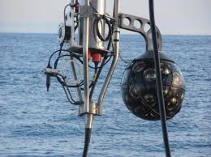
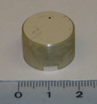
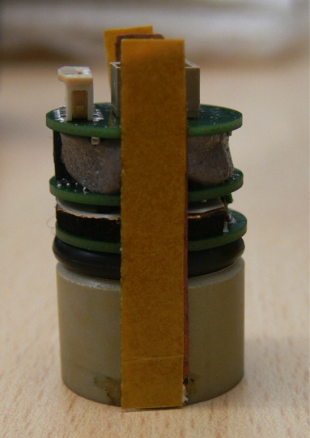
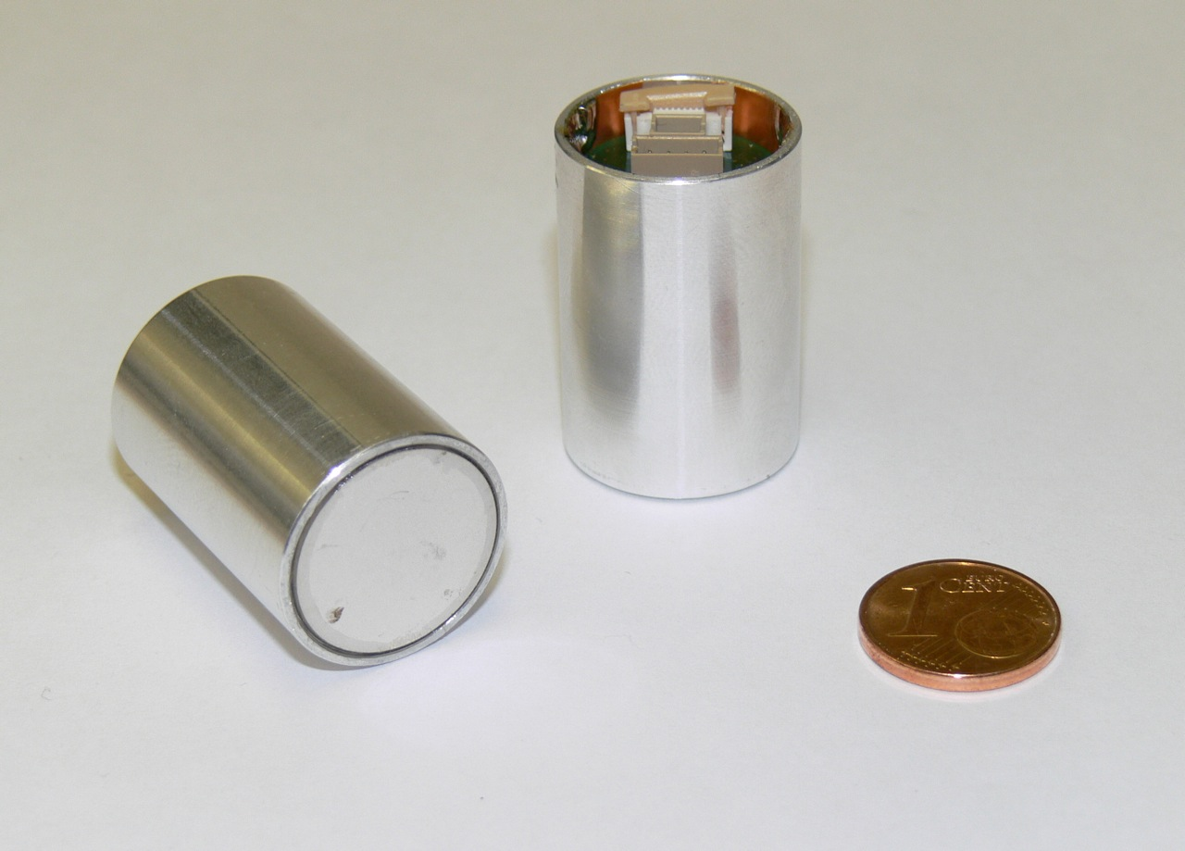
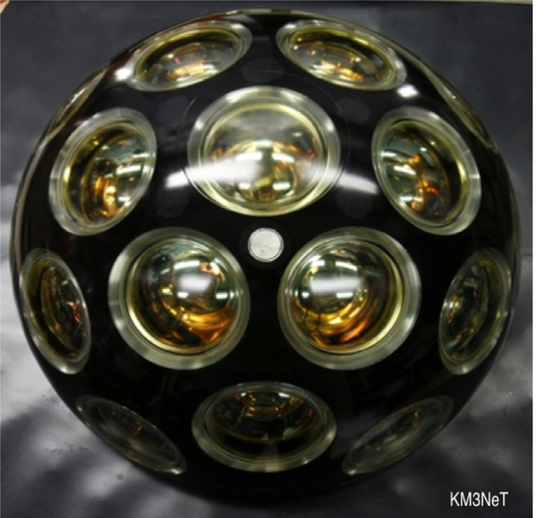
RAPS: Piezo in DOM
Piezo ceramic sensor: Pz27 from Ferroperm
24-bit Sigma-Delta ADC (AD7764BRUZ -TSSOP28). Signal input Range 4Vpp
ADC Clock 25 MHz clock (provided by the CLB): sampling frequency 195.3125 KHz(1/128th of 25 MHz)
FPGA to convert output in AES3 Format (easy readable with CLB FPGA)
Design sensitivity: -160 ± 6 dB re 1V/μPa at 50 kHz (±3 dB variation in 10 kHz:70 kHz)
DOM in ANTARES
The piezo-electric digital acoustic receiver is glued from the inside to the glass sphere of each KM3NeT digital DOM
DOM South pole

Slide 3
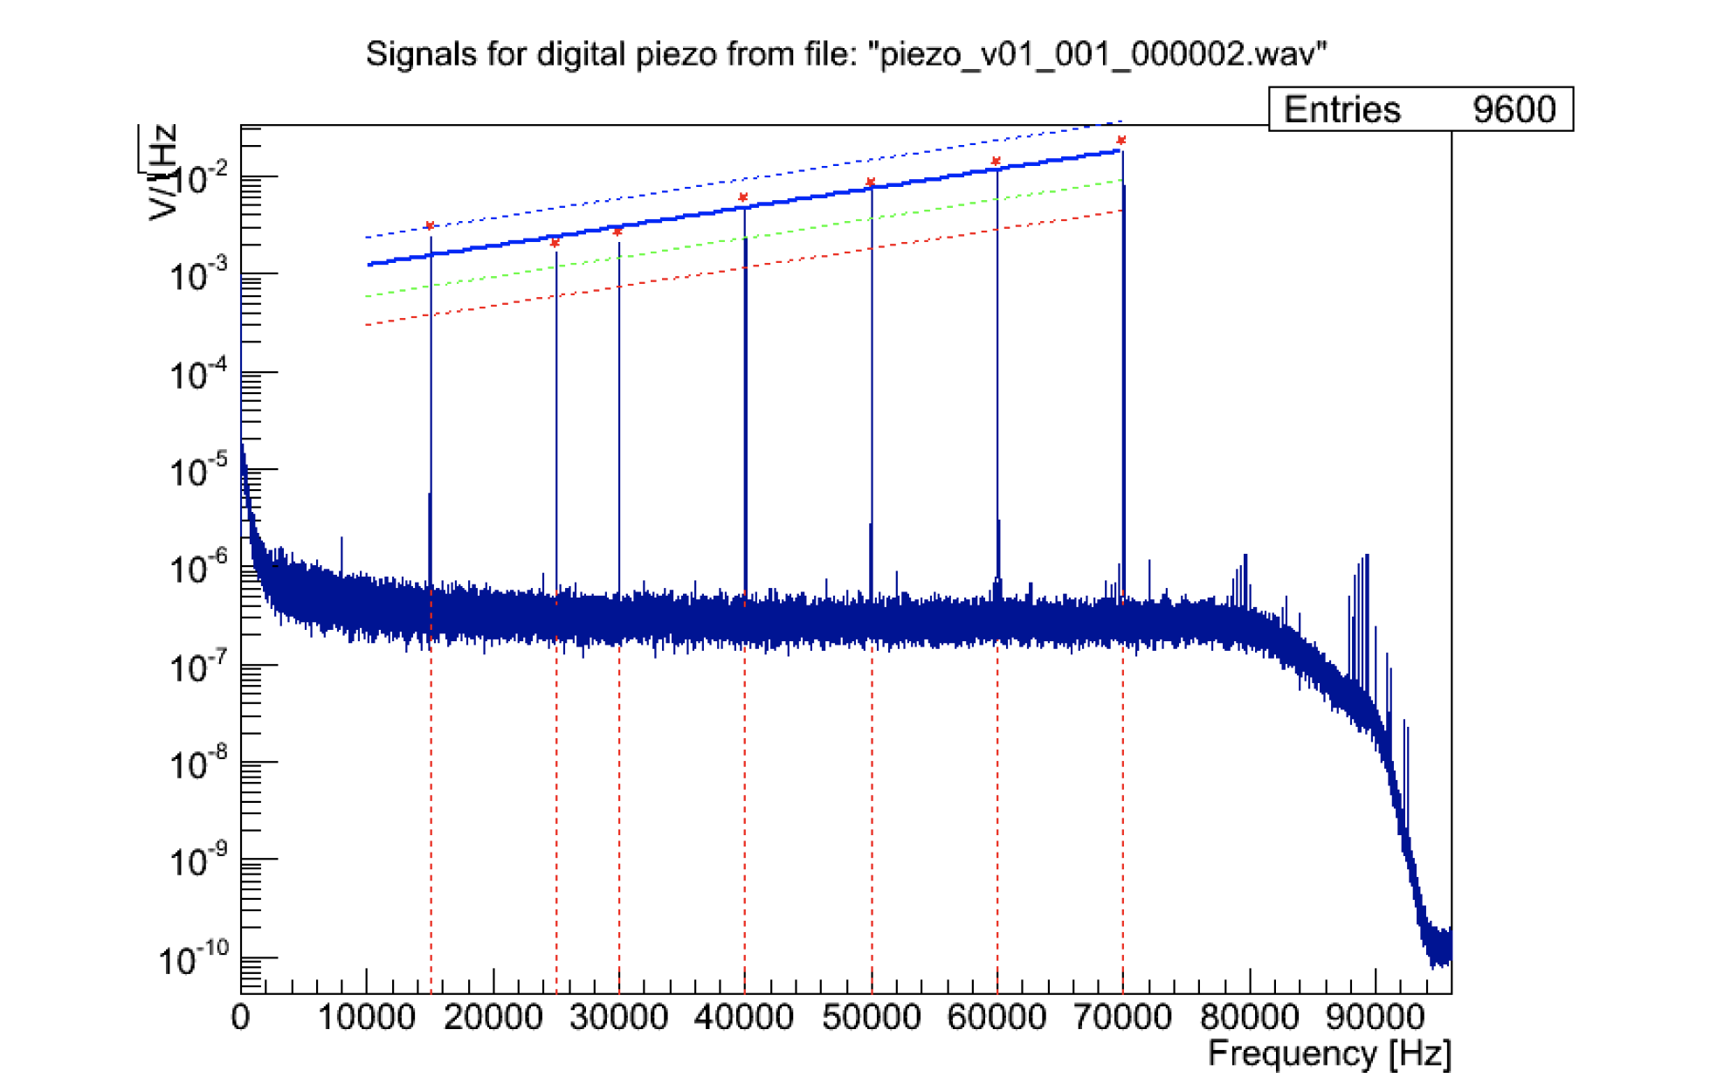
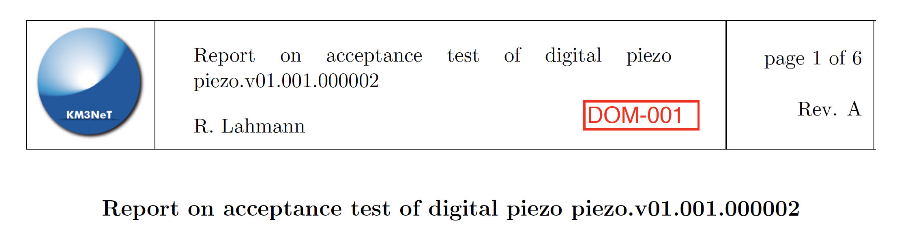
RAPS: Piezo in DOM
Design of the piezo has undergone FIDES Analysis (electronics): FIT 7, negligible
Each piezo receiver is tested at ECAP when received.
Noise and linearity of response

Slide 4
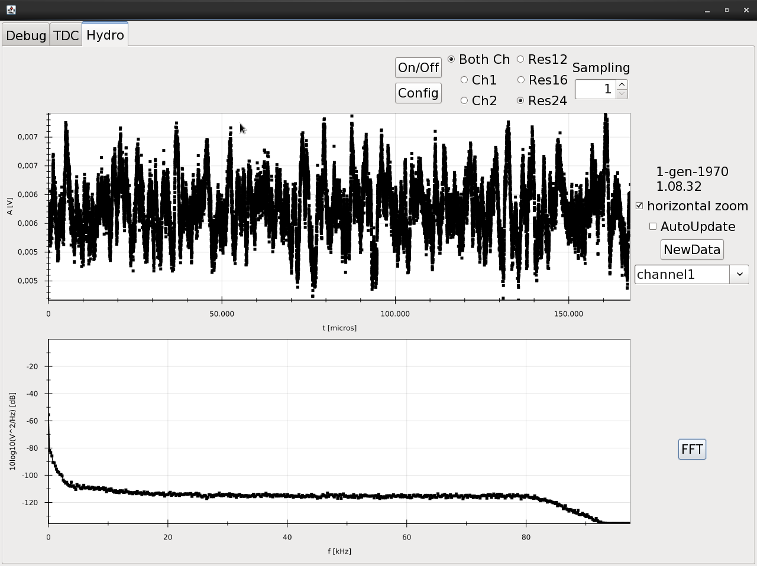
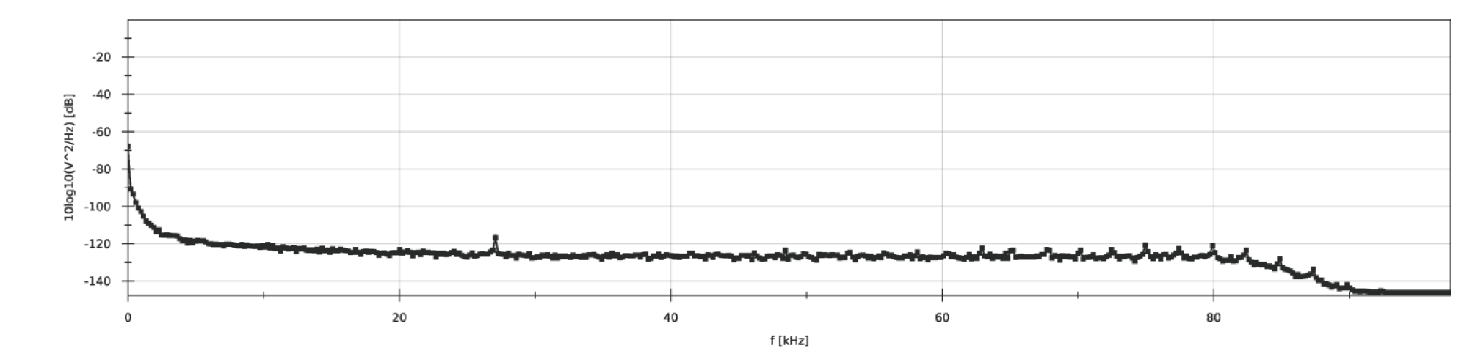
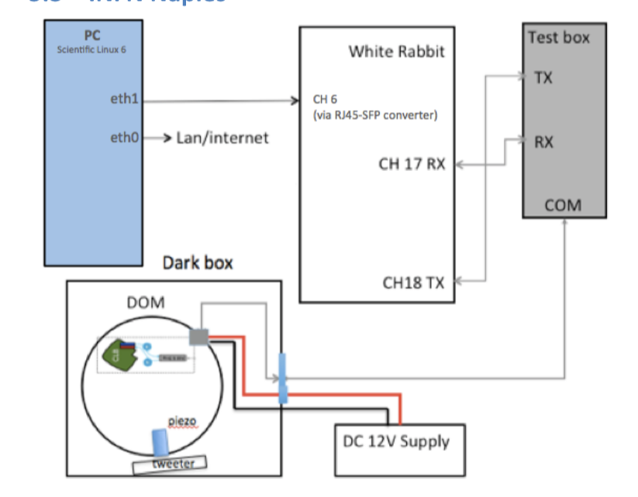
RAPS: Piezo in DOM
Design of the piezo has undergone FIDES Analysis (electronics): FIT 7, negligible
Each piezo receiver is tested at ECAP when received.
DOM Acceptance Test: baseline limits and number of peaks
Baseline check (ADC connected and not noisy). Presence of peaks >6dB in 20-40 kHz range

Slide 5
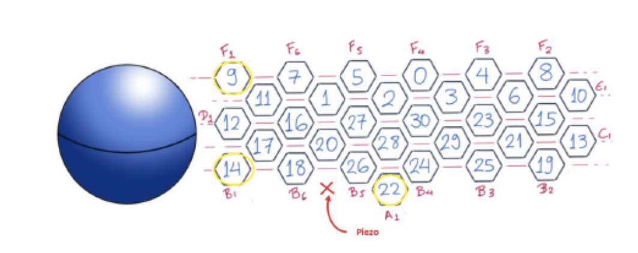
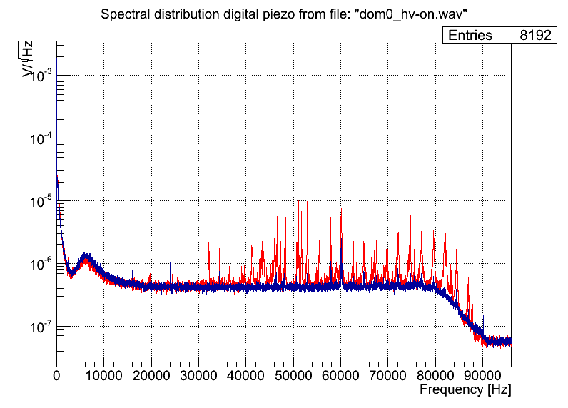
RAPS: Piezo in DOM
Design of the piezo has undergone FIDES Analysis (electronics): FIT 7, negligible
Each piezo receiver is tested at ECAP when received.
DOM Acceptance Test: baseline limits and number of peaks
Test of EM Susceptiviy (Demokritos)
PMTs On
PMTs Off
PMTs contributing to noise of piezo
Piezo Waived if Npeaks <3 and increase of noise is 1.5 dB/kHz in 35-40 kHz range
No more than 2 not working piezos in each DU (not consecutive)

Slide 6
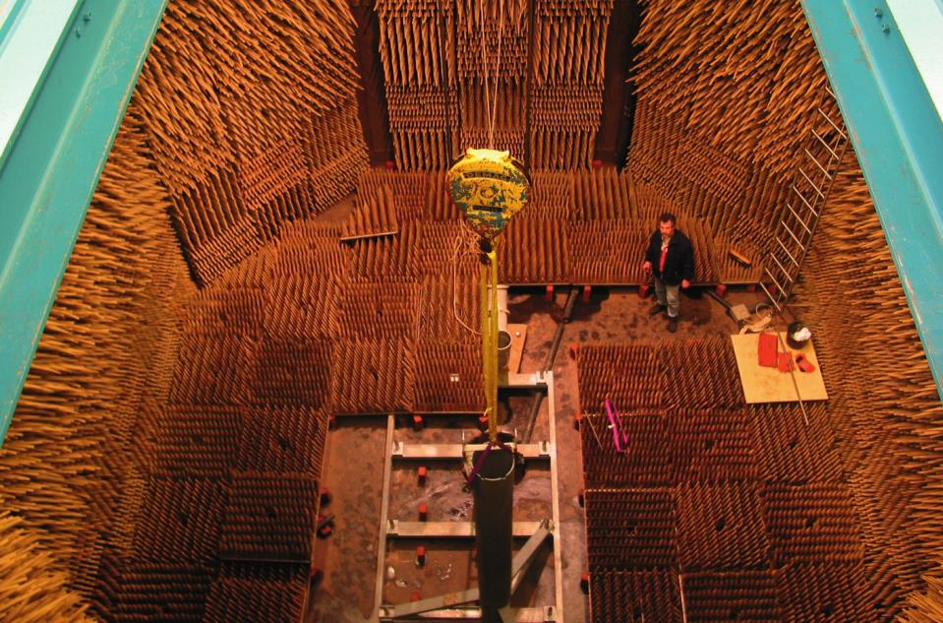
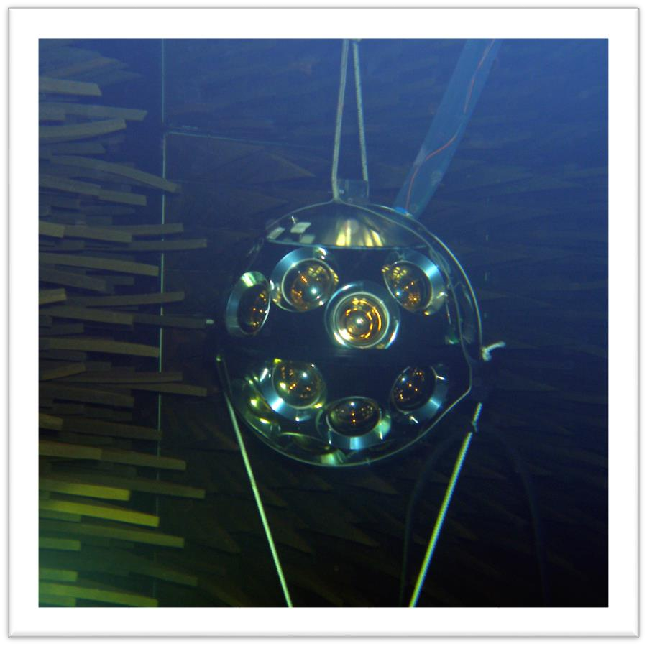
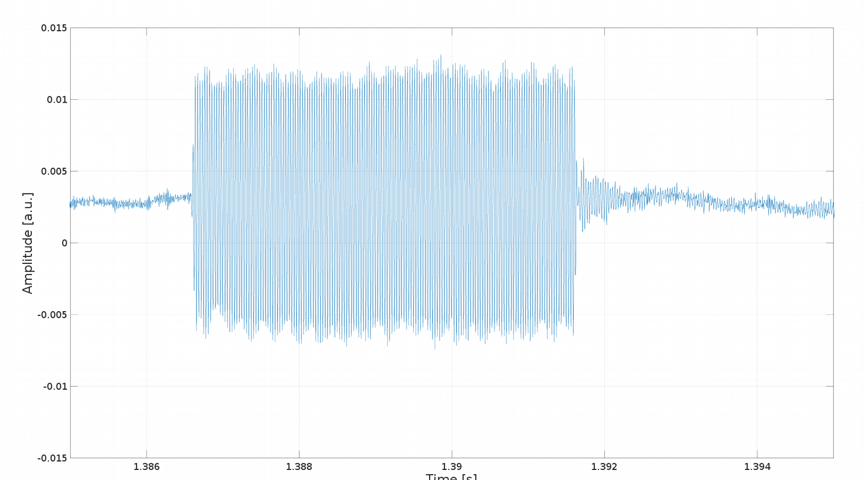
RAPS: Piezo in DOM
Design of the piezo has undergone FIDES Analysis (electronics): FIT 7, negligible
Each piezo receiver is tested at ECAP when received.
DOM Acceptance Test: baseline limits and number of peaks
Test om e.m. susceptivity (Demokritos)
Test of DOM response in water (TNO)
High level of redundancy (18 DOMs/DU, 6 needed for DU line shape fit)
DOM 18 in ORCA DU

Slide 7
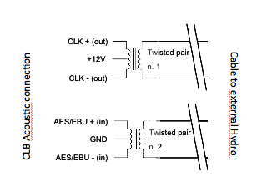
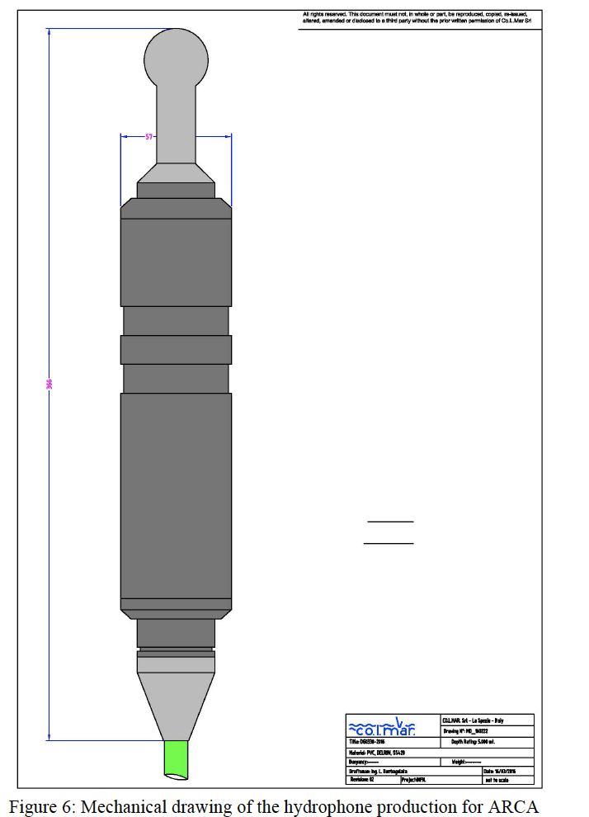
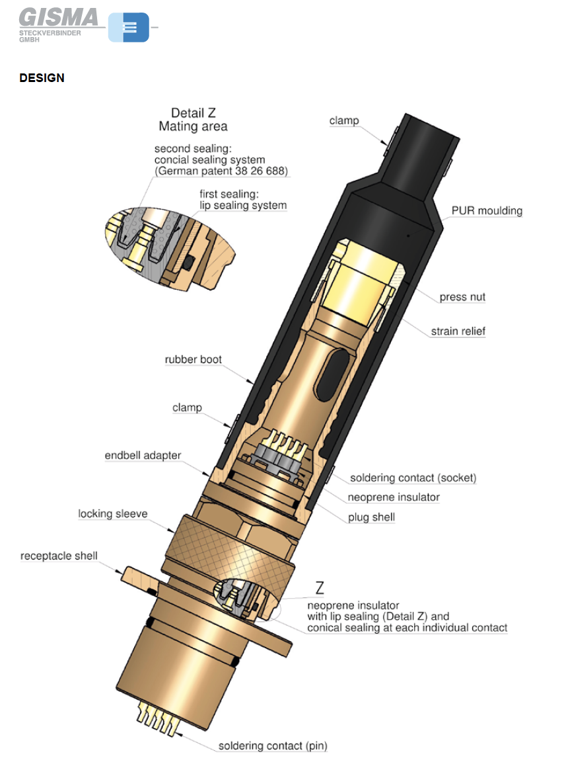
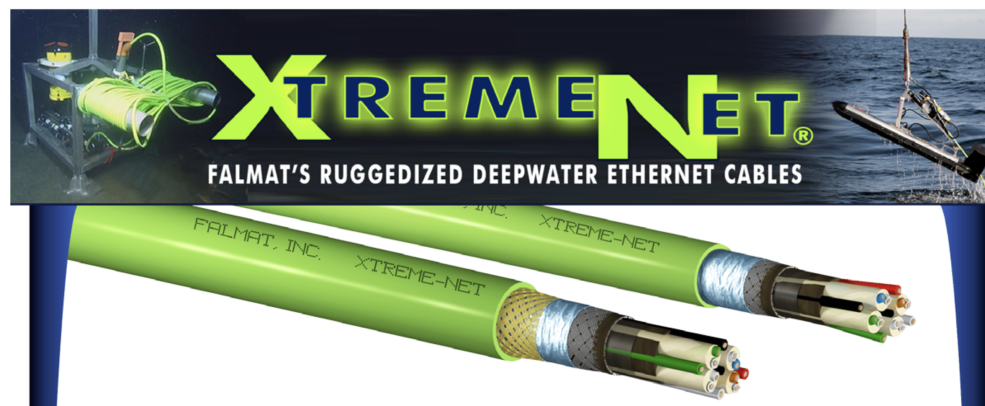
RAPS Hydrophone: COLMAR DG300
Installed on each DU base, CB, JB(ARCA)
Material POM-C. Falmat CAT6 cable. Gisma connector (ARCA) or Seacon (ORCA)
Output AES 3 data, Clock (25 MHz) and 12V power supply provided by Base CLB. Dual Gain
FM022208-08 1Gig Cat6^ 4pr-23AWG Data

Slide 8
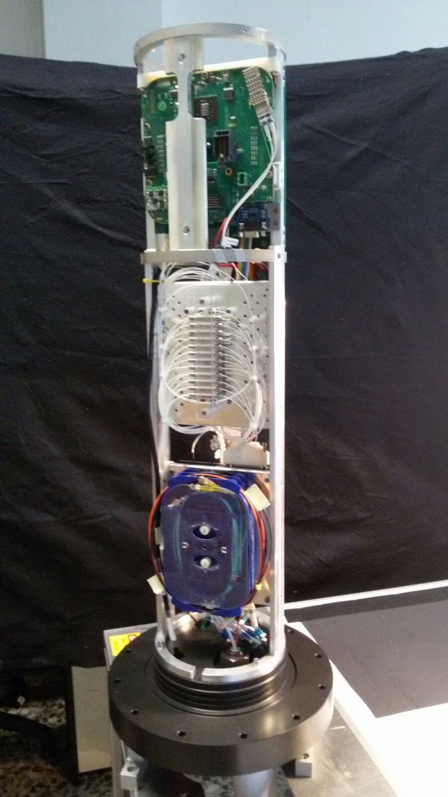
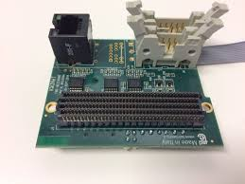
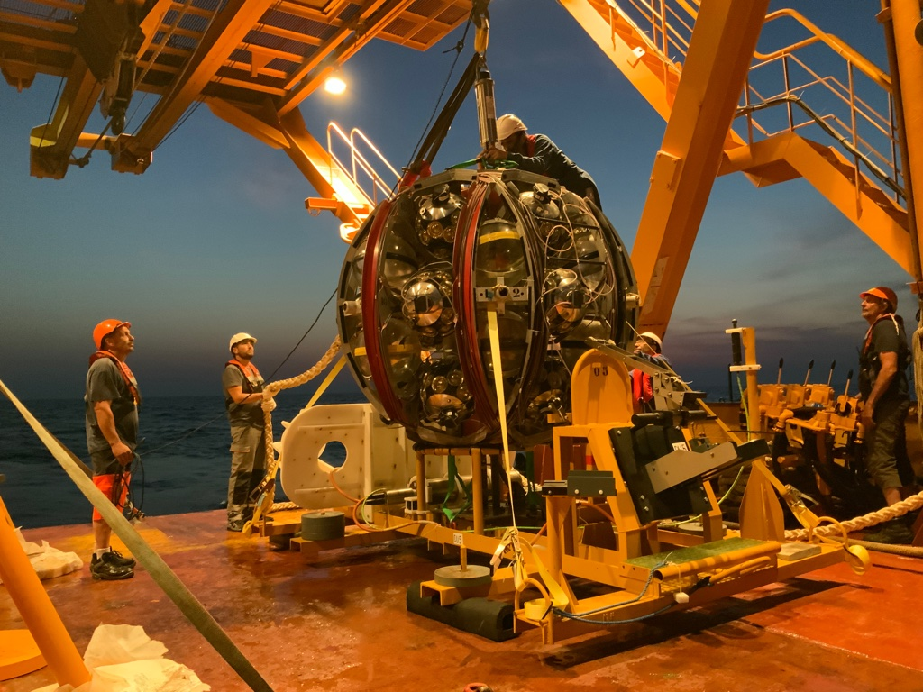
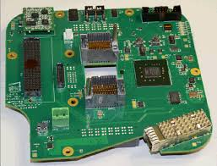
Hydrophone on a DU Base

Slide 9
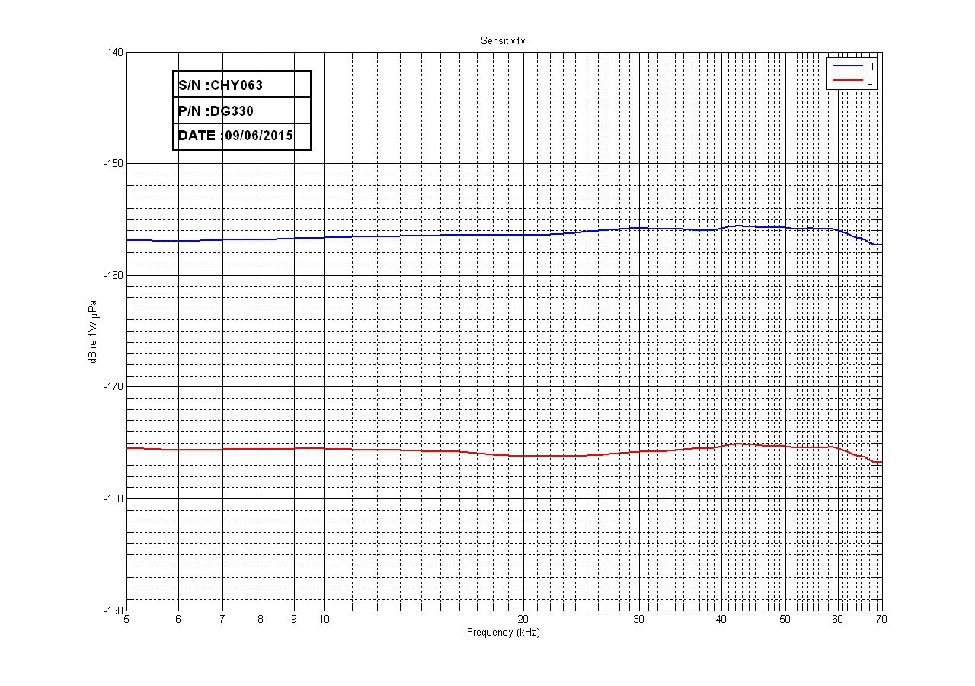
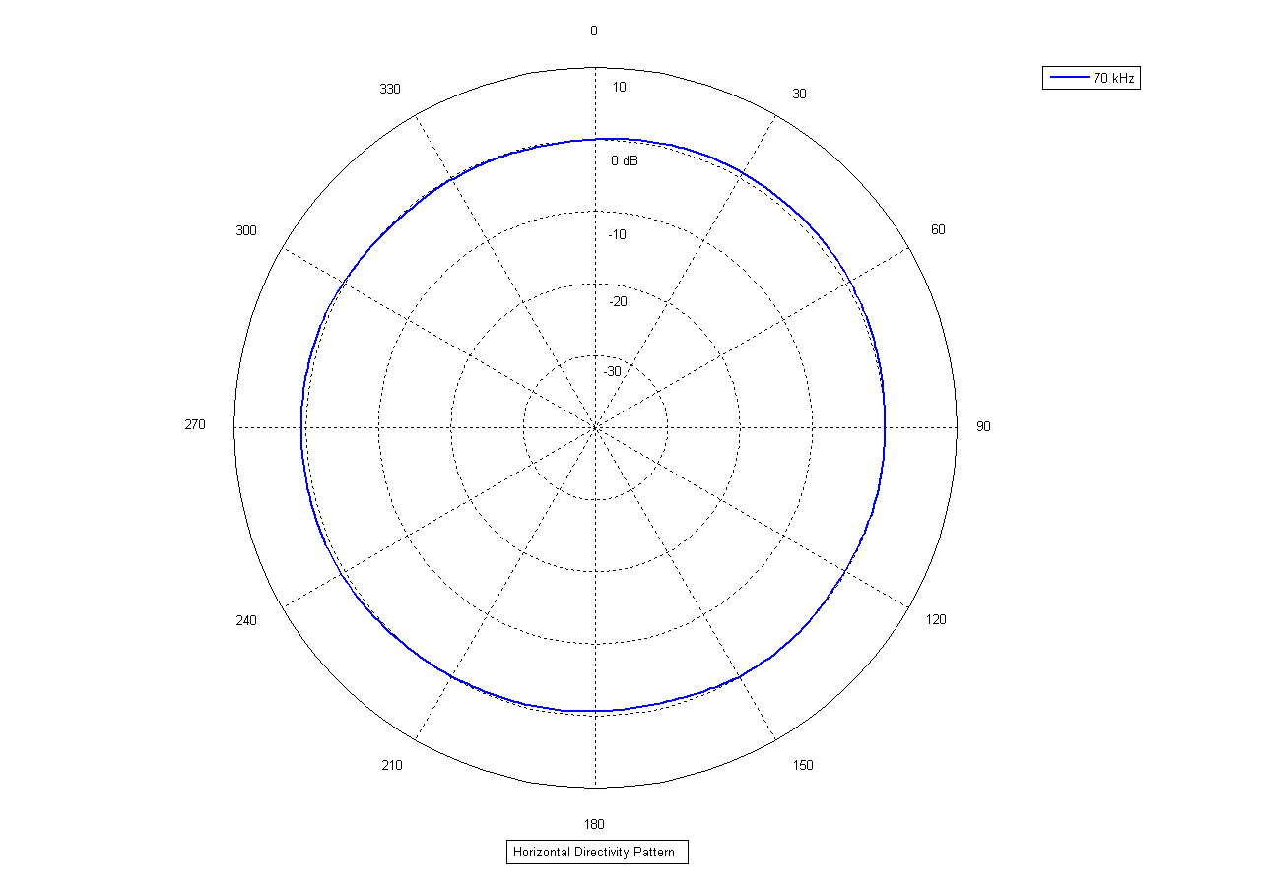
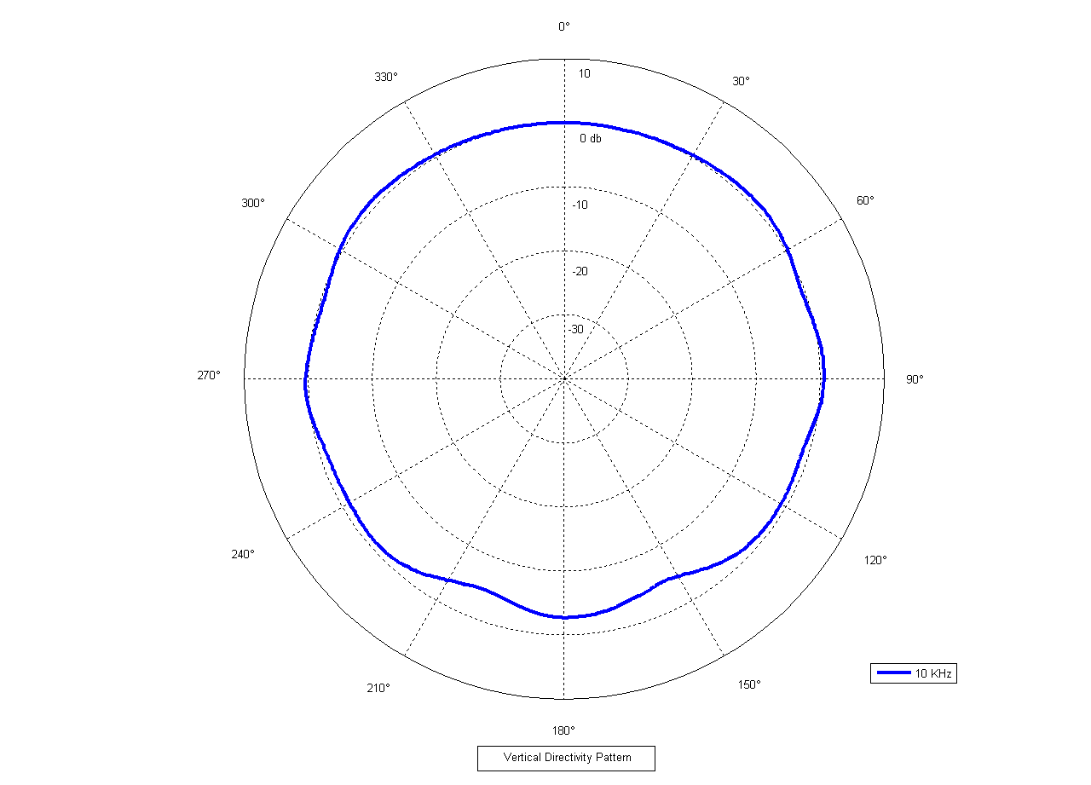
Hydrophone: COLMAR DG330
Dual Gain
Low (+26 dB) : Close beacon detection
High (+46 dB): Very far beacon detection and interdisciplinary science
Sensitivity
Omnidirectional
High-pass 600 Hz filter applied in 2/3 of ARCA hydrophones to get rid of low frequency noise. Negligible impact on time delay

Slide 10
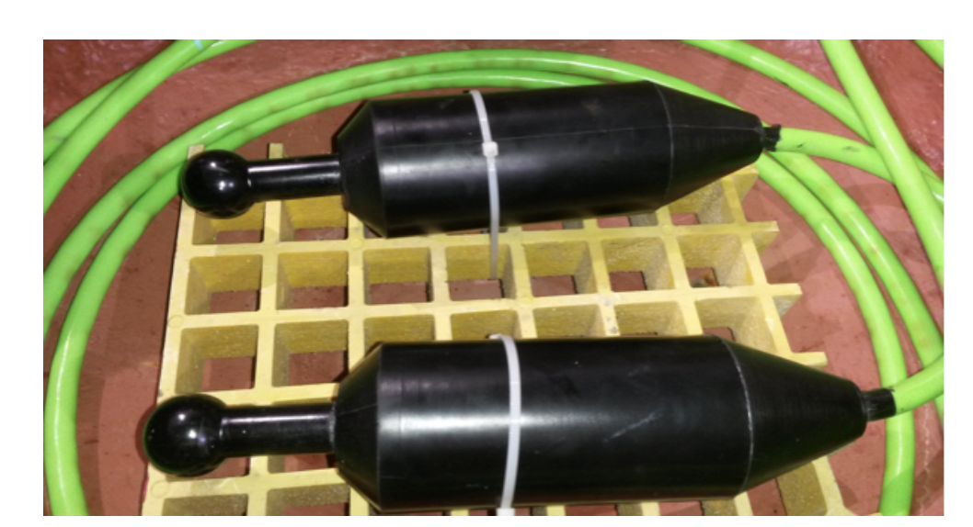
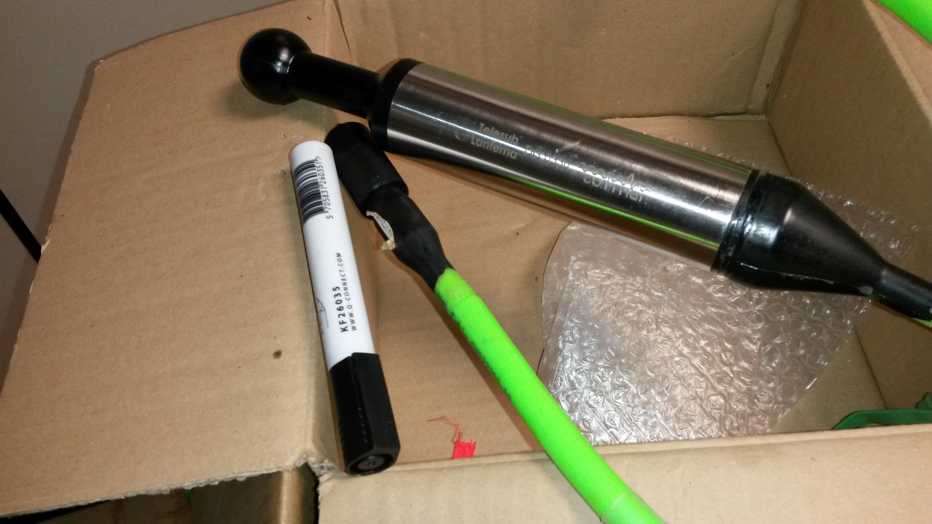
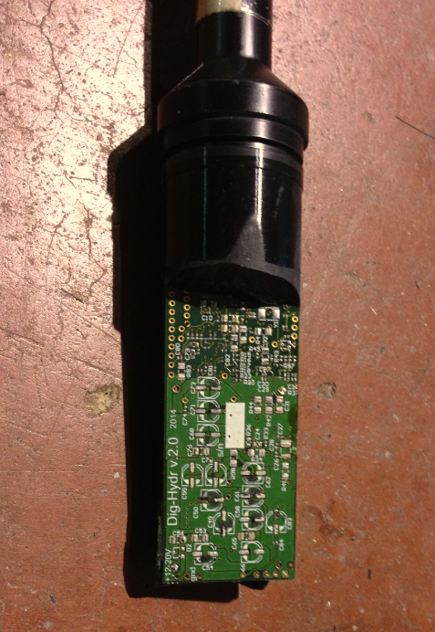
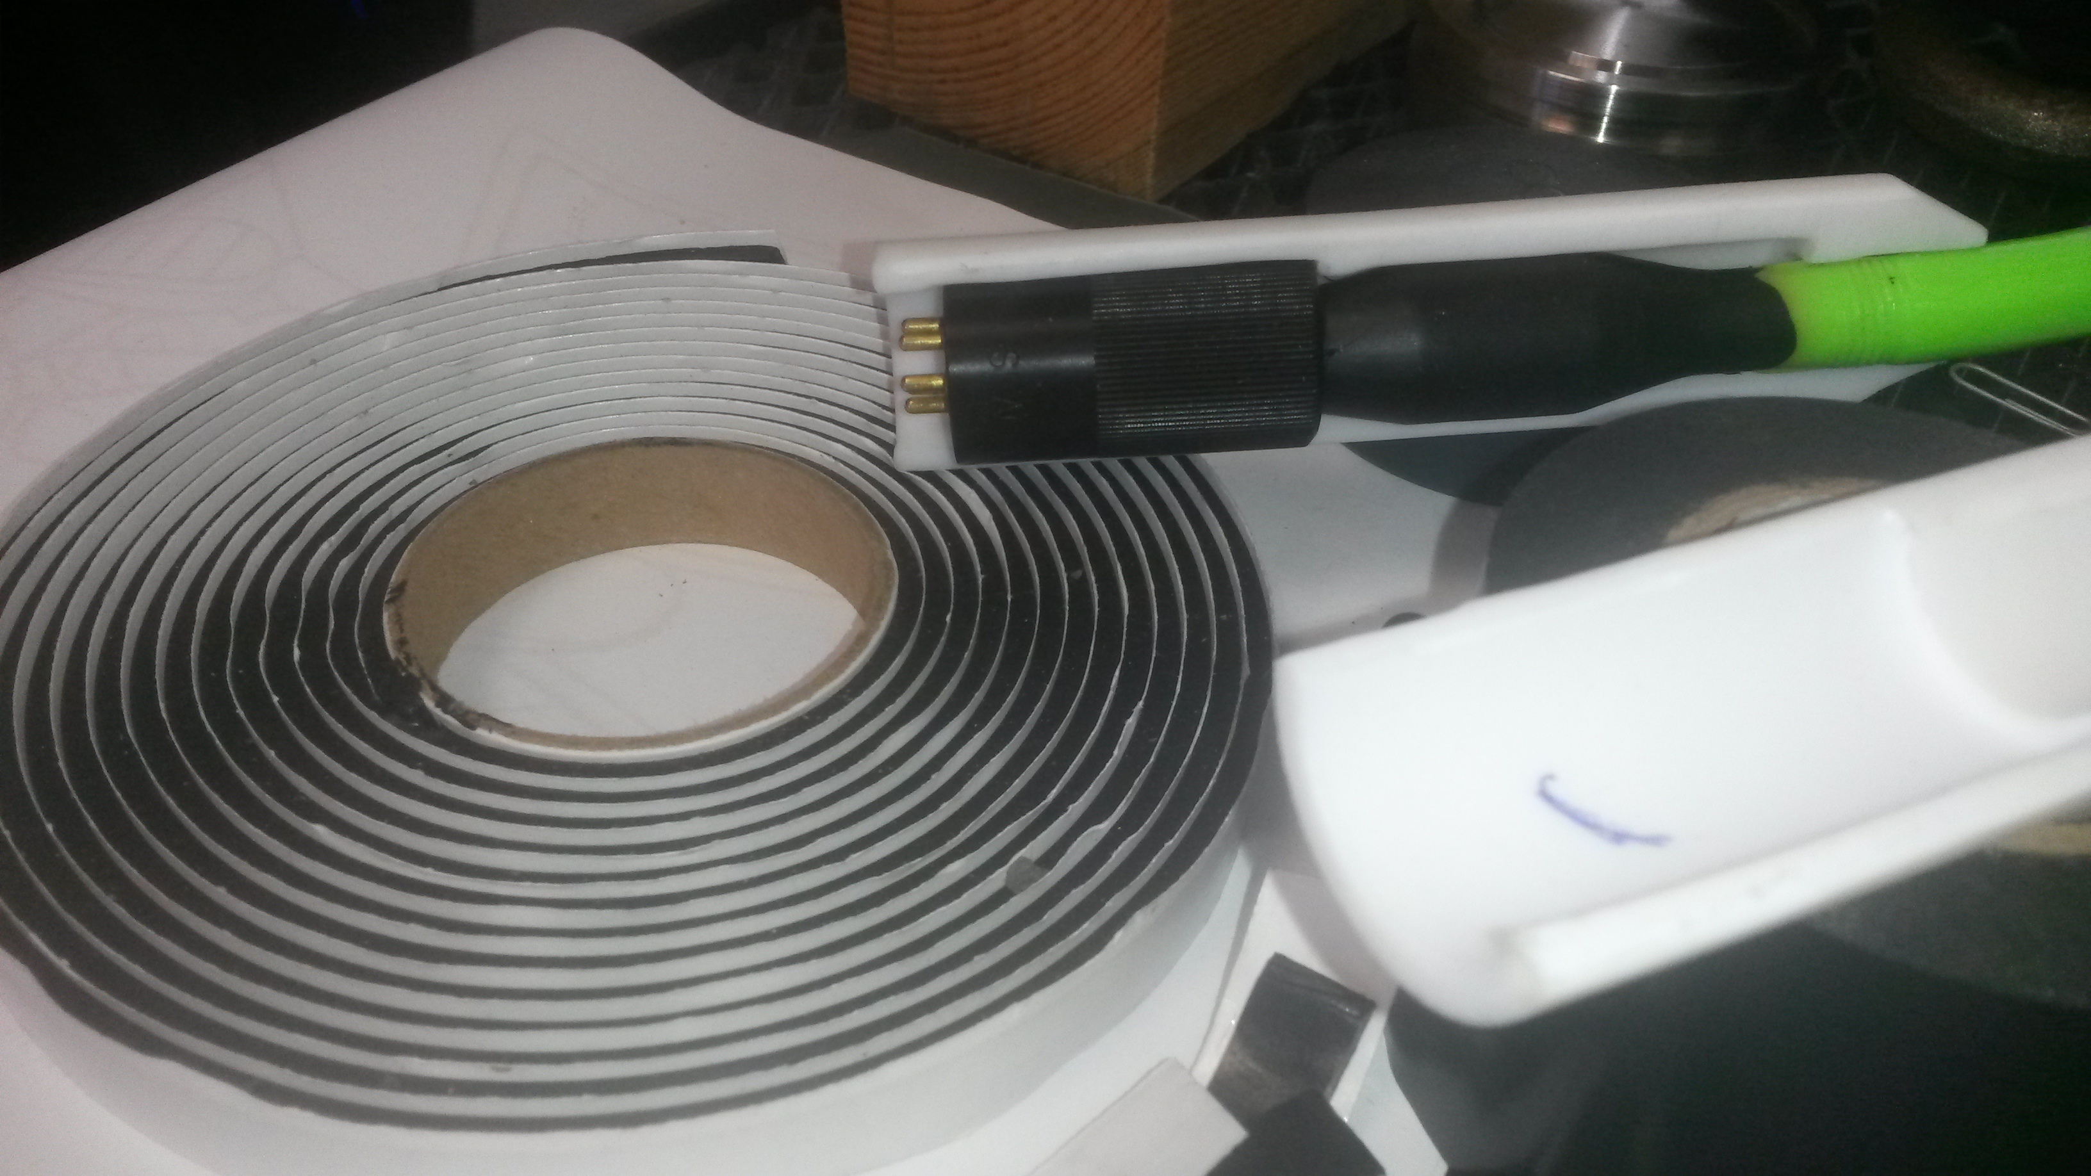
Hydrophone: Previous versions
Mechanical layout corrections

Slide 11
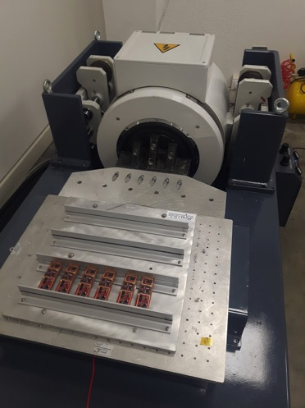
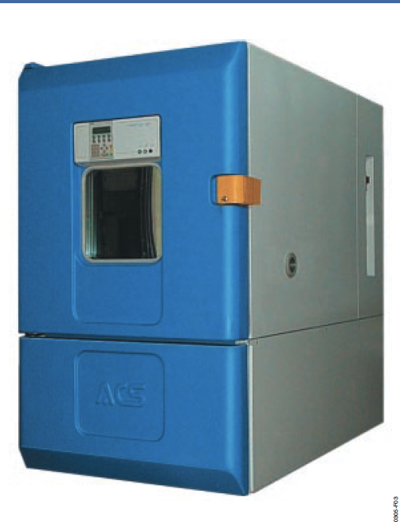
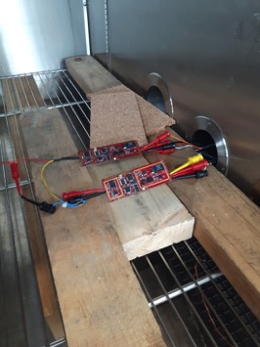
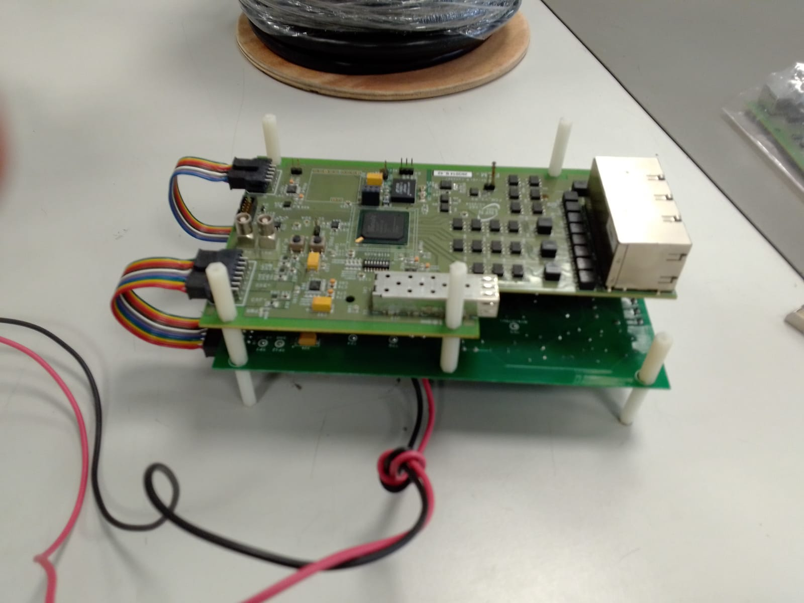
Hydrophone: Qualification - Electronics
FIDES Analysis performed (NDA signed with Colmar): Unit Failure risk (20 years) 19%
Electronics: HALT and HASS: performed at GSD (Italy)
HALT
3 Vibration cycles at 6GRMS (20:400 Hz), Thermal: -60°:+90° → reversible proble (Total noise increase above 80°)
HASS:
1 Vibration cycle (x,z) at 6 GMRS , Thermal: - 40°:+65° → all boards OK

Slide 12
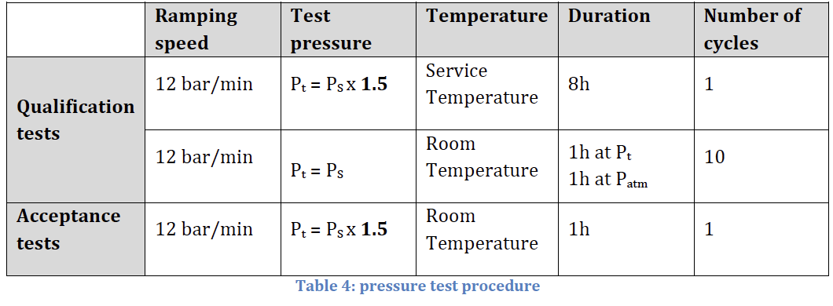
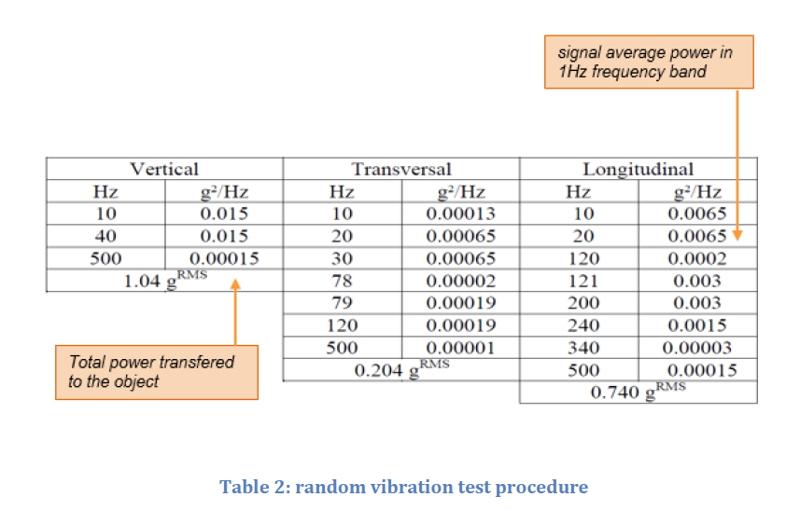
Hydrophone: Qualification and FAT
2 items for qualification
27 ARCA
13 ORCA
Pressure
Vibration
Power on-off: 100 cycles

Slide 13
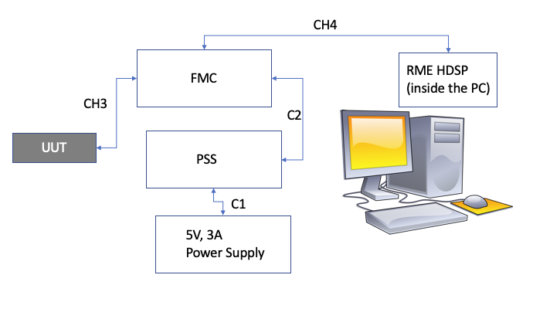
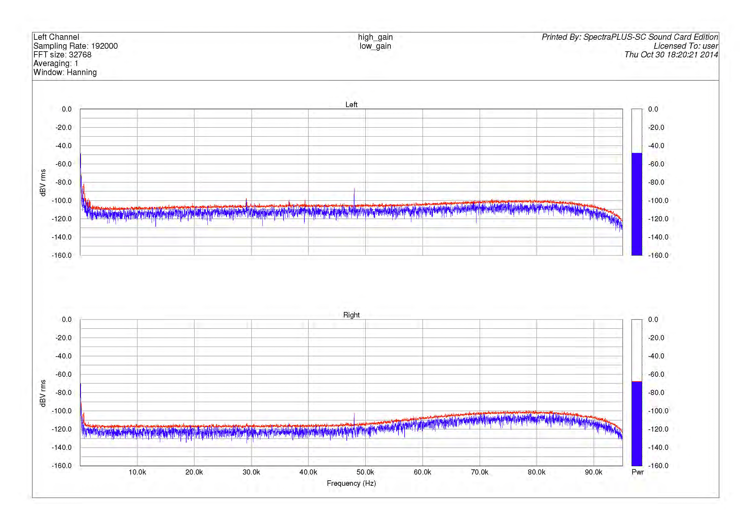
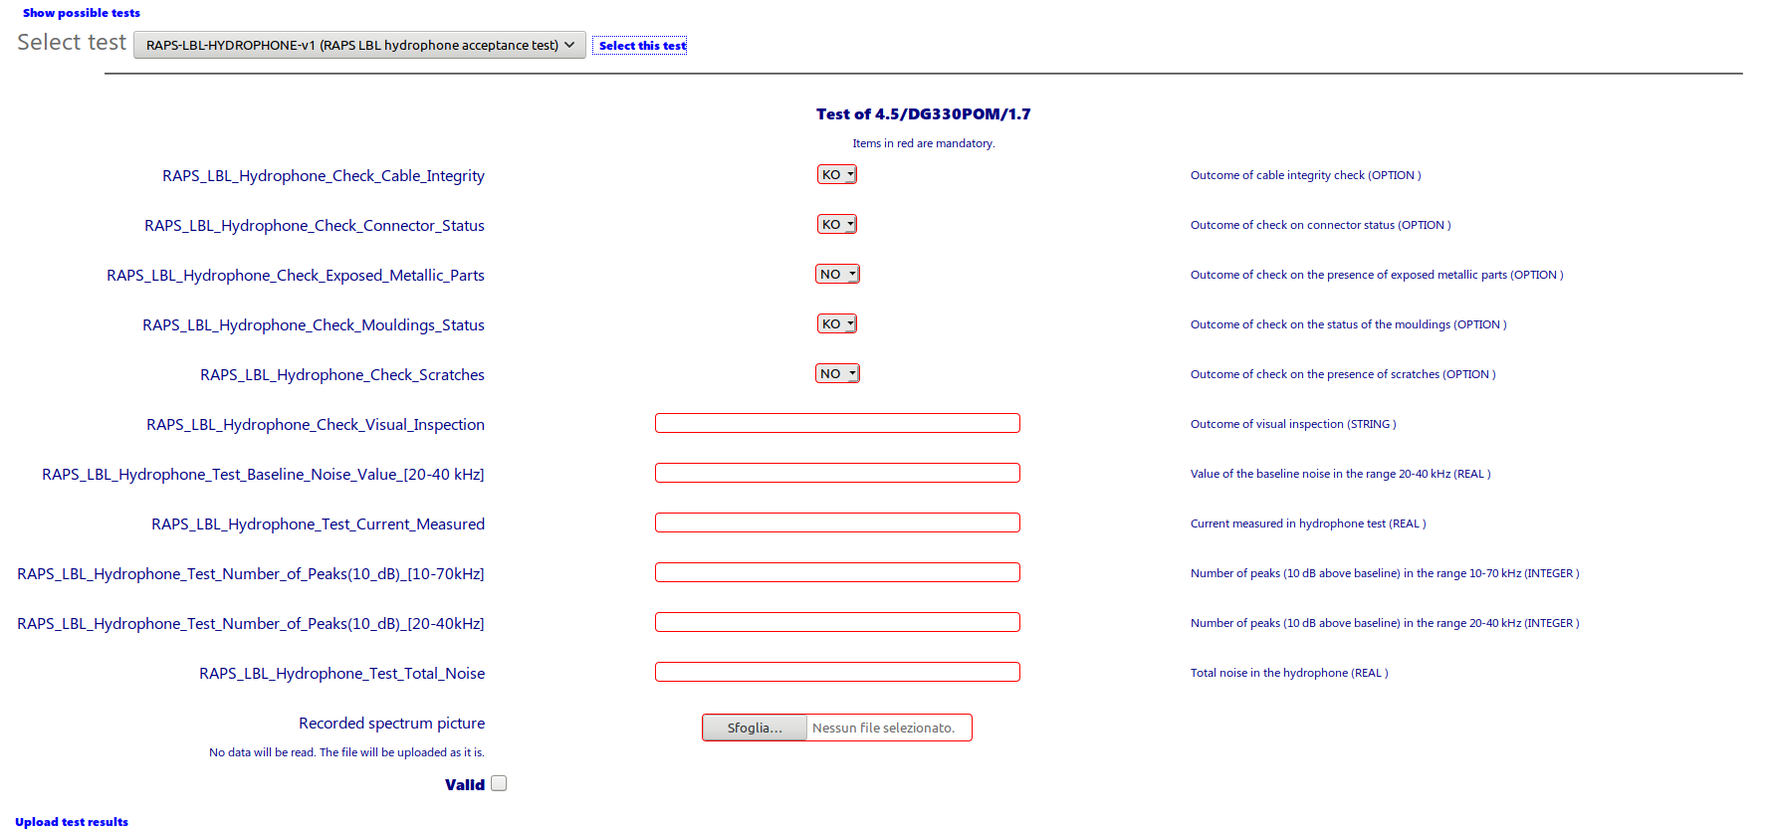
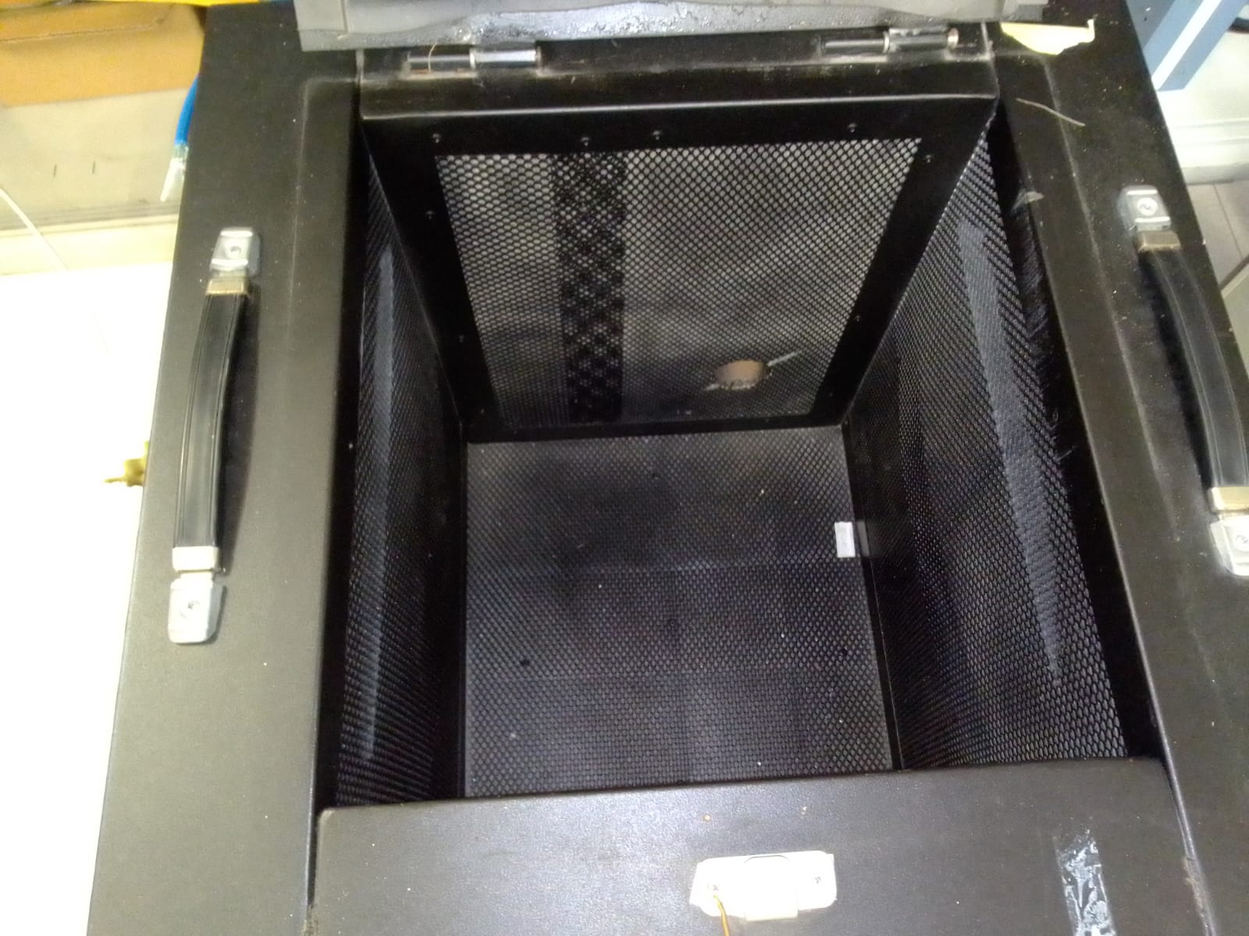
Hydrophone Acceptance
In anechoic chamber + emitter

Slide 14
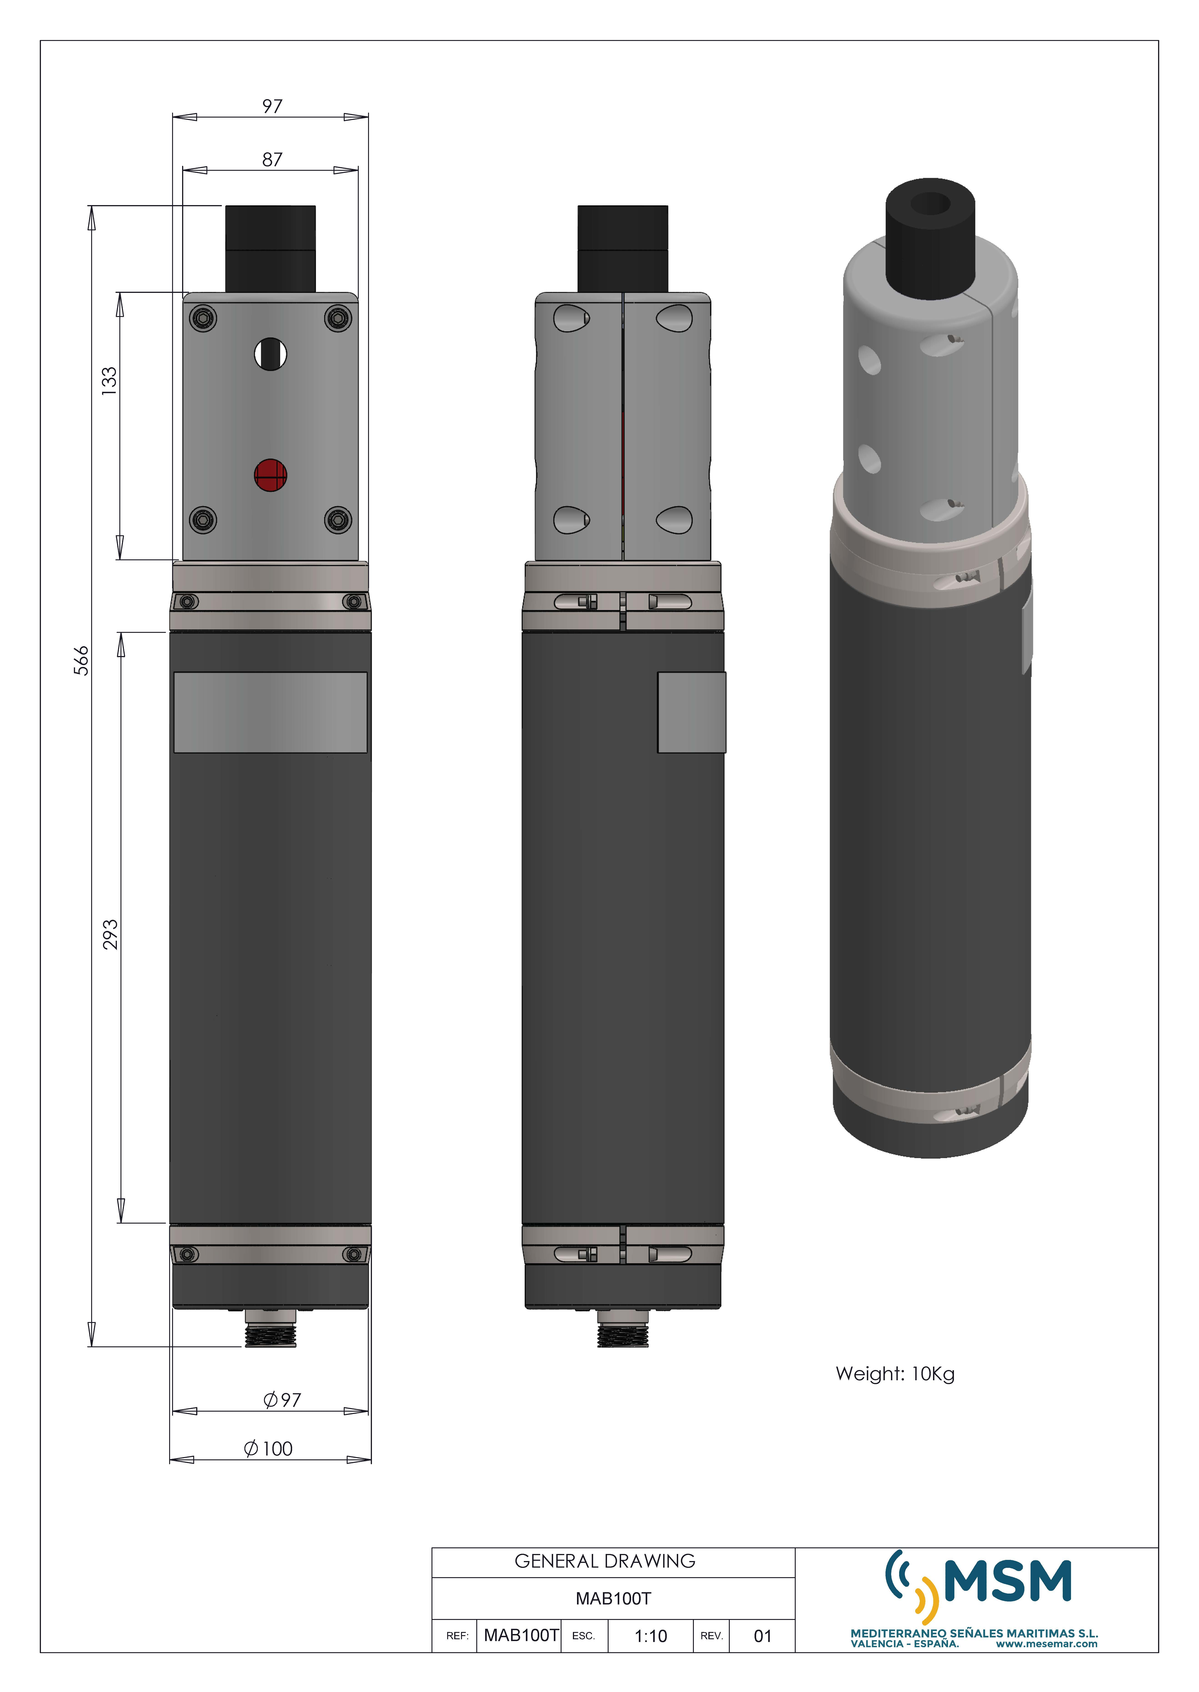
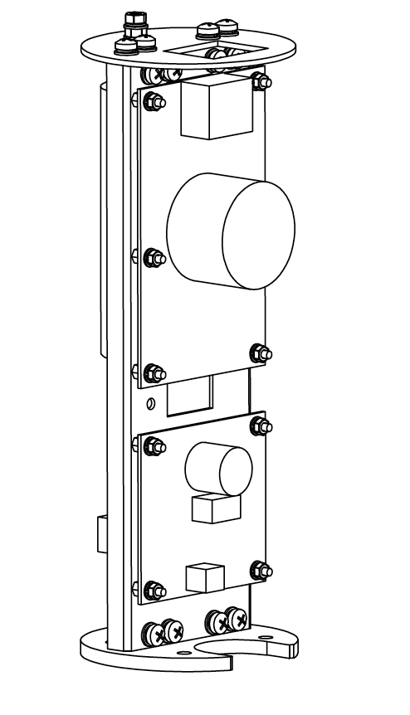
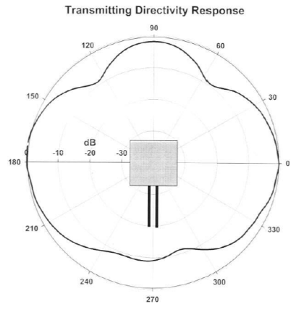
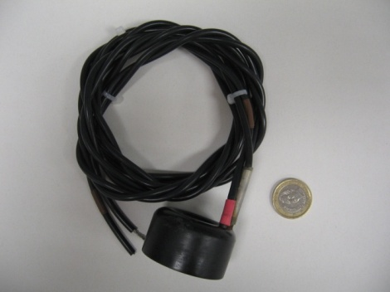
RAPS Acoustic Beacon
Piezo ceramic : FFR SX30
Body and Connector:
Hard Anodised Aluminium /Seacon BC-6F-BH(Autonomous)
Titanium / Gisma series 10 (Triggered)
Transmitting voltage responses of 130 dB re 1 μPa/Volt @ 1 m at 30 kHz.
Usable frequency range: 20 : 40 kHz
Internal or external trigger (settable)
Configurable emission power
Signal emission: sine, sweep, arbitrary
Power supply 12 V

Slide 15
RAPS Acoustic Beacon
Sound Pressure Level (SPL) | 180 dB @ 34kHz re1 µPa at1 m
Frequency range | 20 kHz to 50 kHz
Maximum variation of the TVR per frequency | ±6 dB in the frequency range interval
Beam pattern (Radial; Horizontal plane) | Omnidirectional (±2dB) for each work frequency
Beam pattern (Axial; Vertical Plane) | Toroidal:60° (±10 dB) (±5 dB) for each work frequency in 180°
Intrinsic noise | <-120 dB re V²/Hz
Test Pressure | 400 bars

Slide 16
Acoustic Beacon: Qualification and FAT
FIDES Analysis performed: Unit Failure risk (20 years) 10%
2 items for qualification
6 ARCA
2 ORCA
Pressure
Vibration
Power on-off: 30 cycles

Slide 17
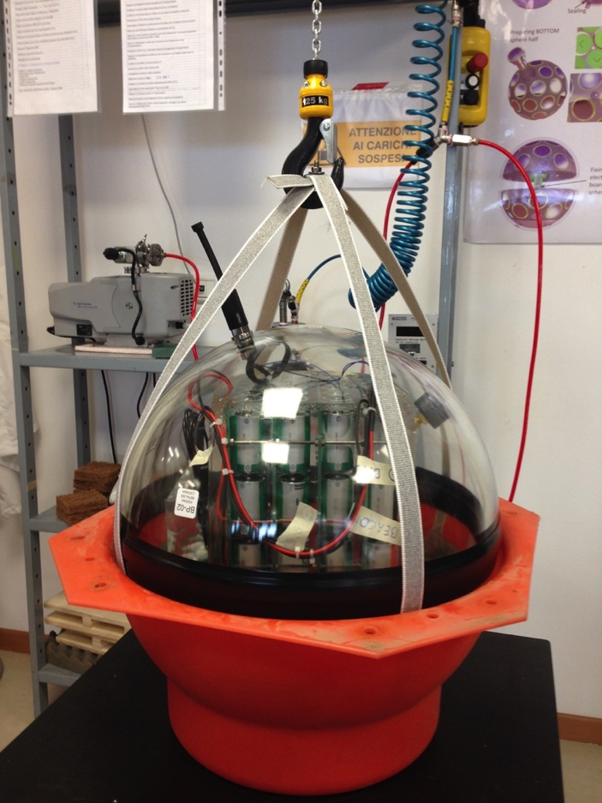
Autonomous Beacons
Recoverable assets ( duration – 3 years)
complement triggered beacons LBL, enlarge the LBL field
Power on/off cylce = 1 / 9 min
Emission: 1 pulse /5 s → 12 pulses /min
Tripods Design: Easy and safe deployment/recovery
Battery pack and autonomous beacons demonstated 2 years operation at 3500 m (KM3NeT-IT). Functional after recovery
In operation since January 2019 in Capo Passero

Slide 18
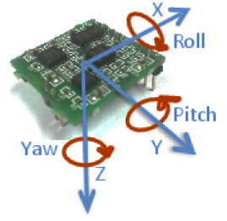
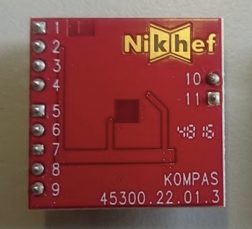
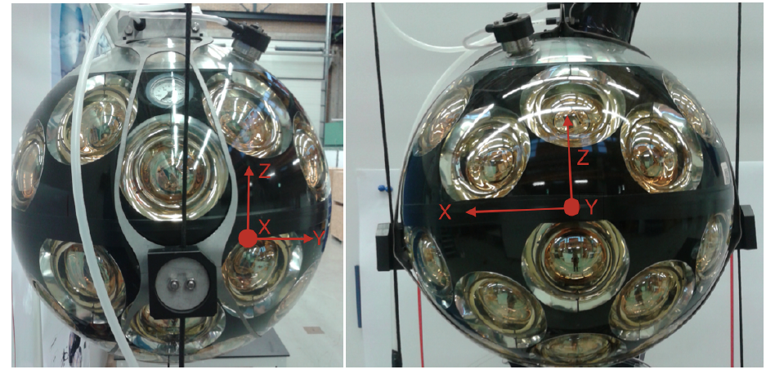
Compass
AHRS-LNS: 2 sensor blocks: 3D Accelerometers and 3D Magnetometers
values averaged every 100 Hz
ST-LSM303: single chip 3H-3A
I2C communication
Compass interrogation rate of 0.1 Hz (data written to DataBase)
Qualification:
FIDES analysis: Unit failure risk in 20 years negligible
Compass burned-in with CLB
 | Accelerometer | Magnetometer
Range | ±2g | ±0.7 Gauss
Nonlinearity | ±2% of a full scale | ±0.1% of a full scale
Resolution | <1 mg | < 7 mGauss
Misalignment | < 10 mrad | N/A

Slide 19
Compass
Problems Encountered:
AHRS:
FW design errors: sensor fusion (formulas): FW rewritten (v 4.1 stable)
CW design (CLB and AHRS): I2C addresses overlapping with other sensors
CLB and AHRS fw
LSMv1:
reduce power consumption, no micro-processor on board, single chip
design not compliant with ST-LSM303 chip optimisation
(wiring routes too close to magnetic gauge, ground plane below the chip) LSMv2:
updated design compliant with ST specification
New LSM3030agr board: new chip from ST (previous LSM303 out of production)
Under test and validation

Slide 20
Compass: Accelerometer and Compass calibration
Rotation of the XYZ-magnetometer in the uniform field should produce a sphere in the (Hx,Hy,Hz) coordinate system if magnetometers are perfectly calibrated.
In case of the presence of hard magnetic materials (have the field independent on the external field) the sphere is shifted.
In case of the presence of soft-magnetic materials (field dependent on the external field) the sphere is deformed - ellipsoid
Hard Iron and Soft Iron
Find “W⁻¹” matrix
(Hx_cal)= (Hx - Hx_offset)
(Hy_cal)= (Hy - Hy_offset)
(Hz_cal)= (Hz - Hz_offset)
(Hx_cal)=(Hx - Hx_offset)
(Hy_cal)=(Hy - Hy_offset)
(Hz_cal)=(Hz - Hz_offset)
W⁻¹

Slide 21
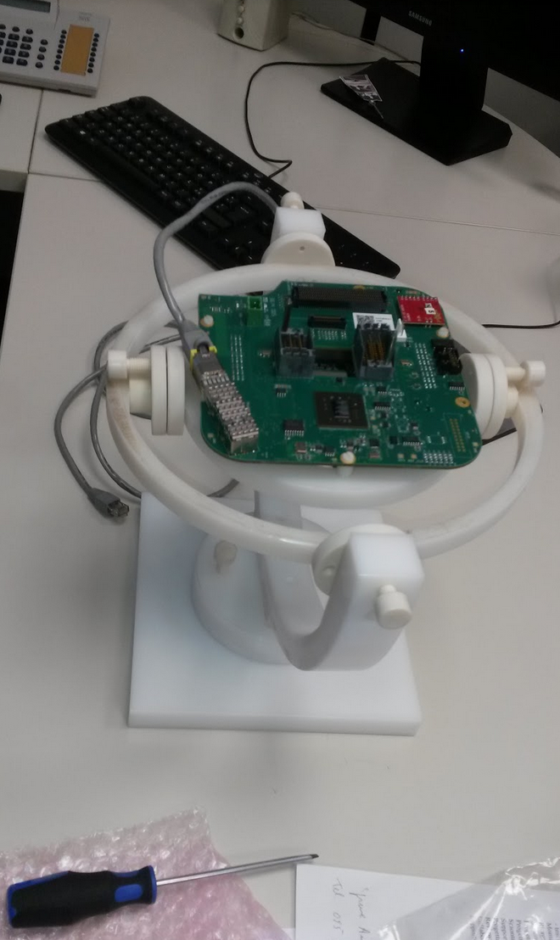
Compass: Calibration Procedure
Calib V2: Rotation in 1 plane:
Calibration of accelerometres
Calibration of magnetometers
Calib V3:
Wobbling
Important:
Check of claibration bench
Only Plastic parts
homogeneaous magnetic field in 1 m³
Far from iron and e.m power sources
No variable magnetic fields
Periodic check of the bench with reference compass

Slide 22
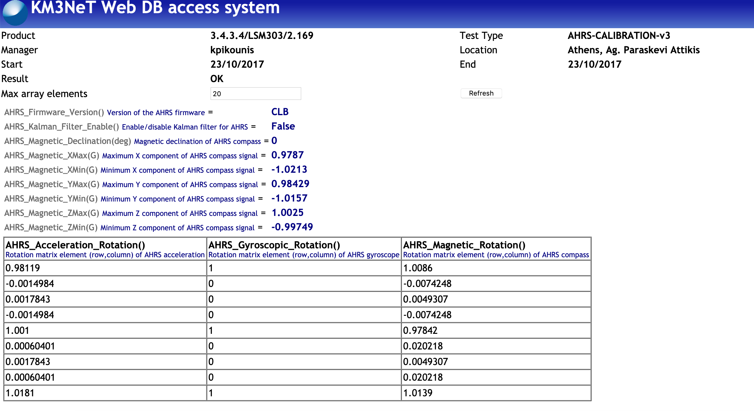
Compass: Calibration

Slide 23

Compass: Calibration Procedure
Check in DOMs (after integration)
Rotation in horizonal plane:
4 reference angles (0°,90°, 180°, 270°)
Check of yaw: residual:
accepted if all residuals <3.5°
In case of failure:
1) Check of calibration and test results
2) waiwing (<6°)
3) recalibration in DOM
Example of failing check
Calibration
DOM test

Slide 24


Compass: Calibration Procedure
In-plane calibration
DU2 F4, F5
DU3 F3, F11
DU4 F16
No Calibration or old fw
DU2 F9, F12:F18
DU3 F17
DU4 F15
Average difference
Adjacent DOMs
DU2: 0.2° (only bottom)
DU3: 0.7°
DU4: 0.3° (LOM stuck)
DU5: 0.9°

Slide 25


Compass: Intrinsic limits
yaw
mechanical mounting of AHRS in CLB and in DOM mushroom: circa 1°
calibration: 3.5°
tilt
mechanical mounting of AHRS in CLB and in DOM mushroom: circa 1°
calibration circa 1°
When DOMs are integrated in a DU additional uncertainties:
mechanics:
DOM mounting on line
magnetic field
presence of BOB (switching DC/DC)
Magnetic declination is taken into account

Slide 26

Compass: Intrinsic limits
DUID INTEGER Identifier of the DU
DOMID INTEGER Identifier of the DOM
POS_X NUMBER X component of position w.r.t. a detector reference point
POS_Y NUMBER Y component of position w.r.t. a detector reference point
POS_Z NUMBER Z component of position w.r.t. a detector reference point
ROT_X NUMBER X component of rotation vector
ROT_Y NUMBER Y component of rotation vector
ROT_Z NUMBER Z component of rotation vector

Slide 27


Compass: online visualisation

