Slide 1
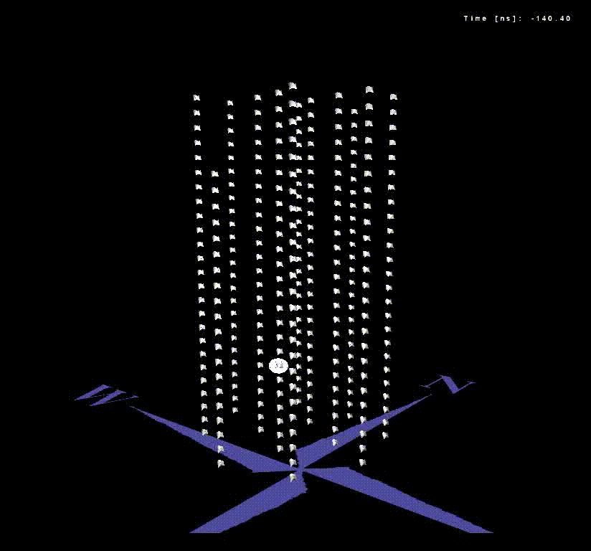
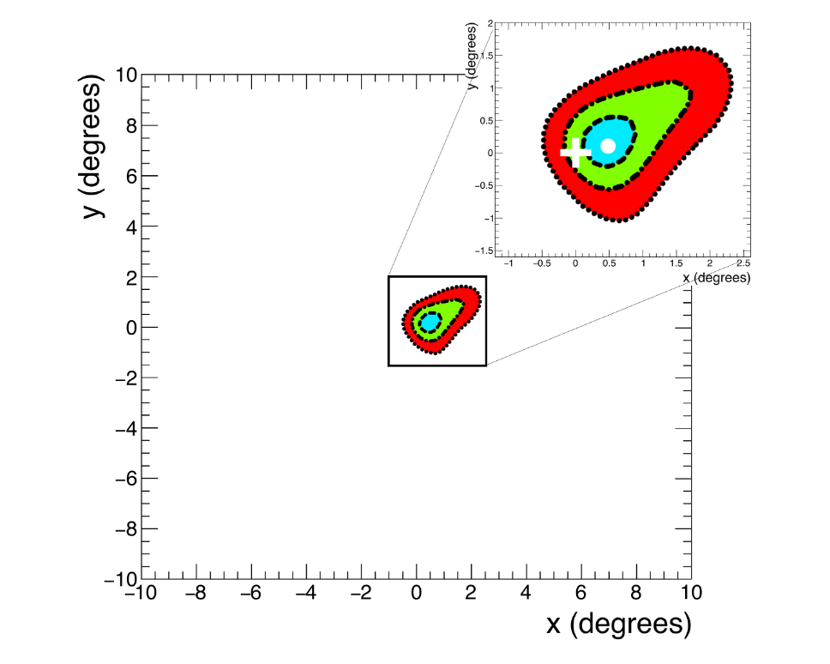
Positioning and Orientation System of KM3NeT
Requirements
Position of the Detector (absolute) Position of seafloor assets (absolute) | <100 m 5 m | ν source determination detector construction | Navigation and Absolute Acoustic Positioning System
Absolute orientation of the Detector | 0.2° | ν source determination | CR Moon/Sun Shadow
Positioning of DOMs (relative) | <20 cm | detector angular resolution (event direction reconstruction) | Relative Positioning System
Orientation of DOMs (relative) | <9° | detector angular resolution (event direction reconstruction) | Compasses CR Moon/Sun Shadow

Slide 2
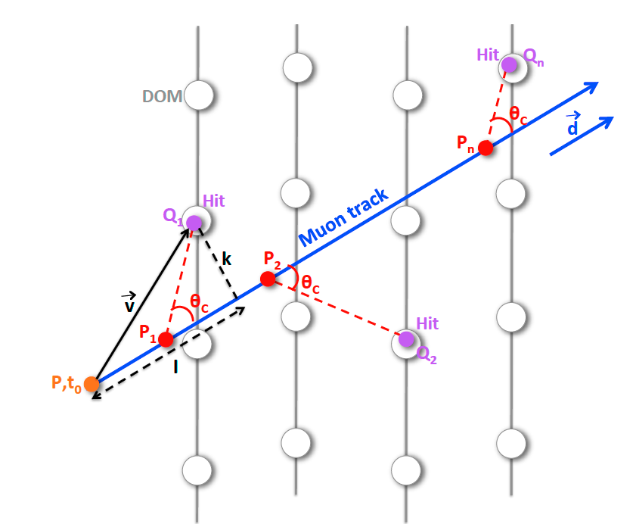
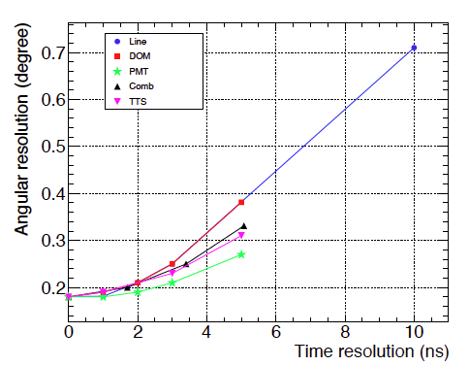
Positioning System of KM3NeT: Requirements
Relative lepton track direction | Measure relative positions of DOMs | Relative Acoustic Positioning System
Angular resolution <0.2° | Resolution 20 cm

Slide 3
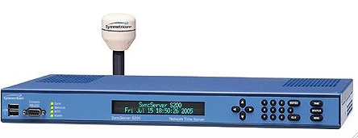

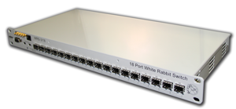
Relative Acoustic Positioning System (RAPS)
Synchronise thousands of light sensors, displaced in a km³ volume, 100 km from the coast 1 ns accuracy:
  White Rabbit time precision protocol over Ethernet
Monitor the position of the structure with 10 cm resolution:
  Positioning system synchrnoised to GPS, auto-calibrating LBL. C sound Measures, Electronic latency of each device measured
GPS
Detection Unit
Hydrophone
100 km cable
White Rabbit Switch Fabric
LBL transceivers

Slide 4
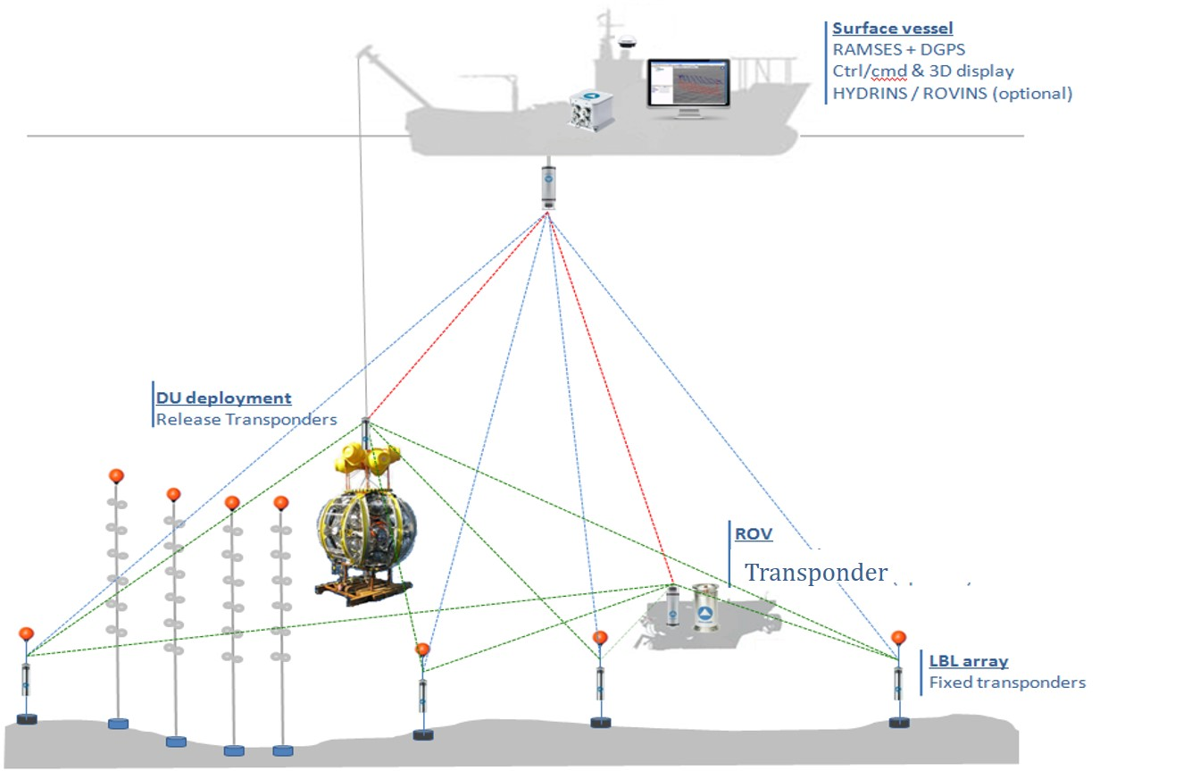

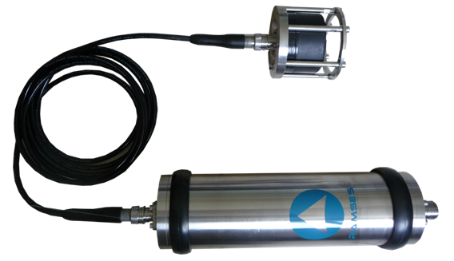
Navigation and Absolute Acoustic Positioning System: ORCA
Absolute position of the LBL elements is provided by NAAPS (Navigation and Absolute Acoustic Positioning System):
Provides Geo-referenced positions of DUs
Provides absolute position of LBL elements of RAPS
Nominal Accuracy: ~ 2 meters
RTA61 acoustic releasable transponder
Ramses range meter

Slide 5
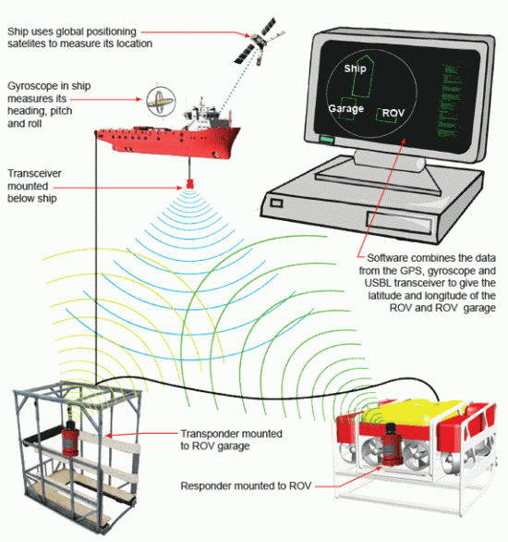
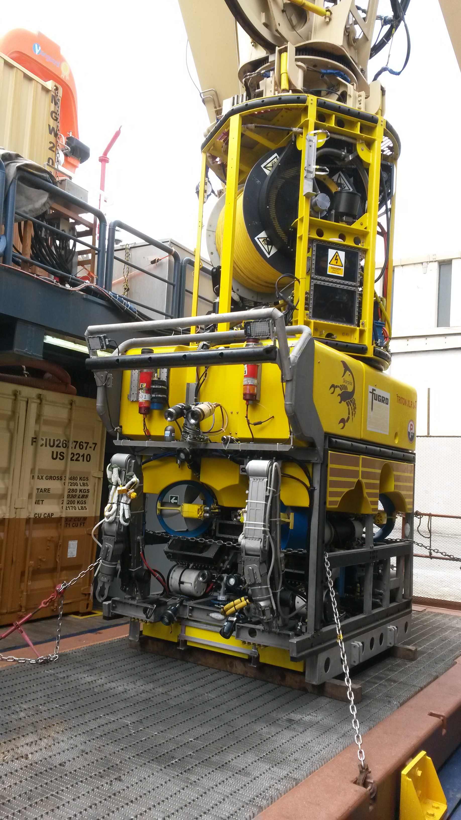
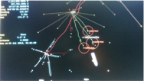
Navigation and Absolute Acoustic Positioning System: ARCA
Commercial USBL (Sonardyne or Kongsberg)
Available on ships used for the deployments
USBL transponder (Applied Acoustics midi, series 1000

Slide 6
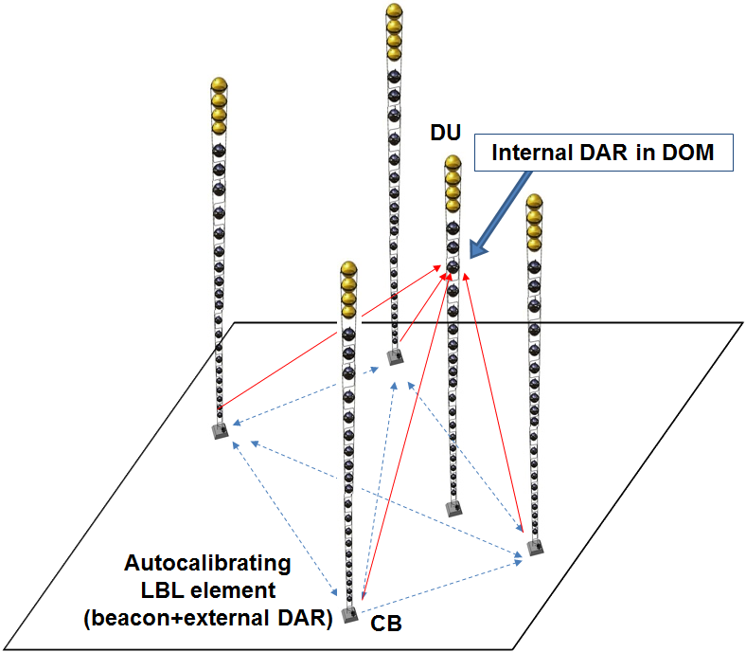
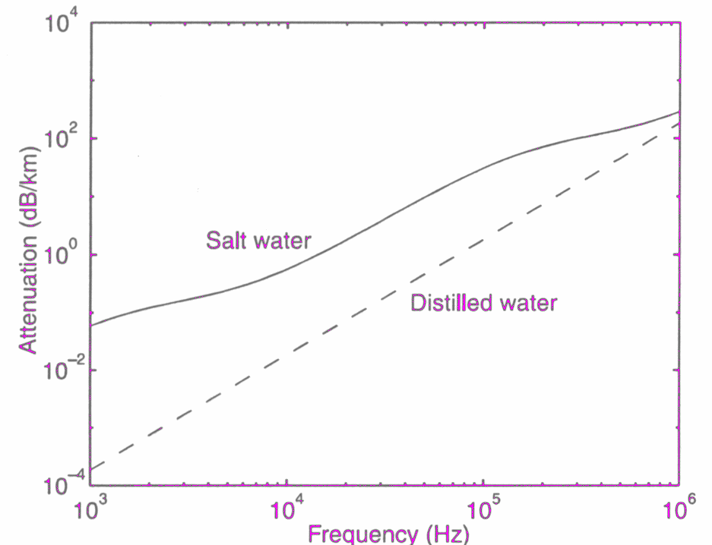
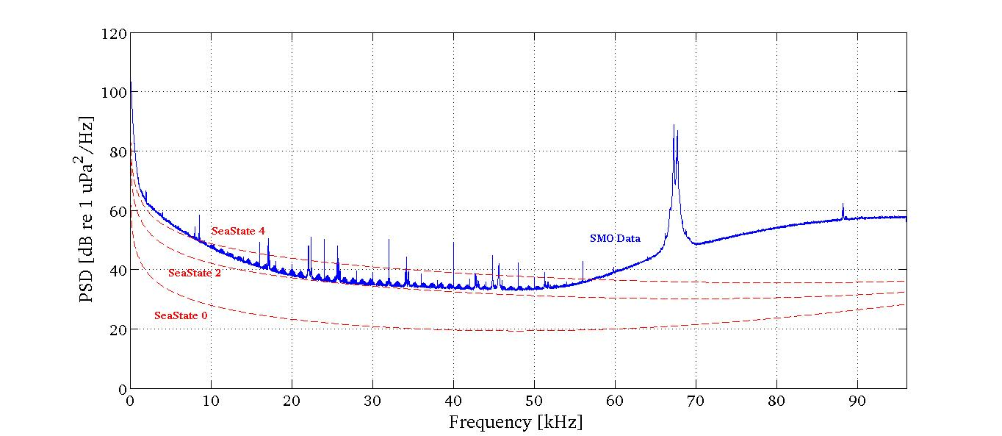
Relative Acoustic Positioning System (RAPS)
Continuous monitoring of the DOMs positions is a mandatory requirement for an accurate direction reconstruction
In KM3NeT the positions of the DOMs are recovered through a relative acoustic positioning system (RAPS) composed of three main sub-systems:
A Long Base-Line (LBL) of acoustic transmitters (beacons) and receivers, located at known positions
An array of digital acoustic receivers (DARs) installed along the detection units (DUs) of the telescope
A farm of PCs for the analysis of acoustic data
Acoustic emitter signals must be detected up to distances of 1 km
20 kHz – 50 kHz
20 kHz – 50 kHz
Suitable frequency range: 20 -50 kHz
Lowest level of PSD: ~40 dB re 1 uPa²/Hz
Attenuation: 1-10 dB/km
Sweep Signal

Slide 7
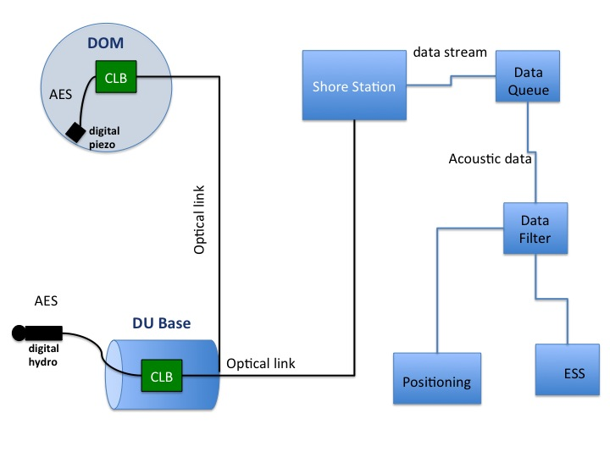
Relative Acoustic Positioning System (RAPS)

Slide 8
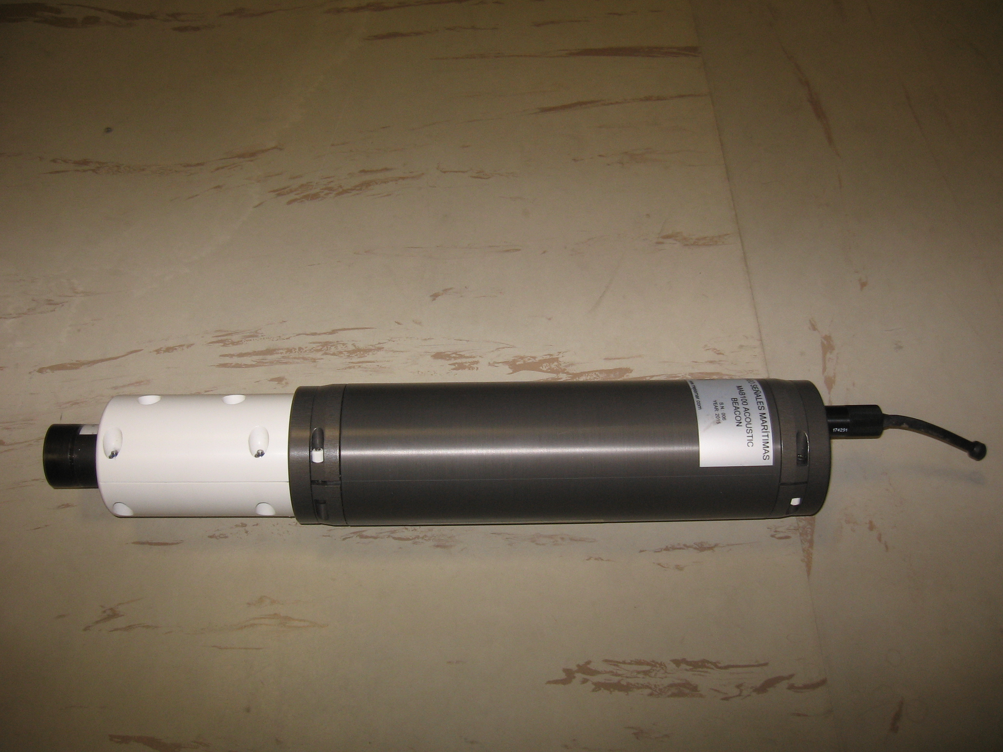

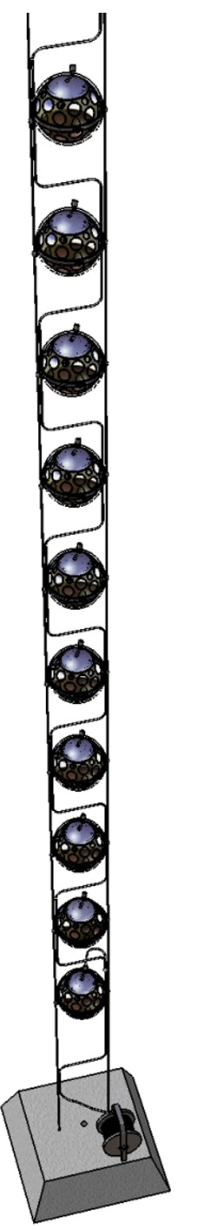
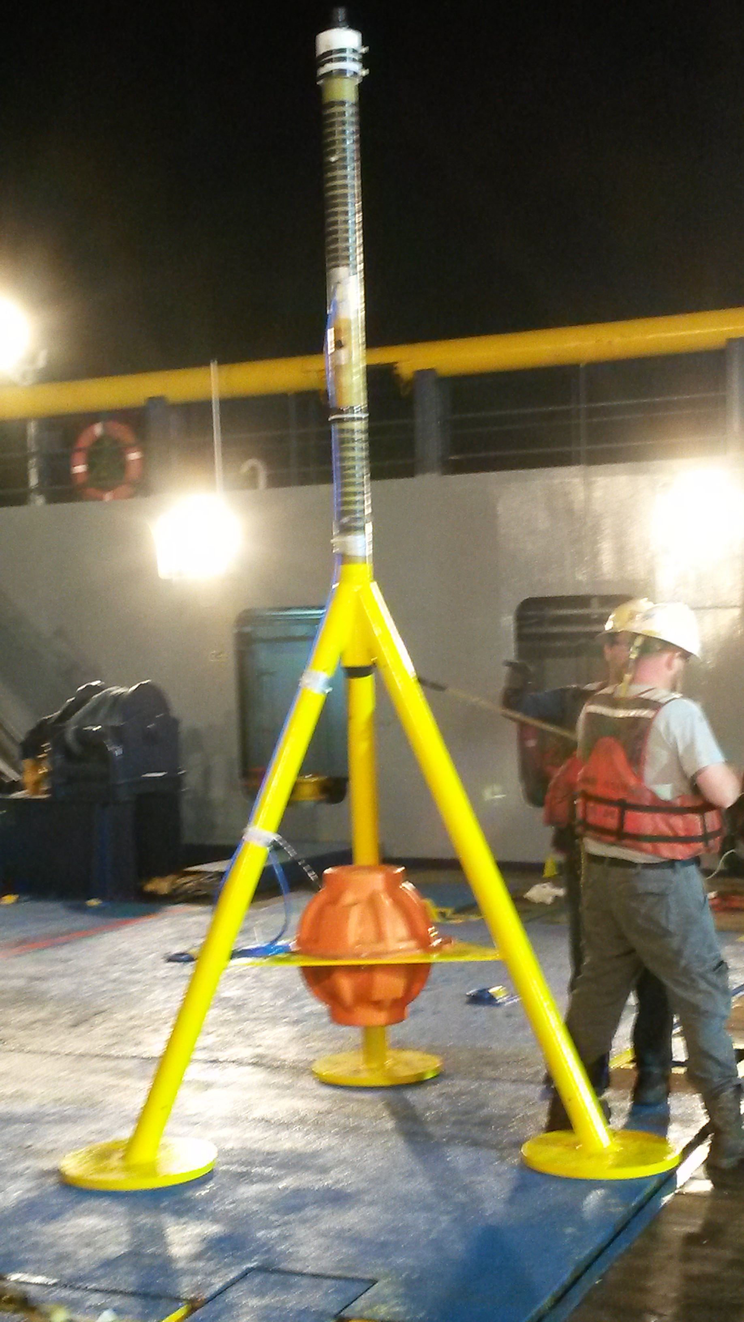
RAPS: Acoustic Beacon
The commercially available piezo-ceramic Free Flooded Rings (FFR) transducers SX30 from Sensor Tech Ltd have been chosen for LBL beacons. Each beacon can be reconfigured via a dedicated RS232 connection for “in situ” optimization of the signal detection. The signal emission trigger is synchronized with the detector master clock with calibrated time delay of 7±1 µs.
Signal Emitted length:
from 0 to 50 ms (typical 5 ms)
Maximum emission amplitude:
180 dB @ 34kHz re 1 μPa at 1 m
Type of acoustic signals:
Monochromatic signals configurable from 1 kHz to 80 kHz
Sine Sweep signals configurable from 20 kHz to 40 kHz (typical 2 kHz range)
Maximum Length Sequence (MLS) signals with lengths from 5.12 ms to 40.96 ms (at 200 ksamples/s)
LBL emitters can be also operated as autonomous emitters.
In this case, the Time of Emission (ToEs) is recovered from the Time of Arrival (ToA) of the pulses to the hydrophones at DU bases (fixed positions), knowing the distance between emitter and receivers, and the sound velocity.

Slide 9

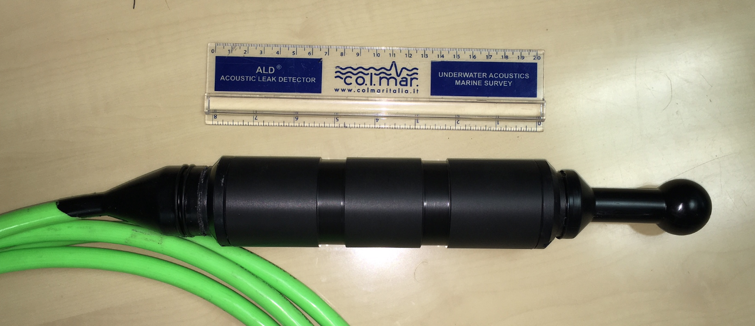
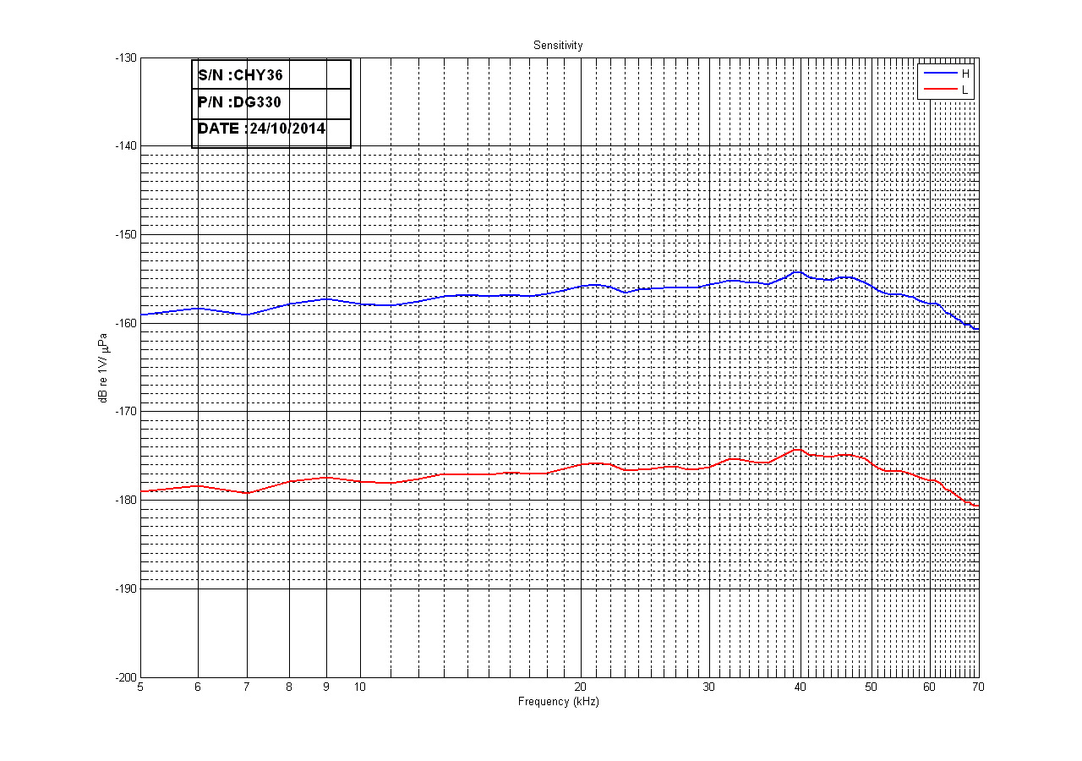
RAPS: Hydrophones in DU Bases
Digital hydrophones are hosted on the base of the DUs. These ‘external’ hydrophones are used to calibrate the LBL by measuring the relative distance among LBL elements. The selected hydrophone is the DG0330 manufactured by Colmar s.r.l.. It consists of a spherical piezo-ceramic element read-out by an analogue board, splitting the signal in two lines with different gains (+46 dB and +26 dB respectively).
All hydrophones calibrated in pressure sensitivity and directionality
Sampling frequency : 195312.5 Hz
Resolution: 24 bits
Dual Gain
Hydrophone data embedded in the Base data packet:
Time stamped by White Rabbit
Time Latency 5 ±1 µs

Slide 10
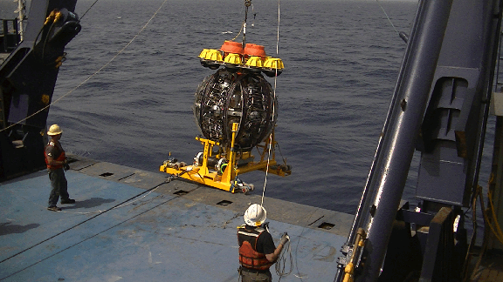
RAPS: Hydrophones in DU Bases
Hydrophone location in DU

Slide 11
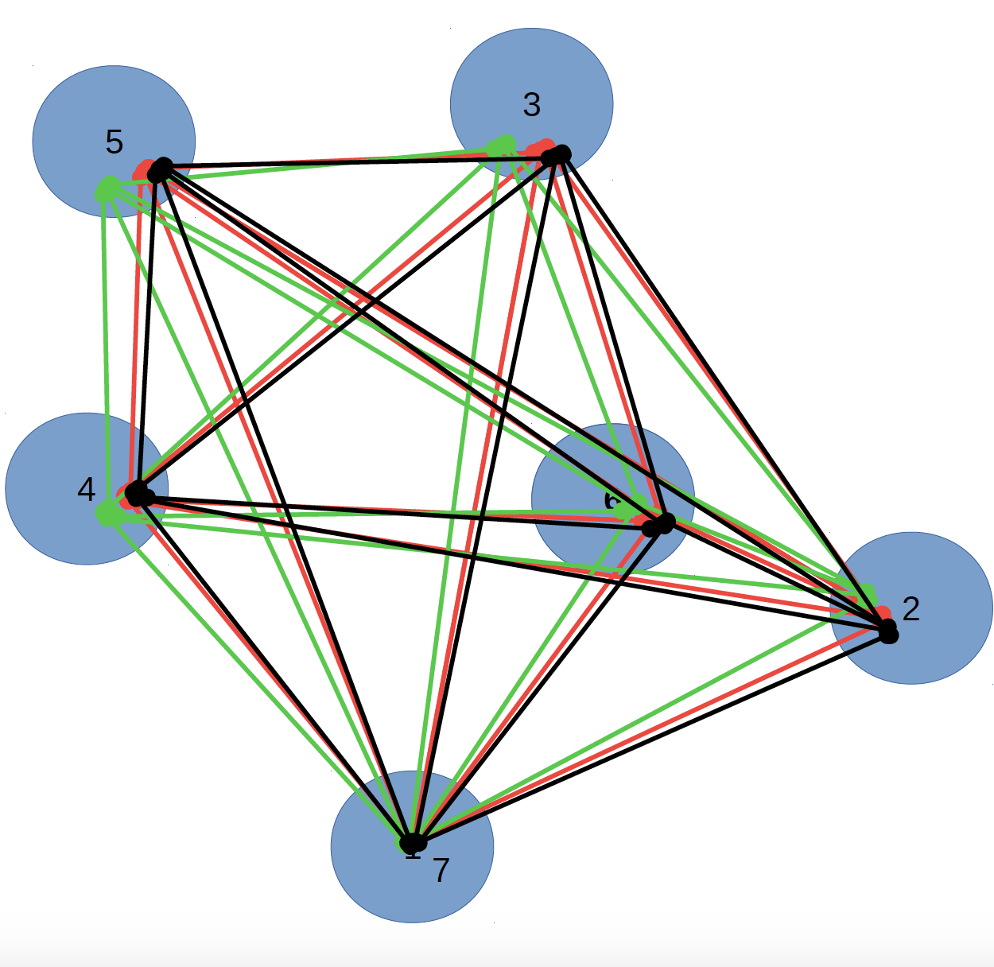
RAPS: Long Baseline (LBL)
To provide relative DOM positioning with an accuracy of about 20 cm, the relative position of the LBL elements must be known with an accuracy of the same order.
Auto-calibrating Long Baseline of acoustic emitters and hydrophones
Autocalibration procedure based on range measurements (knowing the sound velocity in situ)
Iterative algorithm → starting point: nominal position provided by NAAPS
Constraint: fixed hydro-emitter distance in Calibration bases
Output: positions of each LBL element, quality factor (sum of squared residuals)
x-corr (library of beacon signals)
ToE= mean (ToA – range ・c_{sound})
The system is determined if N >= 5

Slide 12
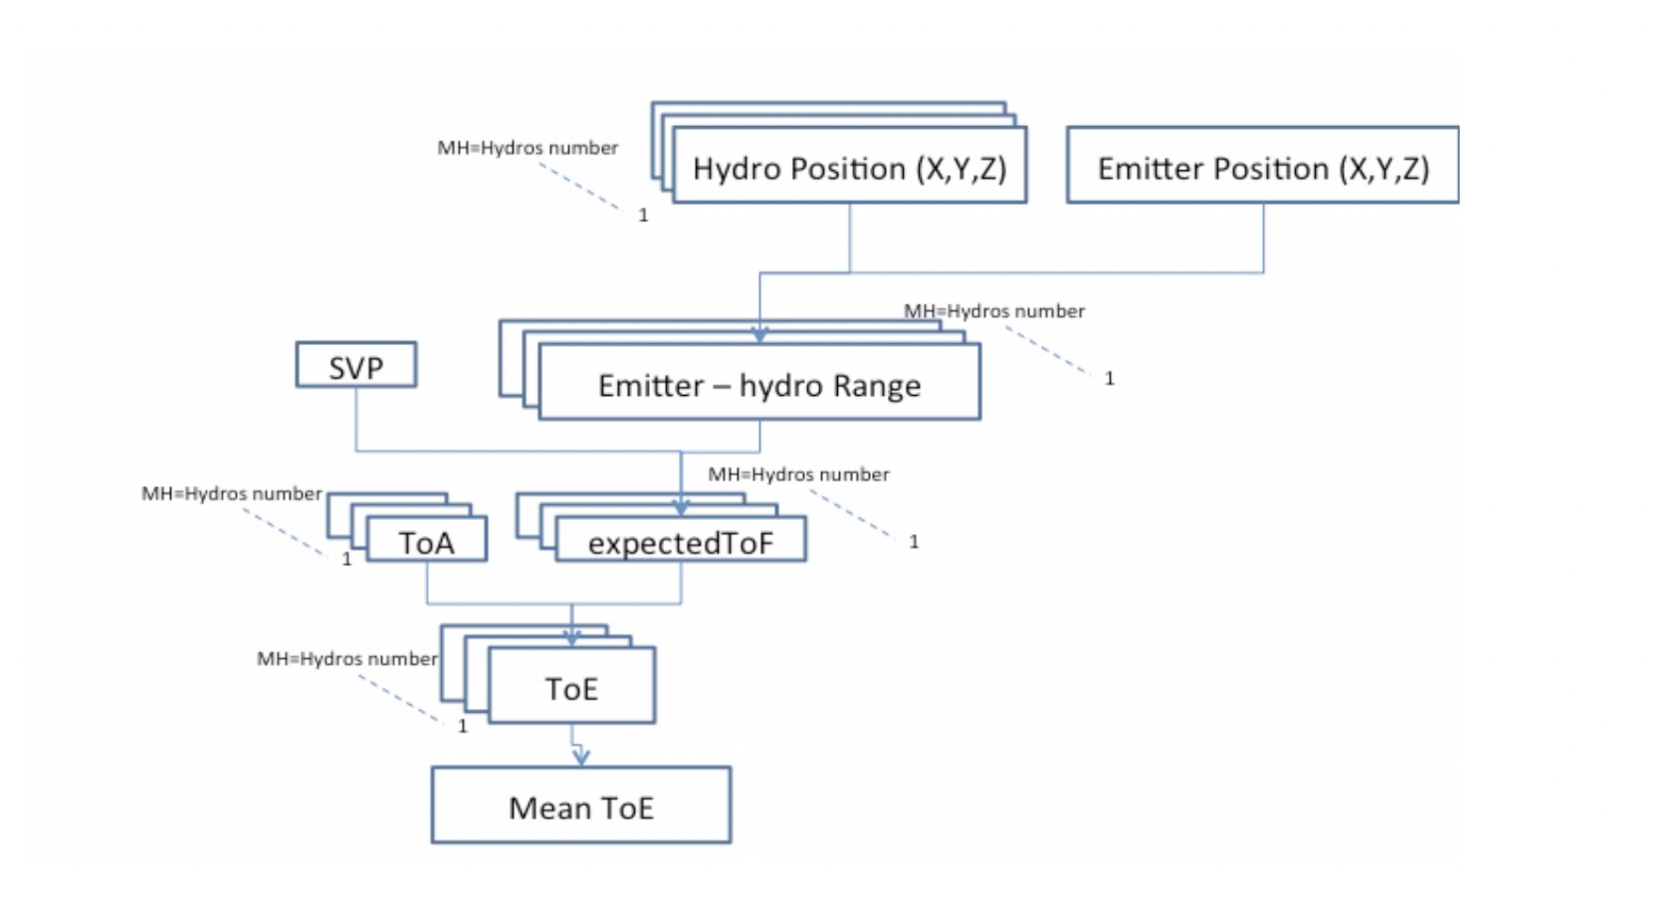
RAPS: Long Baseline (LBL)
ToE: Autonomous Beacons

Slide 13
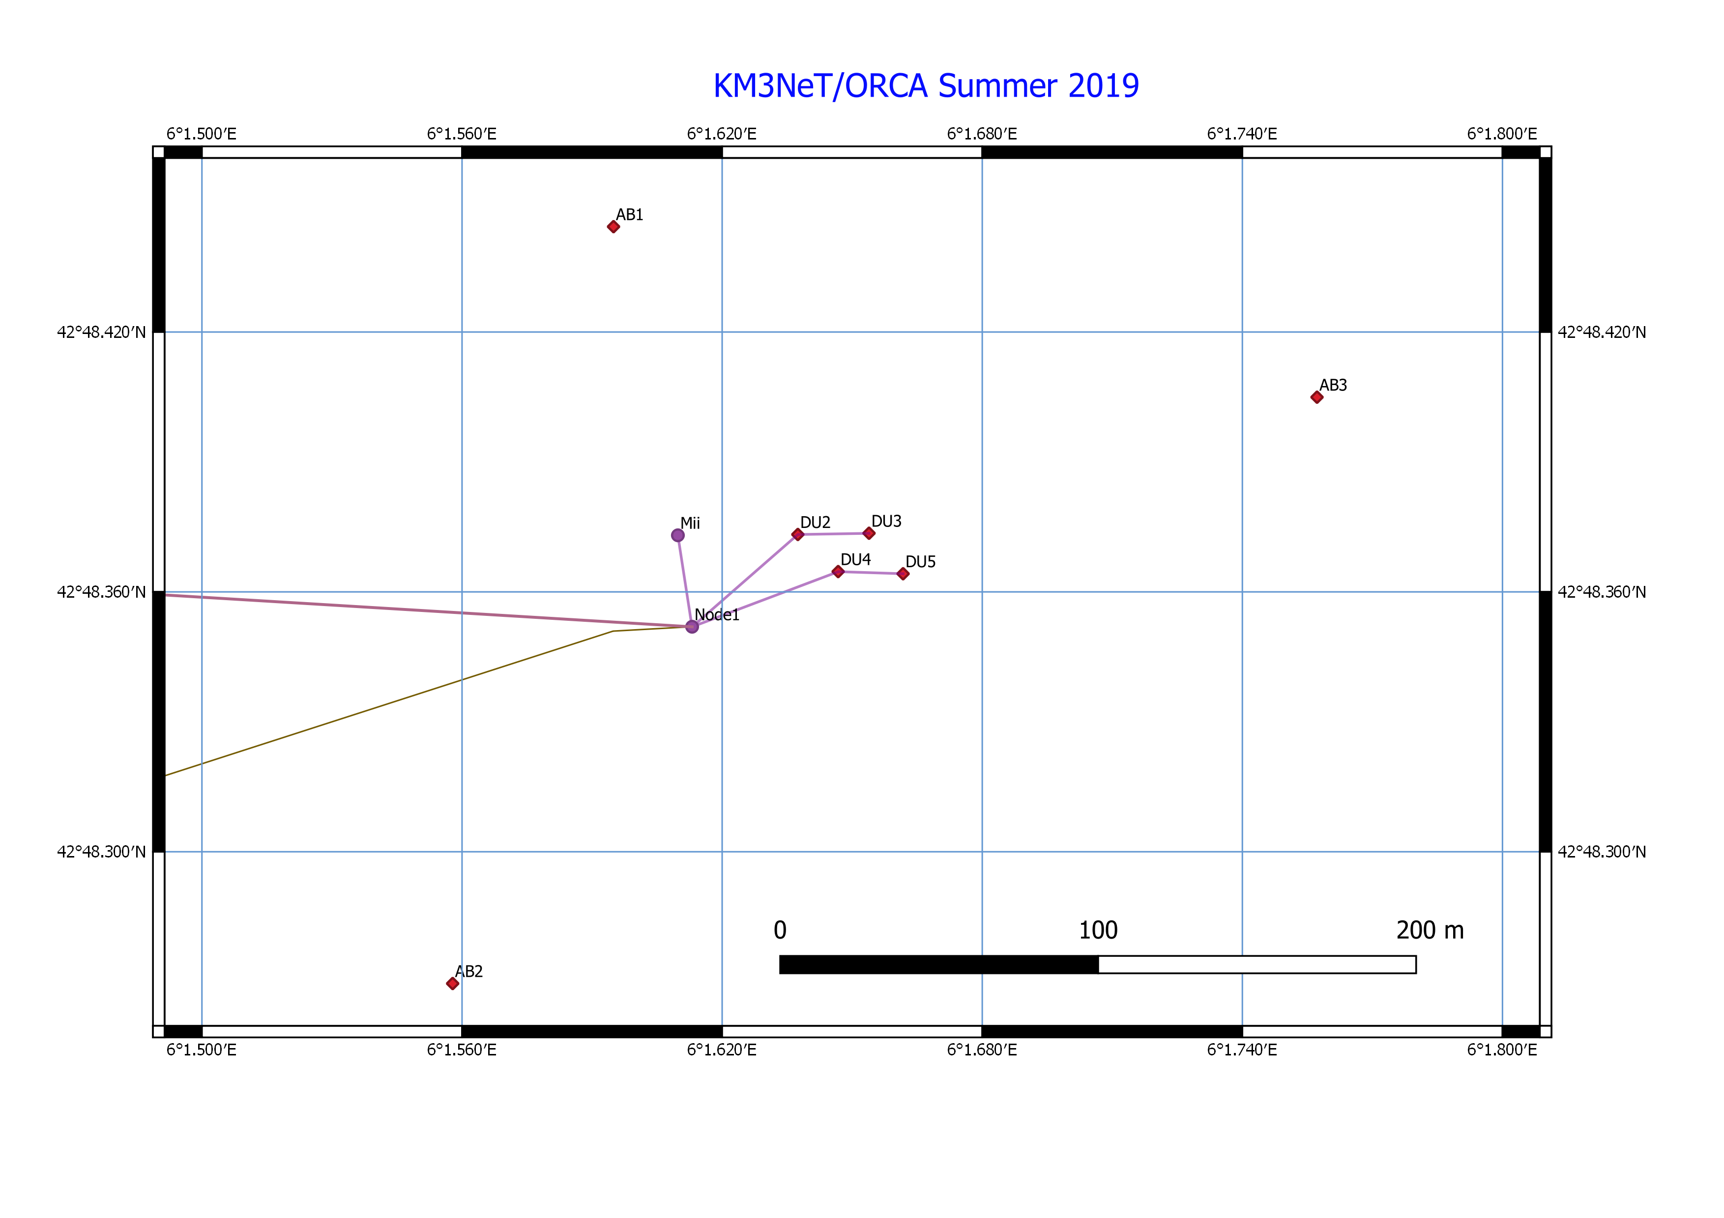
RAPS Long Baseline: Status
Current Acoustic Positioning System (APS):
3 autonomous acoustic emitters (tripods)
Emission rate : 10 minutes (12 pulses /cycle – interpulse interval 5 s)
1 piezo sensor for each DOM
ORCA (4 DUs): hydros in 3 bases
ARCA (DU1): no hydro in base. Use DOM 1
ORCA full configuration

Slide 14
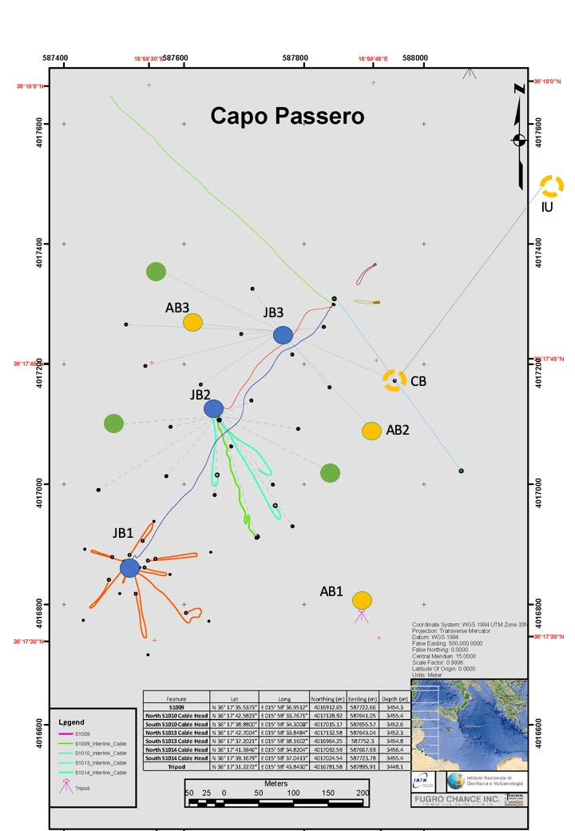
RAPS Long Baseline: Status

Slide 15
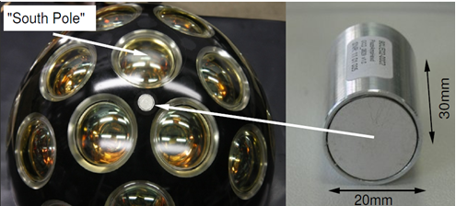
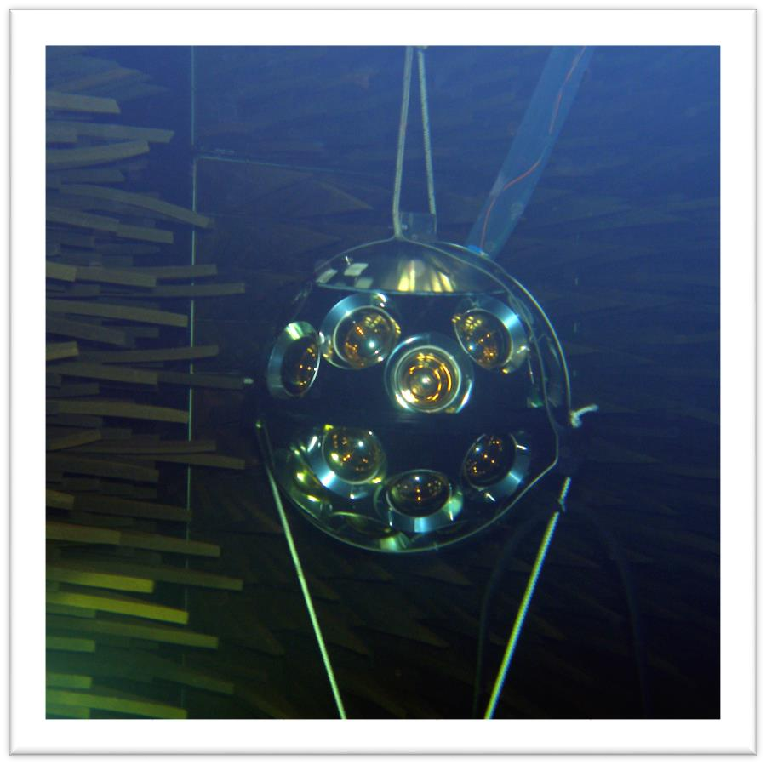
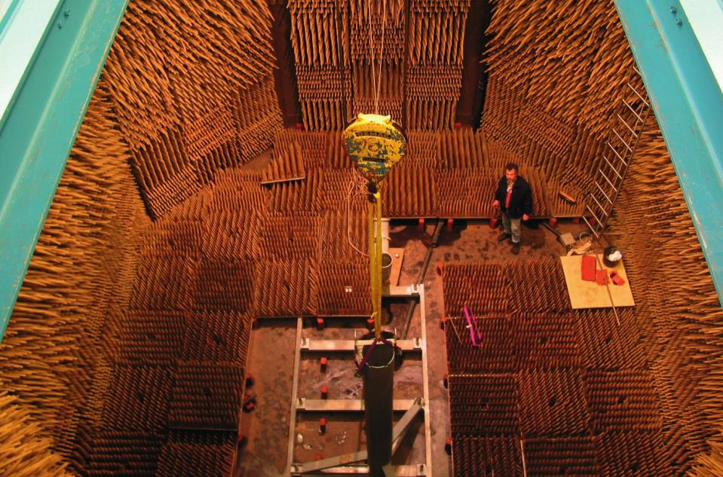
RAPS: Piezo in DOM
The movement of the DUs due to underwater currents is monitored thanks to “internal” piezo-electric Digital Acoustic Receivers (DAR) glued from the inside to the glass sphere of each KM3NeT Digital Optical Module (DOM)
The nominal sensitivity of the sensors is - 160 ± 6 dB re 1V/μPa at 50 kHz with a ± 3 dB variation (long time average) in the range 10 ÷ 70 kHz.
Tests in anechoic acoustically insulated pool at TNO: characterize acoustic behavior of the DOMs in water

Slide 16
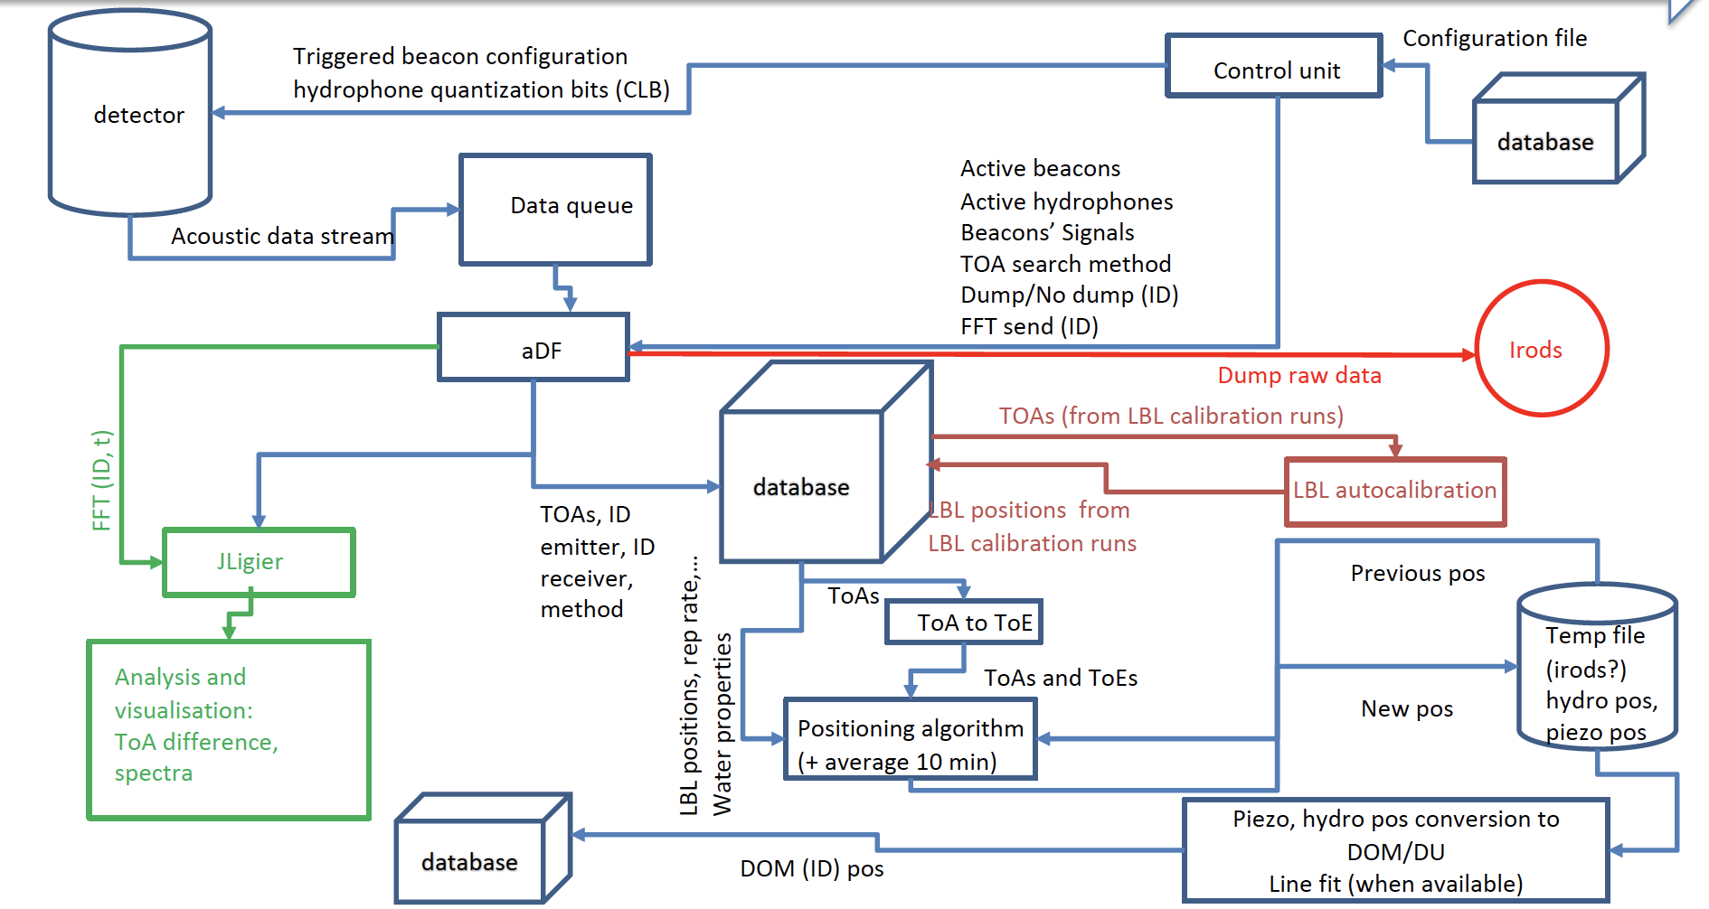
RAPS: DAQ and Control Chain

Slide 17
RAPS: TOA Output data Format
RUN_number | Detector_ID | DOM_ID | DU_number | floor_number | pos_x | pos_y | pos_z | UTC time | displacement_wrt_nominal_position

Slide 18
ToA Estimation

Slide 19
RAPS: Multilateration
System of N equations in 3 variables (N=number of emitters in operations)
Hydro–receivers range = ToF*sound velocity
Variables = [DOM_x, Dom_y, DOM_z]
The algorithm finds the DOM coordinates that minimize the sum of squares of equations
System is over-determined if the number of emitters is >3
DOM positioning algorithm includes the dependency of the sound velocity on the the depth
In first approximation at very deep sea
Effective sound velocity (beacon-receiver) =
a・DOM_{z} / [ln(c_{emitter} +a・DOM_{z} )−ln c_{emitter}]
a=Δc/Δz ~ constant in deep sea

Slide 20
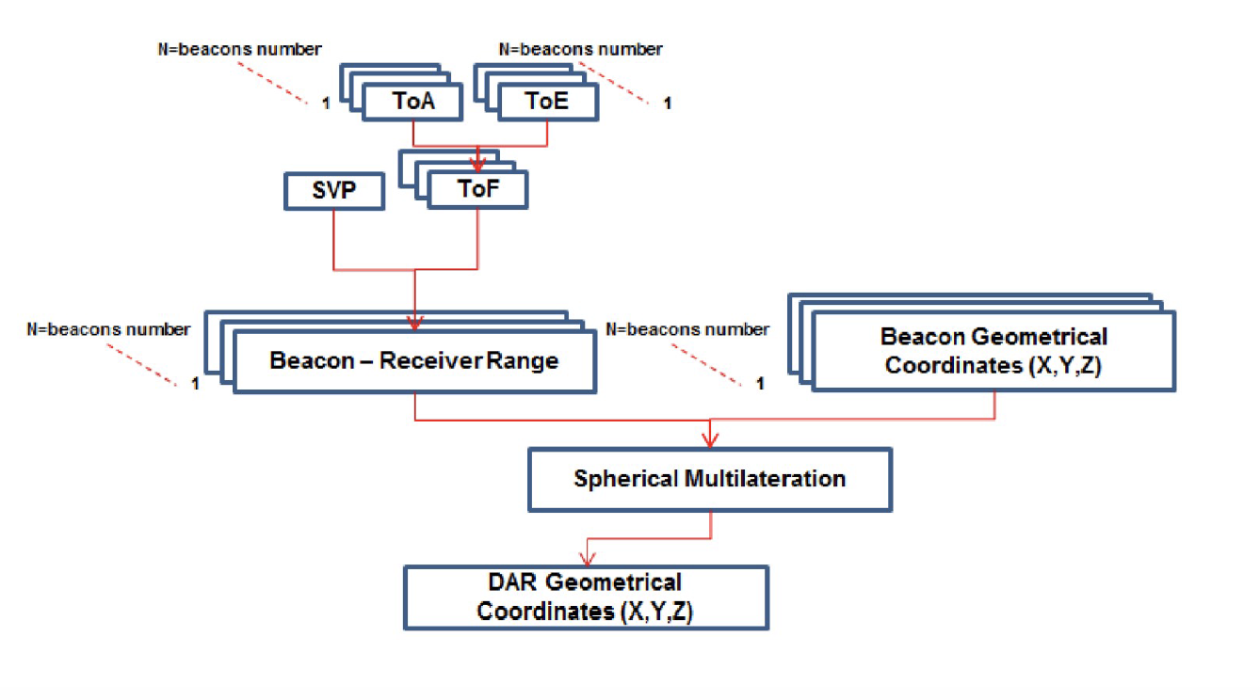
Relative Acoustic Positioning System (RAPS)

Slide 21
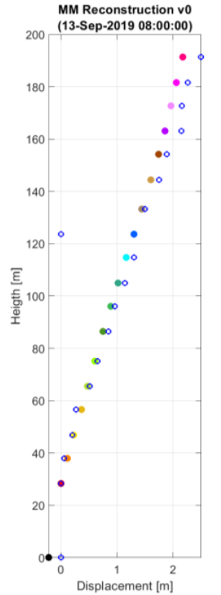
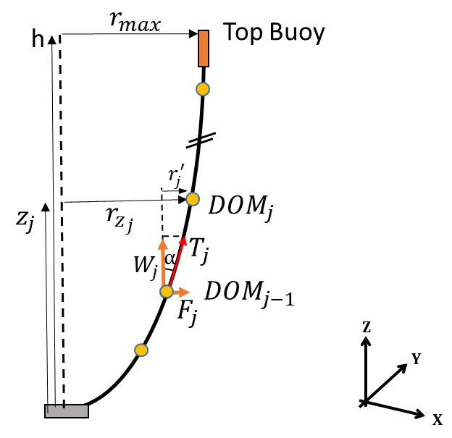
RAPS: DU Line Fit
In order to recover the position of missing/not working DOMs and improve the RAPS resolution a DU line fit procedure has been developed:
V0(Basic): Filter anomalous RAPS data 3D and Bezier Fit of DU
V1: Filter anomalous RAPS data, include compass data, recover effective current, Fit line using a DU mechanical model

Slide 22
Multidisciplinary Science with KM3NeT acoustic elements
In the KMNeT APS all data acquired by the acoustic receivers are transmitted to shore at 195 kHz/24 bit for the real-time identification of the acoustic beacon pulses.
Thanks to the KM3NeT data acquisition architecture the acoustic data stream can be also addressed to other software tools for other purposes ( acoustic neutrino detection, bio-acoustics, geophysics,..).

Slide 23
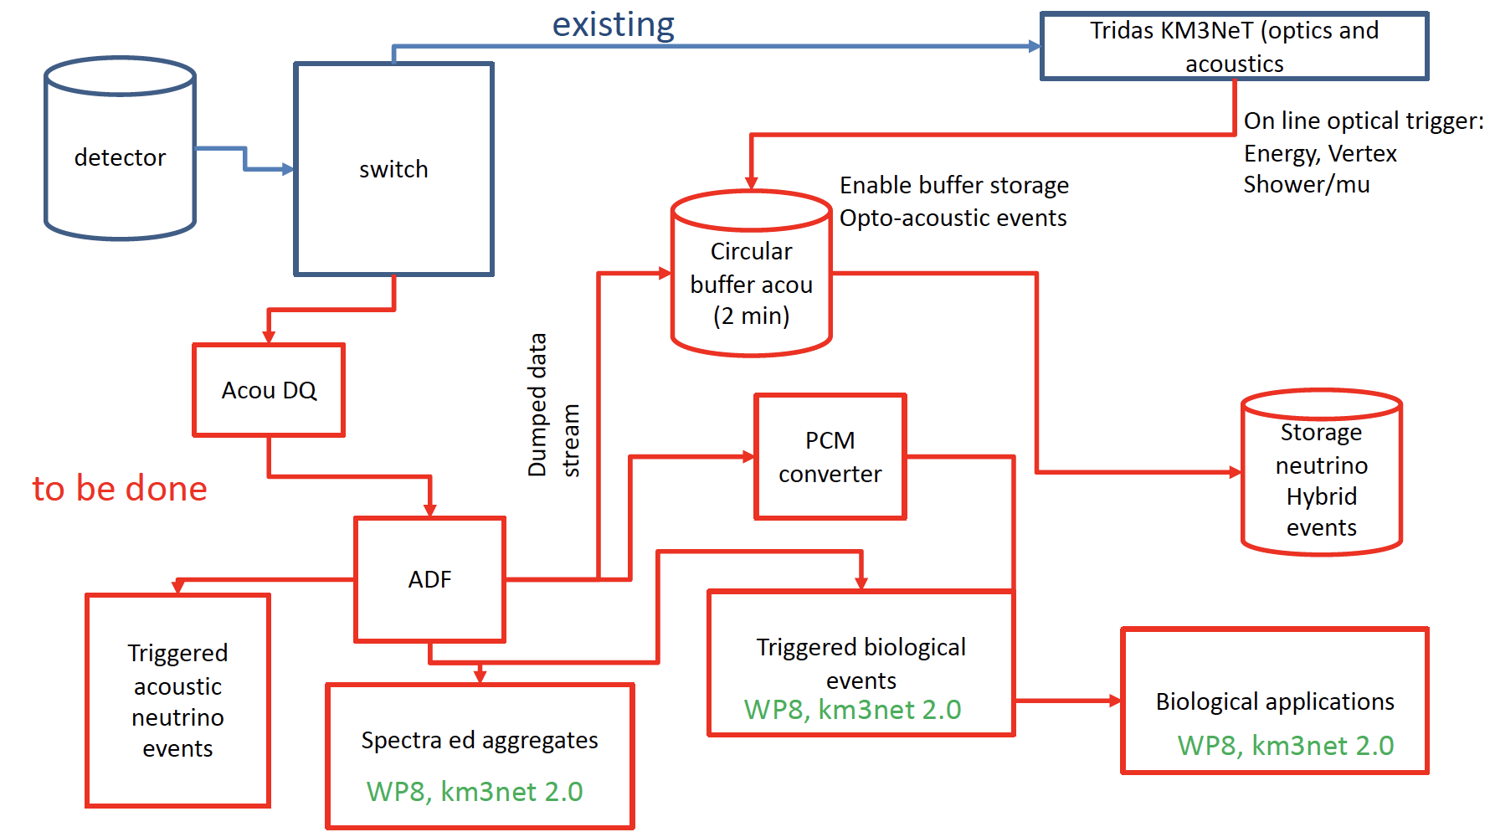
Towards Acoustic Neutrino Detection
Acoustic Data from the telescope will be immediately duplicated for further analysis:
Acoustic-Optical trigger for neutrino events
Dedicated biological triggers

Slide 24
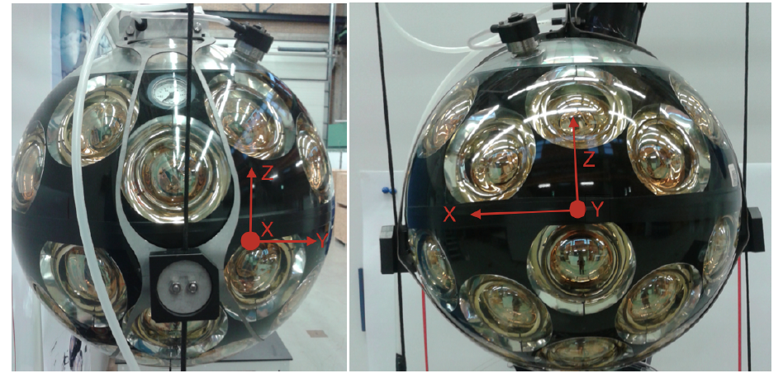
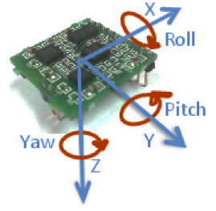
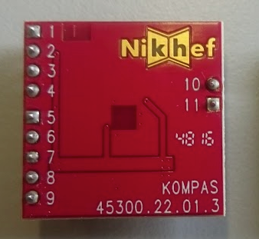
Tilt and Compass board
DOM Orientation in KM3NeT is recovered using custom compass boards interfaced with the detector electronics (CLB)
We use the AHRS (Attitude Heading Reference System) to recover DOM
“yaw”, “pitch” and “roll” from 3-D magnetometers and 3-D accelerometers data.
Each board is equipped with 3D accelerometer (tilt: pitch and roll)) and magnetic gauge (compass)
Raw data are sent to shore and analysed taking into account the calibration coefficients of each compass.
Compasses cannot be calibrated in situ (the DU cannot be rotated in water!)
Calibration of the compass before deployment plays a fundamental role
The LNS-AHRS board
The LSM303 board

Slide 25
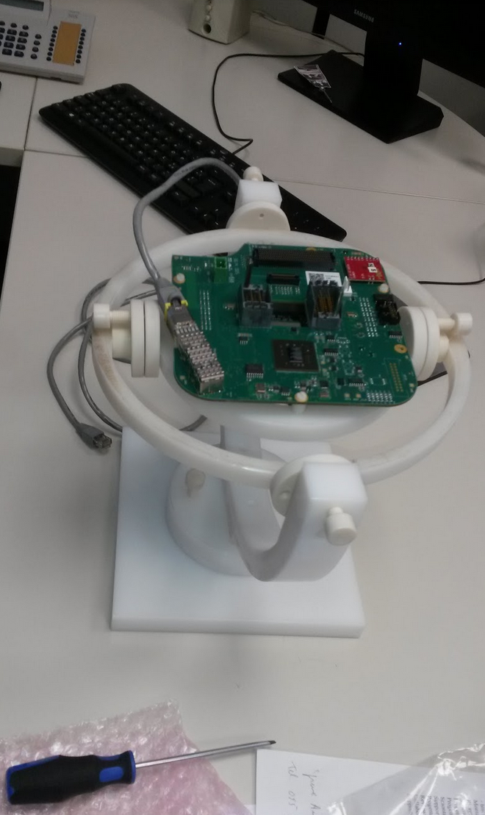
Tilt and Compass board: calibration
Each compass mounted in the CLB board and calibrated (hard iron correction)
After DOM integration the compass (inside the DOM) is tested
Acceptance criteria: error less than 3.5° wrt to each cardinal direction
Compass calibration: wobbling
Correct hard iron effects
Gyro-gimbal for AHRS calibration
Before integration of CLB in DOM
Compass yaw check after DOM integration.
Rotation of DOM in the horizontal plane

Slide 26
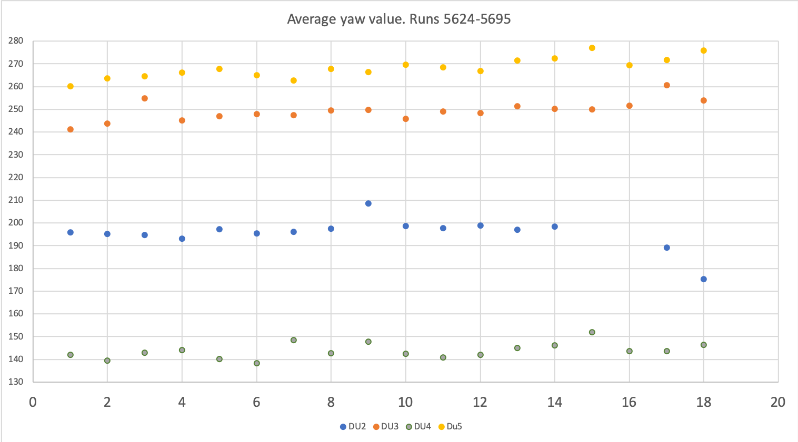
Tilt and Compass board: preliminary results
In-plane calibration
DU2 F4, F5
DU3 F3, F11
DU4 F16
No Calibration or old fw
DU2 F9, F12:F18
DU3 F17
DU4 F15

Slide 27
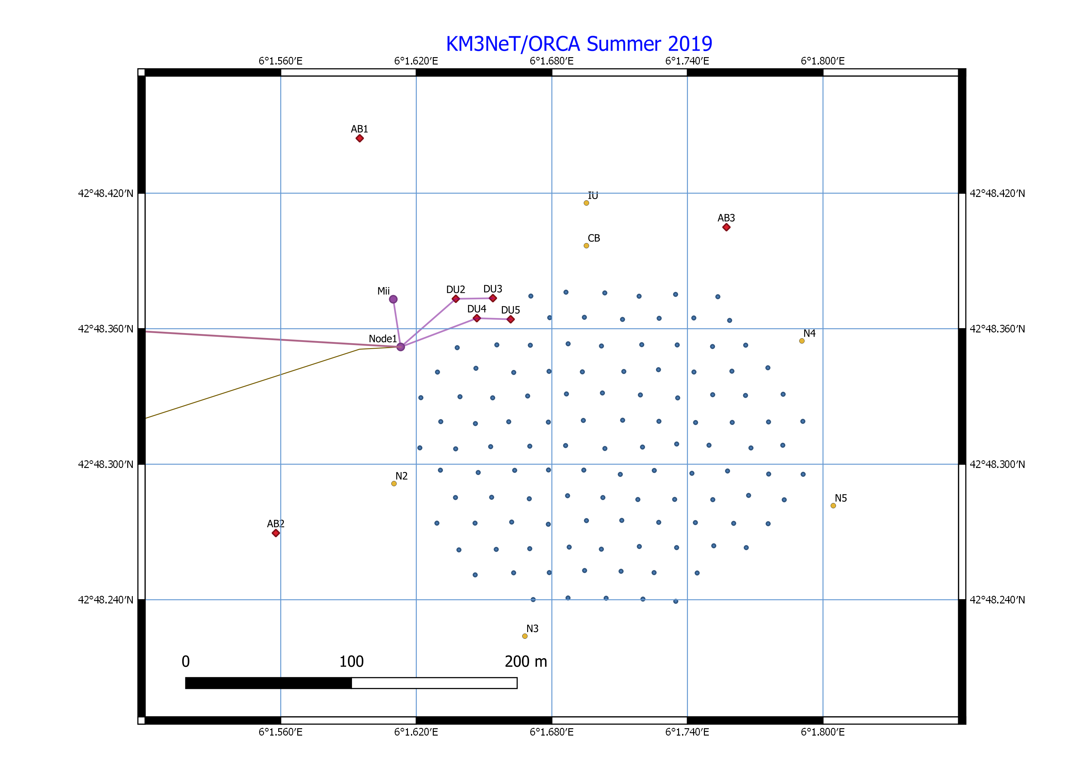
Calibration Units: Calibration Base
Dedicated assets called Calibration Units will be deployed to:
deploy triggered beacons and hydrophones at the rim of the detector
connect oceanographic instruments to measure sound velocity in situ in real time
ORCA Calibration Base
ARCA Calibration Base

Slide 28
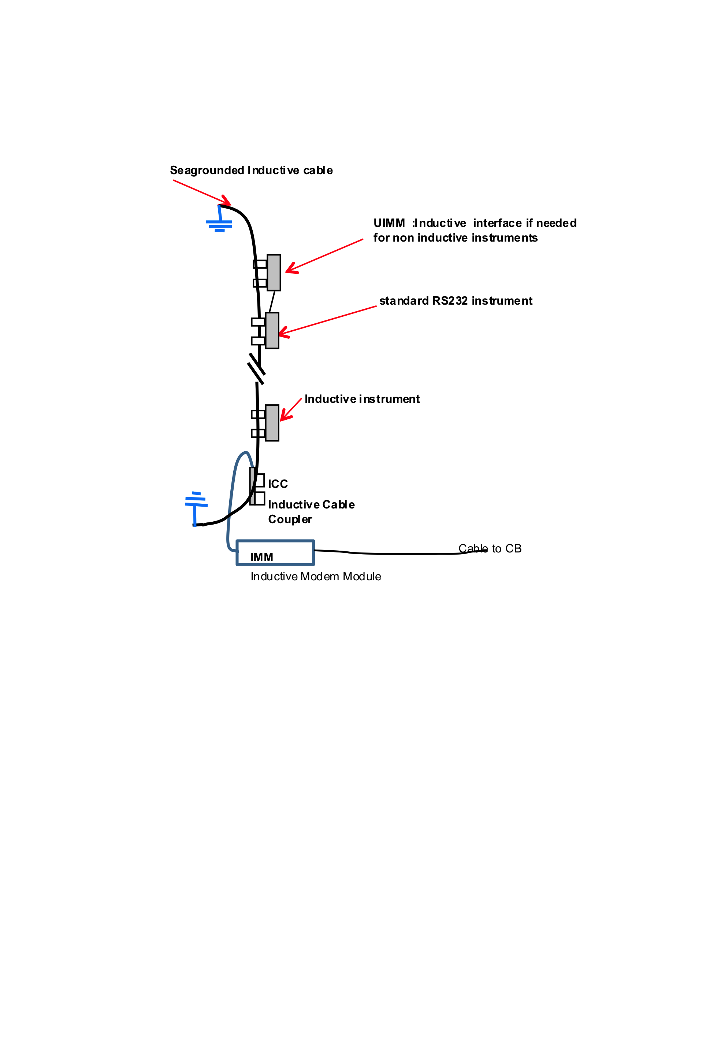
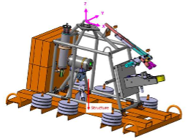
Calibration Units: Instrumentation Unit
Instrumentation Units are recoverable assets equipped with inductive instruments hosting
CTDs (SBE SIP ODO)
SV meters (Valeport mini SVS)
current meters (Aanderaa DCS or Aquadopp)
absolute pressure gauges (Digiquartz)
ORCA Instrumentation Unit Anchor
ARCA Instrumentation Unit Anchor

