Slide 1
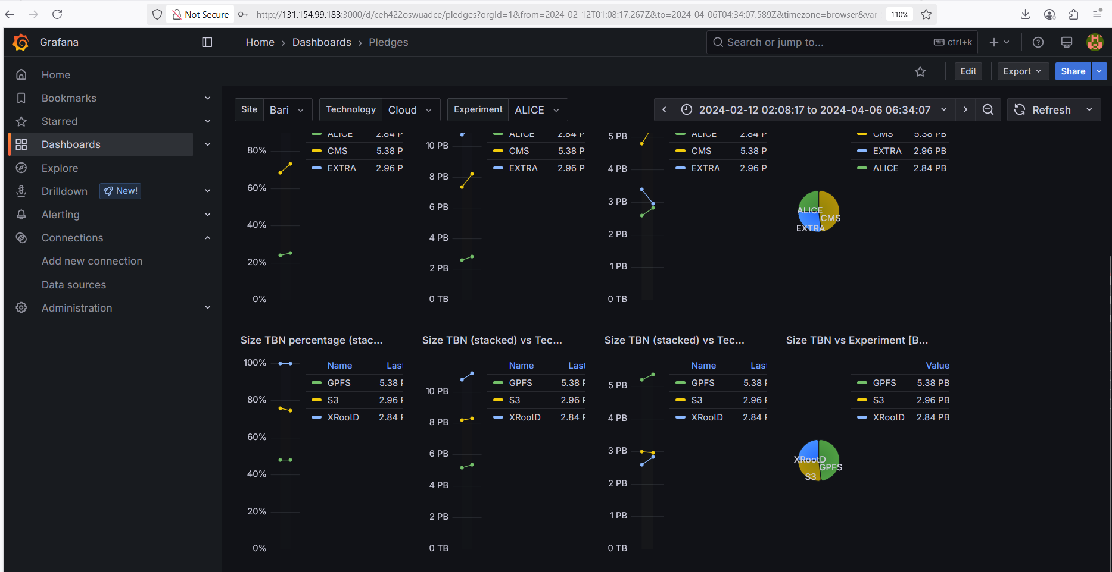

Slide 2
EOSC Node Italy
Matteo Zanaroli
Coordinator of EOSC Node Italy
Ethics and Data Governance Manager at ICSC

Slide 3

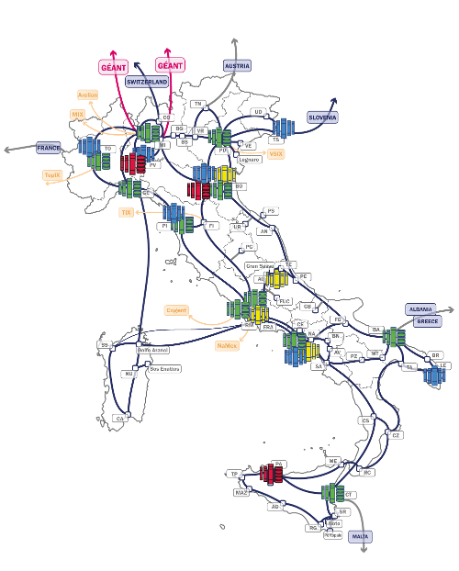

EOSC Node Italy – General Information
The EOSC Node Italy is managed by the ICSC Foundation, that includes 50+ members, a multidisciplinary community (e.g. in silico medicine, smart cities, astrophysics, earth and climate, space economy), among which Italian leading RPOs, e-Infra and RI,
The application as the Italian EOSC Node has been in line with the active participation of the Italian Computing and Data Infrastructure (ICDI), which was one of the four founding members of EOSC and has coordinated Italy’s participation in EOSC since 2018
Founded in 2022, ICSC operates the EOSC Italian Node as a federated infrastructure providing services that have been active for 20+ years
SCOPE: ICSC manages a shared, federated and open infrastructure, representing a unique strategic asset for Italian and international community, supporting Open Science and EOSC.
TARGET USERS: 150k+ researchers of 85+ Italian Universities and Research Institutions; 130+ Research Infrastructures (National, European and Global); EOSC Research Community at large
RESOURCES AVAILABLE:
Federated AAI and integrated service catalogue
Cloud, HPC and storage federated infrastructure
Data Lake and HPC/Cloud federation of data centers
Research and Service product catalogues
Data transfer services benefitting of GARR connection with hundreds of Gigabits per second
Data related services (data preparation, data creation, data analytics)
ELSI (Ethical, Legal and Social Implications) services, including the implementation of ISO27001 Cloud environment and Sandboxes for AI
Catalog of RPOs and SPOs data repositories using D4Science
Education and training programs

Slide 4
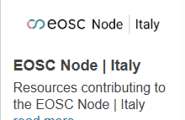
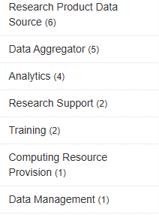
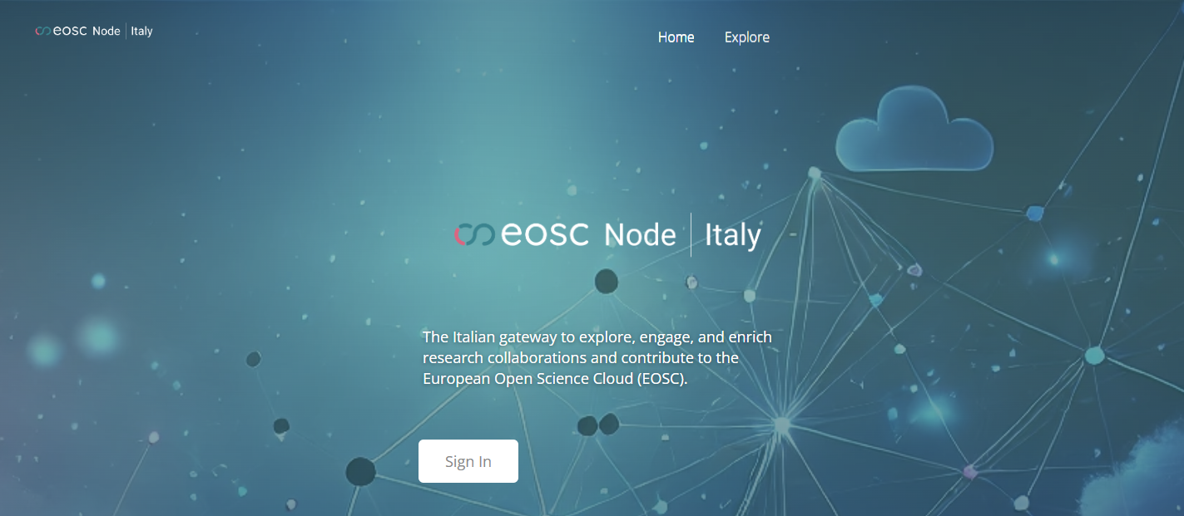

Status of Node development
The EOSC Node Italy is “Enrolled” on the EEN with a federated AAI
The service catalogue of the node is fully integrated with the EU Node and 18 services have been recently onboarded on the
dev instance
A catalogue of 20+ services is already available on the EOSC Node Italy
Entities that have already contributed to the service catalogue:
Service provider for research
Research Performing Organizations and Universities
Italian nodes of Research Infrastructures

Slide 5
Grand challenges
Policy issues including agreements on access to services (i.e. on compute/storage services)
EOSC Node AAI local federation and adoption
From catalogue of catalogues to detailed catalogue
Cross-domain interoperability
The full engagement of the user-community
Continuous institutional support
Main benefits so far
Strategy & Policy: alignment with EU Open Science vision; influence on policy
Technical: shared identity (AAI), interoperability
Collaboration: Cross-border projects
FAIR-by-design integration: National services become part of a wider ecosystem that adheres to the FAIR principles
Visibility: EOSC Italian Node enrolled in the EOSC EU Node and National services onboarded

Slide 6

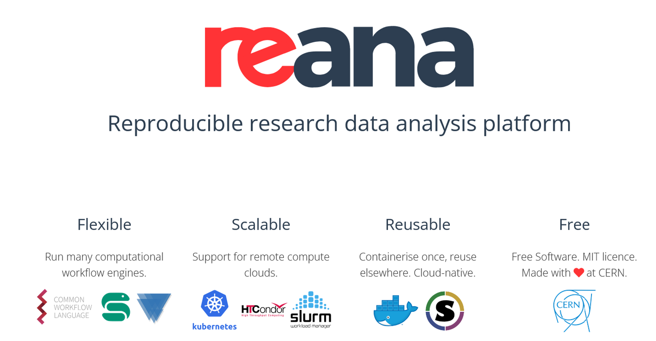
Use cases developed – CERN Reana
Main goals:
Create a distributed workflow to run analysis on a dataset that is too big to be moved and/or run analysis in a
distributed computing area with enough capacity to process the data.
Main contribution of EOSC Node Italy:
Exploit CERN's REANA to instantiate computational workflows on heterogeneous remote clouds
Use the Italian distributed Data Lake as a federated environment for hosting data that could be processed executing
scientific workflows in the EOSC context
Provide multiple scientific communities with access to computing and storage resources and to European federation of
experimental workflow environments, decoupled from specific cloud and resource providers, and leveraging widely
adopted technological solutions.

Slide 7

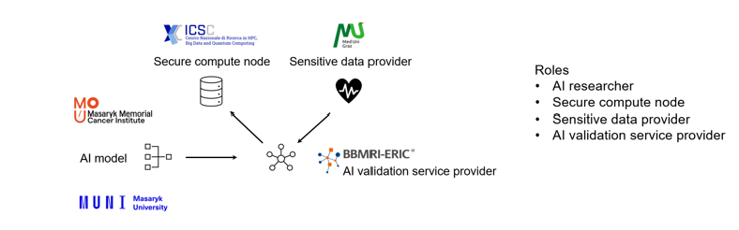
Use cases developed – BBMRI ERIC
Main goals:
Provide a cloud-enabled platform for the multi-centric validation of AI models for prostate cancer screening on
sensitive health data in compliant frameworks
Main contribution of EOSC Node Italy:
Exploit sensitive data storage and analysis facilities leveraging the INFN ISO-certified cloud infrastructure
Provide compute, storage and AI capacities in EHDS (European Health Data Space Regulation) compliant manner for
data-users to the research community leveraging INFN resources and competencies

Slide 8
Added value for the research community
Contribute to change the culture and make Open Science the new normal
Support a strong federation of infrastructures and data for data-driven research
Contribute to the EOSC developments and policies
Participate in projects aimed at developing services to exploit the full federation of EOSC Nodes
Increase the opportunities for Italian researchers and research communities
Having and giving access to high value multidisciplinary competencies and datasets
Access to Cloud and HPC infrastructures
Develop education and training programs
Synergy with EuroHPC key initiatives such as the AI Factory

Slide 9
Thank you
Matteo Zanaroli
matteo.zanaroli@supercomputing-icsc.it

Slide 10










THE MCVAL USE CASE
AND THE EOSC SENSITIVE HEALTH DATA SUBGROUP

Slide 11
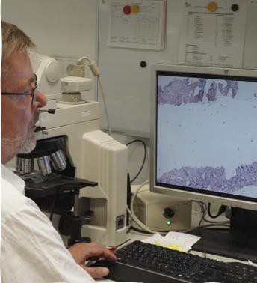
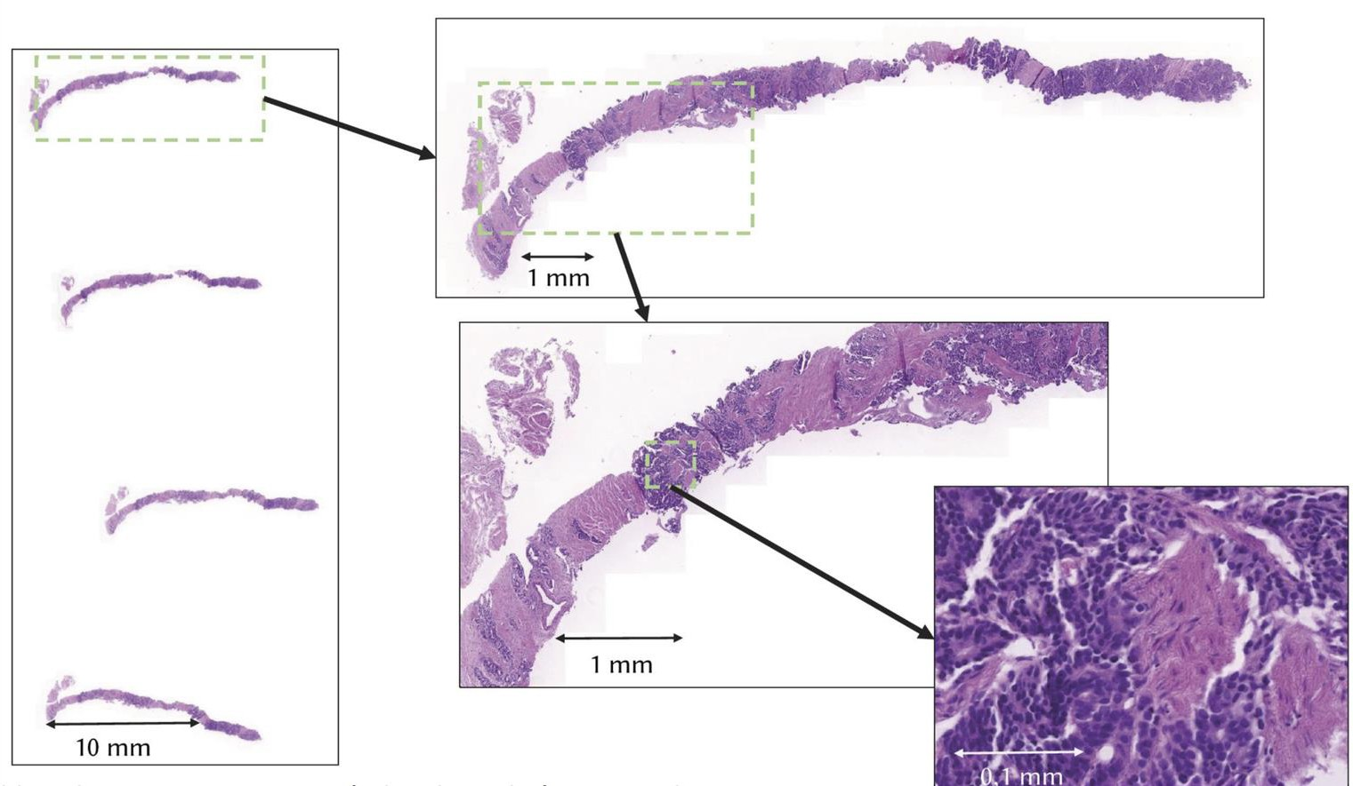
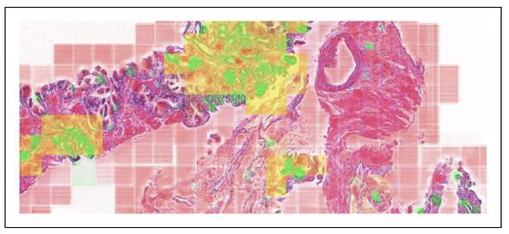
AI assisted prostate cancer screening
MCVAL Background
Manual whole slide image (WSI)
screening
Select region of interest
Zoom into region
Analyse selected region
Repeat
AI assisted WSI screening
Image segmentation
Individual segment analysis
Analysis summary of all segments
Guide pathologist by highlighting segments of interest

Slide 12




Scientific challenge of AI model deployment in clinical setting
Hospital A wants to deploy AI model for prostate-cancer screening
AI model has previously been trained on data from hospital B
AI models do not generalize well to data acquired from new source
AI model must be validated and potentially adapted before deployment at hospital A

Slide 13
MCVAL vision and challenges
MCVAL vision
  Provide a service for the Multi-Centric VALidation of AI models for prostate cancer screening
on sensitive health data in compliant frameworks
Technical challenges
  AI model and validation data must be transferred to secure computing environment via secure channel
  AI models require tailor made computing environments which are often not available in secure computing infrastructures
Legal and ethical challenges
  Legal framework for transfer and processing of sensitive health data across multiple health
institutions and countries does not exist
  Framework for ethical use of sensitive health data across multiple health institutions and countries does not exist

Slide 14
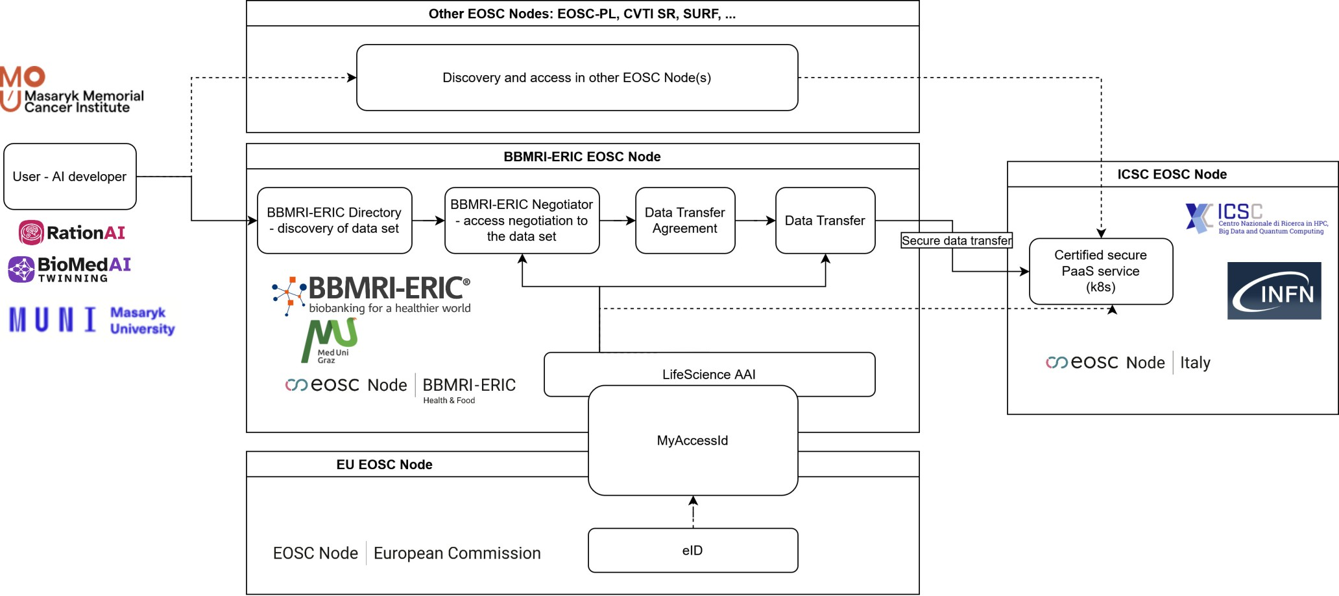
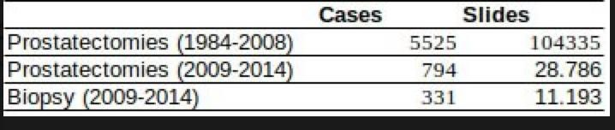

MCVAL USE CASE
Roles – 36 experts involved!
PARTICIPANTS AND ROLES
AI researcher
Secure compute node
Sensitive data provider
AI validation service provider
Participants
MMCI/MU
ICSC/INFN
MUG
BBMRI-ERIC
150TB

Slide 15
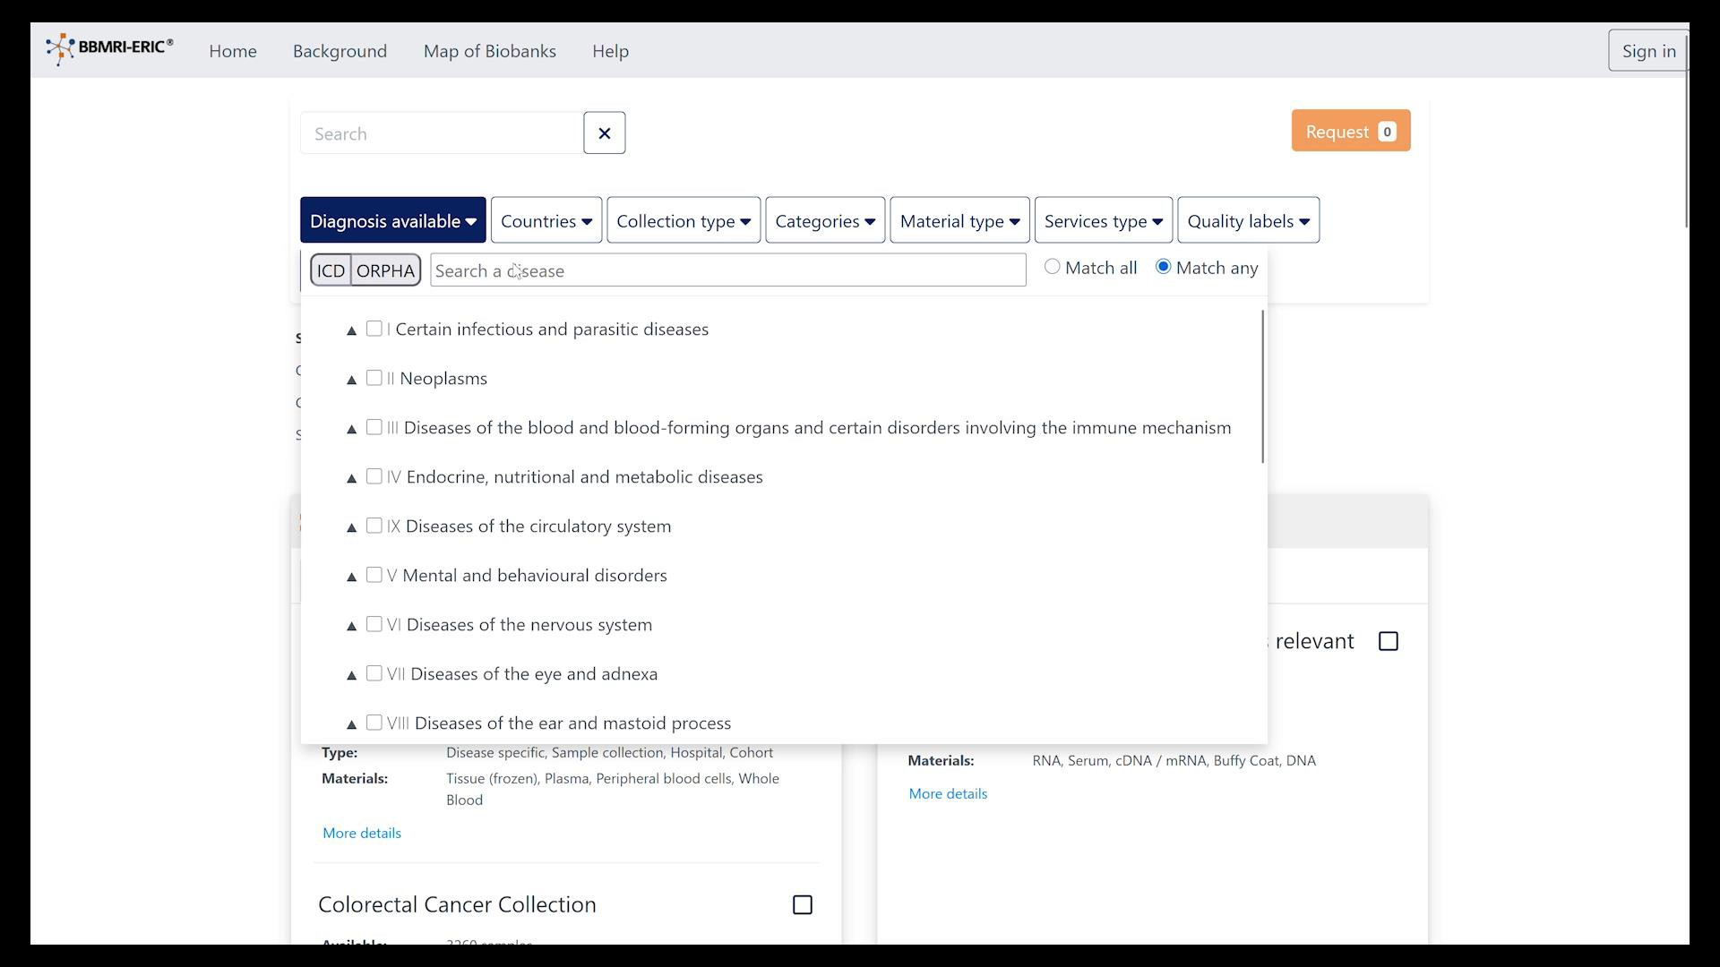
MCVAL demo

Slide 16
Developments and Achievements
Ethics vote
  MMCI – approval for use of AI model
and the overall use case
  MUG – approval for use of data
Contractual framework
  Data transfer agreement
    With MUG
  Data processing agreement
    With ICSC
Interconnecting infrastructure
  Integration of MyAccessId into LifeScience Login/AAI
Compute infrastructure
  Provision of resources complete
  Permission management almost complete
  Kubernetes is deployed in the ISO27001 infra – transition from IaaS to PaaS
  Deployments of AI pipelines
=> Blueprint for Sensitive Health Data subgroup
7

Slide 17
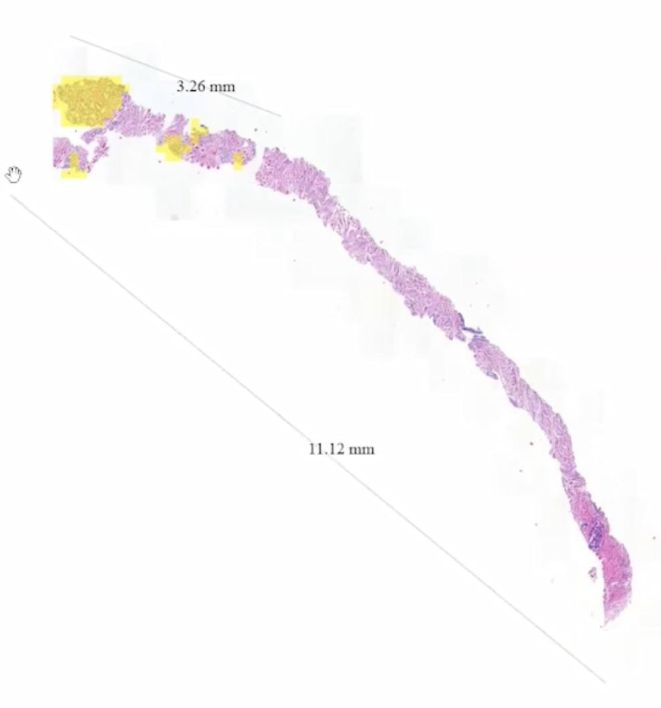
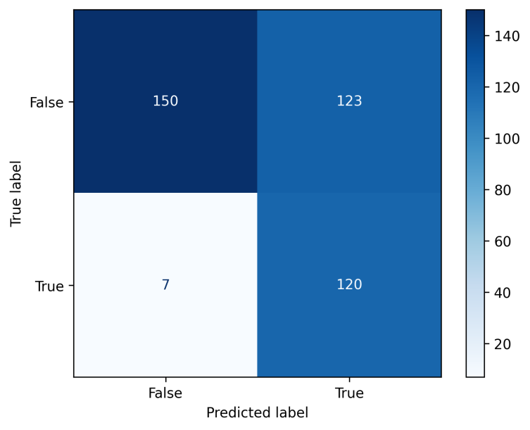
Achievements
Prostate cancer in Austria is 141 cases/100,000 population
(b•elow EU average of 154)
Medical University Graz handles about 220 cases/year
on average – the AI model would assist in speeding up
diagnostics of these
Small-scale pilot given the limited time when the resources
be•came available
Test set: 400 WSIs from 40 patients from Graz (12% of
Graz biopsy data set cases – which did not have slide- level annotations – had to be annotated by a senior
pathologist)
Explainability of individual results provided very good
match to pathologist’s assessment – building trust for
the clinical process
Also unexpected immuno-stainings where classified
correctly
Note: false positive results are high because of the strict optimization for keeping false negatives as low as possible. The model is designed to assist pathologist in the screening process, where false positives are eliminated by the clinician.
The work paves initial steps to expansion of a model used
in routine diagnostics at Masaryk Memorial Cancer Institute
(CZ) to AT and abroad (possibly PL, SK, NL and others via other EOSC Nodes in the future).

Slide 18
How do MCVAL and the EOSC Federation benefit from each other?
Successfully tested the AI model on testing data set from Graz – 400 WSIs
  Positive results esp. for foundational model, paving way to expansion from locally used AI model
to a product usable at different institutions
Contributions of the EOSC Federation to MCVAL
  EU wide network of AI and medical experts
  EU wide clinical health data resources and computing infrastructures for AI model validation,
represented in the EOSC SHD subgroup
  Ability to authenticate using eID
Contributions of MCVAL to the EOSC Federation
  Simplified access to sensitive health data for AI researchers and clinicians
  Legal framework for exchange of sensitive health data across health organizations and countries
  Blueprint for compliant computing infrastructure for processing of sensitive health data

Slide 19












Scaling up MCVAL: the EOSC Sensitive Health Data subgroup
MCVAL will be extended with
Data from EOSC-SK and EOSC-PL
Compute resources from EOSK- SURF
Secure compute node
Sensitive data provider
Future vision:
Catalogue of sensitive health data
for AI model validation
Catalogue of secure computing infrastructures for AI model validation (Computing resources and Services)
Implement AI model validation workflows in common workflow management system at multiple EOSC nodes
AI model
AI validation service provider
EOSC SHD
subgroup
Secure compute node Sensitive data provider

Slide 20
Thank you for your attention and
Thank you to all the highly committed contributors in the MCVAL use case and the SHD subgroup!
MUNI-RationAI/BioMedAI: Adam Džadoň, Adam Kukučka, Matej Pekár, Jozef Kraus, Jakub Pekár, Tomáš Balák, Erik Sedlák, Adam Bajger, Vít "Vejtek" Musil, Karel Štěpka, Tomáš Brázdil, Lukáš Hejmánek
MMCI: Rudolf Nenutil
MUG: Markus Plass
INFN: Francesco Sinsi, Jacopo Gasparetto, Stefano Zani, Carmen Guiliano, Lorenzo Chiarelli, Walentina Catania, Veronica Buccheri, Barbara Martelli, Guisy Sergi, Giacinto Donvito, Alessandro Costantini
ICSC: Matteo Zanarolli
MUNI-LifeScienceAAI: Peter Bolha, Kristýna Kvizdová, Peter Lenyi, Luděk Matyska
BBMRI-ERIC: Jiří Horák, Heimo Müller, Kurt Majcen, Irene Schlünder, Andreas Türk, Jana Pavlic-Zupanc, Eleanor Shember, Michael Prattes, Jens Habermann, Petr Holub
EOSC-SK, EOSK-PL, EOSC-SURF: Jaroslav Budiš, David Cymbalak, Klaudyna Śpiewak-Wojtyła, Piotr Krajewski, Ivar Janmaat

Slide 21





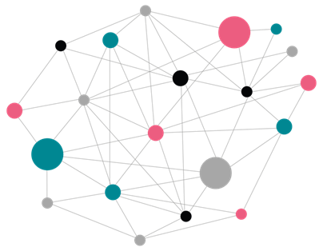
The REANA use case in the EOSC Federation
FAIR (re)analysis of the LHC data in a distributed environment
Giovanni Guerrieri (CERN), on behalf of Tibor Simko and the EOSC Scientific Workflows subgroup
3 November 2025

Slide 22
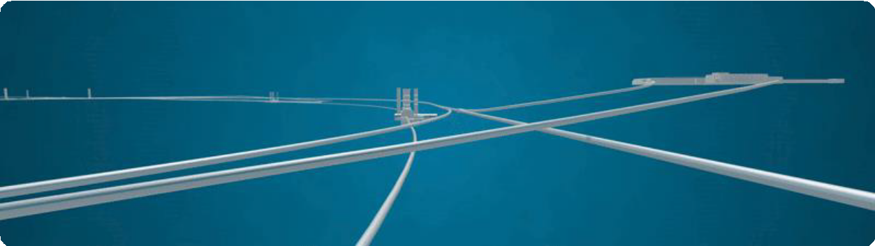
The Large Hadron Collider (LHC)
The LHC at CERN accelerates (not only) protons close to the speed of light
Bunches of protons collide at the interaction points of the detectors

Slide 23
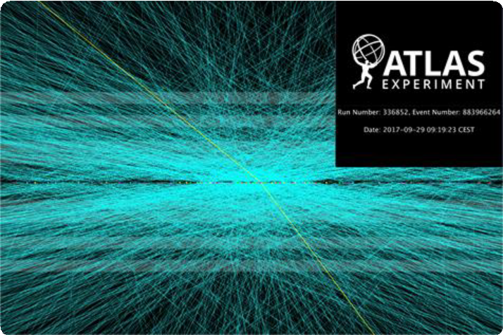
The Large Hadron Collider (LHC)
The ATLAS and CMS detectors record 40 million proton-proton collisions (events) per second
Each collision is a complex mix of thousands of new particles being produced

Slide 24

The Large Hadron Collider (LHC)
_{e}-
_{e}-
e
e
+
+
We analyse the characteristics of these collisions to understand how physics works at subatomic scale (and not only)
We aim to measure rare processes happening
once every 10 billion events
We have a good idea of what happens
theoretically during the collisions
Z
Z
H

Slide 25
The value of the data
_{e}-
?
_{e}-
e
e
+
+
In practice, the detector only records a part of the physics interaction
We then need to simulate the events (according to our theory), and compare them with the output of our detectors

Slide 26
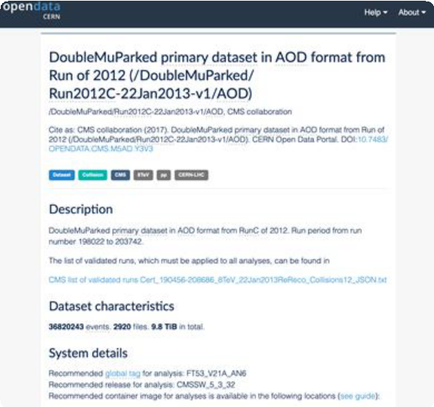
The value of the data
Each experiment simulates up to ~200B events (O(10)PB of data per year), to be used for publications
CERN currently exposes more than 5 PB of Open Data
  Collision data: unique, only producible at the LHC
  Simulated data: produced at a scale (WLCG) that is difficult to reproduce by most of the external communities

Slide 27
Frequently asked questions
1. How do I run my analysis on a dataset that is too big to be moved,
or that I don’t have direct access to?
and / or
1. How do I run my analysis in a place that has enough computing capacity to process the data?

Slide 28
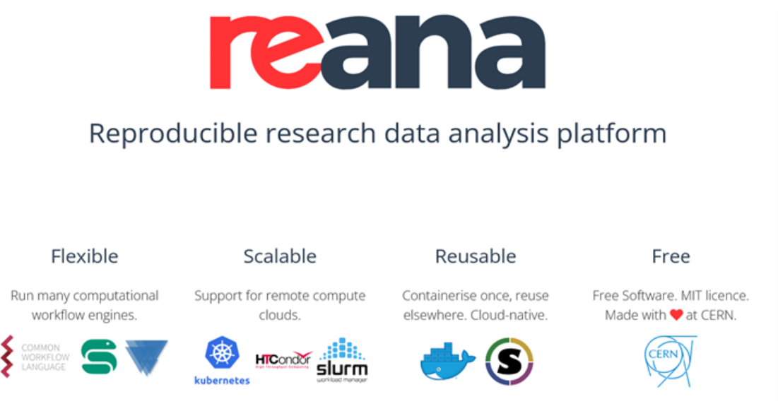
Containerised data analyses
https://www.reana.io

Slide 29
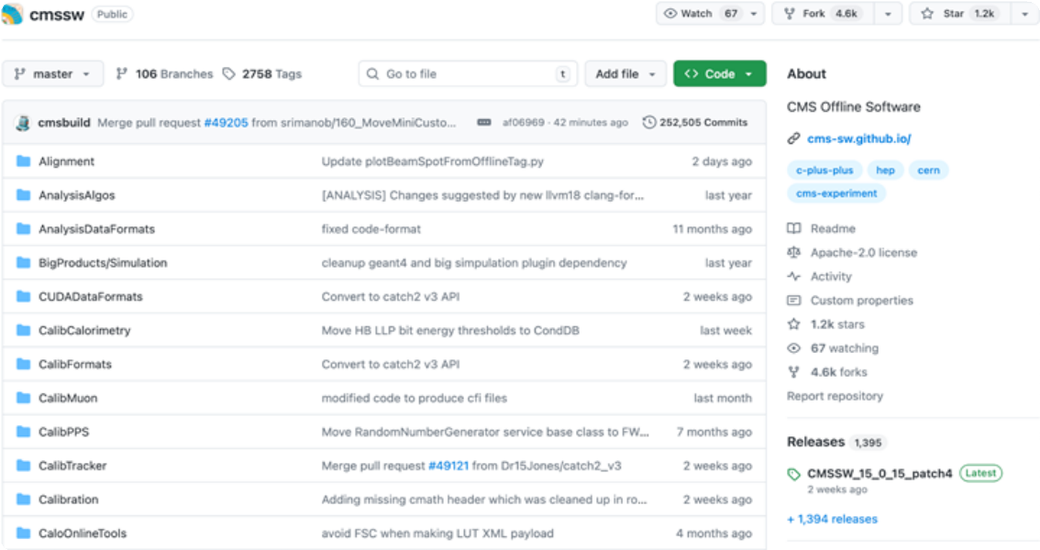
The software
https://cms-sw.github.io

Slide 30
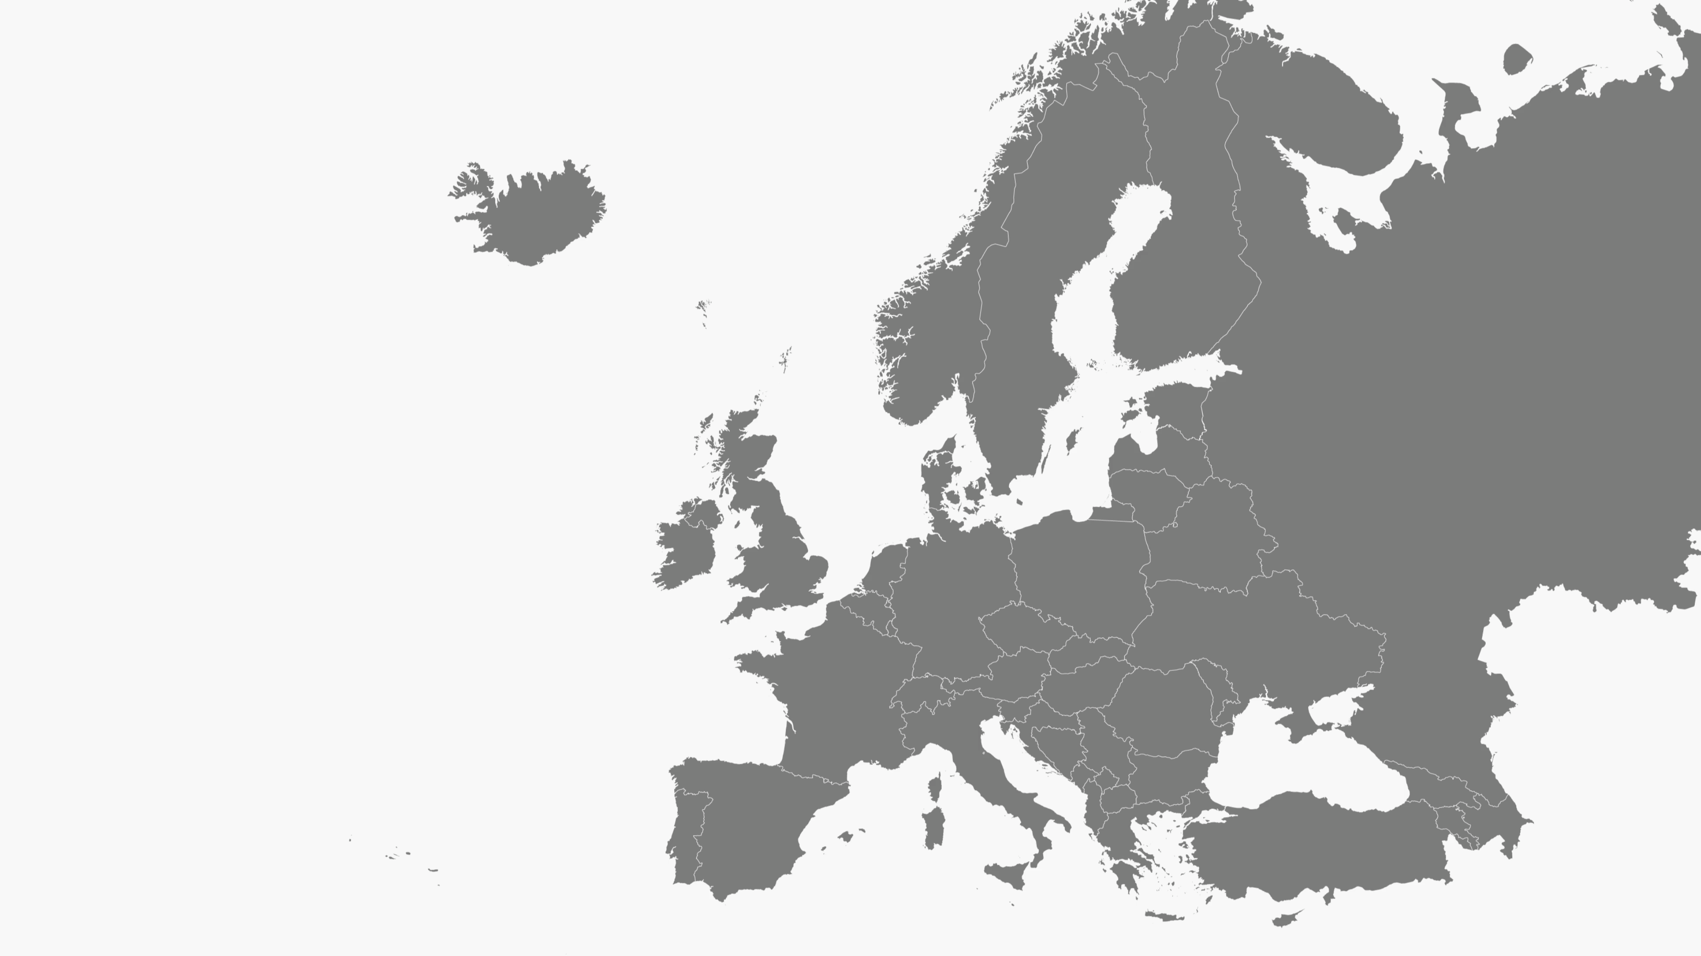
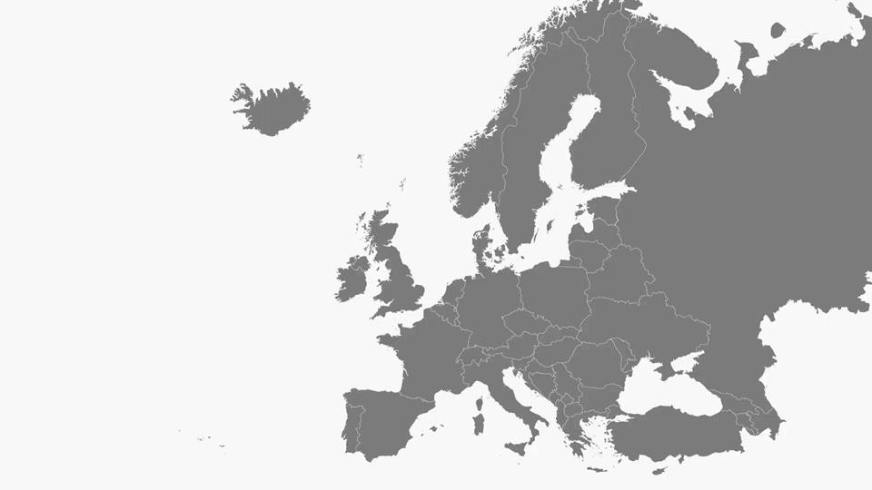
DEMO

Slide 31
REANA meets the EOSC Federation
Enabled REANA to run federated execution of workflows à la WLCG on EOSC Federation
  Near-data computing to efficiently process large amounts of unique data
  Running workflows without direct data access (e.g. testing new models by theorists/phenomenologists by reinterpreting past analyses)
Support a coherent, adaptable approach to research
  Limits the duplication of infrastructures
  Encourages diverse communities to collaborate, share expertise, and address common challenges together.
Not only for particle physics!
  Anyone that needs to run distributed workflows can leverage these functionalities
  Run any CWL, Snakemake, Yadage workflows in any scientific discipline

Slide 32






Thank you!

