Slide 1
SuperB Vacuum
A. CLOZZA

Slide 2
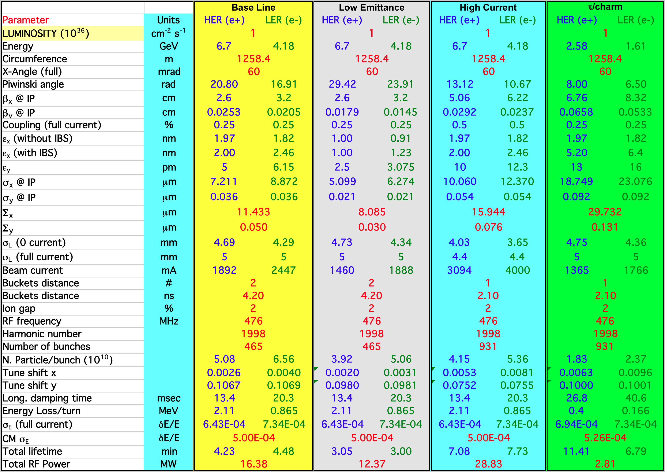
Parameter List

Slide 3
Main Vacuum Related Parameters
Γ = 8.08×E×I×10²⁰ (total photon flux)
HER:
E=6.7GeV I=1.892A Γ_{H}=1×10²² photons/s
LER:
E=4.18GeV I=2.447A Γ_{L}=8.3×10²¹ photons/s

Slide 4
Total Gas Load
η=1×10⁻⁶ (desorption efficiency)
1mbar=2.5×10¹⁹molec. (conversion factor)
Q=Γ η / 2.5×10¹⁹ (gas load)
Q_{H}=4×10⁻⁴ mbar l/s (HER gas load)
Q_{L}=3.3×10⁻⁴ mbar l/s (LER gas load)

Slide 5
Mean Pressure & Pumping
<P>≈10⁻⁹ mbar (mean working pressure)
S=Q/P (pumping speed)
S_{H}=4×10⁵ l/s (HER total pumping speed)
S_{L}=3.3×10⁵ l/s (LER total pumping speed)
L=1258.4 m
S_{0H}=320 l/sm (linear pumping speed)
S_{0L}=260 l/sm (linear pumping speed)

Slide 6
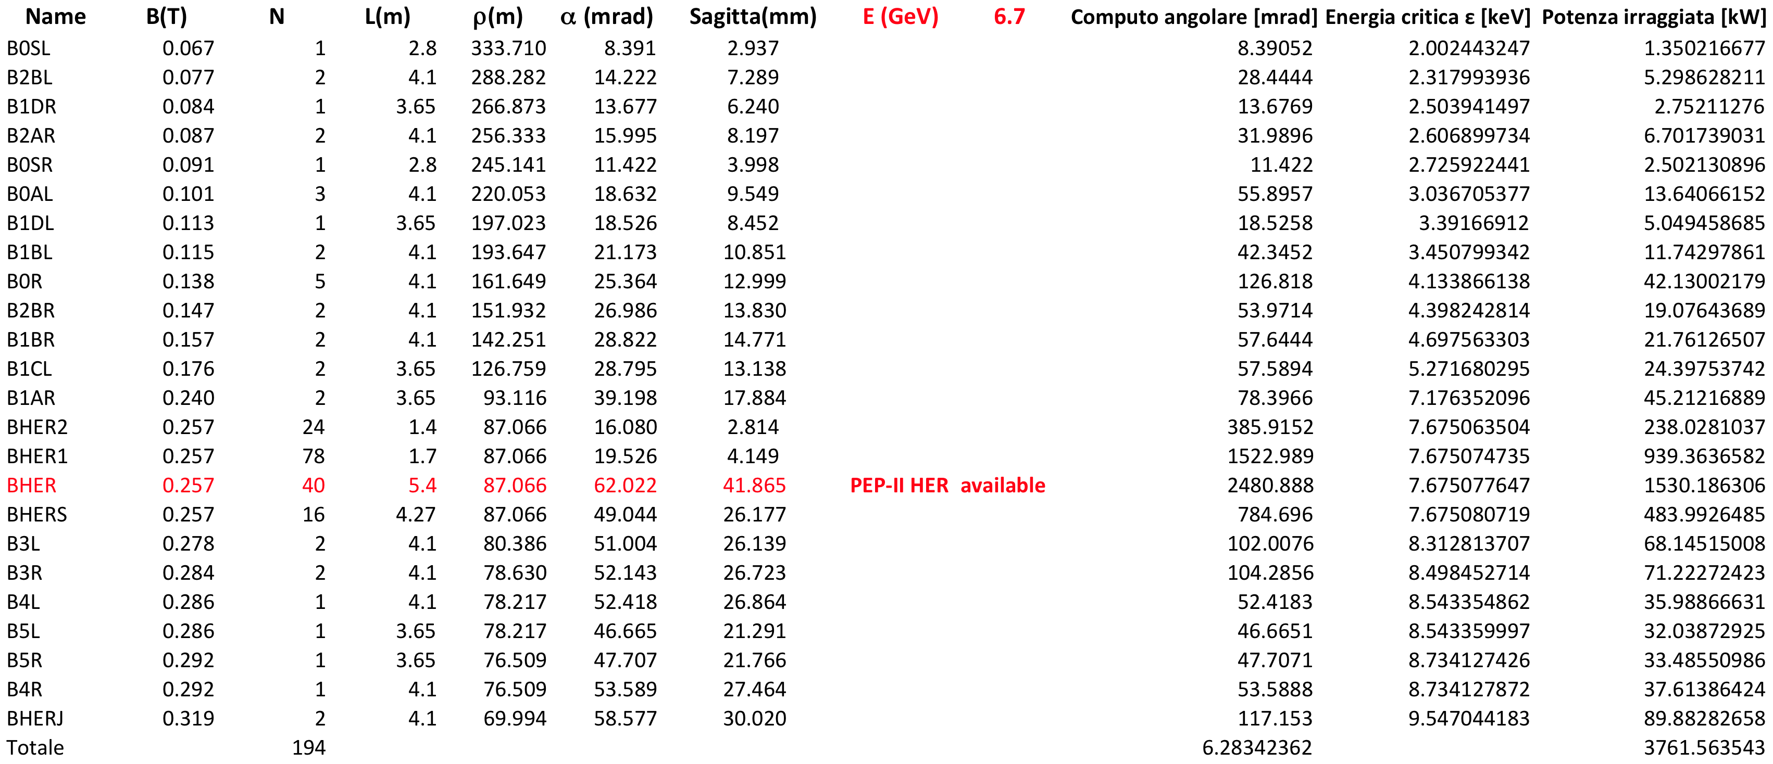
HER SR Power
3.8MW

Slide 7
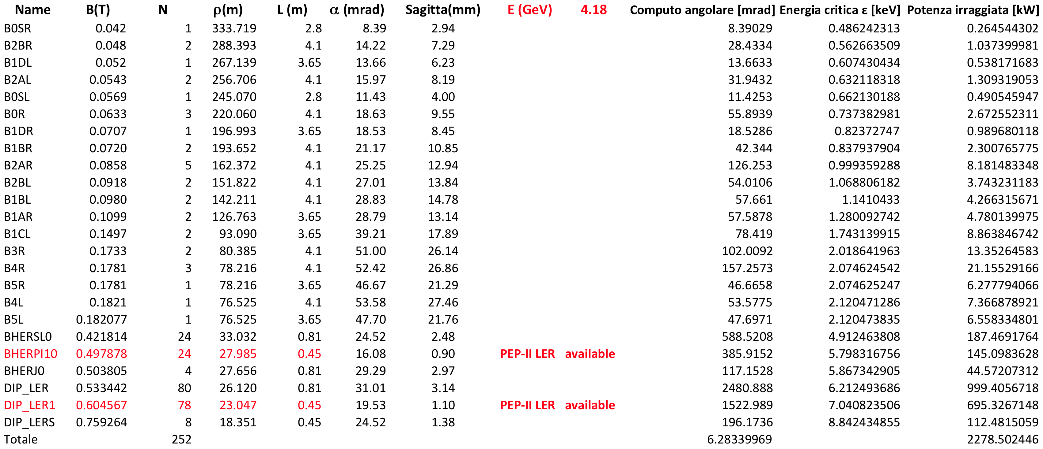
LER SR Power
2.3MW

Slide 8
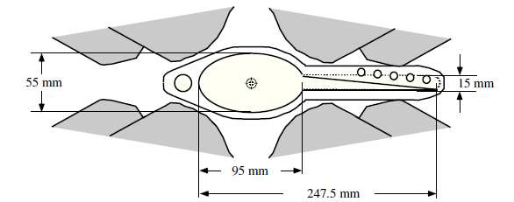
Hypothetical V.C. cross section
100 mm

Slide 9
SR Power Load
HER ρ = 87 m d = 4.2 m γ ≈ 13000
LER ρ = 26 m d = 2.3 m γ ≈ 8200
HER δ ≈ .3 mm
LER δ ≈ .3 mm
P_{H}=3.8MW p_{H}=3kW/m p_{0H}=10W/mm²
P_{L}=2.3MW p_{L}=1.8kW/m p_{0L}=6W/mm²

Slide 10
Pumping & Cooling
Distributed pumping & lumped pumps
  DNEG & DIP plus Ion Pumps
  ≈300 l/sm plus lumped pumps (about 250 / ring)
Water cooled vacuum chamber
  Aluminum for LER (to be checked)
  Copper for HER (to be checked)

Slide 11
Cost Evaluation
Vacuum chamber pipes: ≈10M€ (Al & Cu)
Ion Pumps: ≈4M€
DIP: ≈3M€
RF Shielded Bellows: ≈2M€
RF Shielded Gate Valves: ≈3.2M€
Vacuum Gauges: ≈0.5M€
Fore Vacuum Valves: ≈0.5M€
Fore Vacuum: ≈0.5M€
TOTAL: ≈23.7M€

Slide 12
Cost Evaluation
In the cost evaluation are not included the following items:
  Special coating for e-cloud mitigation
  Clearing electrodes for e-cloud mitigation
  Distributed NEG pumping system
  Beam diagnostic devices
  Injector System Vacuum (LINAC, T.L., Dumping Ring)
These items need more information and must be evaluated

Slide 13
Needed Infos
The value for the mean working pressure
V.C. impedance evaluation
Beam stay clear
e-cloud clearing electrodes
  #, type & position
Dipole gap & multipole bore radius
Beam diagnostic devices
  #, type & position
Kickers
  #, type & position
SR Power load draining from vacuum chamber
A skilled designer

Slide 14
Conclusions
A larger vacuum chamber cross section is probably needed to house a 300 l/m distributed pump and to have a bigger conductance in order to reduce the number of lumped pumps
Particular care to evaluate V.C. impedance (a larger cross section helps too)
Prototyping is mandatory for distributed pumping, cooling studying and clearing electrodes

