Slide 1
Time-shared FEL operation in the SuperB LINAC
S. Guiducci
3 Aprile 2012

Slide 2
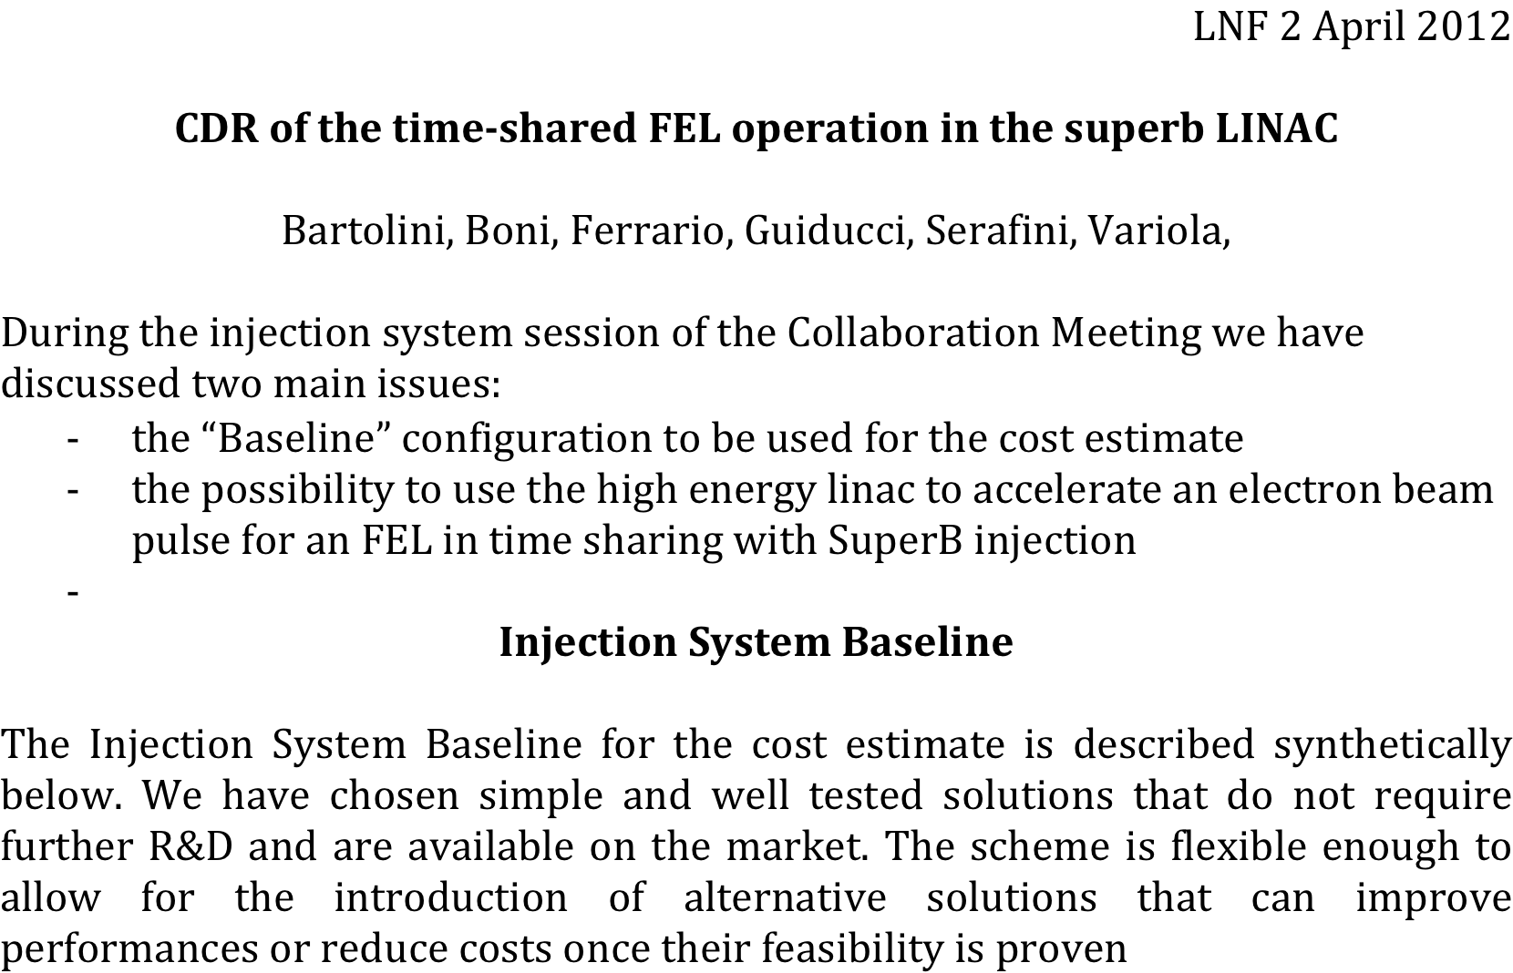
DRAFT: SuperB baseline, not yet circulated to FEL coauthors

Slide 3
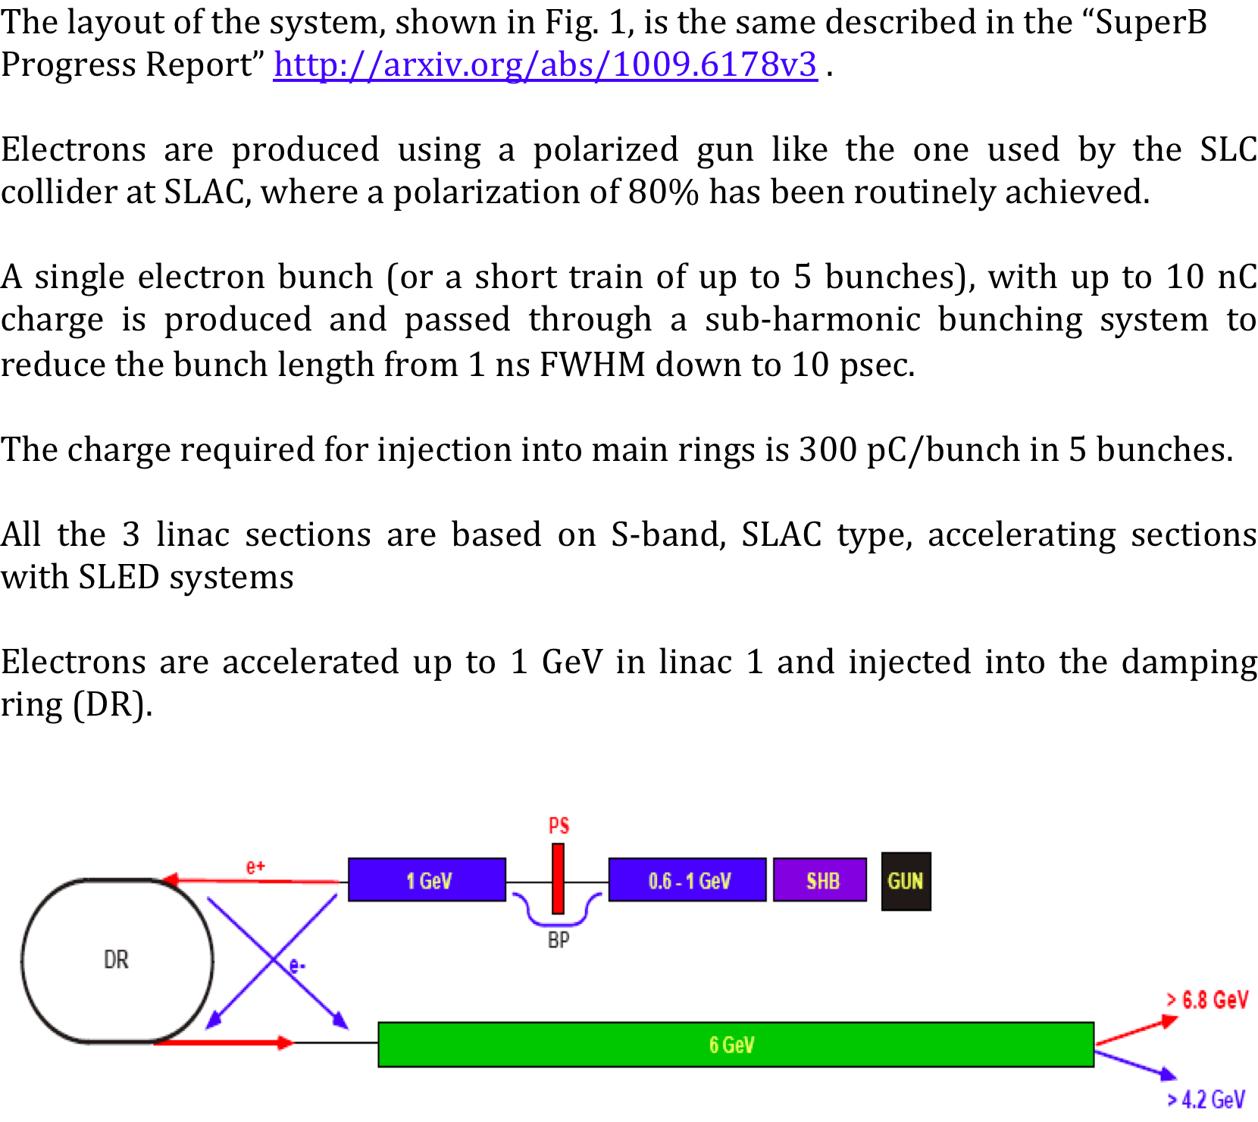
DRAFT

Slide 4
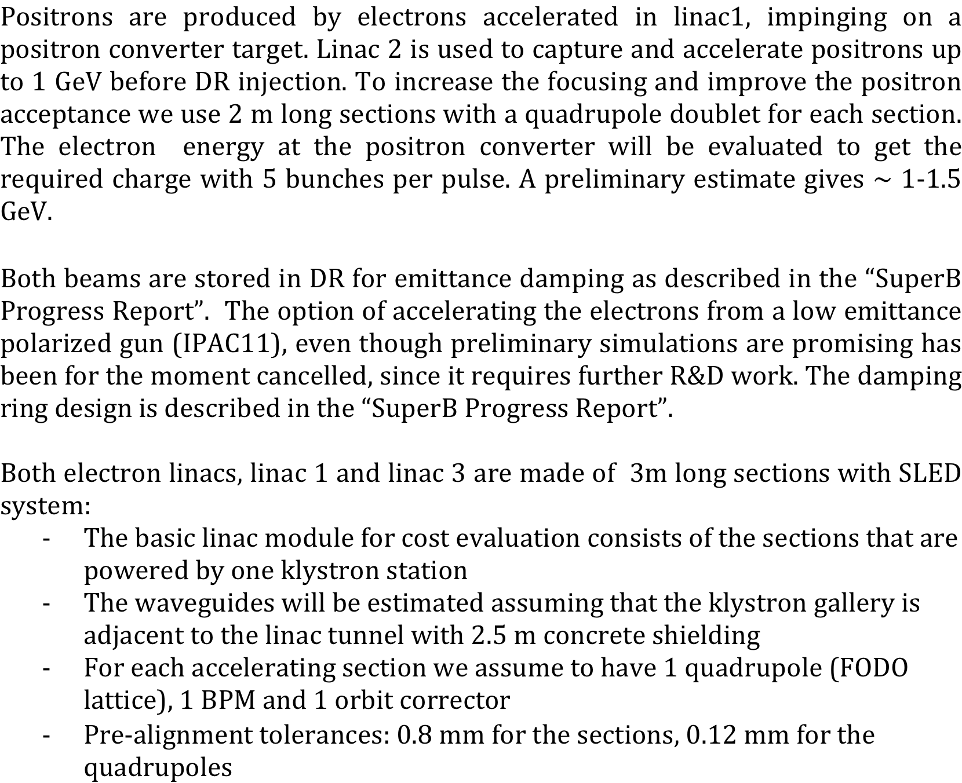
DRAFT
For each 2 sections

Slide 5
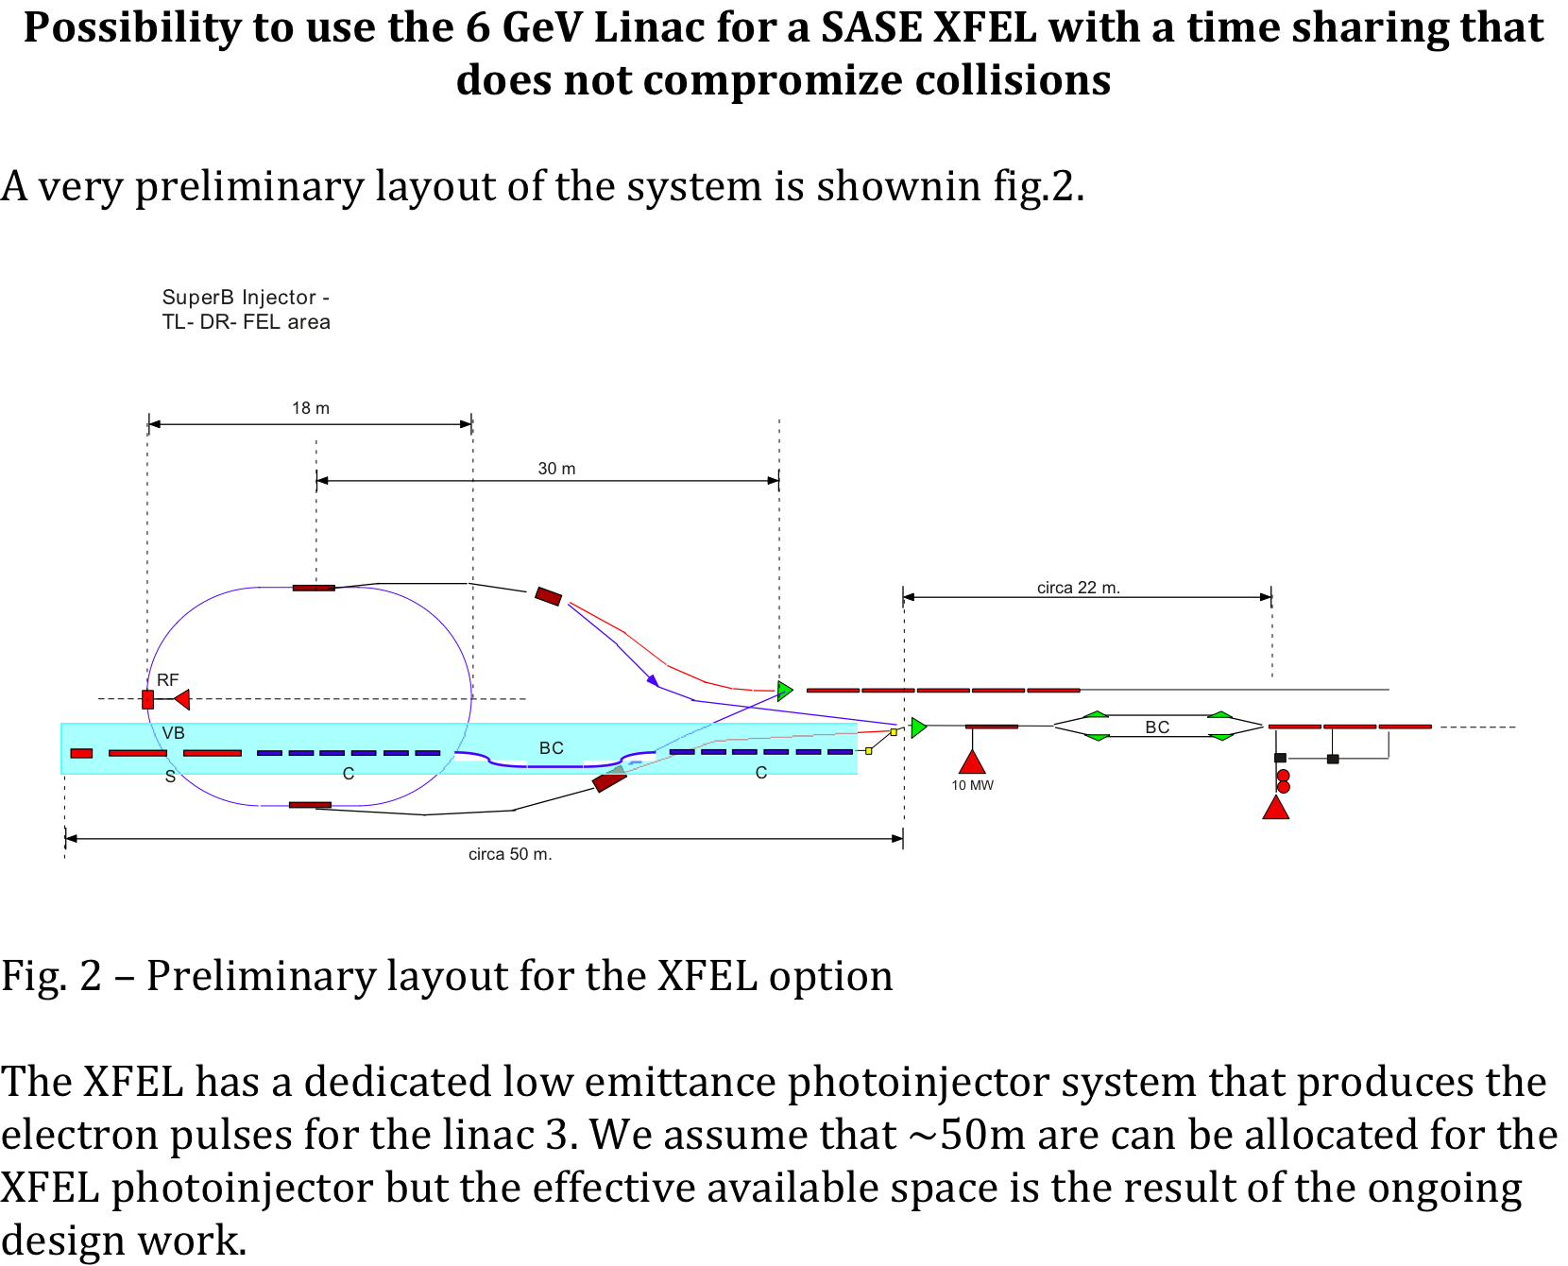
DRAFT

Slide 6
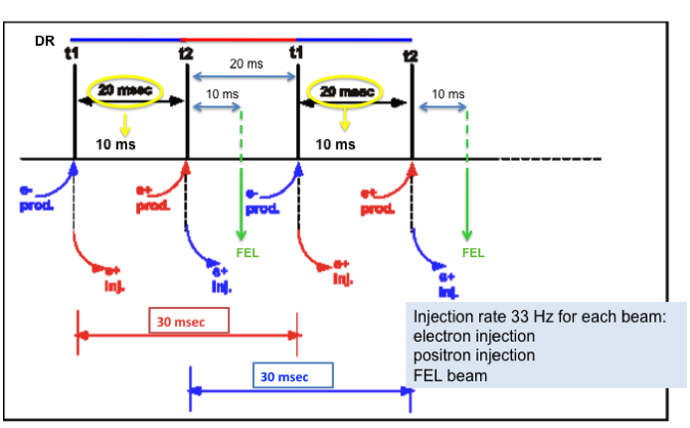
DRAFT
In order to achieve the emittance required for HER injection positrons need to be stored in the DR for ~3 damping times, i.e. for 20 ms. Since the electrons have a lower initial emittance they can get the required emittance for LER injection with a store time of 10 ms.
If the linac repetition frequency is 100 Hz it is possible to accelerate in the linac a pulse for the XFEL during the store time of the positrons in the DR without affecting the injection rate for SuperB. As it is shown in fig. 3 it is possible to inject in each ring at 33 Hz and to provide a dedicated linac pulse for XFEL at 33 Hz. The time duration available for the XFEL pulse, due to the SLED system used for the linac cavities, is of the order of 100 ns.

