Slide 1
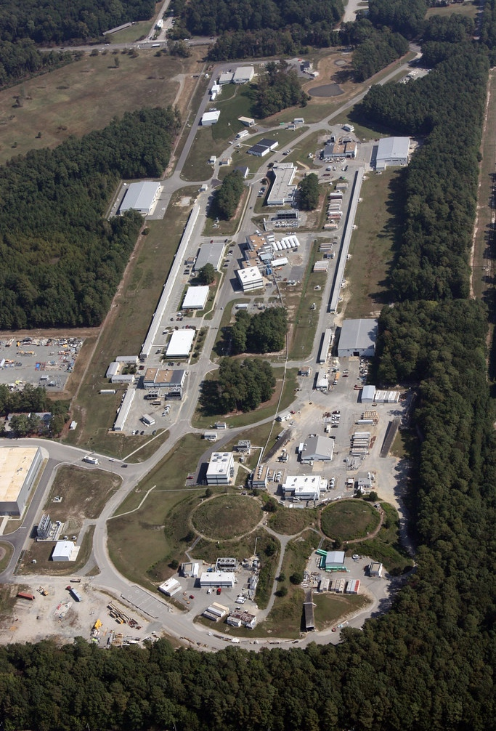


AI methods for BDX-MINI analysis
Marco Spreafico
on behalf of the BDX collaboration

Slide 2
Outline
BDX-MINI
BDX-MINI analysis
AI-based background rejection
Anomaly detection
Conclusions

Slide 3
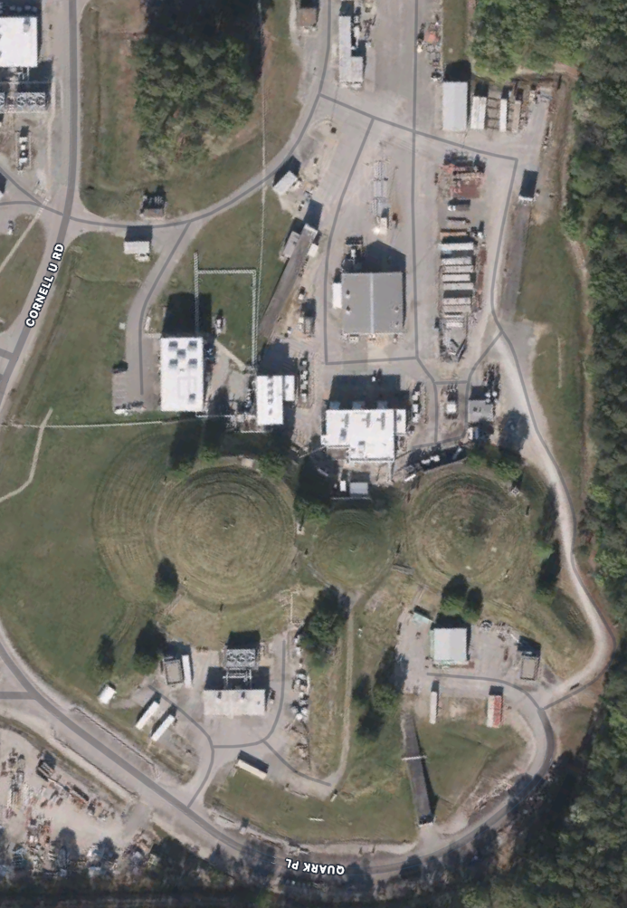
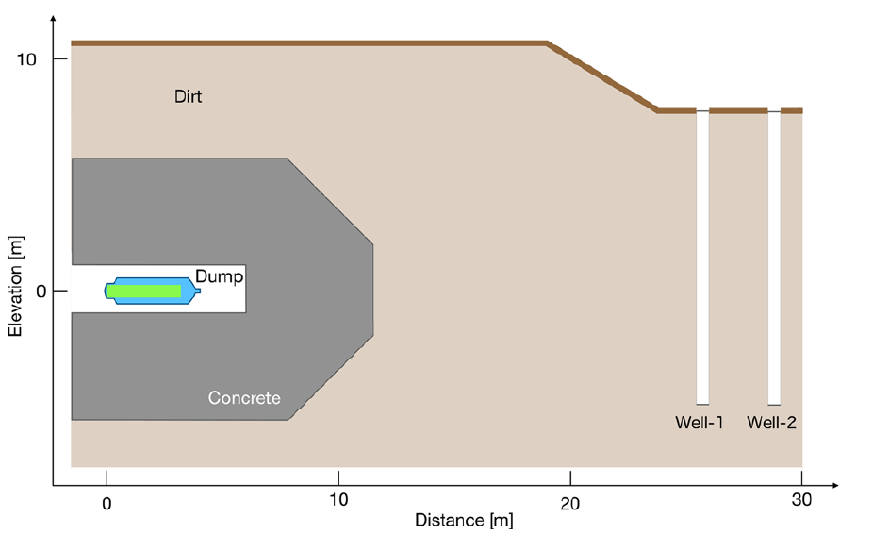

BDX-MINI
BDX-MINI: pilot version of BDX
Detector placed 25 m downstream Hall-A beam dump
2.56 GeV electron beam
Beam current up to 150 μA
Accumulated 2.56 10²¹ EOT
Alternate beam-on and beam-off data (beam-on time ~50%)
CEBAF
Hall A
Beam Dump
Well
Eur. Phys. J C 81.2 (2021), p. 164

Slide 4
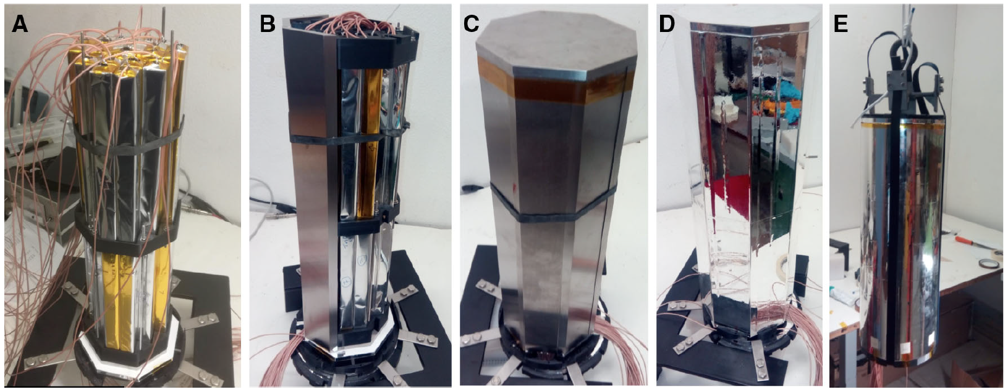
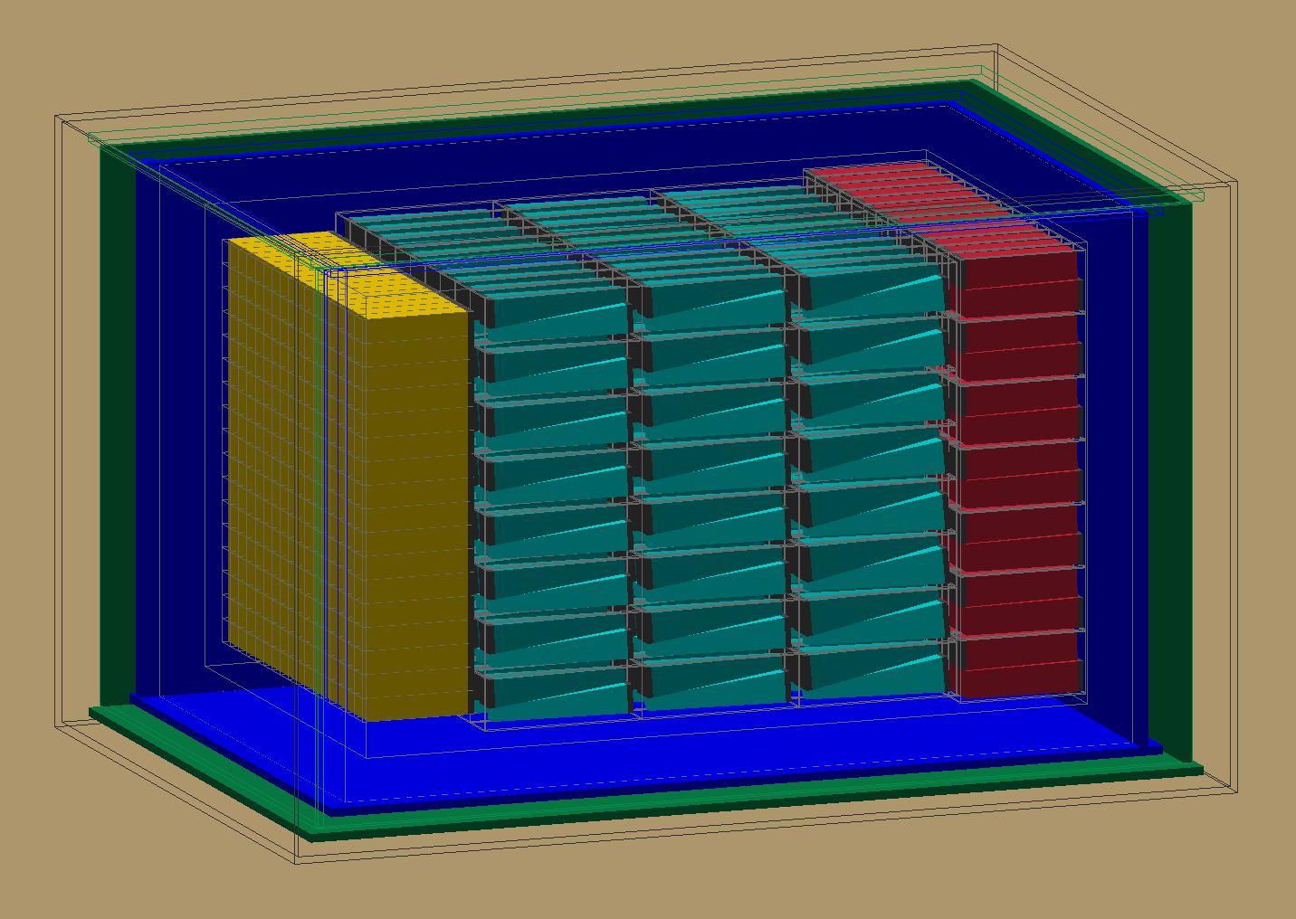
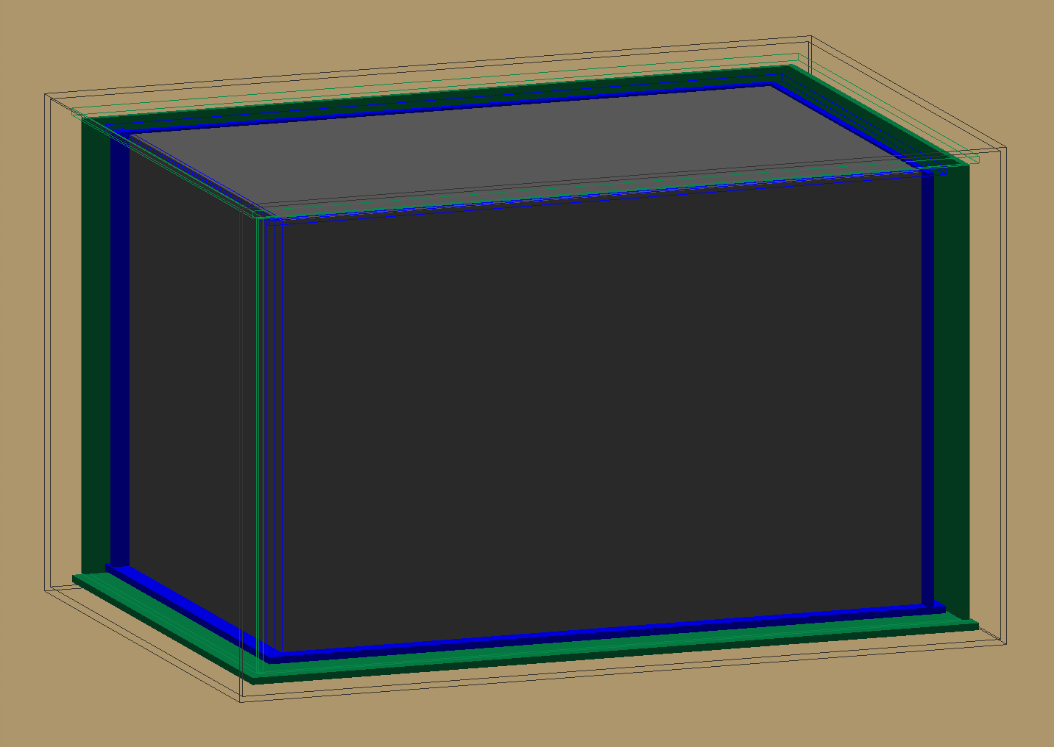
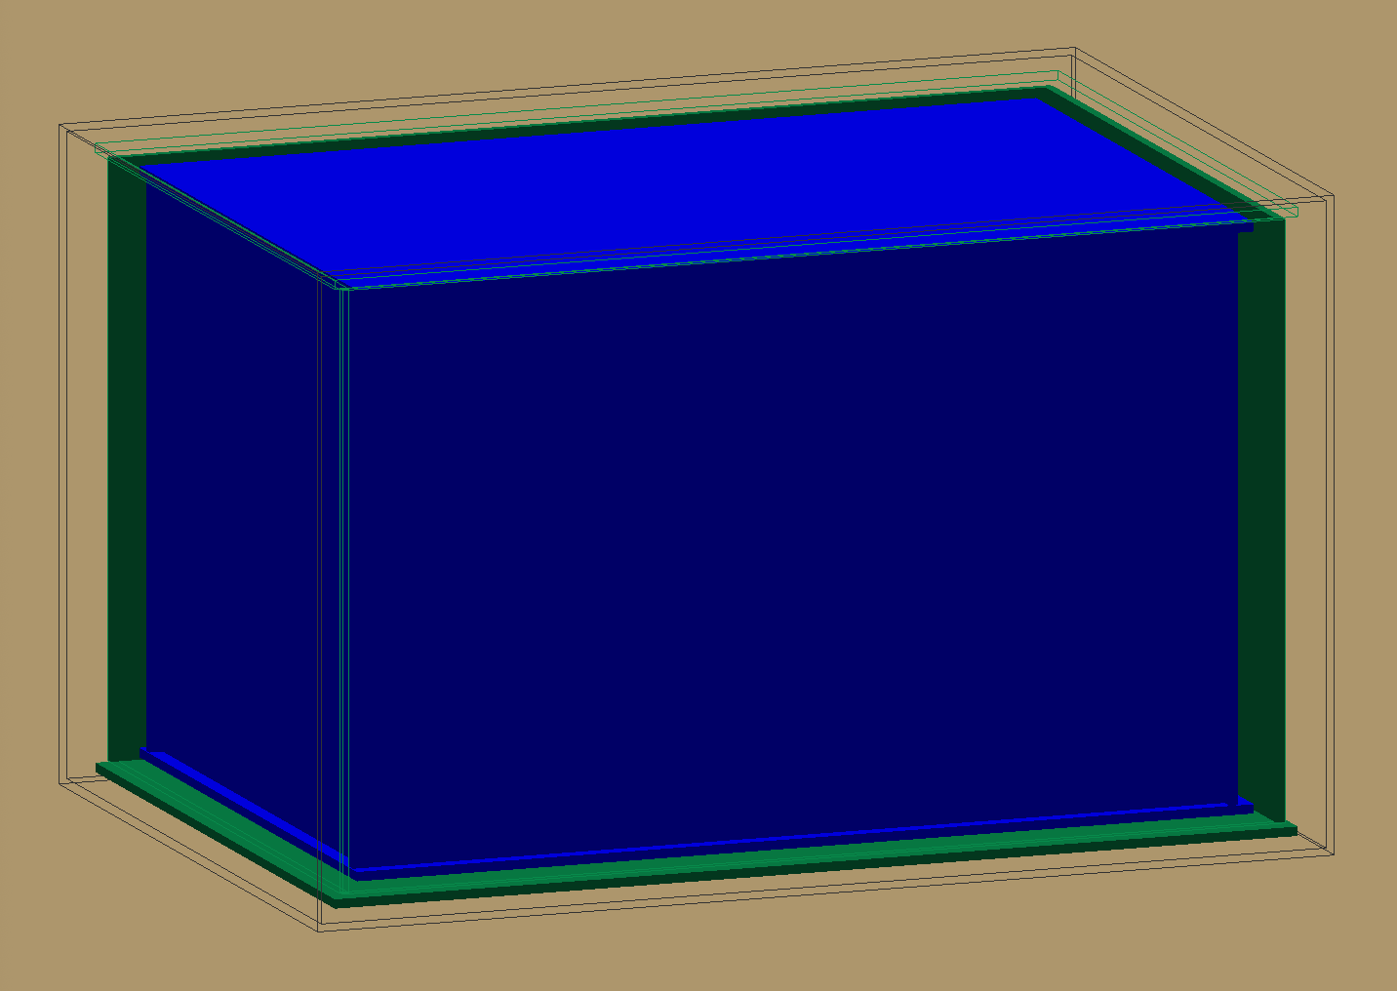

BDX-MINI detector
Detector = small scale version of BDX
ECal: 44 PbWO₄ crystals (1/125
of BDX mass) read by Hamamatsu S13360-6025PE MPPCs
Passive shielding made of 0.8
cm thick tungsten
Two Active veto layers made
by EJ200 plastic scintillator read by WLS fibers and Hamamatsu S13360-3075PE MPPCs
Eur. Phys. J C 81.2 (2021), p. 164

Slide 5
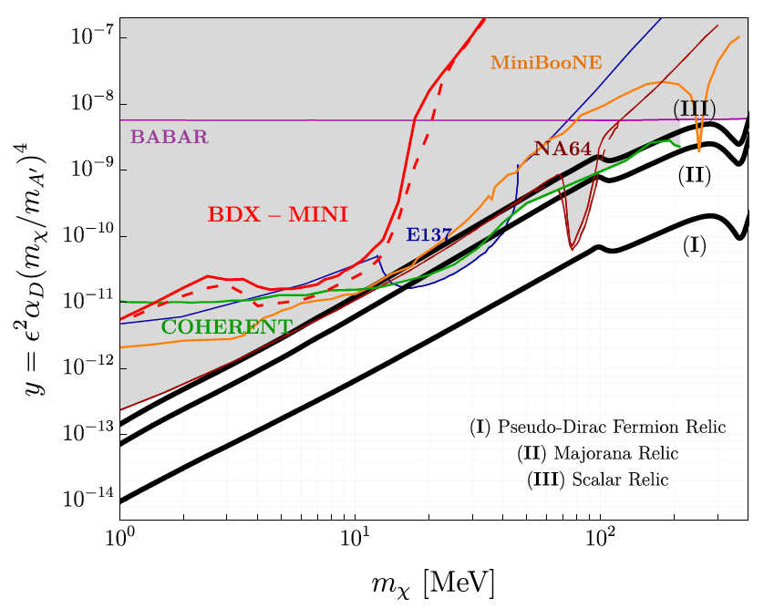

BDX-MINI results
BDX-MINI optimization with blind analysis
Event selection: anti coincidence with veto, data divided in 7 45-MeV wide bins from 40 to 355 MeV plus an overflow bin from 355 to 600 MeV
Yields for 2,56x10²¹ EOT
$n_{on}=3623$
$n_{off}=3822$ ($τ=1.054$)
No excess observed
Evaluated 90% exclusion limit in LDM parameter space
Scalar
Fermion
Phys. Rev. D 106.7 (2022), p. 072011

Slide 6
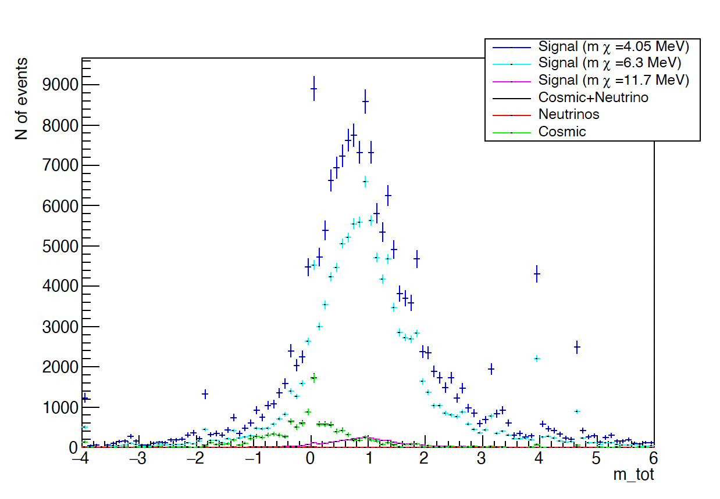
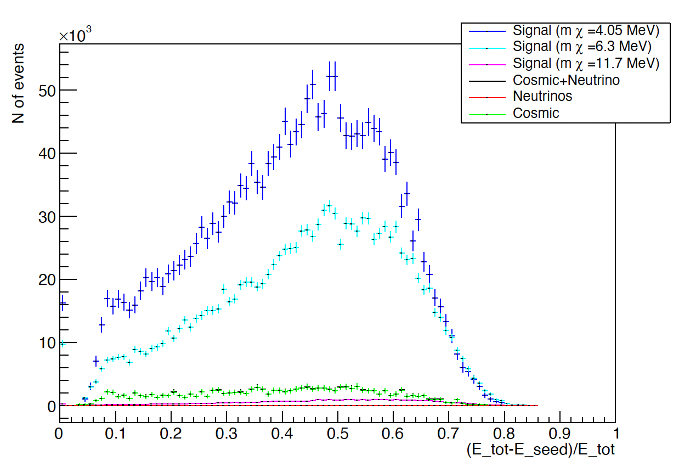
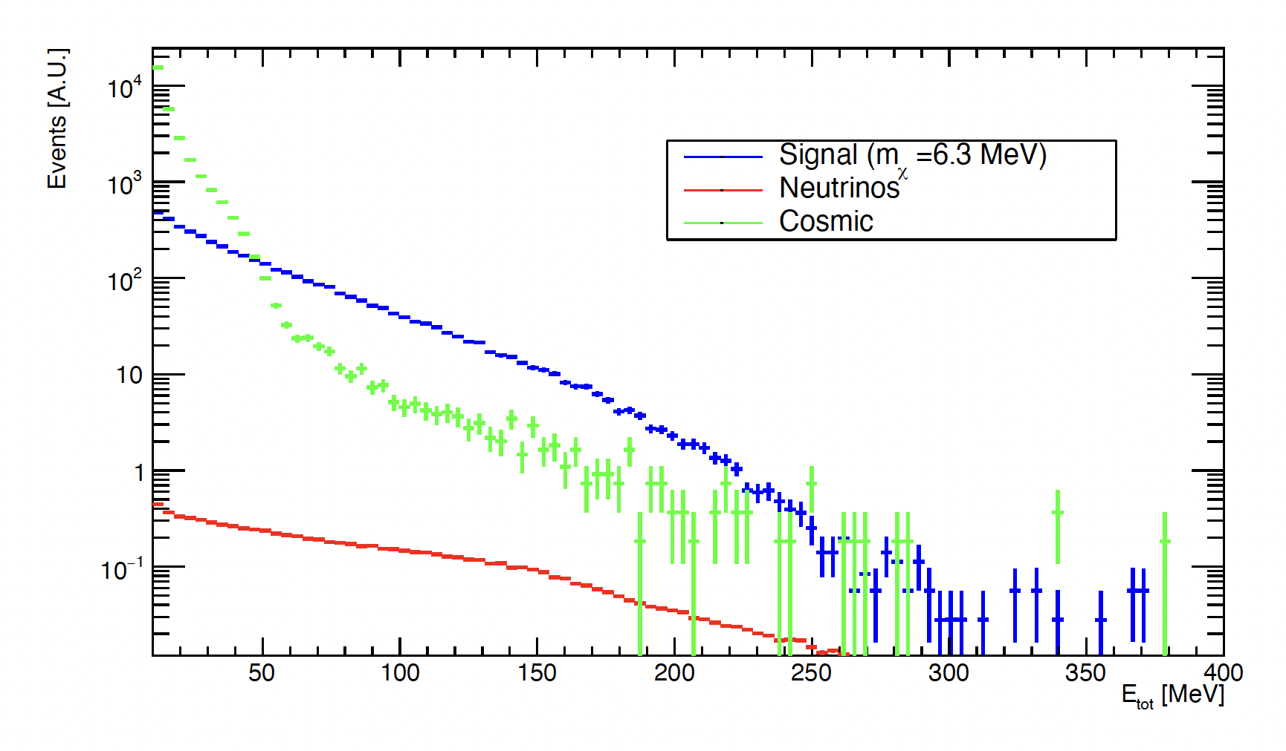
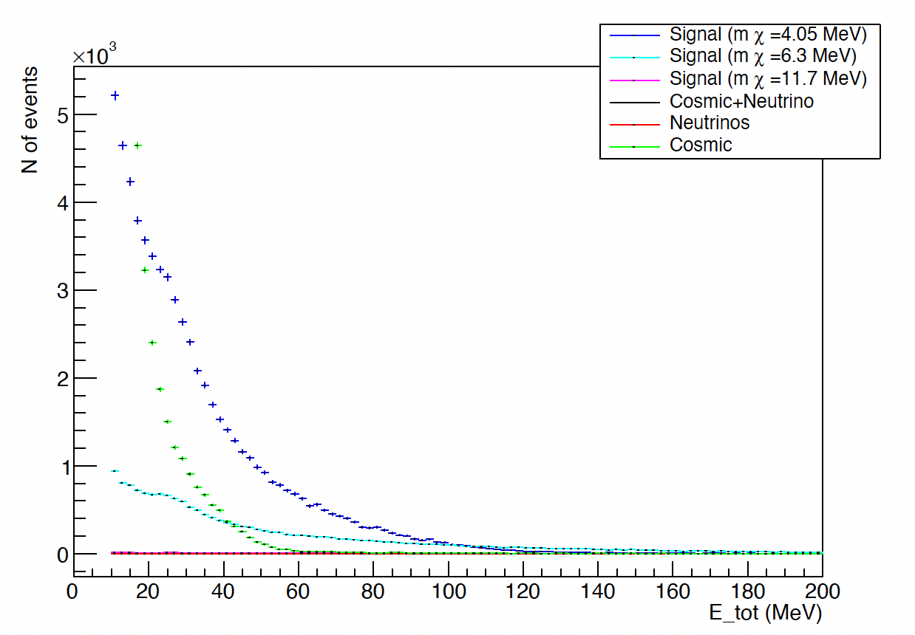
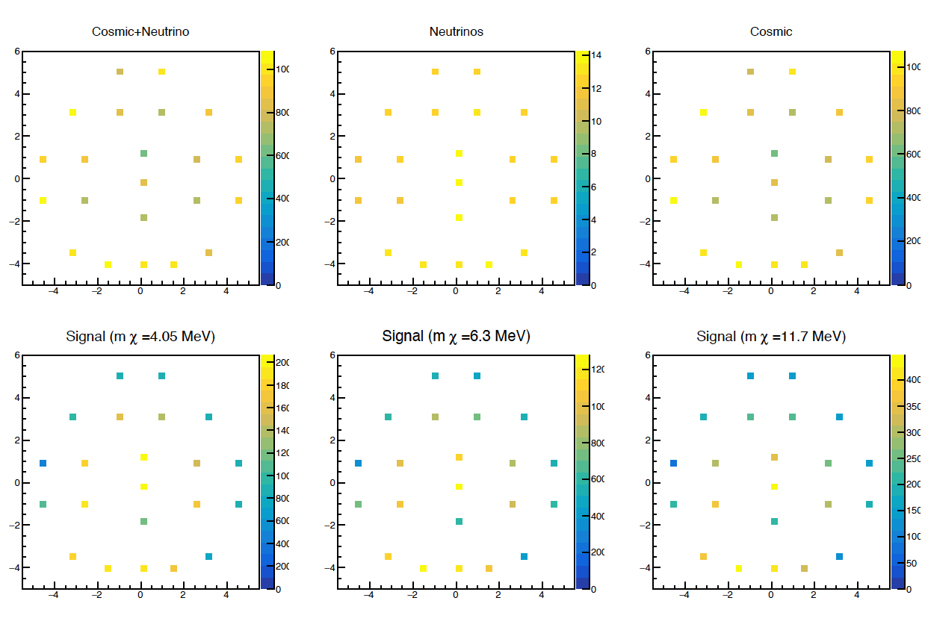
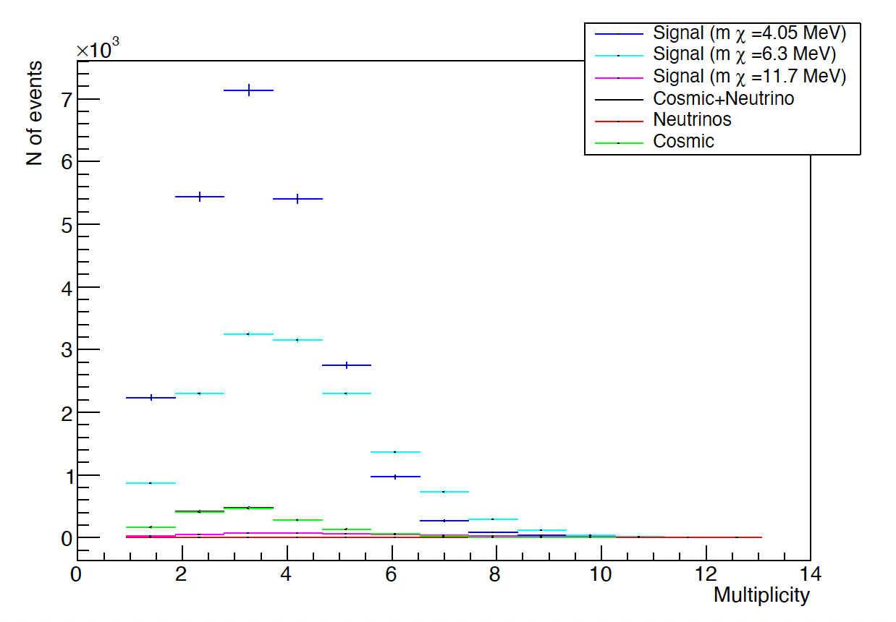
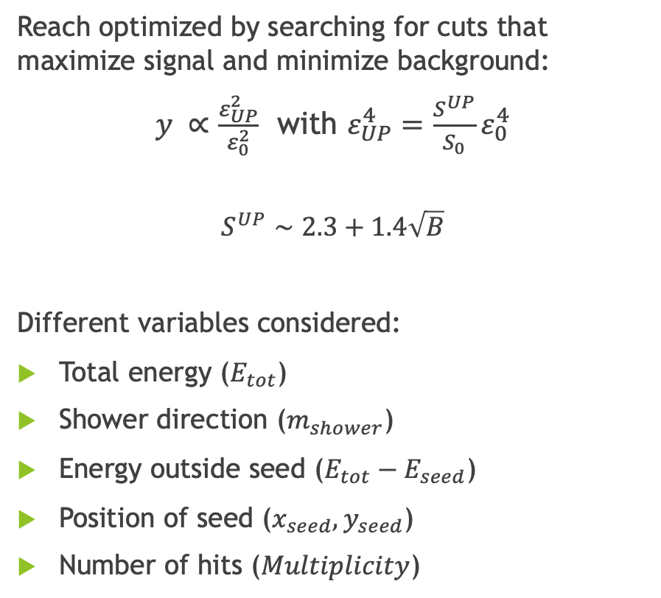
BDX-MINI analysis
Reach optimized by searching for cuts that maximize signal and minimize background:
$y ∝\frac{ε_{UP}^{2}}{ε_{0}^{2}}$ with $ε_{UP}^{4}=\frac{S^{UP}}{S_{0}}ε_{0}^{4}$
$$S^{UP}∼2.3+1.4\sqrt{B}$$
Different variables considered:
Total energy ($E_{tot}$)
Shower direction ($m_{shower}$)
Energy outside seed ($E_{tot}−E_{seed}$)
Position of seed ($x_{seed}, y_{seed}$)
Number of hits ($Multiplicity$)

Slide 7
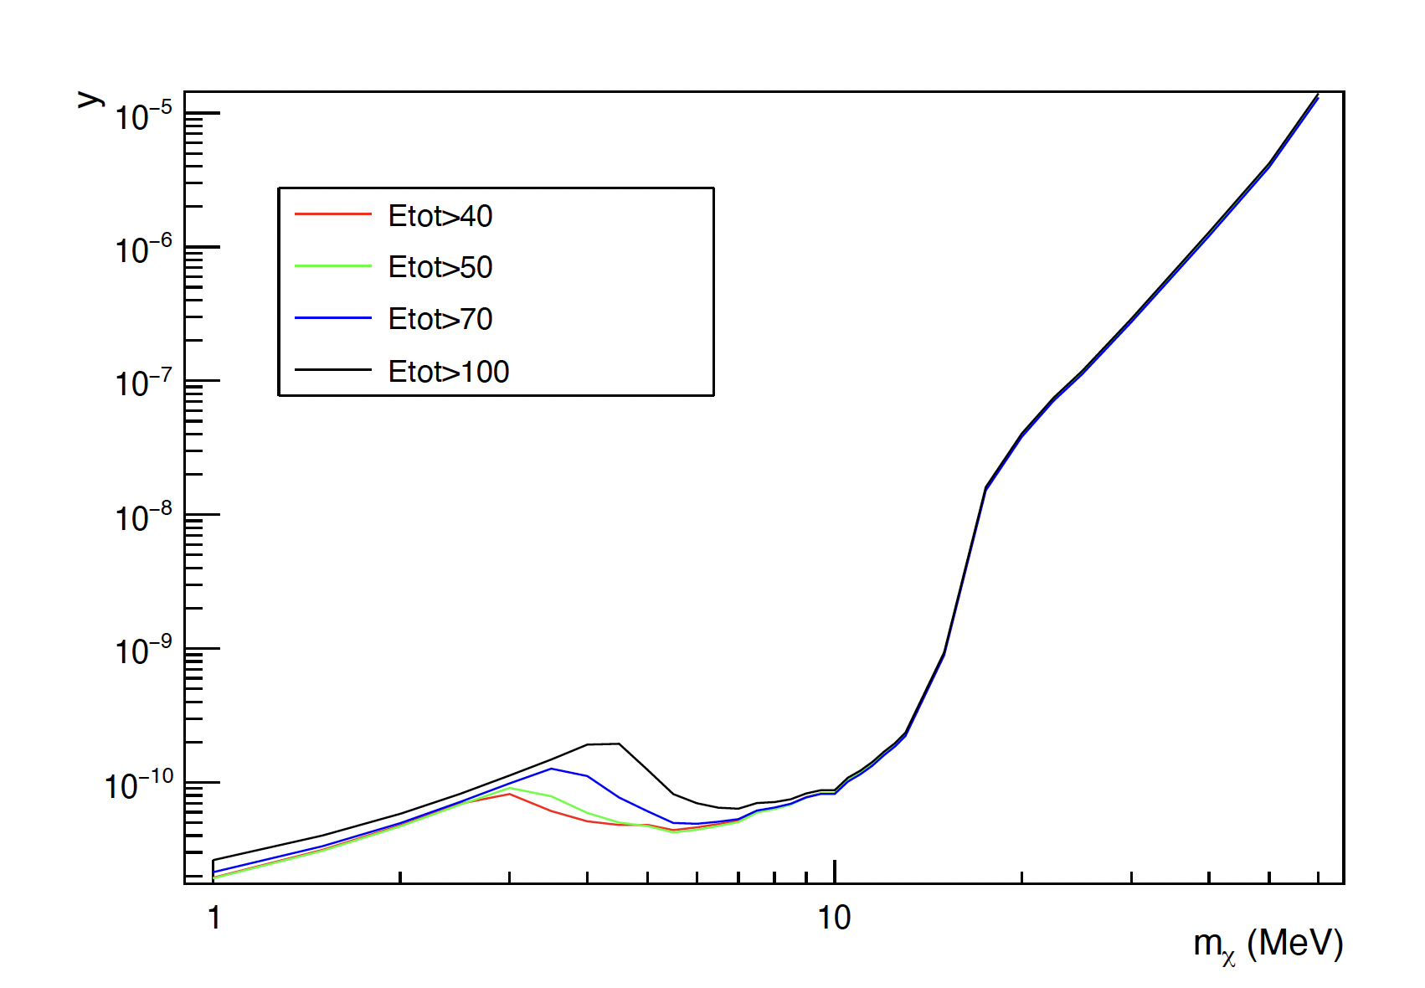
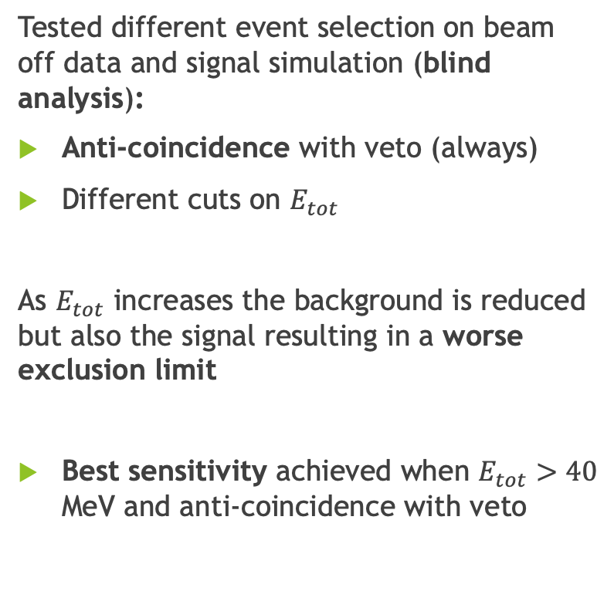
BDX-MINI analysis
Tested different event selection on beam off data and signal simulation (blind analysis):
Anti-coincidence with veto (always)
Different cuts on $E_{tot}$
As $E_{tot}$ increases the background is reduced but also the signal resulting in a worse exclusion limit
Best sensitivity achieved when $E_{tot}>40$ MeV and anti-coincidence with veto
Phys. Rev. D 106.7 (2022), p. 072011

Slide 8
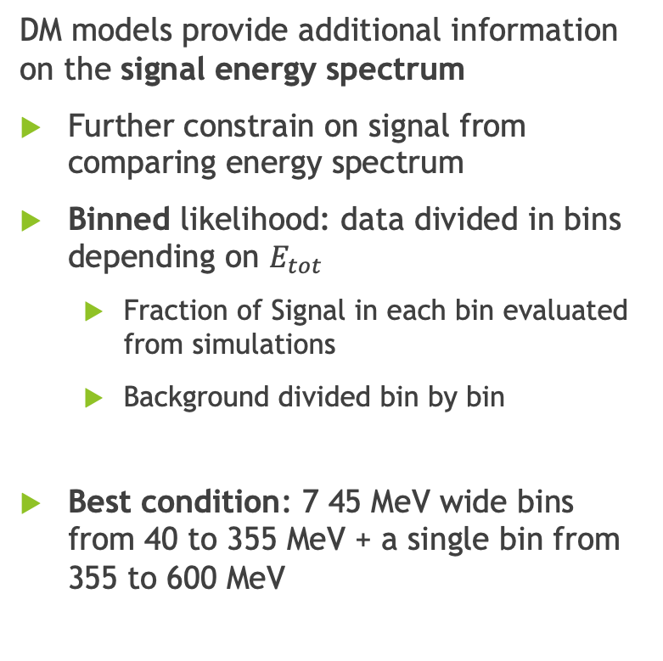
BDX-MINI analysis
DM models provide additional information on the signal energy spectrum
Further constrain on signal from comparing energy spectrum
Binned likelihood: data divided in bins depending on $E_{tot}$
  Fraction of Signal in each bin evaluated from simulations
  Background divided bin by bin
Best condition: 7 45 MeV wide bins from 40 to 355 MeV + a single bin from 355 to 600 MeV
Phys. Rev. D 106.7 (2022), p. 072011

Slide 9
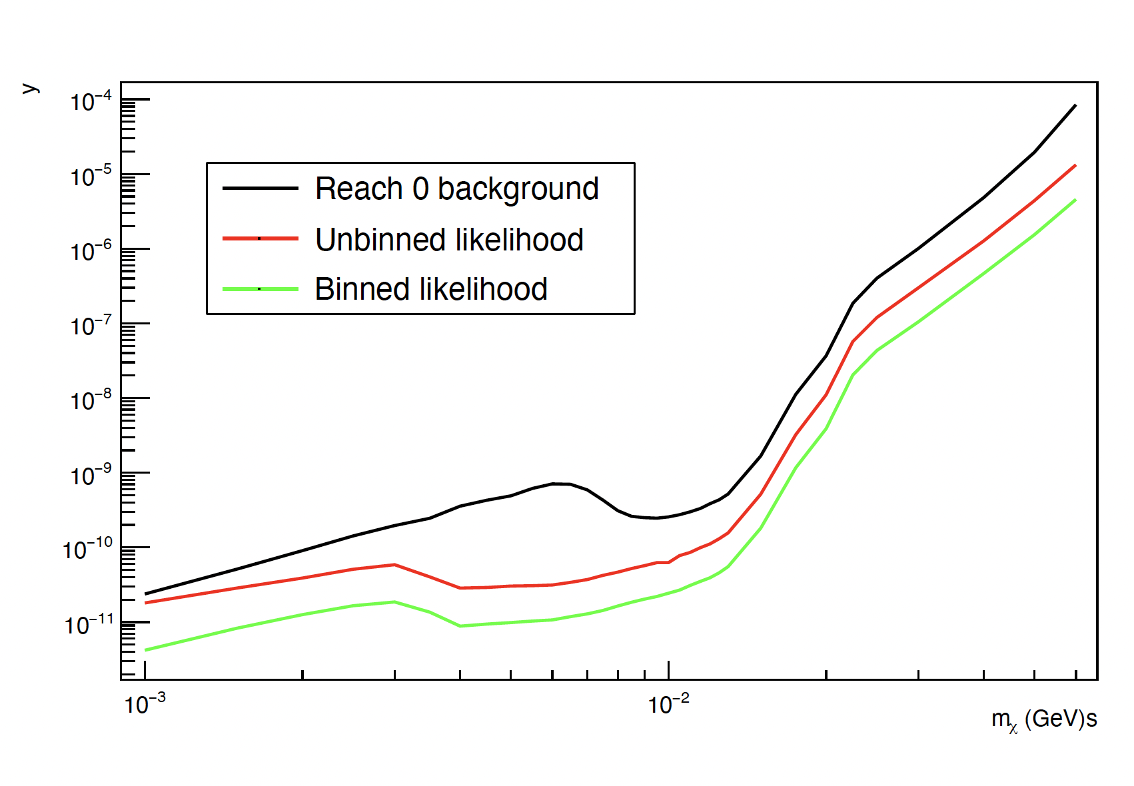
BDX-MINI analysis
Basic condition of searching for a 0 background condition results in a significant loss in signal
By lowering selection cuts signal is preserved, increasing the sensitivity
By using information from the DM model results in a further enhancement of the reach
Can AI algorithm provide better results?

Slide 10
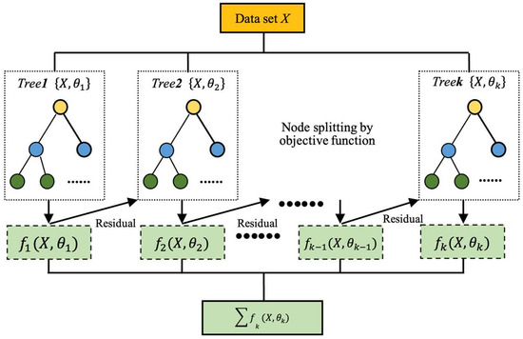
AI-based background rejection
Main limitation to BDX-MINI sensitivity = trade off between signal maximization and background minimization
Efficiency on cut on total energy limited
Test of AI-based algorithms
Boosted Decision Tree: combination of multiple decision trees where each tree is trained to correct the errors of the previous ones
Discrimination between signal (DM) and background (cosmic and neutrino)
Article in preparation

Slide 11
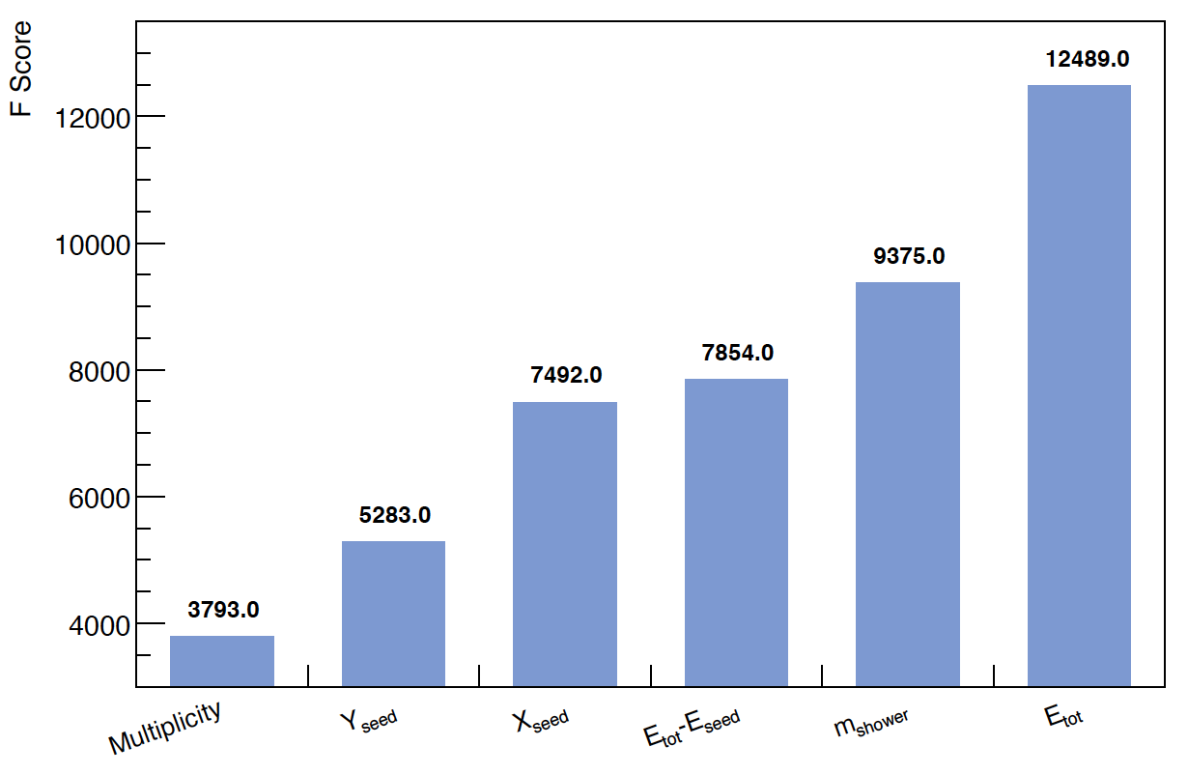
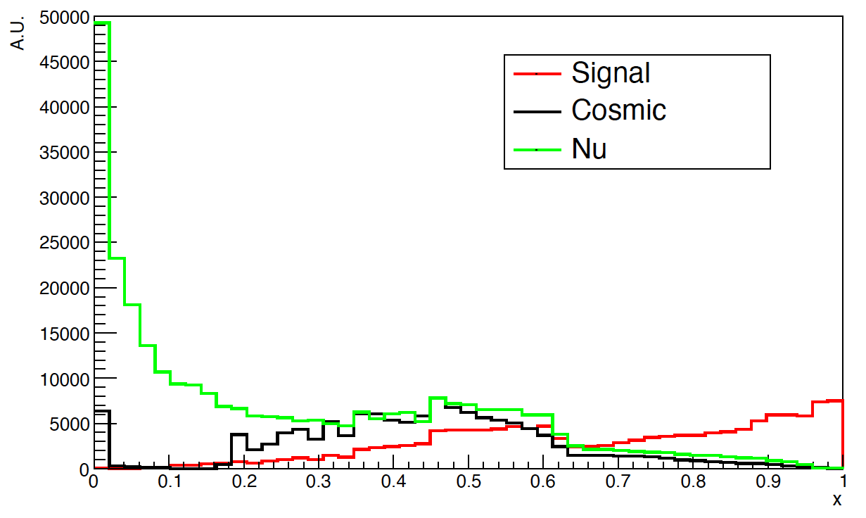
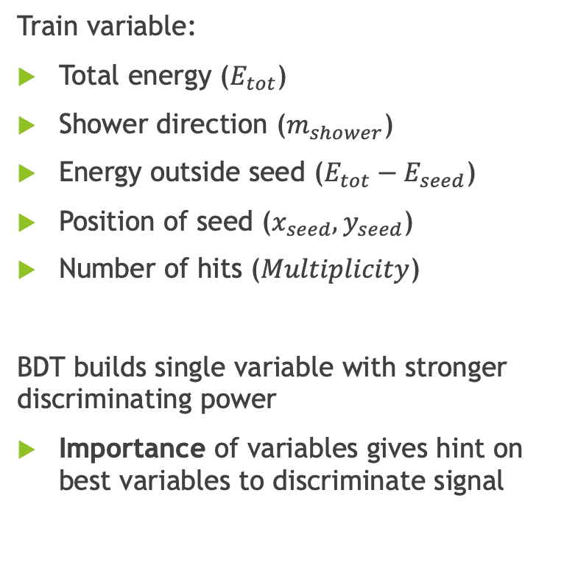
AI-based background rejection
Train variable:
Total energy ($E_{tot}$)
Shower direction ($m_{shower}$)
Energy outside seed ($E_{tot}−E_{seed}$)
Position of seed ($x_{seed}, y_{seed}$)
Number of hits ($Multiplicity$)
BDT builds single variable with stronger discriminating power
Importance of variables gives hint on best variables to discriminate signal
Reject
Keep
Article in preparation

Slide 12
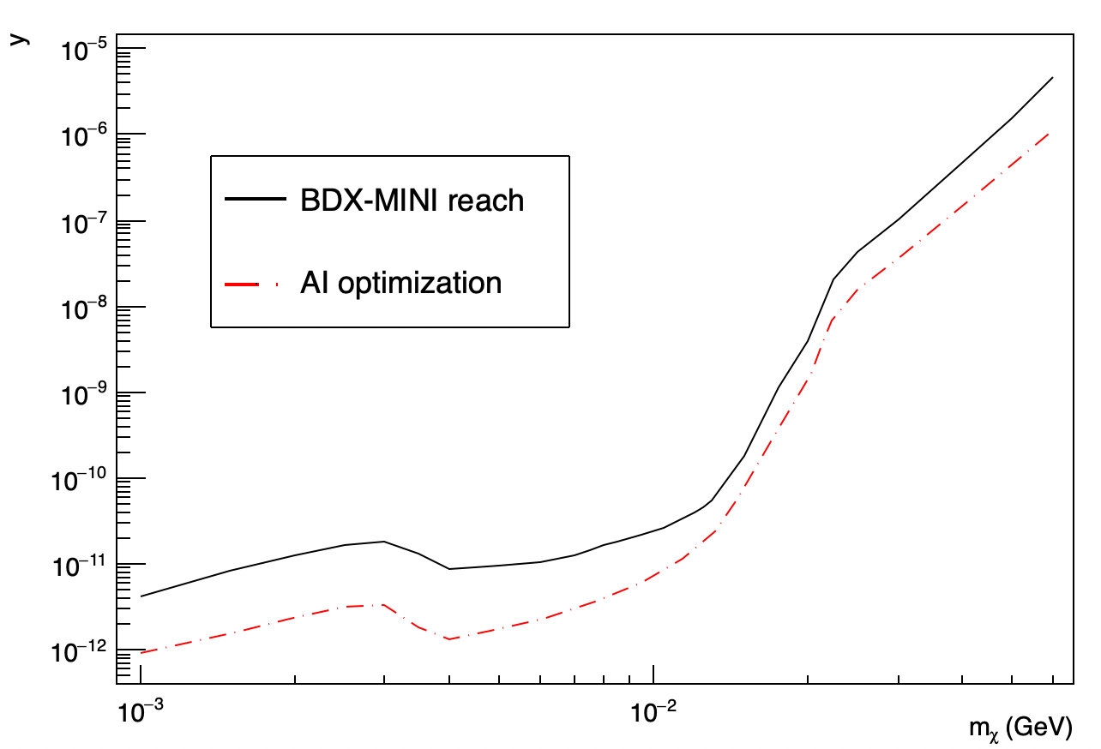
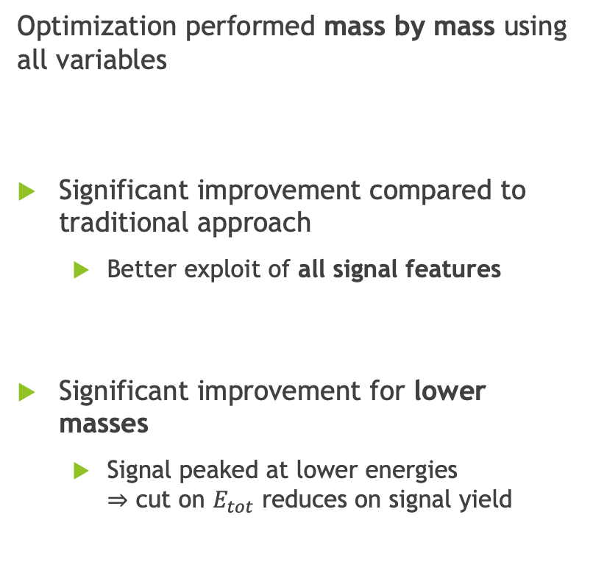
AI-based background rejection
Optimization performed mass by mass using all variables
Significant improvement compared to traditional approach
  Better exploit of all signal features
Significant improvement for lower masses
  Signal peaked at lower energies
  $⇒$ cut on $E_{tot}$ reduces on signal yield
PRELIMINARY
Article in preparation

Slide 13
Anomaly detection
Optimization based on details of specific DM model
Search for a signal excess due to DM production should be independent from the model details
Safe approach: search for cuts that eliminate all background (0 background scenario)
Signal can also be completely cut out
Can AI-based algorithms learn features of background and provide a better way of searching for DM signal?

Slide 14

Anomaly detection
Background known
DM can be searched for as an anomaly compared to the background model
AI algorithm can learn background features from beam off data (blind analysis)
AI-based anomaly detection algorithms can be used to learn the background model and search for outliers (potential DM events)
If no anomaly is observed, the model can provide a model-independent upper limit on the number of signal events

Slide 15
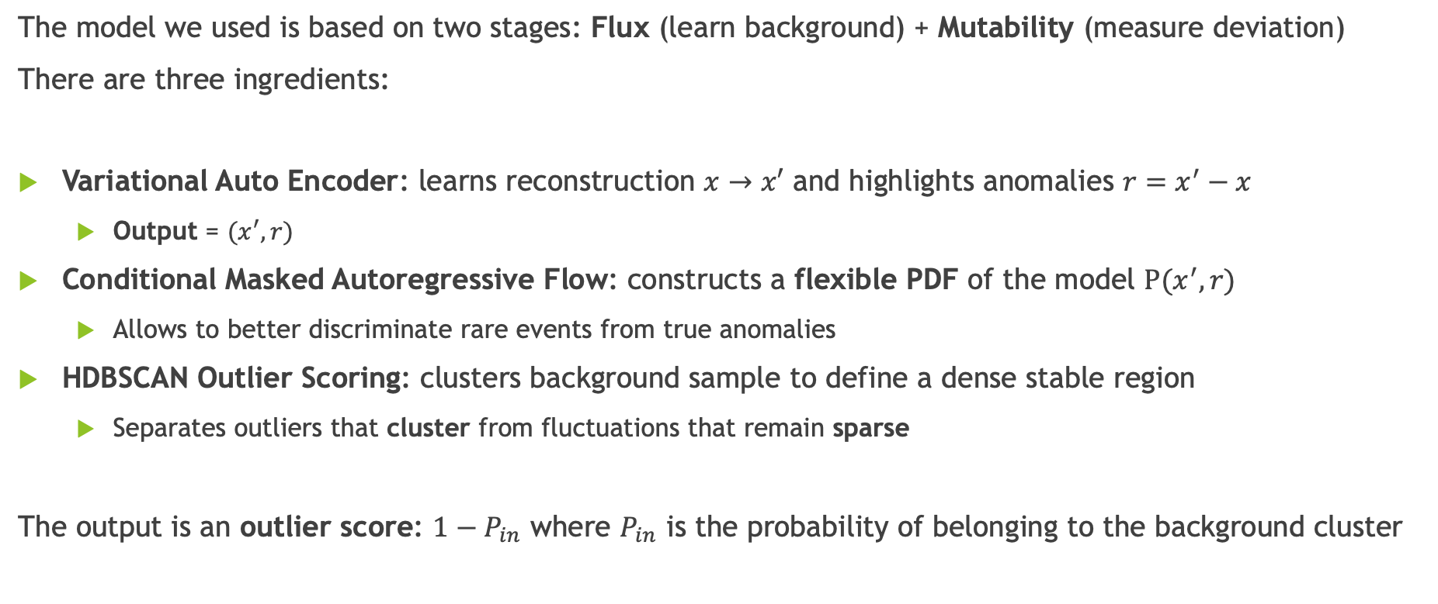
Anomaly detection
The model we used is based on two stages: Flux (learn background) + Mutability (measure deviation)
There are three ingredients:
Variational Auto Encoder: learns reconstruction $x→x′$ and highlights anomalies $r=x^{′}−x$
  Output = $(x^{′}, r)$
Conditional Masked Autoregressive Flow: constructs a flexible PDF of the model $P(x^{′}, r)$
  Allows to better discriminate rare events from true anomalies
HDBSCAN Outlier Scoring: clusters background sample to define a dense stable region
  Separates outliers that cluster from fluctuations that remain sparse
The output is an outlier score: $1−P_{in}$ where $P_{in}$ is the probability of belonging to the background cluster
Mach.Learn.Sci.Tech. 3 (2022) 4, 045012

Slide 16
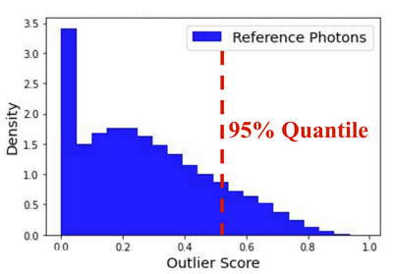
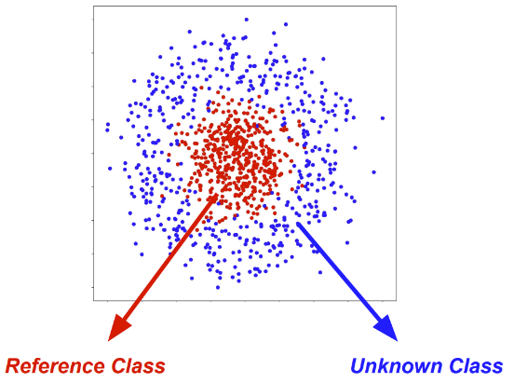

Anomaly detection
The model we used is based on two stages: Flux (learn background) + Mutability (measure deviation)
There are three ingredients:
Variational Auto Encoder: learns reconstruction $x→x′$ and highlights anomalies $r=x^{′}−x$
  Output = $(x^{′}, r)$
Conditional Masked Autoregressive Flow: constructs a flexible PDF of the model $P(x^{′}, r)$
  Allows to better discriminate rare events from true anomalies
HDBSCAN Outlier Scoring: clusters background sample to define a dense stable region
  Separates outliers that cluster from fluctuations that remain sparse
The output is an outlier score: $1−P_{in}$ where $P_{in}$ is the probability of belonging to the background cluster
Mach.Learn.Sci.Tech. 3 (2022) 4, 045012

Slide 17
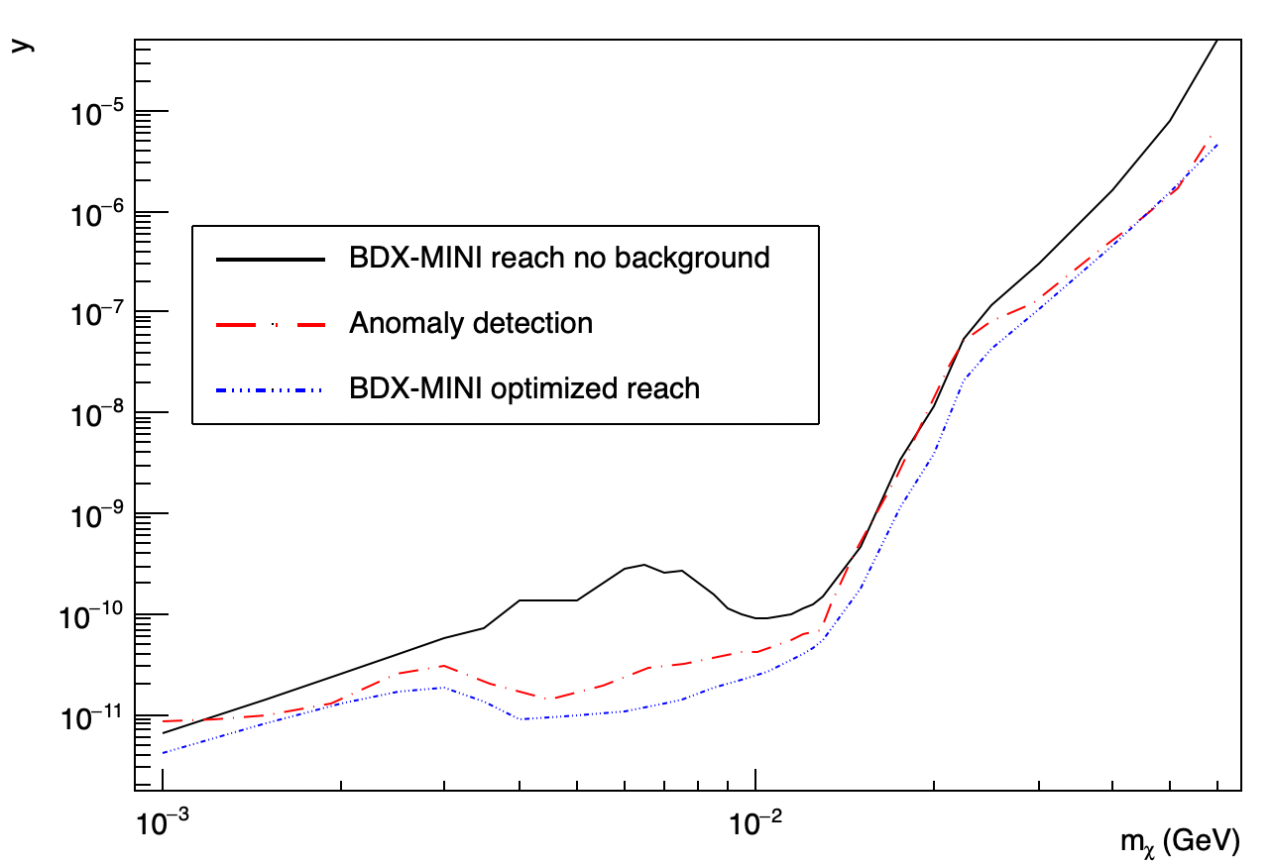
Anomaly detection
Outlier score can be used to reject background events
Can be used as variable for background rejection
Cut is decided based only on background data
Exclusion limit weaker compared to optimized analysis
No model input: upper limit on signal independent from model
PRELIMINARY
Article in preparation

Slide 18
Conclusions
BDX-MINI is a prototype version of BDX and was used as a test of BDX capabilities

Slide 19
Conclusions
BDX-MINI is a prototype version of BDX and was used as a test of BDX capabilities
Optimized analysis achieved compelling results by maximizing signal and minimizing background

Slide 20
Conclusions
BDX-MINI is a prototype version of BDX and was used as a test of BDX capabilities
Optimized analysis achieved compelling results by maximizing signal and minimizing background
BDT-based AI algorithms can improve BDX-MINI background
rejection capabilities

Slide 21
Conclusions
BDX-MINI is a prototype version of BDX and was used as a test of BDX capabilities
Optimized analysis achieved compelling results by maximizing signal and minimizing background
BDT-based AI algorithms can improve BDX-MINI background
rejection capabilities
AI-based Anomaly detection can be used
to set general exclusion limits with no model input

Slide 22
Conclusions
BDX-MINI is a prototype version of BDX and was used as a test of BDX capabilities
Optimized analysis achieved compelling results by maximizing signal and minimizing background
BDT-based AI algorithms can improve BDX-MINI background
rejection capabilities
AI-based Anomaly detection can be used
to set general exclusion limits with no model input
AI based algorithms could be used to significantly improve
BDX sensitivity

Slide 23
THANK
YOU

Slide 24
BACKUP SLIDES

Slide 25
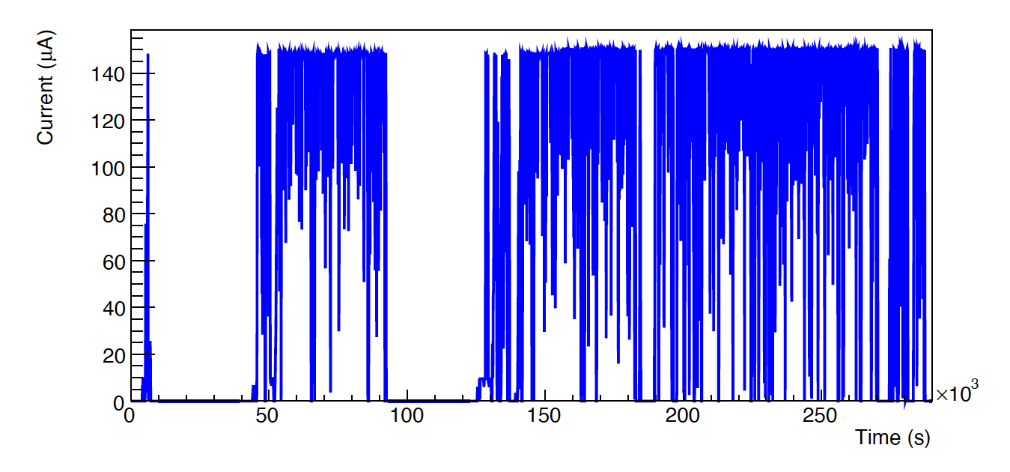
BDX-MINI background
Due to beam energy no muon from beam
Due to limited detector size expected <1 neutrino event
Cosmic background characterized with beam-off data
  Frequent beam trips allow for real-time measurement of cosmic background

Slide 26
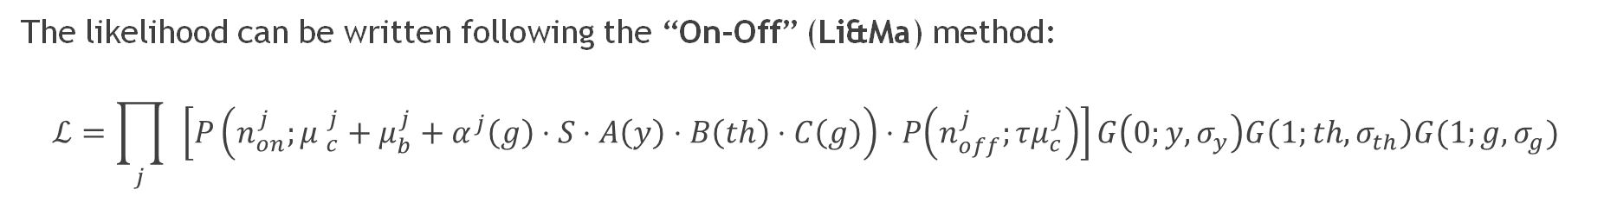
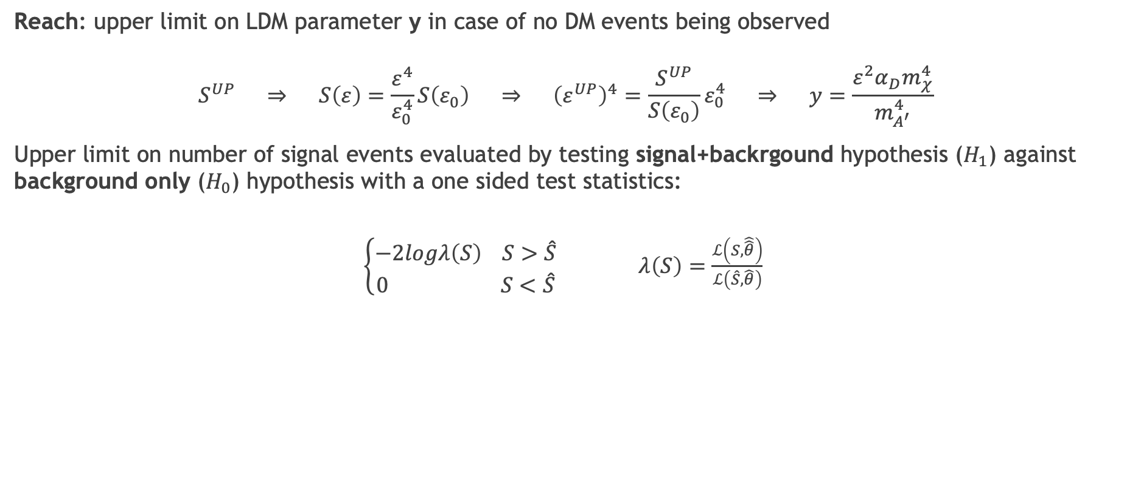
Statystical analysis
Reach: upper limit on LDM parameter y in case of no DM events being observed
$$S^{UP} ⇒ S\left(ε\right)=\frac{ε^{4}}{ε_{0}^{4}}S\left(ε_{0}\right) ⇒ {\left(ε^{UP}\right)}^{4}=\frac{S^{UP}}{S\left(ε_{0}\right)}ε_{0}^{4} ⇒ y=\frac{ε^{2}α_{D}m_{χ}^{4}}{m_{A^{′}}^{4}}$$
Upper limit on number of signal events evaluated by testing signal+backrgound hypothesis ($H_{1}$) against background only ($H_{0}$) hypothesis with a one sided test statistics:
$\left\{\begin{aligned}−2logλ\left(S\right) S>\hat{S} \\ 0 S<\hat{S}\end{aligned}\right.$ $λ\left(S\right)=\frac{ℒ\left(S,\hat{\hat{θ}}\right)}{ℒ\left(\hat{S}, \hat{θ}\right)}$
The likelihood can be written following the “On-Off” (Li&Ma) method:
$$ℒ=\prod_{j}{ }\left[P\left(n_{on}^{j};{μ }_{c}^{j}+μ_{b}^{j}+α^{j}\left(g\right)⋅S⋅A\left(y\right)⋅B\left(th\right)⋅C\left(g\right)\right)⋅P\left(n_{off}^{j};τμ_{c}^{j}\right)\right]G\left(0;y,σ_{y}\right)G\left(1;th,σ_{th}\right)G(1;g,σ_{g})$$
Phys. Rev. D 106.7 (2022), p. 072011

Slide 27
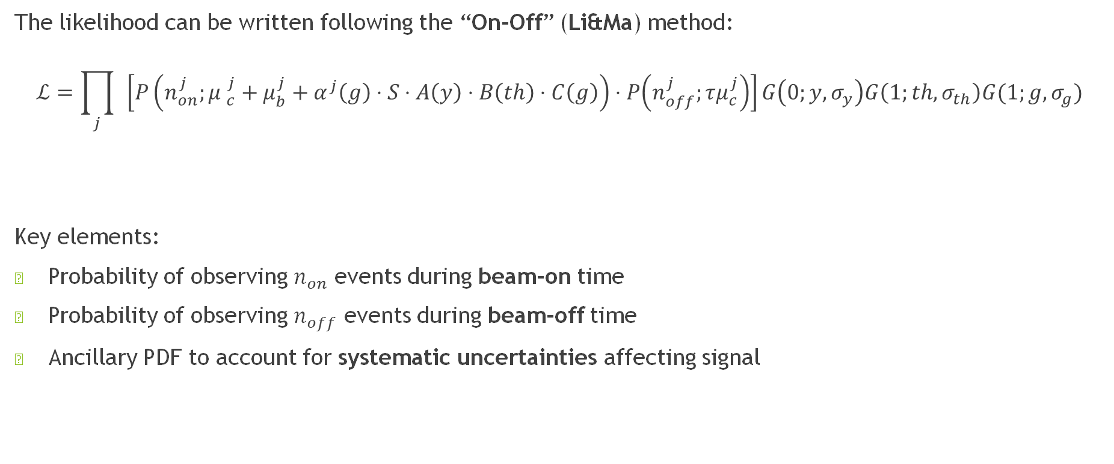
Statystical analysis
The likelihood can be written following the “On-Off” (Li&Ma) method:
$$ℒ=\prod_{j}{ }\left[P\left(n_{on}^{j};{μ }_{c}^{j}+μ_{b}^{j}+α^{j}\left(g\right)⋅S⋅A\left(y\right)⋅B\left(th\right)⋅C\left(g\right)\right)⋅P\left(n_{off}^{j};τμ_{c}^{j}\right)\right]G\left(0;y,σ_{y}\right)G\left(1;th,σ_{th}\right)G(1;g,σ_{g})$$
Key elements:
Probability of observing $n_{on}$ events during beam-on time
Probability of observing $n_{off}$ events during beam-off time
Ancillary PDF to account for systematic uncertainties affecting signal
Beam on
Systematics
Beam off
Ancillary probability distribution
Phys. Rev. D 106.7 (2022), p. 072011

Slide 28
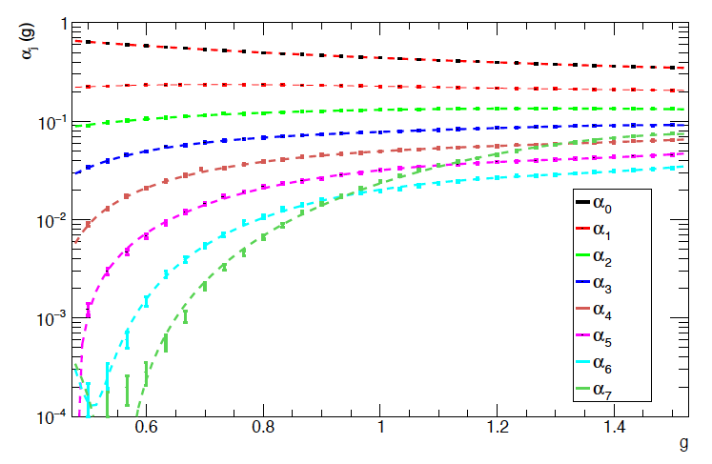

Statystical analysis
The likelihood can be written following the “On-Off” (Li&Ma) method:
$$ℒ=\prod_{j}{ }\left[P\left(n_{on}^{j};{μ }_{c}^{j}+μ_{b}^{j}+α^{j}\left(g\right)⋅S⋅A\left(y\right)⋅B\left(th\right)⋅C\left(g\right)\right)⋅P\left(n_{off}^{j};τμ_{c}^{j}\right)\right]G\left(0;y,σ_{y}\right)G\left(1;th,σ_{th}\right)G(1;g,σ_{g})$$
Key elements:
Probability of observing $n_{on}$ events during beam-on time
Probability of observing $n_{off}$ events during beam-off time
Ancillary PDF to account for systematic uncertainties affecting signal
Splitting in energy bins
Systematics
Splitting in energy bins to better to better constrain signal exploiting its features
Fraction of signal in each bin fixed from simulations (independently for each mass)
Systematic uncertainty on energy causes bin migration
Phys. Rev. D 106.7 (2022), p. 072011

Slide 29
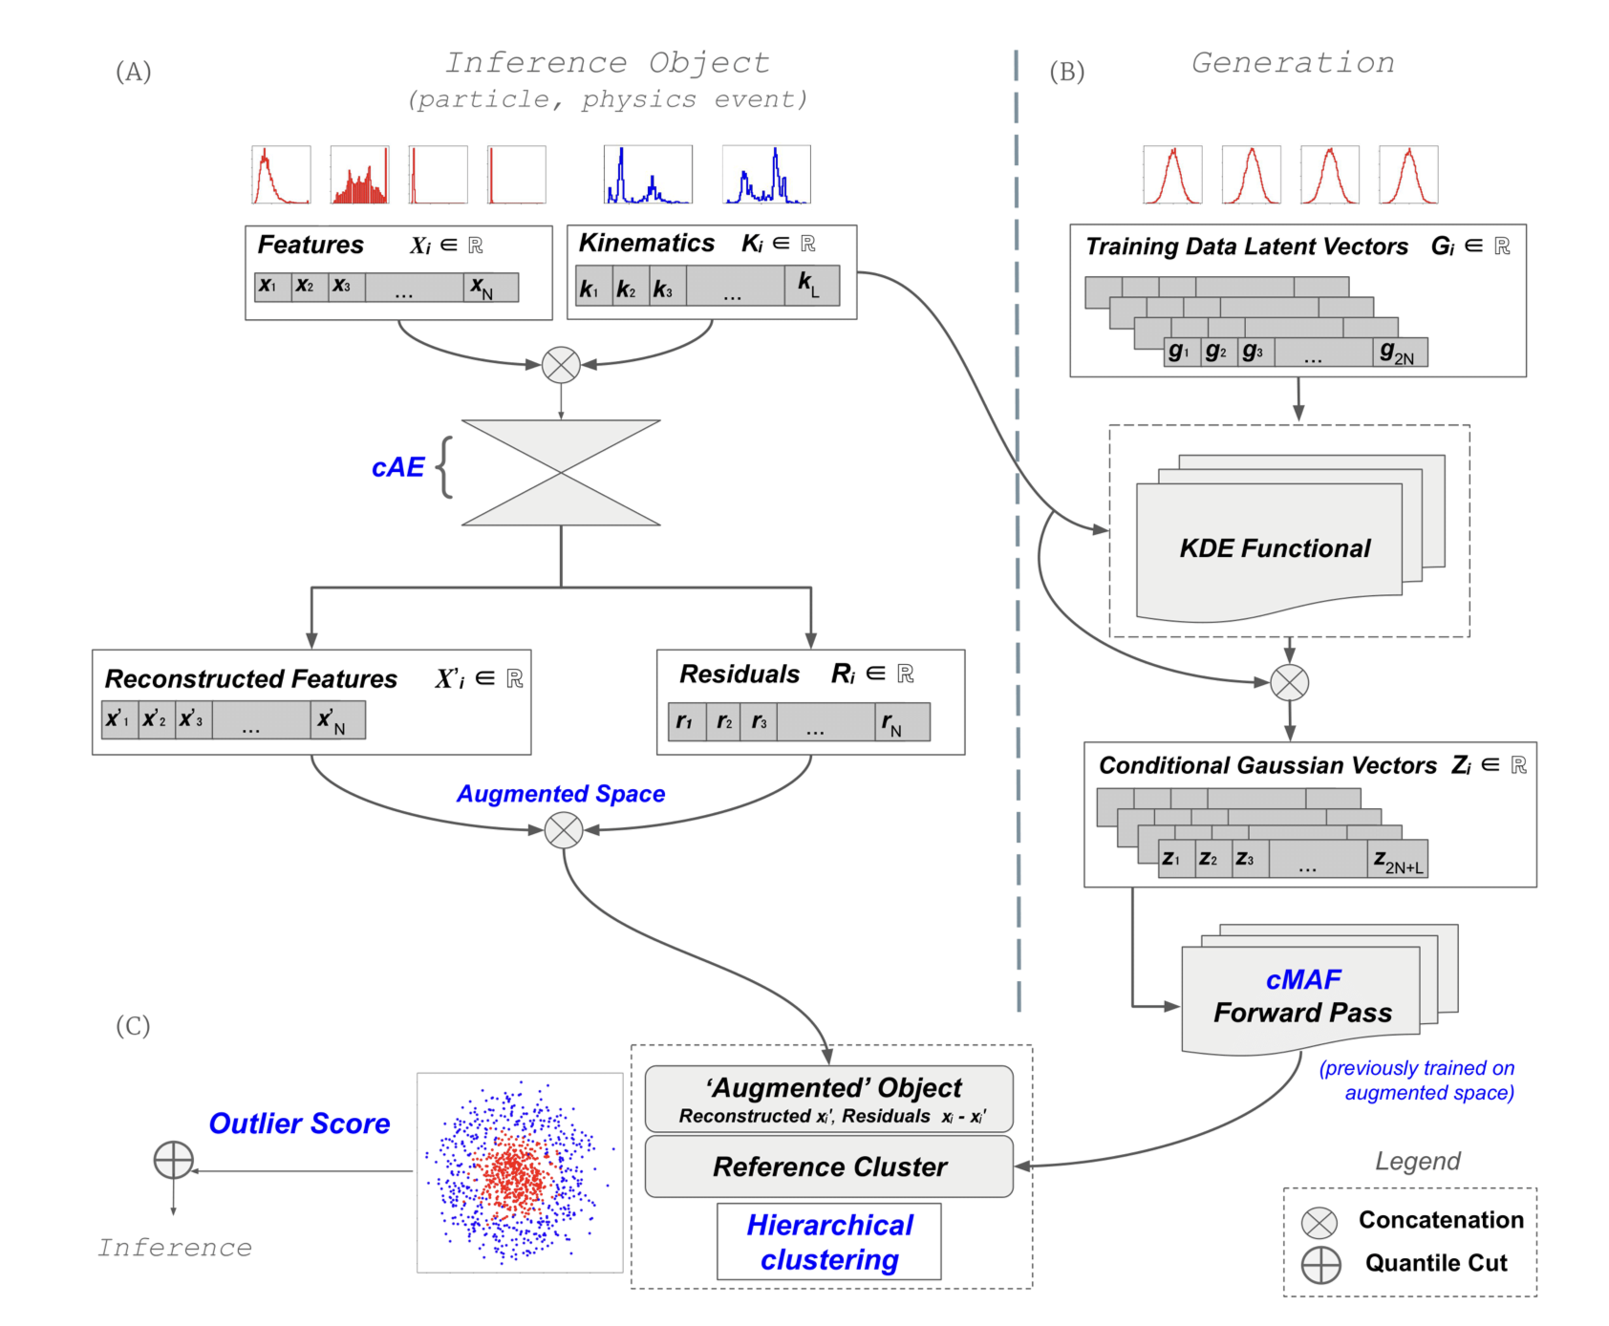
Anomaly Rejection
Mach.Learn.Sci.Tech. 3 (2022) 4, 045012

