Slide 1




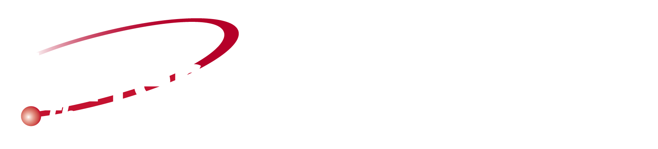
Lepton Double Charge Exchange: a new way to the physics beyond the standard model
A. Spatafora, F. Cappuzzello and H. Lenske
JLAB12 - Italia collaboration meeting
15th Dec 2025 - LNF, Roma, Italy

Slide 2

Context: 0νββ decay and DCE reactions
Idea: LDCE reactions as LNV probe
Proposal: the JLAB experiment
Conclusions

Slide 3
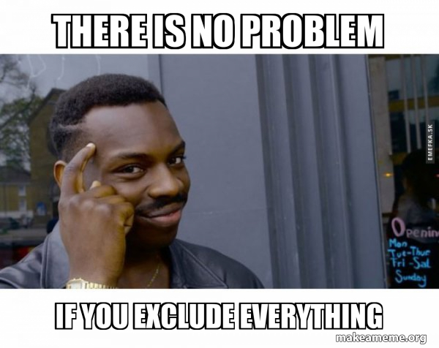
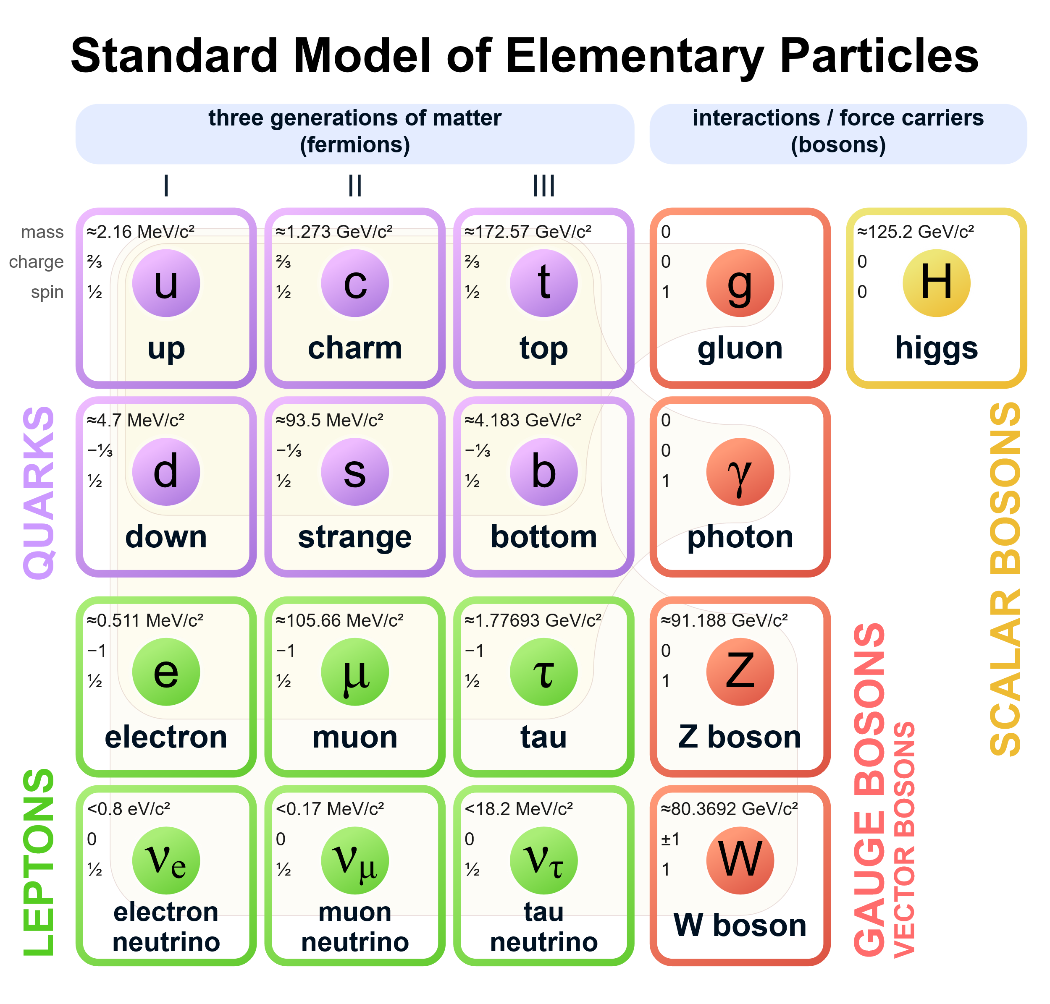
The SM has no problem (for today)!
Measurements agrees with theory
However:
Hierarchy of Scales
Dark matter
Neutrinos have masses
Matter-antimatter asymmetry and baryogenesis
Search for lepton number violation (LNV). Its observation would have profound impact in our understanding of the cosmos, since the same interactions can lead to baryon-antibaryon asymmetry of the universe via leptogenesis. (M. Fukugita and T. Yanagida, Physics Letters B 174, 45(1986))

Slide 4



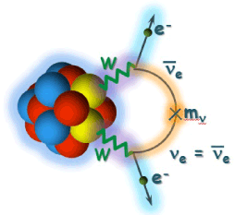
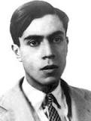
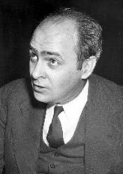
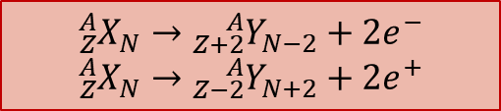
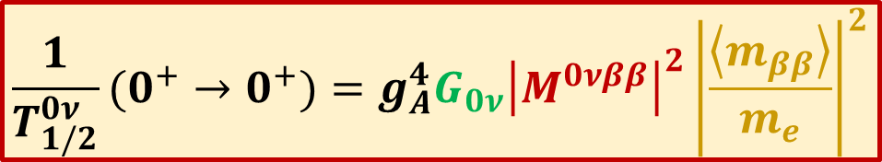
0νββ decay: new physics Beyond the Standard Model
Problems in modern physics:
Neutrinos absolute mass-scale
Neutrinos: Dirac or Majorana
0νββ is the most promising approach
Neutrinoless double beta decay**
${{}_{Z}^{A}X}_{N}→$ ${{}_{Z+2}^{A}Y}_{N−2}+{2e}^{−}$
${{}_{Z}^{A}X}_{N}→$ ${{}_{Z−2}^{A}Y}_{N+2}+{2e}^{+}$
**E. Majorana, Il Nuovo Cimento 14 (1937) 171
W. H. Furry, Phys. Rev. 56 (1939) 1184
Still not observed!
Beyond the standard model
Violation of lepton number conservation
CP violation in lepton sector
Way to leptogenesis and GUT…
Access to effective neutrino masses
$$\frac{1}{T_{1/2}^{0ν}}(0^{+}→0^{+})=g_{A}^{4}G_{0ν}{\left|M^{0νββ}\right|}^{2}{\left|\frac{\left\langle m_{ββ}\right\rangle }{m_{e}}\right|}^{2}$$
Notes:
Slide2-11

Slide 5
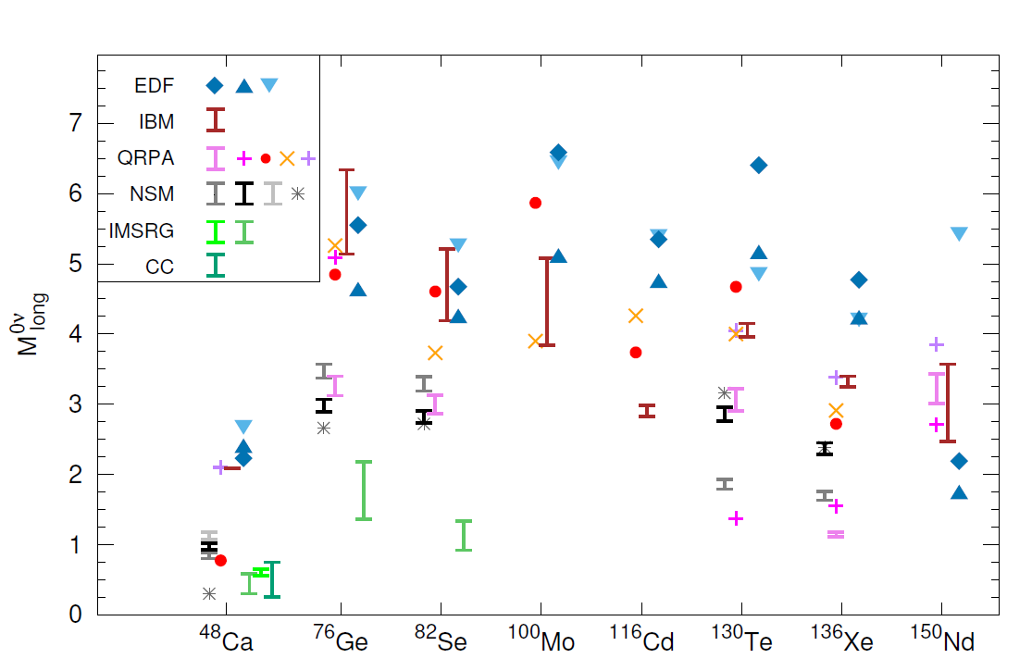

Nuclear Matrix Elements (NMEs):
Nuclear transition probability
$${\left|M^{0νββ}\right|}^{2}= {\left|\left\langle Ψ_{f} | {\hat{O}}^{0νββ} | Ψ_{i}\right\rangle \right|}^{2}$$
Measurements (still not conclusive for 0νββ)
β-decay and 2νββ decay
(π⁺, π⁻), single charge exchange (³He,t), (d,²He), HI-SCE, electron capture, transfer reactions, μ-capture, γ-ray spectroscopy, γγ-decay etc.
A promising experimental tool: Heavy-Ion Double Charge-Exchange (HI-DCE)
1st order isospin probes
2nd order isospin probes
M. Agostini et al., Rev. Mod. Phys. 95, 025002 (2023)
H. Ejiri et al., Phys. Rep. 797 (2019) 1–102
Notes:
Slide13-2

Slide 6

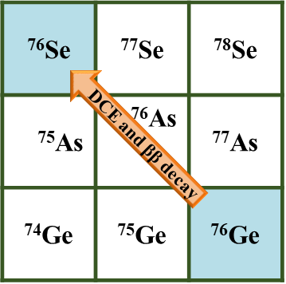


Isobaric nuclear reaction where a parent target transforms into a daughter nucleus changing by two units its charge leaving the mass number unchanged. The opposite occurs in the projectile.
Double Charge Exchange reactions (DCE)
${{{}_{Z}^{A}x}_{N}+{}_{Z}^{A}X}_{N}→$ ${{}_{Z∓2}^{A}y}_{N±2}$ + ${{}_{Z±2}^{A}Y}_{N∓2}$
Nuclear Double Charge Exchange reactions (DCE) to stimulate in the laboratory the same nuclear transition (g.s. to g.s.) occurring in 0νββ
Why to study DCE?
Population of exotic nuclei from stable target and projectile
Nuclear response to second order isospin operator
Connection with second order weak processes
F. Cappuzzello et al., EPJ A (2018) 54:72
Differences | Similarities
Notes:
Slide13-2

Slide 7


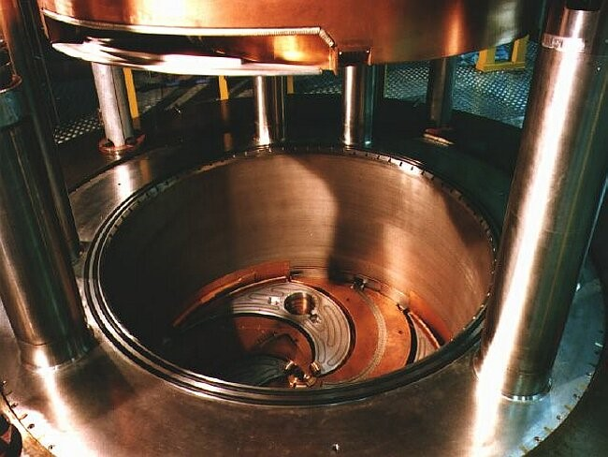
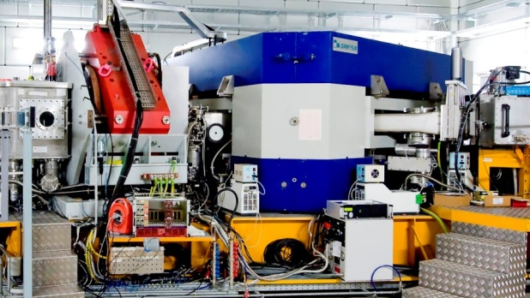
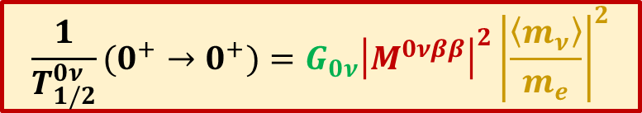
The NUMEN project
Neutrinoless double beta decay**
$$\frac{1}{T_{1/2}^{0ν}}(0^{+}→0^{+})=G_{0ν}{\left|M^{0νββ}\right|}^{2}{\left|\frac{\left\langle m_{ν}\right\rangle }{m_{e}}\right|}^{2}$$
Nuclear Double Charge Exchange reactions (DCE) to stimulate in the laboratory the same nuclear transition (g.s. to g.s.) occurring in 0νββ
**E. Majorana, Il Nuovo Cimento 14 (1937) 171
W. H. Furry, Phys. Rev. 56 (1939) 1184
F. Cappuzzello et al., EPJ A (2018) 54:72
Why?
To extract “data-driven” information on NME for all the systems candidate for 0νββ:
Constraints to the existing theories of NMEs (nuclear wave functions)
Model-independent comparative information on the sensitivity of half-life experiments
Complete study of the reaction mechanism
Where?
Catania, LNS-INFN
K800 Superconducting Cyclotron
MAGNEX magnetic spectrometer
Experience in nuclear reactions
F. Cappuzzello et al., EPJ A 52 (2016) 167

Slide 8
The NUMEN project
How?
Neutrinoless double beta decay**
$$\frac{1}{T_{1/2}^{0ν}}(0^{+}→0^{+})=G_{0ν}{\left|M^{0νββ}\right|}^{2}{\left|\frac{\left\langle m_{ν}\right\rangle }{m_{e}}\right|}^{2}$$
Nuclear Double Charge Exchange reactions (DCE) to stimulate in the laboratory the same nuclear transition (g.s. to g.s.) occurring in 0νββ
**E. Majorana, Il Nuovo Cimento 14 (1937) 171
W. H. Furry, Phys. Rev. 56 (1939) 1184
F. Cappuzzello et al., EPJ A (2018) 54:72
Why?
To extract “data-driven” information on NME for all the systems candidate for 0νββ:
Constraints to the existing theories of NMEs (nuclear wave functions)
Model-independent comparative information on the sensitivity of half-life experiments
Complete study of the reaction mechanism
Where?
Catania, LNS-INFN
K800 Superconducting Cyclotron
MAGNEX magnetic spectrometer
Experience in nuclear reactions
F. Cappuzzello et al., EPJ A 52 (2016) 167

Slide 9
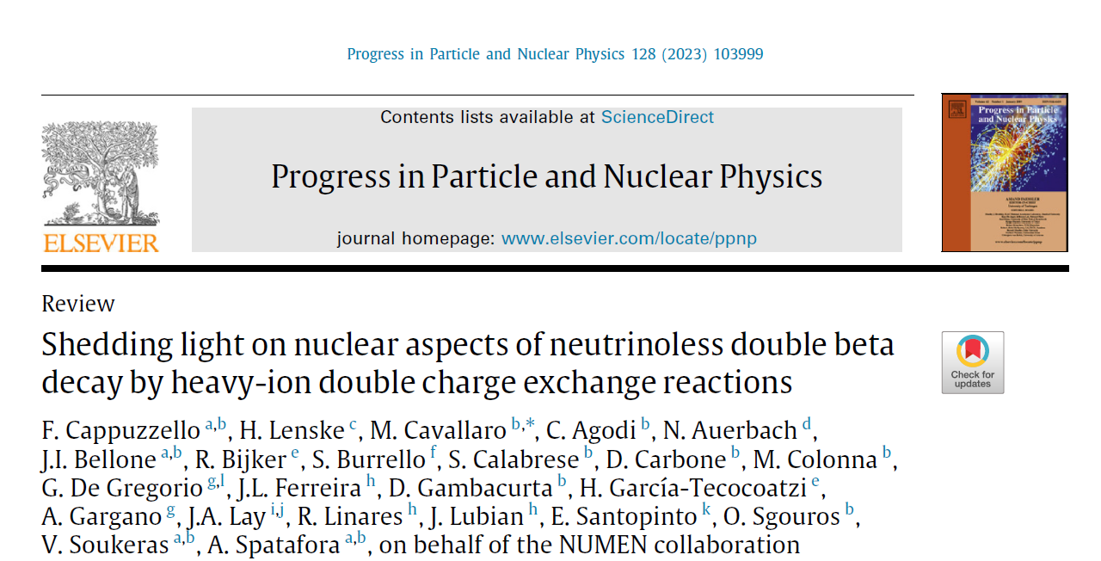
Theoretical aspects of Heavy-Ion Double-Charge Exchange
F. Cappuzzello et al., Progr. Part. and Nucl. Physics 128 (2023) 103999

Slide 10
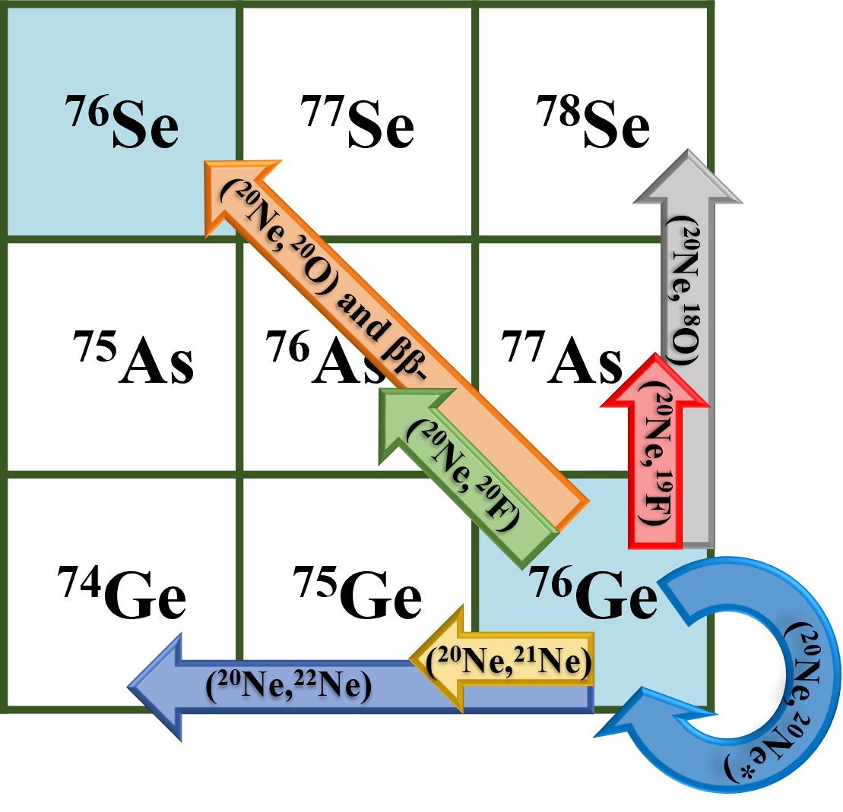
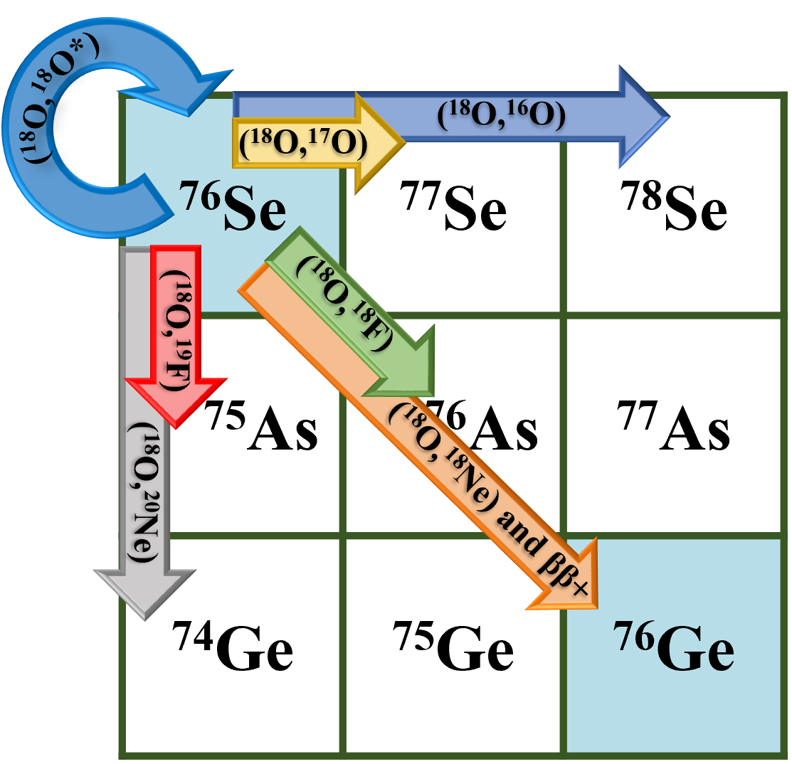
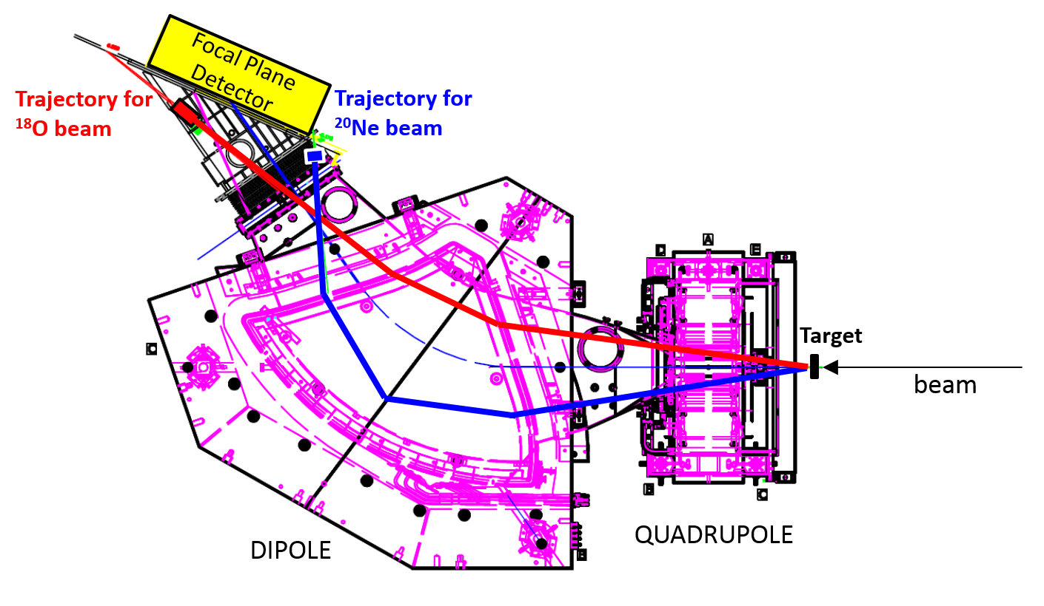

The NUMEN Experiments
Two directions: ββ⁻ via (²⁰Ne,²⁰O) and ββ⁺ via (¹⁸O,¹⁸Ne)
Limitations of the past HI-DCE experiments are overcome!
Complete net of reactions which can contribute to the DCE cross-section: 1p, 2p, 1n, 2n transfer, SCE, elastic and inelastic
Zero-degrees measurements with the MAGNEX magnetic spectrometer
Two (or more) incident energies to study the reaction mechanism
Transitions of interest for 0νββ: Limited number of targets so far, systematic exploration of all the candidates
Notes:
Slide4-4

Slide 11
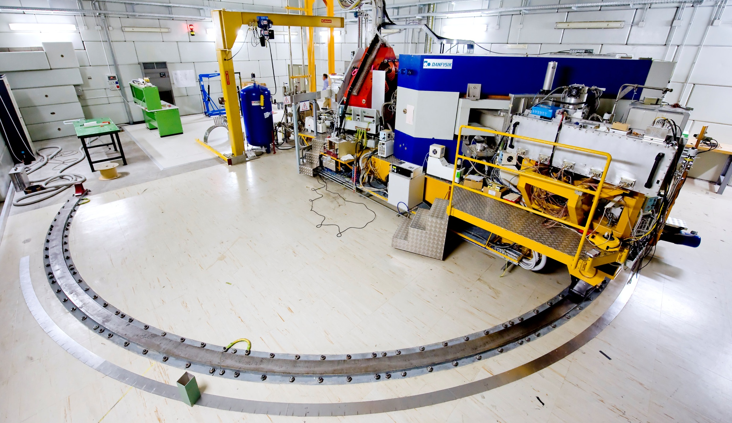
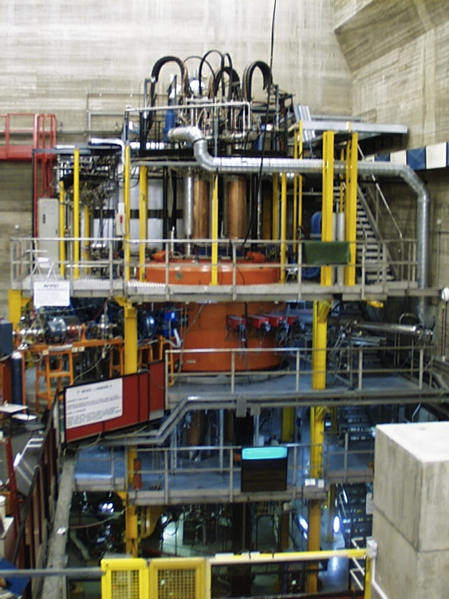

Heavy-Ion Double-Charge Exchange Experiments @ LNS
MAGNEX magnetic spectrometer
Measured resolution:
Energy ΔE/E ∼ 1/1000
Angle Δθ ∼ 0.2°
Mass Δm/m ∼ 1/300
F. Cappuzzello et al., EPJ A (2016) 52:167
M. Cavallaro et al., NIM B 463 (2020) 334
Wide mass range (protons to medium-mass)
Measurement at zero-degrees
A. Badalà et al., Riv. Nuovo Cim. (2020)
K800 Superconducting Cyclotron
In operation since 1996.
Accelerates from H to U ions
Maximum energy 80 MeV/u.
Optical characteristics | Measured values
Angular acceptance (Solid angle) | 50 msr
Angular range | –20° - +85°
Momentum (energy) acceptance | -14%, +10% (-28%,+20%)
Momentum dispersion for k= - 0.104 | 3.68 cm/%
Maximum magnetic rigidity | 1.8 T m

Slide 12
Context: 0νββ decay and DCE reactions
Idea: LDCE reactions as LNV probe
Proposal: the JLAB experiment
Conclusions

Slide 13
The new idea!
Lepton Double Charge Exchange

Slide 14
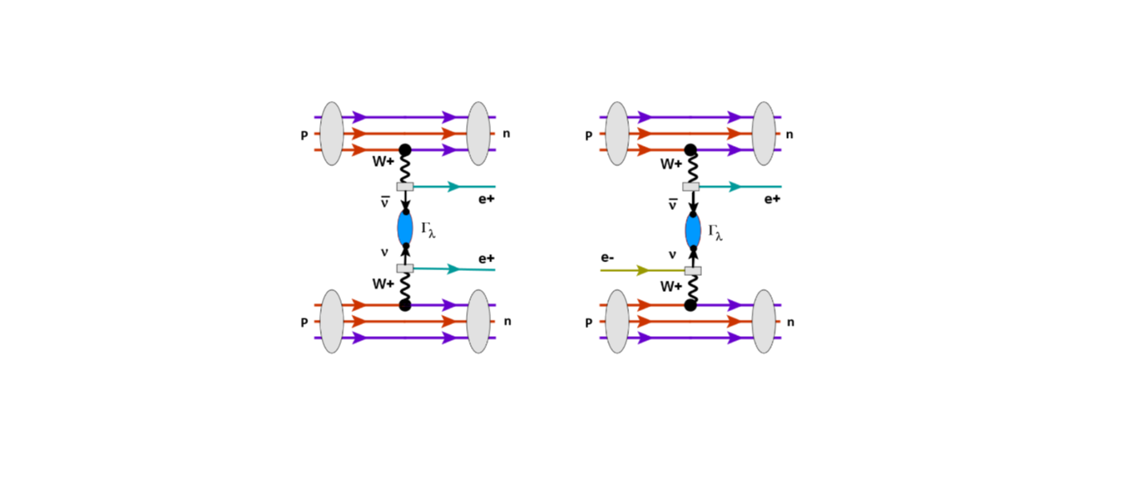
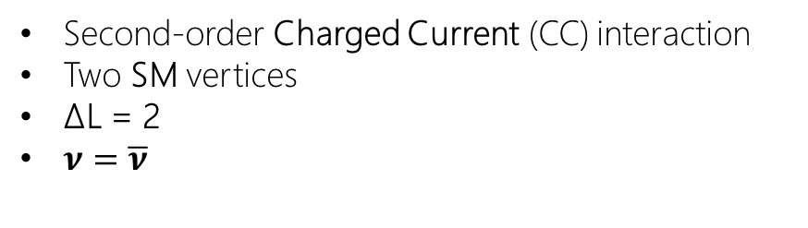
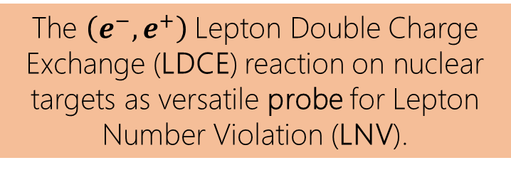
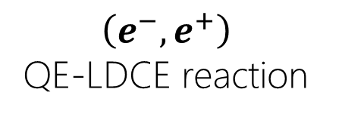
LDCE reactions and LNV
t-channel representation
$\left(e^{−},e^{+}\right)$
QE-LDCE reaction
The $\left(e^{−},e^{+}\right)$Lepton Double Charge Exchange (LDCE) reaction on nuclear targets as versatile probe for Lepton Number Violation (LNV).
Second-order Charged Current (CC) interaction
Two SM vertices
ΔL = 2
$ν=\overline{ν}$

Slide 15
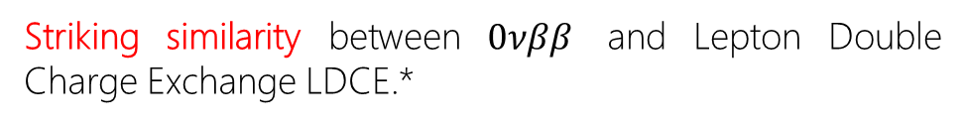
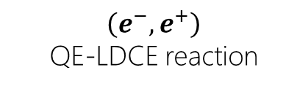

0νββ decay vs LDCE reactions
t-channel representation
$\left(e^{−},e^{+}\right)$
QE-LDCE reaction
Striking similarity between $0νββ$ and Lepton Double Charge Exchange LDCE.*
$0νββ$ decay
Differences:
MeV vs GeV scale
No Q-value issues
LDCE is free of the 0νββ nuclear structure and Q-value constraints
Full spectrum of the final nucleus is populated in LDCE
All nuclei are good candidates as target
s- vs t-channel
*Similar analogy with the LNV-dijet emissions
(to be explored at the future FCC collider)

Slide 16
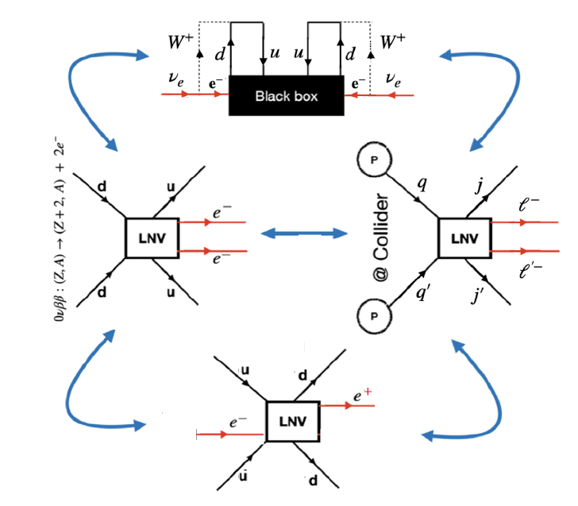
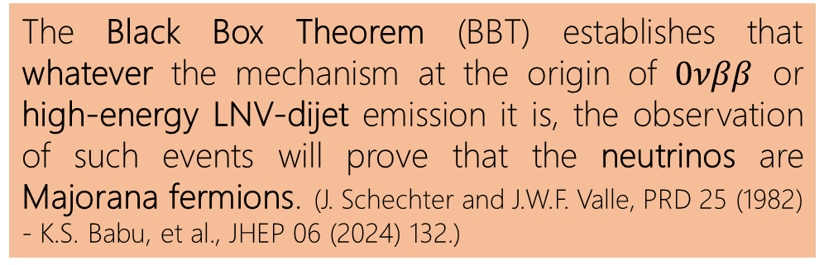
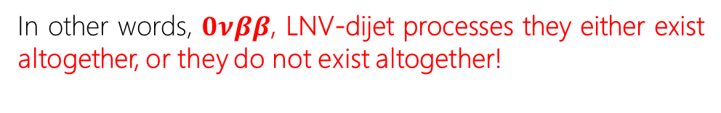
The Black Box Theorem (BBT)
The Black Box Theorem (BBT) establishes that whatever the mechanism at the origin of $0νββ$ or high-energy LNV-dijet emission it is, the observation of such events will prove that the neutrinos are Majorana fermions. (J. Schechter and J.W.F. Valle, PRD 25 (1982) - K.S. Babu, et al., JHEP 06 (2024) 132.)
In other words, $0νββ$, LNV-dijet processes they either exist altogether, or they do not exist altogether!

Slide 17

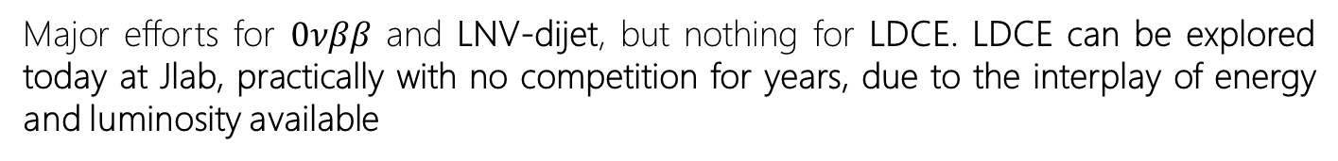
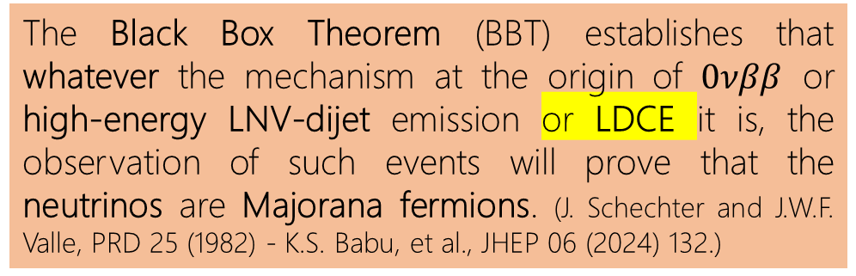
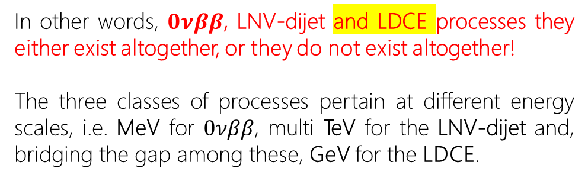
The Black Box Theorem (BBT)
The Black Box Theorem (BBT) establishes that whatever the mechanism at the origin of $0νββ$ or high-energy LNV-dijet emission or LDCE it is, the observation of such events will prove that the neutrinos are Majorana fermions. (J. Schechter and J.W.F. Valle, PRD 25 (1982) - K.S. Babu, et al., JHEP 06 (2024) 132.)
In other words, $0νββ$, LNV-dijet and LDCE processes they either exist altogether, or they do not exist altogether!
The three classes of processes pertain at different energy scales, i.e. MeV for $0νββ$, multi TeV for the LNV-dijet and, bridging the gap among these, GeV for the LDCE.
Major efforts for $0νββ$ and LNV-dijet, but nothing for LDCE. LDCE can be explored today at Jlab, practically with no competition for years, due to the interplay of energy and luminosity available

Slide 18
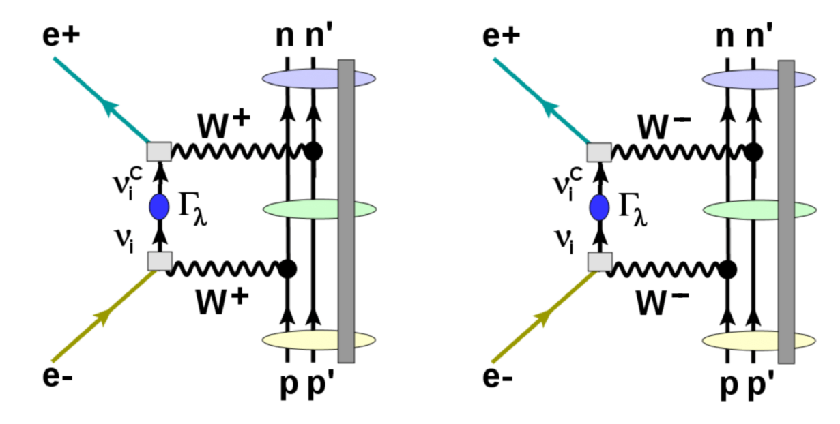

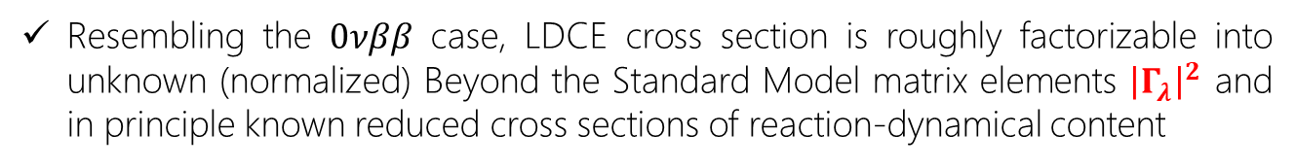

LDCE cross section
Calculations in the semi-phenomenological approach utilizing the Left-Right Symmetric Model (LRSM) to explore the cross-section vs beam energy and target mass dependence (performed by H. Lenske)
$${\overline{ν}}_{μ}+N →μ^{+}+Y$$
$$ν_{μ}+N →μ^{−}+X$$
Resembling the $0νββ$ case, LDCE cross section is roughly factorizable into unknown (normalized) Beyond the Standard Model matrix elements ${\left|Γ_{λ}\right|}^{2}$ and in principle known reduced cross sections of reaction-dynamical content

Slide 19
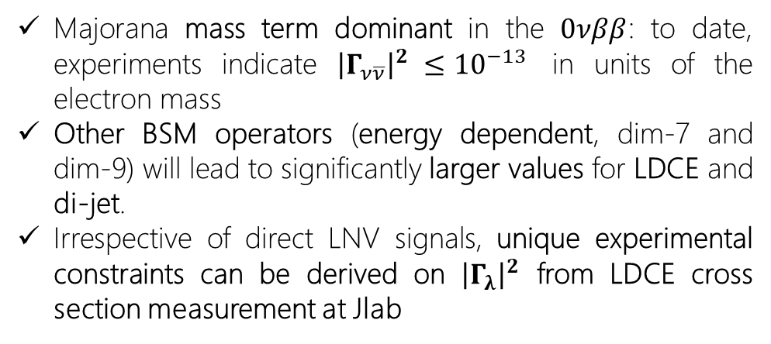
LDCE cross section
Calculations in the semi-phenomenological approach utilizing the Left-Right Symmetric Model (LRSM) to explore the cross-section vs beam energy and target mass dependence (performed by H. Lenske)
s-channel process
Majorana mass term dominant in the $0νββ$: to date, experiments indicate ${\left|Γ_{ν\overline{ν}}\right|}^{2} ≤{10}^{−13}$ in units of the electron mass
Other BSM operators (energy dependent, dim-7 and dim-9) will lead to significantly larger values for LDCE and di-jet.
Irrespective of direct LNV signals, unique experimental constraints can be derived on ${\left|Γ_{λ}\right|}^{2}$ from LDCE cross section measurement at Jlab

Slide 20
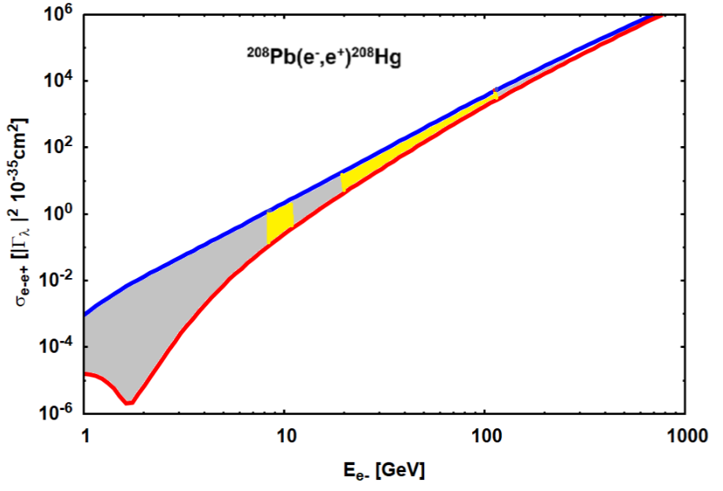
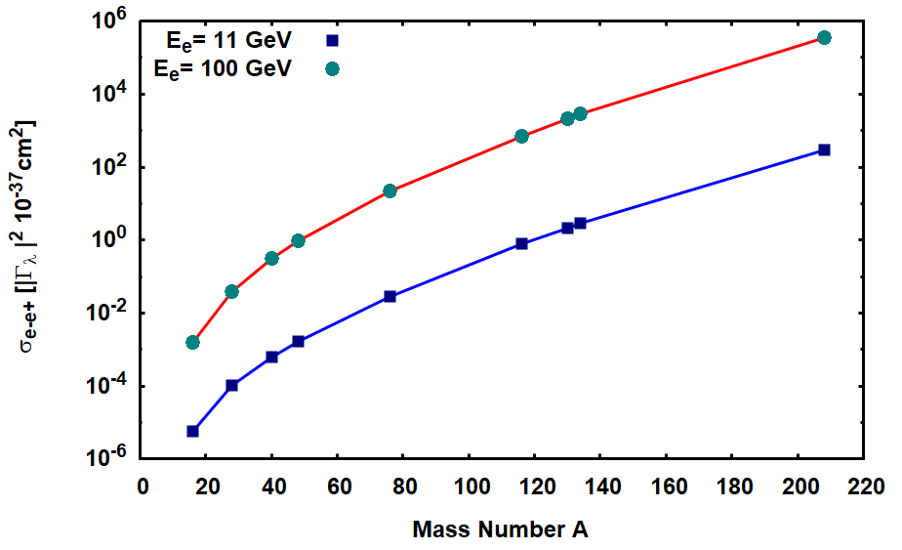



LDCE cross section
Calculations in the semi-phenomenological approach utilizing the Left-Right Symmetric Model (LRSM) to explore the cross-section vs beam energy and target mass dependence (performed by H. Lenske)
Beam energy dependence
DESY
EIC
$$L=\frac{{10}^{31}}{cm^{2}s}$$
$$L=\frac{{10}^{33}}{cm^{2}s}$$
Target mass dependence
$$L=\frac{{10}^{36}}{cm^{2}s}$$

Slide 21
LDCE reaction mechanism
At ∼ 10 GeV scale the LDCE reaction can proceed via Quasi Elastic (QE), Resonant (RES) and Deep Inelastic Scattering (DIS) competing mechanisms
The proposed experiment is thus in line with typical inleastic scattering studies conducted at Jlab
J. A. Formaggio and G. P. Zeller., Rev. Mod. Phys., 84 (2012) 1307

Slide 22
Context: 0νββ decay and DCE reactions
Idea: LDCE reactions as LNV probe
Proposal: the JLAB experiment
Conclusions

Slide 23
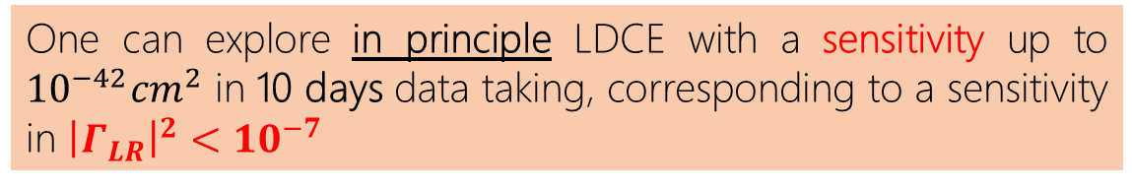
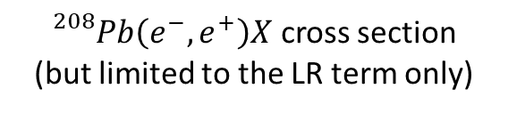


The Jlab LDCE experiment
${}_{}^{208}{Pb}\left(e^{−},e^{+}\right)X$ cross section
(but limited to the LR term only)
Jefferson Laboratory Luminosity
(but only in Hall C)
$$σ={10}^{−35}{\left|Γ_{LR}\right|}^{2}cm^{2}$$
$$L ={10}^{36}cm^{−2}s^{−1}$$
One can explore in principle LDCE with a sensitivity up to ${10}^{−42}{cm}^{2}$ in 10 days data taking, corresponding to a sensitivity in ${\left|Γ_{LR}\right|}^{2}<{10}^{−7}$
What about detection efficiency?

Slide 24
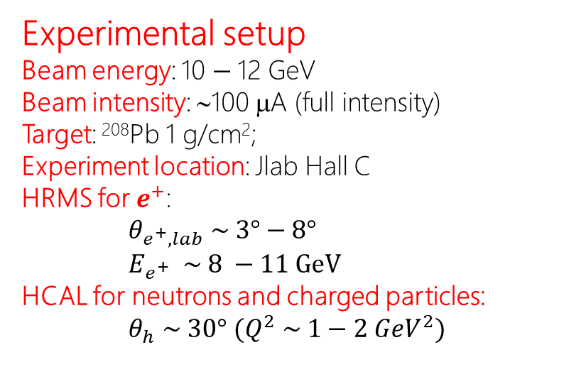
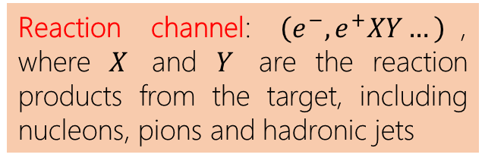
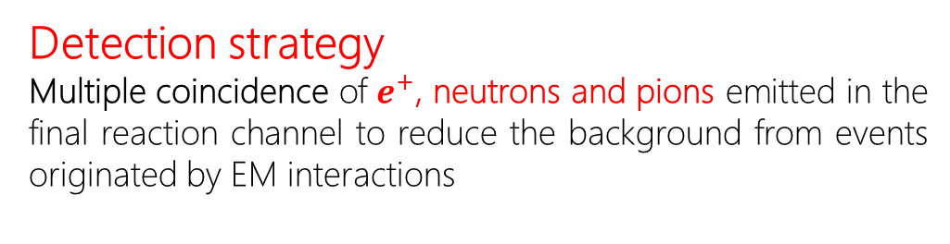
The Jlab LDCE experiment
Experimental setup
Beam energy: 10 $−$12 GeV
Beam intensity: ∼100 μA (full intensity)
Target: ²⁰⁸Pb 1 g/cm²;
Experiment location: Jlab Hall C
HRMS for $e^{+}$:
$θ_{e^{+}, lab} \sim 3°−8°$
$E_{e^{+}} \sim 8 −11 GeV$
HCAL for neutrons and charged particles:
$θ_{h} \sim 30°$ $(Q^{2} \sim 1−2 {GeV}^{2})$
Detection strategy
Multiple coincidence of $e^{+}$, neutrons and pions emitted in the final reaction channel to reduce the background from events originated by EM interactions
Reaction channel: $\left(e^{−},e^{+}XY…\right)$, where $X$ and $Y$ are the reaction products from the target, including nucleons, pions and hadronic jets
What about EM background?

Slide 25
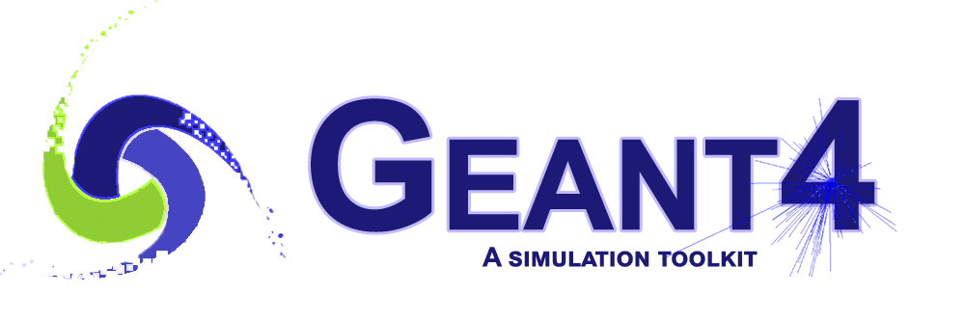
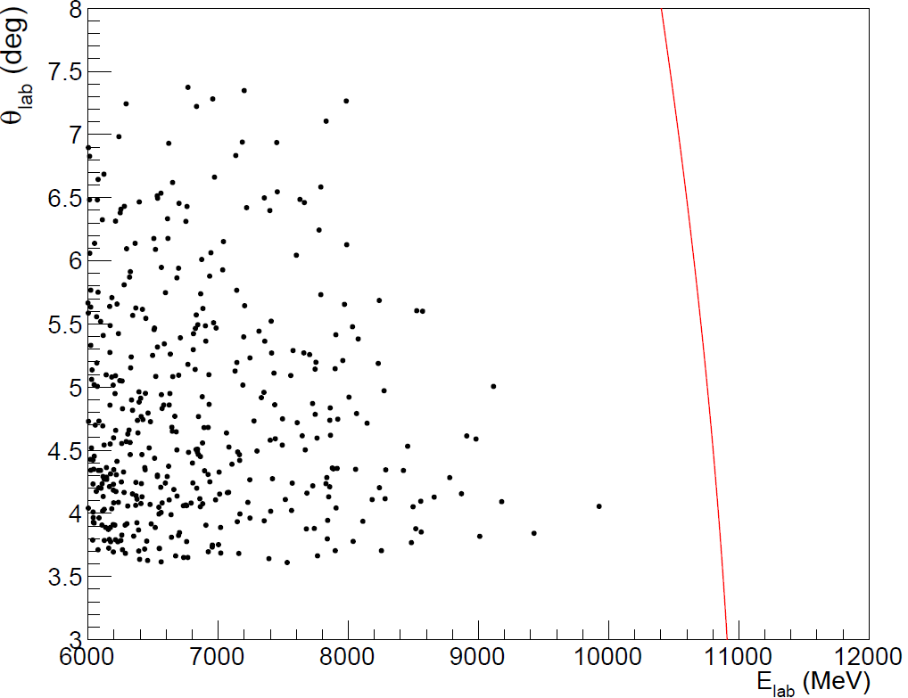
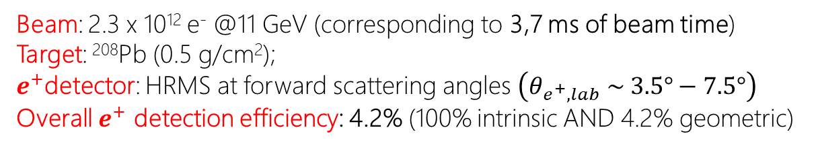
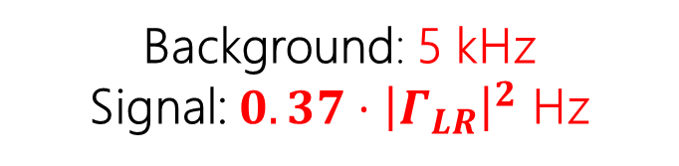
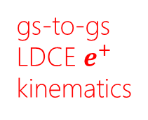
The Jlab LDCE e⁺ background
Beam: 2.3 x 10¹² e⁻ @11 GeV (corresponding to 3,7 ms of beam time)
Target: ²⁰⁸Pb (0.5 g/cm²);
$e^{+}$detector: HRMS at forward scattering angles $\left(θ_{e^{+}, lab} \sim 3.5°−7.5°\right)$
Overall $e^{+}$ detection efficiency: 4.2% (100% intrinsic AND 4.2% geometric)
gs-to-gs LDCE $e^{+}$ kinematics
e⁺ count rate in the HRMS in the ROI @ 100 µA
ROI
Background: 5 kHz
Signal: ${0.37⋅\left|Γ_{LR}\right|}^{2}$ Hz
Multiple coincidences are needed!
Notes:
100 uA sono 6,25*10^14 pps. Ho simulato 2.3 * 10^12 particelle che corrispondono a 3,7 ms di tempo fascio
Ho 32 conteggi nella ROI in 3,7 ms che corrisponderebbero ad un rate di background di 8,7 kHz. Tuttavia la simulazione è stata fatta con 1 g/cm^2 e non 0.5 come dichiarato. Quindi scaliamo con un fattore 2 ed approssimiamo a 5 kHz.

Slide 26
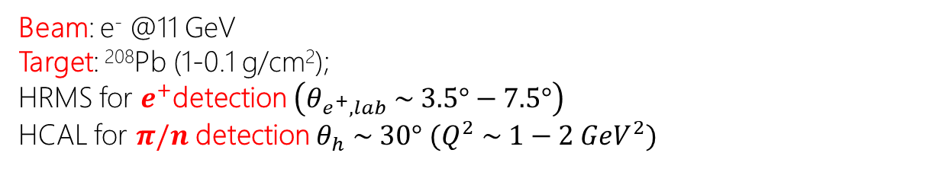
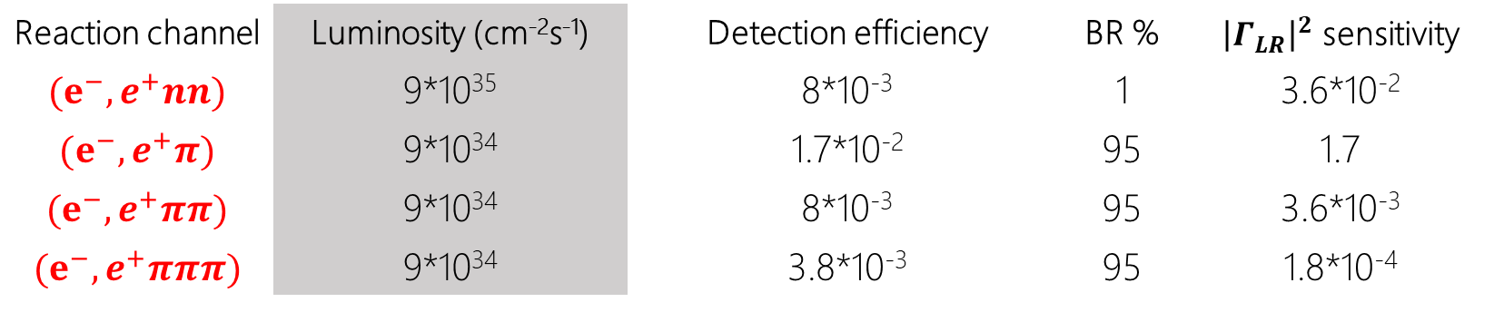
The Jlab LDCE in a multiple-coincidence view
Beam: e⁻ @11 GeV
Target: ²⁰⁸Pb (1-0.1 g/cm²);
HRMS for $e^{+}$detection $\left(θ_{e^{+}, lab} \sim 3.5°−7.5°\right)$
HCAL for $π/n$ detection $θ_{h} \sim 30°$ $(Q^{2} \sim 1−2 {GeV}^{2})$
Reaction channel | Luminosity (cm⁻²s⁻¹) | Detection efficiency | BR % | ${\left|Γ_{LR}\right|}^{2}$ sensitivity
$$(e^{−},e^{+}nn)$$ | 9*10³⁵ | 8*10⁻³ | 1 | 3.6*10⁻²
$$(e^{−},e^{+}π)$$ | 9*10³⁴ | 1.7*10⁻² | 95 | 1.7
$$(e^{−},e^{+}ππ)$$ | 9*10³⁴ | 8*10⁻³ | 95 | 3.6*10⁻³
$$(e^{−},e^{+}πππ)$$ | 9*10³⁴ | 3.8*10⁻³ | 95 | 1.8*10⁻⁴
Luminosity: it refers to the number of nuclei (not nucleons!). Target thickness chosen to minimize the EM background according to GEANT IV simulations.

Slide 27
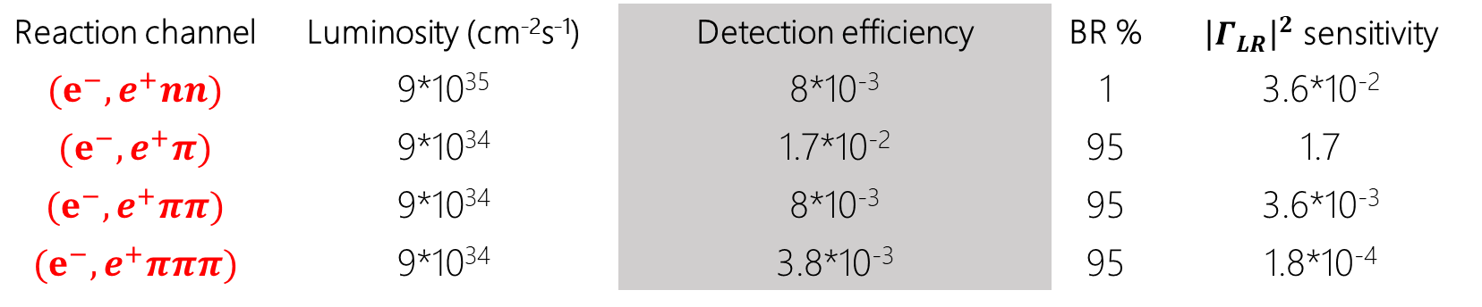
The Jlab LDCE in a multiple-coincidence view
Beam: e⁻ @11 GeV
Target: ²⁰⁸Pb (1-0.1 g/cm²);
HRMS for $e^{+}$detection $\left(θ_{e^{+}, lab} \sim 3.5°−7.5°\right)$
HCAL for $π/n$ detection $θ_{h} \sim 30°$ $(Q^{2} \sim 1−2 {GeV}^{2})$
Reaction channel | Luminosity (cm⁻²s⁻¹) | Detection efficiency | BR % | ${\left|Γ_{LR}\right|}^{2}$ sensitivity
$$(e^{−},e^{+}nn)$$ | 9*10³⁵ | 8*10⁻³ | 1 | 3.6*10⁻²
$$(e^{−},e^{+}π)$$ | 9*10³⁴ | 1.7*10⁻² | 95 | 1.7
$$(e^{−},e^{+}ππ)$$ | 9*10³⁴ | 8*10⁻³ | 95 | 3.6*10⁻³
$$(e^{−},e^{+}πππ)$$ | 9*10³⁴ | 3.8*10⁻³ | 95 | 1.8*10⁻⁴
Detection efficiency: according to the data on HCAL on literature.

Slide 28
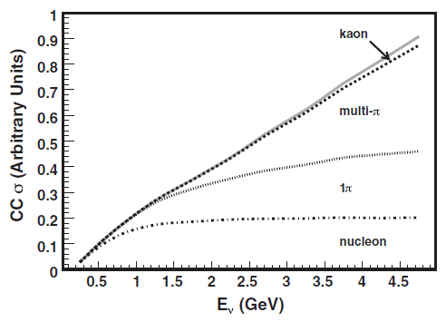


The Jlab LDCE in a multiple-coincidence view
Beam: e⁻ @11 GeV
Target: ²⁰⁸Pb (1-0.1 g/cm²);
HRMS for $e^{+}$detection $\left(θ_{e^{+}, lab} \sim 3.5°−7.5°\right)$
HCAL for $π/n$ detection $θ_{h} \sim 30°$ $(Q^{2} \sim 1−2 {GeV}^{2})$
Reaction channel | Luminosity (cm⁻²s⁻¹) | Detection efficiency | BR % | ${\left|Γ_{LR}\right|}^{2}$ sensitivity
$$(e^{−},e^{+}nn)$$ | 9*10³⁵ | 8*10⁻³ | 1 | 3.6*10⁻²
$$(e^{−},e^{+}π)$$ | 9*10³⁴ | 1.7*10⁻² | 95 | 1.7
$$(e^{−},e^{+}ππ)$$ | 9*10³⁴ | 8*10⁻³ | 95 | 3.6*10⁻³
$$(e^{−},e^{+}πππ)$$ | 9*10³⁴ | 3.8*10⁻³ | 95 | 1.8*10⁻⁴
BR: according to this plot (J. A. Formaggio and G. P. Zeller., Rev. Mod. Phys., 84 (2012) 1307) where in CC reactions the QE channel is expected to be 1% of the total cross section while the $π$ reaction channels are expected to cover the 95% of the total cross section.

Slide 29


The Jlab LDCE in a multiple-coincidence view
Beam: e⁻ @11 GeV
Target: ²⁰⁸Pb (1-0.1 g/cm²);
HRMS for $e^{+}$detection $\left(θ_{e^{+}, lab} \sim 3.5°−7.5°\right)$
HCAL for $π/n$ detection $θ_{h} \sim 30°$ $(Q^{2} \sim 1−2 {GeV}^{2})$
Reaction channel | Luminosity (cm⁻²s⁻¹) | Detection efficiency | BR % | ${\left|Γ_{LR}\right|}^{2}$ sensitivity
$$(e^{−},e^{+}nn)$$ | 9*10³⁵ | 8*10⁻³ | 1 | 3.6*10⁻²
$$(e^{−},e^{+}π)$$ | 9*10³⁴ | 1.7*10⁻² | 95 | 1.7
$$(e^{−},e^{+}ππ)$$ | 9*10³⁴ | 8*10⁻³ | 95 | 3.6*10⁻³
$$(e^{−},e^{+}πππ)$$ | 9*10³⁴ | 3.8*10⁻³ | 95 | 1.8*10⁻⁴
${\left|Γ_{LR}\right|}^{2}$ sensitivity: evaluated in a 10 days experiment at 5σ C.L. It includes background contributions both from $e^{+}$ and $π/n$ according to GEANT IV simulations and 2 ns time windows for coincidence.

Slide 30
Context: 0νββ decay and DCE reactions
Idea: LDCE reactions as LNV probe
Proposal: the JLAB experiment
Conclusions

Slide 31

Conclusions
LDCE is a new (!) promising way to LNV and physics BSM
A new (!) semi-phenomenological theory, based on the LRSM, gives reliable and encouraging cross-section estimates (PRL submission, in progress)
Today, at JLAB, without developing new detectors or technologies, it is possible to attempt a measurement with interesting sensitivities in 10 days measurement.
There are still many open questions:
What is the best signature?
How are the reaction products angularly correlated?
What is the background angular distribution?
How can we verify the results of the GEANT IV simulations?
What is the detection efficiency for high-multiplicity events?

Slide 32

Conclusions
How to answer questions?
Look at the experimental data (if available) for the angular distribution of the backgrounds and their time and/or angle correlations.
CLAS12 (Hall B) would be the ideal instrument for an initial measurement at a lower luminosity and large acceptance conditions. A bit of luck would allow the signal to be observed already under these conditions. In any case, the data would be invaluable for planning a maximum-intensity measurement in Hall C.

Slide 33


Slide 34
Time for discussion!

