Slide 1


The SBN neutrino program at Fermilab
Alberto Guglielmi
INFN Padova
H2020 Probes, M. Sklodowska-Curie
R&I No. 101003460
Pisa, November 27th 2025

Slide 2
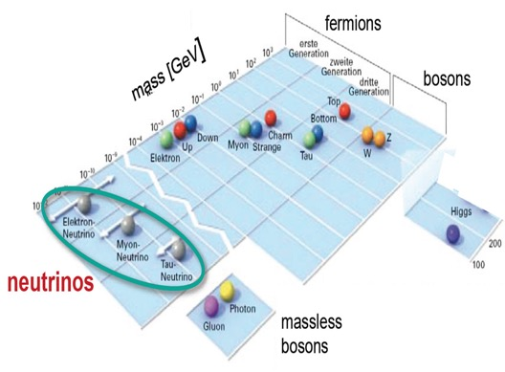
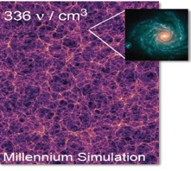
The high energy frontier
The discovery of Higgs bosons has completed the Standard Model (SM) of elementary particles that describes the fundamental matter components and their interactions
  3 different neutrinos; ν_{e} ν_{μ} ν_{τ} , m_{ν} < eV oscillating ν_{α} -> ν_{β}
νs: the most abundant massive particles in the Universe, 336 ν/cm³
neutrino masses and flavor oscillations represent today a main experimental evidence of physics beyond SM. Being some of their fundamental properties still unknown, νs are naturally one of main portals towards beyond-SM physics.
The incredible smallness of ν masses compared to other elementary fermions points to some specific scenario awaiting to be elucidated.

Slide 3

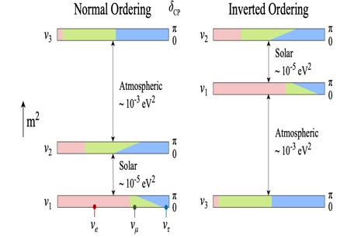
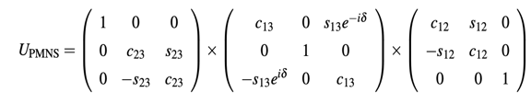
Neutrino oscillations
2 neutrino ν_{α} -> ν_{β} over a distance L: lepton flavor violation process described by the mass states ν₁, ν₂ mixing probability as a function of |Δm²|= m₁² - m₂² mass difference and sin² 2θ coupling amplitude
λ = 4 Ε_{ν}/ Δm² : ν oscillation length, E_{ν} ν−energy
2 different small mass-difference regimes of oscillations have been discovered with:
- solar ν osc Δm²₂₁ ~ 8 x10⁻⁵ eV² and
- atmospheric ν osc Δm²₃₁~2.5 x10⁻³ eV²
+ sub-leading νμ -> νe
  -> 3ν oscillation coherent picture: lepton-mixing matrix of Pontecorvo-Maki-Nagatawa-Sakata, 3 mixing angles + 1 CP-violating phase
C_{ij}: cos θ_{ij} S_{ij}: sin θ_{ij}
sin² 2θ₁₂~ 0.3, sin² 2θ₂₃~ 0.5, sin² 2θ₁₃~ 0.1 determined in 20 years experiments !
but ν mass hierarchy ? δ_{CP} matter-antimatter asymmetry ?

Slide 4
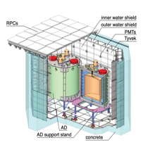
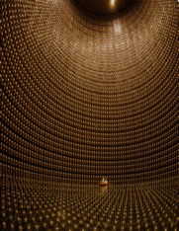
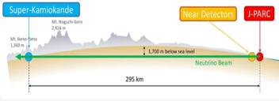
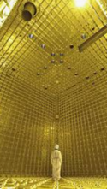
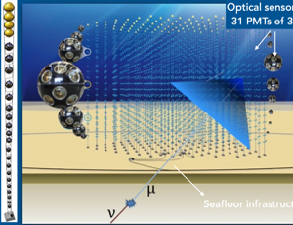
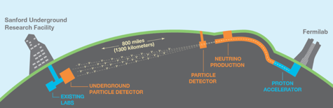

Present neutrino saga…
Still open questions: mass hierarchy, δ_{CP}, ν mass and Dirac/Majorana ν ?
  Several ongoing experiments/projects addressing neutrinos with nuclear reactors, radioactive sources, neutrino beams from proton accelerators and cosmic νs with large ice/water Cherenkov counter telescopes
SK: Atmospheric/solar νμ −> ν_{τ} , ν_{e}
Reactors: Chooz, D-Chooz
Reno, Daya Bay ,…Juno
…subleading νμ −> ν_{e}
T2K--> Hyper-K + NuMI, NovA LBL
KM3NeT-ARCA cosmic νs
DUNE Liquid Argon program

Slide 5

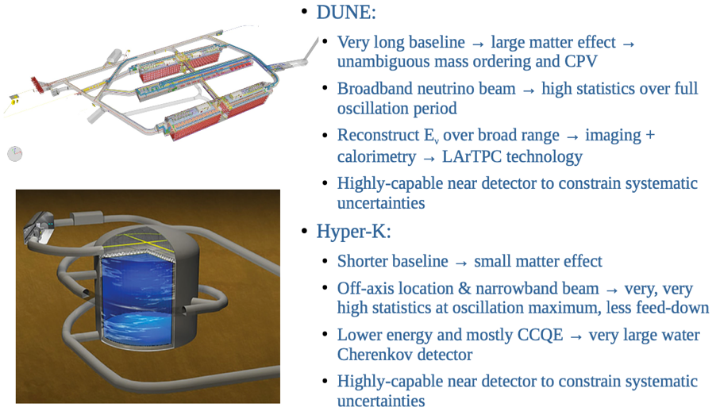
Matter-antimatter asymmetry?
Mass hierarchy, δ_{CP} will be solved by DUNE, HK comparing νμ−>νe oscillation in νμ and anti-νμ beams:
4x 17 kt LAr-TPC, 1.2 -> 2 MW proton beam
260 kt water-Ch, 1.2 MW proton beam

Slide 6
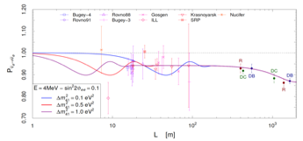
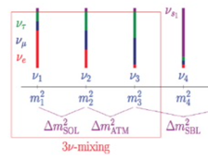
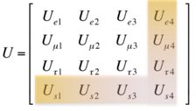
Persisting anomalies in the neutrino sector
    Despite the well-established 3-flavour ν mixing, several anomalies collected so far hinting to additional ν states driving oscillations at small distance with Δm²_{new}~1 eV², small sin²2θ_{new} :
    anti−νe appearance: in anti-νμ accelerator LSND experiment where anti-νe -> e⁺ + n with neutron resulting n + p into d + γ.
    νe disappearance: SAGE, GALLEX experiments with Mega-Curie K-capture calibration sources showing an observed/predicted R = 0.84±0.05, recently confirmed at 4σ by BEST exp.
    Apparent anti-νe disappearance of near-by nuclear reactor experiments RAA, R = 0.934±0.024 but => poor knowledge of U fuel processes consumption
observed/predicted rate
…pointing to sterile ν hypothesized by Bruno Pontecorvo in a 1957 seminal paper…
Bruno Pontecorvo

Slide 7
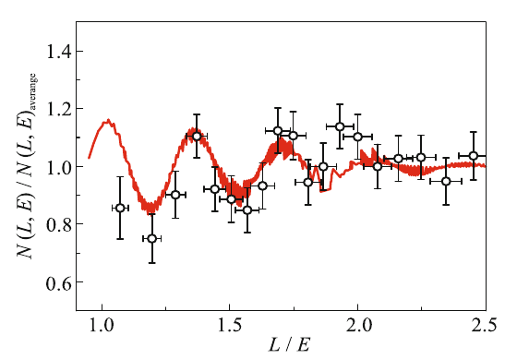
New evidence for oscillations of sterile neutrinos at reactor ?
In 2019 Neutrino-4 experiment (A.P. Serebrov et al.) at Dimitrovgrad SM-3 reactor gave evidence of neutrino oscillation into sterile-νs showing a disappearance signal with a clear L/E ~ 1-3 m/MeV modulation
Neutrino-4
Jetp Lett. 116, 669–682 (2022)
3 years data taking moving the segmented liquid scintillator detector from 6.4 to 11.9 m from reactor core in 24 steps:
Neutrino signal compared with expectation for Δm²~ 7.25 eV², sin²2θ ~ 0.26 as a function of L/E
Reactor On - Off : 223 events/day with Signal/Background ~ 0.54
Δm₁₄² = 7.25± 1.09 eV² with sin² (2θ₁₄) = 0.26 ± 0.08 stat ± 0.05
sterile ν as candidate for Dark Matter ? a quite obvious contribution due to the high density of relic sterile-νs with 𝑚𝜈₄ = 2.7 eV.
Combined analysis: Neutrino-4 (P.R. D 104, 032003, 2021), GALLEX, SAGE and BEST
Δm₁₄² = 7.3 eV² sin² (2θ₁₄) = 0.36 at 5.8 σ C.L. (A.P. Serebrov et al. arXiv:2302.09958)

Slide 8
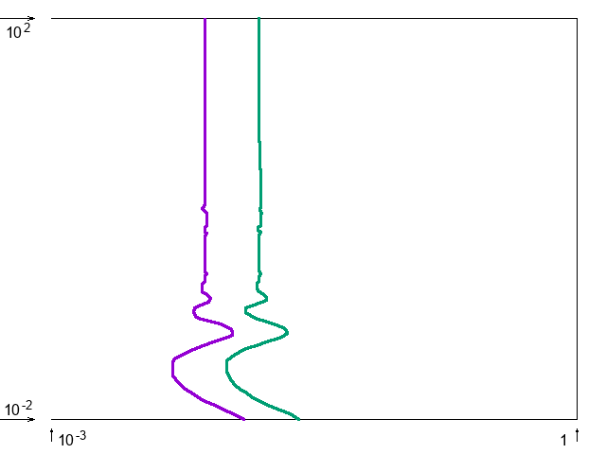
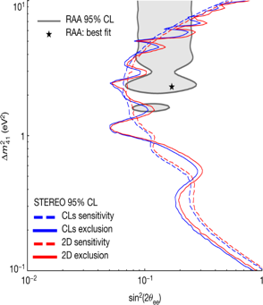
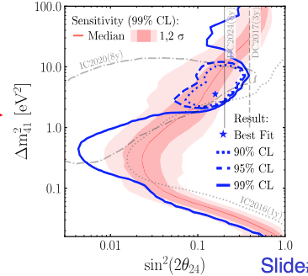
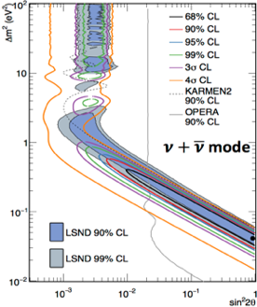
Several experiments at accelerators and reactors…
    Large part of LSND parameters excluded by ICARUS and OPERA ν_{μ} -> ν_{e} at CNGS ν beam; MiniBooNE ν_{μ} -> ν_{e} at FNAL low energy νe event excess not confirmed by MicroBooNE
    Recent anti-ν_{e} measurement at reactors: study of fuel burnup cycle from Daya Bay, RENO STEREO to reconstruct contribution of main isotopes: hint of sterile 𝜈 reduced to 1 𝜎;
    No evidence in νμ disappearance exps NOνA, MINOS/MINOS+,T2K, BUT signal observed in IceCube Δm₄₁²~ 3.5 eV², sin²2θ₄₁ ~ 0.16 ?
ν_{μ} -> ν_{e}
IceCube Prl 133 201804 (2024)
OPERA 90% CL
KARMEN2 90% CL
MiniBooNE ν+ν
4σ
3σ
99%
95%
STEREO
Nature 613,
257–261 (2023)
90%
68%
ICARUS 90% CL
99% CL

Slide 9
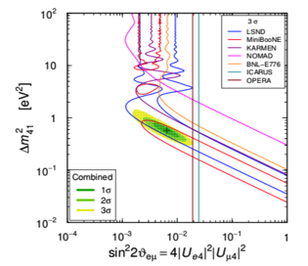
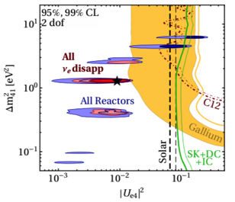
A long-standing puzzle in neutrino oscillation sector
  Clear tension between appearance/disappearance experiments characterized by different neutrino detection techniques and ν energy spectra:
(anti-)ν_{μ} → ν_{e} Appearance
(anti-)ν_{e} Disappearance
(arXiv:2106.05913)
    Measuring both ν app./disapp. in the same experiment with a detector with an optimal neutrino identification/backgr rejection is mandatory
    Far to near detector neutrino spectra comparison: crucial for the control of backgr and beam/detector systematics.

Slide 10
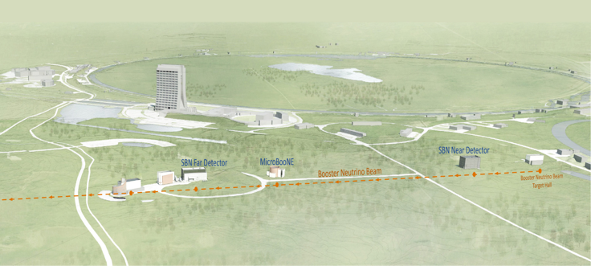


Short Baseline Neutrino (SBN) at FNAL BNB and NuMi beams: a definitive answer to sterile neutrinos ?
ICARUS
600m baseline
470t active volume
SBND
110 m baseline
112t active volume
BNB
φ(ν)/MeV/m²/10⁶ POT
NuMI ~ 6º off-axis
BNB on axis
  ICARUS and SBND LAr-TPC’s installed at 600 and 110 m from the BNB target, searching for sterile-ν oscillations both in appearance and disappearance channels.
  High-statistics ν-Ar cross-section measurements and event identification/reconstruction studies in view of DUNE:
    10⁶ evt/y in SBND <1 GeV from Booster (Eν ~ 0.8 GeV)
    10⁵ evt/y in ICARUS >1 GeV from 6⁰ off-axis NuMI (Eν~2 GeV)
BNB

Slide 11
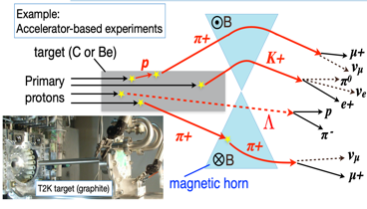
BNB neutrino beam
    8 GeV protons on Be target, ∼5×10¹² p/spill, 1.6 μs spill: 81 x 2 ns bunches 19 ns apart, ~5 Hz.
    Positive (negative) secondary particles are focused (defocused) by a magnetic horn according to I circulation versus.
    50 m decay tunnel where focused mesons propagate/decay producing neutrino.
ν
Be target
83.7%
5.86%
93.6%
15.7%
Anti-neutrino beam: secondary negative particles are focused by reversing the Horn current
0.52+0.05%
0.4+0.2%

Slide 12
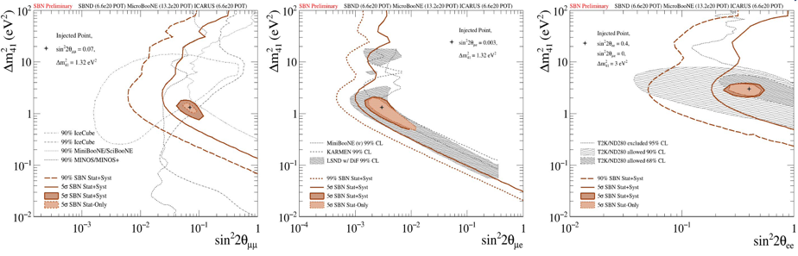
SBN Program: sterile neutrino sensitivity, 3 years (6.6 x10²⁰ pot)
Combined analysis of events collected far by ICARUS at far site and by SBND at near using the same LAr-TPC event imaging technology greatly reduces the expected systematics:
      High νe identification capability of LAr-TPCs rejecting NC event background;
      “Initial” BNB beam composition and spectrum provided by SBND detector.
νμ disappearance
νe appearance
νe disappearance
5σ coverage of the parameter area relevant to LSND anomaly
Probing the parameter area relevant to reactor and gallium anomalies.
Unique capability to study neutrino appearance and disappearance simultaneously

Slide 13
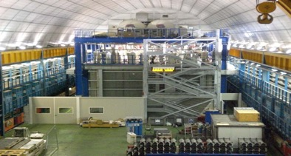
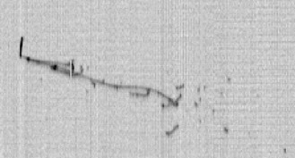
The remarkable evolution of ν-detectors: the ICARUS LAr-TPC
Liquid Argon Imaging technology LAr-TPC, an ‘’electronic bubble chamber’’ to unambiguously reconstruct each ionizing track in complex neutrino events, was first proposed by C. Rubbia in 1977 as an alternative to Cherenkov detectors:
A long R&D culminated in the first large-scale successful experiment ICARUS-T600, 0.76 kt ultra-pure LAr at Gran Sasso INFN Lab exposed underground to CNGS ν beam investigating sterile neutrinos!
      Tracking device: 3D event topology with Δx ~ mm, ionization e- by charged particles can drift undisturbed for meters with E_{D}= 0.5 kV/cm if LAr is sufficiently pure
      Full sampling homogeneous calorimeter: E measurement by charge signal integration;
      Measurement of local energy deposition dE/dx: remarkable e/γ separation, 0.02 X₀ sampling, Χ₀=14 cm, a powerful PID by dE/dx vs range. Momentum of not contained μ is measured by Multiple Coulomb Scattering
      Scintillation light by charged particles provides fast signals for timing/triggering.
T300
T300
atmospheric ν_{e} neutrino
… paving the way for Long-Baseline DUNE experiment!
Notes:
CERN

Slide 14
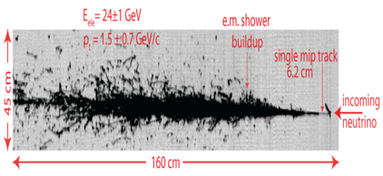

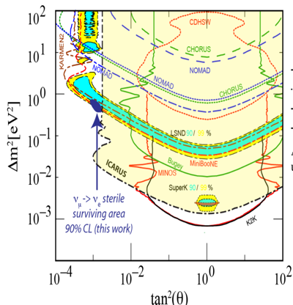
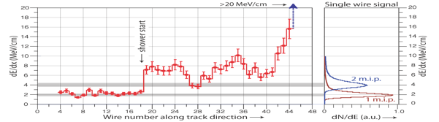
ICARUS T600: a powerful detector for neutrino experiments
    ICARUS concluded in 2013 a successful 3 years long run exposed to CNGS beam and cosmic rays with several physics/technical achievements:
      Demonstrating the unique LAr-TPC capability to identify νe and reject πº background
      Performing with OPERA a sensitive search for νμ ->νe appearance constraining LSND and MiniBooNE νe signals to a narrow region, EPJ C (2013) 73:2599
CNGS νe CC
Collection
Single mip
Evolution from single e-mip to EM shower is evident from dE/dx on individual wires.

Slide 15
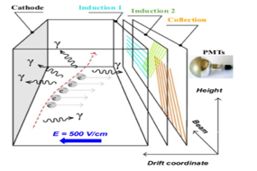
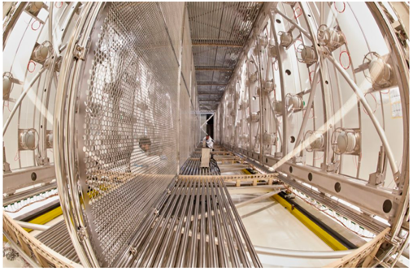
ICARUS at Fermilab
2015-18: extensive overhauling in view of shallow depth operations at Fermilab to explore Δm² ~ 1 eV² region and solve the sterile neutrino question.
2 modules, 2 TPC chambers per module with a central cathode (1.5 m drift, E_{D}= 0.5 kV/cm);
3 readout wire planes per TPC, 54000 wires at 0, ± 60⁰, 3 mm pitch, in total;
360 8” photomultipliers, TPB coated, to detect the scintillation light;
LAr/GAr purified by copper filters and molecular sieves for water absorption.
Structure of one module with 2 TPC chambers
Wires planes
ICARUS installed shallow depth, protected from cosmic rays by:
  4π Cosmic Ray Tagger (CRT) , ~1000 m² two layers scintillation bars surrounding LAr-TPCs, to identify charged cosmics
  ~3 m concrete overburden above the CRT to strongly reduce neutral cosmics.
Central cathode
E-field cage
PMTs
Notes:
CERN

Slide 16
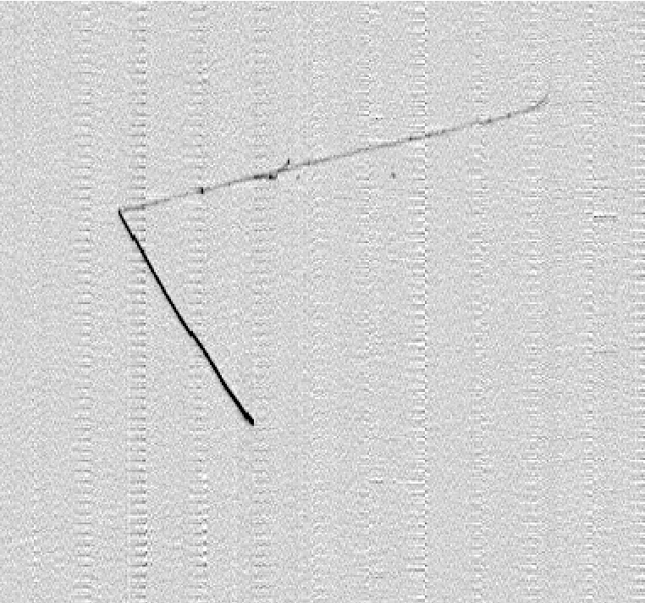
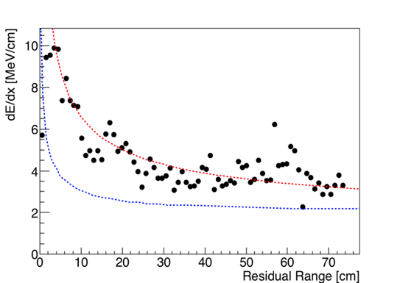
First collected ν event in ICARUS: a BNB QE νμ CC candidate
Selection of ν_{e} events
COLL
  Neutrino interaction vertex well inside the active LAr volume of ICARUS. Two tracks are produced:
    Track 1: downward going muon candidate, exiting on bottom (confirmed by δ rays)
    Track 2: stopping proton.
Beam direction
Track 1 L = 75 cm
Muon with δ−rays exiting on the bottom
0.9 m Drift direction
ICARUS Preliminary
Track 2 L = 74 cm
Stopping proton
Measured dE/dx along track 2
1.2 m Wires
From the study of dE/dx vs range, track 2 is compatible with a proton: E_{DEP}~ 340 MeV, E_{K} =370 MeV (if evaluated from range).
Expected dE/dx vs range for muon, proton

Slide 17
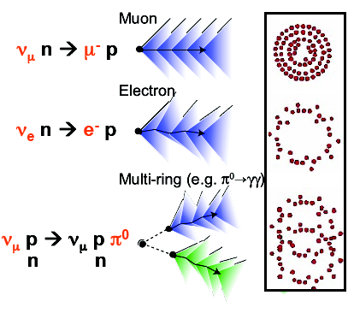
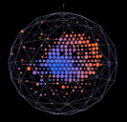
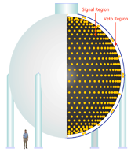
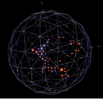


LAr-TPC vs Cherenkov?
MiniBooNE: 800 ton liquid scintillator, primarily Cherenkov light by 1280 PMTs
difficult e/γ separation: π⁰ background!
Proton
ICARUS LAr-TPC ν_{e} atmosph. neutrino event
Electron
superb e/γ separation and
π⁰ background rejection
35 cm
Notes:
CERN

Slide 18
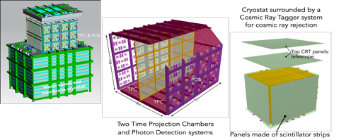
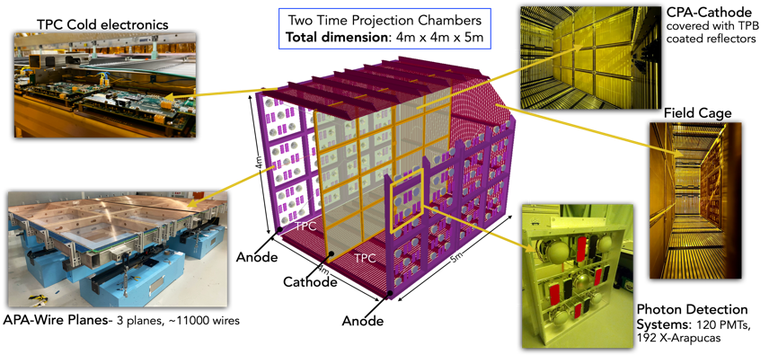
SBN Near detector: SBND at 110 m from target
Two LAr-TPCs with central Cathode, 112 t LAr active volume equipped with cold electronics;
Photon detection systems of scintillation light produced by charged particles in LAr;
The cryostat is surrounded by a Cosmic Tagger system for cosmic ray rejection.
Started data taking: December 2024

Slide 19
Ongoing SBN Research Program
The SBN program is addressing the question of sterile neutrinos with the BNB beam comparing ν_{e} and ν_{μ} interactions at different distances from target as measured by ICARUS and SBND LAr-TPCs.
  ICARUS is smoothly running since June 2022, exposed to BNB and NuMI beams: already collected ~ 7.4 x 10²⁰ pot with BNB and ~ 3.4 x 10²⁰ pot (2.8 x 10²⁰ pot) with NuMI positive (negative) focusing, initially devoted to:
    Investigate ν_{μ} disappearance with BNB ν beam, later complemented by the study of ν_{e} disappearance with off-axis NuMI beam, addressing Neutrino-4 claim;
  Study of ν_{e}, ν_{μ} events from off-axis NuMI beam, to measure ν-Ar interaction cross sections and optimize ν reconstruction/identification in an energy range of interest for DUNE;
  Exploit off-axis NuMI beam to investigate sub-GeV Beyond Standard Model signatures.
SBND is taking data with BNB beam since December 2024, starting the joint operation with ICARUS for the SBN Sterile Neutrino program at Booster: collected proton target statistics in conjunction to ICARUS: 3.6 x 10²⁰ pot (2025)

