Slide 1
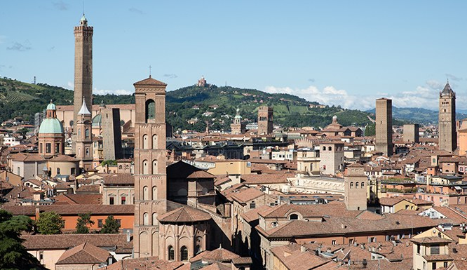
DELPHES Tracking Update
F. Bedeschi,
RD_FCC collaboration meeting
Bologna, December 2025
Outline
Previous implementation
  Issues
Kalman filter implementation
  Validation

Slide 2
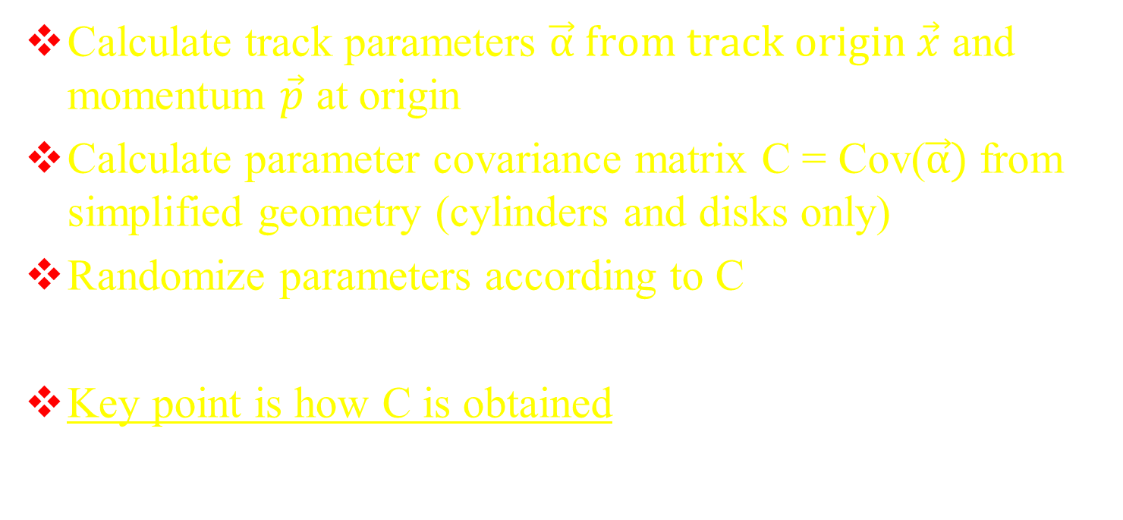
In a nutshell
Calculate track parameters $\vec{α} from track origin \vec{x}$ and momentum $\vec{p}$ at origin
Calculate parameter covariance matrix C = Cov($\vec{α})$from simplified geometry (cylinders and disks only)
Randomize parameters according to C
Key point is how C is obtained

Slide 3
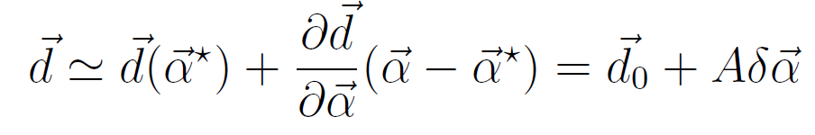
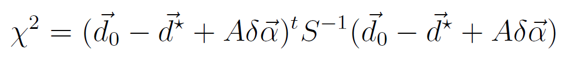
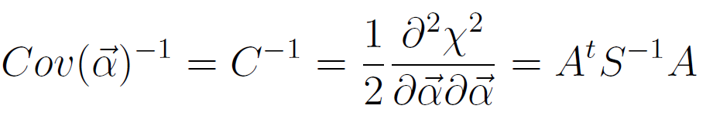
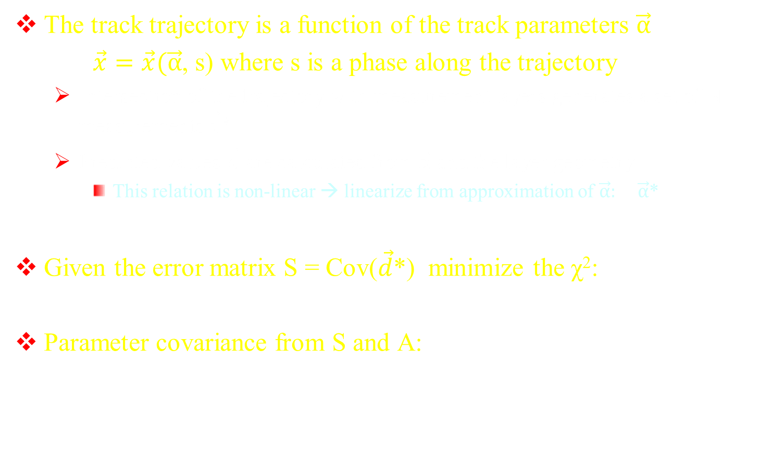
Old implementation (1)
The track trajectory is a function of the track parameters $\vec{α}$
$\vec{x}=\vec{x}(\vec{α}$, s) where s is a phase along the trajectory
  Intersection of the trajectory with measurement layers generates a set of N measurements $\vec{d}$*
  Predicted values $\vec{d}$ are calculated from $\vec{α}$ and the layer geometry
    This relation is non-linear → linearize from approximation of $\vec{α}:$ $\vec{α}$*
Given the error matrix S = Cov($\vec{d}$*) minimize the χ²:
Parameter covariance from S and A:

Slide 4
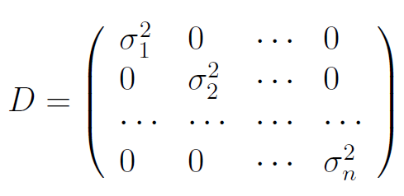
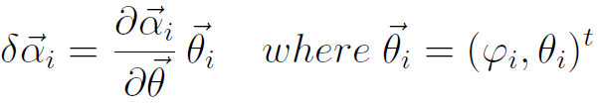
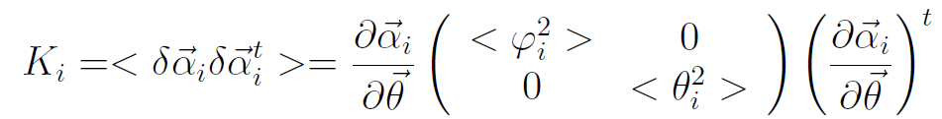
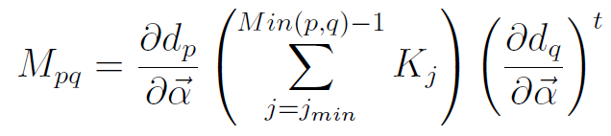
Old implementation (2)
Measurement covariance S = D + M
  D = diagonal with detector resolutions
  M = contributions from multiple scattering (not diagonal)
M is from parameter variations due to MS at each layer i

Slide 5
Issues
Inversion of S is expensive (dimension > 100)
  So initialize grid of C(p_{t}, θ) at D=0, z₀=0
    Get C from bilinear interpolation for tracks inside beam pipe
    Do full calculation only for tracks outside beam pipe
Draw backs:
  C is mostly an approximation (good though!)
  Cannot include mass dependance of MS
    Affects low momentum tracks
  Cannot include single layer efficiencies

Slide 6
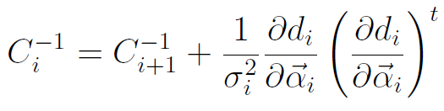
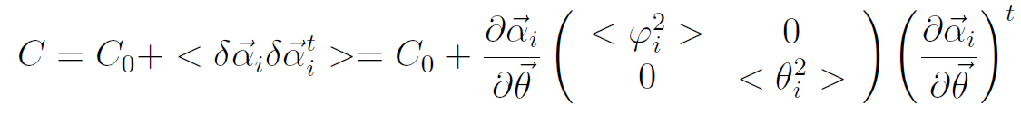
Kalman method (1)
Preamble - Can prove that:
  Ignoring MS:
    The full fit is equivalent to adding one measurement at a time starting from outside and moving in
  Effect of adding the MS contribution of a scattering layer below the last measurement used
  where C₀ is the track parameter covariance before including the effect of MS

Slide 7
Kalman method (2)
Implementation:
  Loop on all layers starting from the last measurement layer outside
    If “measurement” update the covariance matrix accordingly
    Add layer MS contribution for any layer type
Summary:
  Method is fast: involves only inversion of 5x5 matrices
  NO approximations for all tracks
  Easy to implement efficiencies: just decide when using a measurement
  Mass dependance properly included since covariance is recalculated for each track

Slide 8
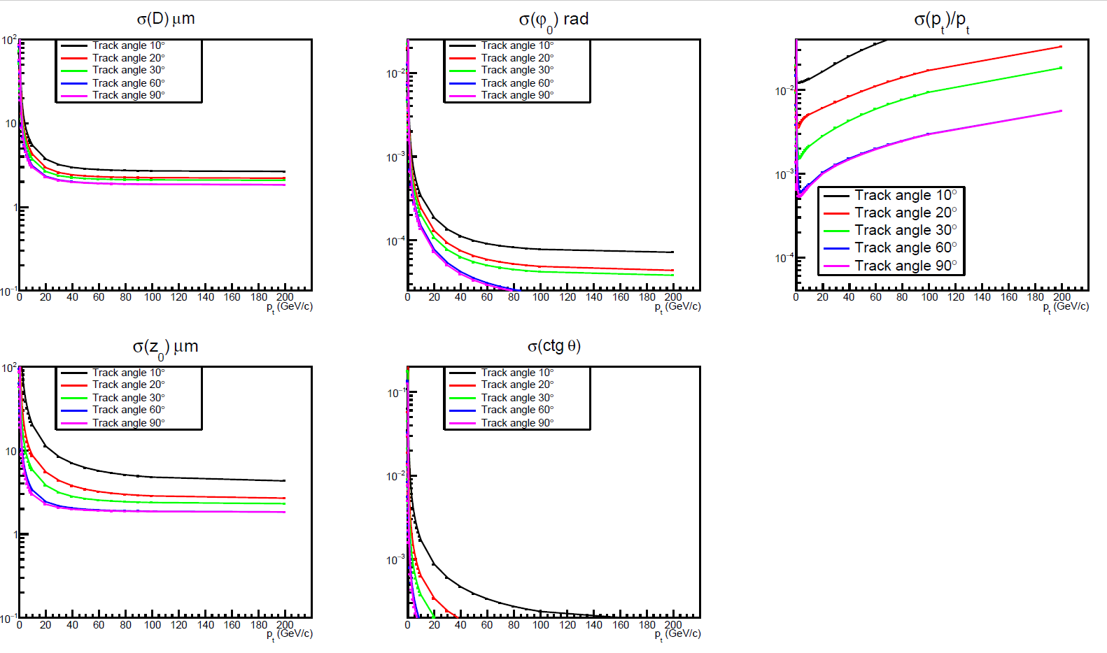
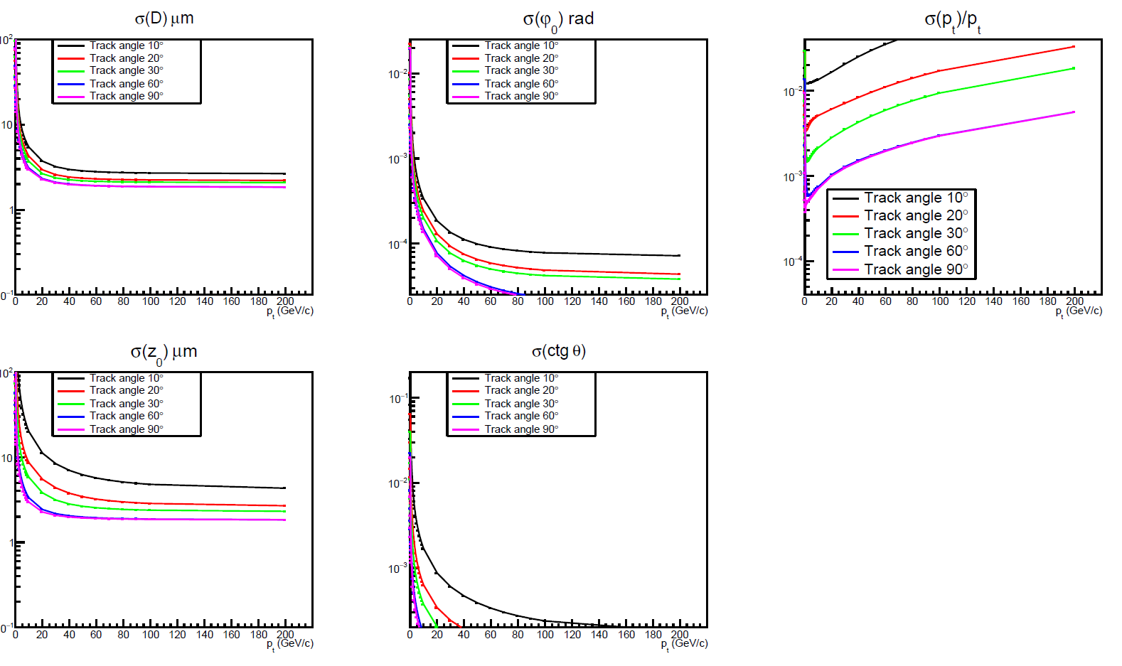
Verification: p_{t} scans
Standard Method
Kalman Method

Slide 9
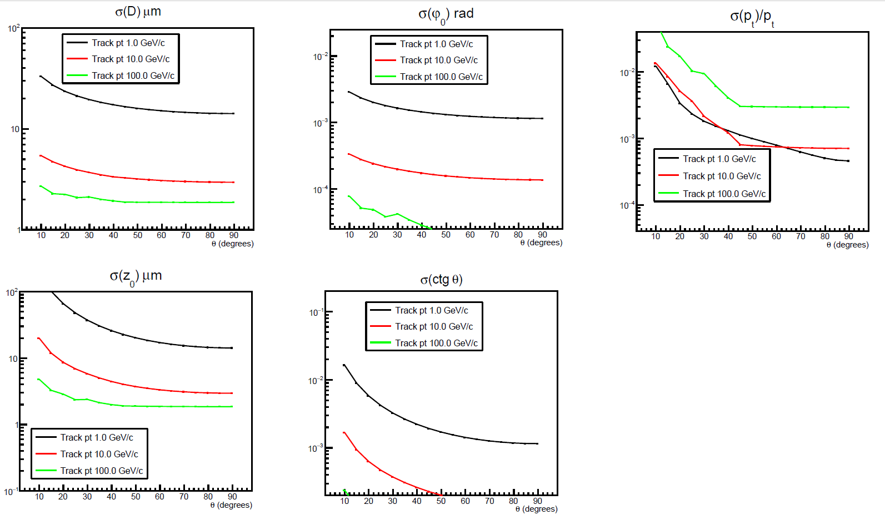
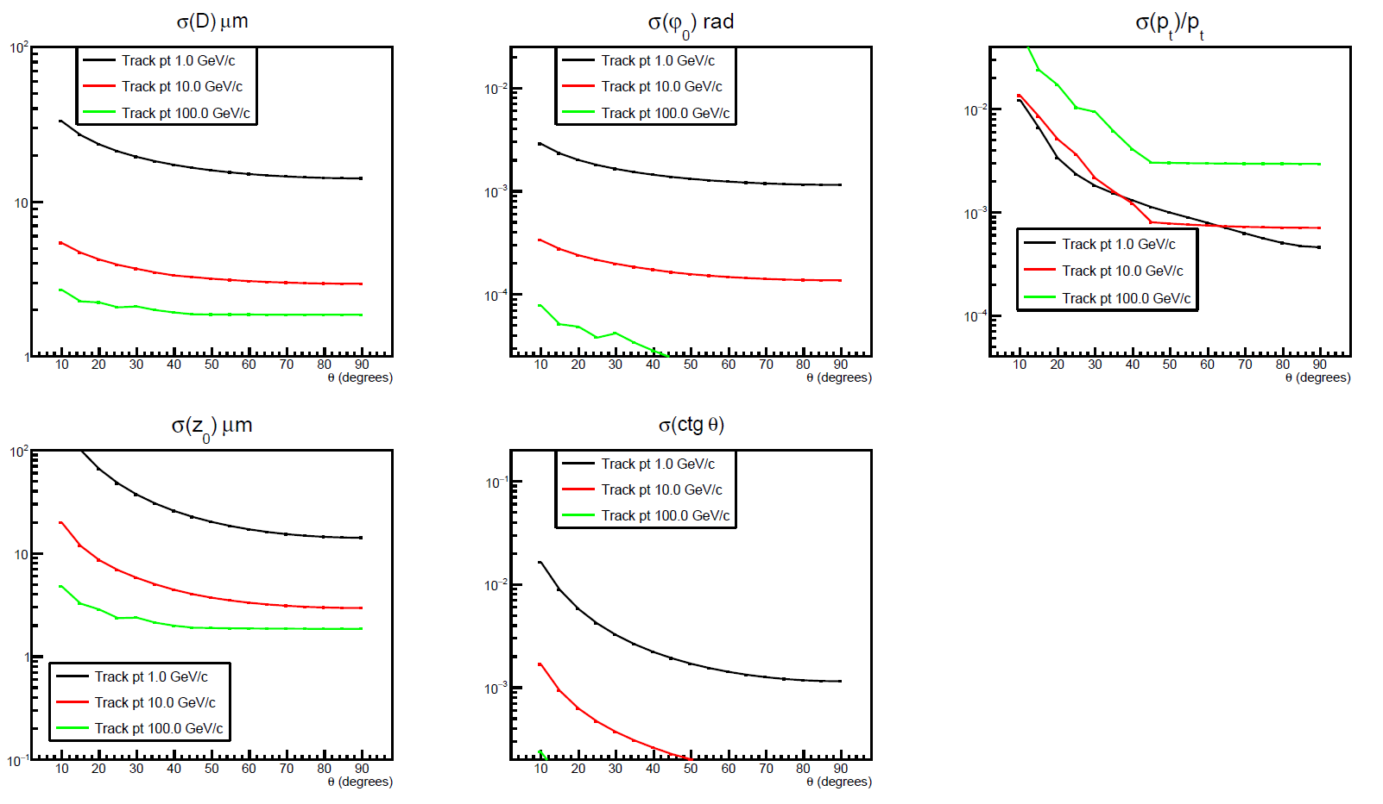
Verification: angle scans
Standard Method
Kalman Method

Slide 10
Concluding
Few fixes
  Minor fixes for special cases not used in DELPHES
  Fixed error on second order correction to MS angle
Updated geometry to match full sim
Links to github:
  Official DELPHES: https://github.com/delphes/delphes
  My fork: https://github.com/fbedesch/delphes
  Standalone: https://github.com/fbedesch/Kalman-tracking
Latest version now included in official DELPHES

