Slide 1
FCC-ee Solenoid Compensation
Special Zoom MDI Meeting
October 23, 2025
Brett Parker, BNL

Slide 2
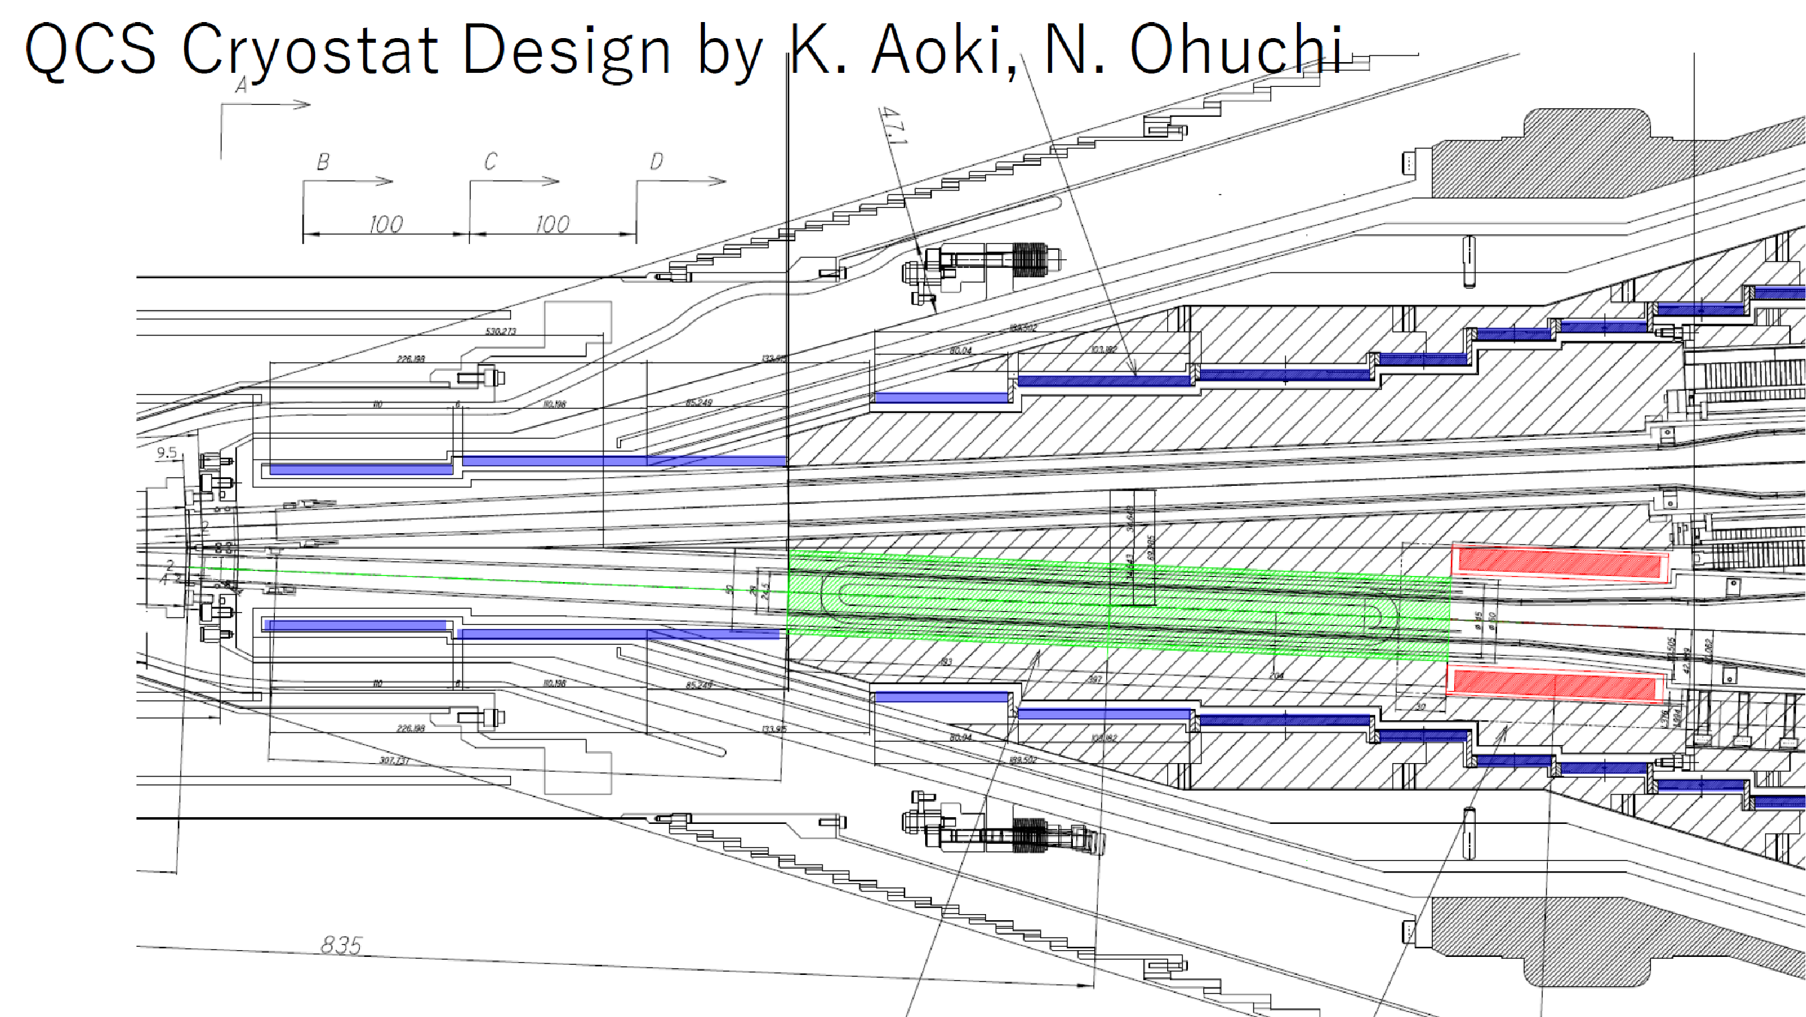
SuperKEKB Cryostat with Anti-Solenoid
I looked to highlight the anti-solenoid coils in blue (B. Parker)

Slide 3
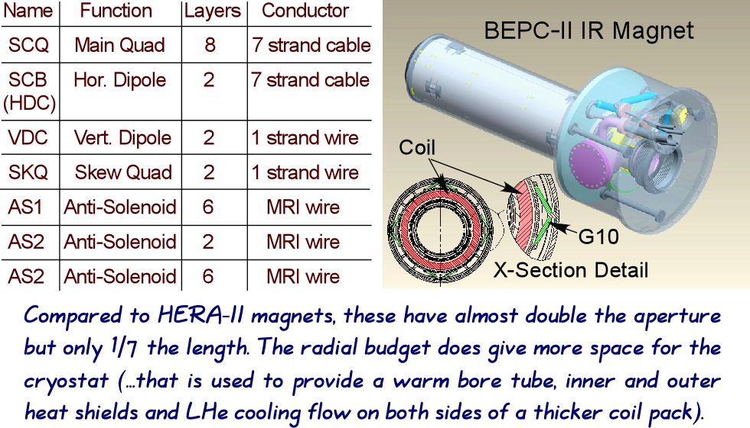
The BEPC-II IR Magnet Design
28 Different Coil Layer Windings

Slide 4
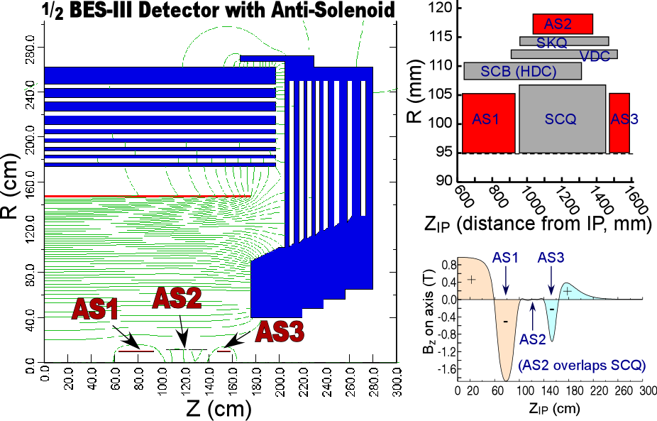
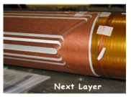
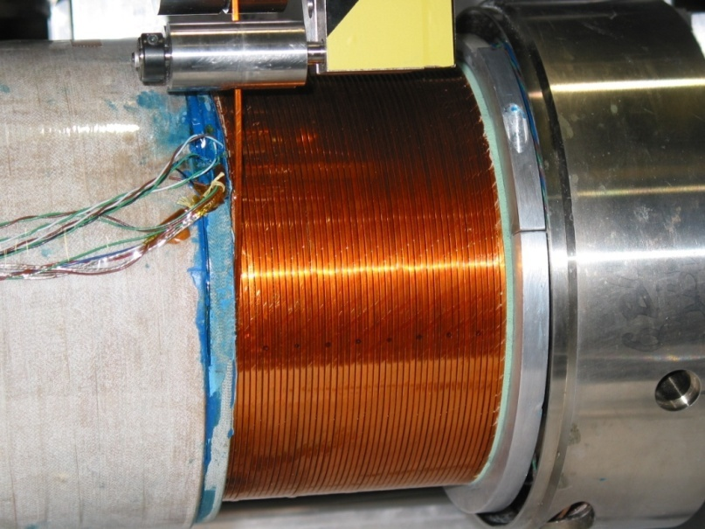
BEPC-II Special Feature: Local BES-III
Detector Solenoid Compensation Scheme
8 layers
Local Compensation
BEPC-II anti-solenoid profile was adjusted via its turn spacing.

Slide 5
FCC-ee Anti-Solenoid Question
Is it worthwhile to tailor the turn spacing in the compensation solenoid, i.e. to spread out the transition from full detector field to fully compensated field, to reduce the impact on emittance?
If so, what overall criteria that should be adopted?

