Slide 1
MDI IR Magnet System Suggested Near-Term Goals for Fall 2025
John Seeman
SLAC National Accelerator Laboratory
October 23, 2025

Slide 2
JS: MDI Fall 2025 Timeline:
FCC-ee lattice down select review at CERN: January 21-23, 2026.
Each lattice proponent needs to produce a document (~<100 pages) with pros and cons by the end of the calendar year 2025.
Our goal: Near-term input should be completed by, say, the first week of December.
MDI contributors will need some time to iterate ideas and suggestions.
Thus, soon start putting together our ideas and parameters.
Should we meet more often?

Slide 3
Near-term MDI magnets tasks:
Understand new magnet locations and strengths (Q1s and Q2s) for both L* = 2.4 m lattices.
Magnet competition: With increased L*, magnet bores will increase with increasing beam size (increasing magnet size) but overall needed strengths will go down as the focal length increases (decreasing magnet size). [Probably same strength but with larger bores.]
First agreement on beam stay-clears and magnet bores.
First agreement on space between Q1C and Q2A.
First agreement on compensation and shielding solenoids.
First agreement on magnet correction windings (numbers and strengths).
Look for overall problems.

Slide 4
Backup Slides
Thank you

Slide 5
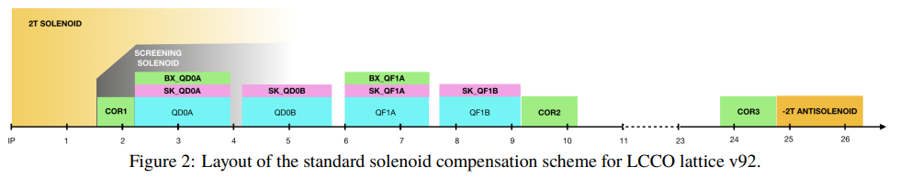
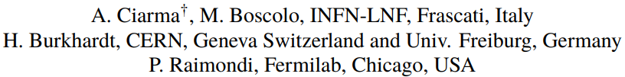
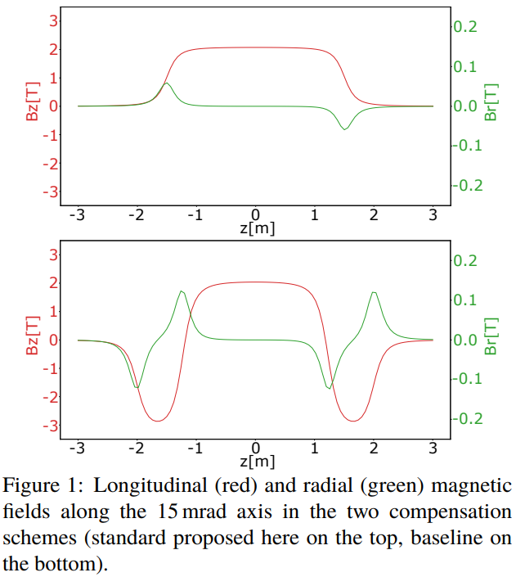
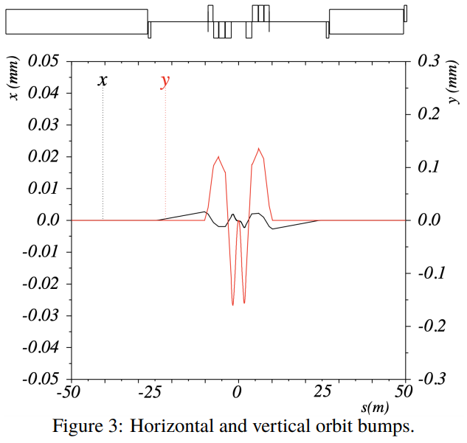
Alternative IR Solenoid Compensation Scheme

Slide 6
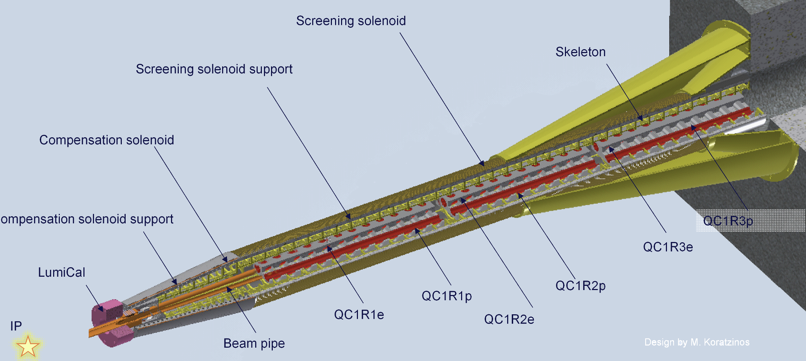
Nominal FCCee magnet raft and cryostat
(M. Koratzinos, …)

Slide 7
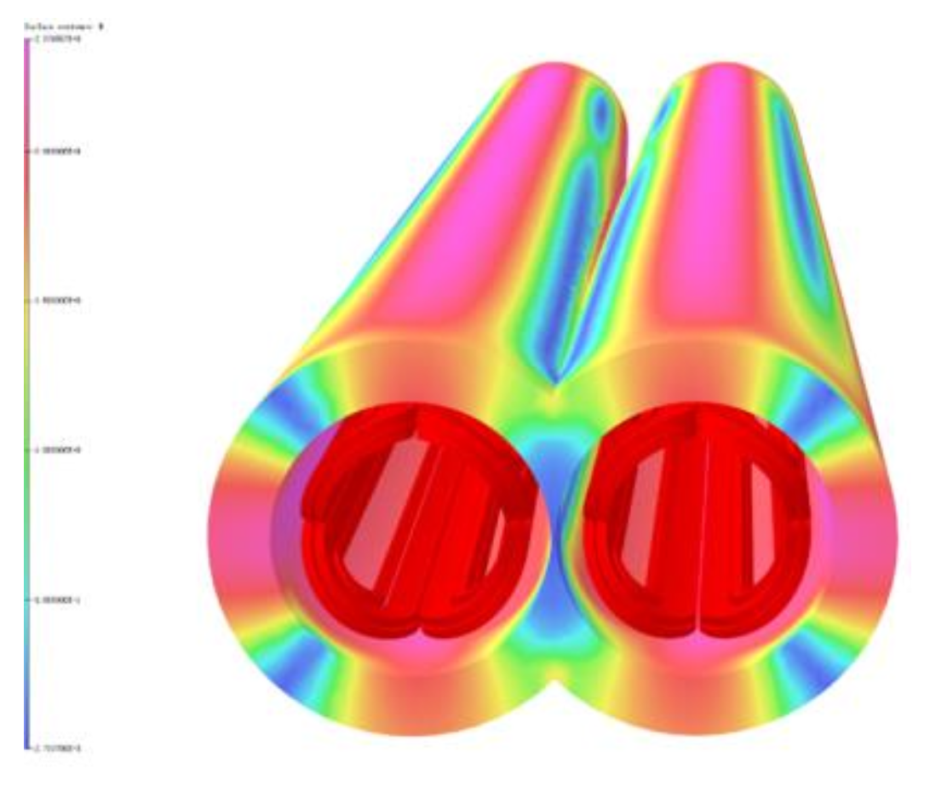
CEPC: Iron shields around QC1a for cross-beam field reduction
CCT magnets
can be built with
with compensation.
Needs verification.
Beam apertures

Slide 8
FCCee IR Cryostat (preferred option):
IR QC1 and QC2 in different cryostats but one integrated raft (not to scale)
Need to make space for cryogens, leads, and cantilever supports.
QC1-1
QC1-2
QC1-3
QC2-1
QC2-2
2.2 m to IP
3.36 m
~1.5 m
2.58 m

Slide 9
Second option: IR QC1 and QC2 in one cryostat and raft (not to scale).
CEPC has adopted this option (Dec 2023).
Cryo
QC1-1
QC1-2
QC1-3
QC2-1
QC2-2
← IP 2.2 m
Support
6.24 m
2 m

Slide 10
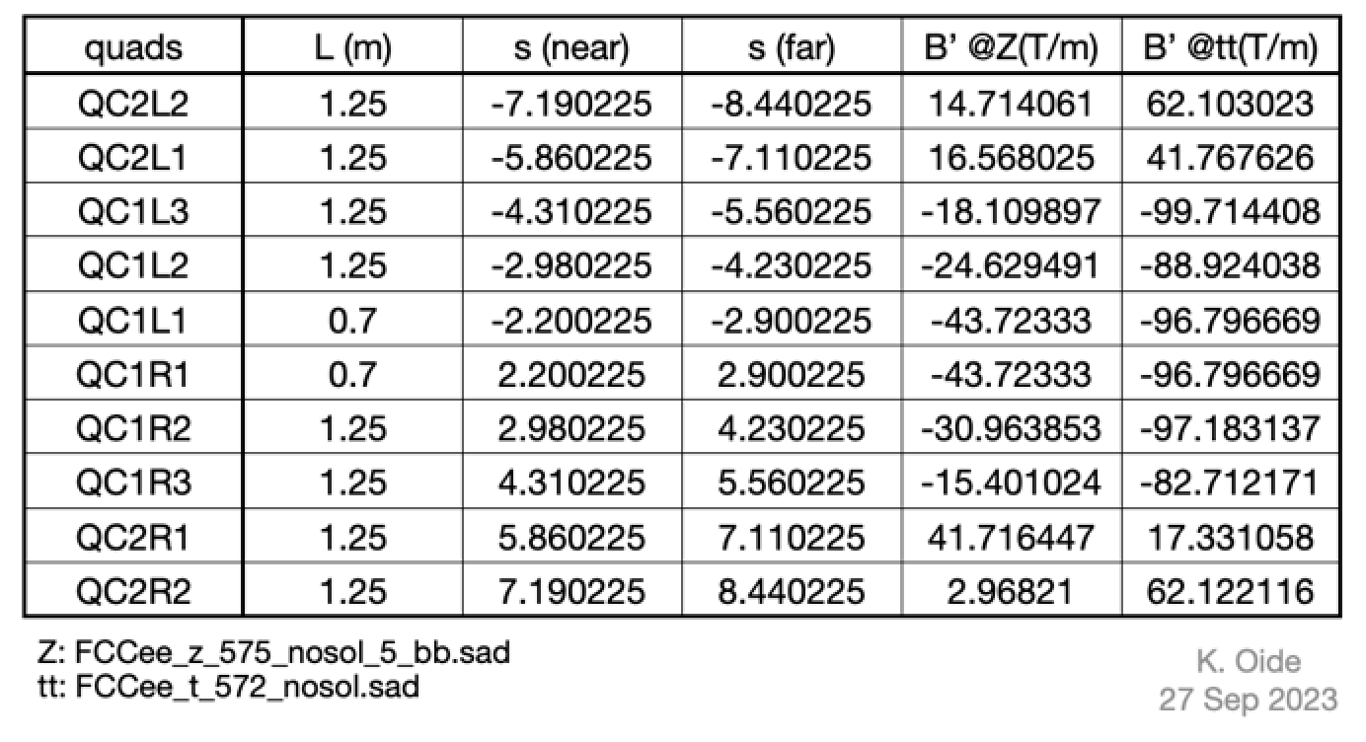
FCCee IR magnet longitudinal locations, lengths, and strengths (K. Oide)
Present separation of QC1 to QC2 is 30 cm.
New Raimondi lattice has separation at 1.5 m.
K. Oide is available to discussion any needed changes. P. Raimondi’s lattice
has more space from QC1 to QC2.

Slide 11
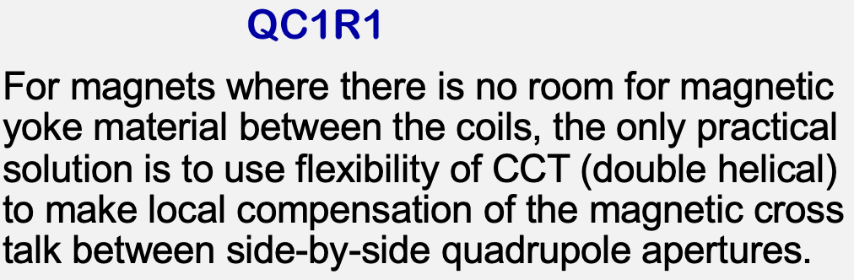
IR Magnet Cross Section View (front and end of each magnet) Showing separated heat shield and vacuum vessel.
Beam centroids
Cryostat vacuum walls
Magnet coils
.
Cryostat outer
support
Cryostat He walls
And heat shield walls
Beam vacuum walls
J. Seeman November 2023

Slide 12
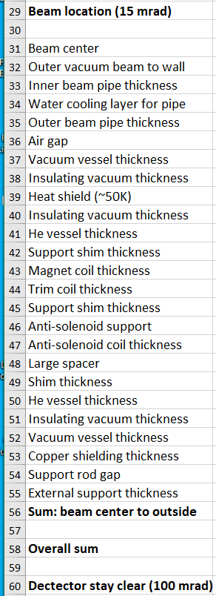
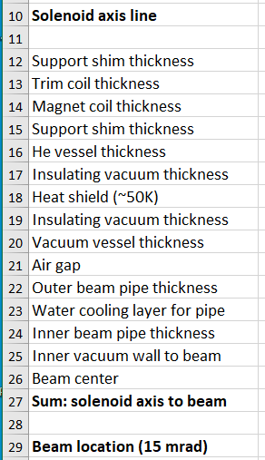
IR cryostat component dimensions

Slide 13
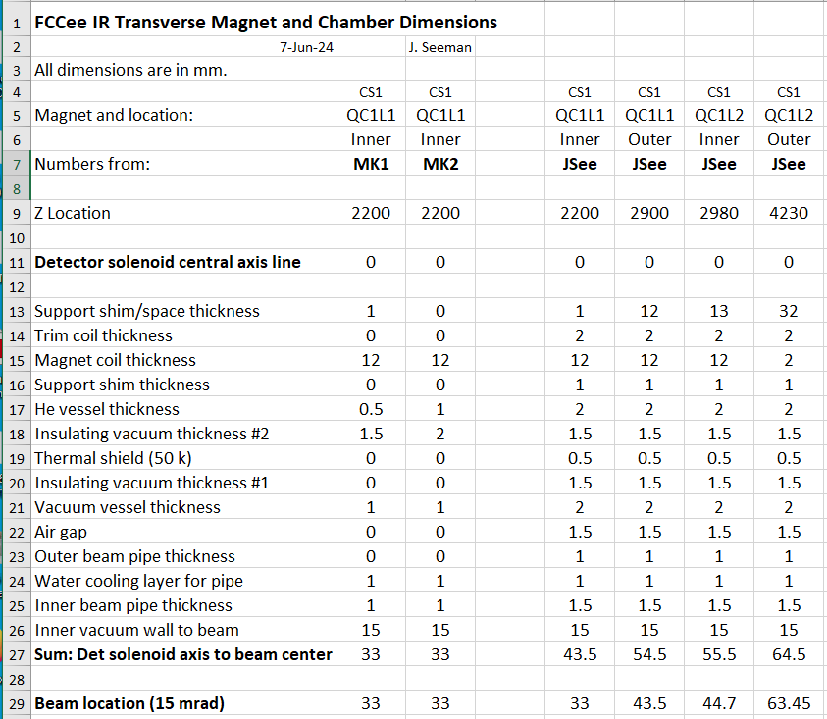
Radial distances from Detector Solenoid axis to Beam axis for QC1A/B

Slide 14
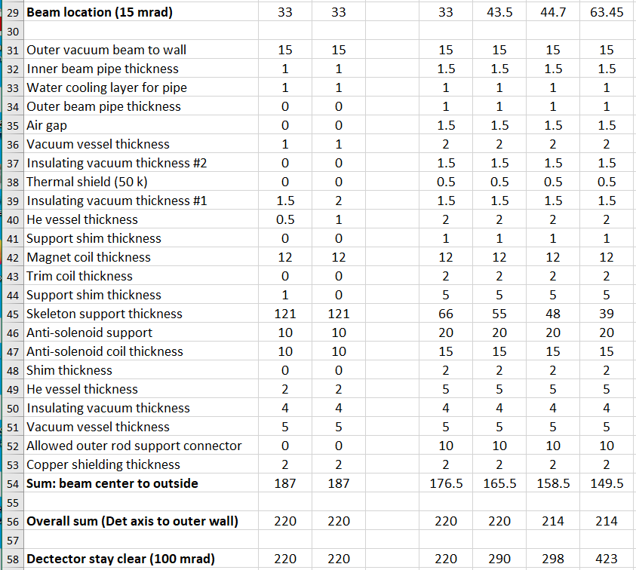
Radial distances from beam location to outer cryostat wall at QC1A/B

Slide 15
Suggested focus topics for FCCee MDI and IR magnets for 2024-2025
Add inner background shielding: W, Ta, or Cu inside magnets in cryostat (Δr?)
Resolve new IR lattice vs present: QC1,QC2 placement and anti-solenoids
Make initial cryostat design (4 or 7 m) by cryogenic/mechanical engineer(s)
Answer if IR magnets need higher-order trim coils
Confirm 100 mrad detector-accelerator cone angle
IR BPMs and other diagnostics
Full list of magnet, vacuum, and cryogenic specifications
Converge on background mask geometry
Make initial layout of magnet/cryogenic splice box
Construct a left and right CCT magnet pair for QC1 and test
Carry out warm test of CCT quadrupole for reduced left-right field cross-talk
Design remote vacuum flanges (need 6 flanges with 2 designs)
Radial differential movements during cool down

