Slide 1




PICOSEC Micromegas gaseous detectors
for precise timing and developments
towards applicable detector
Francesco Guerra
Supervisors: M. Lisowska, F. Brunbauer & E. Oliveri
October 17th, 2025

Slide 2
Outline
  PICOSEC project
    Motivation
    Detector concept
    Developments towards applicable detector
  Single photoelectron measurements
    Detector assembling and testing
    General waveform analysis
    Code improvements
  Measurements with particle beam
    DRD1 test beam
    Signal analysis
    Robust photocathodes
    Large area prototype
  Summary & Conclusions
Francesco Guerra | 26 August 2025

Slide 3
PICOSEC project
Francesco Guerra | 26 August 2025

Slide 4
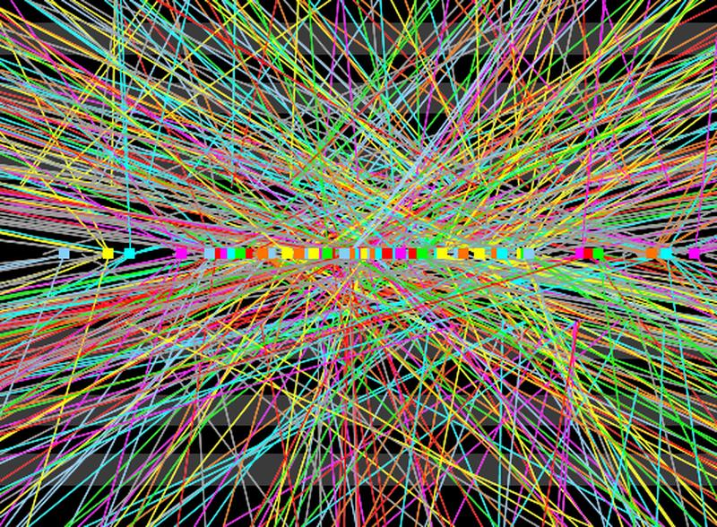
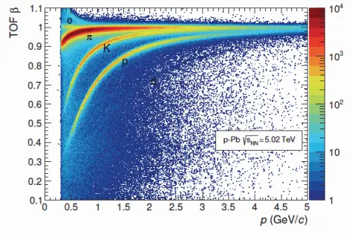
Motivation
  Future high energy physics experiments will go for higher luminosity and precision measurements
  → Highly precise timing detectors are required
Mitigation of pile-up
Precise ToF measurements
Gaseous detectors: cost effective, large area coverage, high rate resistance
Francesco Guerra | 26 August 2025

Slide 5
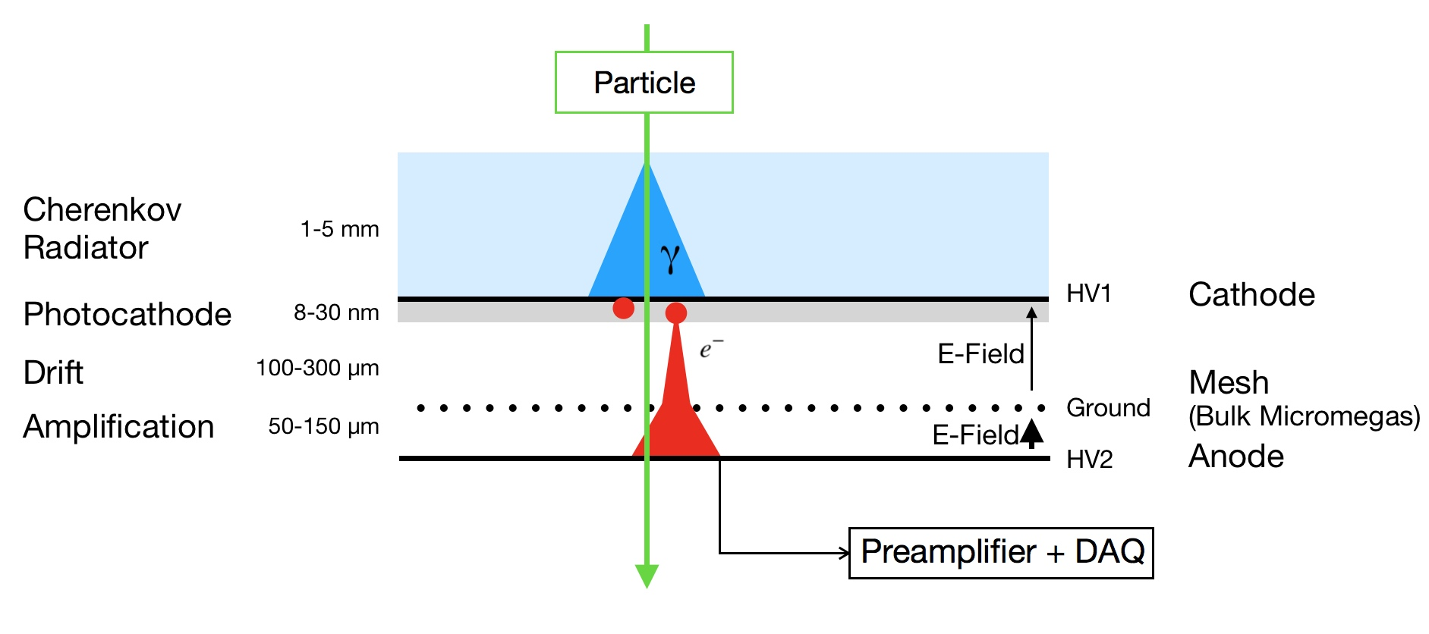
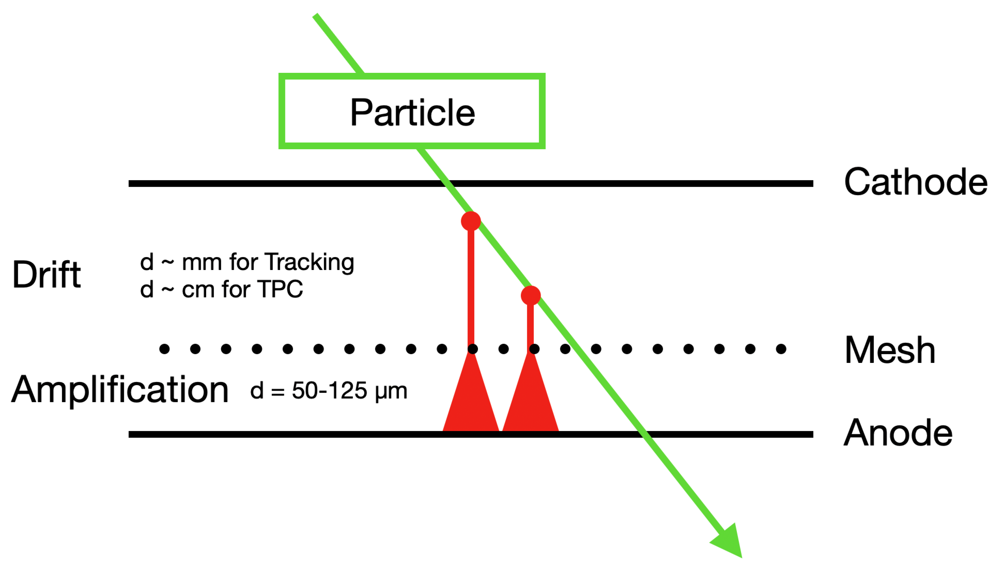
Detector concept
Standard Micromegas
PICOSEC Micromegas
Stochastic nature of ionization
→ Time jitter of a few ns
Photoelectrons produced synchronous in space and time
Early pre-amplification
σ_{t} ≈ 1.5 ns
σ_{t} ≈ O(10) ps
  J. Bortfeldt et al., NIM A 903 (2018) 317
  I. Giomataris et al., NIM A 376 (1996) 29-35
Francesco Guerra | 26 August 2025

Slide 6
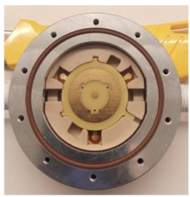
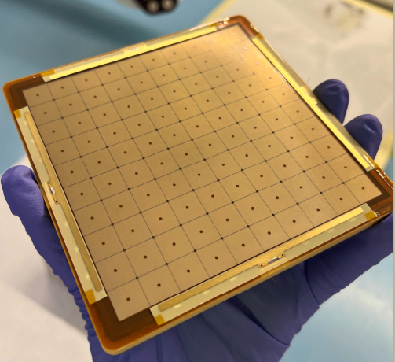
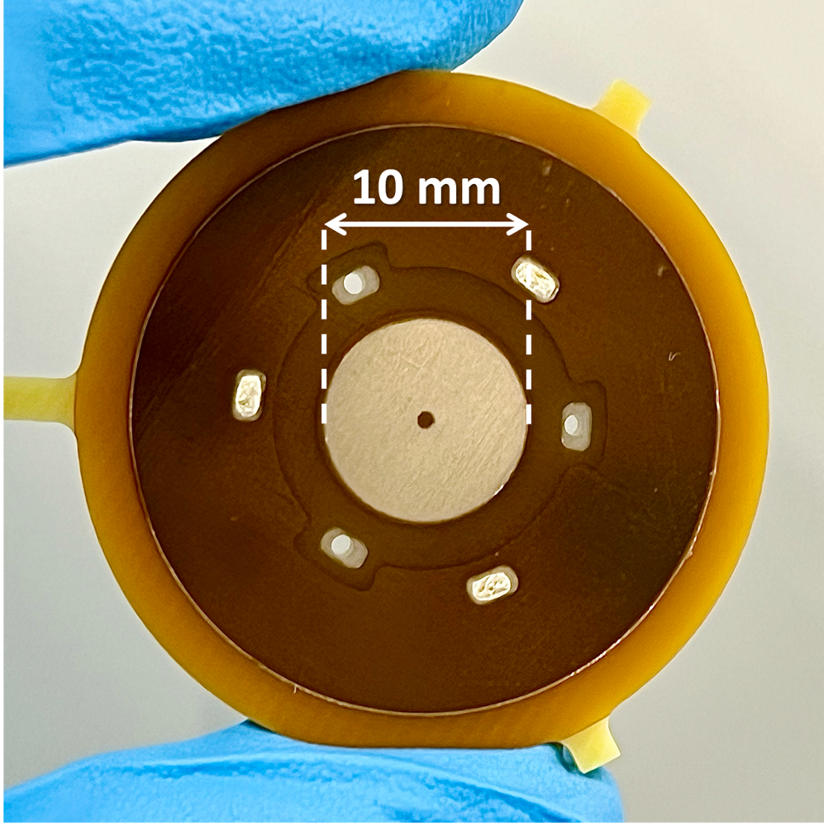
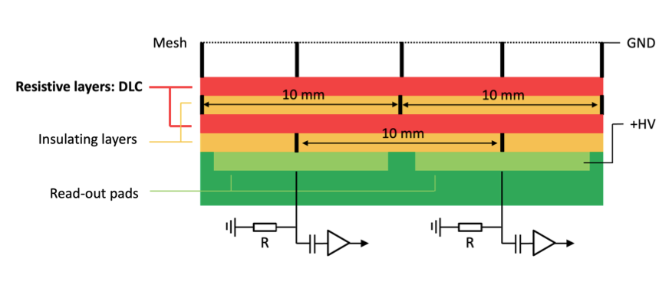
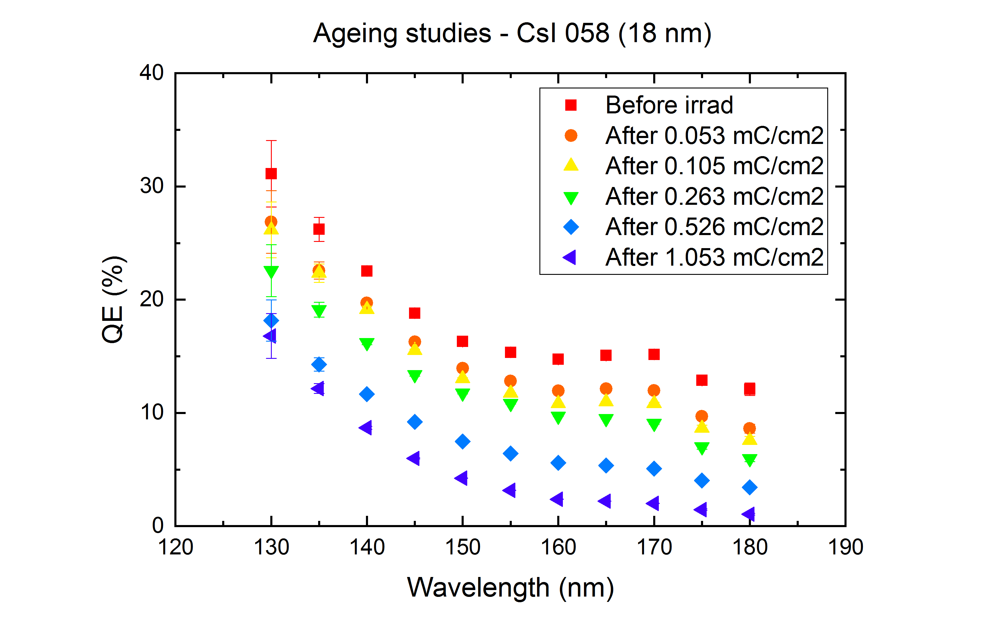
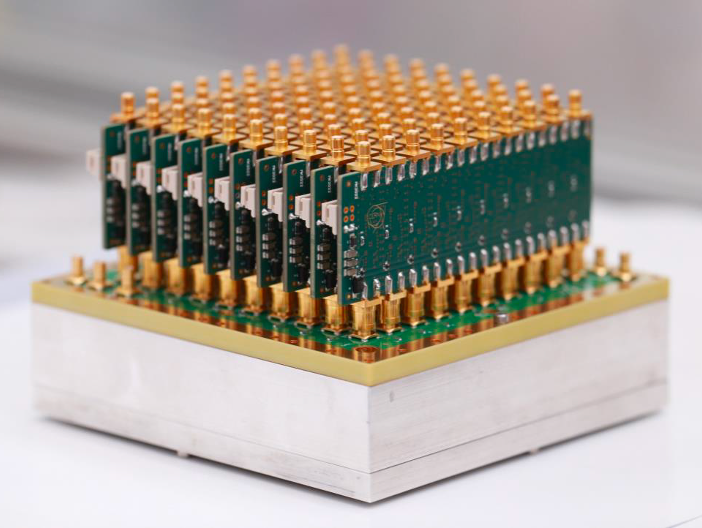
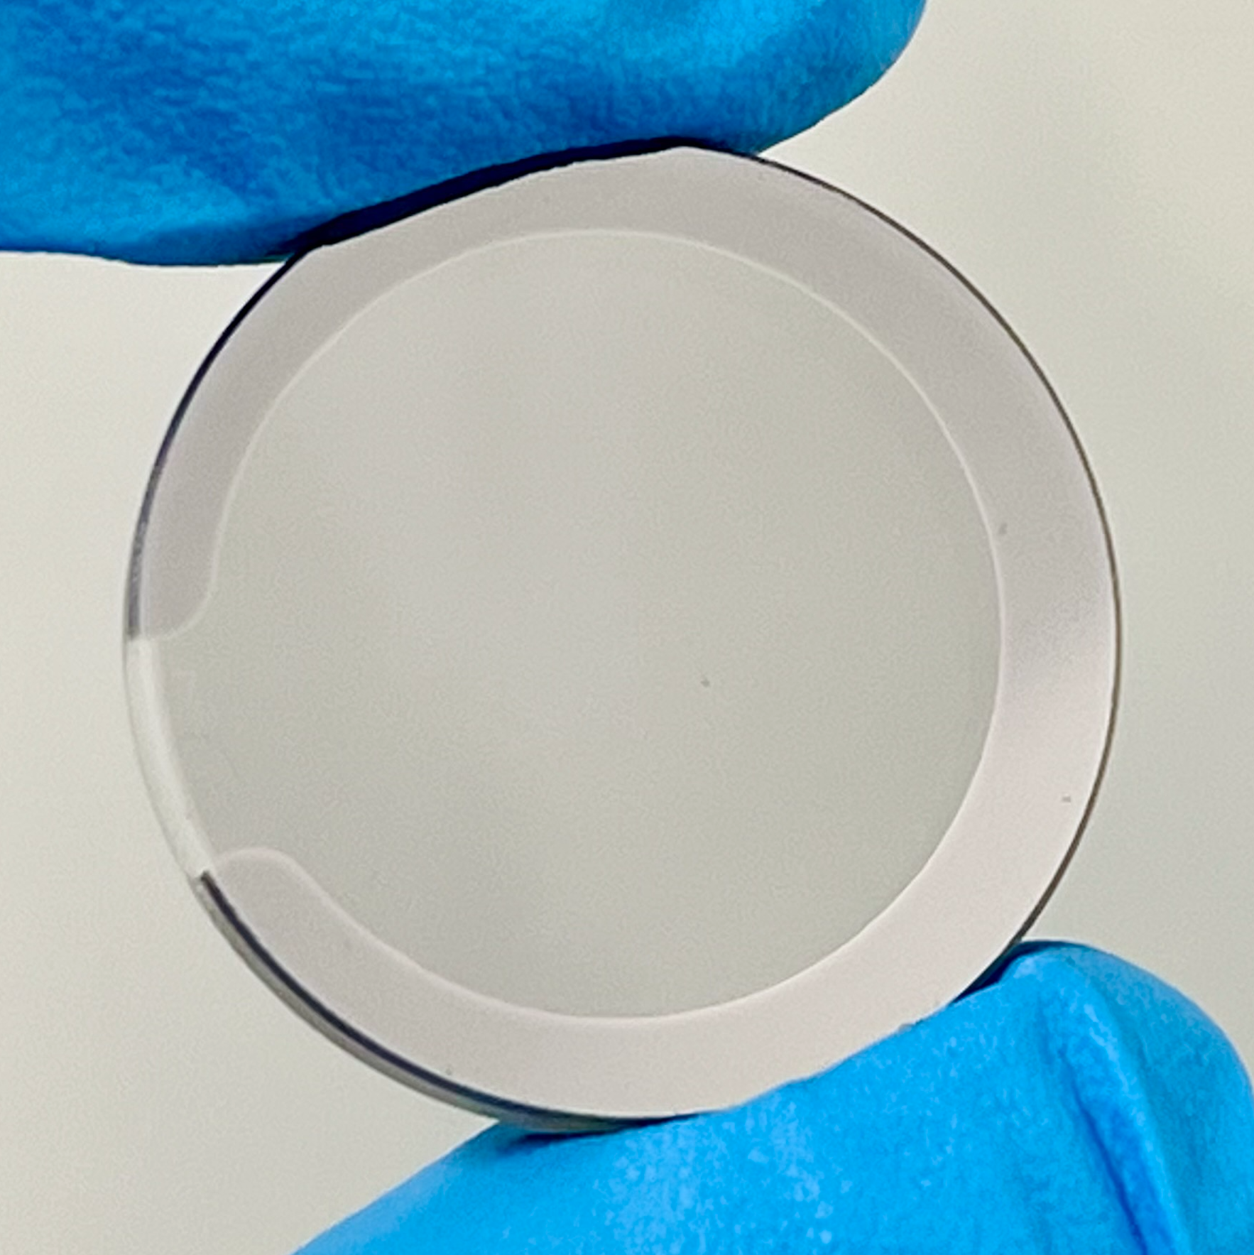
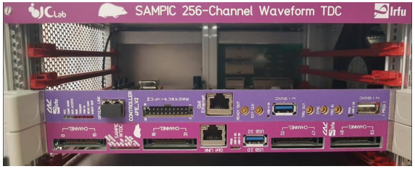
Developments towards applicable detector
Single channel prototypes
Large area prototypes
10 cm
10 cm
Robust photocathodes
Scalable electronics
Ageing studies - CsI
DLC
Ti
B₄C
1 inch
QE
  A. Utrobičić et al., JINST 18 (2023) C07012
  M. Lisowska, PhD dissertation
Francesco Guerra | 26 August 2025

Slide 7
Single photoelectron measurements
Francesco Guerra | 26 August 2025

Slide 8
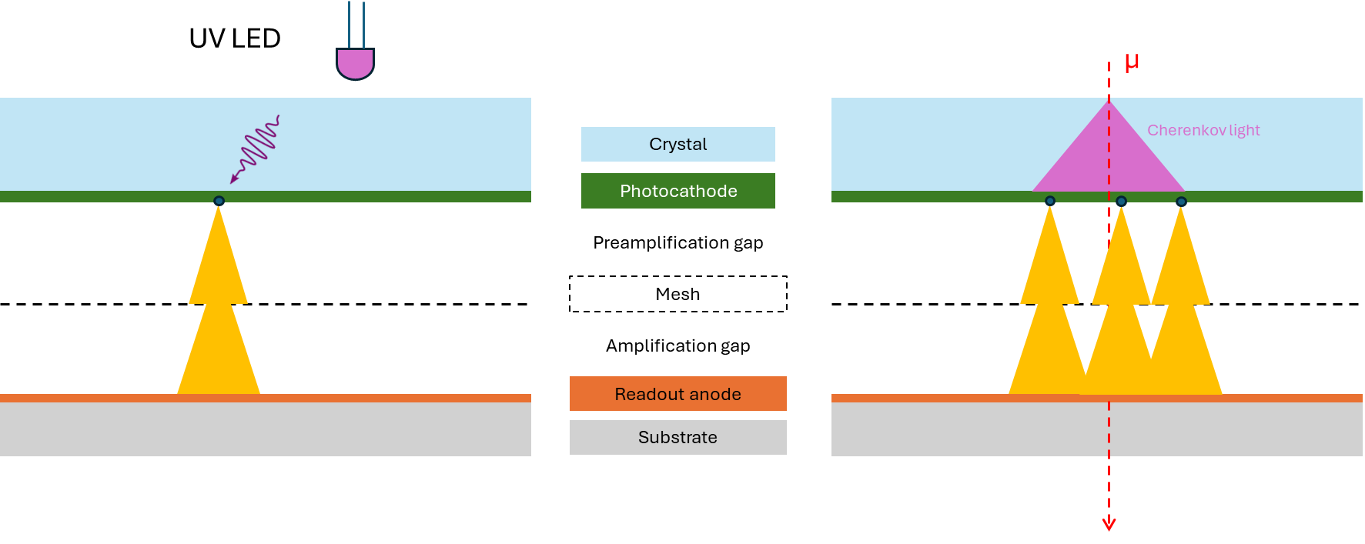
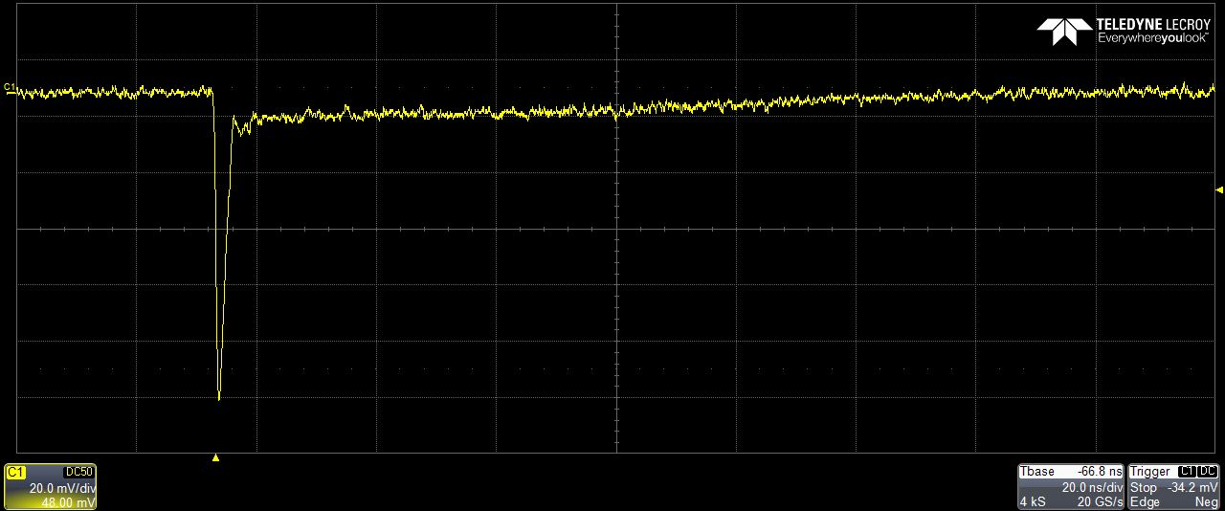
Single photoelectron measurements
Characterise the detector
Extract the average n. of PE produced per particle
HV
Scope
UV LED
DUT
Amplifier
Ion tail
LV
Electron peak
Francesco Guerra | 26 August 2025

Slide 9
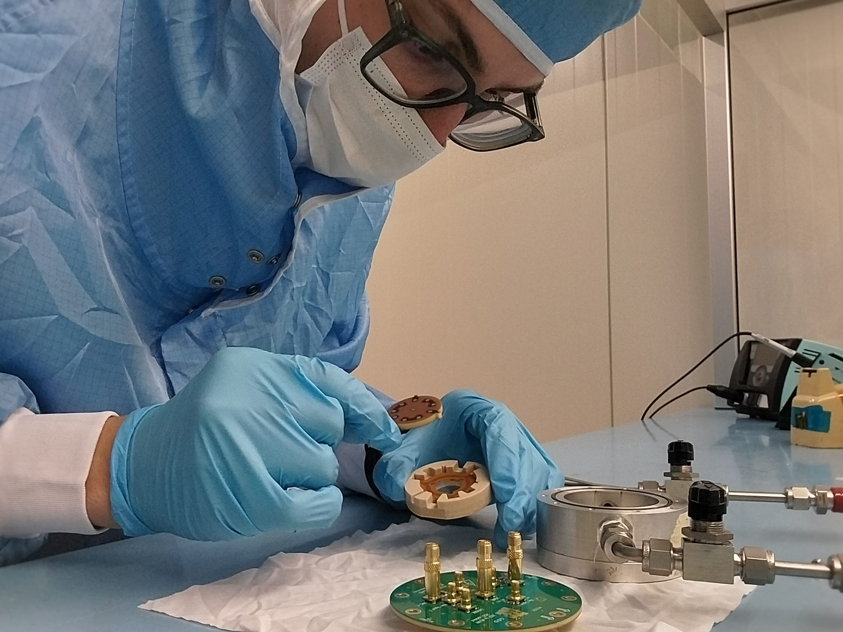

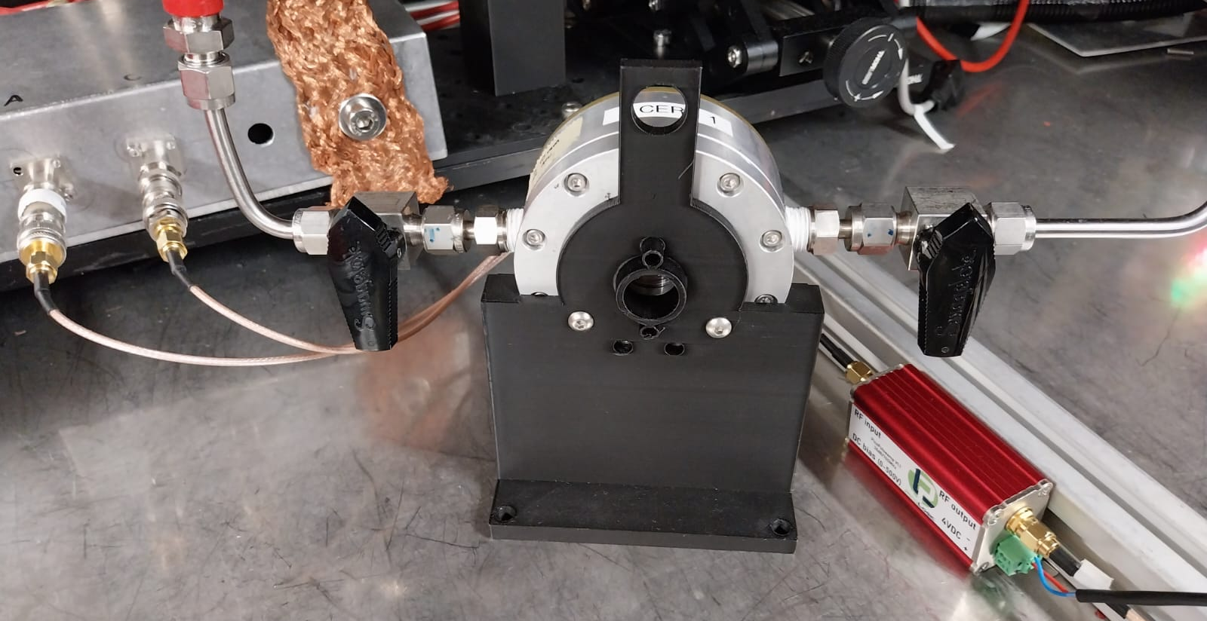
Detector assembling and testing
Outer board
MM board
Spacer
Radiator with photocathode
PEEK insert
Housing
Quartz window
Flange
  M.L.V. Fernandez, Summer student presentation
Francesco Guerra | 26 August 2025

Slide 10
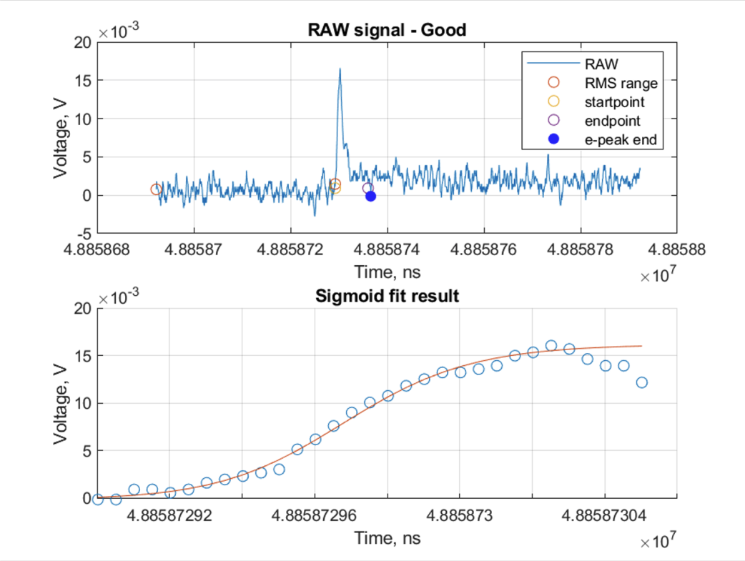
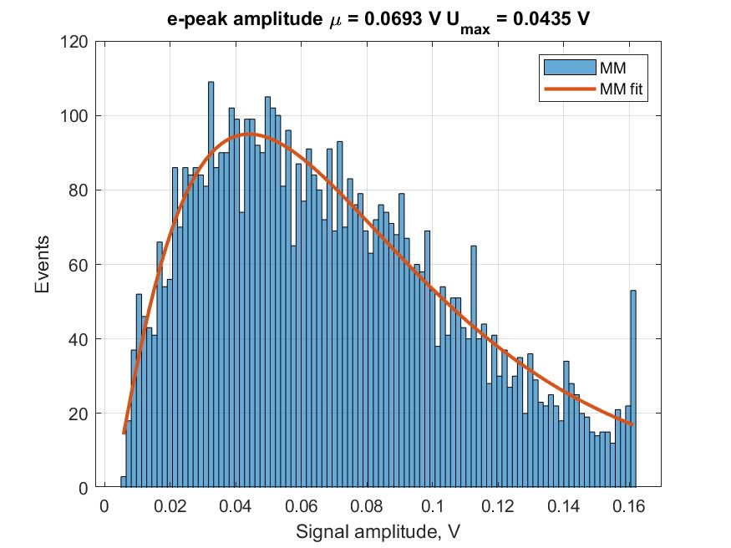
General waveform analysis
Pre-trigger region
Peak amplitude
Polya distribution fit
Francesco Guerra | 26 August 2025

Slide 11
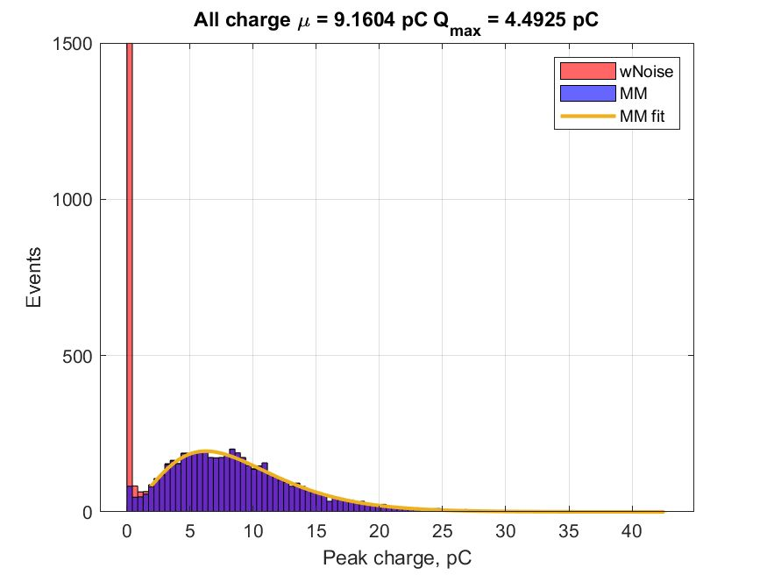
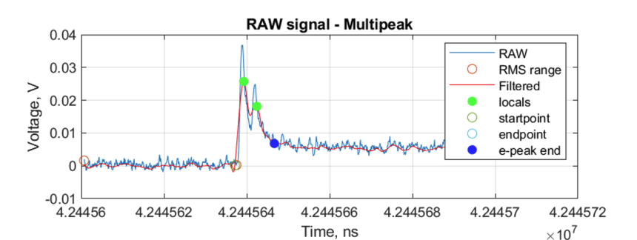
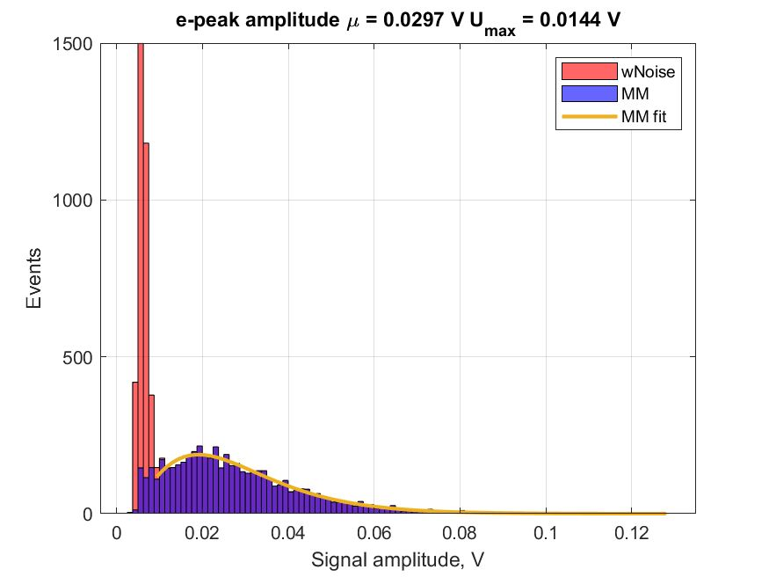
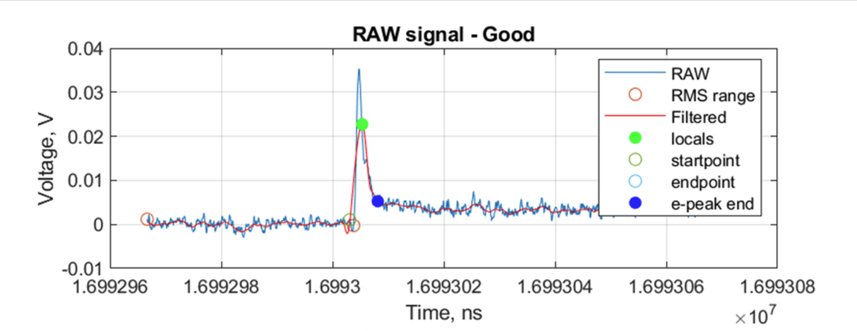
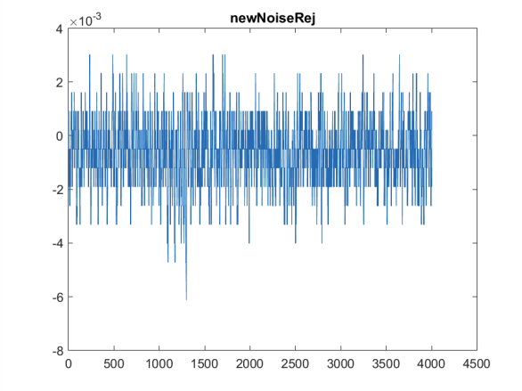
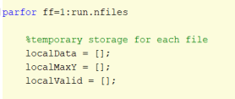
Code improvements
Multi-peak recognition
Filtered analysis
Integrating over the entire waveform
Better noise rejection
Extracting easily general waveform properties (e.g. ion-tail end)
Code parallelization
57 min per run → 11 min per run
Francesco Guerra | 26 August 2025

Slide 12
Measurements with particle beam
Francesco Guerra | 26 August 2025

Slide 13
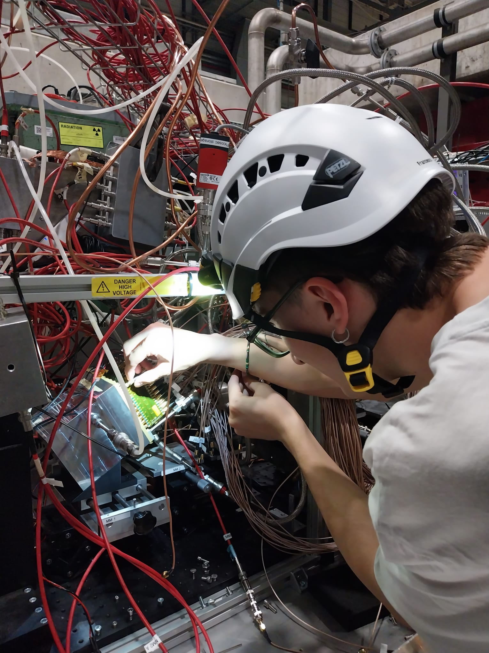
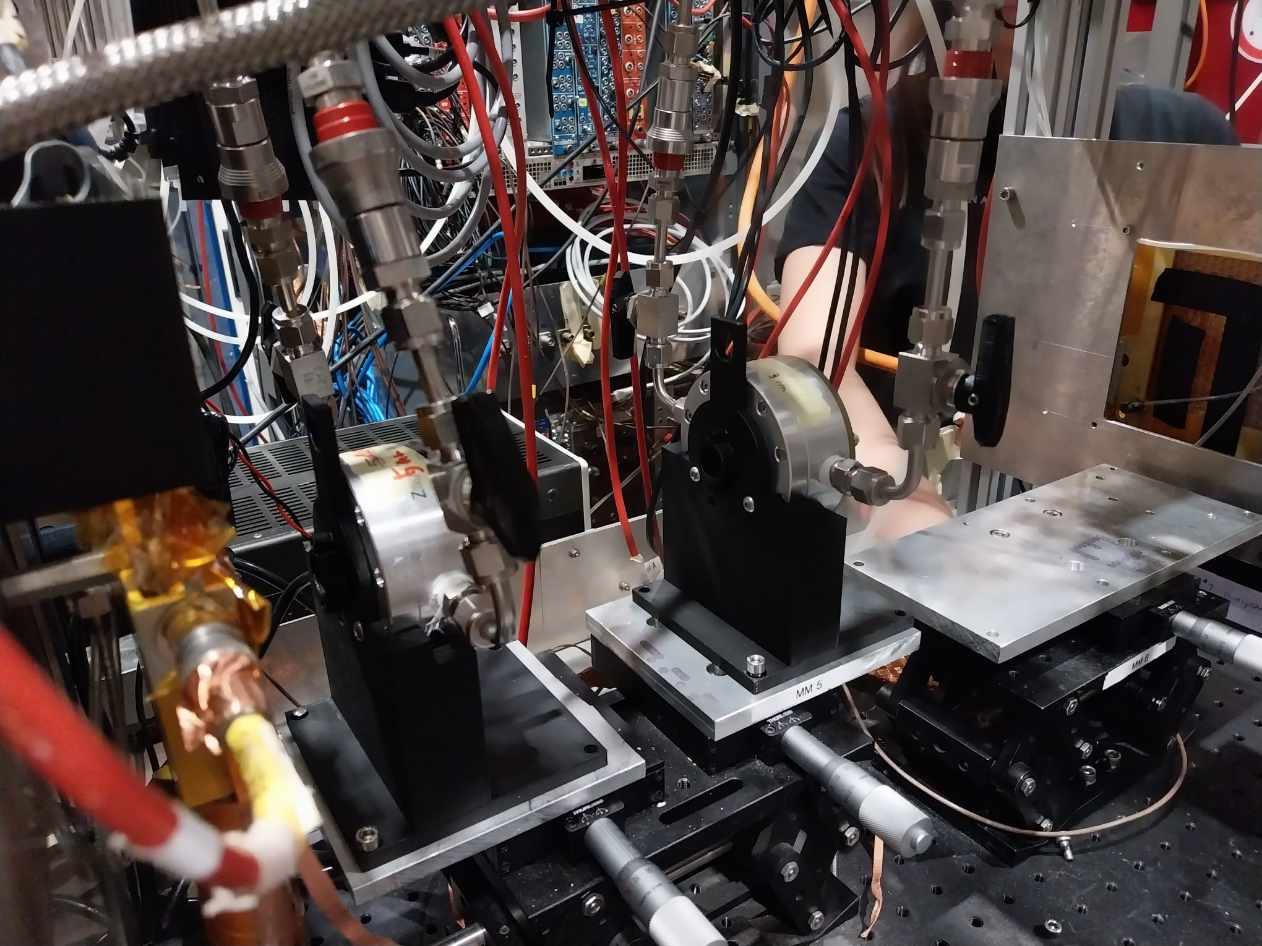
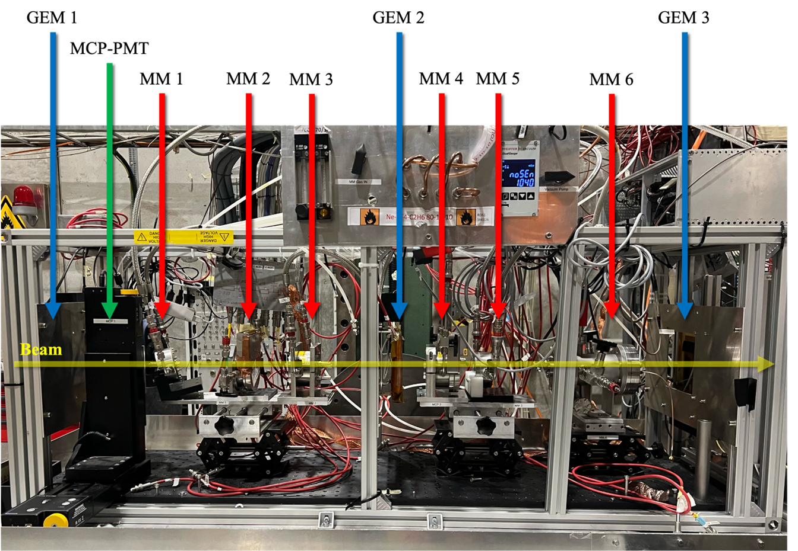
DRD1 test beam
Particle beam @ CERN SPS H4 beamline
We have tested:
Single-channel prototypes
  Different resistivities
  Different photocathodes
Parallel plate prototypes
Different gas mixtures
PICOSEC as photon detector
Multi-channel prototypes
  Medium granularity
  100-channel double layer DLC MM
uRGroove PICOSEC (USTC)
PIMENT (Saclay)
Francesco Guerra | 26 August 2025

Slide 14
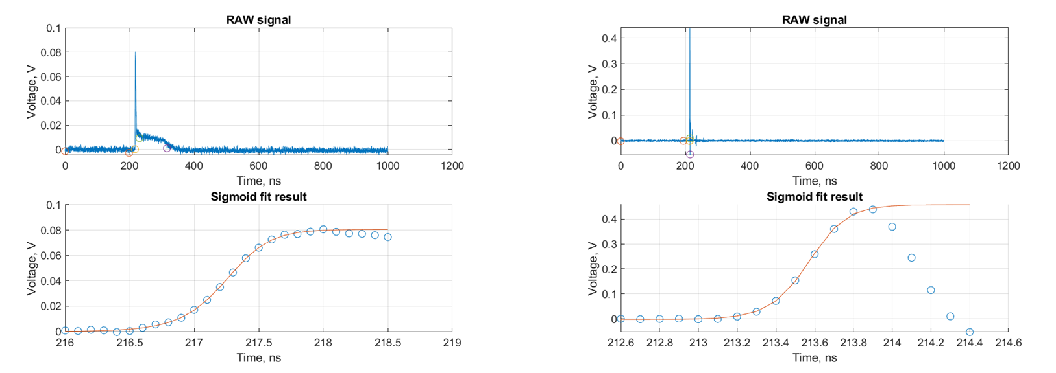
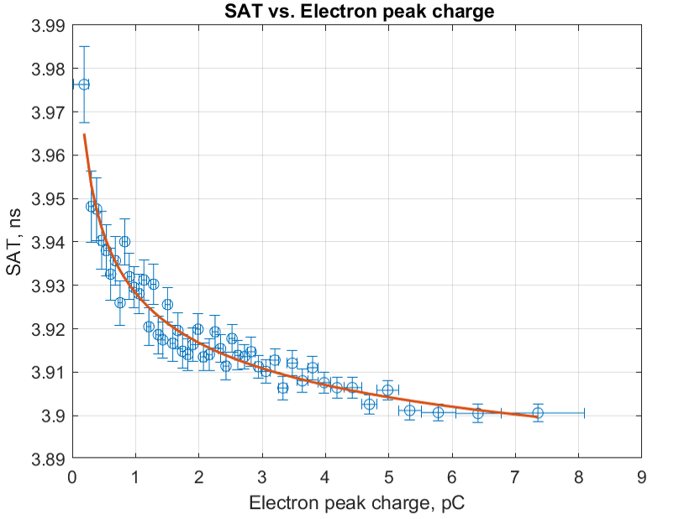
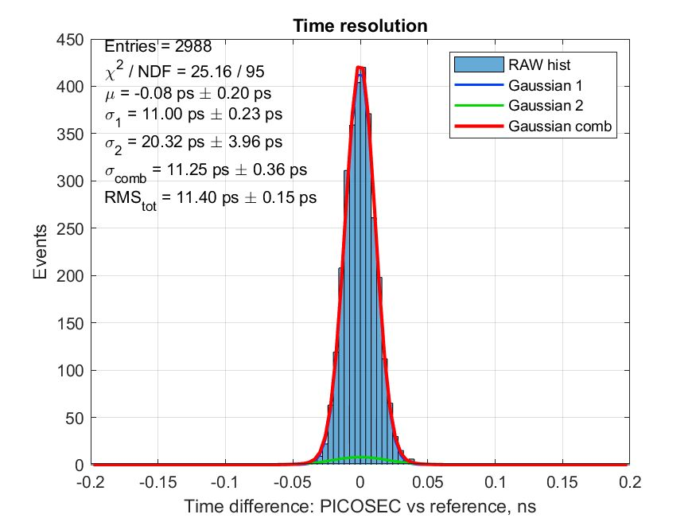
Signal analysis
REF
DUT
20%
20%
t_{REF}
t_{DUT}
Timewalk correction
Preliminary
CsI 3 nm
A: 275V
C: 440V
  A. Utrobičić et al., NIM A 1072 (2024) 170127
  M. Lisowska, PhD dissertation

Slide 15
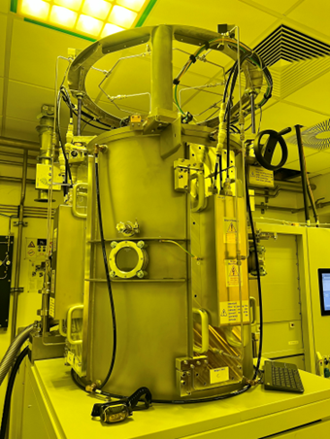
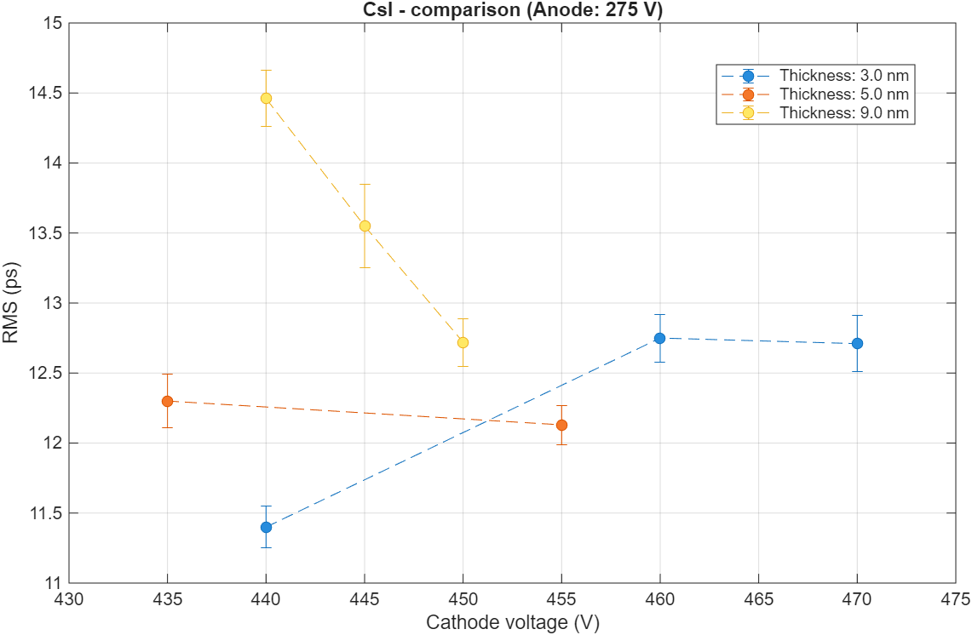
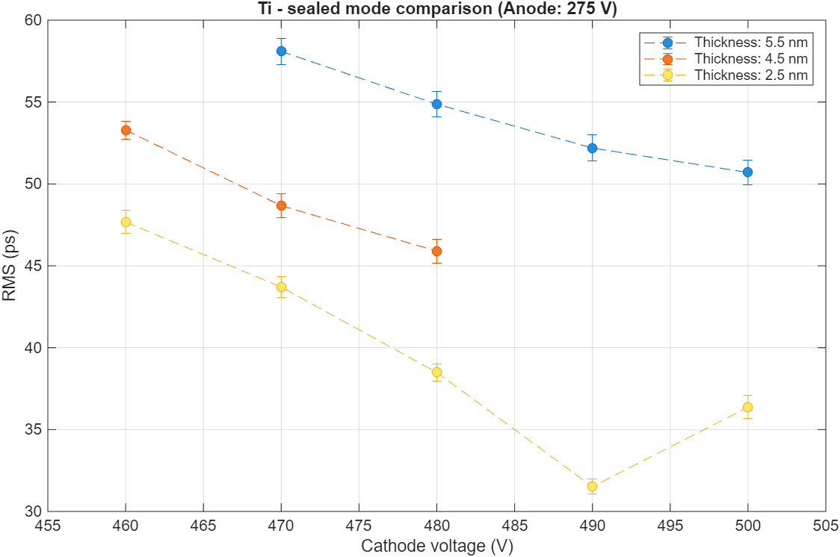
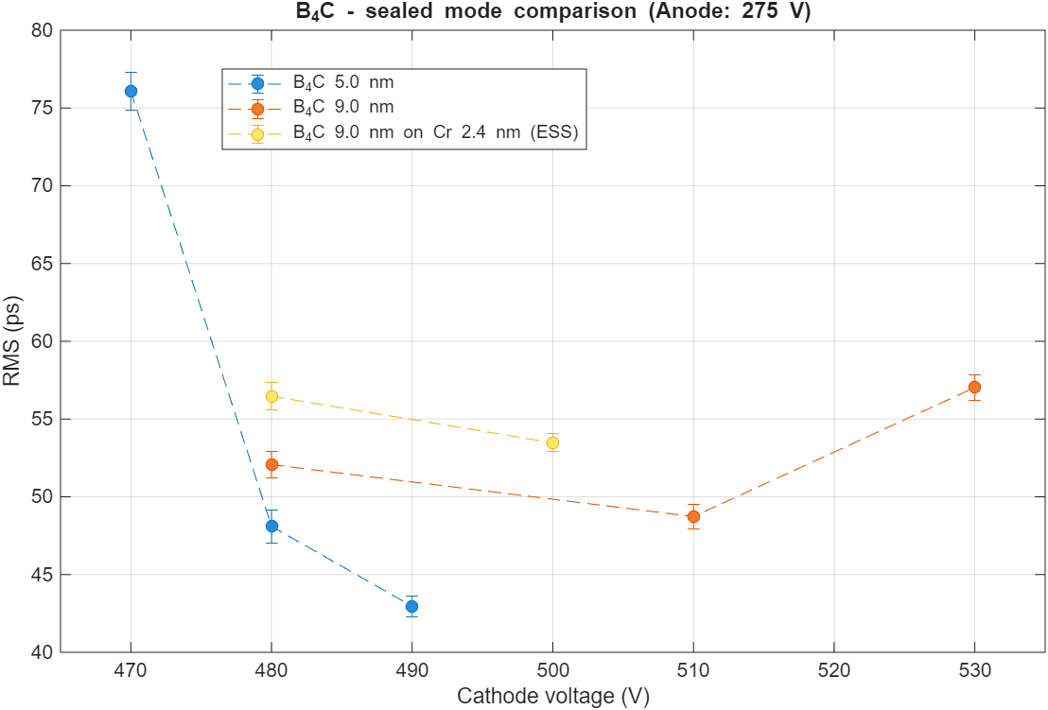
Robust photocathodes
Various thicknesses of CsI, Ti and B₄C were evaluated to identify the optimal choice for application.
Preliminary
Produced at the MPT workshop
Preliminary
Preliminary
The thinner, the better
Francesco Guerra | 26 August 2025

Slide 16

Large area prototype
Double layer DLC MM
10 | 9 | 8 | 7 | 6 | 5 | 4 | 3 | 2 | 1
20 | 19 | 18 | 17 | 16 | 15 | 14 | 13 | 12 | 11
30 | 29 | 28 | 27 | 26 | 25 | 24 | 23 | 22 | 21
40 | 39 | 38 | 37 | 36 | 35 | 34 | 33 | 32 | 31
50 | 49 | 48 | 47 | 46 | 45 | 44 | 43 | 42 | 41
60 | 59 | 58 | 57 | 56 | 55 | 54 | 53 | 52 | 51
70 | 69 | 68 | 67 | 66 | 65 | 64 | 63 | 62 | 61
80 | 79 | 78 | 77 | 76 | 75 | 74 | 73 | 72 | 71
90 | 89 | 88 | 87 | 86 | 85 | 84 | 83 | 82 | 81
100 | 99 | 98 | 97 | 96 | 95 | 94 | 93 | 92 | 91
Photocathode: Ti 2.4 nm
Voltages: -550/275 V
100 mm
Analysed configuration:
Amp.
24
23
Amp.
Scope
34
33
10 mm
Amp.
100 mm
Amp.
10 mm
Marta Lisowska & Francesco Guerra | 6 October 2025

Slide 17
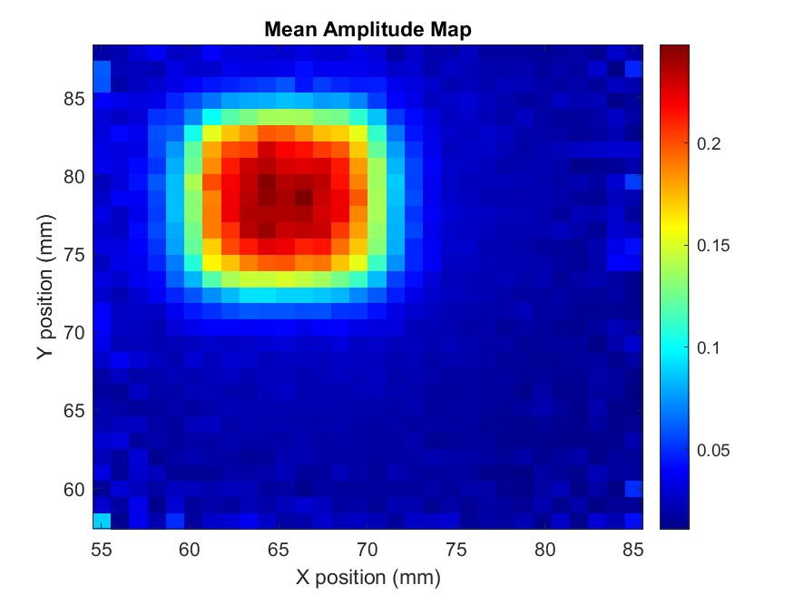
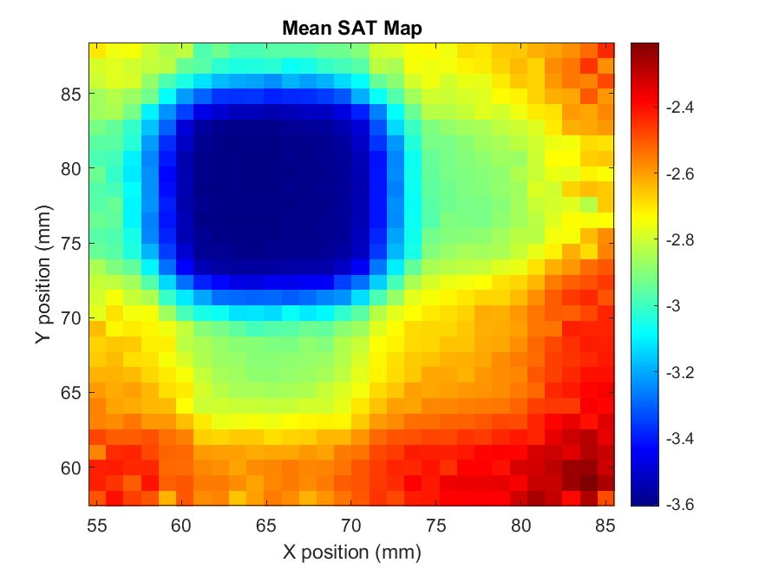
Large area prototype
First studying the pad one by one and then merging them together
24
23
24
23
34
33
34
33
Marta Lisowska & Francesco Guerra | 6 October 2025

Slide 18
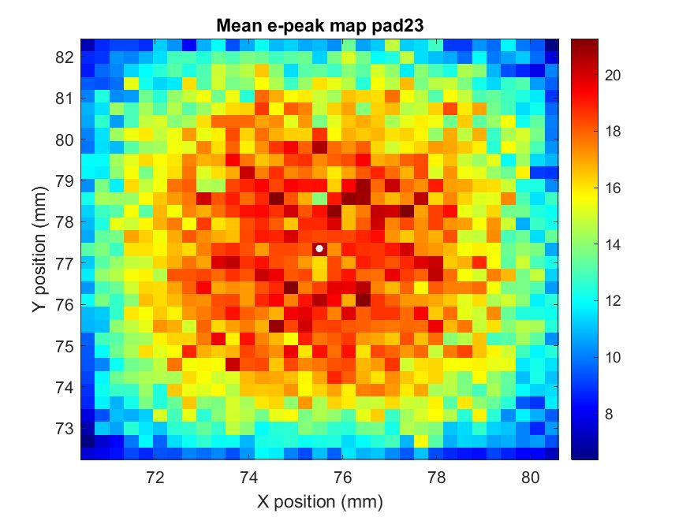
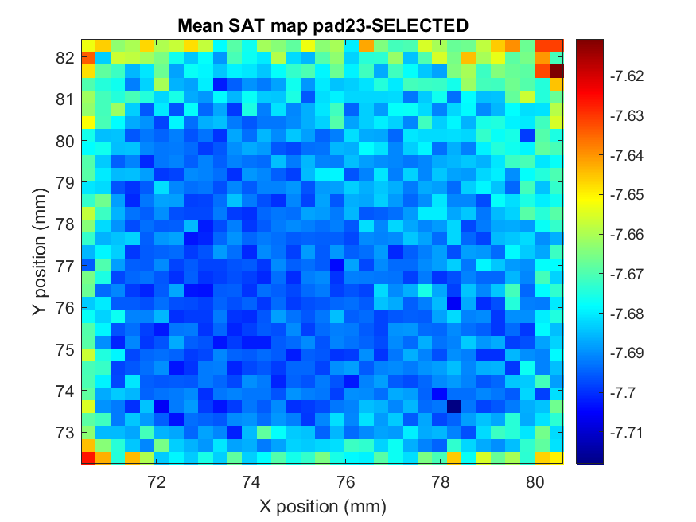
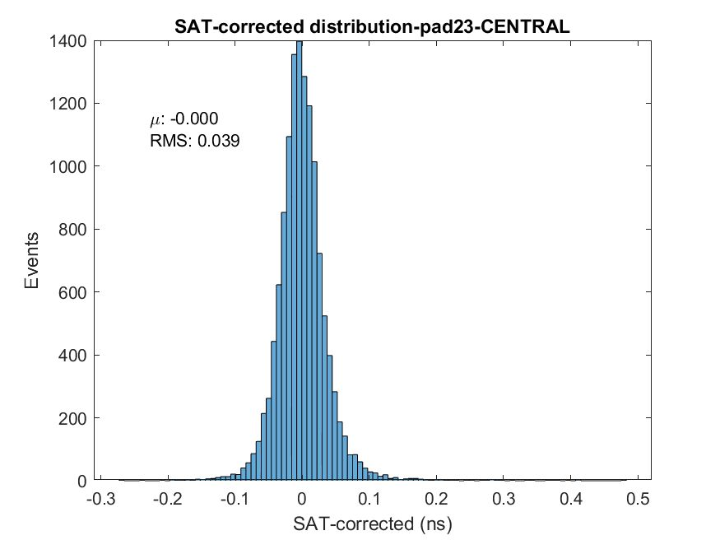
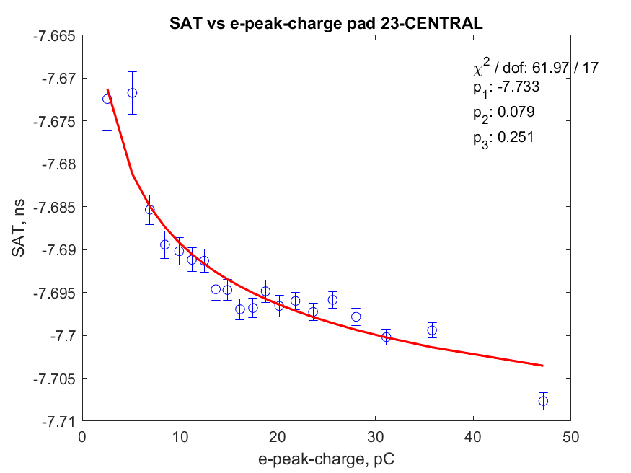

Single pad analysis
Pad center estimation from e-peak charge distribution
Timewalk correction for fully contained events
Time resolution for single pads evaluated as RMS of corrected SAT distribution
24
23
24
23
Fully contained
Time resolution for fully-contained events
PAD | RMS_{SAT} (ps)
23 | 39
24 | 38
33 | 39
34 | 41
34
34
$$Correction curve:$$
$$y=p_{1}+ \frac{p_{2}}{x^{p_{3}}}$$
Marta Lisowska & Francesco Guerra | 6 October 2025

Slide 19
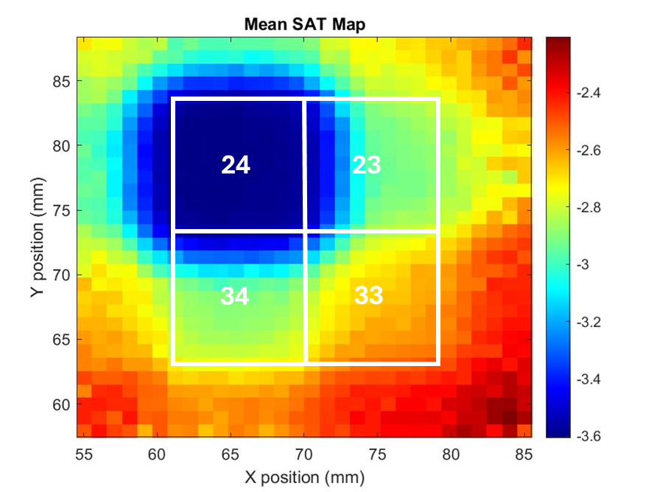
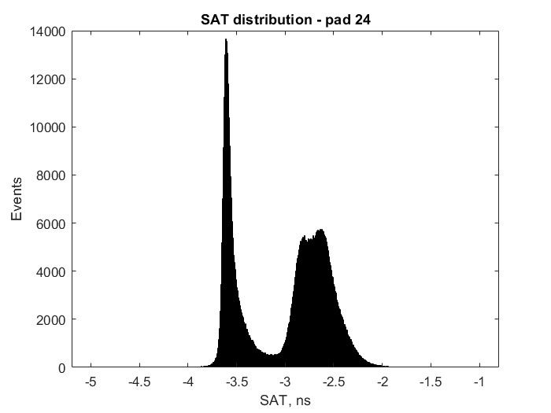
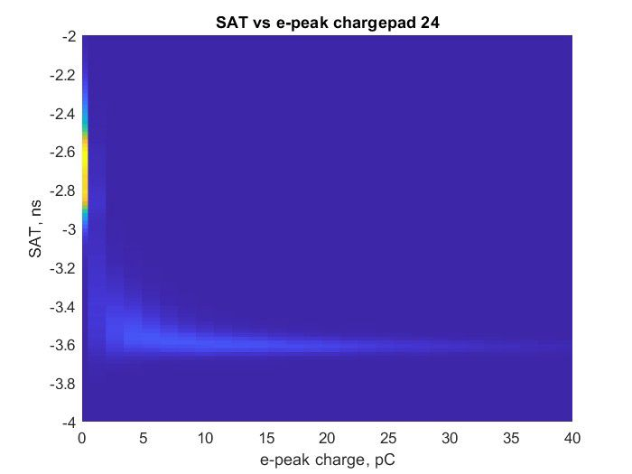
Correlated spurious signals
Events correlated in time even 15 mm distant from pad center
Looking at SAT distribution
Marta Lisowska & Francesco Guerra | 6 October 2025

Slide 20
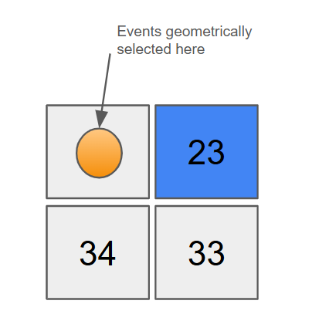
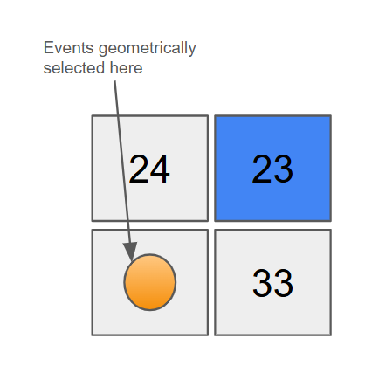
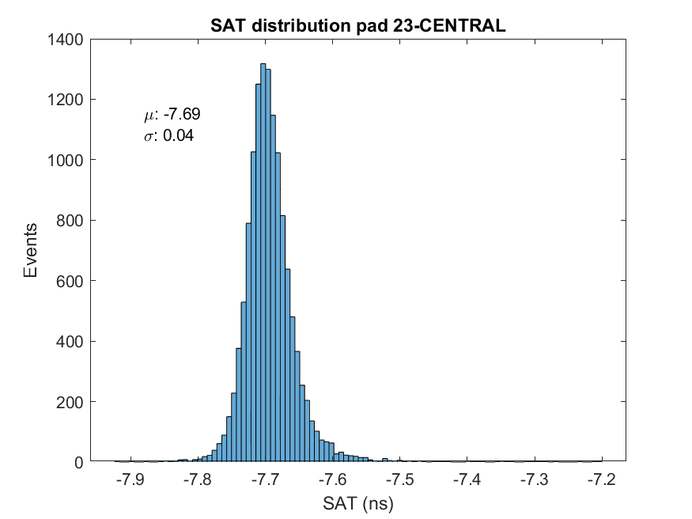
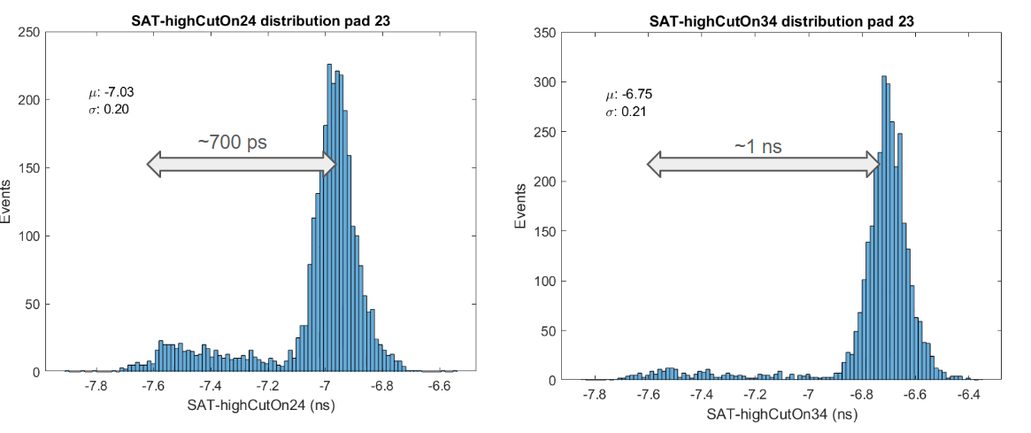
Correlated spurious signals
Cutting geometrically and looking at SAT distribution
SAT in the center of pad 23
Marta Lisowska & Francesco Guerra | 6 October 2025

Slide 21
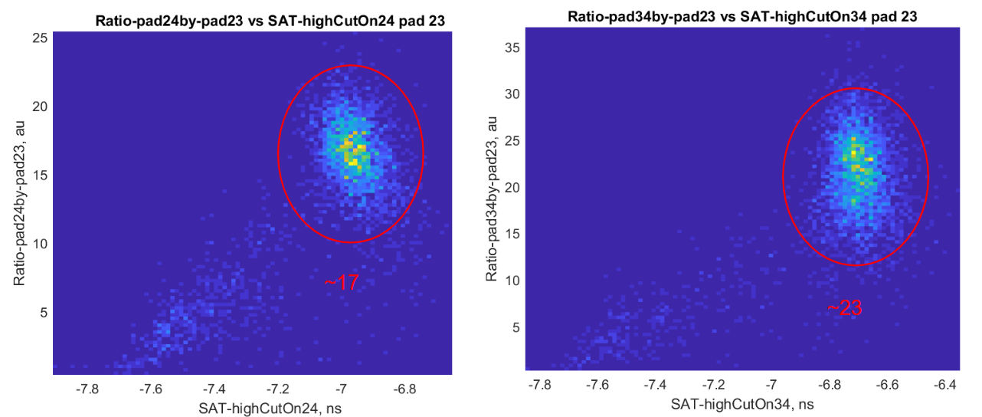
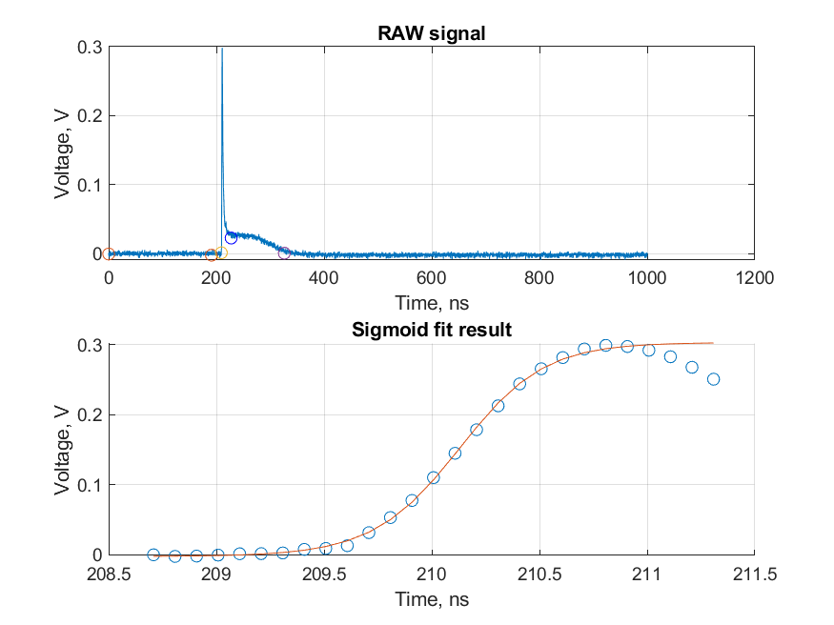
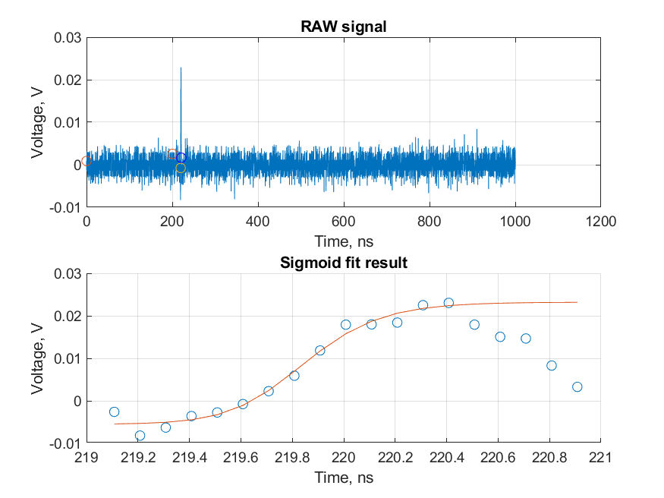
Correlated spurious signals
Adjacent
High frequency related (capacitive coupling)
Amplitudes ratio depends on distance
Possible time correlation with distance
Standard
WORK IN PROGRESS…
Spurious
Diagonal
This effect could be used to enhance spatial reconstruction capabilities of the detector
Marta Lisowska & Francesco Guerra | 6 October 2025

Slide 22




Combining different pads
Cutting on SAT to exclude spurious signals
Correcting SAT on the full set of events recorded by each pad
Merging infos from different pads using eventID
Using a charge weighted algorithm to reconstruct particle hit position
Marta Lisowska & Francesco Guerra | 6 October 2025

Slide 23




Combining different pads
Selected area
24
23
34
33
Combining corrected SAT from different pads
$${SAT}_{comb}= \frac{\sum_{i=1}^{nActive}{{SAT}_{corr}∙ \frac{1}{{σ_{SAT}}^{2}(q_{e_peak})} }}{\sum_{i=1}^{nActive}{ \frac{1}{{σ_{SAT}}^{2}(q_{e_peak})} }}$$
Estimated time resolution for this detector:
45 ± 3 ps
Marta Lisowska & Francesco Guerra | 6 October 2025

Slide 24
Summary & Conclusions
Francesco Guerra | 26 August 2025

Slide 25
Summary & Conclusions
  Progress up to now:
    Improved analysis code for faster processing and better noise rejection
    Tested different photocathodes for time resolution (RMS):
      Ti: ~35 ps
      B₄C: ~50 ps
      CsI: ~12 ps
    Multipad prototype achieved 45 ± 3 ps over a selected area
  Future perspectives:
    Fine tuning of filtered analysis parameters
    Perform a more systematic study of photocathodes
    Investigate correlated spurious signals in detail
    Explore optimized methods for combining SAT from different pads (e.g. machine learning approaches)
Francesco Guerra | 26 August 2025

Slide 26

Thank you for your attention!
Francesco Guerra | 26 August 2025

Slide 27
Backup slides
Francesco Guerra | 26 August 2025

Slide 28


PICOSEC for ENUBET: PIMENT
ENUBET (Enhanced NeUtrino BEams from kaon Tagging) project aims at building a monitored neutrino:
- timing at the ENUBET tagger for single MIP detection (<50 ps)
- timing of e⁻ and 𝛾 showers in an electromagnetic calorimeter (∼10 ps)
- instrumentation of the hadron dump for muon monitor
- time tagging at the neutrino detector
Francesco Guerra | 26 August 2025

Slide 29


Waveform analysis: SNR problem
Triggering higher → biasing results
Triggering lower → picking up noise
Polya distribution fit
Francesco Guerra | 26 August 2025

Slide 30


Time walk correction
Earlier pre-amplification → Bigger avalanche → Reduced signal arrival time
  J. Bortfeldt et al., NIM A 993 (2021) 165049
Francesco Guerra | 26 August 2025

Slide 31

Test beam analysis
Francesco Guerra | 26 August 2025

Slide 32


CsI photocathode
Francesco Guerra | 26 August 2025

Slide 33


Ti photocathode
Francesco Guerra | 26 August 2025

Slide 34


B₄C photocathode
Francesco Guerra | 26 August 2025

Slide 35
Double layer DLC MM
Double layer DLC MM
Charge is being evacuated vertically instead of horizontally
Photocathode: Ti 2.4 nm
Pre-amplification gap: 180 μm
Anode voltage: 275 V
Cathode voltage: 550 V
Achieve higher rate capability
Preserve protection against discharges
Francesco Guerra | 26 August 2025

Slide 36






Rise time behaviour
Are we correcting SAT for some real avalanche dynamics or for something else?
Are there any other timing techniques alternative to CFD that will not suffer from changing rise time ?
Marta Lisowska & Francesco Guerra | 6 October 2025

Slide 37




Old run from July 2022
Probably is not a problem coming from the resistive layer because in this run the multipad analysed was metallic
Adjacent
Diagonal

Slide 38






Timewalk correction
*after cutting on the SAT values to get rid of crosstalk
What is the correct timewalk parametrization to use? Is there some geometrical effect?
Looking only at the pad
Looking only at the center of the pad
Looking at all* the events recorded on the pad

Slide 39

SAT over the pad

Slide 40




SAT over the pad
On pad 23 is difficult to see it because of the scale, but it’s there
Even after timewalk correction the problem is still there

Slide 41





Combining different pads
SAT combined using:
RMS weighted
Max e-peak charge
E-peak charge weighted

