Slide 1




Status of Belle II and
SUPERKEKB
Rachid Ayad
University Of Tabuk3
(on behalf of the Belle II Collaboration)
DARK2012
Dark Forces at Accelerators
Unification of Fundamental Interactions
October 16, 2012

Slide 2

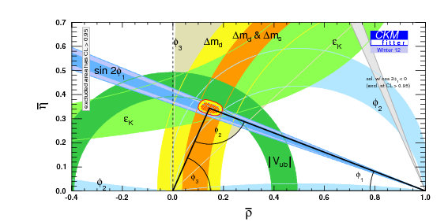
CP Violation and the Unitarity Triangle
CKM
“The” Unitarity Triangle
ℑ
CKM
Angles are determined from CP-violating asymmetries
Area is proportional to the amount of CP violation
ℜ
Length of each side ~ O(λ³), λ ~ 0.22

Slide 3
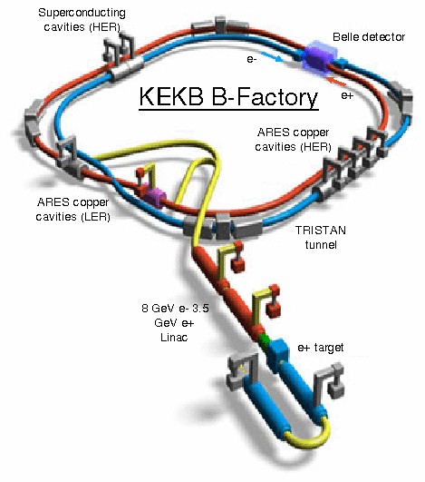

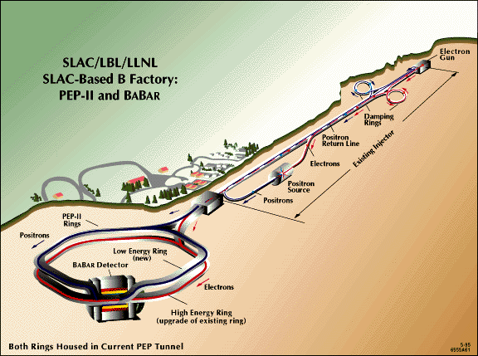




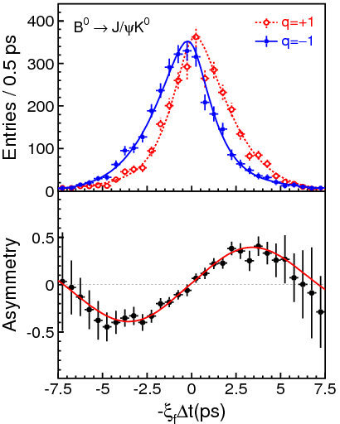
First Phase of B Factories: KEKB and PEPII
Primary physics goal of the B factories:
Measure CP violation in B meson system, confirm the KM mechanism of CP violation...
8.0 GeV e⁻ , 3.5 GeV e⁺
¯° = 0.42
9.0 GeV e⁻ , 3.1 GeV e⁺
¯° = 0.56
Search for time dependent decay asymmetries:
Based on EPR Paradox
Coherent B Anti-B system
w: misleading ID charge identification
e⁺
Y(4S)
e⁺
B⁰ tag
_
B⁰ tag
Δt
sin(2φ₁) ~ 0.679 +/- 0.020
All experiments average (HFAG and PDG)
Most recent reference: Belle Collaboration, PRL 108 (2012) 171802
-Δt(ps)

Slide 4
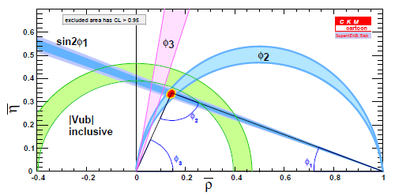
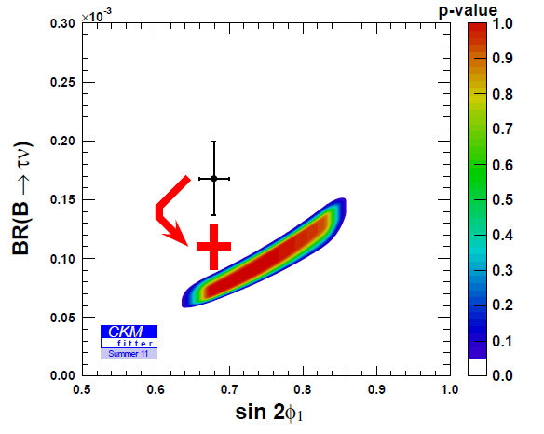
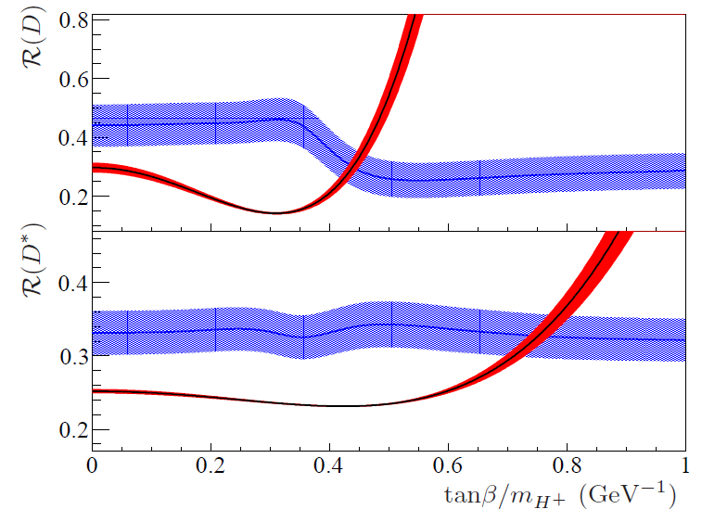
What next…?
Improving precision on CKM picture, search for deviations:
today
50ab⁻¹
Continue a varied flavor physics program; explore New Physics ……
As some tensions ease…
Others emerge…
Black – previous WA
Red – w/new Belle B → ¿ º
BaBar B → D^{(*)} ¿ º
arXiv:1205.5442
Data
SM
…and provide powerful constraints on NP models.
Data
SM
SM

Slide 5
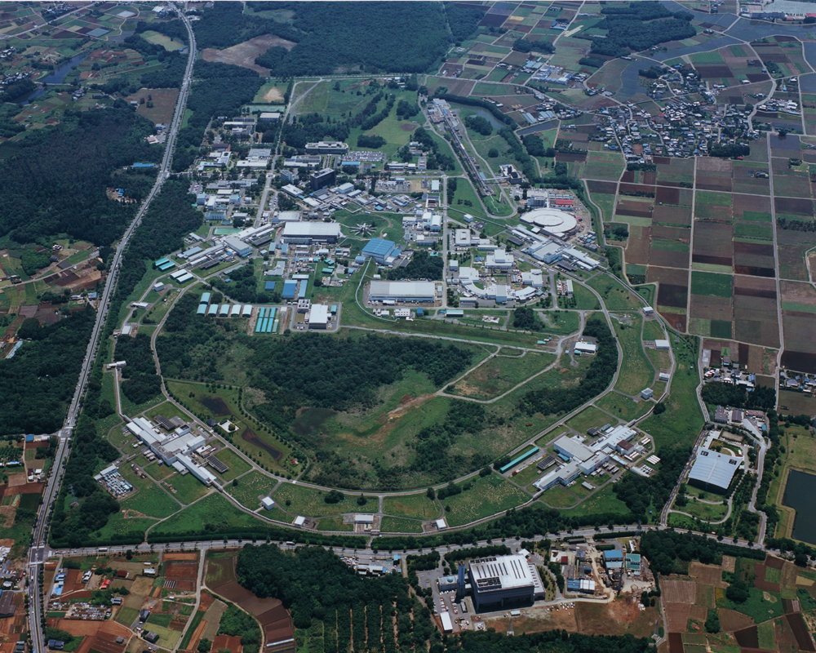
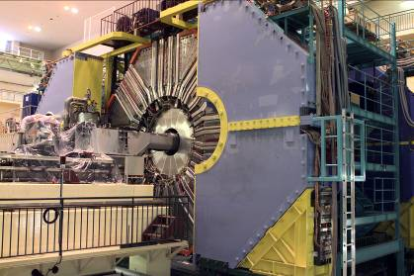
KEKB
Belle

Slide 6
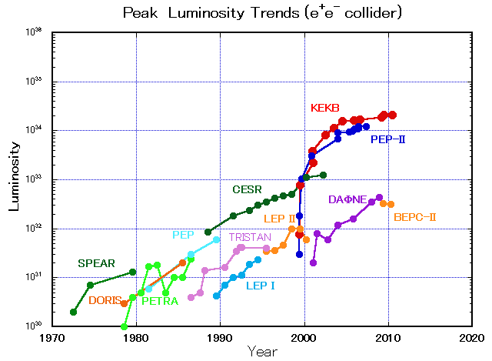
Upgrade!
KEKB ➔ Super KEKB
Belle ➔ Belle II
SuperKEKB+ SuperB
KEKB
PEP-II

Slide 7
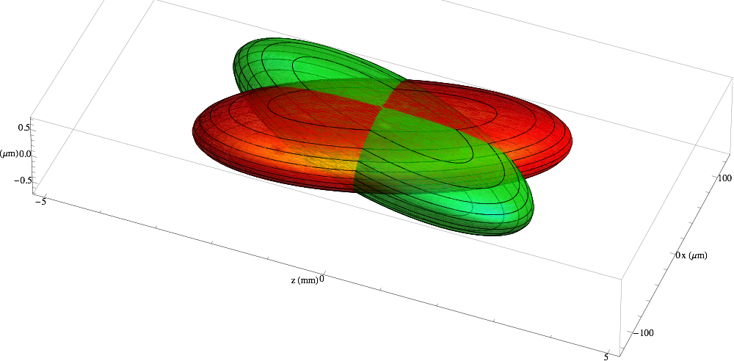
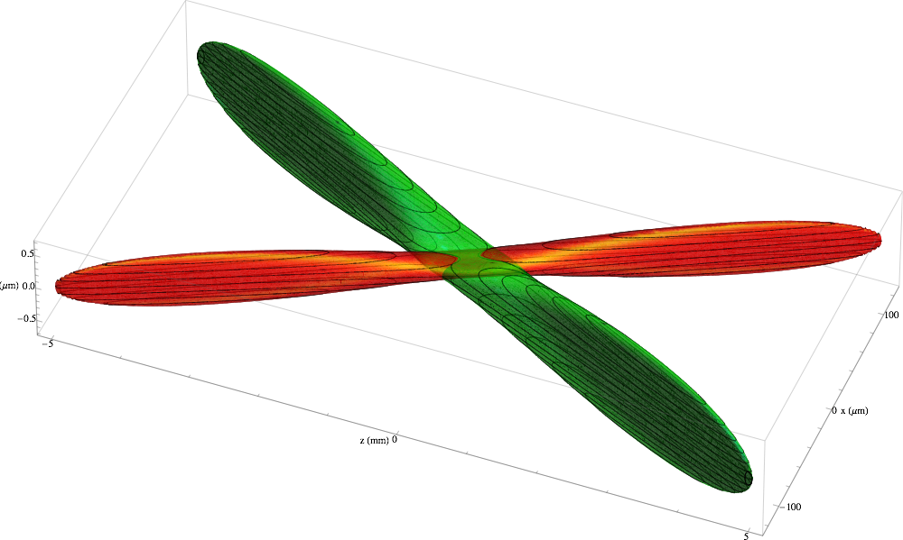
Nano-beams at SuperKEKB
Use nano-beam scheme developed by P. Raimondi for SuperB
(w/o crab)
22 mrad
1μm
5mm
100μm
~50nm
1μm
Vertical beta function reduction
¯_{y}* 5.9 mm → 0.3 mm
Beam current increase.
Overall 40x higher luminosity!
100μm
5mm
83 mrad

Slide 8
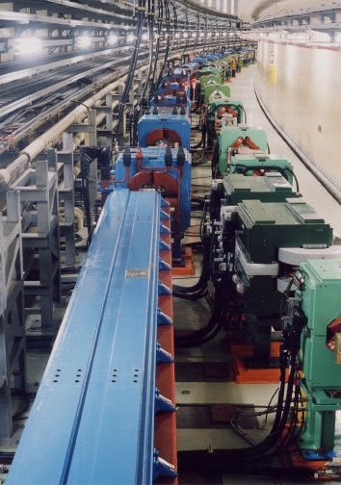



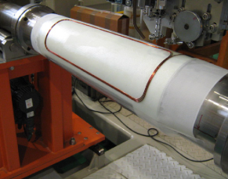
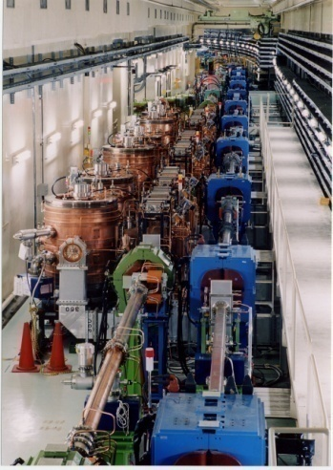


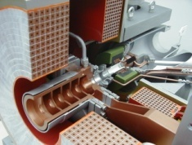
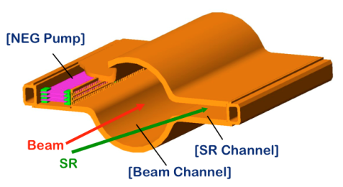
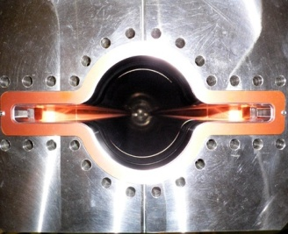

SuperKEKB
Colliding bunches
Belle II
New IR
e- 2.3 A
New superconducting /permanent final focusing quads near the IP
New beam pipe
& bellows
e+ 4.0 A
Replace short dipoles with longer ones (LER)
Add / modify RF systems for higher beam current
Low emittance positrons to inject
Positron source
Redesign the lattices of HER & LER to squeeze the emittance
Damping ring
New positron target / capture section
TiN-coated beam pipe with antechambers
Low emittance gun
Low emittance electrons to inject
L=8·10³⁵ s⁻¹cm⁻²
x 40 Gain in Luminosity

Slide 9

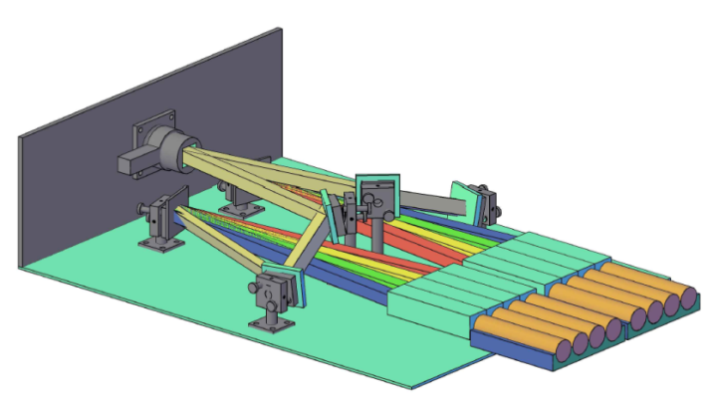
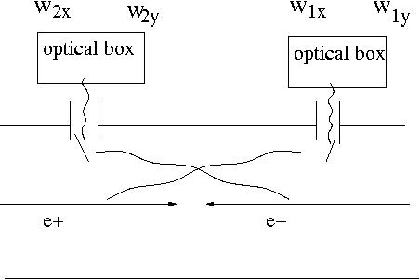
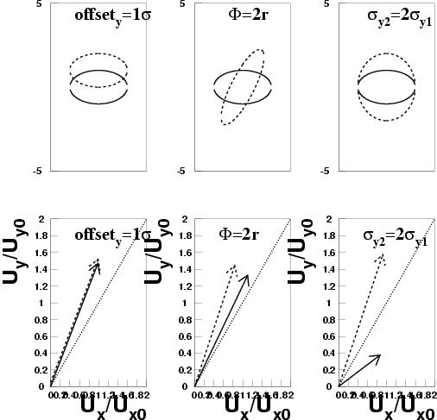
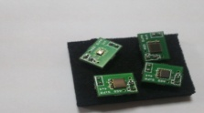
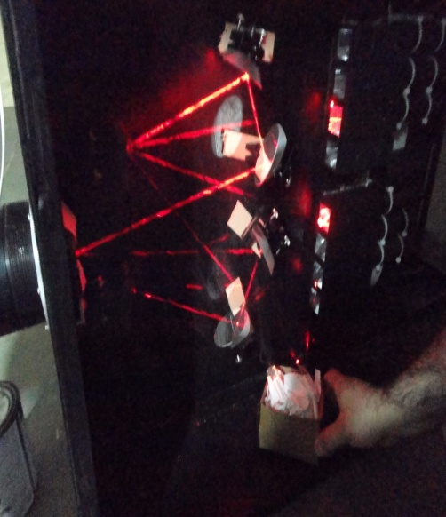
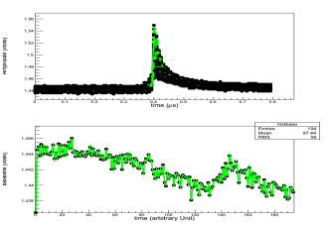
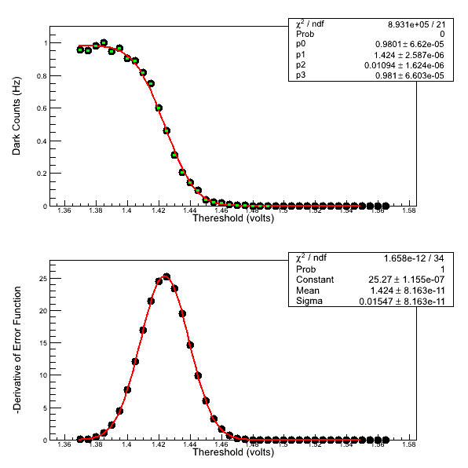
Study of Beam-Beam Instability, The Large Angle Beamstrahlung Monitor
(LABM), Leaded by Giovanni Bonvicini (WSU)
Optical box Design
Large Angle Beamstrahlung Monitor for Beam-Beam Instability
Polarized Beams
Grating to split radiation to several frequencies
Photomultiplier Tubes
Silicon PMs tests at
Tabuk
Large Angle Beamstrahlung Monitor (LABM)
To study Beam-Beam Instability
Beam-Beam instability
Pattern recognition
Waveforms and
baseline study
Finding Threshold
First Prototype
Of the Optical Box tested by red light

Slide 10
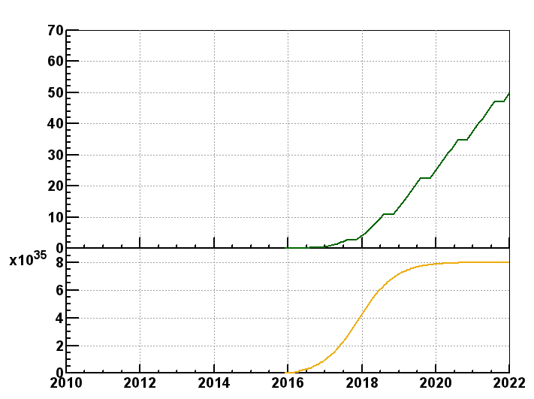
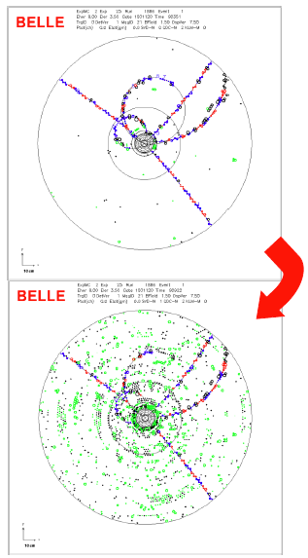
Luminosity Prospects, Detector Requirements
~50 ab⁻¹ (2022)
~10 ab⁻¹ (2018)
Current B factories
Design L: 8 x 10³⁵ cm⁻² s⁻¹
Increased luminosity:
  ~10-20x higher backgrounds, rad. damage
  Increased trigger rates (0.5 ➔ 200 kHz).
Need to maintain excellent performance, hermeticity.
➔Significant detector upgrades!
Belle event with increased background overlaid.

Slide 11
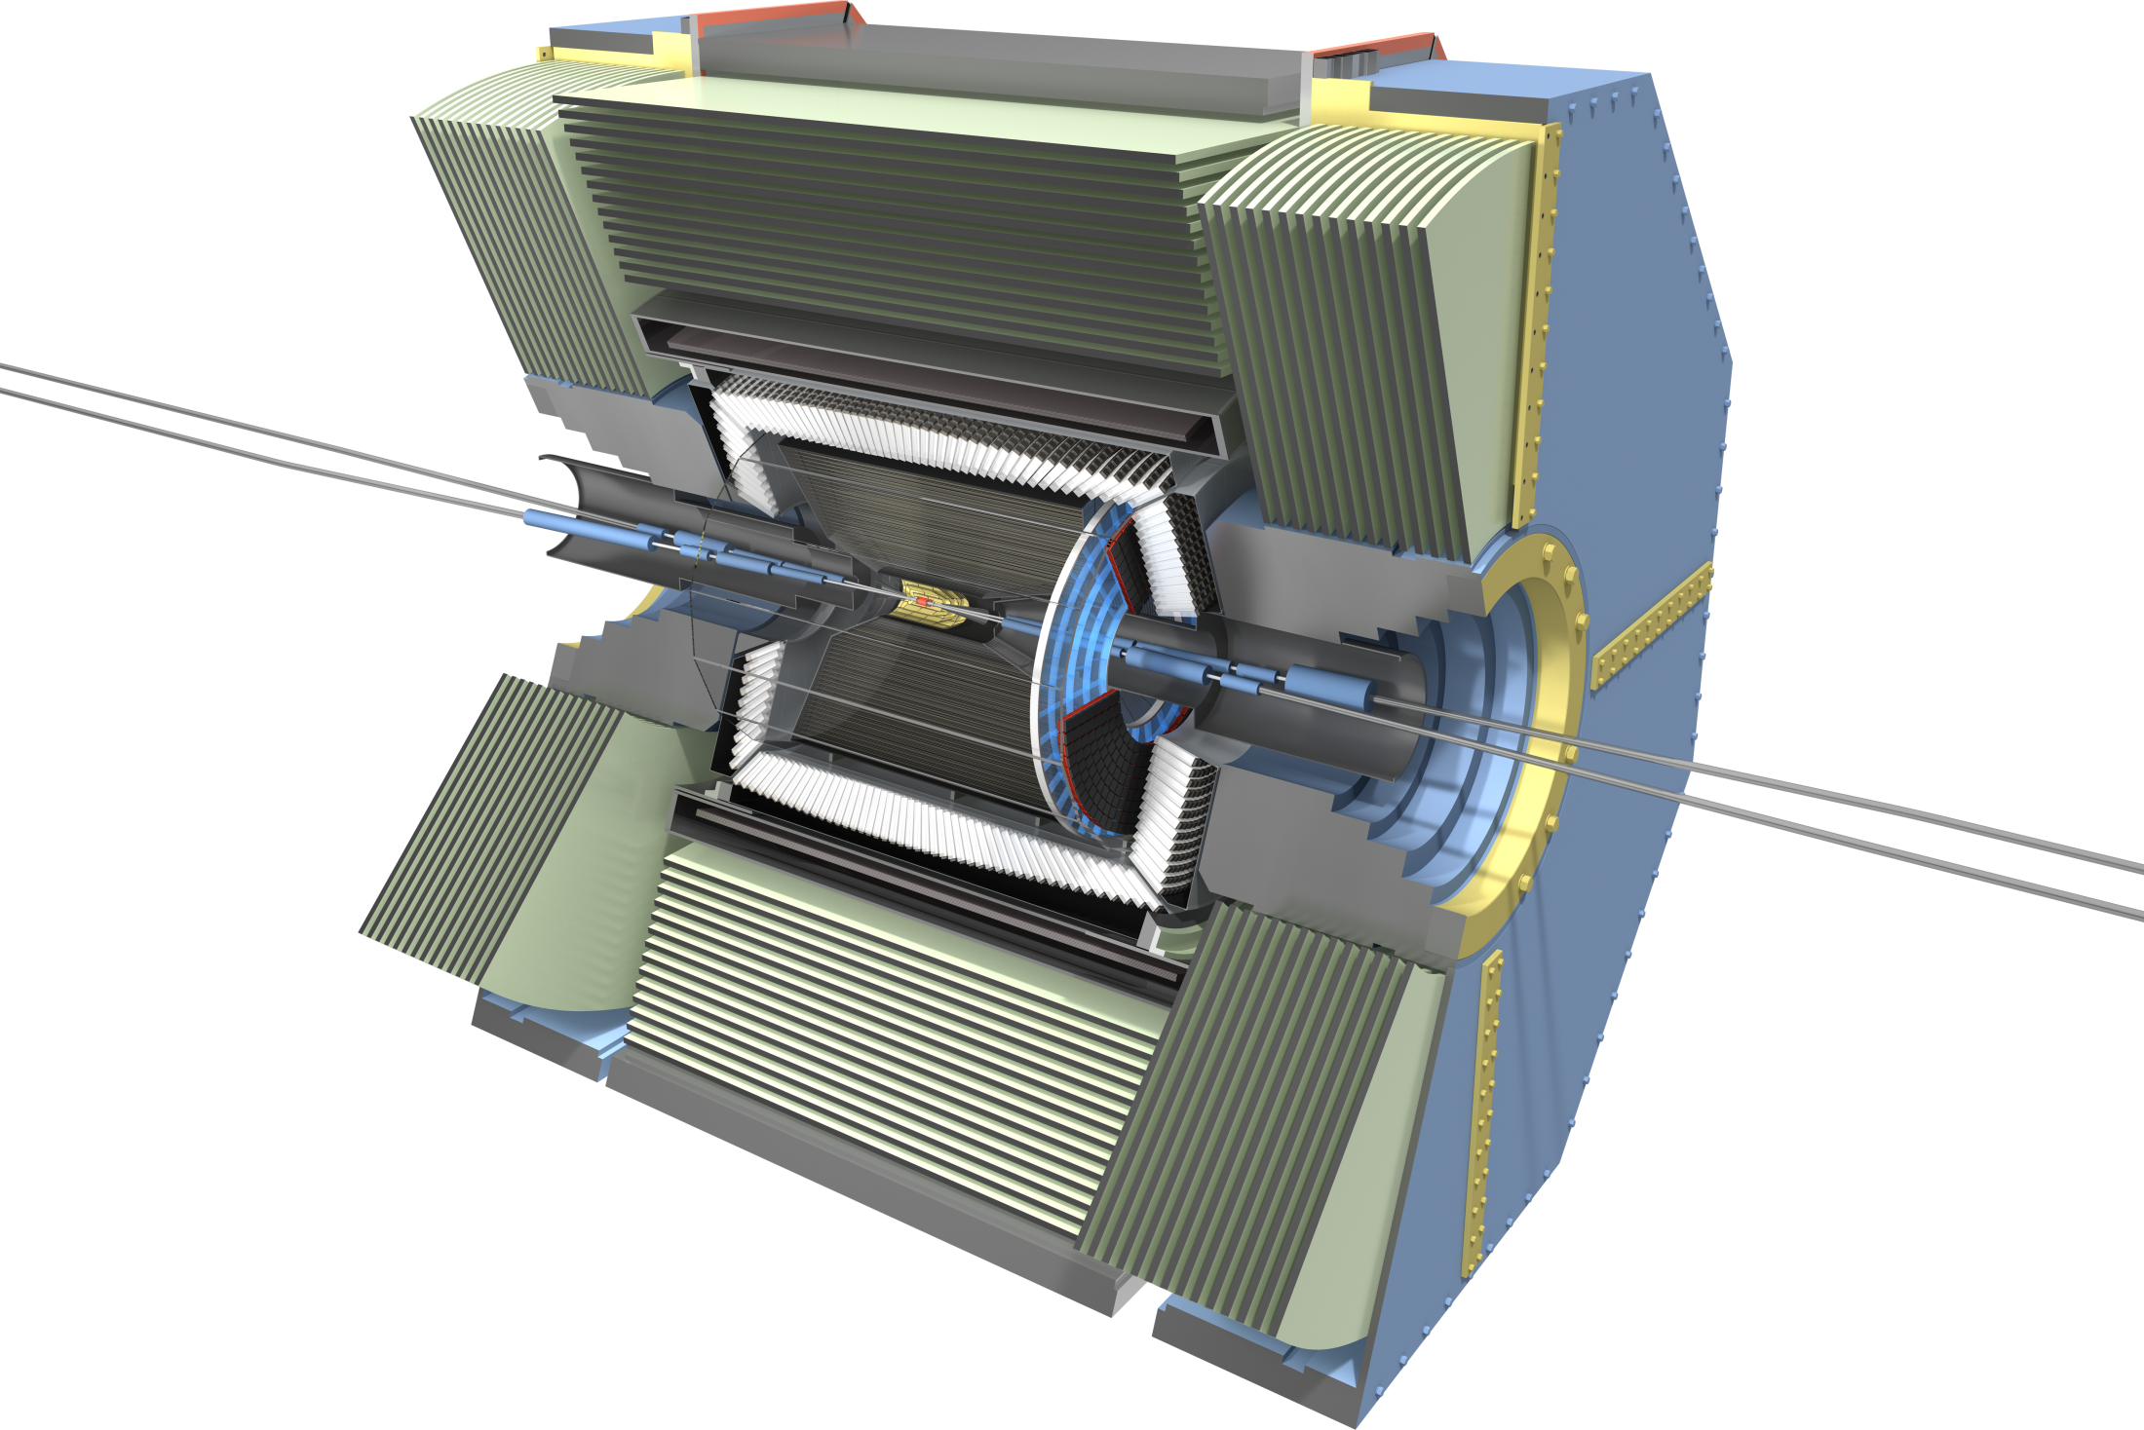
The Belle II Detector
RPC μ & K_{L} counter:
scintillator + Si-PM
for end-caps
CsI(Tl) EM calorimeter:
waveform sampling
electronics,
pure CsI
for end-caps
7.4 m
3.3 m
1.5 m
6 layer inner tracker →
2 layers PXD
(DEPFET) +
4 layers DSSD
7.1 m
Time-of-Flight, Aerogel
Cherenkov Counter →
Time-of-Propagation
counter (barrel),
proximity focusing Aerogel
RICH (forward)
Central Drift Chamber:
smaller cell size,
long lever arm
Belle II Technical Design Report: arXiv:1011.0352

Slide 12
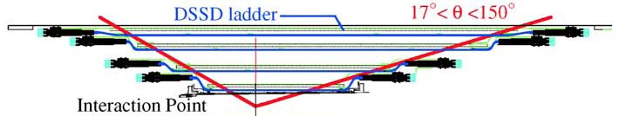
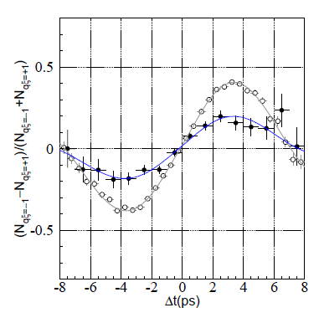
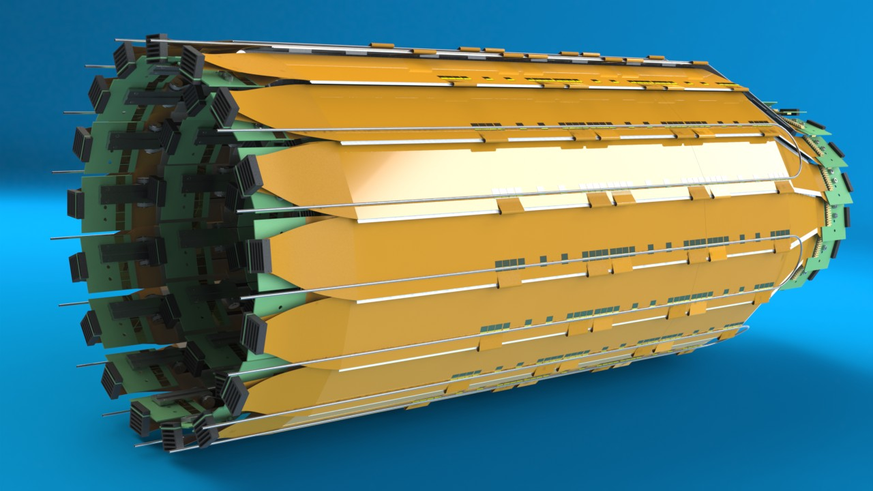
Vertex Detector
Belle II: Pixels (2 layers) + SVD (4 layers)
Belle: SVD (4 layers)
DSSD strip layers
pixel layers
Vertexing improvements:
~25% Improvement in vertex resolution.
~30% higher K_{S} → ¼⁺¼⁻ efficiency.
DEPFET Pixel Mockup
New CP violating phases in b → sqq:
New CP violating phases may be observable by a ¢S between B → J/Ã K_{S} and other modes (e.g., B → ÁK_{S}).
Predicted, for example, by SUSY
GUT models.
Example of power of next
generation of TCPV
measurements.
Silicon Vertex Detector
Belle II projected with 50 ab⁻¹
Open: B → J/Ã K_{S}
Closed: B → Á K_{S}

Slide 13
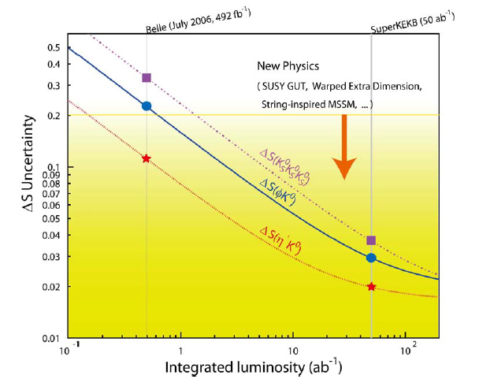
Vertex Detector
Belle II: Pixels (2 layers) + SVD (4 layers)
Belle: SVD (4 layers)
DSSD strip layers
pixel layers
Vertexing improvements:
~25% Improvement in vertex resolution.
~30% higher K_{S} → ¼⁺¼⁻ efficiency.
DEPFET Pixel Mockup
Belle II reach for ¢S in b → sqq:
Silicon Vertex Detector
Belle II projected with 50 ab⁻¹

Slide 14

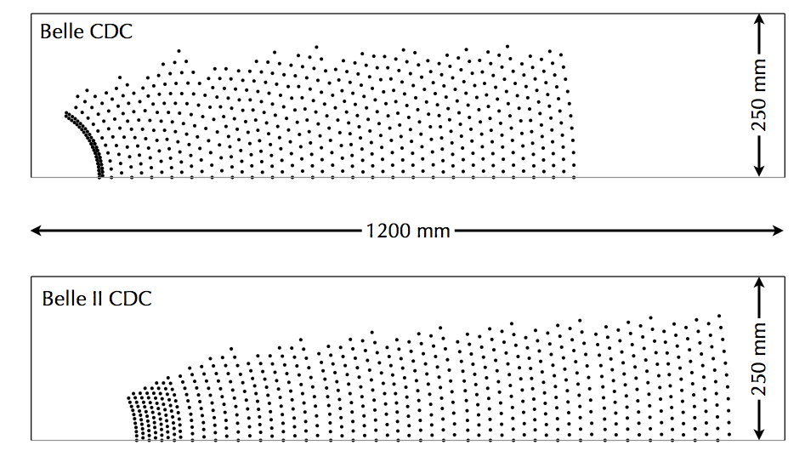

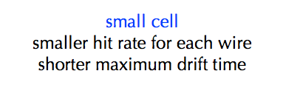
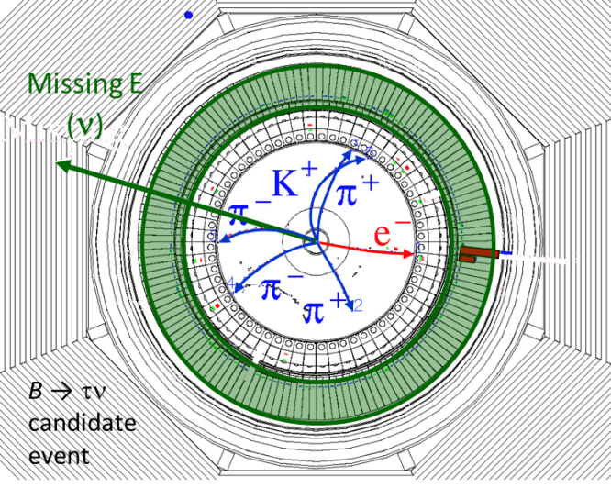
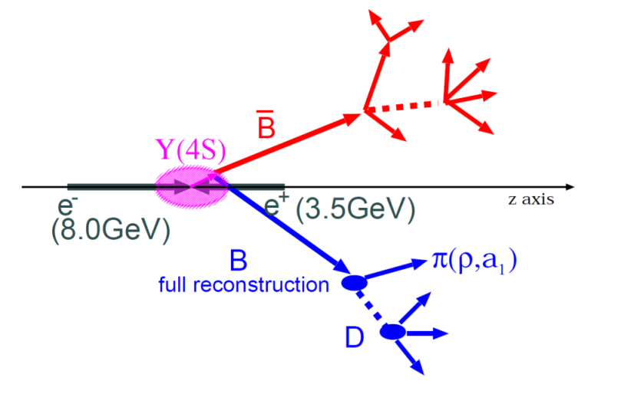
Central Drift Chamber
longer lever arm
improve resolution of momentum and dE/dx
Vital for “full reconstruction”:
Allows measurement of modes with missing energy, neutrinos:
  B → ¿ º
  B → D^{(*)} ¿ º
  B → K^{(*)} º º
(4.0 GeV)
(7.0 GeV)

Slide 15
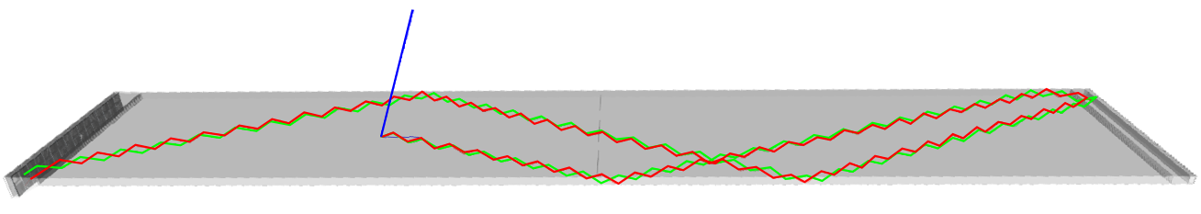
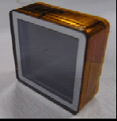
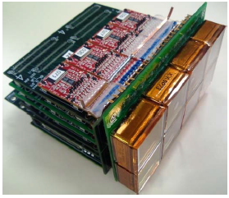
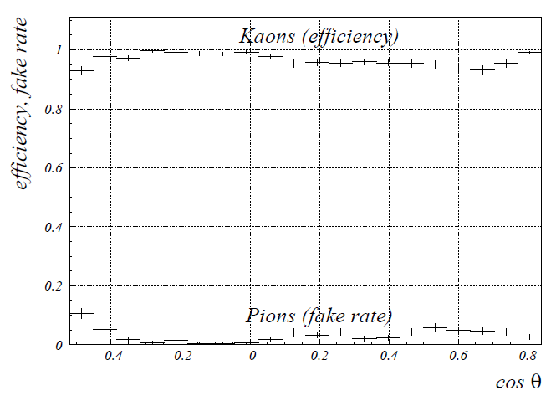
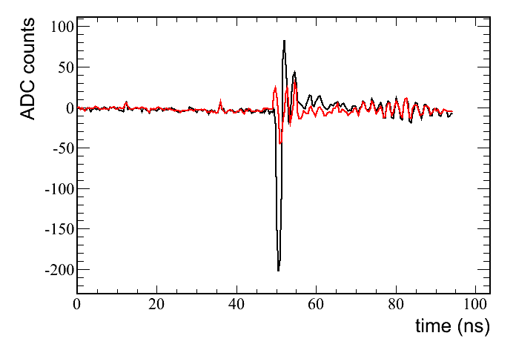
Time-of-Propagation (Barrel PID)
K§, ¼§
MCP-PMTs
Quartz radiator
Focusing Mirror
Compact version of detection of internally reflected Cherenkov (DIRC):
Measure internally reflected Cherenkov pattern in x,y,t.
Significant improvement in K/¼ ID over Belle threshold aerogel + time-of-flight.
Hamamatsu SL-10
16-channel
Micro-channel plate PMTs
Excellent timing (¾_{t} ~ 40 ps)
Compact, integrated GSa/s waveform digitizing readout:
TOP performance at 3 GeV/c
90%
128-channel
integrated module

Slide 16
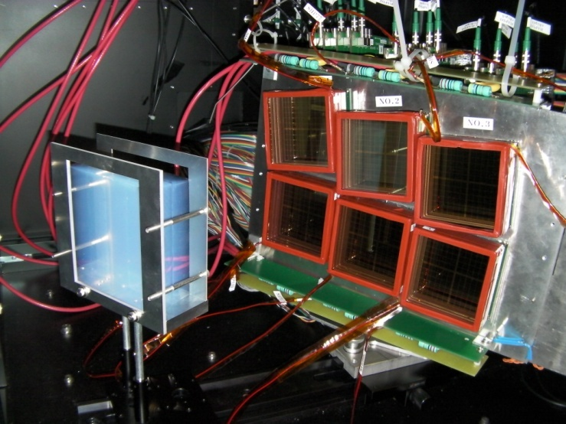
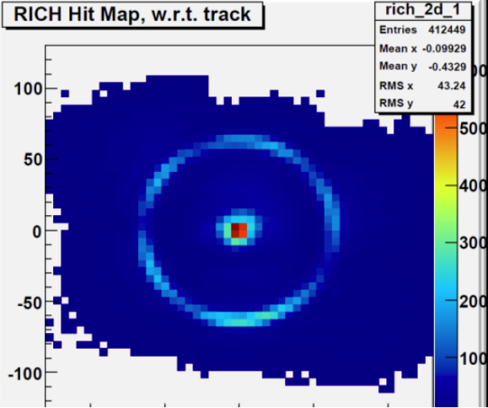
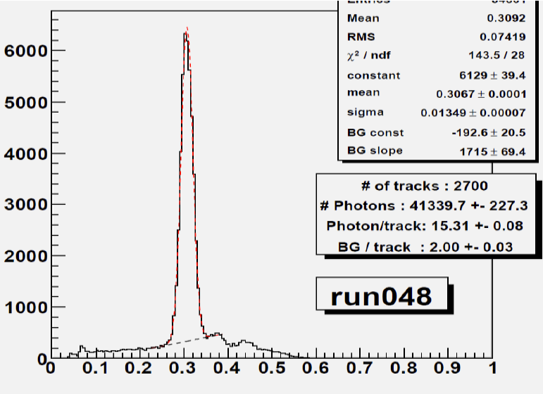
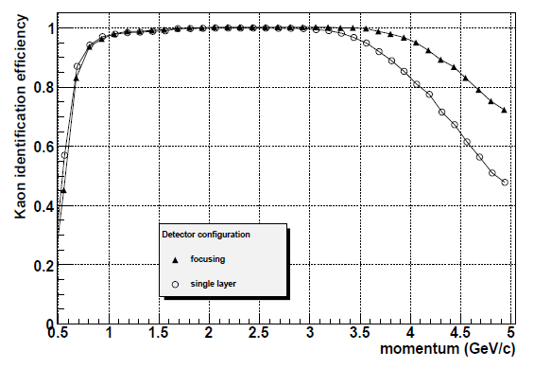
Aerogel RICH (Endcap PID)
Proximity focusing scheme:
Aerogel
Slightly different indices of aerogel stacked ➔ improve Cherenkov angle resolution.
Hamamatsu HAPD
90%
➔ Excellent PID efficiency over wide momentum range.

Slide 17
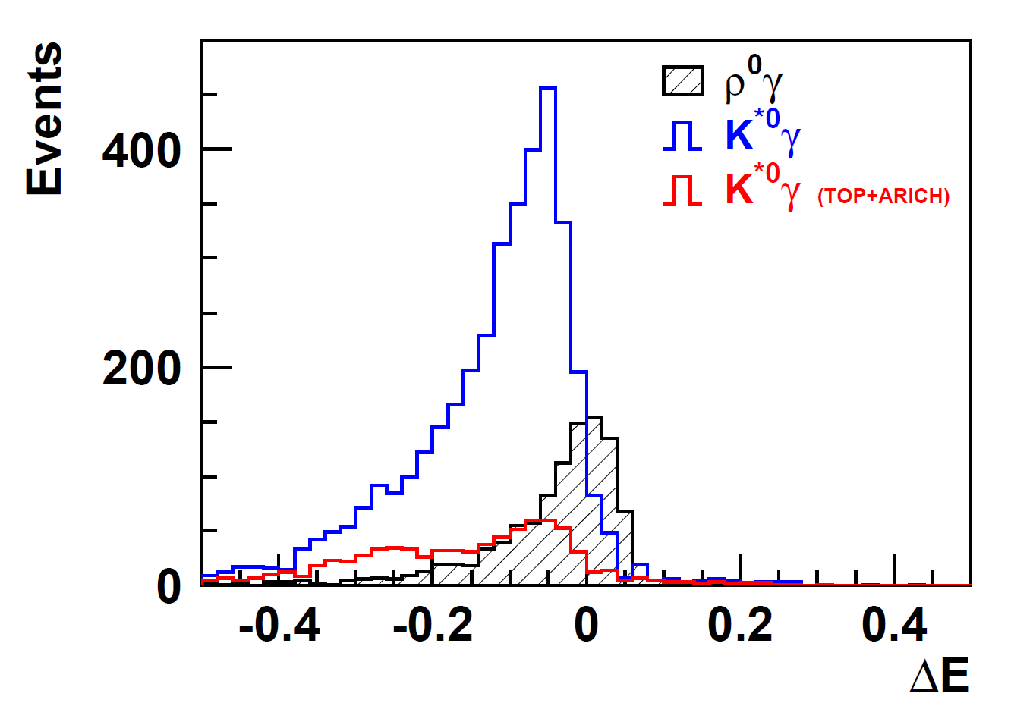
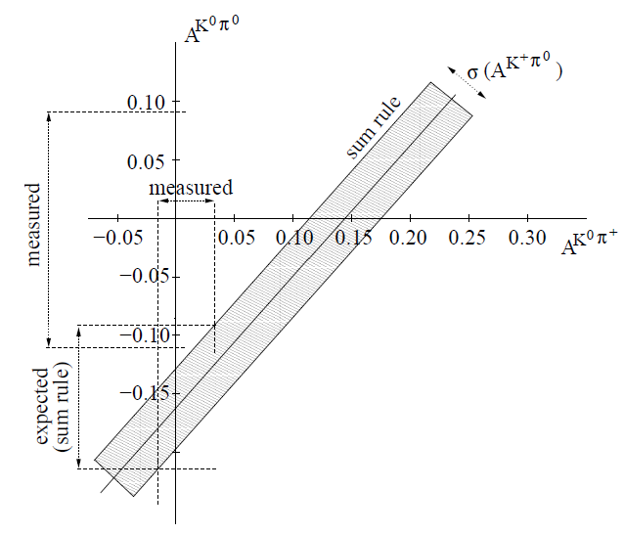

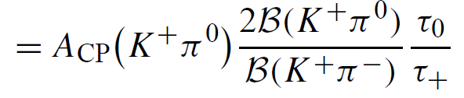
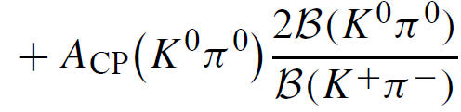
Improved PID Performance
Significant improvement in K/¼ discrimination:
  Rare radiative processes:
    B → ½⁰ (→ ¼⁺¼⁻) °
    B → K* (→ K⁺¼⁻) °
Other physics impact: K¼ CPV puzzle.
  Naively, for K⁺¼⁰, K ⁺¼⁻ we expect:
  ¢A = 0.
  Current Belle value (EPS 2011):
  ¢A = +0.112 § 0.028 @ 4¾
  …but theoretical uncertainty can be large.
Model independent sum rule:
Gronau,
PLB627, 82
(2005)
current

Slide 18
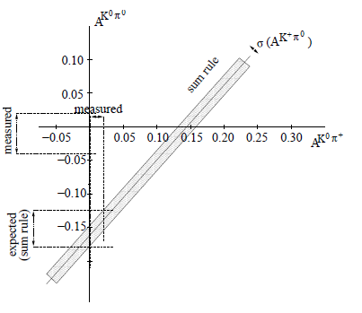

Improved PID Performance
Significant improvement in K/¼ discrimination:
  Rare radiative processes:
    B → ½⁰ (→ ¼⁺¼⁻) °
    B → K* (→ K⁺¼⁻) °
Other physics impact: K¼ CPV puzzle.
  Naively, for K⁺¼⁰, K ⁺¼⁻ we expect:
  ¢A = 0.
  Current Belle value (EPS 2011):
  ¢A = +0.112 § 0.028 @ 4¾
  …but theoretical uncertainty can be large.
Model independent sum rule:
Gronau,
PLB627, 82
(2005)
current
Projected
w/ 50 ab⁻¹

Slide 19





Electromagnetic Calorimeter
Crystals:
  Barrel: reuse existing CsI(Tl).
  Endcaps: (possibly staged) upgrade to pure CsI.
    ➔ Better performance & radiation hardness.
Readout electronics:
  Upgrade to 2 MHz waveform sampling.
  Online signal processing.
  ➔ Improved energy resolution.

Slide 20





K_{L} and ¹ Detector
Endcap:
  RPCs ➔ scintillator to tolerate high BG.
  14 layersx(75 x-strips, 75 y-strips) per layerx(4 quadrants) per each endcap
  16,800 total (for two endcaps) channels w/ waveform digitizing readout.
Barrel:
  Belle RPCs mostly to be reused.
  Inner two layers ➔ scintillator.
y-strip plane
Iron plate
x-strip plane
Aluminium frame
Y strip
X strip
Photon-counting with Hamamatsu MPPCs and waveform sampling readout

Slide 21



Dark Photon at Belle projected to Belle II
From Igal Talk (this workshop)
Misleading electron-electron charge
System from the 3 A systems.
For prompt photon
Powerful decay length cut
But with low purity
In case if background remains of order 1/1000 in the covered phase space
signal_{A} (Belle2) ~ signal_{A}(Belle)*(L(Belle2)/L(Belle))
ε_{Α}(Belle2) = ε(Belle)*(ε(lepton Belle II)/ε(Lepton Belle))⁶ , this improve signal by 6.1% if 1% in electron efficiency.
Displaced vertex efficiency ( In Belle2 better Vertex Detector, small inner CDC cells and larger CDC)
That improves signal: 4.43% if A average decay length is ¼ after inner CDC, 7.8% if at the middle of CDC,
and 10% if ¾ from inner CDC.

Slide 22


WMAP(Wilkinson Microwave Anisotropy Probe)
A. Kosowsky et al Phys. Rev. D, 66, 63007, 2002.
astro-ph/0302218, and astro-ph/0302207
CMB photons (Cosmic Microwave Background) decoupled during the Big Bang at a temperature of ~ 3K: For a flat universe the size of cluster is ~ 1 Deg., so Ω~1
With the help of other peaks, WMAP was able to give:
Ωtot ~ 1 (flat universe)
Ωdark-energy ~ 74%
ΩCDM ~ 22%
Ωbaryonic = 4%

Slide 23

Dark Matter search at Belle
Published by Belle (August 2012, arXiv:1206.5948), to look at Bº invisible final state.
An upper limit of 1.4x10⁻⁴ had been given and will be improve by Belle2 .
We tag one B and we look at invisible decay for the other B
Belle also looked at B⁺ to K⁺ Invisible for example: Phys. Rev. Lett. 99, 221802 (2007)

Slide 24


(A Lot) More Belle II Physics…
Very broad physics program within Belle II!
Only a few examples covered.
For more, see arXiv:1002.5012: “Physics at Super B Factory”

Slide 25
Nominal Construction Schedule Of SuperKEKB and Belle II
(New Schedule Due to Earth Quake damage)
SuperKEKB and Belle II upgrade officially cost about 300 Millions Euros
2009 | 2010 | 2011 | 2012 | 2013 | 2014
Linac
Damping Ring
Main ring
Belle II detector
R&D
Construction
Because of
Earth Quake,
Construction
Phases stay the same but SuperKEKB initial tests will be delayed to Fall 2014
Design Study
Commissioning
Tunnel Construction
Building Construction
R&D
Mass Production
Installation
R&D
Building Construction
Mass Production
Installation
R&D
Delayed to Fall 2015 or Later?
Construction
Cosmic Rays Tests
Mass Production
Installation

Slide 26

Summary
Super KEKB & Belle II are approved by Japanese government.
  Accelerator and detector upgrades are underway. Most Belle II production starts Fall 2012, ECL endcap pure CsI R&D now.
  Belle II Technical Design Report: arXiv:1011.0352
Planning to collect 50 ab⁻¹ by 2022.
  Broad physics program, complementary to LHC.
  More details: arXiv:1002.5012
~400 members from over 60 institutes in 19 countries:
New members welcome! Visit: http://belle2.kek.jp

Slide 27
Backing Slides

Slide 28

Kobayashi-Maskawa Mechanism(1973)
Assumption: 3 generations
The quark fields are rotated:
CP-violating phase
“CKM” matrix

Slide 29

HFAG sin(2φ₁) average value

Slide 30



Time Dependent CPV – Success! (2001)
World record peak luminosity (Belle): 2.1 x 10³⁴ cm⁻² s⁻¹
Performance far exceeding design values!

Slide 31

Variety of Successes from B Factories
Belle and BaBar have advanced a very wide program of physics:
  Observation of time depenCP violation in B decays.
  CKM measurements of:
    Matrix elements.
    Unitary triangle angles.
    CKM verified to ~O(10%)
  Direct CP violation:
    B → K ¼
  New hadronic states:
    X,Y,Z mesons
  Rare probes of new physics:
    b → s °
    b → s
_
B⁰ tag
  Observation of time-dependent CP violation in B system.
  Measurements of CKM matrix elements, angles.
    CKM verified to ~O(10%)
  Direct CP violation:
    B → K ¼
  New hadronic states:
    X,Y,Z mesons
  Rare probes of new physics:
    b → s °
    b → s
B⁰ tag
BaBar LOI (1994)
CKM Fitter (2012)

Slide 32


Variety of Successes from B Factories
Belle and BaBar have advanced a very wide program of physics:
  Observation of time-dependent CP violation in B system.
  Measurements of CKM matrix elements, angles.
    CKM verified to ~O(10%)
  Direct CP violation (e.g., B → K ¼).
  New hadronic states: X(3872),Y,Z,…
  Rare probes of new physics, e.g.,
    B → ¿ º
    b → s ° , b → s
    Rare ¿ decays
  Observation of D mixing.
X(3872)

Slide 33

Complementary to LHC Searches
Previous examples include modes with missing energy.
B → ¿ º; B → D^{(*)} ¿ º; B → K^{(*)} º º
  Multiple neutrinos! Significant missing energy.
These are very challenging experimentally…
  Rely on clean e⁺e⁻ environment and detector
  hermeticity.
Example Belle B → ¿ º candidate
º_{e}
e ⁺
º¿
¿ ⁺
º¿
B⁺
Fully reconstruct “tag” B to determine “signal” B flavor, charge, momentum.
➔ B factories are uniquely suited for such measurements!
B⁻

Slide 34

More Belle II Physics: Lepton Flavor Violation
τ → lγ
τ → 3l, lη
B factories are also ¿ factories!
Many SUSY models predict LFV at higher rate than SM.
  SUSY particles may contribute in loops.
  Higgs mediated LFV decays.
    Important when SUSY particle masses are large (& 1 TeV)
Belle II can access many ¿ LFV modes.
mode | Br(τ → μγ) | Br(τ → 3l)
mSUGRA + seesaw | 10⁻⁷ | 10⁻⁹
SUSY + SO(10) | 10⁻⁸ | 10⁻¹⁰
SM + seesaw | 10⁻⁹ | 10⁻¹⁰
Non-universal Z’ | 10⁻⁹ | 10⁻⁸
SUSY + Higgs | 10⁻¹⁰ | 10⁻⁷

Slide 35


B⁻ → τ⁻ ν impact on New Physics
2 Higgs doublet model
W.S.Hou, PRD 48, 2342 (1993).
Branching fraction enhanced by r_{H}.
Model prediction
Constraint on r_{H} from Belle measurement

