Slide 1
INFN Roma Tre
November 13, 2025
Muon Hunters
Logo
school/institute

Slide 2

Introduction
CONTEXT
  RESEARCH GROUP: Italian High School students (Rome)
  University Roma Tre- section INFN Roma Tre
  ~40 participants, all from different schools
  3 DAYS OF ACTIVITIES
  THEORETICAL BACKGROUND
  EXPERIMENT AND DATA ANALYSIS
  ICD ONLINE MEETING

Slide 3
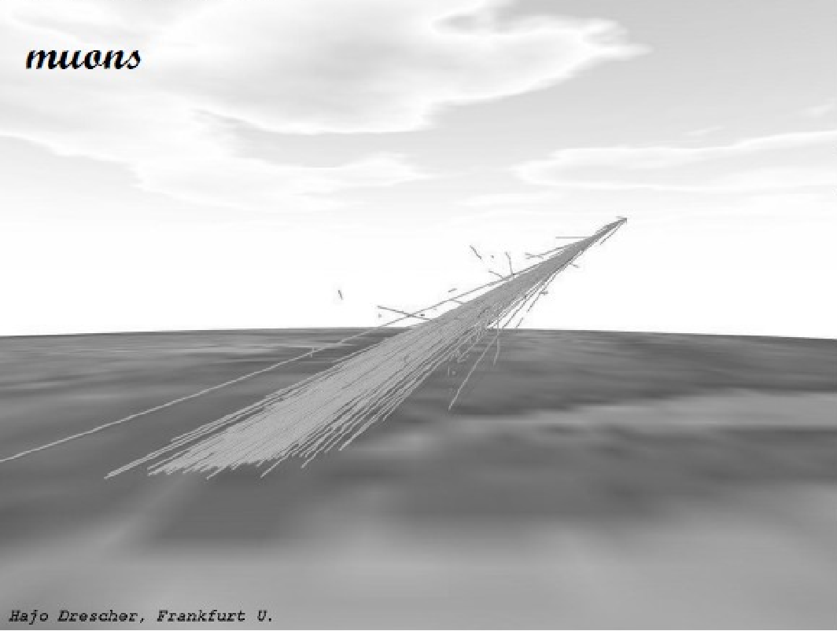

Introduction
COSMIC RAYS AND MUONS
Different sources of cosmic rays
Muons Byproduct of cosmic rays
More linear particle shower

Slide 4
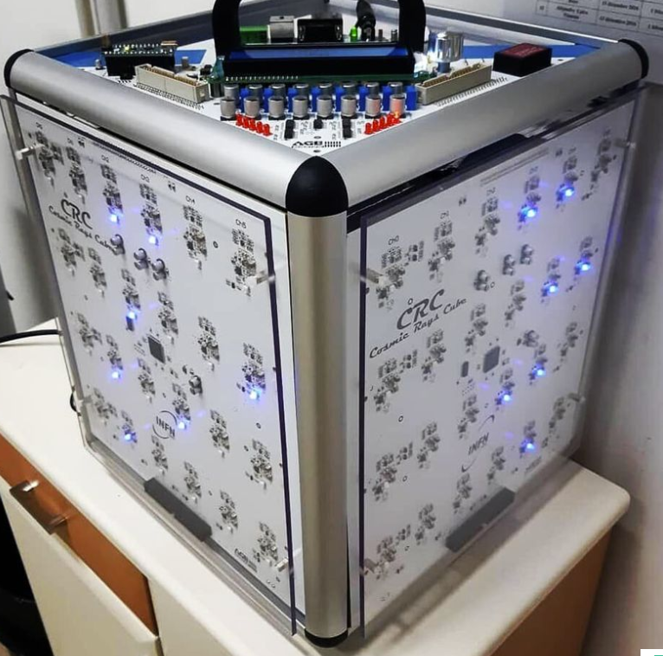
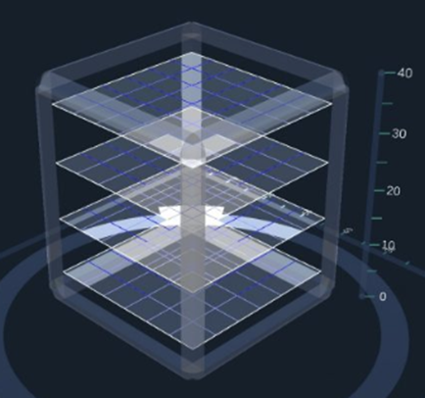
CRC-Cosmic Ray Cube
STRUCTURE
8 Layers of Plastic Scintillators: 4 vertical and 4 horizontal
Optic Fiber
Diodes
Simple Structure
Made by students
Maximum rotation of 180°

Slide 5
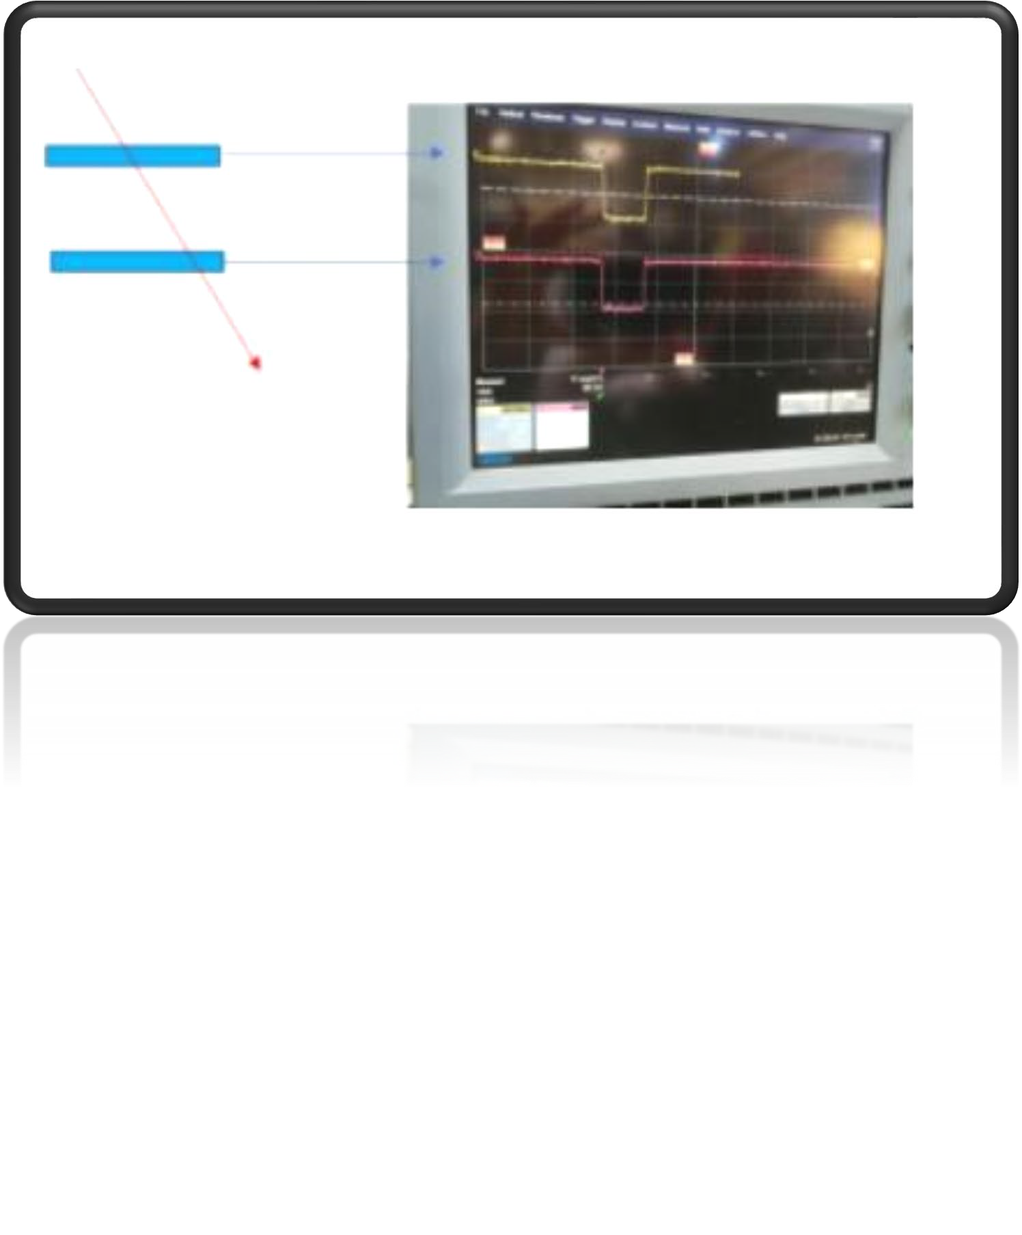
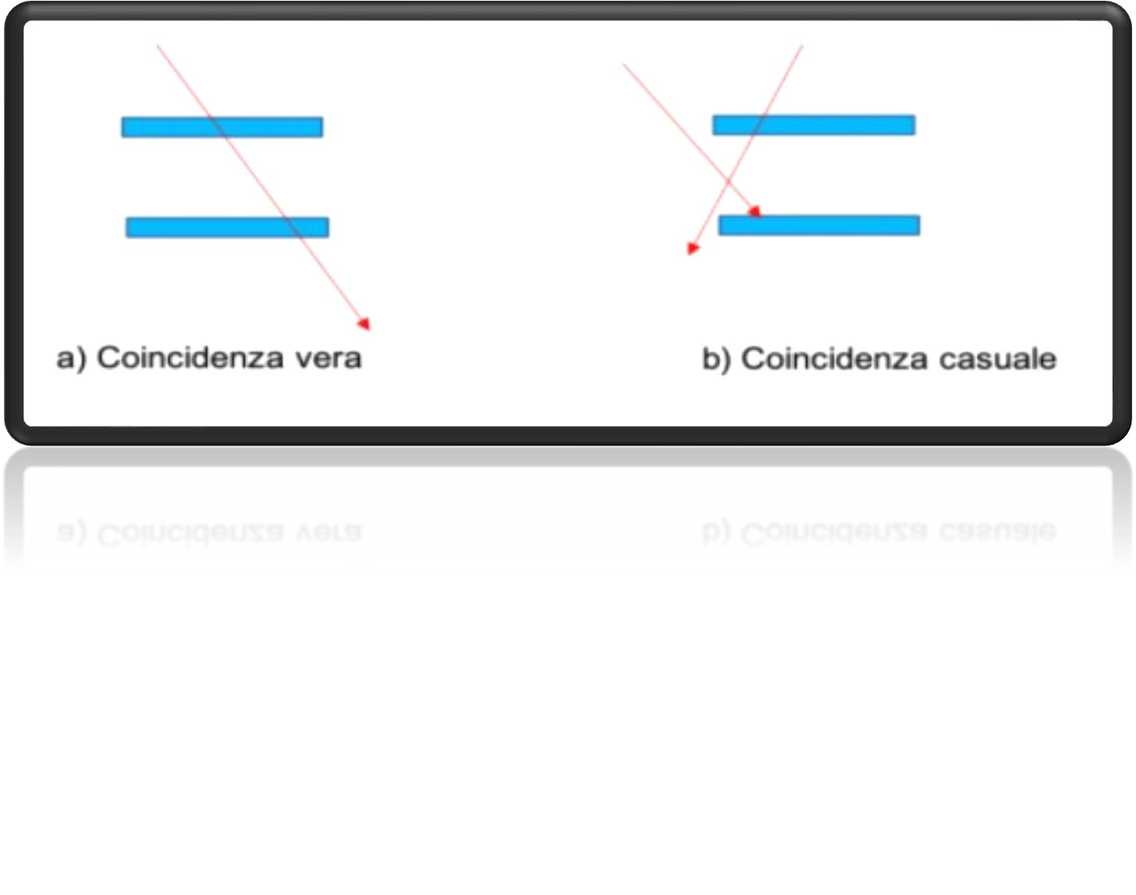
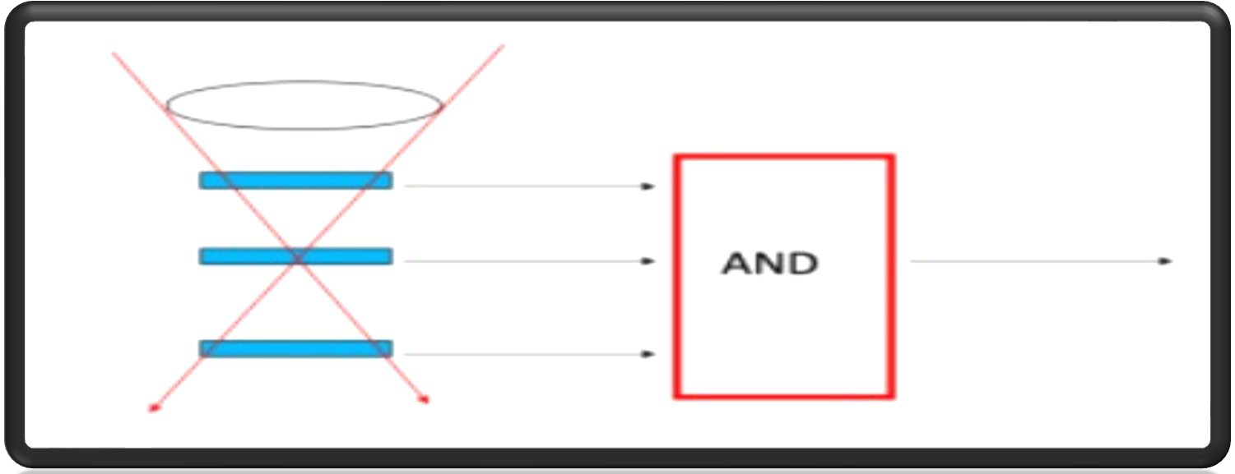
CRC-Cosmic Ray Cube
HOW DOES IT WORK?
Optic fiber catches UV rays, shifts into visible light and activates diodes
1 electric impulse = 1 muon
AND mechanism: all 8 layers activated = 1 muons
LIMITATIONS
Occasional inclination error
Square receiving surface

Slide 6
Data analysis
Data collection
The aim of our measurements was to count muons as a function of the incidence angle.
Each group collected data using the CRC for 2 minutes per angle.
The angles that were investigated were 0°, 10°, 20°… all the way up to 90°
We used the CRC software to record event counts.
Every group did 3 measurements for every angle, for 2 minutes each.
After taking the data we converted counts to frequency.

Slide 7
Data analysis
As the angle increases, the number of detected events decreases.
The more the angle grows the longer the path the particles have to cover before interacting with the detector.

Slide 8
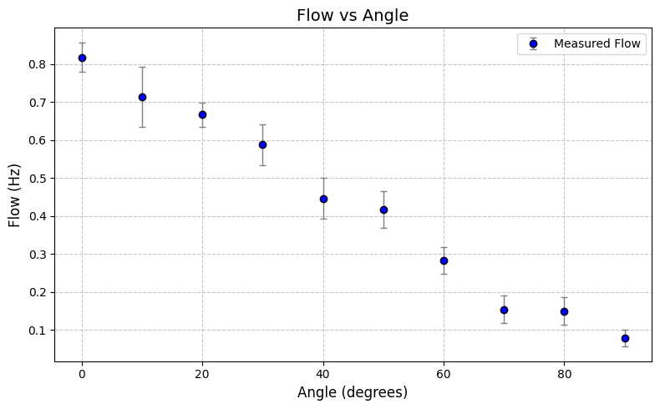
Data
Graphing in excel
Angle [°] | Alt. [m] | Temp. [°C] | GATE [min] | Average | ST.DEV/radN | ST.DEV | Flux [Hz] | ERR. [Hz]
0 | 21 | 23,6 | 2 | 98 | 0,824 | 4,591 | 0,817 | 0,038
10 | 21 | 23,6 | 2 | 85,5 | 1,674 | 9,47 | 0,713 | 0,079
20 | 21 | 23,6 | 2 | 80 | 0,681 | 3,852 | 0,667 | 0,032
30 | 21 | 23,6 | 2 | 70,5 | 1,179 | 6,46 | 0,588 | 0,054
40 | 21 | 23,6 | 2 | 53,5 | 1,191 | 6,522 | 0,446 | 0,054
50 | 21 | 23,6 | 2 | 50 | 1,068 | 5,847 | 0,417 | 0,049
60 | 21 | 23,6 | 2 | 34 | 0,788 | 4,316 | 0,283 | 0,036
70 | 21 | 23,6 | 2 | 18,5 | 0,782 | 4,284 | 0,154 | 0,036
80 | 21 | 23,6 | 2 | 18 | 0,906 | 4,345 | 0,15 | 0,036
90 | 21 | 23,6 | 2 | 9,5 | 0,575 | 2,573 | 0,079 | 0,021
Flux=Av/gate (Hz)
ERR= ST. Dev/gate (Hz)

Slide 9
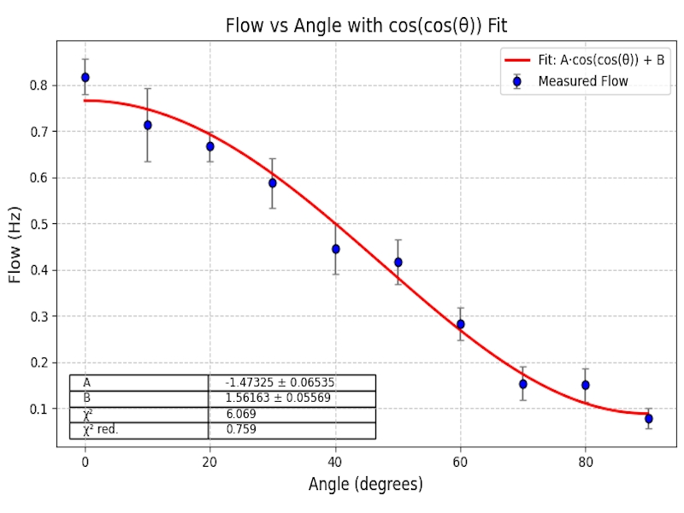
Data
Graphing in Python

Slide 10
Expectations and Final Results
Expected outcomes
From our measurements, we can expect our results to graphically follow the cos²(θ) trend for the utilized angles.
This follows our prediction based on the fact that, the longer trajectory the muons have to follow in order to reach the CRC, the more likely it is for them to encounter obstacles in their path, stopping them.

Slide 11
Expectations and Final Results
Verified outcomes
As expected, the data we gathered acts in accordance with our hypothesis when fitted with the cos²(θ) trend.
We therefore verified that the flux is maximum for vertical muons (0°) and decreases with angle, confirming the expected angular distribution of atmospheric muons.

