Slide 1






Funded by the European Union (EU). Views and opinions expressed are however those of the author only and do not necessarily reflect those of the EU or European Research Executive Agency (REA). Neither the EU nor the REA can be held responsible for them.
Demonstrator RF R&D
Dario Giove
Riunione Annuale RD_Mucoll - Trieste
2 December 2025

Slide 2
The activities described in this paper summarize efforts by:
L. Celona – G. Sorbello – D. Guarnera (INFN and University of Catania)
D. Giove – Elisa Del Core (INFN-LASA)
M. Nenni - C. Mingioni – P. Mereu (INFN Turin)

Slide 3
RF Cavity Structure Rationale
Thin Windows for RF Cavity
RF Cavity Mechanical Design

Slide 4
RF cavities Design
High gradient RF cavities are required in muon cooling channels for the design of a muon collider. A generic ionization cooling channel consists of absorbers with low Z material, a high gradient linac structure (or a few RF cavities) to replenish muon energy lost in the absorbers and alternating super-conducting solenoid to confine the muons in the channel.
Due to the presence of strong magnetic fields from the superconducting solenoids, option for using high gradient superconducting RF cavity is excluded.
Depending on at which cooling stages, high gradient RF cavities are needed in frequencies of the order of 704 MHz, at gradients of 30 MV/m.
A suitable solution may be to use conventional copper cavity with open beam iris covered by thin conducting foils to increase the cavity shunt impedance taking the penetration property of muon beams.
Beryllium due to its low Z and good electric and thermal properties, has been approached as a perfect candidate for the thin conducting foil. Tremendous efforts have been put to study the thermal, electric, and mechanic properties of thin Be foils for application in a RF cavity.

Slide 5
RF Cavity and RF Structure Design
A decision on the type of RF structure that will have to integrated in the cell requires taking into
account a number of parameters that may be summarized as in the following:
the RF frequency
the required real estate gradient of the electric field in a cell vs. the peak gradient achievable in the RF structure
the type of RF coupling from cell to cell in a RF structure
the space available to fit ancillaries (e.g. tuners, power couplers, cooling pipes etc…), considering the tight interference with the cryomagnetic system
expected breakdown rate and eventual mitigation strategy, especially in the high magnetic field and high magnetic gradient they experience
specific materials and surface treatments for the cavity bodies.
the available or realistically feasible power sources
Most of the parameters being used for simulations of the entire cooling section are at the edge or beyond the present state-of-the-art, therefore require careful evaluation of the feasibility of the corresponding technological solution.

Slide 6
RF Cavity and RF Structure Design
The large transverse emittance of the muon beam requires large apertures, and the RF cavities must accommodate up to a 12 cm beam diameter. Such a large bore leads to a low shunt impedance in conventional open beam-pipe structures.
We studied cavities with up to 16 cm diameter with thin (50-200 µm) windows through which the muon beams pass with a reduced scattering rate
This allows the shunt impedance of the device to be increased, the maximum surface field to equal the on-axis accelerating field.
The reference frequency used in the study of the first RF cells has been 704 MHz.
Berillium and aluminum windows have been considered.

Slide 7
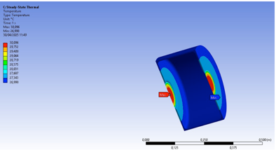
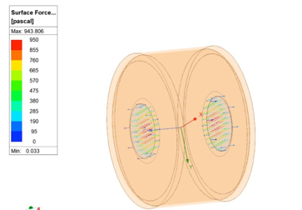
Test facilities: high electric fields in magnets and RF laminas
The RF cavities design foresees the presence of thin (50-200 micron) metallic windows at the cells iris. This will simplify the RF e.m. design but introduces a challenging element related to the mechanical design, the soldering procedures and the capability to sustain RF pressures and thermal stresses.

Slide 8
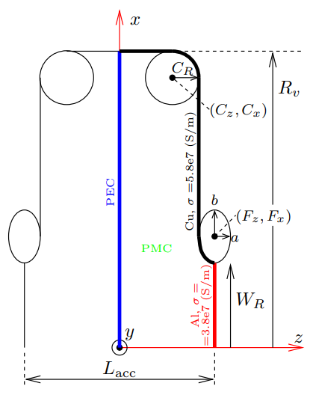
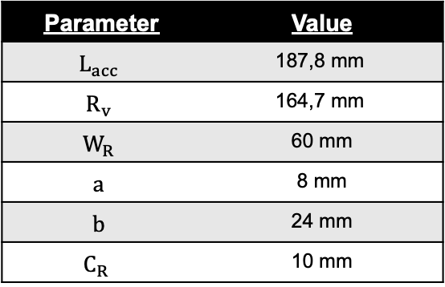
RF cell @704 MHz INFN studies
Parameter | Value
$$L_{acc}$$ | 187,8 mm
$$R_{v}$$ | 164,7 mm
$$W_{R}$$ | 60 mm
$$a$$ | 8 mm
$$b$$ | 24 mm
$$C_{R}$$ | 10 mm

Slide 9
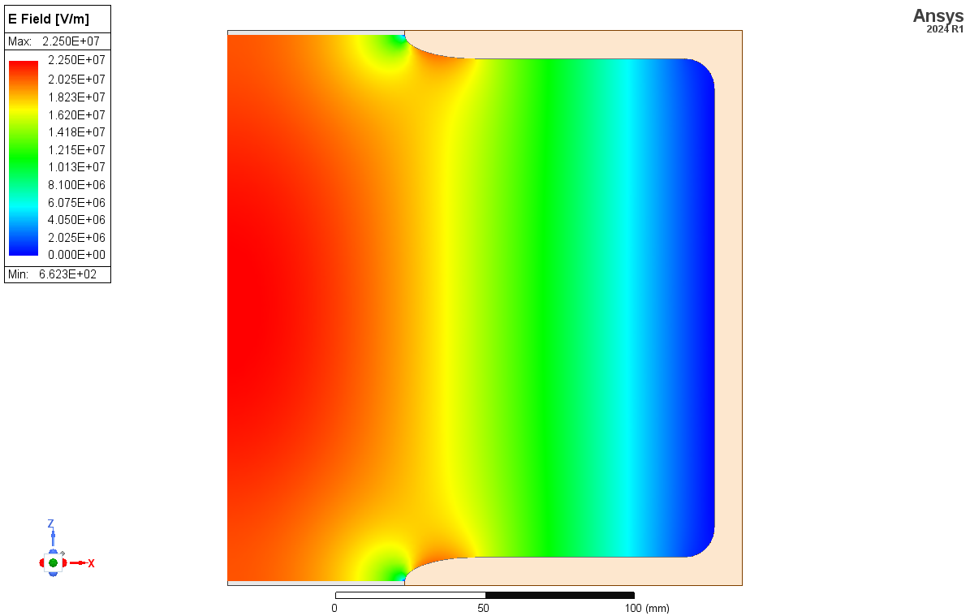
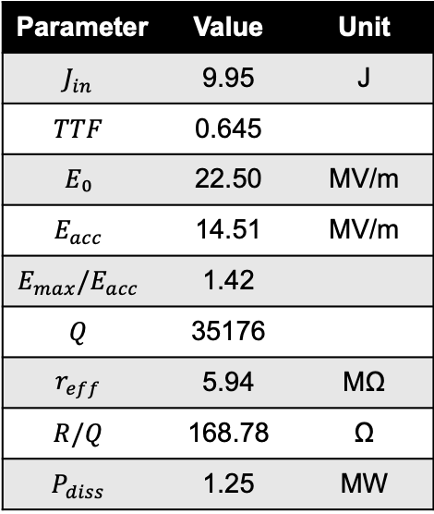
Flat-Top Cavity Geometry
Parameter | Value | Unit
$$J_{in}$$ | 9.95 | J
$$TTF$$ | 0.645
$$E₀$$ | 22.50 | MV/m
$$E_{acc}$$ | 14.51 | MV/m
$$E_{max}/E_{acc}$$ | 1.42
$$Q$$ | 35176
$$r_{eff}$$ | 5.94 | MΩ
$$R/Q$$ | 168.78 | Ω
$$P_{diss}$$ | 1.25 | MW

Slide 10
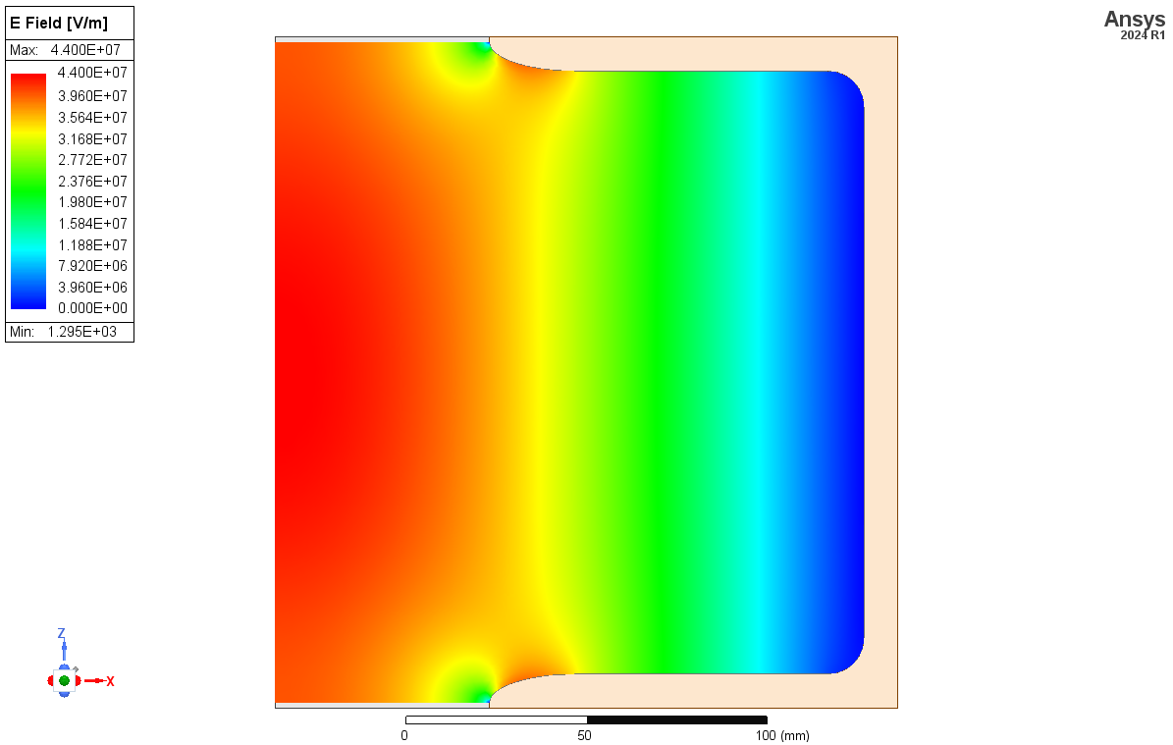
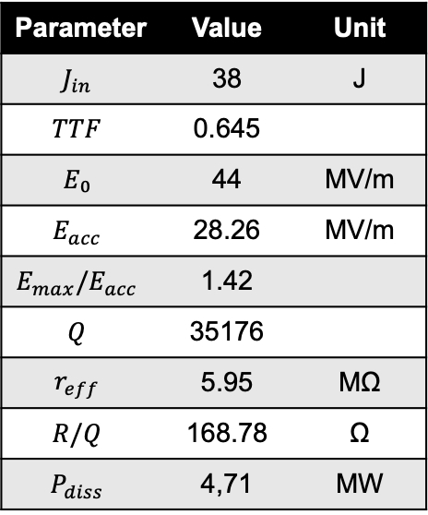
Flat-Top Cavity Geometry
Parameter | Value | Unit
$$J_{in}$$ | 38 | J
$$TTF$$ | 0.645
$$E₀$$ | 44 | MV/m
$$E_{acc}$$ | 28.26 | MV/m
$$E_{max}/E_{acc}$$ | 1.42
$$Q$$ | 35176
$$r_{eff}$$ | 5.95 | MΩ
$$R/Q$$ | 168.78 | Ω
$$P_{diss}$$ | 4,71 | MW

Slide 11
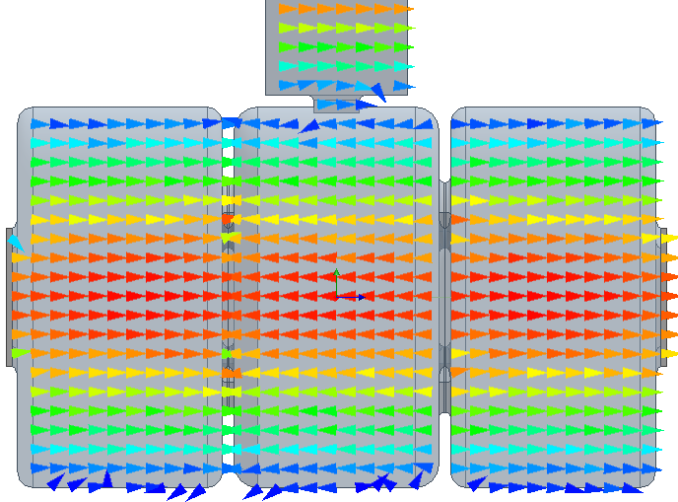
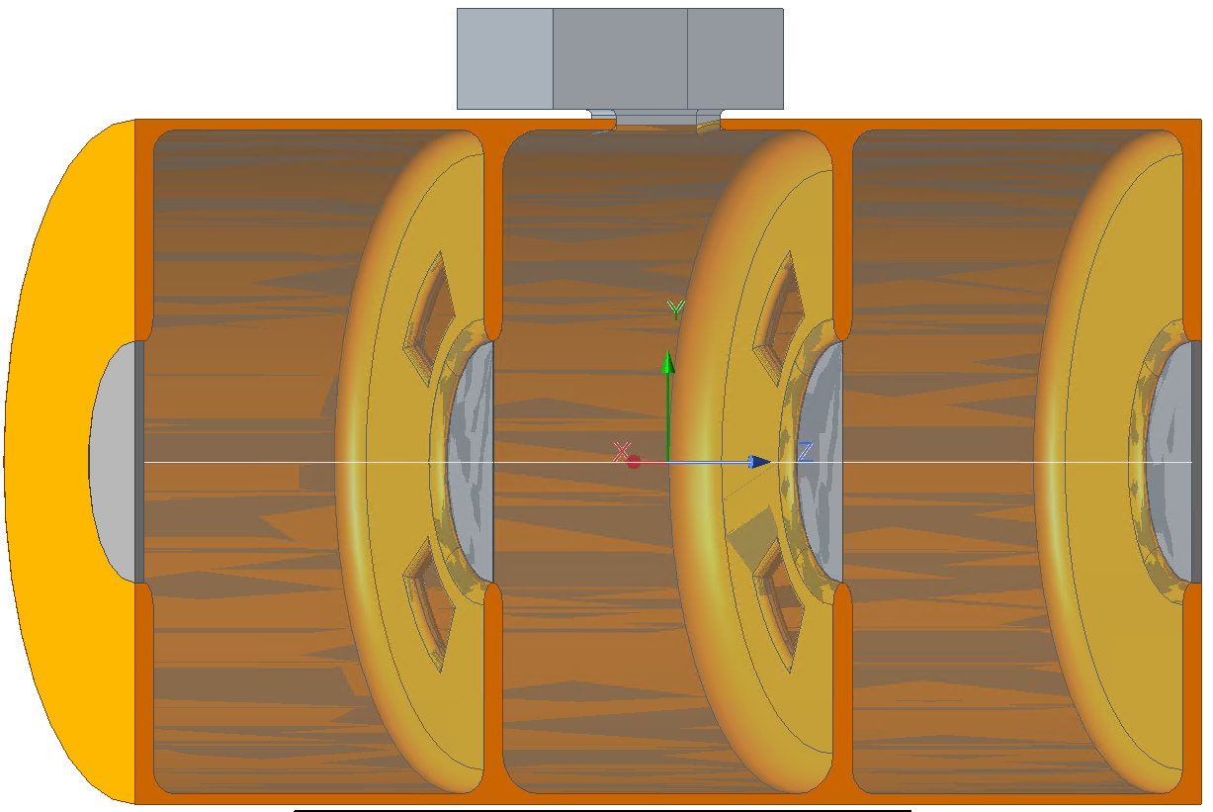
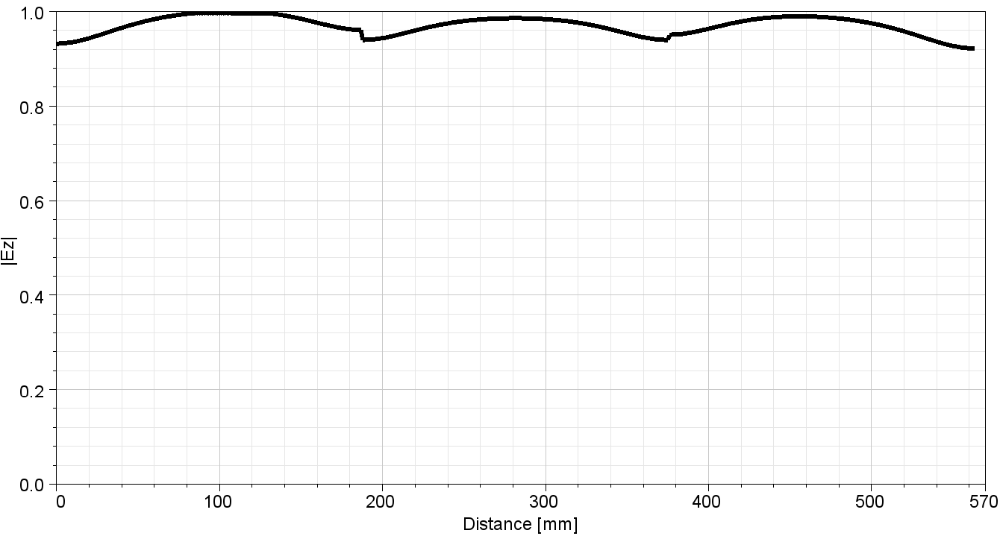
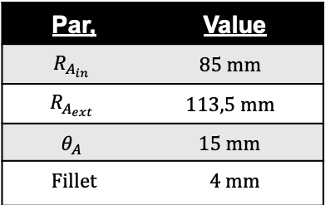
3 cells RF preliminary structure
Par, | Value
$$R_{A_{in}}$$ | $$85 mm$$
$$R_{A_{ext}}$$ | $$113,5 mm$$
$$θ_{A}$$ | $$15 mm$$
Fillet | $4$ mm

Slide 12
RF windows
R&D has been concentrated on the design and analysis of robust RF structure with the Be foils which will operate under high electromagnetic RF fields. The Be foils are exposed to these high EM fields, and RF currents are induced in the foils which lead to temperature gradients within the foils.
The foils may be deformed due to the temperature gradients, and result in detuning of the cavity so that RF power is being reflected if the RF heating can not be conducted away.
At the beginning of the 2000s a lot of computational and experimental works have carried at LBNL (see PAC 2001 contributions).
The windows wee made from high purity Be foils 127 microns thick and with 160 mm diameter (IF-1, 99 % purity Be). Each foil is sandwiched in between two annular Be frames with less purity (PS-200, 98.5 %) by diffusion bonding (braze).
Pre-tension is needed in keeping the foils flat, and is naturally induced from the brazing process. However, the
exact amount of pre-tension was unknown, and difficult to measure and simulate.

Slide 13
RF windows
Within the frame of the R&D activities due to the Muon Collider project in 2022 we have resumed the works carried out in the USA both in consideration of the fact that the authors of the aforementioned had left their activities or had assumed different roles and to understand the difficulties inherent in the project with particular attention to the implementation component.
In this context, INFN researchers immediately turned their attention to a two-pronged approach to the problem.
On the one hand, they resumed the modeling and computational approach aimed at integrating the foils into the cavities, and on the other, they designed and built both foils and measuring tools suitable for the purpose.
The computational approach undoubtedly benefited from a retrospective comparison with similar work carried out by colleagues at CERN.
From an application point of view, to date, only INFN is carrying out construction work within the collaboration.

Slide 14
RF windows
Both the computational part (INFN side) and the implementation part proceeded in parallel.
In this sense, the analysis methodologies linked to the USA approach briefly discussed above were first developed, and at the same time preliminary steps were taken to verify its feasibility.
In general terms, the following points were addressed in order:
window materials
thicknesses and dimensions as required by the BD
surface finishes
surface condition (flat or curved)
surface processing
methods of fixing to RF cavities

Slide 15
RF windows
Looking at the experiences carried out in the USA about the subject it results that the beryllium windows were provided by Brush-wellman, a small specialized company in Fremont,California.
Today the situation is completely different:
In the world only 3 companies provides beryllium components:
Materion Corporation (USA) they incorporated Brush-Wellman
ULBA Metallurgical Plant (Kazakhstan)
IBC Advanced Alloys (USA).
We get a positive answer from Materion about the interest in proving flat windows within diameter and thickness fixed in their catalogue. The minimum order must be of at least 12000$ !!! ULBA delayed any discussion up to now.
Moreover we have to take into account that machining beryllium elements imposes very strict safety requirements that at the moment may not be match at INFN. Even CERN is setting up a devoted laboratory but what may be required for this application has been considered out of the scope of the activity.
An alternative material as the alloy Albemet has not been considered due to the same problems in supply and safety requirements.

Slide 16
RF windows
Due to these considerations INFN proposed to the whole MC collaboration to evaluate aluminum as an alternative choice, at least for the first tests for the demonstrator.
Aluminum has worst mechanical properties with respect to Beryllium but good thermal and electrical conductivity. The Z number is low and this is one of the reason to evaluate its use looking at the reduced contribution in scattering the beam.
To compensate the poor mechanical properties of pure aluminum we have evaluated to use alloys as Al 6061T6 or Al6082T6.
They provide better properties in terms of strength and present the same thermal expansion coefficient and a good IACS (parameter related to electrical conductivity).
A search of commercial available sheets for these alloys with a suitable thickness (150-250 micron) does not provide in the last months valuable results.

Slide 17
RF windows
To fix the windows to the copper RF cavity body different approaches are under analysis:
Brazing (beryllium)
Electron beam welding (aluminium)
Screwing to intermediate rings
Mechanical compression (a sandwich like approach)
Pretension using different thermal expansion materials.
As a first approach we will evaluate a mechanical compression mechanism looking at the different malleability of copper and aluminum alloys and to get experience on the assembly procedure.
The flatness of the surface so far obtained may be studied using a 3D surface analysis tool from microEpsilon named reflectCONTROL that provides flatness control over an area of 100 mm diameter of the order of 15 microns.
The cost of this device does not fit the funds available and we will do single points map using a specialized laser triangulation sensor for reflective surfaces.

Slide 18
RF windows
An activity program starting in September 2025 has been defined with a specialized Italian company (COMEB):
Design a full mechanical layout of a 3 cells structure assuming that the iris windows will be fixed using a mechanical pressure joint (this will include power coupler, cooling channels, power detector loops)
Test mechanical fixing of aluminum sheets using intermediate materials and brazing or electron beam welding
Test mechanical fixing of aluminum sheets using intermediate materials and mechanical compression system
Define a suitable aluminum alloy with a thickness of the order of max. 150 microns
.

Slide 19
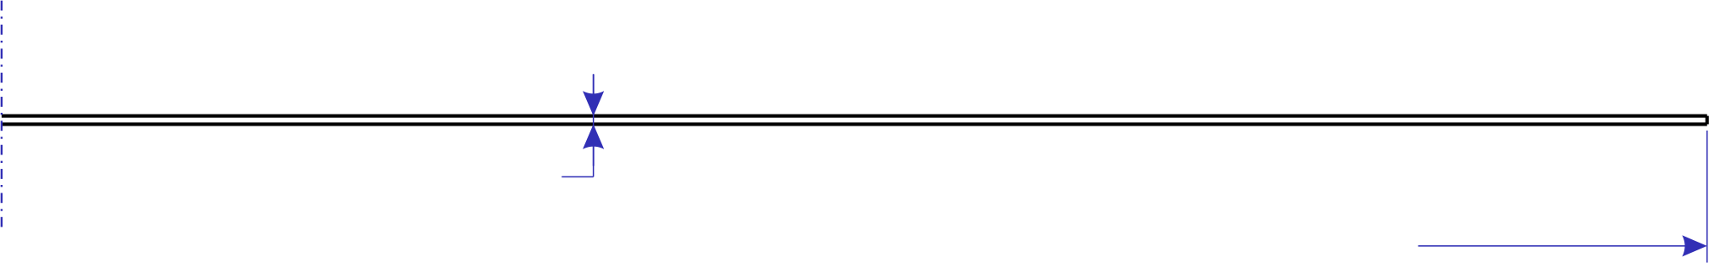
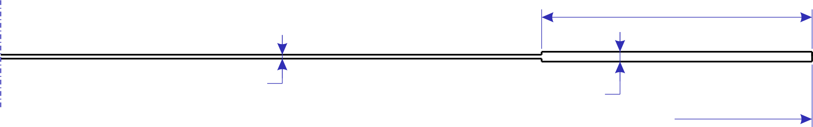
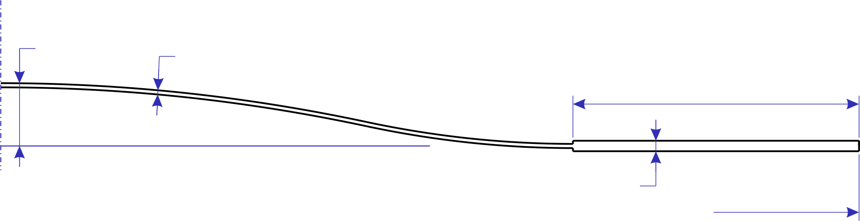
Design of the window
Three possible design analysed
Flat foil
beam axis
Parametric analysis for each design:
foil thickness t_{foil} → 50, 100, 150, 200 μm
window radius R_{w} → 60, 80 mm
accelerating gradient E₀ → 22.5, 40 MV/m
material → Beryllium, Aluminum
t_{foil}
R_{w}
Step foil
20mm
beam axis
 | Density [kg/m³] | Therm. cond. [W/m/K] | Young’s mod. [GPa] | Tensile yield str. [MPa]
Be | 1850 | 202.6 | 302.2 | 525.4
Al | 2710 | 237.5 | 70.9 | 114.8
t_{foil}
0.5mm
R_{w}
1mm
t_{foil}
Curved step foil
beam axis
20mm
Significant advantage of Be
in its mechanical properties
0.5mm
R_{w}

Slide 20
Steps of the analysis
Steady-state thermal & static structural analysis
Average RF heating load
Thermal displacement
Foil temperature field
High thermal inertia compared to short, high-power pulses → the problem can be considered steady-state. Average RF heating load applied
Thermal deformation computed with respect to 20 °C
Total displacement
Static structural analysis
Peak Lorentz force
Displacement
Non-trivial comparison between deformation inertia and pulse velocity → Lorentz force conservatively considered constant and equal to the peak value
Modal analysis
Geometric constraints
Natural frequencies
Optimize geometry to avoid resonance of Lorentz force

Slide 21
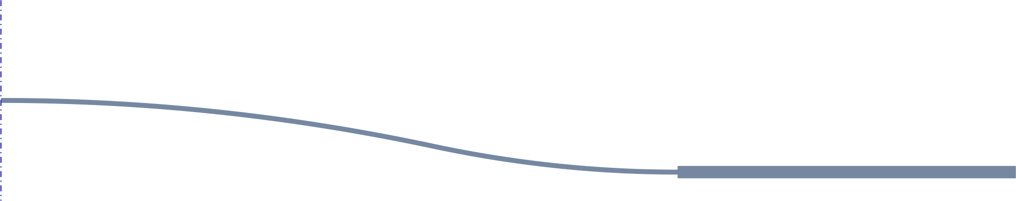
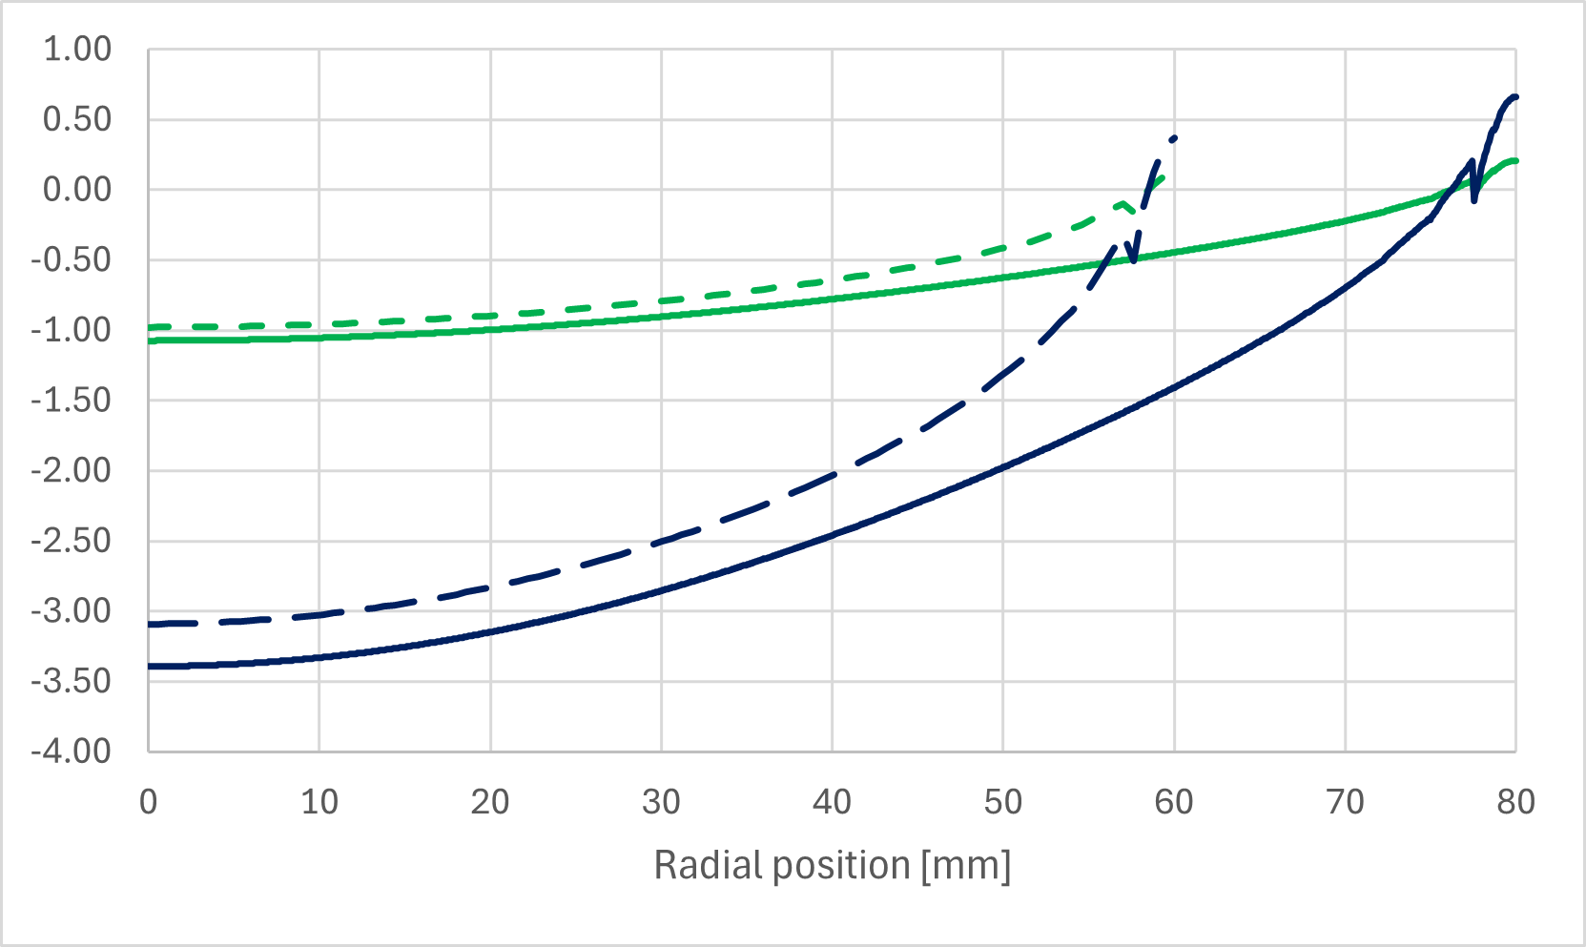
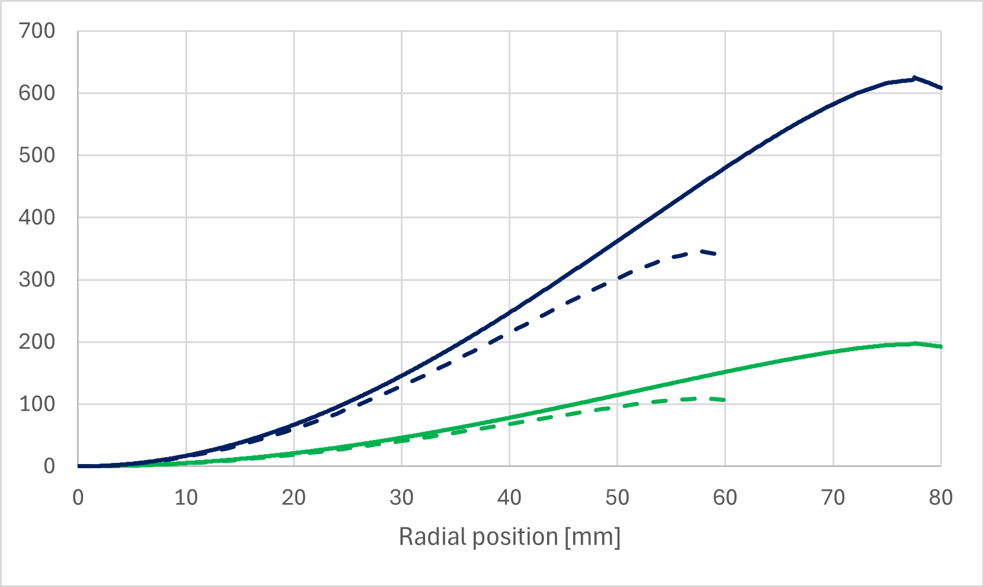
Loads and boundary conditions
axial symmetry
condition
fixed support
to cavity wall
beam axis
Lorentz force positive sign
Lorentz force negative sign
fixed temperature T=300K
same as cavity wall
RF heating
cavity side
Lorentz peak force [kPa]
RF mean heating load [W/m²]
Peak force conservatively considered constant
R_{w} 60 mm
E₀ 40 MV/m
E₀ 22.5 MV/m
R_{w} 80 mm
R_{w} 60 mm
R_{w} 80 mm
E₀ 40 MV/m
E₀ 22.5 MV/m
RF heating averaged on duty cycle. Assumed the same for both Al and Be

Slide 22
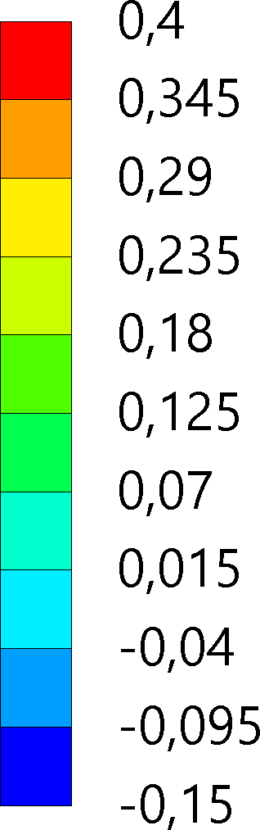

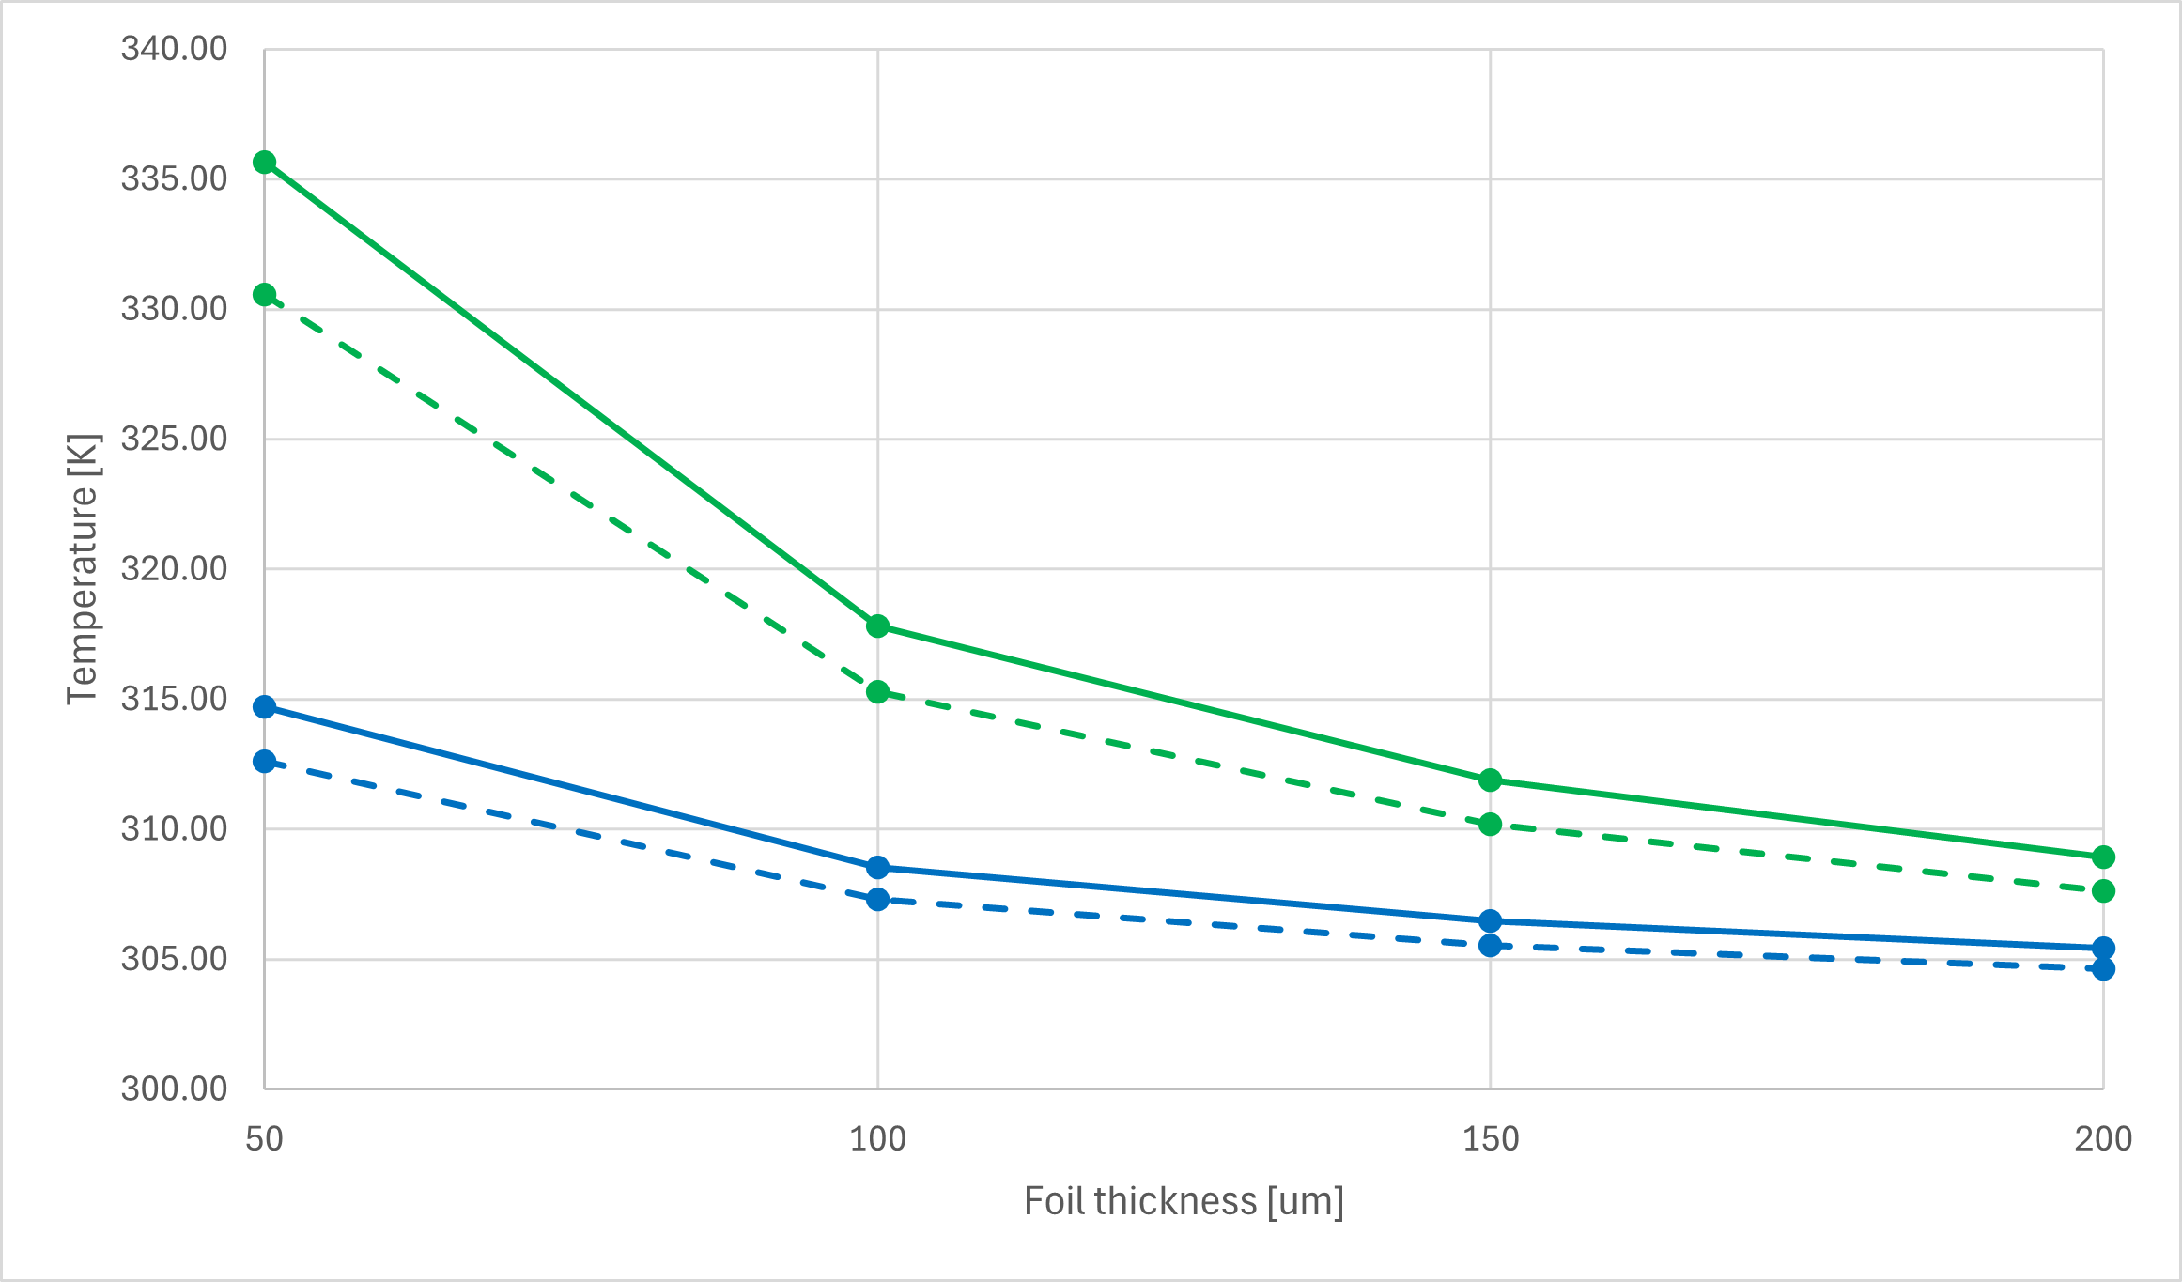
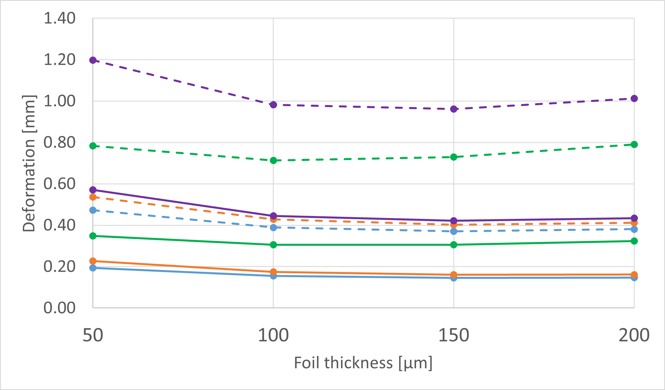
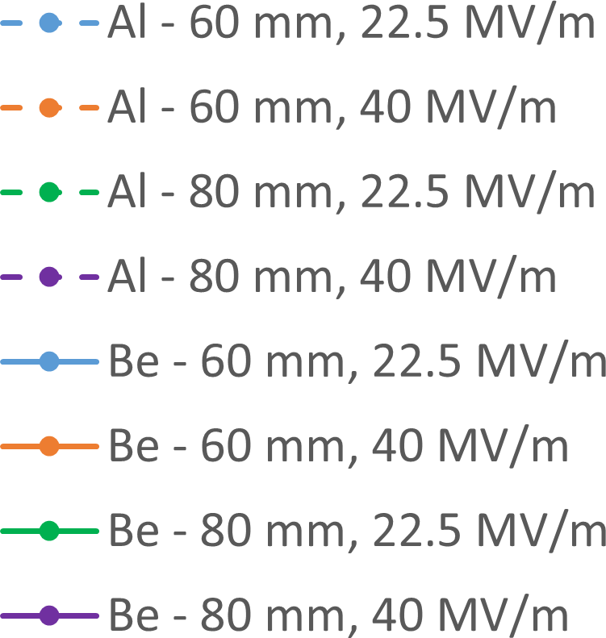
Thermal analysis
Al - t_{foil} 150 μm - R_{w} 60 mm - E₀ 22.5 MV/m
Thermal displacement (axial) [mm]
Curved foil → accentuates the curvature of the foil outward from the cavity
Flat foil → buckling if no other force applied
Thermal displacement
Temperature on beam axis worst case (R_{w} 80 mm - E₀ 40 MV/m)
Thermal displacement (axial) – Curved foil
Flat foil
Al
Be
Step & curved foil

Slide 23
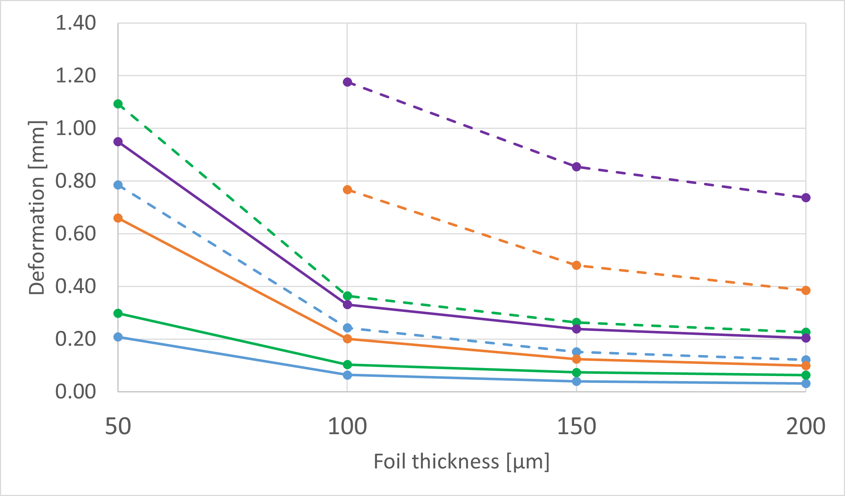
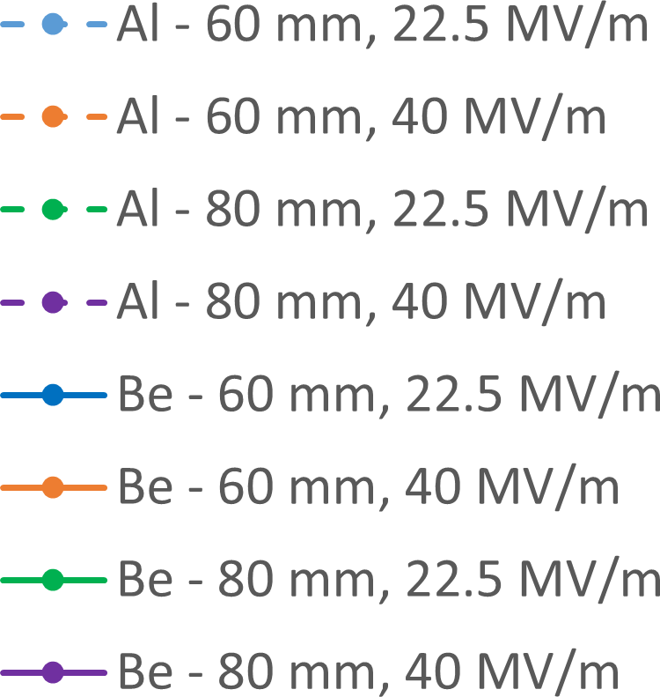
Lorentz force
Counteract the effect of thermal displacement
Flat & step foil→ fails at any thickness value
Al - t_{foil} 150 μm - R_{w} 60 mm - E₀ 22.5 MV/m
Lorentz force-induced deformation [mm]
Lorentz force induced displacement
Lorentz force-induced deformation (axial) – Curved foil
Peak value assumed constant throughout the period
Overly conservative hypothesis
Need to find an average over the period that yields more realistic pressure values
(still ongoing)

Slide 24
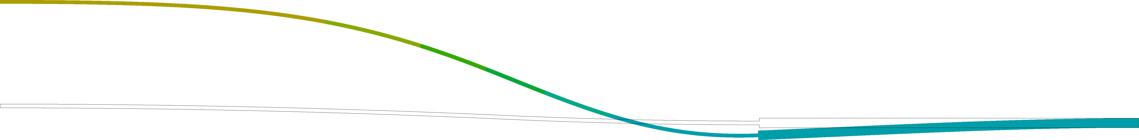
Total displacement
Thermal
Al - t_{foil} 150 μm - R_{w} 60 mm - E₀ 22.5 MV/m
Axial deformation [mm]
Lorentz force
Deformation maximum
Total displacement
Deformation maximum

Slide 25
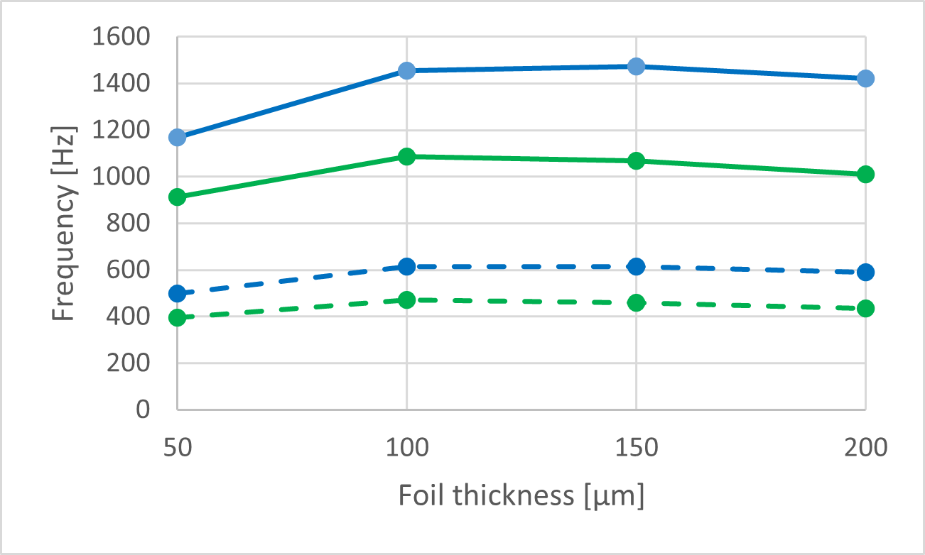
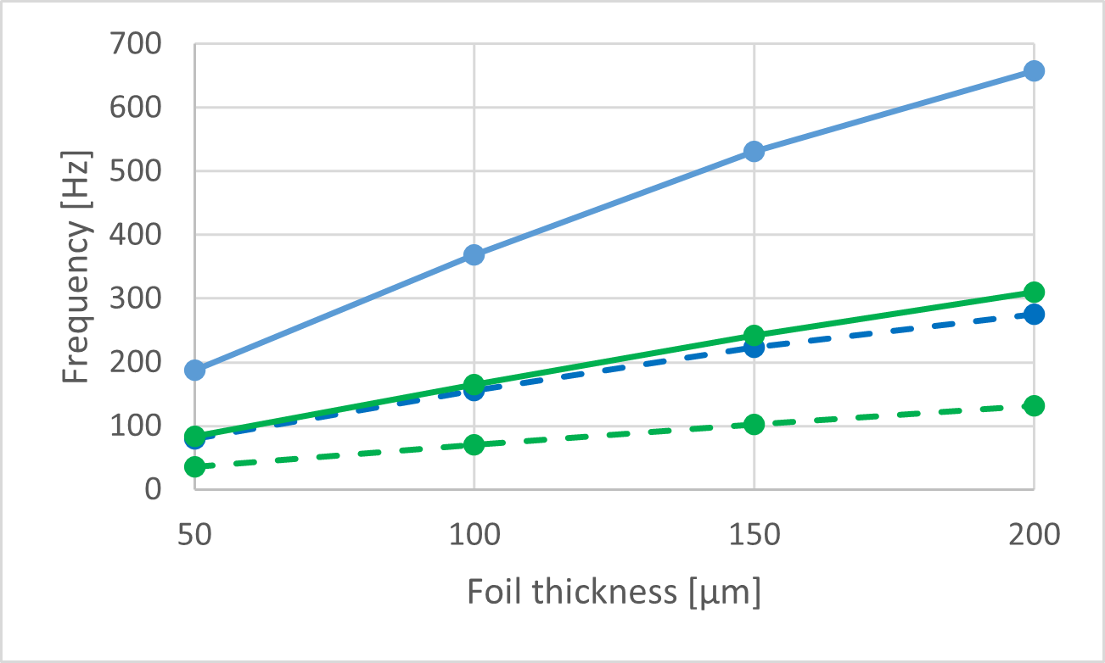
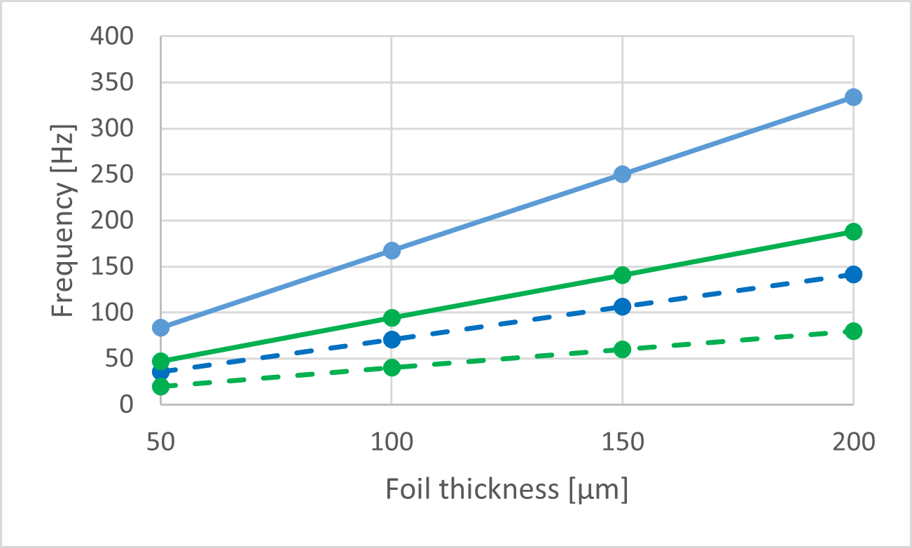
Modal analysis
Design criterion
Lowest mechanical resonant frequency >> power pulse frequency (5 Hz)
Further investigation needed
(e.g. transient analysis, experimental test)
Resonance (of Lorentz force) is still possible in case of low dumping
Curved foil - 1st mode freq.
Step foil - 1st mode freq.
Flat foil - 1st mode freq.

Slide 26
3 cells RF Final Mechanical Design
The mechanical design was developed based on the following key points:
machining by turning and milling (no way to consider deep drawing)
use of OHFC copper and steel for vacuum and RF connection flanges as well as for electric field probes
combination of brazing and sealing with aluminum O-rings and screws (possibility of replacing deteriorated foils)
standard CF160 flanges for connections at the ends
design of a special flange to secure the waveguide due to limited space. The same applies to the waveguide
vacuum pumping through the waveguide (before the separation ceramic)
automatic vacuum maintenance throughout the structure (if closed at the ends with blind flanges)
cooling by means of 6 external circuits

Slide 27
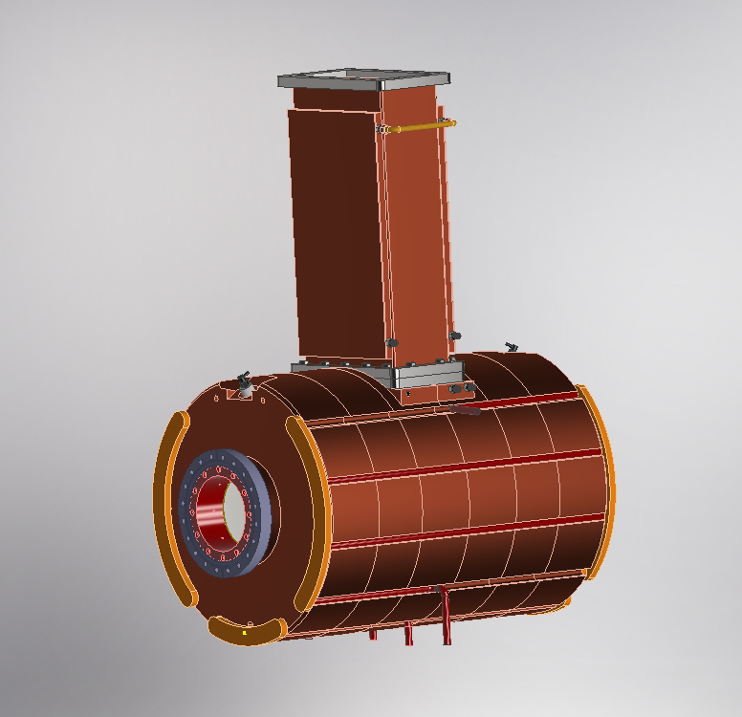
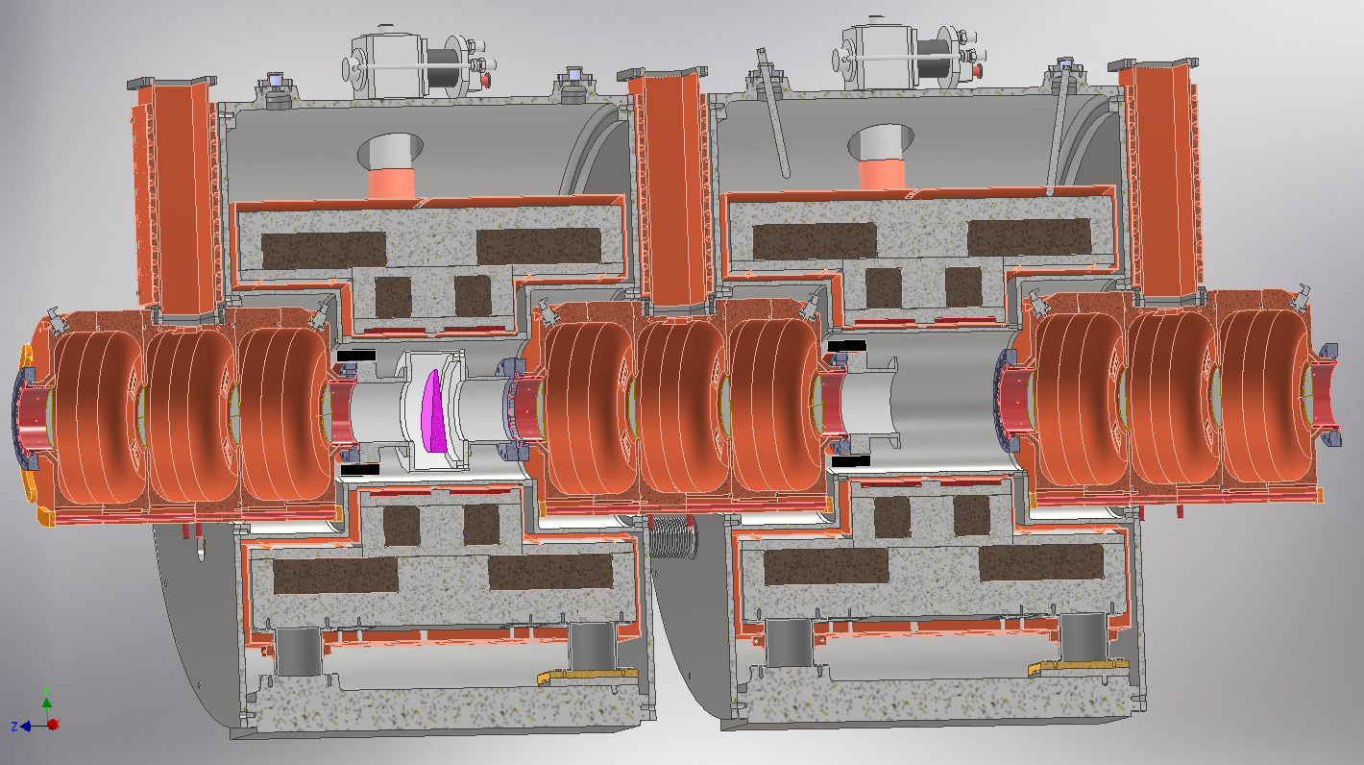
3 cells RF Final Mechanical Design

Slide 28
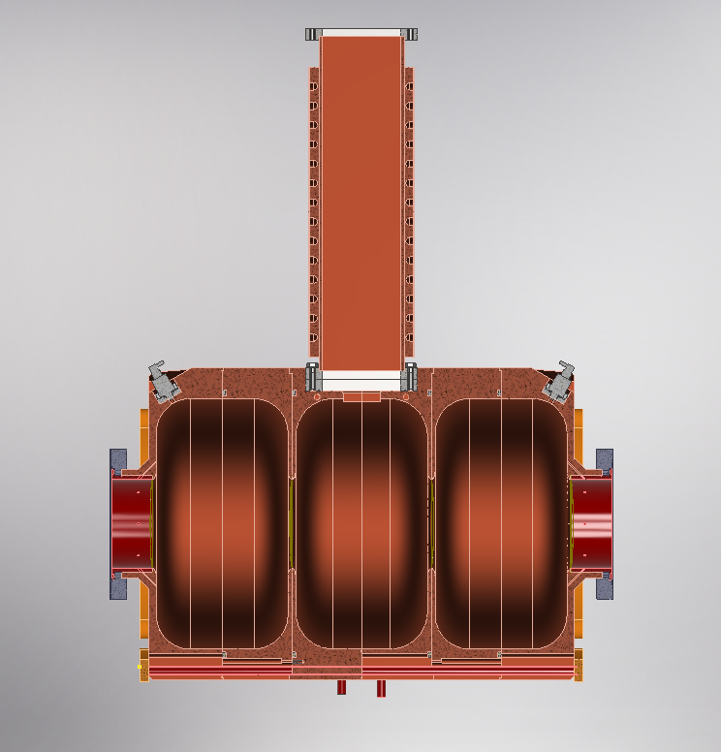
3 cells RF preliminary mechanical design

Slide 29
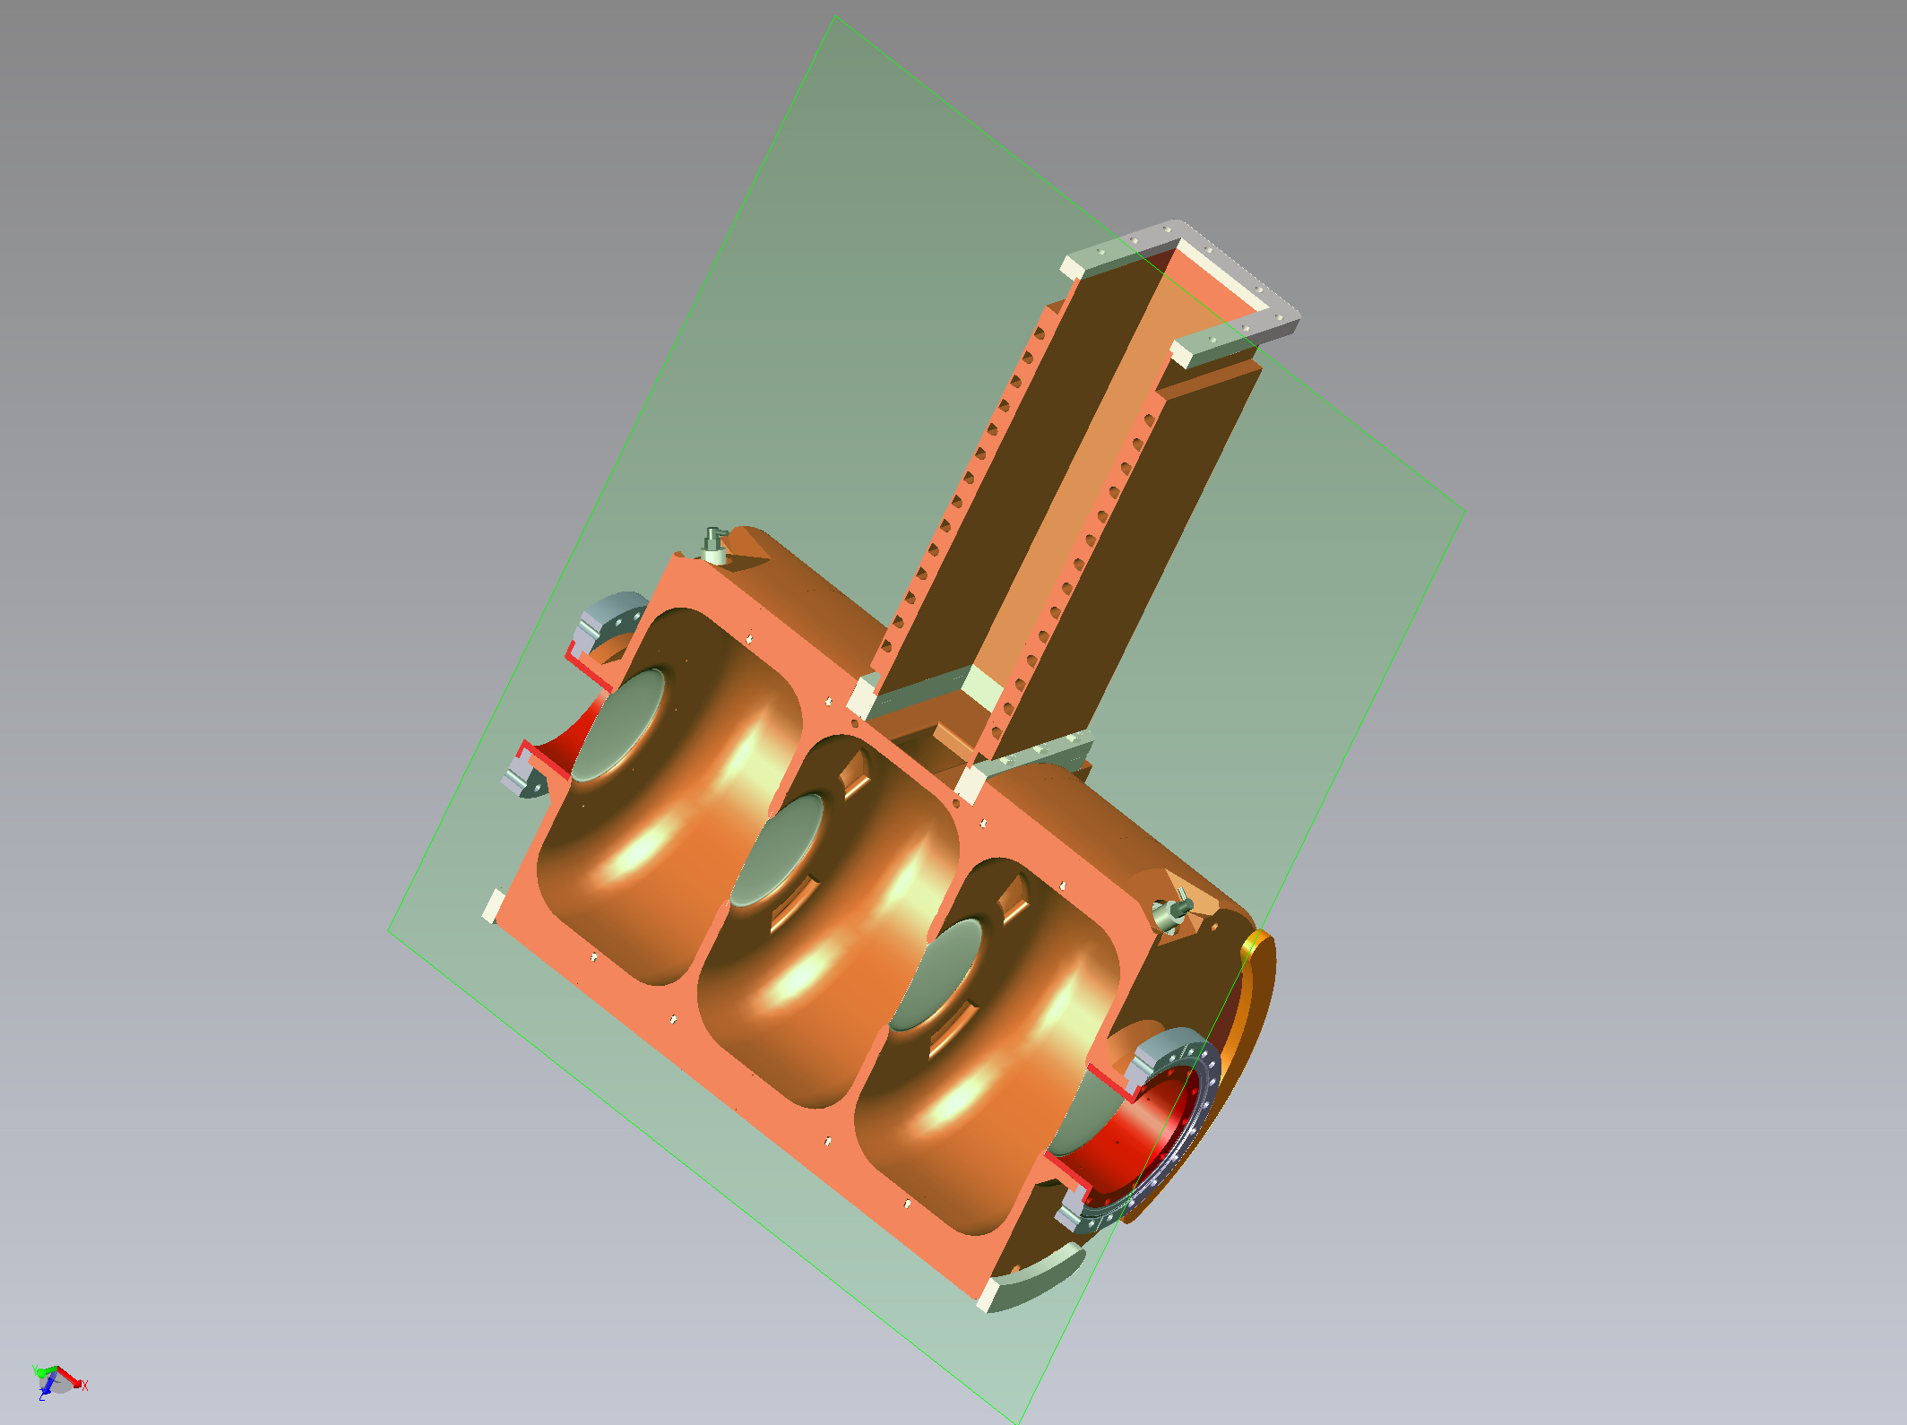
3 cells RF preliminary mechanical design

Slide 30

Thank you
for your attention

