Slide 1






Funded by the European Union (EU). Views and opinions expressed are however those of the author only and do not necessarily reflect those of the EU or European Research Executive Agency (REA). Neither the EU nor the REA can be held responsible for them.
Summary of the IMCC Demonstrator Workshop and Future Prospects
Dario Giove
Riunione annual RD_MUCOL - Trieste
2 December 2025

Slide 2
Muon Cooling Lattice Design
Roadmap Scheme
Cooling and Demonstrator
Tolerances and Errors
Test Stands
Demonstrator Cooling Cell Module
Technological Issues and Open Points
Cryogenic System Options
Fermilab & TTF3 Options

Slide 3
Roadmap Scheme

Slide 4
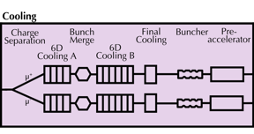
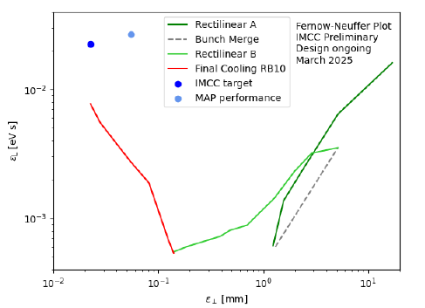
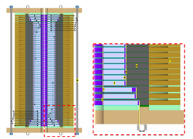
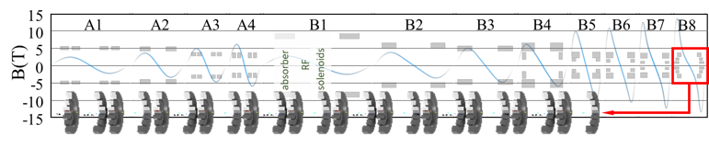
Muon Cooling Lattice Design
Challenges:
Novel, complex lattice with cavities and absorbers in solenoids
High magnetic field
Previous design (MAP)
Goal
Achieved
Achieved:
Much improved lattice design
Developed simulation tools: BDSIM and RFTrack
This allowed to start collective effects studies
Magnet scaled and conceptual designs for 6D cooling
40 T final cooling solenoid conceptual design (55 T is identified to be the limit)
better
better
Key conclusions:
Can in principle reach or exceed performance target
Magnet models and prototypes need to be built
Much improved longitudinal, is useful for collider ring
Study of collective effects important

Slide 5
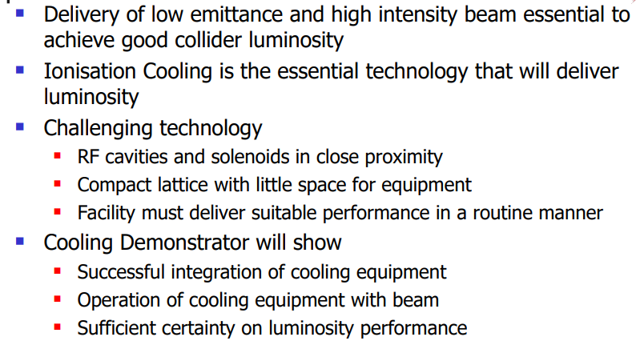
Cooling and Demonstrator

Slide 6
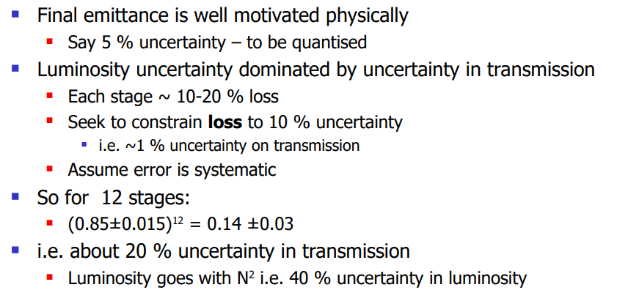
Some Numbers …

Slide 7
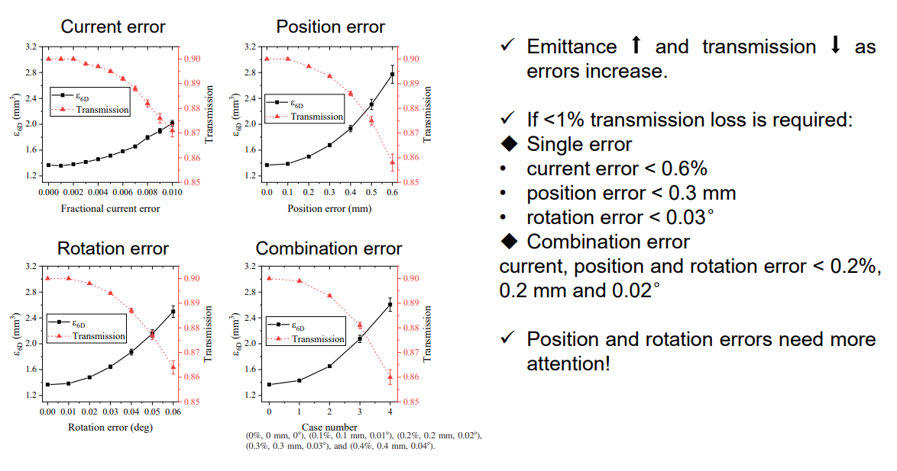
Tolerances and Errors : Solenoids

Slide 8
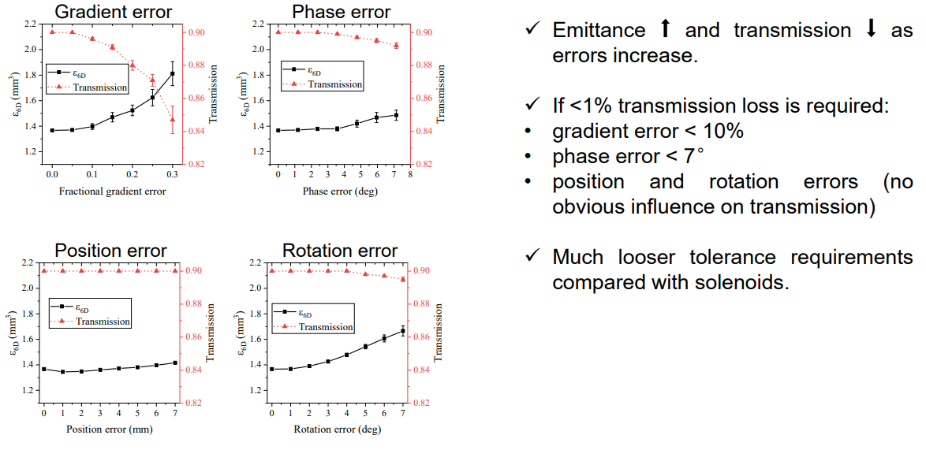
Tolerances and Errors : RF Cavities

Slide 9
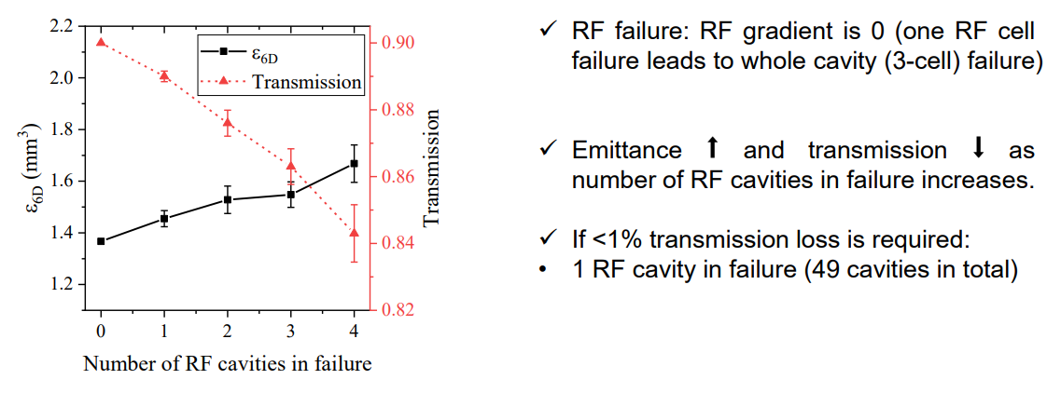
Tolerances and Errors : RF Cavities

Slide 10
Need for RF Test Stand with High Magnetic Field

Slide 11
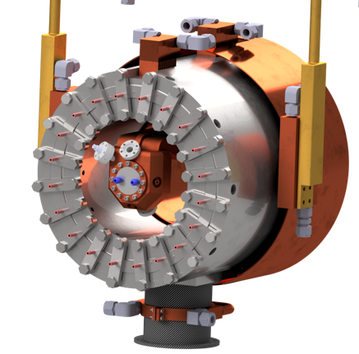
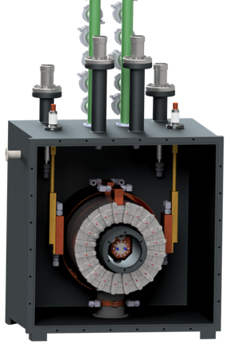
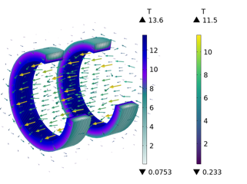
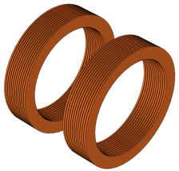
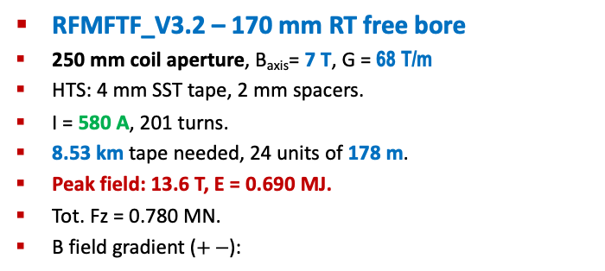
Test Stands
RFMFTF_V3.2 – 170 mm RT free bore
250 mm coil aperture, B_{axis}= 7 T, G = 68 T/m
HTS: 4 mm SST tape, 2 mm spacers.
I = 580 A, 201 turns.
8.53 km tape needed, 24 units of 178 m.
Peak field: 13.6 T, E = 0.690 MJ.
Tot. Fz = 0.780 MN.
B field gradient ($+−$):

Slide 12
Test Stands – INFN -LASA

Slide 13
Test Stands – SLAC-NLCTA

Slide 14
Test Stands – SLAC-NLCTA

Slide 15
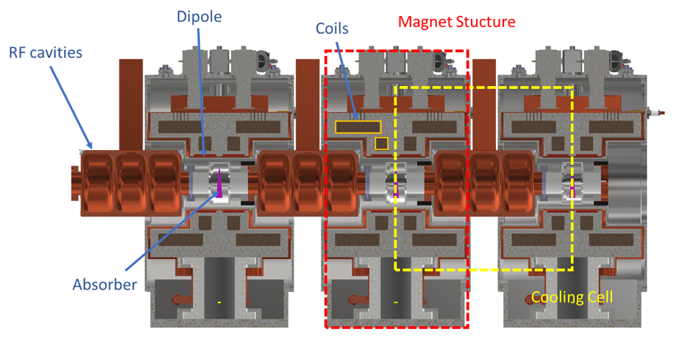
Demonstrator Cooling Cell Module

Slide 16
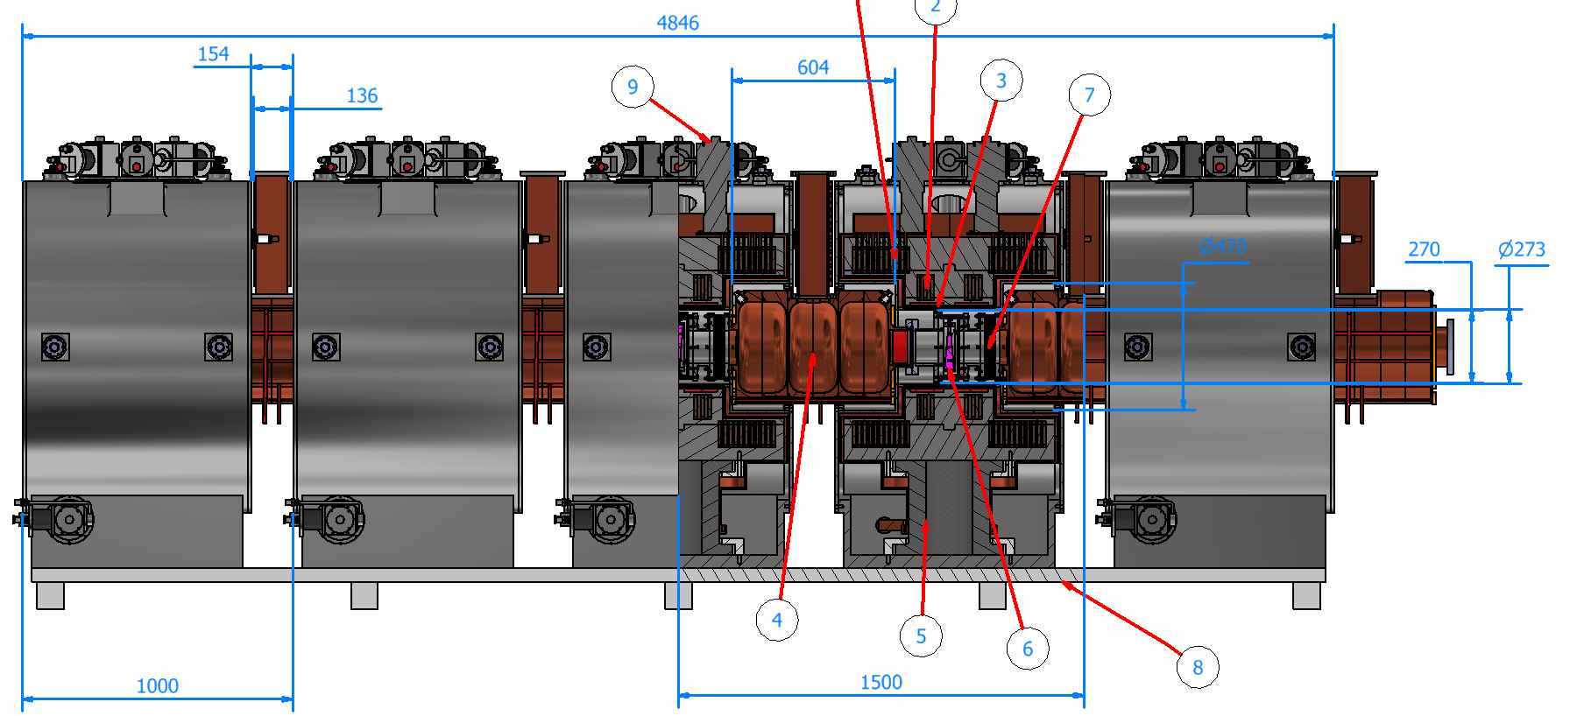
Demonstrator Cooling Cell Module

Slide 17
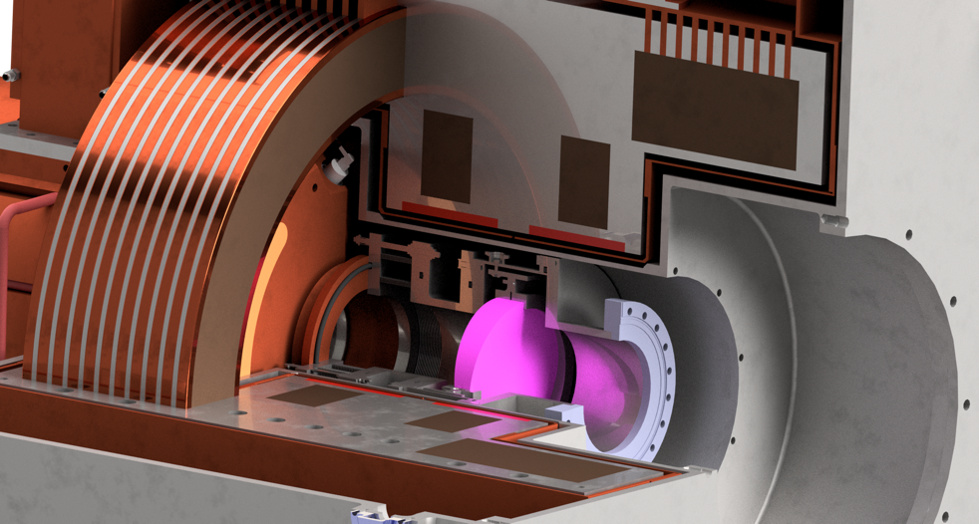
Demonstrator Cooling Cell Module
LiH holder
(adgiustable support)
Custom pillow seal system
LiH

Slide 18
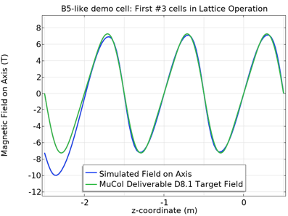
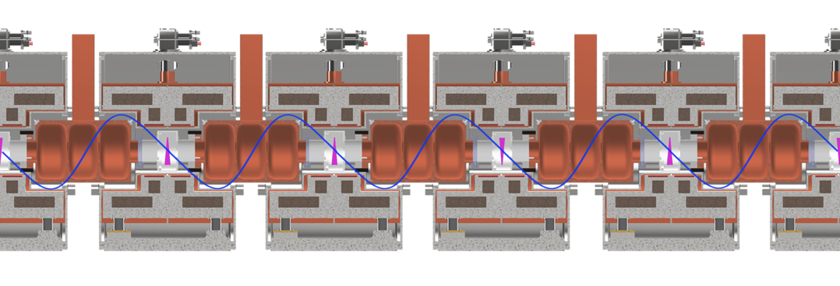
Demonstrator Cooling Cell Module
Initial - final module design not yet considered.
Loss of symmetry: 10 T peak field on axis
  25% current reduction: match peak field on axis.
Unbalanced forces in the first (last) two inter-cell units.
Adiabatic matching?

Slide 19
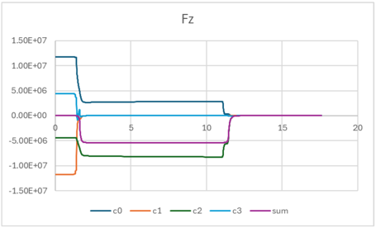
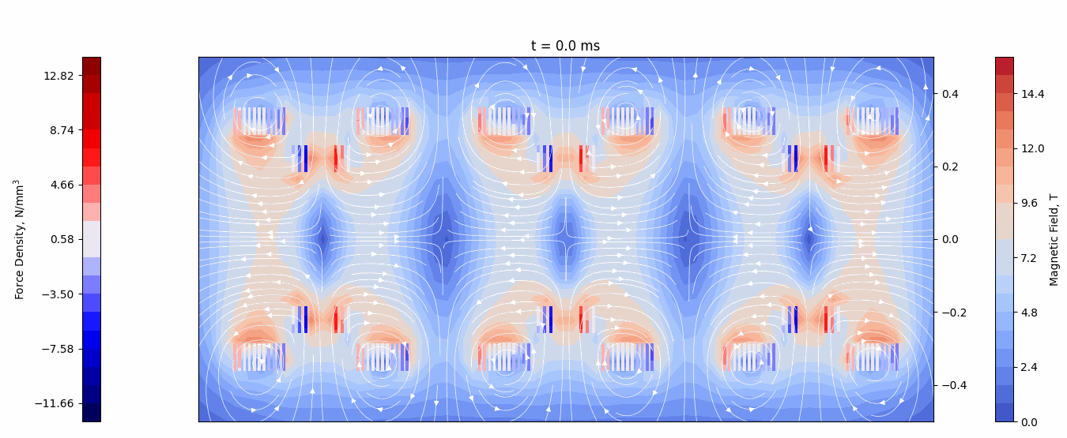
Technological Issues and Open Points
Quench – no protection system:
Quench initiated on one of the inner turns of C1
Quench propagation in C1 and neighbouring coils.
5.4 MN unbalanced force in the central inter-cell module.
  Support structure designed for max 1 MN unbalance!
Courtesy of T. Mulder (CERN)

Slide 20
Technological Issues and Open Points
Disconnection
O’ring
Absorber flange
Bellows
Cavity flange
Vacuum
Ø150mm
Ø230mm
O-ring: Ø 3.5 mm
Compression 20% => ≈2 kg/cm
Total force (two O-ring) → < 240 kg
ΔP → 1 bar (spring force not considered)
Single O-ring seems also feasible (no interspace vacuum) => Increase pressure may reduce space between the internal and external bellow => Less radial space
Connection

Slide 21

Technological Issues and Open Points
Two separate volumes: Absorber and RF cavity
RF cavity:
Pumping and instrumentation on the waveguide => To be checked if that is enough
Absorber:
Small tube for primary pumping and monitoring
Pumpdown from atmospheric with both volumes connected (control ΔP) to avoid damaging the RF windows
Control system to ensure the ΔP do not exceed a certain threshold that could damage the window => Safety valve connecting both volumes

Slide 22
Technological Issues and Open Points
Existing single-beam klystrons are readily available at 704 MHz.
(Higher power MBKs exist at 1GHz and 1.3GHz)
Feasible medium-term prospects are presented: reuse of component designs and direct scaling. (3-4 years)
Entirely Custom 22-Beam CSM Klystron as a potential long timescale solution.
Two-Stage Klystrons may be viable at this frequency – is the increased complexity worth the size / efficiency improvements?

Slide 23


Cryogenic System Options
Cryocoolers + turbo-Brayton or LN₂
Independent cooling circuit for each temp. level
TB system installed at surface level
Modularity with increasing # cells, can add cryocoolers as cooling channel grows
Cryocoolers + compressors installed underground (needs cooling water + electricity)
High energy consumption (12 kW/cryocooler + TB (?))
Maintenance of cold heads every 15’000 h
Requires trained operators for TB part
He liquefier/refrigerator
(can have) independent cooling circuit for each temp. level
Cold box + ancillary services all at surface level, only transfer line to cooling channel
Most energy-efficient option
Likely higher cost than cryocooler + TB option
High He inventory incl. gas management + storage
Complex maintenance of cryoplant every 8’000 h
Requires trained operators

Slide 24
Possible Plan for the 1st Cooling Module
It assume only a moderate increase of resources wrt today
2025 2026-I 2026II 2027-I 2027-II 2028-I 2028-II 2029-I 2029-II 2030-35
RF test stand SLAC 3 GHz
RF test material LASA (1 T resistive magnet)
RFMFTFV3.1 →V3.2 operation
Cryomagnets RFMFTFV3.1 →V3.2
Prototypes RF cells
Prototype C. cell magnets
Design C. Module – ends → Design 1st Cooling cell
construction 1st Cooling cell
Construction & test 1st Cooling Module

Slide 25
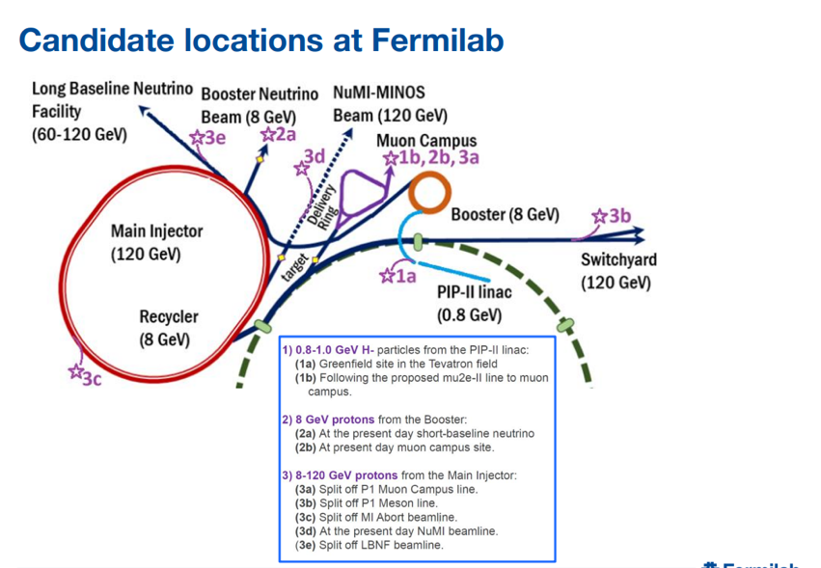
Fermilab & TTF3 Options

Slide 26
Fermilab & TTF3 Options

Slide 27
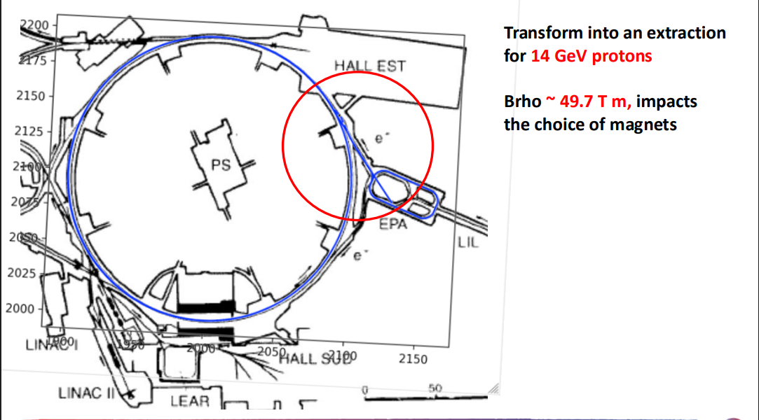
Fermilab & TTF3 Options

Slide 28
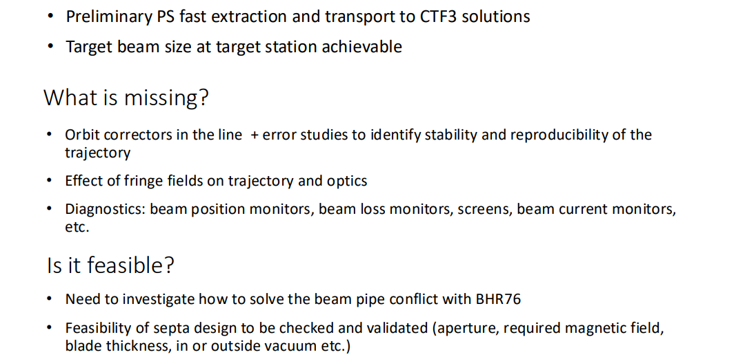
Fermilab & TTF3 Options

Slide 29
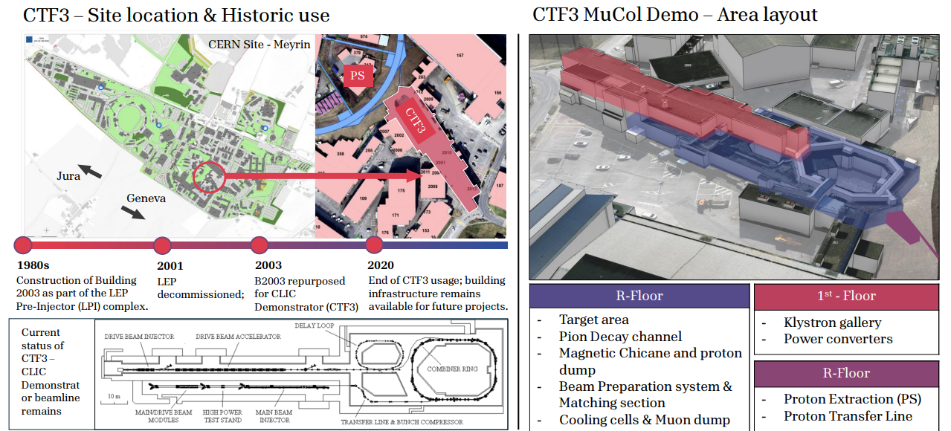
Fermilab & TTF3 Options

Slide 30
Conclusion
Clear vision of the R&D goals: RFMFTF and S5-like cell are technology demonstrators
HTS R&D
  Probe tapes specs (to be able to better specify next procurements)
  Test winding techniques and conductor
  Incremental complexity tests
  Both common and complementary studies with the final cooling solenoid development
Some infomations will arrive by ESMA magnet by IRIS
Strong improvements in modeling
  Some tools are available, some are in development
  We need experimental crosschecks

Slide 31

Thank you
for your attention

