Slide 1

Neutrino Masses and Mixing Angles
a tribute to
Guido Altarelli
Ferruccio Feruglio INFN Padova
Guido Altarelli:
eredità e prospettive 10 anni dopo
2 dicembre 2025
Università Roma Tre

Slide 2
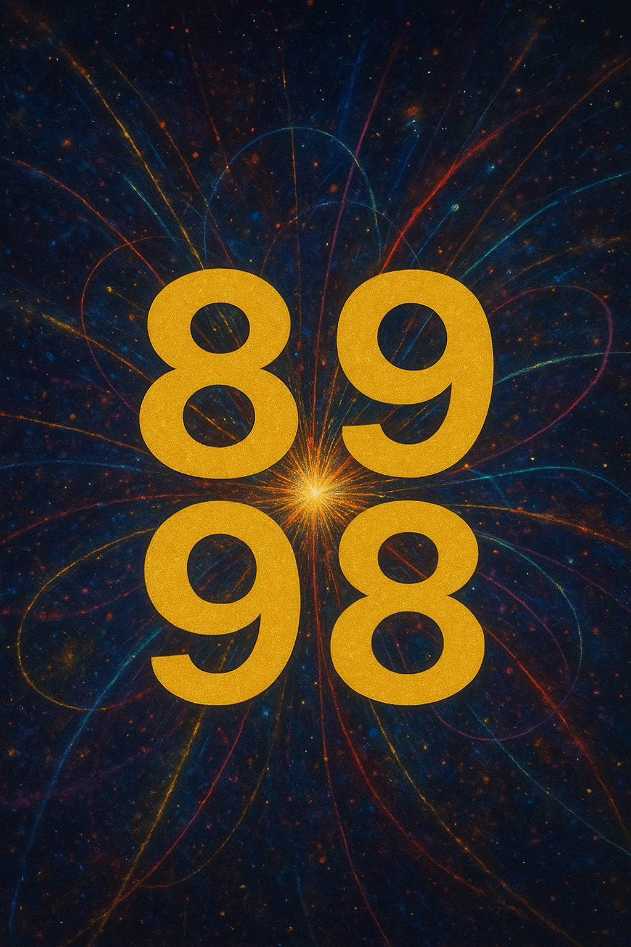

first collisions at LEP
neutrino oscillations
firmly established
here:
some personal memories of Guido contribution to the field
of neutrino masses and mixing angles

Slide 3
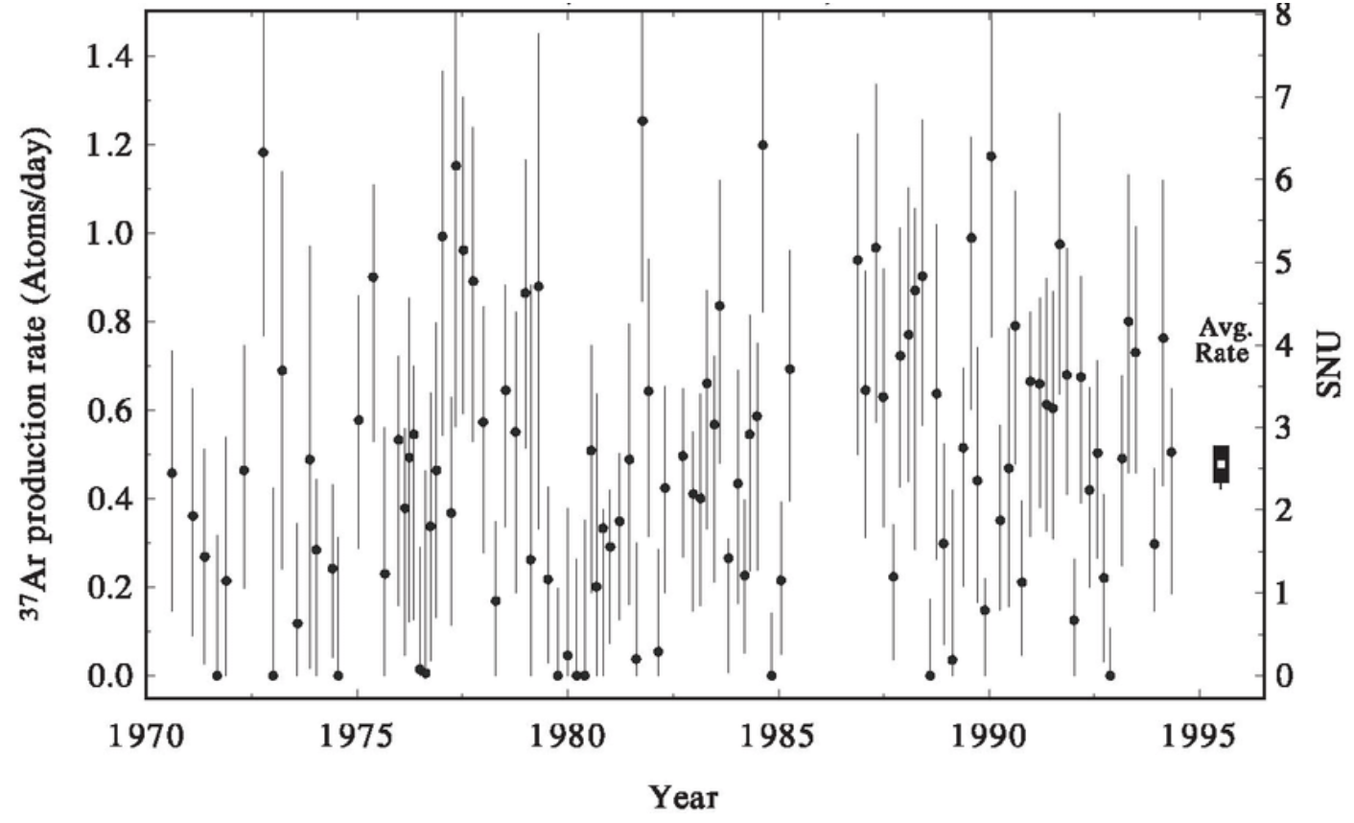
neutrino physics before 1998
1969
1st detection of solar neutrinos by R. Davis at the Homestake mine
solar ν problem starts, no other solar ν experiments for 20 yr!
predizione di Bahcall

Slide 4
neutrino physics before 1998
1969
1st detection of solar neutrinos by R. Davis at the Homestake mine
solar ν problem starts, no other solar ν experiments for 20 yr!
1978
Wolfenstein, Mikheyev, Smirnov (MSW effect)
sizeable solar ν_{e} conversion possible with small mixing angle
1986
1987
detection of neutrinos from SN1987A by Kamiokande, IMB, Baksan.
Kamiokande lower the E threshold below solar v energies ~ 10 MeV
1989
N_{ν} = 3 from LEP
90s
SAGE, GALLEX, GNO
confirm the solar ν problem in the low-energy region of ν spectrum

Slide 5
several proton decay experiments started M = 100 – 3000 tons
atmospheric ν, serious background for p-decay searches, are carefully
studied
Kamiokande, IMB, Soudan
80s
atmospheric ν problem
Prejudices < 1998
solar v problem:
several solutions possible
-- SSM not correct
-- MSW SA attractive
atmospheric ν problem:
it will fade away since it requires
a large mixing angle

Slide 6
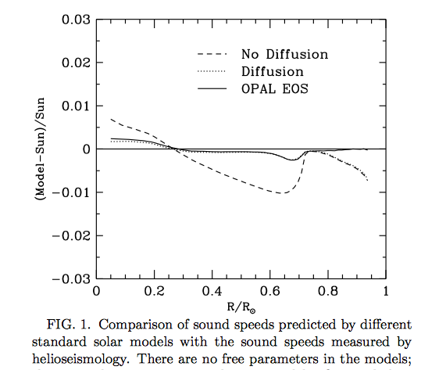
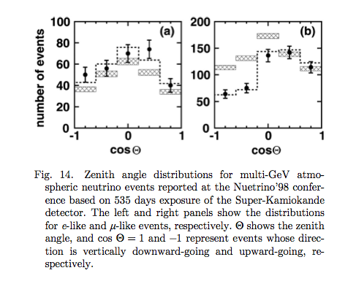
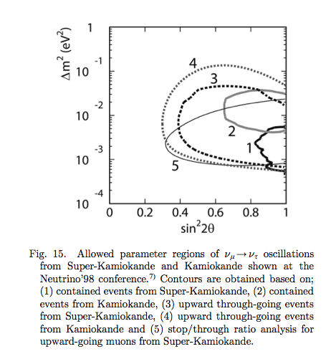
1997 – 1998 turnpoint
1997
solar sound speed from helioseismology
compared with predictions of SSM
(test T-profile in solar interior)
SSM reliable
Bahcall, Pinsonneault, Sarbani Basu, Christensen-Dalsgaard
Phys.Rev.Lett. 78 (1997) 171
1996
Superkamiokande starts, atmospheric ν data shown at Neutrino ‘98
-- zenith angular distributions
of atmospheric ν
-- oscillation solution becomes
compelling
-- determination of
≈1 -> maximal mixing

Slide 7
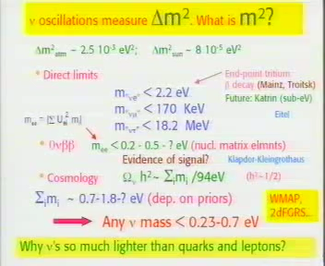
from Guido conclusive talk at Neutrino 2004 (Paris)

Slide 8
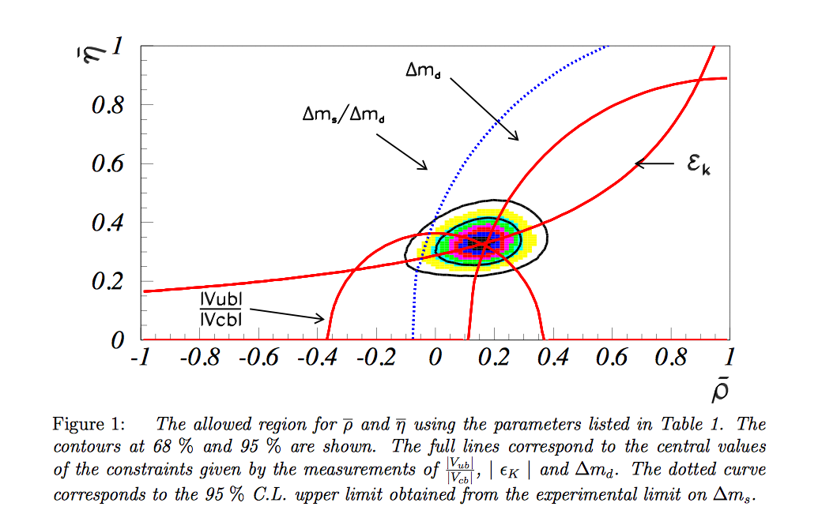

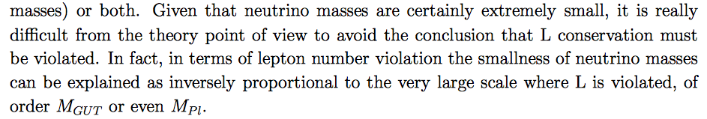
Guido “principles” about neutrinos
a new insight into the flavour puzzle?
[Parodi, Rudeau, Stocchi 9802289]
Quark sector reasonably well-known
at the time, but baseline model for
quark masses and mixing angles missing.
neutrino masses and large ϑ₂₃ were
interesting new inputs
violation of L at a large scale M
“
”
“the most impressive numerology
that comes out from neutrinos”
[GA, Neutrino 2004, Paris]

Slide 9
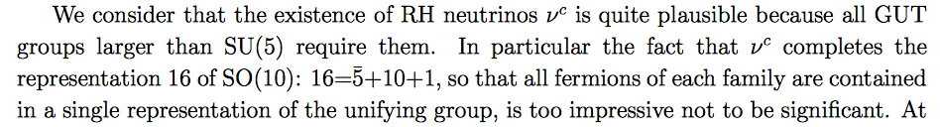
neutrino masses and GUTs
very plausible that this arises from the see-saw mechanism
the simplest realization (type I) needs a right-handed neutrino ν^{c}
“
”
“GUTs are the most attractive conjecture for the large scale picture of
particle physics. GUT is not the SM, is beyond the SM, but is the most
standard physics beyond the SM. Most of us think that there should be
something like a GUT.”
[GA, Neutrino 2004, Paris]
“another big plus of neutrinos is the elegant picture of baryogenesis
through leptogenesis (after LEP has disfavoured BG ath the weak scale)”

Slide 10
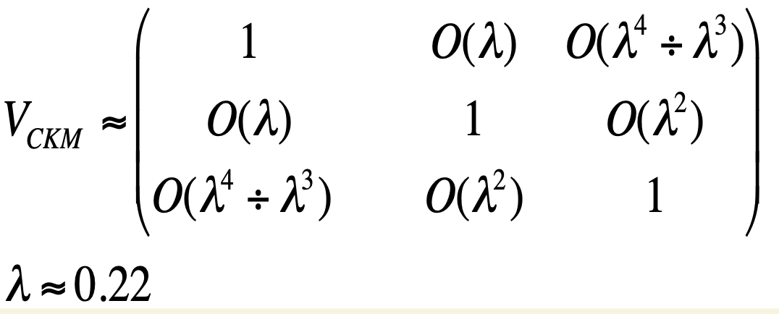
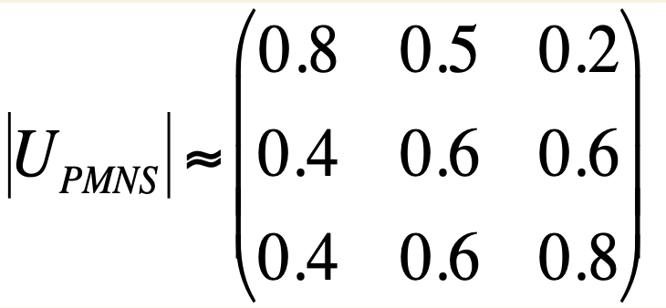
quarks and lepton mixing in GUT

Slide 11



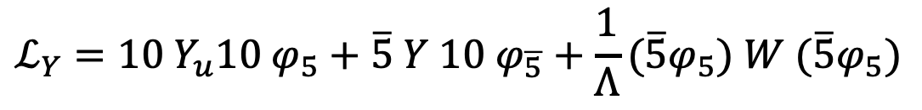



quarks and lepton mixing in SU(5)
minimal SU(5)
$$φ_{5}, φ_{\overline{5}}$$
Higgs
matter
$$ℒ_{Y}=10{ Y}_{u}10{ φ}_{5}+\overline{5} Y 10{ φ}_{\overline{5}}+\frac{1}{Λ}(\overline{5}φ_{5}) W (\overline{5}φ_{5})$$
$$Y_{e}=Y_{d}^{T}$$
LEFT d mixing <-> RIGHT e mixing
RIGHT d mixing <-> LEFT e mixing
$$V_{CKM}$$
misalignment between ${10}_{u}$ and ${10}_{d}$
$$U_{PMNS}$$
misalignment between ${\overline{5}}_{ν}$ and ${\overline{5}}_{e}$
[Hagiwara, Okamura ‘98;
Berezhiani, Rossi ‘98
Altarelli, F. ‘98]
basis for a realistic model

Slide 12
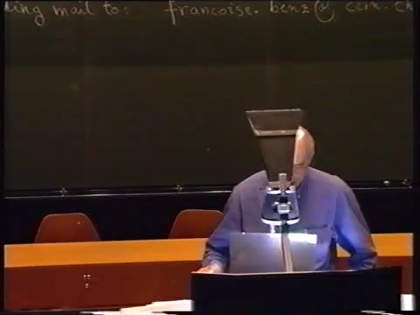

Slide 13
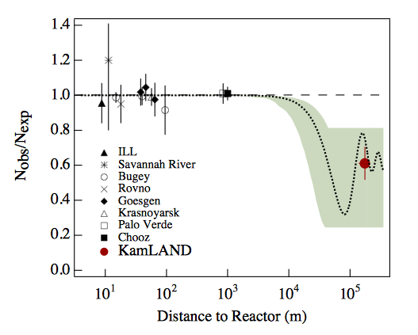
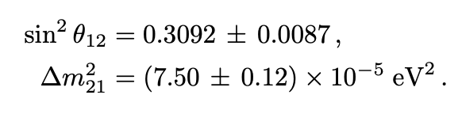
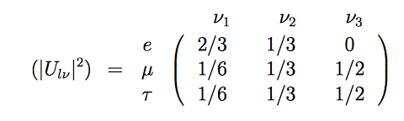

2002: the solar ν problem is solved
MSW LA finally determined
$$Δm^{2}=5.5 ×{10}^{−5} eV^{2}$$
[Bahcall, Gonzalez-Garcia,
Pena-Garay 0212147]
JUNO, 18 Nov 2025
Tri-BiMaximal Mixing
[Harrison, Perkins,
Scott 0202074]
so “symmetric” and soon derived from A₄ discrete symmetry
Ma, Rajasekaran 0106291, Babu, Ma, Valle 0206292; Hirsch, Romao, Skadauge, Valle,
Villanova del Moral 0312244, Ma 0404199, 0409075, Altarelli & F. 0504165, 0512103]

Slide 14
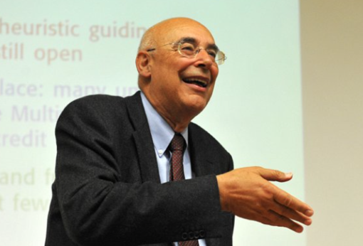
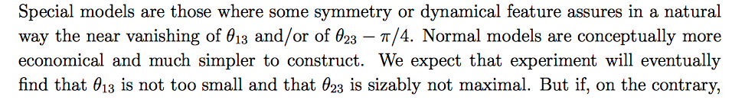
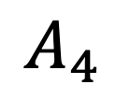
our model had some clean predictions…
ϑ₂₃ nearly maximal
still compatible with data
$$A_{4}$$
ϑ₁₃ < 0.05
wrong!
me: very much excited about this neat prediction!
Guido:
“
”
[Altarelli, 2005]

Slide 15
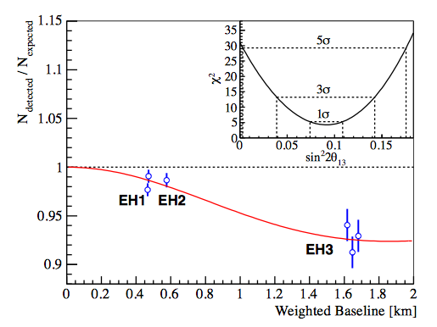
2011/2012 breakthrough: ϑ₁₃ ≠ 0
from LBL experiments searching for ν_{μ} -> ν_{e} conversion
T2K: muon neutrino beam produced
at JPARC [Tokai]
E=0.6 GeV and sent to
SK 295 Km apart [1106.2822]
MINOS: muon neutrino beam produced
at Fermilab [E=3 GeV] sent to
Soudan Lab 735 Km apart [1108.0015]
both experiments favor
sin² ϑ₁₃ ~ few %
from SBL reactor experiments searching for anti-ν_{e} disappearance
Double Chooz (far detector):
Daya Bay (near + far detectors):
RENO (near + far detectors):
[Daya Bay 1203.1669]
DC: sin² ϑ₁₃ = 0.022 ± 0.013
DB: sin² ϑ₁₃ = 0.024 ± 0.004
R: sin² ϑ₁₃ = 0.029 ± 0.006

Slide 16



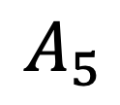

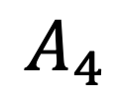
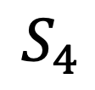

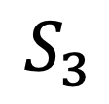





$$S_{3}$$
$$S^{2}={\left(ST\right)}^{3}=1$$
$$T^{2}=1$$
$$A_{4}$$
$$S^{2}={\left(ST\right)}^{3}=1$$
$$T^{3}=1$$
$$S_{4}$$
$$S^{2}={\left(ST\right)}^{3}=1$$
$$T^{4}=1$$
$$A_{5}$$
$$S^{2}={\left(ST\right)}^{3}=1$$
$$T^{5}=1$$
?
$$S^{2}={\left(ST\right)}^{3}=1$$
$$−$$

Slide 17
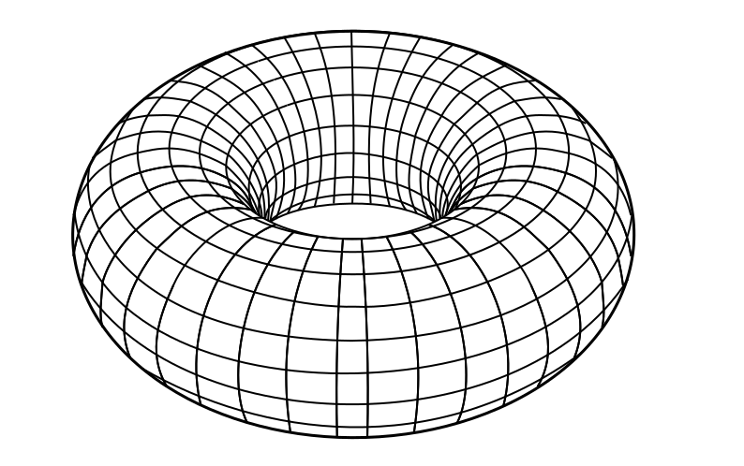
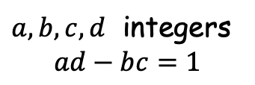
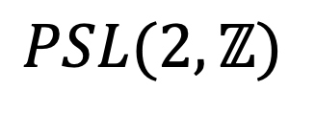
$$S_{3}$$
$$S^{2}={\left(ST\right)}^{3}=1$$
$$T^{2}=1$$
$$A_{4}$$
$$S^{2}={\left(ST\right)}^{3}=1$$
$$T^{3}=1$$
$$S_{4}$$
$$S^{2}={\left(ST\right)}^{3}=1$$
$$T^{4}=1$$
$$A_{5}$$
$$S^{2}={\left(ST\right)}^{3}=1$$
$$T^{5}=1$$
$$PSL(2,ℤ)$$
$$S^{2}={\left(ST\right)}^{3}=1$$
$$−$$
the modular group,
ubiquitous in string theory
[Altarelli, F. 2006]
$a,b,c,d$ integers
$$ad−bc=1$$

Slide 18
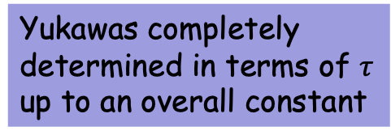
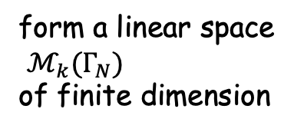
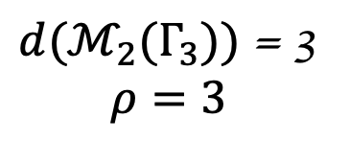
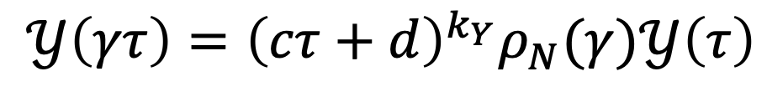
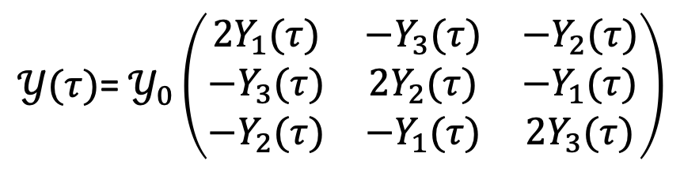

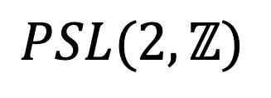
$$PSL(2,ℤ)$$
Yukawa couplings become
modular forms
[F.F. 1706.08749]
form a linear space
$ℳ_{k}(Γ_{N})$
of finite dimension
$$𝒴\left(γτ\right)={\left(cτ+d\right)}^{k_{Y}}ρ_{N}(γ)𝒴\left(τ\right)$$
example
$d(ℳ_{2}(Γ_{3}))$ = 3
$$ρ=3$$
$$w\left(τ,ν\right)=m_{0} ν 𝒴(τ)ν+h.c.$$
$𝒴(τ)$= $𝒴_{0}\left(\begin{matrix}2Y_{1}(τ) & −Y_{3}(τ) & −Y_{2}(τ) \\ −Y_{3}(τ) & 2Y_{2}(τ) & −Y_{1}(τ) \\ −Y_{2}(τ) & −Y_{1}(τ) & 2Y_{3}(τ)\end{matrix}\right)$
Yukawas completely
determined in terms of $τ$
up to an overall constant
8 physical quantities in terms of 2-parameters
exactly this type of picture arises from string theory compactification
on orbifolds.

Slide 19
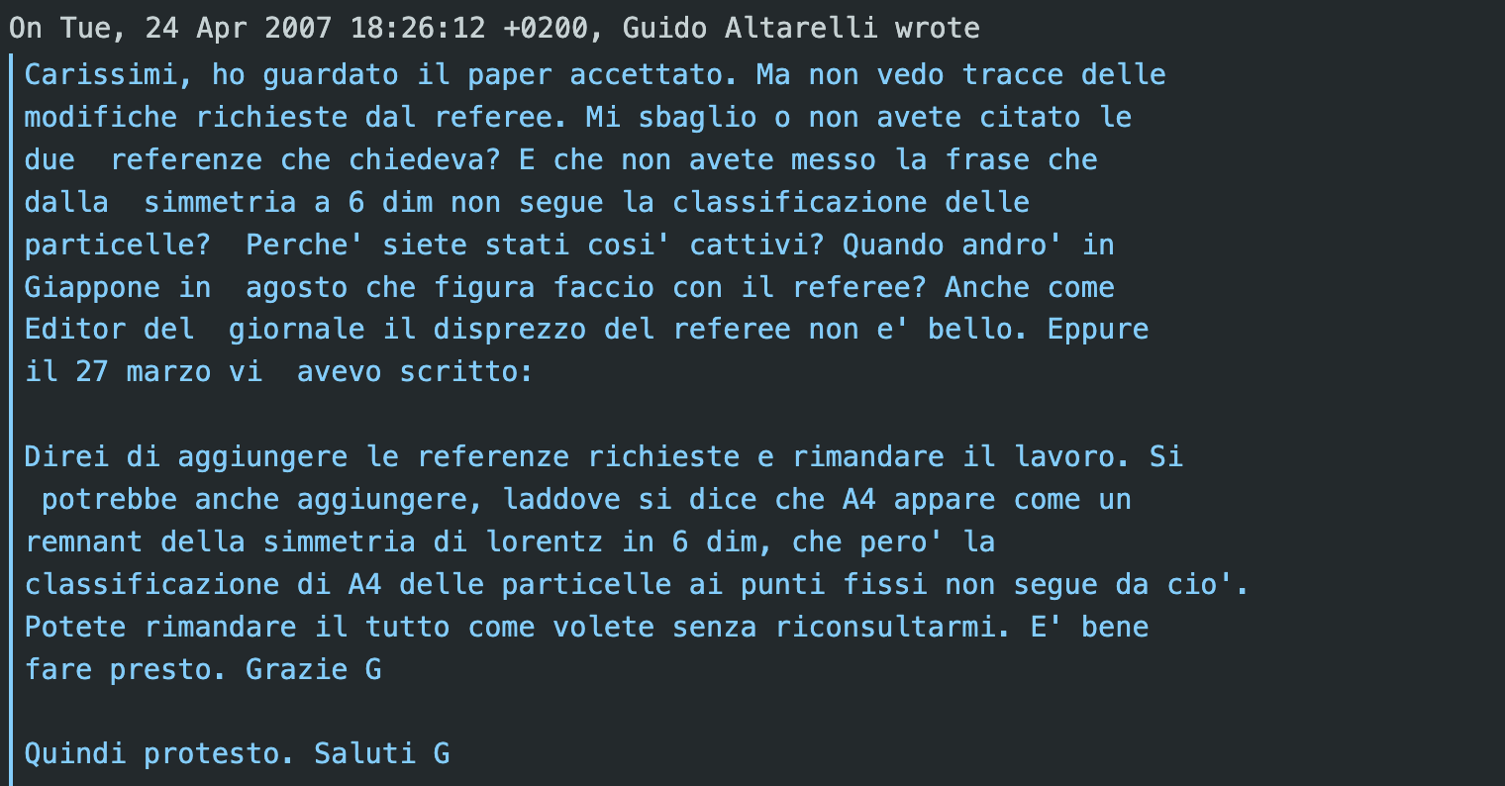

Slide 20
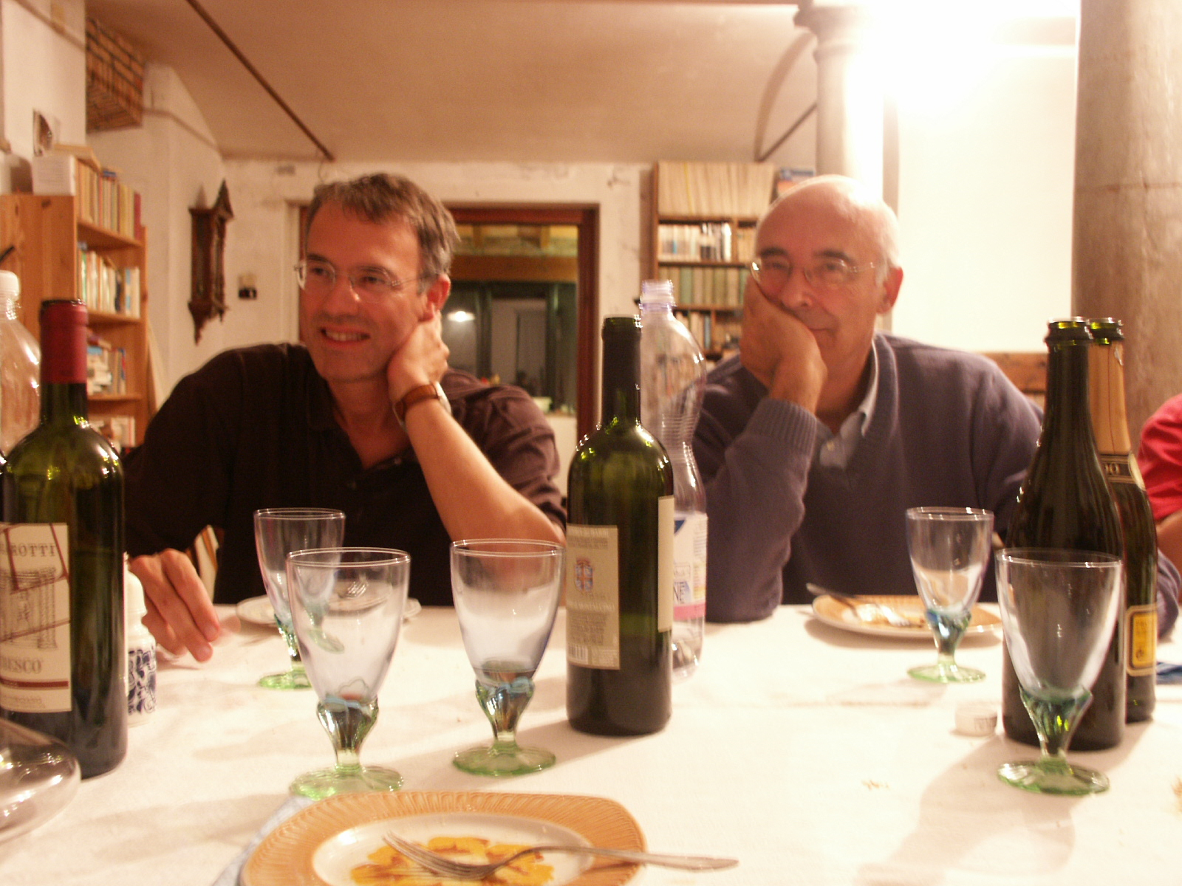

Slide 21


Slide 22
back-up slides

Slide 23

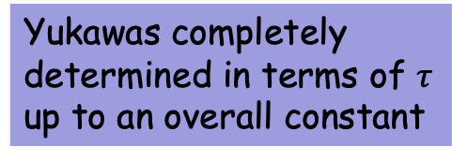
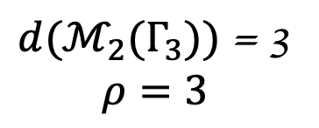
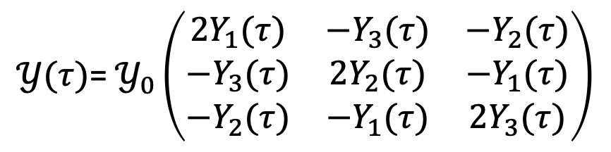

example
$d(ℳ_{2}(Γ_{3}))$ = 3
$$ρ=3$$
$$w\left(τ,ν\right)=m_{0} ν 𝒴(τ)ν+h.c.$$
$𝒴(τ)$= $𝒴_{0}\left(\begin{matrix}2Y_{1}(τ) & −Y_{3}(τ) & −Y_{2}(τ) \\ −Y_{3}(τ) & 2Y_{2}(τ) & −Y_{1}(τ) \\ −Y_{2}(τ) & −Y_{1}(τ) & 2Y_{3}(τ)\end{matrix}\right)$
[F.F. 1706.08749]
Yukawas completely
determined in terms of $τ$
up to an overall constant
no corrections from higher order operators in the exact SUSY limit
by scanning τ VEVs the best agreement is obtained for
2-parameter fit to 5 physical quantities

Slide 24
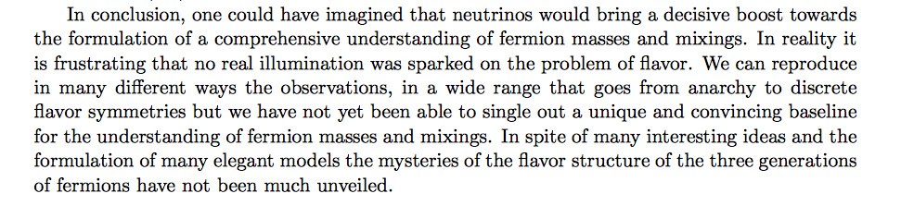
concluding with Guido’s words
[Guido Altarelli, “Status of Neutrino Mass and Mixing” 1404.3859]

Slide 25
Solar Neutrino timeline
1969
1st detection of solar neutrinos by R. Davis at the Homestake mine
solar ν problem starts, no other solar ν experiments for 20 yr!
1969
solution in terms of ν_{e} -> ν_{μ} oscillations by Gribov and Pontecorvo
1974
GUT proposed by Georgi and Glashow
1977
see-saw mechanism for neutrino masses
[Minkowski, Gell-Mann, Ramond, Slanski and Yanagida]
1978
Wolfenstein, Mikheyev, Smirnov (MSW effect)
sizeable solar ν_{e} conversion possible with small mixing angle
1986
1987
detection of neutrinos from SN1987A by Kamiokande, IMB, Baksan.
Kamiokande lower the E threshold below solar v energies ~ 10 MeV
1989
N_{ν} = 3 from LEP
90s
SAGE, GALLEX, GNO
confirm the solar ν problem in the low-energy region of ν spectrum

Slide 26


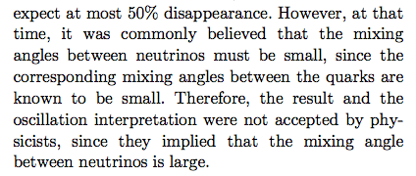
Atmospheric Neutrino timeline
1978
first measurement of
80s
several proton decay experiments started M = 100 – 3000 tons
atmospheric ν, serious background for p-decay searches, are carefully
studied
Kamiokande, IMB, Soudan
atmospheric ν problem
Prejudices < 1997
solar v problem:
several solutions possible
-- SSM not correct
-- resonant spin-flavour precession of ν
-- FCNC solution
-- MSW SA attractive
atmospheric ν problem:
it will fade away since it requires
a large mixing angle
[T. Kajita 2010]

Slide 27
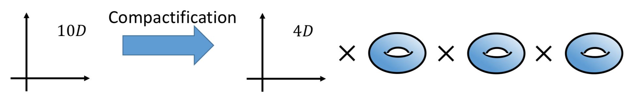
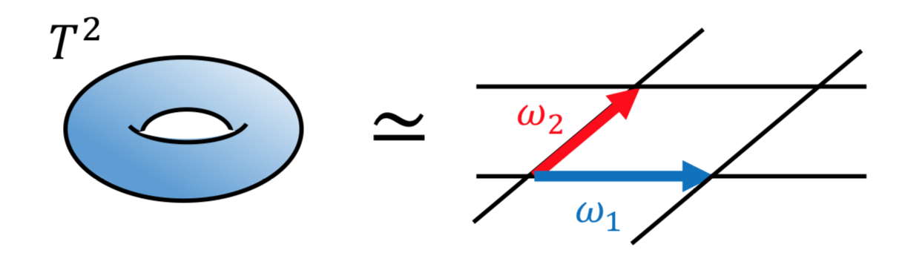
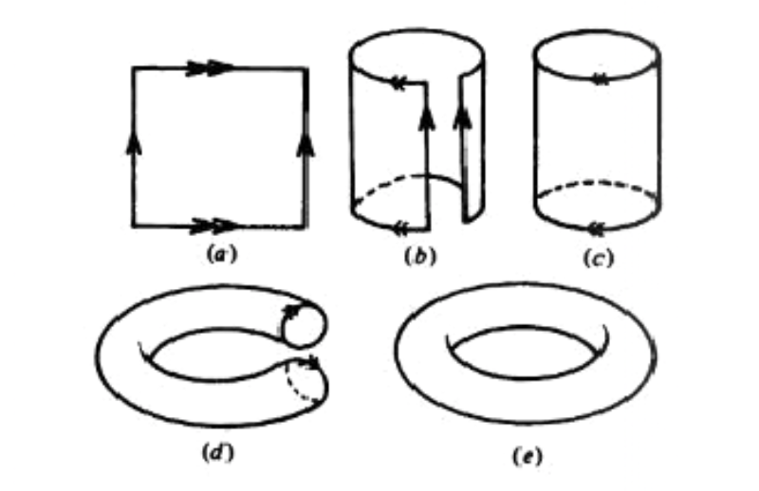
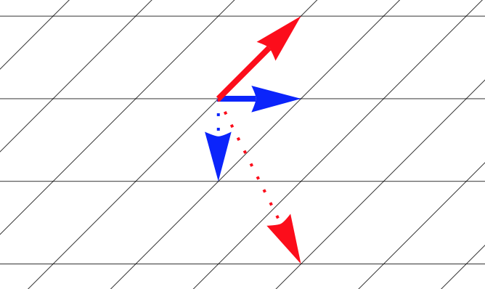

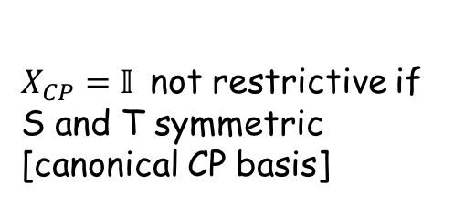



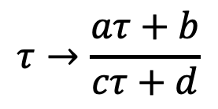
modular invariance
[see H.P. Nilles talk]
string theory in d=10 need 6 compact dimensions
simplest compactification: 3 copies of a torus $T^{2}$
$$∈$$
tori
parametrized by
$$ℳ=\left\{τ\text{=}\frac{ω_{2}}{ω_{1}} Im\left(τ\right)>0 \right\}$$
lattice left
invariant by
modular
transformations:
$$τ→\frac{aτ+b}{cτ+d}$$
$$∈SL(2,Z)$$
$a,b,c,d$ integers
$$ad−bc=1$$

Slide 28
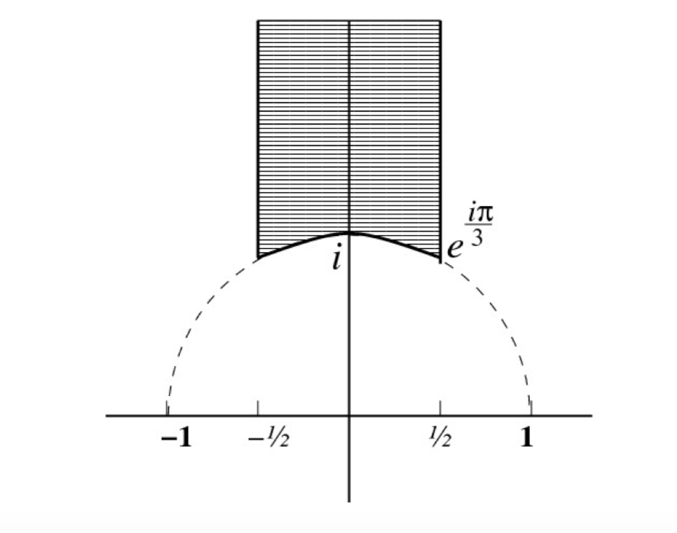






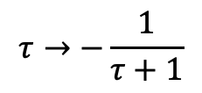
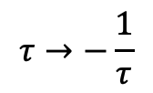





S
fixed point
$$τ=i$$
$$τ→−\frac{1}{τ}$$
$$ℤ_{4}^{S}$$
residual symmetry
ST
$$ℤ_{2}^{ST}×ℤ_{2}^{S^{2}}$$
$$τ=e^{i 2π/3}$$
$$τ→−\frac{1}{τ+1}$$
T
$$ℤ_{}^{T}×ℤ_{2}^{S^{2}}$$
$$τ=i ∞$$
$$τ→τ+1$$
fundamental
domain
modular invariance
completely broken
everywhere but at three
fixed points
$$Im(τ)$$
$SL(2,Z)$ generated by
$$Re(τ)$$

Slide 29



$τ$promoted to a field. Through a gauge choice
we can restrict $τ$ to the fundamental domain
fundamental
domain
unbroken CP
$$Im(τ)$$
$$Re(τ)$$
CP
$$τ→−τ^{∗}$$
[up to modular
transformations]
[Novichkov, Penedo, Petcov and Titov 1905.11970
Baur, Nilles, Trautner and Vaudrevange, 1901.03251]

Slide 30









CP & modular-invariance
CP $↔$ real coupling constants
modular invariance
$$τ→\frac{aτ+b}{cτ+d}$$
$$φ{→\left(c τ+d\right)}^{{−k}_{φ}} φ$$
matter multiplets
$$V→V$$
vector multiplets
$$f_{3}=\frac{1}{g_{3}^{2}}$$
$${(θ}_{QCD}=0)$$
$w\left(τ,φ\right)=U_{i}^{c}{ Y}_{ij}^{u}(τ){ Q}_{j}H_{u}$ + $D_{i}^{c}{ Y}_{ij}^{d}(τ){ Q}_{j}H_{d}$ + ${ E}_{i}^{c}{ Y}_{ij}^{e}\left(τ\right){ L}_{j}H_{d}+…$
$Y_{ij}^{q}(τ)→{\left(cτ+d\right)}^{k_{ij}^{q}} Y_{ij}^{q}(τ)$
$$k_{ij}^{u}=k_{Q_{j}}+k_{U_{i}^{c}}+k_{H_{u}}$$
$$k_{ij}^{d}=k_{Q_{j}}+k_{D_{i}^{c}}+k_{H_{d}}$$
assuming no singularities: $Y_{ij}^{q}(τ)$are modular forms of weight $k_{ij}^{q}$

Slide 31



$k_{ij}^{q}<0:$ no modular forms
$k_{ij}^{q}=0:$ modular forms are constants
$k_{ij}^{q}>0:$ modular forms polynomials in $E_{4}\left(τ\right),E_{6}\left(τ\right)$

