Slide 1



Laboratori Nazionali di Legnaro – INFN
Introduction to Research
ISOLPHARM
D. Cerioni
Oct 7th, 2025

Slide 2
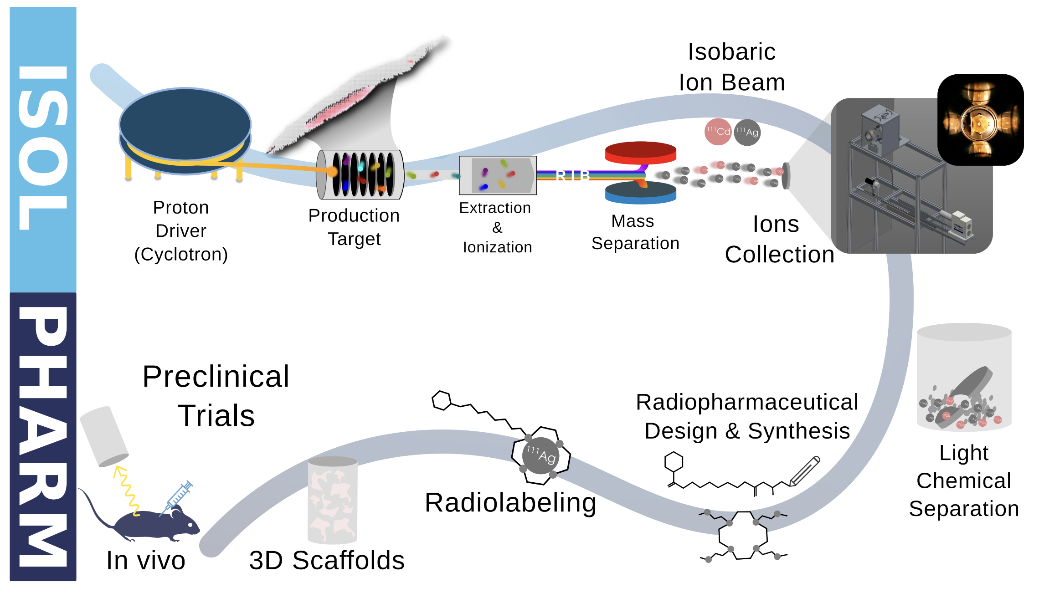
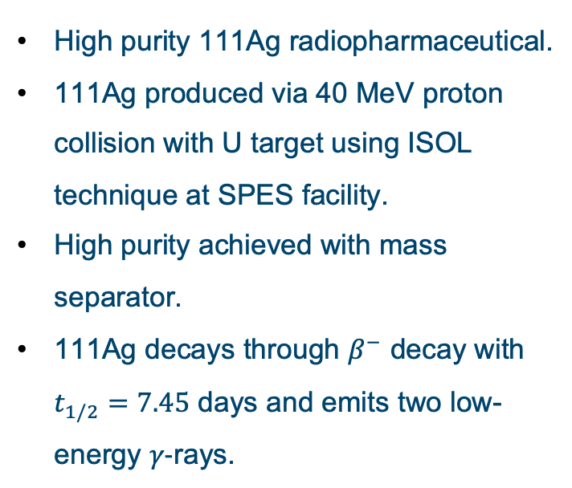
ISOLPHARM project
High purity 111Ag radiopharmaceutical.
111Ag produced via 40 MeV proton collision with U target using ISOL technique at SPES facility.
High purity achieved with mass separator.
111Ag decays through $β^{−}$ decay with $t_{1/2}=7.45$ days and emits two low-energy $γ−$rays.
Notes:
2

Slide 3
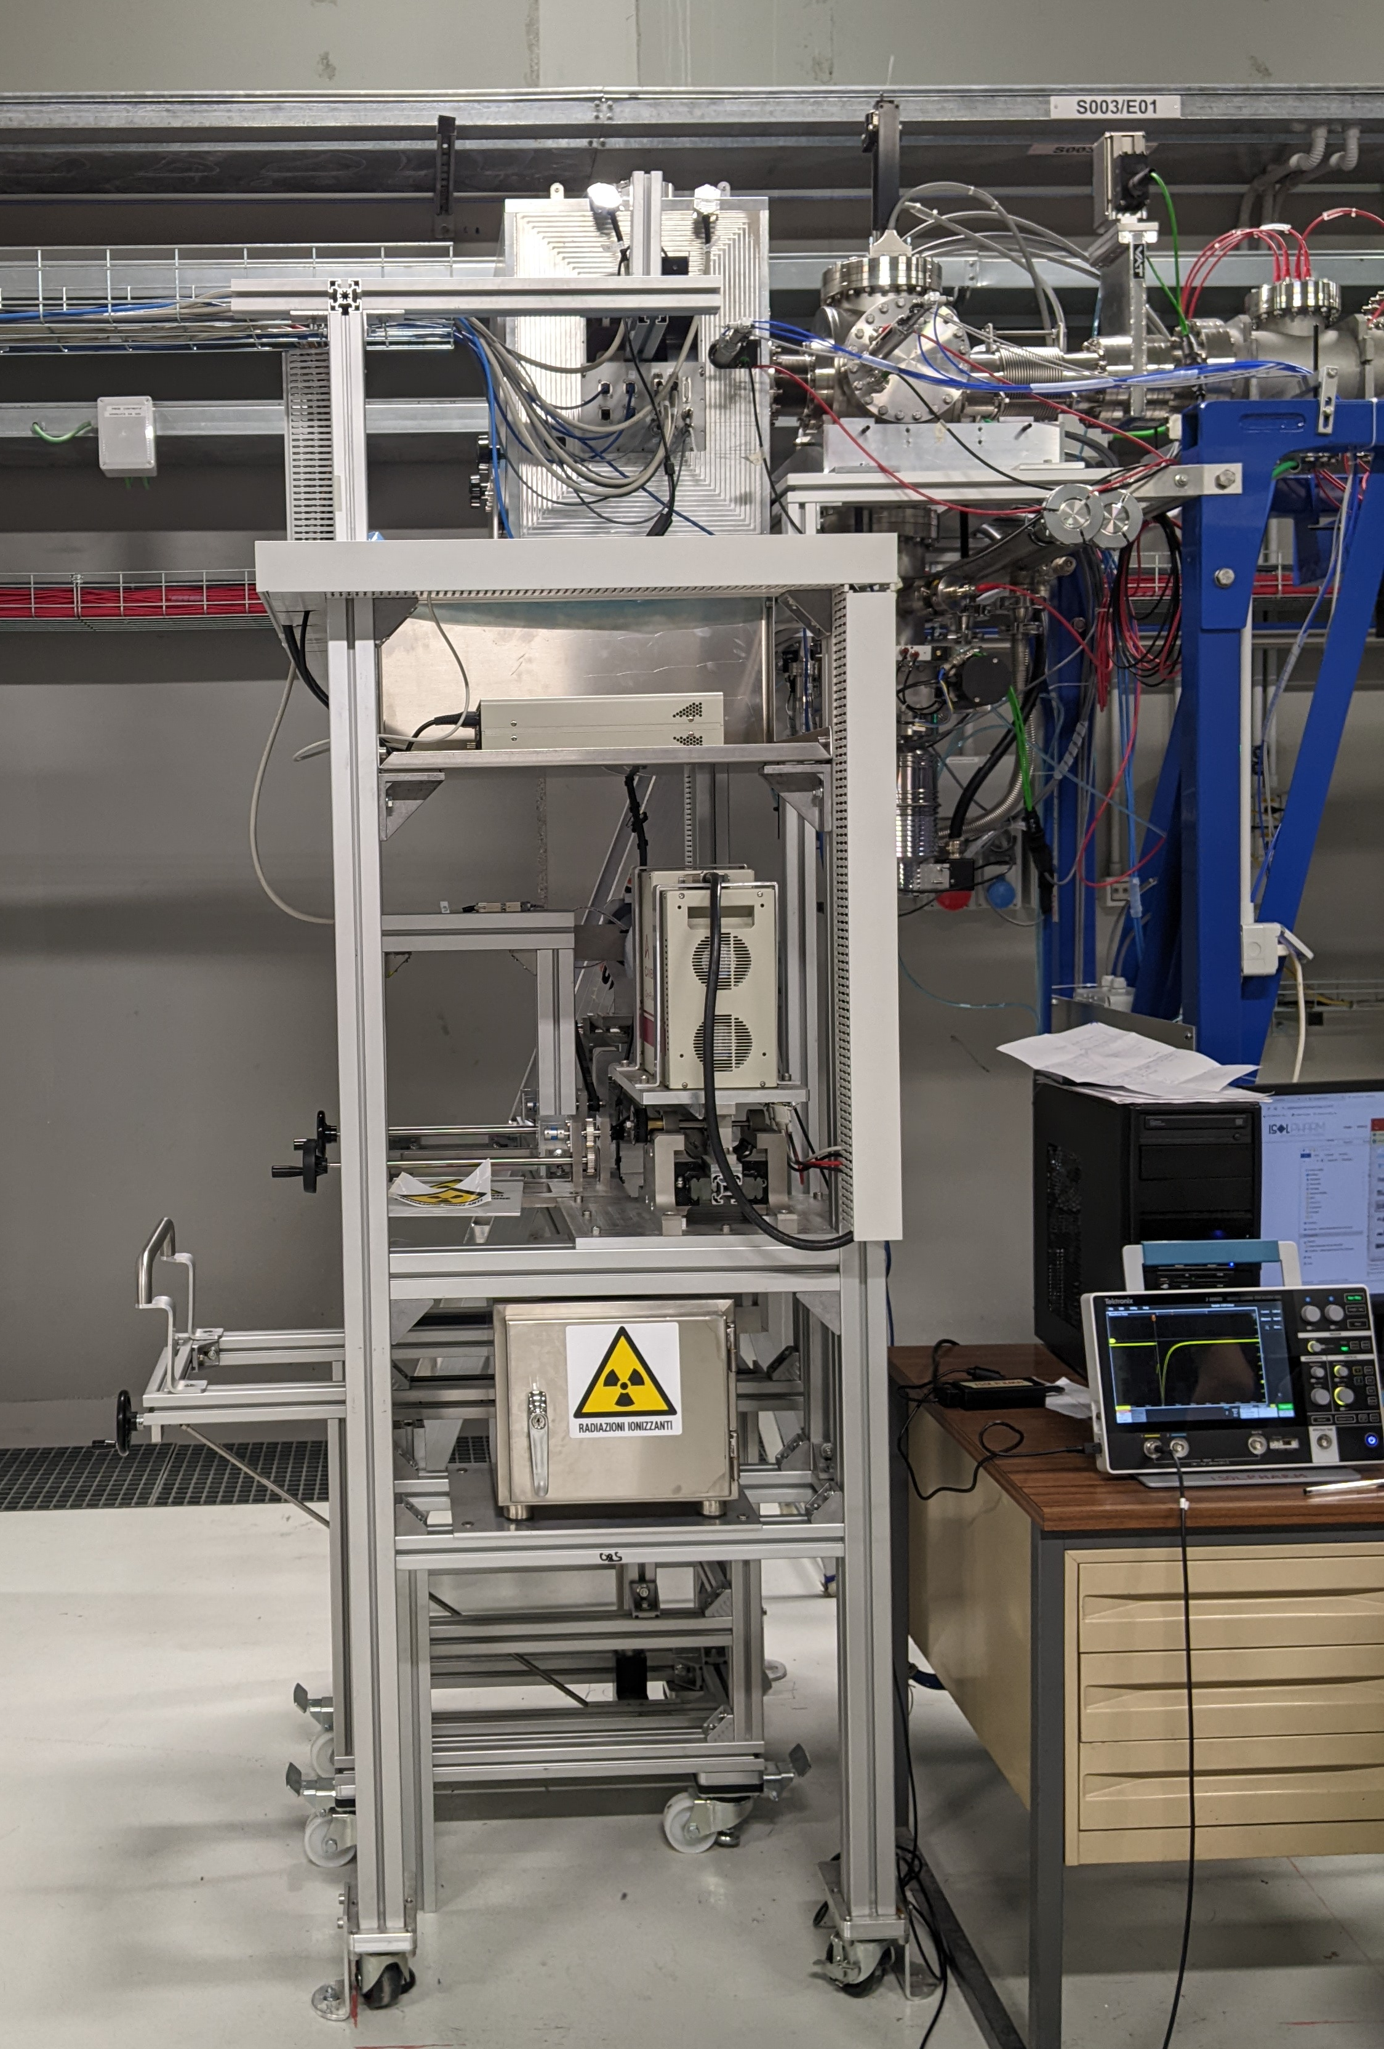
ISOLPHARM IRIS
IRIS is the device located at the end of the beam line which controls the target.
Can change the pellet in order to irradiate multiple of them without breaking the vacuum.
Equipped with a HPGe and an LBC scintillator for pellet activity measurement.
Lead safe on trolley for safe transportation of radiopharmaceutical.
Notes:
3

Slide 4
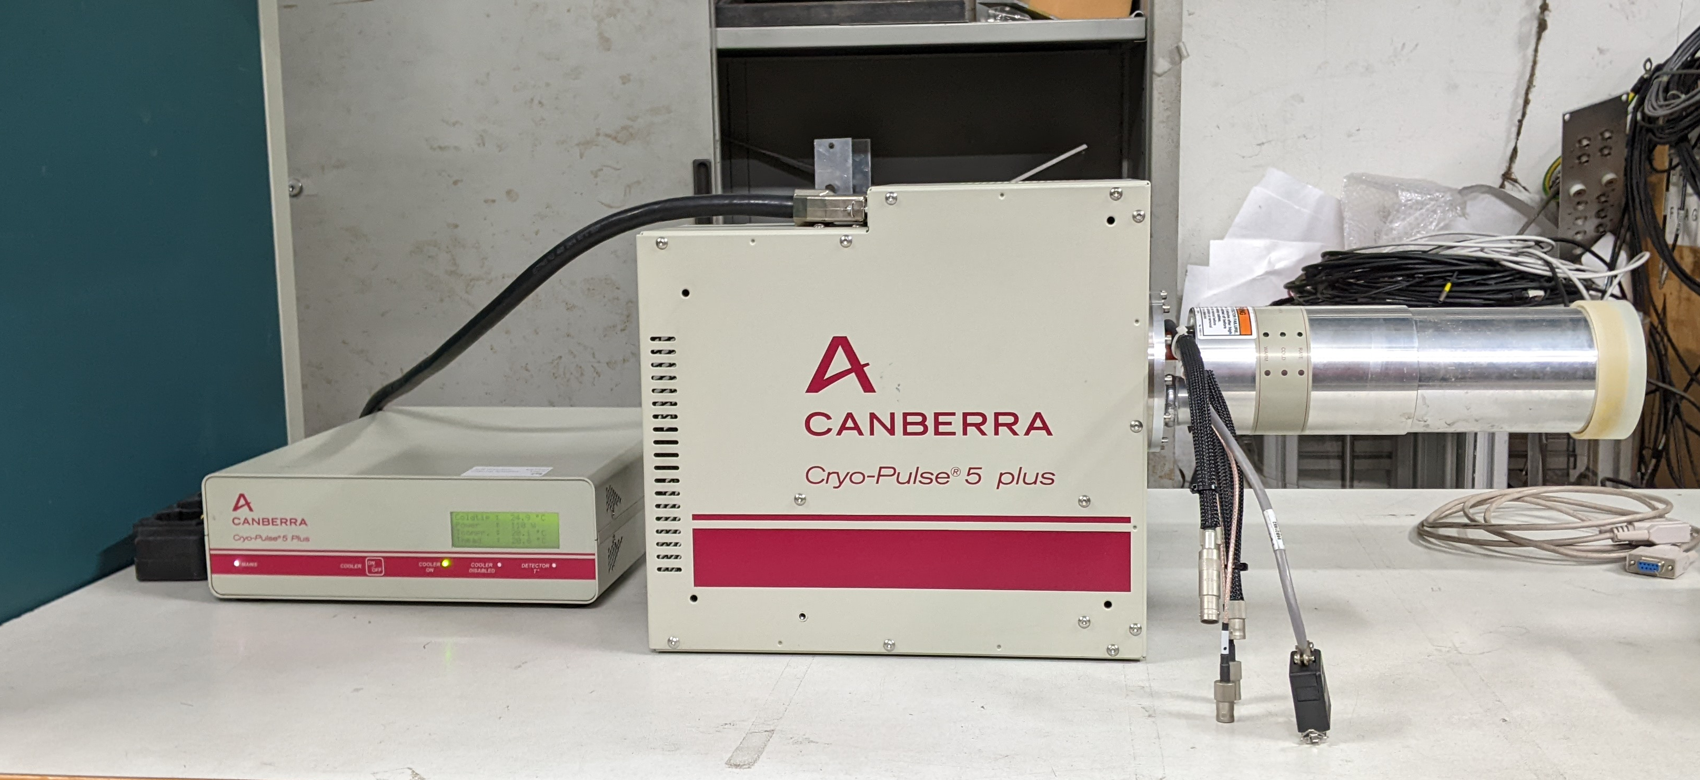
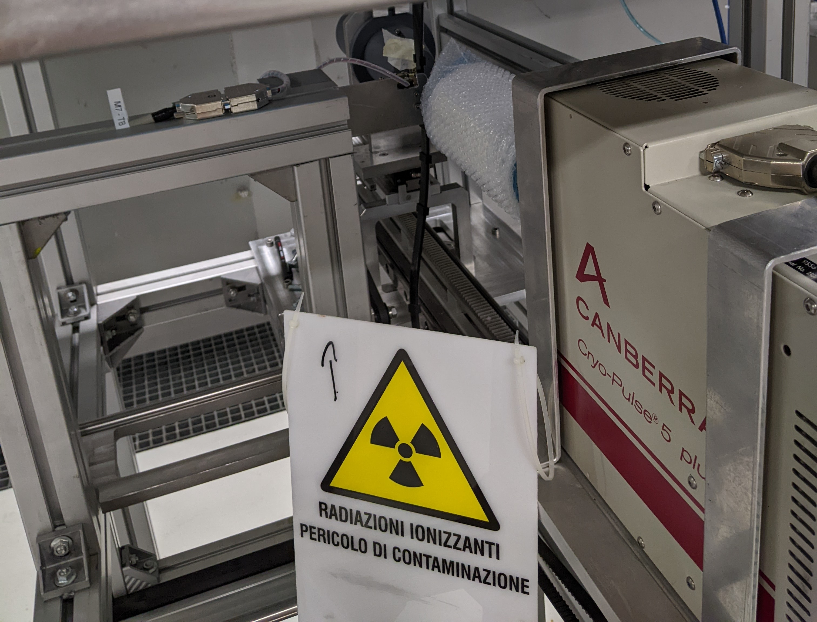
Goal of the internship
Study of the angular efficiency and calibration study of LBC and HPGe detectors for the ISOLPHARM radionuclide implantation station.
Simulation of the LBC detector using the Geant4 toolkit.
Implementation of automatic script to measure the activity of a radionuclide.
Notes:
4

Slide 5
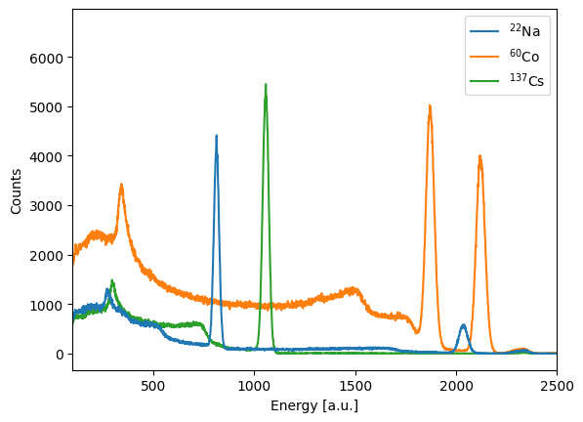
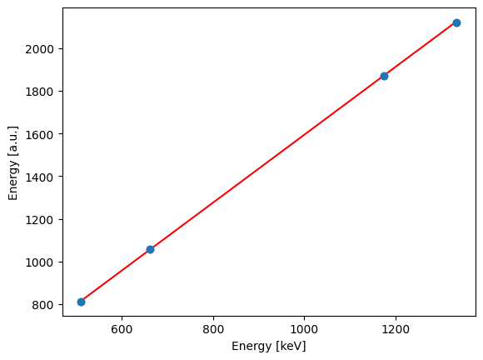
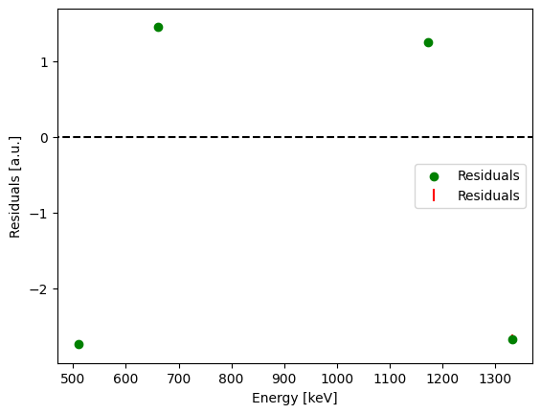
Lanthanum Bromo-Chloride scintillator
22Na + 60Co + 137Cs sources for energy calibration.
Linear function fit for calibration.
High residuals + trend.
Notes:
5

Slide 6
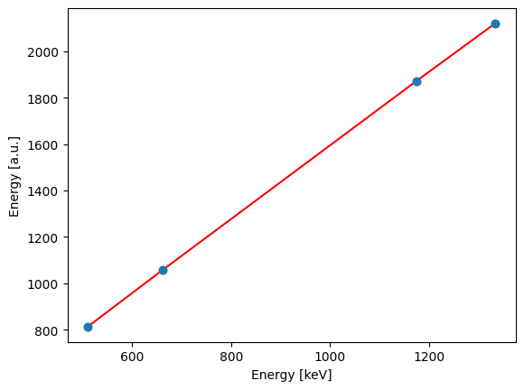
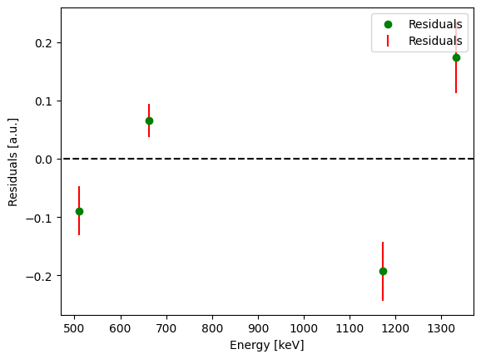
Lanthanum Bromo-Chloride scintillator
22Na + 60Co + 137Cs sources for energy calibration.
Parabolic function fit for calibration (better than linear).
Better residuals over linear calibration.
Notes:
6

Slide 7

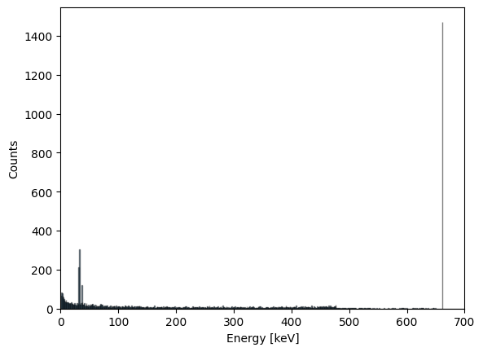
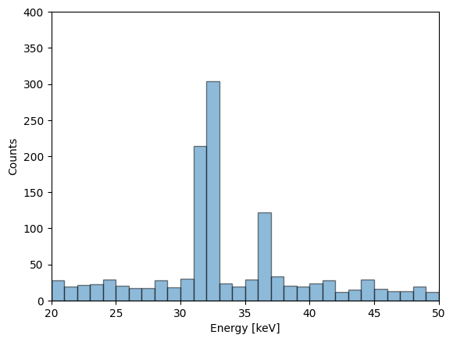
Geant4 LBC simulation
(future) LBC scintillator simulation using Geant4 toolkit.
Geometric efficiency simulation using 137Cs source.
Notes:
7

Slide 8
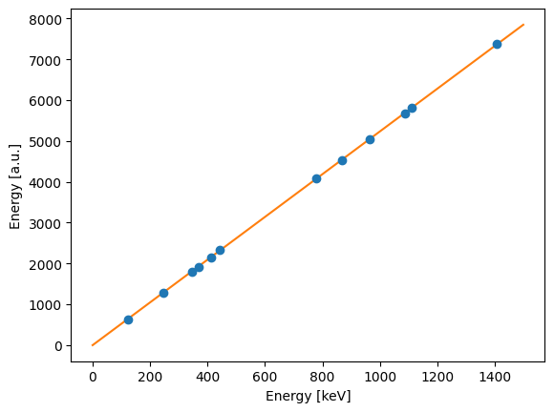
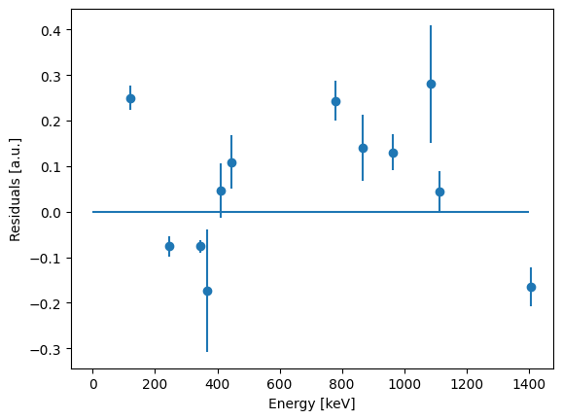
HPGe characterization
152Eu sources for energy calibration and efficiency study.
Parabolic function fit for calibration.
Good residuals, might be improved with multiple sources or more dof.
Notes:
8

Slide 9
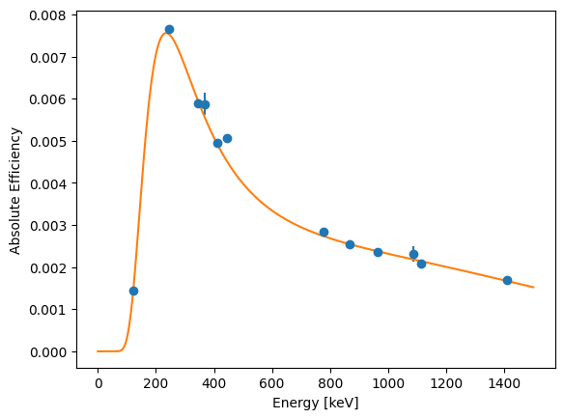
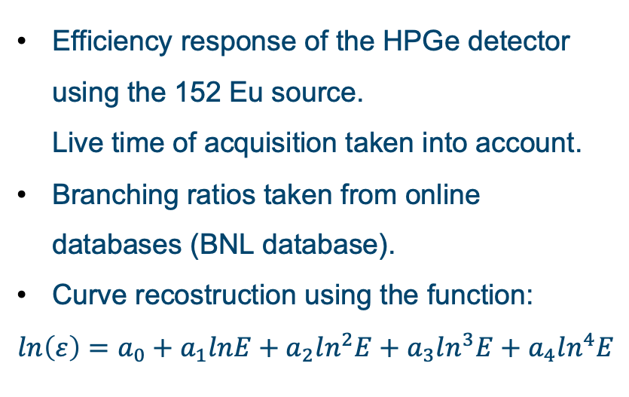
Efficiency study
Efficiency response of the HPGe detector using the 152 Eu source. Live time of acquisition taken into account.
Branching ratios taken from online databases (BNL database).
Curve recostruction using the function:
$$ln\left(ε\right)=a_{0}+a_{1}lnE+a_{2}ln^{2}E+a_{3}ln^{3}E+a_{4}ln^{4}E$$
Notes:
9

Slide 10

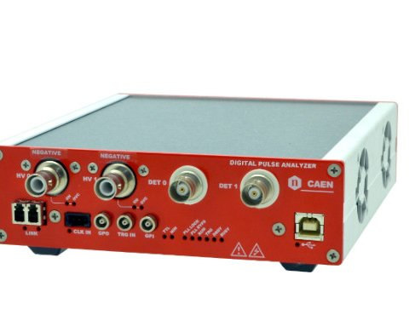
Automation of activity measurement
Connect to the CAEN digitizer and start acquisition.
Import the spectrum.
Perform energy calibration.
Find the peaks and calculate the number of events under each one.
Identify the isotope (IID) using a feed-forward neural network.
Find branching ratios of the peaks using International Atomic Energy Agency database API + local database.
Calculate absolute efficiency of the detector at peak energy.
Calculate activity of the source.
Acquisition
Import Spectrum
Energy Calibration
Peak Area
IID
Branching Ratios
Absolute
Efficiency
Activity Calculation
Notes:
10

Slide 11
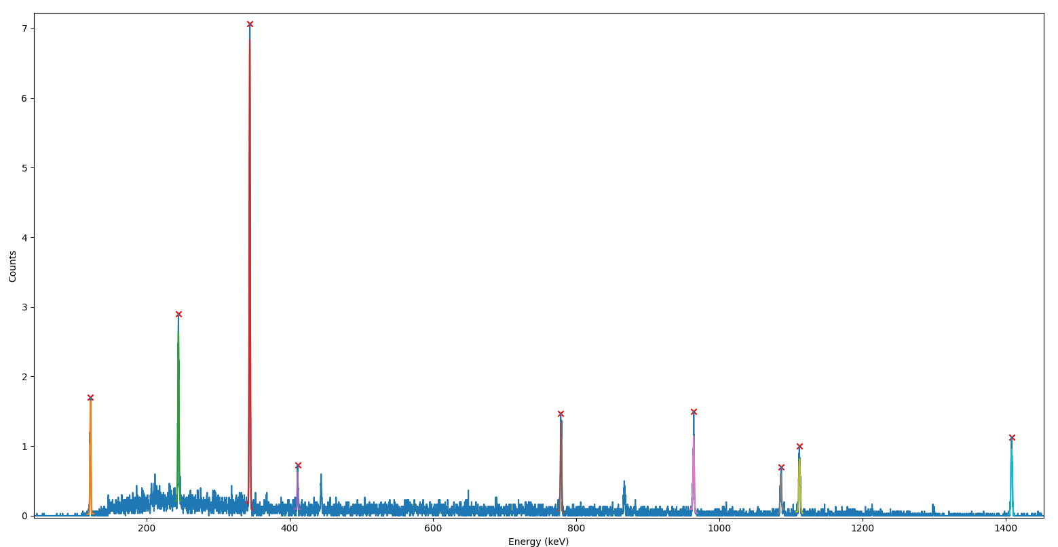
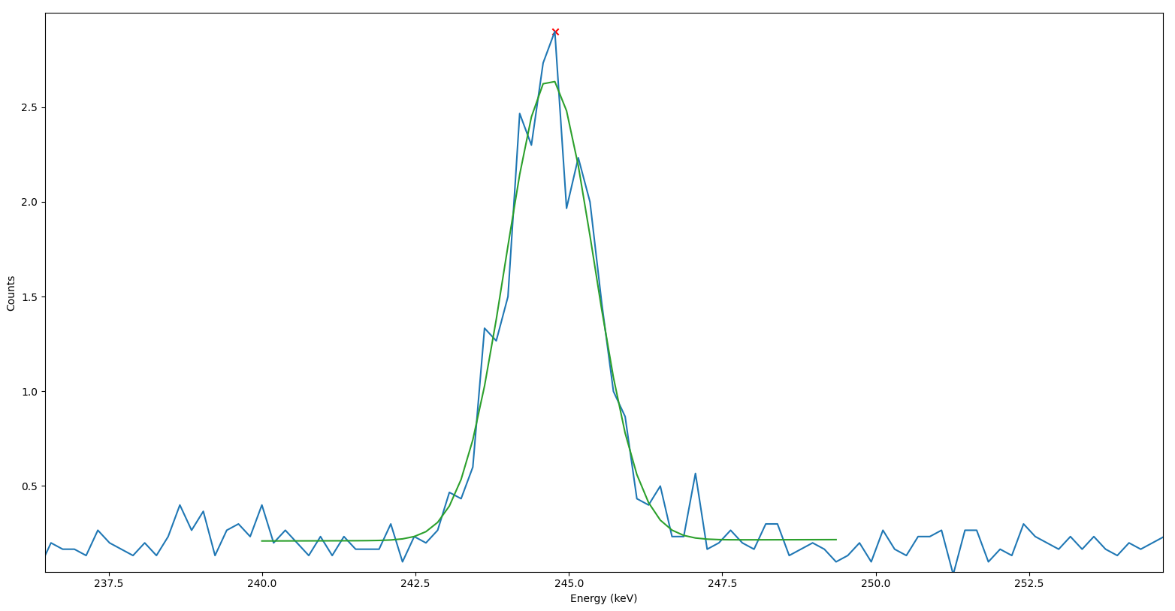
Python script is optimized for IRIS
Calibration data can be easily modified.
Peak finding algorithm parameters optimized for the IRIS HPGe detector.
Gaussian fit with error propagation for activity error calculation.
Integration with IRIS GUI.
Python GUI to show results.
Example of analysis on 152Eu source
Notes:
11

Slide 12
Future Improvement
Better energy calibration (more sources + longer acquisition time).
Better efficiency calibration.
Efficiency divided in relative and geometric to account for different position of detector.
Automatic distance measurement (Detector – Pellet) with stepper motor.
Multiple analysis throughout t he acquisition process.
Remove CoMPASS dependence.
Improved model for Isotope Identification (IID).
Automatic dead time warning.
Centralized server for complex calculations (simulations in G4 and AI training) + NAS (RAID 5 or 6) + encrypted communication for security reason (Matrix protocol).
Notes:
12

Slide 13
Thanks
Thanks to the team
Notes:
13

