Slide 1
CSN3 – An Overview
CSN3
M.Taiuti

Slide 2
OUTLOOK
Structure of the CSN3
Current Activity
Perspectives
Final remarks

Slide 3

The 4 Research Lines
CSN3
512 FTE
Line 1 – 120 FTE
Quarks and Hadron Dynamics
(Jlab, LNF, German-Labs)
Line 2 - 165 FTE
Phase Transitions in Nuclear Matter (160 in Alice)
Line 4 – 73 FTE
Nuclear Astrophysics and Interdisciplinary Research
(LNGS, LNS)
Line 3 - 154 FTE
Nuclear Structure and Reaction Mechanisms
(LNL, LNS)

Slide 4
Facilities- european
LNL
LNGS
LNF
LNS

Slide 5
Facilities– extra-european
5

Slide 6
L1 - Quarks and Hadron Dynamics
Physics performed with Leptonic probes (Jlab, Bonn, Mainz) and Hadronic probes (DAPHNE@LNF)
Non perturbative QCD (baryons and mesons)
NLO pQCD
Hadronization phenomena in nucler matter
Strangeness physics in nuclear matter
N-N correlations
Spin physics

Slide 7
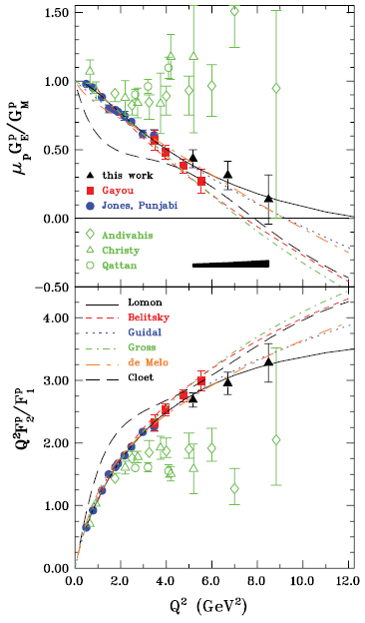
The Structure of the Nucleon
Physics performed with Leptonic probes (Jlab, Bonn, Mainz)
Recoil Polarization Measurements of the Proton Electromagnetic Form Factor Ratio to
Q² ~8.5 GeV²
Extension by more than 50% of the region in which the data are accurately determined
JLab

Slide 8
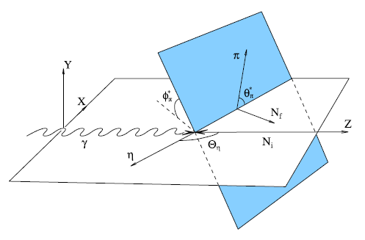
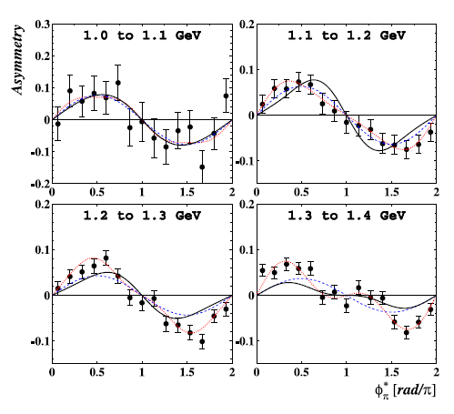
The Structure of the Nucleon
Proton and neutron e.m. form factors
Study of Baryonic Resonances
W ~ 1.5 GeV – 3 GeV
First measurement of the circular beam asymmetry in the γp→π⁰ηp reaction
Search for exotic mesons
MAMBO

Slide 9
N* photoproduction program ✔-published, ✔-acquired
 | σ | Σ | T | P | E | F | G | H | T_{x} | T_{z} | L_{x} | L_{z} | O_{x} | O_{z} | C_{x} | C_{z}
pπ⁰ | ✔ | ✓ | ✓ |  | ✓ | ✓ | ✓ | ✓
nπ⁺ | ✔ | ✓ | ✓ |  | ✓ | ✓ | ✓ | ✓
pη | ✔ | ✓ | ✓ |  | ✓ | ✓ | ✓ | ✓
pη’ | ✔ | ✓ | ✓ |  | ✓ | ✓ | ✓ | ✓
pω/φ | ✔ | ✓ | ✓ |  | ✓ | ✓ | ✓ | ✓
K⁺Λ | ✔ | ✓ | ✓ | ✔ | ✓ | ✓ | ✓ | ✓ | ✓ | ✓ | ✓ | ✓ | ✓ | ✓ | ✔ | ✔
K⁺Σ⁰ | ✔ | ✓ | ✓ | ✔ | ✓ | ✓ | ✓ | ✓ | ✓ | ✓ | ✓ | ✓ | ✓ | ✓ | ✔ | ✔
K^{0*}Σ⁺ | ✔ | ✓ |  |  |  |  |  |  |  |  | ✓ | ✓
pπ⁻ | ✔ | ✓ |  |  | ✓ | ✓ | ✓
pρ⁻ | ✓ | ✓ |  |  | ✓ | ✓ | ✓
K⁻Σ⁺ | ✓ | ✓ |  |  | ✓ | ✓ | ✓
K⁰Λ | ✓ | ✓ |  | ✓ | ✓ | ✓ | ✓ |  |  |  | ✓ | ✓ | ✓ | ✓ | ✓ | ✓
K⁰Σ⁰ | ✓ | ✓ |  | ✓ | ✓ | ✓ | ✓ |  |  |  | ✓ | ✓ | ✓ | ✓ | ✓ | ✓
K^{0*}Σ⁰ | ✓ | ✓
Proton targets
Neutron targets

Slide 10
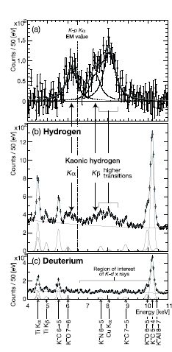
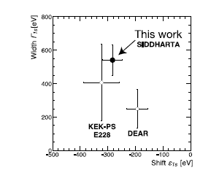
Strangeness and the Nuclear Force
SIDDHARTA
@LNF
Kaonic atoms
Measurement of the energy for the level 1s for the hydrogen kaonic atom
Next measurement:
  deuterium

Slide 11
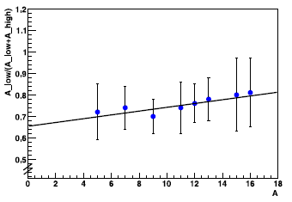
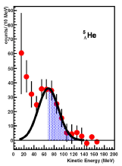
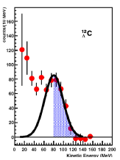
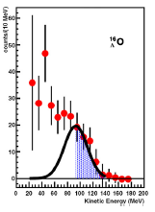
Strangeness and the Nuclear Force
FINUDA
@LNF
Evidence for the two-nucleon induced process in the hypernuclei decay with p-wave Λ
The Hypernuclear Physics is planned @ JLAB12 and JPARC
PANDA: contribution to the Central Tracker TDR

Slide 12
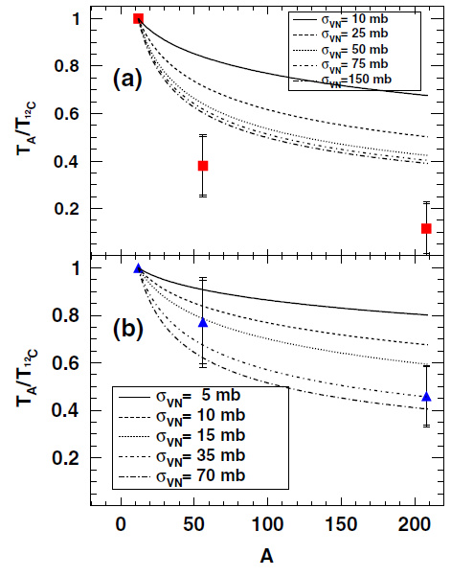
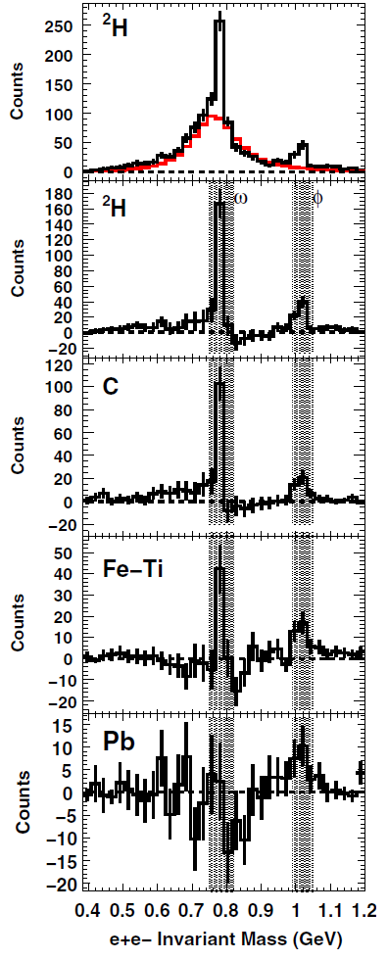
Strangeness and the Nuclear Force
Strangeness to probe hadronization phenomena in nuclear matter
  Evidence of a larger interaction cross section in nuclei
JLab

Slide 13

L2 – Phase Transitions in NM
Global observables and collective effects :
  Multiplicities, elliptic flow …
Degrees of freedom vs. T
Fluctuations and critical behaviours
  hadron ratios and spectra, dilepton continuum, direct photons….
Partonic energy loss in quark-gluon plasma
  jet quenching, high p_{T} spectra, open charm and open beauty
Deconfinements and chiral symmetry restoration:
  charmonium and bottonium
  neutral to charged ratios, resonances
At LHC the longest lifetime of quark-gluon plasma

Slide 14
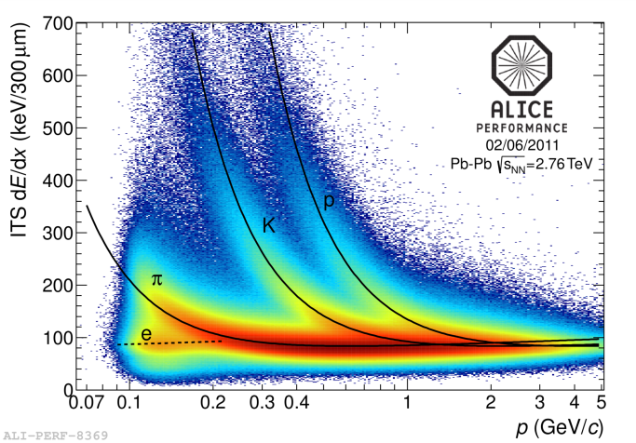
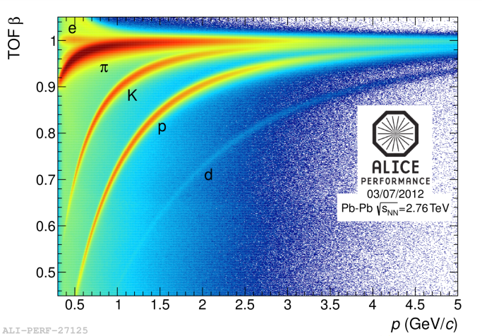
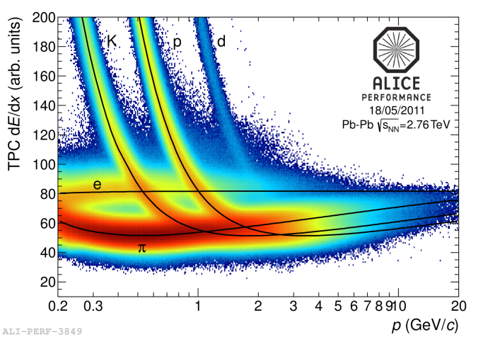
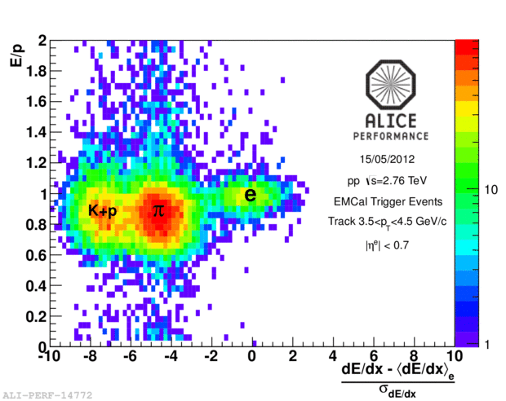
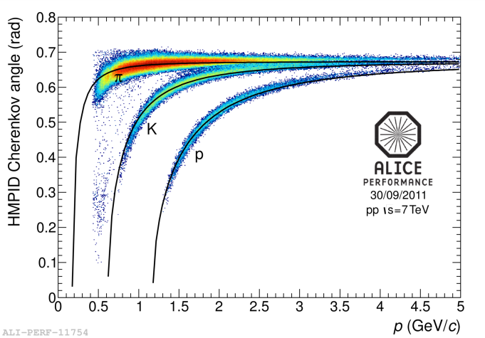
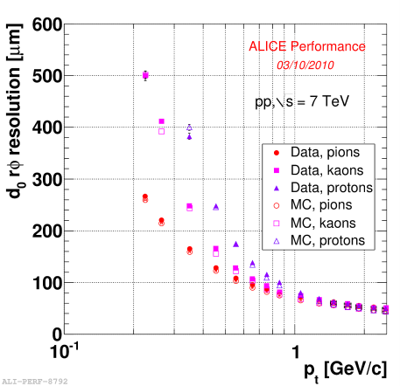
ALICE Performances
ITS
TPC
TOF
ITS
vertexing
EMCAL
HMPID

Slide 15
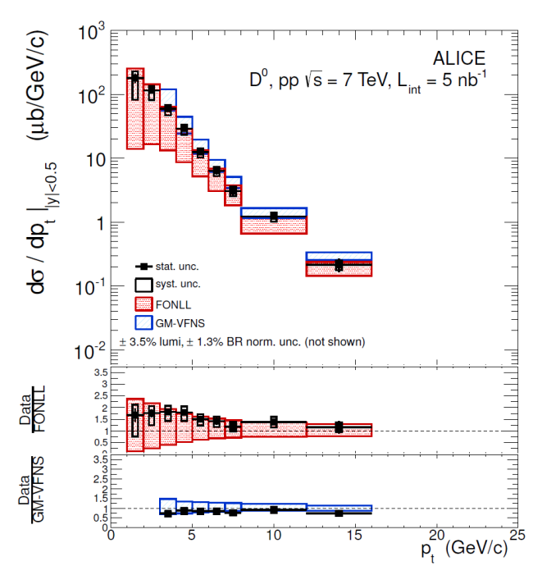
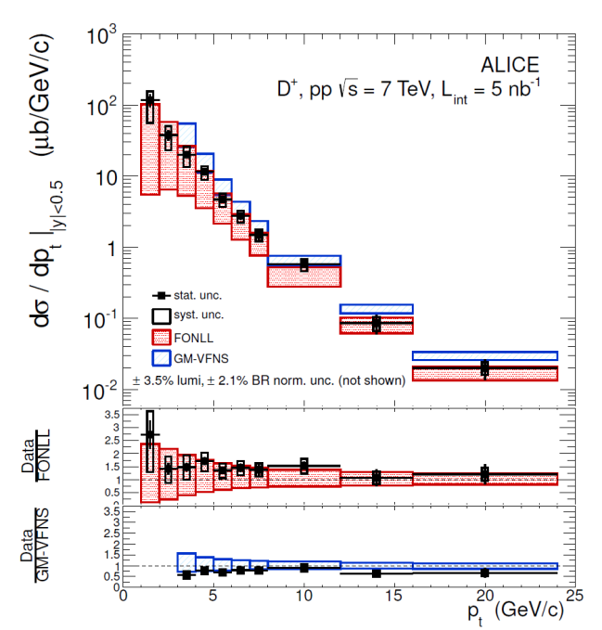
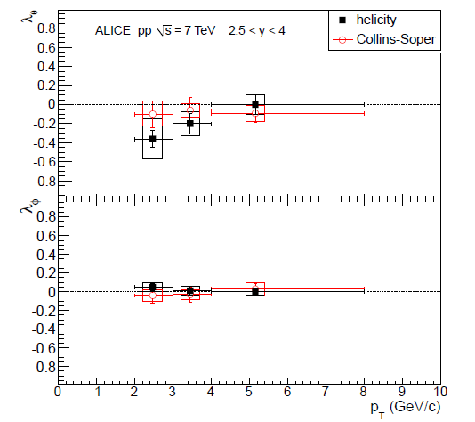
ALICE - p-p Run
Test of pQCD at low p_{T}
First measurement of J/ψ polarization at LHC
D⁰
D⁺
D^{*+}

Slide 16
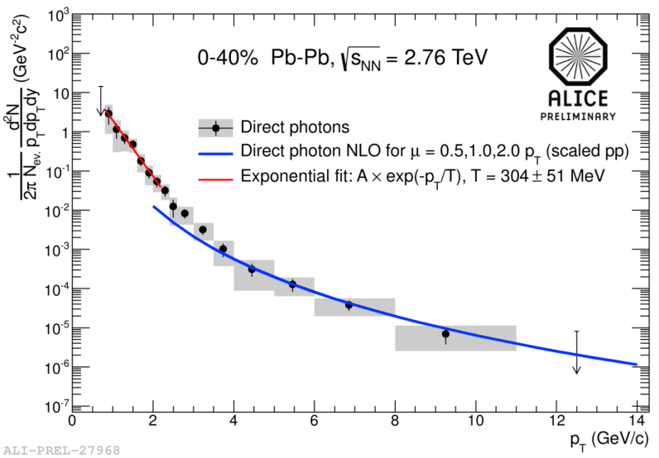
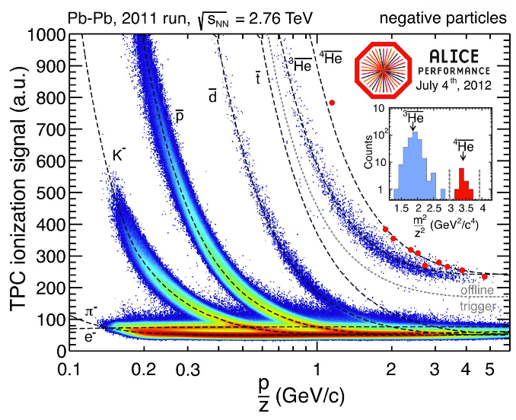
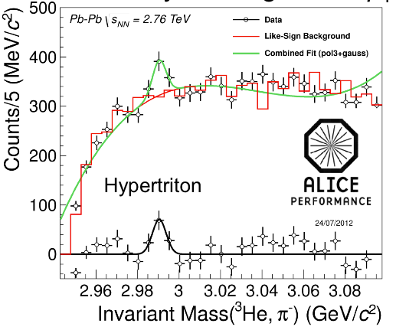
ALICE Results
Measured Temperature of the QGP fireball from photon spectrum
  T ≈ +30% (≈ 300 MeV); highest T in Universe…
Hadronization of the partonic system produces also large objects like nuclei and hyper-nuclei

Slide 17
ALICE Results - Summary
Recent results from lead-lead collisions
  Global observables ⇔ the QGP fireball @ LHC
  Bulk particle prod. ⇔ particle formation from the QGP
  Jet quenching ⇔ opacity of the QGP
  Heavy flavour prod. ⇔ transport properties of the QGP
  Charmonium prod. ⇔ deconfinement in the QGP

Slide 18
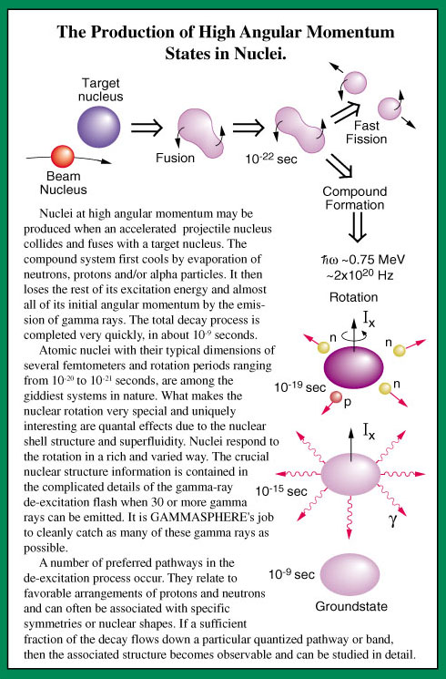
L3 - Nuclear Structure and Reaction Mechanisms
5-10 MeV/A
Heavy-ions
50 MeV/A
Reactions
Decays
(in beam)
Multi-
framm
peripheral
Nuclear
structure
Shell structure
Collettive modes-shape
vs N/Z
Termodynamics
Viscosity-high spin
Equation
of state
Symmetries
LNL
GAMMA- PRISMA- EXOTIC- NUCLEX
LNS
DREAMS - LNS_STREAM - EXOCHIM

Slide 19
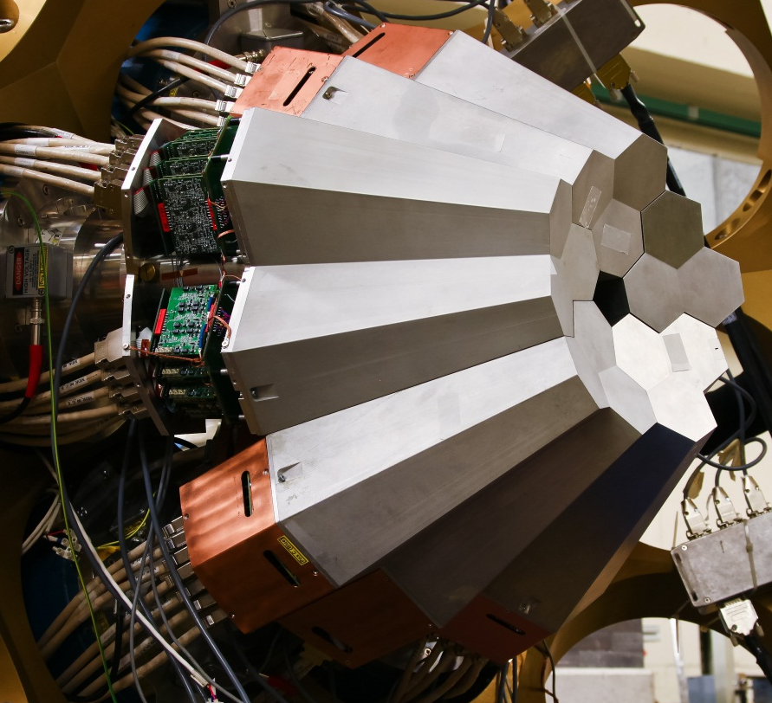
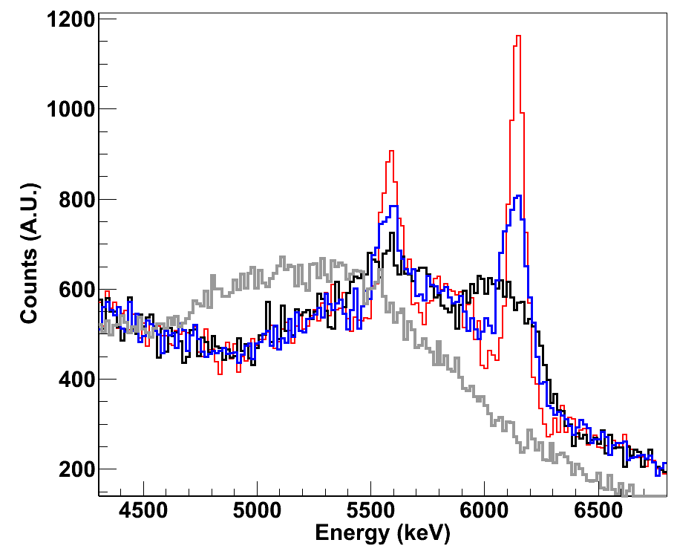
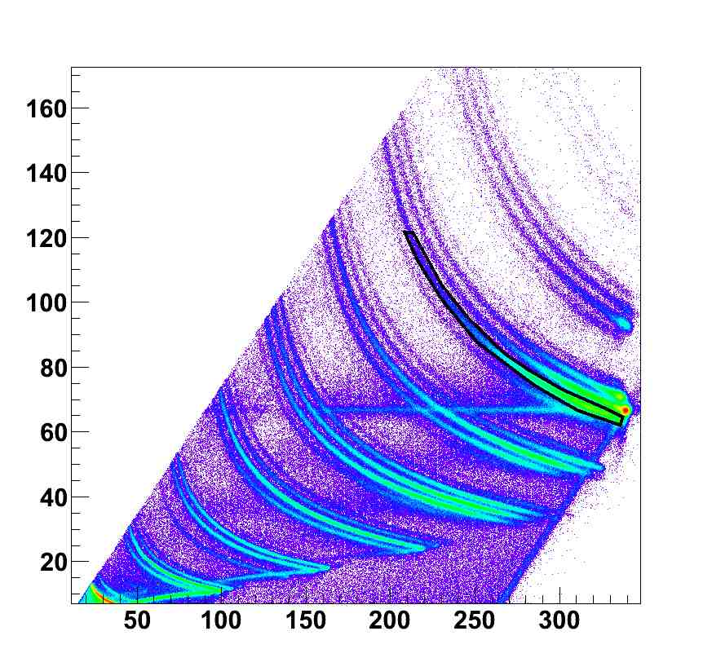
The AGATA Demonstrator @LNL
5 asymmetric triple-clusters 36-fold segmented crystals
  555 digital-channels
  Eff. 3 – 8 % @ Mg = 1
  Eff. 2 – 4 % @ Mg = 30
Main issue is Doppler correction capability
¹⁶O
No Doppler Corr
Crystal Centers
Segment Centers
PSA+Tracking
F
O
N
C
dE (MeV)
B
Be
Li
α
TKE (MeV)

Slide 20
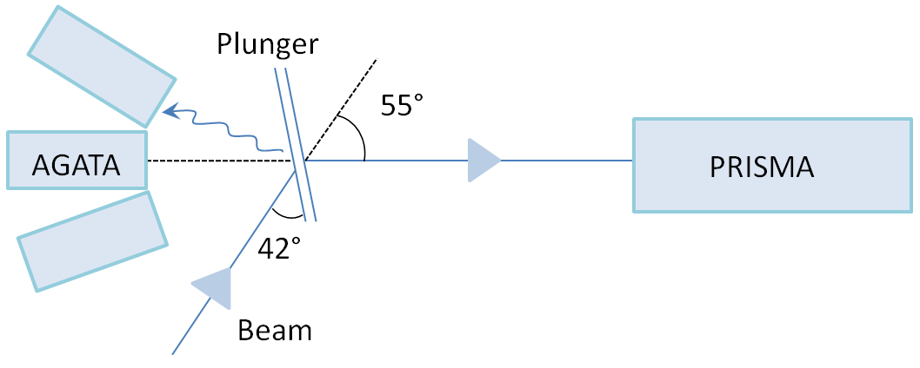
Lifetime Meas. in n-rich Ni, Cu and Zn Isot.
AGATA+PRISMA+ differential plunger
⁷⁶Ge(577MeV) + ²³⁸U, Nb degrader

Slide 21
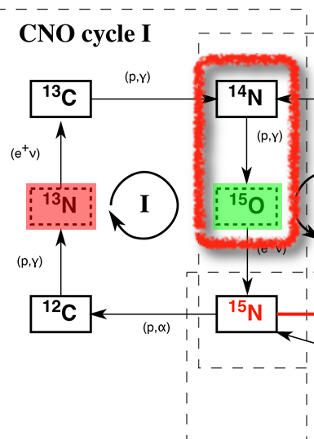
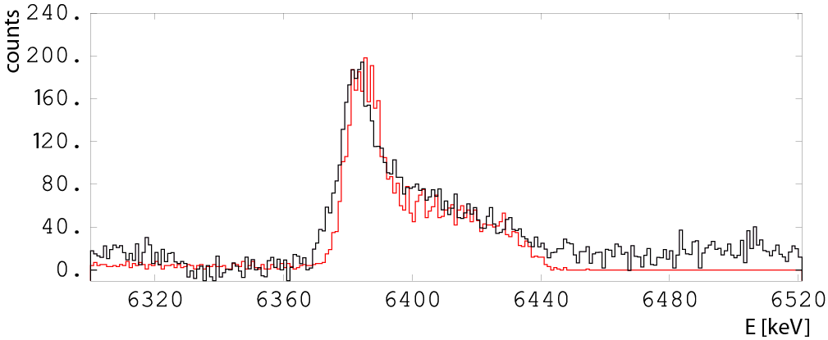
Lifetime Measurement with AGATA
Stellar burning rates and ¹⁴N(p,γ)¹⁵O reaction
The sub-threshold resonance corresponding to the first excited 3/2+ state in ¹⁵O (6.79 MeV) is predicted to play a dominant role when extrapolating the cross-section to the Gamow peak region
@fs nuclear level lifetime
¹⁴N(²H,n)¹⁵O reaction
@ 32 MeV (XTU LNL Tandem)
experimental
@ 162°
simulation

Slide 22
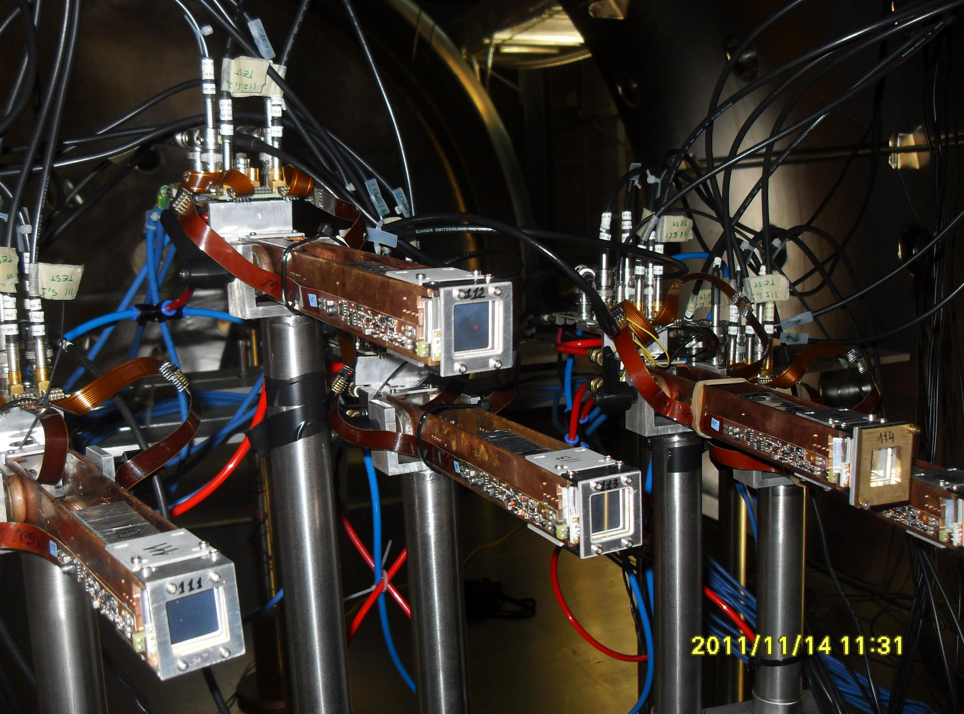
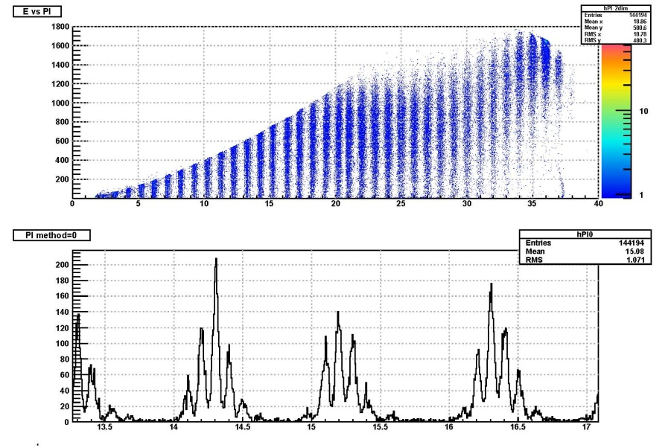
Development Activities @LNL,LNS
R&D for charged particle arrays to be used with radioactive beams (activity FAZIA – PP-SPIRAL2 in FP7 )

Slide 23
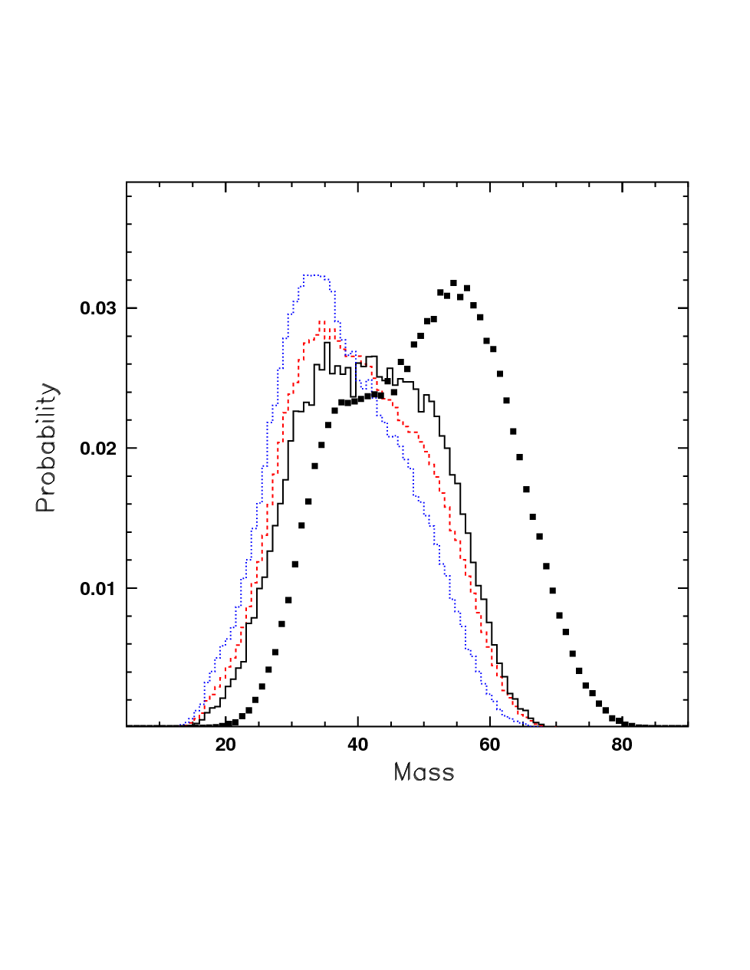
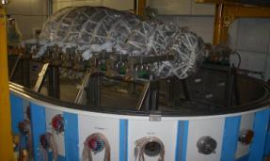
EXOCHIM @LNS
Measurements of charged particles
Detector: CHIMERA
Beams: LNS + EXCYT (improved)
ASY-EOS @GSI
  Higher energy (data analysis in progress)
Isospin Degree of Freedom (n-z)
  Equation of state
  Neutron star radius
  Fission
  Multifragmentation
⁴⁰Ca+⁴⁰Ca
⁴⁸Ca+⁴⁸Ca
Isospin effects in
multifragmentation at Fermi energy
⁴⁰Ca+⁴⁶Ti
⁴⁰Ca+⁴⁸Ca
Mass of the largest fragment
Experiments at the higher energy at GSI in 2011
Tests already made
Multifragmentation with CHIMERA

Slide 24
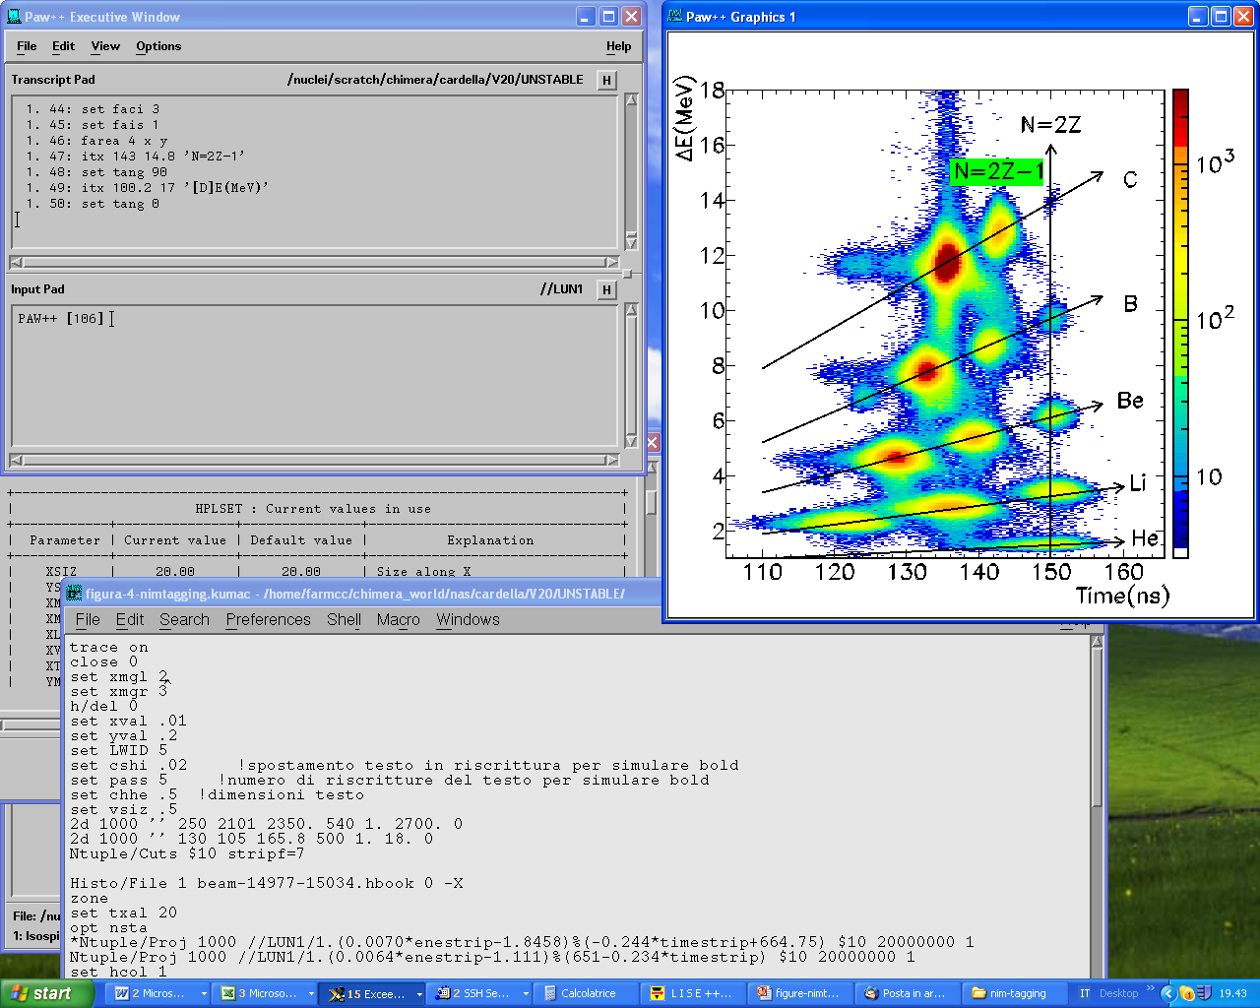
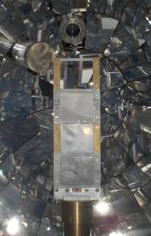
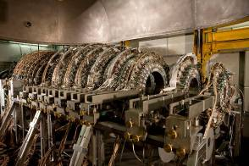
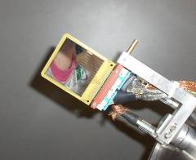
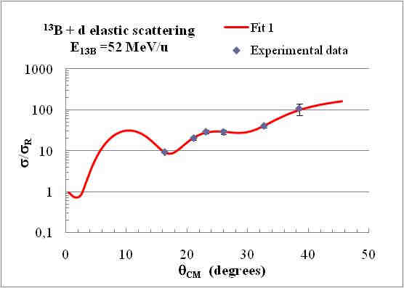
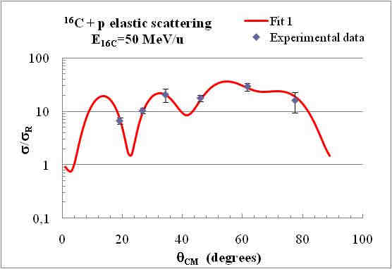
Tagged beam
¹¹Be
n
¹⁰Be
p
p
Target d

Slide 25
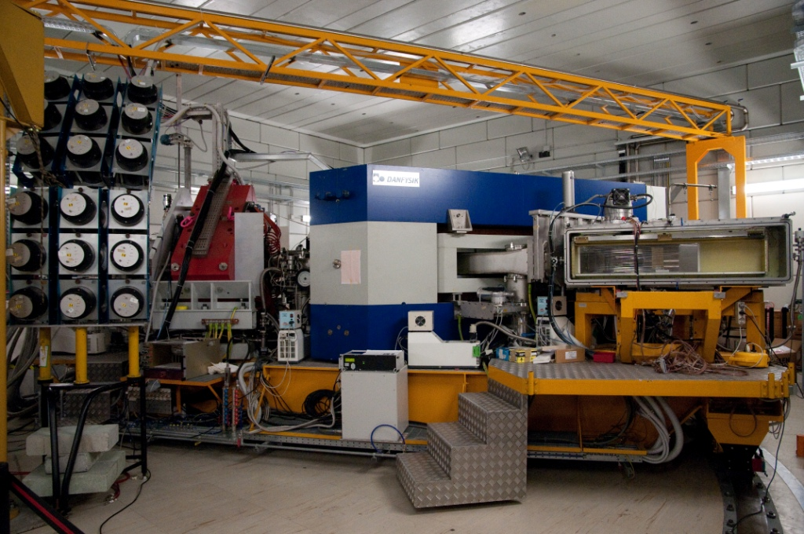
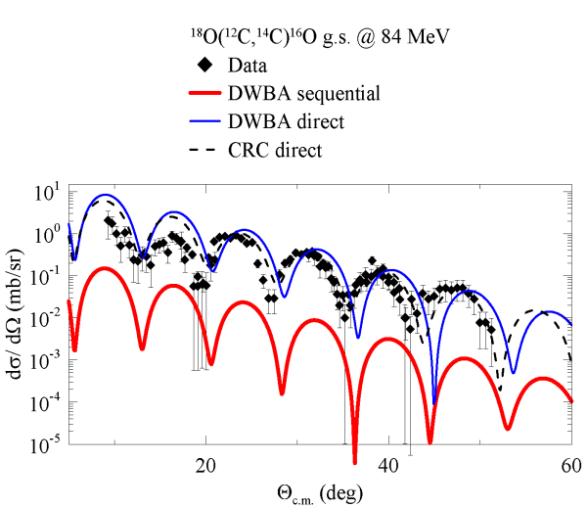
MAGNEX @LNS
MoU INFN - IN2P3 in LEA COLLIGA signed in 2010
EDEN has been installed
MAGNEX
EDEN

Slide 26
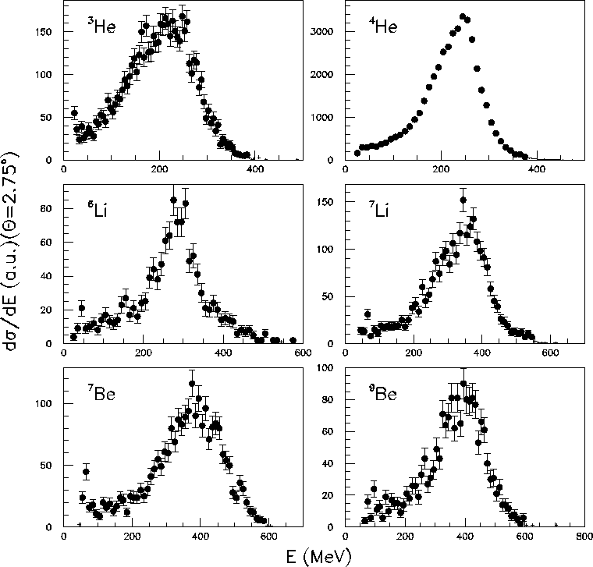
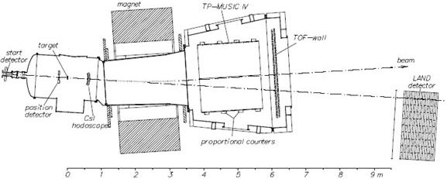
FRAG @LNS
Fragmentation of Ions
Extensive study of nuclear reactions of interest for medical and space applications
Relevant for Space and Hadron-Therapy
Experimental activity extended at GSI at higher energy (FIRST)
¹²C+¹²C
@62MeV
ALADIN
Magnet
TPC MUSIC
Land detector

Slide 27
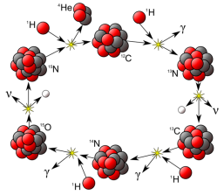
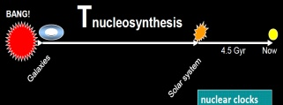
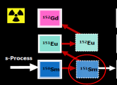
L4 - Nuclear Astrophysics and Interdisciplinary Research
Reactions @ stellar energy
  Nucleosynstesis
  LUNA@LNGS, ASFIN@LNS and ERNA
n-capture for astrophysics and reactor applications
  N_TOF @CERN
Annihilation of anti-protons in nuclei in nuclei 5keV – 5 MeV region of cosmological interest
  ASACUSA @CERN
Pauli principle violation in atomic transitions
  VIP @LNGS
Gravity effects on antimatter
  AEGIS @CERN

Slide 28
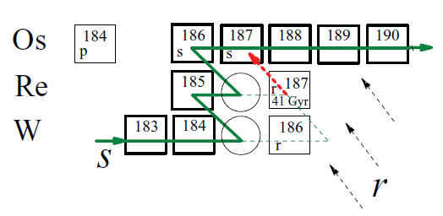
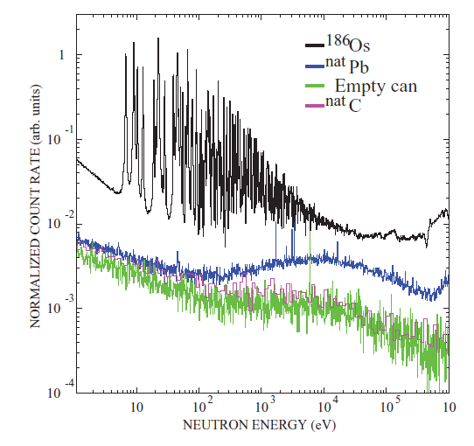
n_TOF@CERN a Cosmic Clock
The precise determination of the neutron capture cross sections of ¹⁸⁶Os and ¹⁸⁷Os is important to define the s-process abundance of ¹⁸⁷Os at the formation of the solar system.
This quantity can be used to evaluate the radiogenic component of the abundance of ¹⁸⁷Os due to the decay of the unstable ¹⁸⁷Re (t_{1/2} = 41.2 Gyr) and from this to infer the time duration of the nucleosynthesis in our galaxy (Re/Os cosmochronometer).

Slide 29
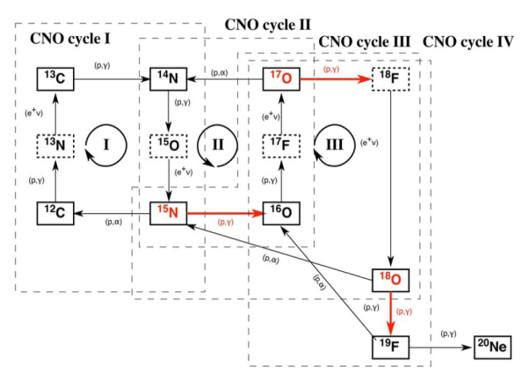
LUNA @LNGS
¹⁵N(p,γ)¹⁶O and ¹⁵N(p,α)¹²C: “bridge” reactions between CNO I e II. Consequences for O and next CNO cycles. Important in the novae explosion and in “Asymptotic Giant Branch” stars
Next measurement: ¹⁷O(p,γ)¹⁷F
LUNA

Slide 30


ASFIN@LNS
¹⁷O(p,α)¹⁴N via the Trojan-Horse-Method
¹⁷O is processed in the CNO cycle and play a key role in the novae nucleosynthesis and γ-ray astronomy
Evaluation of the 65 keV resonance strength and its impact in the reaction rate

Slide 31
What is next?

Slide 32



Upgrade to JLAB@12 GeV
Higher luminosity (10³⁵) and coverage
Forward tagger calorimeter
Neutron detector
R&D for the Rich detector
Contribution to the new tracker with GEM detector

Slide 33


Upgrade to JLab@12 GeV
JLab@12GeV will provide a wide kinematical coverage to study:
  3-D properties of the proton internal structure (GPDs)
  pQCD prediction @ x→1
  Form factors …

Slide 34

ALICE – ITS Upgrade CDR
Key aspects for physics:
Material reduced x3-4
Resolution improved x3-6
Endorsed by LHCC

Slide 35


SPES ISOL facility @LNL
A second generation ISOL facility for neutron-rich ion beams and an interdisciplinary research center
Proton induced fission on UCx
10¹³ fission/s - 8 kW on direct target
Selective Production of Exotic Species
ISOL target 1 (8kW)
Proton driver
Proton and neutron applications
Charge Breeder
HV platform 260kV
Exotic beam transfer to PIAVE-ALPI
Beam cooler
ISOL target 2
High Resolution Mass Spectrometer
Notes:
The SPES project is part of the INFN Road Map for the Nuclear Physics, it is supported by both LNL (Legnaro) and LNS (Catania). The SPES project is based on the ISOL method with an UCx Direct Target able to sustain around 10 kWatt. The primary proton beam is delivered by a driver of at least 40 MeV energy and 200 microA current. Neutron-rich radioactive beams will be produced by Uranium fission at an expected fission rate in the target in the order of 10¹³ fissions per second. The key feature of SPES is to provide high intensity and high-quality beams of neutron-rich nuclei to perform forefront research in nuclear structure, reaction dynamics and interdisciplinary fields like medical, biological and material sciences. The exotic isotopes will be re-accelerated by the ALPI superconducting linac at energies of 10AMeV and higher, for masses in the region of A=130 amu, with an expected rate on the secondary target of 10⁸ pps.

Slide 36








ISOL Roadmap in EUROPE
10¹² fission/s ,
2 MeV/n (A=130)
TODAY
LNS - EXCYT
SPIRAL –
2014-2025
10¹³⁻¹⁴ fission/s
10 MeV/n (A=130)
> 10¹⁵ fission/s
100 MeV/n (A=130)
3x 100 kW direct target
1x 5 MW 2-step target
FROM 2025

Slide 37


LUNA-MV @ LNGS
A 3.5 MV accelerator to measure key reactions of the Helium burning and neutron sources for the s-process:
  ¹²C(α,γ)¹⁶O
  ¹³C(α,n)¹⁶O
  ²²Ne(α,n)²⁵Mg
  (α,γ) reactions on ^{14,15}N and ¹⁸O
Relevant at higher temperatures (larger energies) than reactions belonging to the hydrogen-burning studied so far at LUNA

Slide 38
Major future development
Line 1
  JLAB upgrade
Line 2
  ALICE upgrade
Line 3
  related instrumentation (AGATA, FAZIA) for SPES@LNL
  FRIB,EXCYT@LNS + upgrading of existing instrumentation (CHIMERA, MAGNEX, FARCOS)
Line 4
  related instrumentation (TbD) for LUNA-MV@LNGS

Slide 39
Conclusions
ALICE has collected data with Pb-Pb and producing papers. Ready for next p-Pb data taking.
The experimental campaign with the AGATA demonstrator has been completed at LNL. The realization of ¼ of solid angle is in progress. Nuclei at extremes and more degrees of freedom will be investigated.
Esperiments engaged in upgrades (such as JLAB and CHIMERA at LNS) are progressing.
Several relevant results are obtained with the analysis under way. They are important to guide the future programs.
Improvements to the national infrastructures are in progress.

